Slide 1





Structural effects in nanoceramics induced by swift heavy ion irradiation
JINR Association of Young Scientists and Specialists Conference "Alushta-2021"
A.K. Mutali^{1,2,3}, A.D. Ibrayeva^{2,3}, V.A. Skuratov^{3,4}, A.S. Sohatsky³, Е. Korneeva³, A. Janse van Vuuren⁵, M.V. Zdorovets^{1,2,6}
¹L.N. Gumilyov Eurasian National University, Nur-Sultan, Kazakhstan
² The Institute of Nuclear Physics’ Astana branch, Nur-Sultan, Kazakhstan
³ G.N. Flerov Laboratory of Nuclear Reactions of Joint Institute for Nuclear Research, Dubna, Russia
⁴ National Research Nuclear University MEPhI, Moscow, Russia
⁵Centre for HRTEM, Nelson Mandela Metropolitan University, Port Elizabeth, South Africa
⁶ Ural Federal University, Yeketerinburg, Russia
Alushta-2021

Slide 2
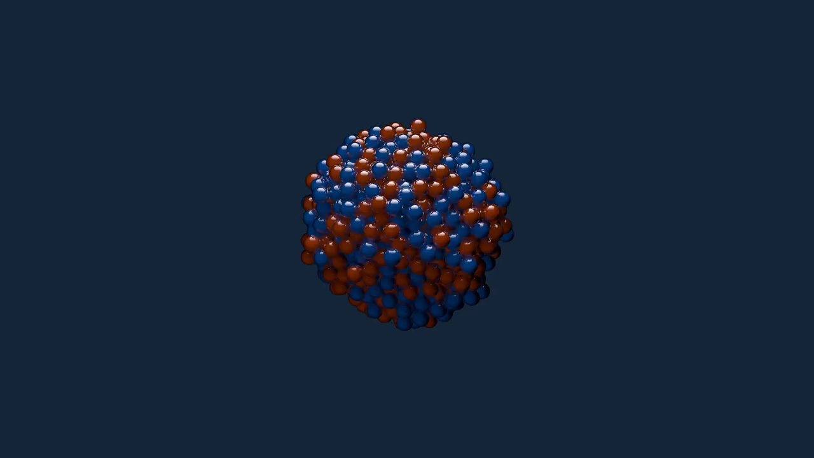
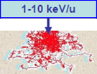
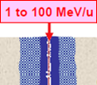
Introduction
Swift heavy ions (SHI)
E > 0.5 MeV/u, M > 4m_{p}, S_{e}>>S_{n}
S_{n}/S_{e} < 0.01 – majority of energy losses is electron stopping power
Simulate the influence of fission fragments and cosmic rays on material properties
1-10 keV/u
0.5 to 100 MeV/u
2

Slide 3
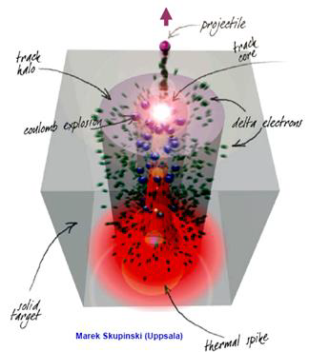
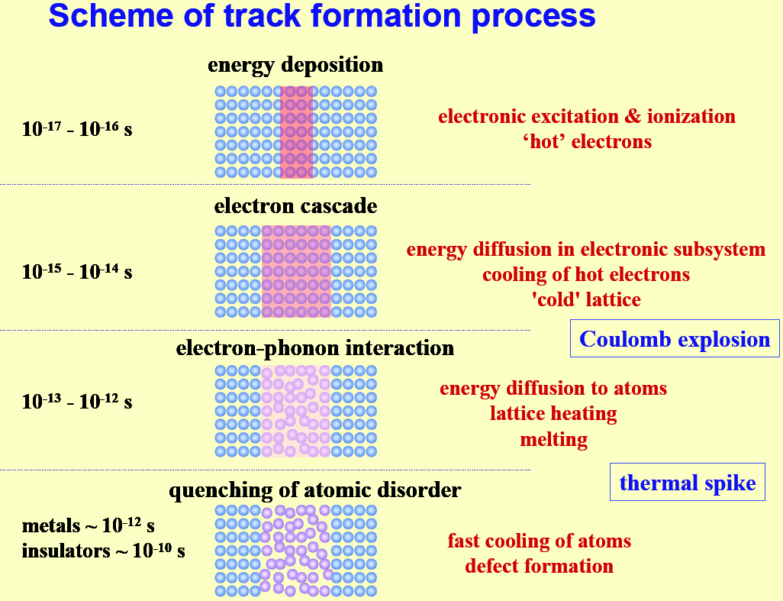
How do swift heavy ions make tracks?
Swift heavy ions E > 0.5 MeV/nucl, A > 4, S_{e}>>S_{n} → latent tracks
C.Trautman (International school on Radiation Effects in Solids, Erice, Italy, July 2004)
3

Slide 4
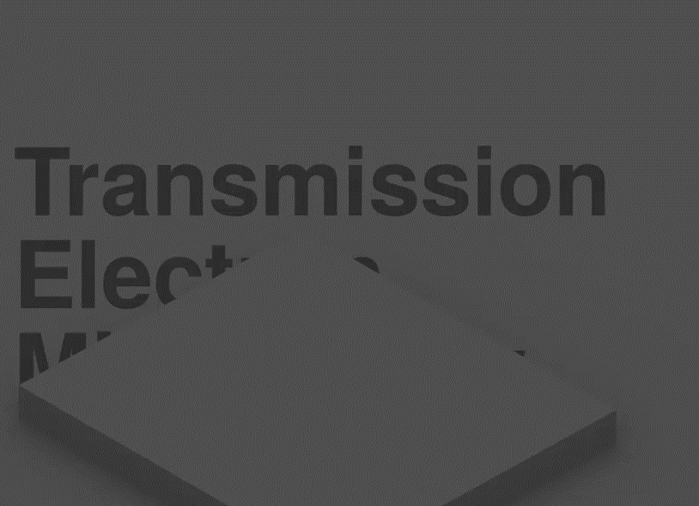
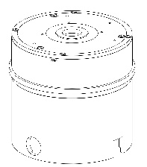
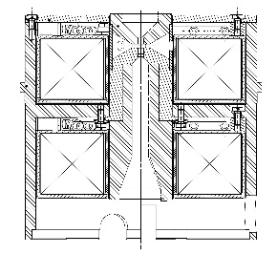
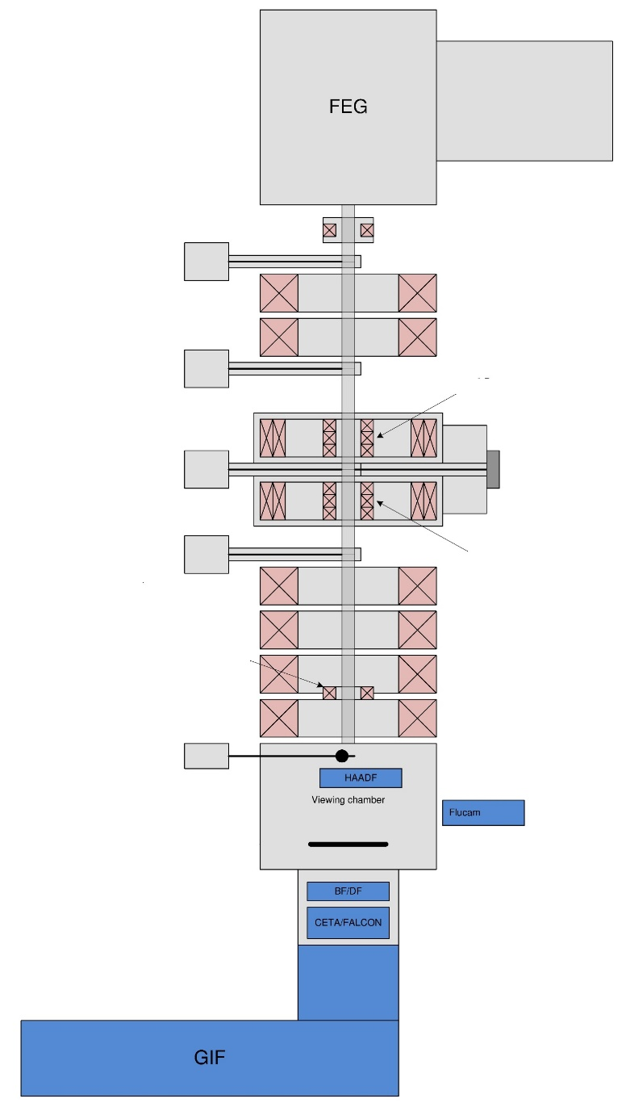
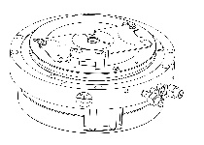
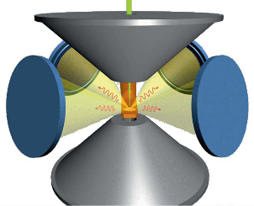
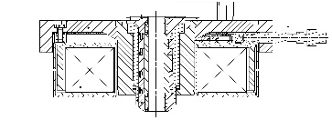
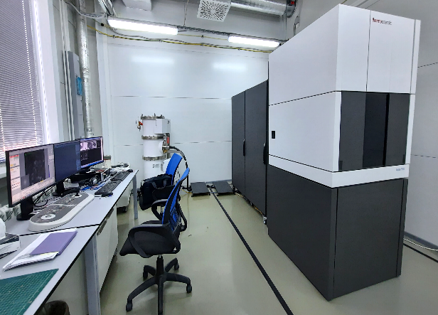
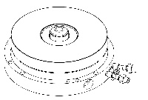
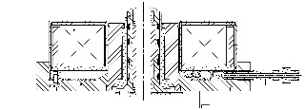
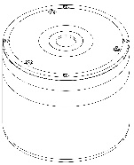
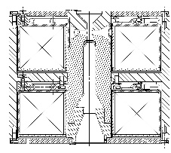
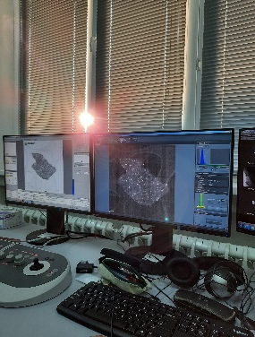
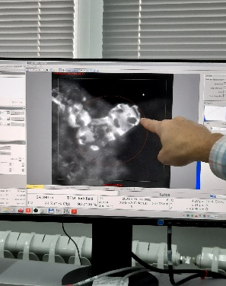
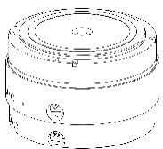
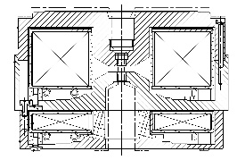
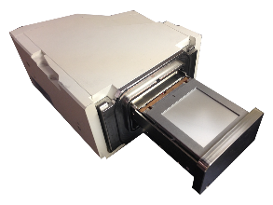
S/TEM TALOS F200i
Condenser lenses C1 and C2
Electron source deflection coils
Источник электронов с полевой эмиссией (Field Emission Gun) в сборе с 200 кВ ускорителем и управляющей электроникой
C1 aperture
Энергодисперсионный детектор Super-X
C2 aperture
Gun deflection coils
Condenser stigmator
Mini condenser lens
Upper objective lens
Objective aperture
SA aperture
Image deflection coils
Objective stigmator
Diffractive stigmator
Компьютеризованный держатель образца
Lower objective lens
Бланкер пучка
Beamstop
Flucam
Diffractive and Intermediate lens
Флюоресцентный экран
Camera CETA-16M
Projector lenses P1 and P2
thermoscientific
4

Slide 5
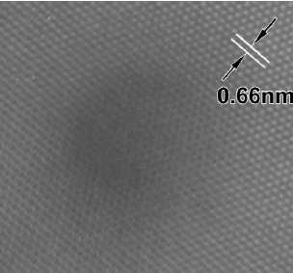

Material
Si3N4 as candidate material for inert matrix fuel hosts
The small absorption cross section for thermal neutrons
The resistance at irradiation with neutrons, α particles,
and fission fragments
Good thermal and mechanical properties
Si3N4 is the ONLY nitride ceramic where latent tracks have been registered
S.J. Zinkle, V.A. Skuratov and D.T. Hoelzer.
Nucl. Instr. Meth. B 191 (2002),758
Aim of this work is to study radiation stability of nanocrystalline Si3N4 in a wide range of electronic stopping powers
Radiation defects induced by swift heavy ions simulating fission fragments impact still remain less studied in comparison with neutron and conventional (low energy) ion irradiation
5

Slide 6
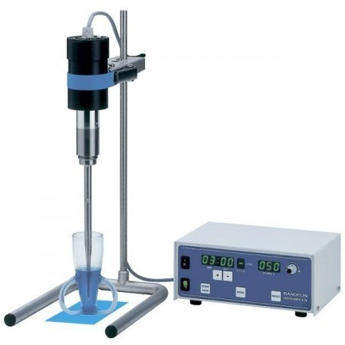
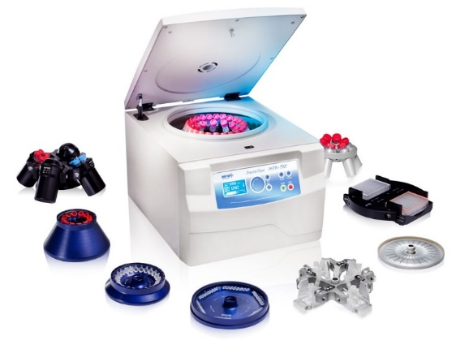
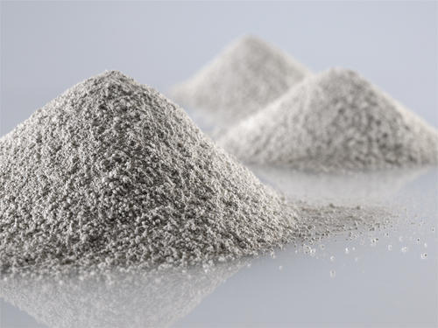
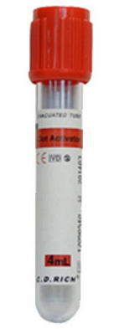
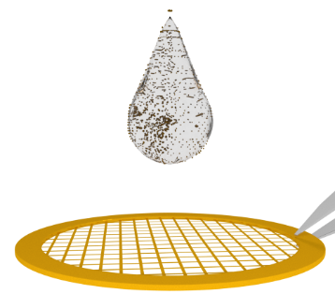
TEM Sample Preparation
Nanopowder
Mix powder in C₂H₅OH
TEM grid
Centrifuge
Ultrasound
3 mm
Scanning/Transmission Electron Microscopes (S/TEM) accelerate electrons through samples, collecting the transmitted electrons to image materials at the nanoscale
As this technique captures electrons that pass through a sample, samples need to be electron transparent
This is typically requires:
Thin Samples, samples thickness <150 nm for regular imaging, <50 nm for HRTEM
Uniform thickness over the area of interest
Clean samples free from contamination
6

Slide 7
Swift Heavy Ion (SHI) irradiation
Incident ion | Energy, MeV | Fluence, cm⁻²
Bi | 714 | 5×10¹¹ (a single ion track regime)
 | 354
 | 287
 | 241
 | 164
 | 106
 | 83
 | 27
Xe | 220 | 5×10¹¹
 | 156 | 5×10¹¹
 | 53
 | 38
All samples were irradiated at accelerators in FLNR JINR (Dubna, Russia) and INP (Nur-Sultan, Kazakhstan).
TEM research was conducted in HR TEM Center of Nelson Mandela University (Port-Elizabeth, South Africa) and Nanocenter of FLNR JINR (Dubna, Russia)
7

Slide 8
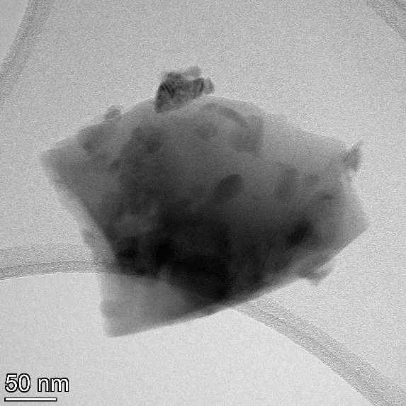
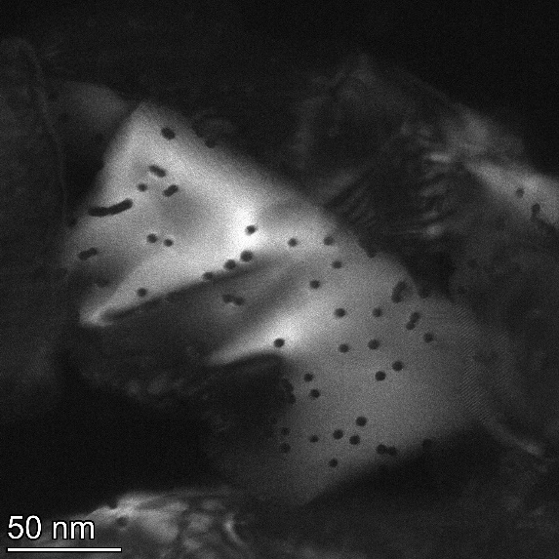
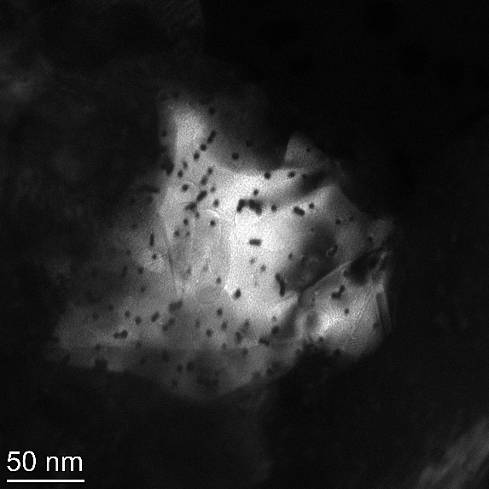
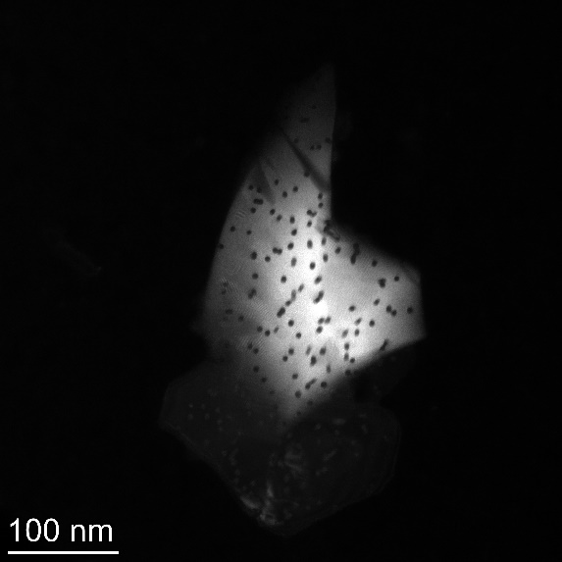
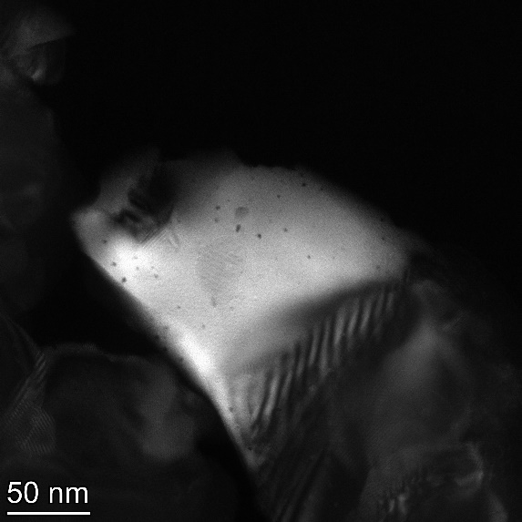
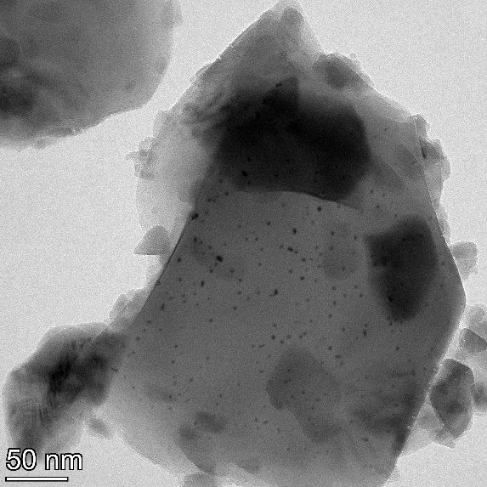
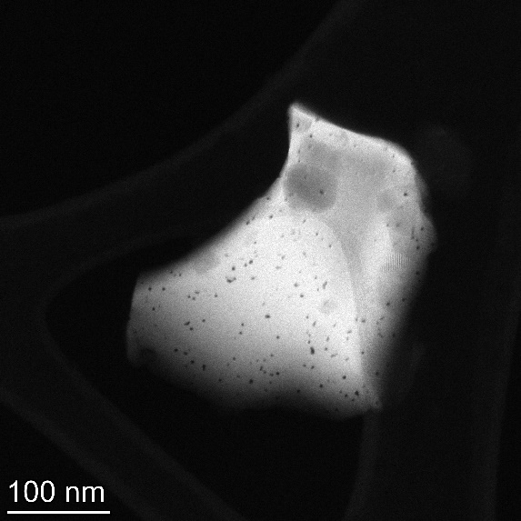
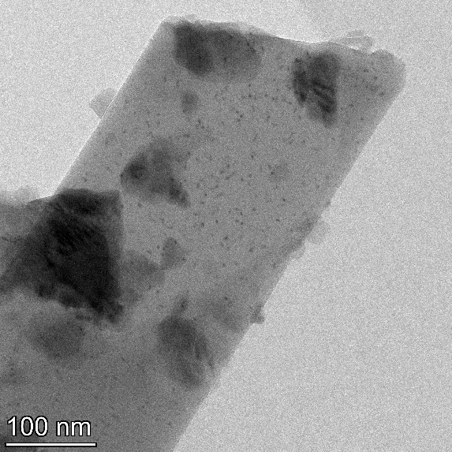
TEM images of n-Si3N4 + Bi, +Xe ions
n-Si3N4 non irradiated_BF
n-Si3N4 + Bi714M-5e11_DF
n-Si3N4 + Bi354M-5e11_DF
n-Si3N4 + Bi241M-5e11_DF
n-Si3N4 + Xe220M-5e11_DF
n-Si3N4 + Xe156M-5e11_BF
n-Si3N4 + Xe53M-5e11_DF
n-Si3N4 + Xe38M-5e11_BF
8

Slide 9
Result Summary
Latent tracks in nanocrystalline Si₃N₄ irradiated with 156, 220 MeV Xe and 714 MeV Bi ions and fluence of 5e11 cm-2 corresponding to a single ion track regime, have been studied using high resolution transmission electron microscopy.
For the first time, parameters of latent tracks in nanocrystalline ceramic matrix were determined in a wide range of electron stopping powers S_{e}.
The threshold electron stopping power for latent track formation in nanocrystalline Si₃N₄ was found to equal ~7.5 keV/nm.
Need further detailed investigation
Future plans for the next year: the study of the radiation resistance of Y₂O₃, TiO₂, CeO₂, Al₂O₃, Cr₂O₃, Y₄Al₂O₉, Spinel to irradiation with high-energy heavy ions.
Bi 354 MeV
Bi 287 MeV
Bi 714 MeV
Bi 241 MeV
Bi 164 MeV
S_{et} ~ 7.5 keV/nm
Bi 1030 MeV
Bi 710 MeV
Bi 106 MeV
Xe 53 MeV
Xe 220 MeV
Xe 156 MeV
Xe 38 MeV
Xe 220 MeV

Slide 10

Thank you for your attention!

