Slide 1





Slide 2



Slide 3

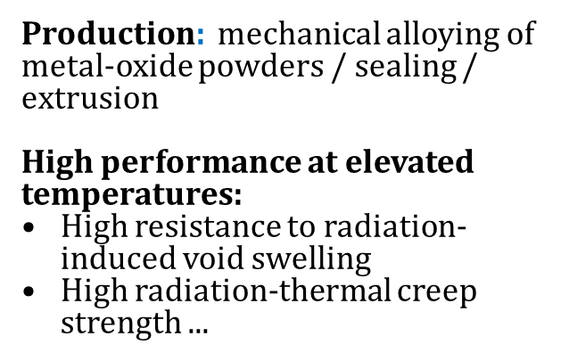
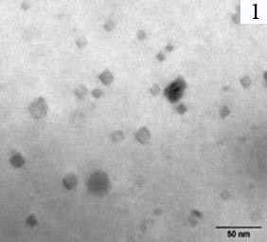
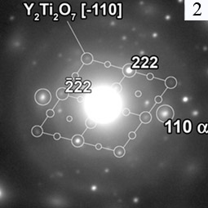
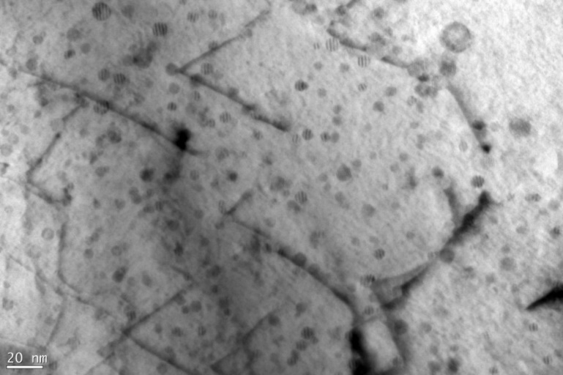
Y₂Ti₂O₇ nanoparticles
EP450 ODS steel (VNINM, Moscow)
Y₄Al₂O₉ nanoparticles

Slide 4
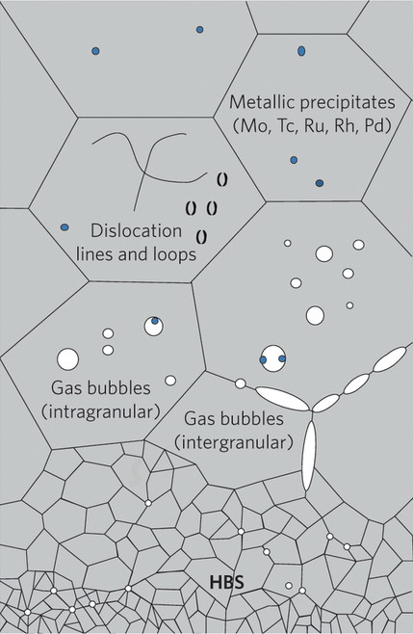
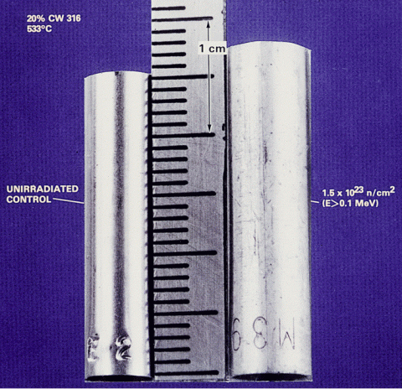
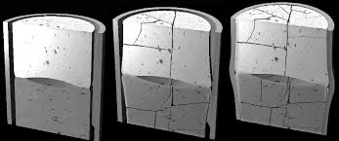
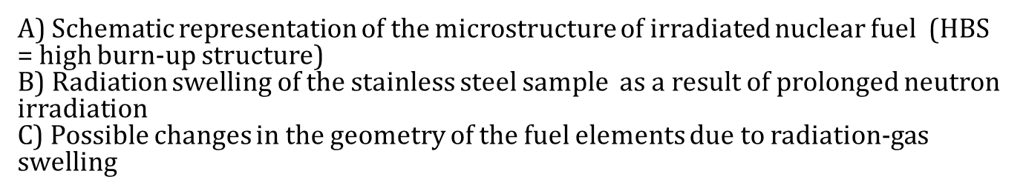
А
B
C

Slide 5



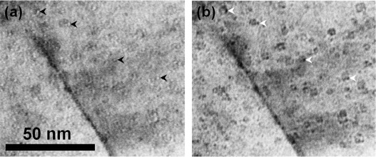
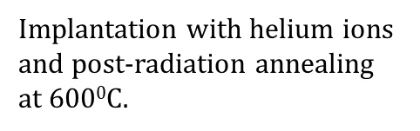
Helium bubble
The mechanical state of ODS alloys can affect the gas swelling of these materials, which has not yet been investigated.
The mechanism of bubble growth during high temperature annealing is still unclear.
Helium bubble
Fe82H-ODS

Slide 6


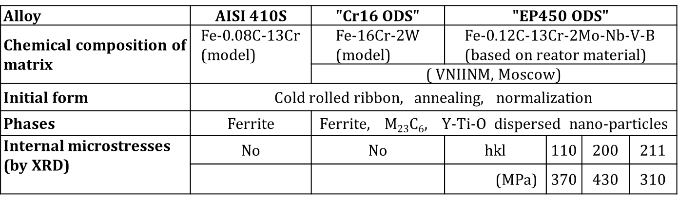
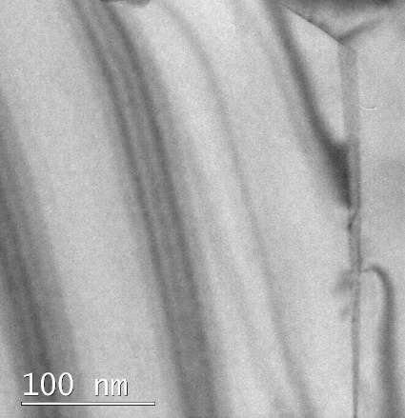
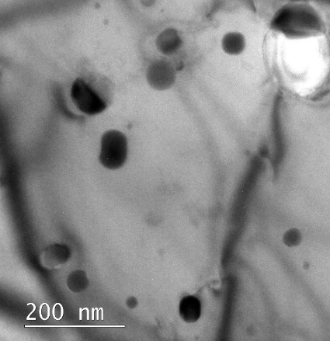
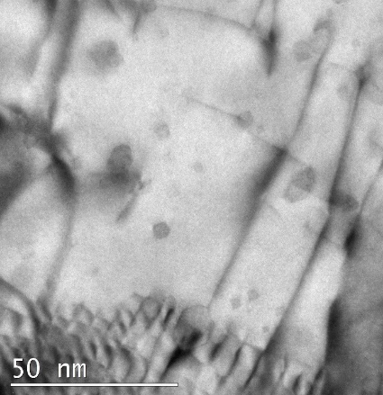
AISI410S
Cr16 ODS
EP450 ODS

Slide 7



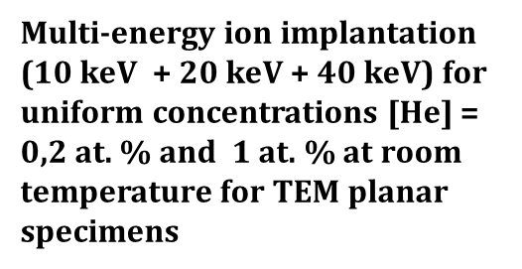
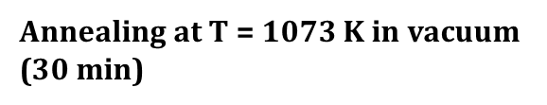

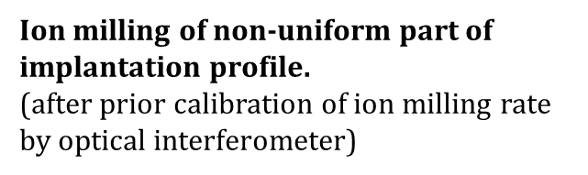
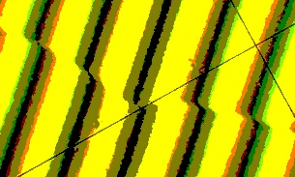
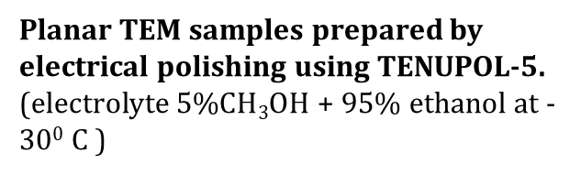

1.
2.
Implantation area
3.
Implantation area
4.
5.

Slide 8

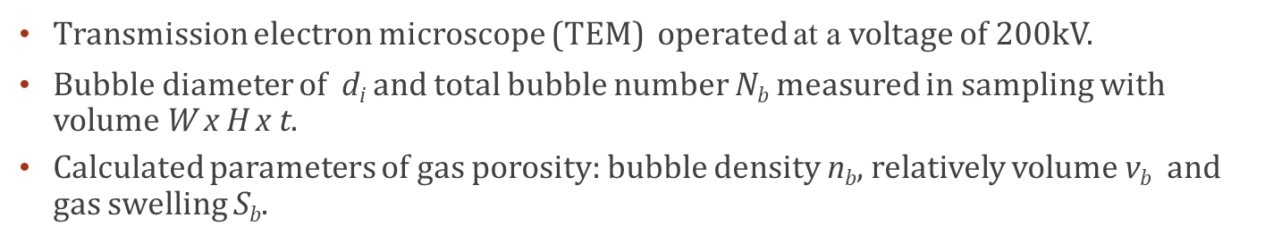
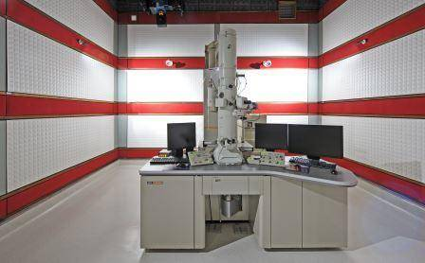
JEOL JEM – 2100 TEM (HRTEM, NMMU, SA)
Notes:
TEM analysis of gas porosity was carried out at a voltage of 200 kV
Here we used a brigh field mode to obtain images of gas bubbles due to the Fresnel contrast

Slide 9
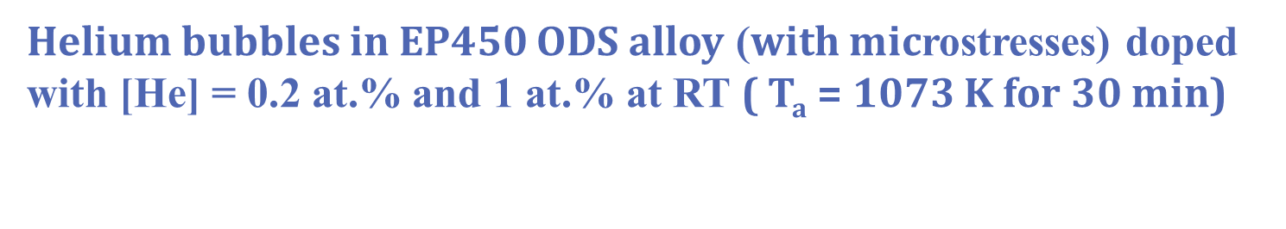
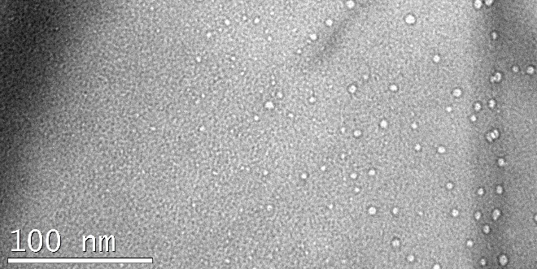
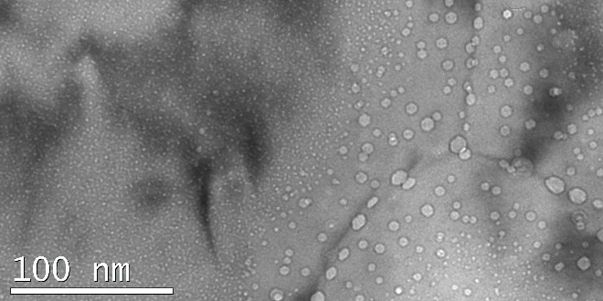
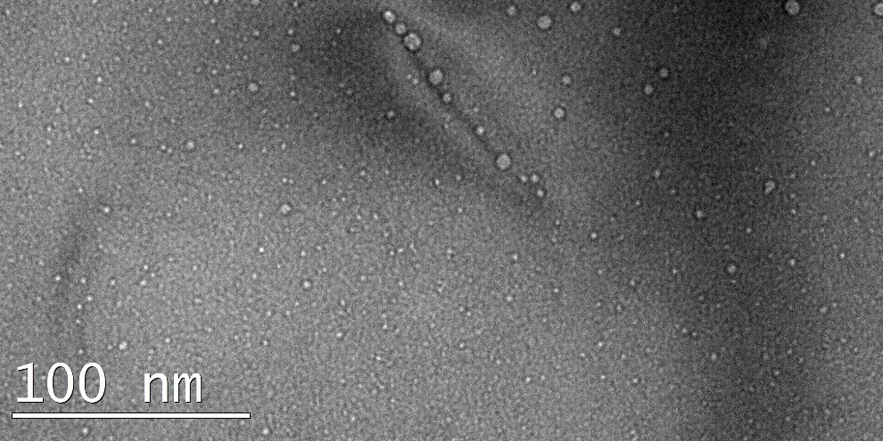
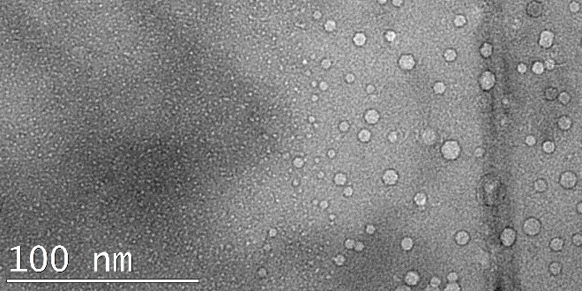
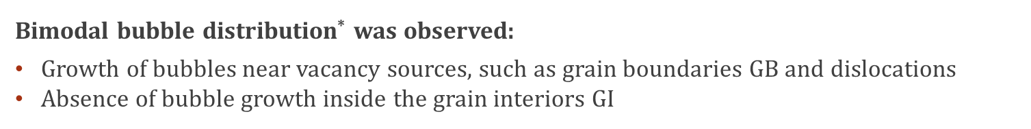
AISI 410S, [He] = 0.2 at. %, 0.04 dpa
AISI 410S, [He] = 1 at. %, 0.2 dpa
GI
GB
GI
GB
Cr16 ODS, [He] = 1 at. %, 0.2 dpa
Dislocation
GI
GB

Slide 10
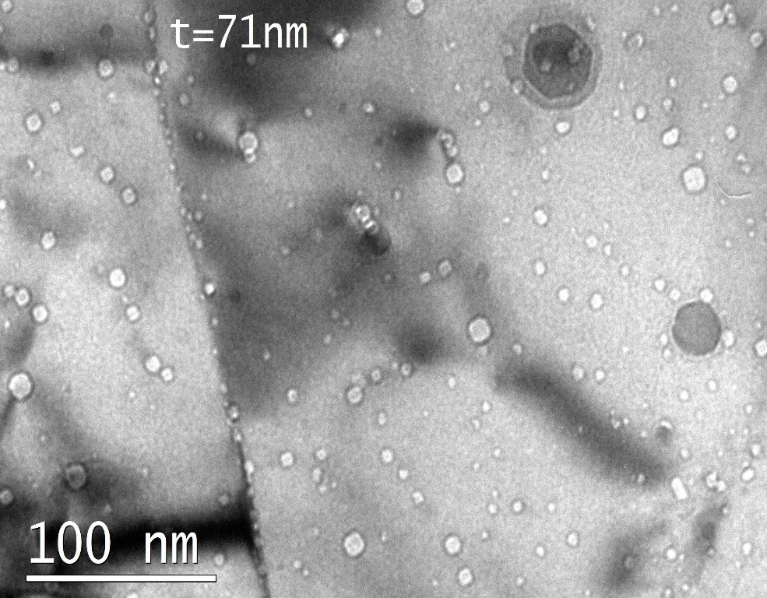
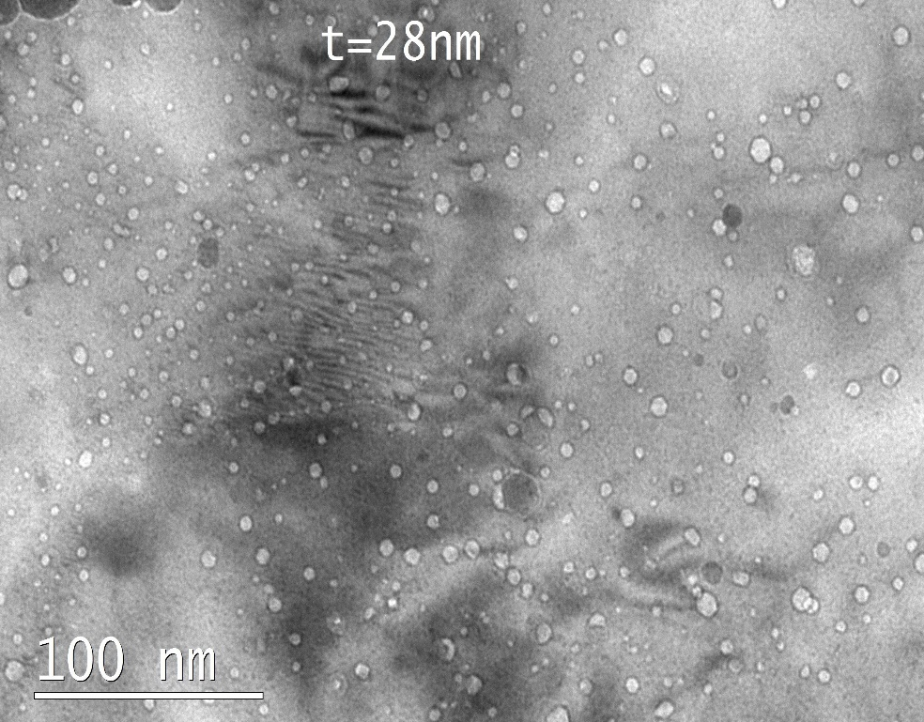
[He] = 0.2 at%, 0.04 dpa
[He] = 1 at%, 0.2 dpa
(Cr,W)₂₃C₆

Slide 11

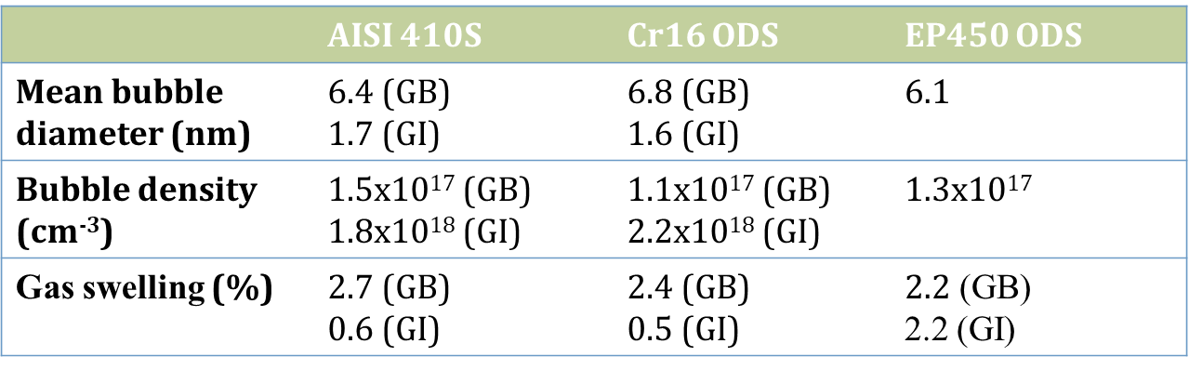
Notes:
Comparing the helium porosity parameters in these samples shows that the overall swelling of EP450 ODS is much higher than that of conventional and Cr16 ODS samples

Slide 12








Tow bubbles before contact
On contact and merge
After merge and relaxation
Regadless of the type of material, the bubble growth occurs by the mechanism of bubble migration and coalescence during high-temperature annealing.
$$r_{1}$$
$$r_{2}$$
$$r$$
Small bubble
Large bubble
Diffusion of helium atoms and vacancies
$$r_{2}$$
$$r_{1}$$
Matrix

Slide 13


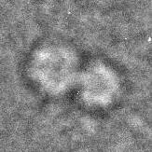
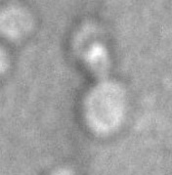

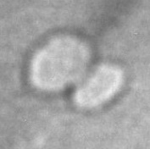
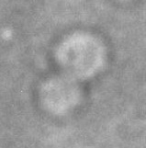

Slide 14

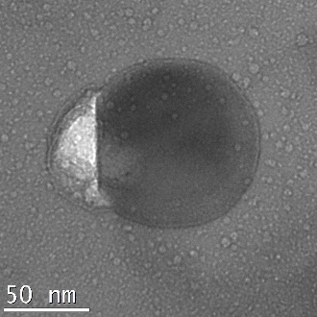
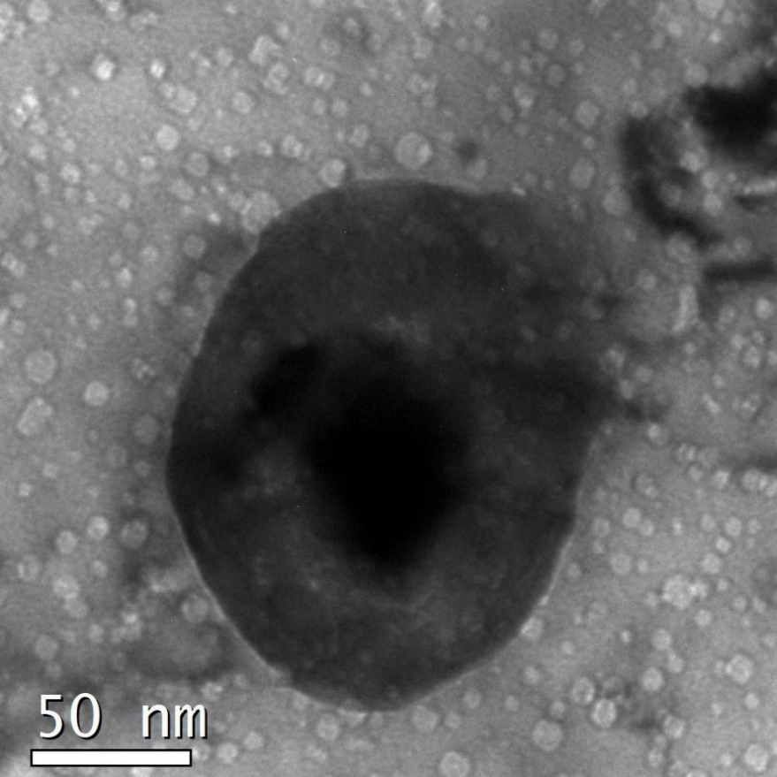
Cr16 ODS alloy
EP450 ODS alloy
Al₂O₃
Y₂Ti₂O₇
Y₂Ti₂O₇

Slide 15

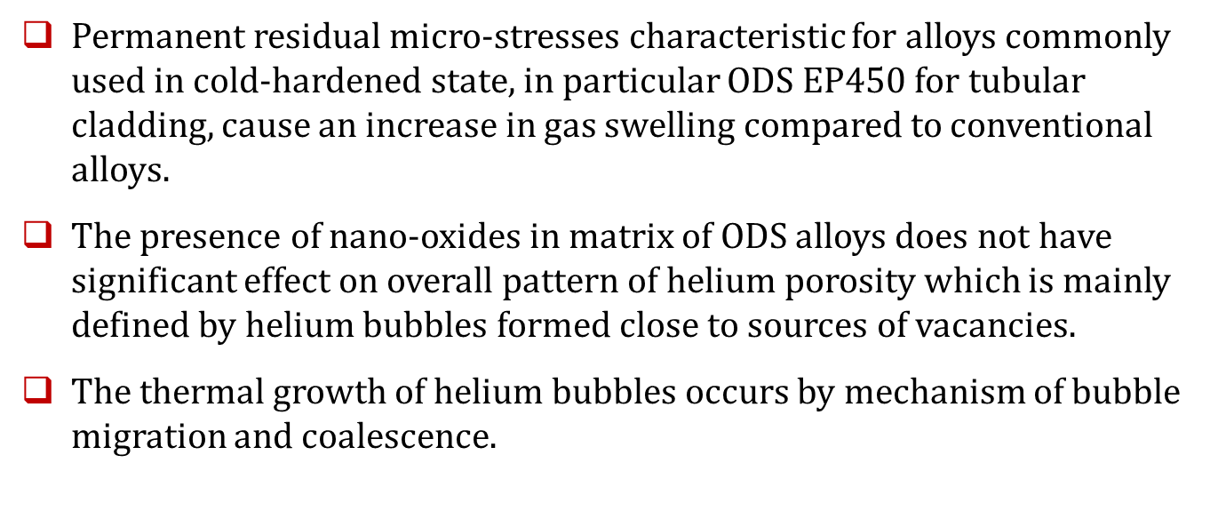
Al₂O₃
Y₂Ti₂O₇
Y₂Ti₂O₇

