Slide 1
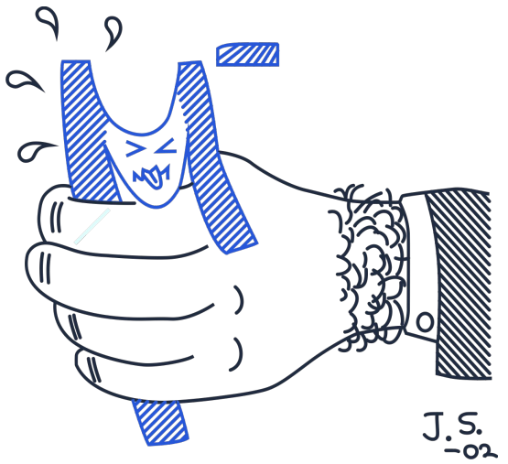
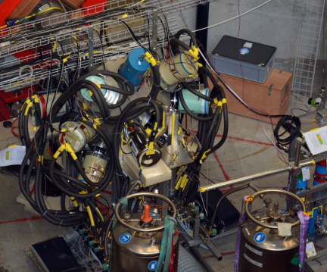
Efficiency of the detectors
Rumyantseva Nadya

Slide 2
Calculation of efficiency
Total Efficiency = Content(integral) / Number of decay in run
Number of decay in run = activity · measurement time · relative intensities
Source | Eu-152 | Y-88 | Co-60
Activity (day of measurement), kBk | 17.482 | 59 | 29.45
Time of measurement, s | 1502.36 | 2080.98
For Th-232 & Au-197 (μ X-ray)
Number of μ in Th run – 5.3·10⁷
Number of μ in Au run – 11·10⁷
Number of decay in run = Number of μ in run · relative intensities

Slide 3
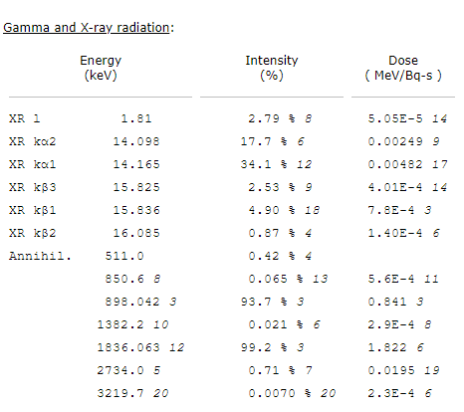
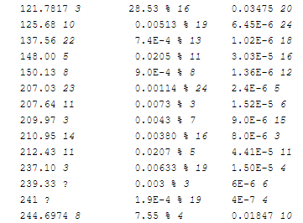
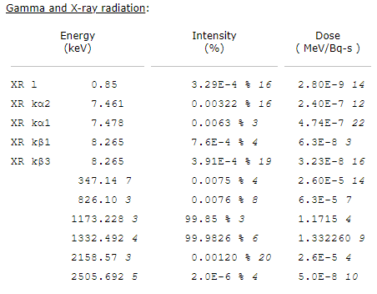
Source 𝛾-lines used for calibrations
Y-88
Eu-152
Co-60
https://www.nndc.bnl.gov/nudat2/dec_searchi.jsp

Slide 4
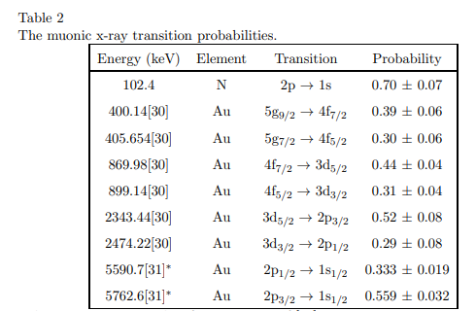
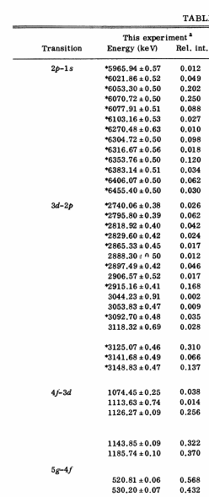
Muonic X-rays used for calibrations
Th-232
Au-197
https://arxiv.org/pdf/nucl-ex/0104030.pdf
https://journals.aps.org/prc/pdf/10.1103/PhysRevC.17.1433

Slide 5
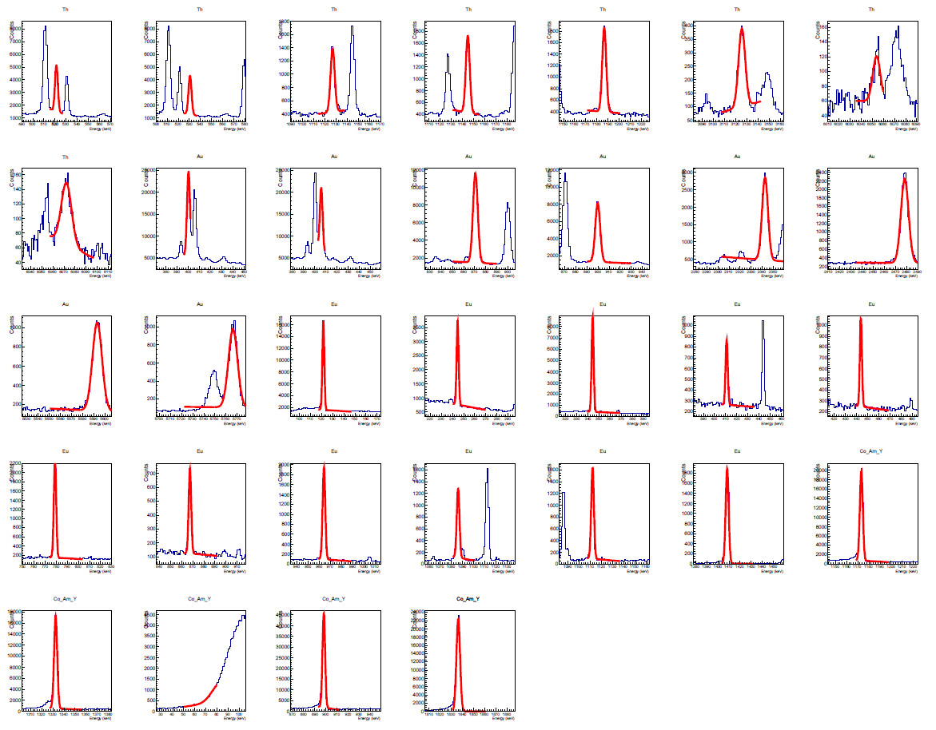
Fit peaks from MB18B
Rumyantseva Nadya | OMC4DBD Collaboration Meeting | 19-20.04.2021
5

Slide 6
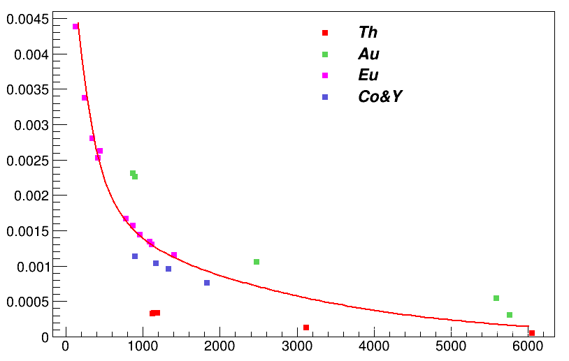
Efficiency lines for MB18B
Energies (keV)
Th: 1126.27, 1143.85, 1185.74, 3125.07, 6053.3
Au: 869.9, 899.1, 2474.2, 5590.7, 5762.6
Eu: 121.8, 244.7, 344.3, 411.1, 443.9, 778.9, 867.3, 964.1, 1085.8, 1112.1, 1408
Co: 1173.2, 1332.5
Y: 898.04, 1836.06
Rumyantseva Nadya | OMC4DBD Collaboration Meeting | 19-20.04.2021
6

Slide 7
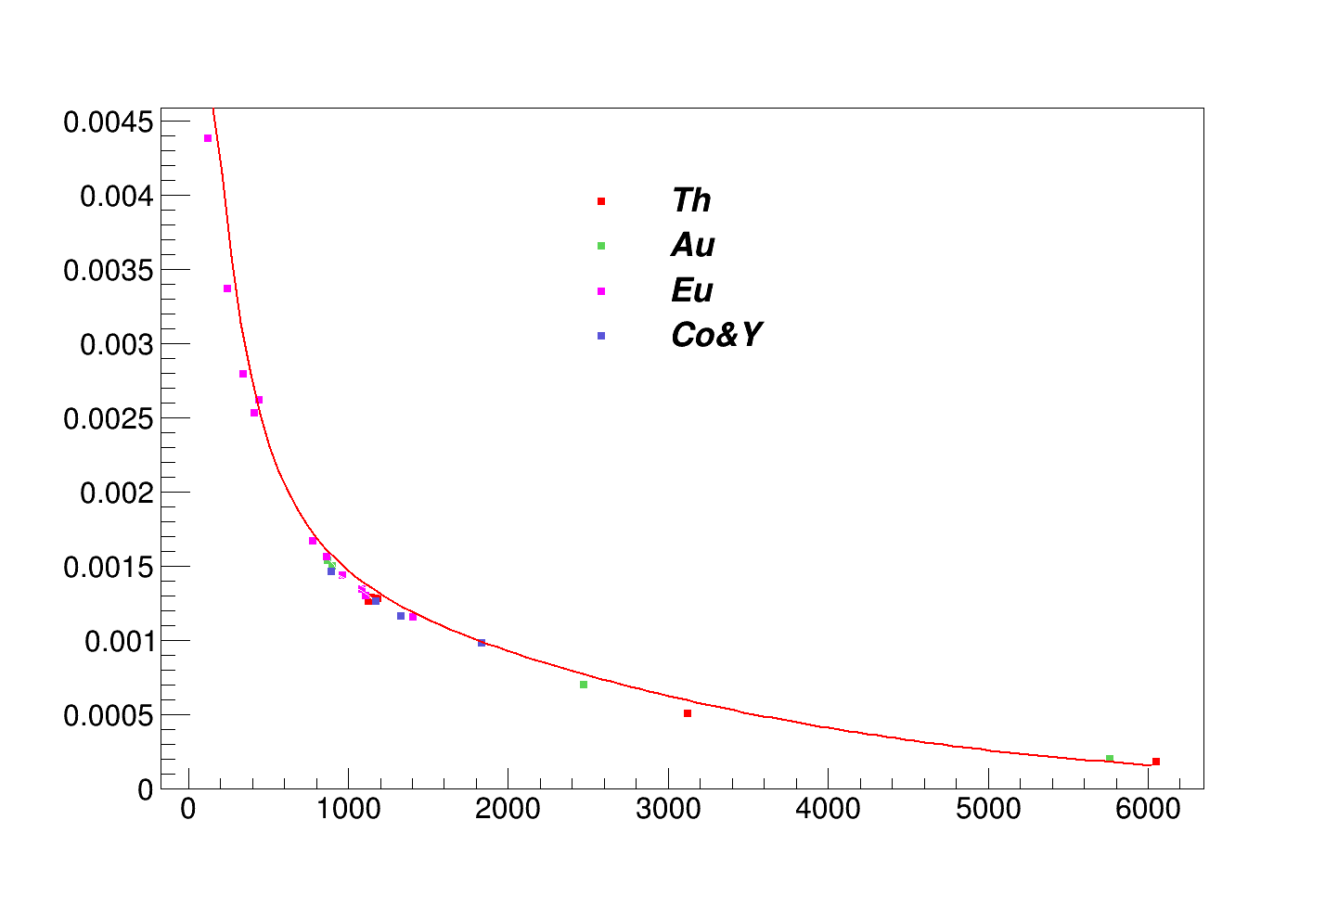
Corrected efficiency line for MB18B
Number of decay in run = activity(Co-60) · measurement time · relative intensities · 0.82
Number of decay in run = activity(Y-88) · measurement time · relative intensities · 0.77
Number of decay in run = (Th-232) Number of μ in run · relative intensities · 0.26
Number of decay in run = (Au-197) Number of μ in run · relative intensities · 0.75
Rumyantseva Nadya | OMC4DBD Collaboration Meeting | 19-20.04.2021
7

Slide 8
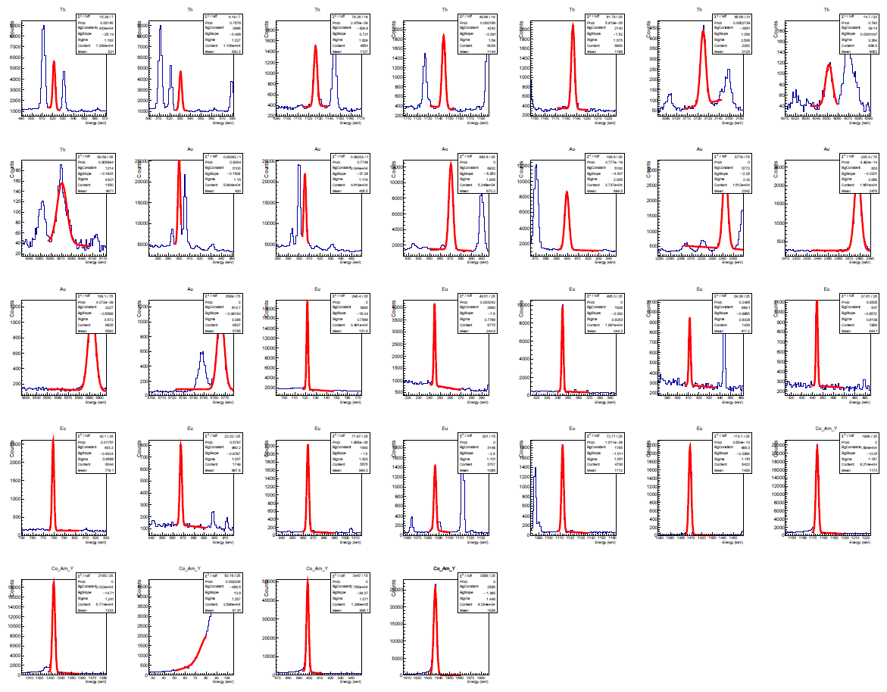
Fit peaks from MB23A
Rumyantseva Nadya | OMC4DBD Collaboration Meeting | 19-20.04.2021
8

Slide 9
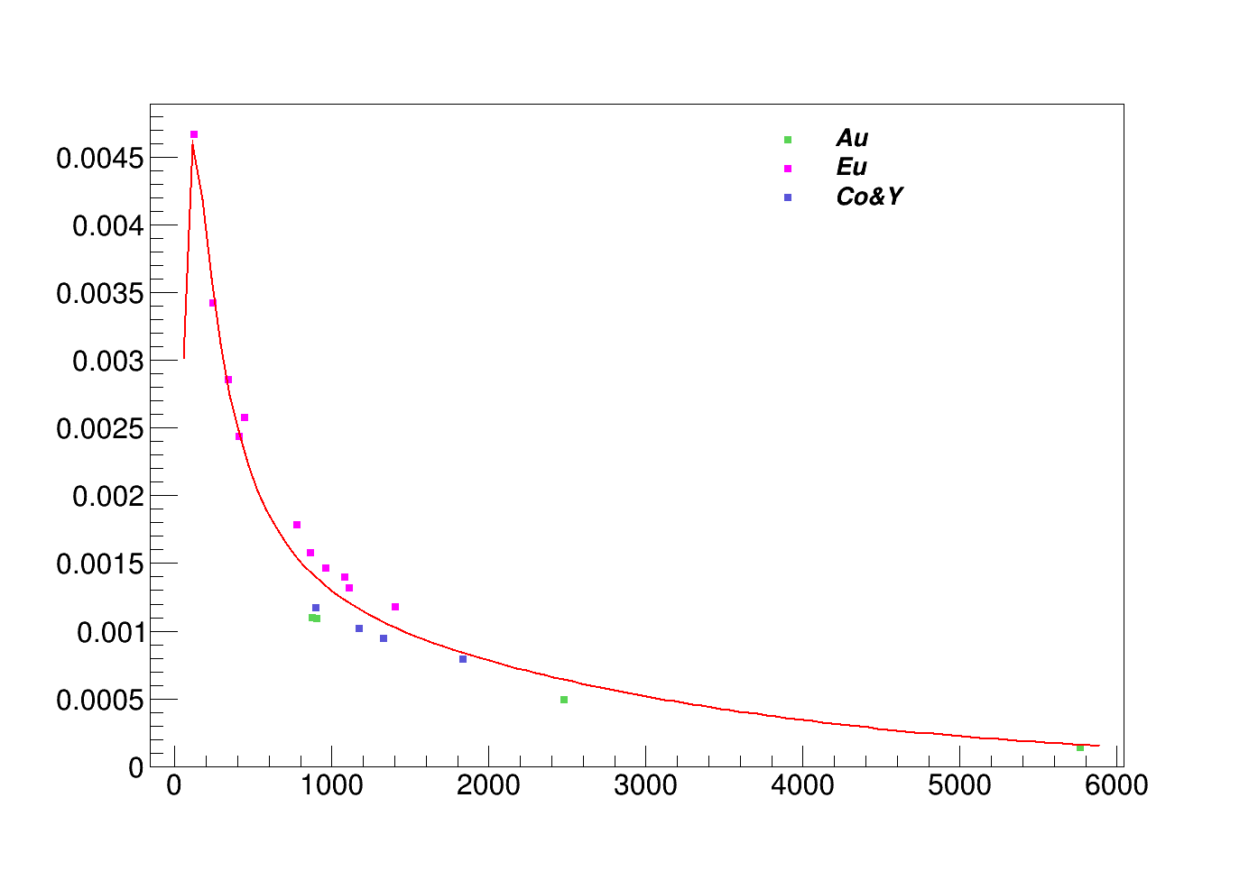
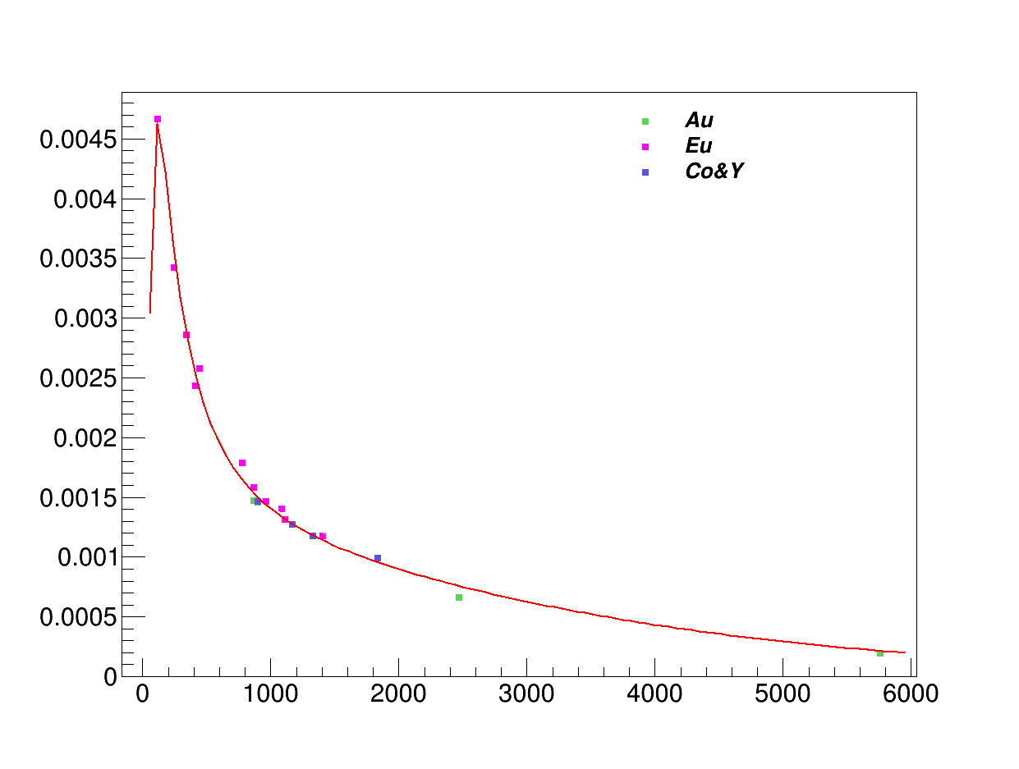
MB23A: corrected vs uncorrected efficiencies
Not corrected efficiency line for MB23A
Energies, keV | Eff, 10⁻⁵ a.e.
296.5 | 311.7
352.6 | 276.4
372.3 | 265.9
381.4 | 261.3
386.3 | 258.9
389.4 | 257.4
439.9 | 235.7
472.2 | 223.9
1368.6 | 106.8
1633.6 | 94.1
2754.0 | 59.1
Corrected efficiency line for MB23A
Preliminary results
Energies, keV | Eff, 10⁻⁵ a.e.
296.5 | 312.9
352.6 | 278.4
372.3 | 268.2
381.4 | 263.7
386.3 | 261.4
389.4 | 259.9
439.9 | 238.8
472.2 | 227.3
1368.6 | 114.2
1633.6 | 101.9
2754.0 | 67.2
Rumyantseva Nadya | OMC4DBD Collaboration Meeting | 19-20.04.2021
9

Slide 10
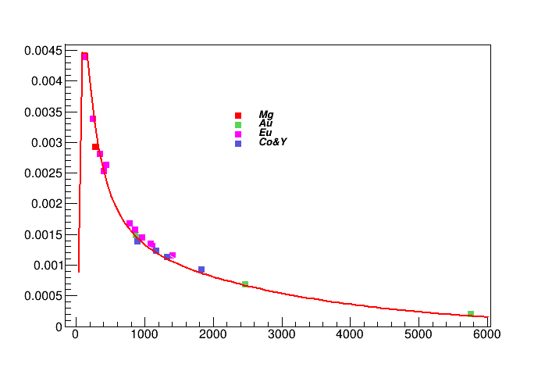
Efficiency lines for MB18B with μX-ray Mg-24
Energies (keV)
Mg: 296.5
Au: 899.1, 2474.2, 5590.7
Eu: 121.8, 244.7, 344.3, 411.1, 443.9, 778.9, 867.3, 964.1, 1085.8, 1112.1, 1408
Co: 1173.2, 1332.5
Y: 898.04, 1836.06

Slide 11
Conclusion, Questions & Remarks
Efficiency calibration procedure has been developed using sources & muonic X-rays
Discrepancies between different sources has been observed. The reason is unknown.
Is correction can be used, how to validate?
It seems that usage of corrected efficiencies is ok for some analysis of Mg-24 data (comments from Dana?).
What can be done in order to improve the situation?
Rumyantseva Nadya | OMC4DBD Collaboration Meeting | 19-20.04.2021
11

Slide 12
Backup slides

Slide 13
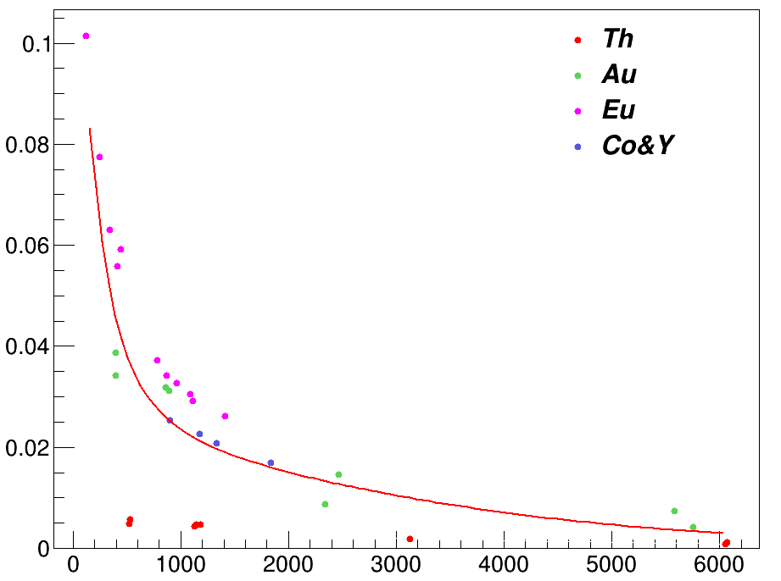
Total Efficiency of the detectors
totalEfficiencies[i] += Content / numberOfDecaysInRun
TF1 *fit = new TF1 ("func", "exp([0]+[1]*TMath::Log(x)+[2]*pow(TMath::Log(x),2.)+[3]*pow(TMath::Log(x),3.)+[4]*pow(TMath::Log(x),4.)+[5]*pow(TMath::Log(x),5.))")
Rumyantseva Nadya | OMC4DBD Collaboration Meeting | 19-20.04.2021
13

Slide 14
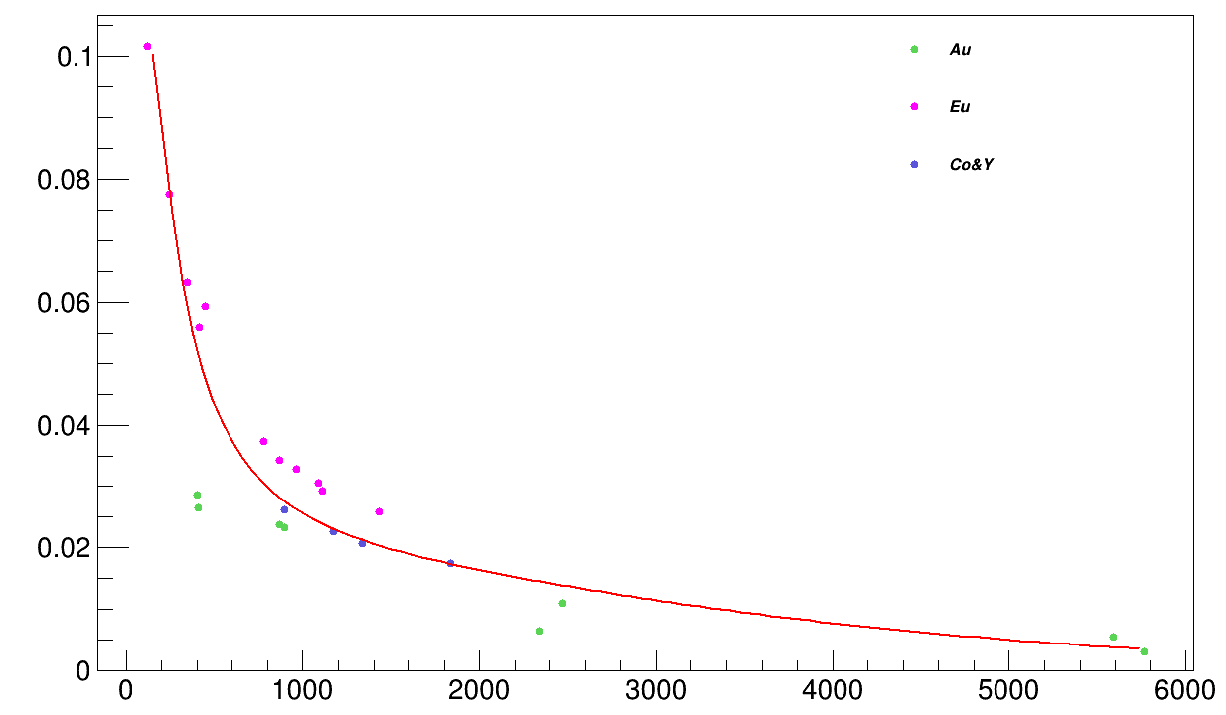
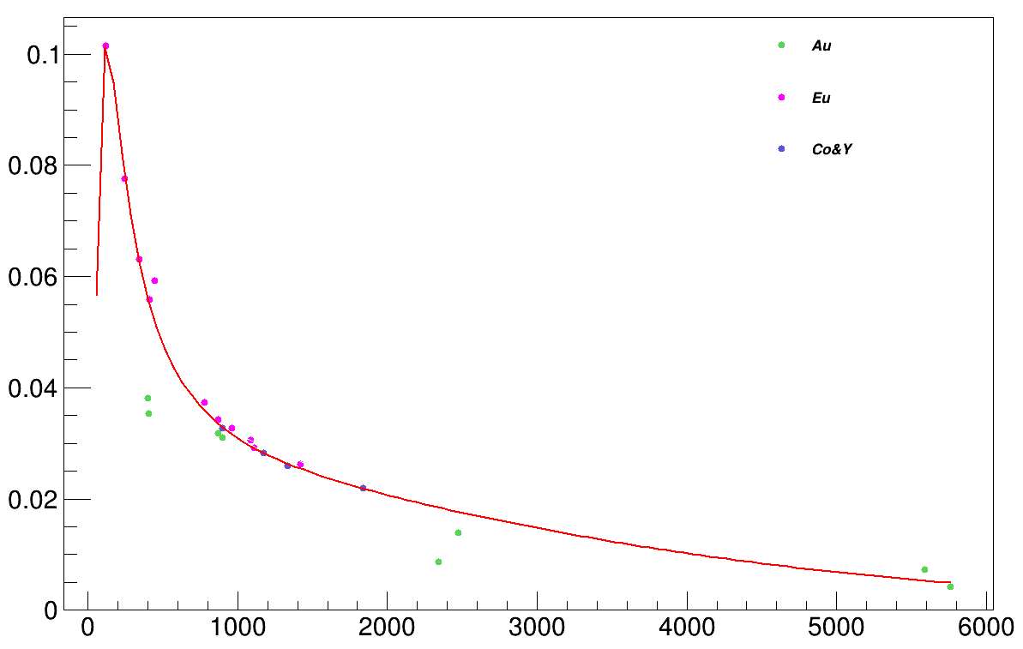
Total Efficiency of the detectors w/o and with corrections
Rumyantseva Nadya | OMC4DBD Collaboration Meeting | 19-20.04.2021
14

Slide 15
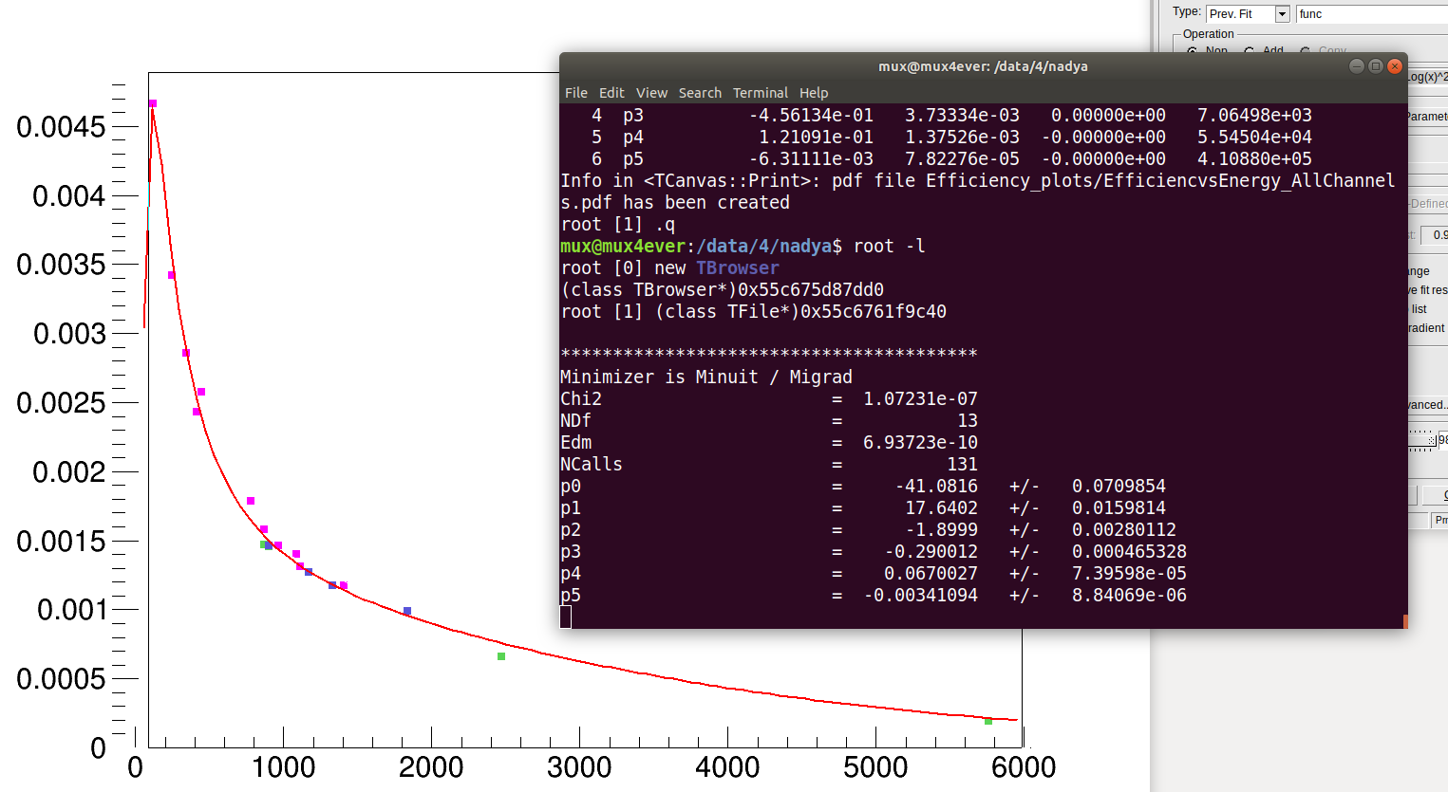
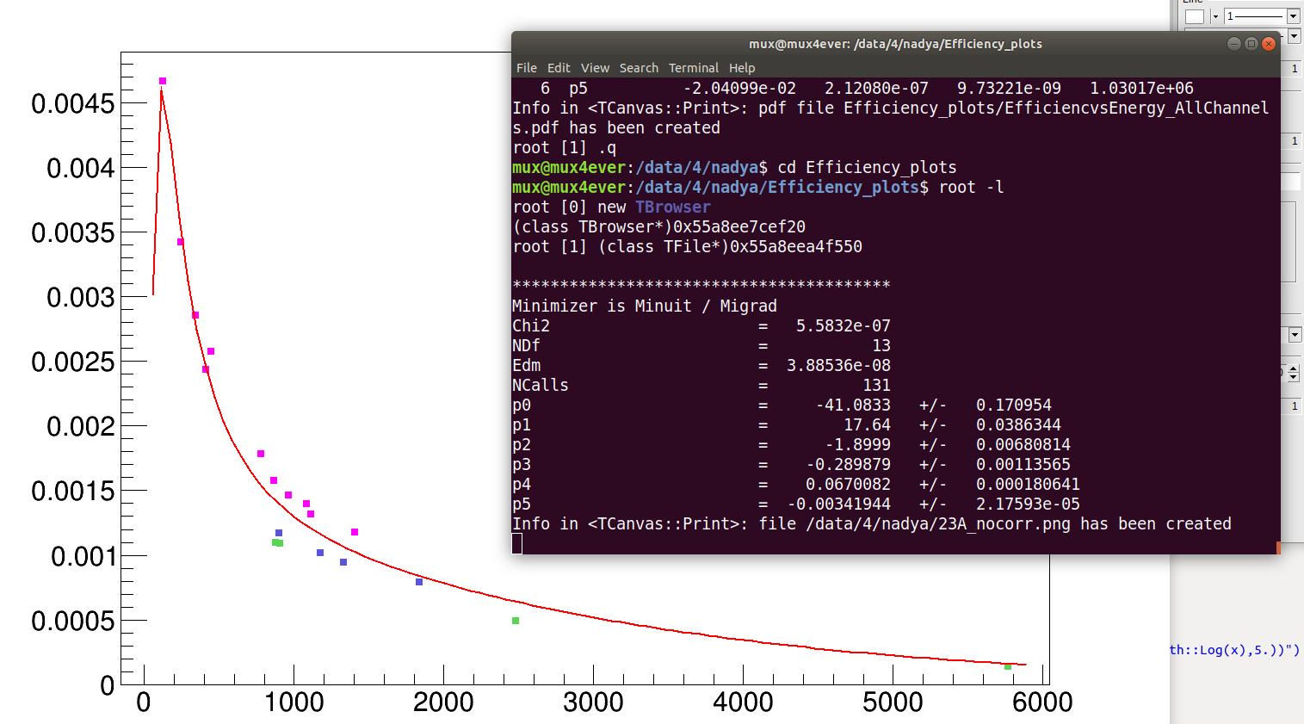
Fit parameters
Rumyantseva Nadya | OMC4DBD Collaboration Meeting | 19-20.04.2021
15

