Slide 1
BM@N Mainframe & Cooling
14.4.2021

Slide 2
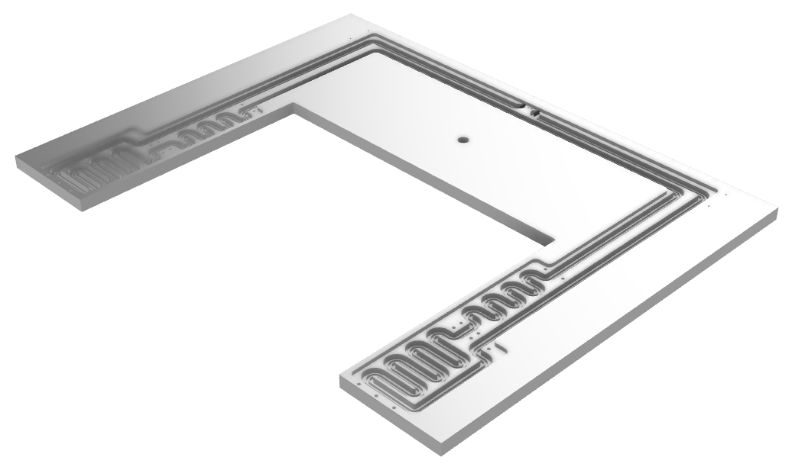
BM@N: New Cooling Plate Design
+ high heat transfer coefficient (HTC)
- long channels
high $Δp$
high $T_{in}−T_{out}$
for calculation of thermal properties:
area & power
cooling liquid

Slide 3
Kinematic Viscosity: NOVEC vs H₂O-Glycol
freezing point
x 10
H₂O @ 20º C
34% Monoethylenglycol
38% 1,2-Propylenglycol
boiling point

Slide 4
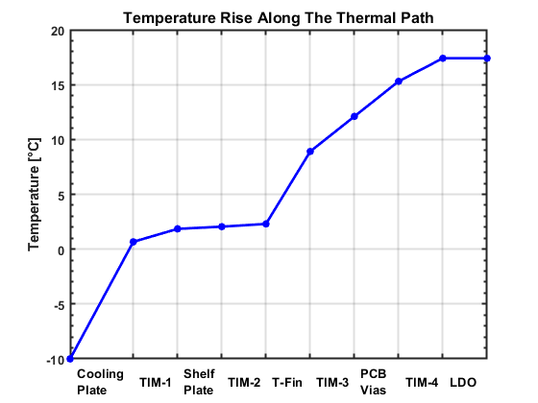
Adjustment to BM@N Requirements
cooling liquid: NOVEC 649
pressure loss: 1.3 bar
flow: 3 l/min
CBM setup with cooling liquid at $−10°C$ gives an electronics temperature $∼17°C$ maximum => stable temp. of environment
10 kW CO₂ + NOVEC plant would be ok

