Slide 1
Draft-00
Global observables in heavy-ion collisions at NICA.
PWG1 status report
G. Feofilov, on behalf of the PWG1/MPD team
V.Fock Institute for Physics, Laboratory of Ultra-High Energy Physics, Saint-Petersburg State University
MPD Collaboration meeting 21.04.2021—23.04.2021, JINR, Dubna
Notes:
1

Slide 3
PWG1-MPD status
Institutes – participants of the PWG1 activity:
SPbSU (St.Petersburg),
INR RAS (Troitsk, Moscow),
MEPhI (Moscow) and
MexNICA Collaboration (Mexica)
PWG1 co-conveners:
Alexander Ivashkin (INR RAS, RF) ivashkin@inr.ru
Grigory Feofilov(SPbSU,RF) g.feofilov@spbu.ru
Regular meetings in October 2020 –April 2021: 6 PWG1 meetings
https://indico.jinr.ru/category/343/
Conferences: --only RFBR in Oct 2020, https://indico.jinr.ru/event/1469/
Please, visit our PWG1 WEB page: https://indico.jinr.ru/category/343/
Send us an e-mail to join the group!
Notes:
Include JINR (Dubna)

Slide 4
PWG1 meetings in October 2020-April 2021
1 October 2020 Talks approval session
https://indico.jinr.ru/event/1600/
Vladimir Zherebchevsky (Saint-Petersburg State University) , «Silicon pixel detectors for the Inner Tracking System of MPD experiment at the NICA collider» and “Detection methods and data analysis for silicon pixel vertex detectors for the experimental set-ups of the NICA complex»
Dr Genis Musulmanbekov (JINR, LIT), “Spectator matter in M-C generators DCM-QGSM and DCM-SMM”
Grigory Feofilov (Saint-Petersburg State University), “Investigation of initial states and development of methods for their analysis in proton and nuclear collisions at energies of the NICA collider.”

Slide 5
PWG1 meetings in October 2020-April 2021
8 October 2020 Talks approval session
https://indico.jinr.ru/event/1620/
Dr Genis Musulmanbekov (JINR, LIT), “Spectator matter in M-C generators DCM-QGSM and DCM-SMM”
12 November, Meeting on Be-Be detector issues
https://indico.jinr.ru/event/1689/
Discussion of Be-Be proposal by MexNICA

Slide 6
PWG1 meetings in October 2020-April 2021
17 December 2020,
https://indico.jinr.ru/event/1771/
G.Feofilov, A.Ivashkin, PWG1 plans for 2021
Alexey Aparin "A brief overview of requirements on centrality classes by different PWG groups”
01 April 2021
https://indico.jinr.ru/event/2066/
Vadim Volkov (INR RAS) , "Comparison of two methods for centrality measurements in MPD experiment”
15 April 2021,
https://indico.jinr.ru/event/2099/
Genis Musulmanbekov(JINR, LIT), “On difference between DCM and Glauber model”.

Slide 7
PWG1 reports at conferences in 2020
ICPPA-2020:
Vadim VOLKOV, Approaches in centrality measurements of heavy ion collisions with forward calorimeters at MPD/NICA facility,
Nikolay KARPUSHKIN, Application of Machine Learning methods for centrality determination in heavy ion reactions at the BM@N and MPD@NICA
NUCLEUS 2020:
Vladislav SANDUL, "MC simulations of beam-beam collisions monitor for event-by-event studies at NICA» ,
Alexander IVASHKIN, «Physics with spectators in MPD/NICA experiment»
Genis MUSULMANBEKOV, «Modification of hadron properties in a dense and hot baryonic matter»
Igor PSHENICHNOV, «What can we learn from remnants of spectator matter in central nucleus-nucleus collisions?»
Vladimir ZHEREBCHEVSKY, «Silicon pixel detectors for the Inner Tracking System of MPD experiment at the NICA collider»
RFBR grants for NICA:
Grigory FEOFILOV, Investigation of initial states and development of methods for their analysis in proton and nuclear collisions at energies of the NICA collider.
Vladimir VECHERNIN, “Clusters of cold dense nuclear matter and their registration with the MPD vertex detector. “
Vladimir ZHEREBCHEVSKY,«Detection methods and data analysis for silicon pixel vertex detectors for the experimental set-ups of the NICA complex»
Alexander IVASHKIN, «Measurements of spectators with forward hadron calorimeter at MPD/NICA experiment”
Vera ERMAKOVA , "Stopping of protons in pA collisions at SPS and NICA energies in analytical hydrodynamic model and in SMASH event generator"
Ivonne MALDONADO, “Hyperons in Bi+Bi collisions at MPD-NICA: Preliminary analysis of production at generation, simulation and reconstruction level”
Igor PSHENICHNOV, «Properties of Spectator Matter in Nuclear Collisions at NICA”
.
SOME HIGHLIGHTS ARE PRESENTED BELOW:

Slide 8
Layout of the talk
Introduction
Two approaches to centrality classes determination
Some slides by Petr Parfenov (MEPhi), ”Centrality deternination based on charged particles multiplicity”
Some slides by Vadim Volkov (INR RAS) , "Comparison of two methods for centrality measurements in MPD experiment”
Theoretical modeling
Some slides by Genis Musulmanbekov (JINR), “On difference between DCM and Glauber model”.
Some slides by Igor PSHENICHNOV (INR), «Properties of Spectator Matter in Nuclear Collisions at NICA”
MPDRoot issues --??? Codes for centrality classes ???
What we are still missing in our Global Observables topic???:
Event plane determination – codes???
Transverse energy measurement
Total multiplicity measurement
Total cross-section measurement

Slide 9
Two main approaches to centrality classes selection: 1) Charged particle Multiplicity classes by TPC and 2) Spectator energy classes by FHCal

Slide 10
Two main approaches to determination of classes of centrality
Multiplicity in TPC as centrality class estimator
-- method was suggested by MEPHI/GSI team
Report by Petr Parfenov at the MPD Physics forum 15.04.2021r:
See https://indico.jinr.ru/event/2065/
https://github.com/FlowNICA/CentralityFramework
https://github.com/Dim23/GammaFit
Draft of analysis note:
https://github.com/FlowNICA/CentralityFramework/blob/master/Documentation/Centrality_AnalysisNote.pdf
Spectator nucleons with FHCal
– by the INR RAS team, see the PWG1 meetings Report by Vadim Volkov at the PWG1 meeting 01 April 2021
https://indico.jinr.ru/event/2066/
or RFBR conference:
https://indico.jinr.ru/event/1469/contributions/9905/attachments/8135/12126/ivashkin_RFBR_2020.pdf
Codes: https://github.com/qweek2/Centrality_NICA/tree/master
.

Slide 11
The 1st aproach: multiplicity classes

Slide 16
…some examples…

Slide 17
Summary for Multiplicity method (from talk by Petr)

Slide 18
???Comments to Multiplicity-based methods??
Very detailed analysis +documentation in two approaches
Important for comparison with RHIC data
… but :
It is used currently at midrapiidty |η |<0.5 (– self-correlations might be possible in the following analysis)
Three parameters (f, μ, k)…
Constant width for all centrality classes (should be optimized)
Systematic errors and effects of various cuts on multiplicity distribution….
Glauber-based approach produces shift to the number of Ncoll….it is the old problem

Slide 19
The 2nd approach: spectators

Slide 20
Conclusion (Vadim)

Slide 21
Summary for the 2nd approach
A few approaches for the centrality measurements with spectators are under development;
They are relied on the space distribution of the deposited energies in FHCal modules;
The results are strongly dependent on the used fragmentation model.
Future plans:
Further development of the centrality determination with the spectators;
Unification and comparison of both (particles multiplicity and spectators) approaches.

Slide 22
Theoretical modelling
Igor PSHENICHNOV, «What can we learn from remnants of spectator matter in central nucleus-nucleus collisions?»
Genis MUSULMANBEKOV, «Modification of hadron properties in a dense and hot baryonic matter»

Slide 23
TEOR-1:
Properties of Spectator Matter in Nuclear Collisions at NICA
I.A. Pshenichnov^{1,2,*}, N.A. Kozyrev^{1,2}, R.S. Nepeyvoda^{1,2}
A.O. Svetlichnyi^{1,2}, U.A. Dmitrieva^{1,2}
¹Moscow Institute of Physics and Technology, Dolgoprudny, Russia
²Institute for Nuclear Research, Moscow, Russia
*e-mail: pshenich@inr.ru
The Conference "RFBR Grants for NICA"
20-23 October 2020
VBLHEP, JINR, Dubna, RUSSIA

Slide 24
TEOR-1:
I. Our model: AAMCC (or A²MC²)
Our model Abrasion-Ablation Monte Carlo for Colliders (AAMCC)¹⁾ is based on the famous Glauber Monte Carlo version 3²⁾ and models of decays of excited nuclei from Geant4 toolkit³⁾ (G4Evaporation, G4SMM, G4FermiBreakUp).
A difference in proton and neutron density distributions in colliding nuclei is taken into account in GlauberMC v.3
We tested and improved⁴⁾ G4SMM (E*/A_{pf} > 3 MeV) and G4FermiBreakUp (the latter is for explosive decays of Z < 9, A < 19 nuclei).
A key ingredient of the model is the calculation of the excitation energy of prefragments. Either Ericson⁵⁾ formula (based on level densities in initial nuclei) or a phenomenological approximation based on ALADIN data⁶⁾ is used.
¹⁾ A. Sveltichnyi., I.P. Bull. RAS: Phys. 84 (2020) 1103
²⁾ C. Loizides, J.Kamin, D. d’Enterria, PRC 97 (2018) 054910
³⁾ J.M. Quesada,V. Ivanchenko, A. Ivanchenko et al., Prog. Nucl. Sci. Tech. 2 (2011) 936
⁴⁾ I.P., A.S. Botvina, I. Mishustin, W. Greiner, NIMB 268 (2010) 604
⁵⁾ T. Ericson, Adv. Phys. 9, 425 (1960).
⁶⁾ A.S. Botvina et al., NPA 584, 737 (1995)
prefragment A
Both prefragments are modelled.
AAMCC is suitable for colliders.
participants
prefragment B
24

Slide 25
II. Forward-backward asymmetry in a collider
Side A
Collisions of identical nuclei
Side B
Fluctuations of nuclear densities,
stochasticity of NN collisions
Unequal numbers of spectator nucleons
The forward-backward asymmetry of a quantity N is defined as:
stand for the numbers of
spectator nucleons, neutrons etc.
at the sides A and B, respectively.
L.P. Csernai, G. Eyyubova, V.K. Magas, PRC 86 (2012) 024912
R. Raniwala, R. Raniwala, C. Loizides, PRC 97 (2018) 024912
25

Slide 26
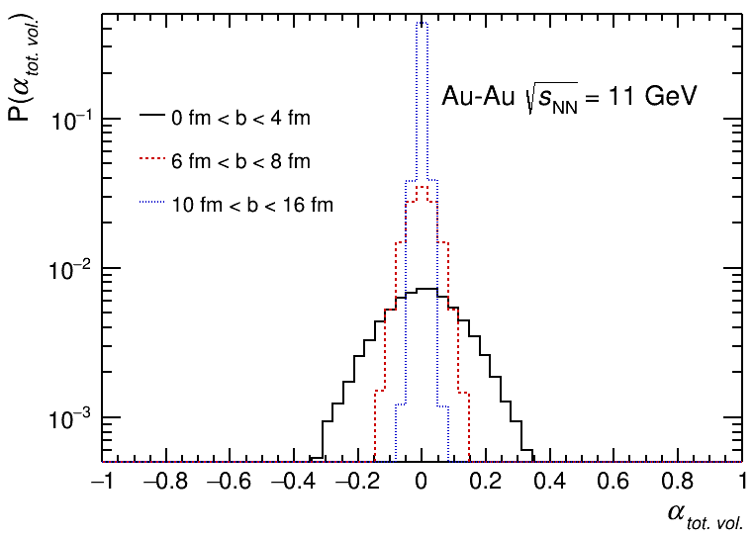
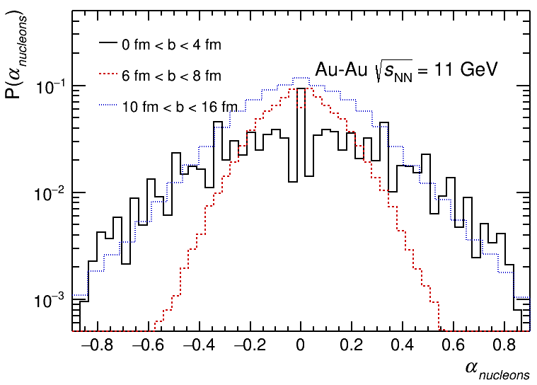
TEOR-1:
Asymmetry of the total spectator volume and of free spectator nucleons
The total spectator volumes (=A_{pf}) includes all
nuclear fragments and nucleons
Asymmetry decreases from central to peripheral
collisions.
Only small parts of large spectator volumes are
affected by fluctuations in numbers of participants.
This effect is of trivial statistical nature.
The dependence on b is not monotonic
The stochasticity of nucleon evaporation in peripheral events adds extra fluctuations.
According to AAMCC, events with low nucleon asymmetry can be classified with confidence as semi-peripheral events.
26

Slide 27
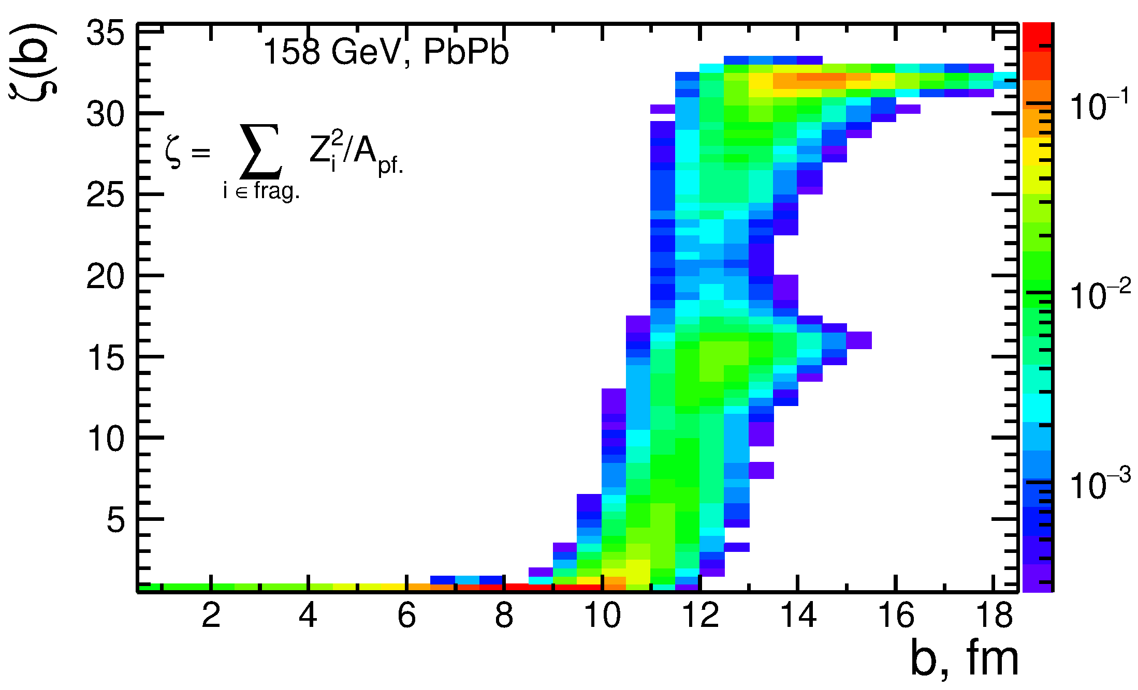
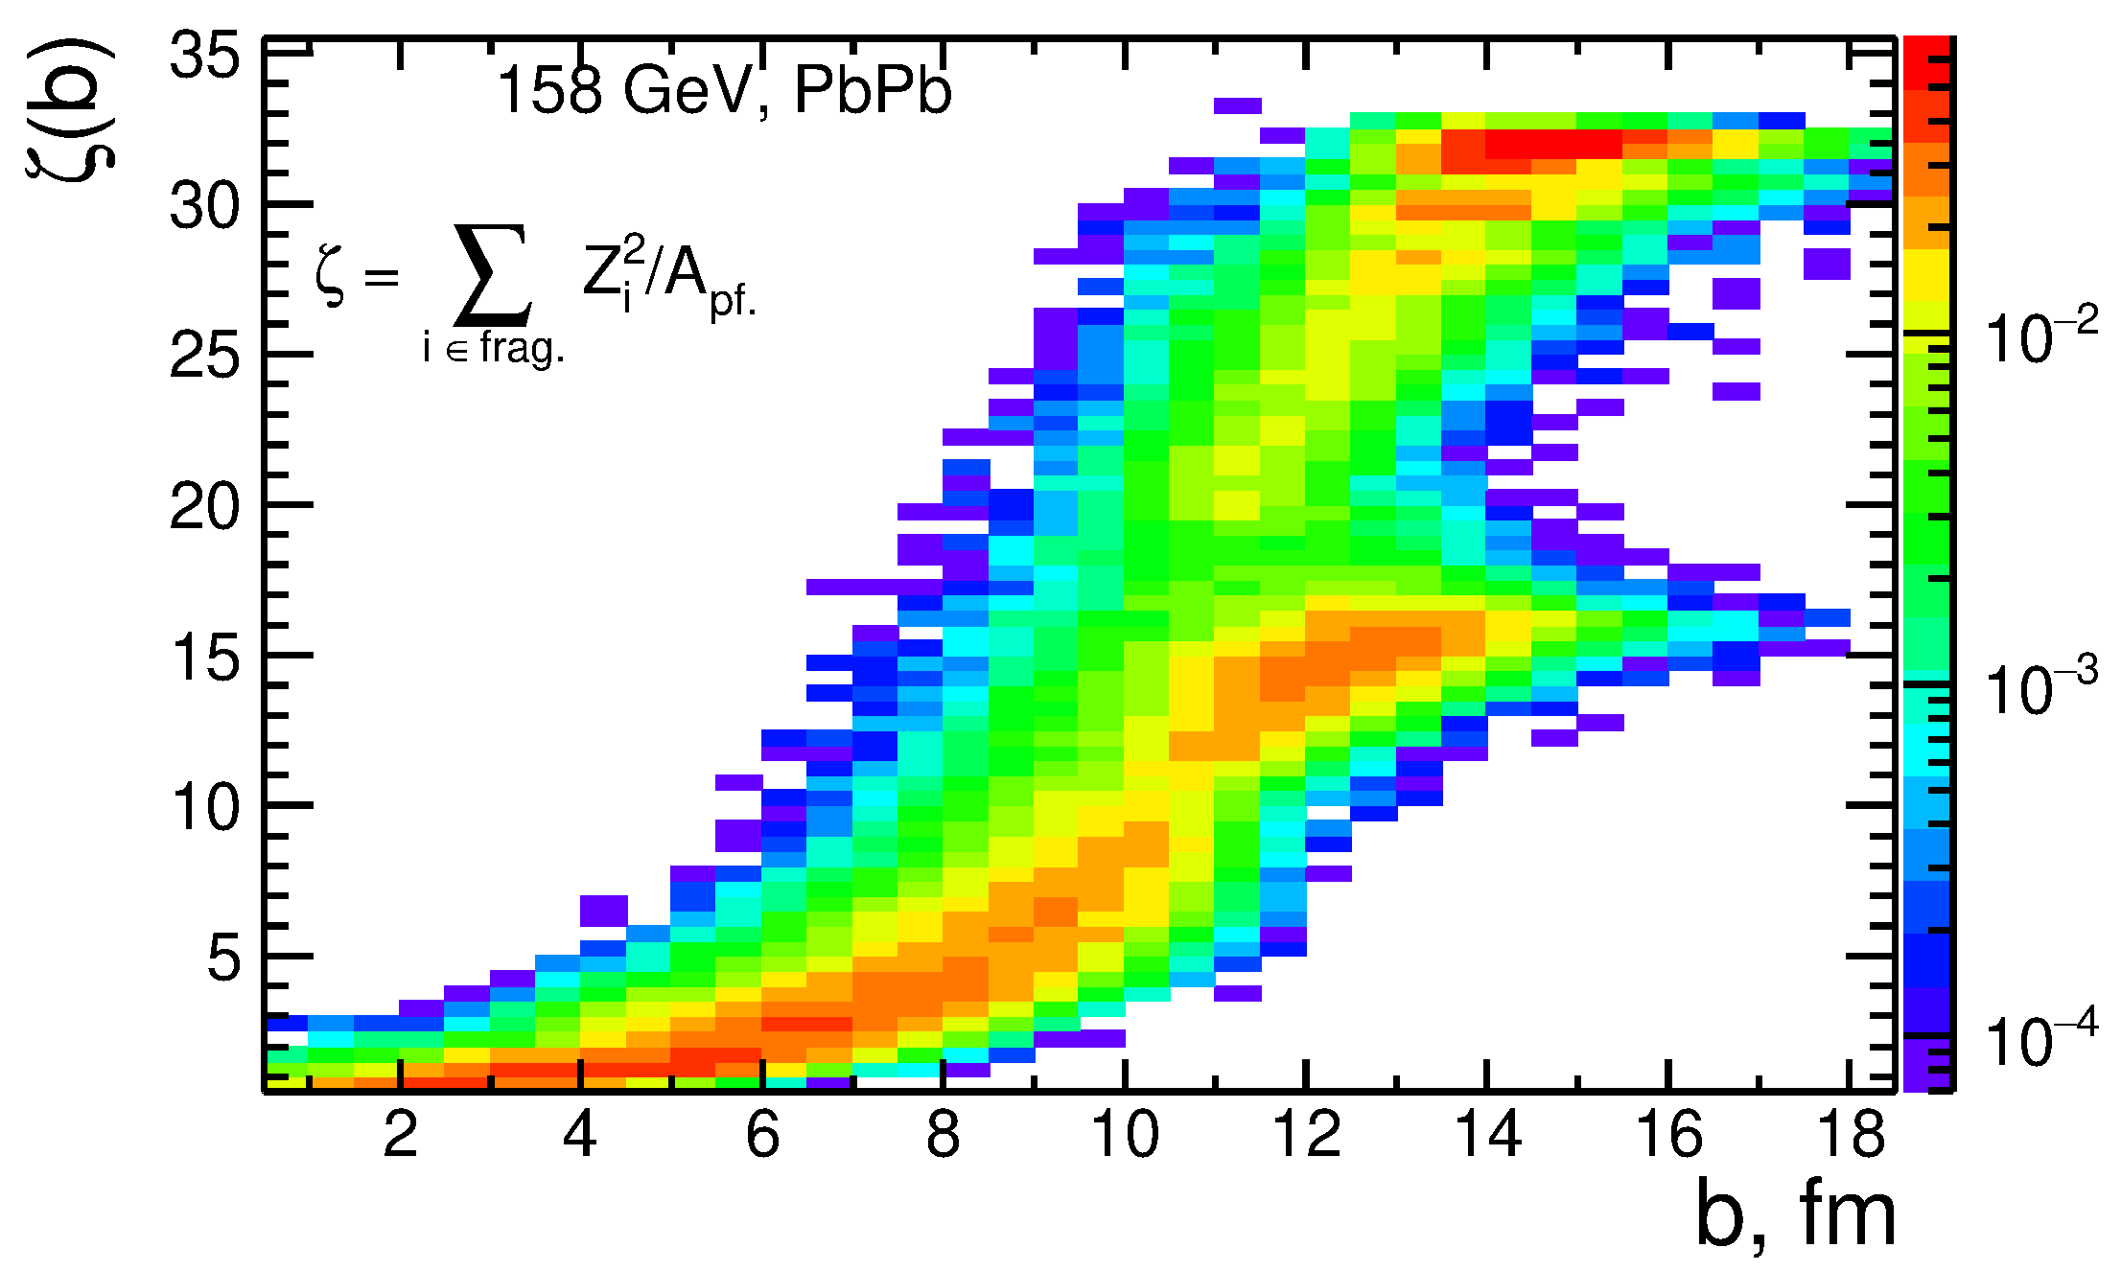
TEOR-1:
III. Sum of squares of fragment charges per spectator nucleon
Ericson
ALADIN
Providing that a scintillator detector is installed in front of a calorimeter,
can be measured along with the total spectator energy (or )
сan be proposed as an additional measure of centrality because
of its monotonic dependence on impact parameter b.
Large values can be attributed to peripheral events, but the exact procedure depends
on AAMCC tuning – subject of future work.
27

Slide 28
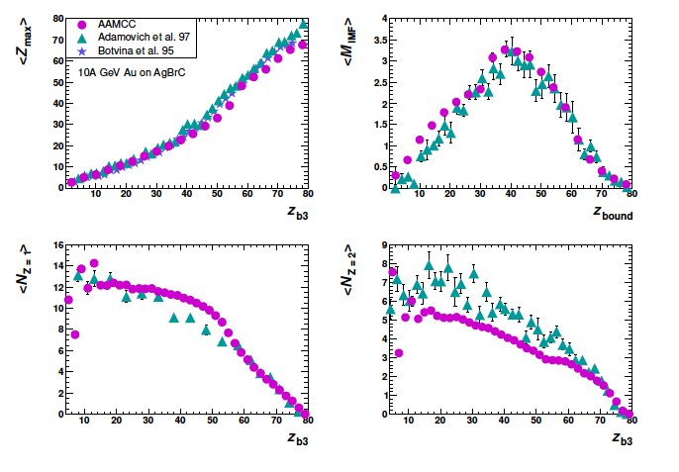
The average maximum charge and multiplicity of fragments as a function of fragment charges [1]
TEOR-1: AAMCC:
Fig.1. Circles: the average maximum charge of fragment < Zmax >, the average multiplicity of intermediate mass fragments < MIMF > with 3 < Z < 30, the average number of hydrogen and helium fragments, NZ=1 and NZ=2, produced in fragmentation of 197Au calculated with AAMCC as functions of Zb3 or Zbound, see text for details. Triangles represent data [18] collected with NIKFI BR-2 photoemulsion (AgBrC) at 10.7A GeV, stars - with Cu target and ALADIN detector[15|. See refernces in [1],
[1] I.A. Pshenichnov et al., Properties of Spectator Matter in Nuclear Collisions at NICA. to be published in PEPAN………
AAMCC gives a nice physics description of fragment charges
in AA collisions
Additional observables for centrality is proposed:
(a sum of fragment charges}²/{total Spect.Energy|

Slide 29
TEOR-2:
G. Musulmanbekov* , V. Zhezher
genis@jinr.ru*
JINR

Slide 30
PWG1 plans of application of codes within the MPDRoot
Some codes are already in the rather good shape and are available in git repositories
Should be the common methods available for MPD collaboration within the MpdRoot
Local discussion on April 1, 2020 on the existing productions: QA, issues/questions, see https://indico.jinr.ru/event/1223/
Discussion at the PWG-1 . the 30th of April 2020, On centrality determination within MpdRoot, urgent tasks for PWG-1, see: https://indico.jinr.ru/event/1286/
A couple of discussions on the codes availability and access also took place during the ongoing VI-th MPD meeting
The concrete steps hopefully will be defined in near time at the joint PWG conveners meeting

Slide 31
Summary
Two approaches for determination of centrality classes (TPC multiplicity-- and novel, FHCal spectator energies-based classes) are developed and tested
Both approaches were also tested for the reaction plane determination
Model estimates of the total multiplicity of charged particles in Au+Au collisions at NICA energies were done
Availability to the collaboration of the codes in the MPDRoot is planned to be ensured
Theoretical studies of the multi-fragmentation processes in heavy-ion collisions at NICA energies are in progress. This will improve the understanding of the collision dynamics and spectator measurements. The ideas could be developed and used for the more precise selection of the central events
Different theoretical estimates of number of binary nucleon-nucleon collisions at NICA energies - the quantity that is widely used as a proxy for centrality in the experimental data normalization, show deviations from the standard Glauber values. This will be taken into account in the future MPD data analysis.

Slide 32
Thank you for your attention!

Slide 33
TEOR-2

