Slide 1
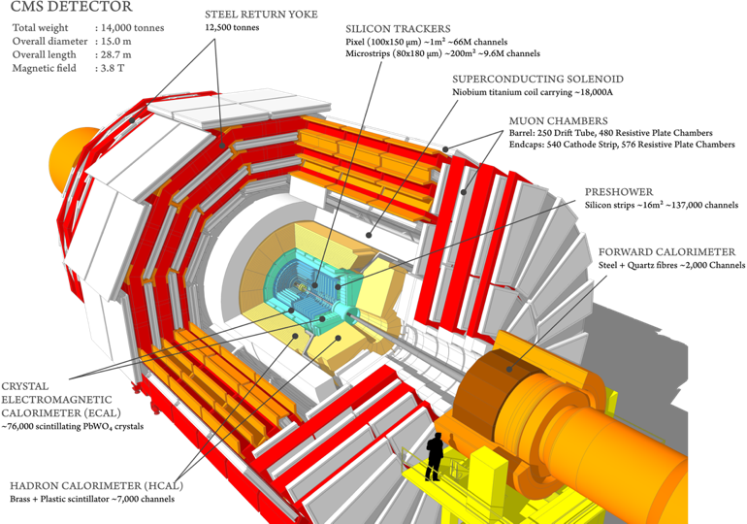
Upgrade of the CMS Detector
Project for 2022-2026
JINR Topic 02-0-1083-2009/2023
“CMS. Compact Muon Solenoid at the LHC”
Project leader: V.Yu. Karjavin
Scientific leader: I.A. Golutvin
21 June 2021. 55th Meeting of the Programme Advisory Committee for Particle Physics
1

Slide 2
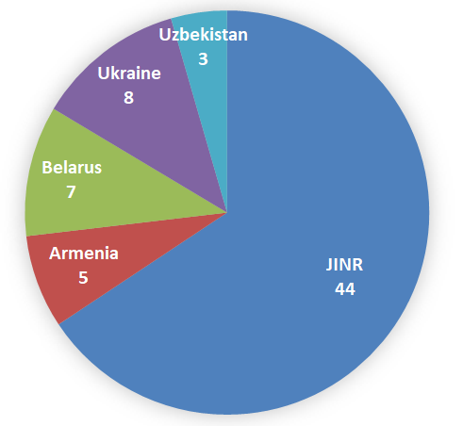
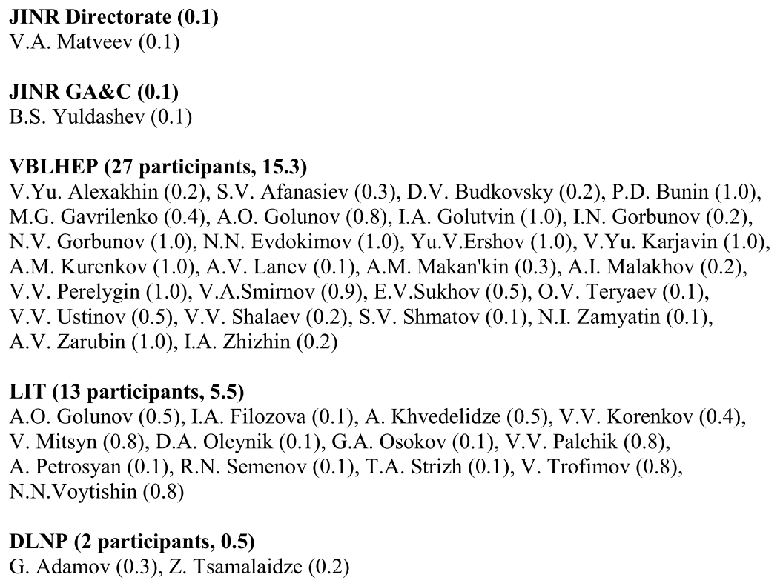
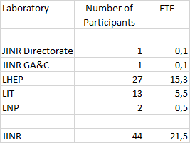
Participants of Projects
44 participants from JINR
23 participants from JINR member-states
Authors:
from JINR: 16 paid and 5 unpaid (4 PhD and 1 emeritus)
from JINR member-states: 6 paid
2

Slide 3
JINR in CMS Collaboration
Over 25 years JINR has been participated in the CMS experiment at the LHC, starting the very beginning of the detector concept development
Within the RDMS Collaboration JINR bears responsibility for the design, construction, commissioning, operation and upgrade of the Endcap Hadron Calorimeters (HE) and
Forward Muon Stations (ME1/1)
JINR scientists play active role in the CMS Physics programme. They contribute actively to the data taking and processing, data analysis for the purpose of obtaining new physics results
94 publications with contribution of JINR physicist's (since 2017):
13 CMS public paper in scientific journals (of more than 510 CMS papers in total)
18 CMS notes with physics analysis
6 CMS operation and upgrade notes
22 papers in peer-reviewed journals
35 articles with reviews of CMS results and on future physics
More than 70 reports at international conferences on the CMS project
3

Slide 4
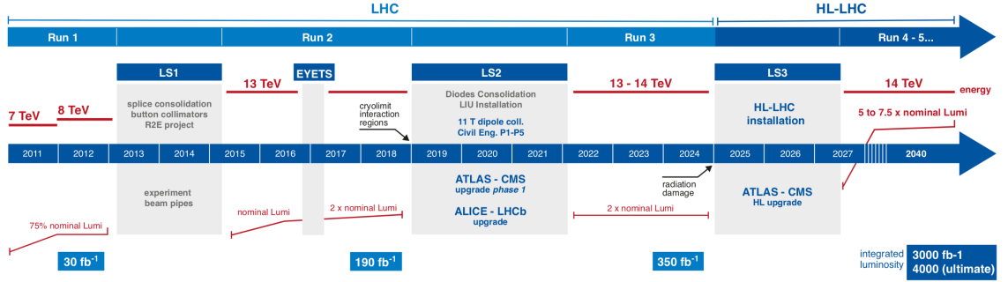
LHC Schedule
we are here…
project
completion
LHC proton-proton collisions started in 2009
In Run 1 ﬁrst 2 years 2010–2012 LHC operated at 7 TeV, delivering integrated luminosity ≈6 fb⁻¹, in 2012 energy was increased to 8 TeV, delivering ≈ 23 fb⁻¹. Higgs boson discovery
Run 2 started in 2015 at 13 TeV with instantaneous luminosity 1.7×10³⁴cm⁻² s⁻¹ (exceeded the design value). Physics tasks: detailed studies of the Higgs boson, standard model (SM) processes and searches for physics beyond the SM
During LHC Long Stop periods LS1 (2013−2015) and LS2 (2018−2021) the CMS detector is upgraded to facilitate an effective operation of all subsystems at high luminosity of 1÷2×10³⁴ сm⁻² s⁻¹ in pp−collisions at the LHC energy 14 TeV
After long shutdown LS3 in 2027 LHC start with HL-LHC operational mode with instantaneous luminosity (5-7.5)×10³⁴cm⁻² s⁻¹. By 2030 LHC will deliver integrated luminosity ~3000 fb⁻¹
4

Slide 5
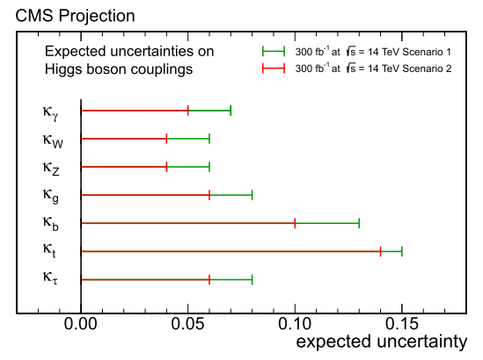

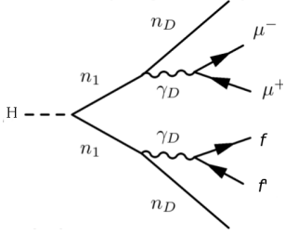
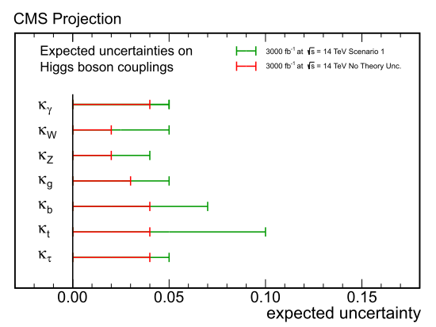
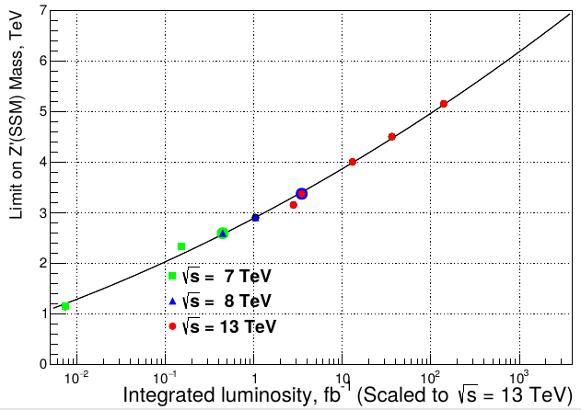
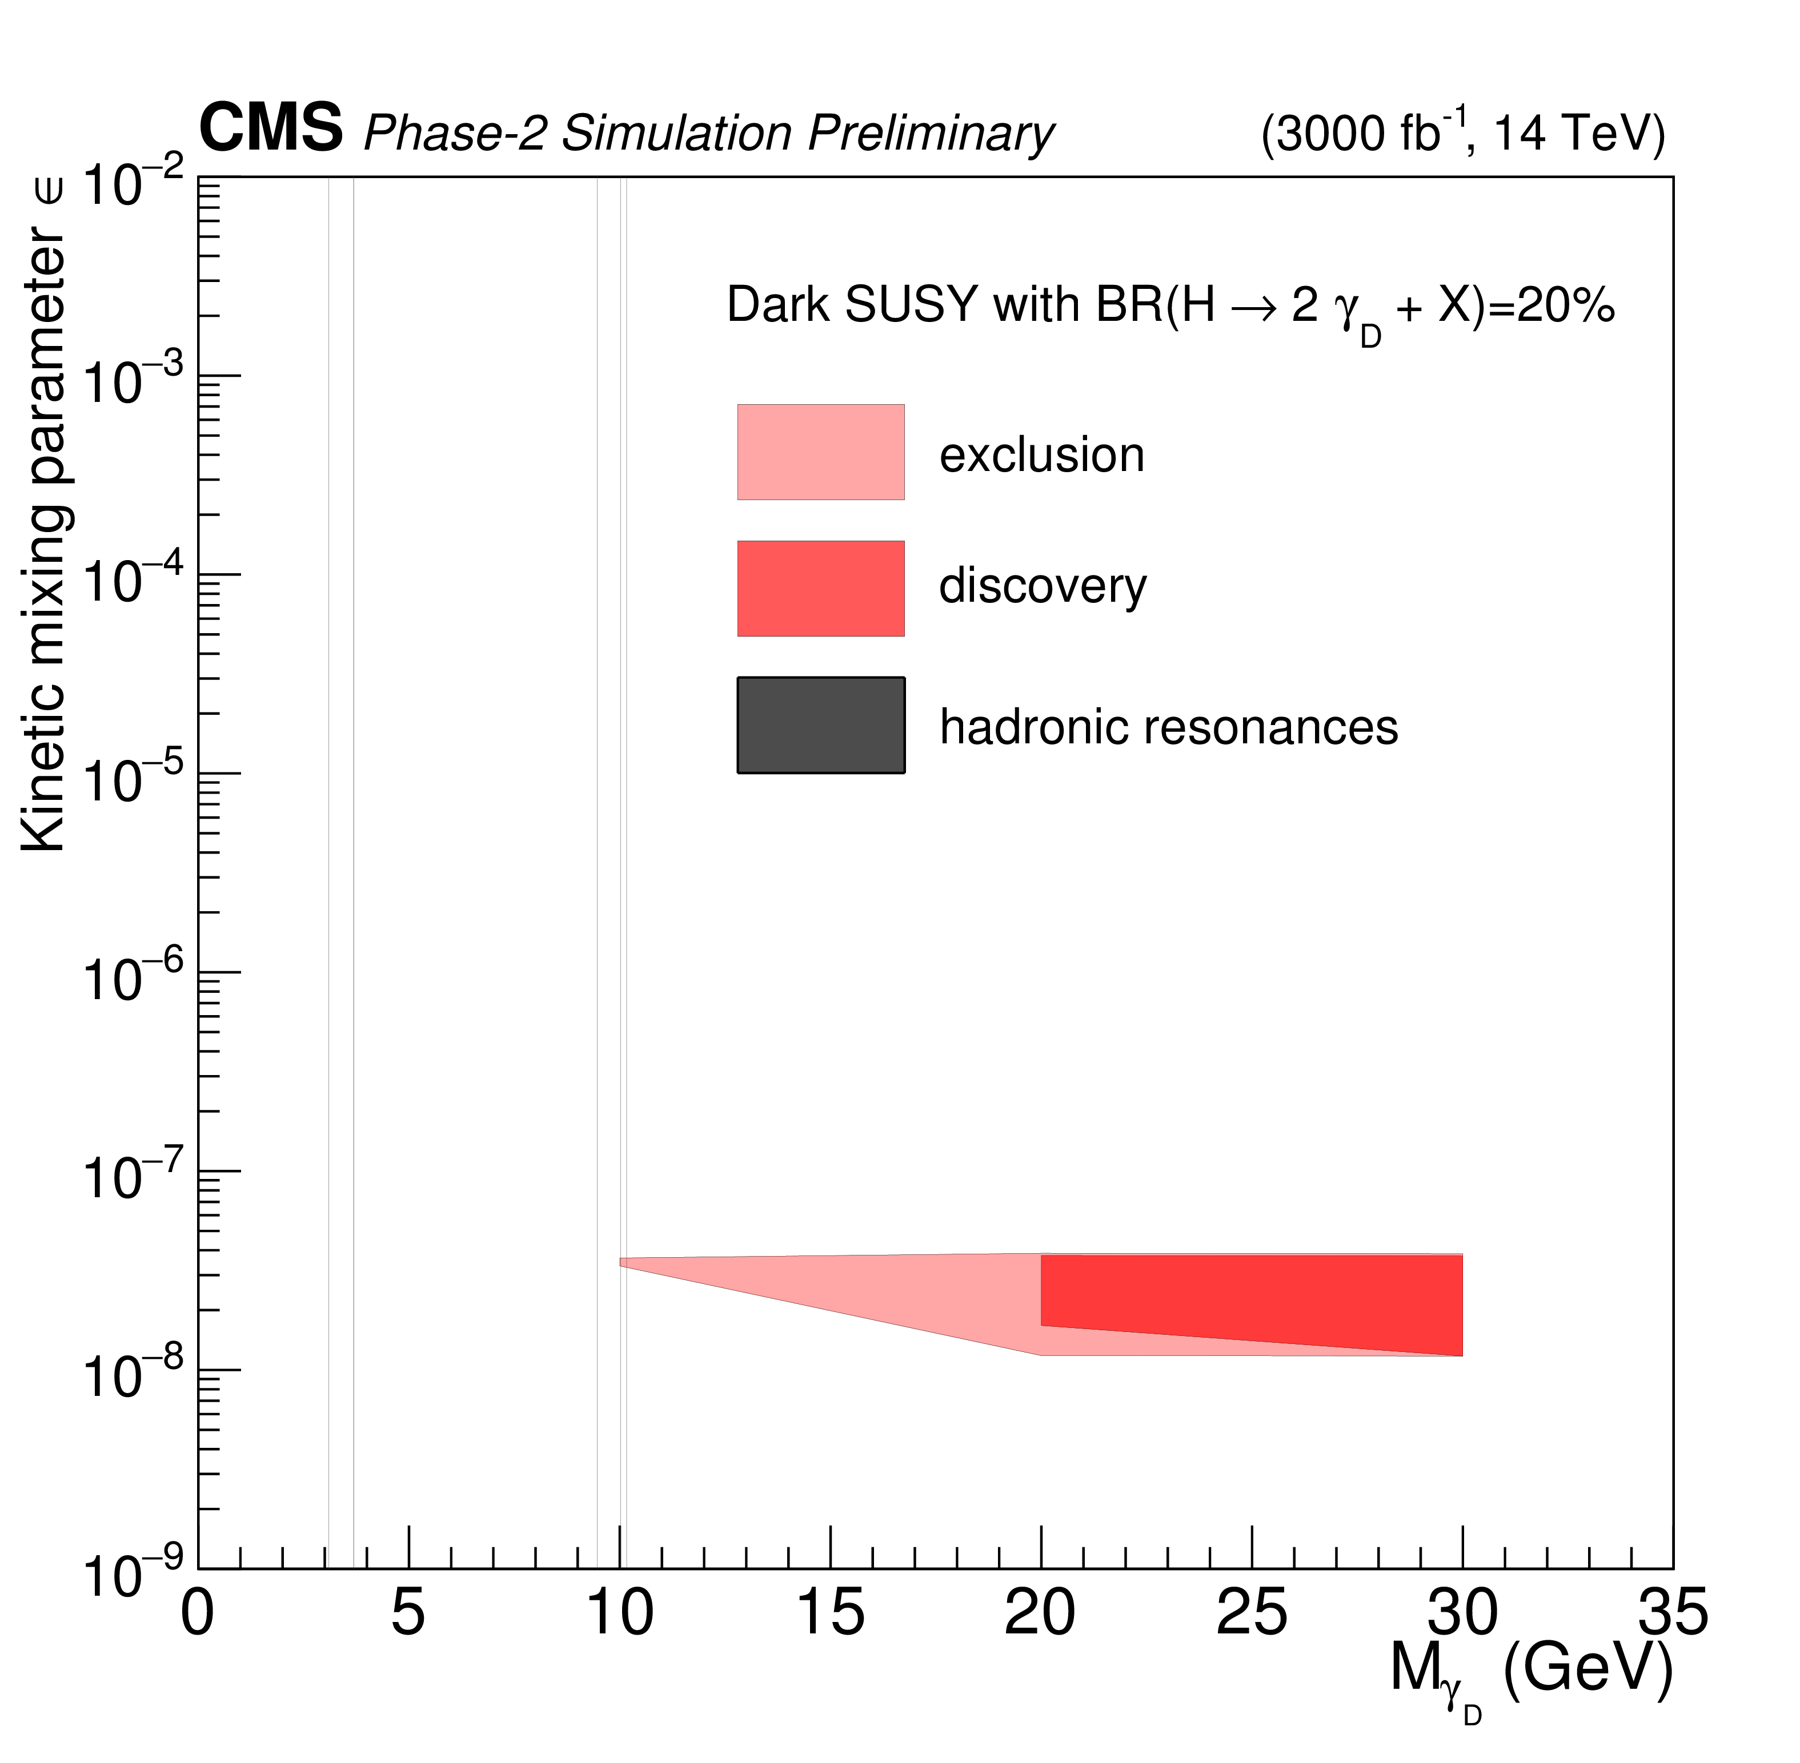
HL-LHC Physics Goals (1)
The main goal of the HL-LHC is to make New Discoveries
Detailed study of the Higgs boson (width, branchings, couplings, rare decays)
Looking for new scalar states of extended Higgs sector
Wide searches for physics beyond the SM (dark matter candidates, supersymmetry, TeV-scale gravity, extended gauge sector, etc.)
Precision tests of the SM, including rare processes
Higgs Projections for 300 fb⁻¹ and 3000 fb⁻¹
New resonances in Hi-mass Dilepton States
Dark photons decaying to displaced muons
HL-LHC will provide the enough statistic for extending physics scenarios
which can be tested with CMS:
for new resonances up to m_{Z’} ~ 6.2-7 TeV (~ 4.56-5.15 TeV with RUN2 data)
dark photon masses (1−30 GeV) and lifetimes cτ = (0.01−10) m in the context of Dark Supersymmetry models.
Higgs boson, the coupling constants to the SM particles will be measured with a precision of 5–14% and 2–10% given the integrated luminosities of 300 and 3000 fb^{–1} , respectively
5

Slide 6
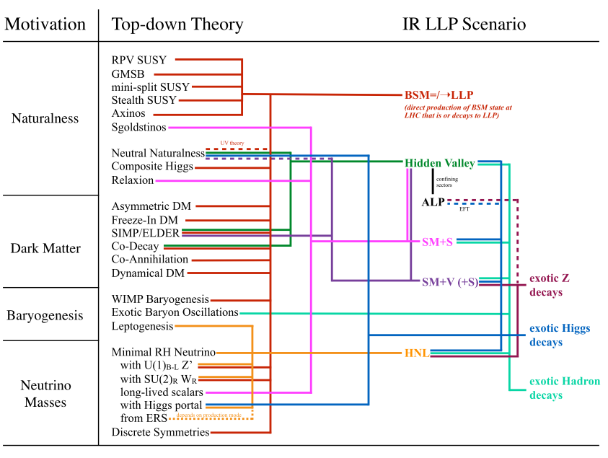
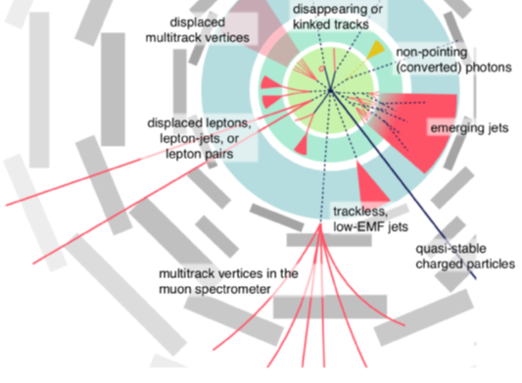
HL-LHC Physics Goals (2)
HL-LHC physics aims to study reactions initiated by Vector Boson Fusion (VBF) and reactions with boosted objects giving narrow or merged jets (possible results of hadronic decays of the W and Z bosons, the Higgs boson, new Higgs states, and other new particles in the same mass range).
LHC produces many Long Lives Particles (LLP) with MeV - TeV masses with signatures involving displaced vertexes. Such states can not be discovered with existing CMS detectors configuration, they have to be reconstructed from outside the tracker volume in calorimeters and in muon system
The capability of the upgraded detectors give possibility of
a dedicated Level-1 triggering for displaced objects
6

Slide 7
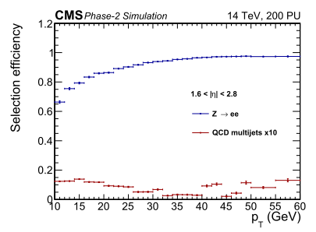
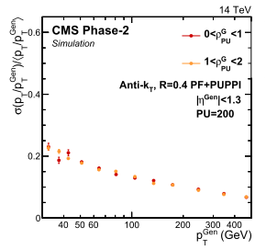
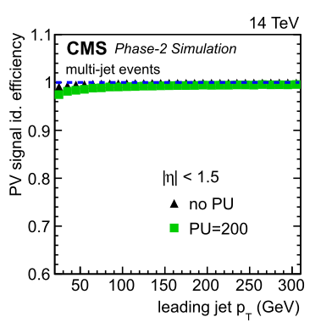
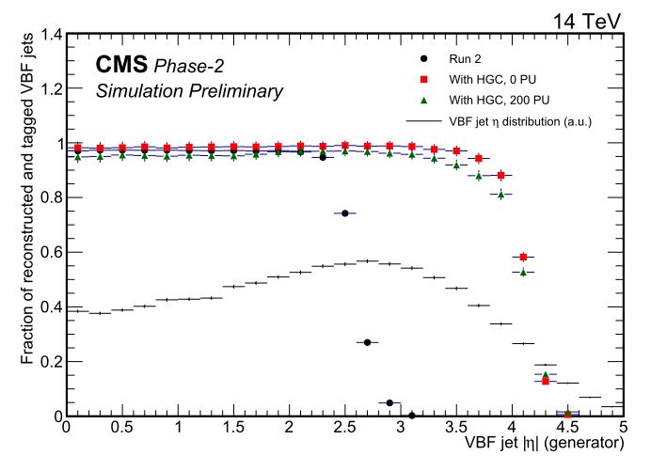
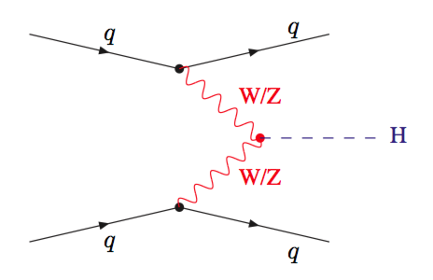
HGCal Impact on Physics
At the HL-LHC conditions with high pile-up (~200) HGCal will provide high effective registration of physics objects (electrons, jets) and primary vertexes
Electron Selection Efficiency (~100%)
Jet response resolution
Primary vertex (PV) reconstruction efﬁciency
Vector Boson Fusion (VBF) jet reconstruction and tagging efﬁciency comparing Run 2 (pileup 25) simulation to the upgraded Phase-2 detector with 0 and 200 pileup events.
Higgs VBF Production
7

Slide 8
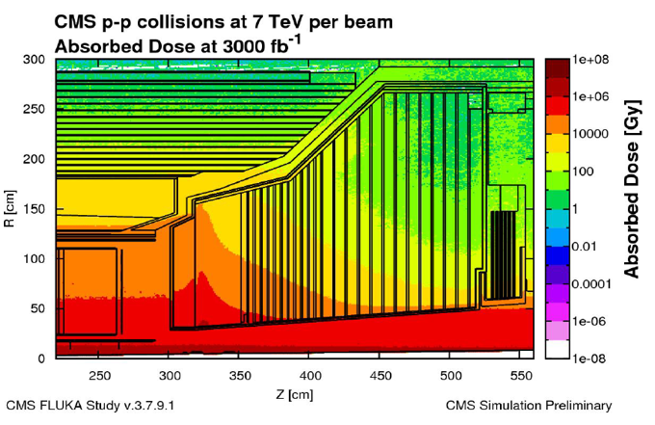
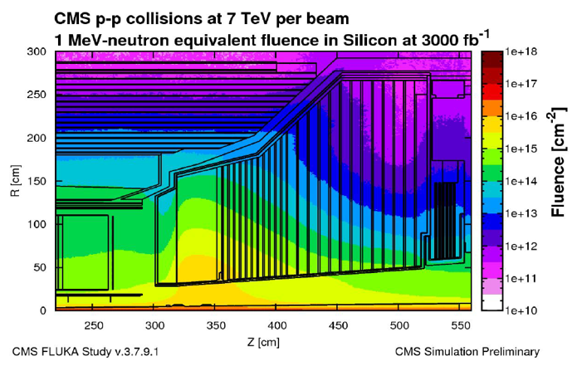
HL-LHC Requirements for Calorimeter Systems
The existing endcap electromagnetic calorimeter (EE) - based on the lead tungstate crystals (PbWO4) and the hadron calorimeter (HE) - based on plastic scintillator- were designed for integrated luminosity of 500 fb⁻¹
At HL-LHC Integrated luminosity will became 3000 fb⁻¹, posing signiﬁcant challenges to radiation tolerance of detectors and pileup
- Fluence ~10¹⁶ n/cm²
- Integrated dose ~2 MGy
Dose of ionizing radiation
The High Granularity Calorimeter (HGCal) is
designed to replace the existing endcap calorimeters
Main design requirements for HGCal :
radiation tolerance
dense calorimeter structure in order to simplify two shower separation and the observation of narrow jets
longitudinal granularity to provide a good electromagnetic energy resolution, pattern recognition and discrimination against pileup
time precision measurement of high energy showers
Fluence (1 MeV equivalent neutrons)
8

Slide 9
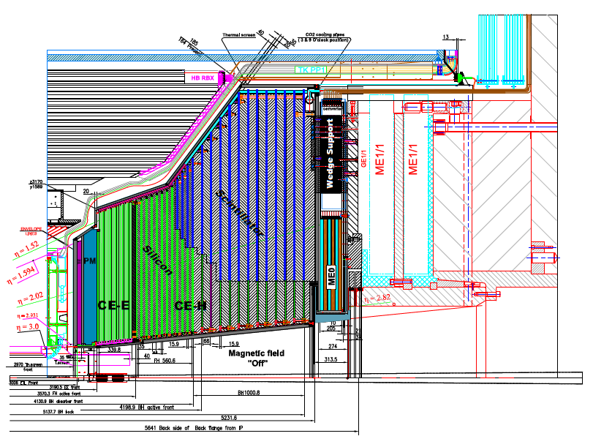
Structure of the HGCal
Key Parameters (from TDR):
HGCal covers 1.5 < η < 3.0
(~640 m² of silicon sensors, ~370 m² of scintillators)
  6.1M Si channels, cell size: 0.5 or 1.1 cm²
  240k scintillator tile channels
  ~31000 Si modules (incl. spares)
  Full system maintained at -30ºC
Longitudinal structure of the HGCAL
consists of 3 types of cassettes:
CE-E cassetts,
CE-H silicon sensor cassettes
CE-H mixed silicon/scintillator cassettes.
Electromagnetic calorimeter (CE-E):
Si, Cu/CuW/Pb absorbers, 28 layers, 25.5 X₀ & ~1.7 λ
Hadronic calorimeter (CE-H):
Si & scintillator, steel absorbers, 22 layers, ~9.5 λ (including CE-E)
Active Elements:
Si sensors are used in high-radiation region CE-E and inner region of CE-H
SiPM-on-Scintillating tiles in low-radiation region of CE-H
9

Slide 10
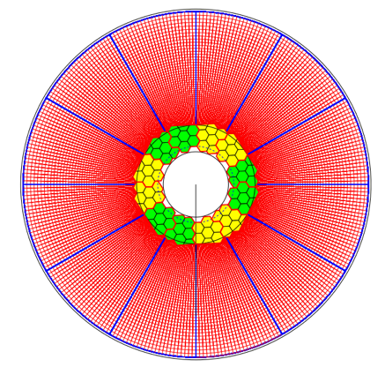
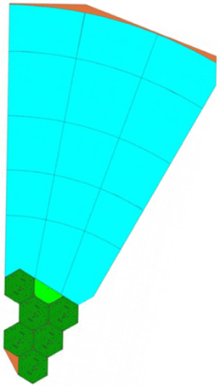
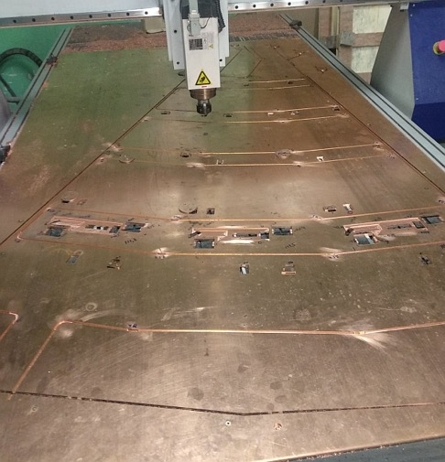
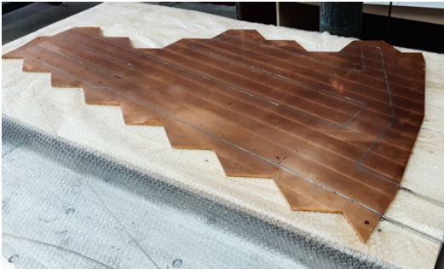
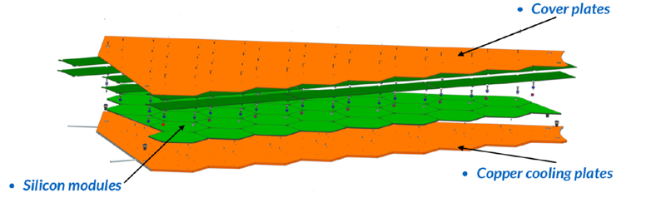
HGCal Composition
The active detector consists of cassettes (30⁰ or 60⁰ sectors) with scintillators and silicon modules assembled on cooling plates
CE-H Mixed layer with silicon
wafers and scintillation tiles
Mixed silicon-scintillator cassette
CE-H Cooling Plates
cooling plate
Material: Oxygen-free copper 6 mm sheets
1300x900 to 2300x1300
Stainless steel tube ⌀4 mm
scintillator tile modules
silicon modules
Silicon sensors in CE-E and CE-H
Layout of the silicon cassette
Mass production in 2022–2024
  Total 546 plates to be delivered at CERN
Front-end electronics on the modules
Readout and control through motherboards
10

Slide 11
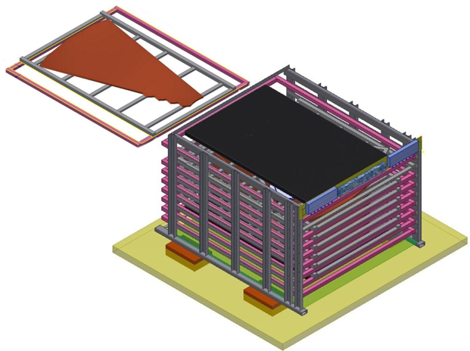
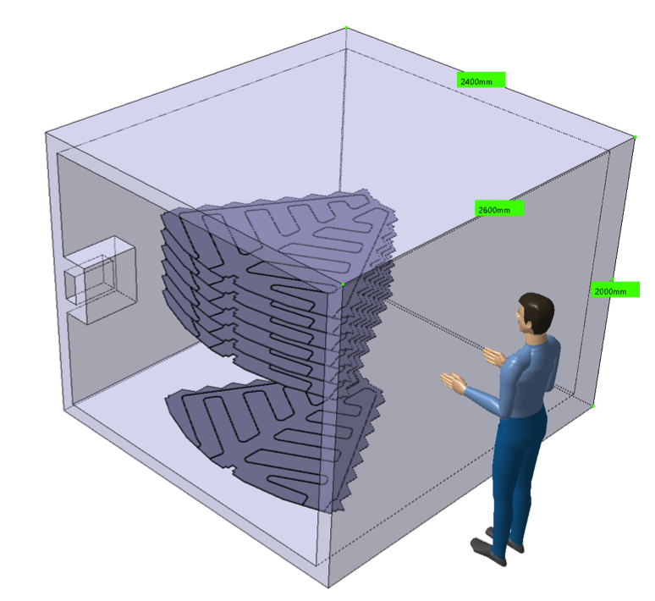
Cold-room facility
Testing and diagnostic of multi-cassettes CE-E and CE-H
Up to 7 cassettes testing in cold environment simultaneously ( room cooled to -35⁰ C)
The duration of tests of one cassettes batch is ~2 weeks including test with cosmic muons
Insertion of the tray
Cold room
Test with cosmic muons
Cassettes
Monitor
µ
Multi-cassette cold-room facility
Design, construction and assembly at CERN in 2021-2022
- Services and cables installation
- Development of cosmic test setup, DAQ, trigger and detector control
Operation in 2022-2025
11

Slide 12
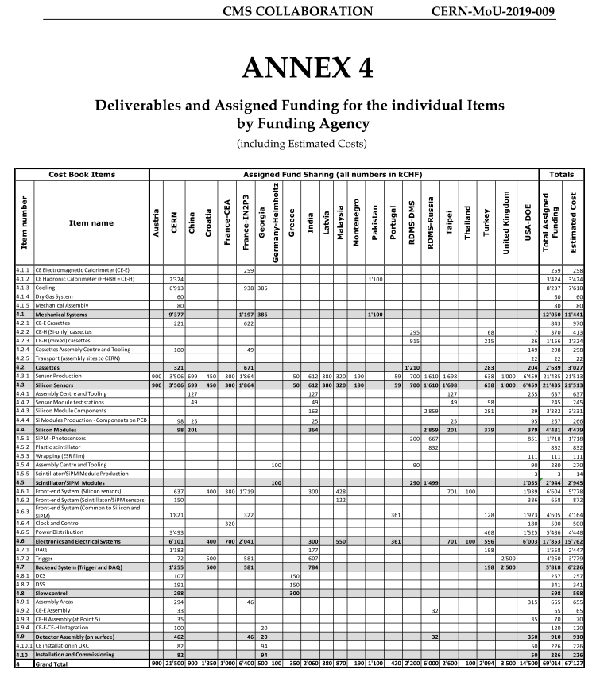
JINR Responsibility in the HGCal Project
The Full Cost of the CMS HGCal Project is 67.127 MCHF
According to the Addendum 14 to the CERN-MoU-2019-009 JINR contribution:
production of CE-H cooling plates
(1210 kCHF)
purchase of silicon sensors
(700 kCHF)
purchase of SiPM photosensors
(200 kCHF)
According to the MoU CMS-2010-010 JINR contribution:
production of multi-cassette cold-room facility (90 kCHF)
testing and diagnostic of CE-H cassette in 2022-2025
assembly and commission of HGCal in 2023-2026
JINR has committed to participated in the HGCal project with total contribution of 2.2 MCHF in CORE
12

Slide 13
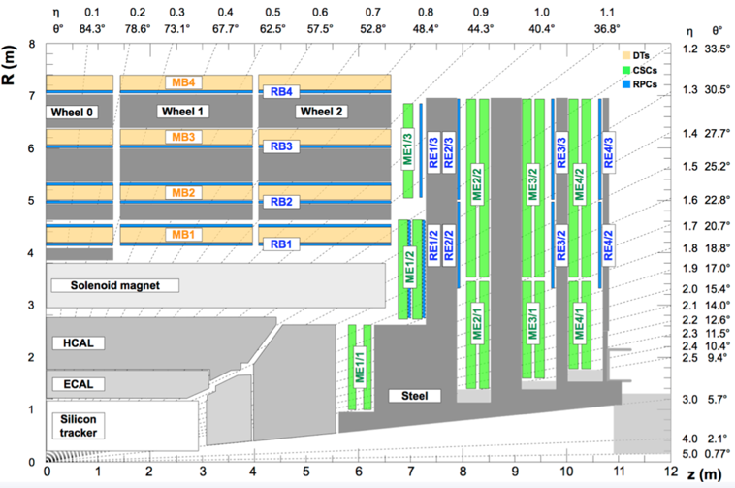
Motivations for Endcap Muon system Upgrade
HL-LHC conditions
Instantaneous luminosity х 5
Integrated luminosity х 10
Pileup х 5
HL-LHC at detectors level
L1 trigger rate х 7.5
L1 trigger latency х 10
DAQ bandtwidth х 10
MEx/1 stations:
ME1/1, ME2/1, ME3/1,ME4/1
Total 180 CSCs
During LS2 period
Additional requirements to sustain work at high rates
to detectors, readout, DAQ
and trigger electronics
The main task of the Endcap Muon system Cathode Strip Chambers ( ME CSC) Phase 2 upgrade: modernization of CSC electronics on the inner rings Muon stations (MEx/1), where the rates is higher with respect to the outer stations
13

Slide 14
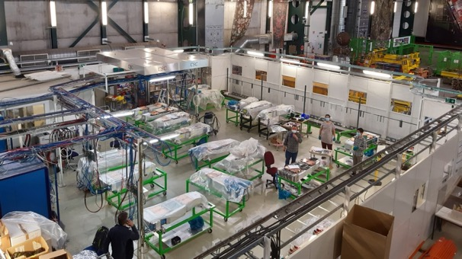
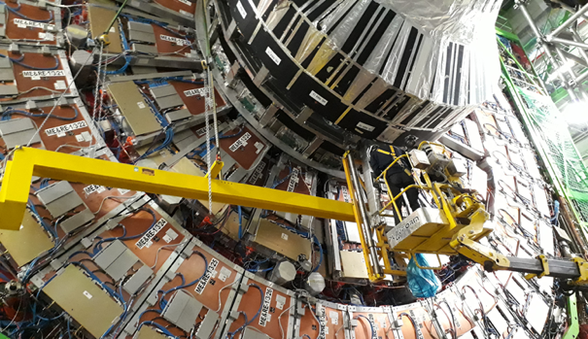
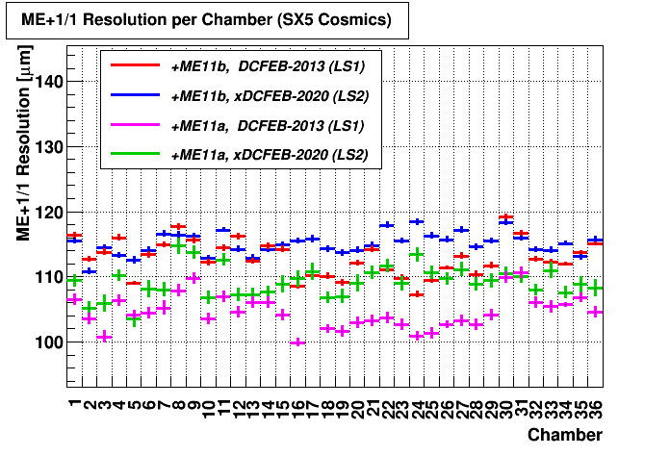
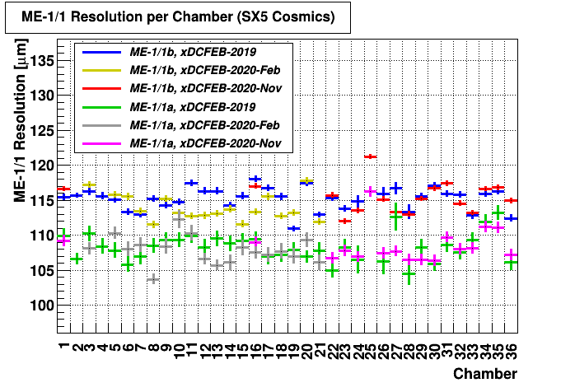
JINR team participation in LS2 CSC upgrade
Upgrade of the Endcap Muon system was performed in LS2 shutdown
Instead of initially planned LS3 because it will be extremely busy
Contribution of JINR in Muon System upgrade
during LS2 period :
Design and construction of 120 new Low Voltage
Distribution boards (LVDB-5)
Refurbishing with new electronics, installation and
commissioning of 180 cathode strip chambers (CSC)
Modernization of the ME1/1 CSC cooling system
Endcap Muon System upgrade infrastructure
CSC upgrade infrastructure
LS2 CSC cosmic test data for both Endcaps
are in good agreement
ME1/1 installation with Loading Machine
14

Slide 15
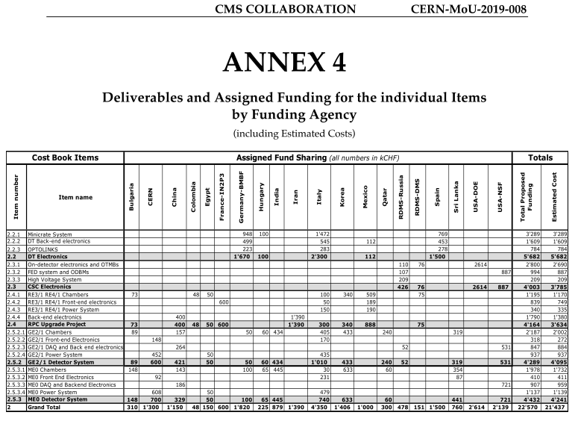
JINR Responsibility in the Muon Upgrade
The Full Cost of the CMS Muon Upgrade is 21.437 MCHF
According to the Addendum №13 to the MoU CERN-MoU-2019-008 JINR contribute to CORE:
upgrade of the CSC electronics (76 kCHF)
RPC Upgrade Project (75 kCHF paid by Georgia Institutions)
JINR group participates in Muon CSC
R&D programme:
CMS CSC ageing study at GIF++
study of CSC characteristics in HL-LHC conditions with uncorrelated background.
study of methods for eliminating the Malter current in a cathode strip chamber
participation in the new gas mixture studies
development and test of an algorithms for track segments reconstruction in the CSC chambers
See details of Muon CSC R&D in backup slides
15

Slide 16
Upgrade Cost Summary
The CMS Phase II Upgrade Cost is 285 MCHF in terms of CORE value
The Phase II Upgrade Common Fund is established at the level of
25’000’000 CHF (twenty-five million Swiss Francs)
According to the Addendums to the Memorandum of Understanding for Collaboration in the Construction of the CMS Detector, JINR has following commitments in CORE (2020-2026):
participation in the Highly Granularity Calorimeter (HGCal) Project with total contribution of 2.2 MCHF
upgrade of the Endcap Muon system Cathode Strip Chambers (CSC) with total contribution of 76 kCHF (these obligations is nearly fulfilled)
Additional contributions:
contribution to Upgrade Common Funds of 289,855 kCHF in 2022-2026 (468.855 kCHF is in a total, 144.928 kCHF is already accounted for 2020-2021)
179 kCHF of operation expenses on technical maintenance of HGCal in 2022-2026 according to М&O_B
16

Slide 17
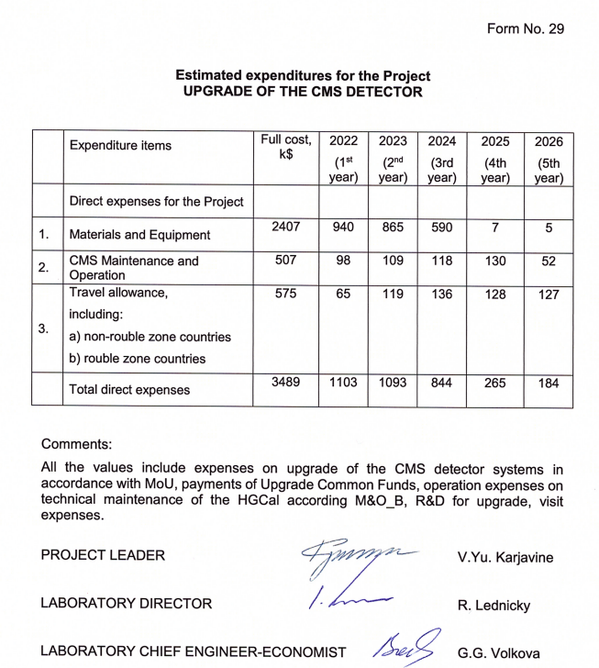
Funding Requested for 2022–2026
17

Slide 18
We are asking PAC
to give recommendation to open a new project “Upgrade of the CMS Detector”
for the period of 2022-2026.
Thank you for your attention!!!
18

Slide 19
BACKUP SLIDES
19

Slide 20
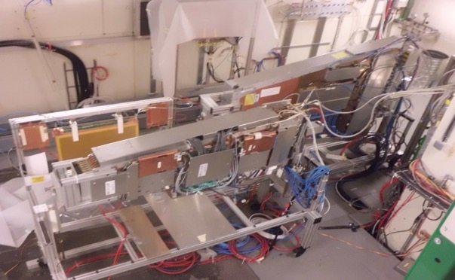
CSC ageing study R&D at GIF++
Main goal - to study will CSCs survive at HL-LHC of L_{int}=3000 fb-1?
Tests at Gamma Irradiation Facility GiF++ :
1. CSC Ageing study.
2. Study of background rates influence on CSC performance
3. Study of methods for Malter current eliminating.
14 TBq Cs137 source (Eγ = 662 keV)
ME2/1
GIF++ Radiation field map
2.4 m
ME1/1
beam
Longevity tests- monitoring CSC performance:
Dark rate/currents
Relative currents
Strip-strip resistance
Test beam measurements:
Efficiency
Spatial resolution
Gas gain
3.3 m
D2: Total flux ~1.7*10⁷ γ/(s*cm²)
Equivalent to 3ˣHL-LHC periods of L=3ˣ3000 fb⁻¹
the integrated charge to be:
ME1/1 - 0.33 C/cm
ME2/1(sect.1) - 0.24 C/cm
20

Slide 21
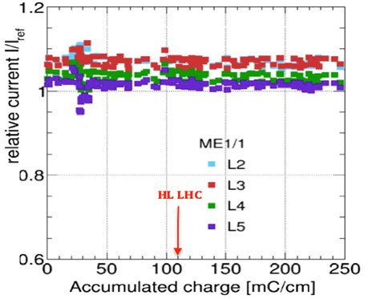
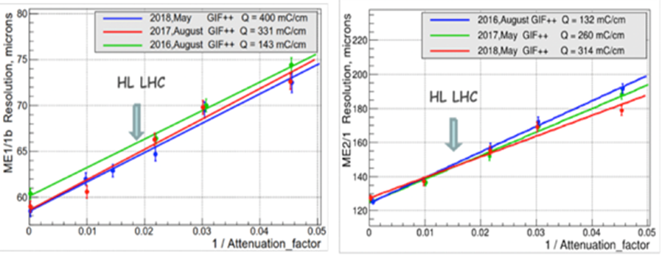
Recent CSC ageing study results
ME1/1 with the accumulated charge
No degradation observed
ME1/1 accumulated charge in time
ME1/1 Relative current I_{layer}/I_{ref}.
CSC spatial resolution vs GIF++ Source intensity
for different values of accumulated charge
With the HL LHC conditions
at L= 5x10³⁴ Hz/cm² the spatial resolution degradation:
10% for ME1/1
16% for ME2/1
ME1/1
ME2/1
21

Slide 22
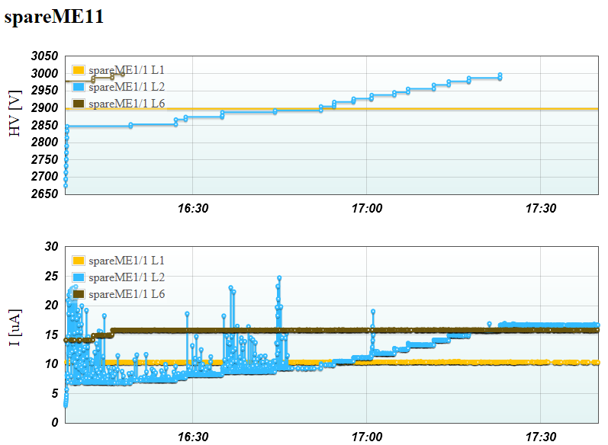
Malter currents at CMS and GIF++
Run2
Beam dump
HV training of the Spare ME1/1 layer 2 (blue) at GIF++
The current is produced by Cs-137 gamma source. As soon as the current disappeared, the voltage is raised manually by 5-10V. At some point Malter current disappears and no seen even at HV=3.0kV
CMS p-p collisions:
One of the 6 CSC ME1/1 layers shows a current spike exceeding 30 µA followed by a long-time discharge. The current persists even after the LHC beams are dumped. The other layers show stable currents around 3 μA
22

Slide 23
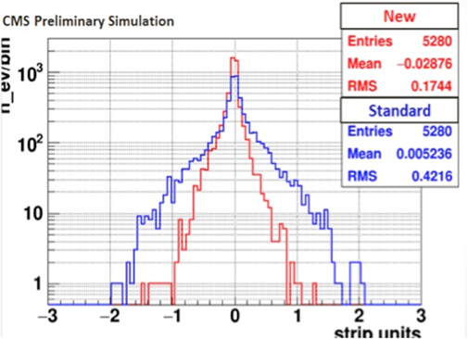
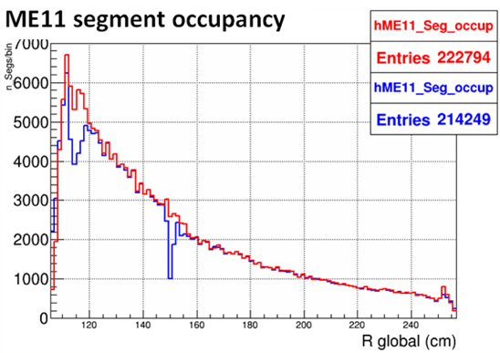
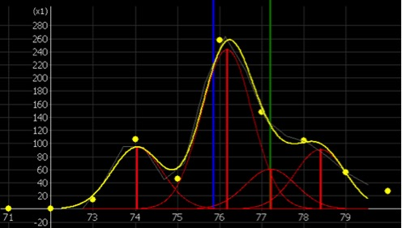
Track-segment reconstruction algorithm development
Development of a new
wavelet-based RecHits reconstruction algorithm
New CSC segment builder algorithm
ADC
Strip number
Spatial residuals for muon track reconstruction
Red - new algorithm, Blue – standard algorithm showing 2.5 times bigger standard deviation than the new one
New algorithm customized
for ME1/1 geometry
Red- eliminated inefficiency in narrow part of the chamber (R=115 cm) and the area of ​​the strip cut (R = 150 cm) between the two parts of the CSC.
An example of the reconstruction of four overlapping signals on a single CSC layer
Green - simulated muon coordinate
Yellow - initial distribution of the signal
Blue - coordinate done with standard algorithm
Red – 4 overlapping cathode signals
recognized by the proposed algorithm
23

