Slide 1


Electronics FE/DAQ/DCS
Leonid Afanasyev
Compilation of presentations at SPD Hardware meetings
on 25 March and 29 April 2021

Slide 2
Estimation of raw data flow
Bunch crossing each 80 ns; crossing rate 12.5 MHz,
Collision rate ~3–4 MHz →
Triggerless DAQ to avoid any hardware biases
Data flux was estimated for the maximum luminosity L = 10³² cm⁻²c⁻¹ and maximum energy √s = 27 GeV.
Within simplified simulation and some safety margin the data flux is estimated as 20 GBytes/s.

Slide 3
Front-end electronics for the free-running DAQ-SPD
Front-end electronics of the detectors has to meet the requirements of a free-running DAQ
General FEE requirements from the DAQ system:
Self-triggered (trigger-less) FEE operation
Digitizing on-board
Zero suppression
Large memory to store the data accumulated in a time slice
Timestamp included in the output format
Compatibility with DAQ (AMBER/NA64)
Optic output
Protocols: S-link, Aurora, UCF
White Rabbit input (option)

Slide 4
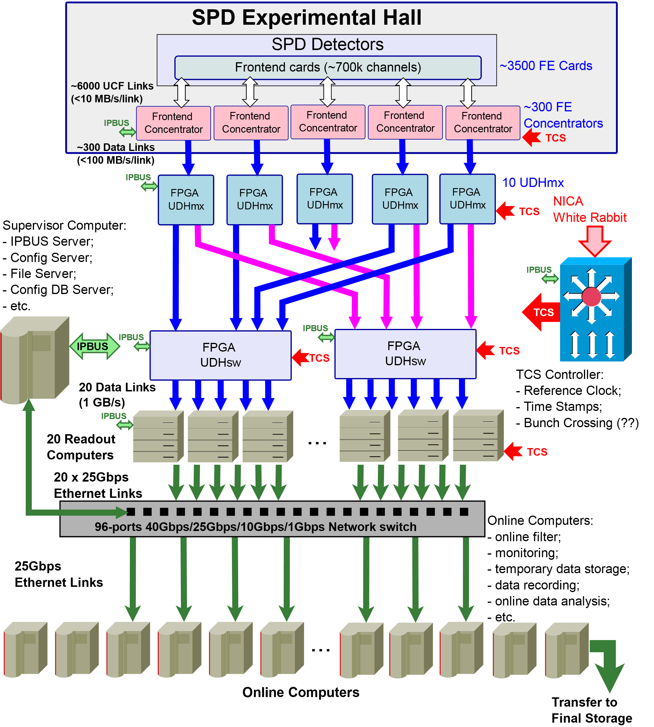
In DAQ of SPD we are planning to employ the ideas developed for the modernized DAQ
of COMPASS/AMBER/NA64 by Igor Konorov group from the Technische Universität of München (TUM). His conception of SPD DAQ is accepted with minor modifications.

Slide 5
Slow control accesses FE cards via the FE Conccentrators
using UDP-based IPBus protocol.
FE Conccentrators retransmit clock signals to FEE and convert detector information to a high speed serial interface running over an optical link.
UCF (Unified Communication Framework) protocol will be a standard high speed link protocol within the DAQ.

Slide 6
The multiplexer (UDHmx) modules receive detector information via serial links, verify consistency of data,
and store them in DDR memories.
The multiplexer is equipped with 32 GBytes of memory.
All accepted data are assembled in sub-slice and distributed to two switches.
Each multiplexer has a bandwidth of 2 GBytes/s.

Slide 7
The switches (UDHsw) perform the final level of slice building and distribute the assembled slices to 20 (?) on-line computers.
Finally, the continuous sequence of slices is built with Network Switch in each PCs

Slide 8
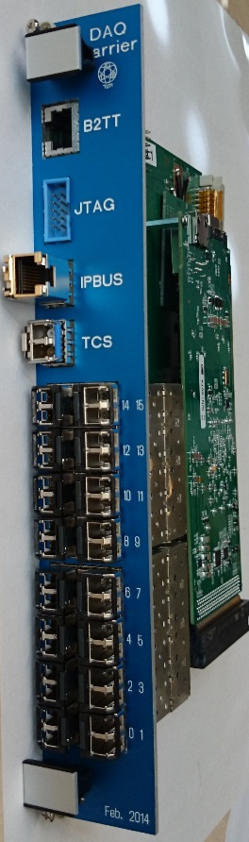
DAQ hardware
Near detector
Mechanics:
374 Front End Concentrators - VME 6U double width 12(15) inputs, 1 outputs
43 VME crates, 0.5kW → 9-10 racks
Option with ATCA crates < 20
Cables:
From detectors to DAQ: 4436 optic links
From DAQ to the control room: 374 optic links (double), max 480 links
In barrack
3 VME crates (1kW)
20 DAQ computers (1kW) → 3-4 racks

Slide 9
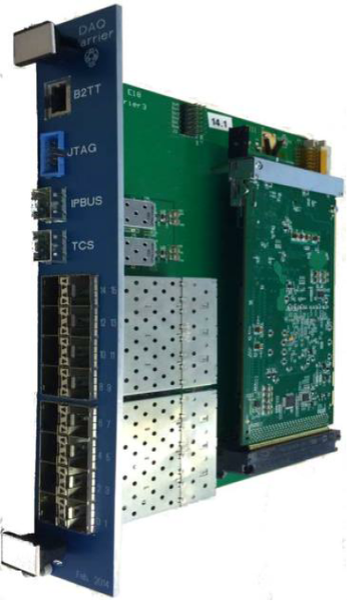
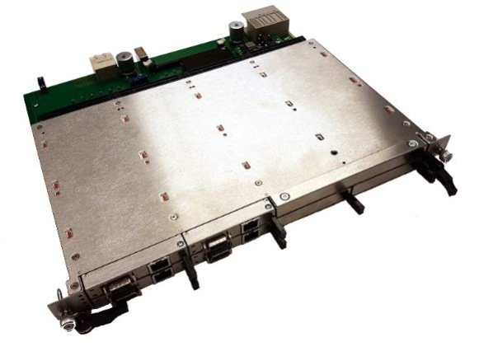
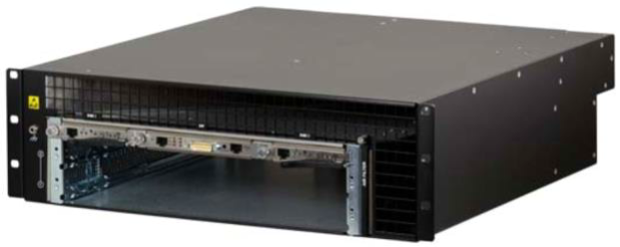
Migration to ATCA (Igor Konorov 08-02-2021)
ATCA Carrier Card :
4 DHmx/DHsw modules
4 Optical interface AMC cards
16 links between A & B connectors
Rear interfaces
8 x Ethernet for IPBus
USB for JTAG
SFP+ for TCS interface + 1:8 fanout
Optical Interface AMC card
8 + 4 FireFly Transceivers

Slide 10
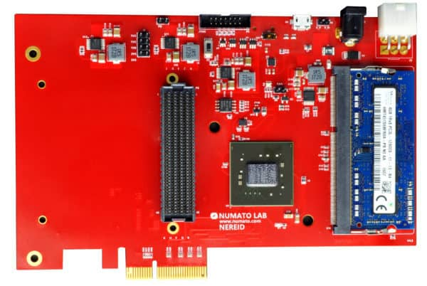
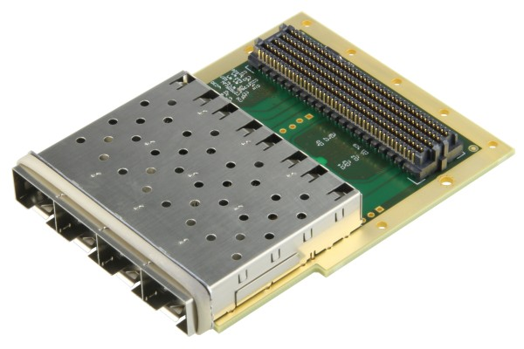
Computer input / PCI Express buffer
Based on commercial hardware
– Nereid Kintex 7 PCI Express
– Trenz FMC – SFP adapter
Kintex 7 XC7K160T FBG676
4x PCIe-Gen2 interface
4 GB DDR3 memory
No dedicated TCS interface

Slide 11
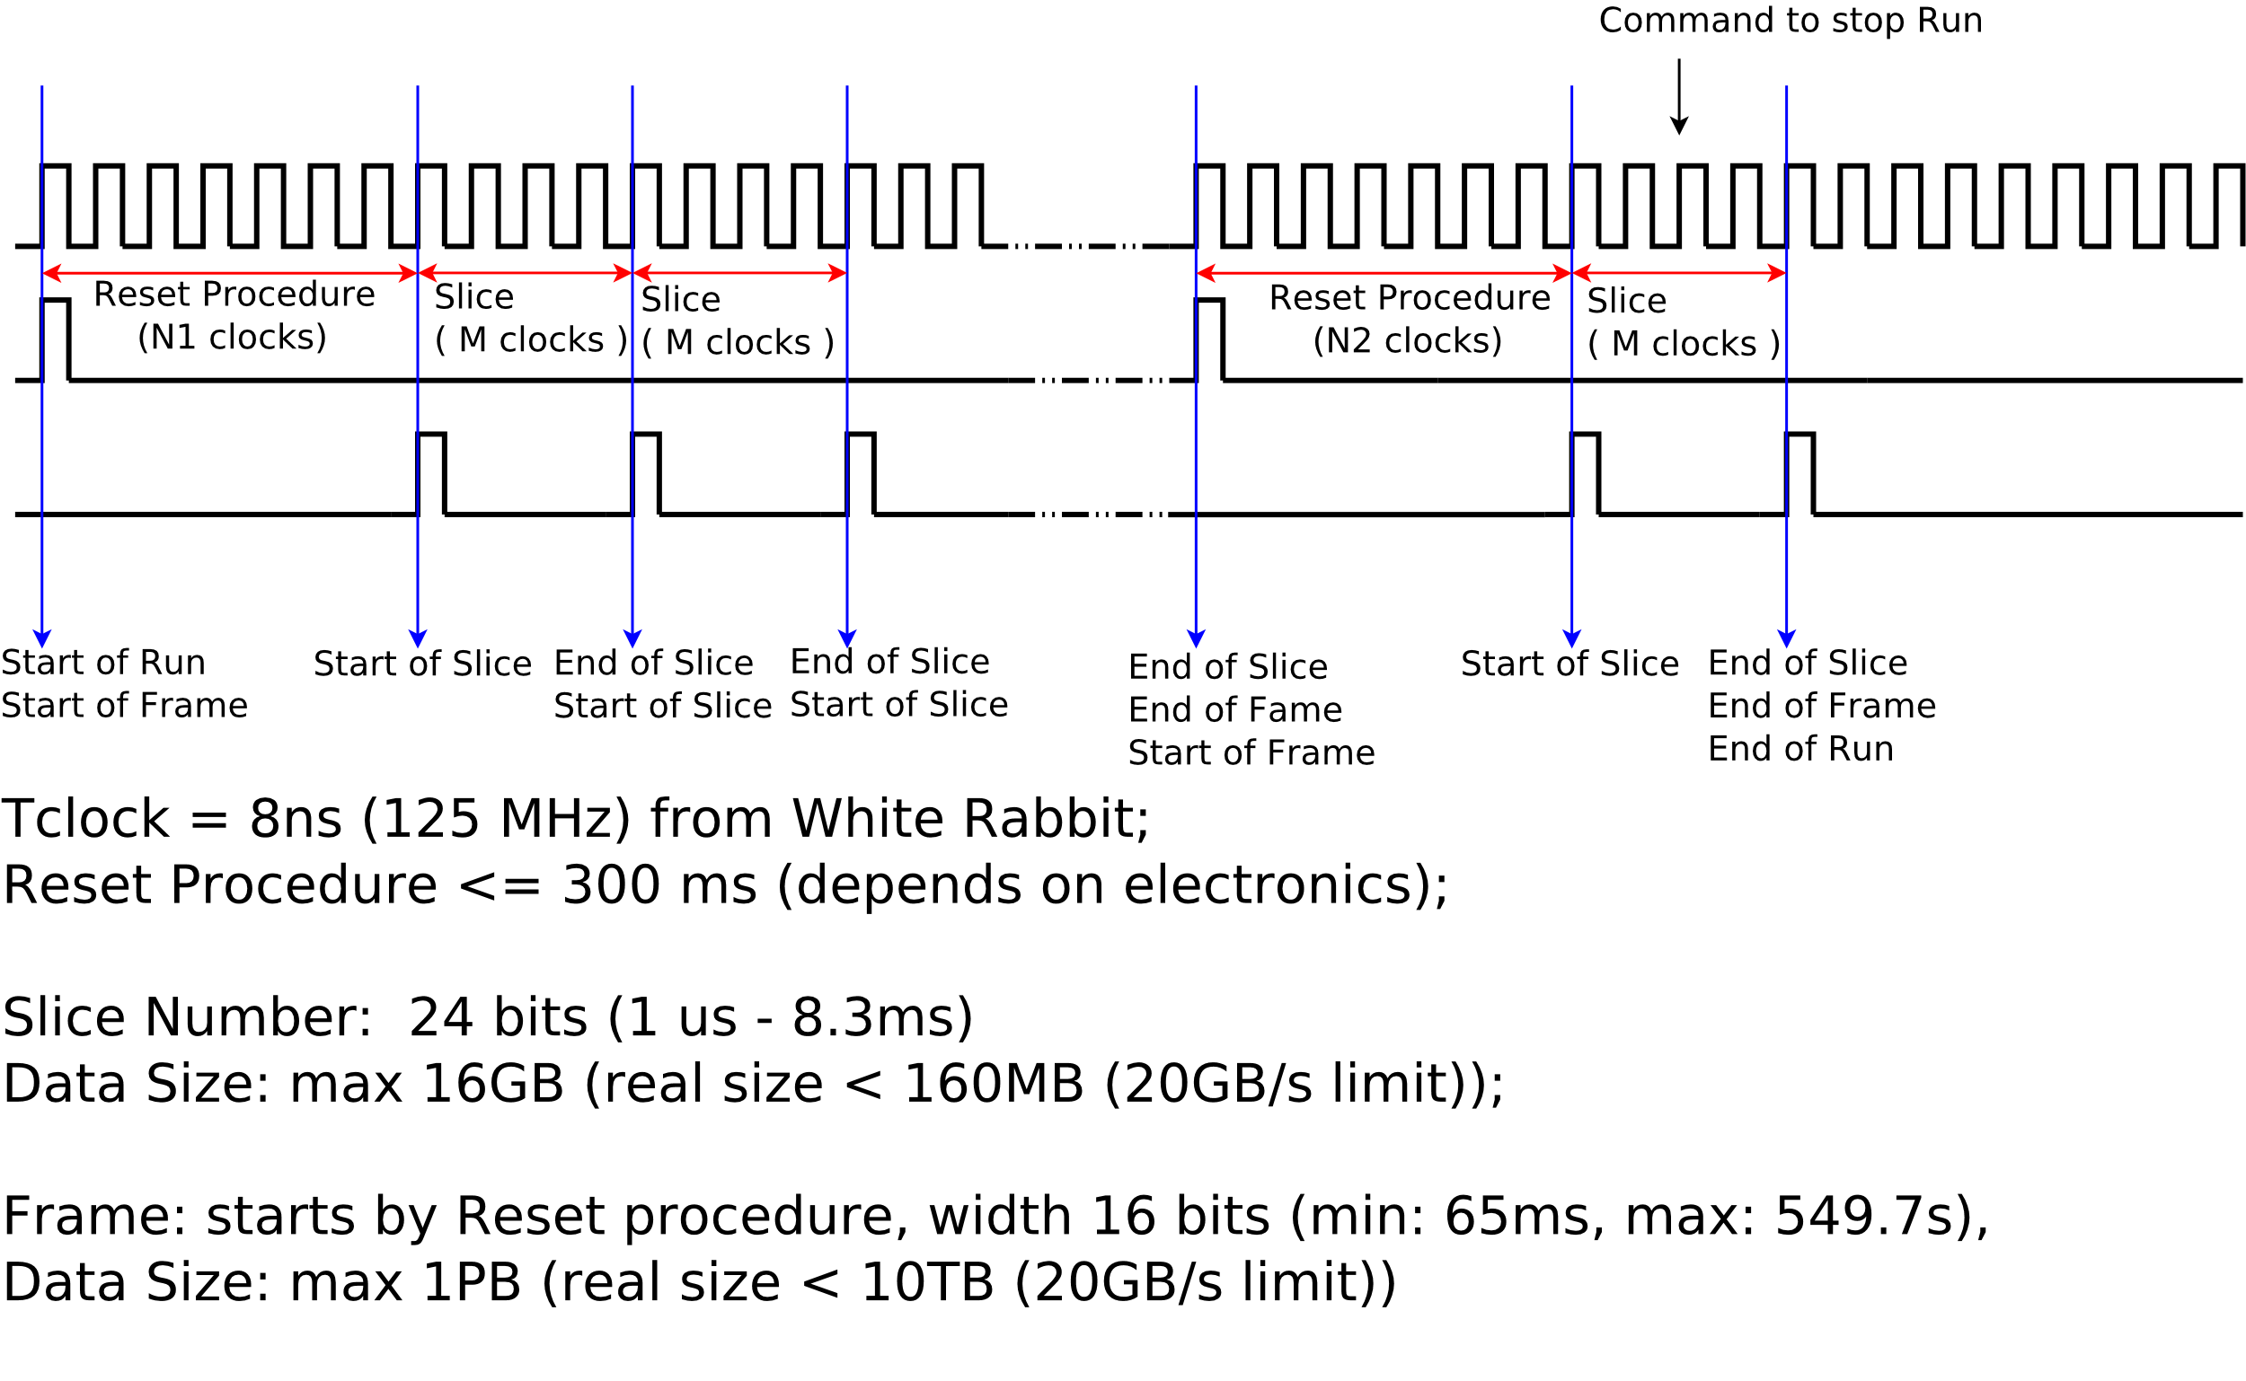
Time diagrams

Slide 12
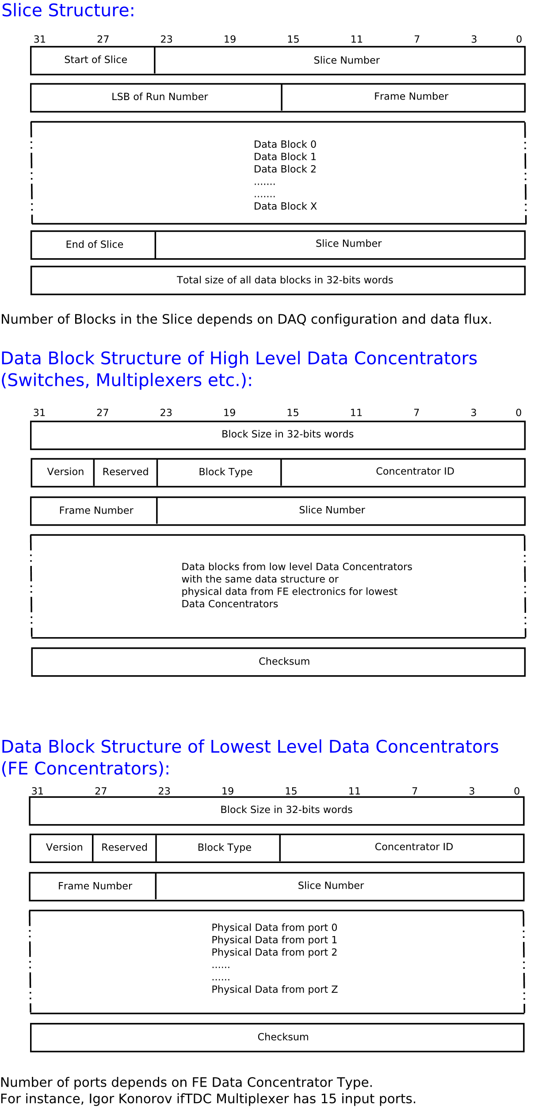
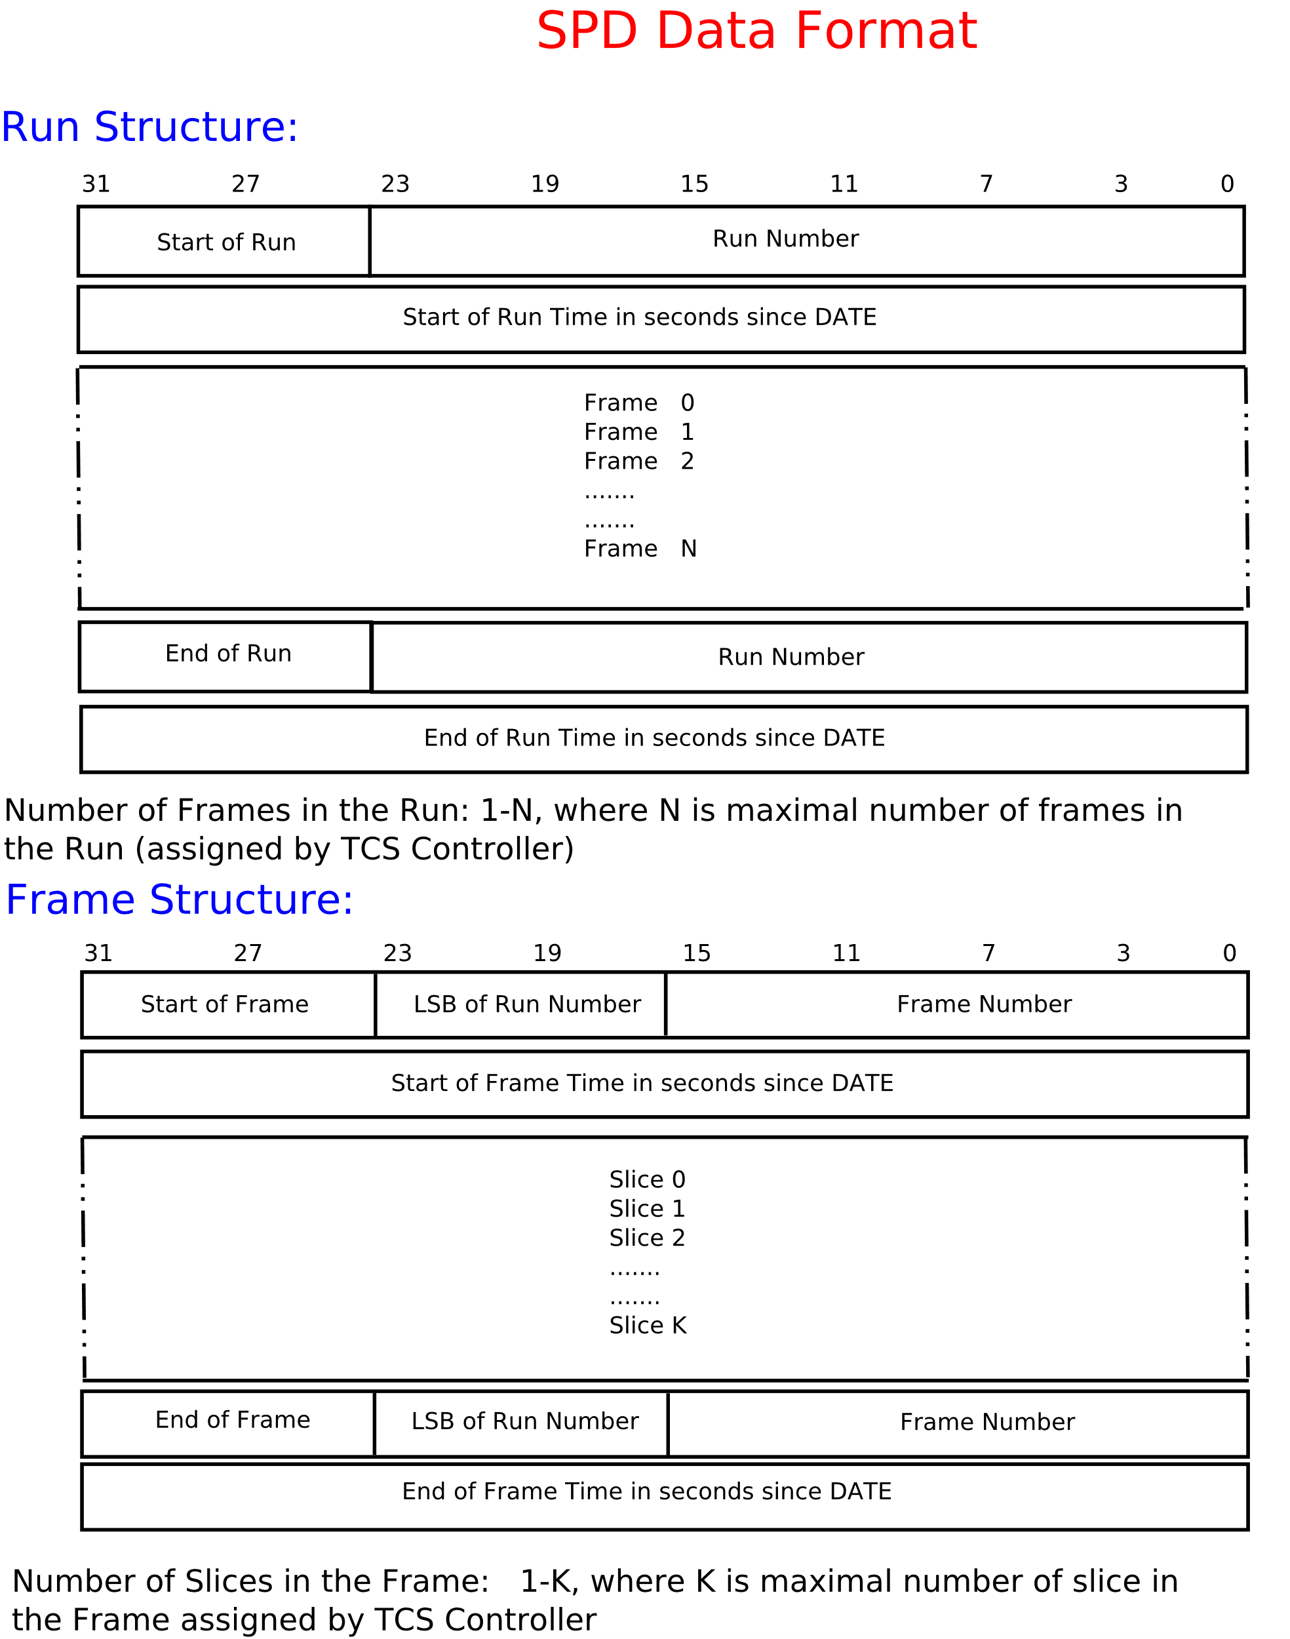
Data Format

Slide 13
Status
AMBER/NA64 DAQ is scheduled to start to start 2-3 year before SPD. Its current status allows us to consider it as the good developed and tested prototype for SPD at the level of CDR.
AMBER/NA64 DAQ consists of dedicated modules of 3 types only: two types of Data Handling multiplexer (DHmx and UDHmx), and Time Control System (TCS).
We already have in Dubna 2 DHmx multiplexers and TCS module. That is enough for testing of Straw Tracker modules ONLY.

Slide 14
Problems
We need to formalize our relations with developers of AMBER/NA64 DAQ modules from Technische Universität of München (TUM). In the best case they should join SPD collaboration in some way. In the worst case we need to find a group which will support these modules with a help of the TUM developers, or develop their own compatible modules.
We start negotiation with a group from St.Petersburg Polytechnic University (SPbPU) as the candidate for such group. SPD relation with this group need to be formalized. The problem of technical documentation transfer form TUM to SPD and SPbPU becomes very actual.

Slide 15
Silicon Vertex Detector Front-end electronics
25.03.2021

Slide 16
Relevant FEE DAQ numbers
# layer | 1 (MAPS) | 2 (MAPS) | 3 (MAPS) | 4 (DSSD) | 5 (DSSD) | Total
Sensor numbers /layer | 448 | 840 | 1736 | 228 | 368 | 596(DSSD) + 3024(MAPS)
Ladder numbers | 11 | 20 | 28 | 19 | 23 | 101
Sensor numbers /stave (module) | 28 | 28 | 28 | 2 | 2
Numbers stave (modules)/layer | 16 | 30 | 62 | 114 | 184
Numbers e-links/stave | 8 | 8 | 8
Numbers analog MUX-OUT/module |  |  |  | 10 | 10
Read-out channels / layer | 128 e-links | 240 e-links | 496 e-links | 1140 | 1840 | 864 e-links + 2980 analog MUX-OUT

Slide 17
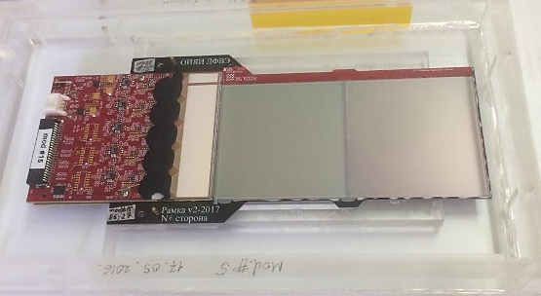
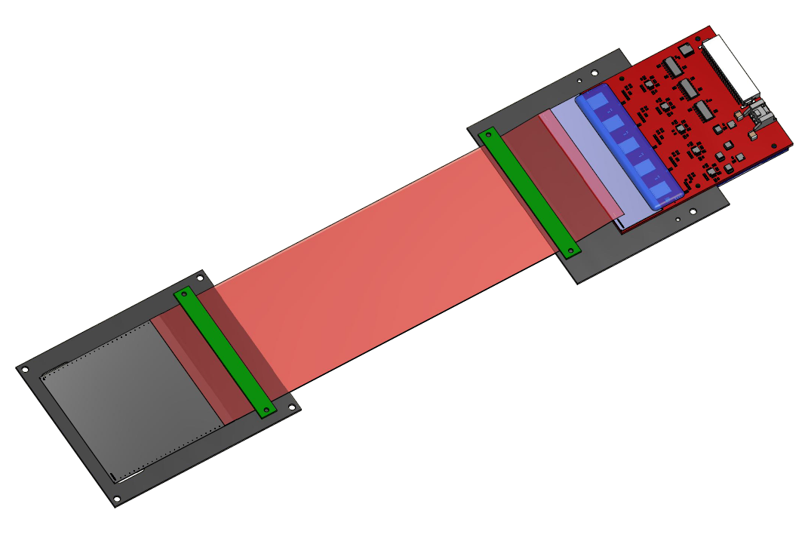
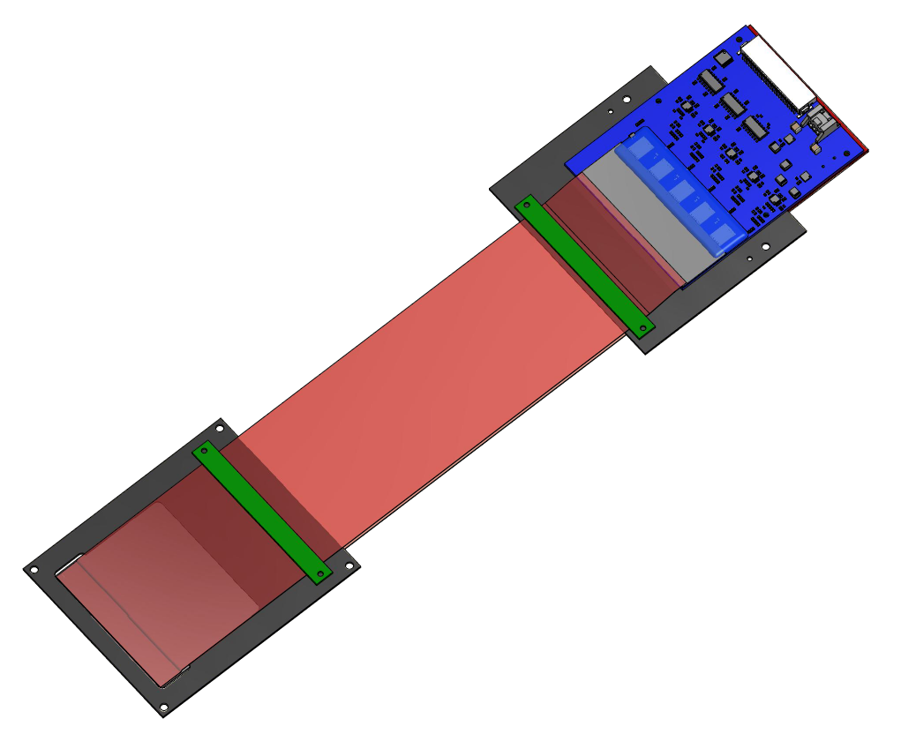
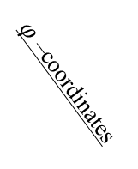
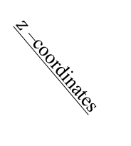
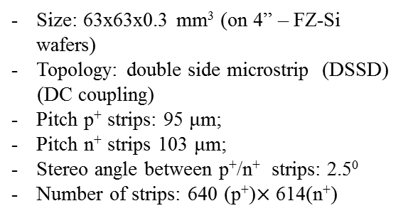
Current SPD Si module prototype
FEE n+
589 channels
BM@N Si-Module
DSSD parameters:
Size: 63x63x0.3 mm³ (on 4” – FZ-Si wafers)
Topology: double side microstrip (DSSD)
(DC coupling)
Pitch p⁺ strips: 95 μm;
Pitch n⁺ strips 103 μm;
Stereo angle between p⁺/n⁺ strips: 2.5⁰
Number of strips: 640 (p⁺)$×$ 614(n⁺)
Polyimide microcables
(300 and 600 mm length)
FEE p+
640 channels
$z$ –coordinates
DSSD
$φ$ –coordinates
The module consists of one silicon detector,
glued to the frame and connected with front-end electronics
via thin polyimide cable. FEE based on VATAGP7.1 ASICs

Slide 18
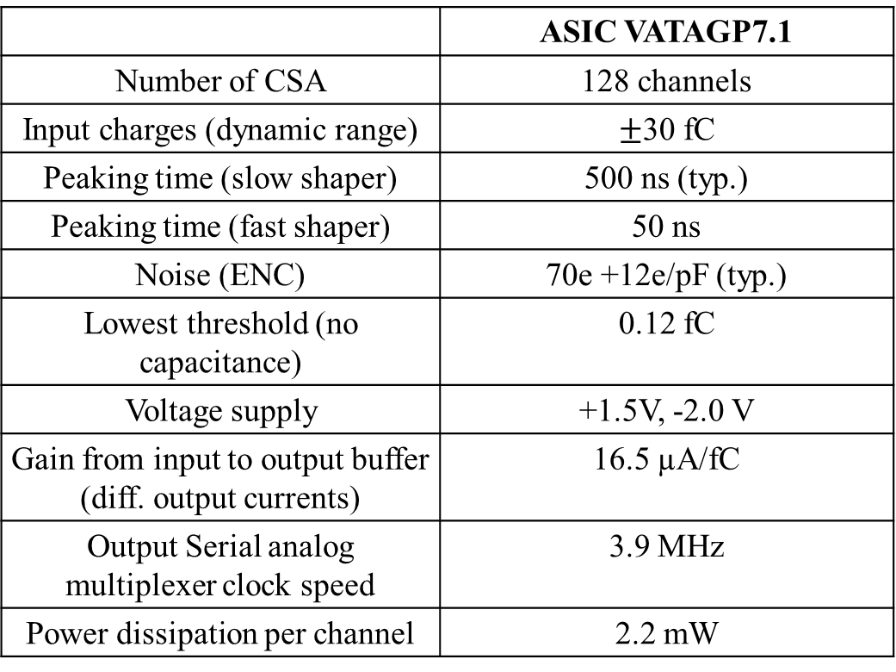
Parameters of read-out chips
 | ASIC VATAGP7.1
Number of CSA | 128 channels
Input charges (dynamic range) | $±$30 fC
Peaking time (slow shaper) | 500 ns (typ.)
Peaking time (fast shaper) | 50 ns
Noise (ENC) | 70e +12e/pF (typ.)
Lowest threshold (no capacitance) | 0.12 fC
Voltage supply | +1.5V, -2.0 V
Gain from input to output buffer (diff. output currents) | 16.5 µA/fC
Output Serial analog multiplexer clock speed | 3.9 MHz
Power dissipation per channel | 2.2 mW

Slide 19
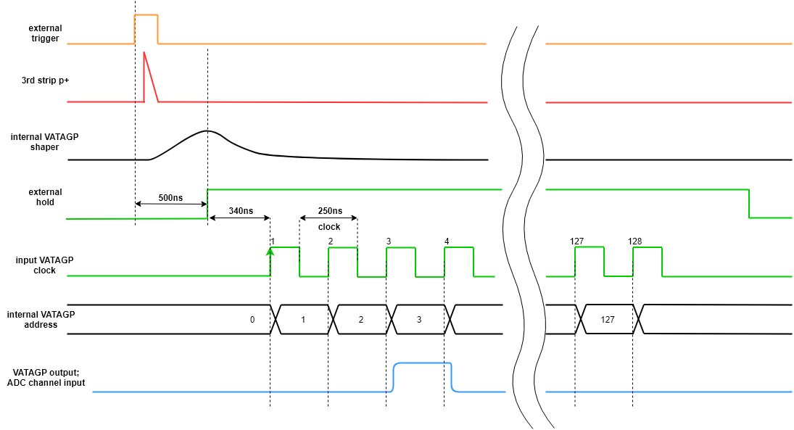
Serial read-out diagram
Detector
ADC
Control Unit
Silicon
Based on FPGA
Multichannel
> 50 MSPS
DAQ System
VATAGP7.1
IDEAS ASICs
Front–end electronics

Slide 20
Possible solutions for ASIC read-out
ASIC | APV25 | VATAGP7.3 | n-XYTER | TIGER | ToASt
Channels number | 128 | 128 | 128 | 64 | 64
Dynamic Range | -40fC ÷ 40fC | -30fC ÷ 30fC | Input current 10nA Polarity - and+ | 1÷50fC | 1÷40fC
Gain | 25mV/fC | 20µA/fC | 59.4 mV/fC | 10.35mV/fc | ToT gain 40ns/fC
Noise | 246e⁻+36 e⁻/pF | 70e⁻+12 e⁻/pF | 900e⁻ at 30pF | 2000e⁻ at 100pF | 1500e⁻
Peaking time | 50ns | 50ns/500ns | 30ns/ 280ns | 60ns/ 170ns | 50 / ≥ 100ns
Power consumption | 1.15mW/ch. | 2.18mW/ch. | 10mW/ch. | 12mW/ch. | 4mW/ch.
ADC | No | No | 16fC, 5 bit | 10-bit Wilkinson ADC | 8 bit
TDC | No | No | Timestamp resolution < 3.125ns | Timestamp resolution < 5ns | Timestamp resolution < 6.25ns
Optimal choice of DSSD module ASIC should be done after ongoing R&D
Choice of MAPS detector is not done.

Slide 21
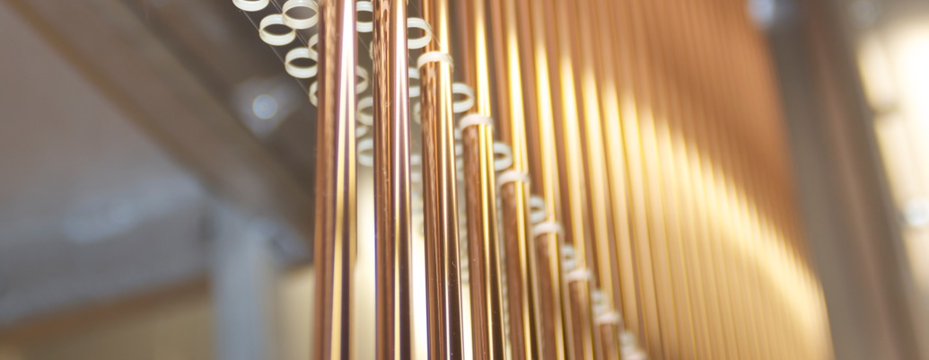
Straw tracker
Notes:
First of all I wish to thank for the invitation and the good reception the Conference organizer. I want to took about straw tracker in the different experiment.
Добрый день. Прежде чем начать доклад о строу трекере СПД расскажу немного о принципах детектирирования при помощи строу трекера.

Slide 22
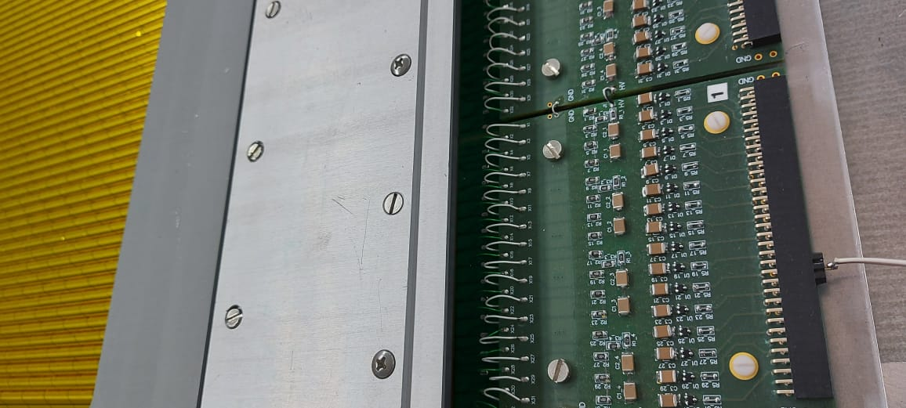
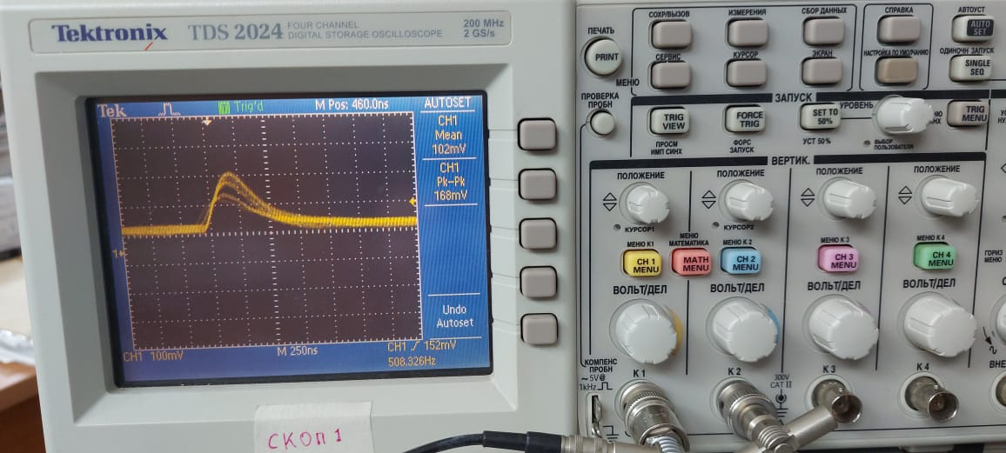
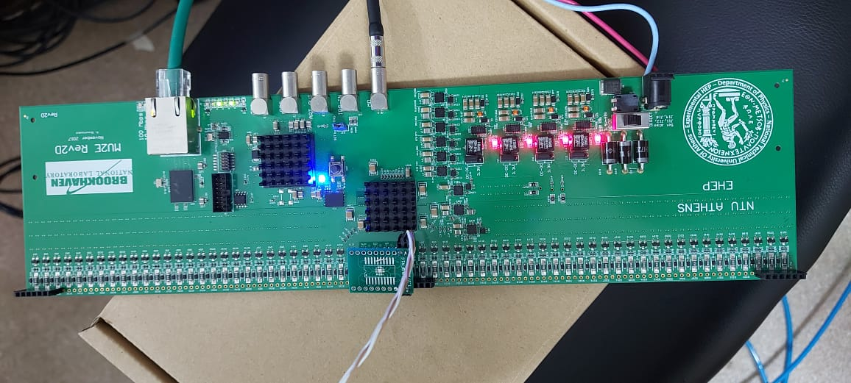
Signals from STRAW chambers with ⁵⁵Fe
Adapter to get the signal from STRAW chamber
Adapter to delivery signal from STRAW chamber into the VMM3 board
Monitor output
Signal from monitor output.
⁵⁵Fe is attached to the STRAW chamber

Slide 23
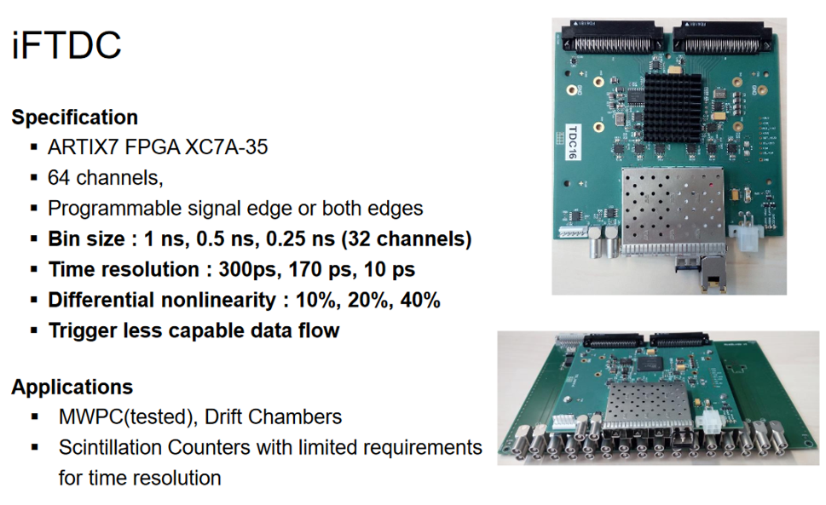
Straw tracker. iFTDC
I.Konorov developed so-called “iFTDC” which is a TDC module built using FPGA chip.
iFTDC can work both in triggered or trigger-less mode (this has been tested and confirmed), has precision down to 150 ps: well above the requirements of the straw tracker.
5 card of iFTDC now is used for tests.
Straw tracker group is studying also
other options for FEE.

Slide 24
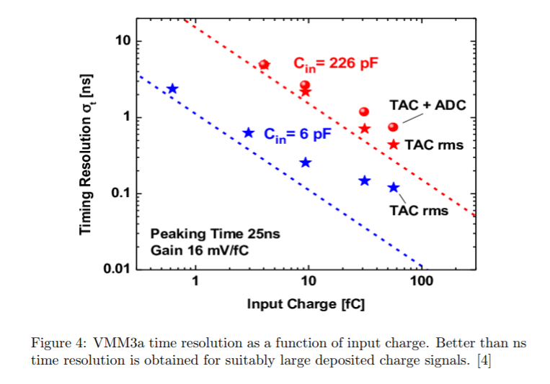
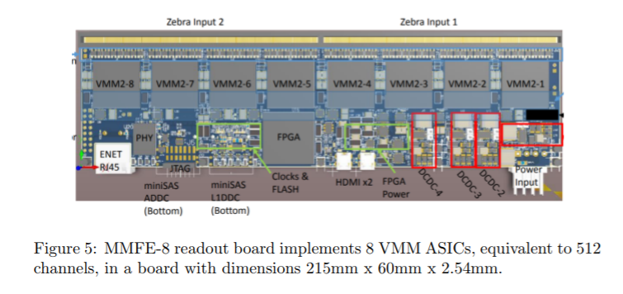
TRACKER ELECTRONICS DUNA

Slide 25
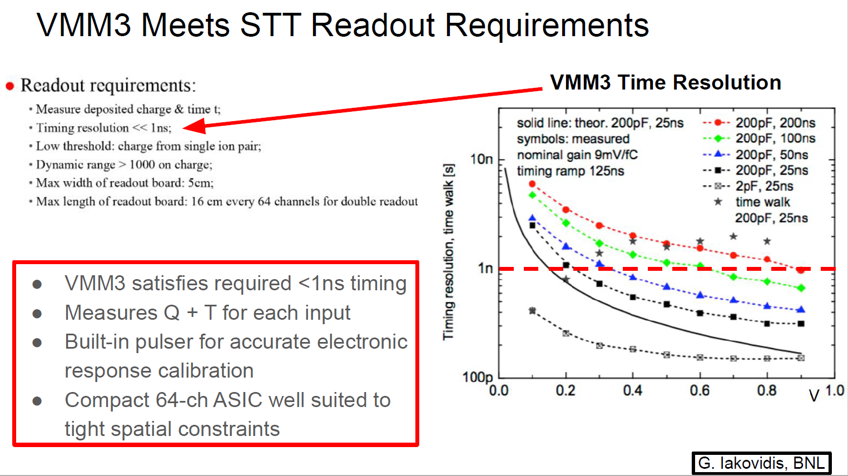

Slide 26
ECAL Front End Readout
Front End electronic for SPD ECAL based of:
  ADC-64 – 14 bit digitizer, 64 MHz – 64 channels
  16 channels Front END card with Power control for SiPms
  16 SiPM board + 1 Temperature sensor
Current version used for tests!!!

Slide 27
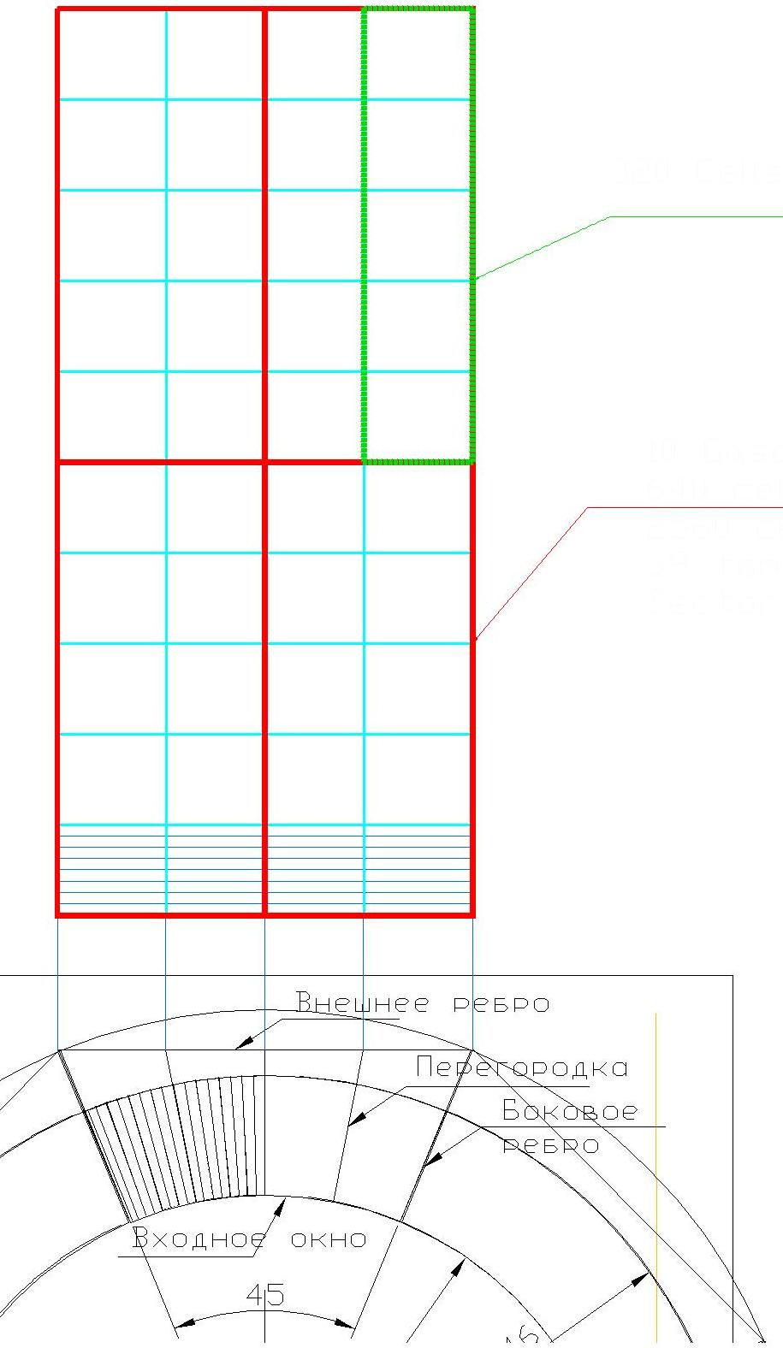
One Sector = 1/8 ECAL
The Frame divided on 8 Sectors
Each sector has 4 Gaskets
Each Gasket has 10 Sections
One Sector – consist of 64 cells
64 cells readout of one ADC-64
ADC-64 Numbers for:
One Sector = 40
One Barrel of 8 Sect.= 40x8=320
Two End Cups = 75x2=150
N_Front_End_Card=4 x N_ADC
Sector
Basket
Section

Slide 28
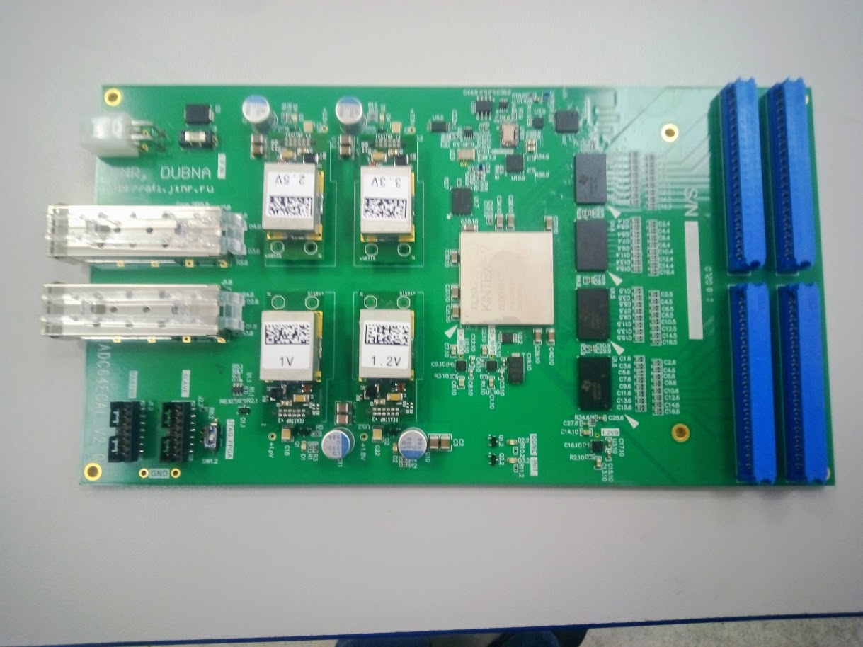
64 channel Wave form digitizer Specially designed for ECAL
ADC_64Ecal – https://afi-project.jinr.ru/projects/adc64ecal/wiki
64 MHz – samples frequency
14 – bit/per sample
White Rabbit provides sub-nanosecond synchronization accuracy
Zero suppression mode
Can operate in Streamer mode – Trigger less DAQ
Water cooling
Can operate in Magnetic Field
Power : ~ 50 Wt.
Total heating: 470*50=23.5kW

Slide 29
Muon (Range) System Front-End Electronics
(analog & digital, FPGA-based)

Slide 30
Main FEE prototype cards
(for test in BTZ)
Analog FEE card
HVS/A-8 -> HVS/AD-8
(LVDS outputs to be implemented)
Analog FEE card
ADB-32 for wire R/O
(no modifications)
Analog FEE card for strips R/O
A-32 -> 2AD-32
(LVDS outputs to be implemented)
Digital FEE cards
MFDM-192
(interface card for SPD/DAQ need to be developed

Slide 31
FE electronics of SPD RS
(analog and digital)
Alekseev G., 25.03.2021
Analog electronics based on two 8-channel chips: Ampl-8.3 и Disk-8.3, used in D0/FNAL и COMPASS/CERN
It is paled to replace by: Ampl-8.51, Ampl-8.11R (will be ready by end of 2021) и Disk-8.15 (ready)
Digital electronics based on FPGA chip Xilinx/Artix7. 192-channel VME units was developed and have been ordered (7pcs) for readout wires and strips (totally 1344 channels) from RS prototype (delivery - autumn 2021.)
RS Prototype test at Nuclotron is fully covered with existing FEE. Analog cards ADB-32 should be delivered from CERN during this summer. The digital VME unit MFDM-192 need to be tested in the ideal case in autumn/winter 2021.

Slide 32
Front-End electronics summary
Silicon vertex detector – TDC/ADC: few promising options is developing for PANDA and ALICE front-end electronics. No final decision yet.
Electromagnetic calorimeter (SiPMs) – ADC: No final decision yet.
Straw tracker: iFTDC developed for COMPASS, NA64 is planned for SPD or VMM3 based TDC/ADC.
Range system – TDC: The SPD range system closely follows the design of the range system of PANDA, which is in a well-advanced state. The digital part of the PANDA front-end electronics is very closed to what we want for the SPD-DAQ.

Slide 33
SPD DCS & BTZ
29.04.2021 Tow talks:
SPD detector control system and Beam Test Zone, A. Chepurnov &
D. Gribkov, SINP MSU: WinCC Open Architecture
DCS of the miniSPD, Kirill Salamatin & Temur Enik, JINR: Tango

Slide 34
DCS very short summery
Tango:
+ free system with open code
+ widely used in JINR
+ implemented at miniSPD
WinCC OA:
+ commercial system Simatic
+ standard for CERN
+ under consideration as standard for JINR !!!
+ gateway for Tango
+ will be implemented for RS in SPD beam test zone
high price of the system and stuff education
still not widely used in JINR

Slide 35
Thank you for attention

