Slide 1
BM@N-STS ELECTRONICS COOLING
THEORETICAL CALCULATIONS & CFD SIMULATIONS
Kshitij Agarwal¹, H.R. Schmidt^{1,2}
¹ Eberhard-Karls-Universität Tübingen – Tübingen (DE)
² GSI Helmholtz Centre for Heavy Ion Research – Darmstadt (DE)
Coordination Meeting on the GSI-JINR Roadmap Agreement
28/04/2021 – Virtual Meeting

Slide 2
BOUNDARY CONDITIONS

Slide 3
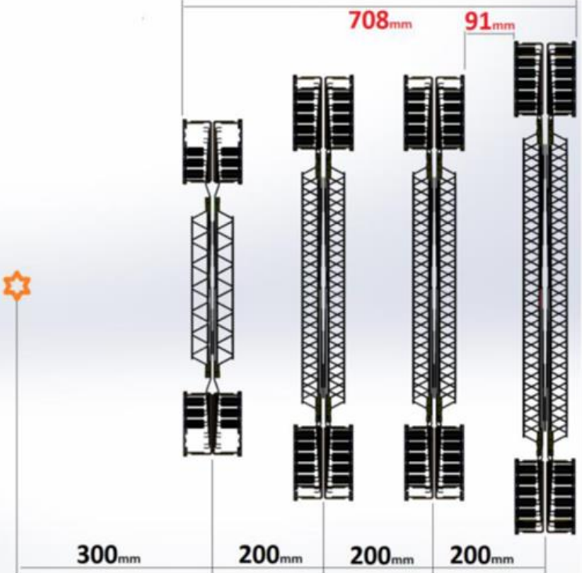
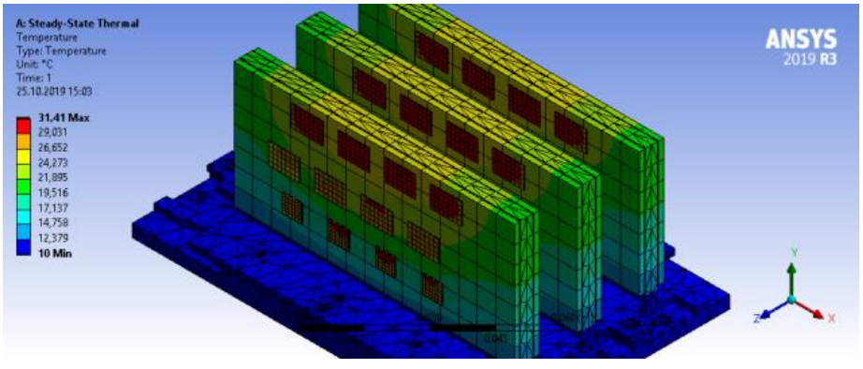
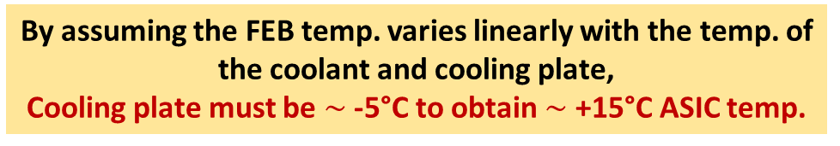
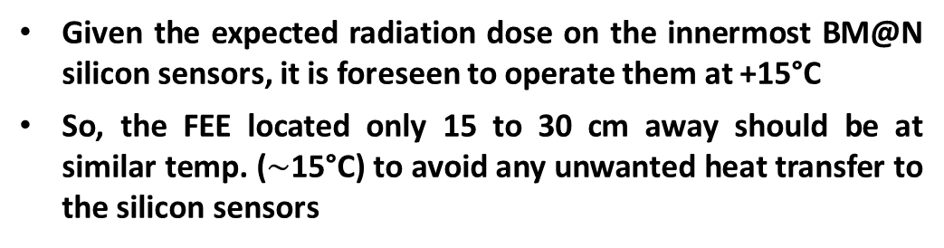
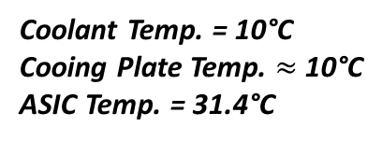


HOW COLD SHOULD THE COOLING PLATES/C-FRAMES BE?
y
Given the expected radiation dose on the innermost BM@N silicon sensors, it is foreseen to operate them at +15°C
So, the FEE located only 15 to 30 cm away should be at similar temp. ($\sim$15°C) to avoid any unwanted heat transfer to the silicon sensors
z
$\sim$30 cm
$\sim$15 cm
Coolant Temp. = 10°C
Cooing Plate Temp. $≈$ 10°C
ASIC Temp. = 31.4°C
By assuming the FEB temp. varies linearly with the temp. of the coolant and cooling plate,
Cooling plate must be $\sim$ -5°C to obtain $\sim$ +15°C ASIC temp.

Slide 4
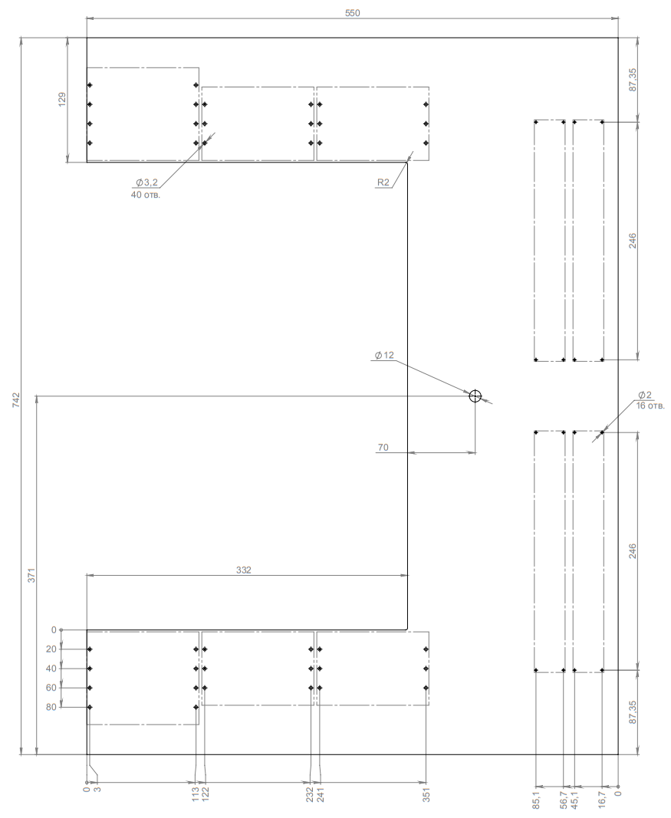
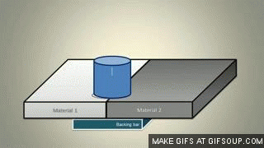
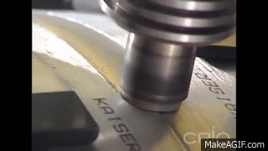
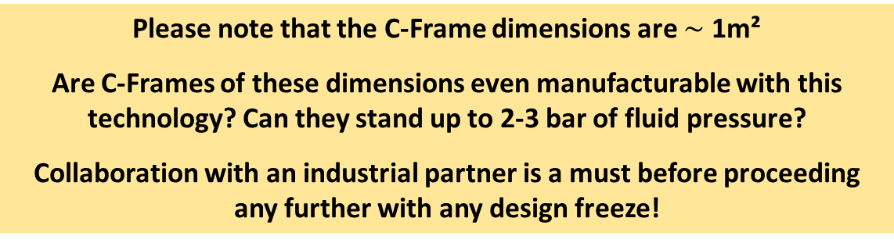
MANUFACTURING OF COOLING PLATES/C-FRAMES
Friction Stir Welding
Technology proposed for CBM-STS cooling plates by CoolTec Electronic GmbH, and a potential solution for BM@N-STS
https://www.cooltec.de/produkte/cold-plates.php
C-Frame 02R
Please note that the C-Frame dimensions are $\sim$ 1m²
Are C-Frames of these dimensions even manufacturable with this technology? Can they stand up to 2-3 bar of fluid pressure?
Collaboration with an industrial partner is a must before proceeding any further with any design freeze!

Slide 5
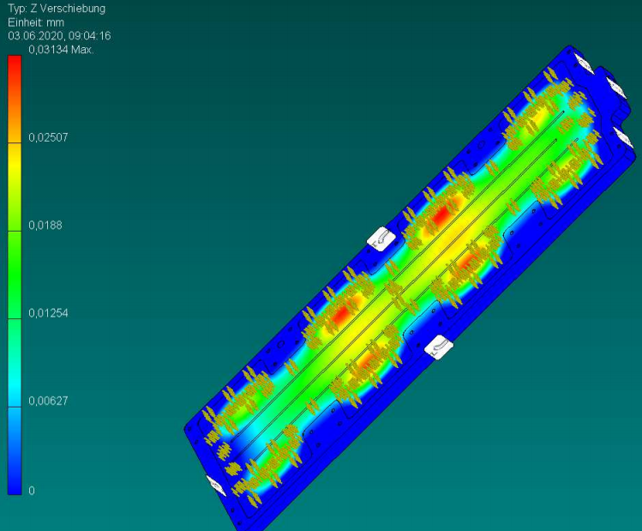
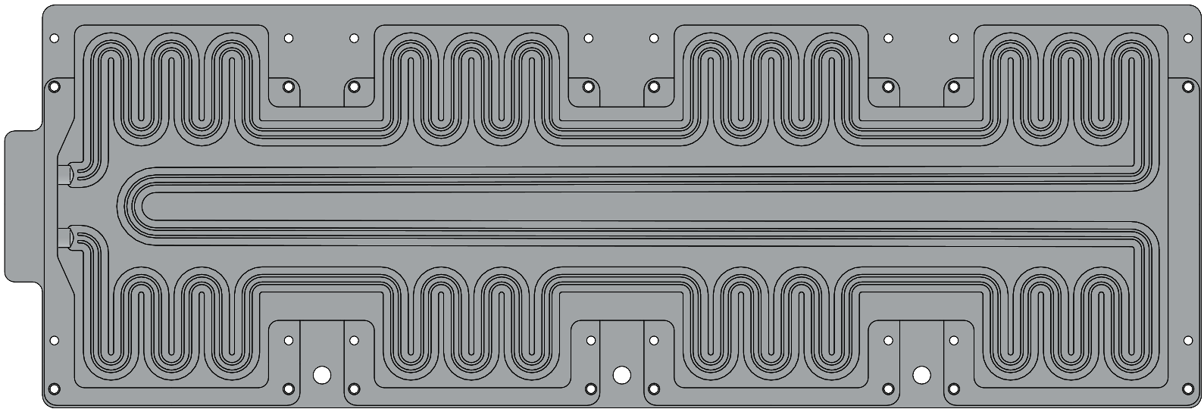
POTENTIAL LEARNINGS FROM THE EXPERIENCES OF CBM-STS
At 5 bars of fluid pressure
The milled-channels have certain manufacturing boundary conditions which must be followed. And has to be complemented with our requirements –
Power dissipation
Coolant temperature
Coolant flow rate
Pressure drop
…

Slide 6
POTENTIAL COOLANTS
[1] 3M NOVEC 649
[2] WATER-GLYCOL MIXTURE

Slide 7
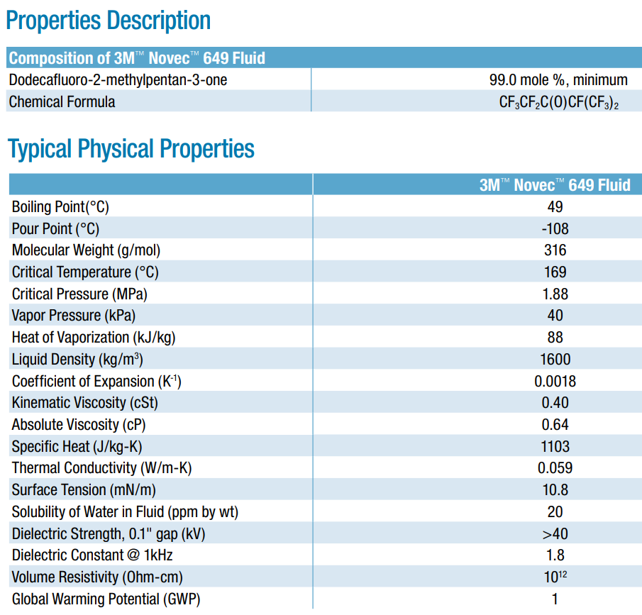
[1] INTRODUCTION TO 3M NOVEC 649
Radiation hard (resistant to gamma radiation > 10 kGy).
So minimal production of radiation byproducts, which otherwise could block cooling lines or cause corrosion!
Usable down to -108°C
Lower heat capacity w.r.t. water. So higher flow would be required.
Green, which ensures long-term availability

Slide 8
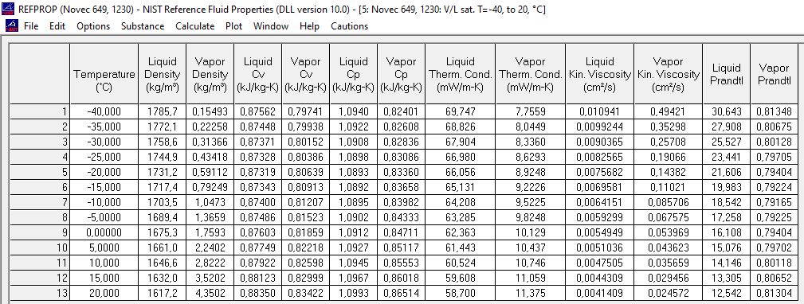
[1] FLUID PROPERTIES – 3M NOVEC 649
Potentially useful reference for any calculations or simulations

Slide 9
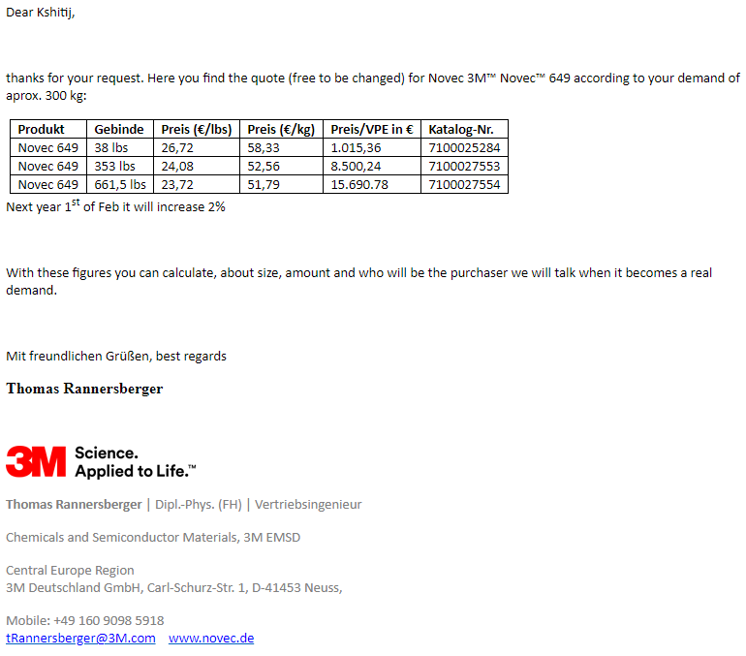
[1] COMMERCIAL AVAILABILITY OF 3M NOVEC 649
Higher quantities could be purchased directly from 3M (€ 50-60/kg)
Lower quantities are readily available in Germany from Ionic Liquid Technologies – IoLiTec (Heilbronn DE)

Slide 10
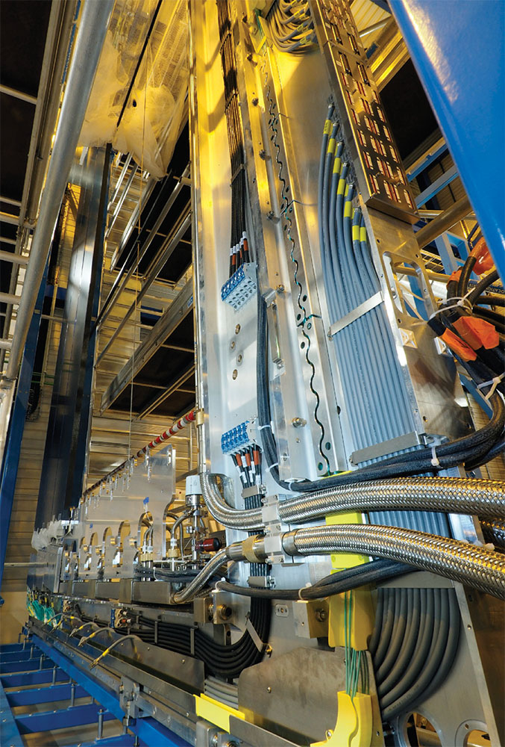
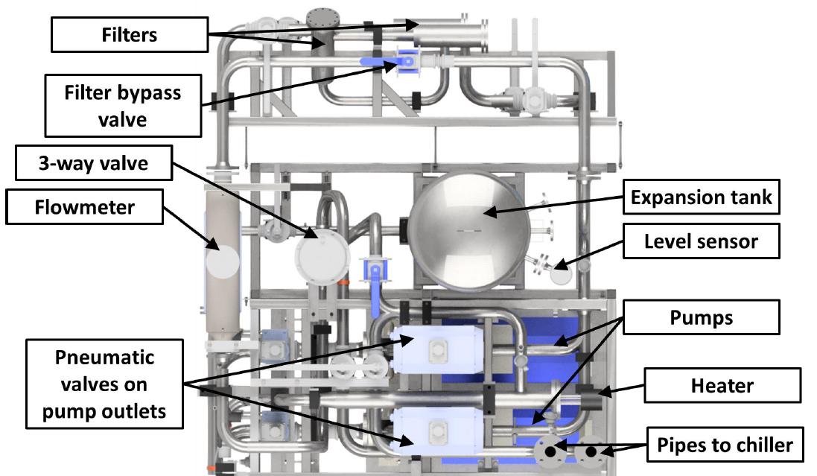
[1] WHERE IN USE SO FAR?
LHCb SciFi Tracker

Slide 11
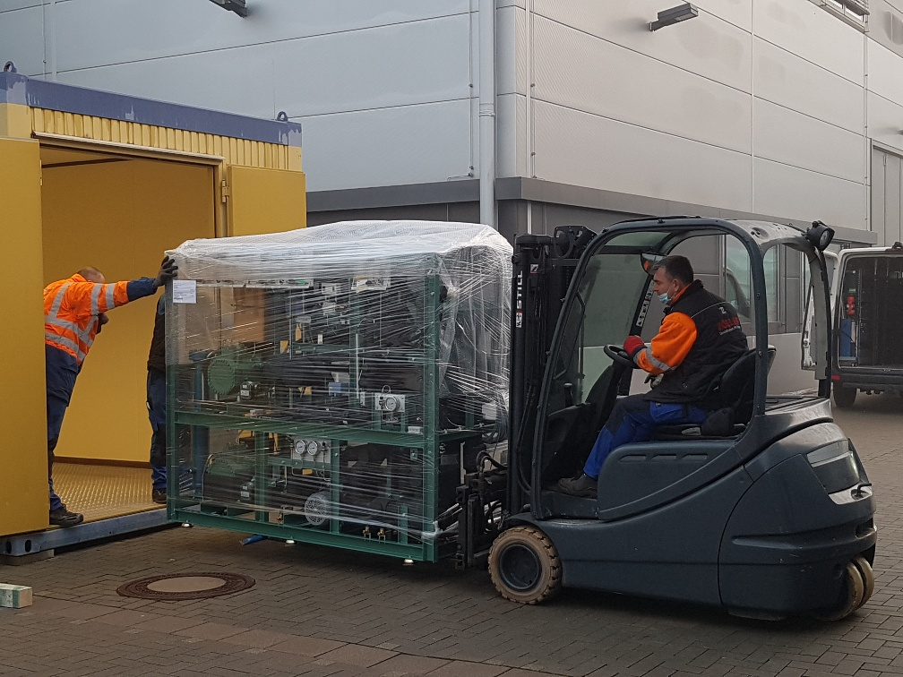
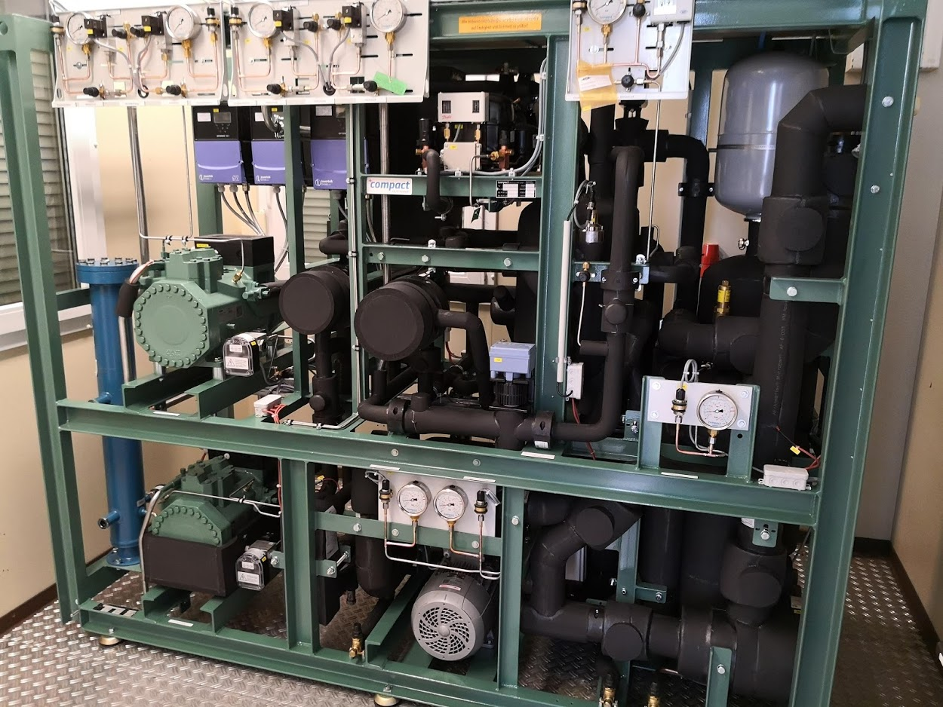


[1] (NEAR) FUTURE: CBM-STS BABY COOLING PLANT
Baby Cooling Plant delivered at GSI on 18.12.2020
7.5 kW cooling capacity at -40°C
Commissioning to be done within 2 months

Slide 12
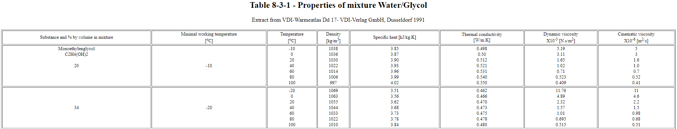
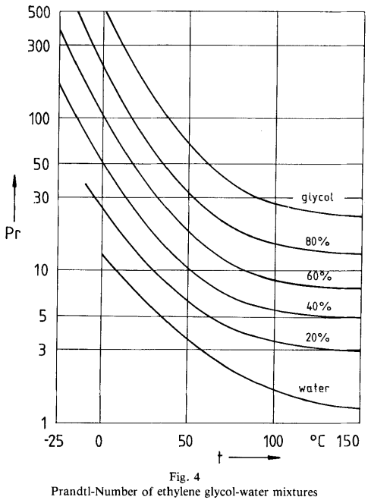
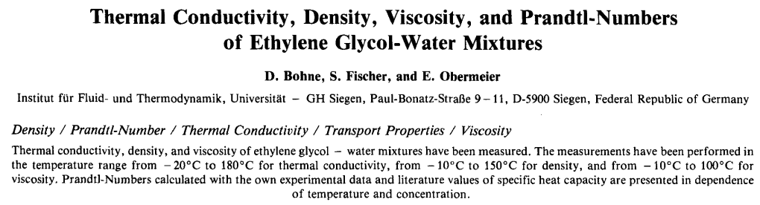
[2] FLUID PROPERTIES – WATER-GLYCOL MIXTURE
Hopefully doesn’t need any introduction ;-)
https://detector-cooling.web.cern.ch/data/Table%208-3-1.htm
https://doi.org/10.1002/bbpc.19840880813
For Prandtl Number

Slide 13
(APPROXIMATE) THEORETICAL MODELLING
[1] PRESSURE DROP
[2] SURFACE TEMP.

Slide 14
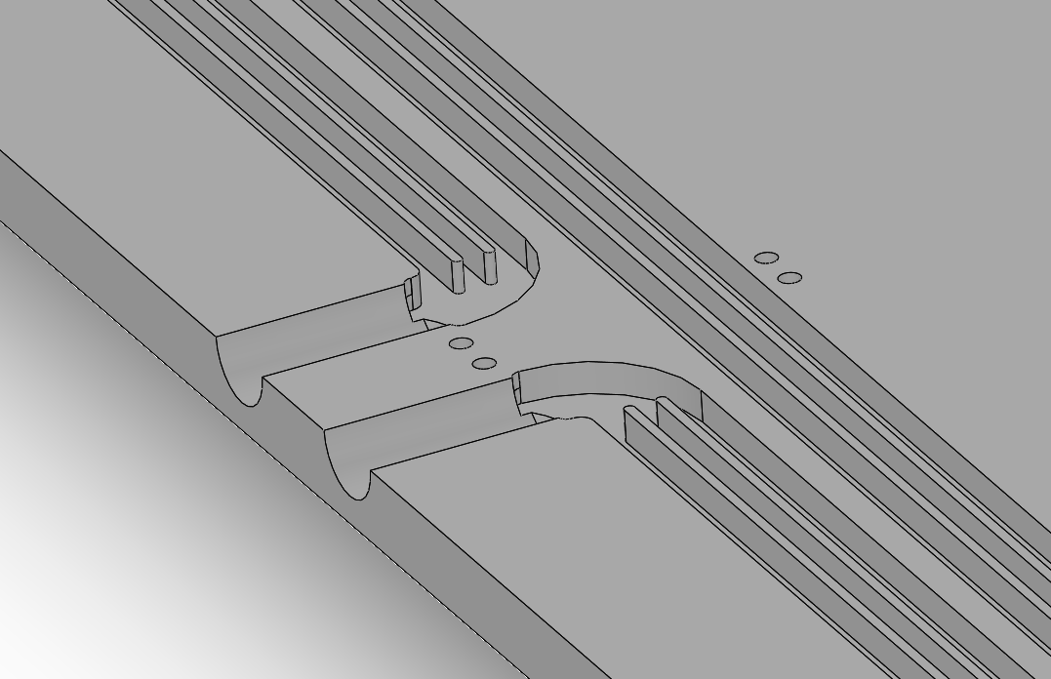









[1] THEORETICAL MODELLING – PRESSURE DROP
Motivation – Can we theoretically model and predict the pressure drop for the BM@N cooling plates for the given boundary conditions (in terms of fluid type, flow numbers and geometry)?
To calculate the pressure-drop per unit length in a tube, we can use Darcy-Weisbach Equation:
where, f_{D} = Darcy Friction Factor (online tool)
ρ = Fluid Density [kg/m³]
v = Fluid Velocity [m/s]
D = Hydraulic Diameter [m] = 4 x Area / Perimeter
$$\frac{∆P}{L}=f_{D}∙\frac{ρ}{2}∙\frac{v^{2}}{D}$$
$$v_{1}$$
$$R_{1}\left(L_{1},D_{1}\right)$$
$$v_{2}$$
$$R_{2}\left(L_{2},D_{2}\right)$$
$$P_{inlet}$$
$$P_{outlet}$$
$$v_{3}$$
$$R_{3}\left(L_{3},D_{3}\right)$$
In the theoretical circuit analogy, individual finned channel represents a flow resistance which the fluid experiences. And since there are three channels running in parallel, they are analogous to three flow resistances connected in parallel.

Slide 15







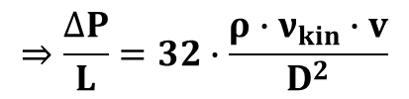





[1] THEORETICAL MODELLING – PRESSURE DROP
To calculate the pressure-drop per unit length in a tube, we can use Darcy-Weisbach Equation:
where, f_{D} = Darcy Friction Factor (online tool)
ρ = Fluid Density [kg/m³]
v = Fluid Velocity [m/s]
D = Hydraulic Diameter [m] = 4 x Area / Perimeter
$$\frac{∆P}{L}=f_{D}∙\frac{ρ}{2}∙\frac{v^{2}}{D}$$
Step #1: Fluid Velocity Calculation
Assuming that there is a laminar flow (because of simplicity in calculation):
where, Re = Reynolds Number
v_{kin} = Kinematic Viscosity [m²/s]
$$f_{D}=\frac{64}{Re}=\frac{64}{\left(\frac{v∙D}{ν_{kin}}\right)}$$
$$⇒\frac{∆P}{L}=32∙\frac{ρ∙ν_{kin}∙v}{D^{2}}$$
Since for a given fluid type and flow, the pressure-drop per unit length will be same in all three finned channels,
$$v_{1}$$
$$R_{1}\left(L_{1},D_{1}\right)$$
$$⇒\frac{v}{D^{2}}=Constant$$
$$⇒{\left(\frac{v}{D^{2}}\right)}_{1}={\left(\frac{v}{D^{2}}\right)}_{2}={\left(\frac{v}{D^{2}}\right)}_{3}$$
$$v_{2}$$
$$R_{2}\left(L_{2},D_{2}\right)$$
$$P_{inlet}$$
$$P_{outlet}$$
So, knowing the geometry of the individual channels (i.e., in terms of the hydraulic diameter) gives the information of the flow distribution amongst them.
$$v_{3}$$
$$R_{3}\left(L_{3},D_{3}\right)$$

Slide 16

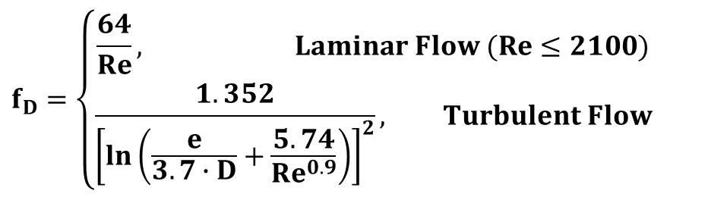


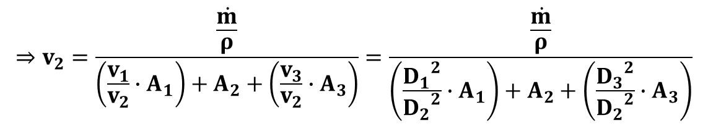


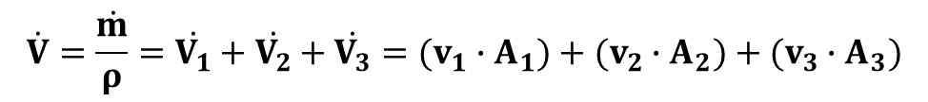



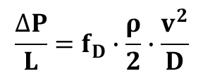
[1] THEORETICAL MODELLING – PRESSURE DROP
For a given inlet volumetric flow rate into the cooling plate ($\dot{V}$),
$$v_{1}$$
$$R_{1}\left(L_{1},D_{1}\right)$$
$$\dot{V}=\frac{\dot{m}}{ρ}=\dot{V_{1}}+\dot{V_{2}}+\dot{V_{3}}=(v_{1}∙A_{1})+(v_{2}∙A_{2})+(v_{3}∙A_{3})$$
$$R_{2}\left(L_{2},D_{2}\right)$$
$$⇒v_{2}=\frac{\frac{\dot{m}}{ρ}}{\left(\frac{v_{1}}{v_{2}}∙A_{1}\right)+A_{2}+\left(\frac{v_{3}}{v_{2}}∙A_{3}\right)}=\frac{\frac{\dot{m}}{ρ}}{\left(\frac{{D_{1}}^{2}}{{D_{2}}^{2}}∙A_{1}\right)+A_{2}+\left(\frac{{D_{3}}^{2}}{{D_{2}}^{2}}∙A_{3}\right)}$$
$$v_{2}$$
$$P_{inlet}$$
$$P_{outlet}$$
$$v_{3}$$
$$R_{3}\left(L_{3},D_{3}\right)$$
And similarly, v₁ and v₃ is calculated.
Pressure-drop will obviously remain the same in every channel.
Step #2: Darcy Friction Factor Calculation
Step #3: Pressure Drop Calculation
$$f_{D}=\left\{\begin{aligned}\frac{64}{Re}, Laminar Flow (Re≤2100) \\ &\frac{1.352}{{\left[\ln\left(\frac{e}{3.7∙D}+\frac{5.74}{{Re}^{0.9}}\right)\right]}^{2}}, Turbulent Flow\end{aligned}\right.$$
Put the flow velocity and the Friction Factor back in the Darcy-Weisbach Eqn:
$$\frac{∆P}{L}=f_{D}∙\frac{ρ}{2}∙\frac{v^{2}}{D}$$
Words of Caution – Real numbers WILL be higher.
Calculation of the velocity distribution is done by assuming laminar flow for the sake of simplicity.
Pressure drop is calculated for straight tubes and having multiple turns will increase the pressure drop.
where, e = Surface Roughness [m]

Slide 17
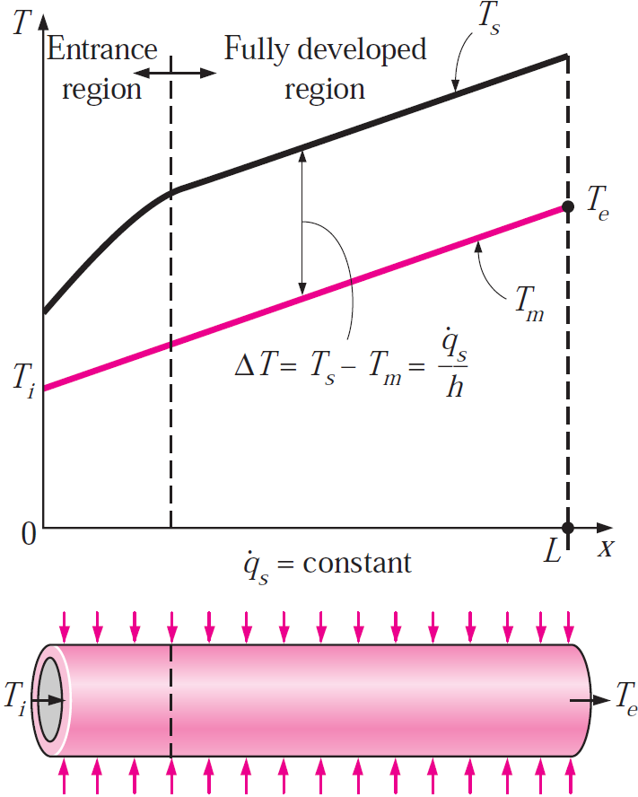


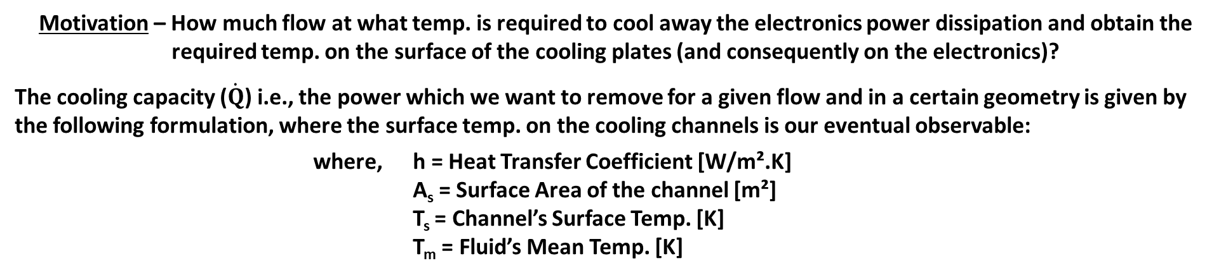


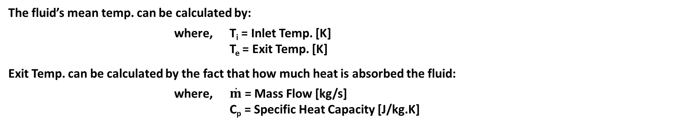
[2] THEORETICAL MODELLING – THERMAL ASPECTS
Motivation – How much flow at what temp. is required to cool away the electronics power dissipation and obtain the required temp. on the surface of the cooling plates (and consequently on the electronics)?
The cooling capacity ($\dot{Q}$) i.e., the power which we want to remove for a given flow and in a certain geometry is given by the following formulation, where the surface temp. on the cooling channels is our eventual observable:
where, h = Heat Transfer Coefficient [W/m².K]
A_{s} = Surface Area of the channel [m²]
T_{s} = Channel’s Surface Temp. [K]
T_{m} = Fluid’s Mean Temp. [K]
$$\dot{Q}=h∙A_{s}∙\left(T_{s}−T_{m}\right)$$
$$⇒T_{s}=T_{m}+\frac{\dot{Q}}{h∙A_{s}}$$
Step #1: Fluid’s Mean Temp. Calculation
The fluid’s mean temp. can be calculated by:
where, T_{i} = Inlet Temp. [K]
T_{e} = Exit Temp. [K]
Exit Temp. can be calculated by the fact that how much heat is absorbed the fluid:
where, $\dot{m}$ = Mass Flow [kg/s]
C_{p} = Specific Heat Capacity [J/kg.K]
$$T_{m}=\frac{T_{i}+T_{e}}{2}$$
$$\dot{Q}=\dot{m}∙C_{p}∙\left(T_{e}−T_{i}\right)$$
$$⇒T_{e}=T_{i}+\frac{\dot{Q}}{\dot{m}∙C_{p}}$$

Slide 18
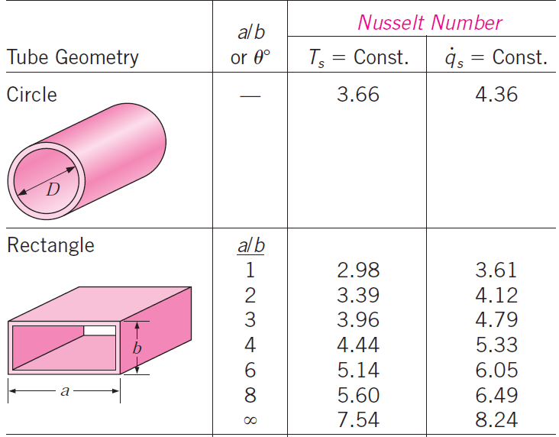
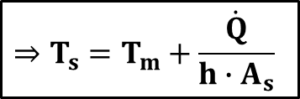
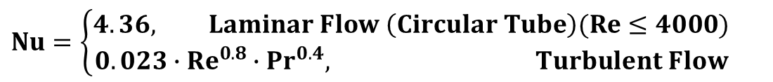

THEORETICAL MODELLING – THERMAL ASPECTS
Step #2: Heat Transfer Co-efficient Calculation
Heat Transfer Coefficient is calculated by:
where, Nu = Nusselt Number
k = Thermal Conductivity [W/m.K]
D = Hydraulic Diameter [m]
For a fully developed flow, the Nusselt Number is:
where, Re = Reynold Number
Pr = Prandtl Number
$$h=\frac{Nu∙k}{D}$$
$$Nu=\left\{\begin{aligned}4.36, Laminar Flow \left(Circular Tube\right)(Re≤4000) \\ 0.023∙{Re}^{0.8}∙{Pr}^{0.4}, Turbulent Flow\end{aligned}\right.$$
Step #3: Average Surface Temp. Calculation
So, for the required cooling capacity ($\dot{Q}$), mass flow and cooling channel geometry, simply insert the values of the mean fluid temp. and the heat transfer co-efficient to obtain the average temp. on the top of the C-Frame:
$$⇒T_{s}=T_{m}+\frac{\dot{Q}}{h∙A_{s}}$$
Words of Caution – Only the average temp. on the surface
A constant power distribution is assumed over the tube. So, no hot-spots can be identified.
The Nusselt number is assumed for circular channels.
The Nusselt number is assumed for a fully developed flow (i.e., no entrance region calculated)

Slide 19
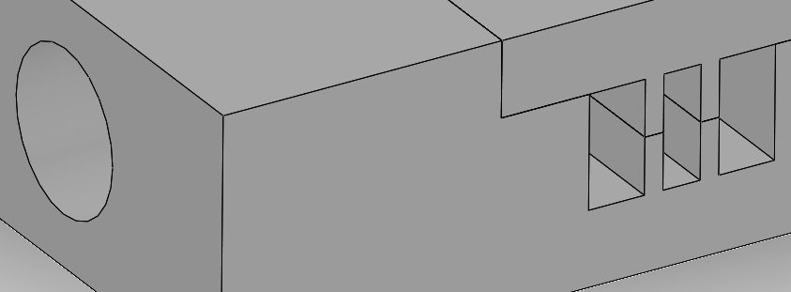
SOME PREDICTIONS (WITH 01L GEOMETRY)
Channel Geometry (based on the CAD file given) :
Ch#1: 3 x 6 mm² Ch#2: 2 x 6 mm² Ch#3: 3 x 6 mm²
Length: 2.9 m (straight channels; w/o any turns or bends)
#2
#3
Ch#1
Assuming the pressure drop limit of < 1 bar, Novec would allow for much higher mass flow due to its low viscosity
At lower power dissipation, both coolants are comparable. But Novec outperforms for higher power dissipation.
Water-Glycol @ 0.05g/s
Novec @ 0.15g/s

Slide 20
SOLIDWORKS COMPUTATIONAL FLUID
DYNAMICS (CFD) SIMULATIONS

Slide 21
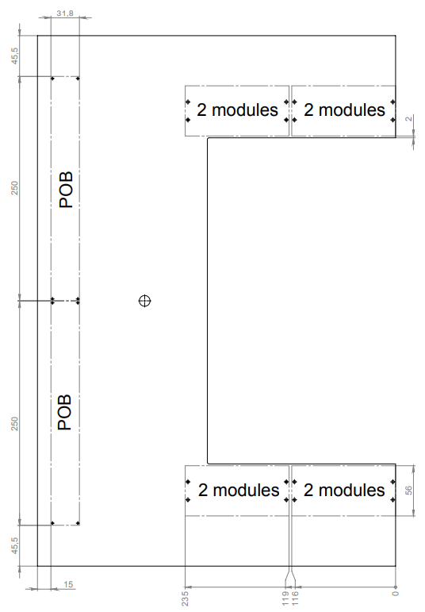
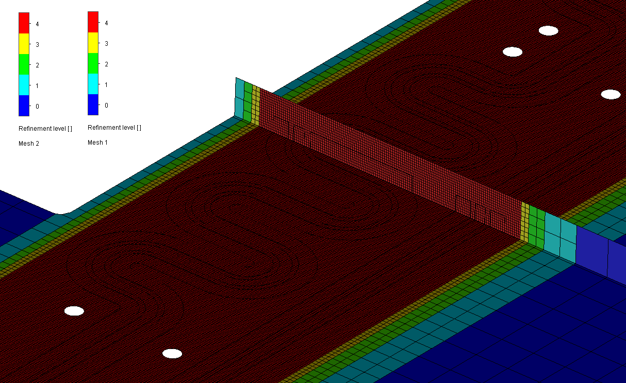
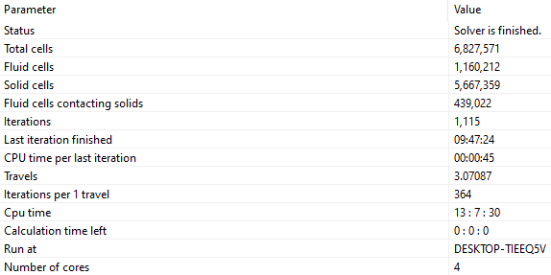
SIMULATION INPUTS – C-FRAME 01L
Total Power Dissipation (no ROBs???):
16 modules (32 FEBs) → 320W from FEBs (ASICs + LDOs; 10W/FEB)
→ 96W from FEASTs (3W/FEAST-pair/FEB)
Mesh Quality Plots
Computationally Intensive!!!

Slide 22
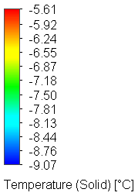
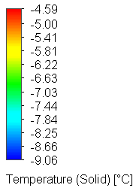
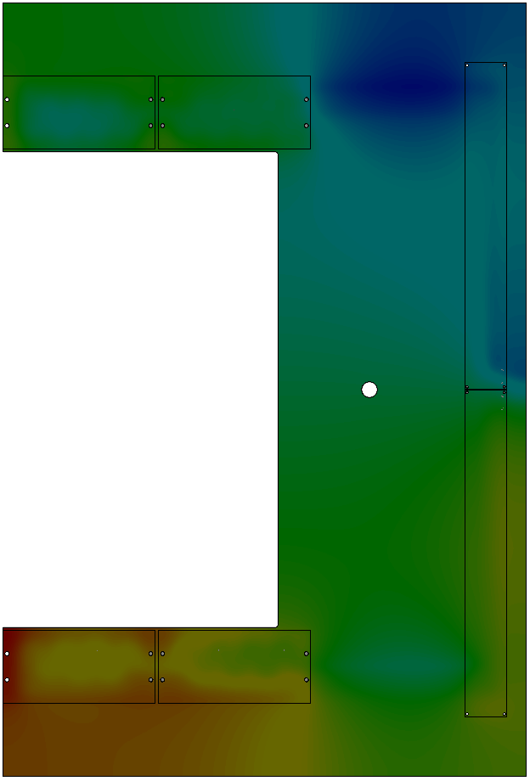
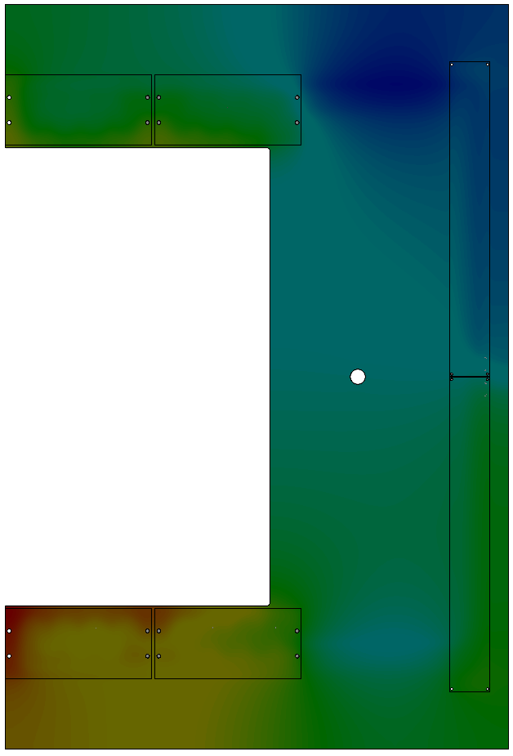
RESULTS: TEMPERATURE DISTRIBUTION
Nothing much separate the two fluids for 01L
Water-Glycol Mixture (66:34)
-10°C @ 50 g/s
3M Novec 649
-10°C @ 150 g/s

Slide 23
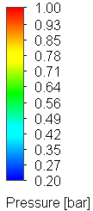

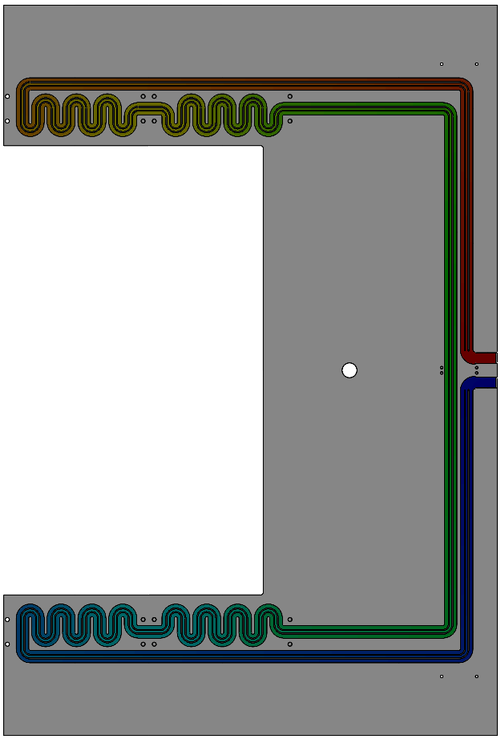

RESULTS: PRESSURE DISTRIBUTION
Nothing much separate the two fluids for 01L
Water-Glycol Mixture (66:34)
-10°C @ 50 g/s
3M Novec 649
-10°C @ 150 g/s

Slide 24
POSSIBLE NEXT STEPS

Slide 25

POSSIBLE NEXT STEPS
My conclusion – 3M Novec 649 at -10°C should be the baseline option for BM@N-STS FEE cooling
Studying the worse-case scenario can tell something conclusive, which is useful for constraining the boundary conditions for the cooling plant
Close collaboration with C-Frame/Cooling Plate manufacturer must be established before any design freeze
  CoolTec Electronic GmbH is a potential partner
  Positive experience of CBM-STS
  In-house capability to perform CFD and pressure-rating simulations

Slide 26
THANKS A LOT ☺
QUESTION/COMMENTS/SUGGESTIONS?

