Slide 1
Status of electronics development and connectivity approach
Dmitrii Dementev
Mihail Shitenkow

Slide 2
Readout chain of BM@N STS
Computing System
GBTxEMU
48 e-links
3 x Sensors
Feb-8 FEE
elinks
Gbit opt.
Feb-8 FEE
2.35 MHit/s/elink
FPGA based emulator of CERN GBTx
serializer and data combiner chip
48 x 80 Mbit/s
to 3.84 Gbit/s optical
GERI-Board
FPGA based
PCIe Interface to computer system
Feb-8 FEE
Feb-8 FEE
BM@N
Data center
Feb-8 FEE
FEB-8 FEE
Data,
Synch,
commands
Data,
Synch,
commands
Synch,
commands
TFC
Timing and Fast Control
Trigger,
WR clock, PPS

Slide 3
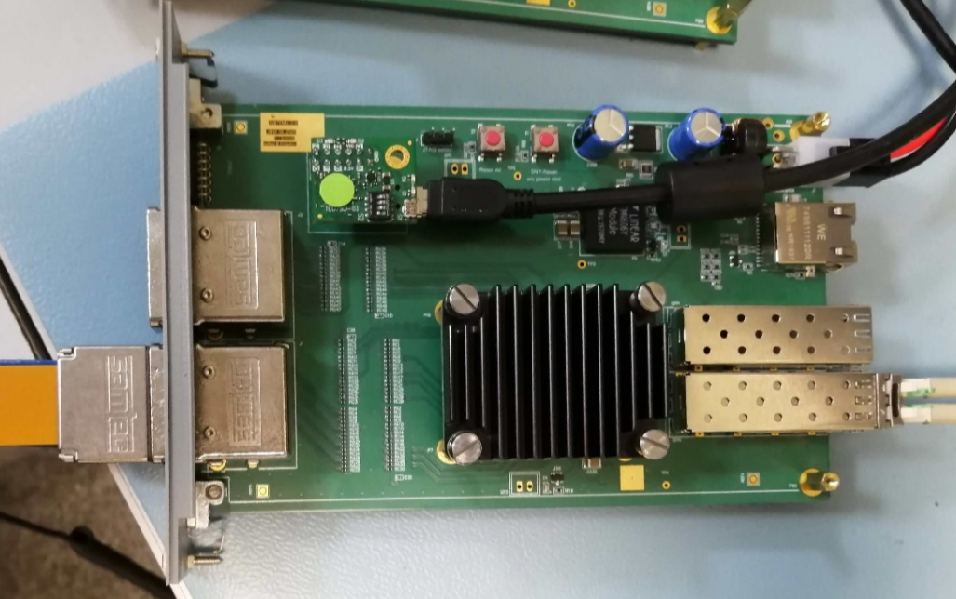
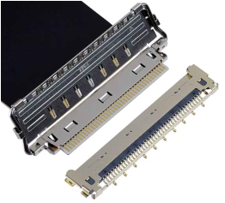
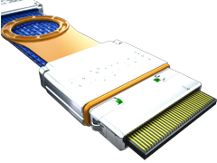
Connectivity approach
Micro coax. cable
~0.7 m long
Twinax cable
~10 m long
Front-end boards
GBTxEMU
FEB-panel
STS-box
Cross-Panel

Slide 4
BM@N FEB-8
Features:
Size: 87*40 mm²;
Thickness with components: 3 mm;
Edge-type connector with two pin groups:
[ HV, LV ] & [ DATA ]
1 Uplink per one ASIC
Advantages:
Increased space for the cabling between FEB-boxes;
90 bending of cables is avoided;
Easy connectivity with a FEB-panel;
Low thickness of the board allows to increase thickness of the cooling fin for one FEB up to 3 mm.
Current status:
Two versions of FEBs were already produced and tested
Specification for the production of the PCBs is ready
Comparison of two FEB geometries

Slide 5
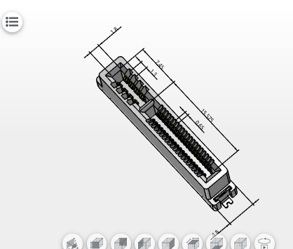
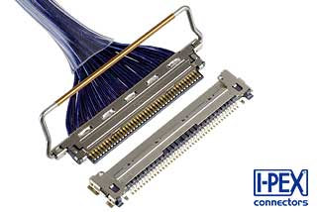
Feb-panel
Data cable
Slim Cool Edge 0.65mm
40 signal
8 Power pins: Power pin pitch at 1.30mm
current rating of 3A per pin
MQA – 1600 pcs already ordered and tested!
HV connectors
Signal return caps
Data cable connector by Ipex:
1.1 mm height
0.4 mm pitch
40 pins (2 FEBs)
18 AWG wires
(to POB)
Edge-card connectors
for the FEBs

Slide 6
Feb-panel open issues
Type of the connectors for the for the data cable and HV, LV cables are not yet finalized
Grounding connection scheme should be tested with more realistic setup (half of the ladder, FEASTs)
Thickness of the thermal interface between FEB and Fin is not known
Solutions proposed for
CBM by P. Koczon
Alternative candidate for HV cable
Alternative candidate for LV cable

Slide 7
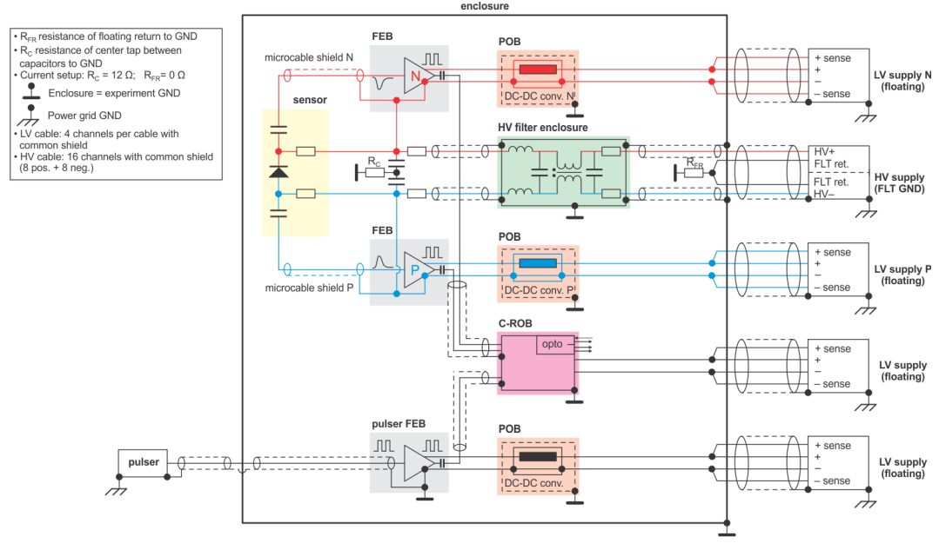
STS powering scheme
From the presentation of Anton Lymanets

Slide 8
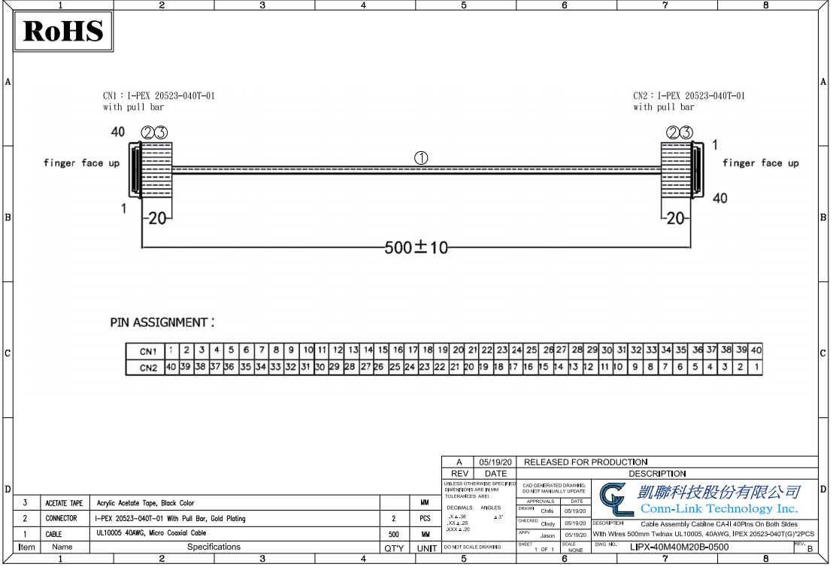
Inner data cables
Cable assembly is produced by Taiwan company, which has a service in Moscow
Ipex Cabline CA-II connectors with AWG 40 microcoax wires (50 Ohm)
Length of the cables: 800 mm

Slide 9
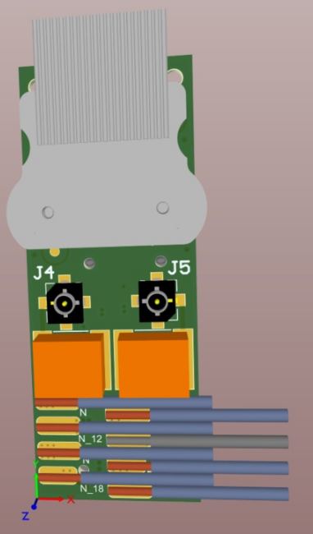
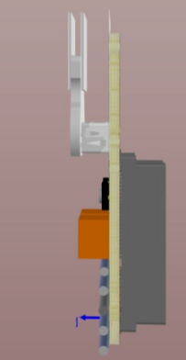
Alternative solution for the inner cables
Benefits:
2-row connector (more compact);
38 AWG instead of 40 AWG;
Mechanical connectivity is more reliable;

Slide 10
Cross panel
Is mounted on the side wall of the STS box
Provides a feed-through interface for data cables for up to six modules
Current status:
Prototype was produced and tested,
Connector type for the inner cable should be finalized
Connector thermal insulation
6 data cables
inside STS box
0.8 m length,
40 AWG coax
6 data cables
Outside STS box
10 m length 32 AWG twinax

Slide 11
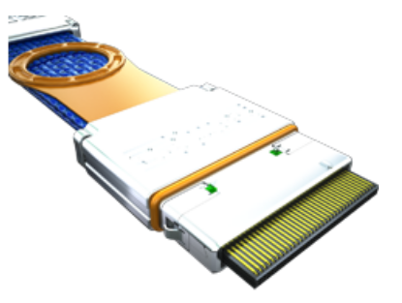
Outer data cables
PN: HDLSP-035-9999 by Samtec;
32 AWG twinax cable
24 pairs
Available length up to 10 m
Eye diagram of the Up-link signal at 80 MHz Clock

Slide 12
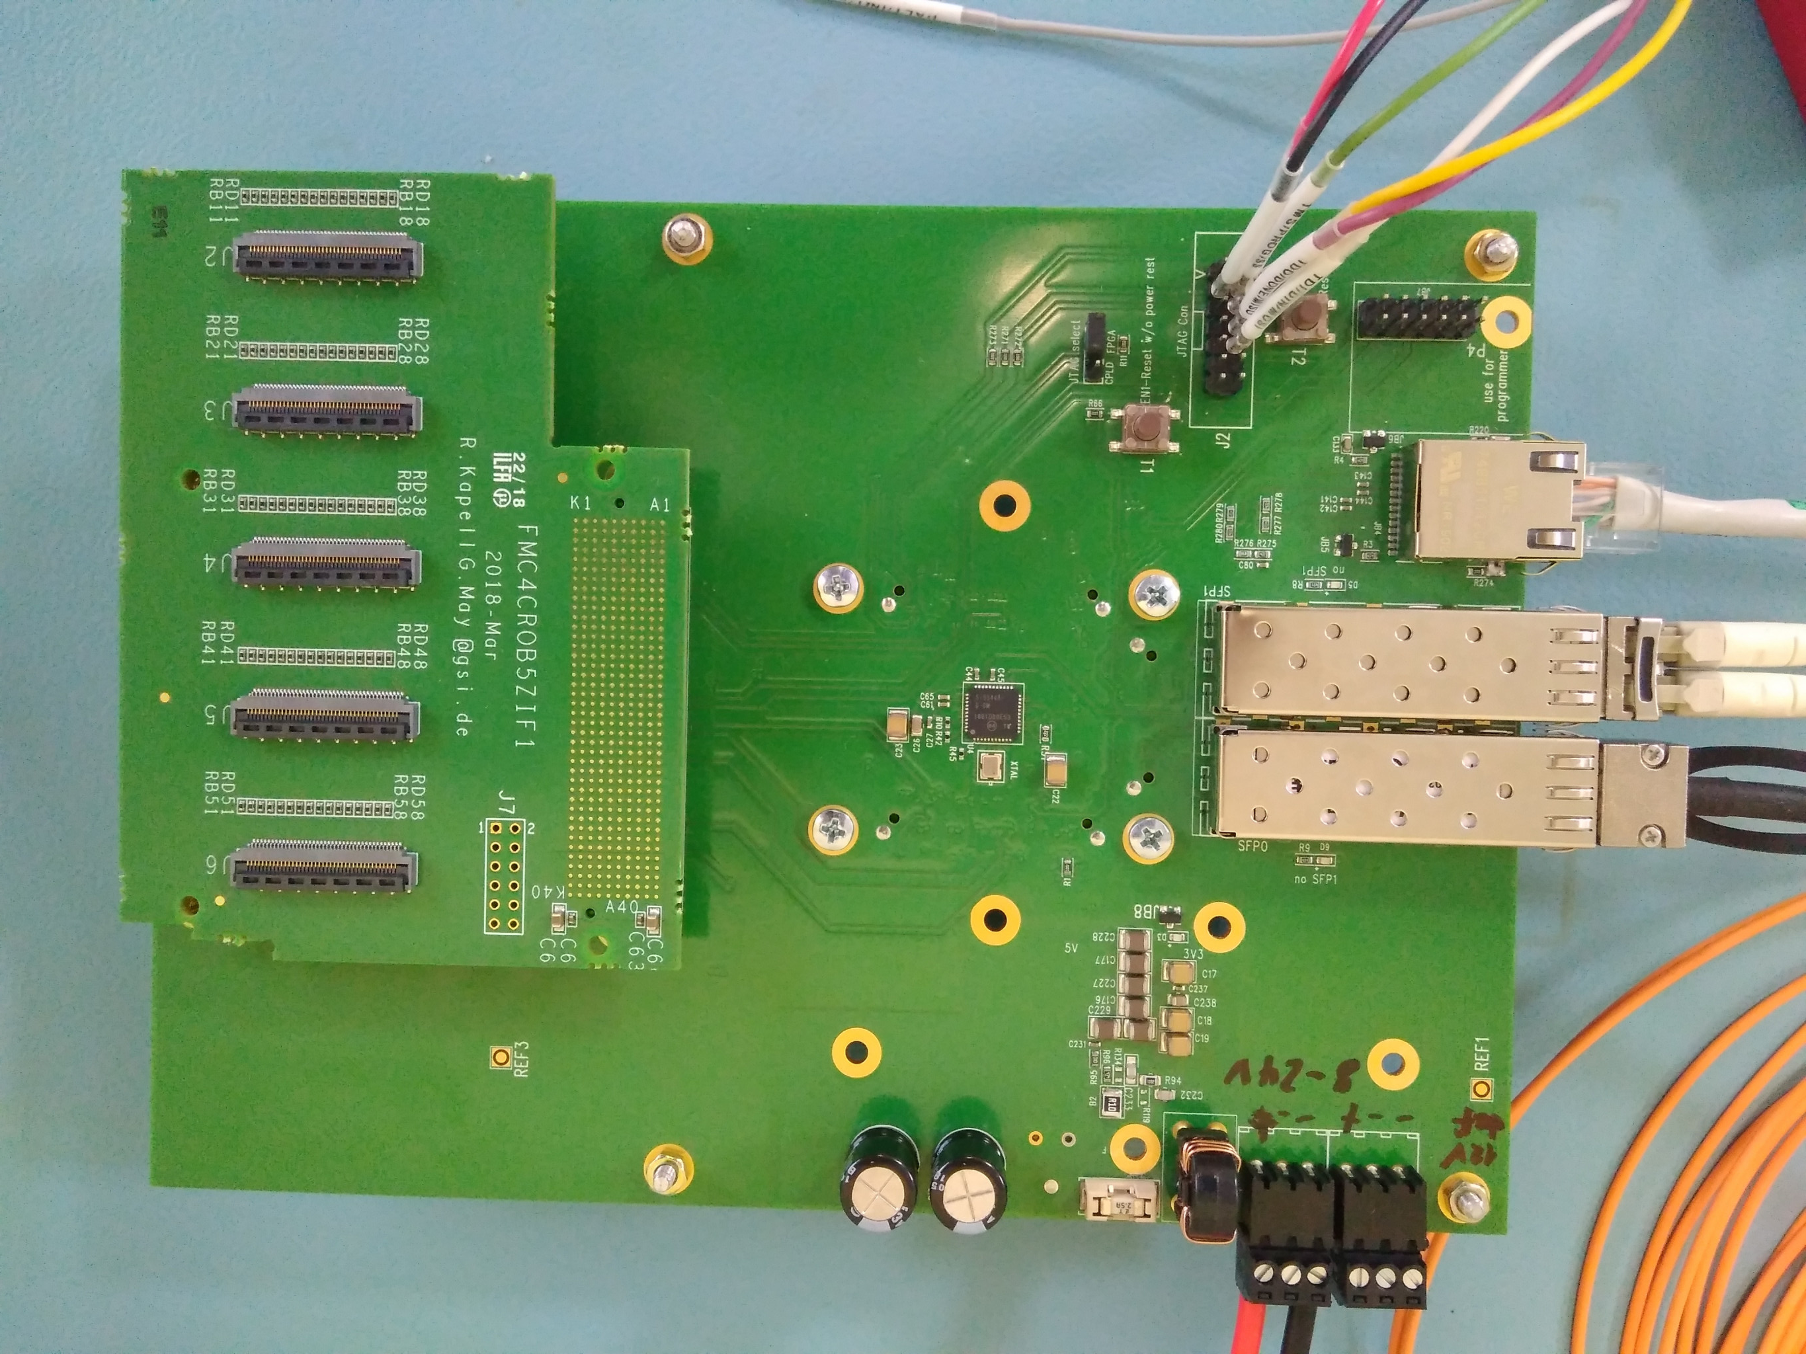
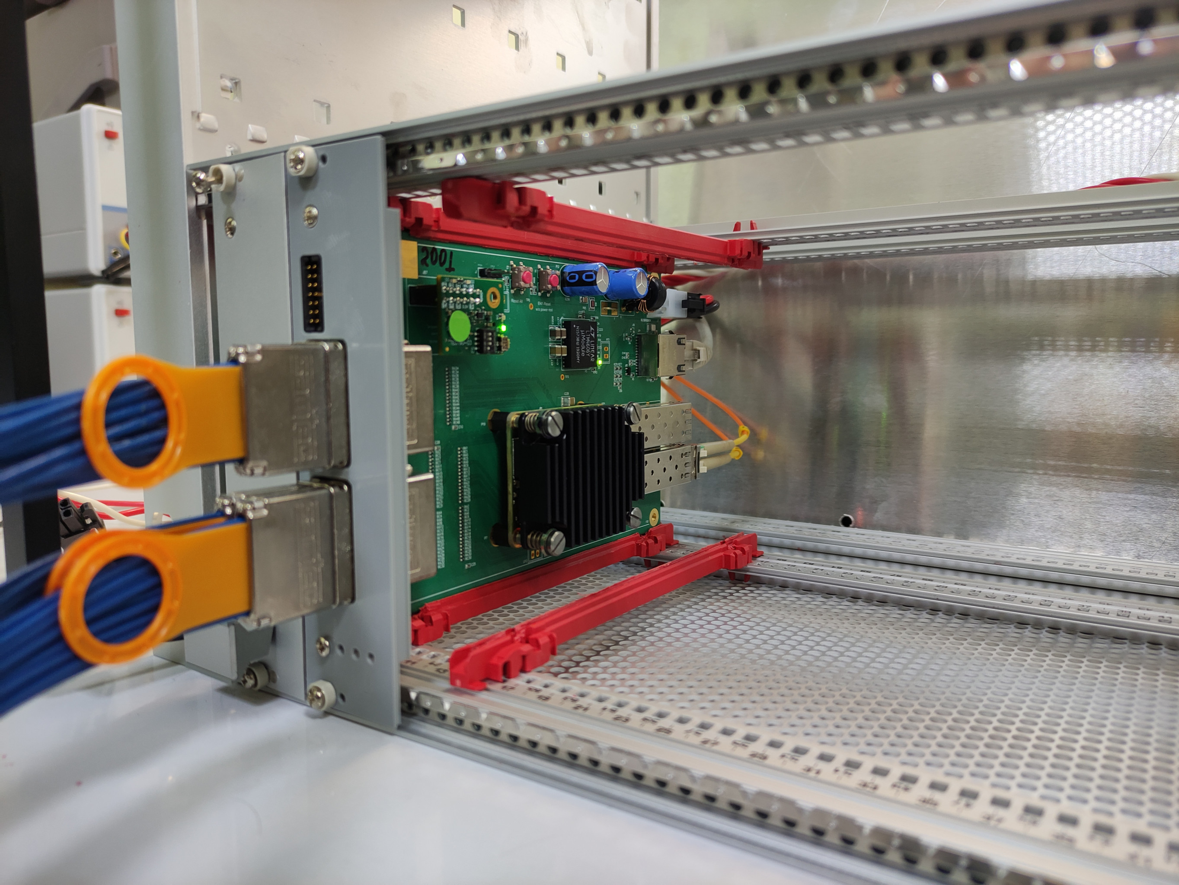
GBTxEMU
First version of GBTxEmu board produced at GSI
New version of the board with HDI6 connectors in crate
Status of the board:
First two boards are now used for the module tests
Specification is prepared for the production of PCBs

Slide 13
Thank you for your attention!

