Slide 1
Flerov Laboratory of Nuclear Reactions
Proposal on prolongation
of the themes
Synthesis and Properties of Superheavy Elements, Structure of Nuclei at the Limits of Nucleon Stability
and
Development of the FLNR accelerator complex
And experimental setups (DRIBs-III)
Sergey Sidorchuk
54th meeting of the PAC on Nuclear Physics
June 23, 2021

Slide 2
Session of the Committee of Plenipotentiaries
March 25 2021
Low energy Nuclear Physics
Pursuit of the research in the vicinity of the stability island of Super-Heavy Elements. For that endeavor, a SHE Factory based on the DC-280 heavy-ion cyclotron was constructed. Substantial increase in the efficiency of experiments is needed for the synthesis of the heaviest elements 119 and 120, and for the study of nuclear and chemical properties of already known elements;
Measuring the masses of SHE at FLNR is planned with the use of a pre-separator followed by a cryogenic gas ion catcher and a TOF mass spectrometer;
The construction of a specialized complex comprising radiochemical laboratories of Class 1 for the manufacture and regeneration of highly radioactive targets is foreseen;
Study of multi-nucleon transfer reactions is promising for the synthesis of new neutron-rich isotopes of heavy and super-heavy elements. The modernized U400R cyclotron will provide conditions for in depth study of these and other low-energy nuclear reactions with heavy ions.

Slide 3
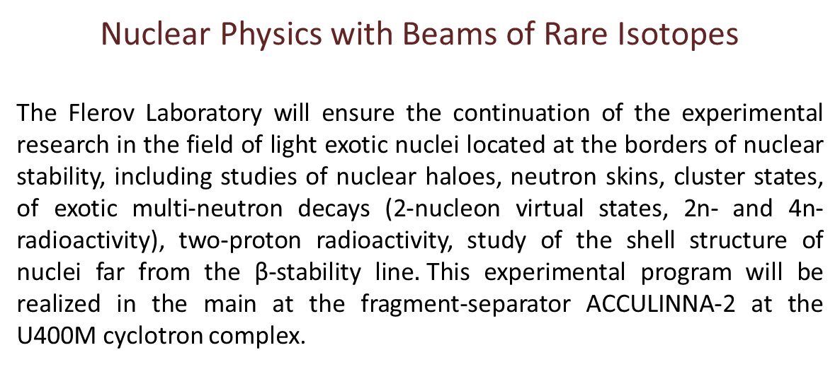
Session of the Committee of Plenipotentiaries
March 25 2021
Nuclear Physics with Beams of Rare Isotopes
The Flerov Laboratory will ensure the continuation of the experimental research in the field of light exotic nuclei located at the borders of nuclear stability, including studies of nuclear haloes, neutron skins, cluster states, of exotic multi-neutron decays (2-nucleon virtual states, 2n- and 4n-radioactivity), two-proton radioactivity, study of the shell structure of nuclei far from the β-stability line$.$This experimental program will be realized in the main at the fragment-separator ACCULINNA-2 at the U400M cyclotron complex.

Slide 4
Session of the Committee of Plenipotentiaries
March 25 2021
Innovations
Interlaboratory International Innovation Centre for Nuclear Physics research is planned to be established. The main tasks of the Centre are the development of technologies and methods in the field of nuclear and radiation medicine, radiation materials science, corresponding IT as well as advanced training of specialists from the JINR Member States.
Several new facilities will be built and set in operation in 2021 – 2026 in the frame of the Innovation Centre program:
DC-140 cyclotron for the development of technologies for radiation materials science and applied research with heavy-ion beams, electronic component testing, track pore membrane research and production;
40 MeV electron accelerator (Rhodotron) coupled with radiochemical laboratory Class-I for development of methods of radioisotope production in photonuclear reactions for nuclear medicine.

Slide 5
03-0-1129-2017/2021→2023
Development of the FLNR accelerator complex
and experimental setups (DRIBs-III)
Leaders: I.V. Kalagin, S.N. Dmitriev, S.I. Sidorchuk
Scientific leader: Yu.Ts. Oganessian
03-5-1130-2017/2021→2023
Synthesis and Properties of Superheavy Elements, Structure of Nuclei at the Limits of Nucleon Stability
Leaders: M.G. Itkis, S.I. Sidorchuk
Scientific leader: Yu.Ts. Oganessian

Slide 6
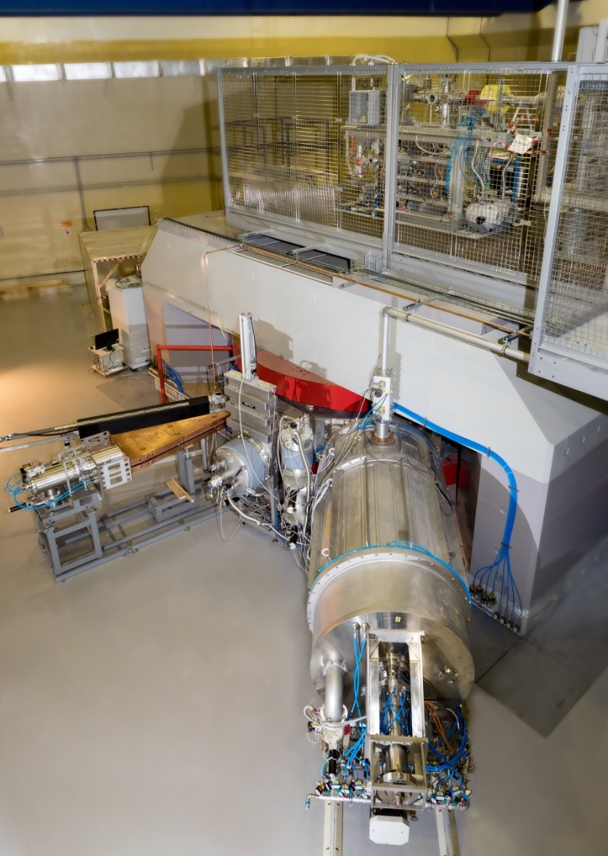
SHE Factory:
Put into operation in 2019. Experiments started in 2020
Goals for the period 2022 – 2023:
Increase in intensity of ⁴⁸Ca, ⁵⁰Ti, ⁵⁴Cr
beams accelerated at the DC-280 cyclotron;
Launch of the Flat-top system to improve the efficiency of beam acceleration;
Stable long-term operation.
Risks:
Limitation in intensity due to instability of chemical compounds of Ti&Cr.
Beam intensities extracted
from the DC-280 cyclotron
Ion | E_{ion} [Mev/nucl.] | I_{INJ} [pμA] | I_{EXTR} [pμA]
¹²C⁺² | 5.9 | 29,8 | 10
⁴⁰Ar⁺⁷ | 4.9 | 28.7 | 10.4
⁴⁸Ca⁺¹⁰ | 4.8 | 24 | 7.1
⁴⁸Ti⁺¹⁰ | 4.8 | 2.2 | 1
⁵²Cr⁺¹⁰ | 5.2 | 7 | 2.4
⁸⁴Kr⁺¹⁴ | 5.9 | 2.9 | 1.4

Slide 7
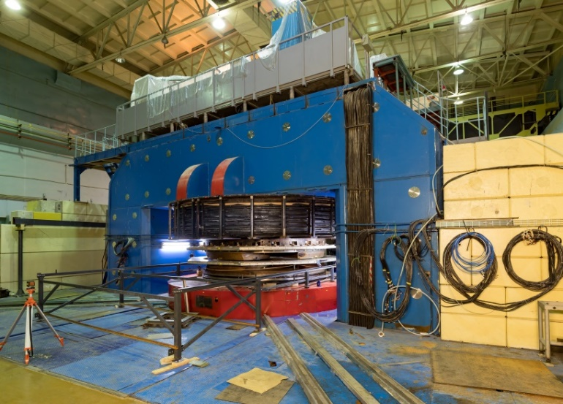
U400М: completion of modernization and launch (2022)
Ion | 2019 |  | 2022
 | E (MeV/u) | I(pμA) | E (MeV/u) planned | I(pμA) planned
⁷Li | 35 | 5 | 39 | 10
¹¹B | 30 | 3 | 33 | 6
¹⁵N | 47 | 0.5 | 51 | 2
¹⁸O | 36 | 0.5 | 40 | 1.5
²²Ne | 45 | 0.3 | 50 | 1
³⁶S | 40 | 0.2 | 44 | 0.2
⁴⁸Ca | 34 | - | 38 | 0.1
Start of Experiments
Replacement:
Damaged winding;
Vacuum system;
Control system;
Radiation safety system

Slide 8
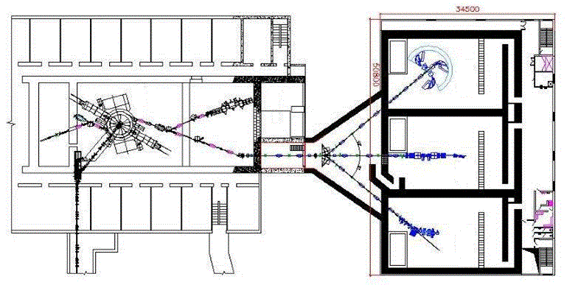
U400R ACCELERATOR COMPLEX:
reconstruction of the cyclotron; new building
The main goals:
Ensuring a smooth variation of energy;
Decrease of the energy spread to ΔE/E=10⁻³;
Improvement of the emittance to 10π mm⋅mrad;
Increase of the intensity of accelerated ions.
Threats:
Delay in permission from ROSATOM.
No. | Works | 2022 | 2023 |  | 2024 |  | 2025
1. | Equipment picking
2. | Dismantling U400
3. | Assembling U400R and tuning
4. | Construction of the new building
5. | Launch of U400R
Ion | Ion Energy, (MeV/nucleon) | Intensity of the extracted beam
⁴ He ¹⁺ | 6.4 - 27 | 23 рμА *
¹⁶ O ²⁺ | 1.6 - 8 | 19.5 рμА *
¹⁶ O ⁴⁺ | 6.4 - 27 | 5.8 рμА *
⁴⁰ Ar ⁴⁺ | 1 - 5.1 | 10 рμА
⁴⁸ Ca ⁶⁺ | 1.6 - 8 | 2.5 рμА
⁴⁸ Ca ⁷⁺ | 2.1 - 11 | 2.1 рμА
⁵⁰ Ti ¹⁰⁺ | 4.1 - 21 | 1 рμА
⁵⁸ Fe ⁷⁺ | 1.2 - 7.5 | 1 рμА
⁸⁴ Kr ⁷⁺ | 0.8 - 3.5 | 1.4 рμА
¹³² Xe ¹¹⁺ | 0.8 - 3.5 | 0.9 рμА
²³⁸ U ²⁷⁺ | 1.5 - 8 | 0.1 рμА

Slide 9
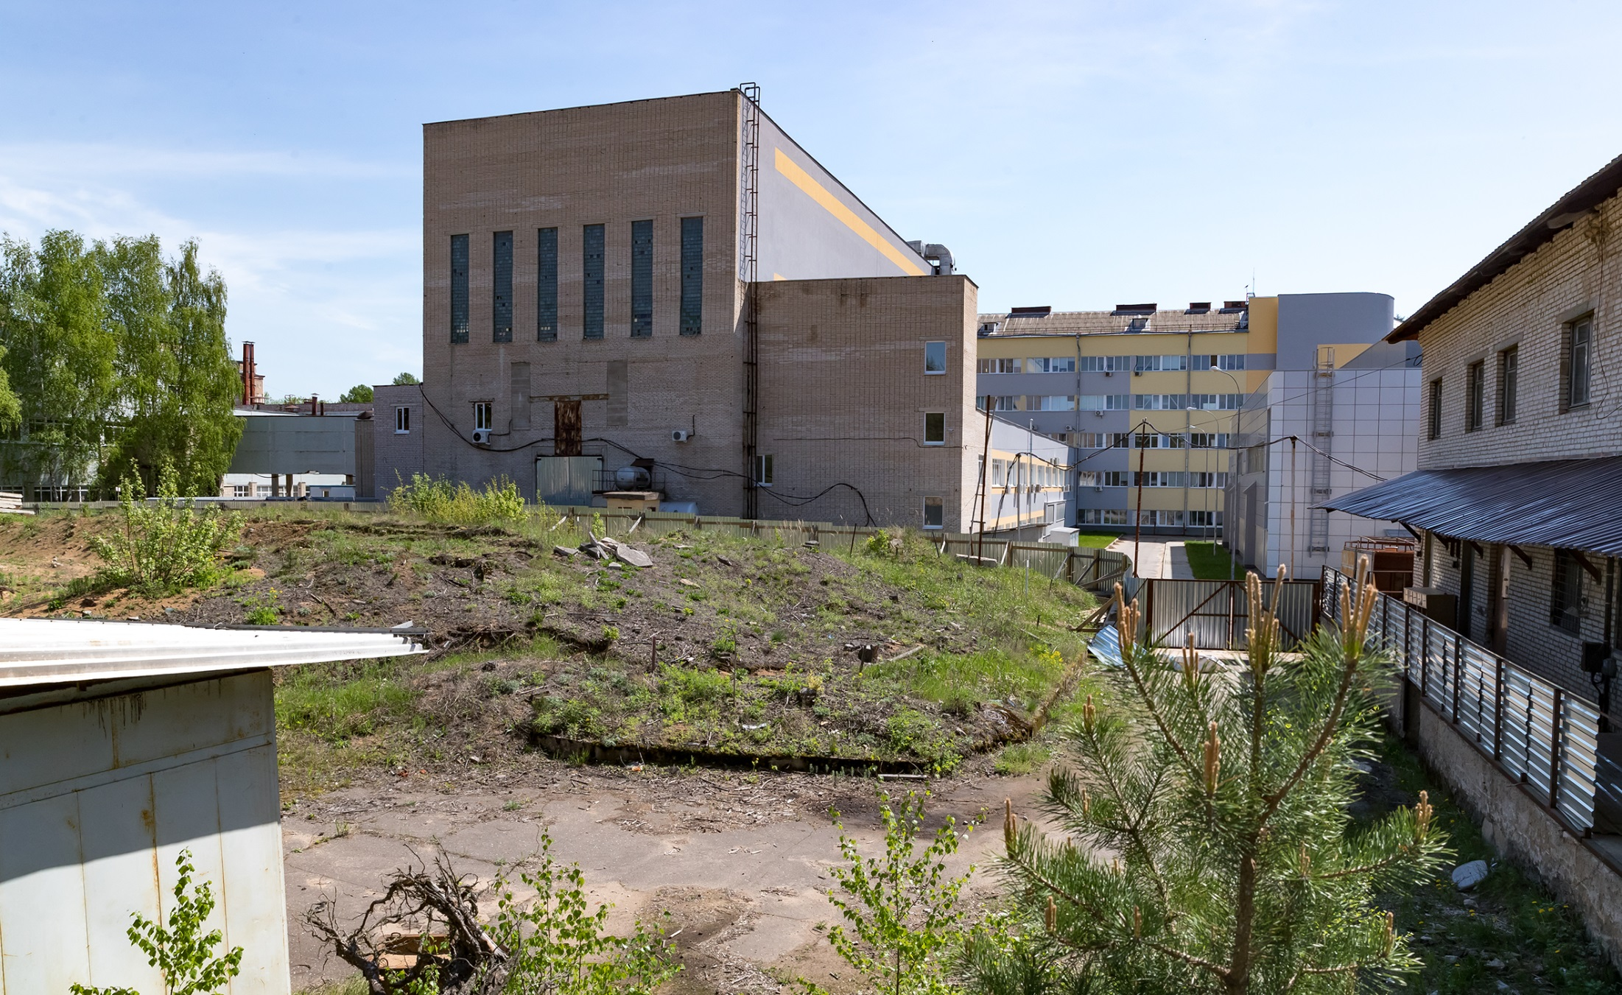
U400R: FUTURE CONSTRUCTION SITE
for the NEW BUILDING (2021-2024)
The project received a positive conclusion of GLAVGOSEXPERTIZA in 2021;
Permission of ROSATOM for construction is expected;
Start of construction in 2022.

Slide 10
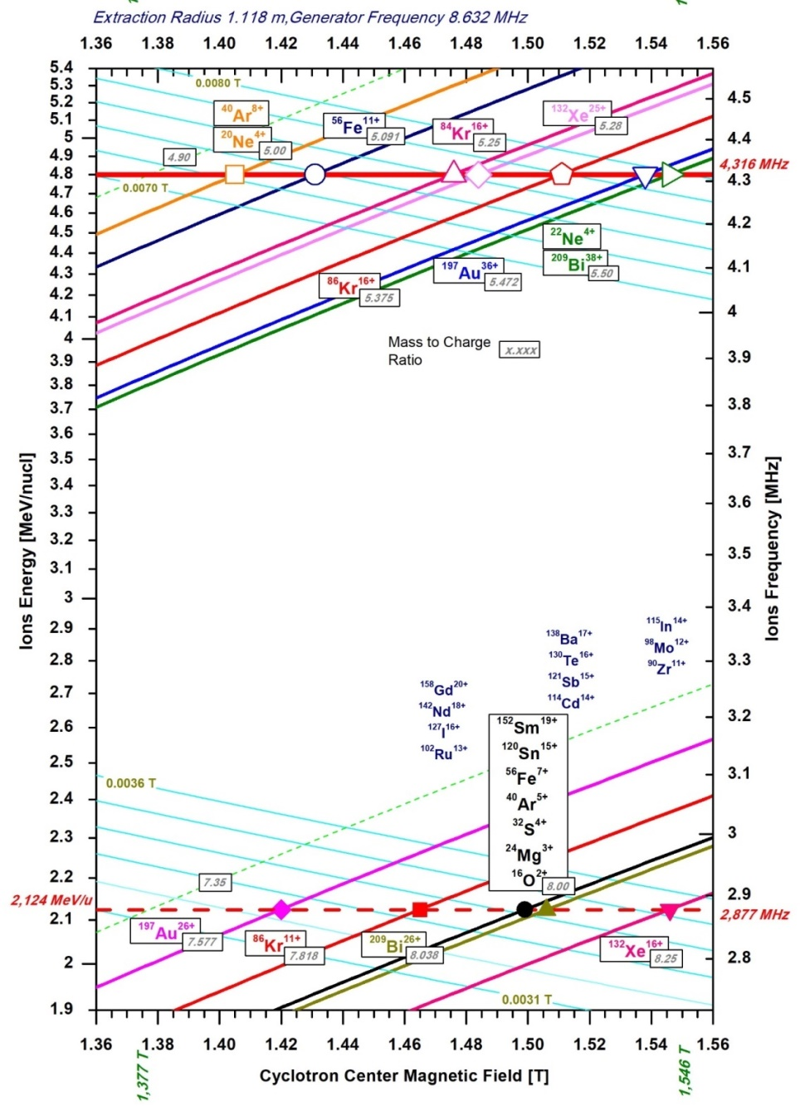
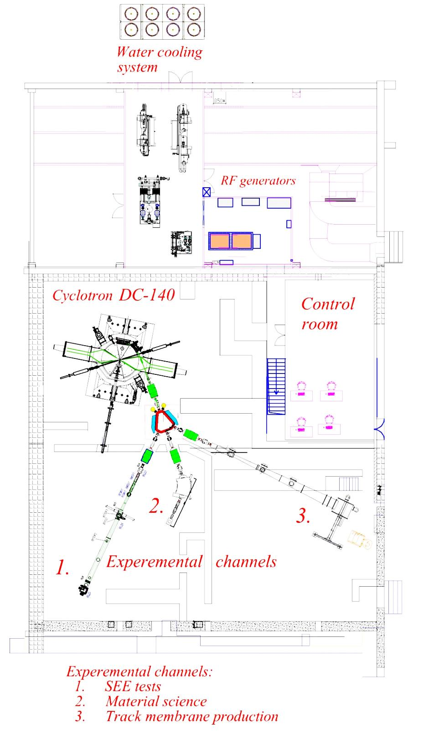
DC-140: heavy ion cyclotron
for applied studies (2020 -2023)
Ion beams from O to Bi with energies 4.8 and 2.1 MeV/n.
The main goals of the project include studies within solid state physics, surface modifications of materials, production of track membranes and testing of electronic components for single radiation effects
Threats:
Negative conclusion on the state of the building foundation.

Slide 11
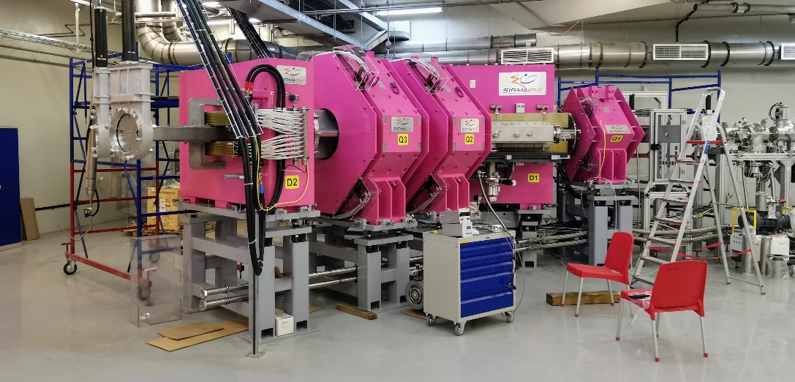
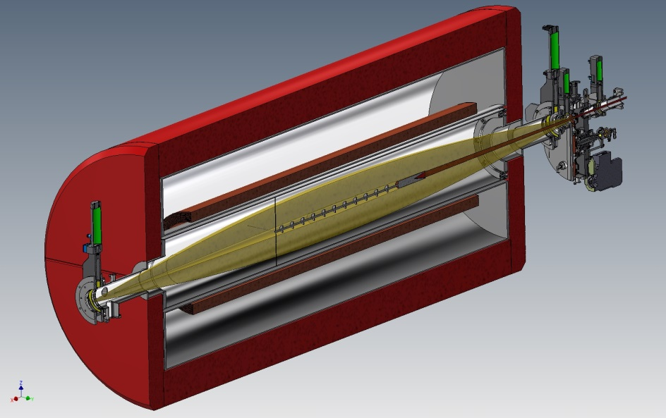
Design, construction, and launch of experimental facilities
DGFRS-III. Chemistry, spectroscopy, mass-spectrometry of SHE (2022)
Gas catcher+MR TOF specrometer. Mass-spectrometry of SHE (beyond 2023)
Solenoid-based separator. Chemistry of short-lived SHE (beyond 2023)

Slide 12
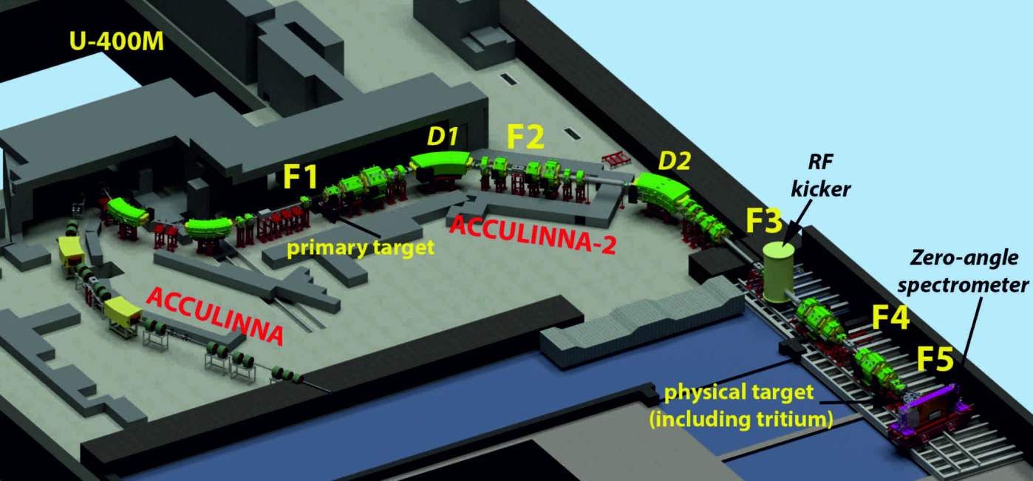
Design, construction and launch of experimental facilities
Experimental facilities at the fragment-separator
ACCLULINNA-II
Construction and launch of the tritium-target complex (2022).
Risks: no permission from FMBA ;
Beam test of the RF-kicker;
Development of detection systems:
Micro-strip silicon detectors;
Plastic scintillators and stilbene crystals to detect neutrons;
Active gas target – Time projection chamber (AGT-TPC).

Slide 13
Sketch of the experimental program
at the FLNR accelerators for 2022 – 2023
SHE Factory:
Experiments with beams of ⁵⁰Ti and ⁵⁴Cr actinide targets (DGFRS-II):
²⁴⁴Pu(⁵⁰Ti,3-4n)^{290,291}Lv,
²³⁸U(⁵⁴Cr,3-4n)^{288,289}Lv
to be compared ²⁴⁸Cm(⁴⁸Ca,3-4n)^{292,293}Lv;
²⁴³Am(⁵⁴Cr,3-4n)^{293,294}119;
²⁴⁸Cm(⁵⁴Cr,3-4n)^{298,299}120;
^{mix}Cf(⁵⁰Ti,3-4n)120;
Chemistry of SHE (DGFRS-III)
²⁴²Pu(⁴⁸Ca,3-4n)^{286,287}Fl.
Continuation of experiments on the synthesis of Fl&Mc and study of properties of decay products (DGFRS-II);
Threats:
Limitation in intensity due to instability
of chemical compounds of Ti&Cr;
Destruction of targets at high beam
intensity;
Delay in obtaining a license to work
with high radioactive materials.
Delay in delivery of Cf.

Slide 14
Sketch of the experimental program
at the FLNR accelerators for 2022 – 2023
U400:
Multi-nucleon transfer (SHELS-CORSET):
²³⁸U+²³⁸U→²⁰⁸Pb+²⁶⁸No*;
Deep inelastic transfers and quasifission (CORSET);
Spectroscopy of isotopes of transfermium elements (SHELS)
²²Ne + ²³⁸U,^{242,244}Pu;
Test chemistry of light homologue of Nh - Tl
¹⁴¹Pr(⁴⁶Ti, 3n)¹⁸⁴Tl .
U400M:
One more approach to ⁷H (ACCULINNA-II):
⁸He+²H→⁷H+³He;
Test run with neutron deficient ²⁷S;
Risks:
Low intensity of U beam extracted from the cyclotron.
Risks:
Delay in the launch of U400M;
No compelling suggestions to increase 7H statistics.

Slide 15
Financing and implementation schedule for the
DRIBs-III project for 2017 – 2023 (k$)
with amendments approved by the Committee of Plenipotentiaries
On March 25, 2021
SHE Factory
 | 2017 | 2018 | 2019 | 2020 | 2021 | 2022 | 2023 | Total
Exp. Building | 2800 | 1285 | 45 | 5 | 0 | 0 | 0 | 4135
DC280 | 1230 | 140 | 450 | 255 | 0 | 0 | 0 | 2075
New facilities | 3440 | 1450 | 1060 | 2370 | 2420 | 2100 | 1400 | 14240
22 pers.
U400R accelerator complex
Assembly hall | 90 | 455 | 460 | 1460 | 720 | 0 | 0 | 3185
New U400R exp. caves | 10 | 240 | 65 | 320 | 1550 | 3400 | 2700 | 8285
U400 → U400R | 0 | 0 | 0 | 410 | 140 | 2200 | 2000 | 4750
19 pers.
U400M
Modernization У400М | 2240 | 1820 | 1760 | 1500 | 1550 | 250 | 0 | 9120
41 pers.
DC140
42 pers.
DC140 | 0 | 0 | 0 | 0 | 2500 | 2600 | 1900 | 7000
1st class RCC project
RCC | 0 | 0 | 0 | 0 | 200 | 500 | 500 | 1200
5 pers.
Facilities
Separators, detectors | 3290 | 3320 | 3100 | 2930 | 2260 | 1350 | 2370 | 18620
115 pers.
Experiment support
Experimenting | 2990 | 2850 | 2900 | 1390 | 2750 | 2600 | 2200 | 17680
Total | 16090 | 11560 | 9840 | 10640 | 14090 | 15000 | 13070 | 90290

Slide 16
Outlook beyond 2023
RADIOCHEMICAL LABORATORY of CLASS I
The laboratory is intended to handling and processing of very radioactive materials, in particular:
Manufacturing and regeneration of actinide targets for the SHE research;
Development of new technologies for production of radioisotopes and their extraction from irradiated targets for scientific, radioecological, medical and other applications;
Other possible directions are being considered.
Conceptual design is planned to be completed by the beginning of the next 7-year period (2024-2030).
PHYSICAL TASKS AND NEW EXPERIMENTAL FACILITIES
Mass-spectrometry, spectroscopy, chemistry of SHE, MNT reactions, cryogenic tritium target
THREE SCIENTIFIC THEMES
Heavy and Super-heavy nuclei;
Light nuclei at the drip-lines;
Reaction mechanisms.
REVISION OF THE OF THE STRUCTURE OF THE LABORATORY
Three themes → three departments

Slide 17
Project closure proposal
Construction of a prototype of the initial section of a high-current heavy-ion linear accelerator
(2020 – 2021)
Project within the theme (03-0-1129-2017/2021)
Leader: L.V. Grigorenko

Slide 18
THANK YOU!

Slide 19
50th meeting of the PAC for Nuclear physics, June 24 2019
Recommendation. The PAC recommends the opening of the project “Construction of a prototype of the initial section of a high-current heavy-ion linear accelerator aimed at producing intense radioactive ion beams for basic research” under the theme “Development of the FLNR Accelerator Complex and Experimental Setups (DRIBS-III)” for the two-year period 2020–2021. The PAC is convinced that the full accomplishment of the project would require its extension beyond this period. This work should be supported both in terms of manpower and financial resources, but so that the just starting programmes on research of superheavy elements at the new SHE Factory are not perturbed. At the same time, the PAC recommends elaborating a more detailed work schedule for the development of the facility by determining the stages, their goals and the required resources.

Slide 20
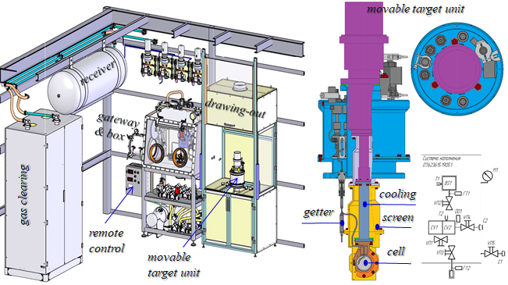
Cryogenic Tritium Target (2023)

Slide 21
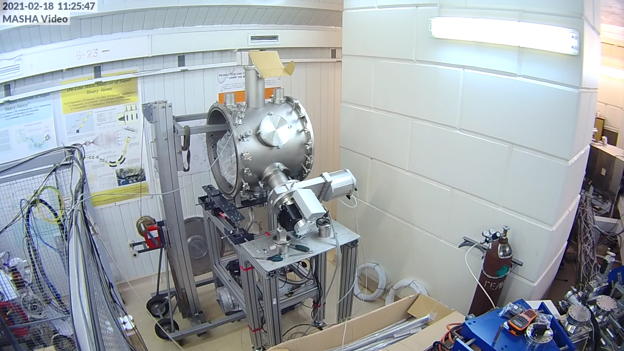
Gas Catcher (2023)

Slide 22
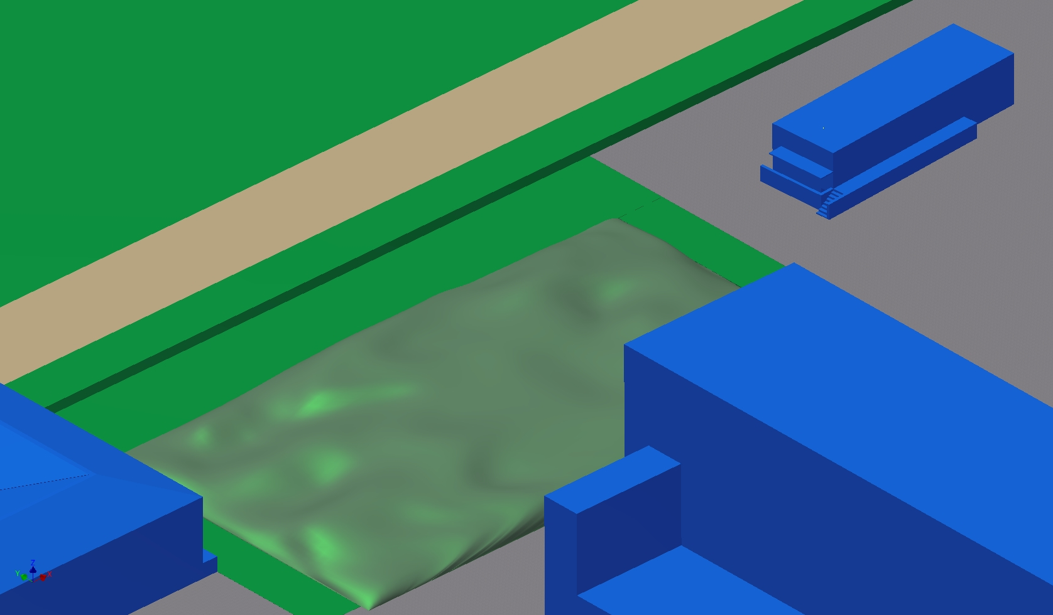
НОВЫЙ ЭКСПЕРИМЕНТАЛЬНЫЙ ЗАЛ УСКОРИТЕЛЯ У400R
СКЛАД
ЗДАНИЕ УСКОРИТЕЛЯ
У400R
СКЛАД

Slide 23
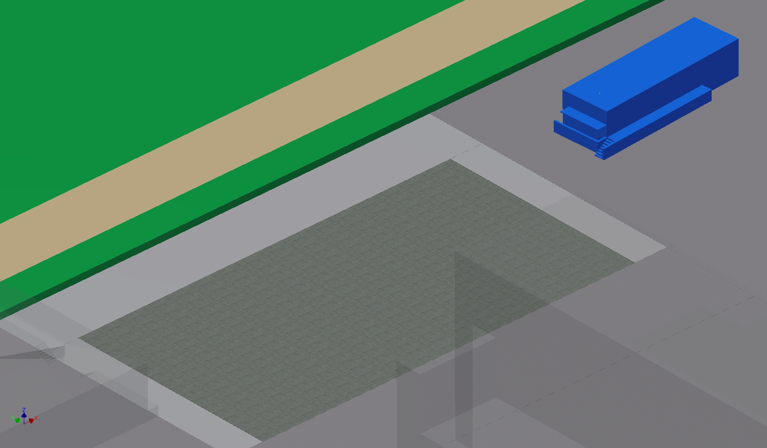
НОВЫЙ ЭКСПЕРИМЕНТАЛЬНЫЙ ЗАЛ УСКОРИТЕЛЯ У400R
СКЛАД
ЗДАНИЕ УСКОРИТЕЛЯ
У400R
СКЛАД

Slide 24
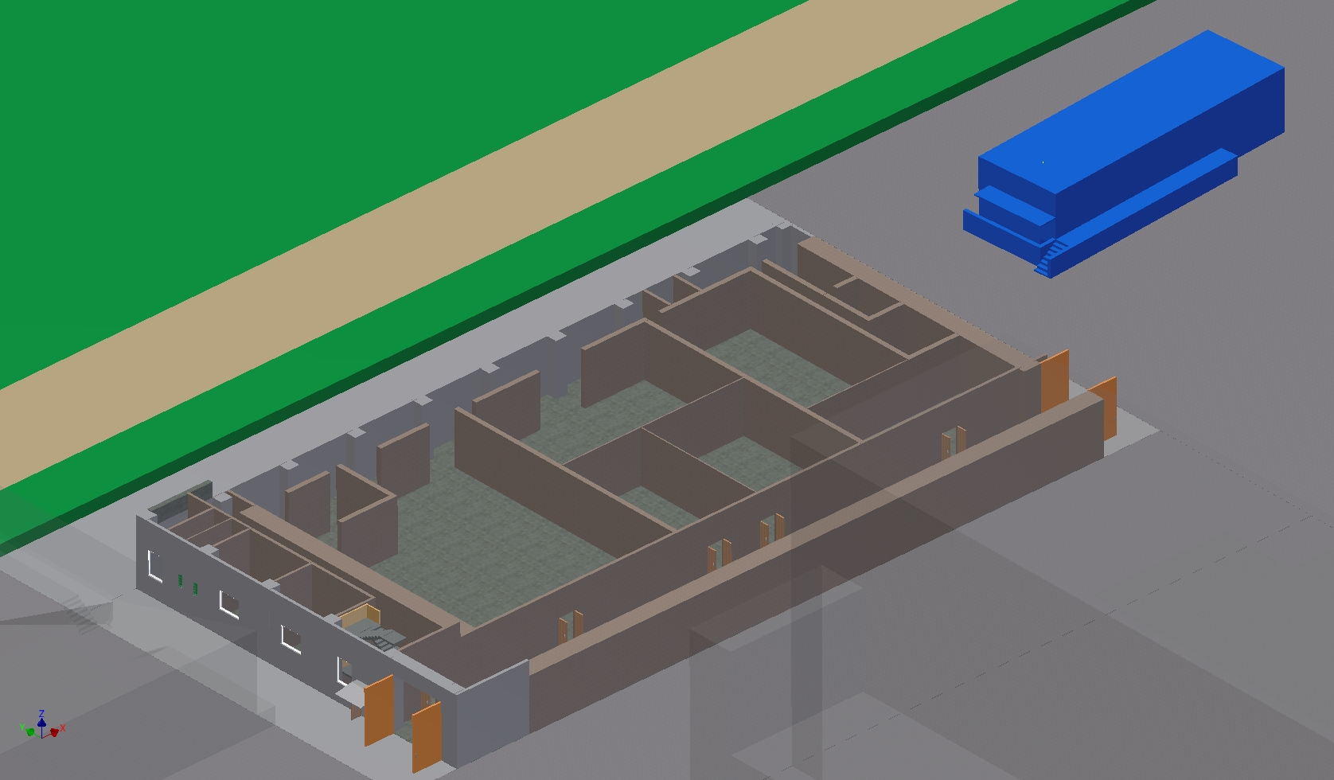
НОВЫЙ ЭКСПЕРИМЕНТАЛЬНЫЙ ЗАЛ УСКОРИТЕЛЯ У400R
СКЛАД
ЗДАНИЕ УСКОРИТЕЛЯ
У400R
СКЛАД

Slide 25
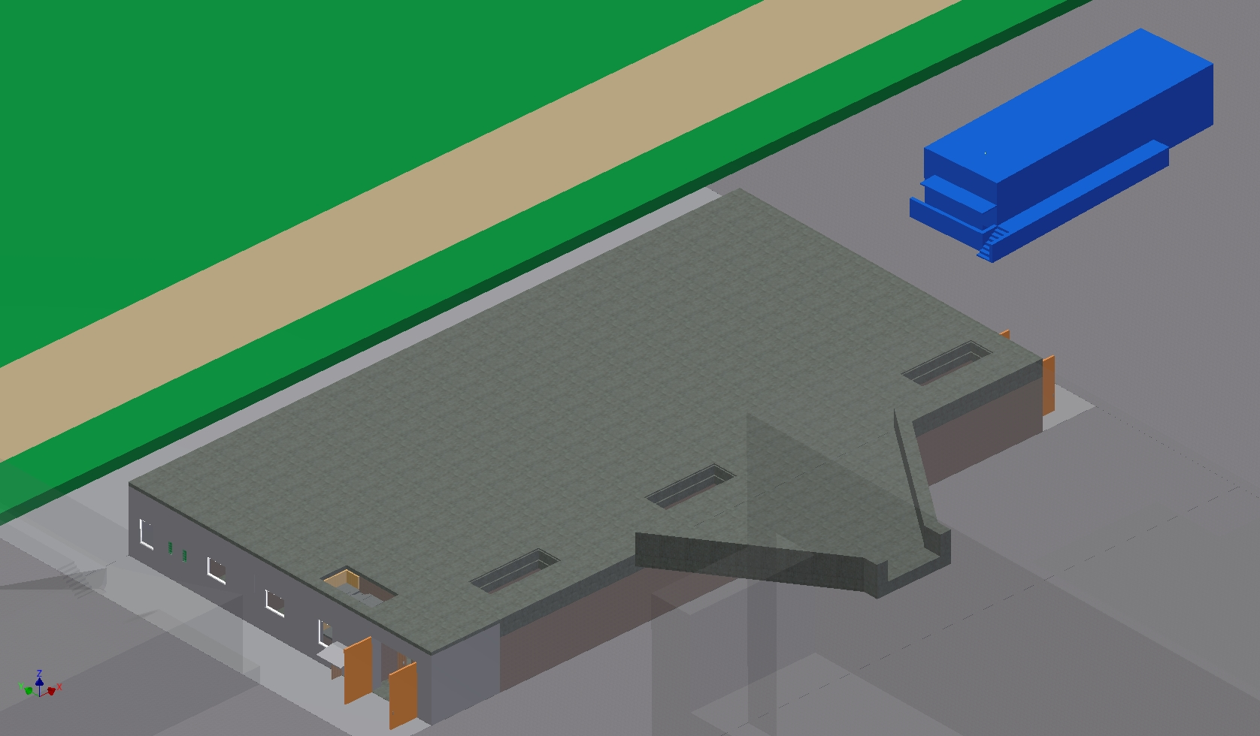
НОВЫЙ ЭКСПЕРИМЕНТАЛЬНЫЙ ЗАЛ УСКОРИТЕЛЯ У400R
СКЛАД
ЗДАНИЕ УСКОРИТЕЛЯ
У400R
СКЛАД

Slide 26
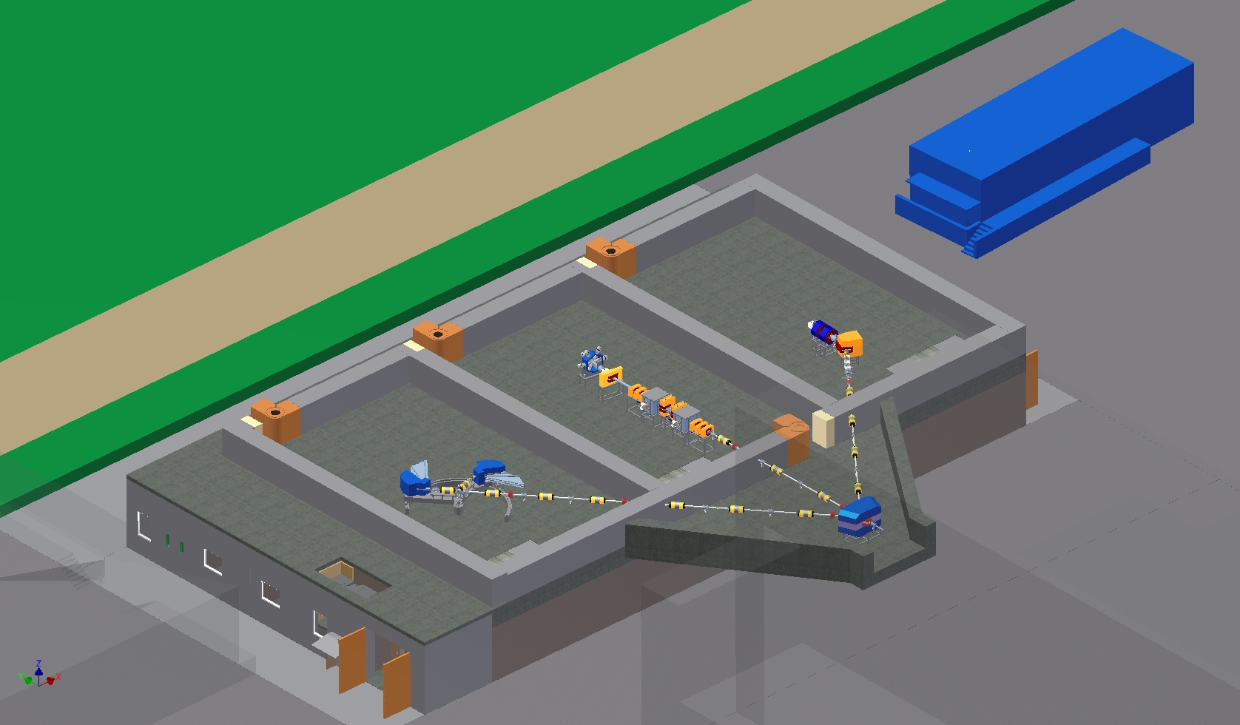
НОВЫЙ ЭКСПЕРИМЕНТАЛЬНЫЙ ЗАЛ УСКОРИТЕЛЯ У400R
СКЛАД
ЗДАНИЕ УСКОРИТЕЛЯ
У400R
СКЛАД

Slide 27
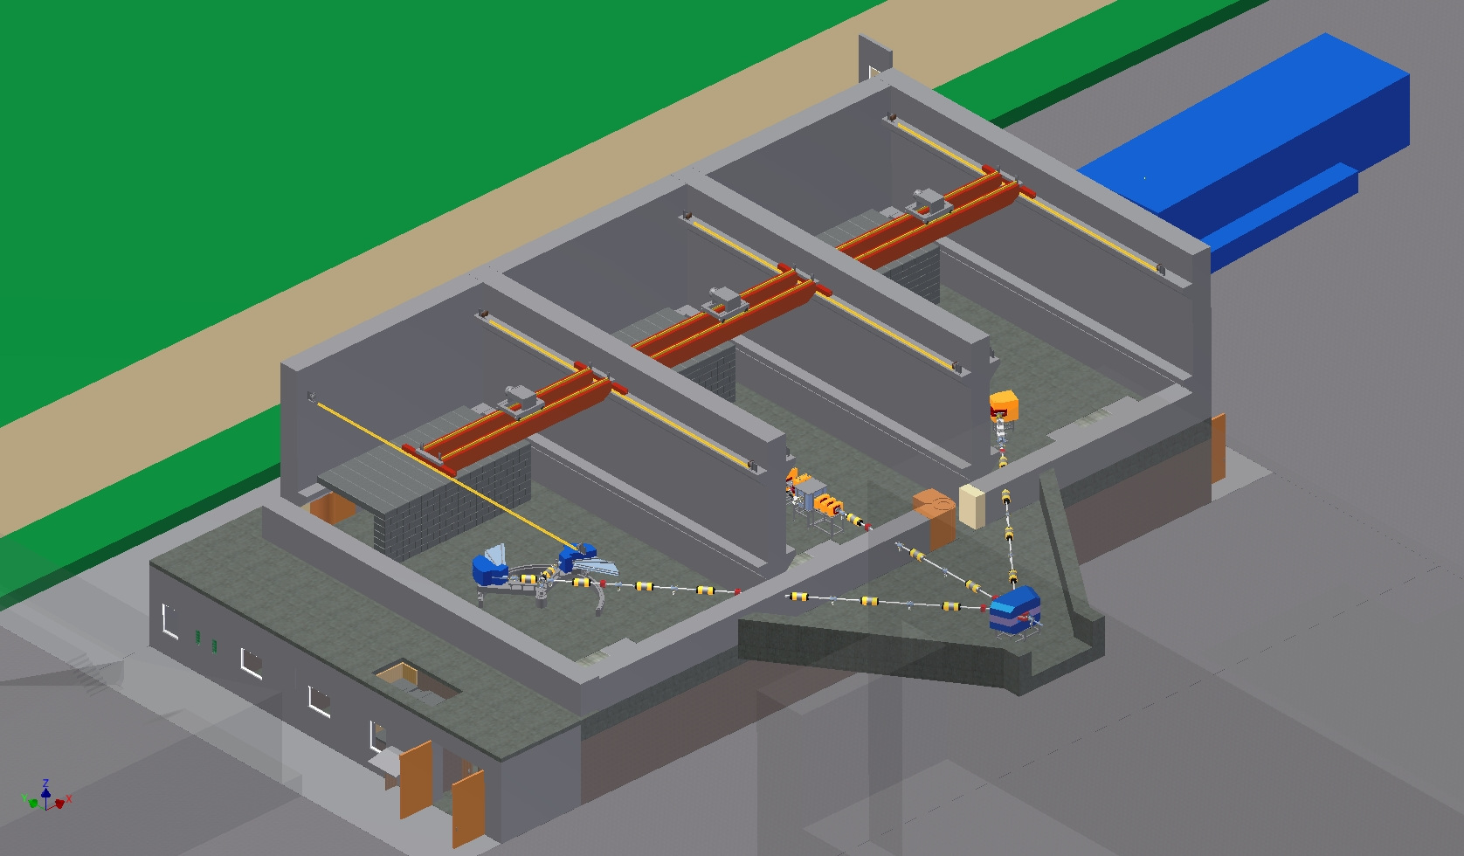
НОВЫЙ ЭКСПЕРИМЕНТАЛЬНЫЙ ЗАЛ УСКОРИТЕЛЯ У400R
СКЛАД
ЗДАНИЕ УСКОРИТЕЛЯ
У400R
СКЛАД

Slide 28
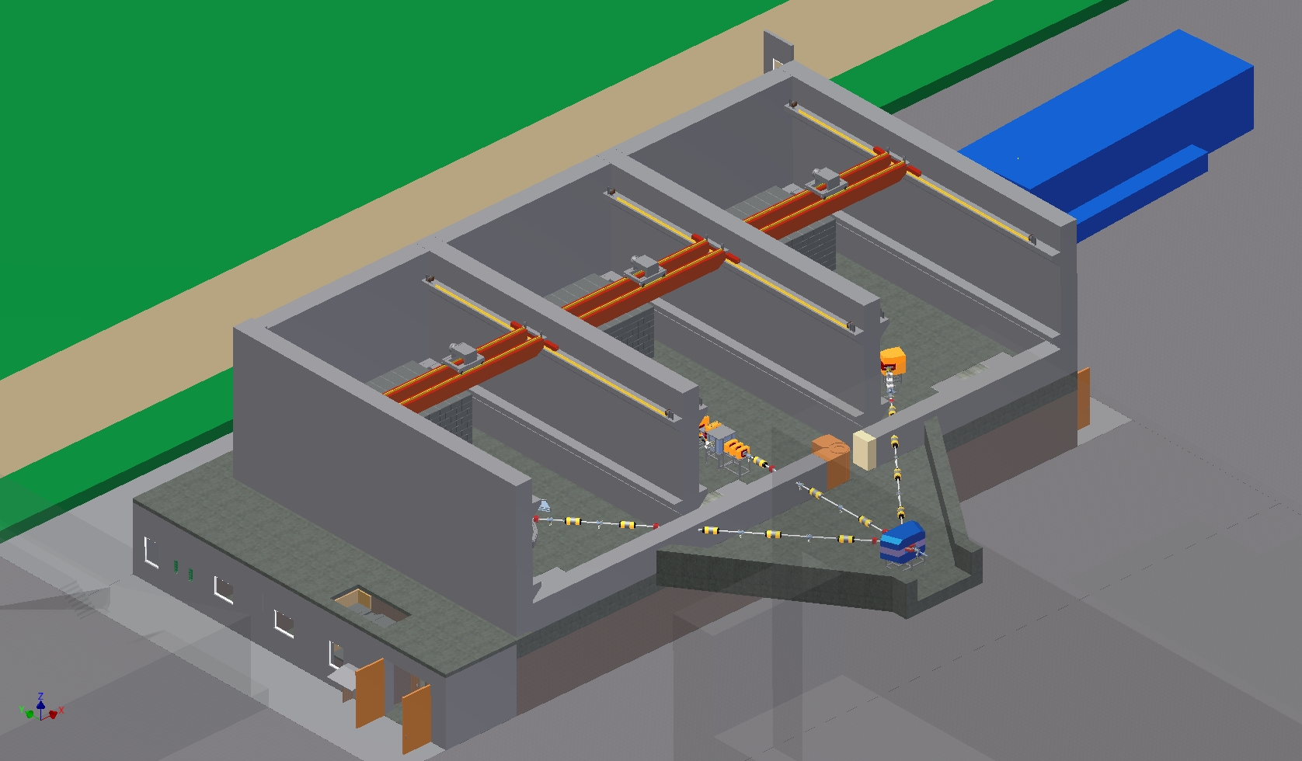
НОВЫЙ ЭКСПЕРИМЕНТАЛЬНЫЙ ЗАЛ УСКОРИТЕЛЯ У400R
СКЛАД
ЗДАНИЕ УСКОРИТЕЛЯ
У400R
СКЛАД

Slide 29
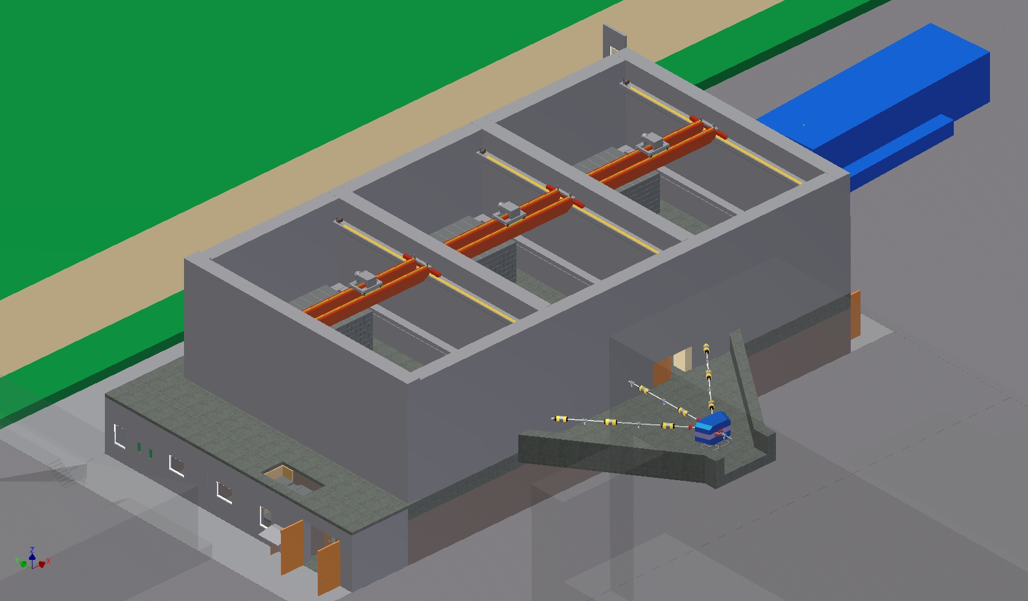
НОВЫЙ ЭКСПЕРИМЕНТАЛЬНЫЙ ЗАЛ УСКОРИТЕЛЯ У400R
СКЛАД
ЗДАНИЕ УСКОРИТЕЛЯ
У400R
СКЛАД

Slide 30
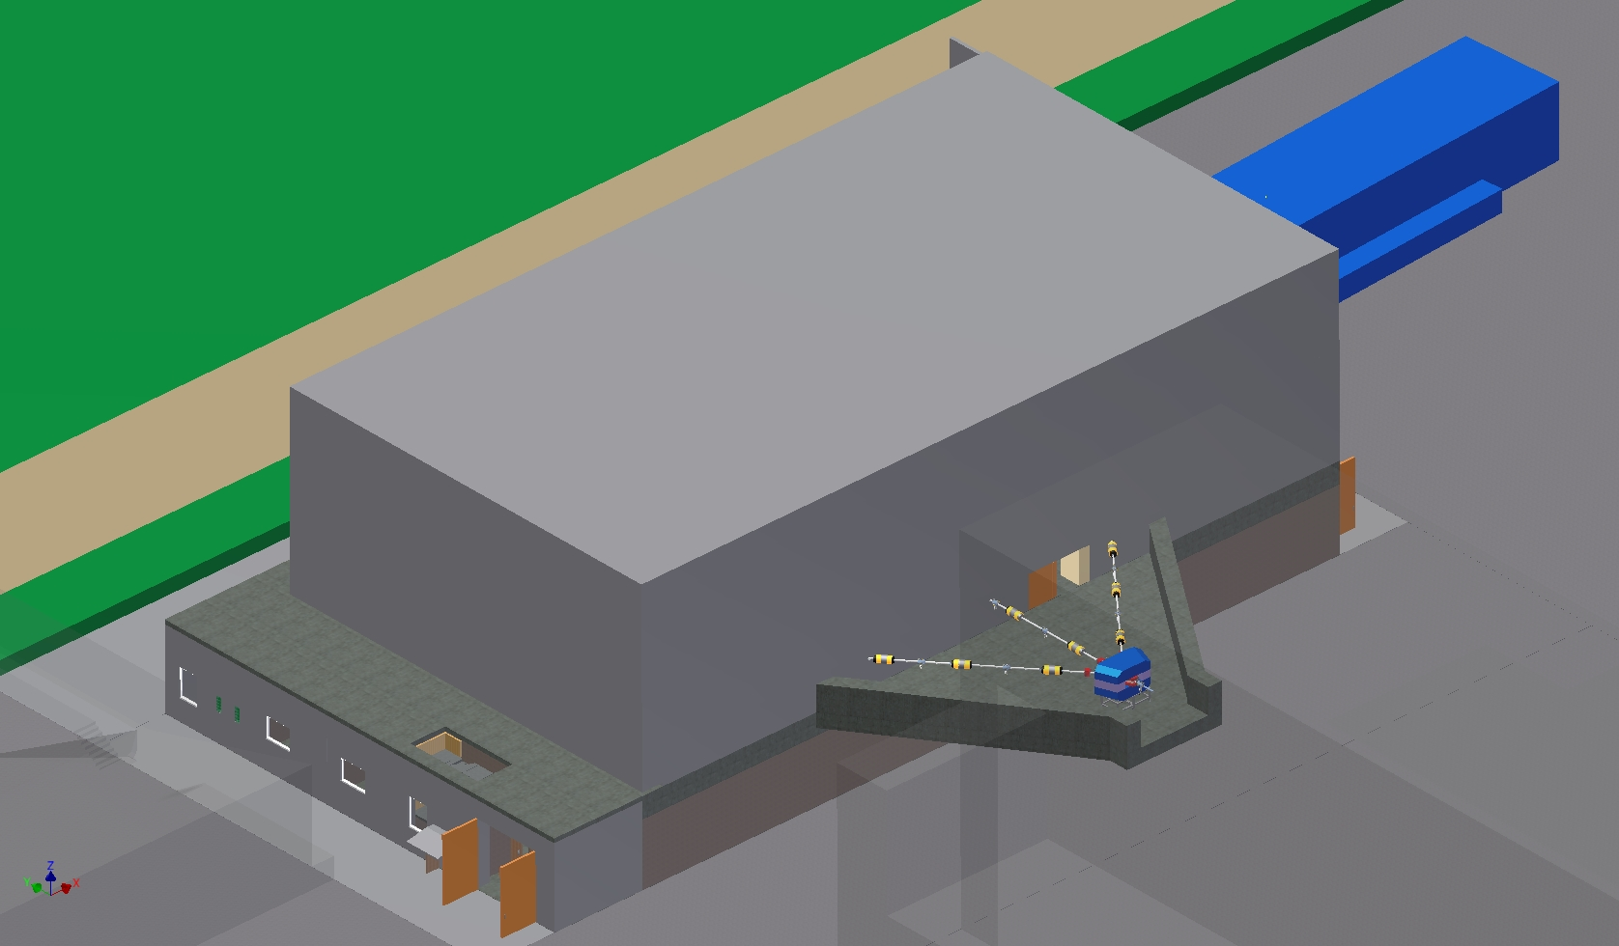
НОВЫЙ ЭКСПЕРИМЕНТАЛЬНЫЙ ЗАЛ УСКОРИТЕЛЯ У400R
СКЛАД
ЗДАНИЕ УСКОРИТЕЛЯ
У400R
СКЛАД

Slide 31
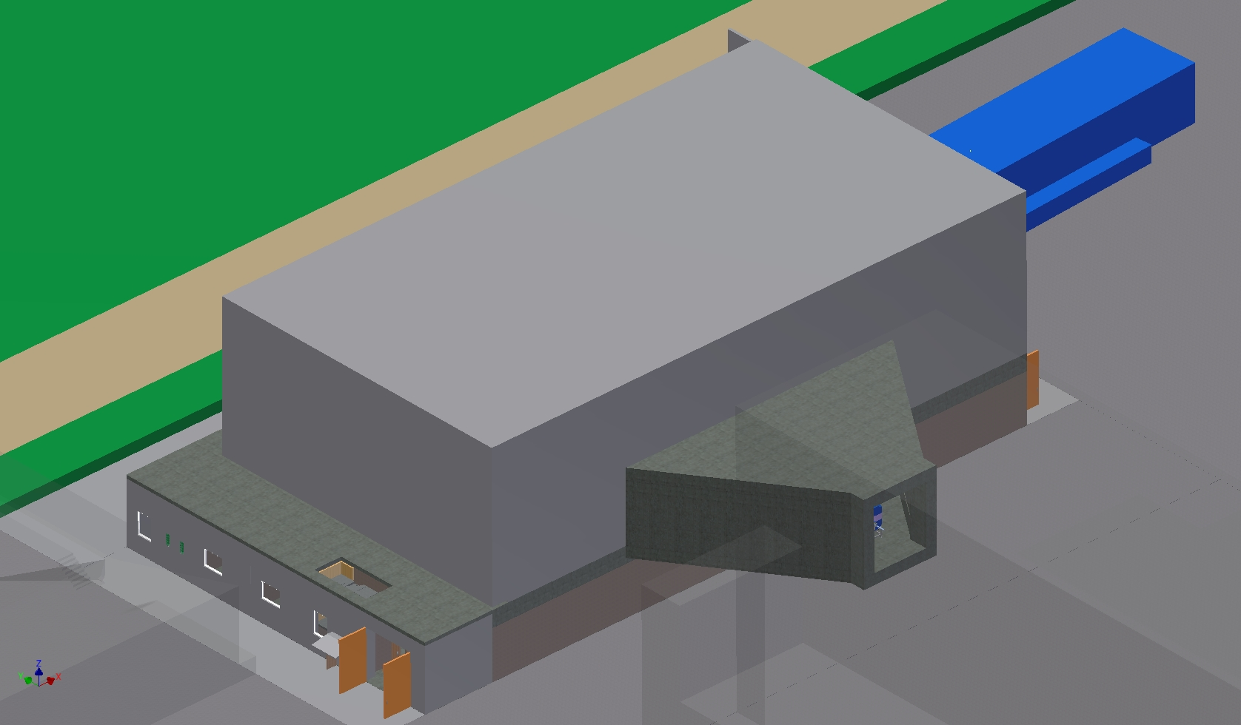
НОВЫЙ ЭКСПЕРИМЕНТАЛЬНЫЙ ЗАЛ УСКОРИТЕЛЯ У400R
СКЛАД
ЗДАНИЕ УСКОРИТЕЛЯ
У400R
СКЛАД

Slide 32
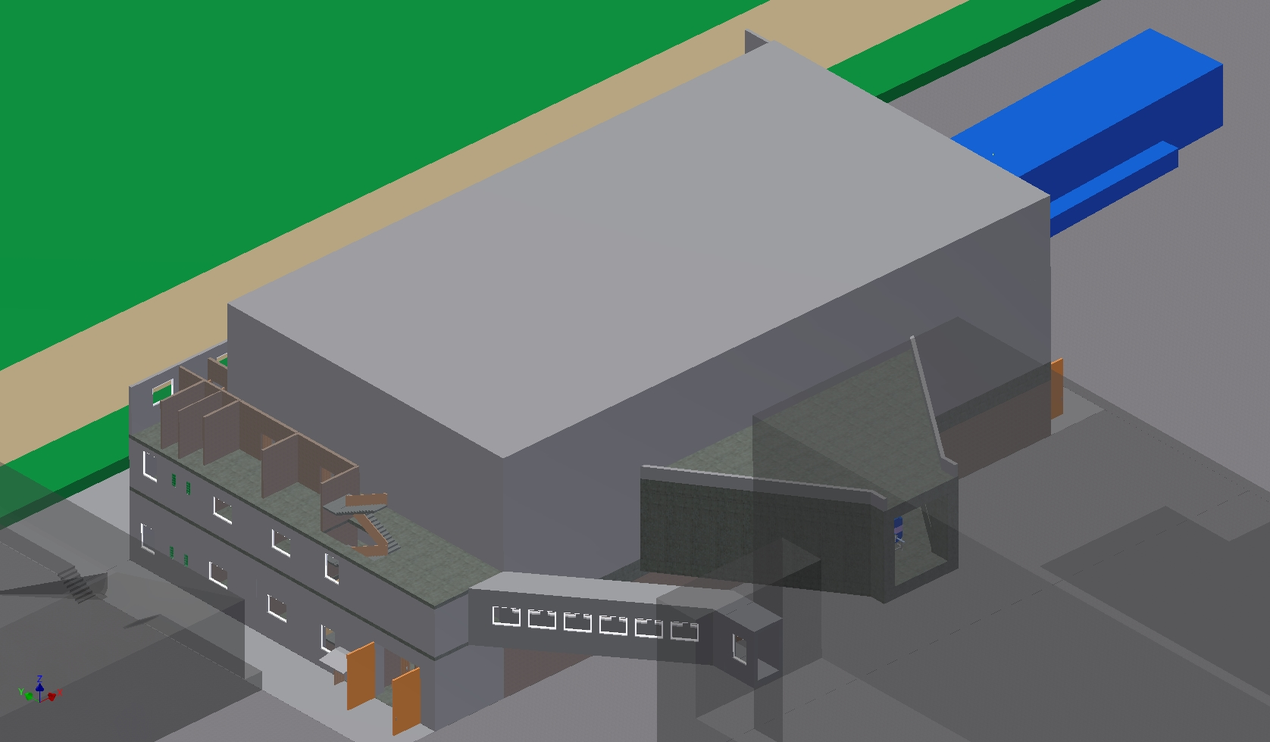
НОВЫЙ ЭКСПЕРИМЕНТАЛЬНЫЙ ЗАЛ УСКОРИТЕЛЯ У400R
СКЛАД
ЗДАНИЕ УСКОРИТЕЛЯ
У400R
СКЛАД

Slide 33
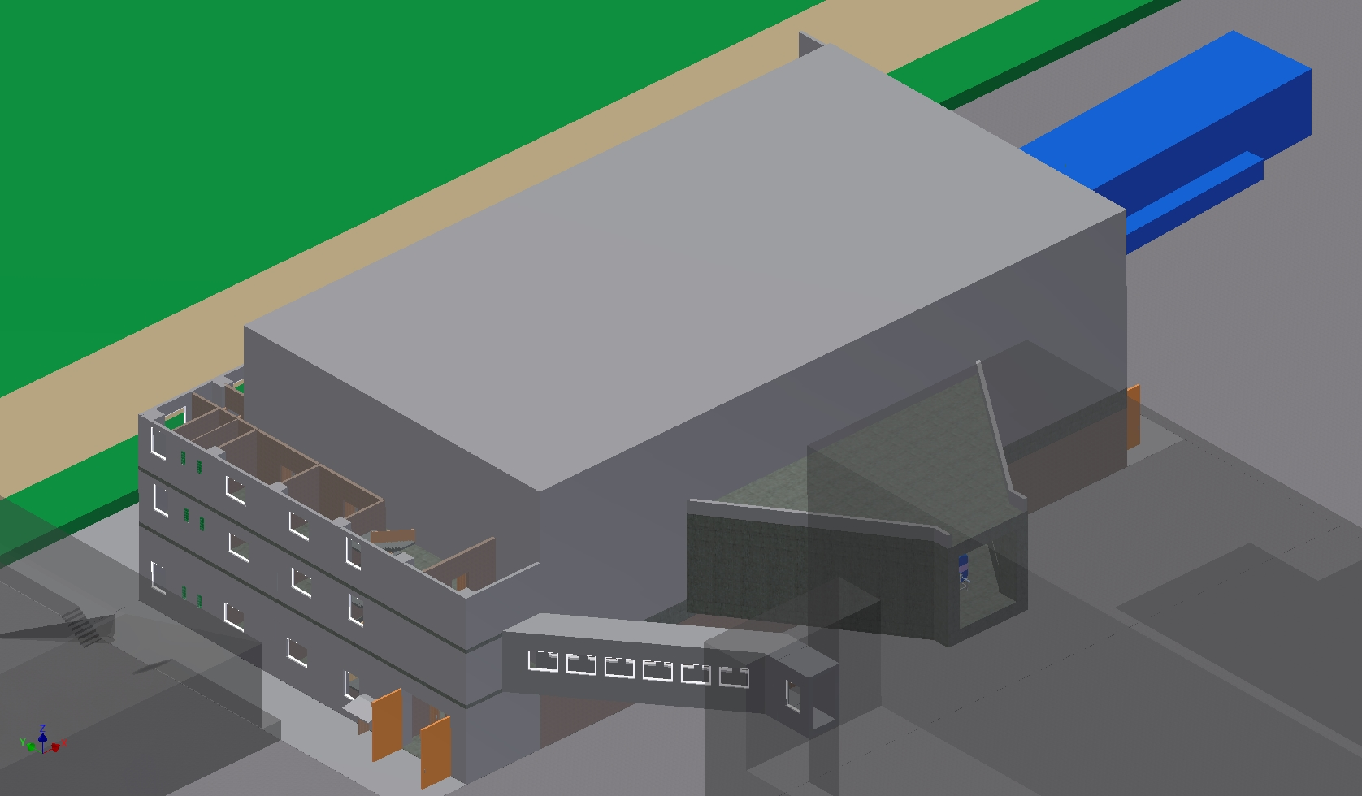
НОВЫЙ ЭКСПЕРИМЕНТАЛЬНЫЙ ЗАЛ УСКОРИТЕЛЯ У400R
СКЛАД
ЗДАНИЕ УСКОРИТЕЛЯ
У400R
СКЛАД

Slide 34
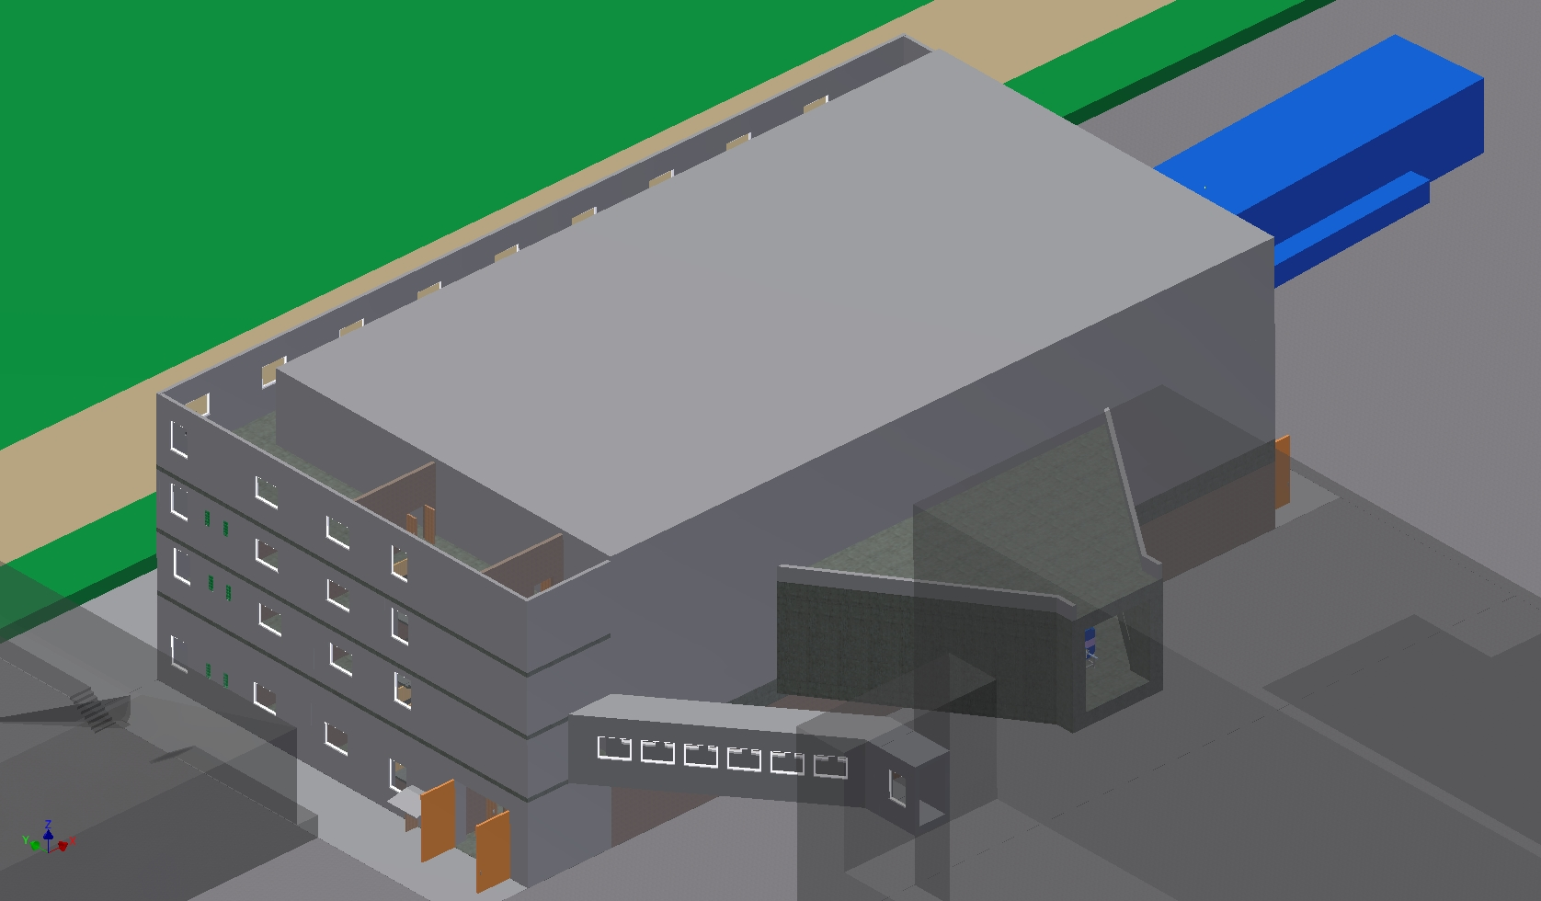
НОВЫЙ ЭКСПЕРИМЕНТАЛЬНЫЙ ЗАЛ УСКОРИТЕЛЯ У400R
СКЛАД
ЗДАНИЕ УСКОРИТЕЛЯ
У400R
СКЛАД

Slide 35
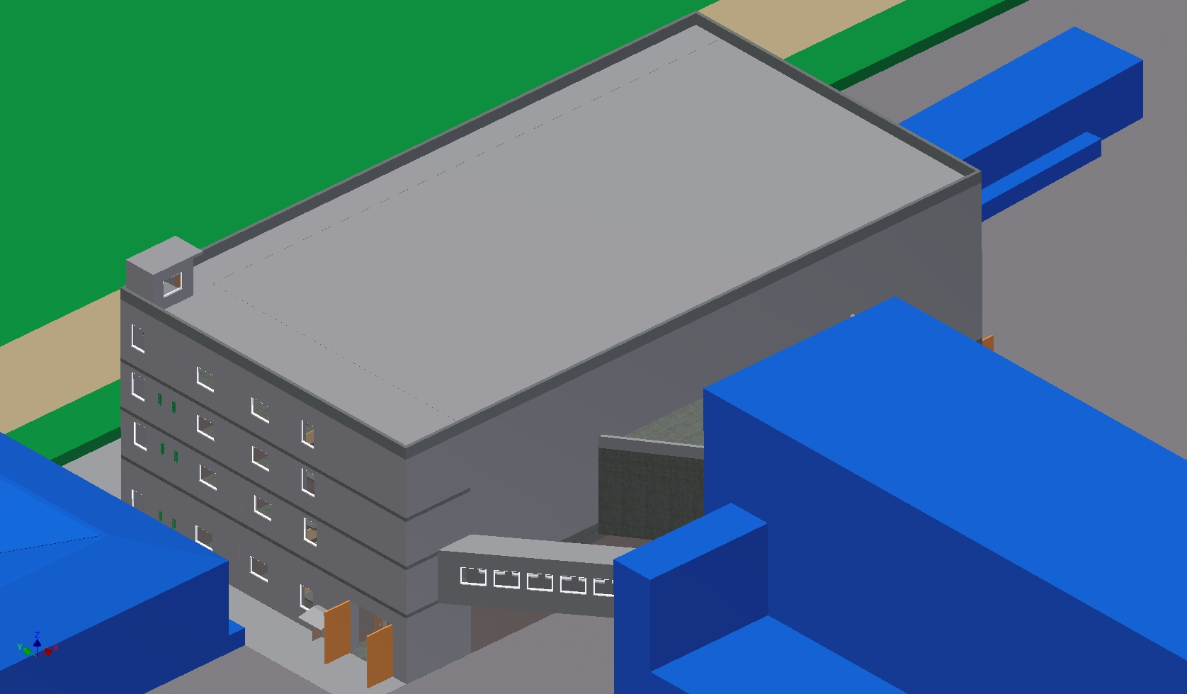
НОВЫЙ ЭКСПЕРИМЕНТАЛЬНЫЙ ЗАЛ УСКОРИТЕЛЯ У400R
СКЛАД
ЗДАНИЕ УСКОРИТЕЛЯ
У400R
СКЛАД

Slide 36
Parameters of U400R
Name | U-400 | U-400R
Magnet weight | 2100 t. | 2100 t.
The power supply of the main magnet | 850 kW | 200 kW
The magnetic field level | 1.93 - 2.1 Tesla | 0.8 - 1.8 Tesla
The angular length of the sector at the final radius | 42° | 42°
The gap between the sectors at the final radius | 45 mm | 45 mm
The gap between the poles in the valley | 300 mm | 300 mm
Number of dees | 2 | 2
Voltage on the dees | 80 kV | 80 kV
The range of accelerated A/Z | 5 - 12 | 4 - 12
The range of acceleration frequencies | 5.42 - 12.2 MHz | 5.42 - 12.2 MHz
Accelerating field harmonics | 2 | 2÷6
The final acceleration radius | 1.72 m | 1.8 m
The energy factor K | 305 - 650 | 100 - 506
The working vacuum | (1-5)⋅10⁻⁷ Torr | (1-2)⋅10⁻⁷ Torr
Beam extraction | Charge exchange | Charge exchange and/or electrostatic deflector
Number of extraction lines | 2 | 2

