Slide 1
Development of high resolution TOF system
  Wang Yi
Department of Engineering Physics, Tsinghua University

Slide 3
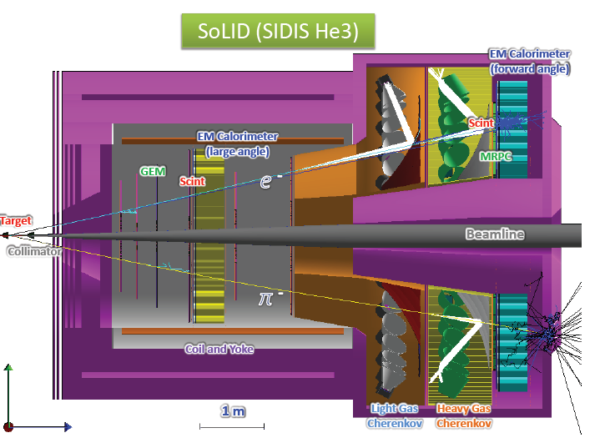
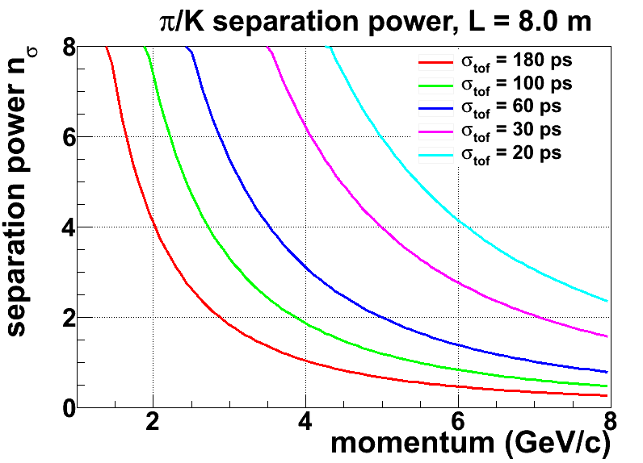
Main requirements for SoLID-TOF
The MRPC is developed for the TOF of SoLID
Main Requirements for TOF:
  π/k separation up to 7GeV/c & 3 σ
  Time resolution < 20ps
  Rate capability : 20kHz/cm²
20ps

Slide 4
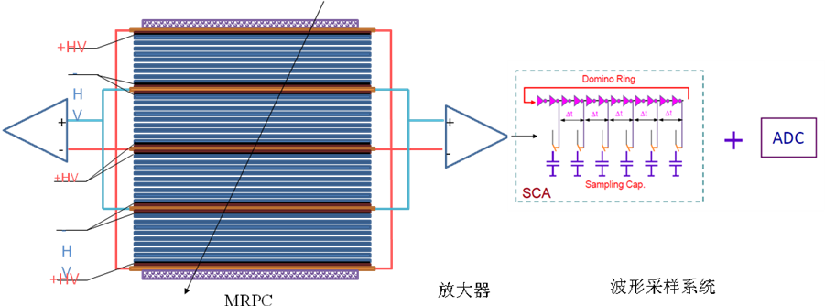
Time requirement for MRPC and electronics
σ_{TOF} <20 ps， the intrinsic resolution of narrow gaps MRPC is around 15ps，so the time jitter of readout electronics <13~15 ps。
4

Slide 5
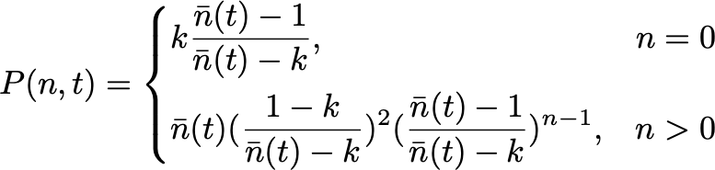

Intrinsic time resolution of standard MRPC
Electron multiplication
Time resolution:

Slide 6
Intrinsic time resolution vs. gap number
When avalanche strength~28
The thinner gas gap, the better time resolution
The time will not be improved when gap number > 20
For time resolution <10ps. The width of gas gap should less than 160 μm

Slide 7
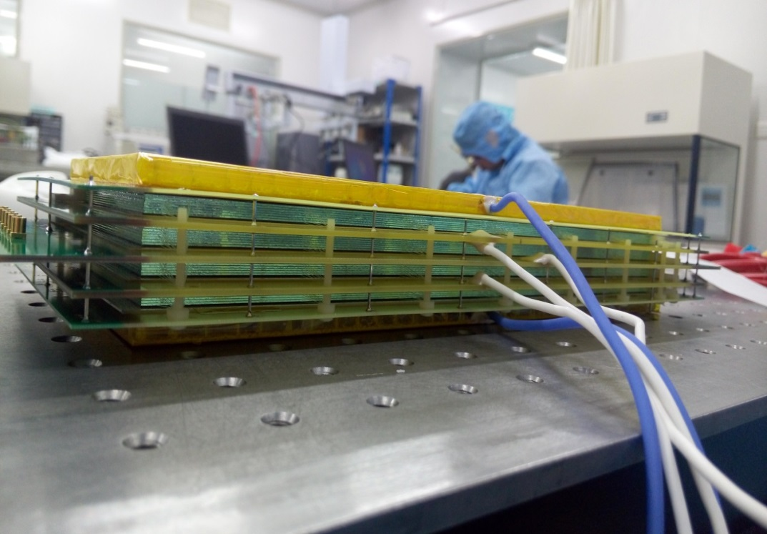
Prototype design
 | 1st MRPC | 2nd MRPC | 3nd MRPC
Width of gas gap (μm) | 250 | 104 | 128
Number of gap | 6 | 4 x 8 = 32 | 4 x 8 =32
Electrode | Float glass | Float glass | Low resistive glass
Glass thickness (μm) | 700 | 500 | 400
Readout strip | 7 mm +3 mm | 7 mm + 3mm | 5mm + 2mm
Close to real prototype !

Slide 8
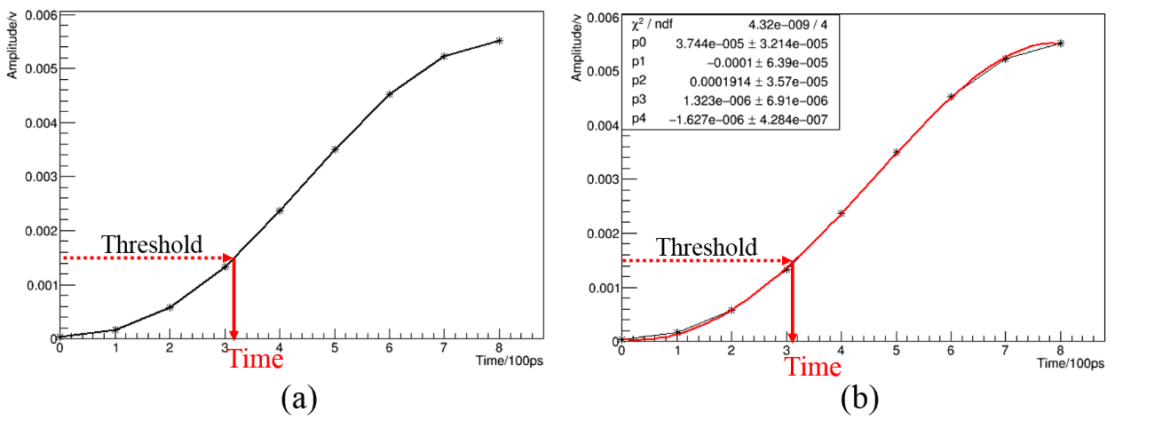
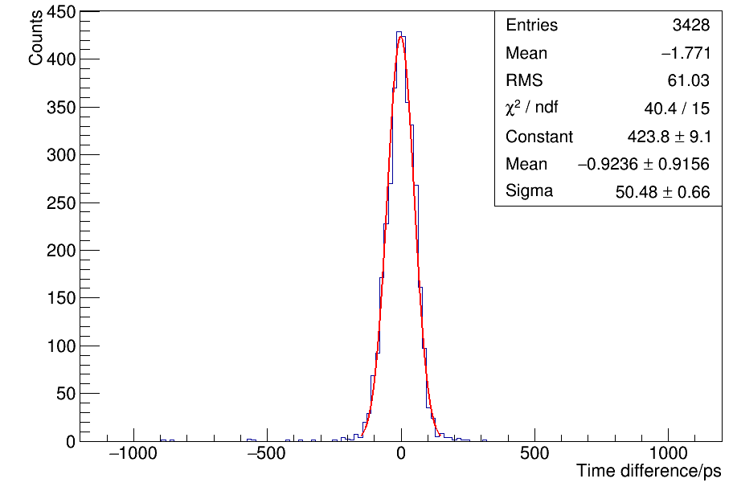
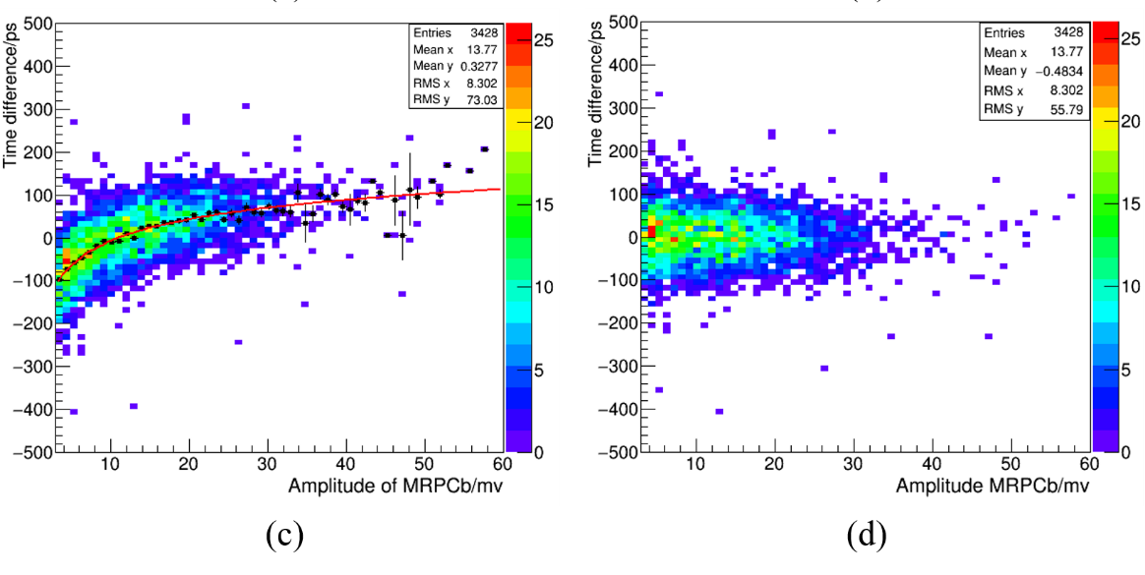
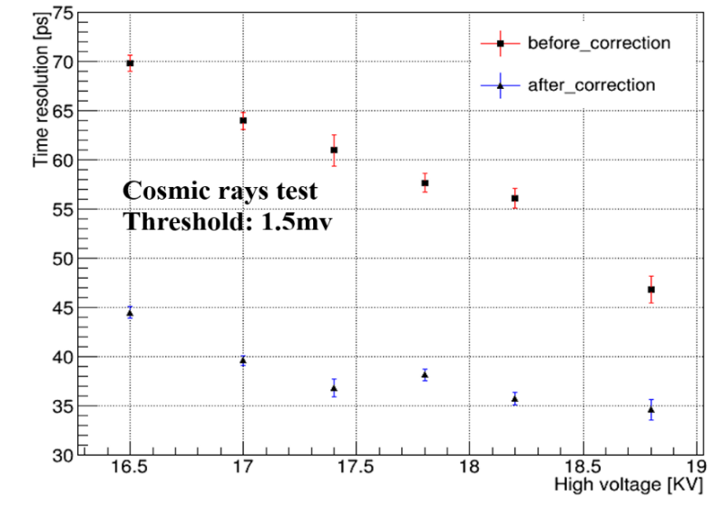
Cosmic ray test
1st MRPC + TI amplifier + Lecroy Oscilloscope
Cosmic rays
E: 121 kV/cm
~ 35.6ps

Slide 9
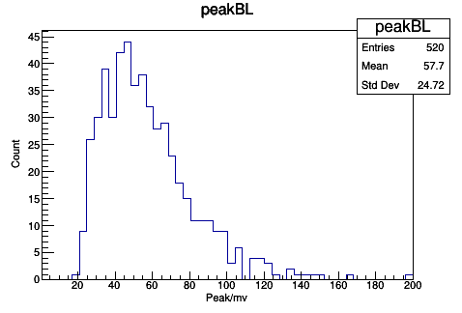
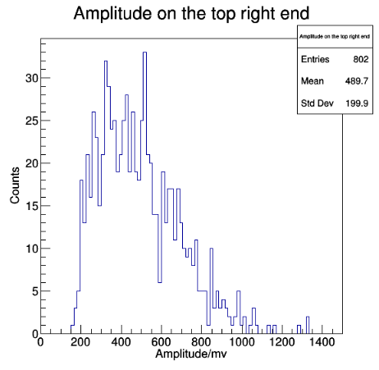
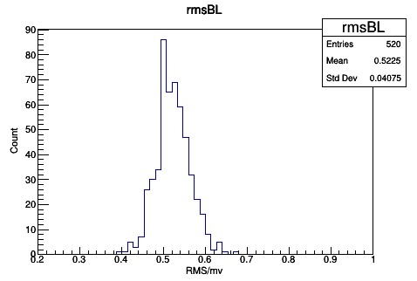
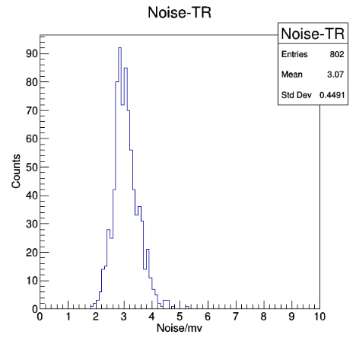
Comparison of 2nd and 3nd MRPC
2nd MRPC
3rd MRPC
Amplitude
3rd > 2rd
Base line noise

Slide 10
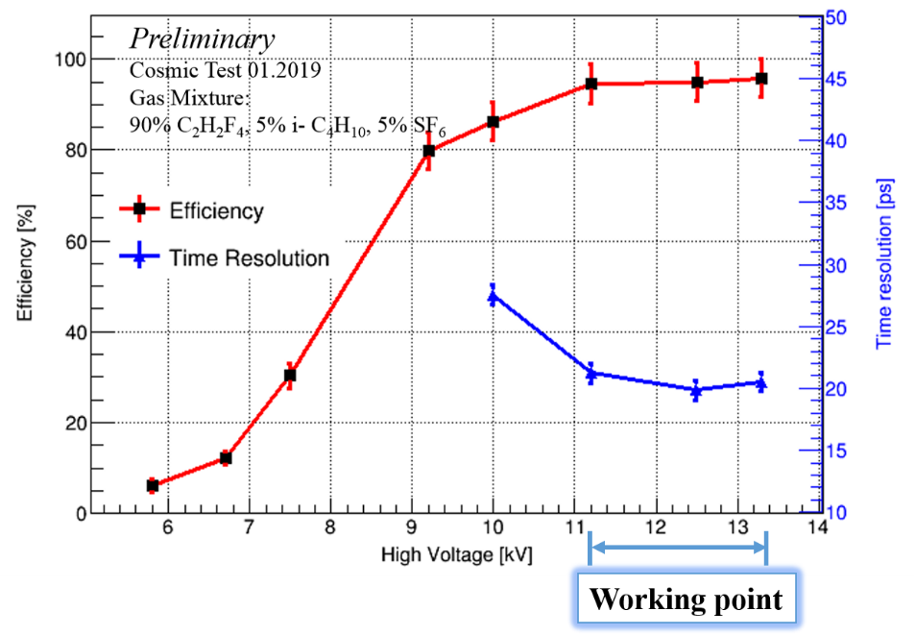
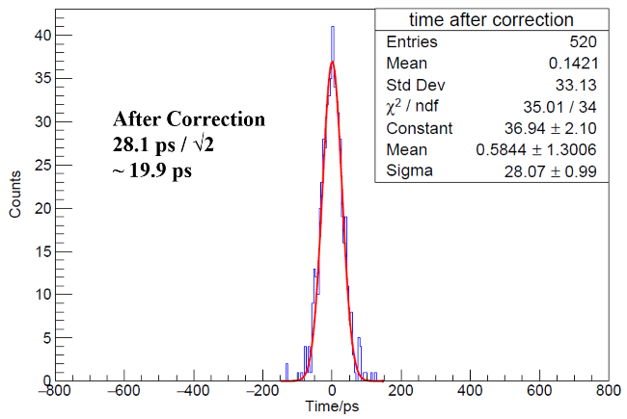
Performance of 2nd MRPC
2nd MRPC + USTC FEE + Lecroy Oscilloscope
Electric field：150 kV/cm
Voltage: $11 kV\sim 13 kV$，Eff$\sim 95\%$，Time resolution$\sim 20 ps$

Slide 11
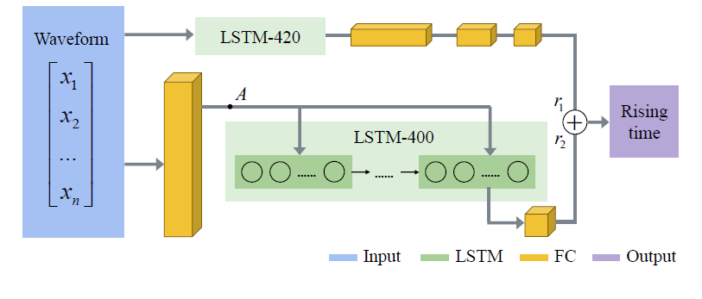
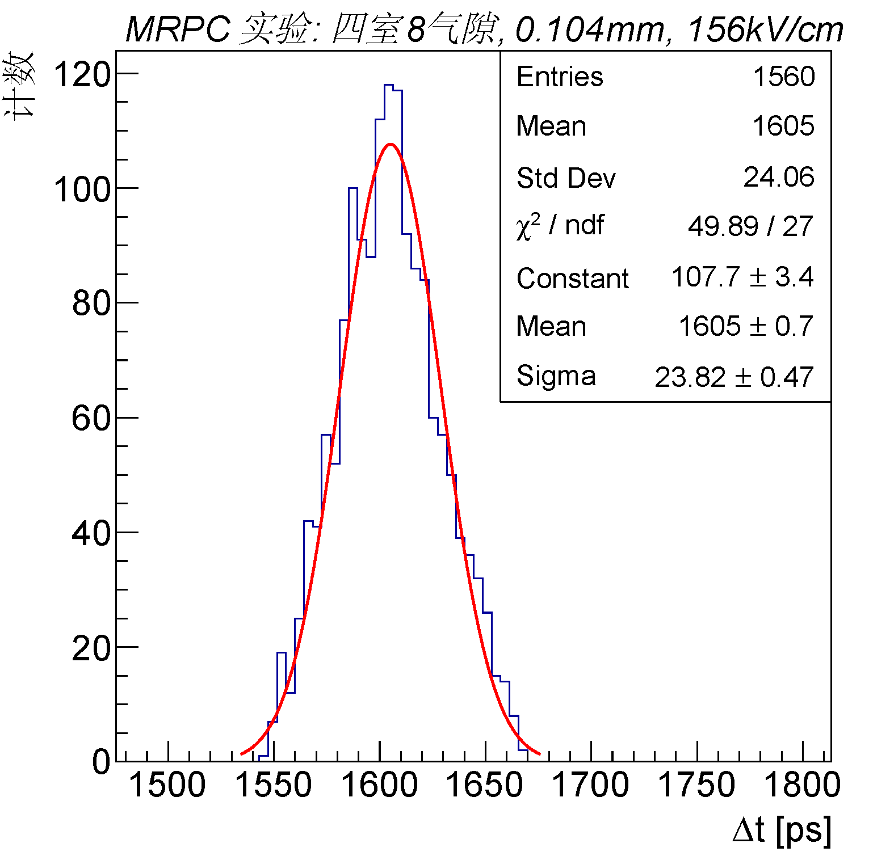

Analyisis with Neural network
ComLSTM (Combined LSTM)：FC combined with LSTM，
Network training：60k simulated data，Input is 10 points of leading edge,
=16.8ps

Slide 12
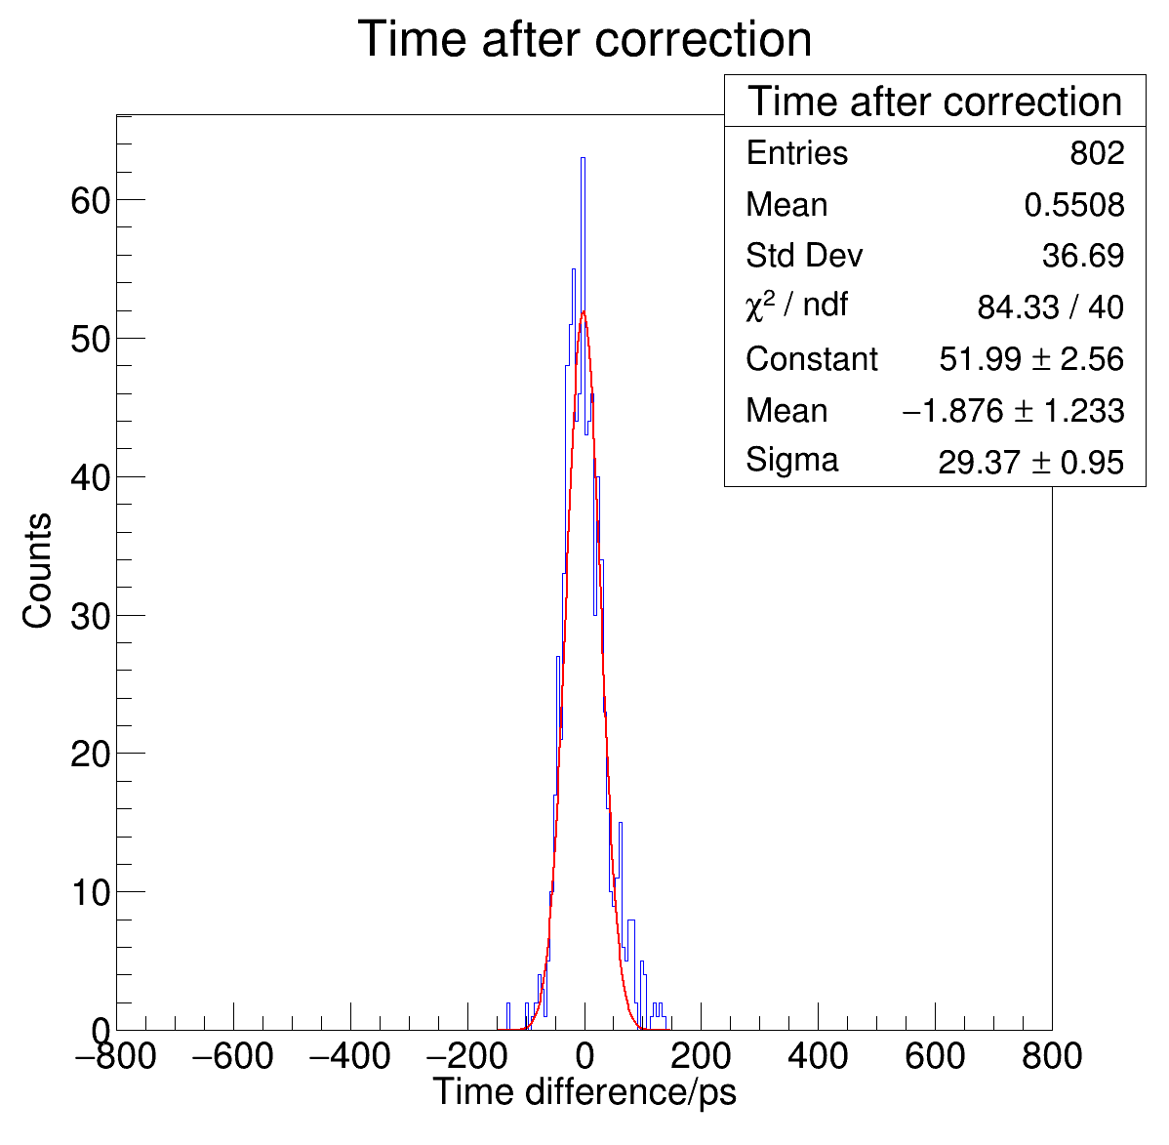
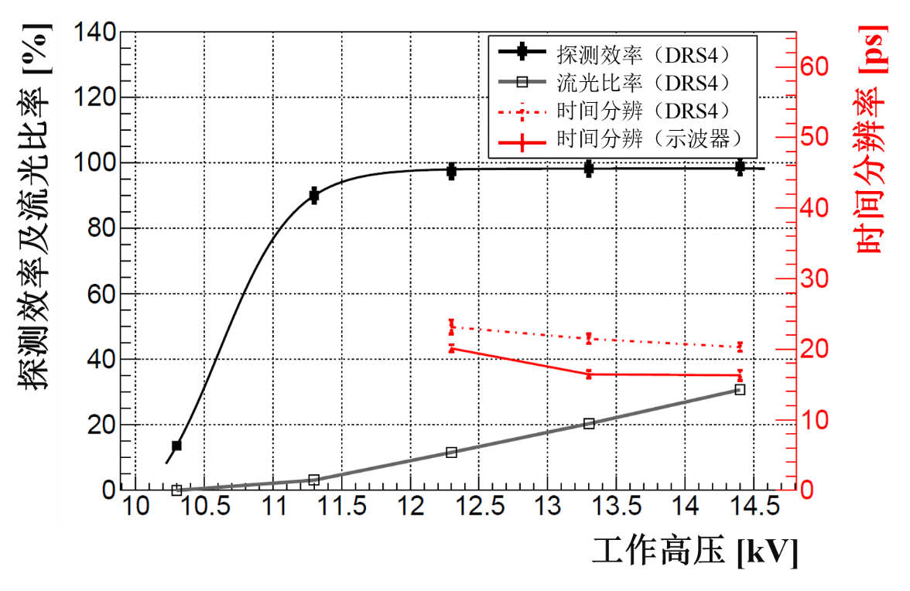
Performance of 3nd MRPC
3rd MRPC + USTC FEE + Lecroy Oscilloscope
Electric field：
140 kV/cm
Time resolution：20.8ps

Slide 13
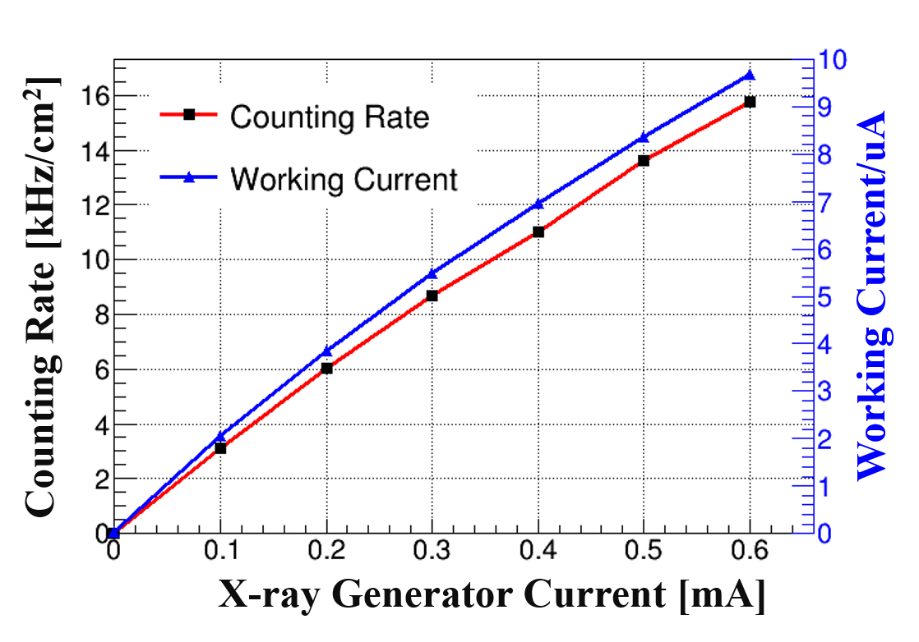
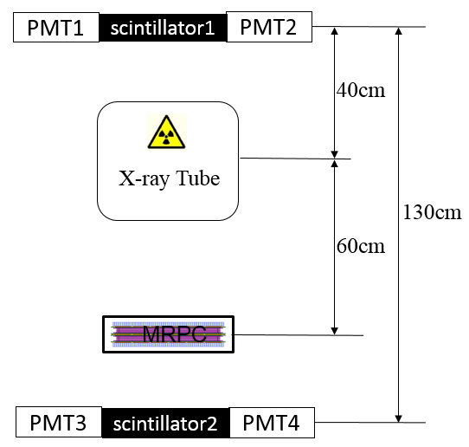
Test at high rate environment
μ
High rate test system
Working current and counting rate .vs. X-ray strength

Slide 14
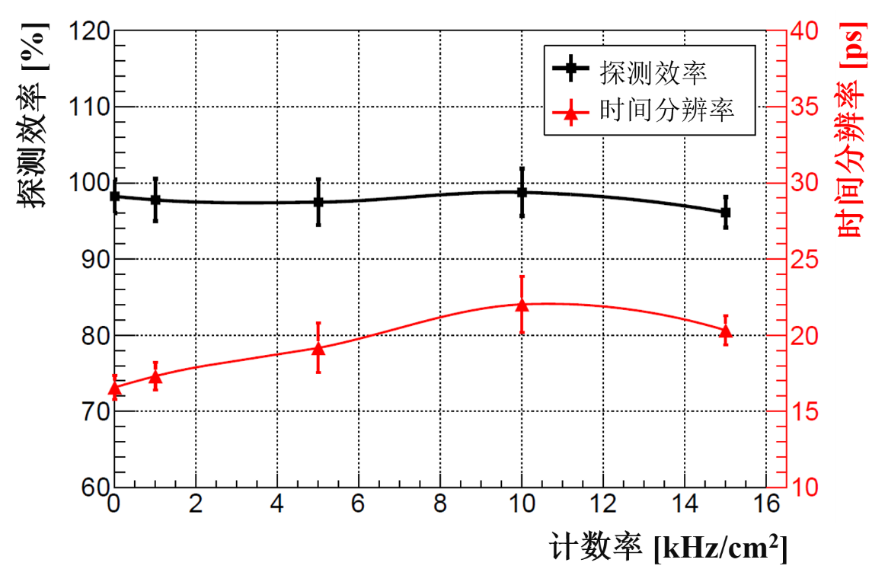
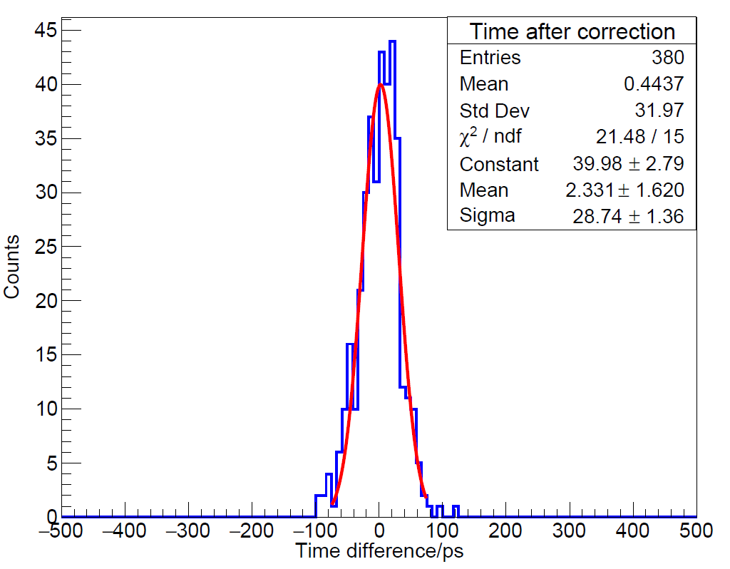
Performance at high rate environment
X-rays
55kV/0.55uA
Rate ~ 15 kHz/cm²
Time resolution
28.74 ps / √2
~ 20.32 ps

Slide 15
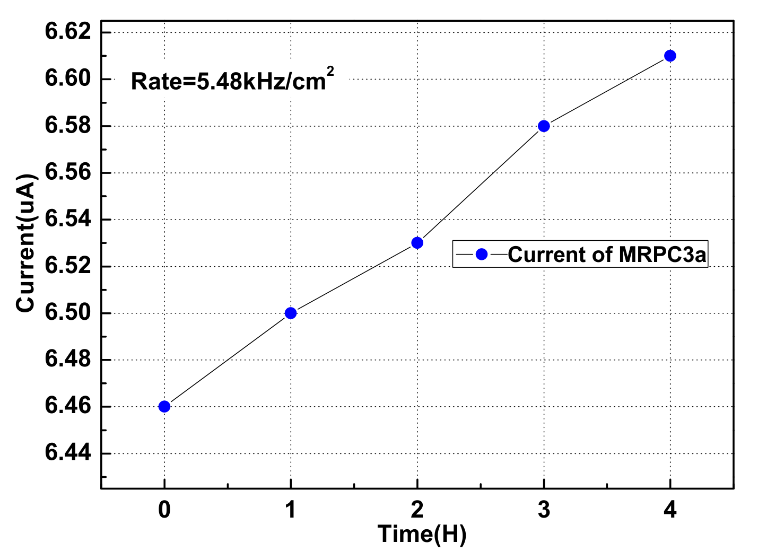
Gas pollution at high rate environment
Read by TDC moniter
The MRPC3a (8 gas gaps, 250 μm gap width, active area 33*27.6cm²) was irradiated widely under X-ray in the lab. The operating current increased with a slope about 40 nA/h.
Box size: 60cm*60cm*20cm, flow rate: 100 mL/min
Reason: Gas pollution in gas gap

Slide 16
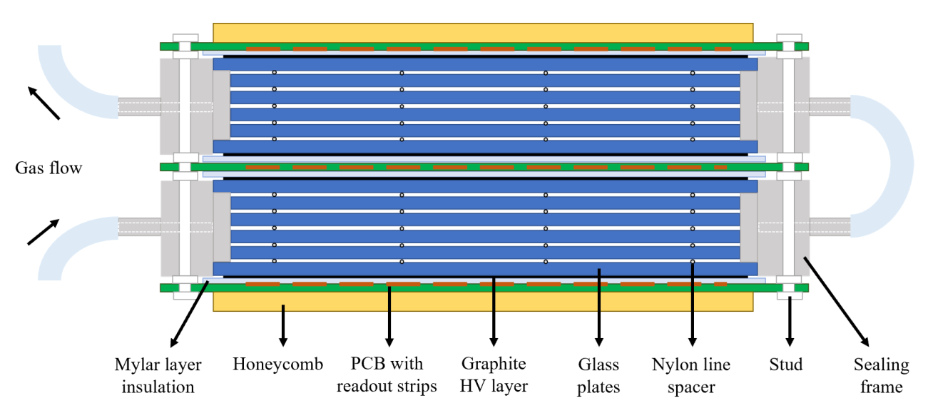
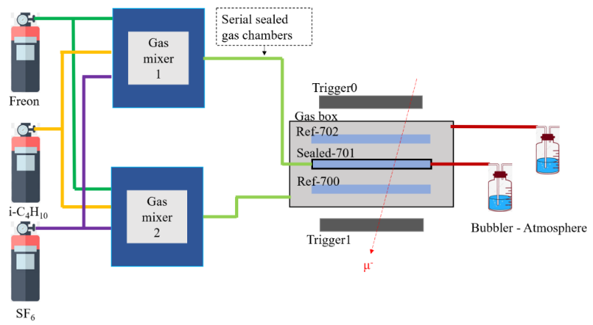
Development of a sealed-MRPC
Parameter | Value
N of gas gap | 2×5
Detector volume | 约350×350×50mm³
Width of gas gap | 0.25mm
Readout channel | 24 channels, 10mm strip width + 3mm gap，32 cm length
Signal readout | Differential, double-ended
Gas volume | ~170 ml
Strip impedance | ~42 Ω
The sealed MRPC has shown excellent air-tightness under low gas flow.
  4 ml/min “standard gas”： Freon/iC₄H₁₀/SF₆ 90/5/5
  1 ml/min pure Freon
  Bubble stably
  Serial chambers

Slide 17
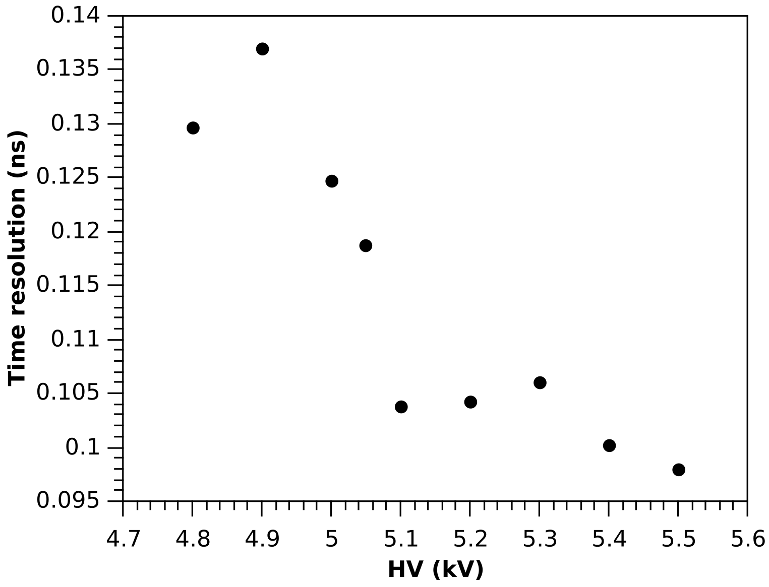
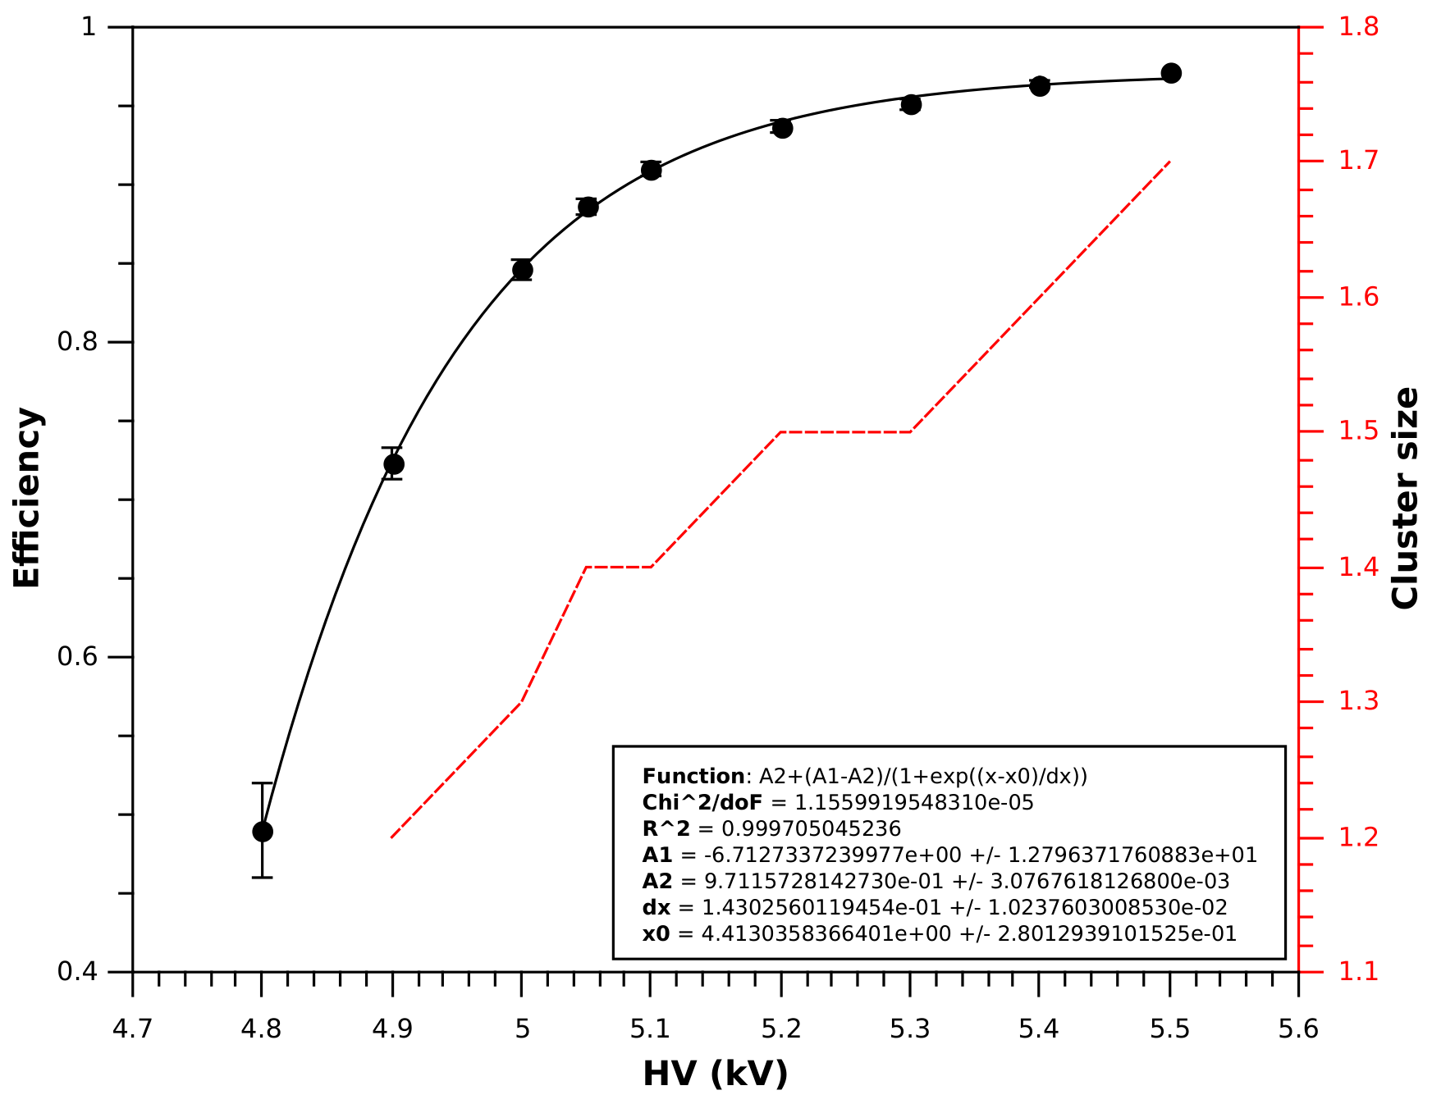
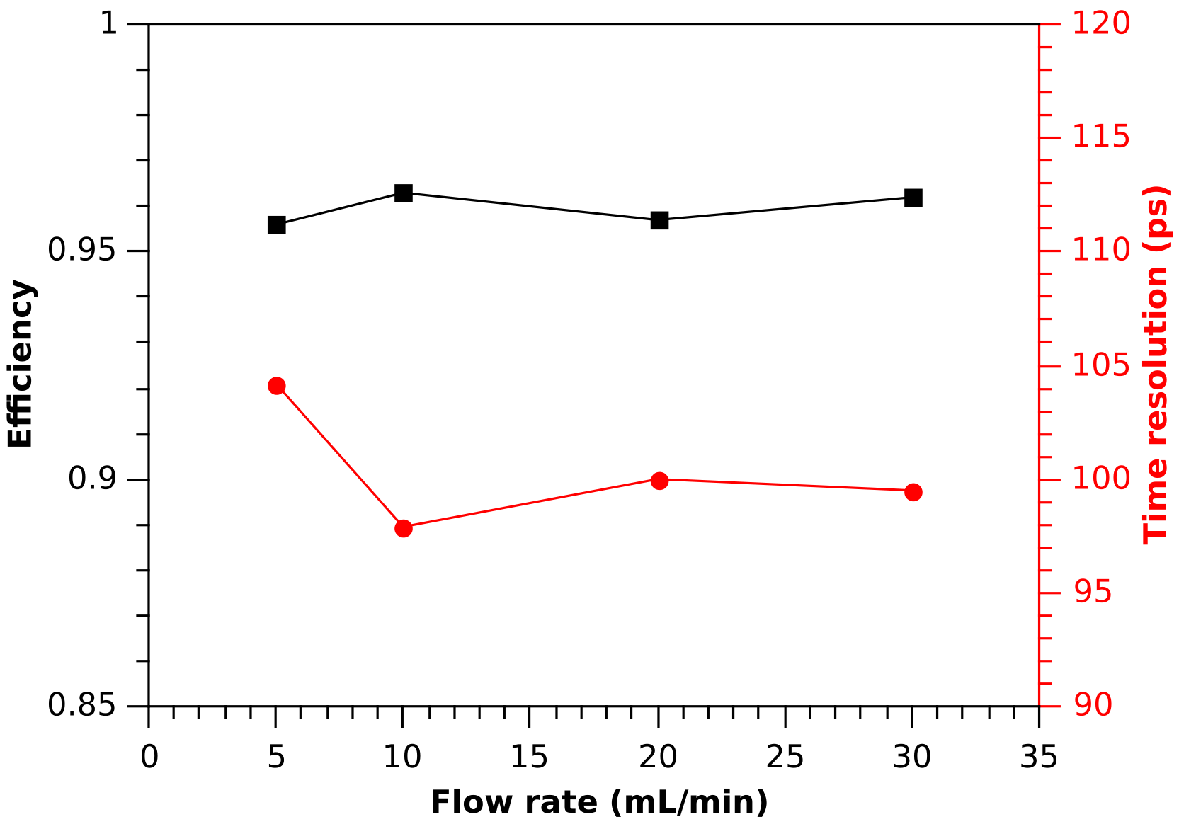
Cosmic ray test
10 mL/min individual gas supply for sealed prototype.
Standard gas mixture: Freon/iC4H10/SF6 90/5/5
300 mV PADI threshold.
Dark current: < 20 nA, Noise rate: < 1 Hz/cm²
Reasonable ToT, position resolution comparable to reference counters

Slide 18
Performance of sealed-MRPC under X-ray
X-ray started since 0:28:00
5k
4.3k
3.4K
(Hz/cm²)
OFF
OFF
OFF
Stable current for over 6h: 5->5.02->4.99μA
We did not observe obvious gas pollution effect!

Slide 19
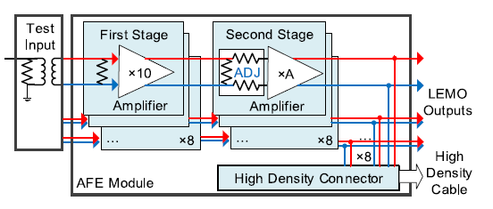
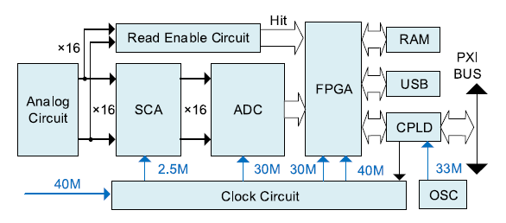
Fast amplifier and SCA digitizer
Time digitizer (not ready)
Fast FEE by USTC
    SCA (DRS4)：1024 sampling capacitor
    Max sampling rate：5.12 GHz
    Noise：0.5 mV
    Time jitter：3 ps
    Gain：26 dB~40 dB
    Band width：1.4 GHz
    Time jitter：4 ps
Nucl. Instrum. Meth. A 925 (2019) 53.

Slide 20
FPGA-TDC
Time precision is about 10ps !

Slide 22
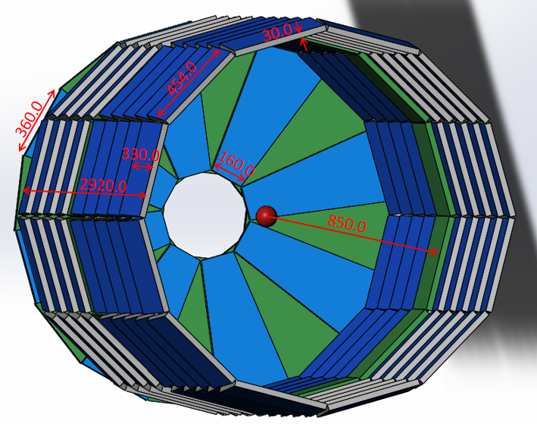
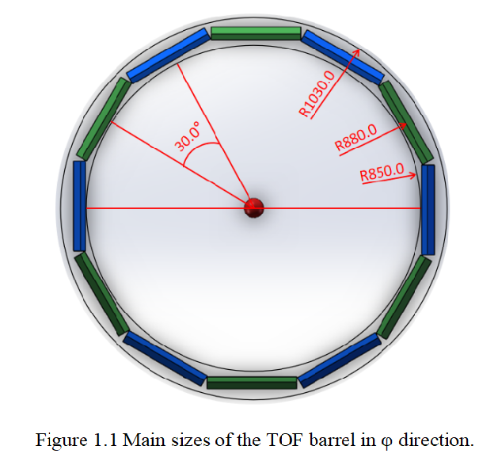
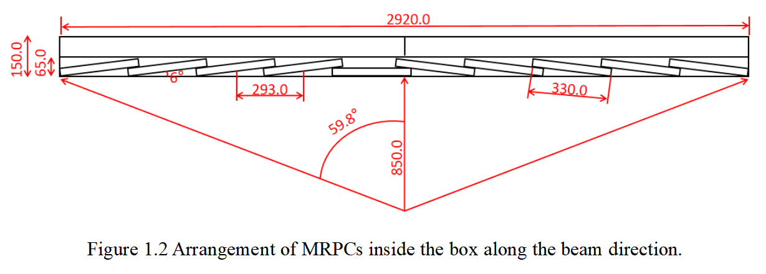
Layout of MRPC-TOF
12 module for
one circle
Each module consists of
10 sealed MRPC

Slide 23
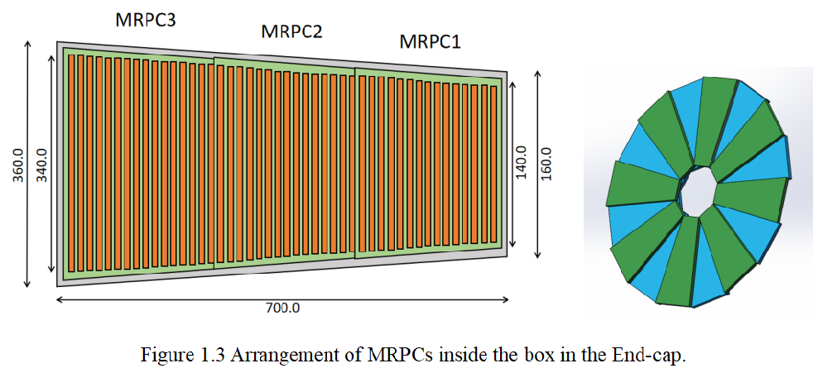
End-cap MRPC-TOF
eTOF consists of 16 modules and each module consists of 3 sealed MRPC.

Slide 24
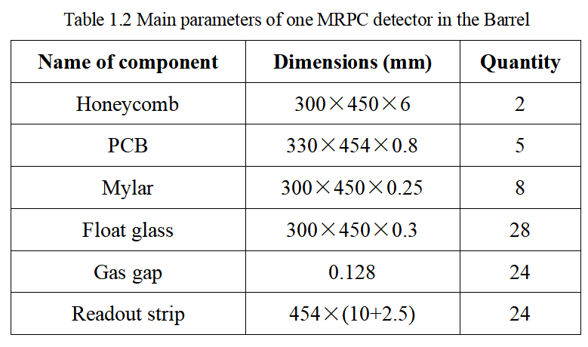
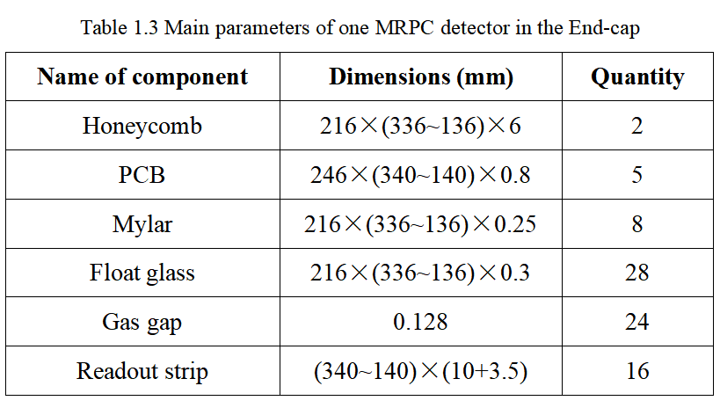
MRPC description
Fast amplifier+ SCA
NINOs + FPGA TDC

Slide 25
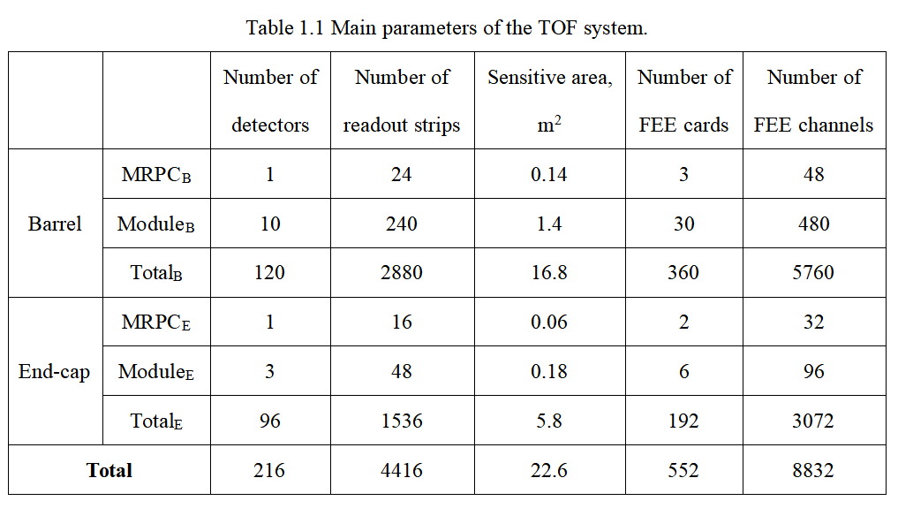
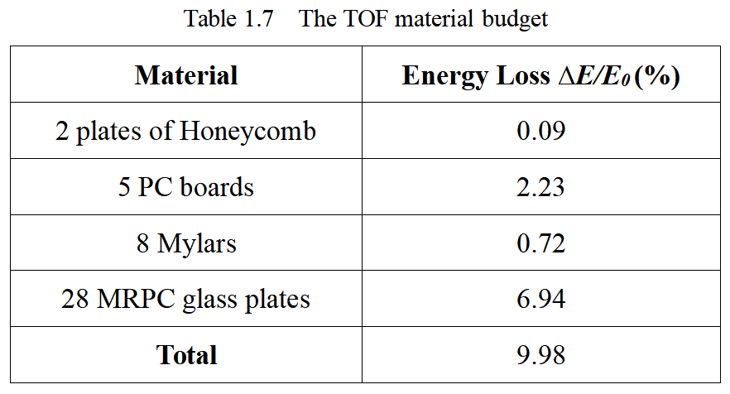
TOF system

Slide 26

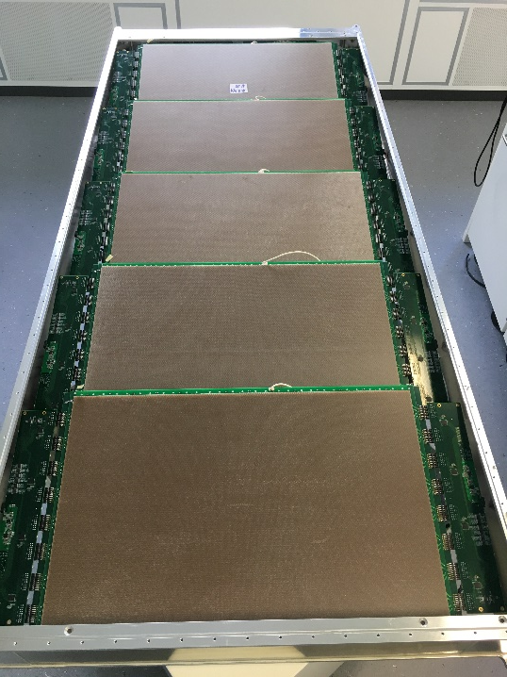
Advantage of sealed MRPC
Performance: fast gas exchange
Economy: save gas
Environmental protection

Slide 27
Thanks for your attention !

