Slide 1
Fast Beam-Beam Collisions Monitor for experiments at NICA
А.А. Baldin (1), G.A.Feofilov*(2), P.Har’yuzov (1), F.F.Valiev (2)
(1) JINR and Institute for Advanced Studies "OMEGA", Dubna, RF
(2) V.Fock Institute for Physics, Laboratory of Ultra-High Energy Physics, Saint-Petersburg State University
Reported by Grigory Feofilov at the SPD meeting, Thursday, 10.06..2021 , 15:15
Job is supported by RFBR grant #18-02-40097
https://indico.jinr.ru/event/2152/timetable/#20210610.detailed
Notes:
1

Slide 2
Layout
MicroChannel Plate (MCP) for BBC- Conceptual ideas
General requirements to functionality of the beam-beam collisions monitoring at NICA
MCP-based solutions for
Beam Position Monitor (BPM) and
Fast Beam-Beam Collisions counters (FBBC) for NICA
First test results and prototyping
Some plans

Slide 3
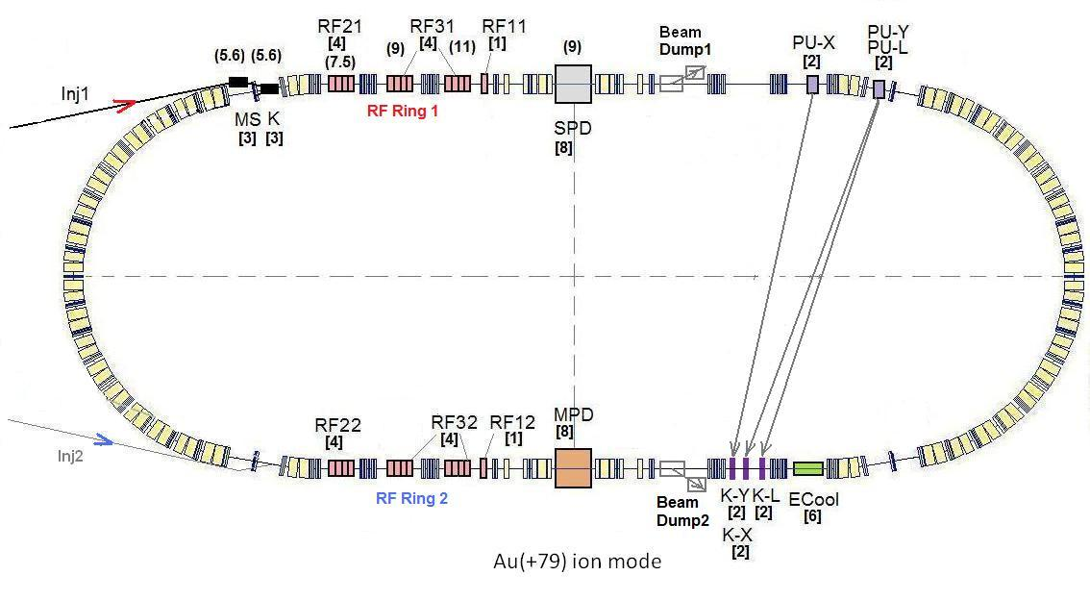
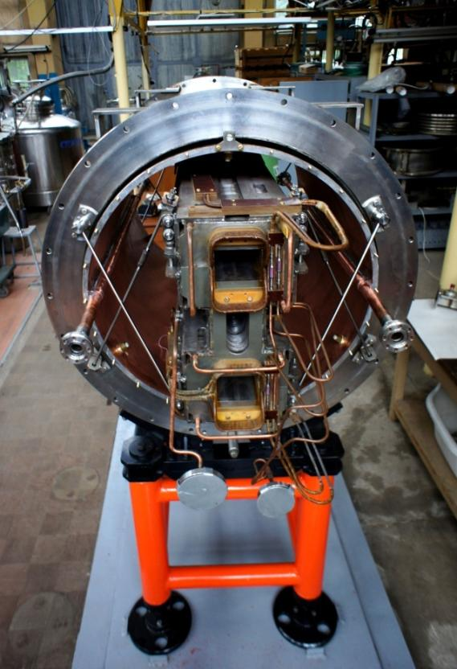
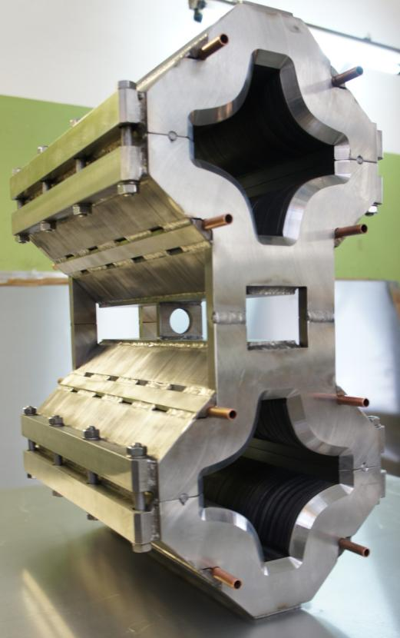
The Collider
45 T*m, 4.5 GeV/u for Au⁷⁹⁺
SPD
Ring circumference, m | 503,04
Number of bunches | 22
r.m.s. bunch length, m | 0,6
β, m | 0,35
max. int. Energy, Gev/u | 11,0
r.m.s. Δp/p, 10-3 | 1,6
IBS growth time, s | 1800
Luminosity, cm⁻² s⁻¹ | 1x10²⁷
MPD
Double aperture magnets:
dipole & quadrupole
prototypes
[1] http://nica.jinr.ru/projects/collider.php
Notes:
The lattice design and prototyping of most collider elements are completed. The ring circumference is twice as one of the Nuclotron. For the gold beam a Luminosity at the energy above 10 GeV per nucleon will be 10 to the 27

Slide 4
General requirements to functionality
of the beam-beam collisions monitoring at NICA
1) To provide the event-by-event measurements of:
beam location
3D-beam profile (2 dimensional + time structure)
luminosity monitoring
2) Additional functionality in determination of:
the reaction plane
the multiplicity class relevant to the event centrality in nucleus-nucleus collisions
T0 --the collision time
Location of the Interaction Point (IP)
Possible application in local polarimetry

Slide 5
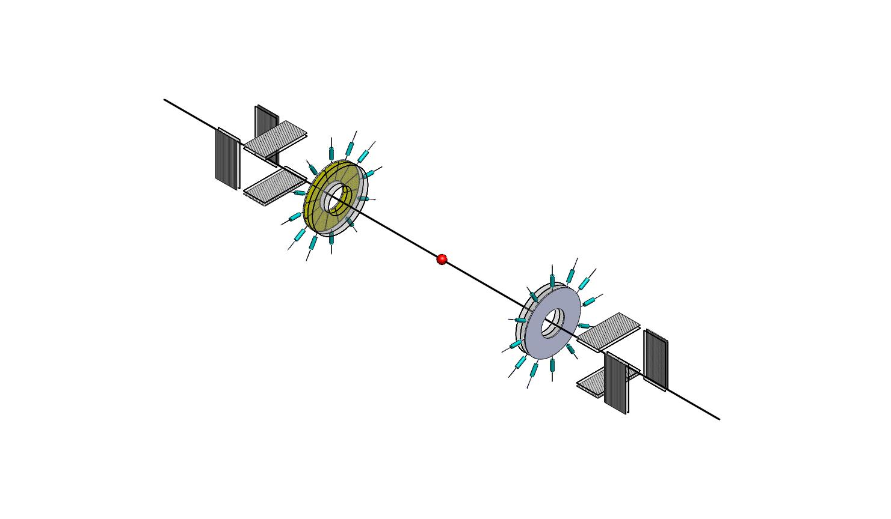
Fast beam–beam collisions monitor for experiments at NICA
(1) Fast monitoring of the beam position and profile (BPM) (2) The event-by-event fast monitoring of beam-beam collisions (FBBC)
(BPM)
(BPM)
Baldin, G. A. Feofilov, P. Har'yuzov, F. F. Valiev
NIMA, 958, 162154, 2019
Reported at the VCI2019
DOI:10.1016/j.nima.2019.04.108..

Slide 6
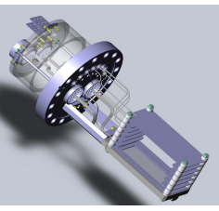
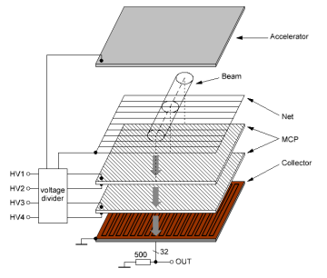
(BPM) at the NUCLOTRON
MCP-based device for fast monitoring of the beam profile (BPM) at the NUCLOTRON [1]
[1] A.Baldin, A.Berlev, I.Kudashkin, A.Fedorov, Space-time characteristics of the circulating beams, Letters to ECHAIA, 2014, vol.11, №2 (186), p.209-218

Slide 7
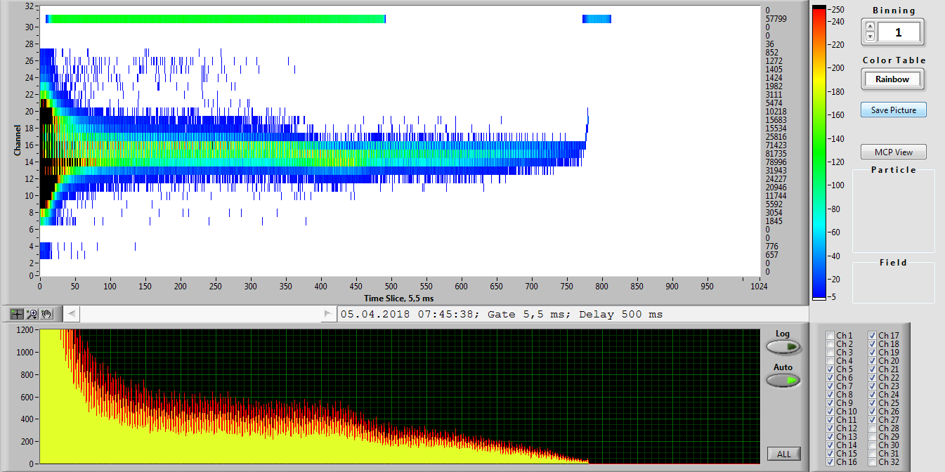
BPM tests AT NUCLOTRON, JINR in February-April 2018
Space-time characteristics of the circulating beams
Dynamic profile of an accelerated krypton beam inside the NUCLOTRON accelerator ring (Vertical readings of the upper pattern in mm).
Example of the Kr beam position measurements at the NUCLOTRON. The energy of beams was 3.5GeV , beam intensity --10⁶, vacuum 10⁻⁸ Torrr. Time Slice = 5,5 ms. Y scale has 3 mm channel bin width.
Notes:
Работы проделанные в рамках сеанса февраль-апрель 2018.
МКП детекторы на 7-м прямолинейном участке кольца Нуклотрона в районе станции внутренних мишеней.
Накоплен богатый методический материал по работе детектора на основе МКП, расположенного внутри кольца Нуклотрона на теплом прямолинейном промежутке в районе станции внутренних мишеней. Информация о пространственно временном расположении пучка в ускорителе передавалась в on-line режиме на пульт Нуклотрона и пульт линейного ускорителя. Детектор был запущен в начале работы с пучками углерода и выключен 05.05.2018 в 20:00 Детектор успешно проработал весь сеанс. Обеспечено круглосуточное, непрерывное предоставление информации в графическом виде в режиме on-line на пульт Нуклотрона и пульт линейного ускорителя ЛУ-20.

Slide 8
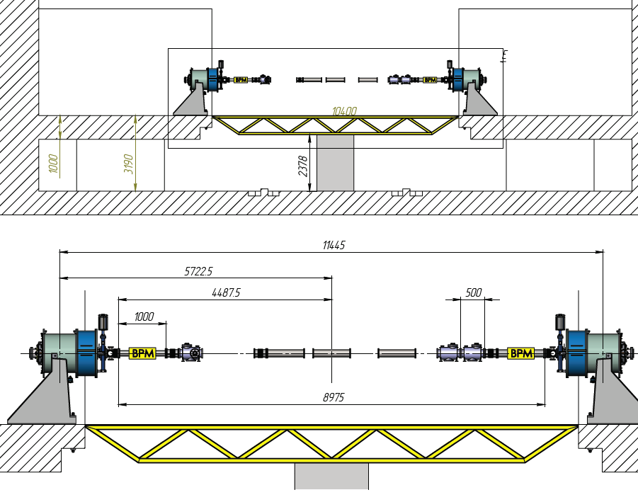
Possible location of BPM for measuring emittance of the NICA collider in the SPD area at the first stage.
(see also talk by A.A.Baldin at this session)

Slide 9
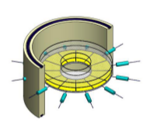
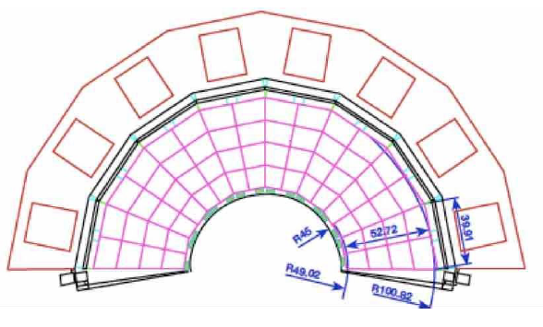
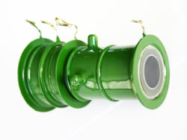
Fast Beam-Beam Collisions monitoring (FBBC) conceptual design
Option-2 outside :
FBBC based on sector MCP
Setup in the vacuum chamber
Option-1 inside the vacuum pipe:
Compact modules of the Fast Beam-Beam Collision Monitor (FBBC) based on the circular MCP chevron setup.
Sector readout pads and MCP set-up are embedded into a vacuum flange with hermetic 50 Ohm signal and HV feedthroughs.
Option-3 outside:
Several independent MCP hermetised
MCP setups ( likeTOPAZ)

Slide 10
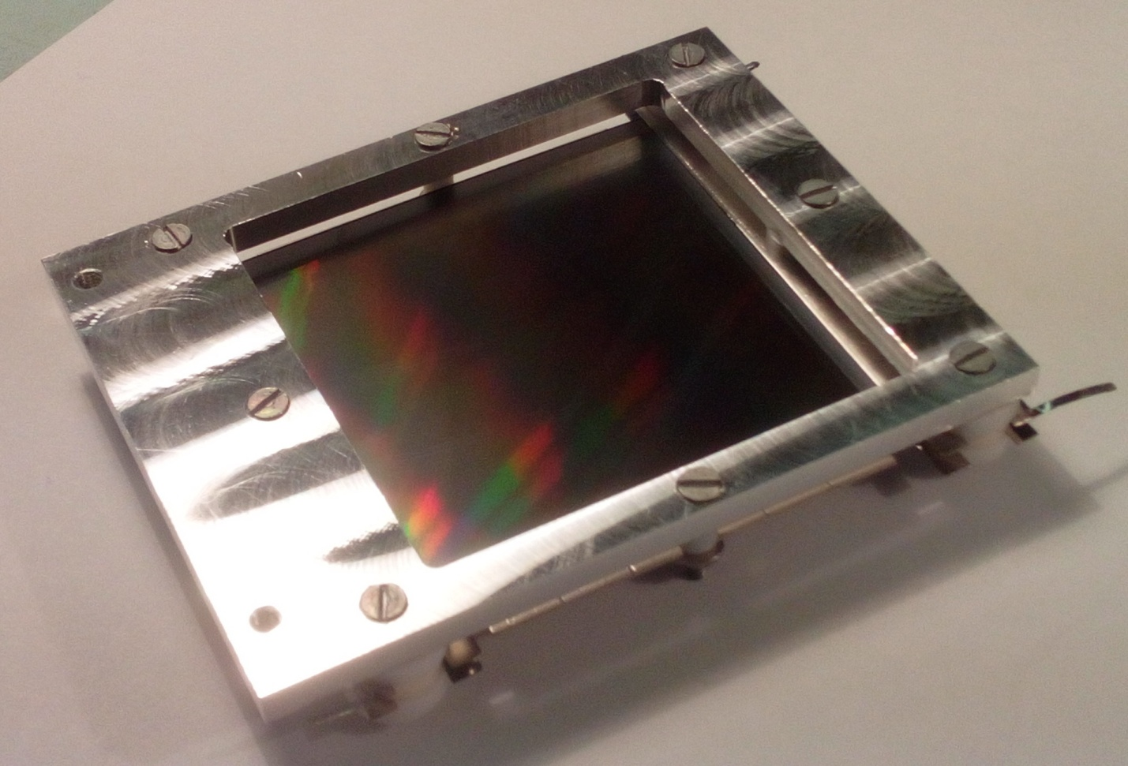
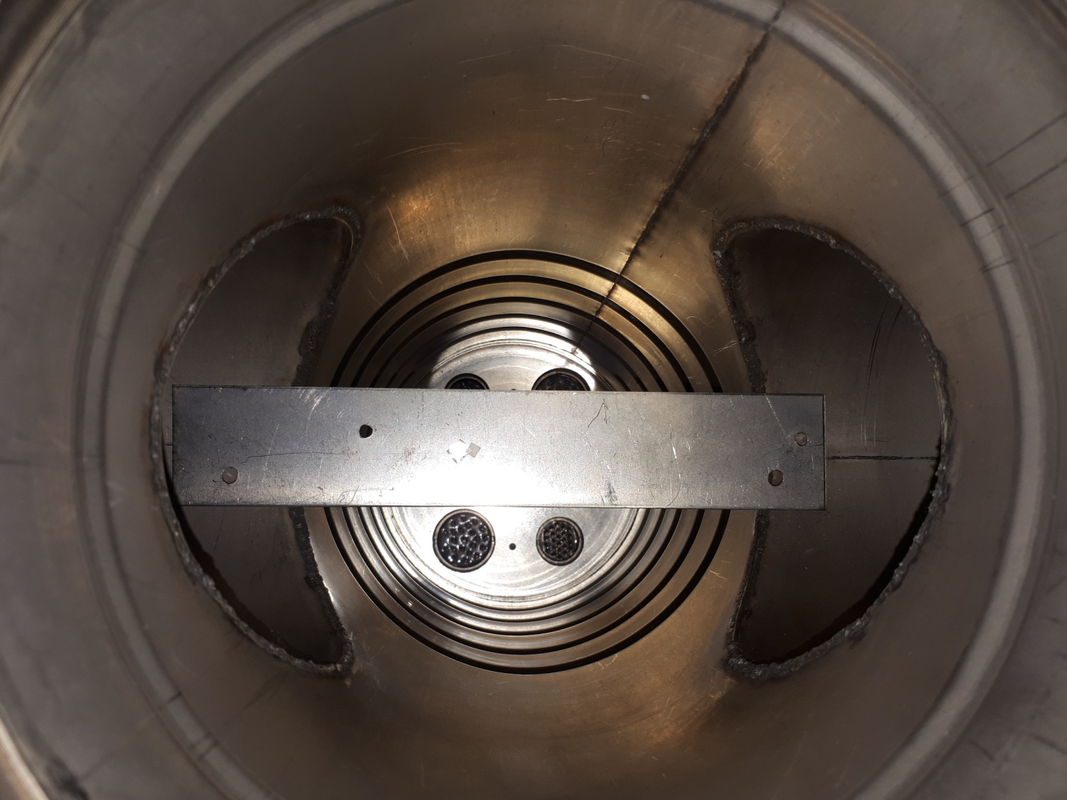
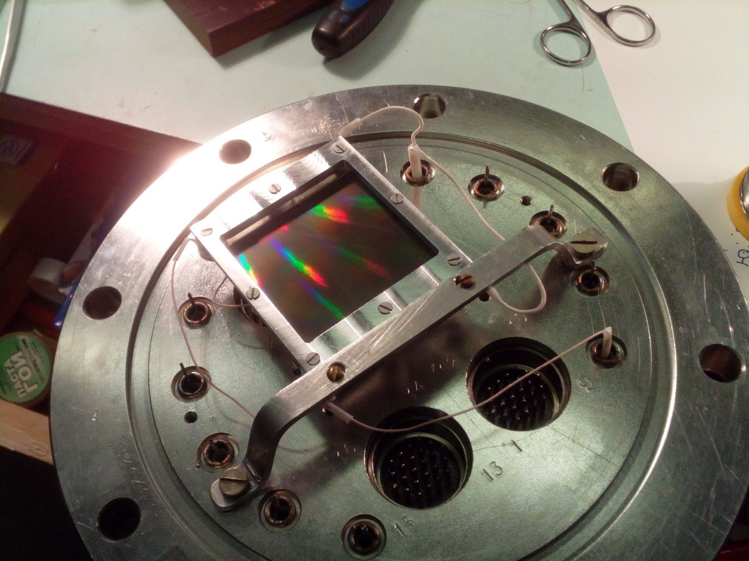
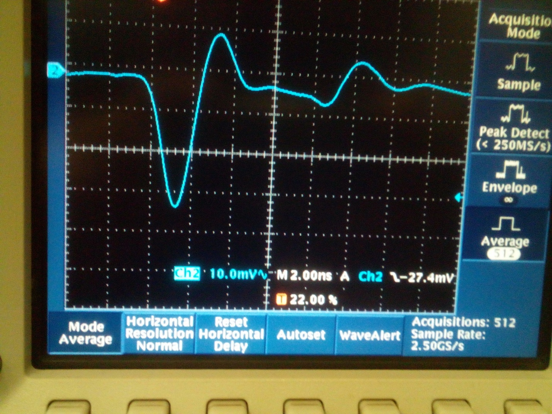
MCP tests at JINR and SPbSU
MCPs: 43x63, 6mkm channel
https://baspik.com/eng/products/mkp/
²⁴¹Am
The ultra-high vacuum (UHV) compatibility and low-mass compact design.

Slide 11
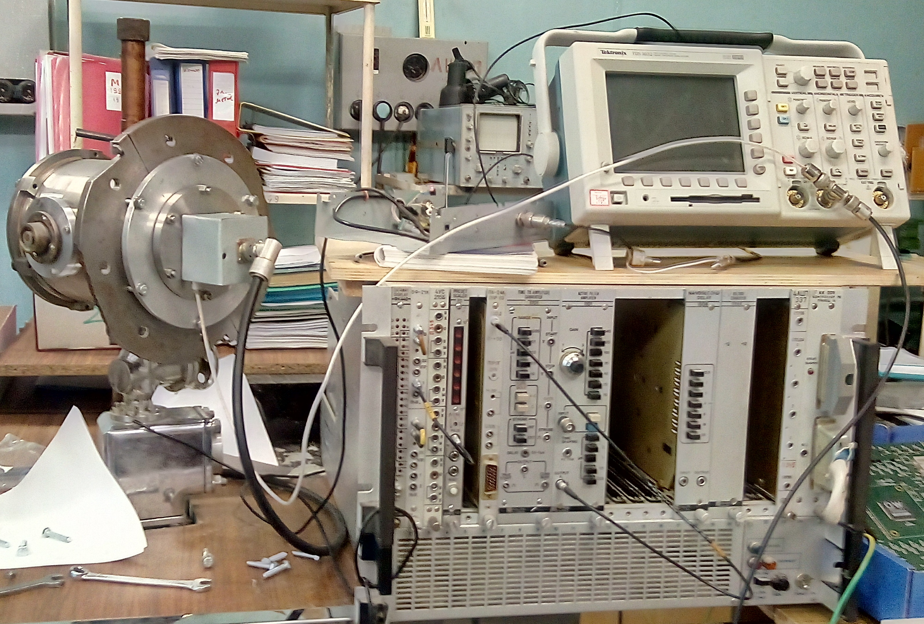
R&D in Saint-Petersburg
Study to improve MCP readout timing characteristics.
study of the possibility of improving the emission properties of MCPs by applying thin films with high SEE properties (Al203)
optimization of the information readout system
.

Slide 12
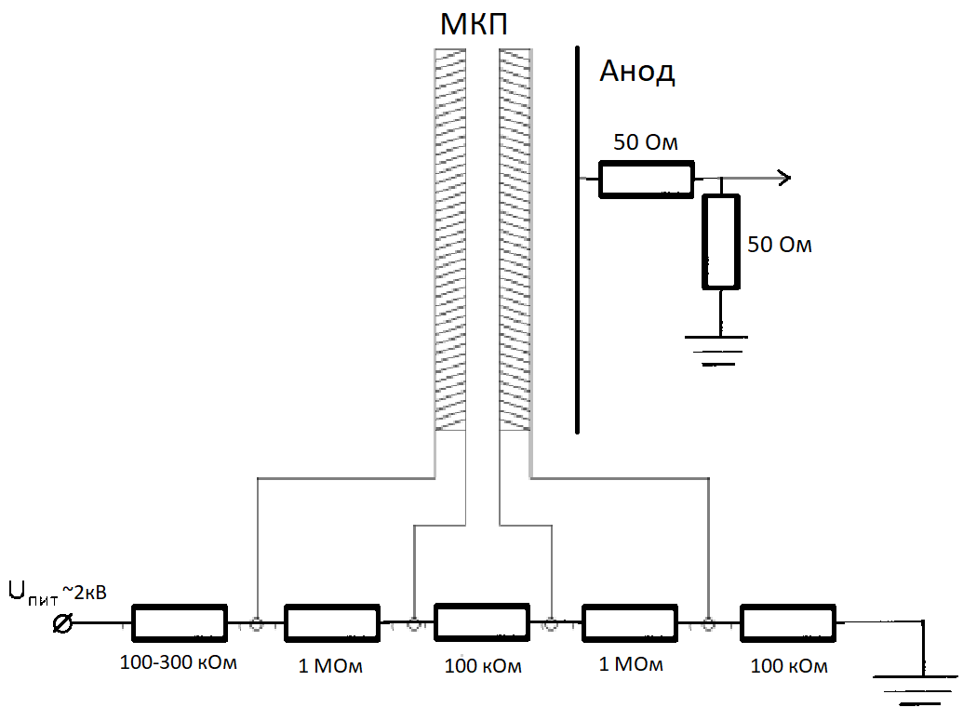
MCP anode and signal transfer line optimization
400 mV fast (τ~800ps) signal from t BASPIC MCP the with additional 10 nm layer of Al2O3
(HV: 2,2 kV) and optimized readout line

Slide 13
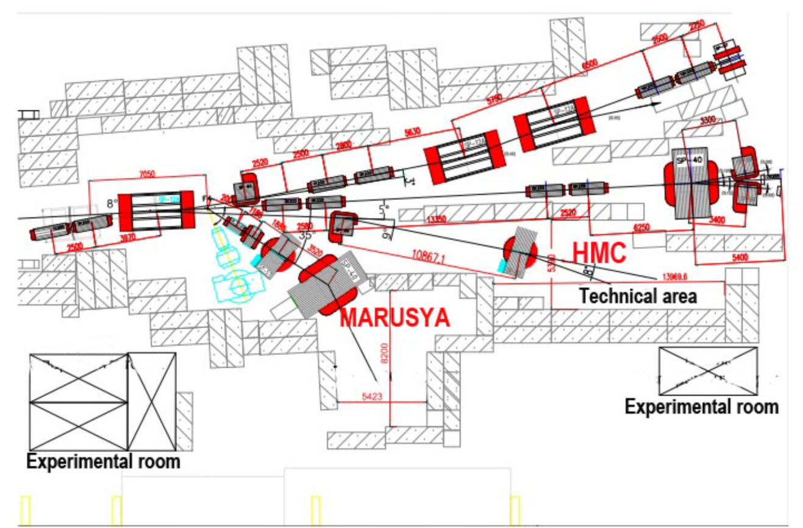
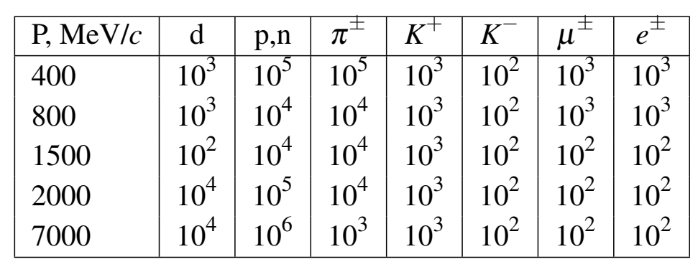
Future plans:
Fast front-end readout electronics design
Model simulations
Circular MCP setups
Extensive tests at the Beam test facility at JINR

Slide 14
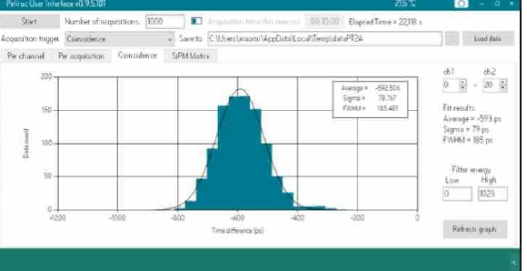
Tests of CAEN multichannel fast timing system Petiroc2A

Slide 15
Fast electronics for MCP multi-anode system readout
Despite the satisfactory potential accuracy of timing (up to ~40 ps) of the multichannel system based on CAEN Petiroc2A, the data output rate is low (44 kHz)
while the required for the beam-beam collision operation is at least ~14 MHz.
So, it is proposed to develop a prototype of a registration system based on high-speed discrete comparators of the ADCMP572 / ADCMP573 type as primary recorders in a multichannel time-code converter based on the FPGA.
These ADCMP572 / ADCMP573 type comparators feature a high switching rates
(35 ps) with jitter of the order of 15 ps with a minimum signal duration of 85 ps.

Slide 16
Conclusions
MCP-based solutions for Beam Position Monitor (BPM) and Fast Beam-Beam Collisions counters (FBBC) for NICA are proposed with the account of the wide functional request that could be provided.
The concept of the MCP-based Beam Position Monitor (BPM) was succesfully tested at the NUCLOTRON beams
New MCPs with the improved characteristics, such as small diameter (6μ) channels, low resistivity (3-10 MOhm), high gain (~10⁷), short fast rise-time (~0.8ns) signals, could be used in future. The ultra-high vacuum (UHV) compatibility and low-mass compact design allow the application inside the vacuum beam line.
The first prototypes were prepared in the UHV design and the in-lab test started showing subnanosecond rise time
The work is in progress with main focus on the future fast front-end multichannel electronics design for the readout of 1ns signals and with the plans for the in-beam tests at JINR

Slide 17
BACK-UP SLIDES

Slide 18
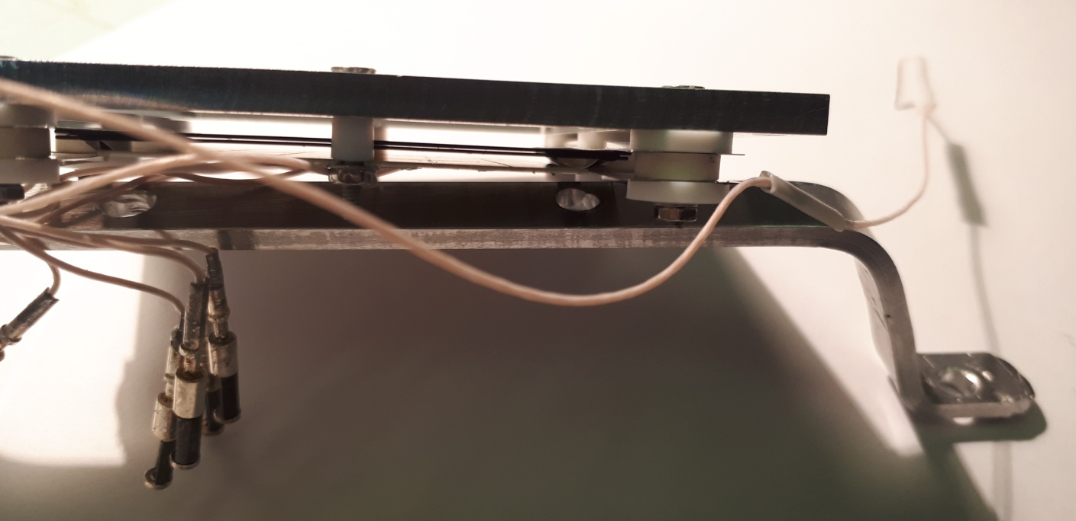
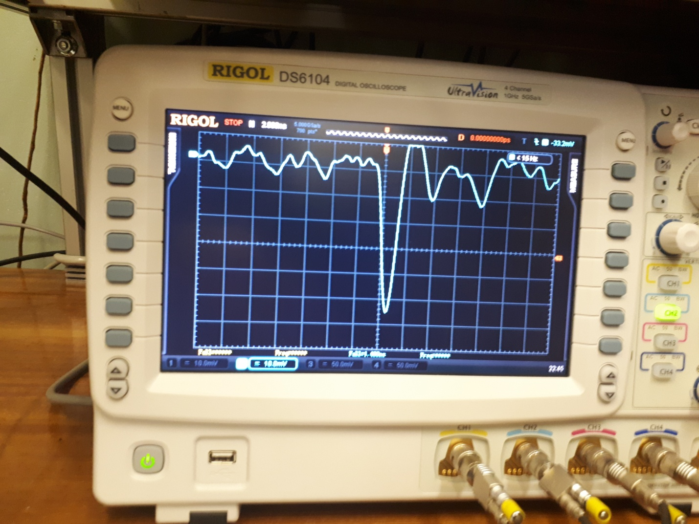
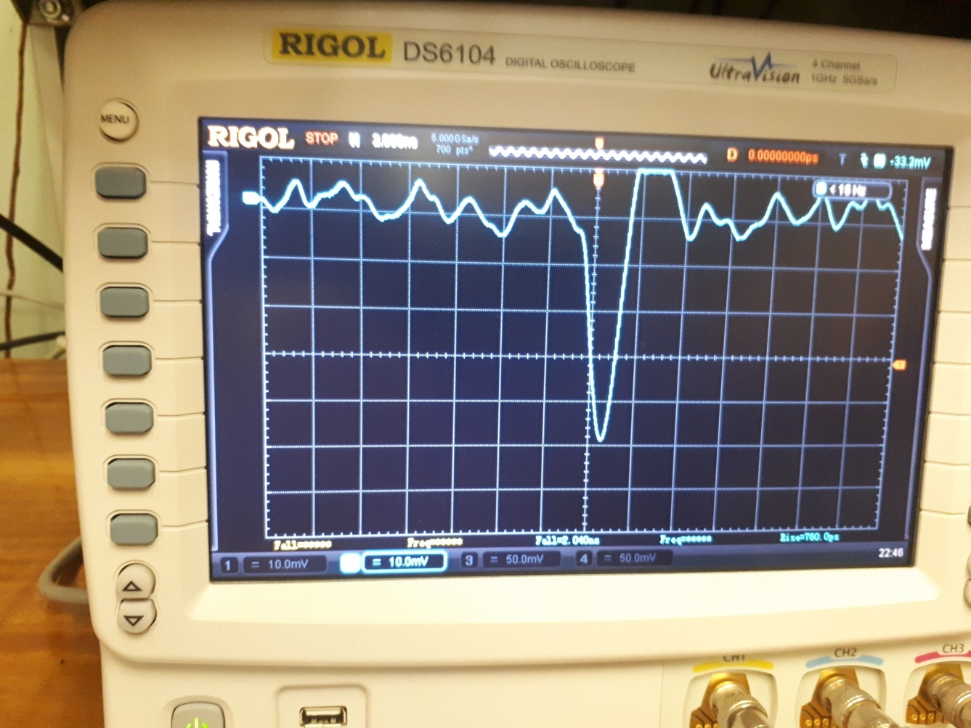

Slide 19
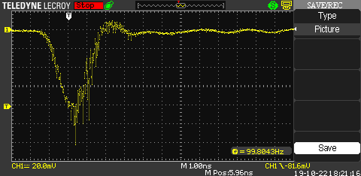
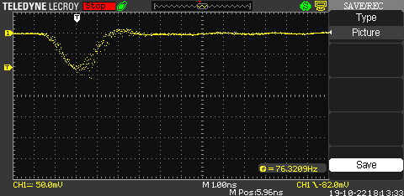
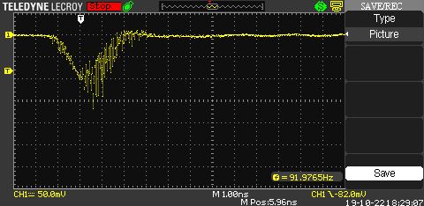

Slide 20
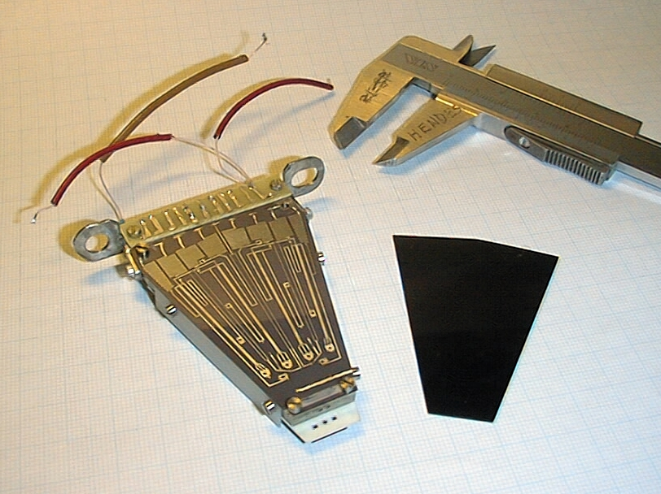
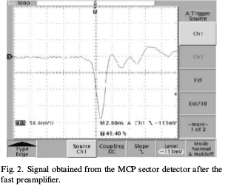
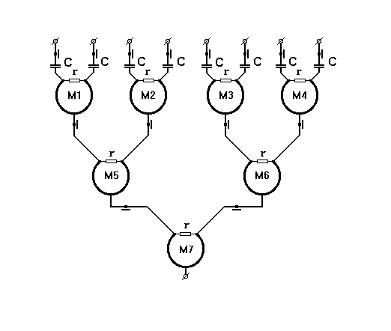
General scheme of Circular Bridges Summator for 8 input channels.
The in-beam tests of the detector prototypes and electronics at CERN GIF area (150 GeV/c muons) and at the T10 area of the CERN PS beams (7.5 GeV/c). The detector to be tested was positioned between 4 fast scintillation counters which determined the charged particle trajectories and were included in the trigger. The detector output signal passed the fast (1 GHz), low-noise preamplifiers and was then sent (see Fig. 2) to the fast timing electronics. The dynamic range of the signals applied was from 30 mV to 1:5V [3] .The best experimental in-beam results obtained previously with chevron MCP detector was in 75 ps timing resolution obtained at 75% efficiency for the registration of a single MIP [3].

Slide 21
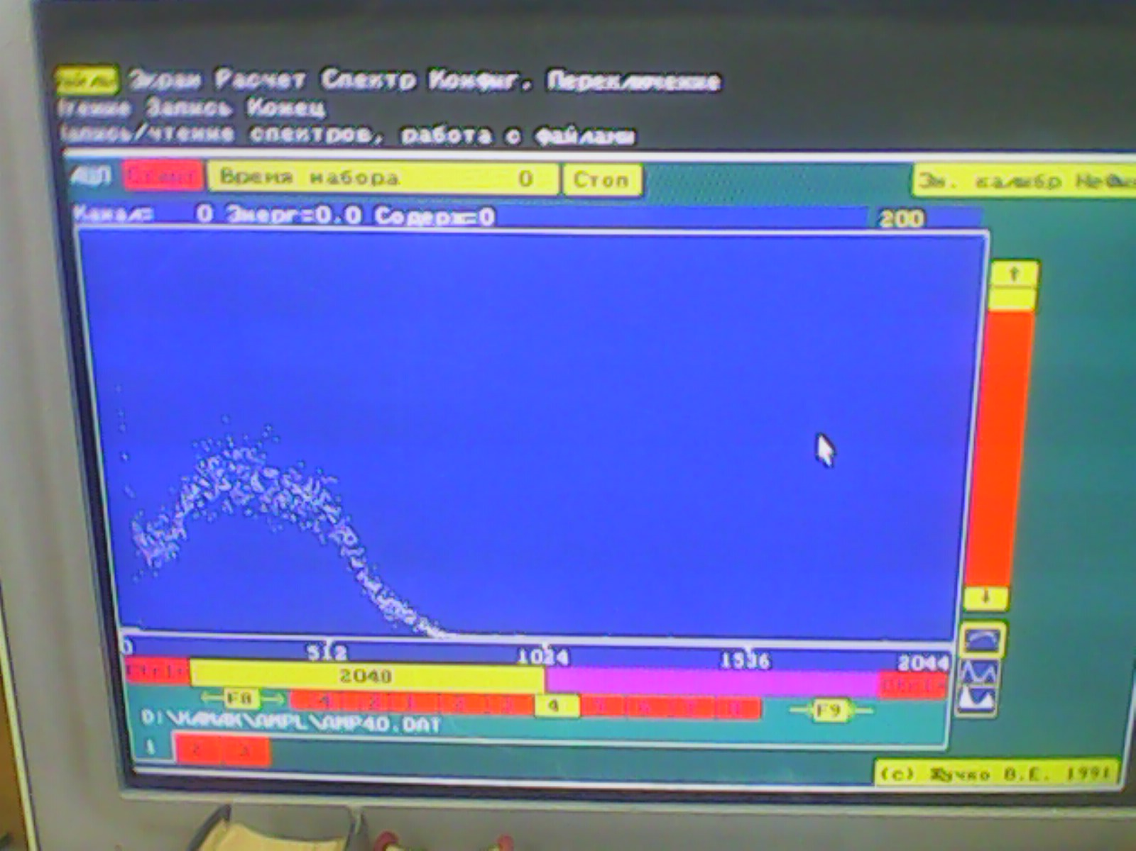
Studies of the new MCP characteristics

Slide 24
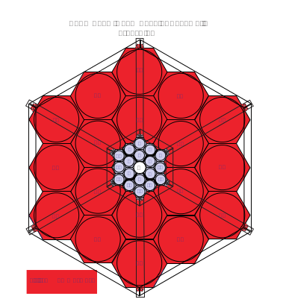
Beam-beam interaction and t0 counters at STAR [1]
To analyze the vertical component of polarization, the following spin asymmetry (ε) is formed:
Fig.1 The STAR beam-beam counter as seen looking towards the interaction point from outside of the STAR magnet. (2.2 < |η| < 5.0) [1].
[1] L.C.Bland for STAR collaboration, STAR RESULTS FROM POLARIZED PROTON COLLISIONS AT RHIC, arXiv: hep-ex/0403012
See also report by Prof. Maria Elena Tejeda-Yeomans, 23.10.19
at the present NICA meeting.
The symbols R(L) -- refer to the condition of hits hits in the corresponding phototubes, imposed to avoid ambiguities in the azimuthal angle to assign to the event.
↑ (↓) --refer to the direction of the polarization of the particular bunch crossing.

Slide 25
Micro Channel Plates (MCPs)
as a MIP detector
[1]A.Baldin,G.Feofilov,F.F.Valiev et al. ,”Microchannel plates as a detector for 800 MeV/c charged pions and protons.” // JINR Rapid Communications. 1991. No 4/50/-91. p.27-36.
[2] A.A.Baldin, G.Feofilov,Yu.Gavrilov, A.Tsvinev,F.Valiev, “Proposals for a new type of microchannel-plate-based vertex detector”, // NIM A323. 1992. p. 439-444.
…
[3]V.Bondila, L.Efimov D.Hatzifotiadou, G.Feofilov, V.Kondratiev, V.Lyapin, J.Nysten, P.Otiougova, T.A.Tulina, W.H.Trzaska, F.Tsimbal, L.Vinogradov, C.Williams, Results of in-beam tests of an MCP-based vacuum sector prototype of the T0/centrality detector for ALICE, NIM A, Volume 478, Issues 1–2, 1 February 2002, Pages 220-224.
…
[4] G. Feofilov, V. Kondratev, O. Stolyarov, T. Tulina, F. Valiev, and L. Vinogradov, Development and Tests of MCP Based Timing and Multiplicity Detector for MIPs, ISSN 1547-4771, Physics of Particles and Nuclei Letters, 2017, Vol. 14, No. 1, pp. 150–159. © Pleiades Publishing, Ltd., 2017.

Slide 26
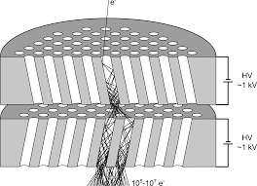
Micro Channel Plates (MCPs) as a MIP detector [1,2]
Active target-converter
MCP-Amplifier
Readout anodes
[1]A.Baldin,G.Feofilov,F.F.Valiev et al.
Microchannel plates as a detector for 800 MeV/c charged pions
and protons. // JINR Rapid Communications. 1991. No 4/50/-91. p.27-36.
[2] A.A.Baldin, G.Feofilov,Yu.Gavrilov, A.Tsvinev,F.Valiev,
Proposals for a new type of microchannel-plate-based vertex detector// NIM A323. 1992. p. 439-444.

Slide 27
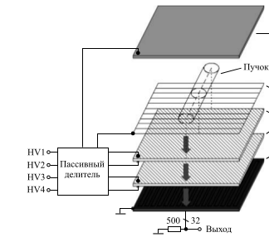
Beam Position Monitor (BPM) [1].
Anode
Gating grid
MCP-1
MCP-2
Strip readout
Beam
[1] A.Baldin, A.Berlev, I.Kudashkin, A.Fedorov, Letters to ECHAIA, 2014, vol.11, №2 (186), p.209-218

Slide 28
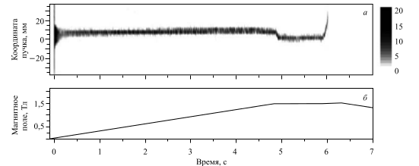
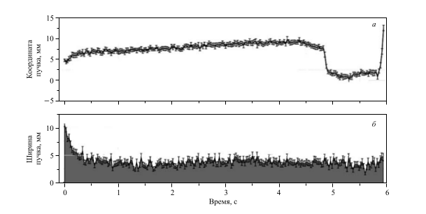
Space-time characteristics of the circulating beams
TESTS AT NUCLOTRON, JINR
Example of the deutron beam
position measurements
by using the residual gas
interaction MCP-based detector
at the NUCLOTRON.
The energy of deutron beams
was= 4GeV,
beam intensity -10⁸,
Vacuum 10⁻⁸ Torrr.[1]
[1] A.Baldin, A.Berlev, I.Kudashkin, A.Fedorov, Letters to ECHAIA, 2014, vol.11, №2 (186), p.209-218
Notes:
МКП детектор на выводе пучка из Нуклотрона
Собранный ранее, новый детектор на МКП (49Х64мм, 32канала, разрешение 2мм. ) был смонтирован в специально изготовленную камеру, установленную на выводе пучка между шибером и выходной мембраной.
Установка была успешно испытана на отсутствие течей, подключена к регистрирующей системе, проверена на работоспособность и настроена на существующий уровень электрических помех.
В течении всего сеанса проводилась регистрация данных детектора в различных режимах его работы с целью детального изучения его возможностей и недостатков.
В результате проведённых измерений было выявлено следующее:
- подтверждена принципиальная возможность использования МКП детектора в качестве неразрушающего профилометра на выведенном пучке.
- выявлены недостатки в конструкции детектора, систем регистрации и отображения в условиях его конкретного специфического расположения в зоне повышенного фона рассеяния. Эти недостатки будут устранены или минимизированы при модернизации существующего и (или) изготовлении новых детекторов.

Slide 29
Space-time characteristics of the circulating beams
TESTS AT NUCLOTRON, JINR in February-April 2018
Dynamic profile of an accelerated krypton beam inside the NUCLOTRON accelerator ring (Vertical readings of the upper pattern in mm).
Example of the Kr beam position measurements at the NUCLOTRON. The energy of beams was 3.5GeV , beam intensity --10⁶, vacuum { 10⁻⁸ Torrr. Time Slice = 5,5 ms. Y scale has 3 mm channel bin width.
Notes:
Работы проделанные в рамках сеанса февраль-апрель 2018.
МКП детекторы на 7-м прямолинейном участке кольца Нуклотрона в районе станции внутренних мишеней.
Накоплен богатый методический материал по работе детектора на основе МКП, расположенного внутри кольца Нуклотрона на теплом прямолинейном промежутке в районе станции внутренних мишеней. Информация о пространственно временном расположении пучка в ускорителе передавалась в on-line режиме на пульт Нуклотрона и пульт линейного ускорителя. Детектор был запущен в начале работы с пучками углерода и выключен 05.05.2018 в 20:00 Детектор успешно проработал весь сеанс. Обеспечено круглосуточное, непрерывное предоставление информации в графическом виде в режиме on-line на пульт Нуклотрона и пульт линейного ускорителя ЛУ-20.

Slide 30
NICA collider : from protons and polarized deuterons to very massive gold ions
Heavy ions will be accelerated up to kinetic energy of 4.5 GeV per nucleon, the protons – up to 12.6 GeV.
Two interaction points are foreseen: one for heavy-ion studies with the MPD detector [1] and another for polarized beams for the SPD experiment [2].
[1] V. Golovatyuk, V. Kekelidze, V. Kolesnikov, O. Rogachevsky, A. Sorin, The Multi-Purpose Detector (MPD) of the collider experiment, Eur. Phys. J. A52 (8) (2016) 212. doi:10.1140/epja/i2016-16212-1.
[2] R.Abramishvili, et al., Spin Physics Experiments at NICA-SPD with polarized proton and deuteron beam. Letter of Intent, LoI-02.06.14 , JINR, Dubna.

Slide 31
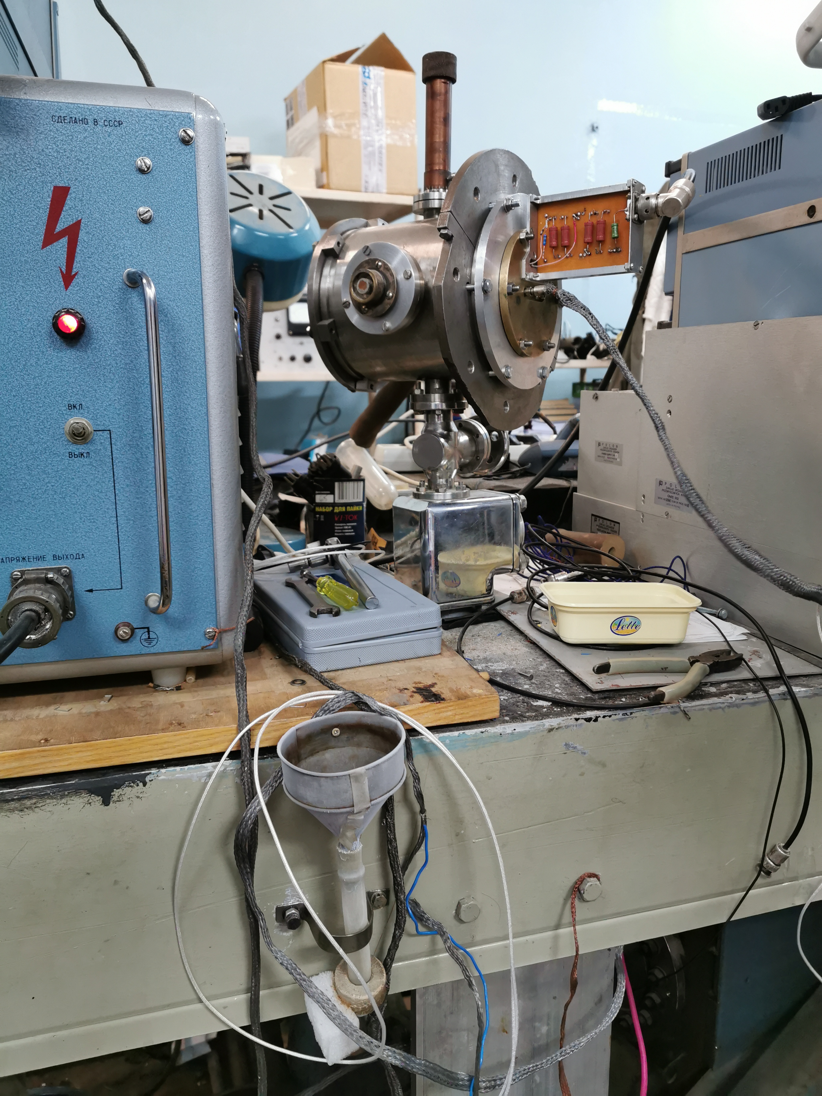
MCP test bench at SPbSU
Passive summator based on circular bridges (UHF microelectronics design) assembled inside the test board. 8 inputs 50 Ohm , 1 coaxial 50 Ohm output, 8 charge outputs.

Slide 32
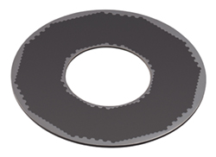
Micro Channel Plates
OPTIONS:
High resolution rectangular 43x63 mm² MCPs
with 6-15 µm - channel diameter -- could be used for the BPM
2) Sector type MCPs with the multipad isochronous readout
of the MCP array--could be used for the FBBC
3) MCP 56-15ch 12-15 with 15 µm - channel diameter
--could be considered for a very compact FBBC
placed inside the vacuum beam pipe
(Dimensions: 24 mm center hole and
the outer diameteris 60 mm)
OPTIONS:
VTC "BASPIK" detectors with a gap clearance between MCPs (with separated power supply). https://baspik.com/eng/news/456/
This unique feature helps to get amplification gain factor above 1×10⁷

