Slide 1
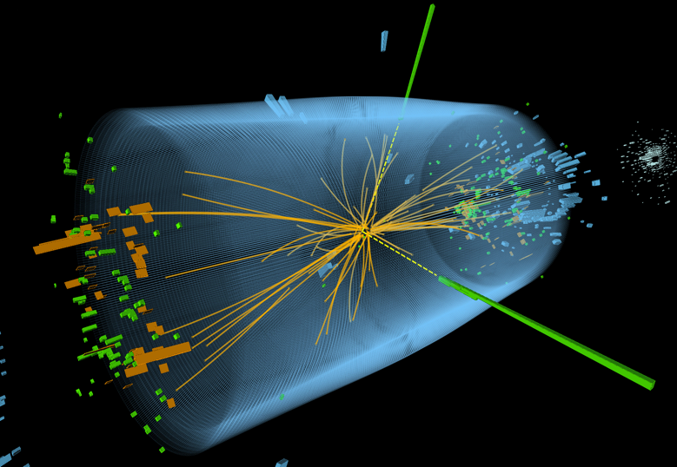
Manfred Jeitler
LHC results and future collider projects
Lecture 1:
The discovery of the Higgs boson

Slide 2
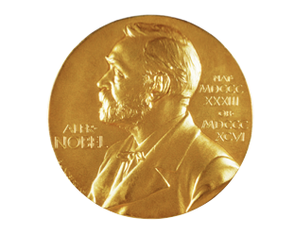
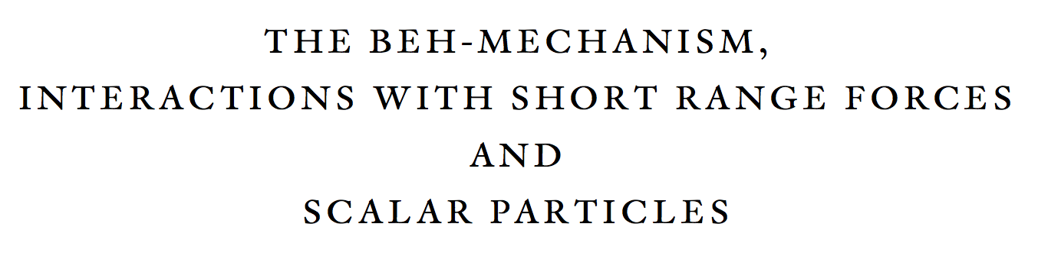


Slide 3
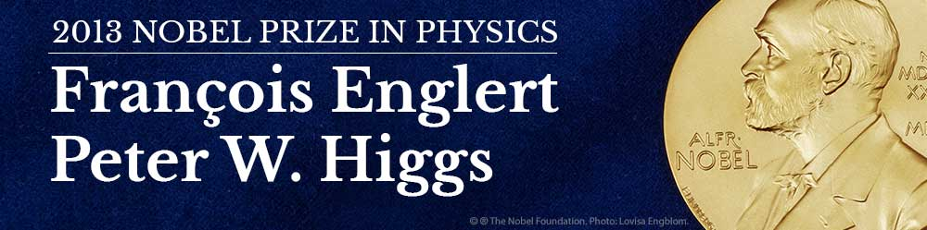
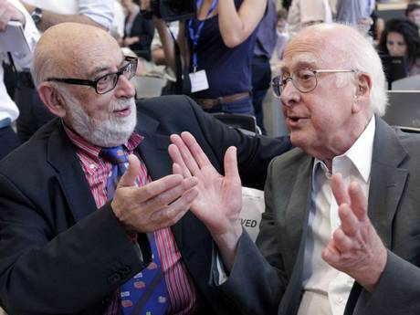
8 October 2013
The Royal Swedish Academy of Sciences has decided to award the Nobel Prize in Physics for 2013 to
François Englert and Peter Higgs
“for the theoretical discovery of a mechanism that contributes to our understanding of the origin of mass of subatomic particles, and which recently was confirmed through the discovery of the predicted fundamental particle, by the ATLAS and CMS experiments at CERN’s Large Hadron Collider”

Slide 4

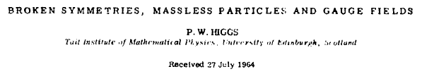
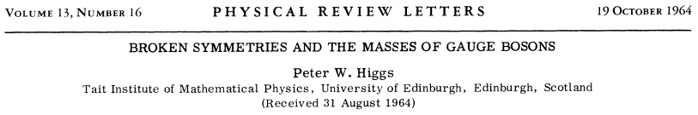

The Seminal Papers

Slide 6
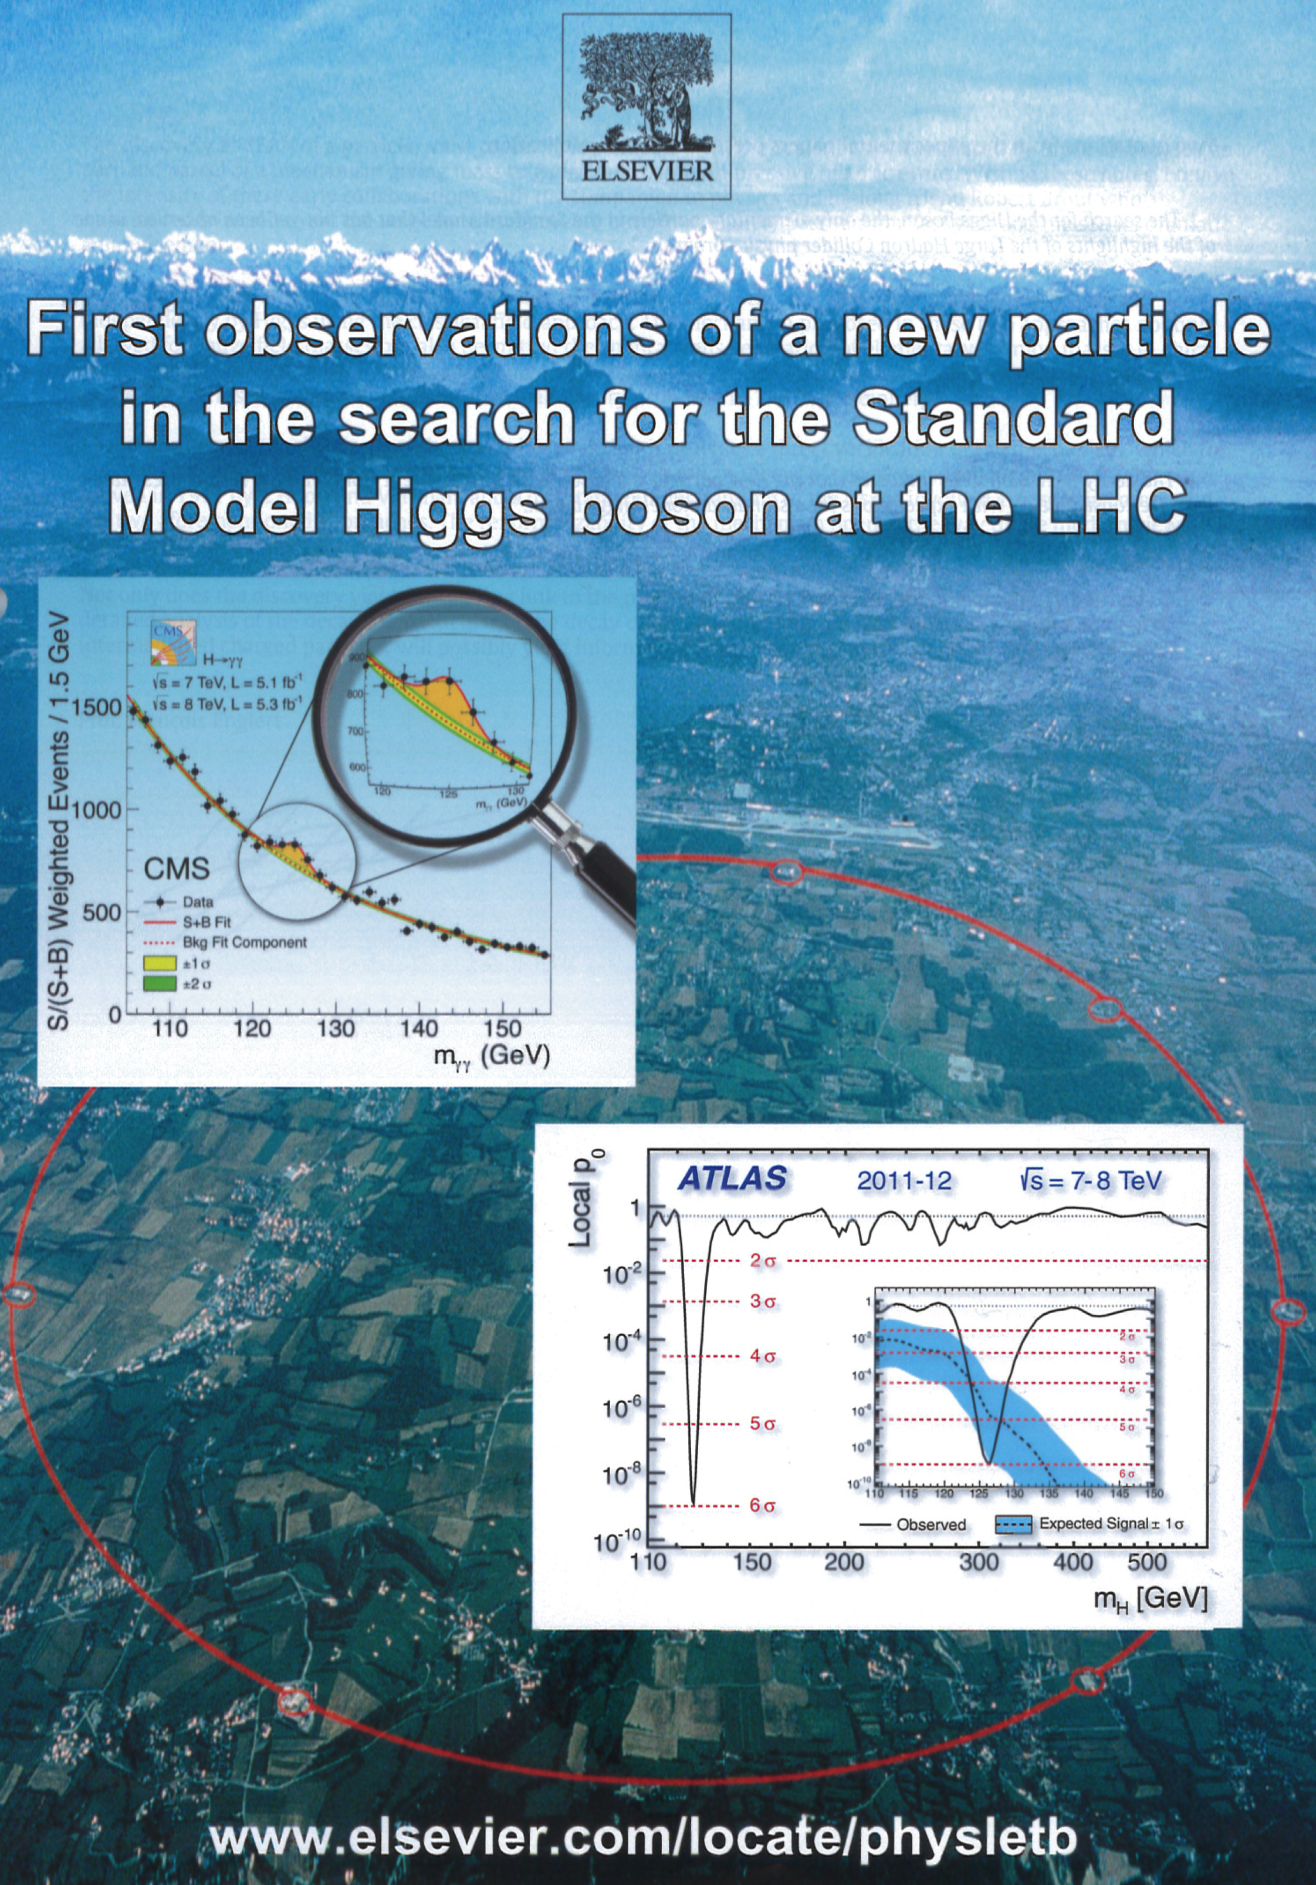
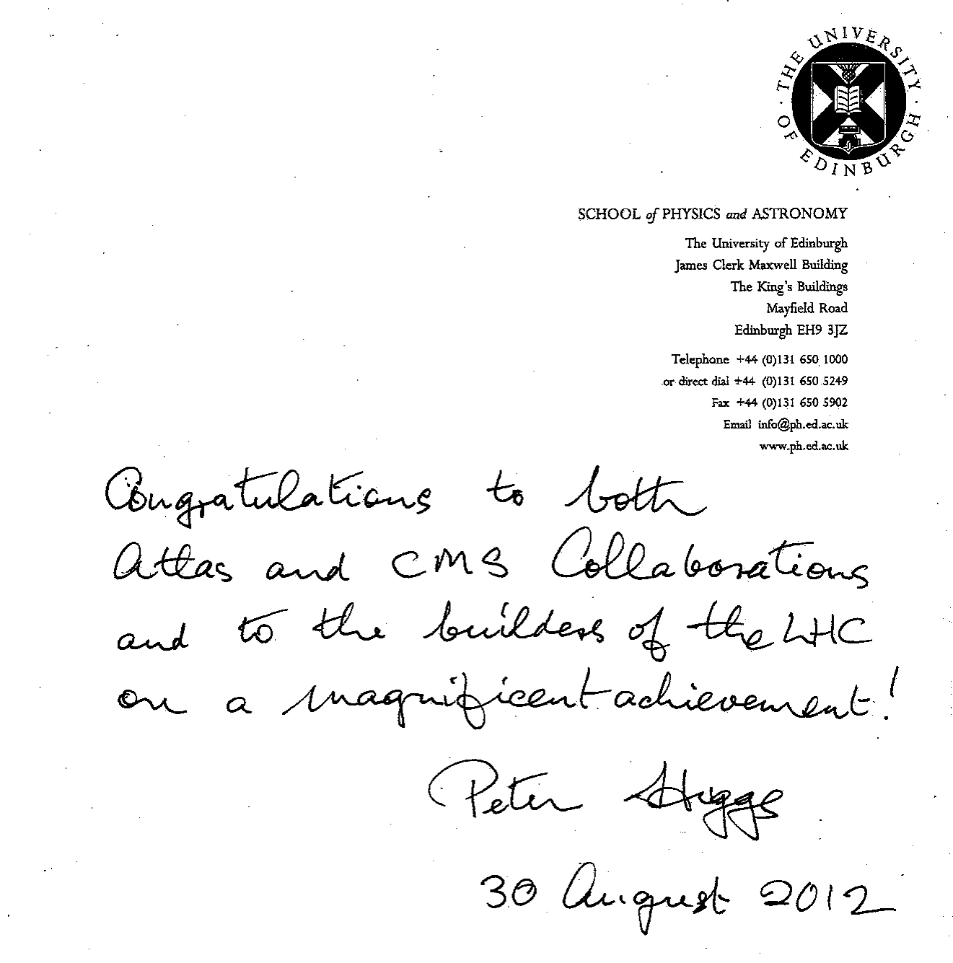
Publication of results in
Journal Physics Letters

Slide 7
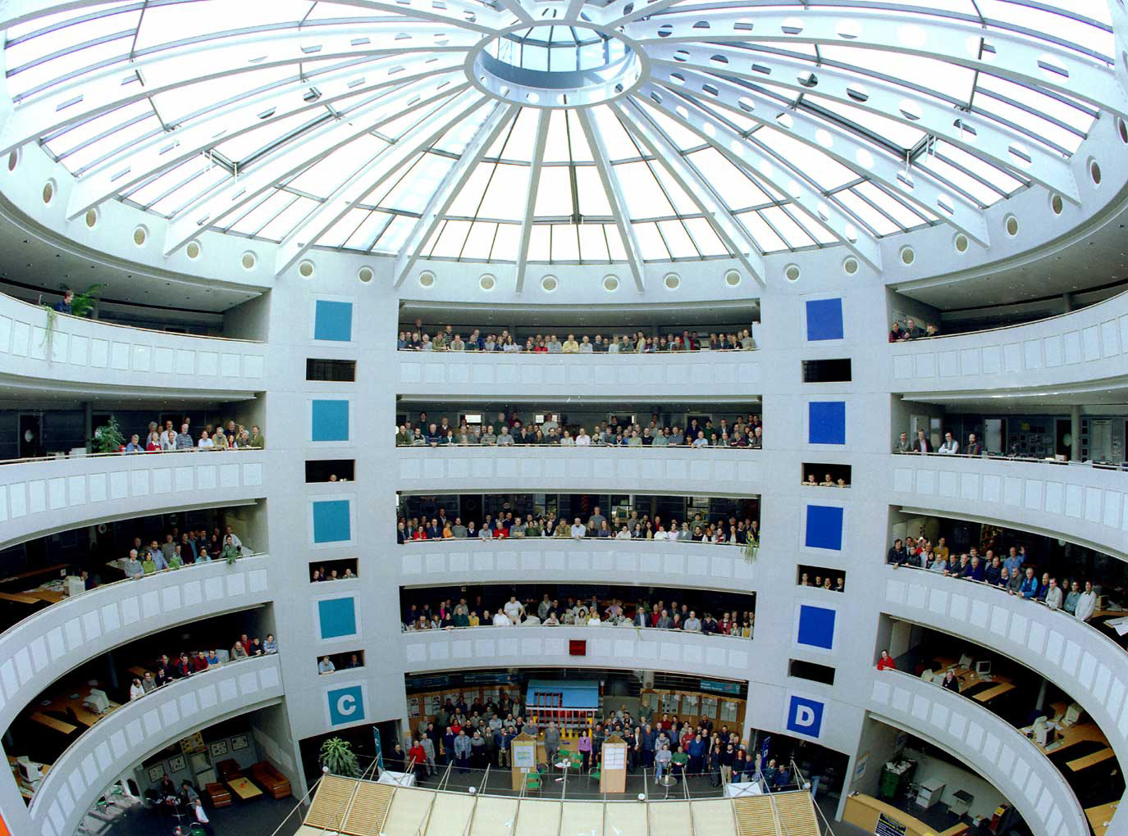
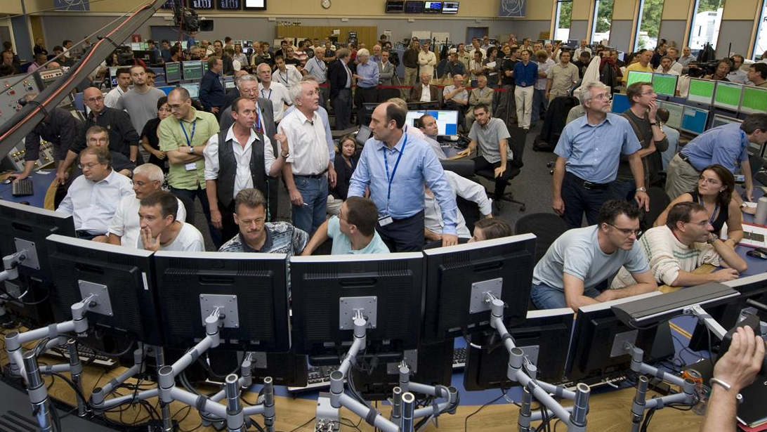
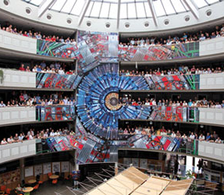
ATLAS
LHC
8 October 2013
The Royal Swedish Academy of Sciences has decided to award the Nobel Prize in Physics for 2013 to
François Englert and Peter Higgs
“for the theoretical discovery of a mechanism that contributes to our understanding of the origin of mass of subatomic particles, and which recently was confirmed through the discovery of the predicted fundamental particle, by the ATLAS and CMS experiments at CERN’s Large Hadron Collider”
CMS

Slide 8

Quarks
Forces
?
Standard Model
Leptons

Slide 9
Quarks
Forces
Standard Model
Leptons

Slide 10
Why do we need a Higgs boson?
The Standard Model describes all particles we know ...
... but all these particles would be massless!
  most of the mass of the matter we see is due to the interaction between elementary particles
  so, it is not true that “without the Higgs boson there would be no mass”

Slide 11
Why do we need a Higgs boson?
The Standard Model describes all particles we know ...
... but all these particles would be massless!
  most of the mass of the matter we see is due to the interaction between elementary particles
  so, it is not true that “without the Higgs boson there would be no mass”
  however, experiment shows that the elementary particles themselves also have some mass (and W and Z bosons are very heavy!)
  adding mass terms “by hand” would destroy the theory
The formulae of the Standard Model can be modified in a way to give mass to elementary particles …
… but then the Model predicts a new particle: the Higgs boson
  found only in 2012
  had to exist if the Standard Model was correct!

Slide 12
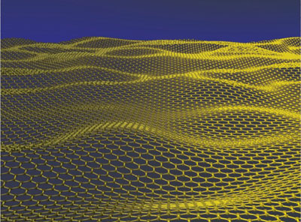
Higgs field permeating all space
All massive particles interact with this field

Slide 13
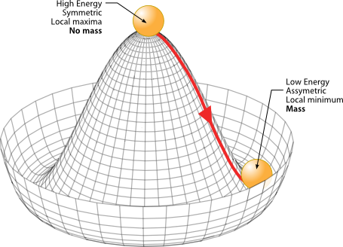
Spontaneous symmetry breaking
Introducing mass “by hand” would destroy the theory
keep basic symmetry but introduce non-zero mass by spontaneous symmetry breaking
“Mexican hat” potential

Slide 14
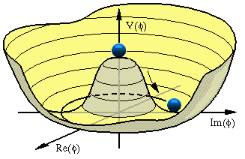
The Higgs mechanism
The solution: Glashow-Salam-Weinberg used a model elaborated by several authors at the beginning of the 1960s
    the gauge symmetry of the model is conserved
    but the ground state of a new field
    “spontaneously” breaks the symmetry
      analogous to ferromagnetism
  the minimal solution introduces a doublet of complex
  scalar fields – 4 degrees of freedom – and
  a non-zero vacuum expectation value v (≈246 GeV)
    one component corresponds to a physical, electrically neutral
    scalar particle – the “Higgs boson”
    the remaining components add a new degree of freedom to
    the W± and Z bosons (longitudinal polarization); mass terms appear
“Weinberg angle”
Notes:
v = 246 GeV
sin theta ~ 0.5 (more exactly: 0.47) → theta = 28 degrees cos theta = 0.88
e / sin theta = g (coupling)
electric charge e: e/sqrt(eps0 hbar c) = sqrt (4 pi alpha) ~ 0.3

Slide 15
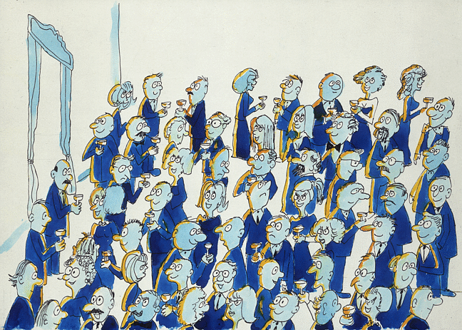
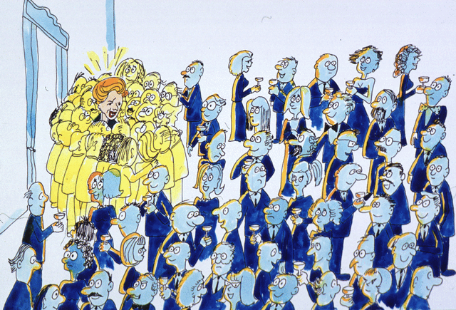
The Higgs mechanism
illustrated by David Miller
A uniform field can give mass to a passing particle

Slide 16
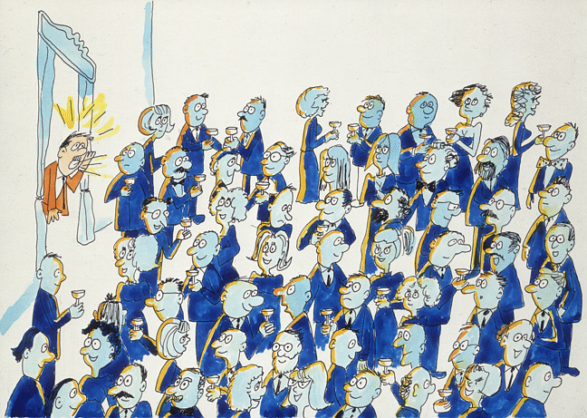
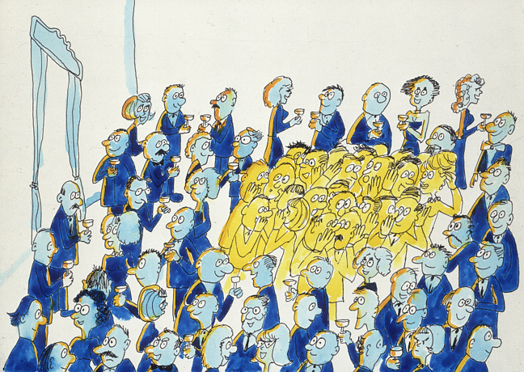
The Higgs mechanism
illustrated by David Miller
A uniform field can give mass to a passing particle
Even without a passing particle, the field can form “clusters”:
this is the Higgs boson
The Higgs mechanism illustrated
by David Miller

Slide 17
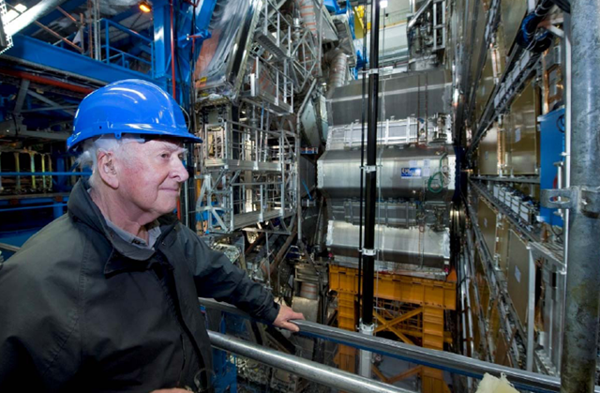

(Prof. Peter) Higgs at the ATLAS experiment

Slide 18
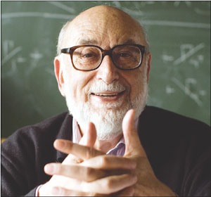
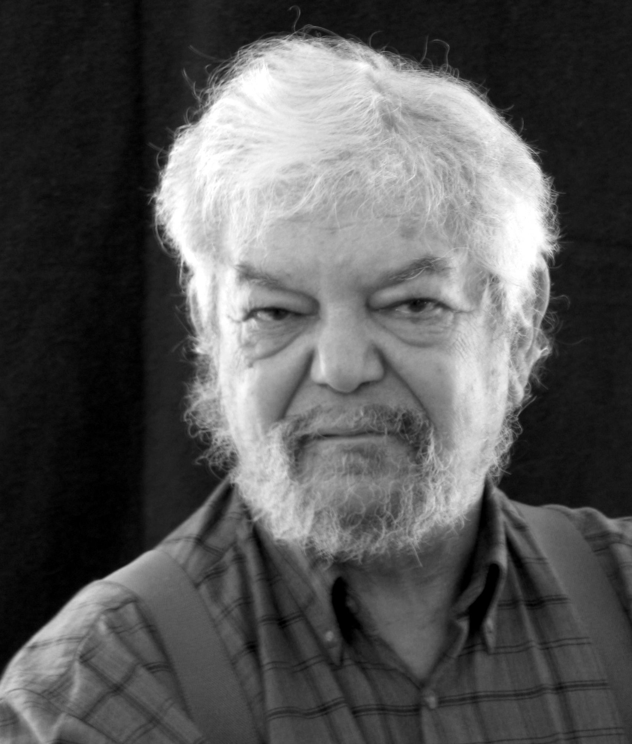
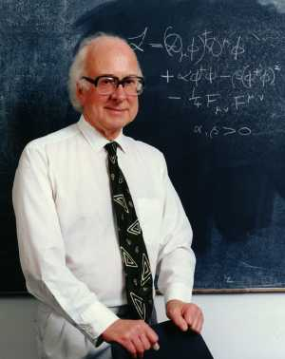
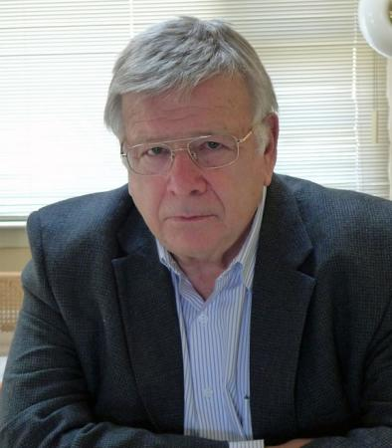
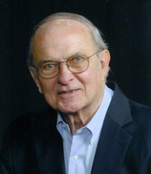
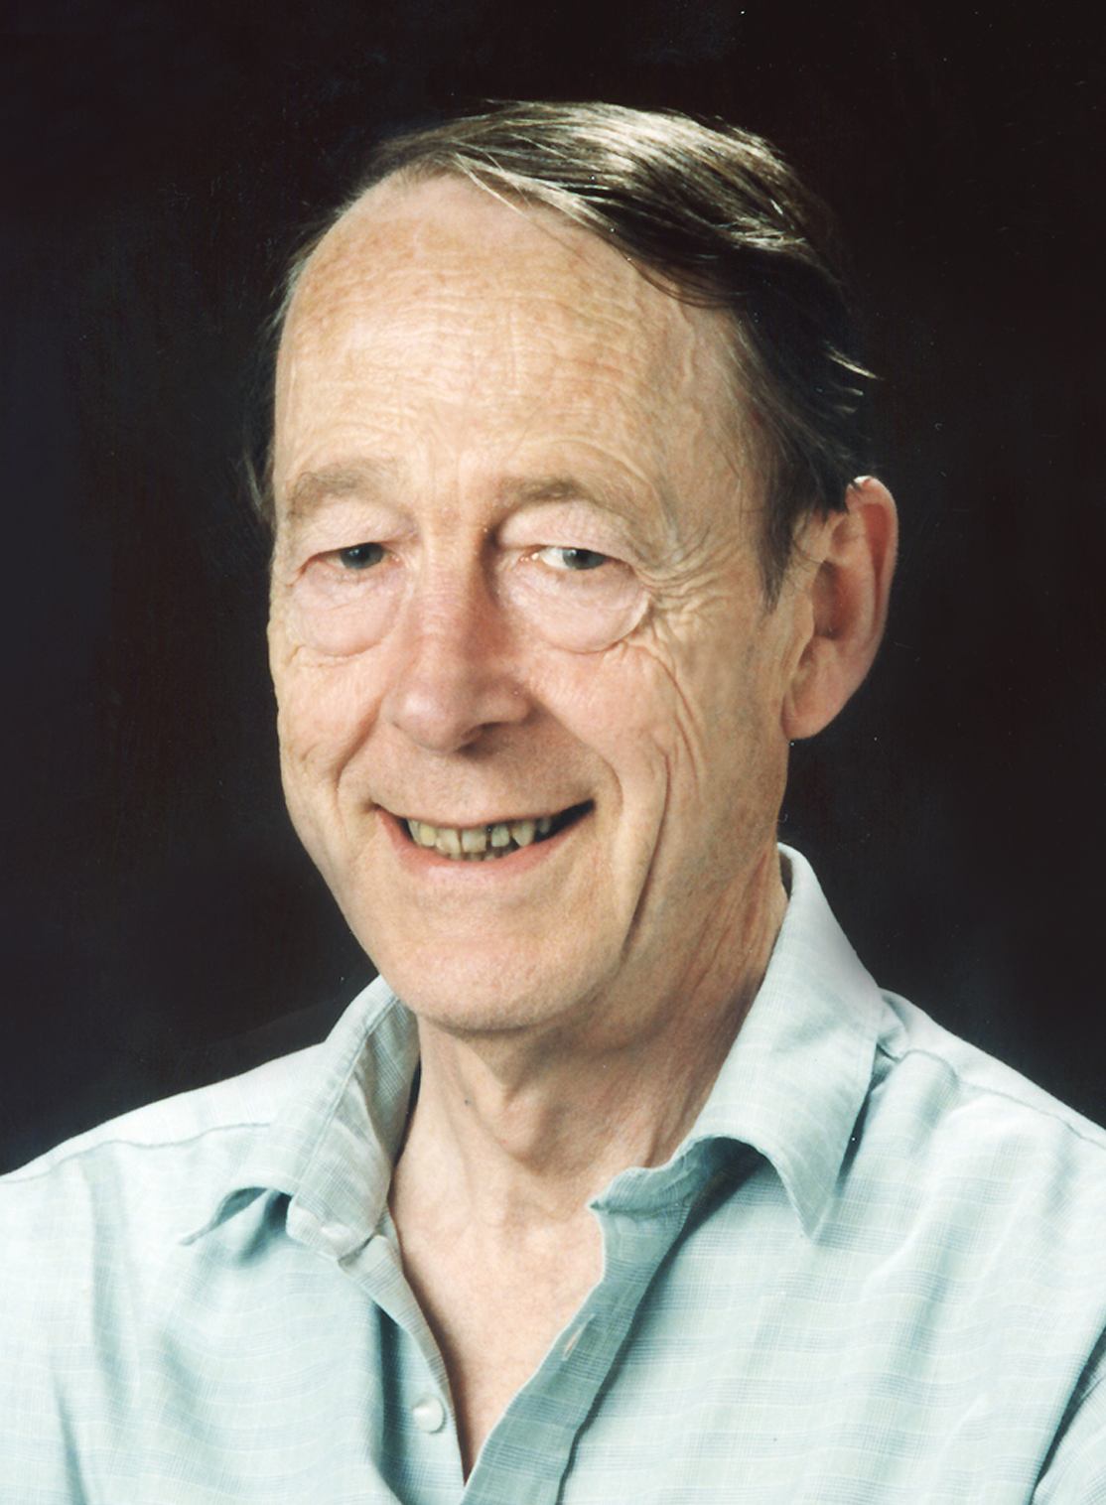
[P.W. Higgs,
“Broken symmetries, massless particles and gauge fields”,
Phys.Lett.12(1964)132]
[P.W. Higgs,
“Broken symmetries and the masses of gauge bosons”,
Phys.Rev.Lett.13(1964)508]
F. Englert
R. Brout
(1928-2011)
[F. Englert and R. Brout,
“Broken symmetry and the mass of gauge vector mesons”,
Phys.Rev.Lett.13(1964)321]
P.W. Higgs
[G.S.Guralnik, C.R.Hagen, T.W.B.Kibble, “Global conservation laws and massles particles”, Phys.Rev.Lett.13(1964)585]
G.S. Guralnik
C.R. Hagen
T.W.B. Kibble

Slide 19
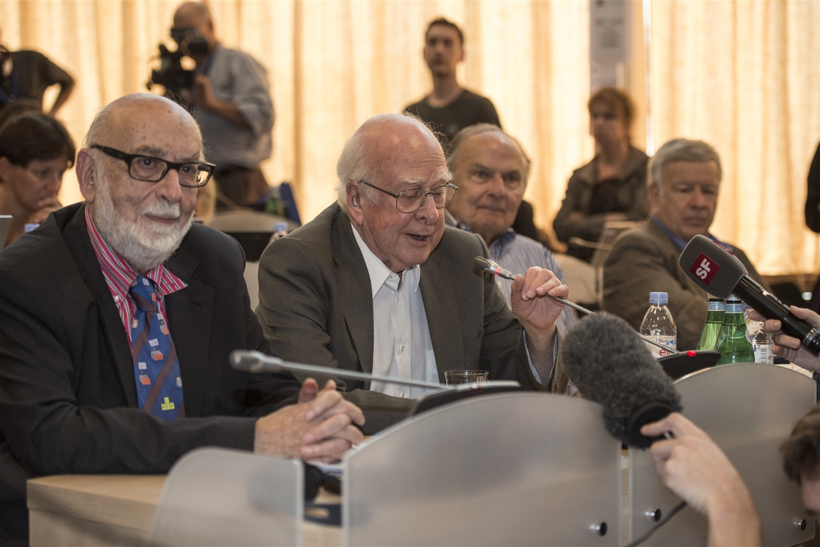
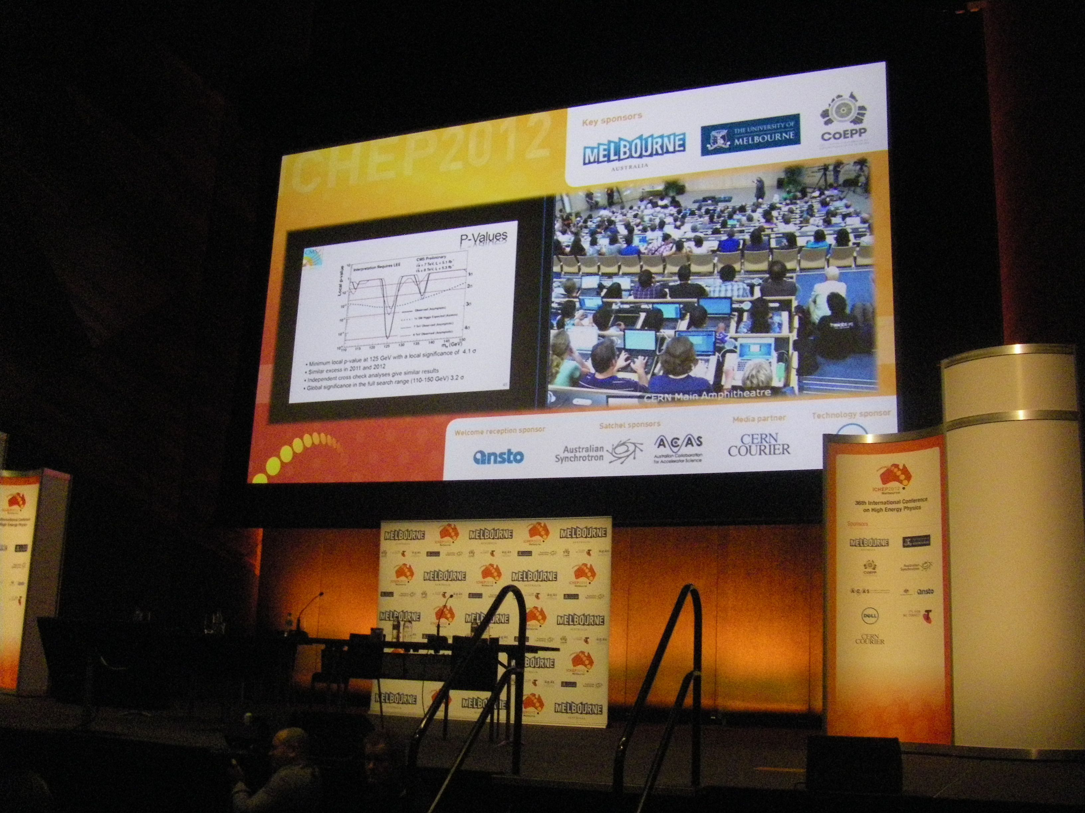
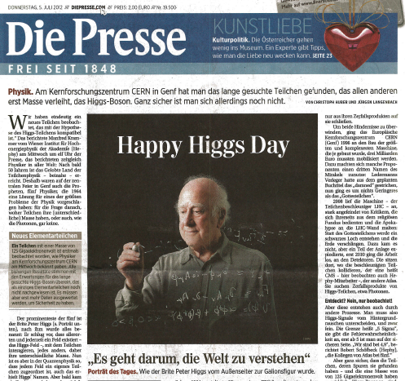
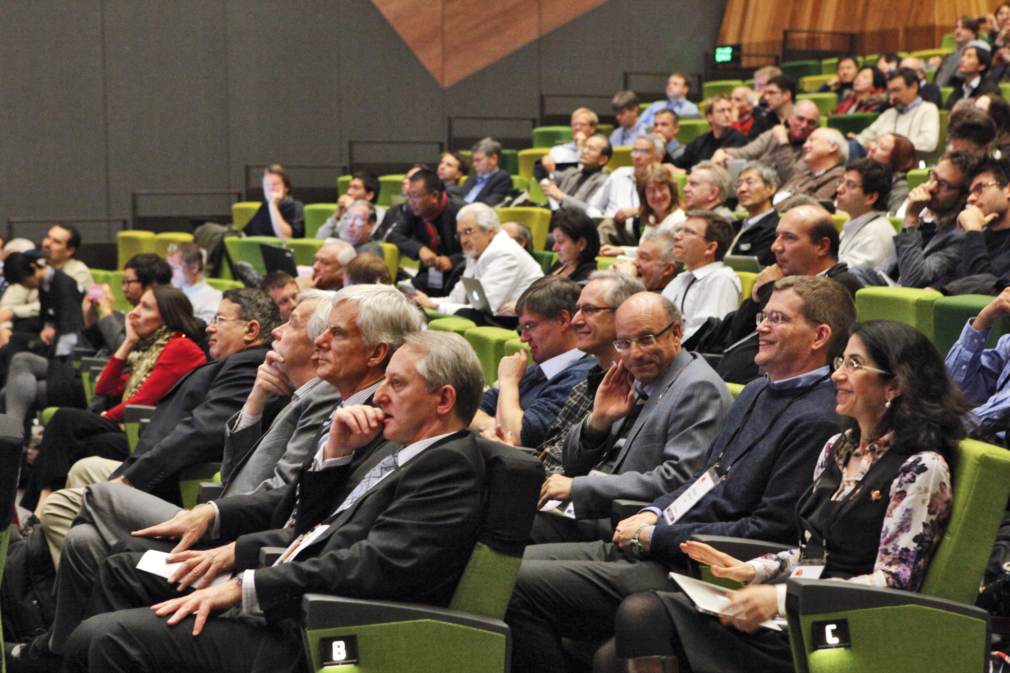
1964 theoretical studies
CERN
4 July 2012
C. R. Hagen
G. Guralnik
P. Higgs
T. Kibble
F. Englert
R. Brout
ICHEP Melbourne
4. Juli 2012

Slide 20
How can we “find” an elementary particle?
most elementary particles are not stable
many of them are so short-lived that they never reach our detectors
  although travelling almost at the speed of light
  in particular, this is also true for the Higgs boson
what we see are decay products
  “messenger particles”
  they allow us to draw conclusions concerning the “mother” particle
  in particular, we can calculate its mass:

Slide 21
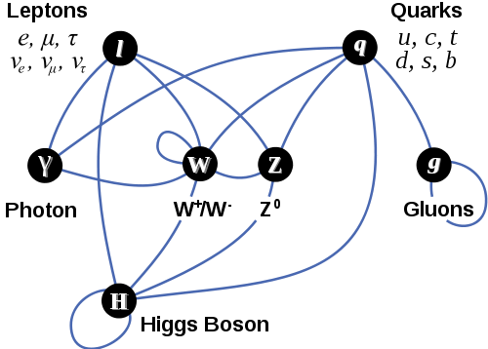
Higgs couples to all massive particles

Slide 22
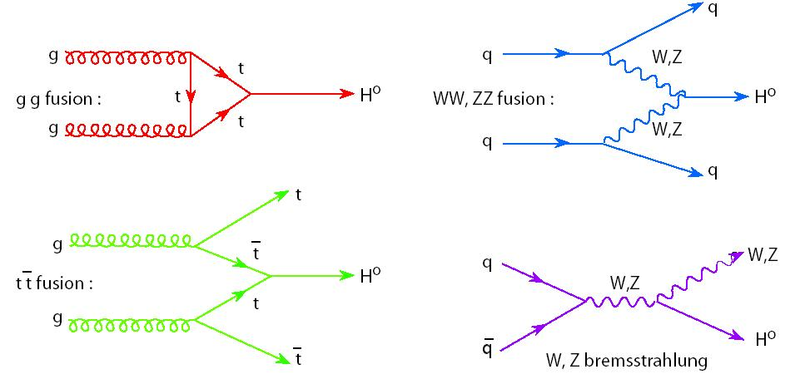
Higgs production
Notes:
Feynman graphs; time from left to right

Slide 23
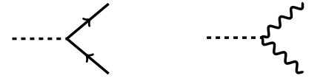
Higgs decays
H
H

Slide 24
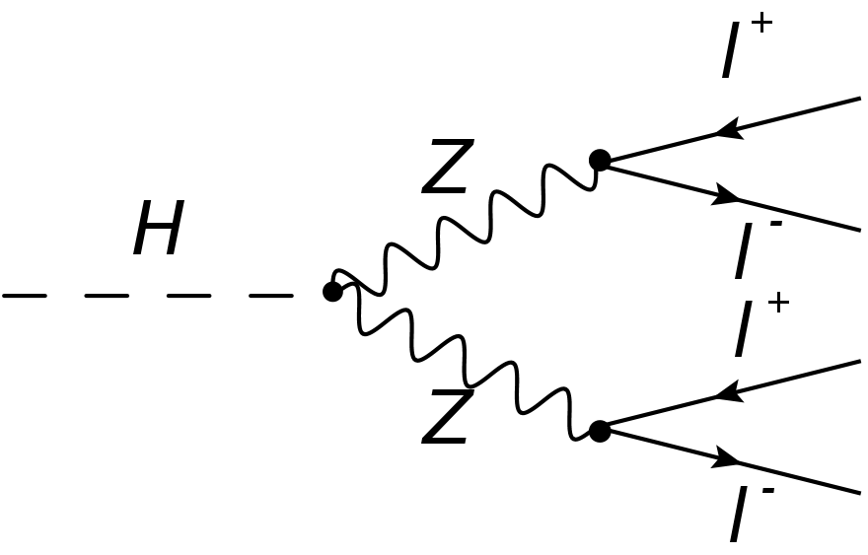
Higgs decays
H
H

Slide 25
Higgs decay to two photons

Slide 26
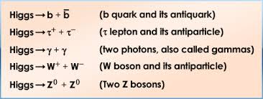
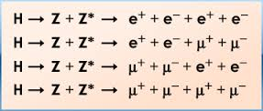
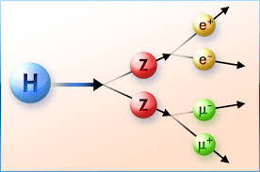
Higgs signatures

Slide 27
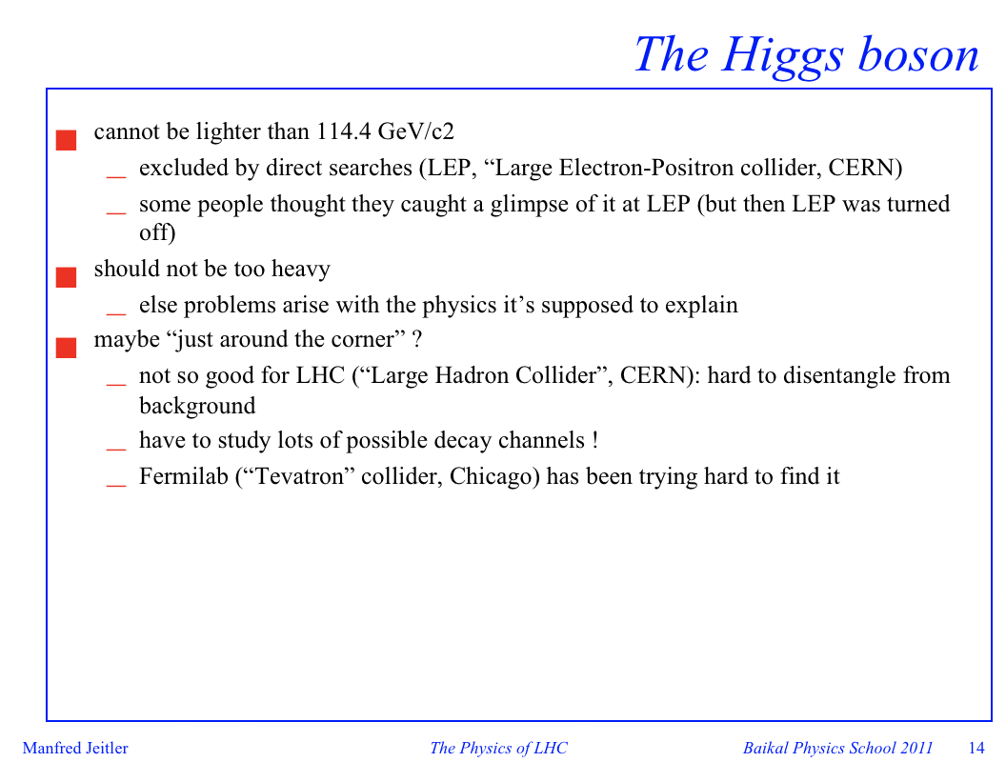
slide from 2011:

Slide 28
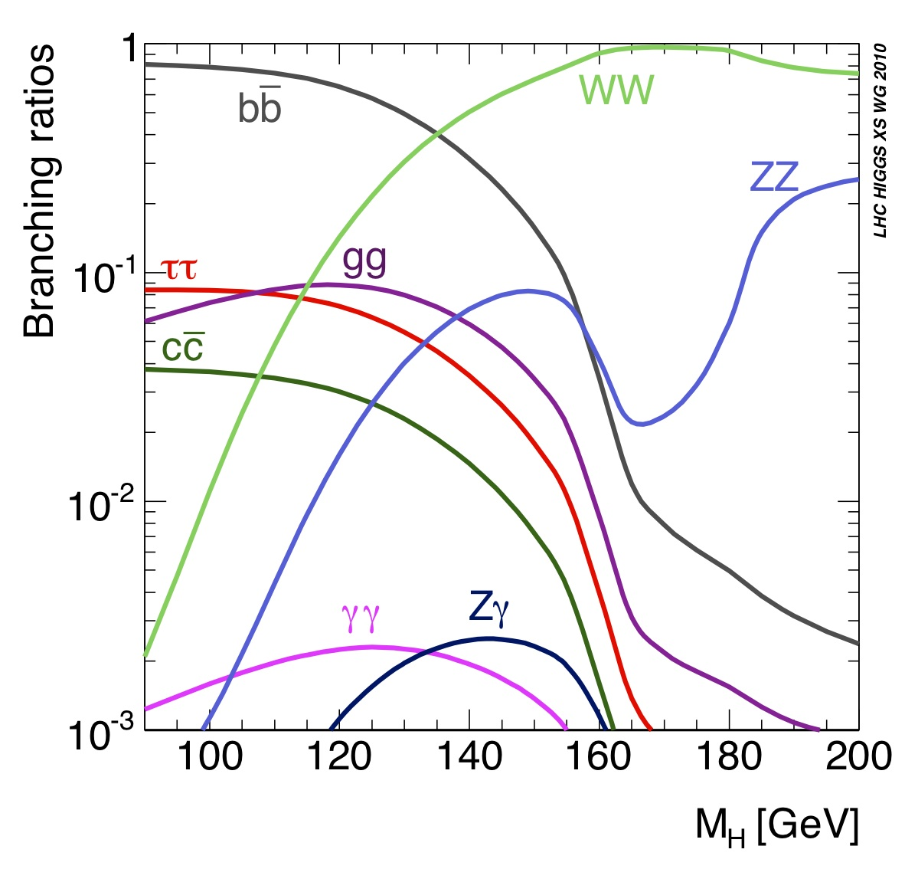
Higgs decays (branching ratios)

Slide 29
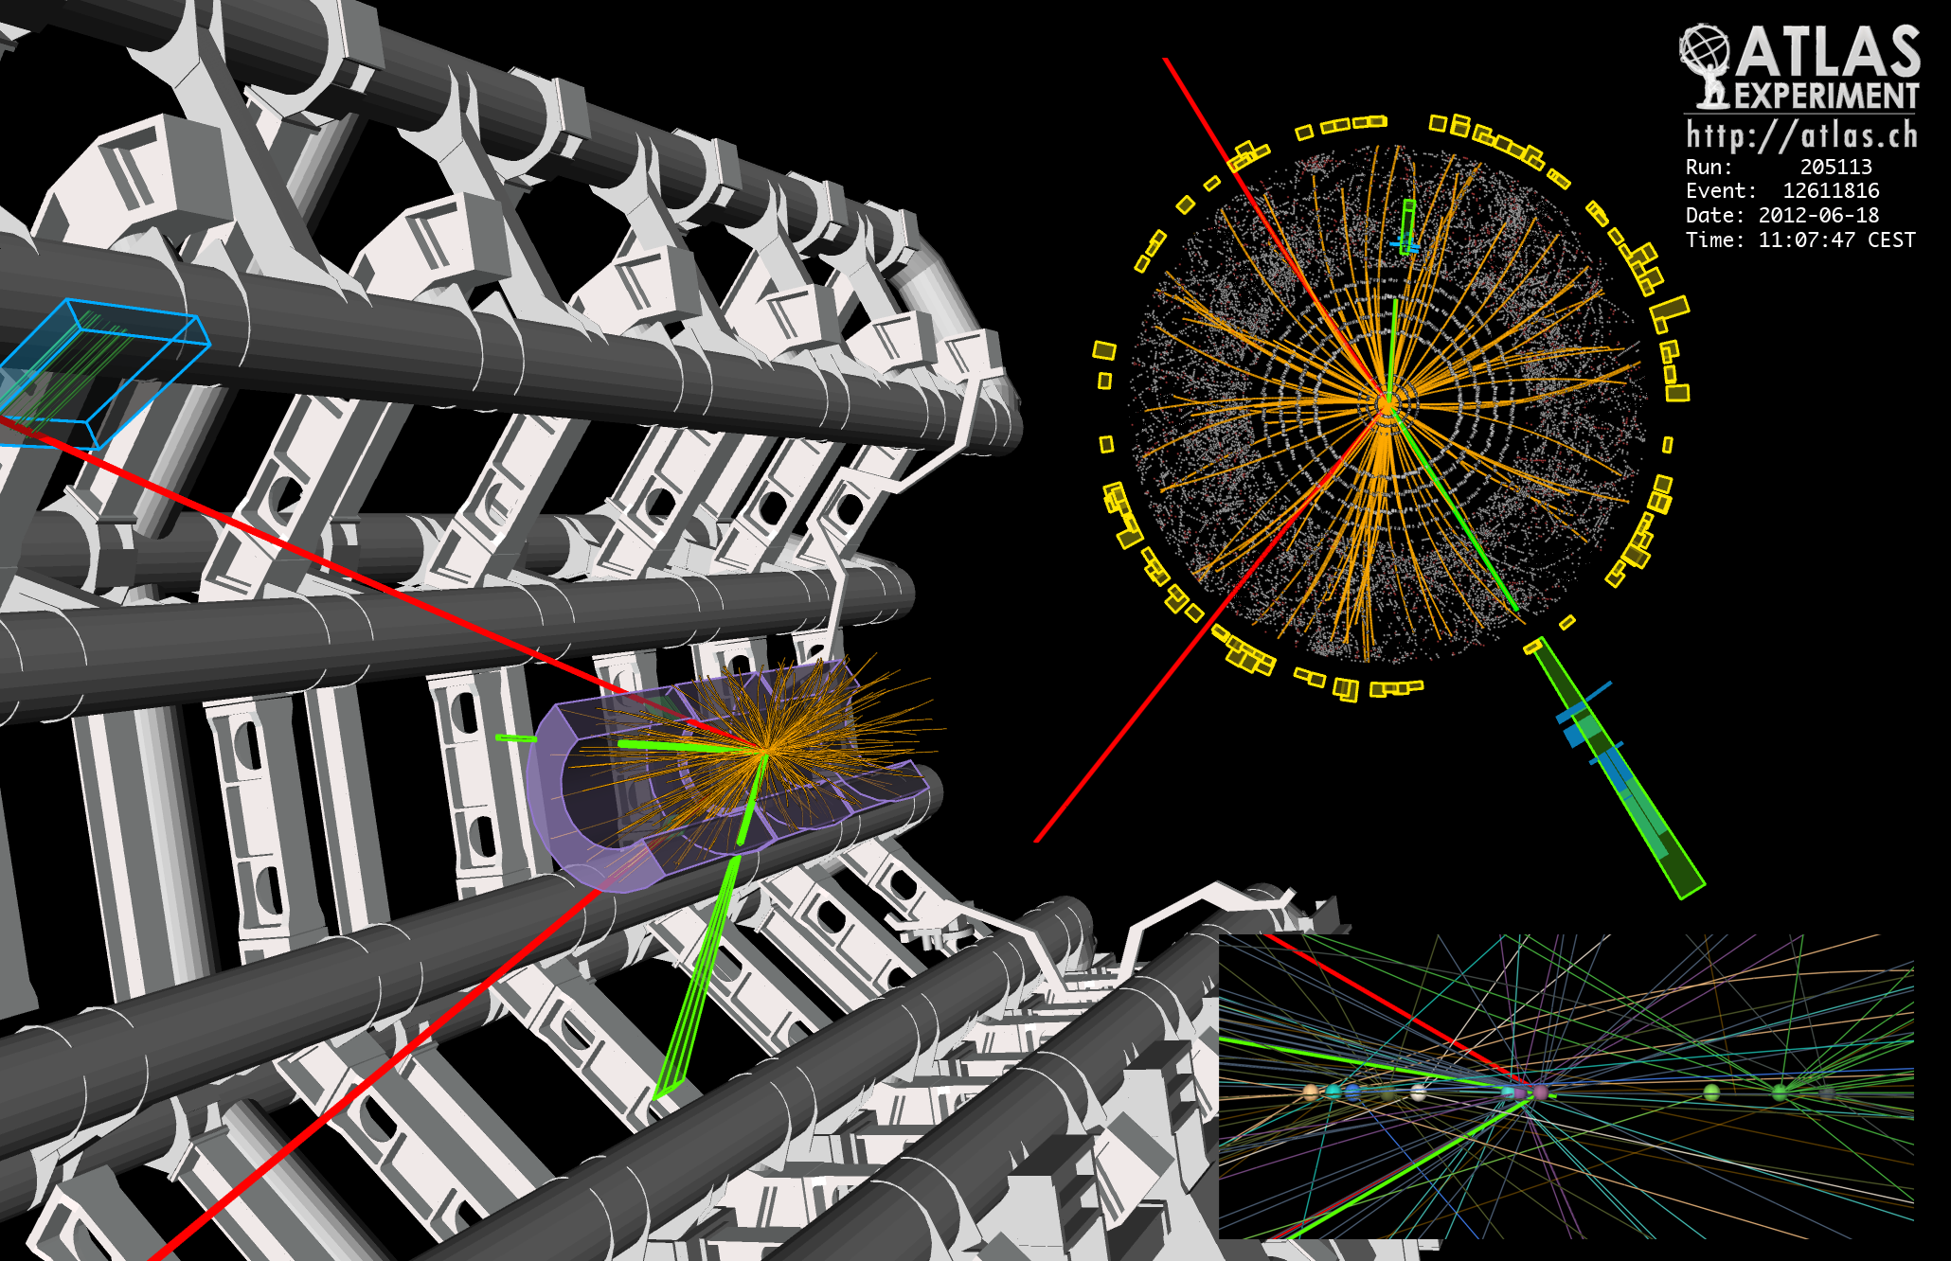
H → ZZ → 2μ + 2e
C.-E. Wulz
29

Slide 30
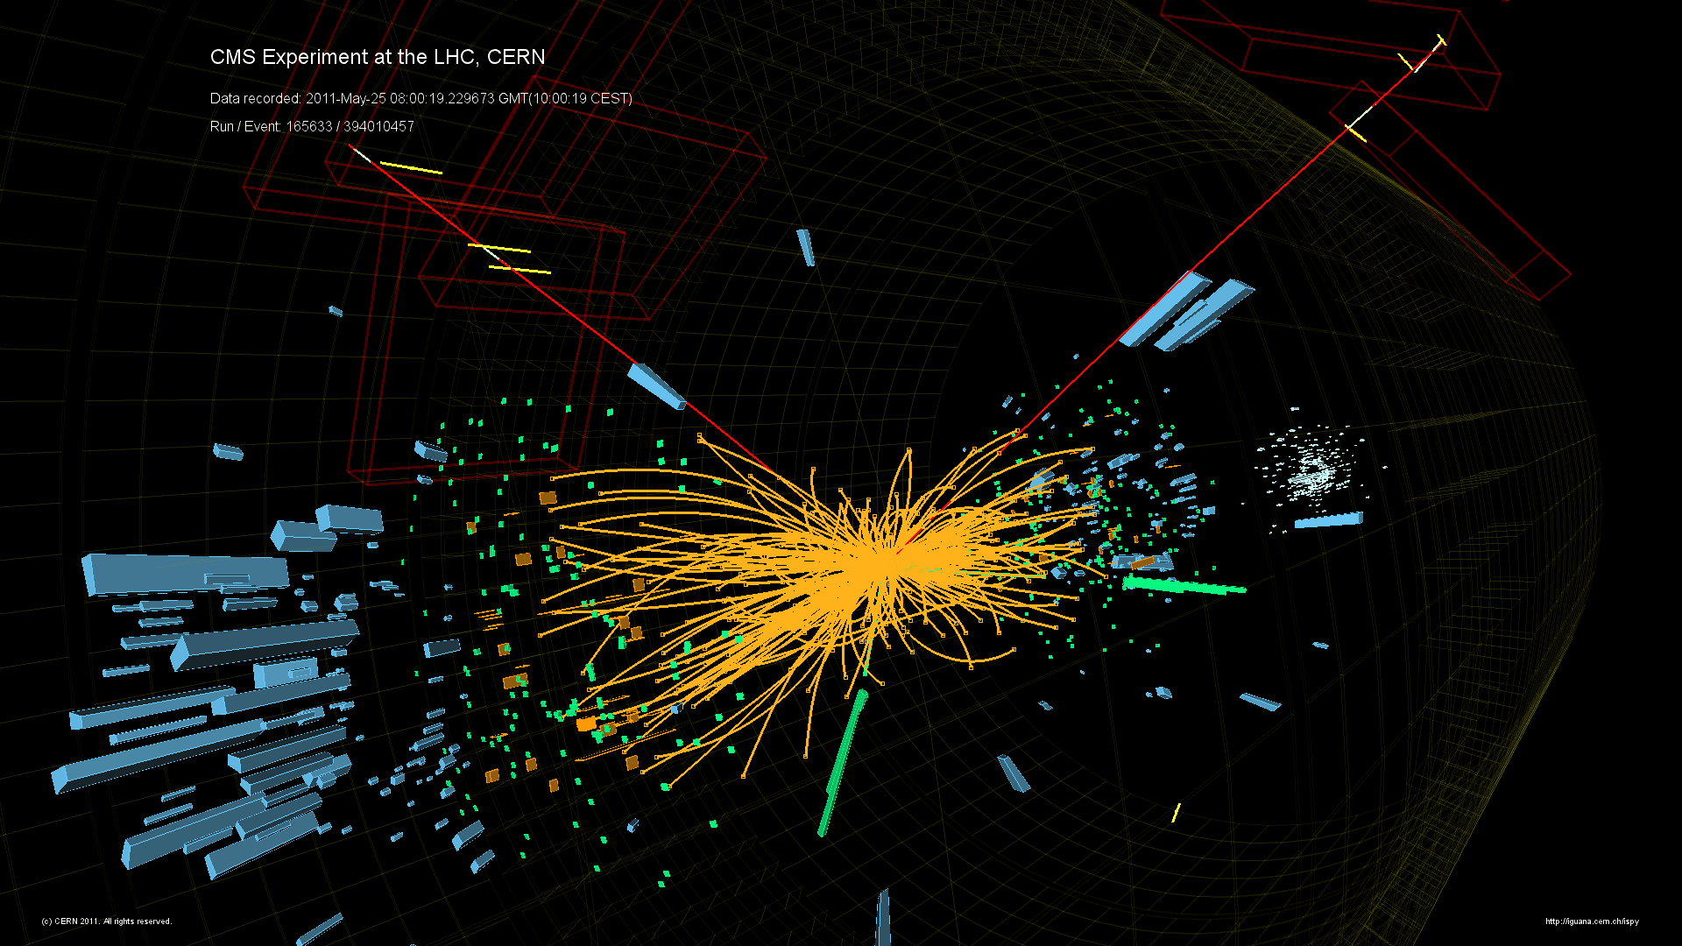

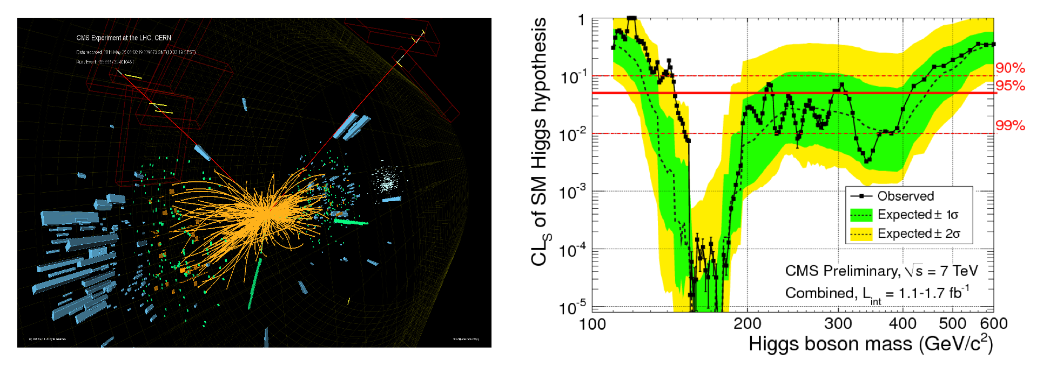
H -> eeμμ candidate

Slide 31
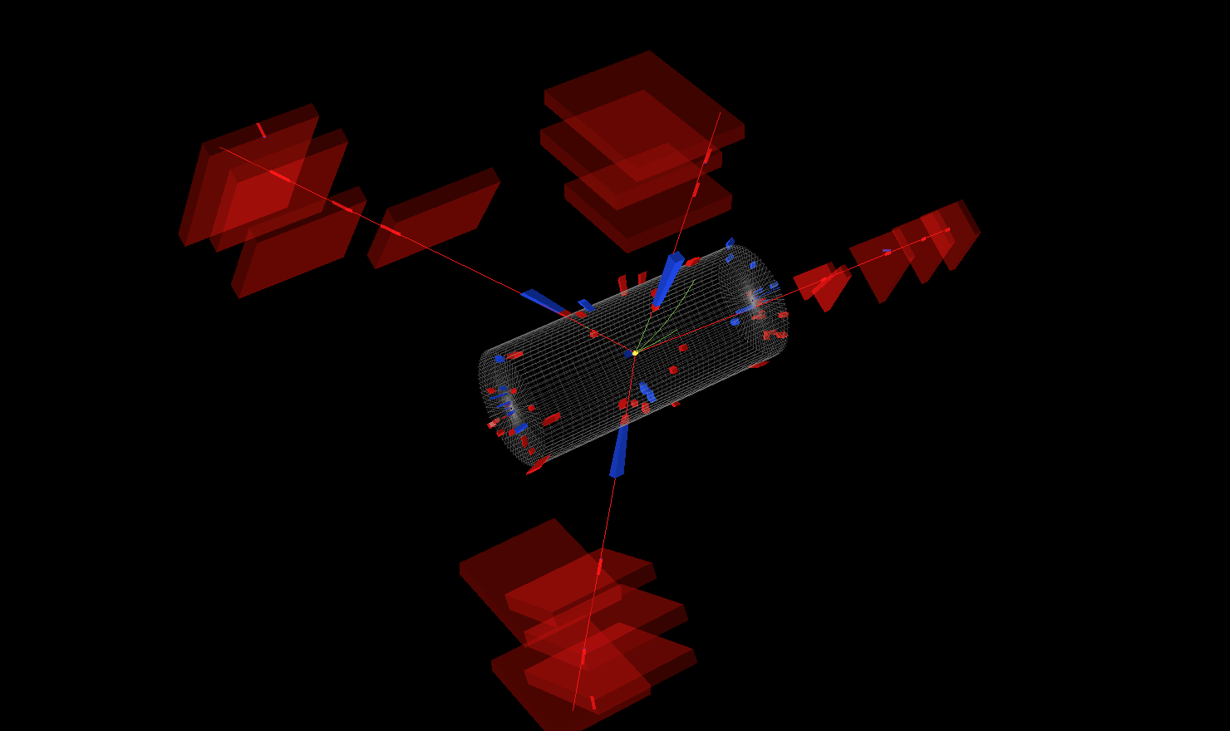
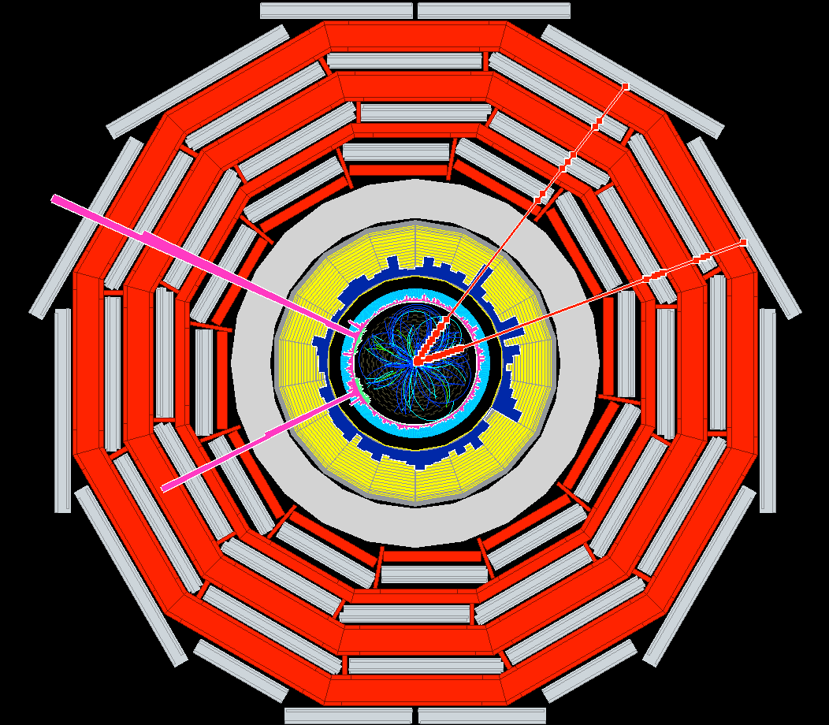
Simulated decay of a Higgs boson
4 muons
C.-E. Wulz
31

Slide 32
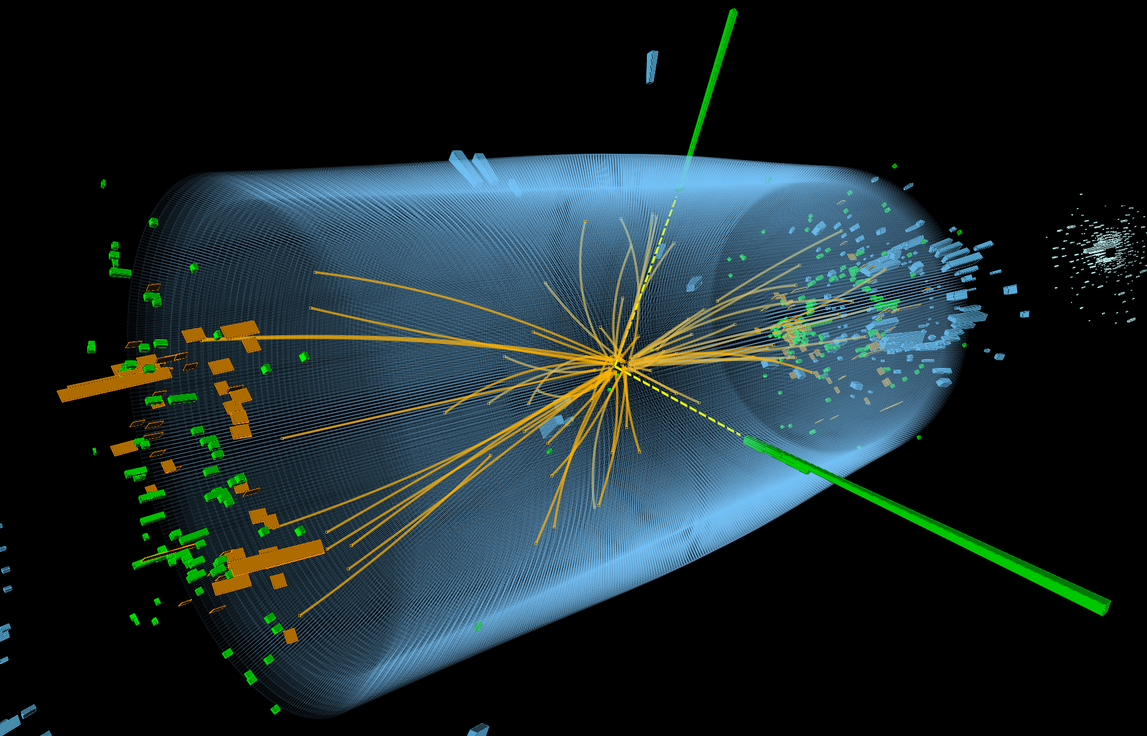
H → 2γ

Slide 33
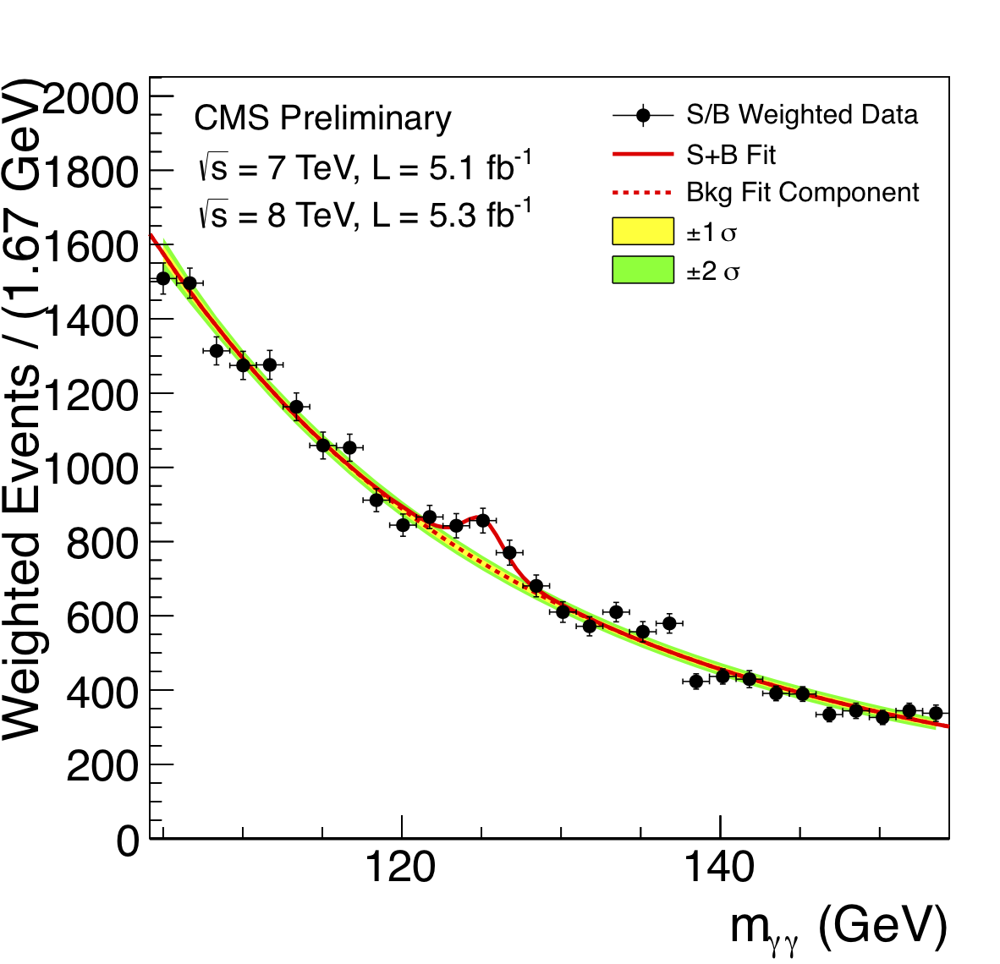
Higgs signal in γγ-channel
(decay into two photons)

Slide 34
H → γγ

Slide 35
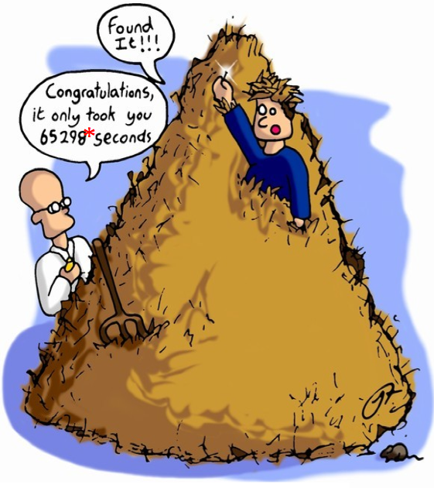
The Higgs boson: looking for a needle in a haystack
an individual event cannot be identified for sure as showing a Higgs boson decay
there are only “candidate events”
only the statistical distribution proves its existence

Slide 36
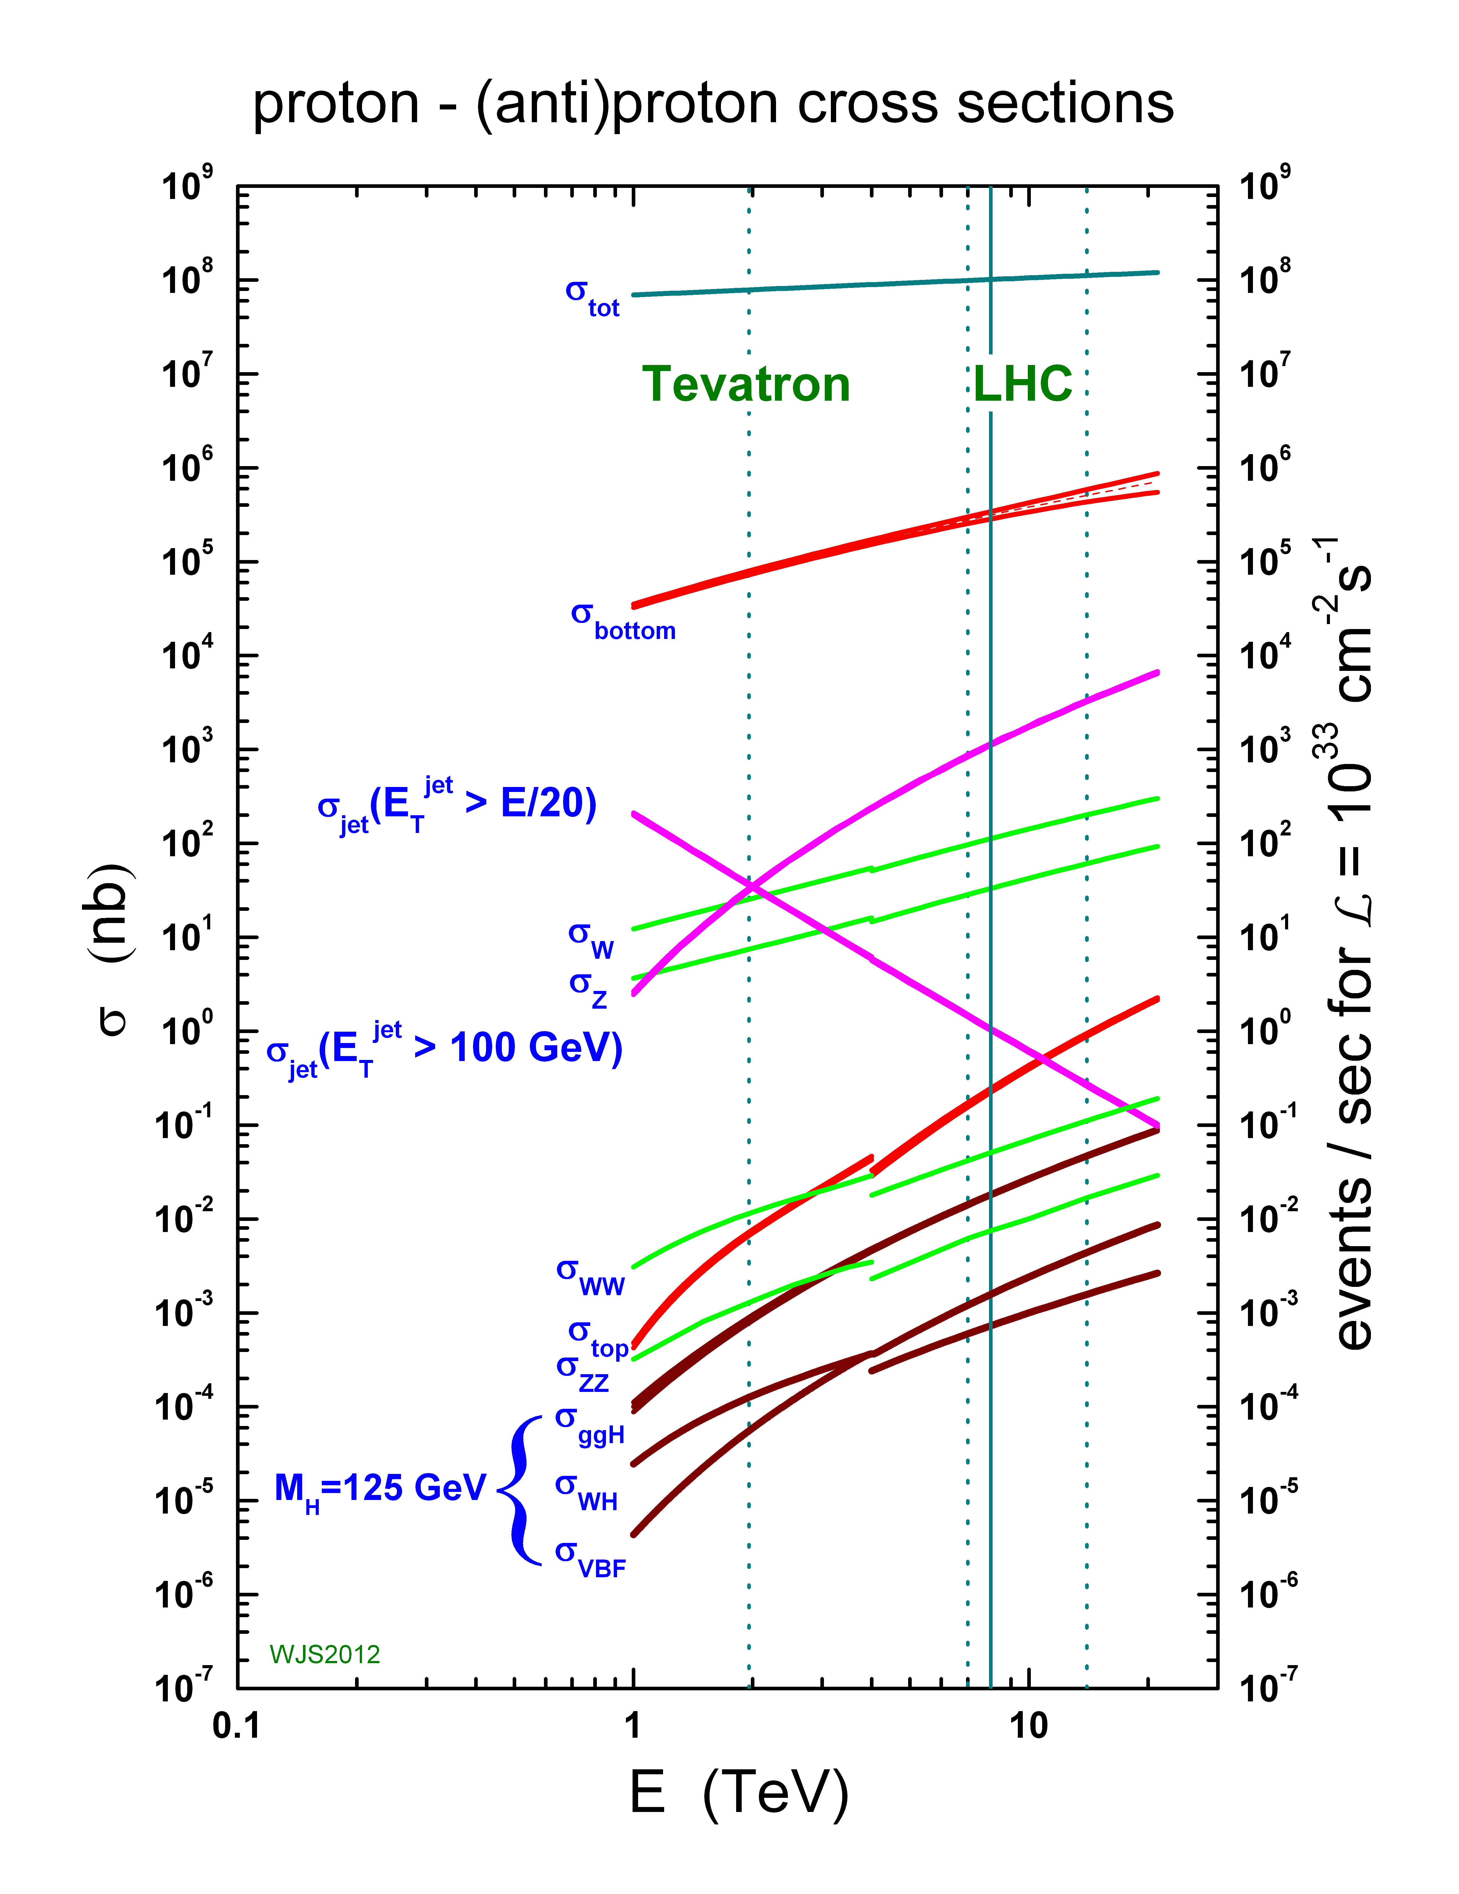
Cross sections
(relative probabilities) of processes at LHC
proton-proton
proton-antiproton

Slide 37


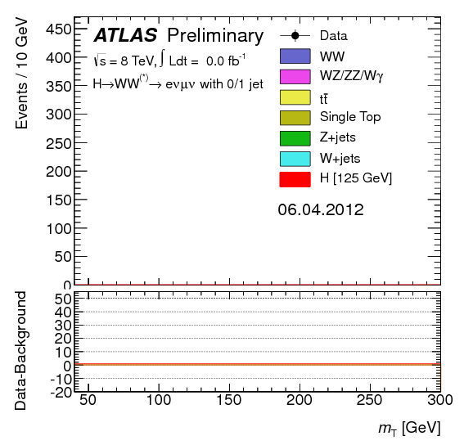
The Birth of a Particle
Diphoton
ZZ Four leptons
WW (lvlv)
Clear excesses in these three channels

Slide 38
https://youtu.be/KjHvGyPlcT4
Notes:
https://www.youtube.com/watch?v=KjHvGyPlcT4

Slide 39
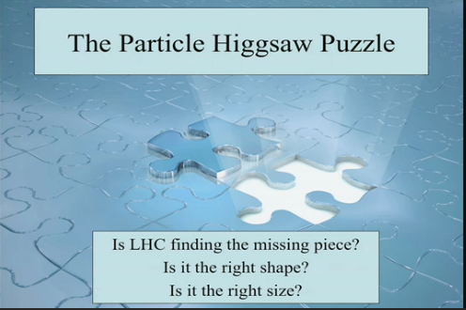
YES!
Notes:
It is a Higgs particle, not just a “Higgs-like” particle

Slide 40
Properties
Spin
  must have spin=0
Parity
  must have positive parity
coupling to fermions
  first decays seen were decays into bosons
  H → fermions (τ⁺τ⁻ , bb) were established later

Slide 41

Higgs production channels: comparison to standard model value

Slide 42
Projection of precision to be achieved

Slide 43

Not explaining the flavor Hierarchy
~6 orders of magnitude
Neutrinos are not even on the scale!
The BEH sector includes most of the free parameters of the Standard Model

Slide 44
relative masses of elementary particles

Slide 46


Slide 47
What’s next?
The Standard Model has been confirmed
New questions arise
The Standard Model does not give a complete description of the subatomic world
Open questions:
  “Fine-tuning” of Higgs mass
    Supersymmetry
  Neutrino oscillations and masses
  Dark Matter
  Dark Energy
  Gravitation
  Extra Dimensions ?

Slide 48
BACKUP

