Slide 1


Some PWG1 tasks for the MC production
using the available event-generators
for a new MPD Physics Performance paper
G. Feofilov,
V.Fock Institute for Physics, Laboratory of Ultra-High Energy Physics, Saint-Petersburg State University
the PWG1/MPD meeting, Thursday, the 20th of May 2021,
at 18:00 Moscow time
Notes:
1

Slide 2
Layout of the talk
1) Introduction
2) Discussion of the MC production for the Physics Performance paper
Task 1. Compare to STAR Au+Au data at √s_{NN}=9.2 GeV: analysis of Bi+Bi
(Au+Au?) MC data in the same pseudorapidity and centrality intervals of the multiplicity-based classes
Task 2: New simulations for the Physics Performance paper
Selection of the pseudorapidity intervals for the multiplicity-based classes of Bi+Bi data at √s_{NN}=9.2 GeV in order to minimize the autocorrelation effects in the data analysis
Class-wize optimization of the centrality class-width
Account of influence of the wide distribution in Z position of the interaction vertex on (i) the selection of the multiplicity classes and (ii) a possible bias in the FHCal measurements
Event-generators that could be used and discussed in the MPD Physics paper: SMASH, URQMD, DCM-QGSM-SMM, AMPT, AAMCC…something else?
3) The next steps
-- Centrality classes based on charged particles multiplicity
-- Classes with the account of space distribution of the deposited energies in FHCal modules
Briefly from theoretical modeling of Spectator Matter in Nuclear Collisions at NICA
Discussion and Conclusions

Slide 3
Two main approaches to determination of classes of centrality
Multiplicity in TPC as centrality class estimator
-- method was suggested by MEPHI/GSI team
Report by Petr Parfenov at the MPD Physics forum 15.04.2021r:
See https://indico.jinr.ru/event/2065/
https://github.com/FlowNICA/CentralityFramework
https://github.com/Dim23/GammaFit
Draft of analysis note:
https://github.com/FlowNICA/CentralityFramework/blob/master/Documentation/Centrality_AnalysisNote.pdf
Spectator nucleons with FHCal
– by the INR RAS team, see the PWG1 meetings Report by Vadim Volkov at the PWG1 meeting 01 April 2021
https://indico.jinr.ru/event/2066/
or RFBR conference:
https://indico.jinr.ru/event/1469/contributions/9905/attachments/8135/12126/ivashkin_RFBR_2020.pdf
Codes: https://github.com/qweek2/Centrality_NICA/tree/master
  .
Global observables in heavy-ion collisions at NICA.
PWG1 status report , MPD Collaboration meeting 21.04.2021—23.04.2021, JINR, Dubna

Slide 4
Discussion of the MC production
Task 1: to start and compare with STAR@RHIC)
Selection of the pseudorapidity intervals and centrality classes
STAR@RHIC: Au+Au collisions at √s _{NN}=9.2GeV, year 2008 , a short test run of ~3000 good events [1]
Energy dependence of particle ratios,π−/π+, p/p, K−/K+ and K/π, plotted as a function of √sNN. Results from 0–10% central Au+Au collisions at 9.2 GeV at midrapidity (|y|<0.5) are compared with those from AGS, SPS and RHIC.
Azimuthal anisotropy measurements
Pion interferometry measurements
[1] STAR Collaboration, Bulk Properties in Au+Au Collisions at √ s_{NN}= 9.2 GeV in STAR Experiment at RHIC, Nucl.Phys.A830:275c-278c,2009; arXiv:0907.1943v2

Slide 5
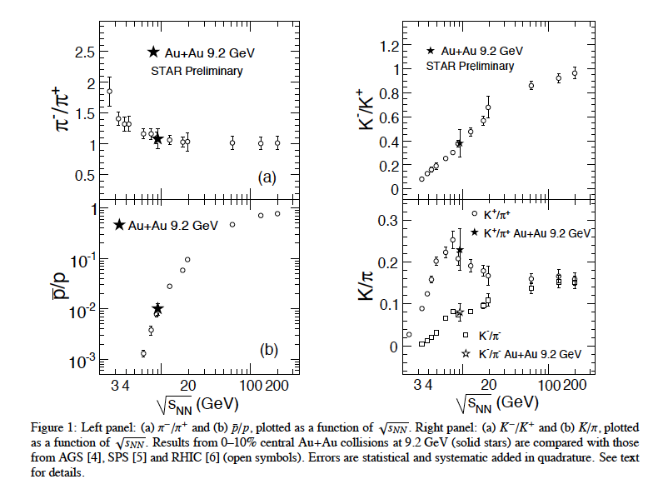
We have to start and compare with STAR@RHIC [1]
Energy dependence of particle ratios
[1] STAR Collaboration, Bulk Properties in Au+Au Collisions at √ s_{NN}= 9.2 GeV in STAR Experiment at RHIC, Nucl.Phys.A830:275c-278c,2009; arXiv:0907.1943v2
At midrapidity
(|y|<0.5)
Centrality
Class
0-10%

Slide 6
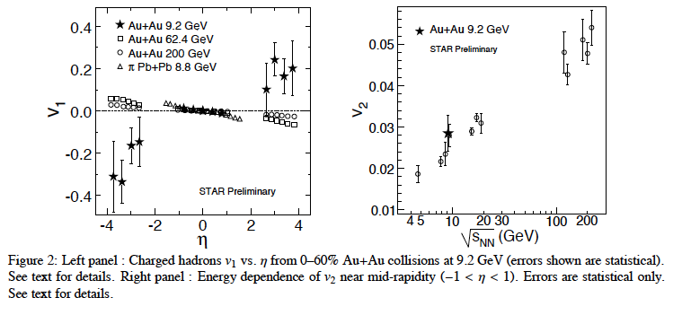
We have to start and compare with STAR@RHIC [1]
Azimuthal anisotropy measurements
[1] STAR Collaboration, Bulk Properties in Au+Au Collisions at √ s_{NN}= 9.2 GeV in STAR Experiment at RHIC, Nucl.Phys.A830:275c-278c,2009; arXiv:0907.1943v2
At midrapidity
(|η|<1.0)
Centrality
class 0-60%

Slide 7
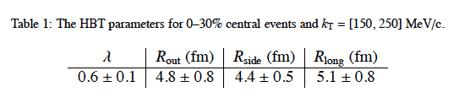
We have to start and compare with STAR@RHIC [1]
[1] STAR Collaboration, Bulk Properties in Au+Au Collisions at ‾‾‾√ sNN‾= 9.2 GeV in STAR Experiment at RHIC, Nucl.Phys.A830:275c-278c,2009; arXiv:0907.1943v2
Pion interferometry measurements
Centrality
class 0-30%

Slide 8
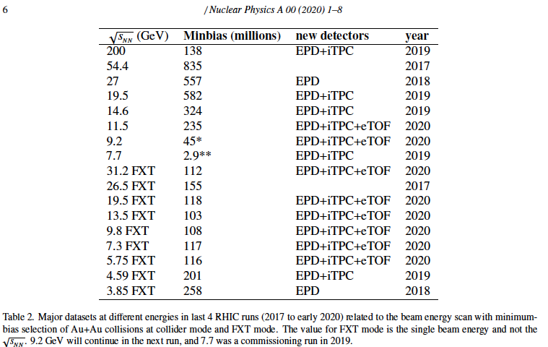
STAR@RHIC data-sets [2]
[2] https://www.osti.gov/servlets/purl/1762771 --we have to check the data-sets available!

Slide 9
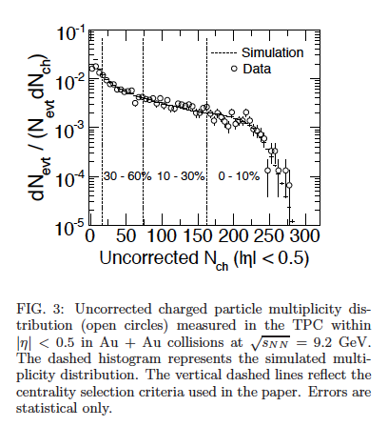

Multiplicity distribution at STAR@RHIC in Au+Au at √sNN= 9.2 GeV
PHYSICAL REVIEW C 81, 024911 (2010)
February 2010Physical Review C 81(2)
DOI:10.1103/PhysRevC.81.024911
SourcearXiv
https://www.researchgate.net/publication/235576464_Identified_particle_production_azimuthal_anisotropy_and_interferometry_measurements_in_AuAu_collisions_at_sNN92_GeV

Slide 10
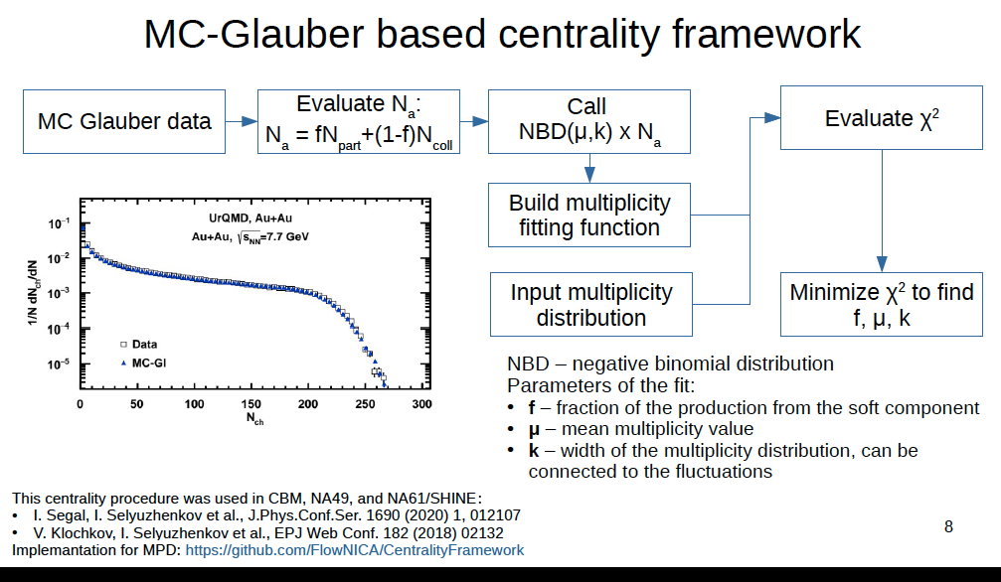
Slide drom Petr Parfenov talk:

Slide 11
Slide drom Petr Parfenov talk:
Note slightly different STAR analysis:

Slide 12
Centrality classes selection to compare with STAR
What is needed:
MC simulations fo Bi+Bi collisions at 9.2 GeV for 0-10%, 0-30%, 30-60% and 0-60% and 10-30% multiplicity-based centrality classes
Central pseudorapidity intervals: |η|<0.5 and |η|<1.0
Statistics: ~ 100 mln min bias events -- ?
…something else?

Slide 13
Discussion of the MC production
Task 2:Selection of the pseudorapidity intervals and centrality classes for MPD analysis and MC simulations for the Physics Performance paper
---- Bi+Bi collisions at √s _{NN}=9.2GeV

Slide 14
Some comments to Multiplicity-based methods used in the PWG1
Very detailed analysis +documentation in two approaches used
Important for comparison with RHIC data
… but we have to continue to investigate the problems:
Multiplicity-based method is being used currently at the midrapiidty |η |<0.5: therefore, auto-correlations might be possible in the analysis of fluctuations etc. Different pseudorapidity intervals should be selected
Three parameters (f, μ, k) in standard Glauber-based approach …
Constant class width for all centrality classes (should be optimized)
Systematic errors and effects of various cuts on multiplicity distribution….one of the items for studies
Glauber-based approach produces noticeble bias to the number of binary collisions Ncoll….it is the old problem – is also one of the items for further studies and checks with the MC event generators

Slide 15
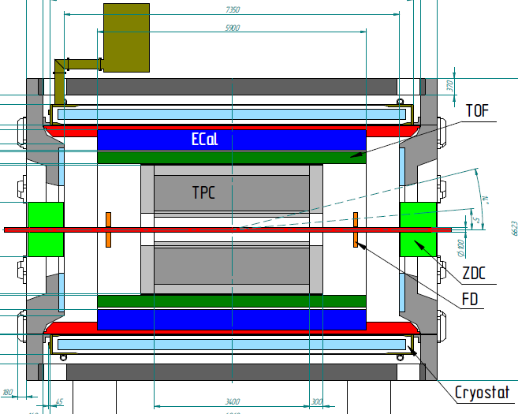
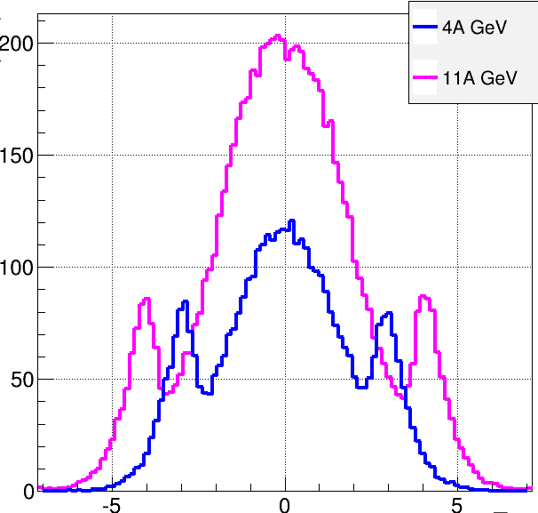
Multi-Purpose Detector (MPD)
stage I: TPC, TOF, ECAL, FHCal, FFD
stage II ( 2023): + ITS + EndCap (CPC, Straw, TOF, ECAL)
stage II
acceptance
URQMD
charged
b<11 fm
11 A GeV
4 A GeV
dN/dη
TPC
CPC
TOF
ECal
FFD
FHCal
FHCal
FFD
η
stage I: put in operation in 2022
Notes:
The MPD will be put in operation at two stages. At the first one the barrel part will be equipped with major tracking detector TPC, TOF end ECAL. FHC and FD will be operational as well.
At the second stage the detector will be supplemented with IT and end cap subdetectors.
FFDs, which are symmetrically placed to the MPD center along the beam line. Each sub-detector array has a hole for the beam pipe and locates at a distance of 75 cm from the center. Its acceptance in pseudo-rapidity is 2.5 ≤| η |≤ 3.2.

Slide 16
Centrality of relativistic heavy ion collisions
^{In} ^{ALICE as an example}
PHYSICAL REVIEW C 88, 044909 (2013)
FIG. 10. (Color online) Distribution of the sum of amplitudes in the VZERO scintillators. The distribution is fitted with the NBD- Glauber fit (explained in the text), shown as a line. The centrality classes used in the analysis are indicated in the figure. The inset shows a zoom of the most peripheral region.
Results indicate that selection of a narrow centrality class in multiplicity does not assume real selection of very central events in terms of the impact parameter

Slide 17
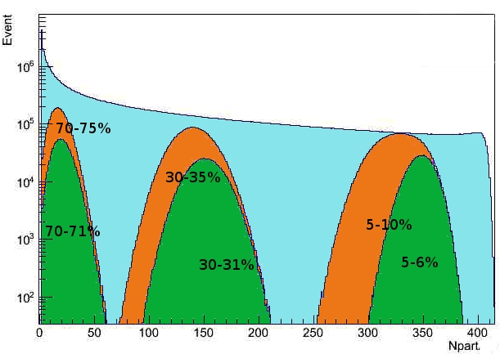
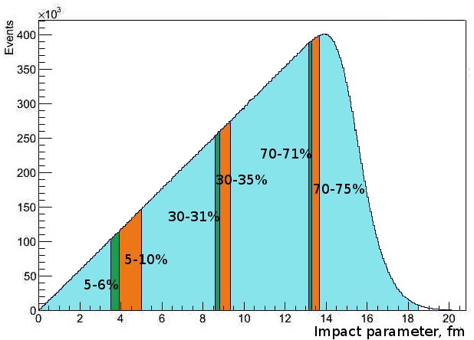
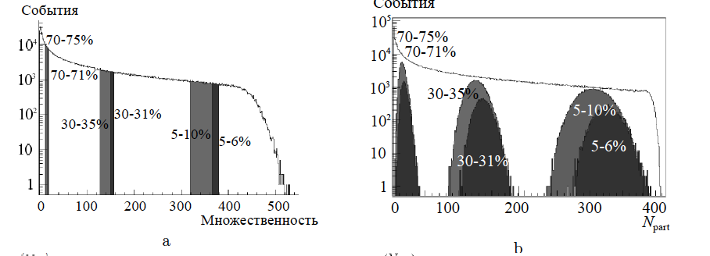
Impact parameter b, multiplicity and N_{part} in MC Glauber model
Percentile
MC Glauber, PbPb 2.76TeV
b
b
Some impact parameter centrality classes
Npart distribution in the different centrality classes
Centrality and multiparticle production in ultrarelativistic nuclear collisions
Drozhzhova T.A., Kovalenko V.N., Seryakov A.Y., Feofilov G.A.
Physics of Atomic Nuclei. 2016. Т. 79. № 5. С. 737-748.

Slide 18
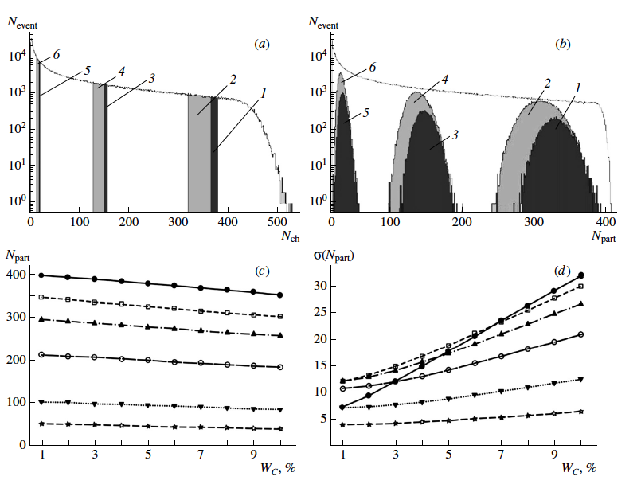
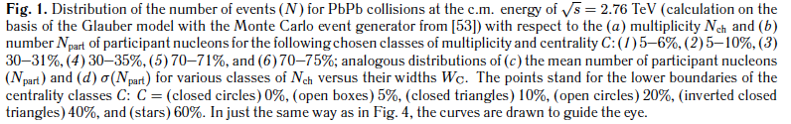
Centrality-wise optimization of the class width

Slide 19
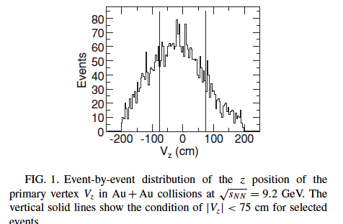
Account of influence of the wide distribution in Z of the interaction vertex position, on the selection of the multiplicity classes
PHYSICAL REVIEW C 81, 024911 (2010)
STAR: Uniform detector performance within |η| < 1.0
STAR:sufficient statistical significance of the measured observables
MPD:
Z-pozition of the primary vertex is
MPD:
Uniform detector performance within |η| < 1.5

Slide 20
Proposals for MC simulations for the Physics Performance paper
Statistics for Bi+Bi collisions at 9.2 GeV: ~ 100 mln min bias events -- ?
Central pseudorapidity intervals for TPC physics analysis: |η|<0.5 and |η|<1.0
Different pseudorapidity intervals should be considered for multiplicity classes selections In order to avoid trivial autocorrelations : TPC tracks in 0.5 <|η|<1.5
Other pseudorapidity intervals: e.g. FFDs, which are symmetrically placed to the MPD center along the beam line 2.5 ≤| η |≤ 3.2 (also mini-BeBe – ?) could be aslo considered for the multiplicity classes selection
Class-wise optimization of the class width: MC simulations fo Bi+Bi collisions at 9.2 GeV for 0-1%, 0-3%, 0-5%, 0-7%, 0-10%, 0-20% multiplicity based centrality classes (and similar optimization for the FHCal classes)
Z-position of the interaction vertex should be taken into account in the new MC simulations production. Studies of z-cuts are needed.

Slide 21
Available event-generators and models:
SMASH, URQMD, DCM-QGSM-SMM, AMPT, AAMCC …some other?
…to be discussed

Slide 22
The next steps:
Distribution inside the PWG1 of tasks and subtasks of the MC simulations production is requested in view of the Physics Performance Paper preparation
The main two approaches (multiplicity-based and FHCal energy) to the determination of the classes of centrality are valid and important for the further investigations.
Other approaches to centrality classes definition (selection of pseudorapidity intervals, account of asymmetry of the total spectator volume in AAMCC and fragmentation processes, effects of nucleon stopping, etc… ) should be also developed further
We have two main experts – Petr Parfenov and Vadim Volkov -- who may trigger via the PWG1 the requests on MC production at NICA clusters in line with results of our discussion
Please, join these tasks– today we discuss only centrality that is just one item in the list of global observables
Other proposals are welcome!

Slide 23
Thank you for your attention!

Slide 24
Summary-1
Two approaches, are being developed for determination of centrality classes in AA collisions: (i) traditional multiplicity-based, and (ii) novel approach, based on spectators spatial distributions in FHCal
Theoretical considerations aimed at physics description of fragmentation processes in AA collisions and for understanding of the collision dynamics, are also in progress. An additional observable for centrality classes is proposed: a ratio of (a sum of fragment charges}²/{total Spect.Energy}.
Selecting multiplicity classes, as a proxy to centrality in heavy-ion collisions, is needed at the first stage of MPD data analysis to compare with the already existing results obtsained at RHIC.
Codes for selecting events for classes for multiplicity are developed and accessible. Documentation is also provided (however, the working groups must interact closely with the PWG1)
Global observables in heavy-ion collisions at NICA.
PWG1 status report , MPD Collaboration meeting 21.04.2021—23.04.2021, JINR, Dubna

Slide 25
Summary-2
The choice of classes on the energy of spectators in the FHCAL calorimeter ---- the procedure is demonstrated based on the newly developed approach of accounting not only energy, but also the spatial distribution of energy of spectators hitting the calorimeter.
This new FHCAL technique provides an independent selection of classes of events (and it excludes also autocorrelations in the analysis of data on fluctuations and correlations of observables).
Some problems relevant to the centrality classes selection are revealed: -- The events with a rather wide set of impact parameters could be mixed into the class. The trivial volume fluctuations are to be minimized by centrality-wise optimization of the class width used. --The number of binary collisions obtained in a standard Glauber approach is usually model biased (e.g. Glauber). It should be taken into account in the MPD data physics analysis.
Global observables in heavy-ion collisions at NICA.
PWG1 status report , MPD Collaboration meeting 21.04.2021—23.04.2021, JINR, Dubna

Slide 26
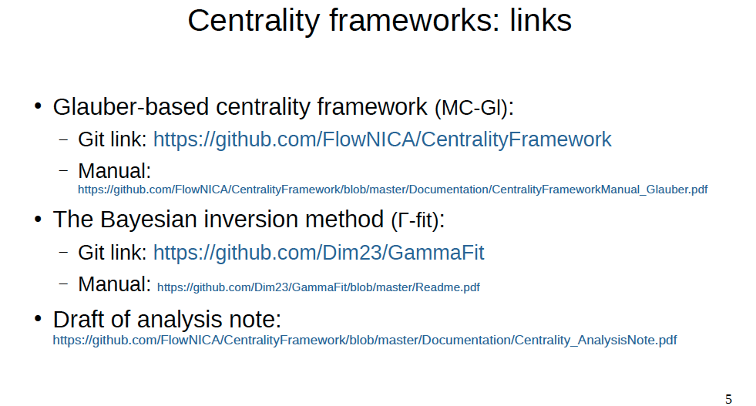

Slide 27
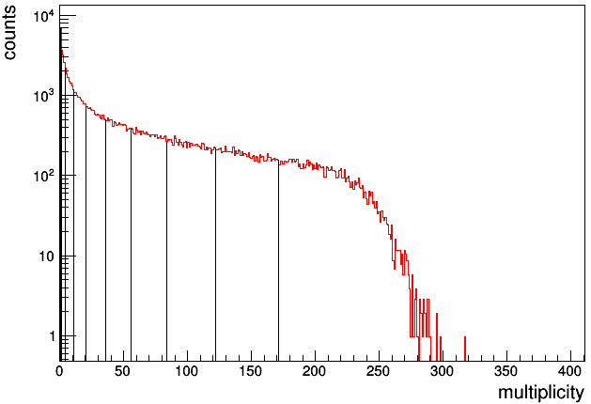
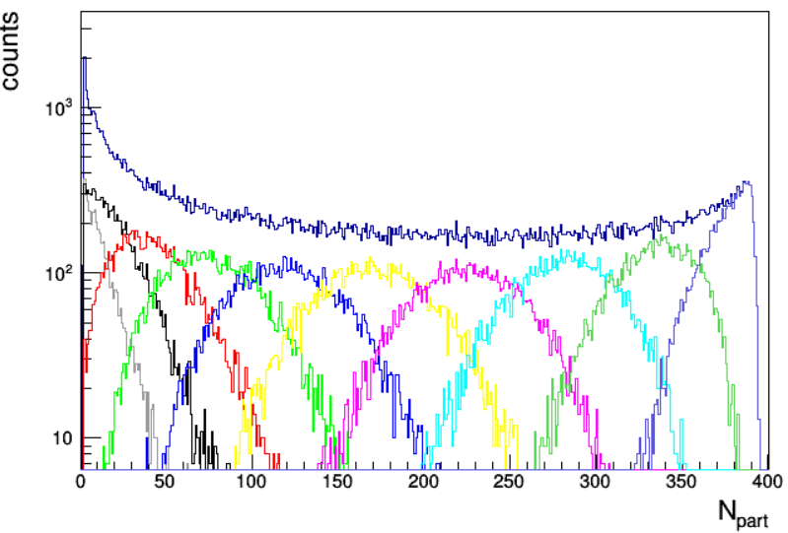
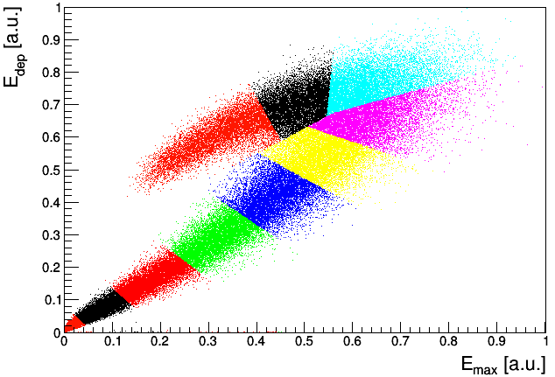
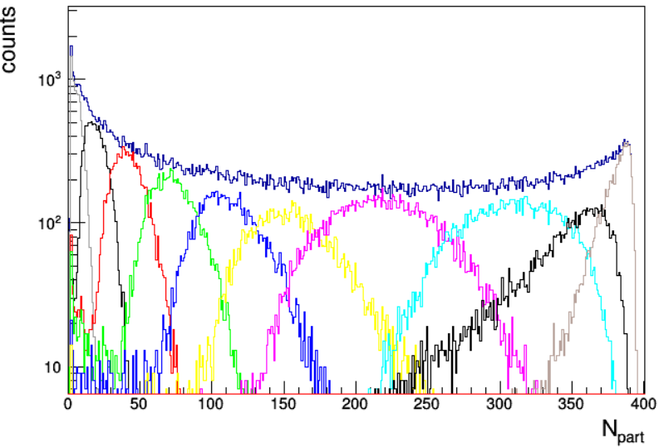
TPC multiplicity vs FHCal classes comparison
10-20%
0-10%
central events
peripheral events
Two methods of centrality determination comparison
1. TPC multiplicity bins
2. 2D-Fit
In both cases the participants are taken directly from the DCM-SMM
FHCal gives more accurate results for peripheral events, while for the most central events the accuracy is close and of the order of 15%.

Slide 28
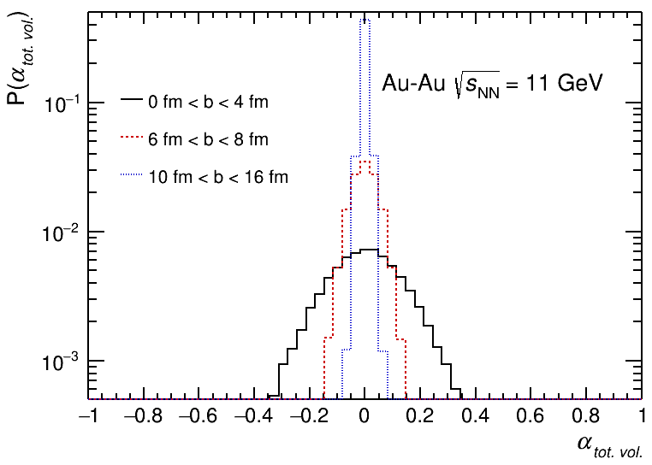
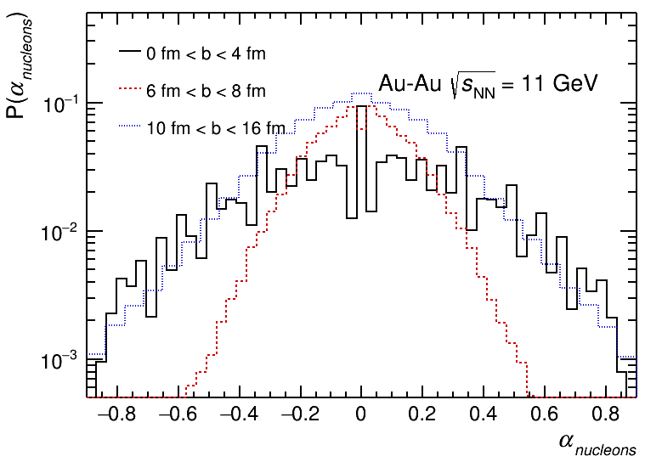
Asymmetry of the total spectator volume and of free spectator nucleons
The total spectator volumes (=A_{pf}) includes all
nuclear fragments and nucleons
Asymmetry decreases from central to peripheral
collisions.
Only small parts of large spectator volumes are
affected by fluctuations in numbers of participants.
This effect is of trivial statistical nature.
The dependence on b is not monotonic
The stochasticity of nucleon evaporation in peripheral events adds extra fluctuations.
According to AAMCC, events with low nucleon asymmetry can be classified with confidence as semi-peripheral events.
28

