Slide 1
Status of the ECAL
Abraamyan Kh.U., Afanasiev S.V., Alekseev P.E., Dabrowska B., Dryablov D.K., Dubinchik B.V., Kakurin S.I., Kirin D., Kovachev L., Kozin M., Kuznecov A.S., Sakulin D.G., Stavinskiy A.V. Sukhov E.V., Ustinov V.V., A.V., Tyapkin I.A., Zhigareva N.M.
Ocrober 03 2021

Slide 2
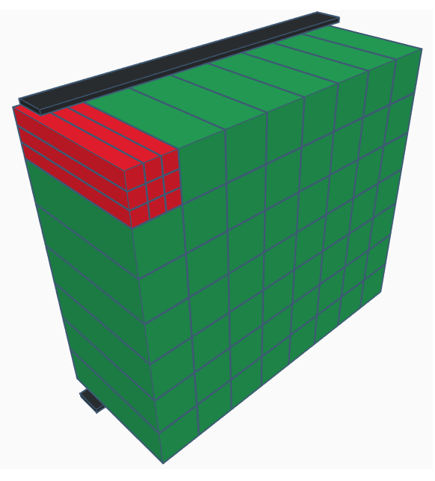
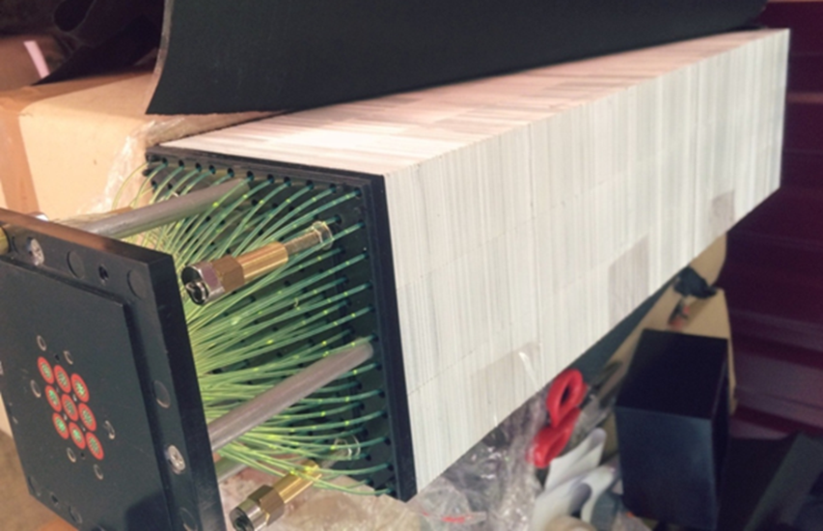
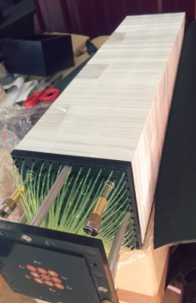
ECAL BM@N
ECAL is formed from lead-scintillation modules "Shashlyk"-type in the wall size of 8x7 modules (96x84 cm2). The total number of active cells in one ECAL wall is 504. The 441 cells of one wall were used in the experimental run 2018. Modules for the second wall have been prepared and will be operated in 2021.
56 modules
The «Shashlyk» module is a lead-scintillator sandwich which read out by means of wavelength shifting fibers .
9 cells
In module
Module type «shashlyk»
504 cells with MPPC (SiPM) (multipixel photon counter)
220 plates (Pb +Sc)
Notes:
2
2
Составной частью установки BM@N является электромагнитный калориметр (ECAL), состоящий из десятков модулей. Модуль электромагнитного калориметра собран из девяти башен (4 см² каждая башня). Каждая башня состоит из 220 чередующихся плиток из Pb и пластикового сцинтиллятора.
Использование космических мюонов позволяет провести индивидуальную коррекцию регистрируемых амплитуд сигналов в соответствии с выделившейся в чувствительном объеме энергии.
Для моделирования таких процессов используется метод Монте-Карло. Результат прохождения конкретного мюона через пластину определяется случайными величинами — длинами свободного пробега, косинусами углов отклонения, а также событиями прохождения либо через свинец, либо через сцинтиллятор.
The component of BM @ N installation is an electromagnetic calorimeter (ECAL) consisting now about 50 modules. The module of the electromagnetic calorimeter is assembled from nine towers (4 cm2 each tower). Each tower consists of 220 alternating tiles of Pb and a plastic scintillator.
To simulate such processes, the Monte Carlo method is used. The result of the passage of a specific muon through a plate is determined by random variables-the mean free paths, the cosines of the deflection angles, and also by passage events either through lead or through a scintillator.
2
ECAL на BM@N состоит из десятков модулей. Модуль электромагнитного калориметра собран из девяти башен (4 см² каждая башня). Каждая башня состоит из 220 чередующихся слоев из Pb и Sc.
Предварительная калибровка электромагнитных модулей не проводилась.
Ячейки в ECal являются индивидуальными устройствами. Эти обстоятельства требуют координации всех записанных сигналов, то есть перевода амплитуды записанного сигнала в энергетические единицы.
The component of BM @ N installation is an electromagnetic calorimeter (ECAL) consisting now about 50 modules. The module of the electromagnetic calorimeter is assembled from nine towers (4 cm2 each tower). Each tower consists of 220 alternating tiles of Pb and a plastic scintillator.
To simulate such processes, the Monte Carlo method is used. The result of the passage of a specific muon through a plate is determined by random variables-the mean free paths, the cosines of the deflection angles, and also by passage events either through lead or through a scintillator.

Slide 3
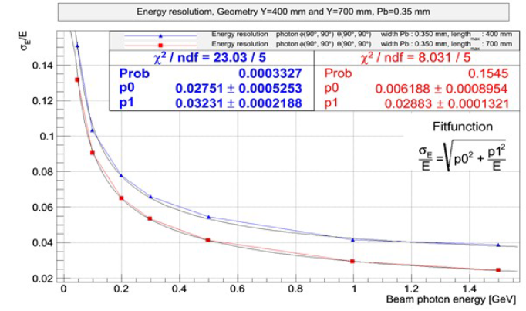
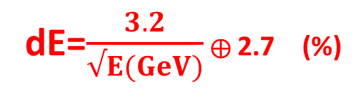
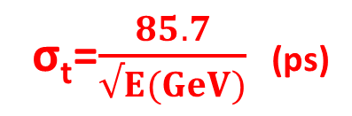
ECal key parameters
MPD NICA Technical Design Report of the Electromagnetic calorimeter (ECal)
(http://mpd.jinr.ru/wp-content/uploads/2019/01/TDR_ECAL_v3.6_2019.pdf)
Energy resolutions of the calorimeter with lengths of the modules – 400mm (blue line).
Time resolution of the “Shashlyk” type calorimeter
dE=$\frac{3.2}{√E(GeV)}$ ⊕ 2.7 (%)
σ_{t}=$\frac{85.7}{√E(GeV)}$ (ps)

Slide 4
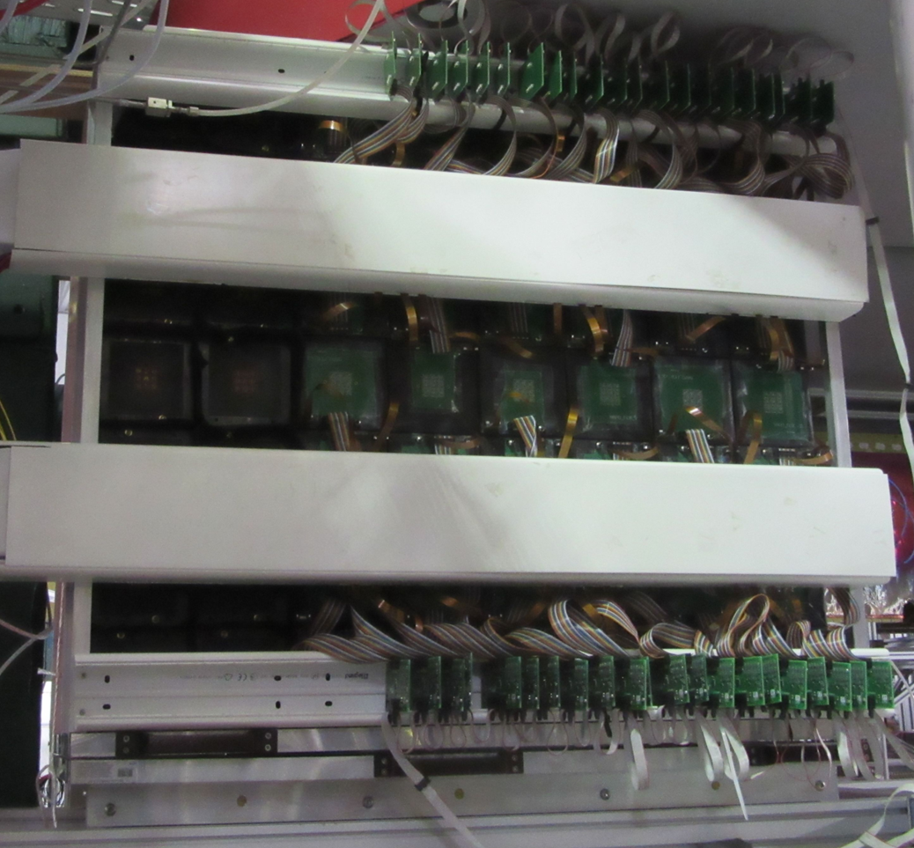
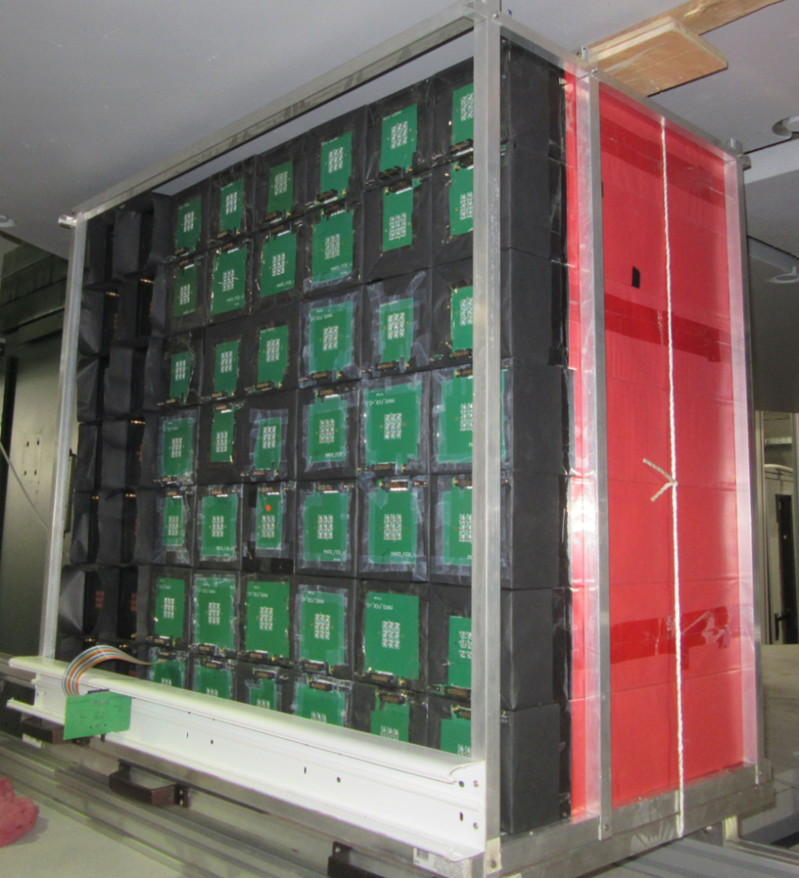
The ECAL location in the magnet (Run 7)
The ECAL detector was assembled from 56 modules stacked in a wall of 8x7 modules. The front-end electronics are located directly behind the detectors. ( SiPM power supply and ADC)
ADC
7
ADC
8

Slide 5
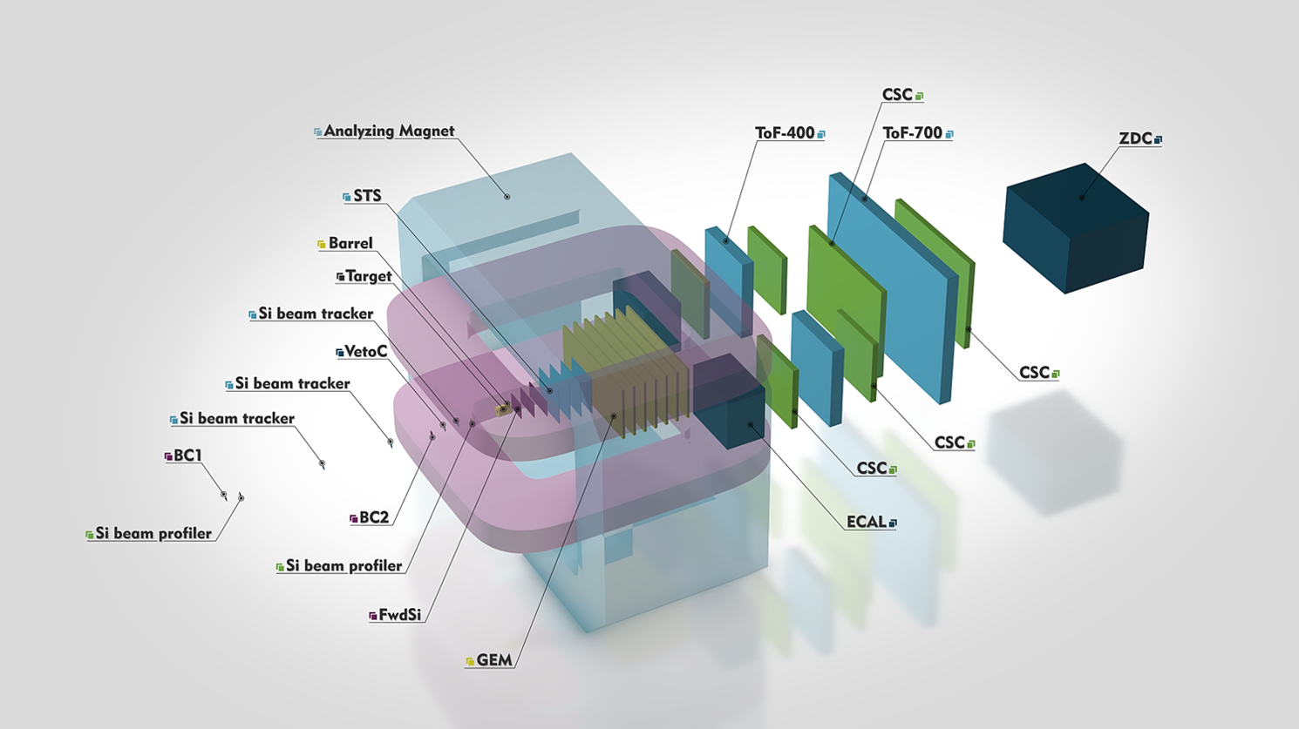
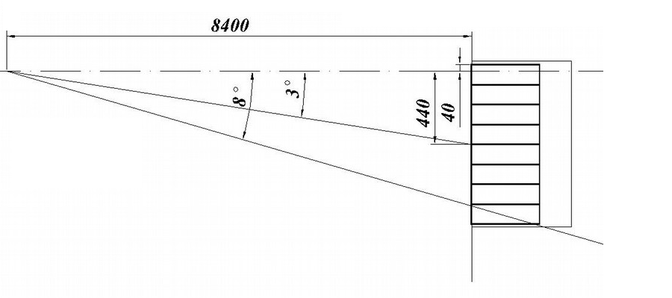
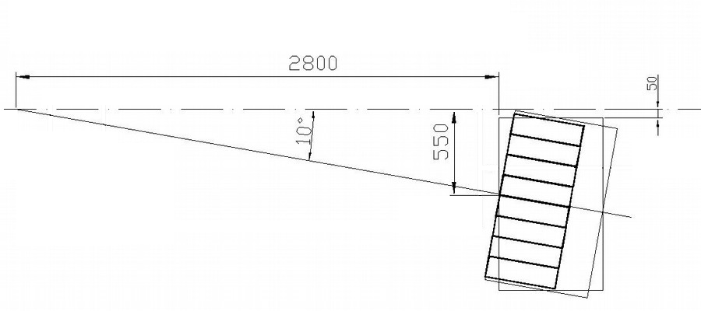
The ECAL location in the BM@N setup
and positions in run 7.
Position 1, Run 7 (SRC) ECAL calibration runs
C 3.17 AGeV ➝ Pb, run ids 3503-3511, ~2 M ev.
Position 4, Run 7 (BMN) ECAL data analysis
Kr 2.6 AGeV ➝ Sn, run ids 4921-4966, ~5.7 M ev.
2018 year ECAL setup (run 7)
  one swall 7x7 modules, 441 cells
New ECAL setup
  two Walls of 8x7 modules, 1008 cells

Slide 6
ECAL data analysis
Petr Alekseev on behalf of BMN ECAL group
6th Collaboration Meeting of the BM@N Experiment at the NICA Facility
JINR
October 26–27, 2020

Slide 7
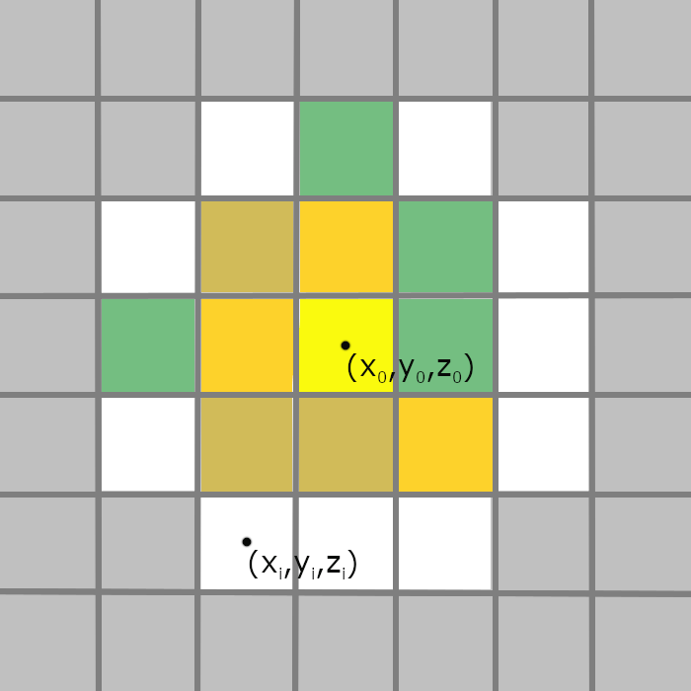
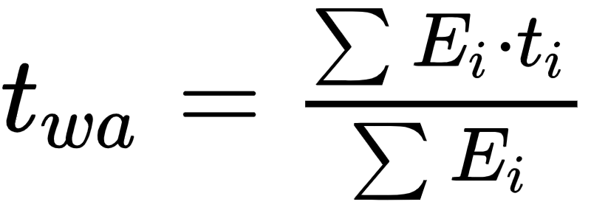
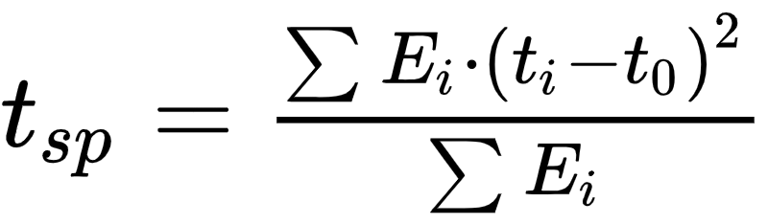
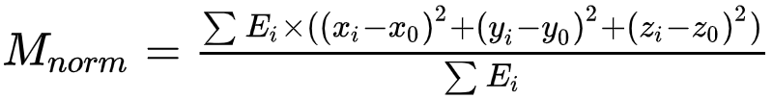
Cluster parameters
Minimal cell energy is 30 MeV, other cells are ignored
Cluster radius is 10 cm (21 cells of 5x5 area)
Cluster parameters are:
  energy
  center gravity
  weighted average time (t_{wa})
  time spread (t_{sp})
  normalized moment (M_{norm})

Slide 8
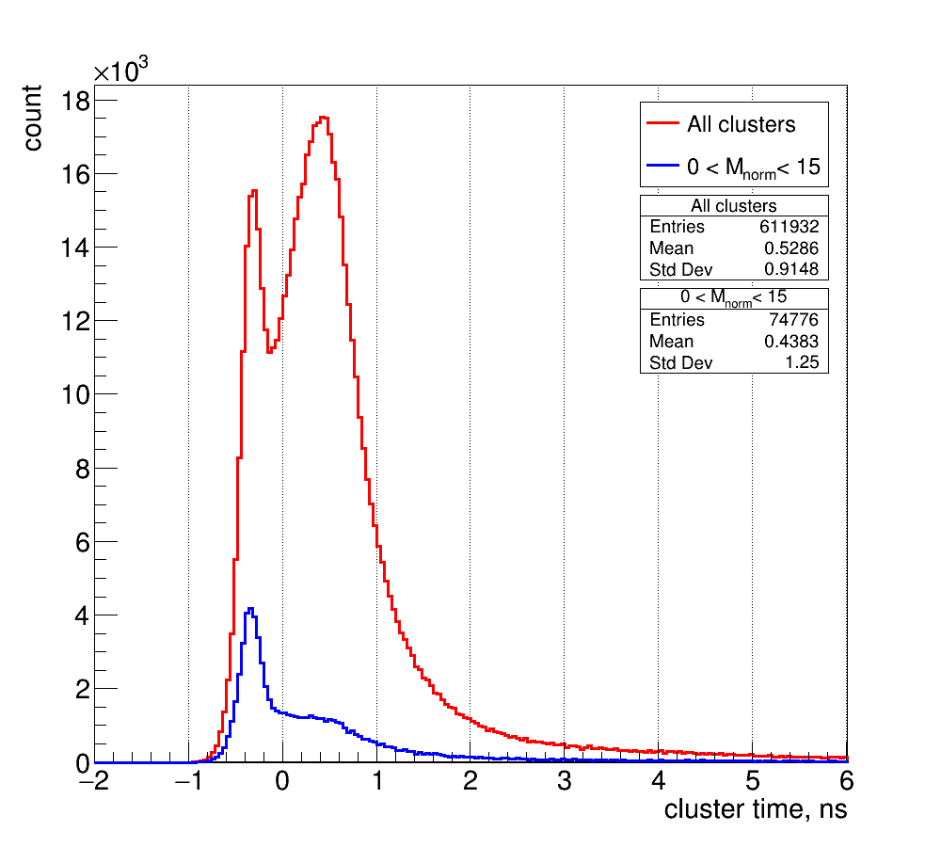
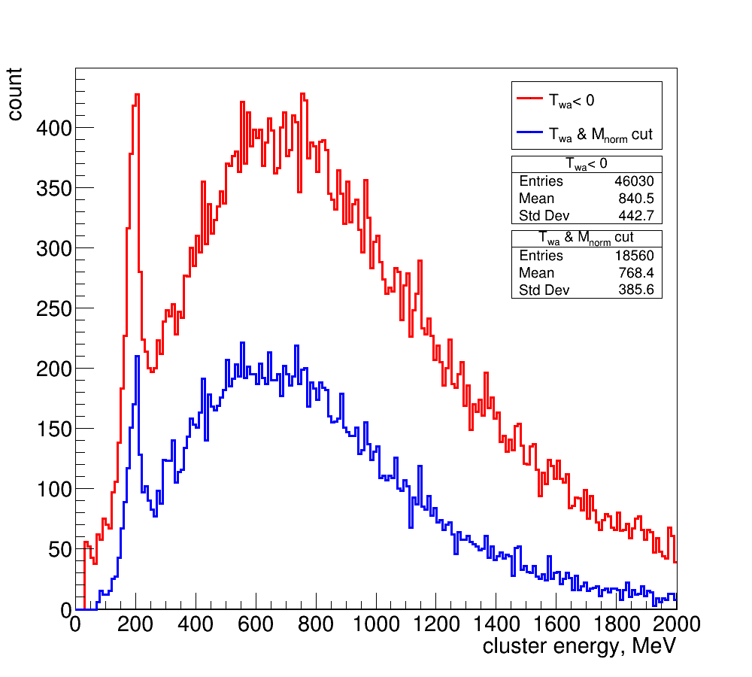
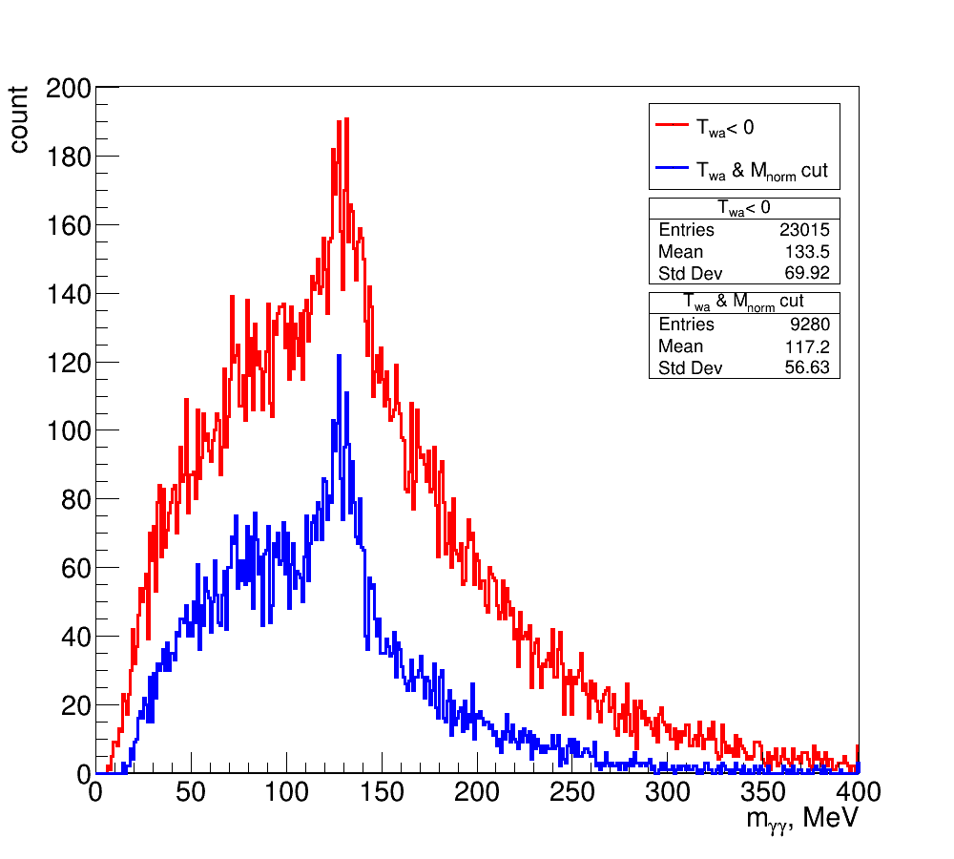
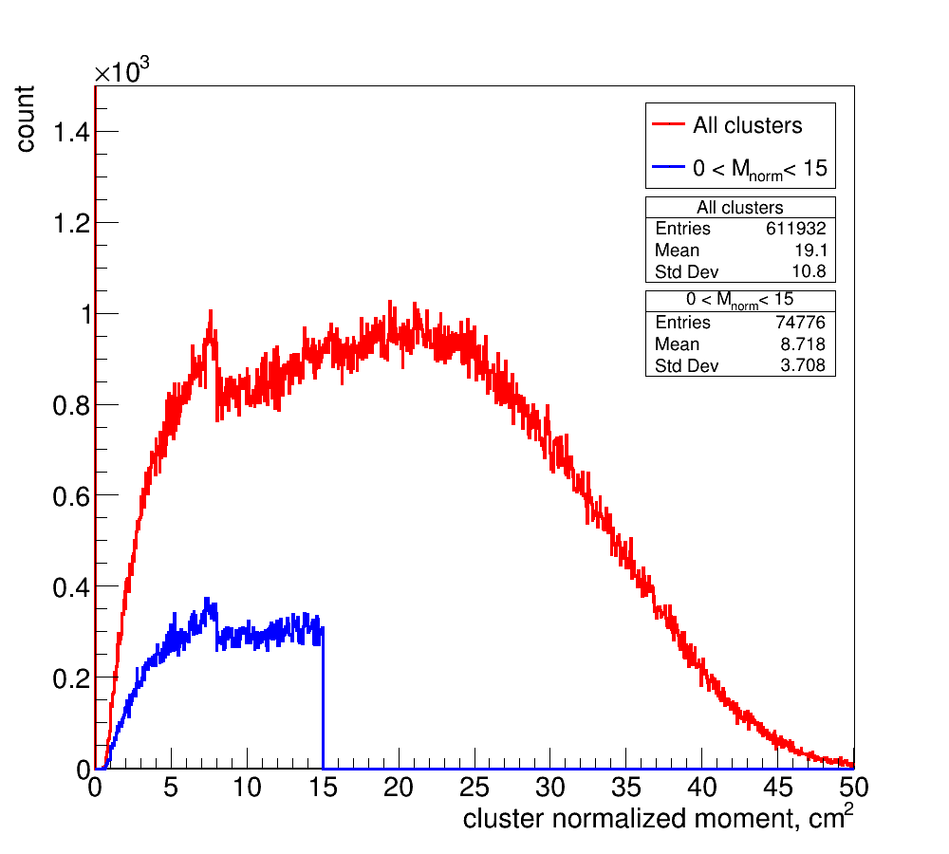
Simulation:
GEANT4, DCMQGSM KrSn 2.36AGeV, ~2M ev
Effective mass spectrum
Cluster time
Cluster energy
Normalized moment
t_{wa} < 0
M_{norm} < 15
N_{cells} > 1
E_{cluster} no cut

Slide 9
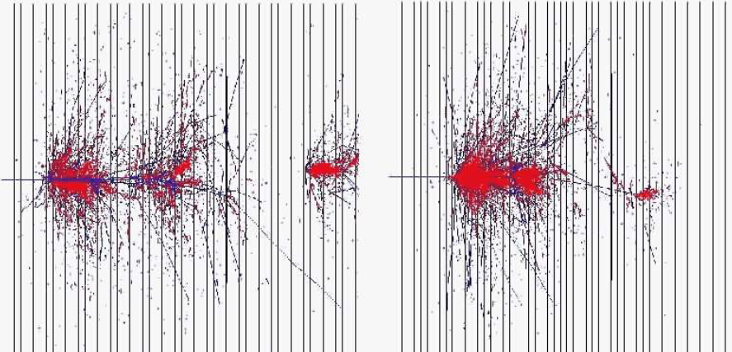
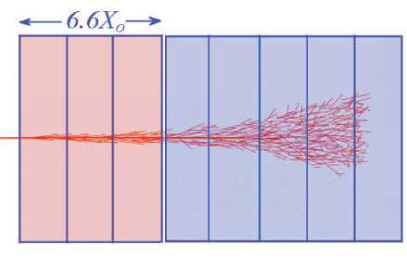
Normalized moment
Electromagnetic shower
Hadron shower
HELIOS

Slide 10
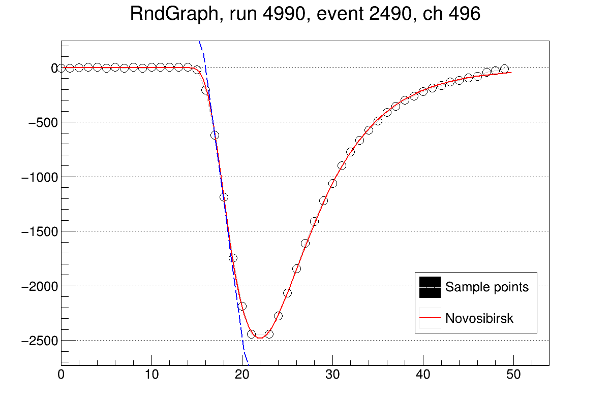
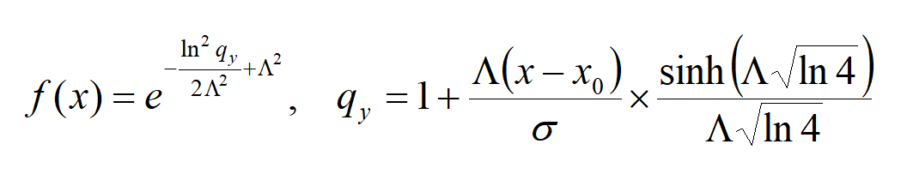
ECAL signal raw to digi conversion
Pedestal - mean of slices 0..7
Novosibirsk fit
Peak amplitude A_{peak} and time T_{peak}
Cell start time T_{cell}
Amplitude A - mean of T₀...T₀+20 slices
Get coords from geometry file
Novosibirsk function:

Slide 11
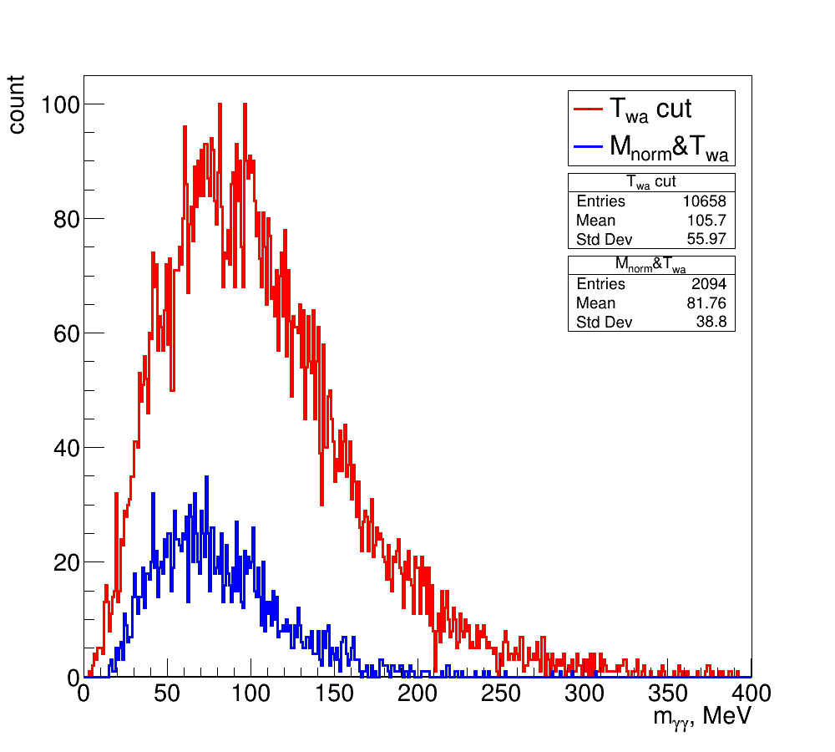
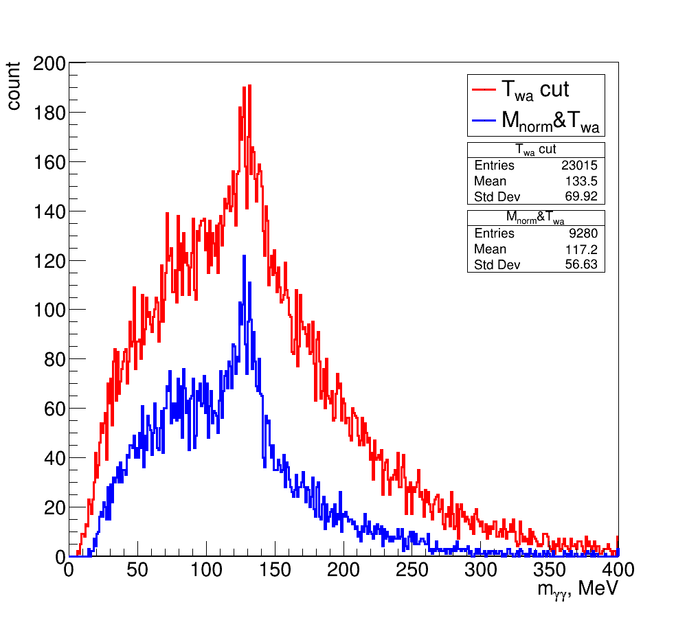
Experimental data:
Effective mass spectra with cuts KrSn 2.36AGeV
Exp. data. -1.5 cm < Z_{vertex}< 0 cm
Monte-Carlo simulation.
T_{wa}< 0
0 < M_{norm}< 15
T_{wa}< 0
0 < M_{norm}< 15
Why the big discrepancy?

Slide 12
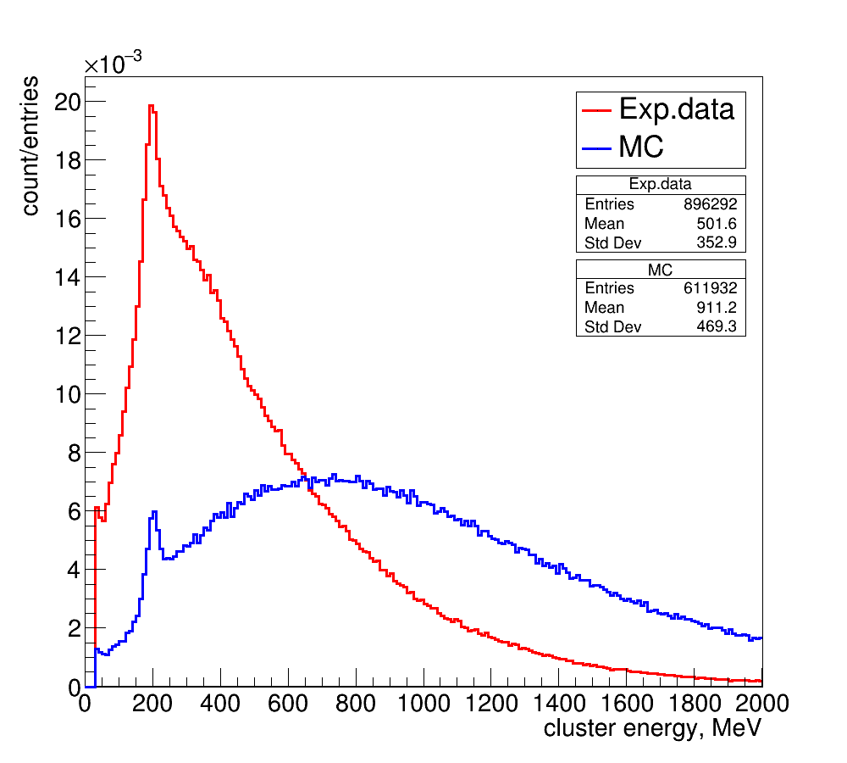
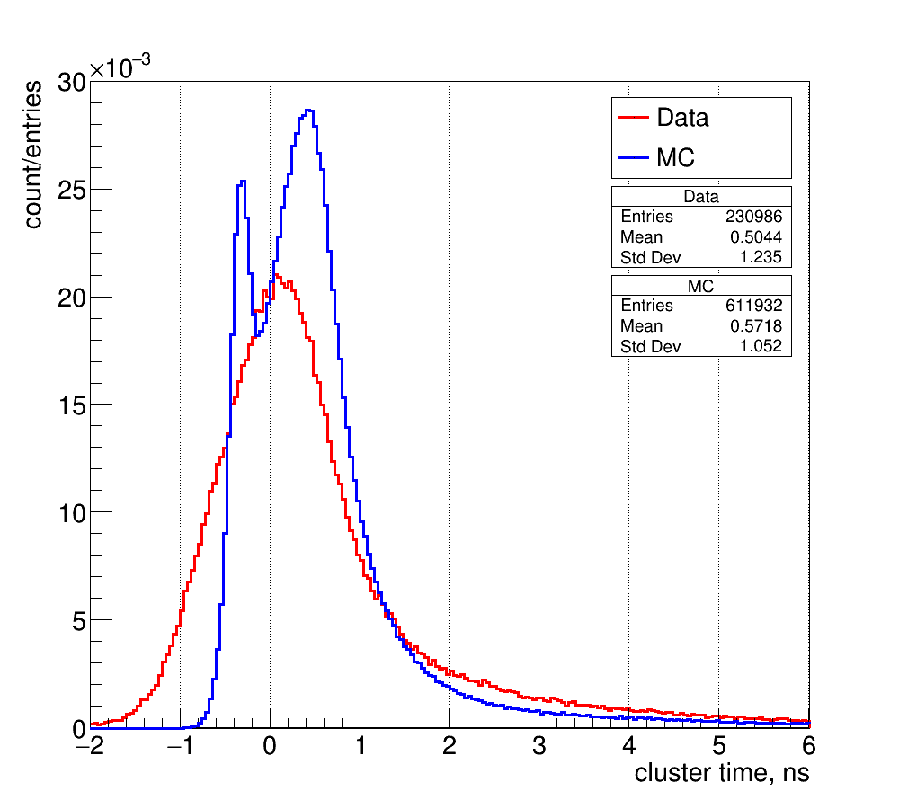
Investigation of problem points in the processing of experimental data.
Mean cluster energy
Time resolution of ECAL
clusters energy
Cluster time t_{wa}, ns

Slide 13
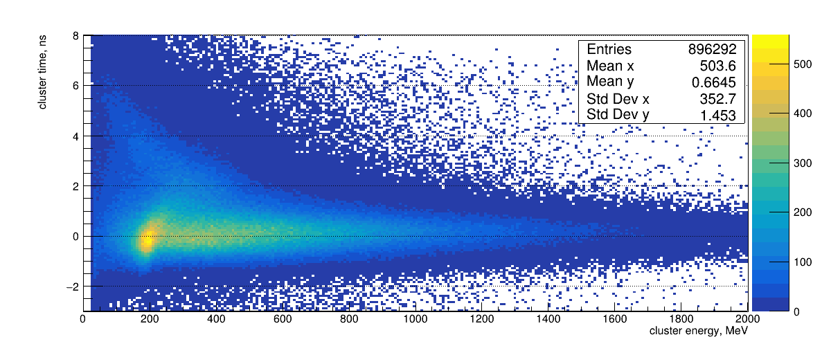
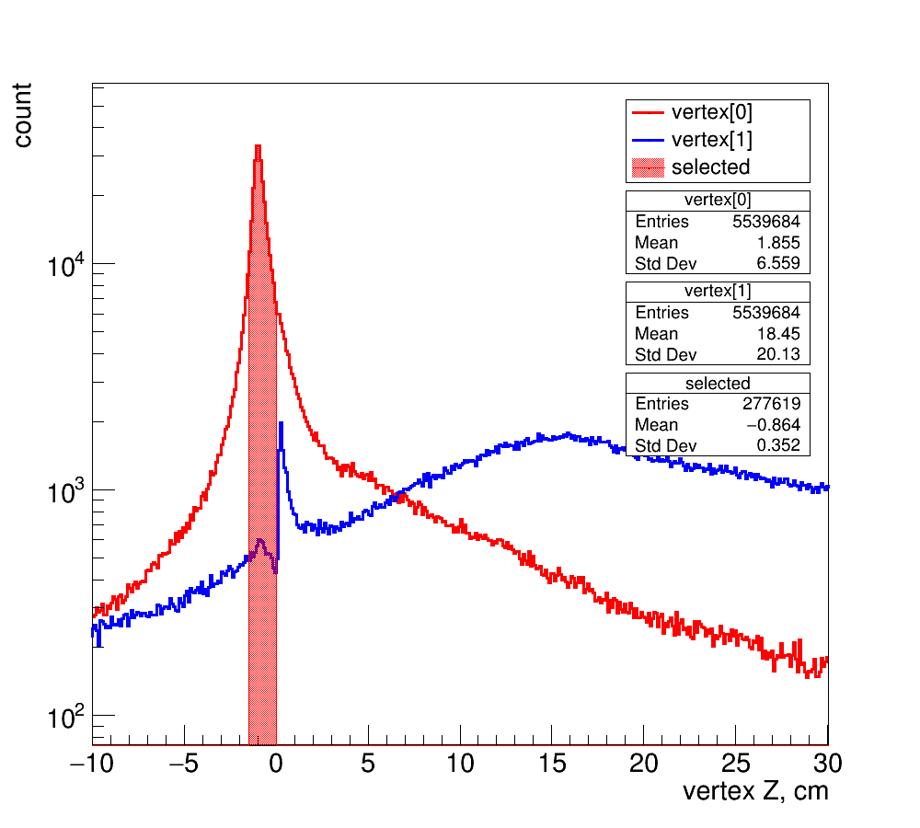
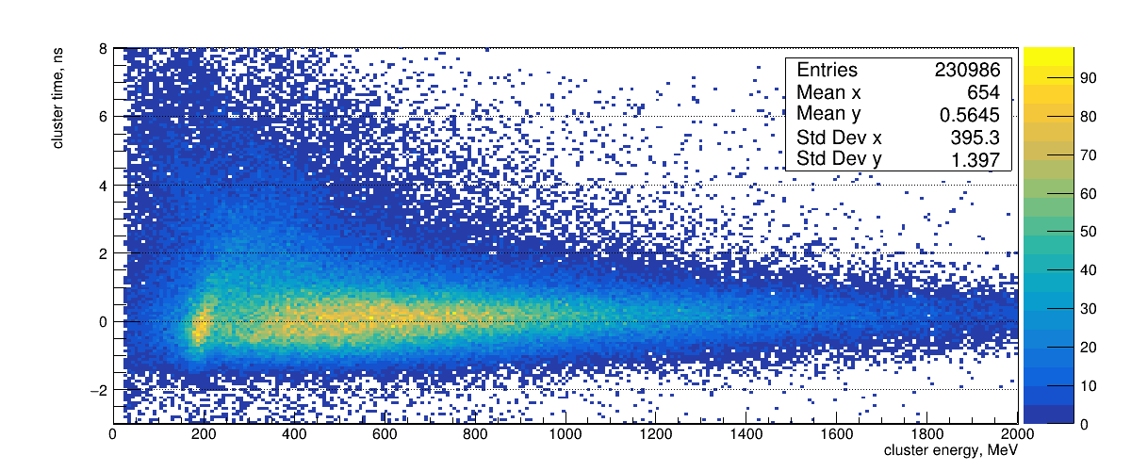
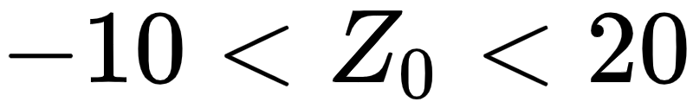
Add vertex information into analysis
ECAL cluster time vs energy (experiment)
Kr 2.6 AGeV➝ Sn (2.57), runs 4921...4966, ~5.7M events
No cut
All clusters involved into effective mass calculation
Events selected that has primary vertex found in the range
(using run_reco_bmn.C)

Slide 14
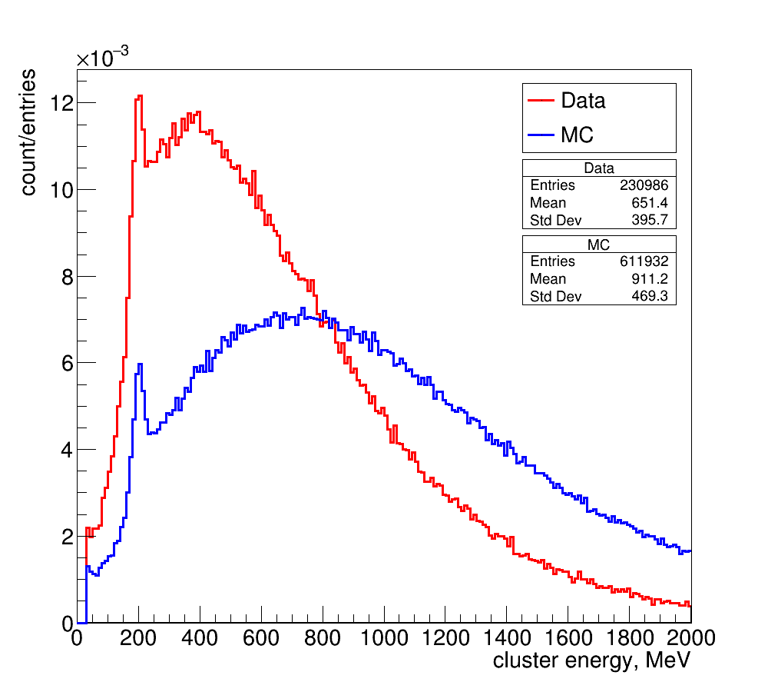
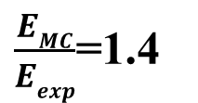
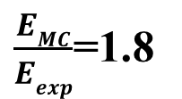
ECAL clusters energy spectra with vertex cut.
$\frac{EMC}{Eexp}$=1.8
$\frac{EMC}{Eexp}$=1.4
Experimental data spectrum of all clusters involved into effective mass calculation
Events selected that has primary vertex found
The vertex information significantly improves the ratio of MC and experimental data, but does not fully explain.

Slide 15
The proposed source of the background is particles from secondary interactions.
It is planned to:
perform MC modeling with detailed geometry of the GEM chambers.
add into analysis beam type information

Slide 16
Analysis of ECAL time resolution.

Slide 17
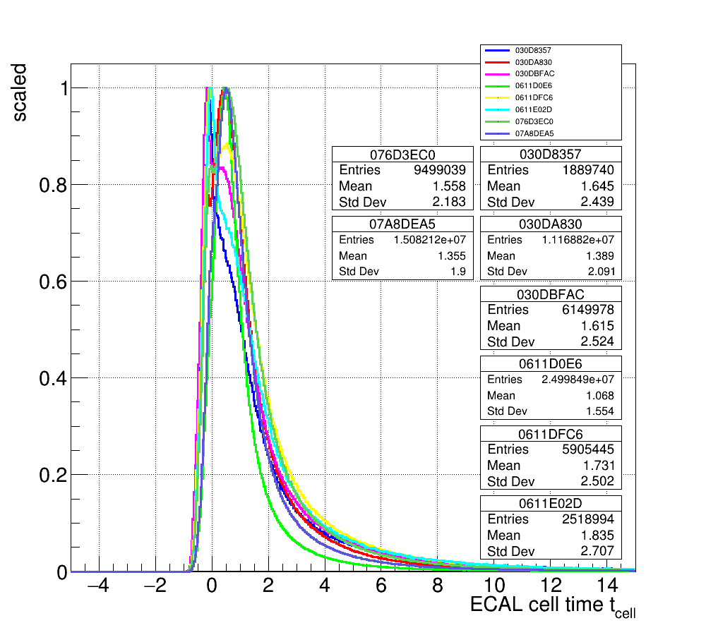
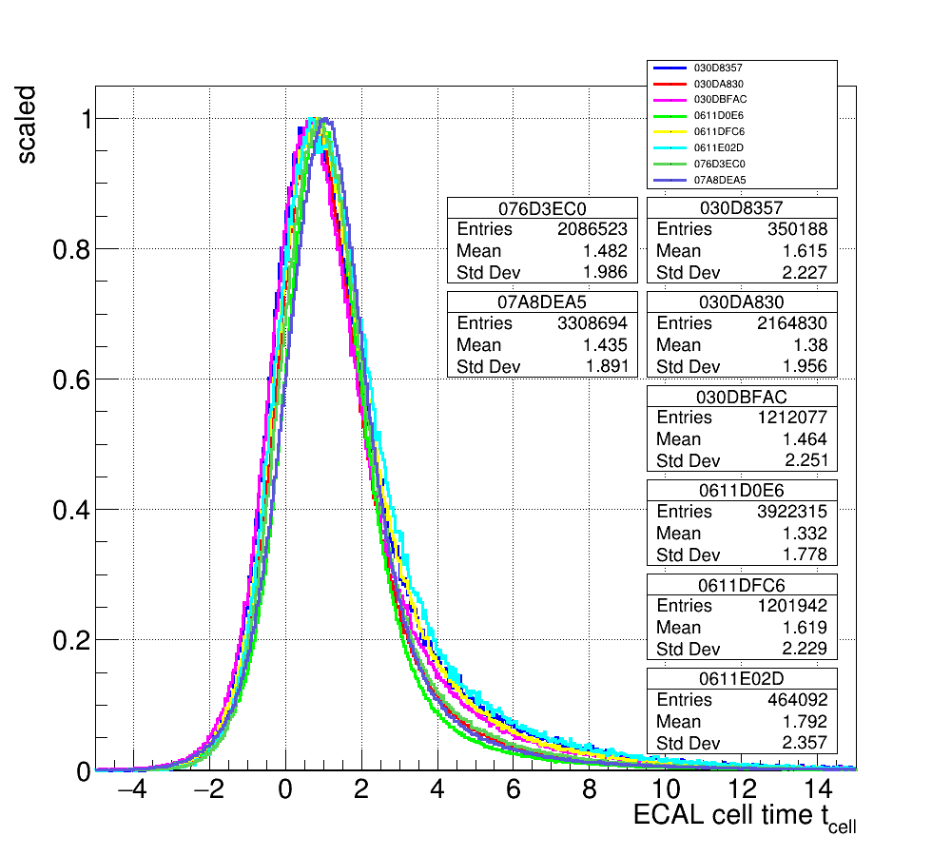
MC estimation of the experimental time resolution.
The estimation of the time resolution was performed by the method of “ time distortion” of the MS calculations. Cells time distortion in MC was set to match the width of the experimental distribution.
MC KrSn 2.36AGeV mb
No distortion (original state)
Exp.data KrSn
Time shifted to match MC on the half height of the rising edge

Slide 18
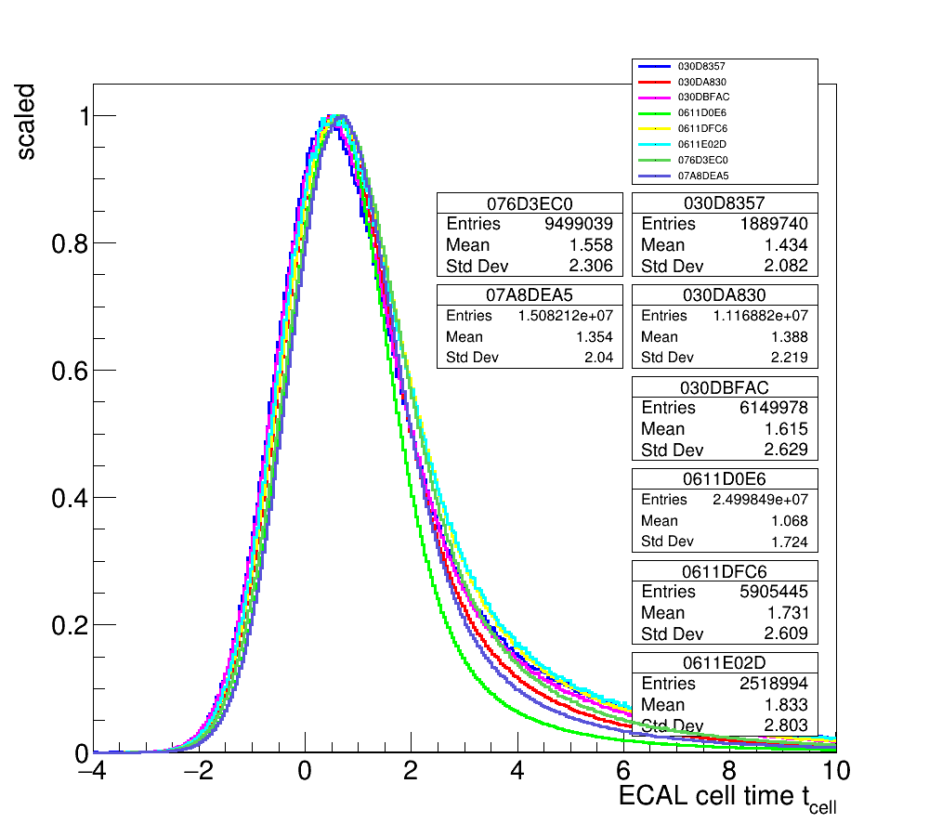
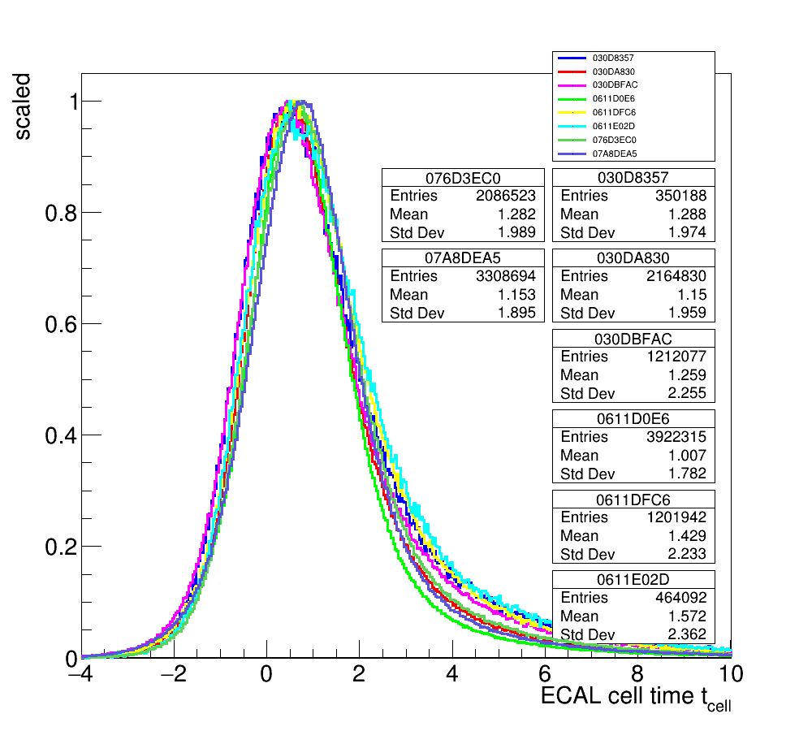
MC estimation of the experimental time resolution.
The best agreement between the MS calculations and the experimental data was obtained for σ_{t}=750 ps.
MC KrSn 2.36AGeV mb
Time distortion (σ = 0.75 ns)
Exp.data KrSn
Time shifted to match MC on the half height of the rising edge

Slide 19
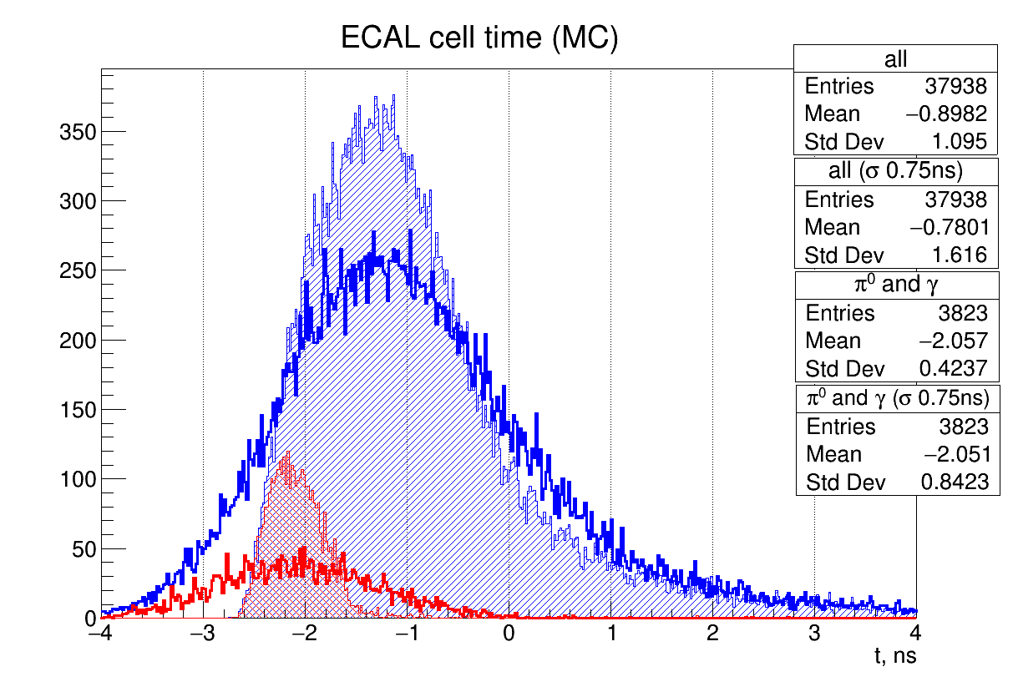
Estimation of the time resolution for the event selection criteria.
The criteria for clusters selection based on the time of arrival of the signal is determined by the time of delay of the background particles relative to the gamma quanta. The shaded areas correspond to the gamma (red) and neutron (blue) detection times without distortion. They are offset by 1 ns. This is enough to suppress the background by an order of magnitude. A time spread of 0.75 ns (bright red and blue line ) devalues the time analysis.

Slide 20
Source of the time distortion for experimental data.
The time resolution of the ADC was investigated by measuring the time difference between the two ADC channels. The times were measured both for a single ADC and for two ADCs synchronized from an external source. For a single ADC, the time resolution has good agreement with the TDR data. The time resolution of paired ADCs is significantly wider and significantly bifurcates at amplitudes of 5000.
Gen
Att
ADC 1
PC
Att
ADC 1
Gen
Att
PC
Att
ADC 2
Synchronization

Slide 21
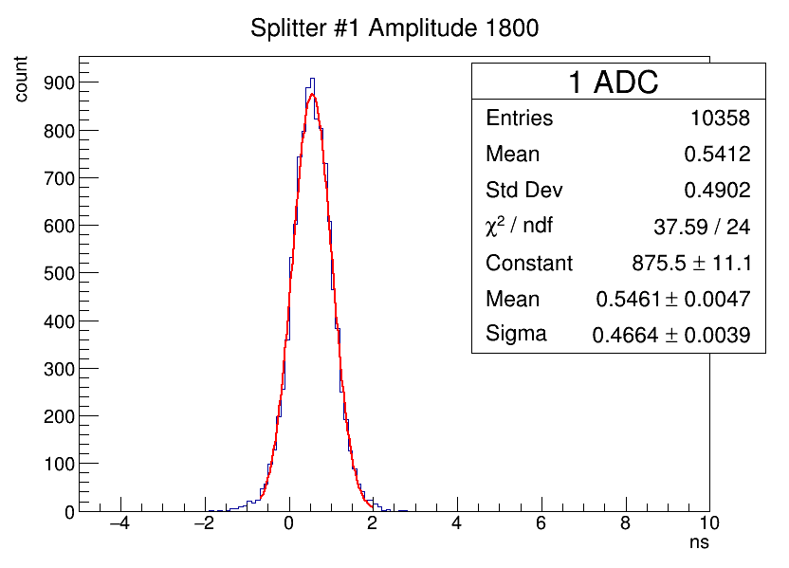
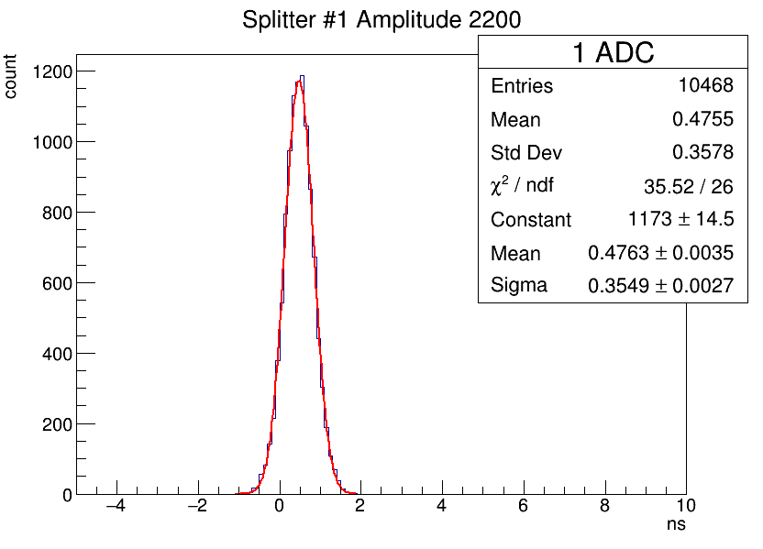
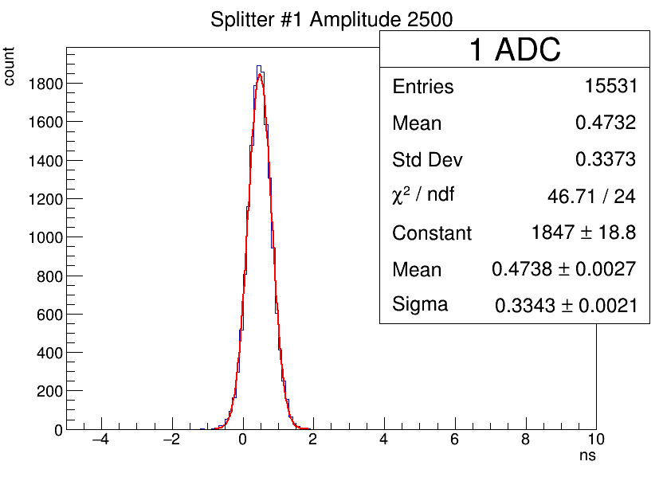
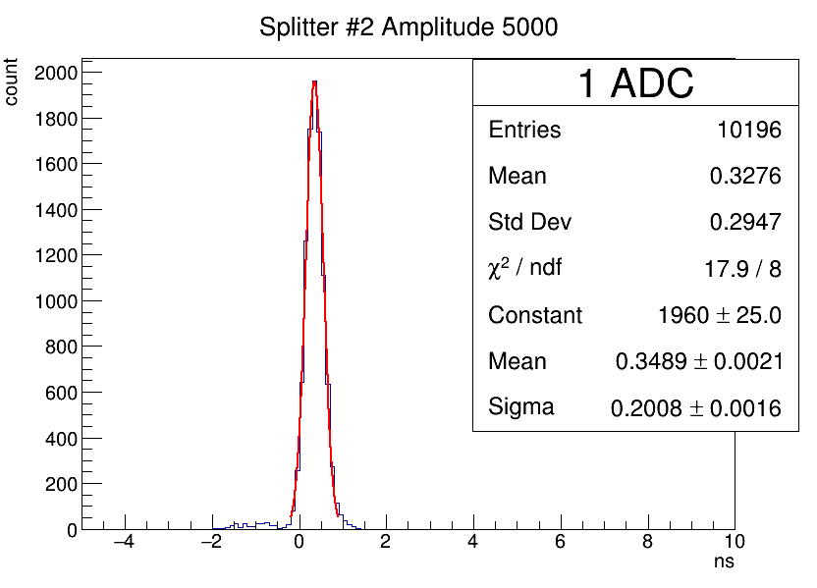
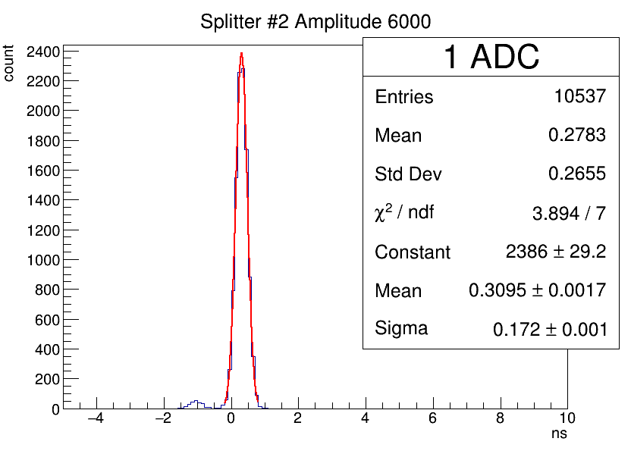
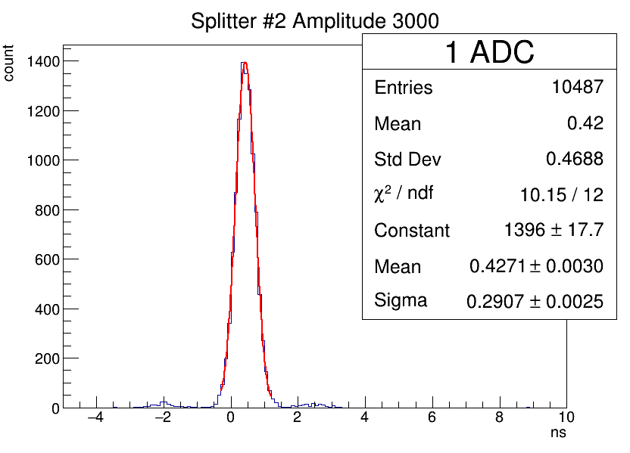
Time difference between the two channels in single ADC

Slide 22
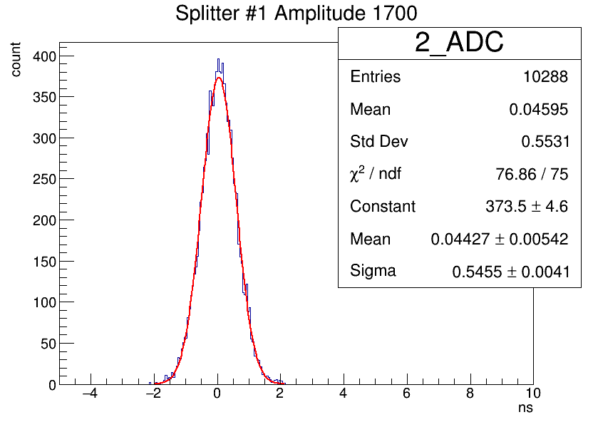
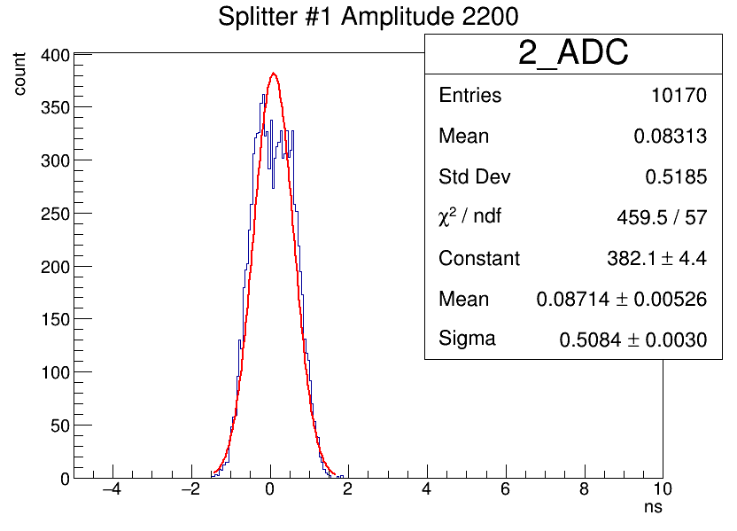
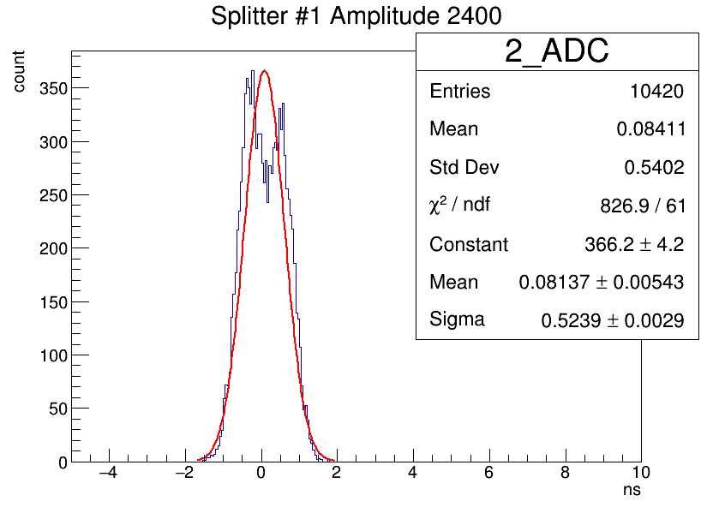
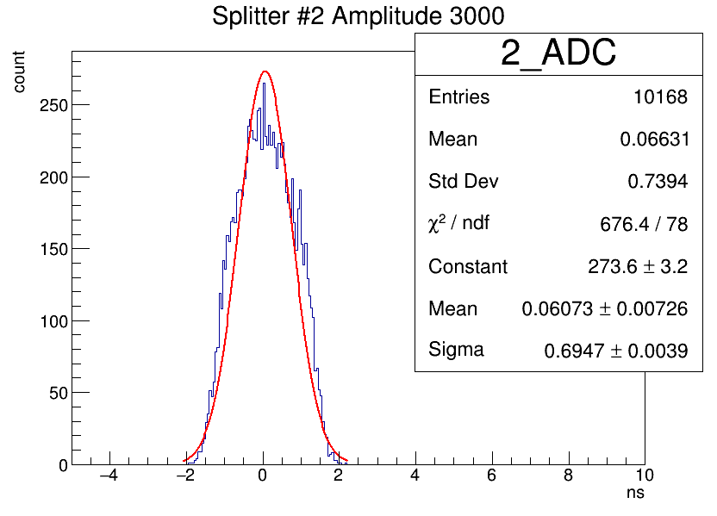
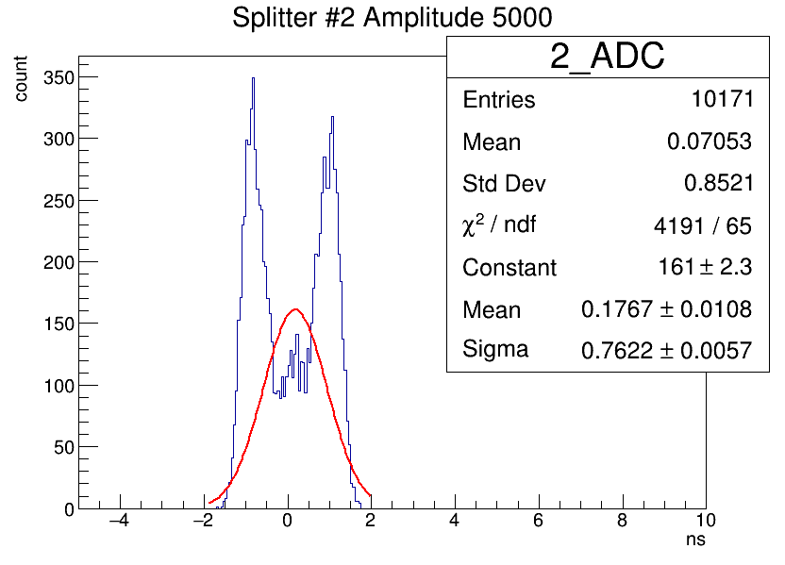
Time difference between two channels in two ADCs

Slide 23

For a single ADC, the time resolution has good agreement with the TDR data. The time resolution of paired ADCs is significantly wider and sensitive bifurcates at amplitudes of 5000.

Slide 24
The proposed source of the time distortion is external start of ADCs.
Unfortunately, it is not possible to correct the information from run 7.
Possible solutions for run 8 are
to use the 64th free ADC input for synchronization
make changes to the ADC synchronization system.
This item was completed in the summer of this year.

Slide 25

The time spread of the signal in the ADC was reduced to 50 ps.

Slide 26



A global problem is the spatial distribution of the electromagnetic shower along the detector. This leads to a significant time shift of the recorded signal depending on the initial energy.

Slide 27

A modern approach to solving the problem of the time distortion of a shower is the registration of time and amplitude from each layer of the detector.
Project HGCAL CMS
A modular reconstruction framework designed to fully exploit HGCAL potential
  Goal: process the energy deposited by particles on HGCAL [RecHits] and return particles and probabilities

Slide 28
Preparation for RUN 8

Slide 29


Operation regimes for ECAL
Close to beam
RUN 8 position out of SRC aperture

Slide 30

New mechanics for the two-arm calorimeter
is ready.

Slide 31


The ADC and modules for the two arms ECAL have been prepared.
The non standard modules from the right arm of the ECAL were checked and prepared for replacement.
Tested modules for the left arm of the ECAL.
Right arm
Left arm

Slide 32
ECAL assembling time-table will be prepared in connection to GEM chambers and magnetic measurement.

Slide 33
Thank for your attention!

Slide 34
BACKUP

Slide 35



ECAL two arms installation (status 2020).
- main effort was add ECAL data analysis considering signal time parameters
- assembled of two racks for ECAL in the magnet
- performed tests array of modules for second arm of the ECAL
Location of Ecal in the magnet SP-41
New racks for ECAL

Slide 36




The test of the modules for second arm of ECAL
The modules was tested using monitors in three position. Each positions gives attenuated amplitude and allowed to calculate quality of the module.
The decay coefficients for tested modules.
bad
cells
bad
cells

