Slide 1
Software contribution from MIPT: Event Metadata System and a set of services for BM@N
8th Collaboration Meeting of the BM@N Experiment at the NICA Facility, October 2–9, 2021
Peter Klimai

Slide 2
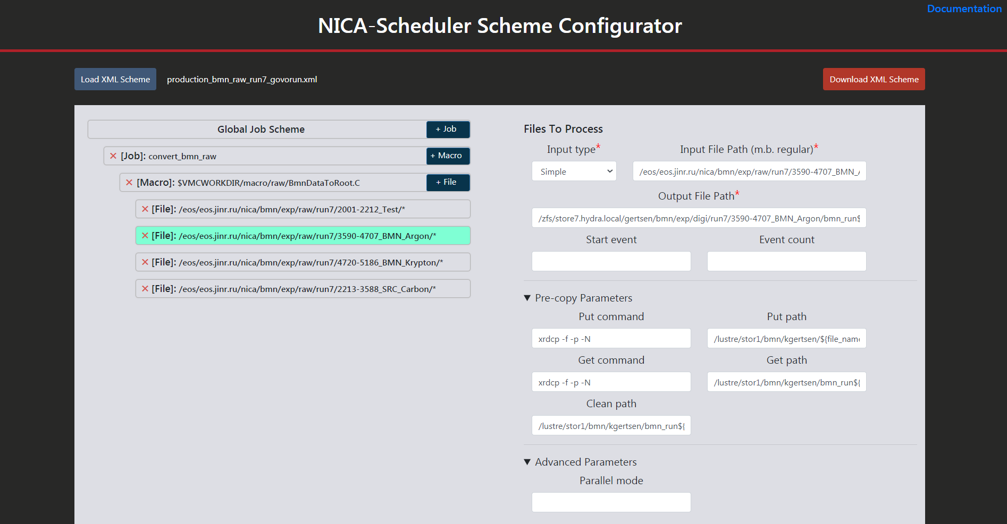
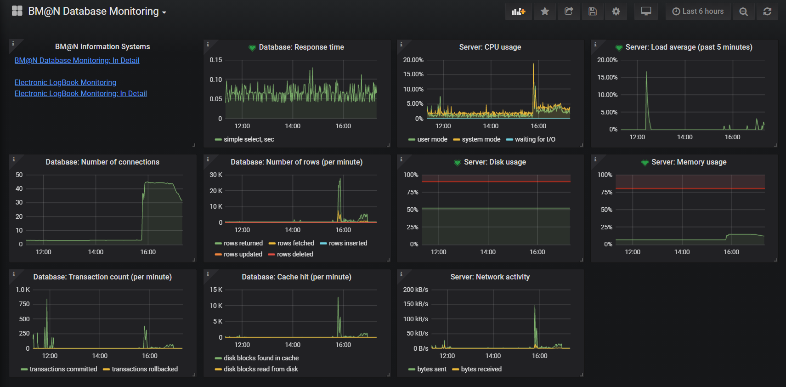
MIPT Projects for BM@N
MIPT projects for BM@N include services for:
Visualization,
Monitoring,
Statistics collection, and more
About MIPT-NPM:
http://npm.mipt.ru/ru/
https://research.jetbrains.org/groups/npm

Slide 3
Project Summary
Project | URL | Status
NICA scheduler configurator GUI | https://bmn-scheduler.jinr.ru | In production
Monitoring service | https://mon-service.jinr.ru | In production
Next-generation event display | https://github.com/mipt-npm/visionforge | Working on ROOT integration
Slow control system viewer | https://bmn-tango.jinr.ru | In production
Statistics collection script | https://git.jinr.ru/nica/bmnroot/-/tree/dev/services/statistics | Available as part of BmnRoot
Event Metadata System | https://git.jinr.ru/nica_db/emd | Prototype
Condition database REST API | https://git.jinr.ru/nica_db/condb_api | In progress
Experimental data migration tool (text to database) |  | New

Slide 4
Event Metadata System
The work was funded by the Russian Foundation for Basic Research (RFBR) grant according to the research project №18-02-40125.

Slide 5
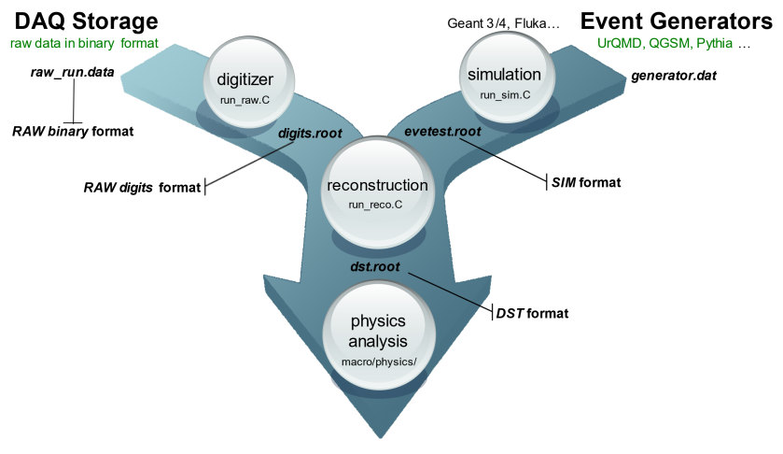
Event Metadata System Goals
Indexing of all reconstructed events stored in ROOT DST files
Storing necessary event metadata, such as:
Number of primary and all reconstructed tracks
Track number of +/- charged particles
Primary and secondary particles found
Number of hits by detectors
Total input and output charge in the event
Software version
Reference to the storage location
Flexibly tune per experiment (BM@N, BM@N SRC, MPD, SPD)
Convenient access to metadata (Web, REST API, C++)
Search for required set of events
Provide statistics and check the quality of the catalogue of physics events

Slide 6
Event Metadata System Requirements
Scalability
Today for BM@N: overall ~500M events
Future (all NICA experiments): several Billion events per year
Performance
Not too many RPS, but heavy ones
Availability and fail safety
Role-based access
Event Consumer, Index Writer, Index Administrator
Interaction with other systems
Run metadata is stored in Condition database
Authentication and authorization via FreeIPA
FairRoot-based frameworks (BmnRoot, etc.)

Slide 7
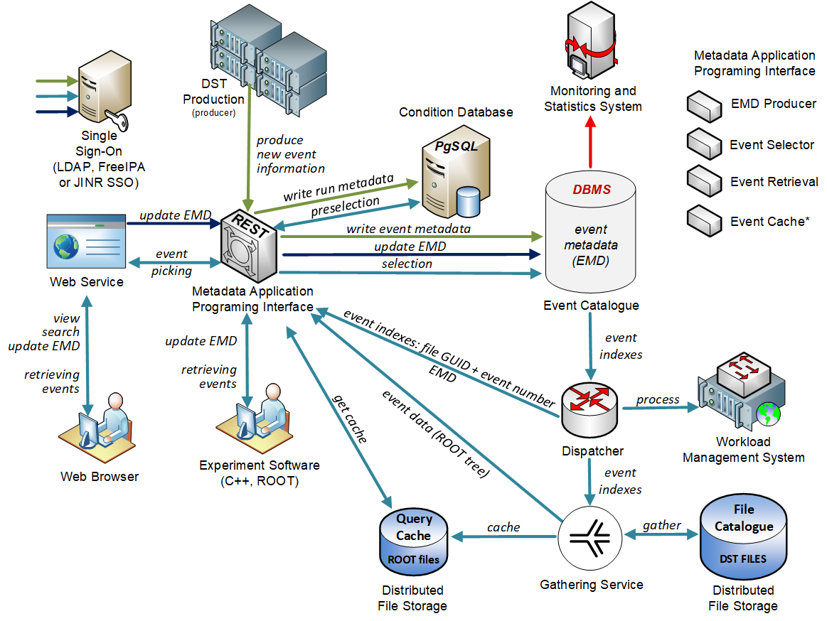
EMD System Architecture
For more details:
E. Alexandrov, I. Alexandrov, A.Degtyarev, K. Gertsenberger, I.Filozova, P. Klimai, A. Nozik and A. Yakovlev, “Design of the Event Metadata System for the Experiments at NICA”, Phys. Part. Nuclei Lett. 18, 603–616 (2021).

Slide 8
EMD Database Choice
Existing SQL vs. Existing NoSQL vs. Custom
Horizontal vs. Vertical scaling
Ease of maintenance
Hardware cost
Other experiment’s experience
No single “best” solution
ATLAS Event Index architecture example (from: E. Cherepanova et al, “The ATLAS EventIndex using the HBase/Phoenix
storage solution”, talk at GRID-2021)

Slide 9
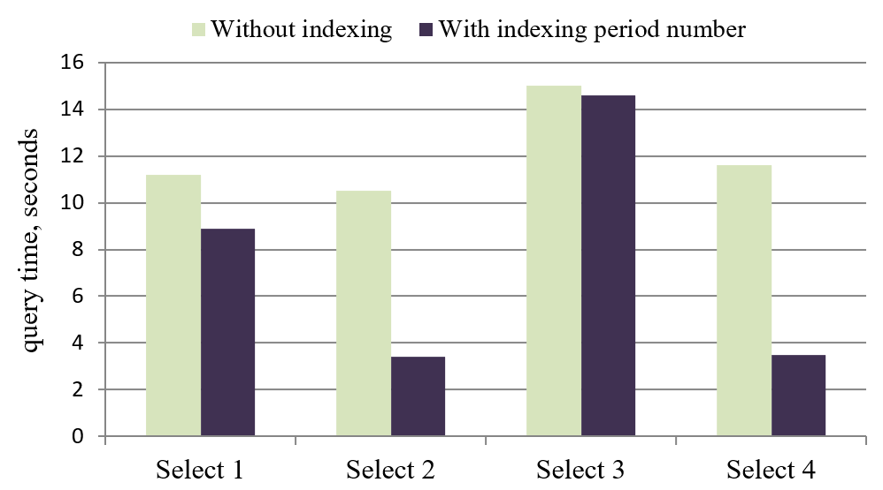
DBMS Choice – PostgreSQL test example
HW Config 2: Intel Core i9-10900F 2.80GHz (20 CPU cores), 64 GB RAM, 1TB NVMe SSD disk, CentOS Linux 8.2, PostgreSQL 12.5
<- Example test result for 500M events
Select 1: period_number=6 AND software_id=0 AND primary_tracks > 5;
Select 2: period_number=6 AND software_id=2 AND primary_vertex = false AND detector_hit[bits:0-5];
Select 3: period_number=5 AND run_number > 100 AND primary_vertex = true AND particles[bits:5-9] > 4;
Select 4: period_number=4 AND software_id=1 AND primary_tracks>6 and all_tracks>40 AND particles[bits:10-14].

Slide 10
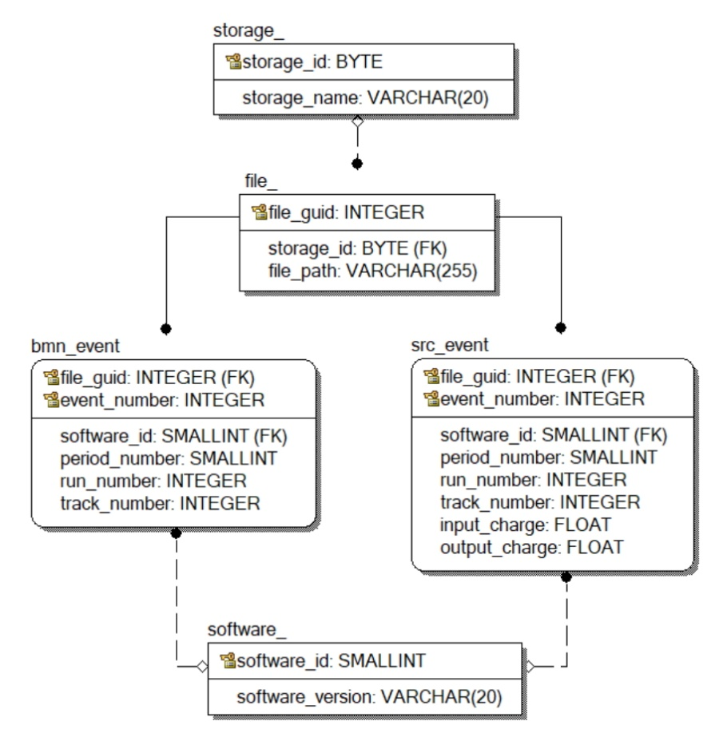
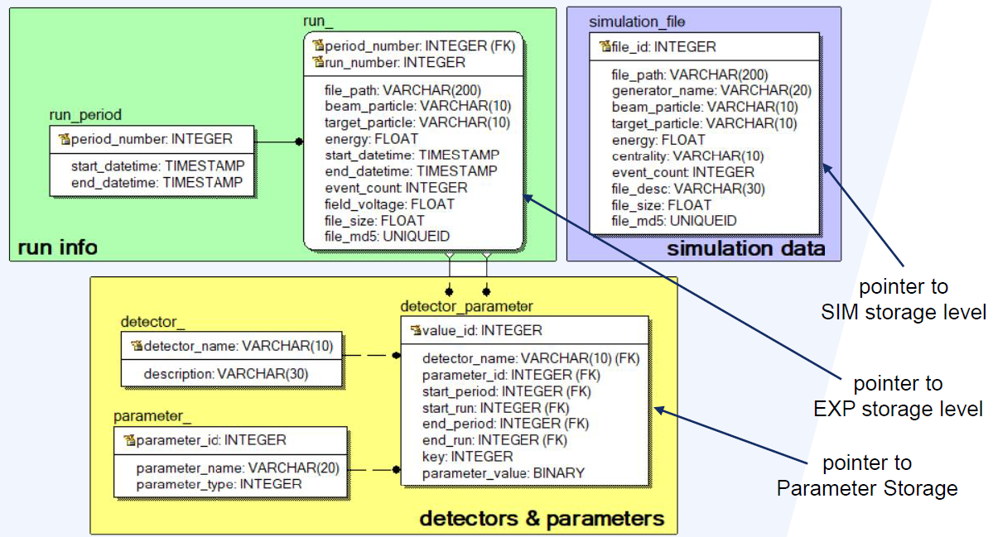
Database Schema Examples
EMD
Database:
Condition Database:
Configurable

Slide 11
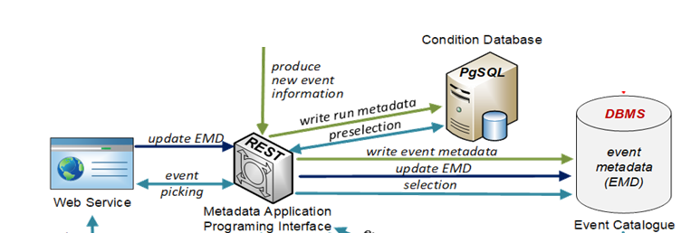
REST API and Web UI Implementation
Using Kotlin programming language
JVM runtime
ktor framework for Web UI and API
JDBC for Database connectivity
Jackson for (de)serialization
Kotlinx.html
Packed in Docker
Configuration file provided in YAML
Auto provisioning (WIP)

Slide 12
Configuration File Example
[…]
- name: "BM@N SRC Events" api_url: "/event_api/v1/src" web_url: "/event_web/src" db_table_name: "src_event" parameters: - name: track_number type: int intervals: true web_name: "Total track number" - name: input_charge type: float intervals: true web_name: "Input charge" - name: output_charge type: float intervals: true web_name: "Output charge"
event_db: # condition_db - similar host: *** port: *** db_name: *** user: *** password: *** title: "Event Index Main Page" pages: - name: "BM@N Events" api_url: "/event_api/v1/bmn" web_url: "/event_web/bmn" db_table_name: "bmn_event" parameters: - name: track_number type: int intervals: true web_name: "Total track number"
[…]

Slide 13
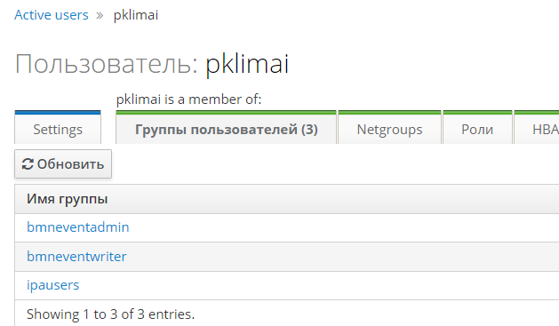
FreeIPA Integration
user_auth: ldap_server: bmn-ipa.jinr.ru ldap_port: 389 user_dn_format: "uid=%s,cn=users,cn=accounts,dc=jinr,dc=ru" ldap_username: ***** ldap_password: ***** writer_group_dn: "cn=bmneventwriter,cn=groups,cn=accounts,dc=jinr,dc=ru" admin_group_dn: "cn=bmneventadmin,cn=groups,cn=accounts,dc=jinr,dc=ru"
https://bmn-ipa.jinr.ru
Writer or admin role – can create events in the catalogue
Admin role – can delete event records
Everyone else – read only access

Slide 14
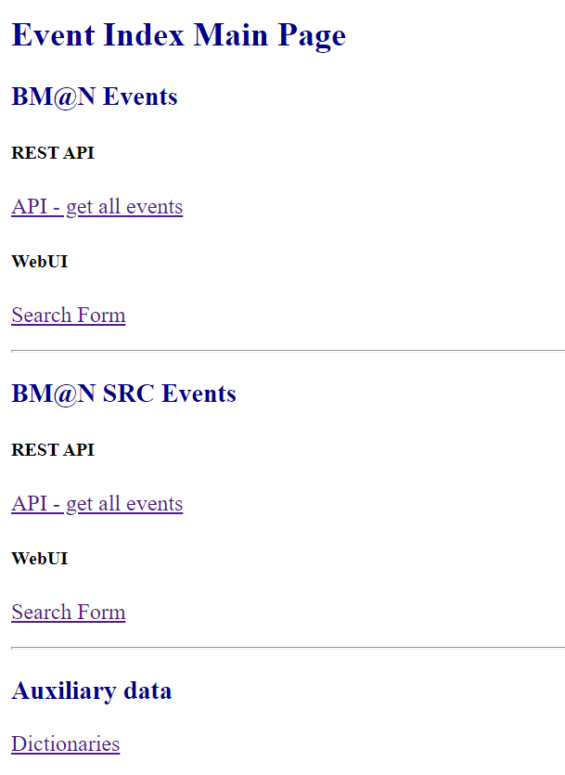
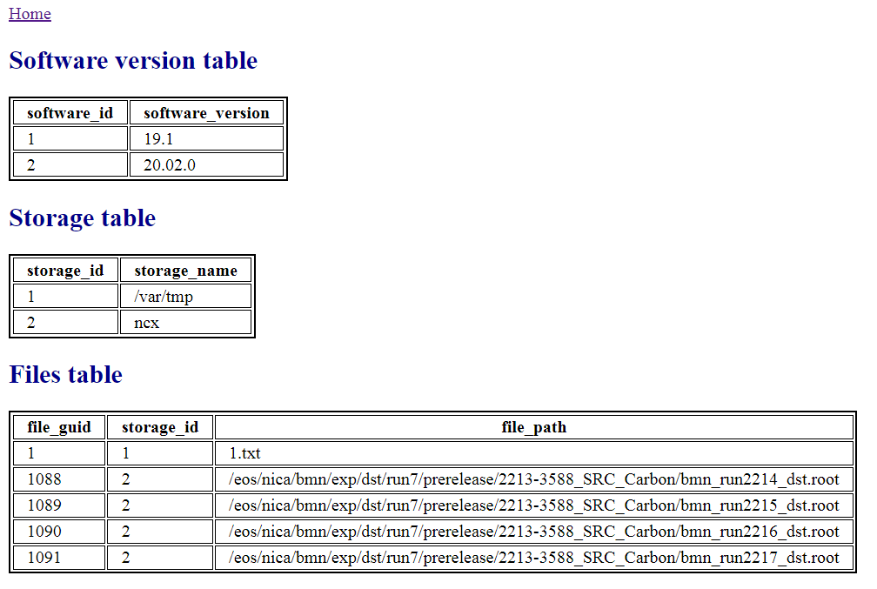
Web UI Main Page (Test Prototype)

Slide 15
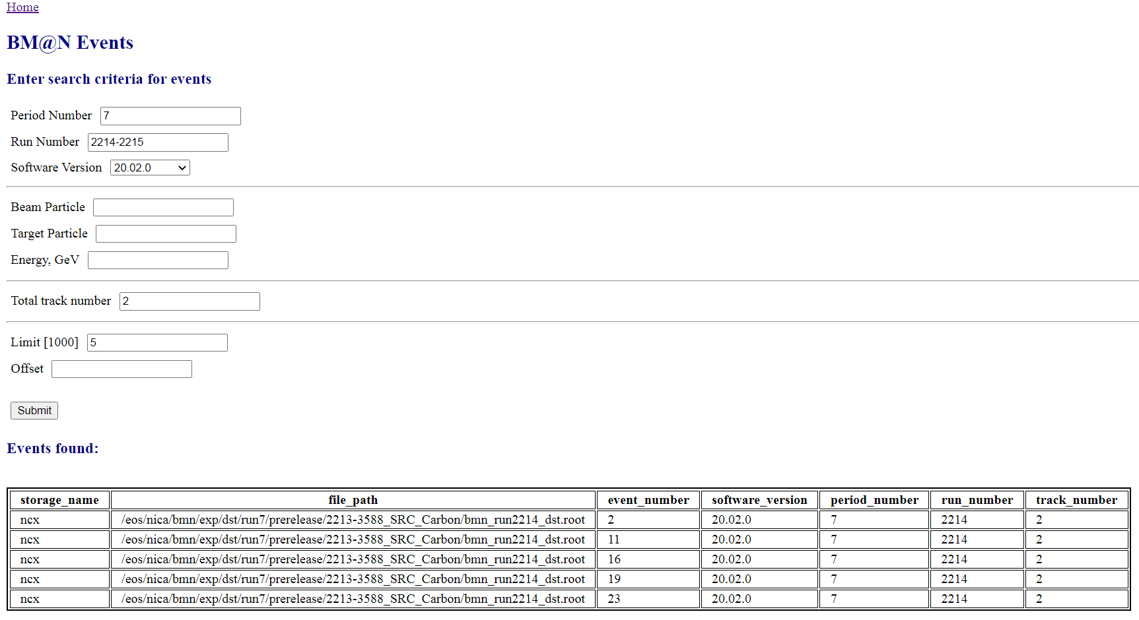
Web UI View (Test Prototype)
Selection based on standard parameters
Preselection based on Condition DB
Selection based on configured parameters
Limit and offset

Slide 16
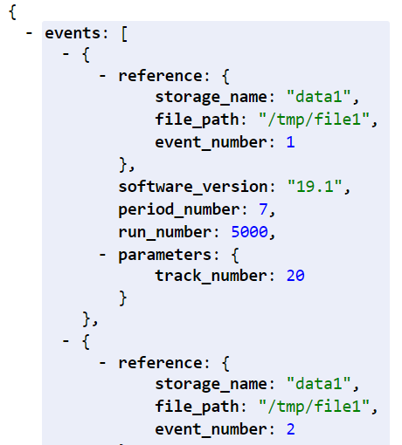
API Details
HTTP API using JSON formatting
HTTP POST to create events in the catalog
HTTP GET to obtain event records
Same filtering criteria as Web UI, including range support, e.g. /event_api/v1/bmn/events?period_number=7&run_number=5000+&software_version=19.1&track_number=10-15

Slide 17
EMS Current Status
Event Metadata System current status
Database based on PostgreSQL is deployed
REST API and Web UI test prototype deployed
Macro to write BM@N events in the catalogue
Started to fill the event catalogue with real BM@N events
Work in progress
Monitoring
HA and Backup
Automated Deployment

Slide 18
Slow Control System Viewer

Slide 19
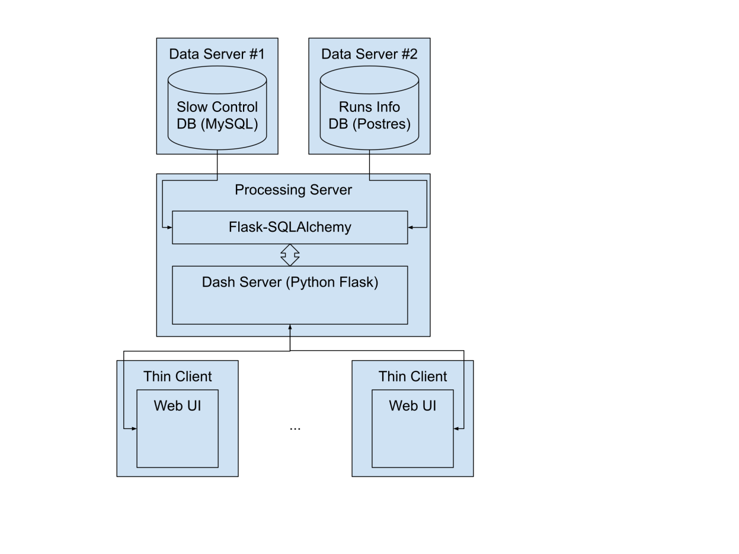
Slow Control Viewer – Task
Task
Web interface for slow control system of BM@N
Existing SCS Tango has MySQL DB with all sensor data obtained during runs
Show sensor data graph based on:
User-friendly alias for parameter name OR domain/family/member/name as stored in DB
Run no. OR time interval
Parameter can be 1d array – in this case a multigraph is displayed
Implementation
Uses Python-based Dash framework, all packed in Docker container
Sources: https://git.jinr.ru/nica_db/tango_web
Deployed at: https://bmn-tango.jinr.ru/
SC data
Run data

Slide 20
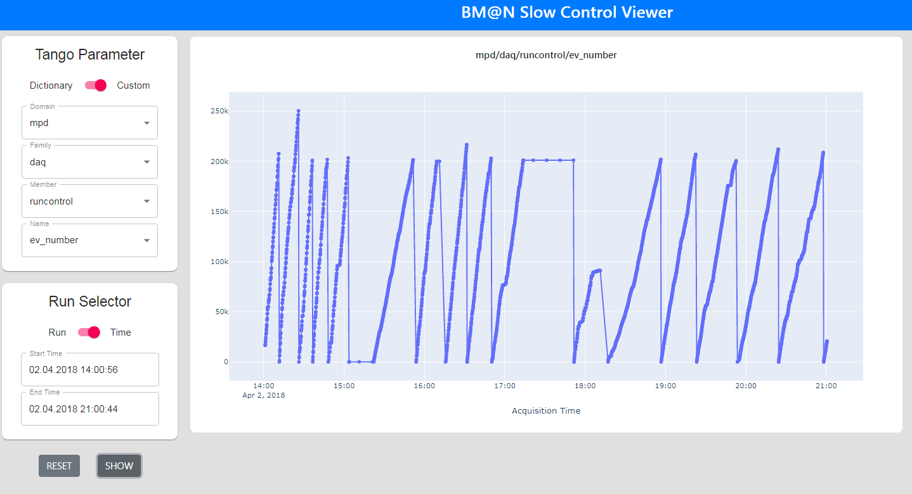
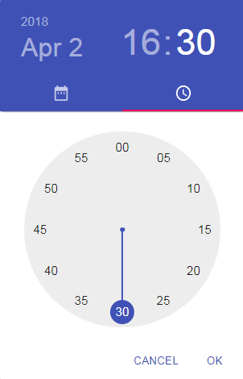
Example 1 – Parameter and Time Selection
https://bmn-tango.jinr.ru

Slide 21
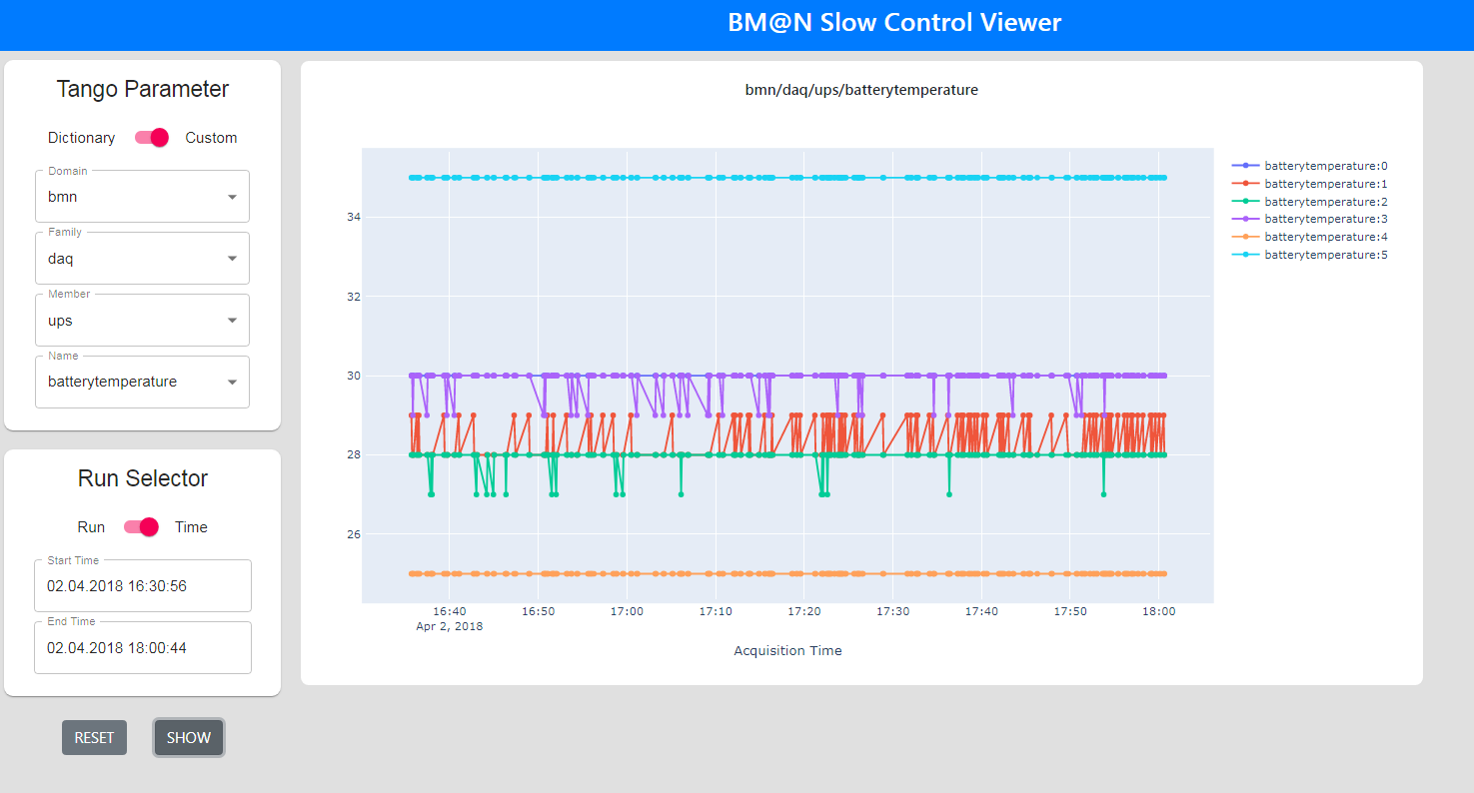
Example 2 – Multigraph

Slide 22
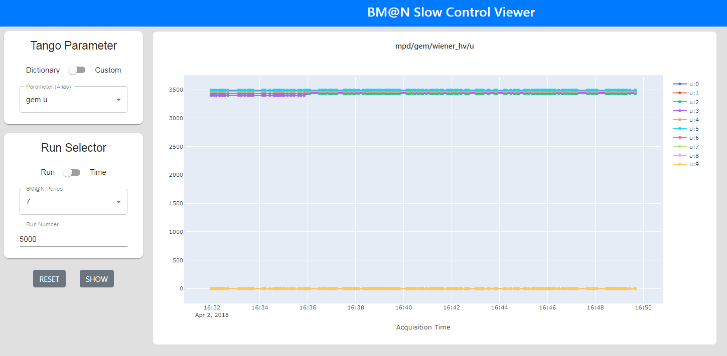
Example 3 – Parameter Dictionary
https://bmn-tango.jinr.ru
Notes:
Gas Electron Multipliers (GEM) voltage

Slide 23
Thank You!

