Slide 1
BM@N Condition Database and related web services
3-8 October 2021
8th Collaboration Meeting of the BM@N Experiment at the NICA Facility
Alexander Chebotov
JINR, LHEP

Slide 2
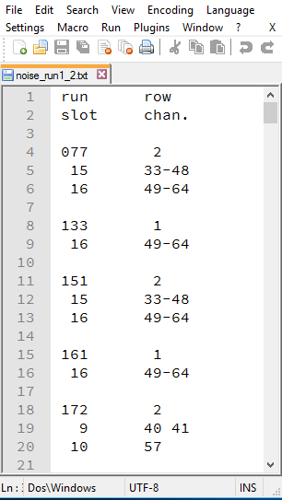
BM@N in Nuclotron Sessions (2015 – 2018)
Session №51 (d,C) Feb. 22 – Mar. 15, 2015
Session №52 (d) June 29 – June 30, 2016
Session №53 (d, $d^{↑}$) Dec. 9 – Dec. 23, 2016
Session №54 (C) Mar. 7 – Mar. 18, 2017
Session №55 (C,Ar,Kr) Mar. 3 – Apr. 05, 2018
Excel
Text
HTML

Slide 3
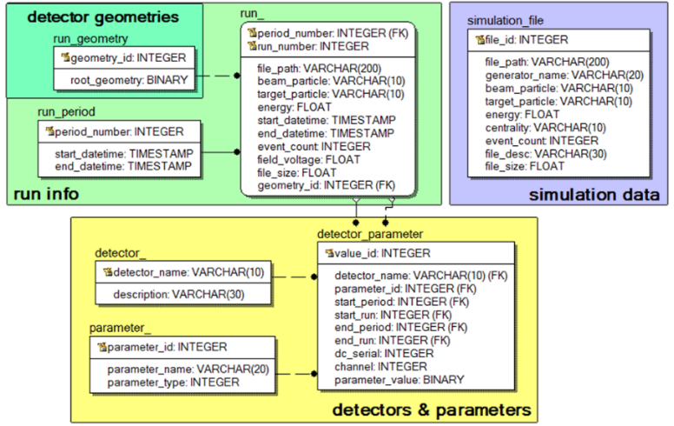
BM@N Database
The database has been implemented via PostgreSQL DBMS
The database contains information on the sessions and runs of the experiment, the detectors and their geometries, parameters of the experiment and their values, and information on simulation files.
The developed database is a complex data storage of the BM@N experiment, which provides unified user access and data management.

Slide 4
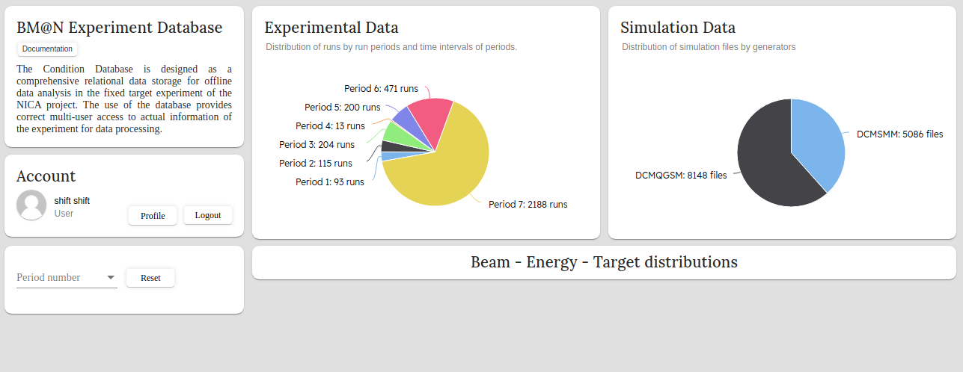
Web service for the BM@N Database

Slide 5
Distribution of the Experimental Data and Simulation Data
The Experimental Data diagram is used for the graphical display of the summary information on the experimental data in the form of the distribution of the run numbers in the past sessions of the BM@N experiment.
The Simulation Data diagram implemented for representation of the distribution of files with BM@N simulated events across various event generators.

Slide 6
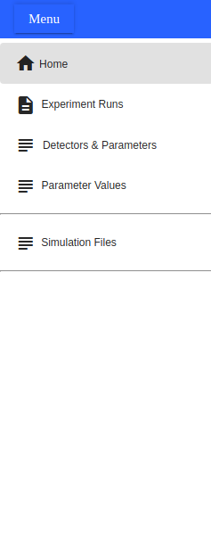
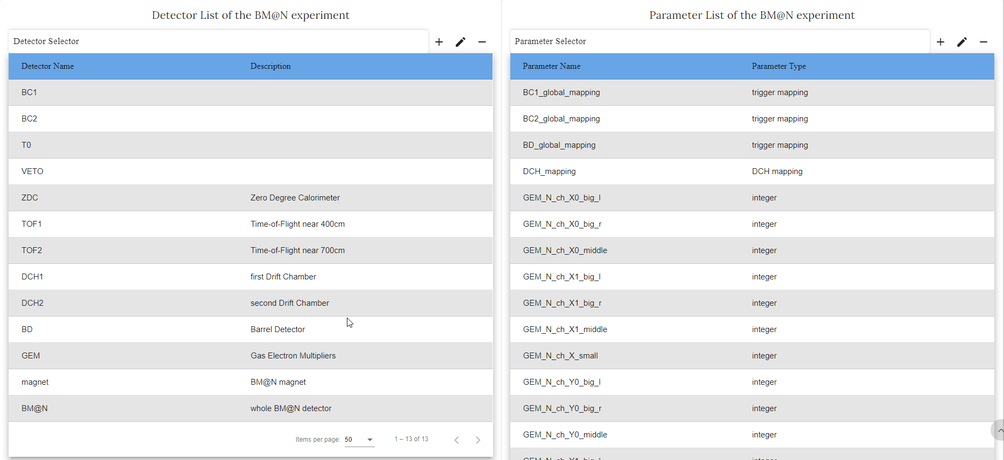
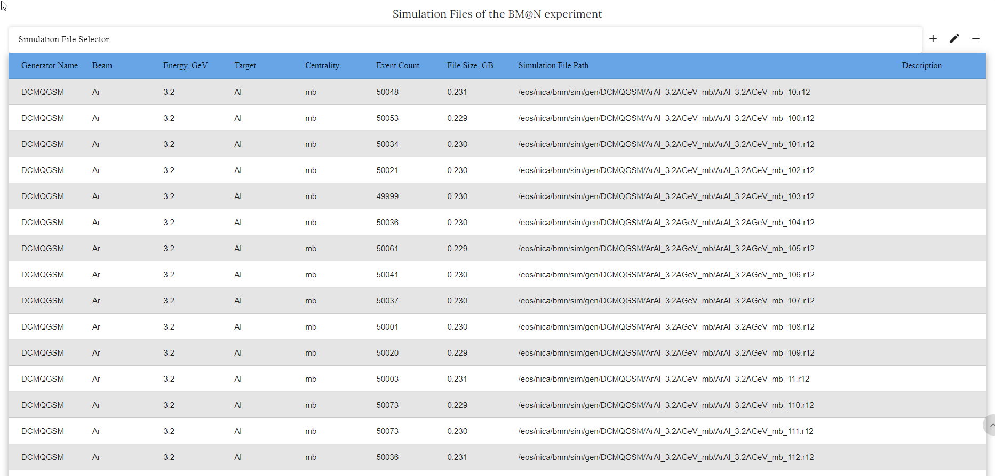
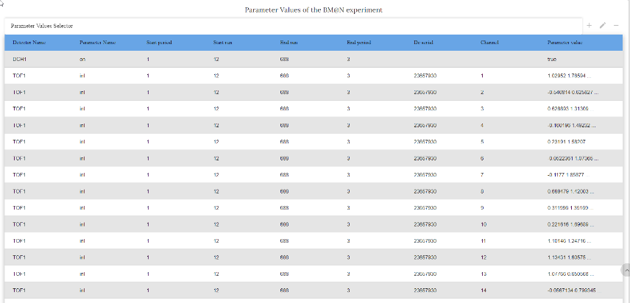
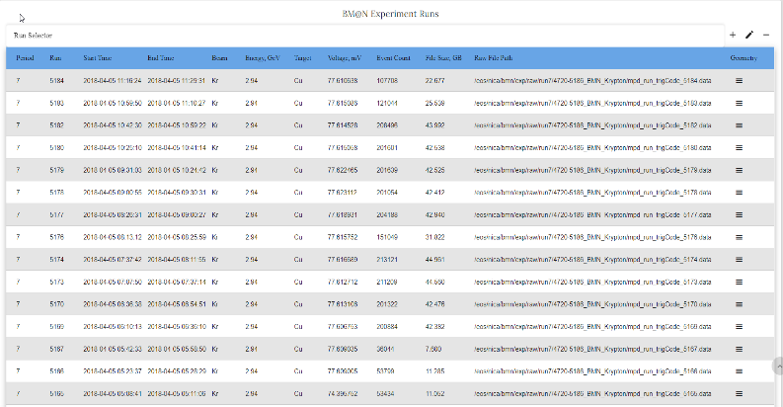
Parameter Values
Stored data in Tables
Detector & Parameters
Simulation Files
Experiment Runs

Slide 7
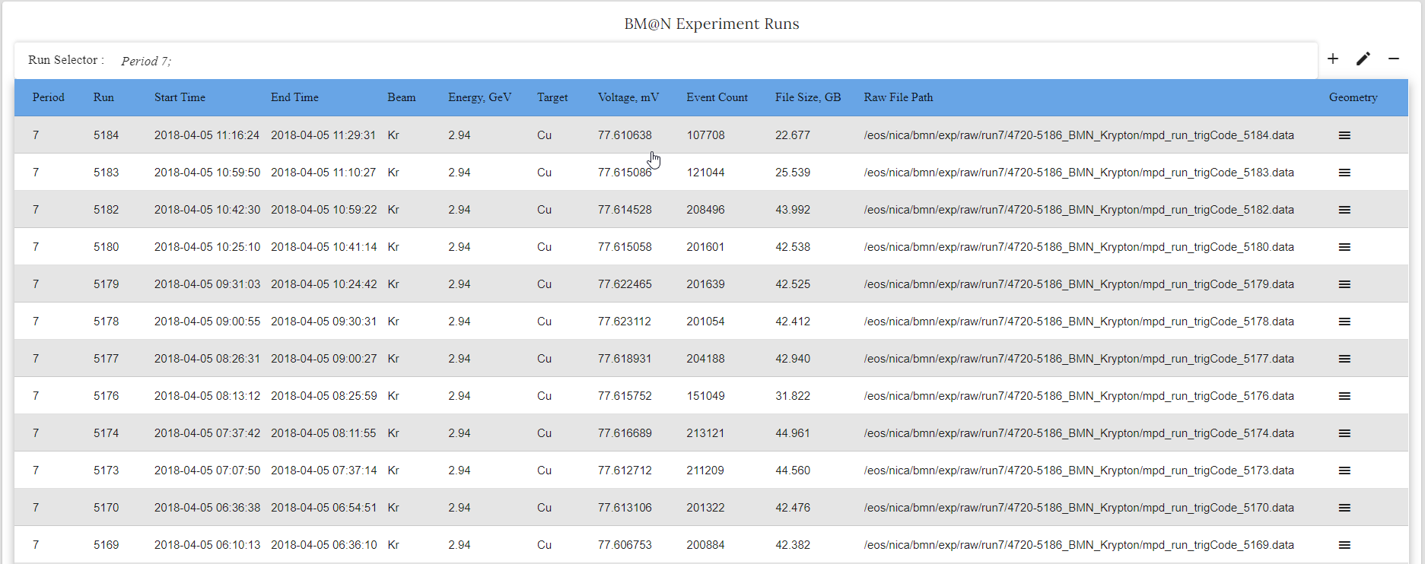
BM@N Experiment Runs

Slide 8
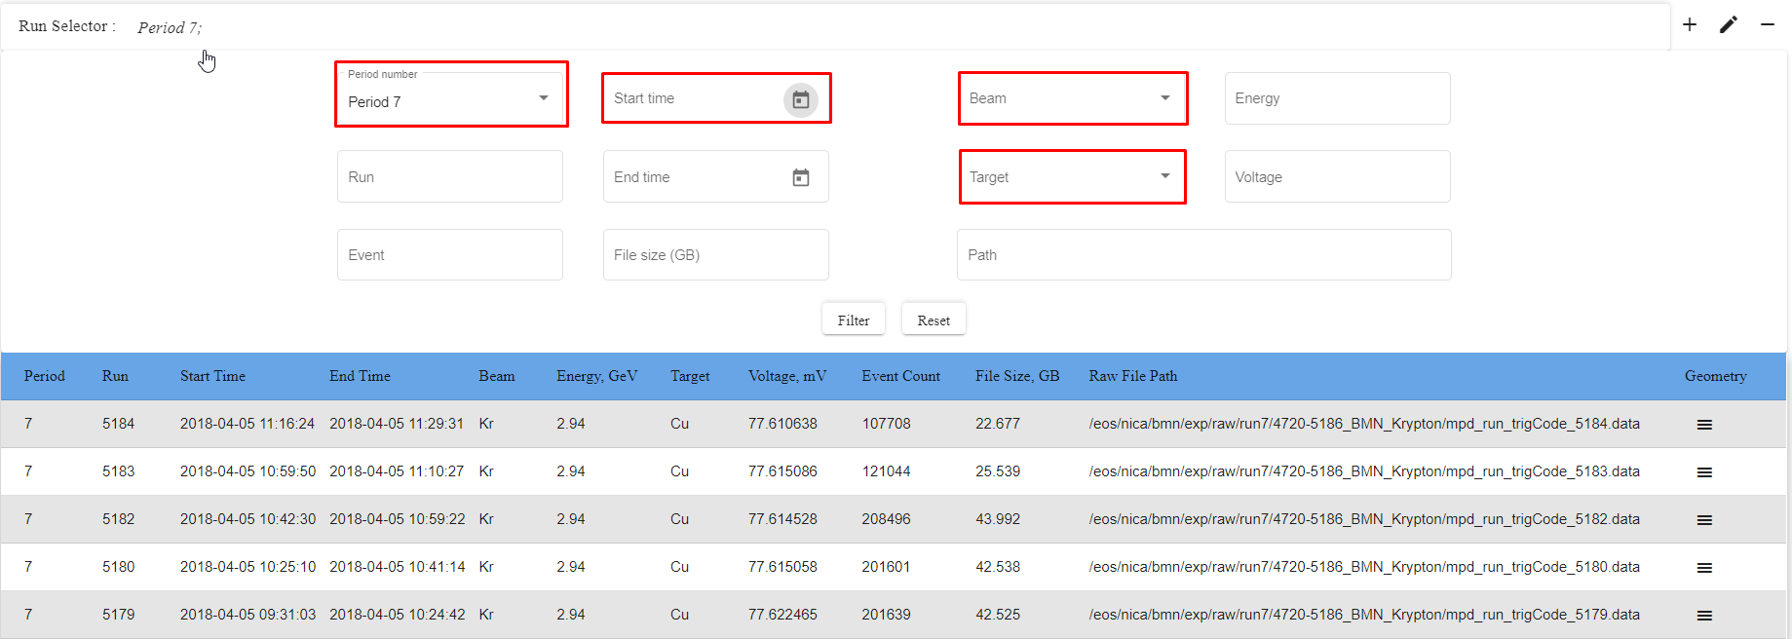
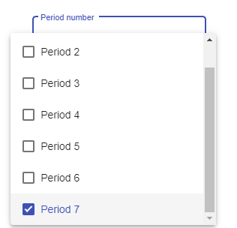
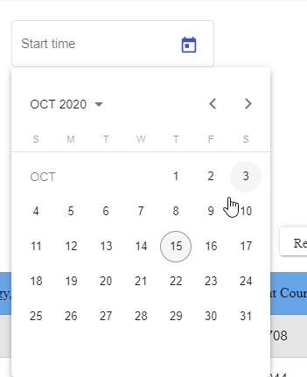
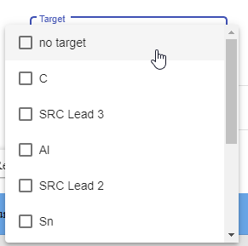
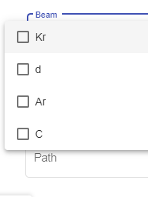
Selector for Experiment Runs

Slide 9
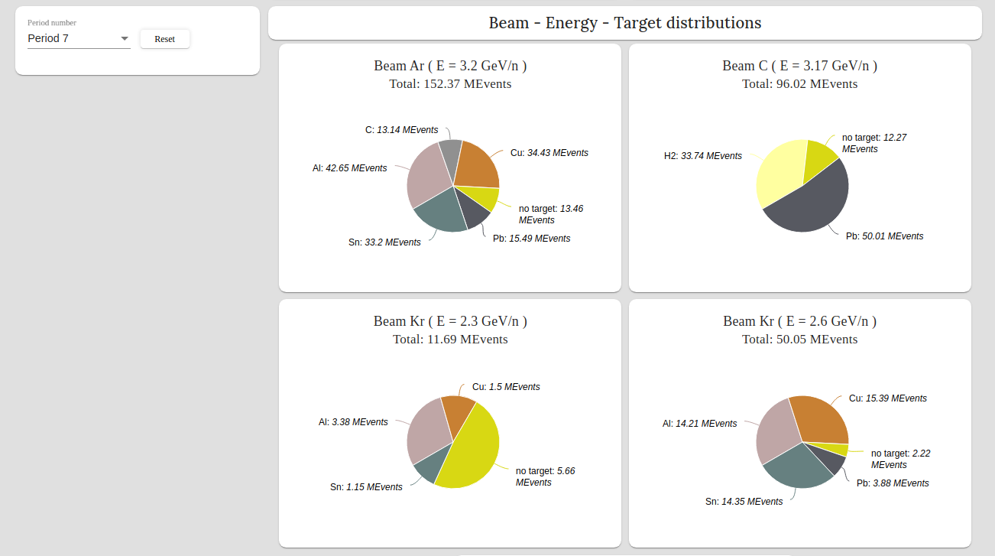
Event Distribution for selected period
Each diagram graphically shows the number of events for different targets for the same type of particle beam and a certain energy.

Slide 10
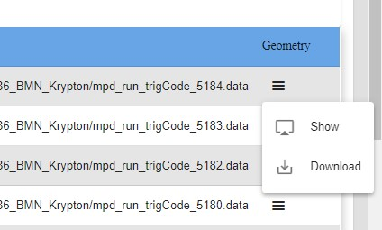
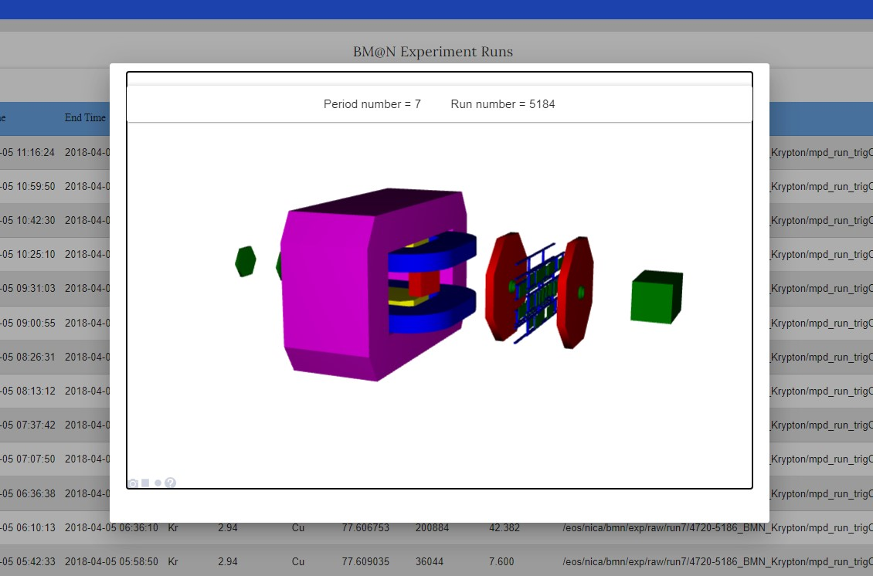
Geometry Display in the Service
In the Experiment run table, you can use the interactive visualization of the geometry of the experiment.

Slide 11
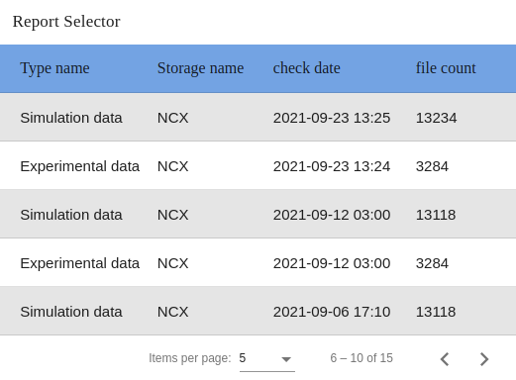
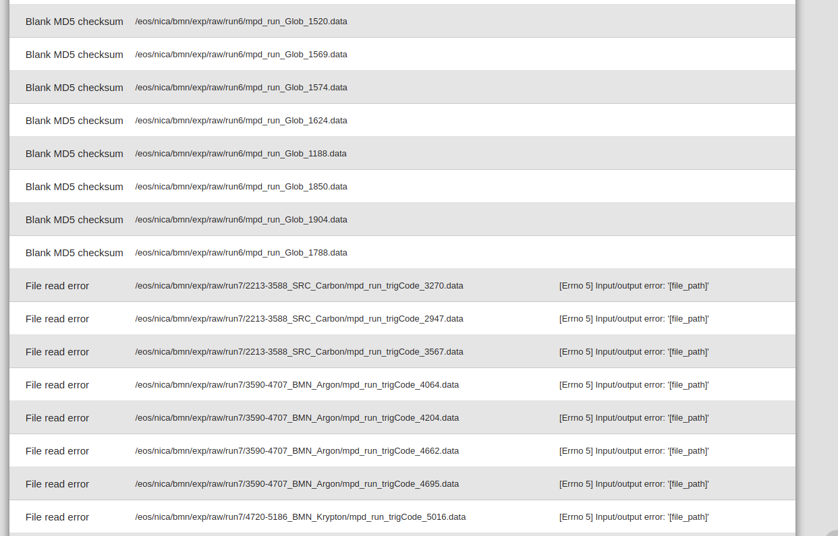
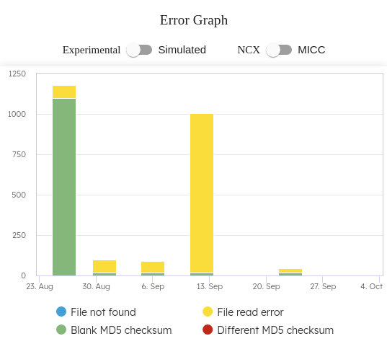
Data
Inspector
Data Inspection Service

Slide 12
FreeIPA: Single Authentication & Authorization

Slide 13
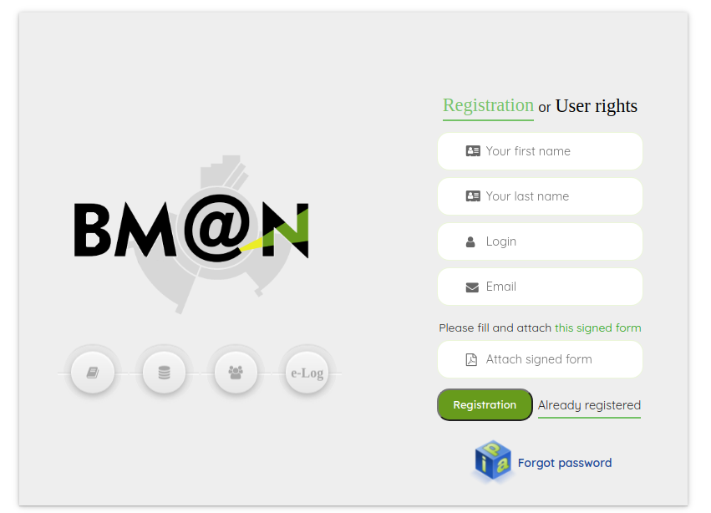
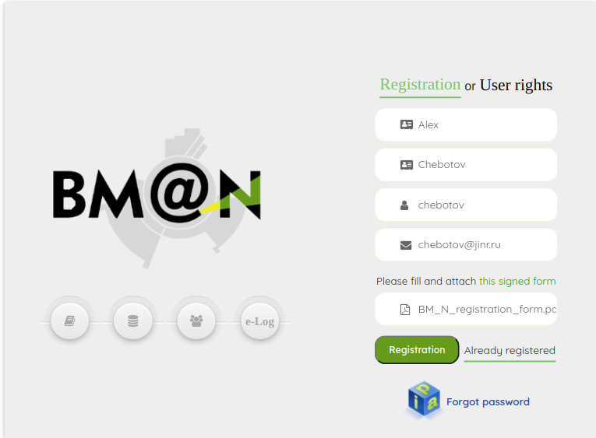
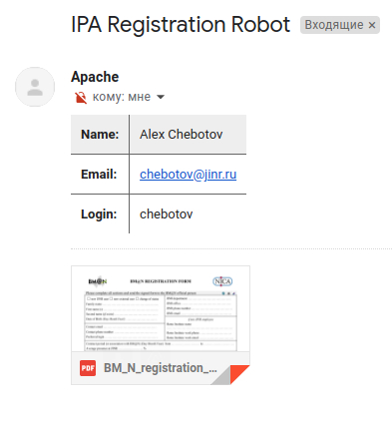
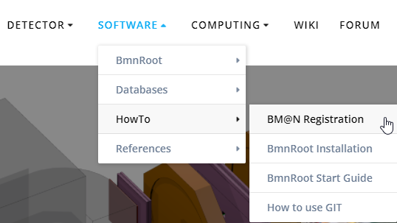
Registration form for BM@N services
https://bmn.jinr.ru/registration
Official BM@N collaboration web-site

Slide 14
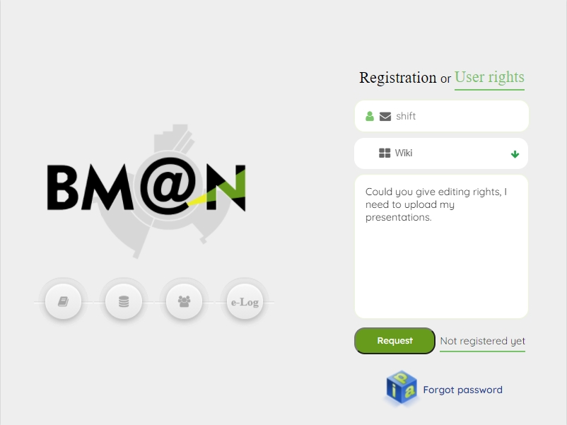
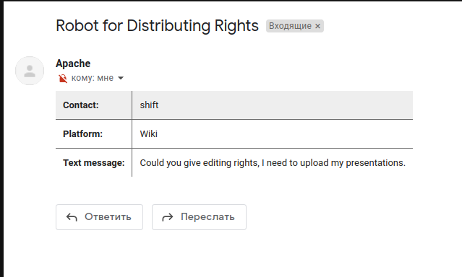
Request for user rights

Slide 15
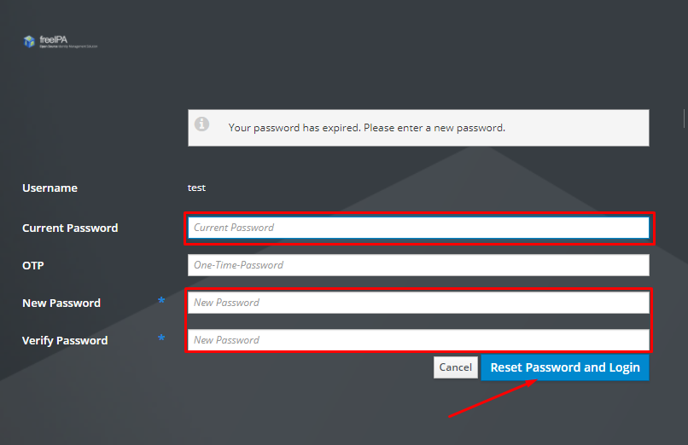
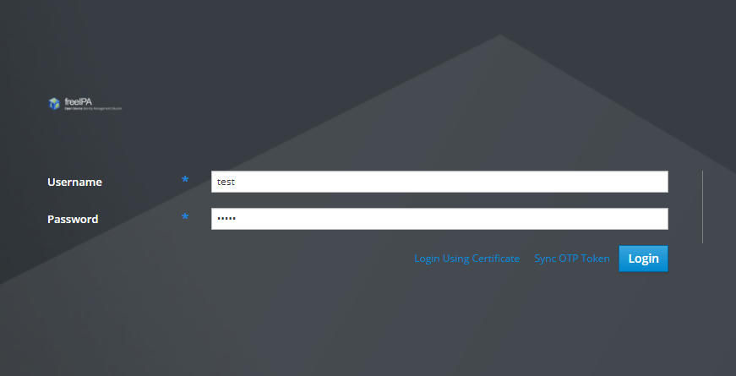
FreeIPA: Single Authentication & Authorization
After first entering the credentials, you will be prompted to change the temporary password; you need to enter data only in the selected areas
https://bmn-ipa.jinr.ru

Slide 16
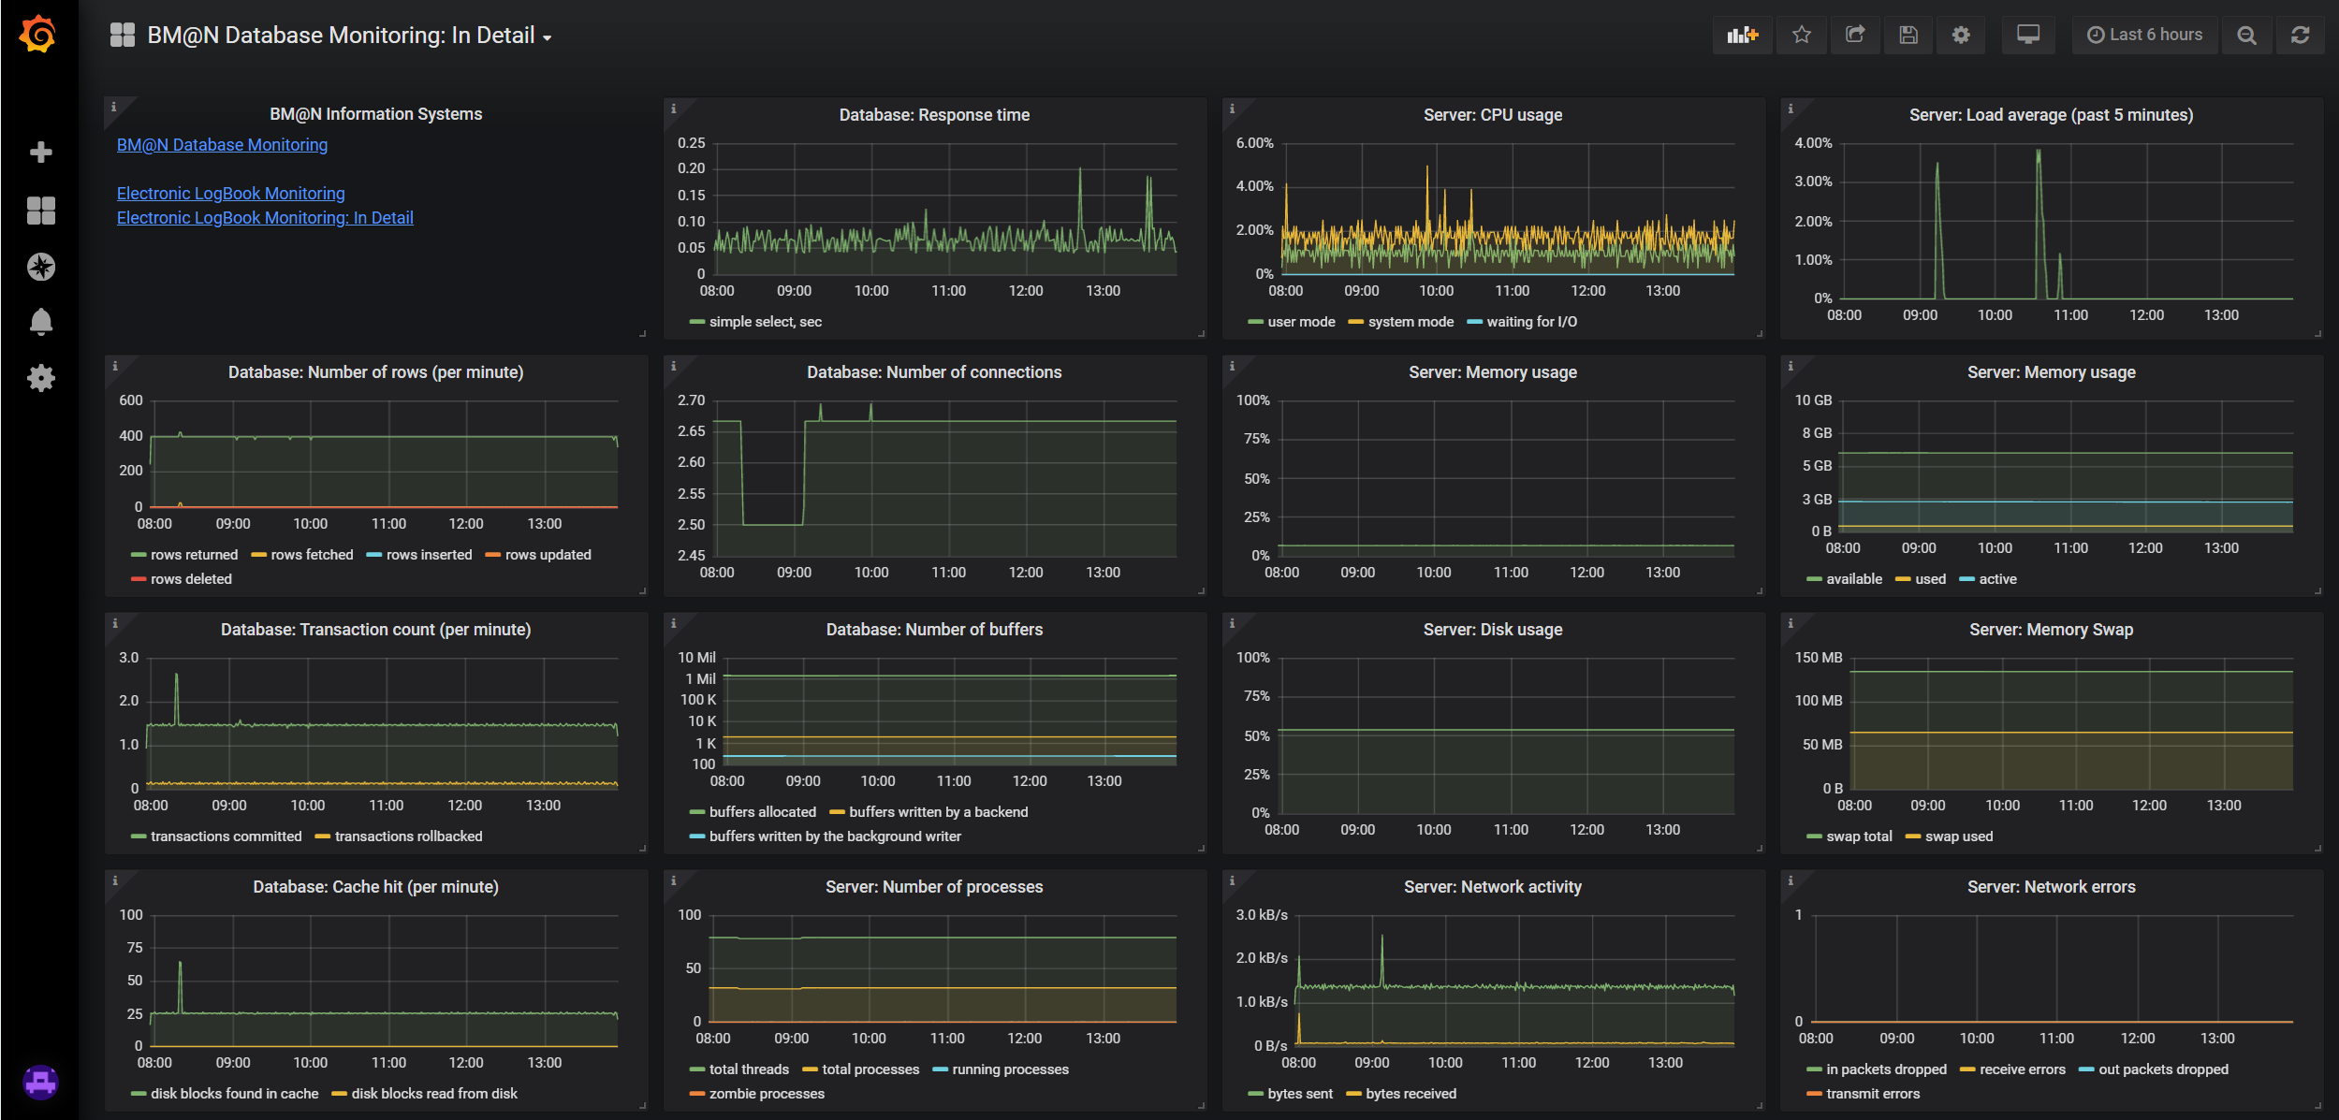
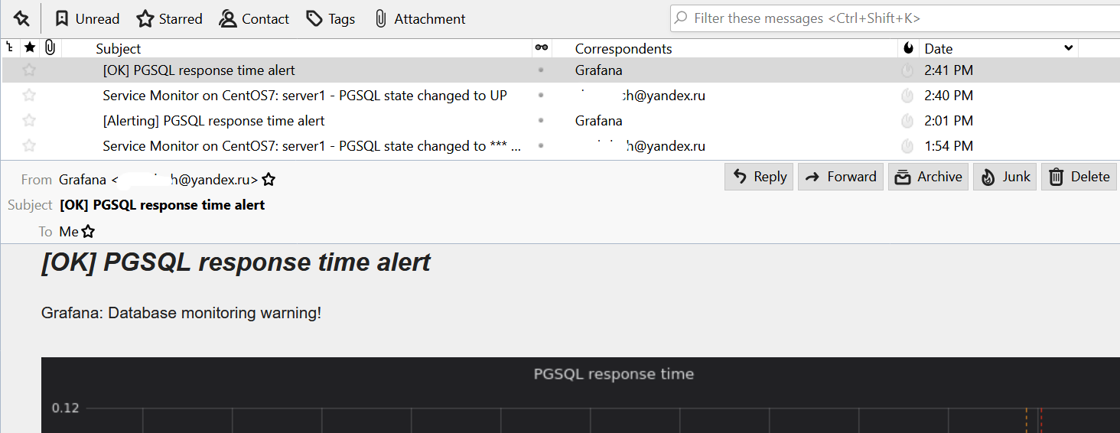
Monitoring Information Systems
Grafana View
Email Notifications
BM@N Database
Electronic Logbook
To control the stable operation of services we use platform Grafana. It has functions for collecting, analyzing and visualizing data, and supports email notifications

Slide 17
Conclusions
The web application has been developed with an adaptive design, functional data selector and convenient tools for viewing and managing information on the experiment which is further used in the data processing.
New component has been created for visualization of statistics on obtained and simulated events in the form of diagrams on the home page of the application.
Registration service has been implemented, which provides the registration of new collaboration members and allocation of additional rights.
Monitoring system on Grafana is used for tracking state of the Unified Database and host servers.
Data inspection service has been developed for checking the integrity and correct accessibility of stored experimental and simulated files.
The work was funded by the Russian Foundation for Basic Research (RFBR) grant under the research project 18-02-40125
Notes:
Summing up

Slide 18
Thank you for your attention!

Slide 19
Backup

Slide 20
FreeIPA: Single Authentication & Authorization
Document Server
Electronic Logbook
5 Services
1
17 Groups
2
40 Users
3
Geometry Database
Experiment Database
admins
writers
readers

Slide 21
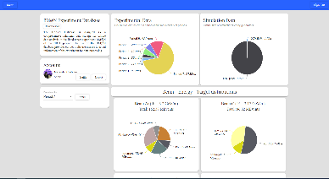
Web-service Structure
Condition Database
FreeIPA
Web service
Integrity Database

