Slide 2
DIRAC use for BM@N tasks: status and perspectives
8th collaboration meeting
Konstantin Gertsenberger, Igor Pelevanyuk, Dmitry Tsvetkov
7 October 2021

Slide 3
A moment of retrospective
6th BM@N collaboration meeting:
General information about DIRAC and how it may be useful for BM@N tasks
7th BM@N collaboration meeting:
Initial tests have been successfully performed. Basic workflow and scripts designed and presented.
8th BM@N collaboration meeting:
First real(useful) Monte-Carlo have been performed!

Slide 4
File types
Type | Decription
RAW | Raw data of events written by DAQ after Event Builder
DIGI(digits) | Digits of detectors after digitizer macros
DST_{exp} | Reconstructed events: hits, tracks, vertex and other reconstructed data
GEN | Generated events after simulation
DST_{sim} | Reconstructed events containing modeled information for comparison

Slide 5
BMN offline job types
Experiment data | Monte-Carlo data
RawToDigit | GenToSim
DigitToDst | SimToDst
DstToAna | DstToAna

Slide 6
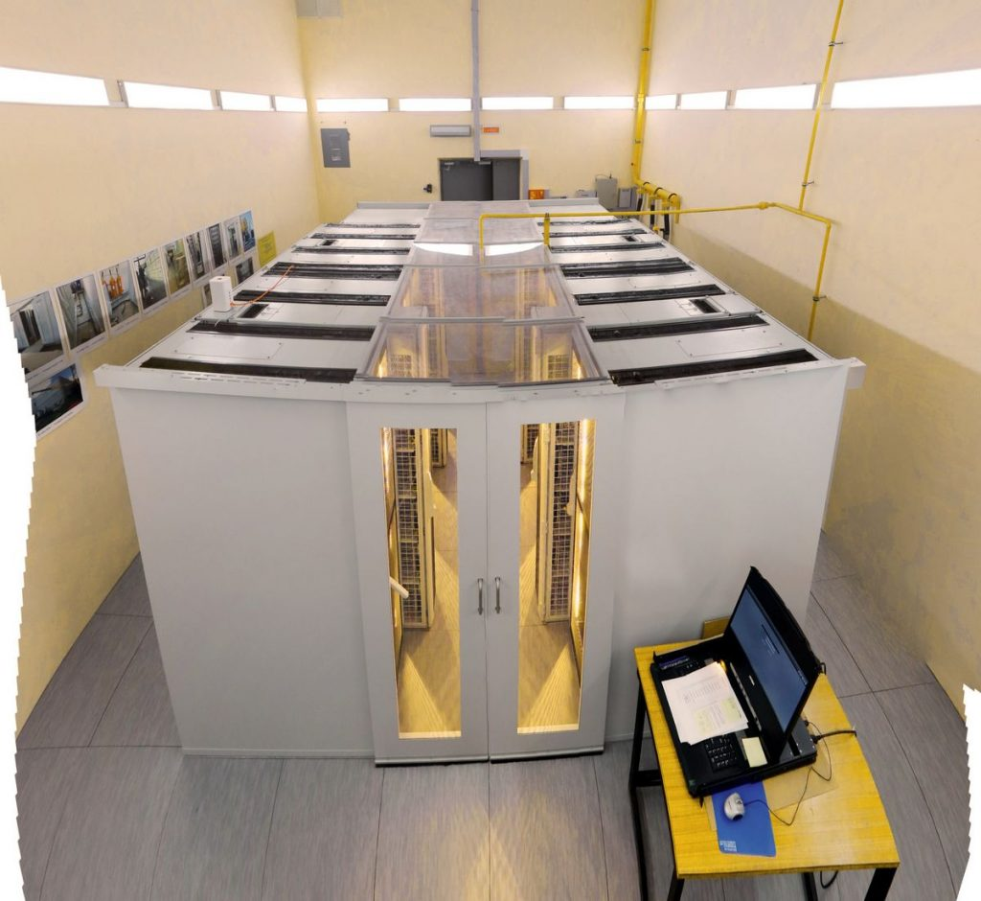
JINR Main Resources
EOS LIT
EOS HybriLIT
EOS LHEP
Tapes
Disks
EOS
EOS
EOS
Tier-2/CICC
Tier-1
Govorun/HybriLIT
NICA Cluster
Clouds
HybriLIT auth
NICA CLUSTER auth
Direct auth
LIT auth
SLURM job submit
SLURM job submit
SGE job submit
Create VM
manually

Slide 7
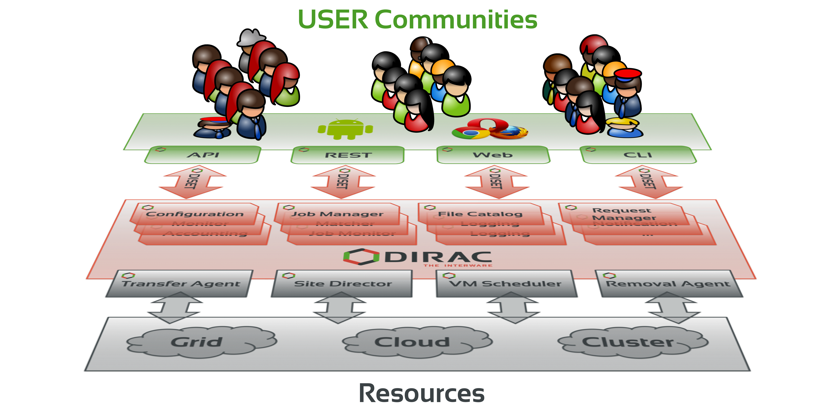
What is DIRAC?
DIRAC provides all the necessary components to build ad-hoc grid infrastructures interconnecting computing resources of different types, allowing interoperability and simplifying interfaces. This allows to speak about the DIRAC interware.
Web
CLI
API
REST

Slide 8
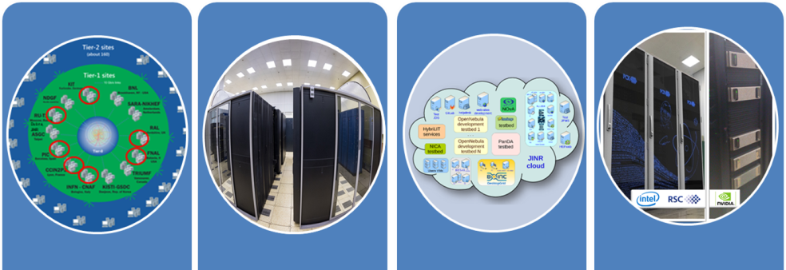
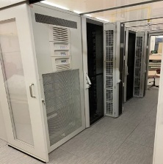
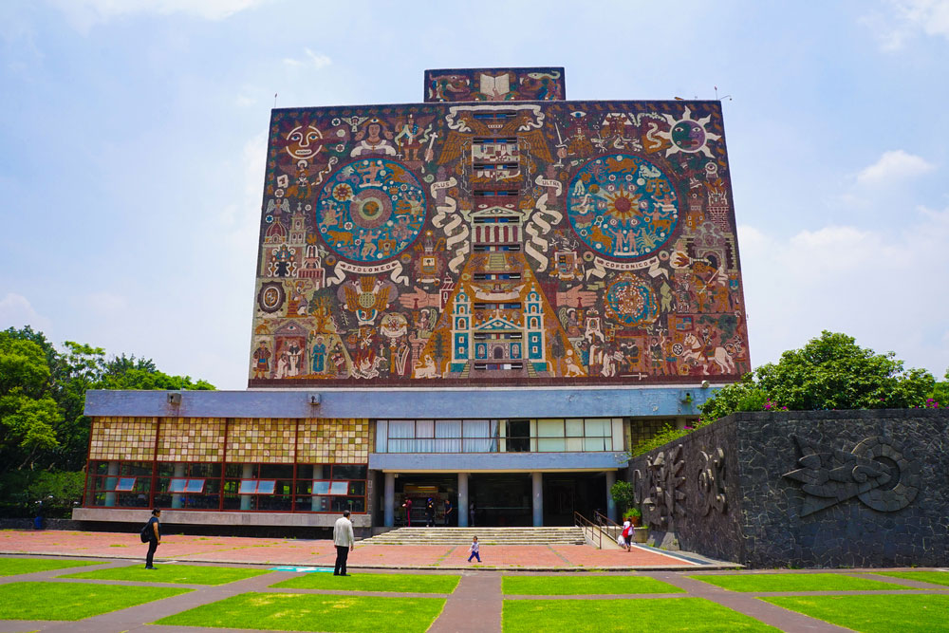
What was done in JINR
EOS
Tier-1
CICC/Tier-2
Clouds
Govorun
NICA Cluster
UNAM
Running
Running
Running
Running
Running
Running
The computing resources of the JINR Multifunctional Information and Computing Complex, clouds in JINR Member-States, cluster from Mexico University were combined using the DIRAC Interware.

Slide 9
Workload management
Submit thousand of jobs to DIRAC Job Queue
Tier-1
CICC/Tier-2
Clouds
Govorun
NICA Cluster
UNAM

Slide 10
Workload management
Submit thousand of jobs to DIRAC Job Queue
User Job
User Job
User Job
User Job
User Job
User Job
User Job
User Job
User Job
Tier-1
CICC/Tier-2
Clouds
Govorun
NICA Cluster
UNAM

Slide 11
Workload management
Submit thousand of jobs to DIRAC Job Queue
User Job
User Job
User Job
User Job
User Job
User Job
User Job
User Job
User Job
Pilot job
Pilot job
Pilot job
Pilot job
Pilot job
Pilot job
Tier-1
CICC/Tier-2
Clouds
Govorun
NICA Cluster
UNAM

Slide 12
Workload management
Submit thousand of jobs to DIRAC Job Queue
User Job
User Job
User Job
User Job
User Job
User Job
Pilot job
Pilot job
Pilot job
Pilot job
Pilot job
Pilot job
User Job
User Job
User Job
User Job
User Job
User Job
Tier-1
CICC/Tier-2
Clouds
Govorun
NICA Cluster
UNAM

Slide 13
DIRAC: Jobs vs Resources
Tier-1
CICC/Tier-2
Clouds
Govorun
NICA Cluster
RawToDigit |  |  | Not tested
DigitToDst |  |  | Not tested
GenToSim |  |  | Not tested
SimToDst |  |  | Not tested
This schema only relates to DIRAC jobs, not jobs submitted directly to resources

Slide 14
Explanation
RawToDigi – Huge size of input files is main limitation. There should be at least 100 GB of disk space per CPU core.
Cloud resources – potentially can perform all workload. But the network may be a limiting factor for remote clouds.
NICA cluster – was used less in the last half a year by all DIRAC users(BM@N, MPD).

Slide 15
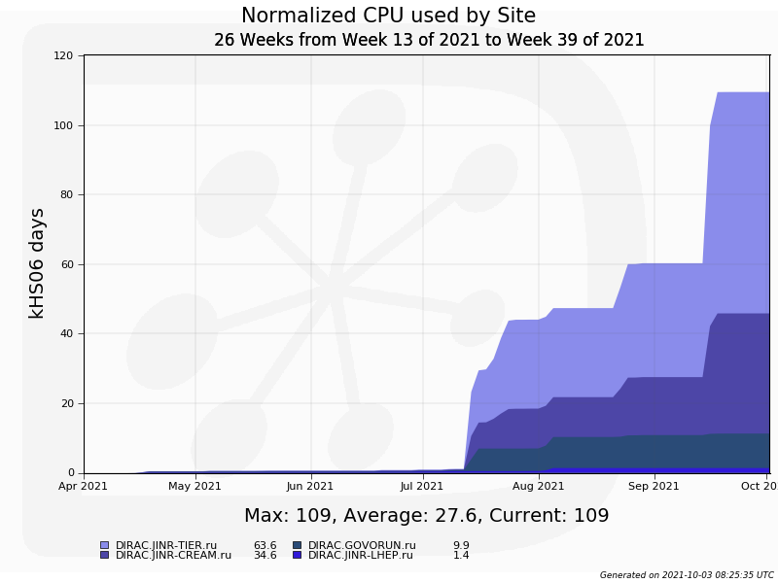
Half year BM@N statistic
Real work starts
Tier1
Tier2
Govorun
Total number of jobs: 14000
Average duration: 12 hours
Total wall time: 19 years

Slide 16
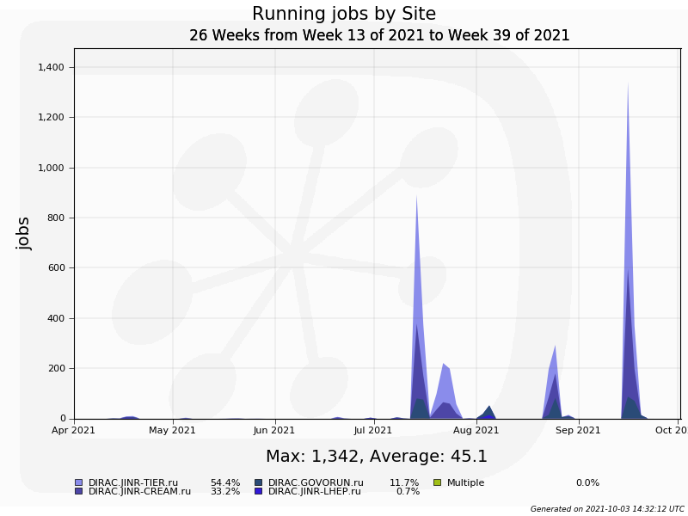
Load of distributed resources
In the mid of September total amount of running jobs exceeded 1600.
Quotas(cores):
Tier1: 920 (NICA shared)
Tier2: 1000 (NICA shared)
Govorun: 192
NICA cluster: 250
JINR Cloud: 90 (All shared)
Members-states clouds: ~500 (All shared)

Slide 17
BMN MC workflow
1. Check the resource and configure software
2. Download r12 over root protocol from NICA-EOS
3. Perform run_sim_bmn.C
4. Perform run_reco_bmn.C
5. Copy result_bmn_dst.root to MLIT-EOS over DIRAC

Slide 18
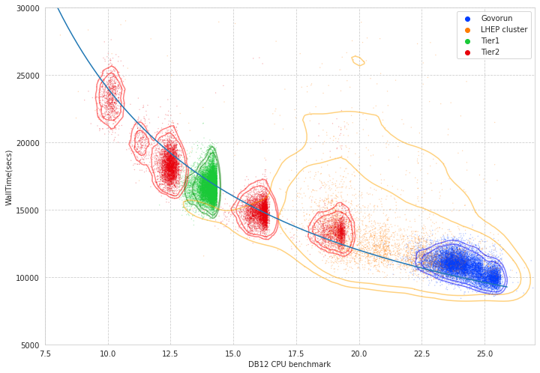
Global performance analysis

Slide 19
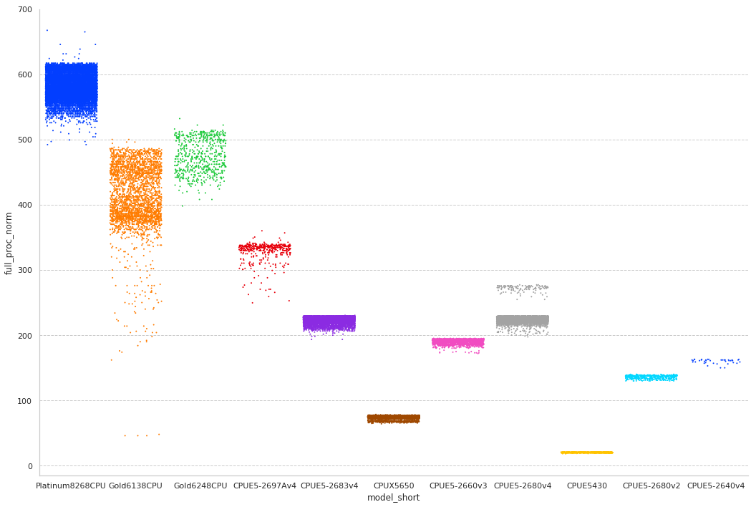
Processors total

Slide 20
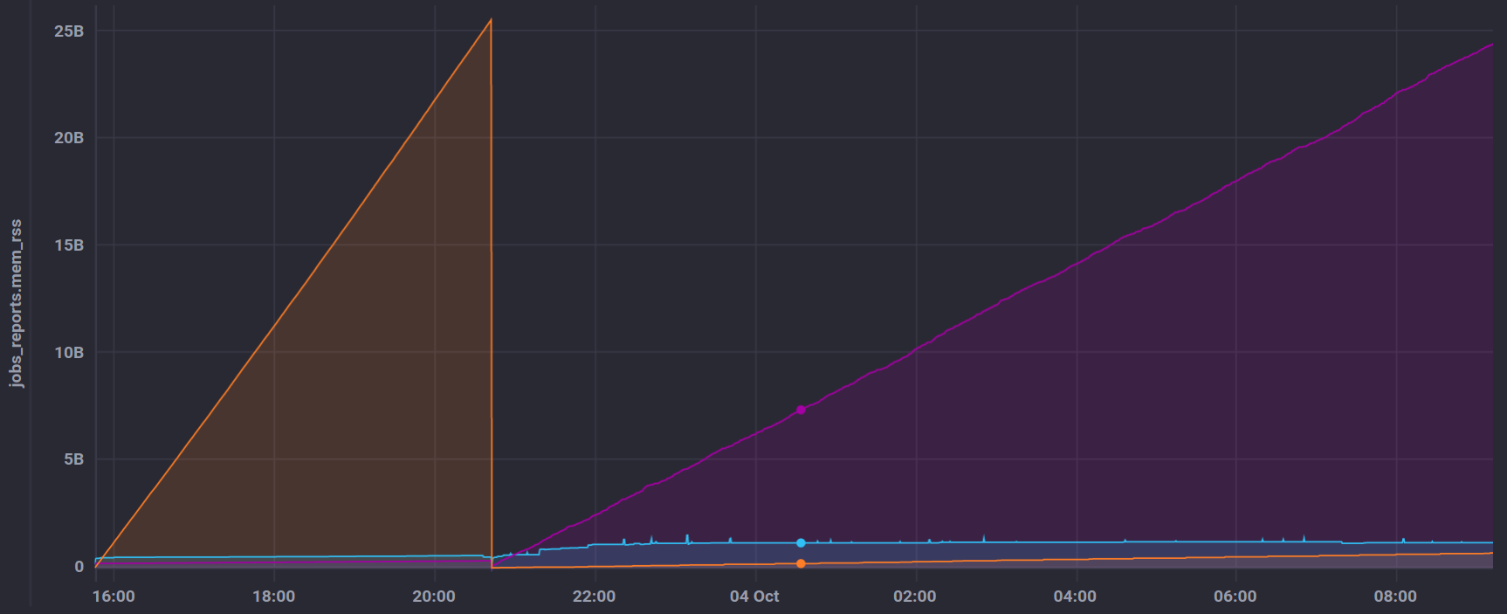
User job monitoring
GenToDst job on Govorun
Disk out
Disk in
RAM usage

Slide 21
Conclusion on BM@N+DIRAC
First real workload has been successfully executed!
If you have a task to generate a lot of data for your work, please contact Konstantin or me.
Resources available now through DIRAC:
Computing: Tier1, Tier2, Govorun, Cloud, LHEP,
Storage: JINR EOS in LIT
It is much better to run software from official BM@N repository because it is mapped to CVMFS.
With DIRAC there are a set of tools that may enhance understanding of behavior of massive amount of user jobs.

