Slide 1
Forward Silicon Tracker and beam detectors upgrade status
Yuriy Kopylov behalf on Forward Silicon Tracker team
8th Collaboration Meeting of the BM@N Experiment at the NICA Facility, 3-8 October 2021

Slide 2
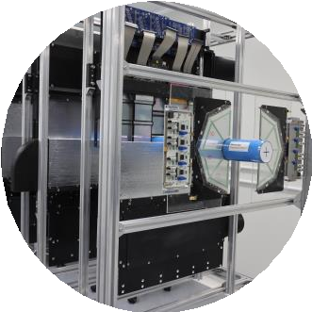
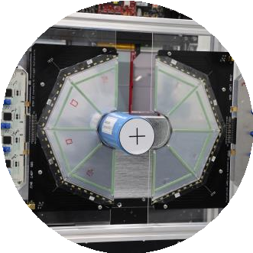
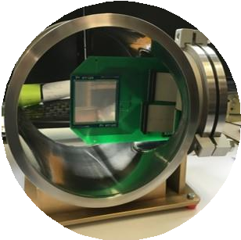
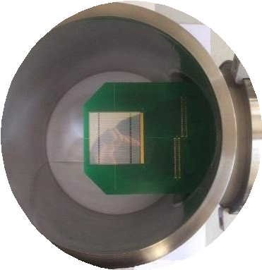
Beam Silicon detectors and Forward Silicon Tracker
Beam profilometer (two station)
Forward Silicon Tracker
(three XY planes)
Multiplicity trigger
(64-radial strips plane)
Target
Beam tracker
(three station)
Direction of Ion Beam
2

Slide 3
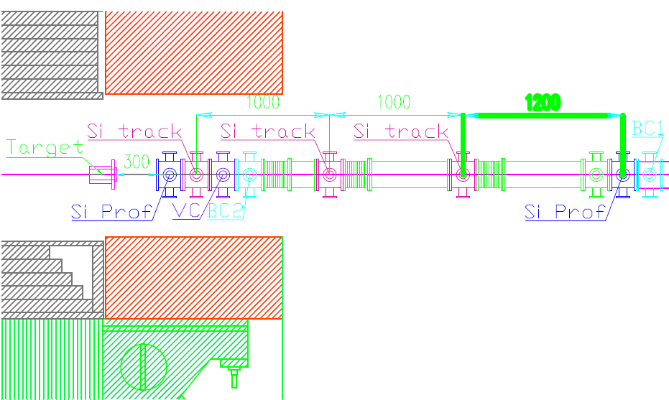
Position of beam Si detectors before a target
SP-41
Beam direction
*magnet_SP41_on_BM@N_22_10_18 Model
Semen Piaydin

Slide 4
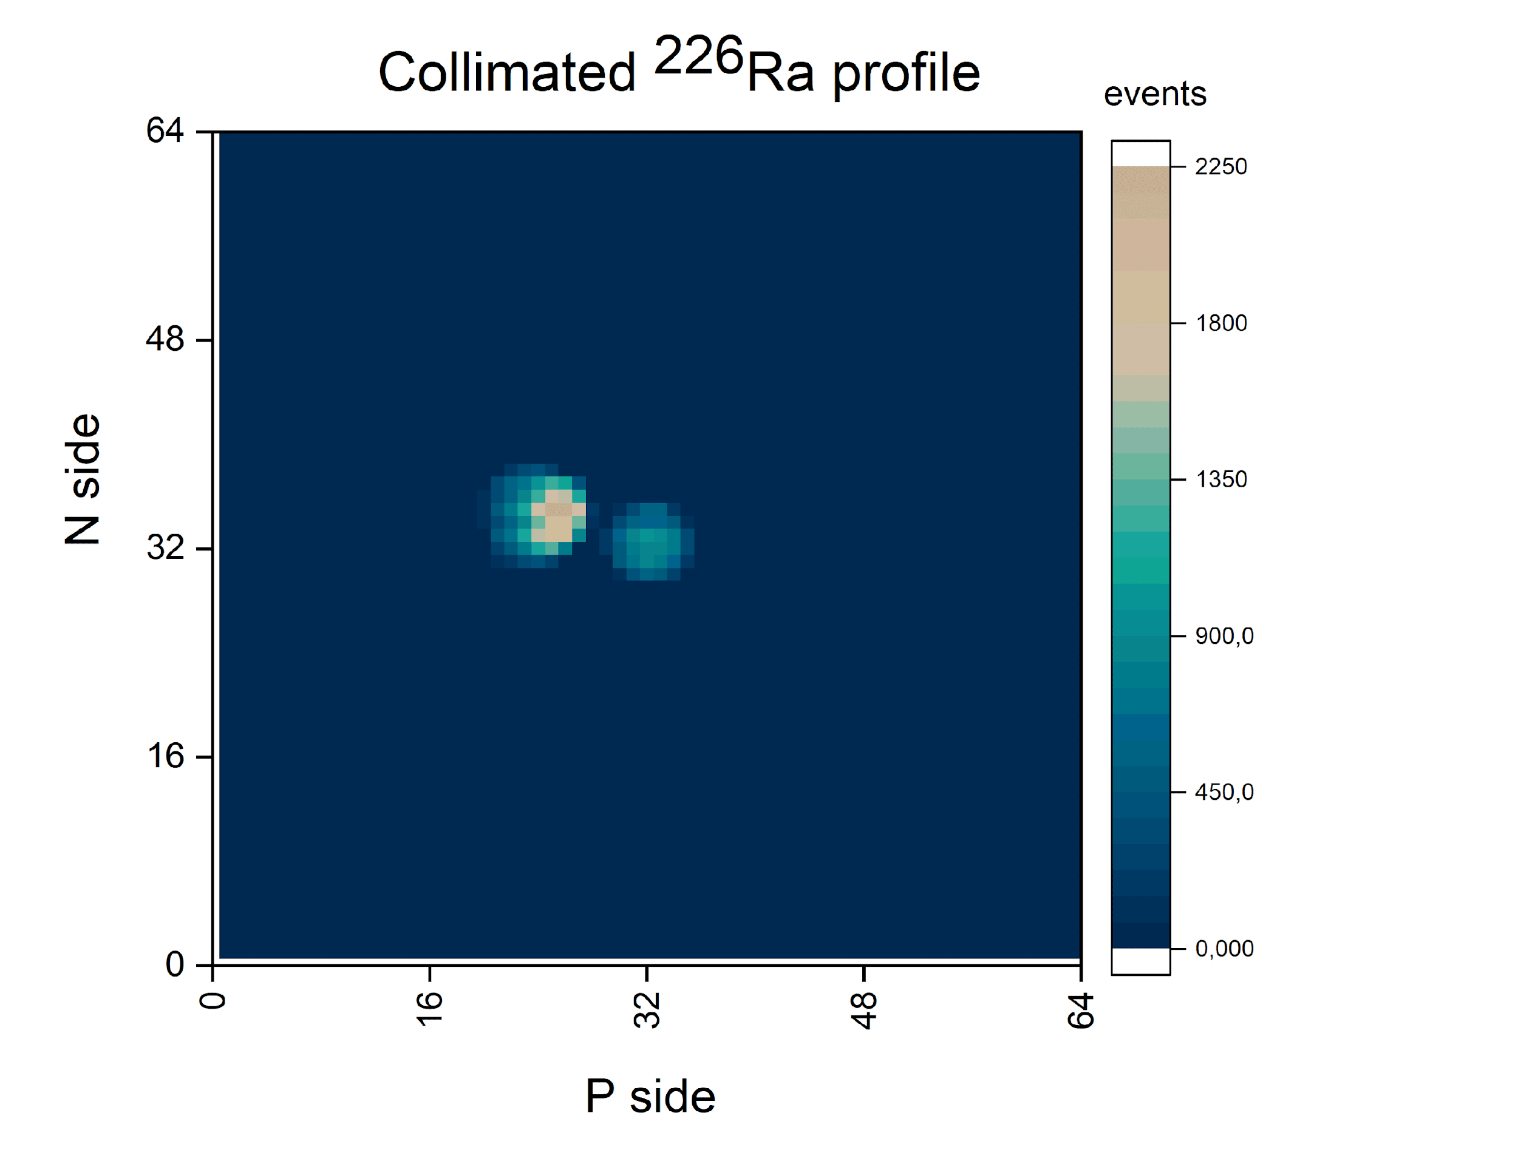
Beam profilometer is necessary for beam tuning (alignment of the center beam with the center of the target)
detector: DSSD, (32p⁺×32n⁺), strips pitch = 1.8 mm, thickness (Si) -175 μm, active area (60 × 60) mm²;
mechanical design: the plane of the profilometer is automatically removed from the beam zone to the parking position;
FEE: for light (₆C ÷ ₁₈Ar) ions based on VA163 + TA32cg2 (32 ch, dynamic range (DR): -750fC ÷ +750fC) desing in progress;
current status:
- two vacuum stations with flanges and cable connectors are ready, Silicon Detectors assembled on PCBs and tested with alpha-source (5.5 MeV), autonomus (ADC+DAQ) subsystem ready;
- for heavy (Kr ÷ Au) ions will be developed another version of the FEE with DR = ± 20 pC.
working position
parking position

Slide 5
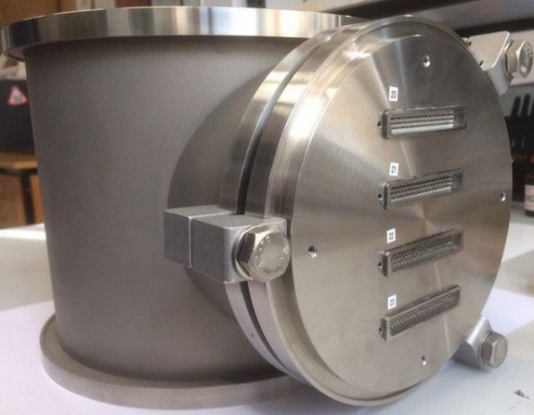
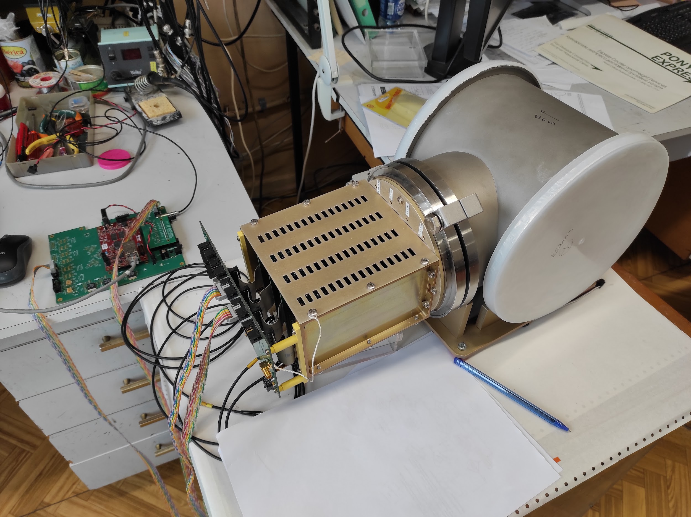
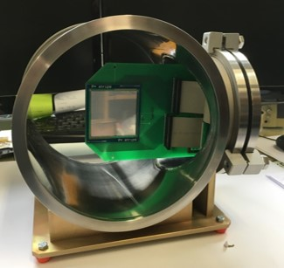
Beam tracker measures the XY-coordinates of the trigger ion in the target plane
Beam tracker Cross-board
Box with FEE cards
Detector | DSSD (128x128 strips, thickness 175 μm)
FEE ASICs | VATA64HDR16.2 (64ch; t_{s} = 100÷300 ns; Gain = Low/High; -20pC ÷ +55pC range)
Beam profilometer
autonomous DAQ
Vacuum station with DSSD inside
current status:
- three vacuum stations with flanges and cable connectors are ready, Silicon Detectors assembled on PCBs and tested with ²³⁸Pu alpha-source (5.5 MeV). One beam tracker station fully assembled and tested with alpha-source and autonomus DAQ subsystem in “self trigger” mode.
- It is necessary to estimate delay time between detector and global trigger signals within DAQ BM@N.

Slide 6
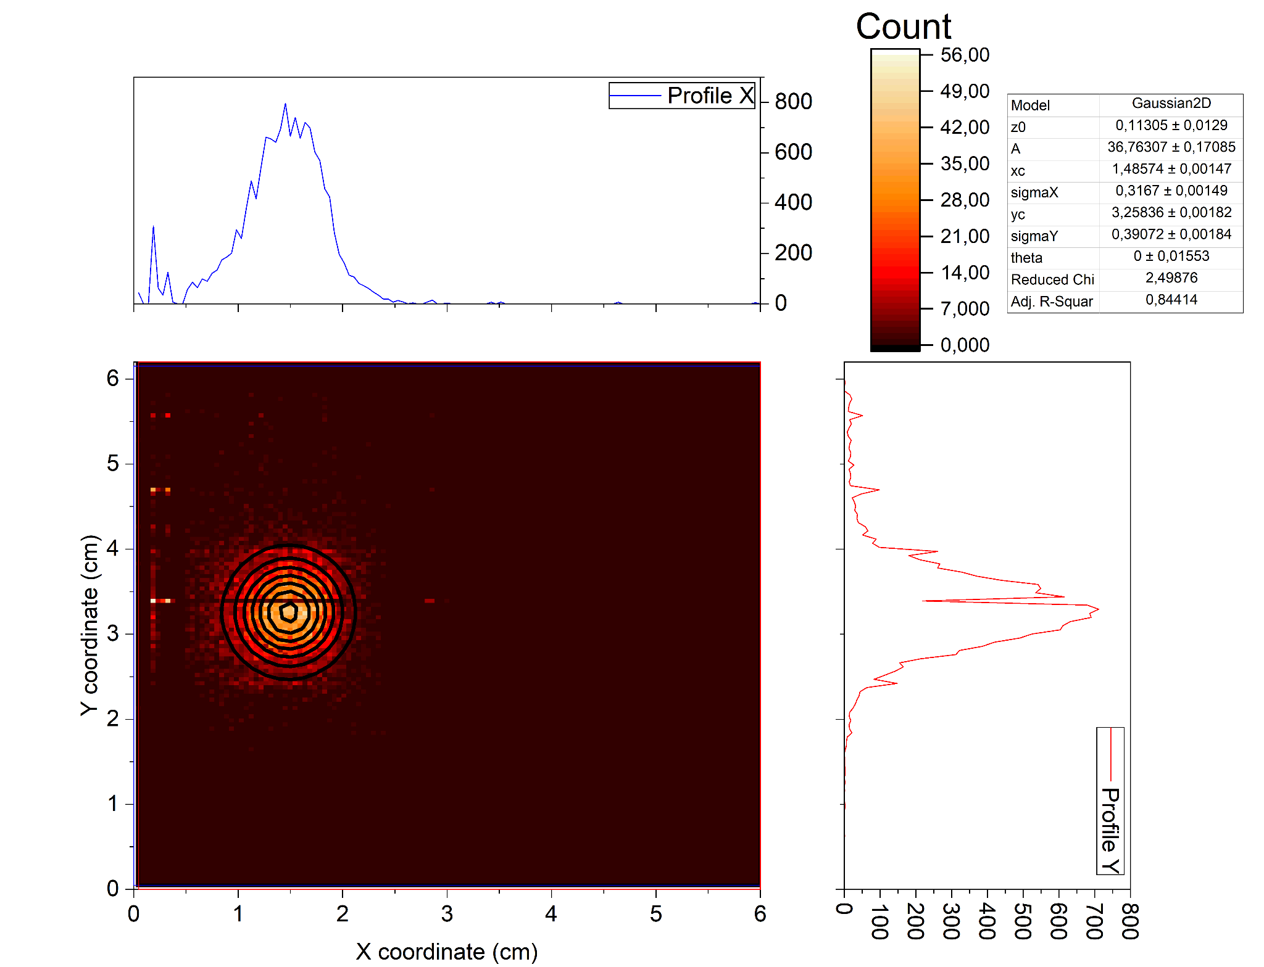
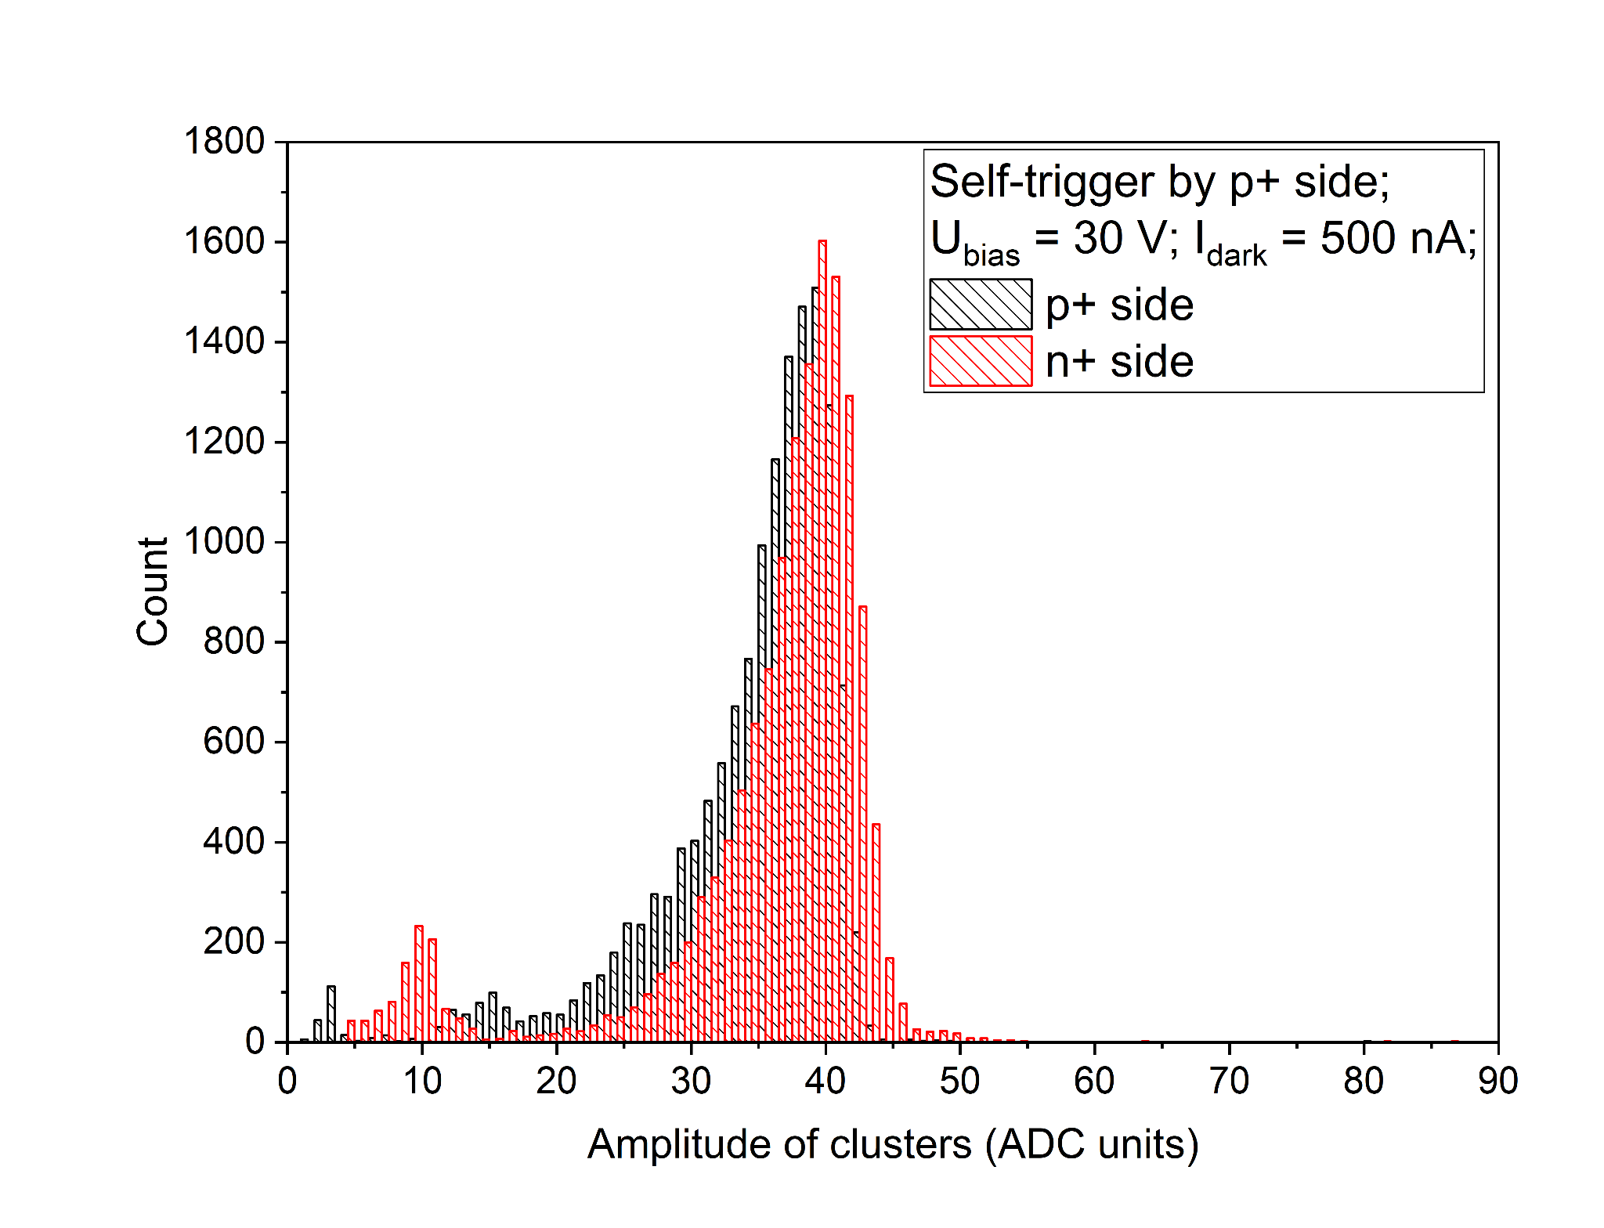
Beam tracker + autonomous DAQ test results
B. Topko, Yu. Topko, S. Khabarov
E_{ɑmax} = 5.499 MeV
Hits and profile distributions with 2D Gaussian fitting function
Amplitude of cluster distributions for p+ and n+ sides
Since alpha particles in ²³⁸Pu decay have E_{ɑmax} = 5.499 MeV (without energy loss in air and ohmic DSSD layer) FEE based on VATA64HDR16.2 can be used for ₆C detection (ΔE ≅ 2.2 MeV in 175 𝜇m Si)

Slide 7
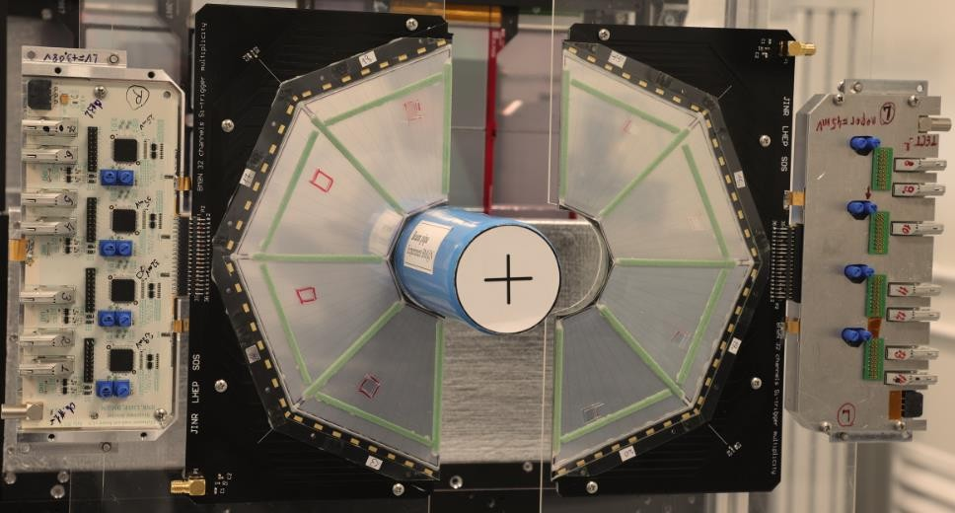
Trigger multiplicity (SiD)
detector: Silicon single-sided Detector, 525 μm thickness, 8 strips located at an angle with an interval of 5.63° and is an isosceles trapezoid in shape (45°) and active area 30.8 cm2 (5 times bigger than previous Si- multiplicity trigger 2018).
mechanical design : new design is based on 2 symmetric half planes (inner diameter Ø 52 mm), which simplify multiplicity trigger assembling process around installed beam pipe. Multiplicity trigger is located at 120 mm downstream the target*.
status:
- two detector planes assembled and tested with FEE-2018 based on 32 channel IC-AST-1-1 (Minsk) with adjustable disrciminator threshold (2 fC);
- new variant (threshold 1 fC) FEE-2021 based IC-AST-1-1 and IC-AST-1-2 is under tuning + test.
Beam
*Lashmanov N., Trigger simulation in the BM@N experiment,
8th Collaboration Meeting of the BM@N Experiment at the NICA Facility, 3 October 2021

Slide 8
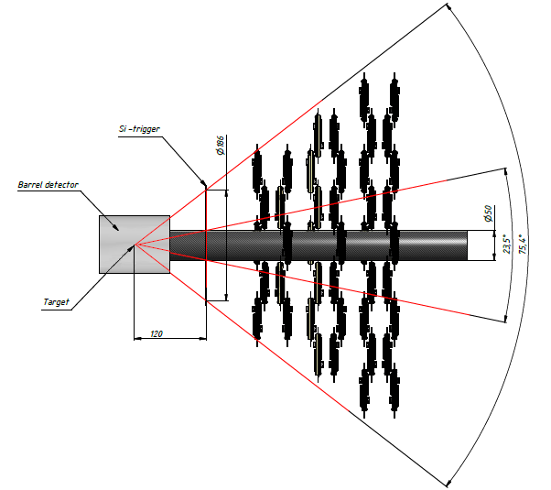
Forward Silicon Detectors Configuration (BM@N – 2020)*
Positions of Si-planes on the beam-channel XZ (left) and YZ (right)
*B. Topko, Forward Silicon Detectors upgrade status,
5th Collaboration Meeting of the BM@N Experiment at the NICA Facility, 21 April 2020

Slide 9
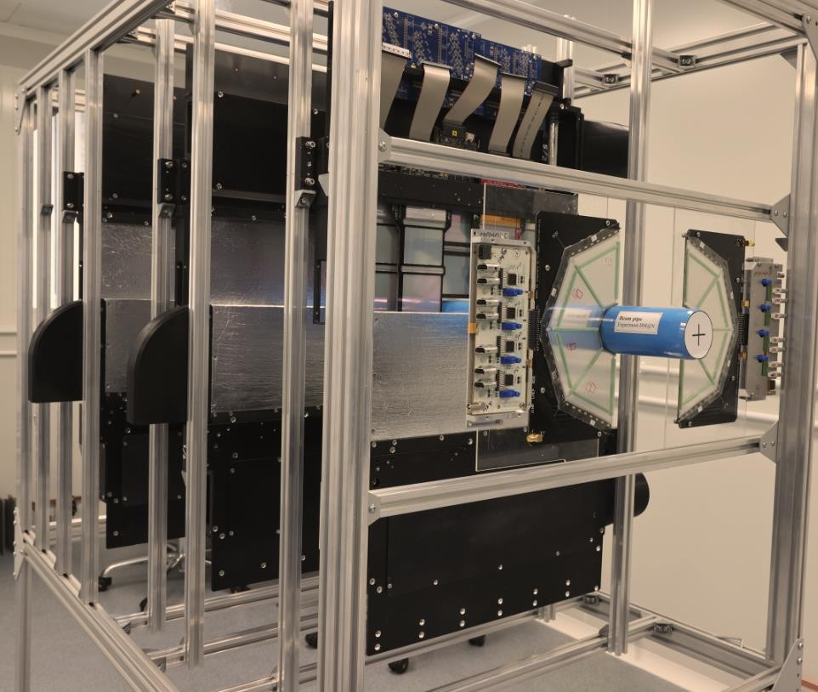
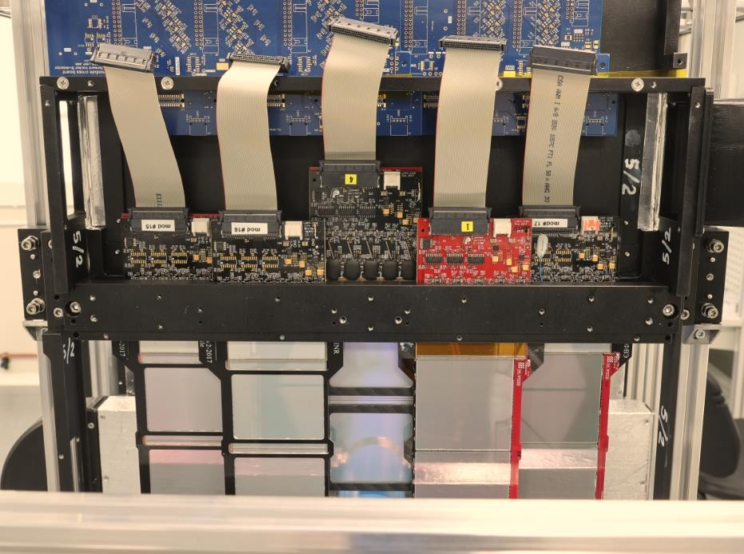
Forward Silicon Tracker test in the Si - clean room (215 bld.)
Upper half-plane without EM + light shielding (5 modules)

Slide 10
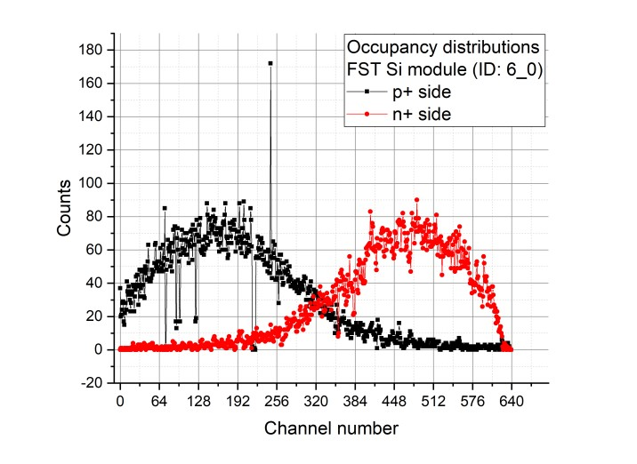
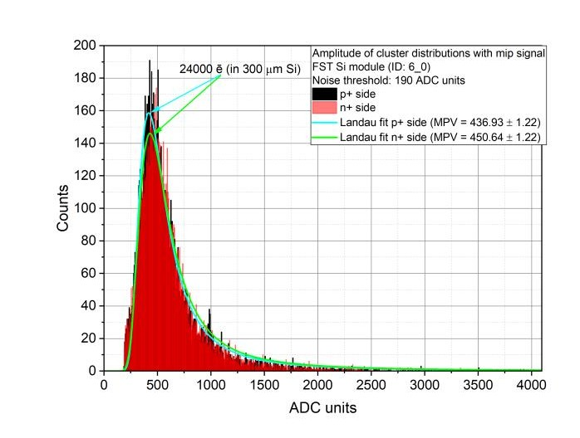
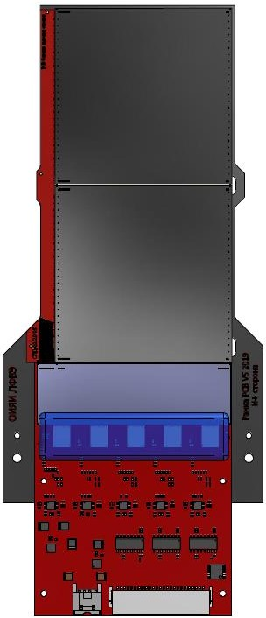
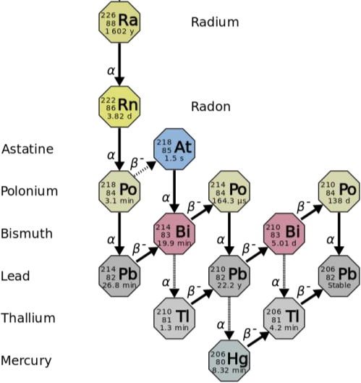
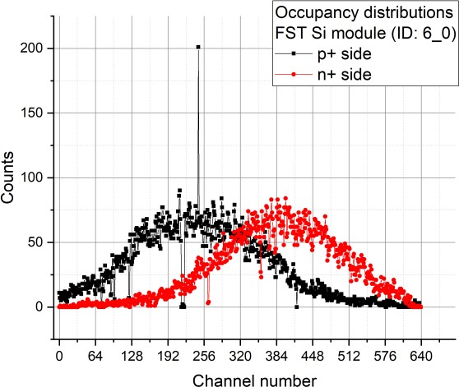
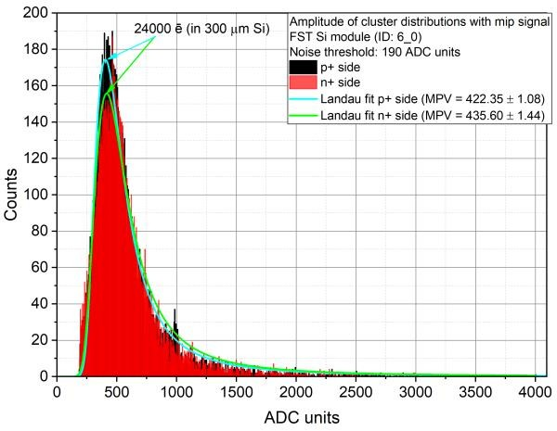
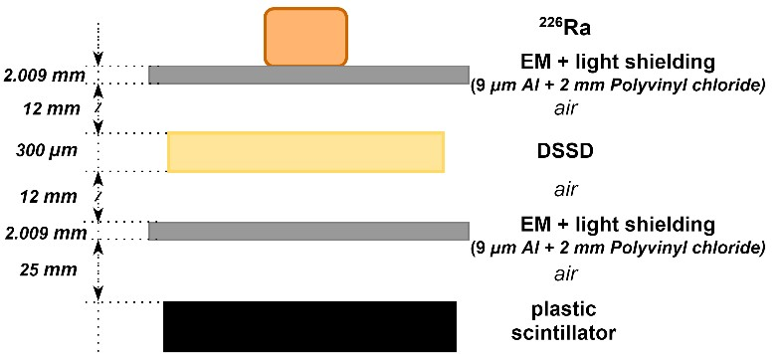
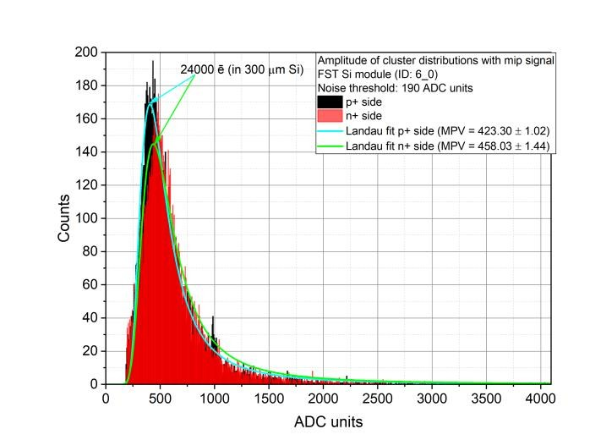
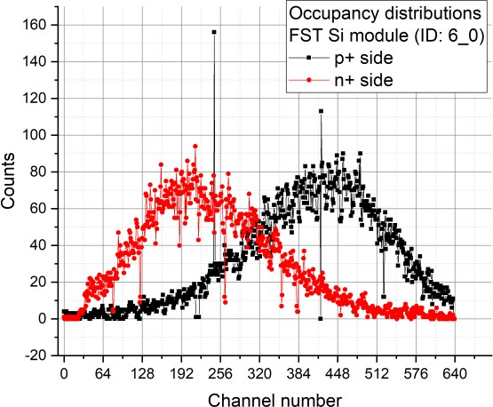
FST Si module test results
1
1
RA source positions
1 2 3
HV = 75 V; T = 17 ⁰C
639
0
n+ side p+ side
0
639
2
2
Electron end-point energy up to 3.27 MeV (²¹⁴𝐵𝑖)
HV = 75 V; T = 17 ⁰C
83
3
Measurement with RA source cross-section
(trigger rate: 150 Hz)
3
Ufd = 30 V
Module ID | <ENCp+> ē RMS | <ENCn+> ē RMS | SNR p+ side | SNR n+ side | Bad channels ratio, %
6_0 | 1963.60 | 2 237.88 | 12.22 | 10.72 | 1.25
HV = 75 V; T = 17 ⁰C
17

Slide 11
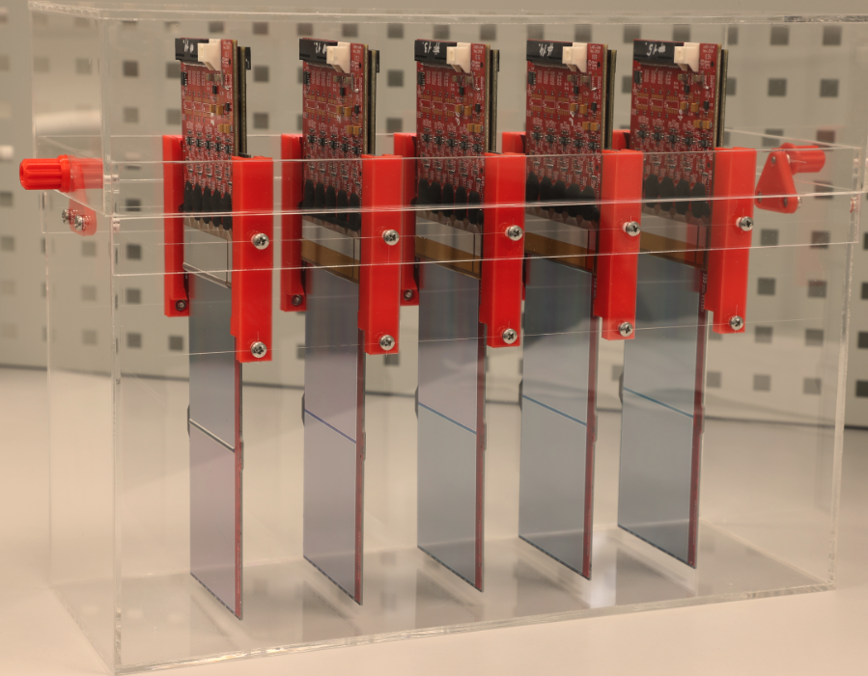
Forward Silicon Tracker status summary
Detector | DSSD (640 (p⁺)$×64$0(n⁺) strips, thickness 300 μm)
FEE ASICs | VATAGP7.1 (128 ch, $±$30 fC range)
FEE PCBs | 1 PCB board = 5 x VATAGP7.1
Mechanical support | In the manufacturing stage
Summary | Ready to assembly and test
The top path-panel
20 from 42 FST Si modules fully assembled and tested (45%);
FEE problem: the Si modules assembly proccess was stopped on June 20 2021: 1) the assembly process of ASICs on FEE PCBs within VBLHEP infrastructure was started; 2) the incoming inspection of ASICs was improved;
The Si modules assemly process will be continue after October 15 2021
Forward Silicon Tracker half-planes assembly and testing are not started!
The bottom path-panel

Slide 12
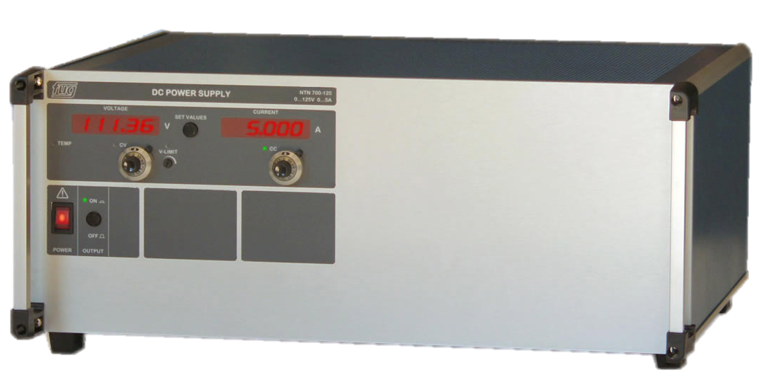
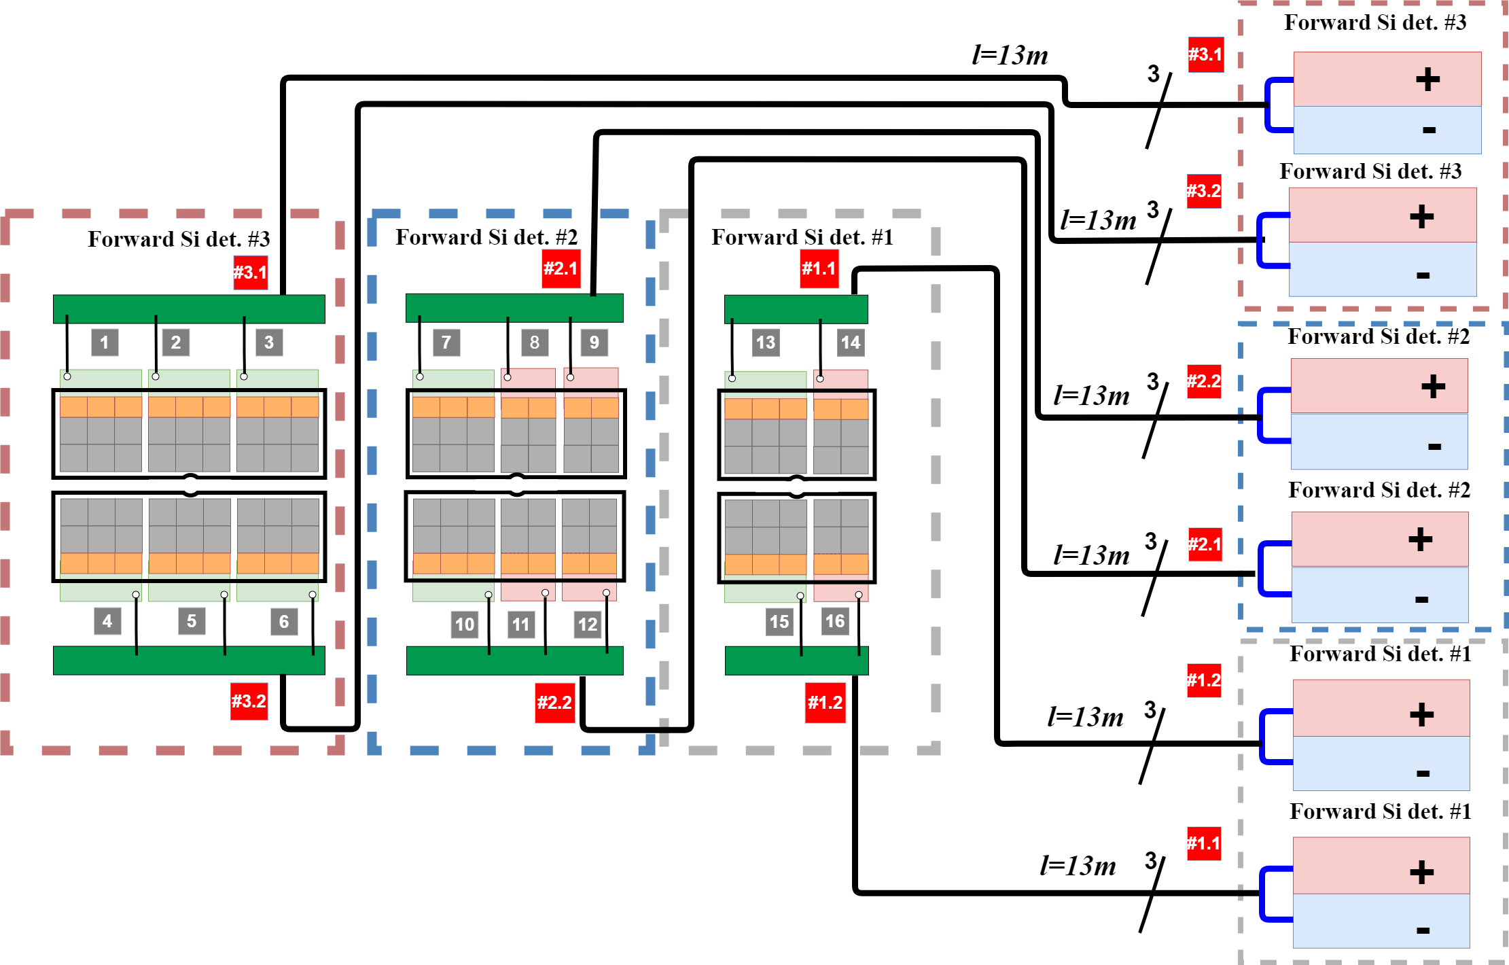
Low Voltage connection scheme
Fug NTN 350-6.5(0÷6,5 V/30 A)
BM@N DAQ
Low voltage power supply (FuG company)
Number of equipment units, 12 pcs
U-40
ADC-64
HV
LV
3 × Patch-Panel
 |  | Forward Si det. #1 | Forward Si det. #2 | Forward Si det. #3
I _{LV}, A | U_{LV}, V | 10 | 14 | 2×9
- 75,18 | -3 | 17,9 A | 25,06 A | 32,22 A
+45,61 | +3 | 10,87 A | 15,21 A | 19,53 A

Slide 13
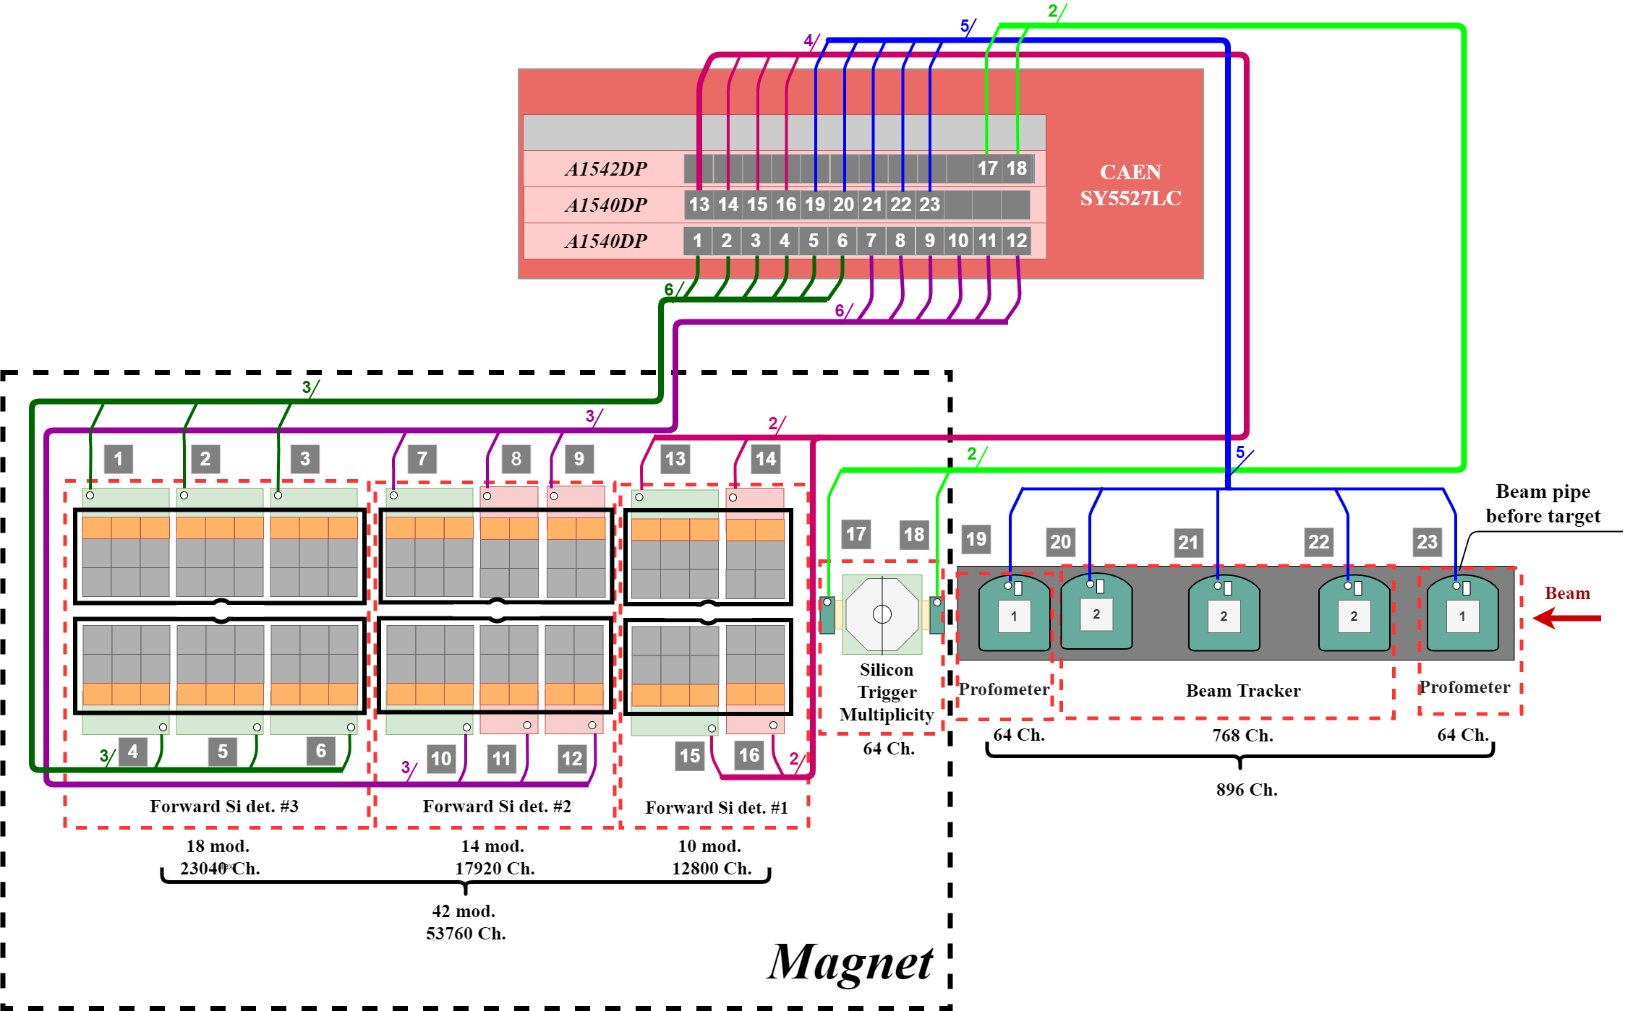
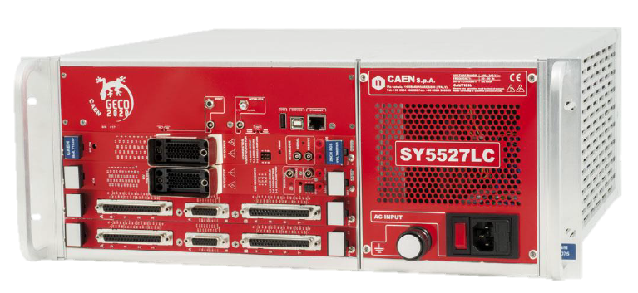
High Voltage connection scheme
CAEN SY5527LC
A1540DP
High voltage source
(CAEN company)
HV blocks are located in the crate:
A1540DP (3 шт. 100 В/ 1мА)
A1542DP (1 шт. 500 В/ 1мА)
High voltage source for systems:
Forward Silicon tracker +
Beam tracker +
Profilometr +
Si-trigger multiplicity

Slide 14
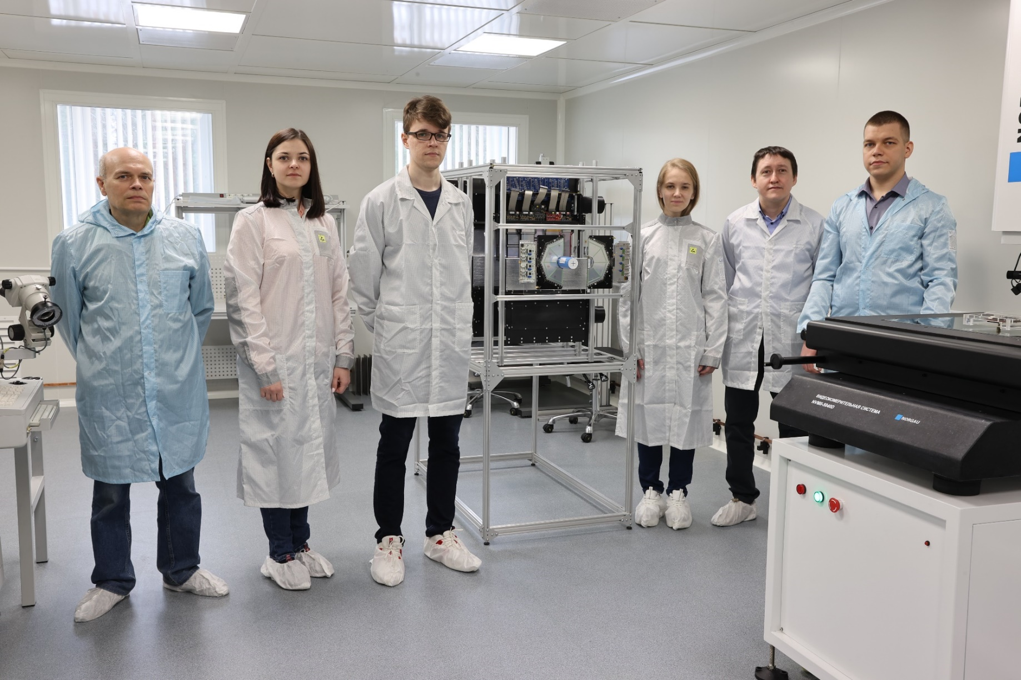
Forward Silicon and beam detectors team
In the photo (from left to right):
Zubarev Evgeny
Streletskaya Ekaterina
Topko Bogdan
Topko Yulia
Tarasov Oleg
Kopylov Yury
Beyond the camera:
Khabarov Sergey
Smirnov Alexander
Sheremeteva Anastasiia
Zamyatin Nikolay

Slide 15
Thank you for your attention!

