Slide 1

8th BM@N Collaboration Meeting (3-8 October, 2021)
Trigger detectors and trigger system
Trigger group

Slide 2
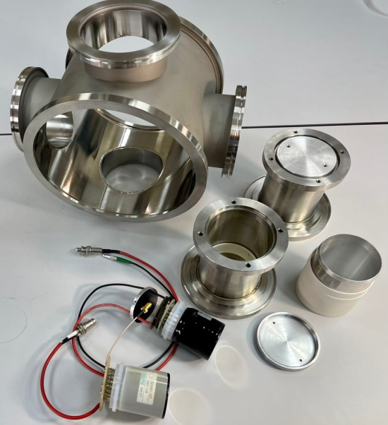
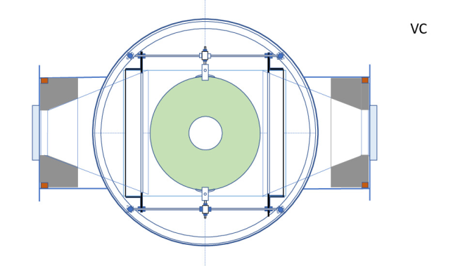
BC1 and VC
Vacuum components
• major components (boxes, quartz windows, PMT holders) ready ✓
• minor items (O-rings, clamps, etc.) supplied (double-check needed) ✓
PMT and bases
• PMT Hamamatsu R2490-07 available ✓
• PMT sockets Hamamatsu E678-21C available ✓
• new base designed, PCBs are ordered, prototype is being tested ✓
• housing designed, all parts are produced ✓
Scintillators
• 100x100x0.25mm³ (BC1) and Ø100x10mm, hole Ø27mm (VC) available ✓
• scintillator mounts tentative design done, production planned for Oct-Nov
Electronics
• cables, HV and signal, HV power supply available ✓
• additional linear fan-out modules produced ✓
• amplifier CAEN N979 ordered ✓
• TQDC, TDC, CAEN digitizer N6742 available ✓
Ongoing and planned commissioning tests
• gain change at high beam intensity ongoing tests with LED and laser
• gain change in magnetic field (VC) will be tested on site (after installation ?)
Overall status: some delays in design and production of mechanical parts due to pandemic, but so far no major setbacks or points for extra concern

Slide 3
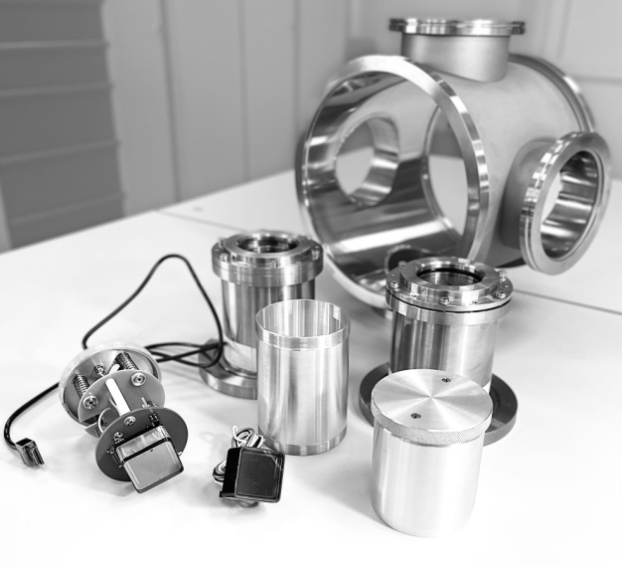
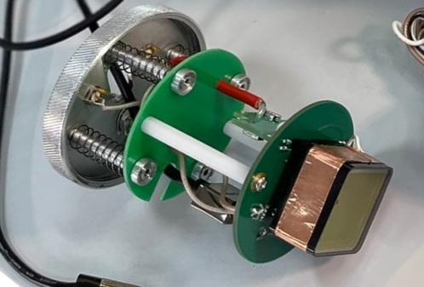
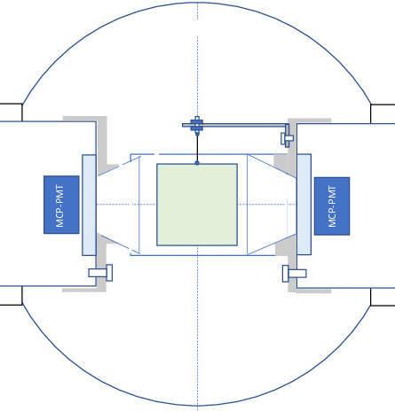
BC2
Vacuum components
• major components (boxes, quartz windows, PMT holders) ready ✓
• minor items (O-rings, clamps, etc.) supplied (double-check needed) ✓
PMT and FEE
• MCP-PMT XPM85112/A1-Q400 (Photonis) available ✓
• FEE designed, all parts produced, first PMT is being tested ✓
• housing designed, all parts are produced ✓
Scintillators
• BC400B 30x30x0.15mm³ available ✓
• scintillator mounts tentative design done, production planned for Oct-Nov.
Electronics
• cables, HV and signal, HV power supply available ✓
• additional linear fan-out modules produced ✓✓
• TQDC, TDC, CAEN digitizer N6742 available ✓
Ongoing and planned commissioning tests
• time resolution ongoing tests with laser
• gain change at high beam intensity ongoing tests with LED and laser
• gain change in magnetic field will be tested on site (after installation ?)
• the same PMTs, FEE and read-out chain are being prepared for
the SRC T0 counters, performance will be checked in the SRC run
Overall status: similar to BC1, VC – i.e., some delays, but not major

Slide 4
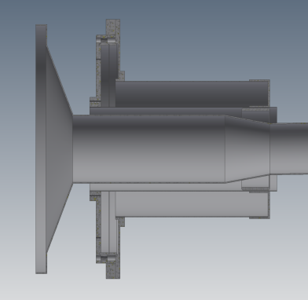
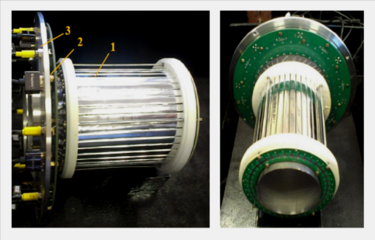
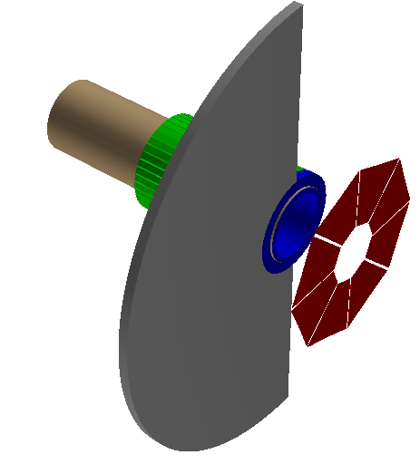
BD upgrade (I)
upgrade is finished ✓
New FEE board
• less noise, more flexibility to set thresholds
• increased pulse width >12 ns
• additional inputs for test pulses
tests with cosmics planned for Nov-Dec. ✓
Inner Pb shield
(cylinder 15 cm long, 4 mm thick)
inner dia. of the shield is 70 mm
i.e., radial gap between the shield and vacuum
pipe is 2 mm,
4 mm of Pb leaves 1 mm gap for support material
design in progress, production scheduled for Nov. ✓
Outer Pb shield
(half-disc R=25 cm, 1 cm thick)
production scheduled for Nov.
Overall BD upgrade status: on schedule, design and production of the Pb shields is now given more attention
fixed ✓
BD strips
Vacuum pipe
Inner Pb shield
BD strips
outer Pb
shield

Slide 5
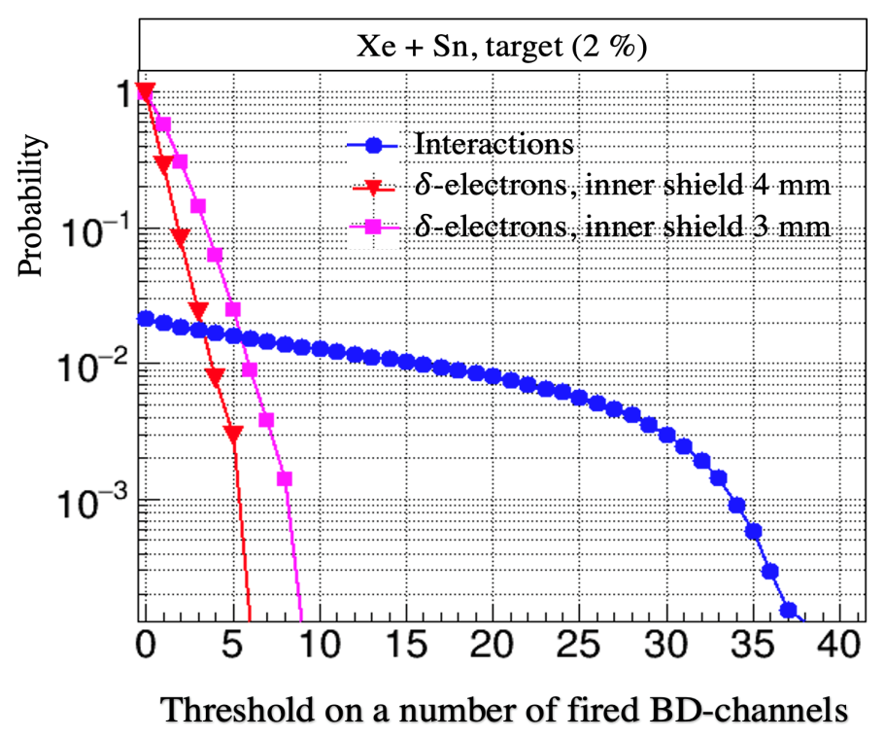
BD upgrade (II)
Simulation of δ-electron background for different thickness of inner shield

Slide 6
Trigger 0-level Unit (T0U) I
New design
  Increased input/output line number
    Extra TTL-50 Ohm input or output lines
    Extra LVDS input or output lines
  Completely new firmware (100% Verilog)
  New server

Slide 7
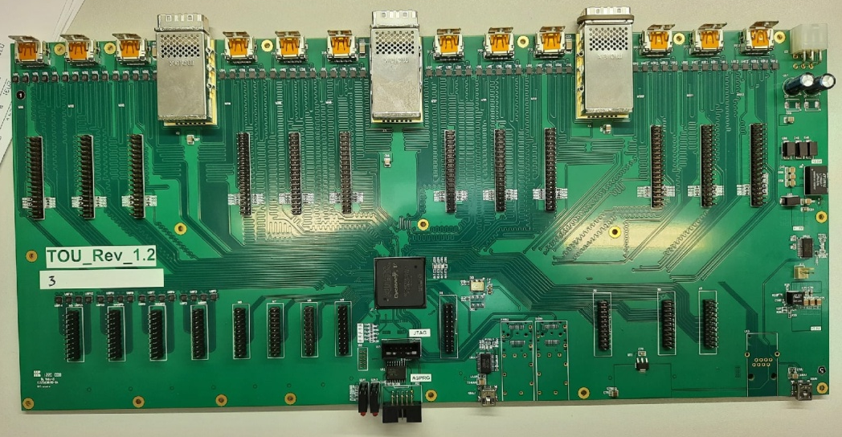
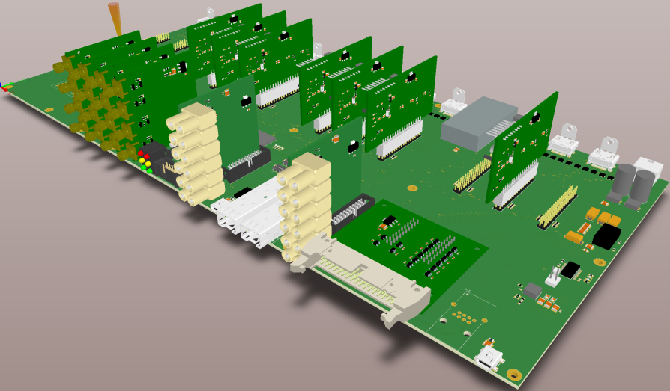
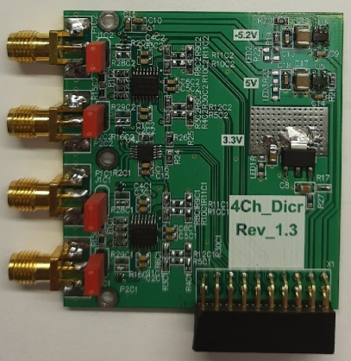
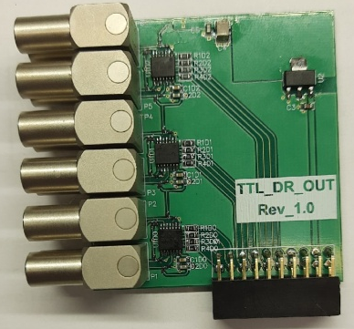
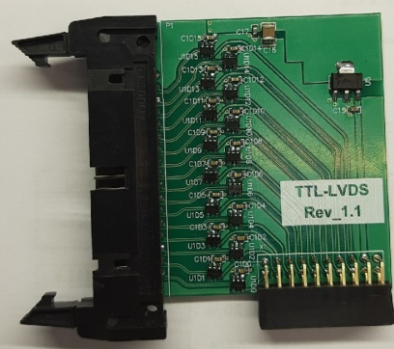
Trigger 0-level Unit (T0U) (II)
New boards – manufactured and checked.
4-ch. Input discriminators
-2 to 2V input
Threshold 5mV step
1.5 GHz equivalent input rise time bandwidth
12-channel 50 Ohm TTL input or output board
16-channel LVDS input or output board
Ready ✓

Slide 8
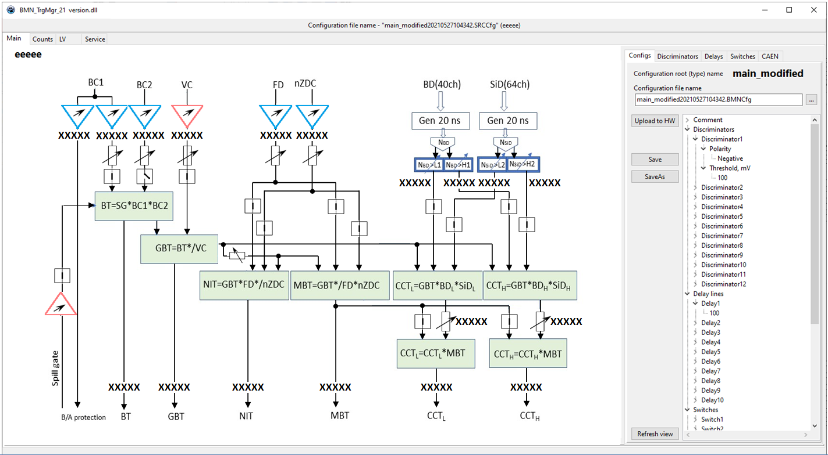
T0U Server (I)

Slide 9
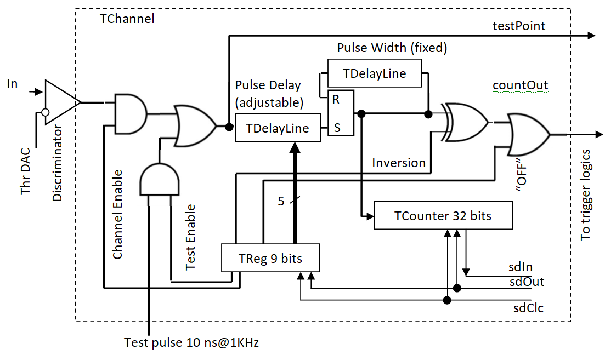

Input channel
Input discriminator range +3V..-2V (new +2V..-2V), step ~5 mV
Input Signal could be inverted
Channel contains adjustable delay line and fixed shaper
≡

Slide 10
Delay lines
Delay lines are asynchronous for ordinary channels with short delay and synchronous for channels with long delay
Asynchronous delay is built using FPGA element propagation delay. Very resource consuming. Not longer than 45 ns
Synchronous delay uses FPGA 100 MHz internal clock counting therefore introduces jitter +/- 5 ns
Synchronous delays used in circuits with delay longer than 50 ns

Slide 11
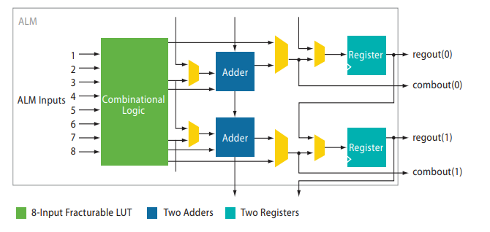
Asynchronous delay
Used FPGA Cyclone 5 contains ~29 000 elements (ALM – Adaptive logical unit)
One delay cell consumes 1 ALM
One input channel uses ~200 ALMs
We expect to use >30% of FPGA resources
A - Delay via LUT +Mux (as a single gate) = ~ ¼ ns
B - Delay via LUT+2Muxs+reg (as a D-trigger) = ~3/4 ns

Slide 12
T0U Server (II)
What’s new:
  Interactive trigger components (click-sensitive)
  All modifications are saved to “configuration file” in text format.
  Old configuration files are not deleted
  Non-experts are allowed to upload only predefined set of configurations corresponding to the run type

Slide 13
T0U Server (III)
What’s new (continued):
  Configuration file name consists of a name itself + creation time, for example “gold_gold20210527104342.BMNCfg”
  T0U server is able to receive commands from the Run Control System (RCS) to upload a configuration according to the run type using Trigger System Configuration manager.
  Trigger System Configuration manager distributes commands to the HV and T0U servers For example if RCS sends command “gold_gold” then all trigger system servers will upload configuration “gold_gold” with the latest time-stamp

Slide 14
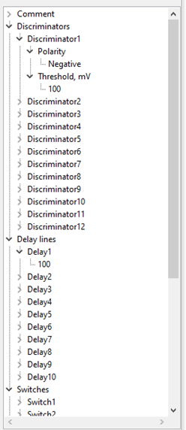
Configuration file
T0U Configuration file is a text file with tree-like structure
The system assumes to use the Trigger System Global Configuration. This file also has a tree-like structure with subsystem Configuration file names for in tree leafs
Not clear if the Trigger System Global Configuration manager is needed in 2022 Beam run => could be omitted

Slide 15
Communication interface (I)
To communicate to higher level system and inside Trigger system we use DIM protocol, see https://dim.web.cern.ch/
Why DIM:
  Client/server architecture
  Based on TCP/IP, fast, uses service logical name addressing
  Developed at CERN in 80-s for LEPP experiments
  Will be supported for LHC experiments
  Recommended by CERN JCOP as an interface for home made software to SCADA systems
  Open source
  Is very simple + has a lot of debugging stuff
  Has both Client and Server managers for WinCC OA (PVSSII)

Slide 16
Communication interface (II)
T0U server publishes BMN_TrSys_SpillSummary DIM-Service data block for each spill as follows (expected to be written to the data stream)
  Counts in BD, 40 integers
  Multiplicity in BD, 41 integers
  Counts in T0U, 20 integers
  Service information (Trigger DCS PC actual time etc.) ~20 integers
  Loaded configuration file name (ASCII text)
  Set of logic logics for T0U nodes (ASCII text)

Slide 17
Communication interface (III)
T0U server receives BMN_TrSys_RunTypeComd command to DIM Command Service containing a run type name or a full configuration file name
Run type
Name
Run Control system
Run type
Name
Trigger system config. manager
T0U server
To be discussed
To other subscribers of
“BMN_TrSys_SpillSummary”
Spill summary
DAQ

Slide 18
The end
Thank you for attention

Slide 19
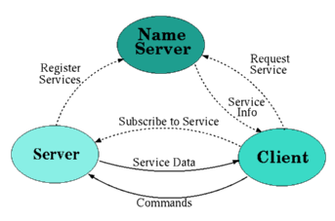
Distributed Information Management System (DIM)
DIM, is a portable, light weight, package for information publishing, data transfer and inter-process communications. Like most communication systems, is based on the client/server paradigm.
The basic concept in the DIM approach is the concept of "service". Servers provide services to clients. A service is normally a set of data (of any type or size) and it is recognized by a name - "named services". The name space for services is free.
Services are normally requested by the client only once (at startup) and they are subsequently automatically updated by the server either at regular time intervals or whenever the conditions change (according to the type of service requested by the client).

