Slide 1






















Information on the Resolution of the
129th session of the JINR Scientific Council
(February 2021)
and on the decisions of the JINR
Committee of Plenipotentiaries
(March 2021)
Notes:
1

Slide 2
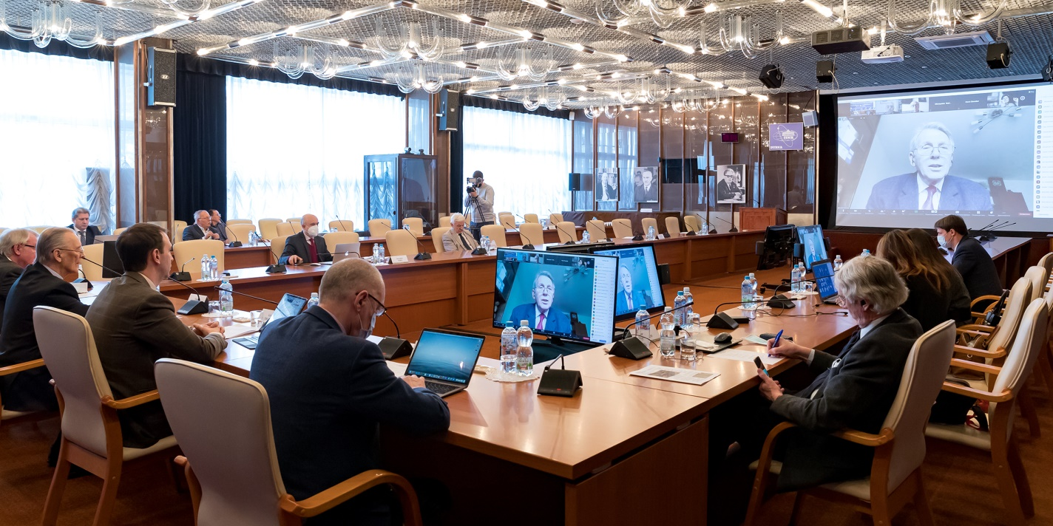
the 129th session of the JINR Scientific Council (18 February 2021)
AGENDA
The 129th session of the JINR Scientific Council took place
on 18 February 2021 in videoconference mode.
Report by the JINR Director (G. Trubnikov)
Progress of implementation of the NICA project (V. Kekelidze)
First experiments at the SHE Factory (Yu. Oganessian)
Programme of the JINR Centre of Radiobiology Research (A. Bugay)
Proposal for updates to the 7-Year Plan for the Development of JINR for 2017-2023 (A. Sorin)
PACs’ recommendations (I. Tserruya, M. Lewitowicz, D. L. Nagy)
Membership of the PACs (G. Trubnikov)
Scientific report “Implementation of the SKIF project at the Budker Institute of Nuclear Physics (Novosibirsk)” (P. Logatchov)
Scientific report “The recent SEM and ENAA investigations of carbonaceous meteorites obtained in collaboration with JINR and PIN (RAS) and their potential relevance to Astrobiology and the origin and distribution of biospheres” (R. Hoover)
Awards and prizes
Proposal for naming the Laboratory of Information Technologies after M. Meshcheryakov (G. Trubnikov, V. Korenkov)
Announcement of elections of the VBLHEP Director (G. Trubnikov)
It was co-chaired by JINR Director Grigory Trubnikov and by Professor Catalin Borcea (Horia Hulubei National Institute of Physics and Nuclear Engineering, Bucharest, Romania)
Notes:
2

Slide 3
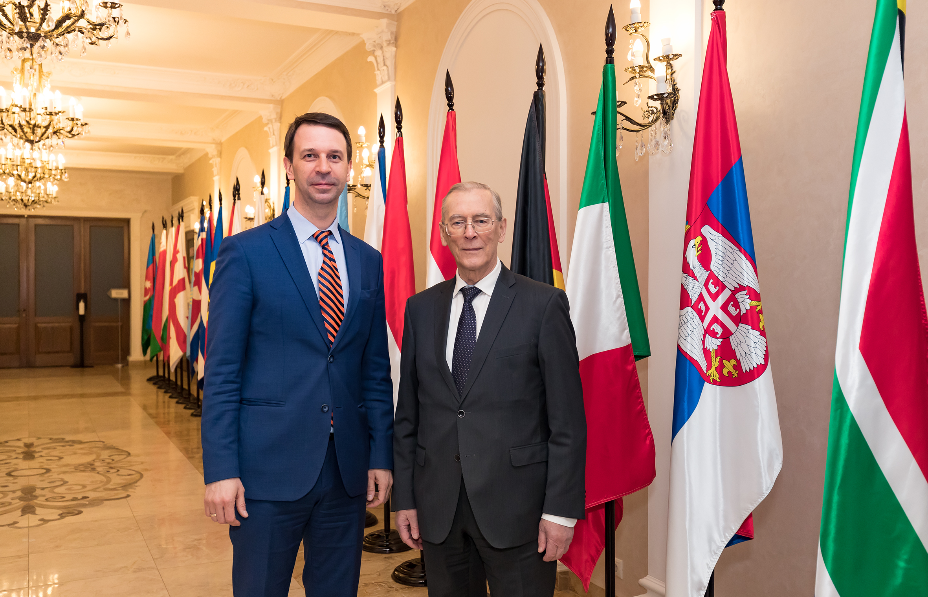
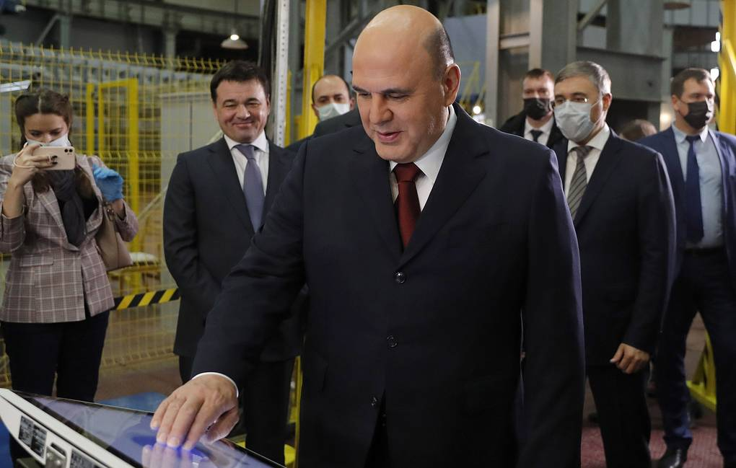
129th session of the JINR Scientific Council
RESOLUTION
The Scientific Council warmly thanks Victor Matveev for his outstanding contribution to the development and success of JINR during his mandate at the head of JINR.
The Scientific Council takes note of the comprehensive report by the JINR Director Grigory Trubnikov, covering the decisions of the last session of the JINR Committee of Plenipotentiaries (November 2020), the selected results and achievements obtained in JINR, and the latest events in the development of international cooperation.
The Scientific Council welcomes the endorsement by the JINR Committee of Plenipotentiaries of the programme of JINR development presented by Grigory Trubnikov. The Scientific Council also fully endorses the JINR Long-Term Development Strategic Plan up to 2030 and Beyond.
In particular, the Scientific Council strongly appreciates the recent success obtained during the commissioning of the Booster of the NICA complex illustrated by the first accelerated Booster beam. The Scientific Council also welcomes the progress in constructing the NICA collider systems and MPD, as well as the high-quality results of the scientific collaborations around NICA and the plans in this direction for 2021.
The Scientific Council is impressed by the result of the first experiment on synthesizing moscovium isotopes performed at the Factory of Super Heavy Elements (SHE) and processing the first data taken with the new DGFRS-2 separator.

Slide 4
129th session of the JINR Scientific Council
General considerations
The Scientific Council appreciates the installation of two new clusters of the Baikal Neutrino Telescope, whose deep-water detector has reached an effective volume of 0.35 km³, thus making Baikal-GVD one of the three largest telescopes in terms of the effective area and volume and the largest in the Northern Hemisphere.
The Scientific Council notes the progress of implementation of the User Programme with the IBR-2 spectrometers remaining operational even under the pandemic conditions. The Scientific Council also supports the activity performed for developing the concept of the new neutron source for FLNP in JINR.
The Scientific Council is pleased with the contribution of the JINR Tier1 centre to the CMS experimental data processing in 2020, noting that, in terms of performance, the JINR Tier1 is ranked second among the world Tier1 centres for the CMS experiment.
The Scientific Council also welcomes the publication of the scientific results achieved using the Govorun supercomputer resources.
The Scientific Council notes the extension of the applied research scope of JINR, in particular, in order to contribute to the COVID-19 related research made in cooperation with partner institutions.
The Scientific Council also welcomes the Committee of Plenipotentiaries’ approval of the initiative to establish an interlaboratory innovation centre of JINR.
The Scientific Council highly appreciates the reported new steps in strengthening the cooperation with non-member states inproliferation of shared interests in research and technology, as well as in training and information exchange activities.

Slide 5
129th session of the JINR Scientific Council
Recommendations in connection with the PACs
The Scientific Council took note of the recommendations made by the PACs at their meetings in January 2021, as reported at this session by Itzhak Tserruya, Chair of the PAC for Particle Physics, Marek Lewitowicz, Chair of the PAC for Nuclear Physics, and Dénes Lajos Nagy, Chair of the PAC for Condensed Matter Physics.
The Scientific Council requests the JINR Directorate to consider these recommendations while preparing the JINR Topical Plan of Research and International Cooperation for the year 2022.The Scientific Council acknowledges the measures being taken by the JINR Directorate to consolidate the JINR scientific programme on the main tasks of the current Seven-Year Plan.
In particular, the Scientific Council welcomes the mandate given by the JINR Directorate to all three PACs to propose an approach for prioritisation of JINR projects. The Scientific Council highly values work of the PACs on prioritisation of the projects within the JINR Topical Plan. The Scientific Council advises that the JINR Directorate is advised to act together with the leadership of the JINR laboratories towards applyingthe PACs’ recommendations where possible for consolidation of the available intellectual and material resources.

Slide 6
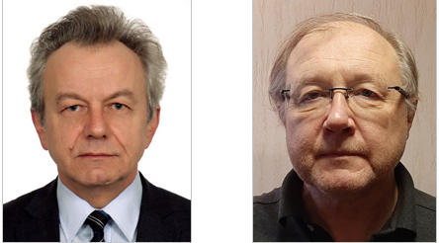
129th session of the JINR Scientific Council
Membership of the PACs
The Scientific Council appoints
Wojciech Dominik (Institute of Experimental Physics, Warsaw University, Poland) and
Alexandre Ivanov (Institut Laue-Langevin, Grenoble, France) as new members of the
PACs for Particle Physics and for Condensed Matter Physics respectively.
The Scientific Council thanks Jan Pluta and Joachim Mnich for their dedicated
work in the PAС for Particle Physics.
Announcement of new elections of Director of VBLHEP
The Scientific Council announced a vacancy for the position of Directorof VBLHEP. The elections will be held at the 131st session of the Scientific Council in February 2022.
Naming of the Laboratory of Information Technologies
The Scientific Council supported the proposal of the JINR Directorate for naming the Laboratory of Information Technologies after Academician Mikhail Meshcheryakov

Slide 7
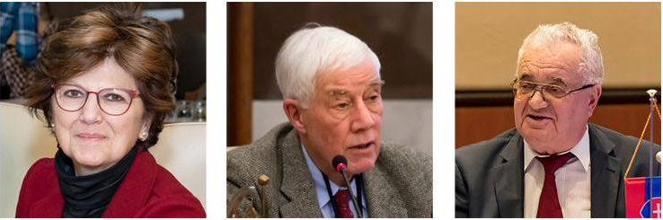
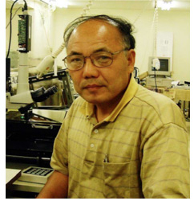
129th session of the JINR Scientific Council
Awards and prizes
The Scientific Council approves the proposal of JINR Director Grigory Trubnikov to award the title “Honorary Doctor of JINR” to Professor Luisa Cifarelli, Professor Michael Waligórski, and Professor Stanislav Dubnička, in recognition of their outstanding contribution to the advancement of science and education of young scientists.
The Scientific Council approves the Jury’s recommendations on the award of JINR annual prizes for the best papers in the fields of scientific research, methodology, research and technology, and applied research.
The Scientific Council approves the recommendations of the Jury of awarding the Bruno Pontecorvoprize for 2020 to Professor Niwa Kimio (Nagoya University, Japan) for the development of the high-resolution nuclear emulsion technique, which led to identification of the tau neutrino and direct observation of tau neutrino oscillations.

Slide 8
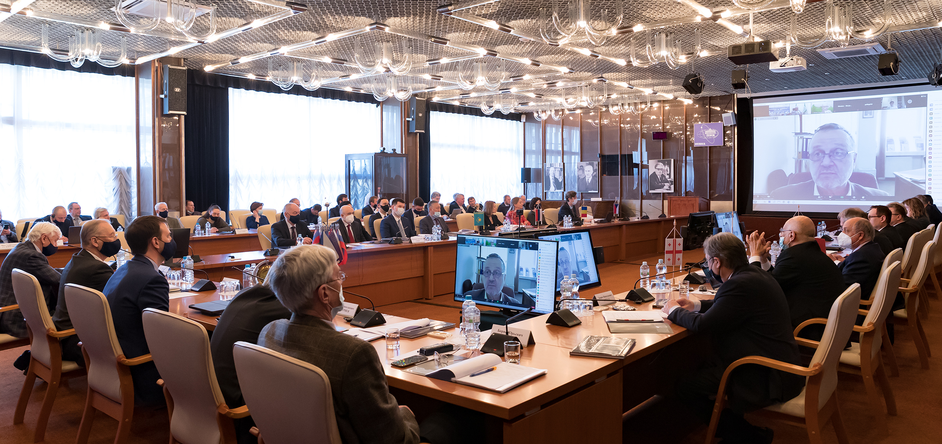
the session of the JINR Committee of plenipotentiaries of the Governments of the Member States of the Joint Institute for Nuclear Research (25 march 2021)
The representative of Romania, Florin-Dorian Buzatu, was elected Chair of the Committee of Plenipotentiaries.
Agenda
Report by the JINR Director (spokesperson: G. Trubnikov)
Execution of the JINR budget for 2020 and draft of the revised budget of JINR for 2021
Results of the meeting of the JINR Finance Committee held on 22 March 2021
Endorsement of appointments of Vice-Directors, Chief Scientific Secretary and Chief Engineer of JINR
Naming the Laboratory of Information Technologies after M. Meshcheryakov
Agenda for the Year of Bulgaria with JINR and arrangements for the CP session to be held in Bulgaria and scheduled for November 2021

Slide 9

IIO 2030+
Science organization activity
The Committee of Plenipotentiaries RESOLVED:
1. To take notice of the information presented by the JINR Directorate on the
recommendations of the 129th session of the JINR Scientific Council, the proposal
for updates to the Seven-Year Plan for the Development of JINR for 2017–2023,
the JINR management activities for realizing the long-term strategy of the Institute,
the Member States’ contribution to the total performance of the large-scale projects
of the Institute, and the most important events of JINR.
2. To approve the JINR Long-Term Development Strategic Plan up to 2030 and Beyond; to commission the JINR Directorate to pursue the work on the Seven-Year Plan for the Development of JINR for 2024–2030.
3. To assent to the JINR Directorate’s initiative to form a strategic development committee (SDC) reporting to CP Chair and to recommend that the Plenipotentiaries of the Member States of JINR submit their appointees prior to the 1st of May of 2021.
4. To endorse the JINR Directorate’s activities for implementing the JINR Long-Term Development Strategic Plan up to 2030 and Beyond in as much as improving the JINR management’s performance, organization restructuring of the JINR central management and developing a complex monitoring system of KPIs for the long-term strategy.
5. To approve the presented amendments to the Seven-Year Plan for the Development of JINR for 2017–2023, the recommendations made by the JINR Finance Committee, and the general directions for the updates endorsed at the previous CP session of November 2020.
Staff policy
RESEARCH PROGRAMME
Social environment
Administrative management
PR, Outreach, Communications

Slide 10
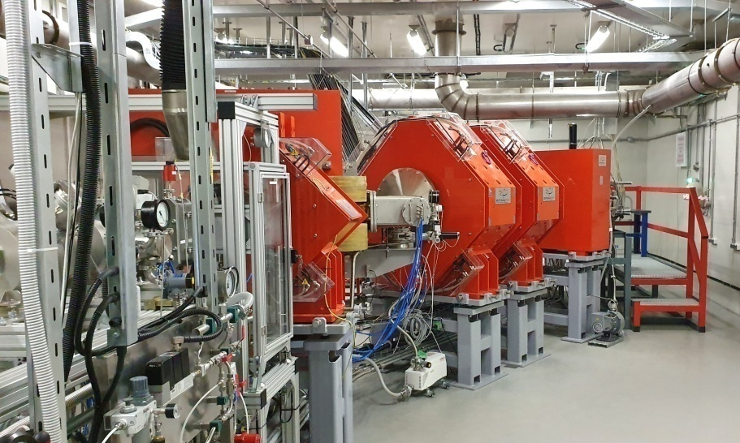
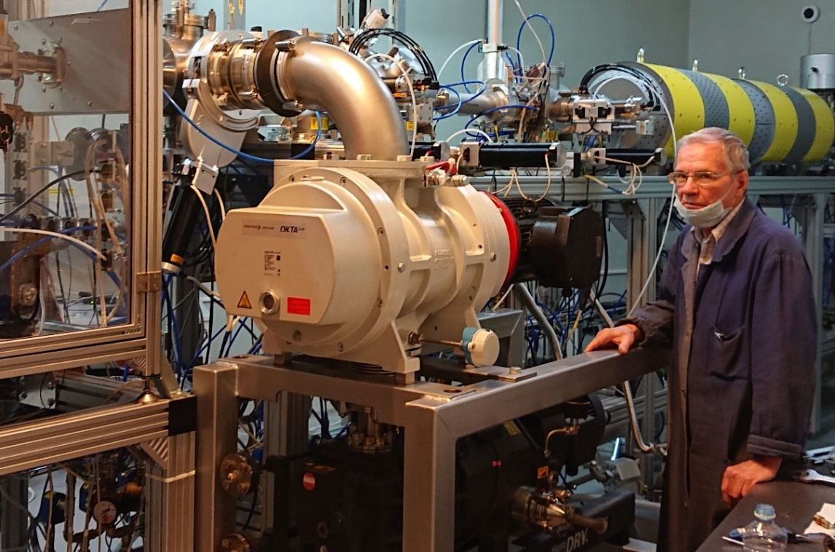
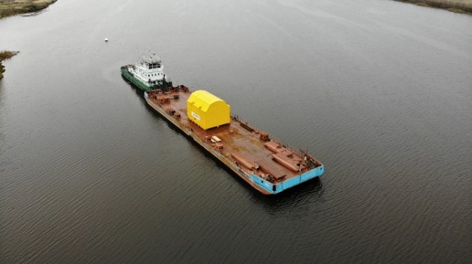
6. To recognize the substantial research-and-engineering, intellectual and human resources contributed by the JINR Member States to the realization of the large-scale projects of the Institute, in particular, the extensive involvement of researchers and specialists in the MPD, BM@N и SPD collaborations, signing the Memorandum of Understanding on the Baikal-GVD, and research in neutrino astrophysics, neutrino astronomy and neutrino physics, the Member States’ contribution to creating and commissioning the SHE Factory, establishing the IBR-2 international user committee, as well as to the increasing number of the Govorun supercomputer users from Member States and starting the activities for connecting new cloud components of the JINR Member States to DICE (Distributed Information and Computing Environment).
7. To congratulate the JINR Directorate on having one of the basic blocks of the NICA complex ― the superconducting synchrotron booster commissioned on the 20th of November of 2020 with Russian Prime-Minister M. Mishustin as special guest; to note with satisfaction that generating a sustainable circulation of the beam of monovalent helium ions injected in the Booster was achieved in strict compliance with its scheduled date on 19th of December of 2020.
8. To value highly the Directorate and Baikal-GVD team’s activities for having launched the largest deep-water neutrino telescope in the Northern hemisphere, the commissioning ceremony of which was on the 13th of March of 2021 and involved the Plenipotentiary of the Russian Federation, Minister of science and higher education of Russia V. Falkov.

Slide 11
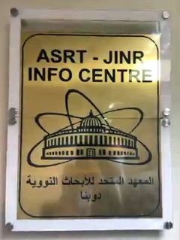
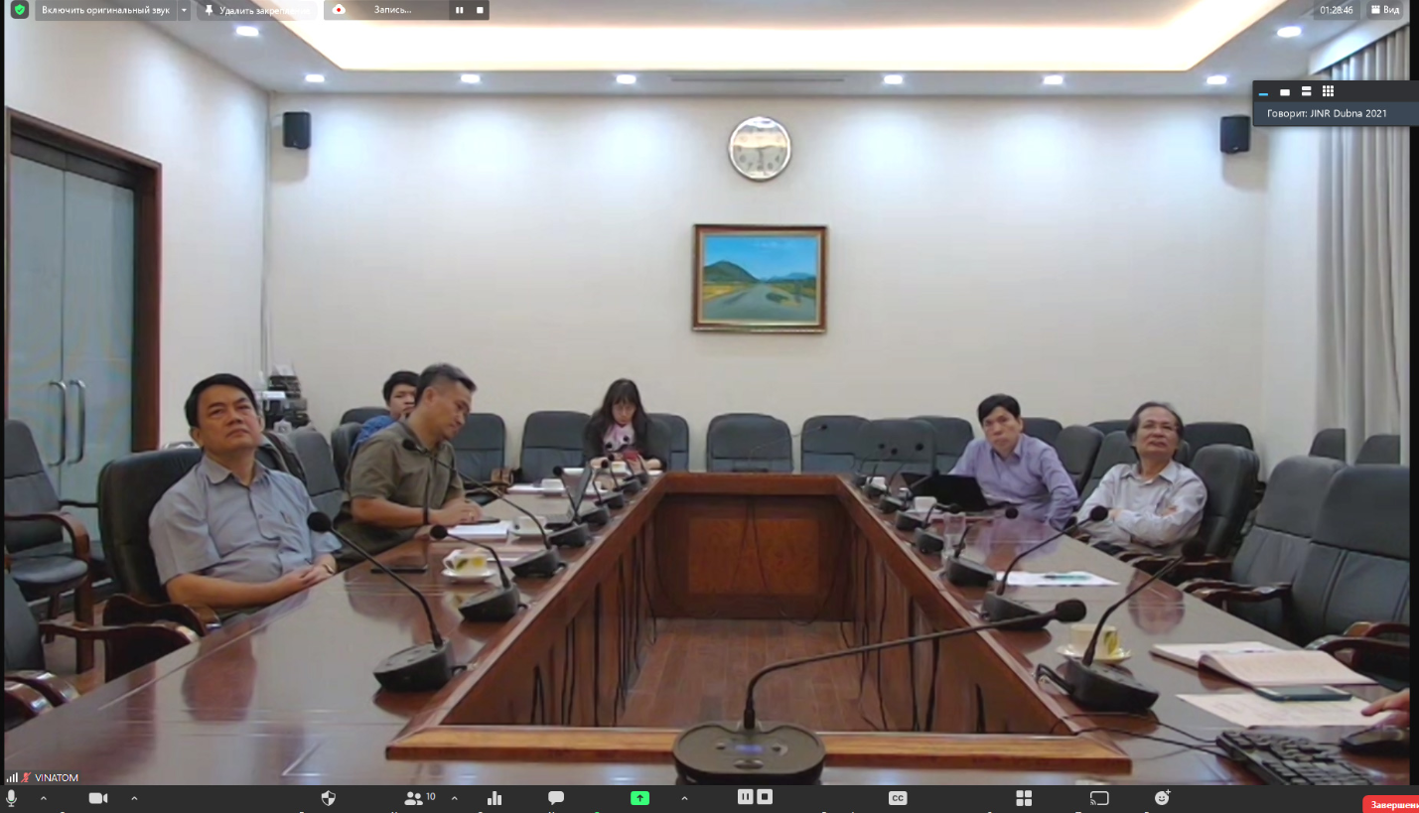
9. To note with satisfaction that the first experiments in synthesizing moscovium isotopes in 48Ca+243Am reaction carried out at the SHE Factory in November of 2020 and January of 2021 resulted in fifty-five decay events observed for moscovium-288, six events observed for moscovium-289 , and tentative detection of α-decay of dubnium-268 that first-ever evidenced a new lawrencium-264 isotope discovery.
10. To greet the opening of the JINR Information Centre at the Academy of Scientific Research and Technologies
(ASRT) of the Arab Republic of Egypt held on the 23rd of December of 2020.
11. To endorse the JINR Directorate’s activities for executing the agendas for the 65-year anniversary of JINR and the Year of Bulgaria with JINR, as well as for setting out the scope of JINR’s participation in the agenda for the Year of Science and Technologies in the Russian Federation.
12. To welcome the information on having held the first meeting of the Joint Coordination
Committee for Vietnam–JINR Cooperation as a vehicle for Vietnam’s growing participation in
JINR, –– in which regard to note the JINR Directorate’s support of the implementation of the
resolution made at the CP session of November 2019 to develop a plan of cooperation between
the Vietnam Academy of Sciences and Technology, VINATOM and JINR for the execution of the
project of a new reactor for research in Vietnam.
13. To endorse the JINR Directorate’s activities of developing a design concept for the Innovation Centre for nuclear technologies, its international research programme and project management plan.

Slide 12
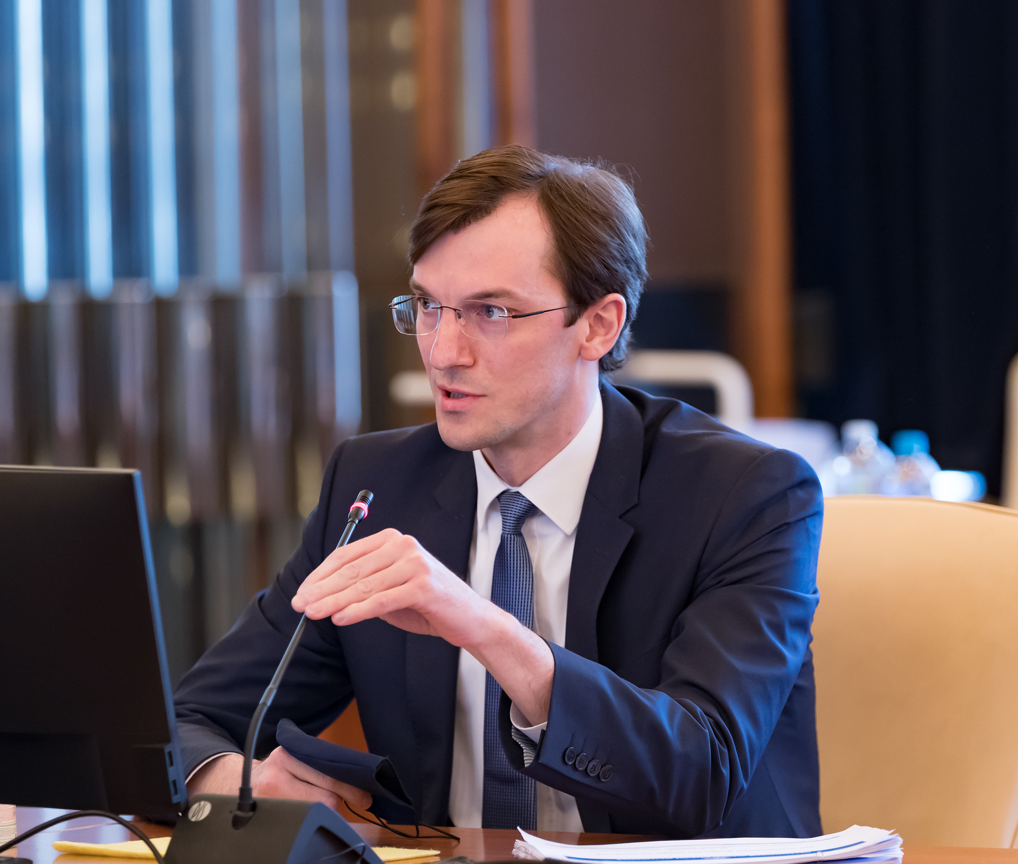
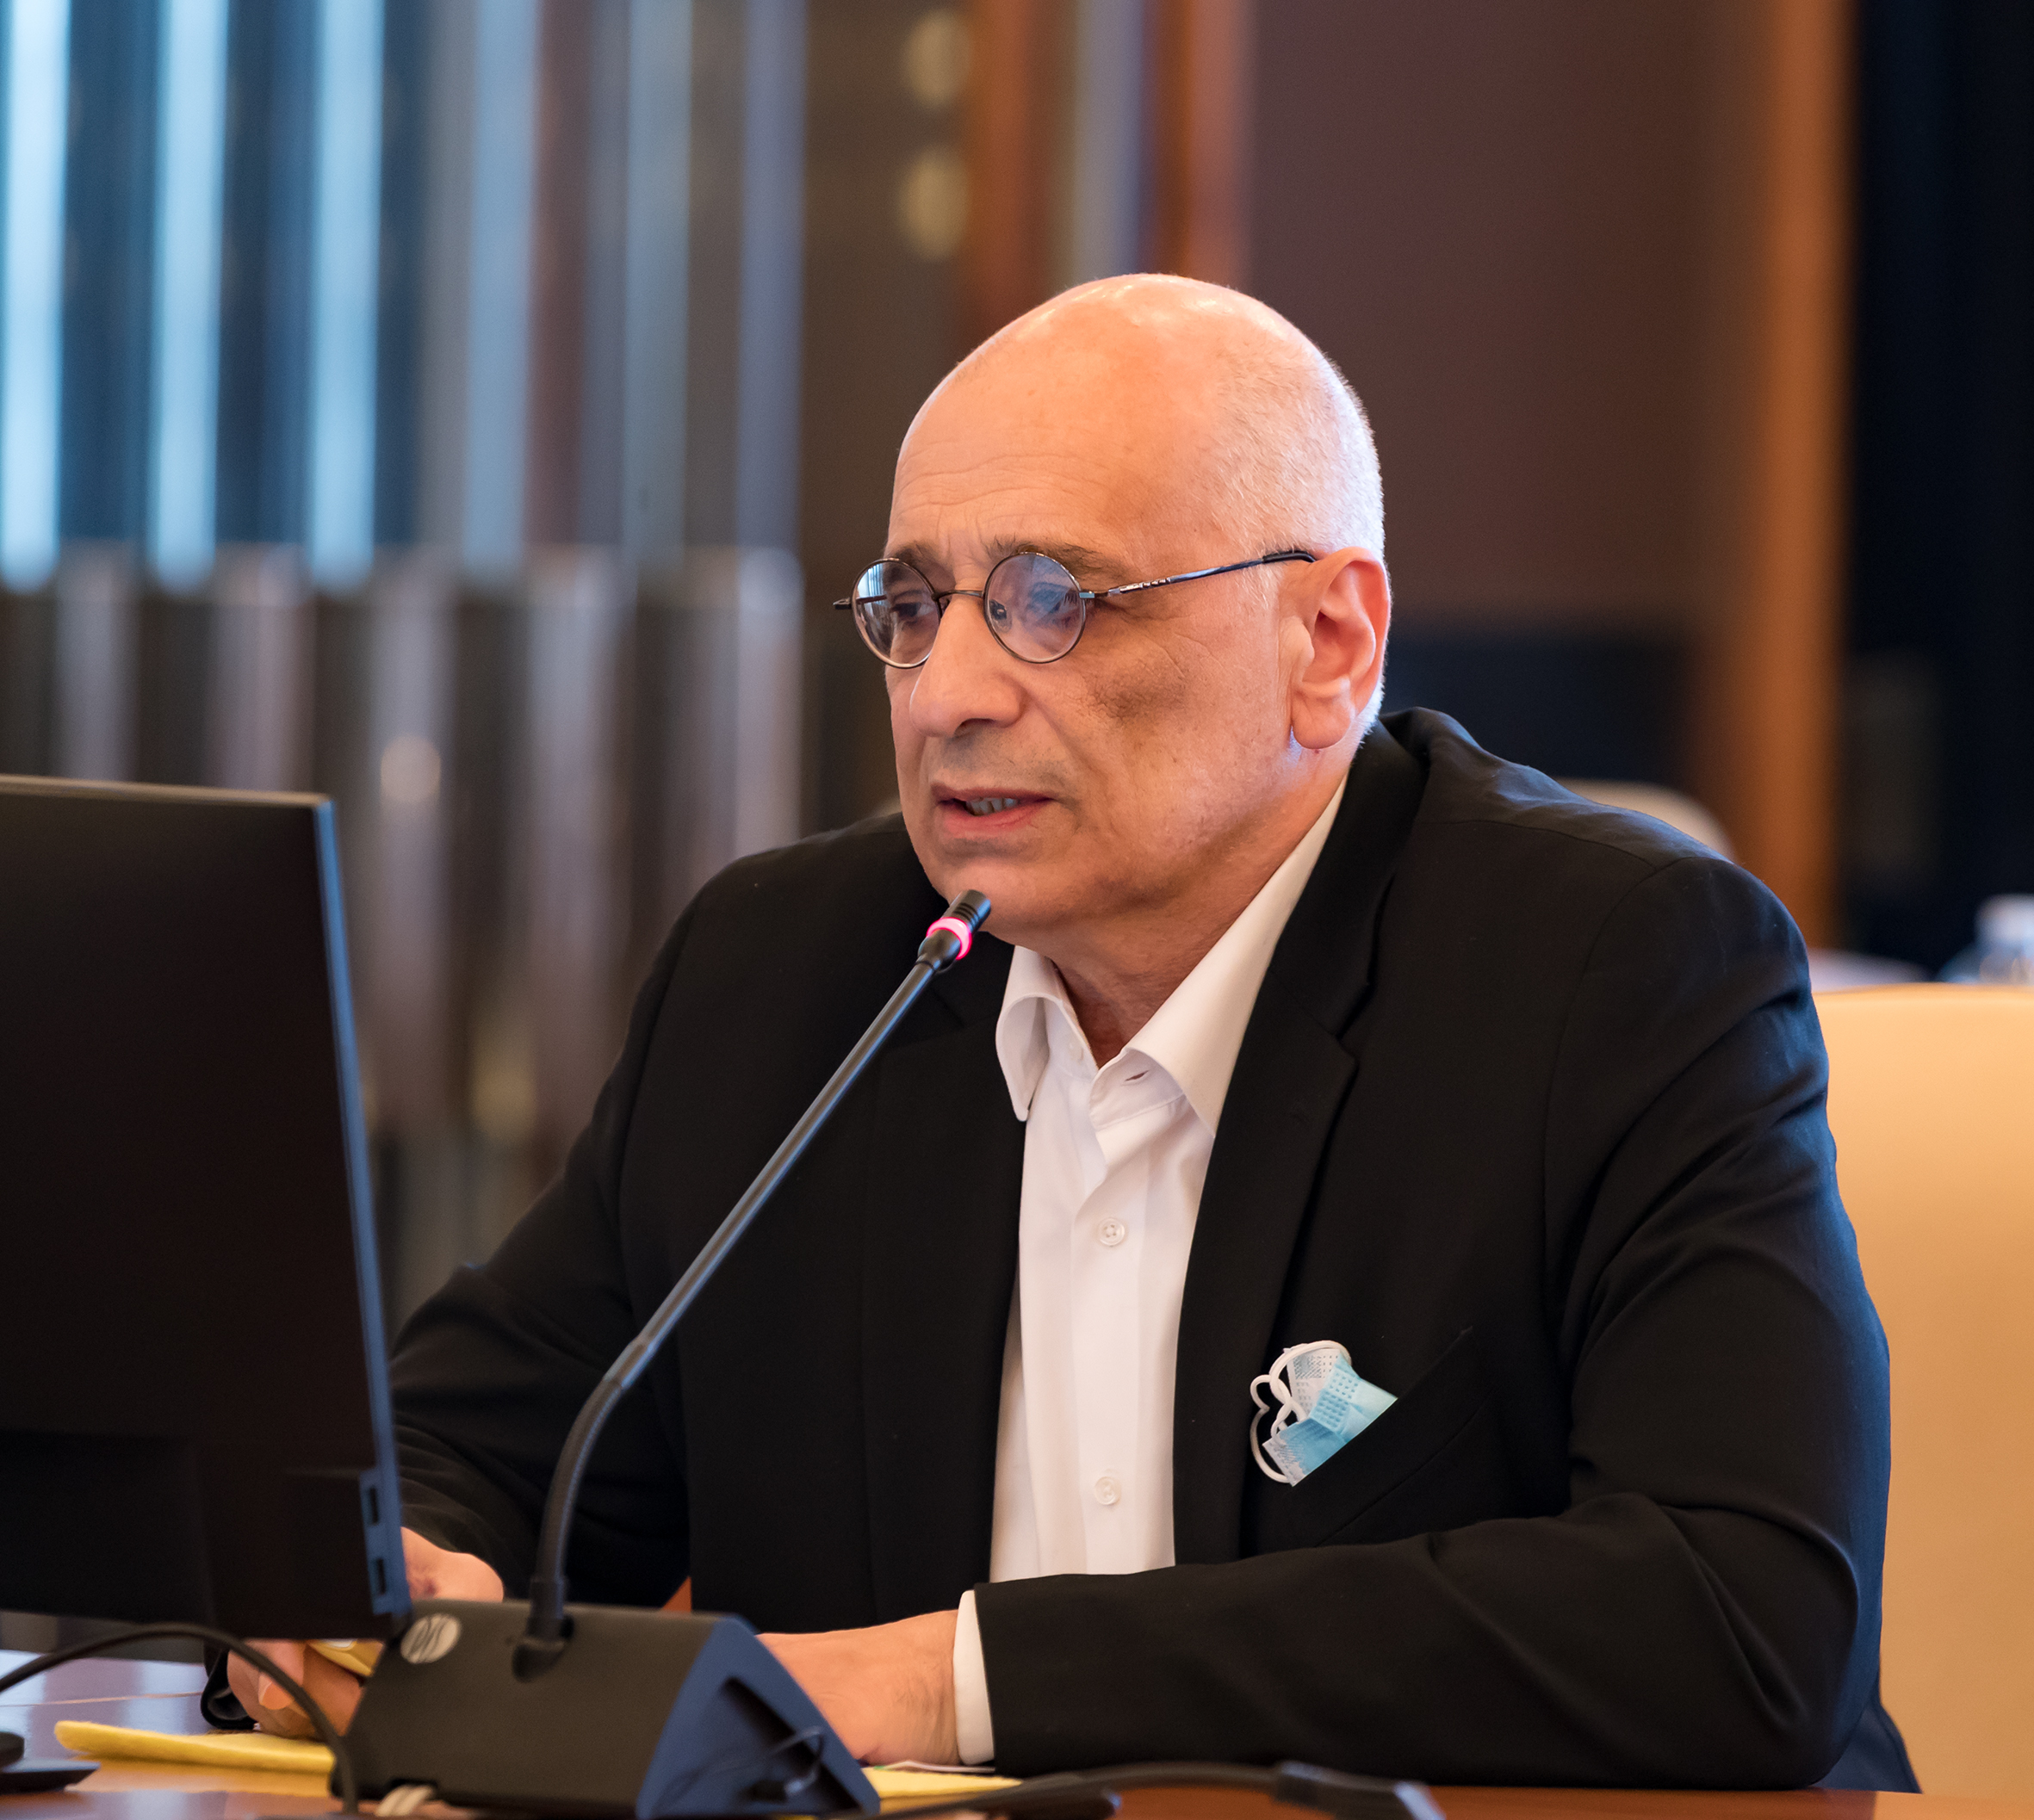
The Committee of Plenipotentiaries took notice of the information on the execution of the JINR budget for 2020, and approved the consolidated final adjustment of the income and expenditure of the JINR budget for 2020.
The Committee of Plenipotentiaries approved the revised JINR budget of
US$ 265 825.2 thousand bottom line for 2021.
The Committee of Plenipotentiaries approved the minutes of the Finance Committee meeting held on the 22nd of March of 2021.
With reference to the fact that the coronavirus pandemic of 2020 resulted in an international cooperation surplus on the budget, CP commissioned the JINR Directorate to consider an issue of equivalent increase of this expenditure item when budgeting for 2022 and 2023.
The Committee of Plenipotentiaries approved the audit schedule for auditing the JINR financial results of 2020 as presented by the JINR Directorate.

Slide 13
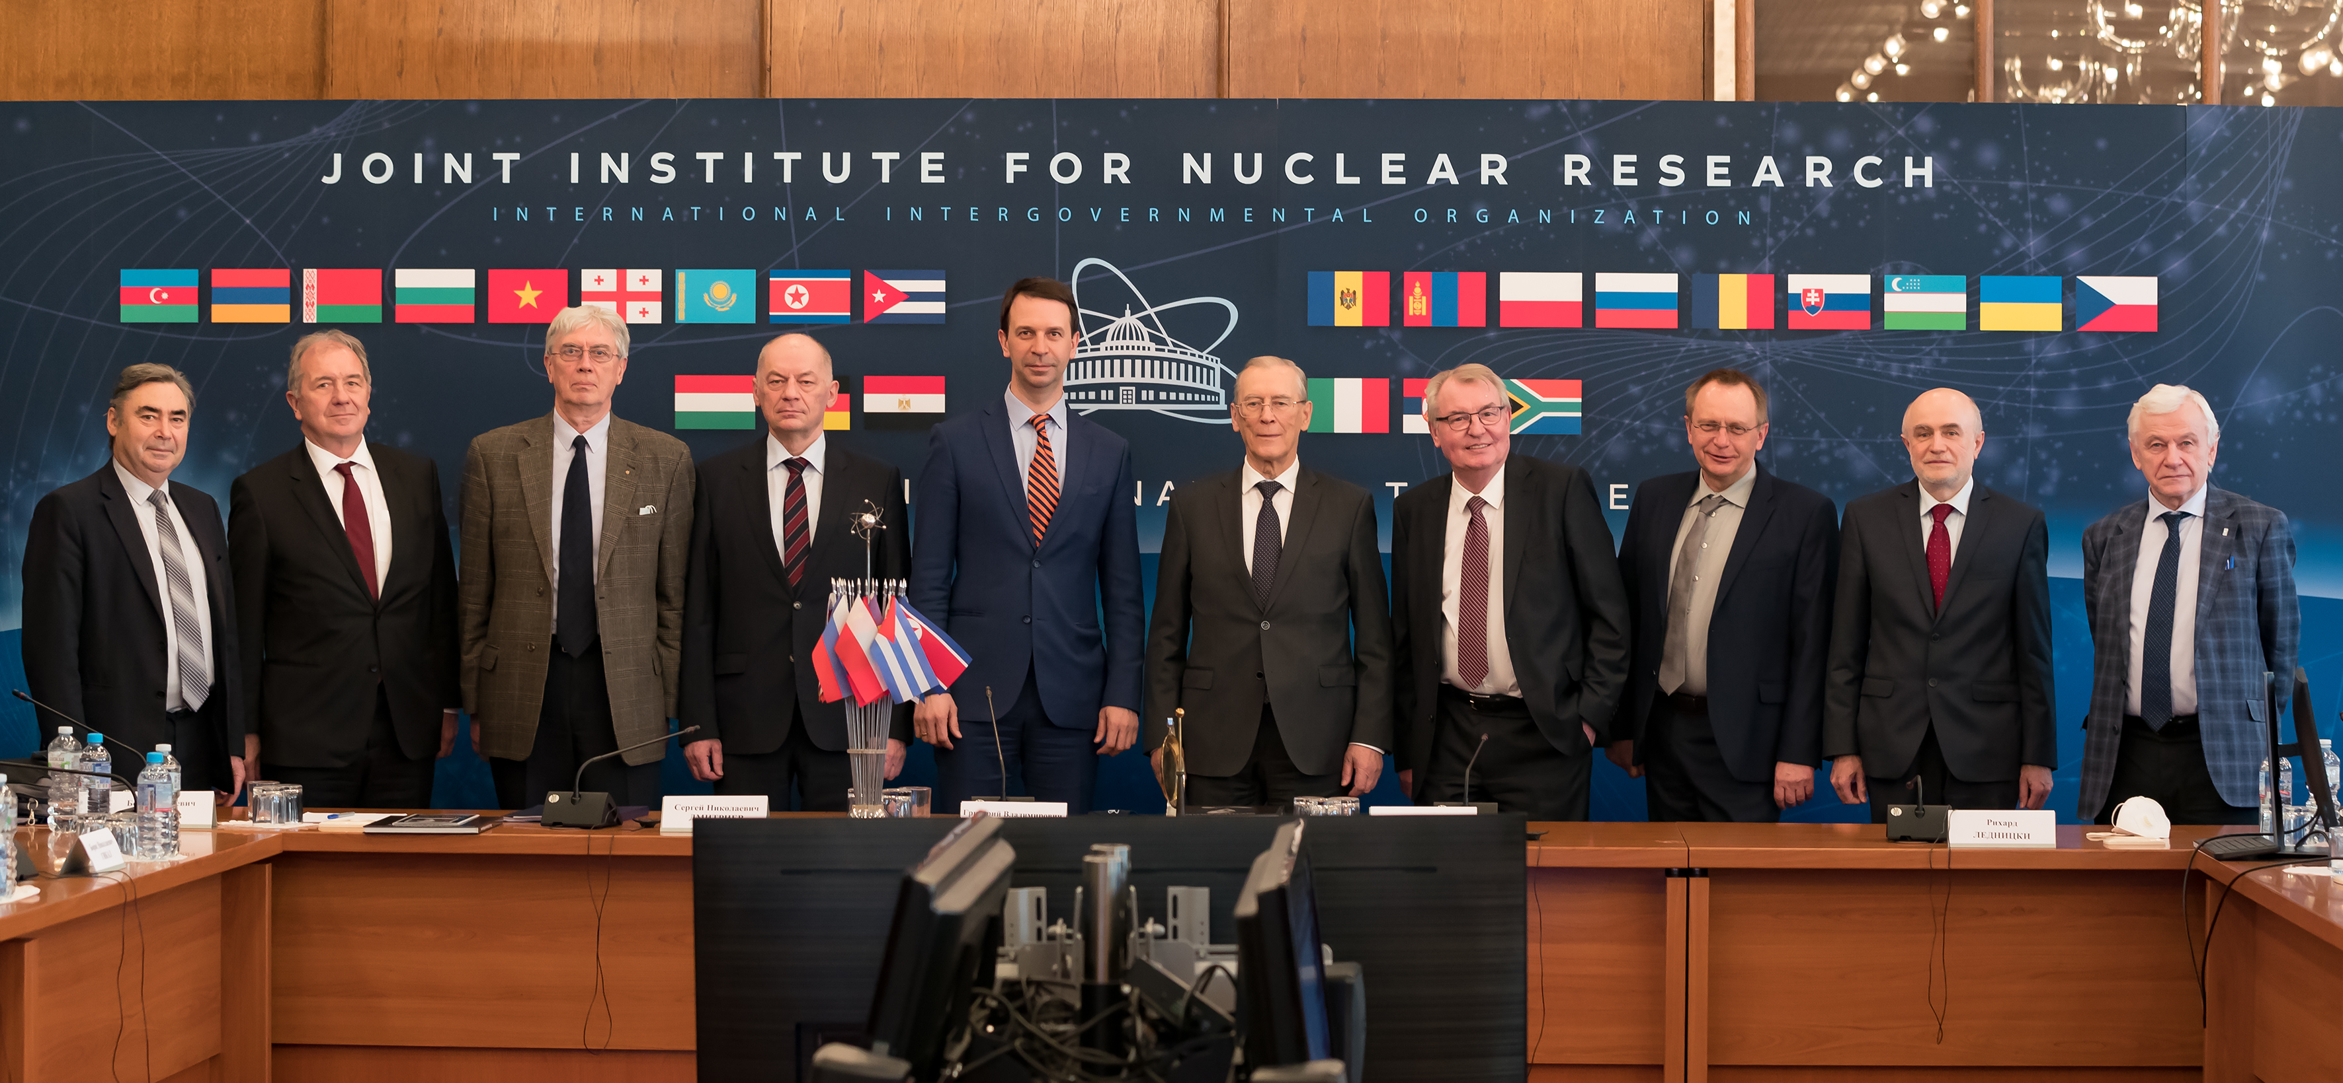
Having heard and discussed the proposal for “Endorsement of appointments of Vice-Directors, Chief Scientific Secretary and Chief Engineer of JINR” submitted by JINR Director G. Trubnikov, the Committee of Plenipotentiaries RESOLVED:
Following the voting results, to confirm in office:
Vice-Directors of JINR – Sergey Dmitriev, Vladimir Kekelidze, Latchesar Kostov
Chief Scientific Secretary of JINR – Sergey Nedelko
Chief Engineer of JINR – Boris Gikal
whose term of office will expire together with the elected Director in office, i. e. on the 1st of January of 2026.
To express gratitude to Richard Lednický, Boris Sharkov, Alexander Sorin for their continuous performance as Directorate, their huge contribution to the Institute’s achievements and the development of international research cooperation.

Slide 14
The Committee of Plenipotentiaries have scheduled the next session for 22–23 November 2021
The next meeting of the Finance Committee will be held on 18–19 November 2021

