Slide 1


Development of experimental techniques and applied research with slow monochromatic positron beams (PAS)
54th meeting of the PAC for Condensed Matter Physics
28 June 2021, Dubna
Project leaders: A.G.Kobets^{a),c)}, K. Siemek^{a),b)}
Scientific leader: I.N.Meshkov^{a),d)}
Research activities (K. Siemek)
Beam development (A.G.Kobets, I.N.Meshkov)
^{a)} Dzhelepov Laboratory of Nuclear Problems of Nuclear Problems JINR, Joliot-Curie 6, 141980 Dubna, Moscow region, Russia
^{b)} Institute of Nuclear Physics PAS, E. Radzikowskiego 152, 31-342 Krakow, Poland
^{c)} Institute of Electrophysics and Radiation Technologies, NAS of Ukraine, Chernyshevsky St. 28, 61002 Kharkov, Ukraine
^{d)} Saint-Petersburg State University, University Embankment 7/9, 199034 St Petersburg, Russia

Slide 2
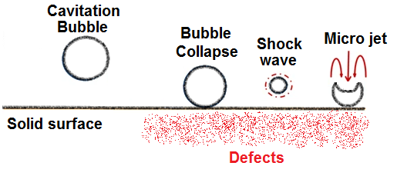
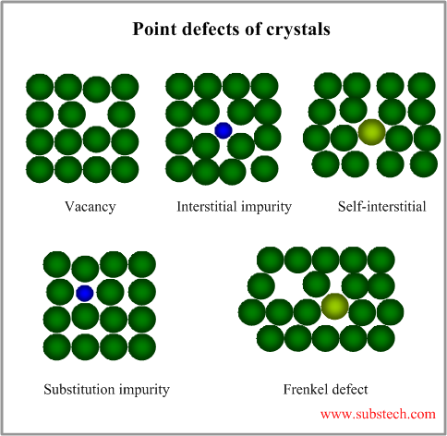
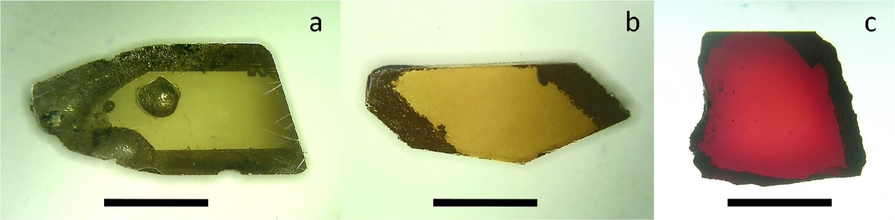
Research activities
Studies of destructive process
Defects
Source: K. Siemek, M.K. Eseev, P. Horodek, A.G. Kobets, I.V. Kuziv, Defects studies of nickel aluminum bronze subjected to cavitation Appl. Surf. Sci. 546 (2021) 149107
Modification of materials properties
The properties of materials are profoundly influenced by the presence of imperfections.
It is important to have knowledge about the types of imperfections that exist and the roles they play in affecting the behavior of materials.
Source: K.Siemek, A.P.Yelisseyev, P.Horodek, S.I. Lobanov, A.A.Goloshumova, A.V.Belushkin, L.I.Isaenko, Optical and positron annihilation studies of structural defects in LiInSe₂ single crystals, Optical Materials 109 (2020) 110262

Slide 3
Research activities
Studies of destructive process:
Studies of materials for usage in IV type nuclear reactors - Institute of Nuclear Physics PAS, Cracow [dr. P.Horodek], Institute of Radiation Problems NAS, Baku [dr M.N. Mirzayev] , Institute for Nuclear Research and Nuclear Energy, Sofia [dr E.P.Popov], University of Szczecin [prof. K.Czerski], JINR [dr. V. A. Skuratov], Belarusian State University [dr. V. V. Uglov], Sumy State University, Ukraine [prof. A. Pogrebnjak], Institute for Theoretical and Experimental Physics [dr T.V. Kulevoy], PTU Tomsk [dr R. Laptev];
cavitation, wear, corrosion process- Institute of Nuclear Physics PAS, Cracow [prof. J.Dryzek], Northern Arctic Federal University, Arkhangelsk [dr. M.Eseev];
Studies of materials modification:
Surface modification by ion implanatation in semiconductors and MOS structures - UMCS Lublin [dr M.Kulik], CNT Hochiminh [dr Luu Anh Tuyen], Institute of Physics, VAST, Hanoi [prof. Le Hong Khiem];
Study of defects in optical materials - IGM SB RAS and NSU, Novosibirsk [dr. L.I. Isaenko, dr. A. P. Yelisseyev]; JINR [dr. A.V Belushkin]
Mechanical modification of materials – sandblasting, hydrostatic extrusion, surface modification attrition techniques -Institute of Nuclear Physics PAS, Cracow [dr. P.Horodek, dr. E.Dryzek], UE, Cracow [dr. M.Sarnek], AGH University, Cracow [dr. M. Wróbel], Rzeszów University of Technology [dr. W. Nowak]
Surface modification of zeolite ZSM-5 by irradiation - [dr Luu Anh Tuyen, CNT Hochiminh];
Multiferroic BaTiO₃ nanopowoders -STU, Voronezh [prof. L.Korotkov];

Slide 4
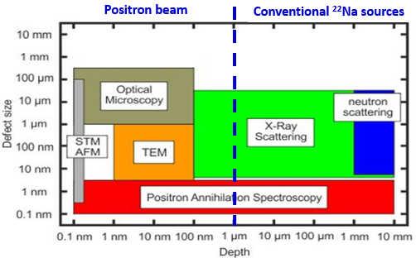
Research activities
PAS techniques:
angular correlations of gamma quanta
Doppler Broadening spectroscopy (DBS)
positron annihilation lifetime spectroscopy (PALS)
Positron annihilation spectroscopy (PAS) is a suitable tool for studying changes in the material structure. It is a sensitive method for the detection of open-volume defects such as vacancies, dislocations, etc.
thin films, layered structures,
Irradiation with ions
nanoparticles, powders,
uniform materials,
irradiation with heavy
ions and neutrons
Possibilities:
determination of defect concentration
evaluation of defect concentration profile
detection of the kind/size of defects
Source: https://www.hzdr.de/db/Cms?pNid=3581

Slide 5
Publications since 2020:
Research activities
a) using monochromatic positron beam:
1. K.Siemek, M.K.Eseev, P.Horodek, A.G.Kobets, I.V.Kuziv Defects studies of nickel aluminum bronze subjected to cavitation, Applied Surface Science 546 (2021) 149107.
2. K.Siemek, P.Horodek, V.A.Skuratov, J.Waliszewski, A.Sohatsky, Positron annihilation studies of irradiation induced defects in nanostructured titanium, Vacuum 190 (2021) 110282.
3. K.Siemek, J.Dryzek, M.Mitura-Nowak. A.Lomygin, M.Schabikowski, Positron annihilation studies of long range effect in Ar, N and C-implanted silicon, Nuclear Instruments and Methods in Physics Research B 456 (2020) 73.
4. R.Laptev, A. Lomygin, D. Krotkevich, M. Syrtanov, E. Kashkarov, Y. Bordulev, K. Siemek, A. Kobets, Effect of Proton Irradiation on the Defect Evolution of Zr/Nb Nanoscale Multilayers, Metals 10 (2020) 535.
5. R.Laptev, L. Svyatkin, D. Krotkevich, E. Stepanova, N. Pushilina, A. Lomygin, S. Ognev, K. Siemek, V. Uglov, First-Principles Calculations and Experimental Study of H+-Irradiated Zr/Nb Nanoscale Multilayer System, Metals 11 (2021) 627.
b) using only conventional ²²Na positron source:
1. K.Siemek, A.P. Yelisseyev, P.Horodek, S.I. Lobanov, A.A.Goloshumova, A.V.Belushkin, L.I.Isaenko, Optical and positron annihilation studies of structural defects in LiInSe₂ single crystals, Optical Materials 109 (2020) 110262.
2. W. Nowak, K. Siemek, K. Ochał, B.Kościelniak, B. Wierzba Consequences of different mechanical surface preparation of Ni-base alloys during high temperature exposure, Materials 13 (2020) 3529.
3. E. Demir, M.N. Mirzayev, E.P. Popov, P. Horodek, I.G. Genov, K. Siemek, D.M. Mirzayeva, V.A. Turchenko, M. Bulavin, A.I. Beskrovnyi, A.H. Valizade, H.V. Akhundzada, S.I. Karaaslan, Effects of high-energetic ³He⁺ ion irradiation on tungsten-based composites, Vacuum 184 (2021) 109934.
4. M.N.Mirzayev, A.Abdurakhimov, E.Demir, A.A.Donkov, E.Popov, M.Yu.Tashmetov, I.G.Genov, T.T.Thabethe, K.Siemek, K.Krezhov, F.Mamedov, D.M.Mirzayeva, M.V.Bulavin, V.A.Turchenko, T.X.Thang, T.Z.Abdurakhmonov, P.Horodek, Investigation of the formation of defects under fast neutrons and gamma irradiation in 3C-SiC nano powder, Physica B Condens. Matter. 611 (2021) 412842.

Slide 6
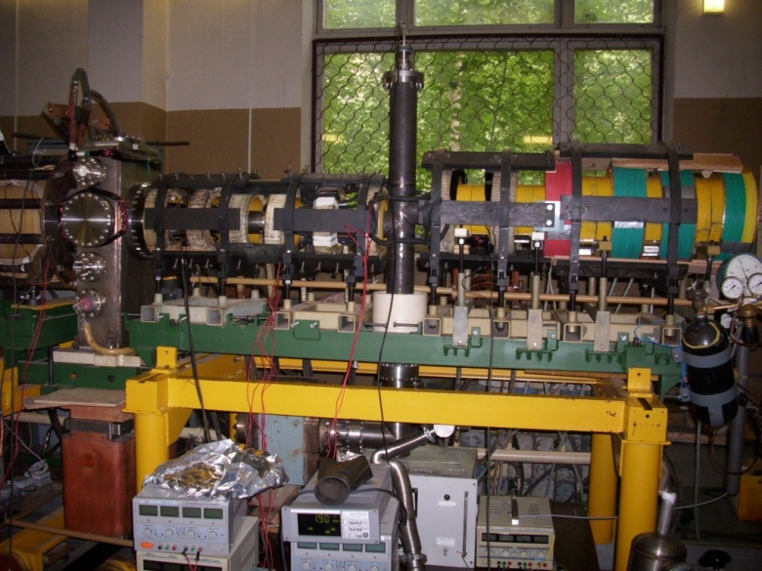
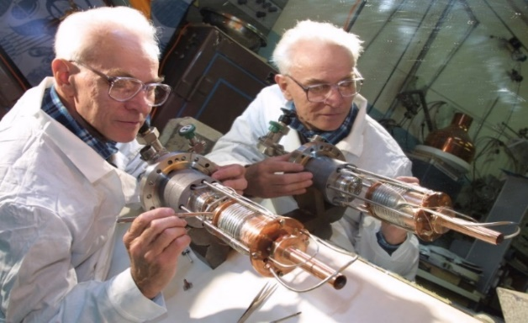
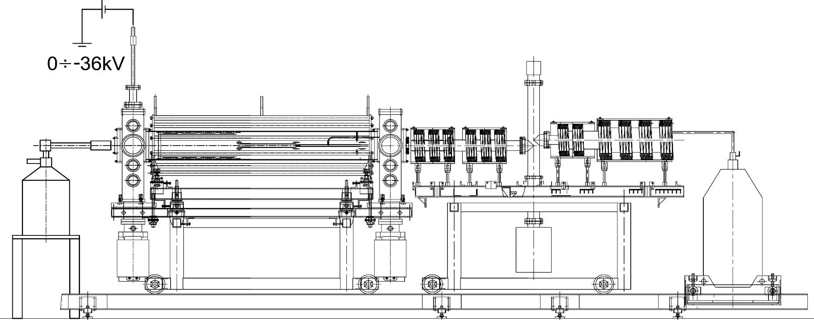
Beam development
7 K
Frozen Ne
Feature | Value
activity of ²²Na | ~30 mCi
moderator | frozen Ne (7K)
magnetic field | 100 Gs
vacuum conditions | 10⁻⁹ Torr
intensity | ~10⁶ e⁺/s
energy range | 50 eV ÷ 36 keV
diameter of the flux | 3 mm
Target
0 ÷ - 36 kV
30 mCi ²²Na source
e+ trap
B||
B⊥
LHe

Slide 7
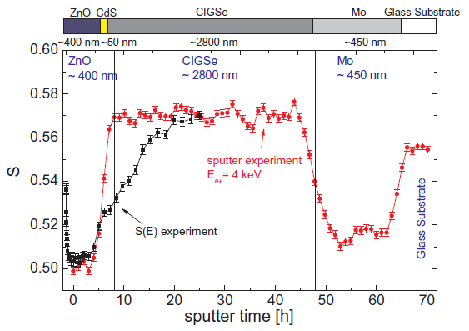
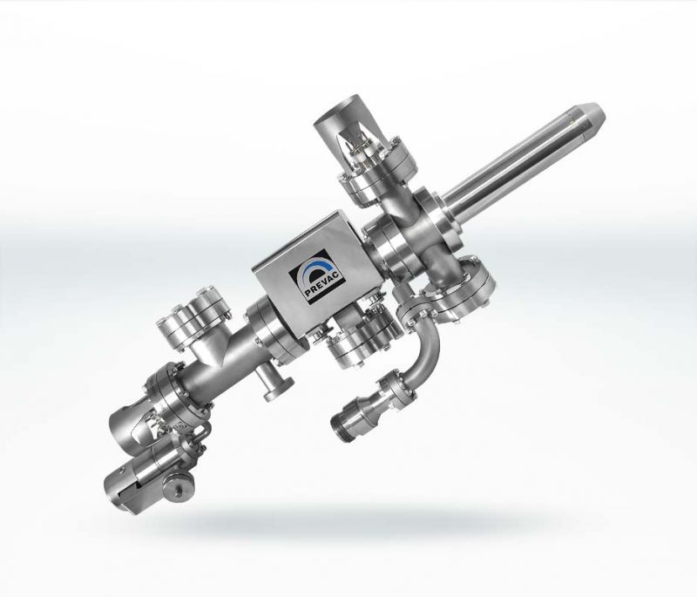
Improving depth resolutions in positron beam spectroscopy by concurrent ion-beam sputtering.
Beam development
Fig. The simultaneous in situ sputter experiment (red) on a CIGSe solar cell and a
comparable S(E) measurement (black) of the same sample from E= 0.03 keV to
E = 24 keV.. Ref.: M. John et al., Nuclear Inst. Meth. Phys. Res. B 423 (2018) 62–66

Slide 8
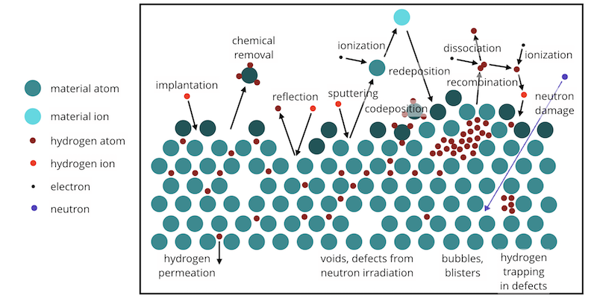
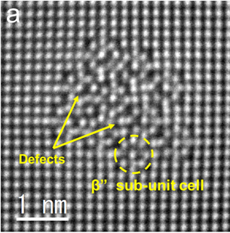
Beam development
Additional technique: Coincidence Doppler broadening
Relation of the area under the wing part of annihilation line A_{S} to total area below this line A:
defines the participation of e⁺e⁻ pairs with high momentum
identify the chemical elements around the positron annihilation sites
Fig. Plasma-surface interactions in a fusion reactor. Source: https://www-amdis.org/workshops/ictp-2020
Fig. STEM images of the β” precipitate in aluminium alloy. Ref.: T. Maeda et al. Sci Rep 8, 16629 (2018)

Slide 9
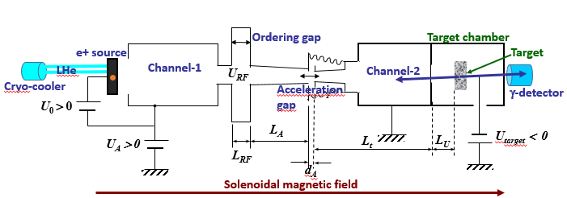
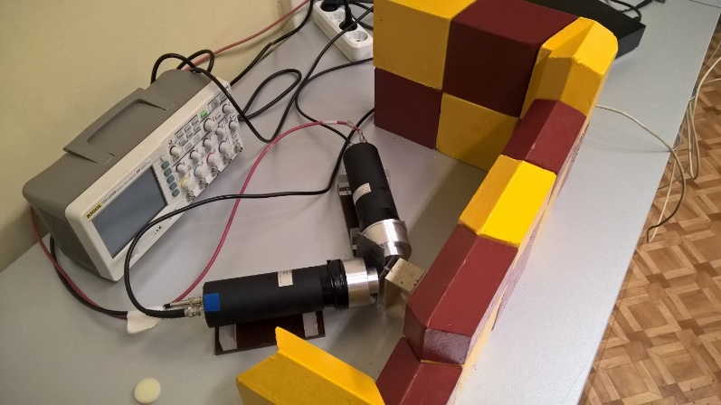
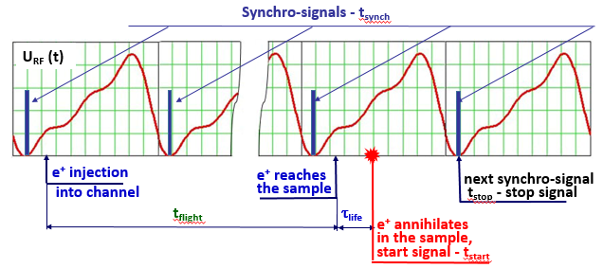
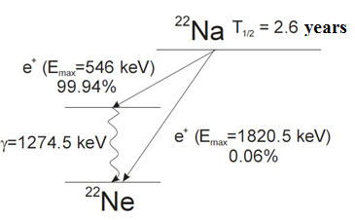
Beam development
Conventional ²²Na sources
Additional technique: Positron lifetime on the beam
Stop signal 511 keV
Fig. Scheme of forming of the ordered positron flux
Start signal 1274 keV
τ_{life} = t_{stop} – t_{start} – t_{flight}
Fig. Synchronization and start – stop signals
Ref: P.Horodek, A.Kobets, I.Meshkov et. al. Acta Physica Polonica A 136 (2019) 315

Slide 10
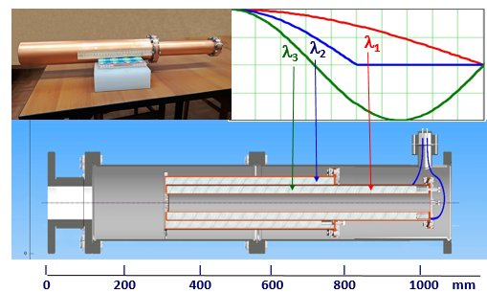
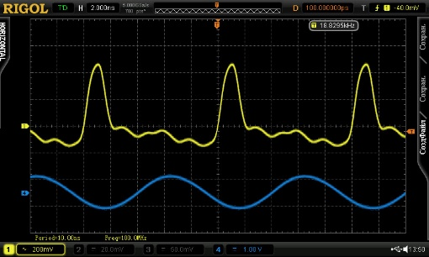
Beam development
During 2019 – 2020 have been designed and manufactured:
The RF cavity of three harmonics frequency,
The vacuum chamber of RF system,
The magnetic system solenoids.
All these elements have been mounted on the positron beam channel.
10 ns
Synchro signal
Fig. The drawing of a three-frequency quarter-wave resonator
1st RF harmonics
Fig. The phase reference pulse

Slide 11
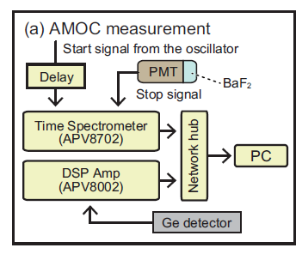
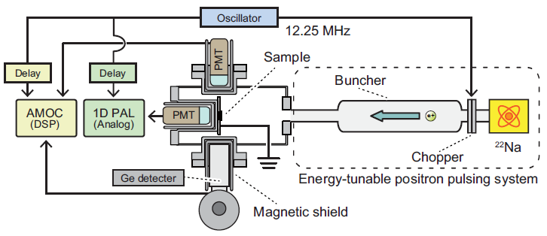
Beam development
Background reduction
Positron age-momentum correlation (AMOC)
=>100 MHz
13 mCi
²²Na source
http://prntscr.com/16rncrr
Fig. An energy-variable positron age-momentum correlation (AMOC) measurement system with a pulsed ²²Na-radioisotope-based beam at National Institute of Advanced Industrial Science and Technology (AIST), Tsukuba, Japan
Ref. Kenji Ito Preliminary Results on Low-energy Positron Age-momentum Correlation Measurements Based on a Radioisotope-source Positron Beam JJAP Conf. Proc. 7, 011302 (2018) https://doi.org/10.7567/JJAPCP.7.011302

Slide 12
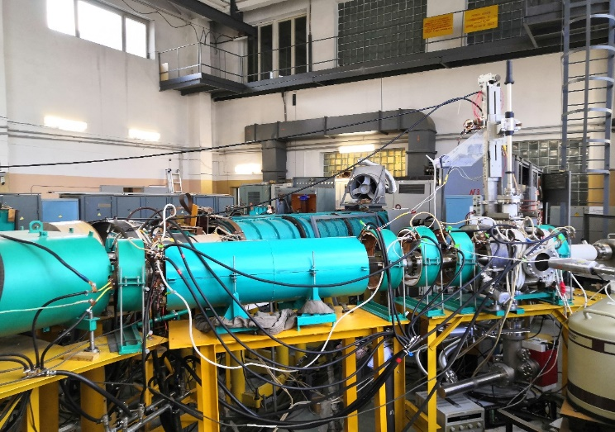
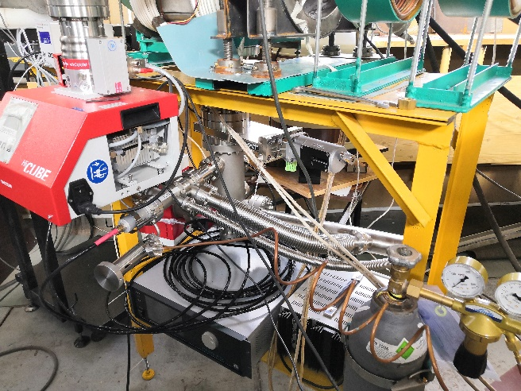
Summary
Realized in 2018-2021:
The slow positron specialized channel
construction was completed
The new method of ordering flux was invented
A system of reactive ion etching was developed
A spectrometer for the coincidence Doppler spectroscopy method was bought
A new sample chamber was projected
Experimental research was conducted in several areas
Plans:
implementation of the method of ordering positron flux:
mounting of the new measurement chamber
completion of ordered positron beam formation
purchase of a new spectrometer for positron lifetime measurements with an ordered positron beam
continuation of experimental research

Slide 13
Summary
List of graduates for 2016-2020:
Marat Eseev, 2016 - Doctor of Sciences
Pawel Horodek, 2019 - Doctor of Sciences
Andrei Kobets, 2020 – Ph.D.
Sergei Melnikov, 2019 – MSc
Institutional cooperation:
1. INP PAS in Cracow;
2. JINR: FLNP and FLNR;
3. NAFU Arkhangelsk;
4. PTU Tomsk;
5. ITEP Moscow;
6. CNT Hochiminh;
7. STU Voronezh.
Thank you for your attention !

