Slide 1
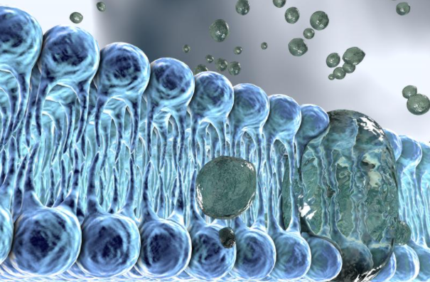
Investigating model lipid membranes complementarily by neutron and Raman scattering
Yersultan Arynbek, Dmytro Soloviov
Sector of Raman spectroscopy, FLNP
PAC for CMP, 28-29 June, 2021

Slide 2
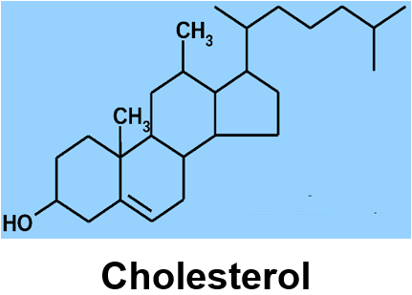
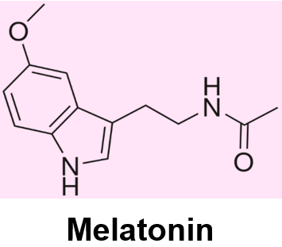
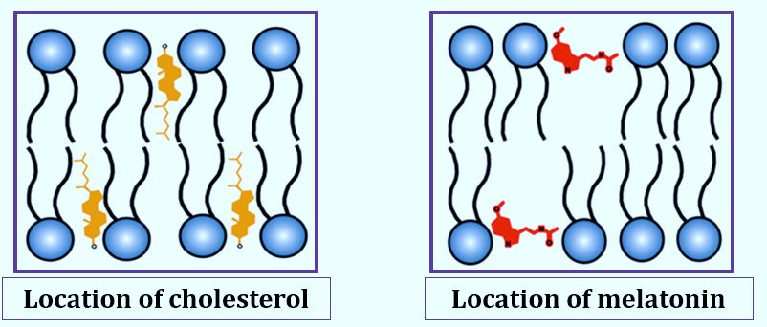
Cell membrane
Lipids are one of the most important classes of biomolecules involved in cellular signaling, energy storage and building of cellular membranes.

Slide 3
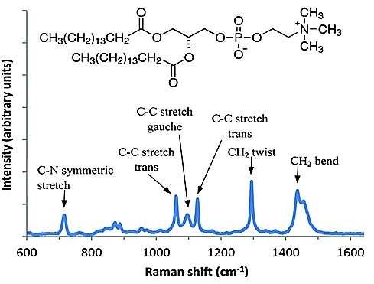
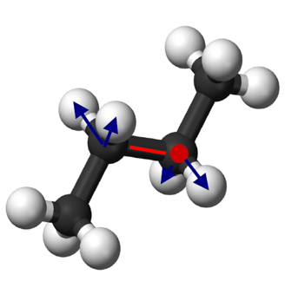
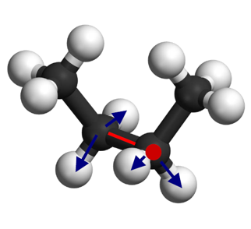
Raman spectrum of DPPC
The spectral range of 1030 cm⁻¹ – 1150 cm⁻¹
is sensitive to trans/gauche conformations, has the three dominant Raman bands (1062 cm ⁻¹, 1096 cm ⁻¹, 1127 cm ⁻¹ )
trans conformer
1096
1062
1127
gauche conformer

Slide 4
Schematic illustration of the preferential areas of influence of melatonin and cholesterol
Area of impact of melatonin
Area of impact of cholesterol
Raman band 1062 cm⁻¹ is most sensitive to changes resulting from the addition of Melatonin
1062
1127
Raman band 1127 cm⁻¹ is most sensitive to changes resulting from the addition of Cholesterol
1096
The integral area (S) ratio (S₁₀₆₂/S₁₀₉₆ , S₁₁₂₇/S₁₀₉₆) serves as an index of the strength of the lattice order/disorder effects in lipid bilayer

Slide 5
Two-component system: the changes in the trans/gauche Raman markers as a function of cholesterol/melatonin molar content (9%,20%,29%) to the DPPC phospholipid
Cholesterol
Melatonin

Slide 6
Integral area ratios of trans/gauche Raman lines for DPPC membranes with the varied contents of cholesterol melatonin
 | Melatonin 0 % | Melatonin 9 % | Melatonin 20 % | Melatonin 29 %
Cholesterol 0% | 1.75±0.04 | 1.39±0.03 | 1.11±0.02 | 0.92±0.02
Cholesterol 9% | 1.85±0.01 | 1.64±0.01 | 1.35±0.004 | 1.08±0.003
Cholesterol 20% | 2.04±0.14 | 1.96±0.14 | 1.59±0.11 | 1.45±0.1
Cholesterol 29% | 2.33±0.14 | 1.96±0.14 | 1.89±0.12 | 1.54±0.09
Ratio of
(1062/1096)
 | Melatonin 0 % | Melatonin 9 % | Melatonin 20 % | Melatonin 29 %
Cholesterol 0% | 1.43±0.08 | 1.32±0.29 | 1.18±0.06 | 0.99±0.08
Cholesterol 9% | 2.17±0.13 | 1.45±0.32 | 1.41±0.07 | 1.39±0.11
Cholesterol 20% | 2.38±0.14 | 2.33±0.51 | 1.96±0.09 | 1.59±0.12
Cholesterol 29% | 2.86±0.17 | 2.04±0.45 | 2.00±0.09 | 1.67±0.13
Ratio of
(1127/1096)

Slide 7
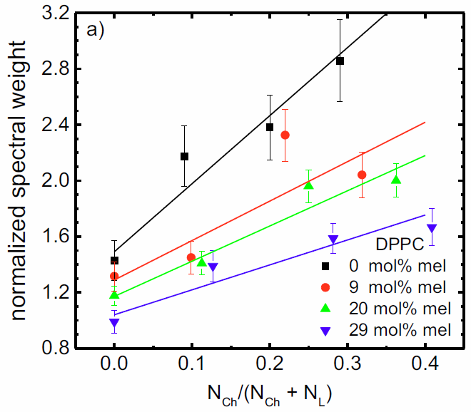
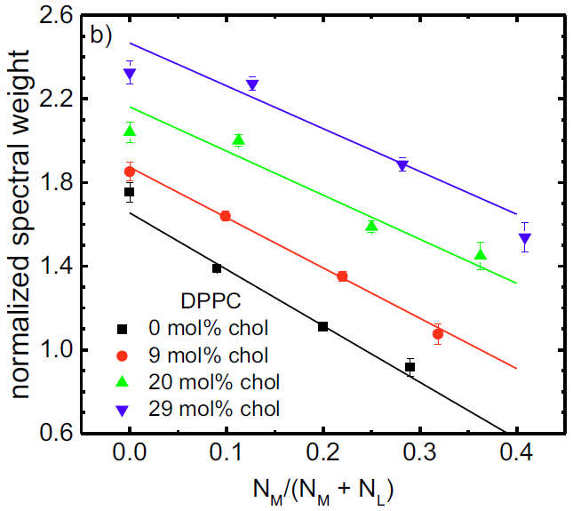
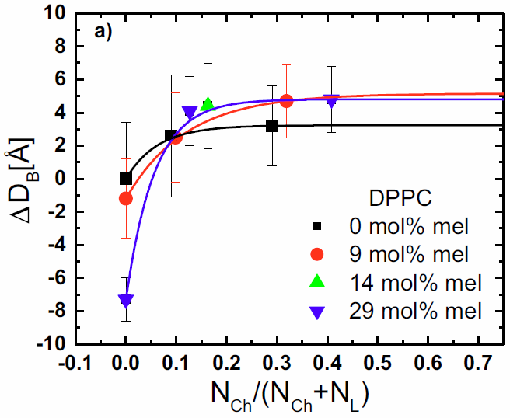
Three-component system
Raman
Raman
SANS
Dependency of the ratios of trans/gauche conformers as functions of the molar fractions of added cholesterol –the ratio of spectral weights at 1062 cm⁻¹ and 1096 cm⁻¹
Dependency of the ratios of trans/gauche conformers as functions of the molar fractions of added melatonin –the ratio of spectral weights at 1127 cm⁻¹ and 1096 cm⁻¹
The relative thickness changes ΔD of bilayers prepared of DPPC as functions of the molar fractions of cholesterol

Slide 8
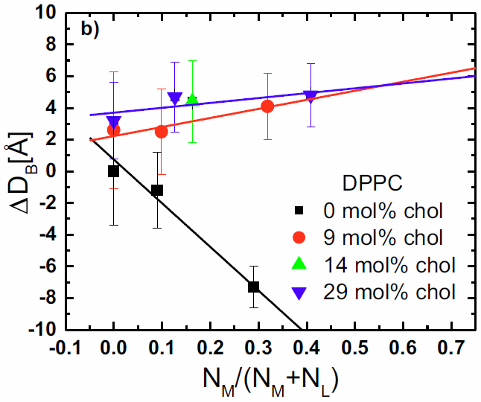
Three-component system
Raman
Raman
SANS
Dependency of the ratios of trans/gauche conformers as functions of the molar fractions of added cholesterol –the ratio of spectral weights at 1062 cm⁻¹ and 1096 cm⁻¹
Dependency of the ratios of trans/gauche conformers as functions of the molar fractions of added melatonin –the ratio of spectral weights at 1127 cm⁻¹ and 1096 cm⁻¹
The relative thickness changes ΔD of bilayers prepared of DPPC as functions of the molar fractions of melatonin

Slide 9
Summary
Raman spectroscopy demonstrates high sensitivity to the alteration of the trans/gauche conformers changes in the three-component system.
The vibrational dynamics of phospholipid hydrocarbon chains is affected proportionally (to some extent) by both additives: cholesterol and melatonin.
The dynamic properties of the studied system indicate the predominant influence of cholesterol (ordering effect) rather than melatonin.
Although at the high concentrations of melatonin ~ 20% and higher the fluidizing effect of melatonin is capable to inhibit the condensing effect of cholesterol.
We consider our results complementary and in a good agreement with the neutron scattering results.
This study was recently published in Biochimica et Biophysica Acta (BBA) – Biomembranes, DOI:10.1016/j.bbamem.2021.183651

Slide 10
Thank you for your kind attention!

