Slide 1

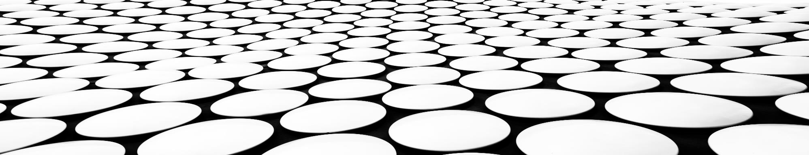
Super charm-tau factory: precision experiments with tau lepton and charmed hadrons
Vitaly Vorobyev, BINP
for the SCT Team
Dubna, July 7th, 2021

Slide 2
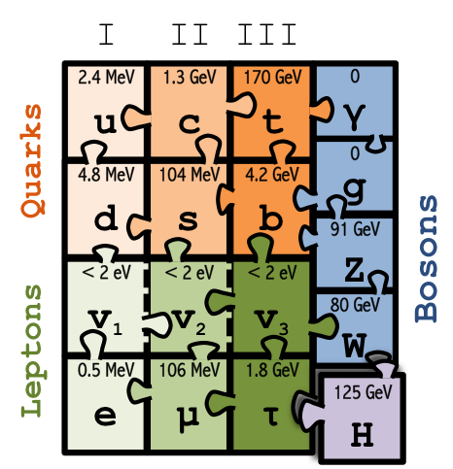
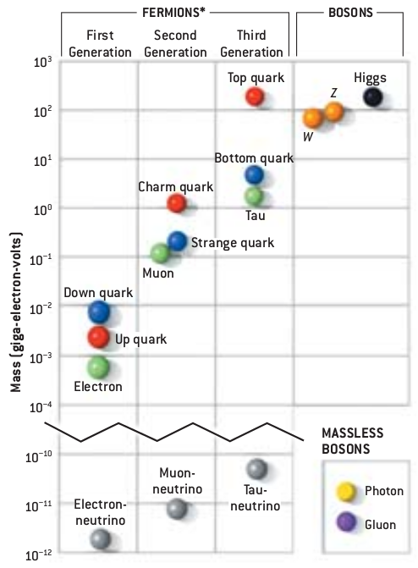
Status of the Standard Model
The Standard Model (SM) is the most successful physics theory so far
  Gauge fields: carriers of electroweak and strong interactions
  Matter fields: three generations of quarks and leptons
  The Higgs mechanism
Limitations of the SM
  Dark matter
  Neutrino masses
  Baryonic asymmetry of the Universe
  The electroweak hierarchy problem: why is the Higgs so light?
  The flavor puzzle: why three generations? 18 (25) parameters!
  …
Quest for the New Physics (NP)
  The SM may be a low-energy effective theory for a more general and beautiful theory
  Our goal is to find the traces of that theory experimentally and theoretically
2012

Slide 3

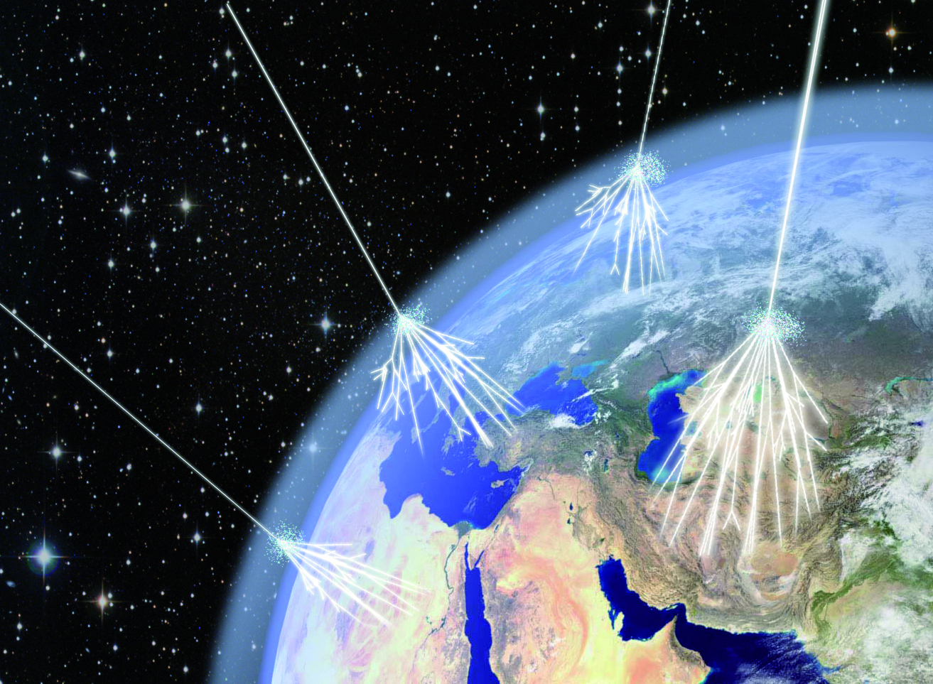
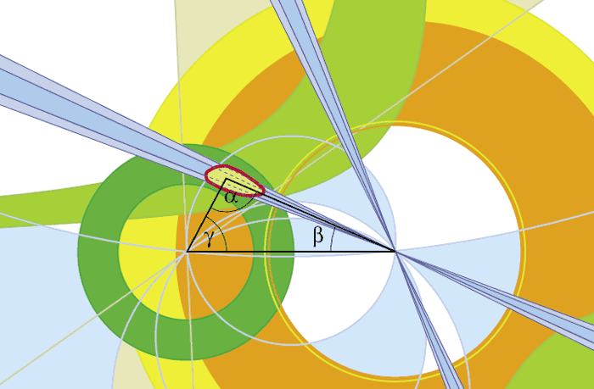
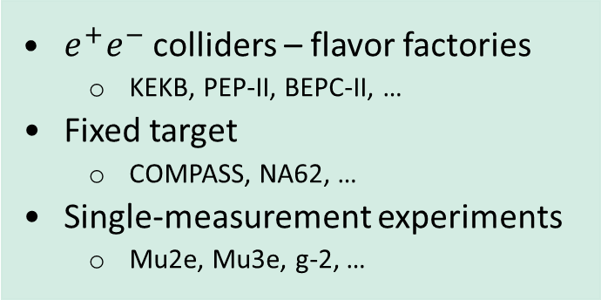
Energy frontier
  Proton colliders
    Tevatron, LHC
Cosmic frontier
  Cosmic-ray air showers
  Cosmic neutrino
  Gravitational waves
  Space experiments
Precision frontier
  $e^{+}e^{−}$ colliders – flavor factories
    KEKB, PEP-II, BEPC-II, …
  Fixed target
    COMPASS, NA62, …
  Single-measurement experiments
    Mu2e, Mu3e, g-2, …

Slide 4
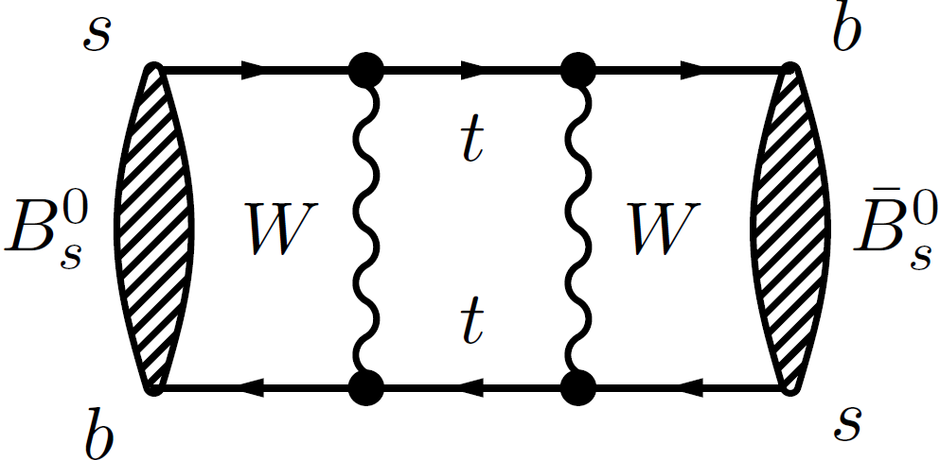
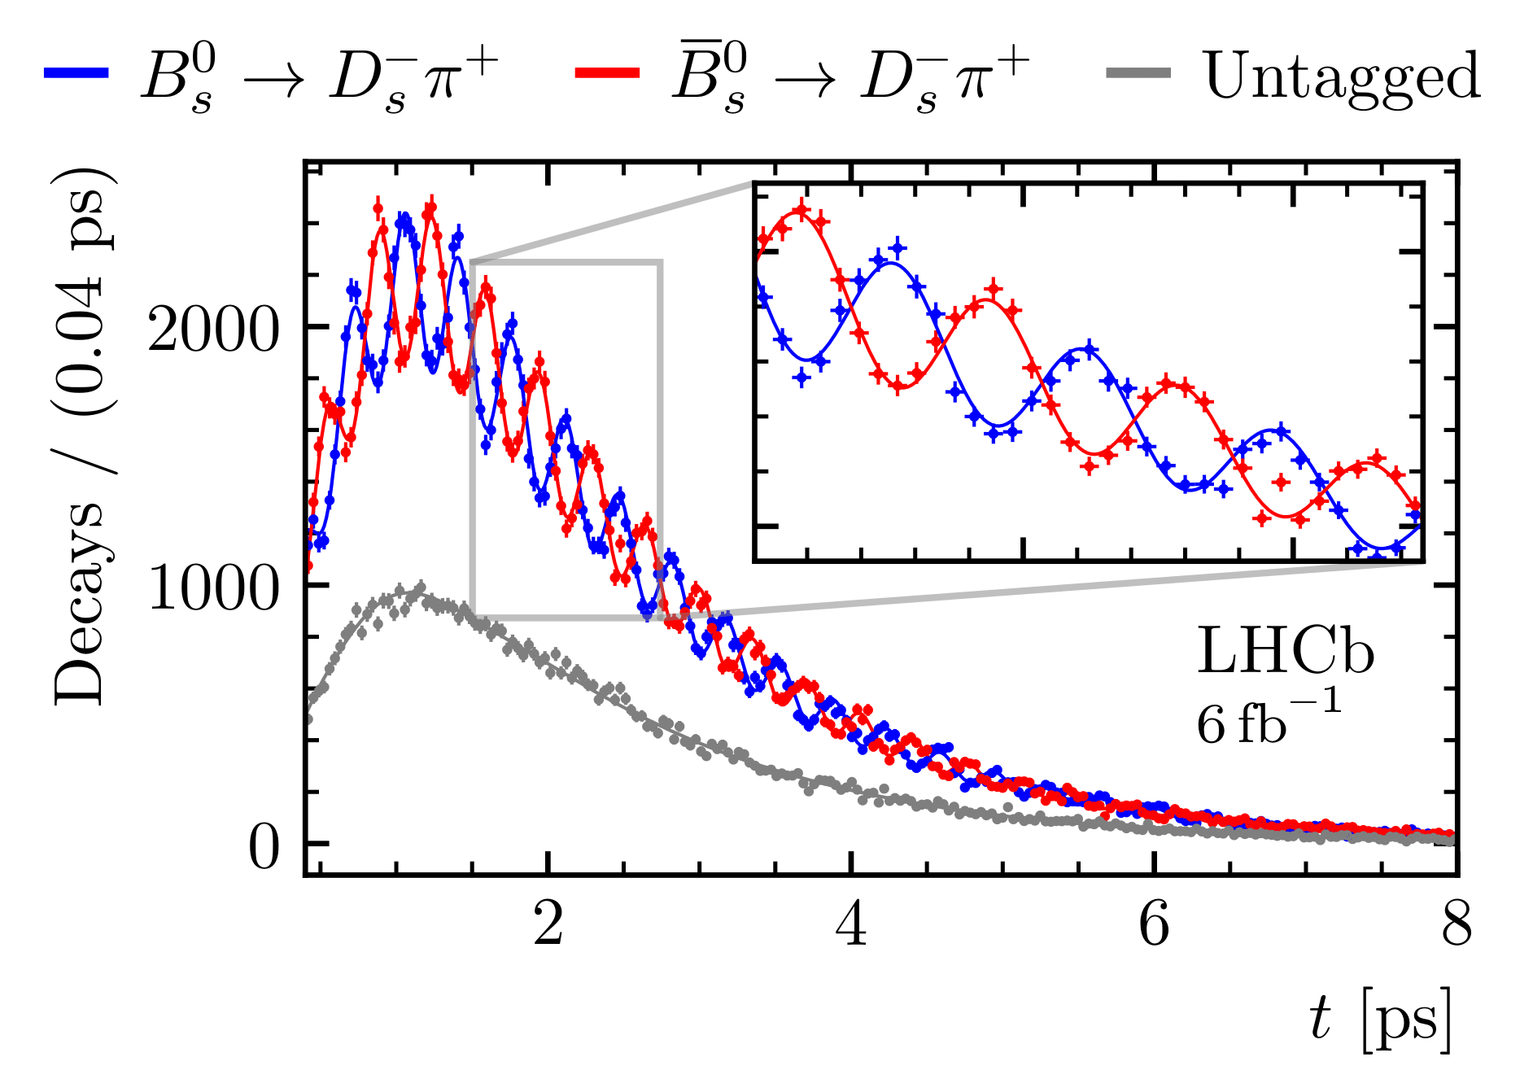
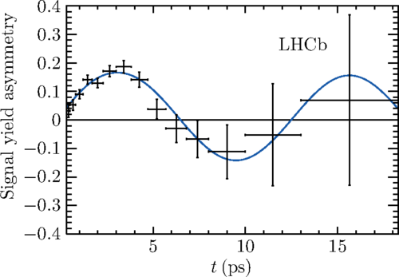
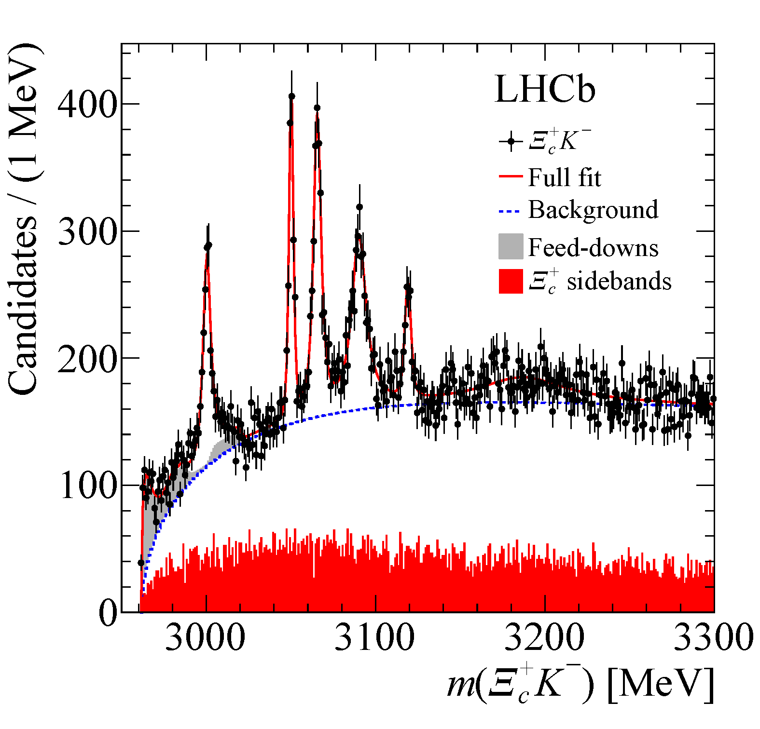
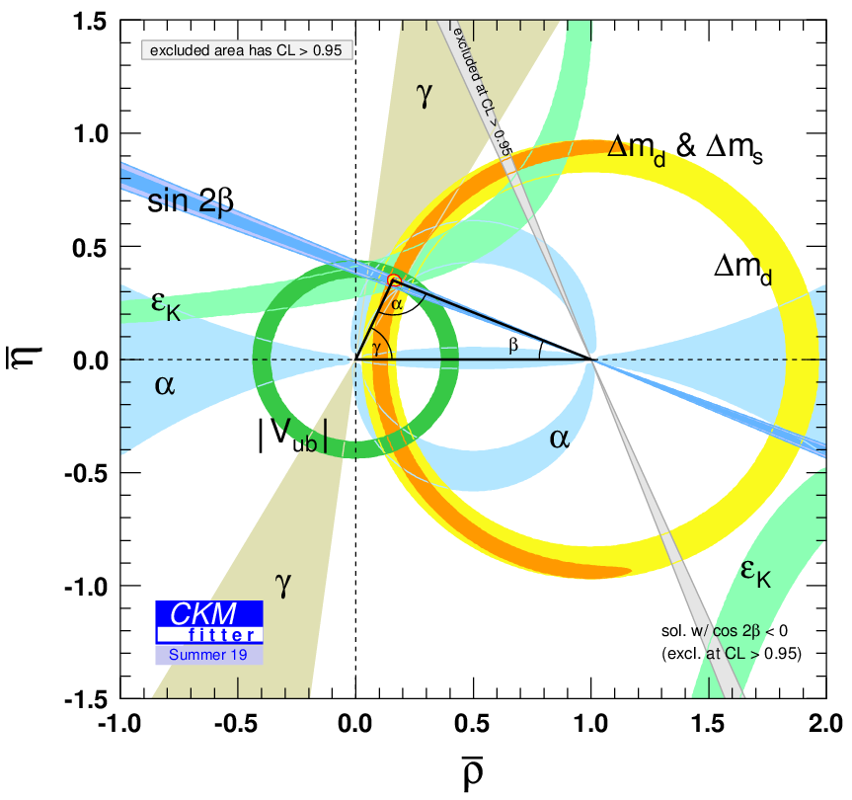

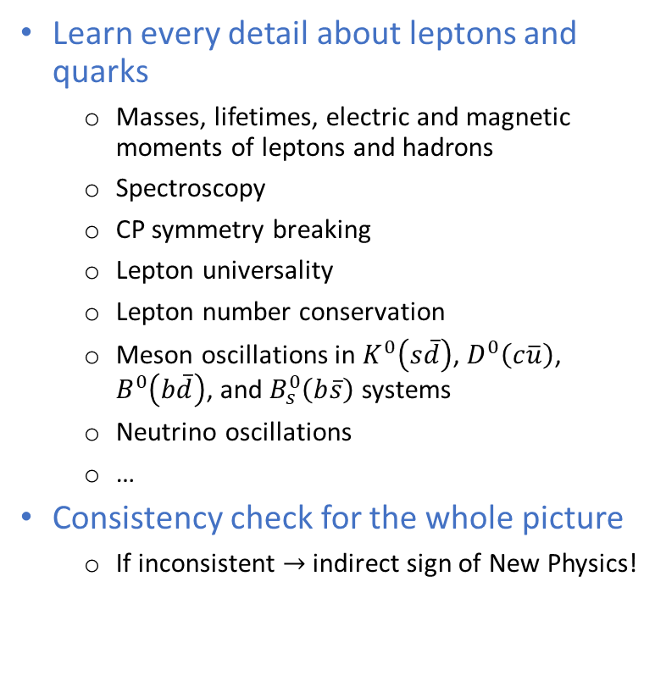
Flavor physics
$$B^{0}→J/ψK_{S}^{0}$$
Learn every detail about leptons and quarks
  Masses, lifetimes, electric and magnetic moments of leptons and hadrons
  Spectroscopy
  CP symmetry breaking
  Lepton universality
  Lepton number conservation
  Meson oscillations in $K^{0}\left(s\overline{d}\right)$, $D^{0}\left(c\overline{u}\right)$, $B^{0}\left(b\overline{d}\right)$, and $B_{s}^{0}\left(b\overline{s}\right)$ systems
  Neutrino oscillations
  …
Consistency check for the whole picture
  If inconsistent $→$ indirect sign of New Physics!

Slide 5
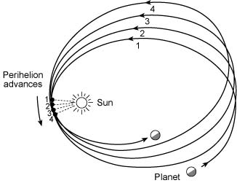
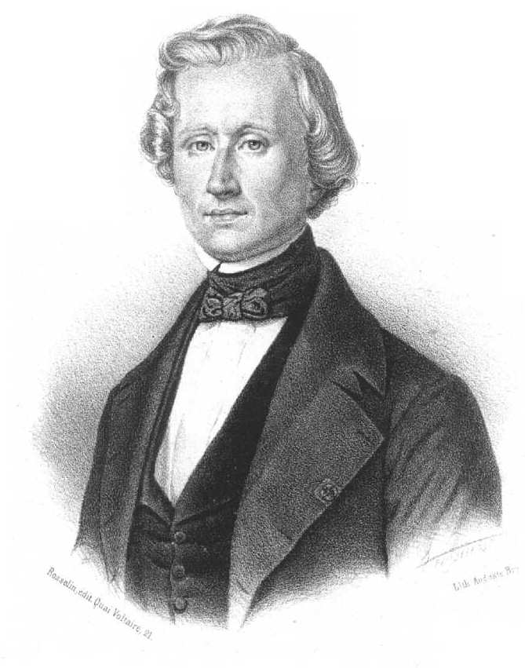
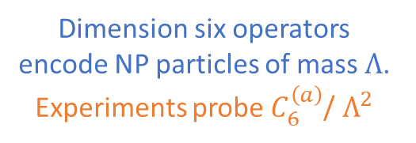
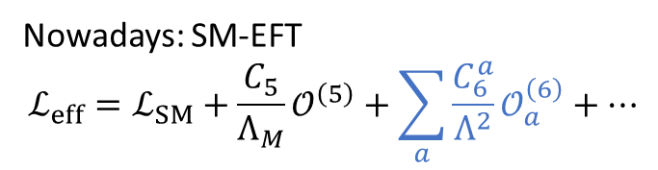
The power of indirect NP searches
Physics Briefing Book by European Strategy for Particle Physics Preparatory Group [arXiv:1910.11775 [hep-ex]]
Nowadays: SM-EFT
$$ℒ_{eff}=ℒ_{SM}+\frac{C_{5}}{Λ_{M}}𝒪^{\left(5\right)}+\sum_{a}{\frac{C_{6}^{a}}{Λ^{2}}𝒪_{a}^{\left(6\right)}}+…$$
Dimension five operator breaks lepton number
Dimension six operators encode NP particles of mass $Λ$. Experiments probe $C_{6}^{\left(a\right)}$/ $Λ^{2}$
Urbain Le Verrier, 1859
Indirect hint for general relativity via the Mercury perihelion precession anomaly

Slide 6
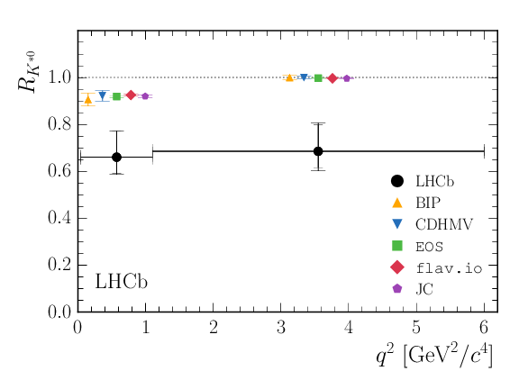
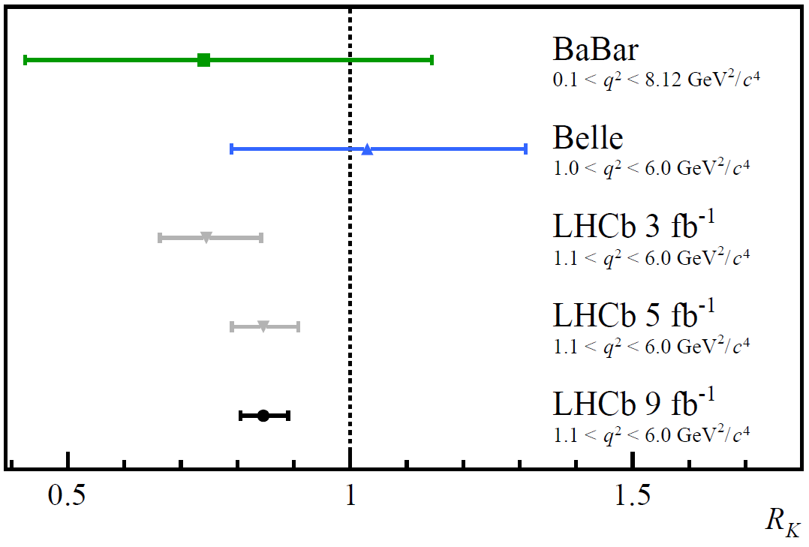
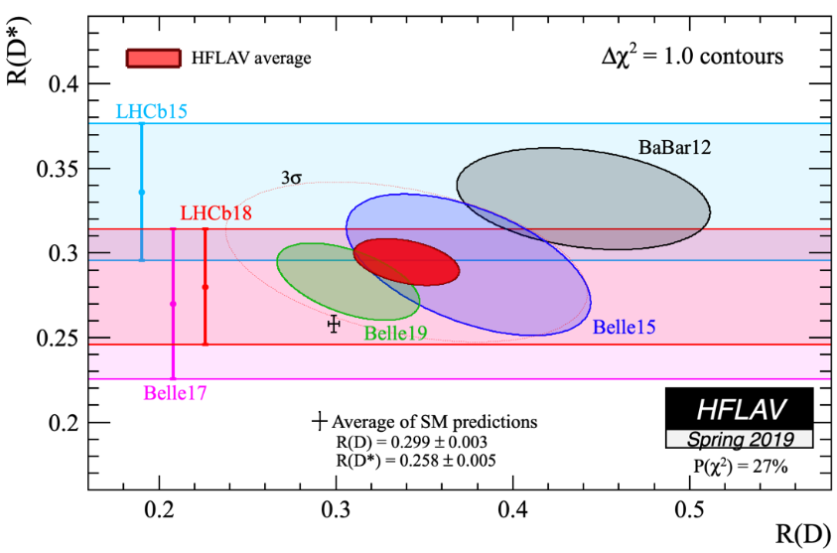
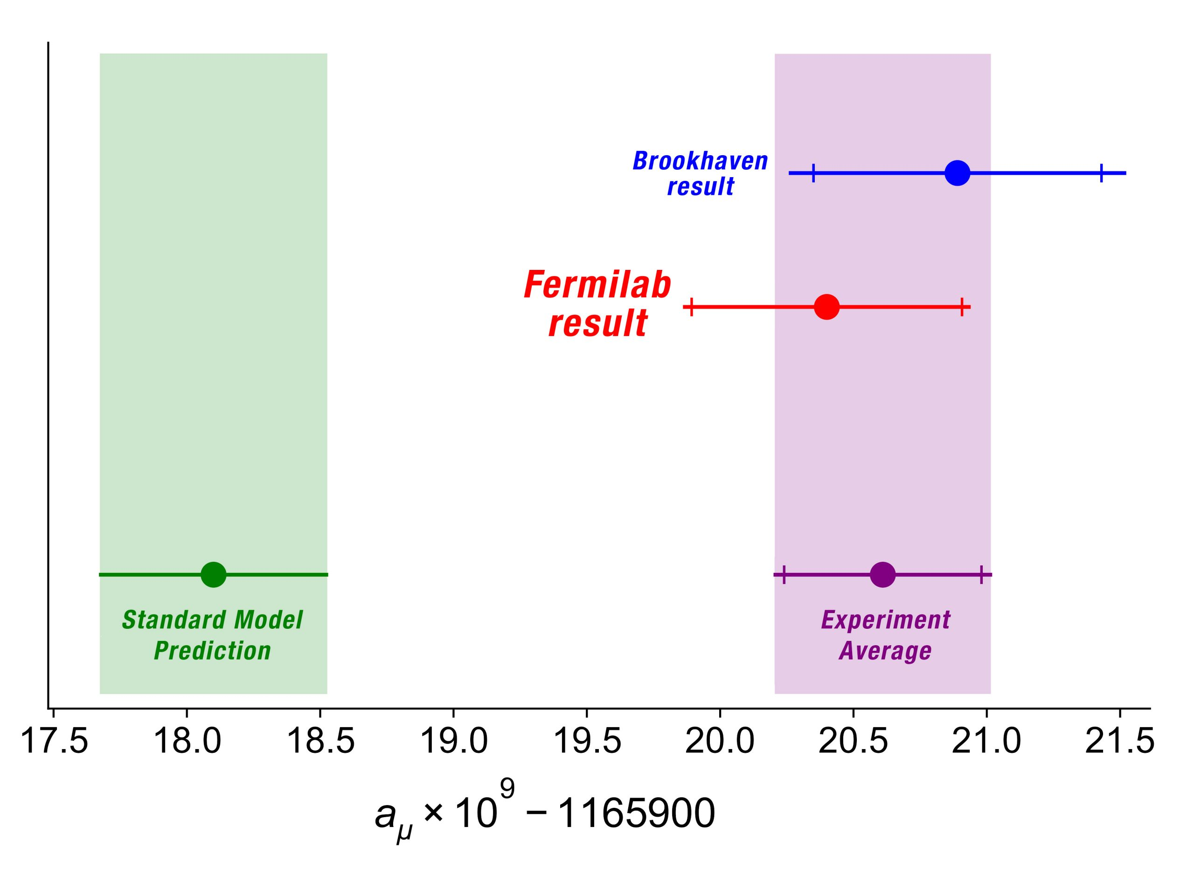
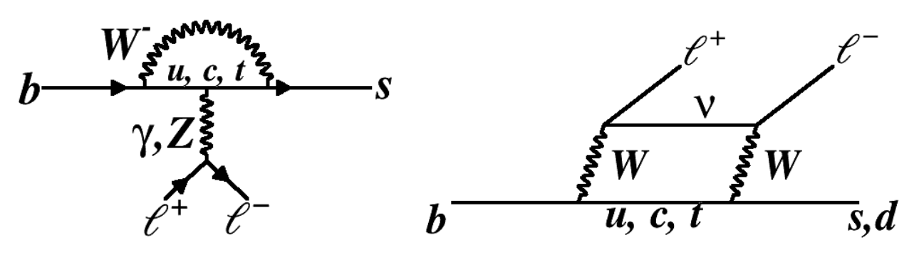

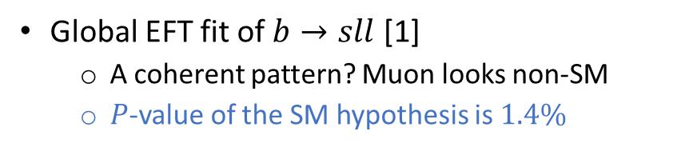





Flavor anomalies
[1] Eur. Phys. J. C 79, 714 (2019) and 80, 511 (2020)
$B→Kμ^{+}μ^{−}$, 2021, $3.1σ$
$B→K^{∗}μ^{+}μ^{−}$, 2017, >$2σ$
$B→D^{\left(∗\right)}lν$, >$3σ$
Muon $g−2$, 2021, $4.2σ$
$$R_{K}=\frac{ℬ\left(B^{+}→K^{+}μ^{+}μ^{−}\right)}{ℬ\left(B^{+}→K^{+}e^{+}e^{−}\right)}$$
$$R_{D}=\frac{ℬ\left(B→Dτ\overline{ν}\right)}{ℬ\left(B→Dl\overline{ν}\right)}$$
Global EFT fit of $b→sll$ [1]
  A coherent pattern? Muon looks non-SM
  $P$-value of the SM hypothesis is $1.4\%$

Slide 7

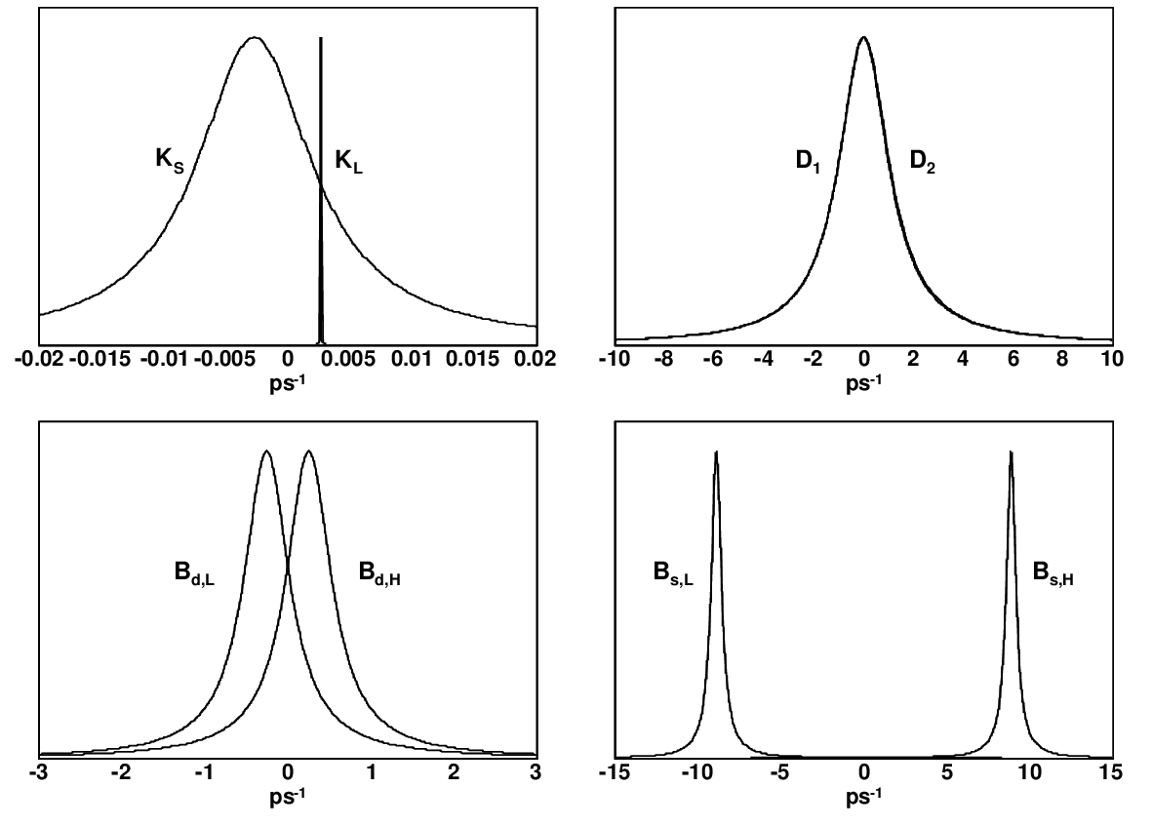

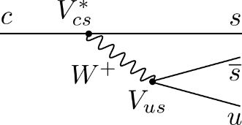

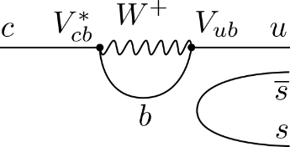
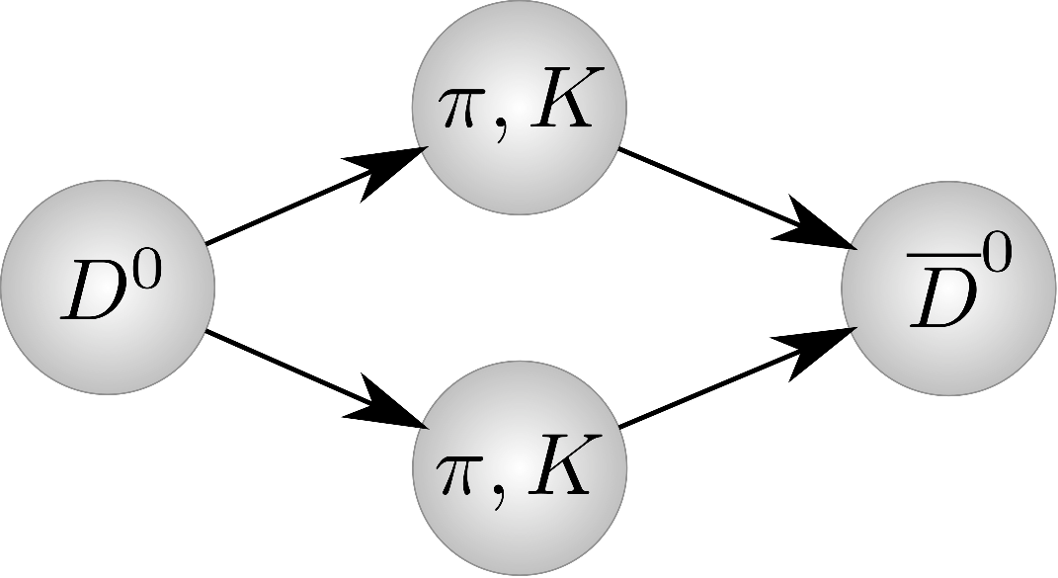
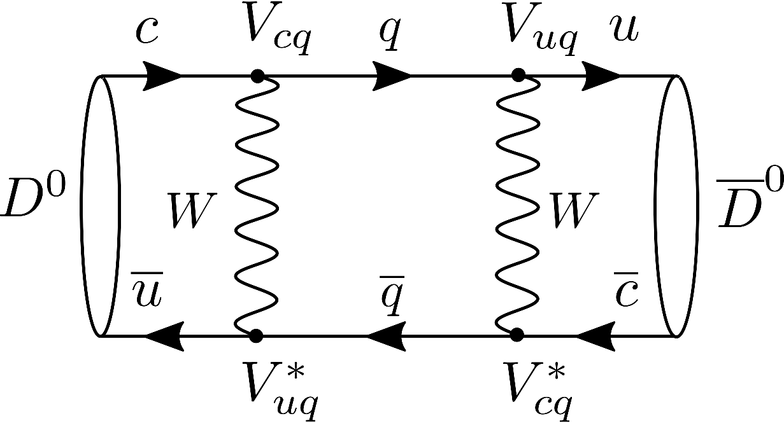
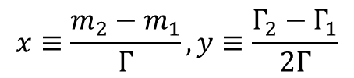








Uniqueness of the charm quark
$$D\left(c\overline{q}\right)$$
(Tree) charm decays
Most of the SM CPV
1. The only heavy up quark forming hadrons
Beauty CPV: not a teenager anymore
$$K^{0}$$
$$D^{0}$$
  Sensitivity to the NP coupling with up quarks
  Charm hadrons are challenging for QCD calculation since charm has intermediate mass
$$V_{CKM}≡\left(\begin{matrix}V_{ud} & V_{us} & V_{ub} \\ V_{cd} & V_{cs} & V_{cb} \\ V_{tu} & V_{ts} & V_{tb}\end{matrix}\right)$$
2. Charm mixing parameters are small $𝒪\left({10}^{−2}\right)$
$$B^{0}$$
$$B_{s}^{0}$$
  Charm mixing observed in 2012
  Large distance dynamics is important
  Nearly null-test for NP contributions
$$x≡\frac{m_{2}−m_{1}}{Γ}, y≡\frac{Γ_{2}−Γ_{1}}{2Γ}$$
$$K\left(s\overline{q}\right)$$
$$B\left(b\overline{q}\right)$$
Charm CPV: a two years old baby
3. CP symmetry breaking in charm is small $𝒪\left({10}^{−4}\right)$
arXiv:1207.2195 [hep-ex]
  CPV in charm observed in 2019
  Quark mixing matrix is almost real for two generations
  Nearly null-test for CP-violating NP
Kaon CPV: mature, but not retired
[The metaphor is borrowed from Y. Grossman talk at Moriond 2021]

Slide 8
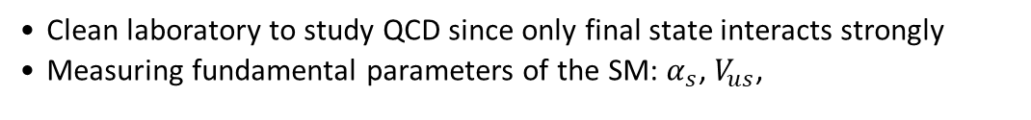

Uniqueness of the $τ$ lepton
1. The heaviest lepton
  Potentially more sensitive to NP than electron and muon
2. The only lepton decaying to hadrons
  Clean laboratory to study QCD since only final state interacts strongly
  Measuring fundamental parameters of the SM: $α_{s}$, $V_{us}$,
3. A laboratory to test weak interactions
  Precision test of the SM predictions in leptonic tau decays
4. A laboratory to search for NP
  CP symmetry breaking
  Lepton number violating decays
  Charged Higgs boson etc.

Slide 9
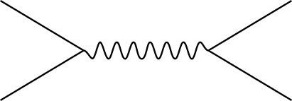
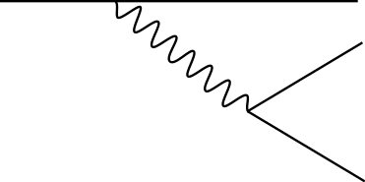
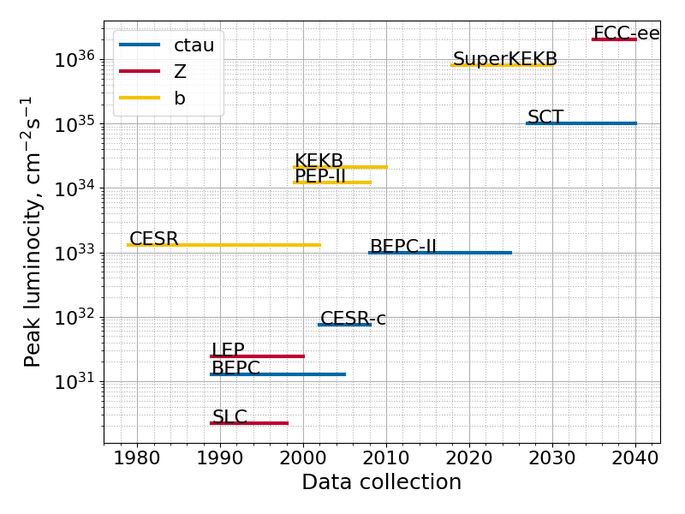
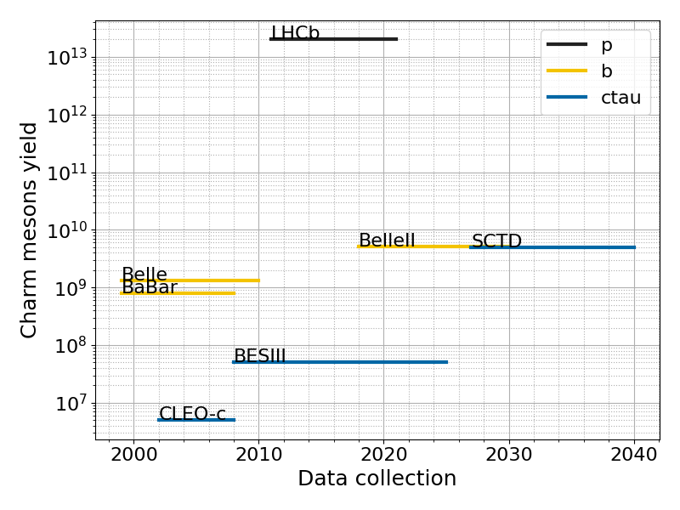
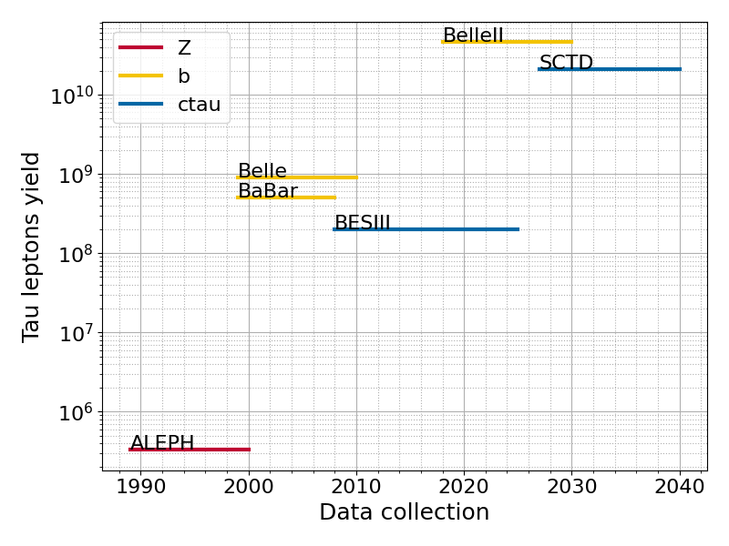











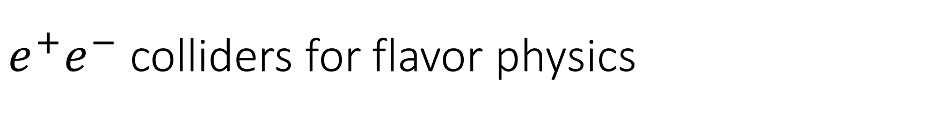







$e^{+}e^{−}$ colliders for flavor physics
Flavor factories: charm-tau, B, Z, Higgs
$$ψ\left(nS\right)$$
$$Υ\left(nS\right)$$
$$Z$$
$$e^{+}$$
$$c$$
$$b$$
$$c$$
$$\sqrt{s}, GeV$$
$$2$$
$$7$$
$$10$$
$$90$$
$$e^{−}$$
$$γ, Z$$
$$\overline{c}$$
$$W$$
  Sample size is one of many constituents of the physics potential
  Production mechanism and backgrounds are important!
$$D$$
$$τ$$

Slide 10
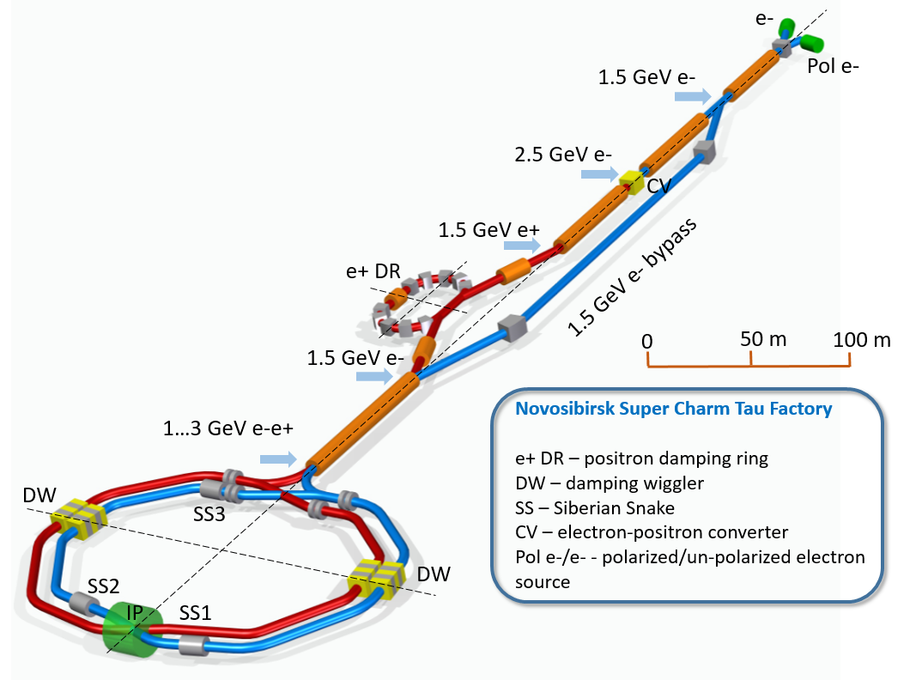
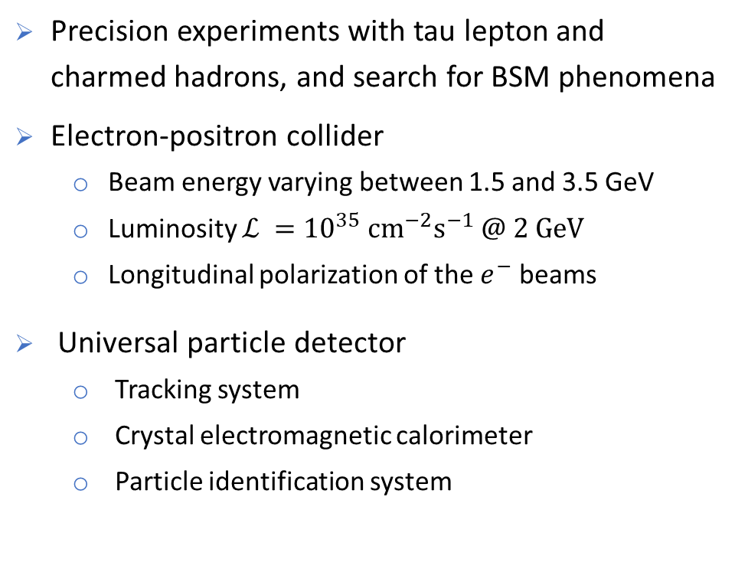
The SCT experiment
Conceptual design available
ctd.inp.nsk.su
Precision experiments with tau lepton and charmed hadrons, and search for BSM phenomena
Electron-positron collider
  Beam energy varying between 1.5 and 3.5 GeV
  Luminosity $ℒ ={10}^{35} {cm}^{−2}s^{−1} @ 2 GeV$
  Longitudinal polarization of the $e^{−}$ beams
Universal particle detector
  Tracking system
  Crystal electromagnetic calorimeter
  Particle identification system
5 м
10

Slide 11
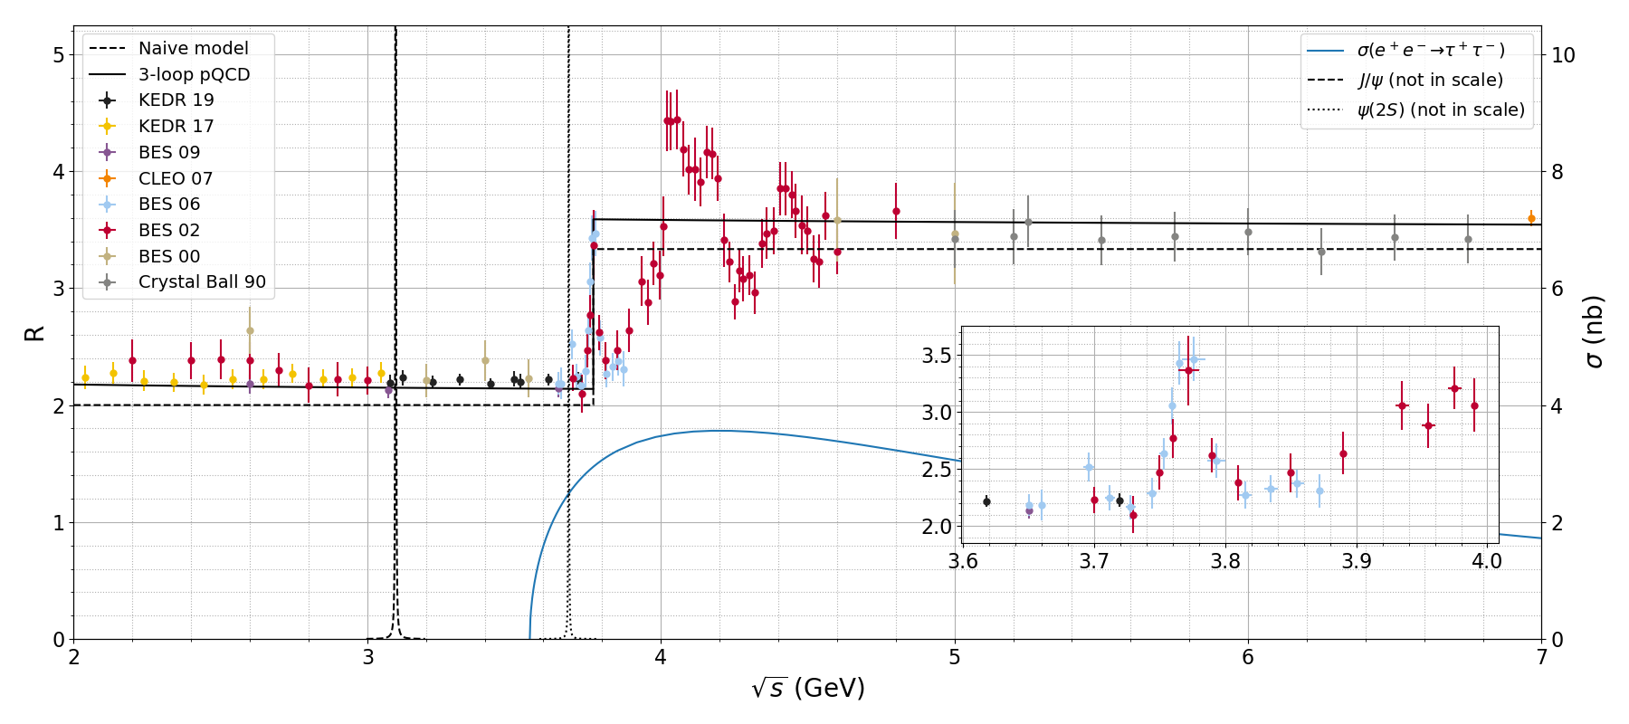




















The SCT energy range
Threshold production of nonrelativistic particles provides best conditions for their comprehensive study
$$R≡\frac{σ\left(e^{+}e^{−}→hadrons\right)}{σ_{0}\left(e^{+}e^{−}→μ^{+}μ^{−}\right)}$$
$$ℒ ={10}^{35} {cm}^{−2}s^{−1}$$
$$ψ\left(4040\right)$$
$$Y\left(4230\right)$$
A one-year dataset
$$J/ψ$$
$$ψ\left(2S\right)$$
$$ψ\left(4160\right)$$
$$ψ\left(4415\right)$$
$2E$, $GeV$ | Events recorded
$$3.1$$ | $$1012 J/ψ$$
$$3.69$$ | $$1011 ψ(2S)$$
$$3.77$$ | $${10}^{9} D\overline{D}$$
$$4.17$$ | $${10}^{8} D_{s}{\overline{D}}_{s}$$
$$3.55÷4.3$$ | $$1010 τ τ$$
$$4.65$$ | $$108 Λ_{c}^{+}Λ_{c}^{−}$$
$$ψ\left(3770\right)$$
$$τ$$
$$D$$
$$D_{s}$$
$$Λ$$
$$Σ$$
$$Ξ$$
$$Λ_{c}$$
$$Ξ_{c}$$
$$Ξ_{cc}^{++}$$
$$Ω_{c}$$

Slide 12


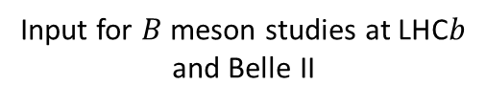
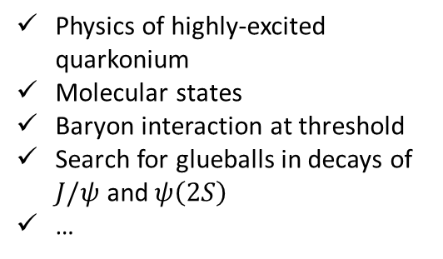

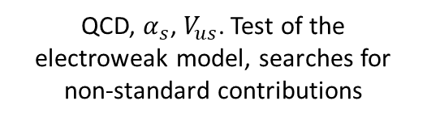
SCT Physics in a nutshell
Input for $B$ meson studies at LHC$b$ and Belle II
Measurement of the strong phases of $D$ decay amplitudes
Measurement of absolute branching fractions
Searches for rare and forbidden decays of the charm quark
$CP$ violation in charm
…
charm
QCD
Physics of highly-excited quarkonium
Molecular states
Baryon interaction at threshold
Search for glueballs in decays of $J/ψ$ and$ψ\left(2S\right)$
…
Precision measurement of the $τ$ lepton properties
Michel parameters, tests of lepton universality
Precision measurement of hadronic $τ$ decays
Search for $CP$ and T violation in $τ$ decays
…
tau
Test of the electroweak sector of the SM
QCD, $α_{s}$, $V_{us}$. Test of the electroweak model, searches for non-standard contributions

Slide 13
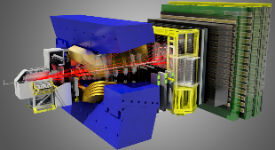


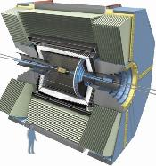
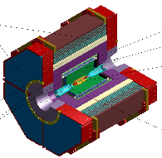





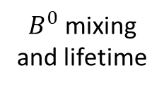



































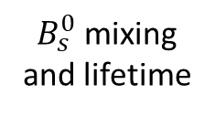




$$B^{0}→D^{0}π^{+}π^{−}$$
$$B^{+}→h_{1}^{+}h_{2}^{+}h_{3}^{−}$$
$$b→s/d γ$$
$$b→ulν$$
Only charged particles in the final state
CKM $α, β$
$$V_{ub}$$
$$V_{cb}$$
$B^{0}$ mixing and lifetime
$$B_{s}$$
$$Λ_{b}$$
CPV in $D^{0}→h^{+}h^{−}$
$τ$ lifetime
$$B→D^{0}τν$$
$$Υ\left(6S\right)$$
$$Ω_{b}$$
$$D^{0}→eμ$$
CKM $γ$
Charged Higgs
$$Σ_{b}$$
$$φ_{s}$$
$$B→K_{s}^{0}K_{s}^{0}K_{s}^{0}$$
$$B_{s}^{0}→μμ$$
$B_{s}^{0}$ mixing and lifetime
$$B→K^{∗}ll$$
$$Υ\left(5S\right)$$
$$B→D^{∗}τν$$
$$B→K_{s}^{0}π^{0}γ$$
$$B^{0}→μμ$$
$$τ→μμμ$$
$$B→K^{+}π^{−}π^{0}$$
$$B→hνν, τν$$
$$D^{0}→μμ$$
Charm spectroscopy
SUSY,
Charged Higgs
$$X\left(3872\right)→J/ψππ$$
$$α_{s}$$
$$D→lν$$
Charged Higgs
Clear BSM
Charm mixing
$$τ→hadrons$$
Clear BSM
LFU
$$D→invisible$$
Neutral particles in the final state
$$τ→lνν$$
$$τ→μγ$$
$$sinθ_{W}$$
Dark matter
Model-independent $D^{0}→K_{S}^{0}π^{+}π^{−}$
$$Z_{c}\left(3900\right)→J/ψπ$$
LFU
Quantum correlated $D^{0}{\overline{D}}^{0}$
Absolute branching fractions
SCT
CPV in charm
$$δ_{Kπ}$$
$$V_{cd}$$
Polarized beam
New CPV
$$J/ψ\left(c\overline{c}\right)→W^{+}s$$
$$J/ψ→hadrons$$

Slide 14



Advantages of the SCT factory
Threshold production of $τ$ leptons and charmed hadrons
Longitudinal polarization of the electron beam
  Well-defined initial state
  Low multiplicity of particles
  Kinematic constraints
  Boosted sensitivity to 𝒞𝒫 violation in baryons and $τ$ leptons
  Measuring the Weinberg angle
Coherent $D^{0}{\overline{D}}^{0}$ pairs
Full event reconstruction
  Measuring charm mixing and 𝒞𝒫 violation with unique techniques
  Measuring phases of the decay amplitudes
  Superior background suppression
  Measuring absolute branching fraction of charmed hadrons

Slide 15







Experiments with charmed hadrons
CP symmetry tests
Spectroscopy
Rare and forbidden decays
Charm mixing
Branching fractions and decay dynamics
Other experiments
Lepton universality tests
Decays to invisible
…
$$D^{0}$$
$${\overline{D}}^{0}$$

Slide 16












(Semi-)leptonic $D_{\left(s\right)}$ decays
$$D_{s}^{+}→τ^{+}ν, τ^{+}→e^{+}ν_{e}{\overline{ν}}_{τ}$$
$$0.6 {фб}^{−1}$$
$$f_{D}V_{cd}$$
$$g_{l}$$
CLEO-c, PRD 79 (2009), 052002
$$Γ\left(D^{+}→lν\right)=\frac{G_{F}^{2}}{8π}f_{D}^{2}m_{l}^{2}m_{D}\left(1−\frac{m_{l}^{2}}{m_{D}^{2}}\right){\left|V_{cd}\right|}^{2}$$
Measurement of branching fractions : $f_{D}$, $V_{cd}$, $V_{cs}$
Lepton universality test
$$913 {фб}^{−1}$$
Belle, JHEP 09 (2013), 139

Slide 17






Detailed study of the charmonium-like states
Exiting QCD laboratory
Cross sections to be measured as function of $\sqrt{s}$:
  $e^{+}e^{−}→J/ψπ^{+}π^{−}$
  $e^{+}e^{−}→J/ψπ^{0}π^{0}$
  $e^{+}e^{−}→ψ\left(2S\right)π^{+}π^{−}$
  $e^{+}e^{−}→D\overline{D}, D^{∗}\overline{D}$, …
  $e^{+}e^{−}→D\overline{D}γ$
  $e^{+}e^{−}→D\overline{D}\left(nπ\right)$
  $e^{+}e^{−}→D_{s}^{+}D_{s}^{−}$
  $e^{+}e^{−}→D_{s}^{+}D_{s}^{−}\left(nπ\right)$
  $e^{+}e^{−}→Λ_{c}{\overline{Λ}}_{c}$
  …
X(4700)
Y(4660)
X(4500)
Х(4630)
Z(4430)⁺
Y(4360)
X(4160)
X(4274)
Y(4260)
Z(4250)⁺
X(4140)
Z(4200)⁺
X(3915)
X(3872)
Y(4008)
Z(4050)⁺
ψ₂(3820)
Z_{c}(4020)⁺
X(3940)
_
Z_{c}(3900)⁺
X(3860)
DD
S=0
S=1
S=0
S=1
J^{PC}
10 years vs. 0.1 year vs. 1 day at SCT

Slide 18







CPV in charm
Measurement of CP asymmetries in decays of $D^{0}$, $D^{+}$, $D_{s}^{+}$ at the precision level of $∼{10}^{−4}$
  Advantage of full event reconstruction
  Coherent $D^{0}{\overline{D}}^{0}$ pairs
CF
DCS
SCS
SCS
$$ΔA_{CP}=\left(−15.4±2.9\right)×{10}^{−4}$$
$$D^{0}→h^{+}h^{−}$$
2019
long-distance dynamics is important in charm decays: re-scattering leads to the complex connections between the worlds of hadrons and quarks [I. Bigi]
CLEOc $0.818 {fb}^{−1} @ 3774 MeV$ [PRD 81, 052013 (2010)]

Slide 19



The use of coherent $D^{0}{\overline{D}}^{0}$ pairs
Accessing the phases
Accessing the charm mixing
A pair of neutral D mesons produced at threshold carries photon quantum numbers $J^{PC}=1^{−−}$:
$$ψ_{DD}∝D_{1}^{0}{\overline{D}}_{2}^{0}+𝒞D_{2}^{0}{\overline{D}}_{1}^{0}, 𝒞=−1$$
The interference term gives access to the phase difference between $D^{0}$ and ${\overline{D}}^{0}$ decay amplitudes
  $$δ_{Kπ}≡arg\left(\frac{𝒜\left({\overline{D}}^{0}→K^{−}π^{+}\right)}{𝒜\left(D^{0}→K^{−}π^{+}\right)}\right)$$
  Coherence factors and CP content of multibody decay amplitudes
  Phases of the $D^{0}→K_{S}^{0}π^{+}π^{−}$
Measuring charm mixing with quantum correlations
  Charm mixing cancels at first order for the coherent decays
  $$Γ_{ij}∝{\left|\left\langle i | D_{2}\right\rangle \left\langle j | D_{1}\right\rangle −\left\langle i | D_{1}\right\rangle \left\langle j | D_{2}\right\rangle \right|}^{2}+𝒪\left(x^{2},y^{2}\right)$$
  Charm mixing contributes to non-coherent time-integrated decays
  $$Γ_{i}∝{\left|\left\langle i | D\right\rangle \right|}^{2}\left(1−y Reλ_{f}−x Imλ_{f}\right)+𝒪\left(x^{2},y^{2}\right)$$
Several unique techniques to measure charm mixing and CP violation in charm based on this phenomenology
Access to the $𝒞=+1$ state with $e^{+}e^{−}→D^{0}{\overline{D}}^{0}γ$
  Charm mixing contribution is doubled instead of being cancelled!
Essential input for B factories and LHCb

Slide 20


Tau lepton

Slide 21




Leptonic $τ$ decays
Michel parameters
Tau polarization
$$\frac{dΓ\left(τ^{∓}\right)}{dΩdx}∝x\left(1−x\right)+\frac{2}{9}ρ\left(4x^{2}−3x−x_{0}^{2}\right)+ηx_{0}\left(1−x\right)∓\frac{1}{3}P_{τ}\cos{θ_{l}}ξ\sqrt{x^{2}−x_{0}^{2}}\left[1−x+\frac{2}{3}δ\left(4x−4+\sqrt{1−x_{0}^{2}}\right)\right]$$
SCT with polarized electrons allows measurement the tau lepton Michel parameters with precision better then that of Belle II
$$x≡\frac{E_{l}}{E_{max}}, x_{0}≡\frac{m_{l}}{E_{max}}$$
[Epifanov, Phys. Atom. Nucl. 83 (2020) 944]

Slide 22




Leptonic $τ$ decays
Michel parameters
Tau polarization
$$\frac{dΓ\left(τ^{∓}\right)}{dΩdx}∝x\left(1−x\right)+\frac{2}{9}ρ\left(4x^{2}−3x−x_{0}^{2}\right)+ηx_{0}\left(1−x\right)∓\frac{1}{3}P_{τ}\cos{θ_{l}}ξ\sqrt{x^{2}−x_{0}^{2}}\left[1−x+\frac{2}{3}δ\left(4x−4+\sqrt{1−x_{0}^{2}}\right)\right]$$
SCT with polarized electrons allows measurement the tau lepton Michel parameters with precision better then that of Belle II
$$x≡\frac{E_{l}}{E_{max}}, x_{0}≡\frac{m_{l}}{E_{max}}$$
$$g_{τ}$$
Lepton universality test
$$Γ\left(τ^{−}→ν_{τ}l^{−}{\overline{ν}}_{l}\right)=\frac{G_{τ}G_{l}m_{τ}^{5}}{192π^{3}}f\left(\frac{m_{l}^{2}}{m_{τ}^{2}}\right)r_{EW}$$
$$g_{l}$$
Parameter | Expectation | Best measurement
$$\frac{ℬ\left(τ^{−} →ν_{τ}μ^{−}{\overline{ν}}_{μ}\right)}{ℬ\left(τ^{−}→ν_{τ}e^{−}{\overline{ν}}_{e}\right)}$$ | $$0.972564±0.000010$$ | $$0.9796±0.0016±0.0036$$ [BaBar, PRL 105 (2010) 051602]

Slide 23








Hadronic $τ$ decays
Spectral functions
[Rev. Mod. Phys. 78 (2006) 1043]
$$\frac{dΓ\left(τ^{−}→had ν_{τ}\right)}{d(phsp)}=\frac{G_{F}^{2}}{4m_{τ}}{\left|V_{CKM}\right|}^{2}L_{μν}H^{μν}$$
Measuring $\left|V_{ud}\right|$, $\left|V_{us}\right|$, $α_{s}\left(m_{τ}\right)$, and $m_{s}$
Testing the factorization of hadronic and leptonic currents
Testing conserved vector current
Hadronic vacuum polarization in the non-perturbative region
Second class currents
$$J^{PG}=0^{+−} \left(a_{0}\right)\text{,} 1^{++} \left(b_{1}\right), …$$
Highly suppressed by isospin ($τ→η^{\left(′\right)}πν$, …)

Slide 24





LFV and CPV with tau
$$τ→μγ$$
ISR photon background [arXiv:1206.1909 [hep-ex]]
Allowed in several BSM scenario, including SUSY, leptoquarks, technicolor, and extended Higgs models
$𝒪\left({10}^{−9}\right)$ – reachable upper limit at SCT for the branching of $τ→μγ$
Requires excellent $π/μ$ separation
$CP$ symmetry breaking
CPV in tau production
$$J_{EM}∝F_{1}γ^{μ}+\left(\frac{i}{2m_{τ}}F_{2}+γ^{5}F_{3}\right)σ^{μν}q_{ν}$$
  Current limit: $\left|d_{τ}\right|≲{10}^{−17} e⋅cm$
  Tau EDM with polarized electrons: $σ\left(d_{τ}\right) \sim {10}^{−20} e⋅cm$
CPV in tau decays (e.g., $τ→Kπν_{τ}$)
Beam polarization is essential for these measurements
[PRD 51 (1995) 5996]

Slide 25


The Weinberg angle
Electroweak model $SU{\left(2\right)}_{L}×U{\left(1\right)}_{Y}$ (Glashow, 1961)
$$A_{μ}=B_{μ}^{0}\cos{θ_{W}}+W_{μ}^{0}\sin{θ_{W}}$$
$$Z_{μ}=W_{μ}^{0}\cos{θ_{W}}−B_{μ}^{0}\sin{θ_{W}}$$

Slide 26




$J/ψ$ cross section asymmetry
Interference between the $e^{+}e^{−}→γ^{∗},Z→J/ψ$ processes produces left-right asymmetry of the total cross section
$$A_{LR}≡\frac{σ_{+}−σ_{−}}{σ_{+}+σ_{−}}=\frac{3/8−\sin^{2}{θ_{eff}^{c}}}{2\sin^{2}{θ_{eff}^{c}}\left(1−\sin^{2}{θ_{eff}^{c}}\right)}{\left(\frac{m_{J/ψ}}{m_{Z}}\right)}^{2}P_{e}$$
$$A_{LR}≈4.7×{10}^{−4}P_{e}$$
  $σ_{+}$ ($σ_{−}$) is the total $e^{+}e^{−}→J/ψ$ cross section for right- (left-)handed electrons
  $P_{e}$ is the average electrons polarization, $P_{e}<1$
Statistical precision with a one-year data set:
$$\frac{σ\left(\sin^{2}{θ_{eff}^{c}}\right)}{\sin^{2}{θ_{eff}^{c}}}≈0.3\%, σ\left(\sin^{2}{θ_{eff}^{c}}\right)≈5×{10}^{−4}$$
It tests weak interaction of the charm quark
An opportunity to observe deviation of the $\sin^{2}{θ_{eff}^{c}}$ from its value at $Z$ peak (test of the EW model)
SCT
JHEP 2020, 76 (2020)

Slide 27


And many more…
Charmed baryons
Two-photon physics
$σ\left(e^{+}e^{−}→hadrons\right)$
Spectroscopy of charmed baryons
$J/ψ$ decays as a factory of light states
  Search for glueballs and hybrids
Rare $J/ψ$ decays ($D_{s}^{\left(∗\right)+}lν$, $D_{s}^{+}ρ^{−}$, …)
Rare charmonium transitions
  $η_{c}\left(2S\right)→h_{c}γ$
  $ψ\left(3770\right)→χ_{c2}γ$
  …
Rare D decays ($D^{0}→γγ$, …)
Radiative D decays ($D→Xγ$)
$D→invisible$
…
Workshops on future super charm tau factories
  2017.12, Novosibirsk (link)
  2018.03, Beijing (link)
  2018.05, Novosibirsk (link)
  2018.12, Orsay (link)
  2019.11, Moscow (link)
  2020.11, Hefei (online, link)
  Fall 2021 (online, in preparation)
ctd.inp.nsk.su

Slide 28
Physics: conclusions
Precision frontier will dominate in particle physics in the next several decades
Physics program of the SCT experiment is unique and extensive
SCT factory will be the first flavor factory with polarized electron beams

Slide 29




Thank you!

Slide 30
Backup

Slide 31




The factory colliders
$B$-factories
10 GeV
PEP-2 (USA)
KEK-B (Japan)
Super KEK-B (Japan)
LHCb (CERN)
x50
$Φ$-factories
1-2 GeV
DAFNE (Italy)
VEPP-2000 (BINP)
$cτ$-factories
3-7 GeV
BEPC-II (China)
SCT, HIEPA
x100
Z-factories
Higgs-factories
45-175 GeV
LEP/LEP-2 (CERN)
FCC-ee (CERN)
CEPC (China)
x10000
completed in operation being designed

Slide 32





Charm mixing
Coherent $D^{0}{\overline{D}}^{0}$ pair decays
Measuring charm mixing with combination of coherent and incoherent $D^{0}$ decays
$$Γ\left(i,j\right)∝{\left|\left\langle i | D_{2}\right\rangle \left\langle j | D_{1}\right\rangle −\left\langle i | D_{1}\right\rangle \left\langle j | D_{2}\right\rangle \right|}^{2}+𝒪\left(x^{2},y^{2}\right)$$
[1]
CLEO-c [1]: $\text{0.82} {fb}^{−1} @ ψ\left(3770\right)$
  Joint analysis of $261$ processes
  First measurement of $\sin{δ_{Kπ}}$
$$y=\left(4.2±2.0±1.0\right)\%$$
$$R_{D}=\left(0.533±0.107±0.045\right)\%$$
$$\cos{δ_{Kπ}}=+0.81±0.22±0.07$$
$$\sin{δ_{Kπ}}=−0.01±0.41±0.04$$
[1] Phys. Rev. D86 (2012) 112001

Slide 33














$Λ$ formfactors
JHEP 2020, 76 (2020)
$$α≡\frac{s{\left|G_{M}^{ψ}\right|}^{2}−4m_{Λ}^{2}{\left|G_{E}^{ψ}\right|}^{2}}{s{\left|G_{M}^{ψ}\right|}^{2}+4m_{Λ}^{2}{\left|G_{E}^{ψ}\right|}^{2}}, ΔΦ≡\arg\left(\frac{G_{E}^{ψ}}{G_{M}^{ψ}}\right), α_{1}, α_{2}$$
CP asymmetry in $Λ→pπ^{−}$:
  $$A_{Λ}≡\left|\frac{α_{1}+α_{2}}{α_{1}−α_{2}}\right|≲5×{10}^{−5}$$
  SM limit:
  $$A_{Λ}≲5×{10}^{−5}$$
  Expected precision:
  $$σ\left(A_{Λ}\right)=1.2×{10}^{−4}$$
$$e^{−}\left(k_{−}\right)$$
$$p\left(l_{1}\right)$$
$$γ\left(P\right)$$
$$Λ\left(p_{1}\right)$$
$$π^{−}\left(q_{1}\right)$$
$$\overline{Λ}\left(p_{2}\right)$$
$$π^{+}\left(q_{2}\right)$$
$$e^{+}\left(k_{+}\right)$$
$$\overline{p}\left(l_{2}\right)$$
$$e^{+}e^{−}→J/ψ→\left[Λ→pπ^{−}\right]\left[\overline{Λ}→\overline{p}π^{+}\right]$$
Setup | SCT one-year $σ$ ($10^{−4}$)
 | $$P_{e}$$ | $$α$$ | $$ΔΦ (rad)$$ | $$α_{i}$$
5D $P_{e}=0$ | Fixed | $$1.5$$ | $$3.1$$ | $$2.8$$
5D $P_{e}=0.8$ | $$1.3$$ | $$1.2$$ | $$1.6$$ | $$0.9$$
3D $P_{e}=0.8$ | $$4.3$$ | $$1.2$$ | $$2.4$$ | $$3.4$$

Slide 34



Charm decay rates
Time-dependent
Incoherent
Boost
$$D^{∗±}→Dπ^{±}, B→DX, e^{+}e^{−}→c\overline{c}→D\overline{D}X, pp→c\overline{c}X$$
$${\left|\left\langle f | ℋ | D^{0}\left(t\right)\right\rangle \right|}^{2}=e^{−Γt}{\left|𝒜_{f}\right|}^{2}\left[1−\left(y Reλ_{f}+x Imλ_{f}\right)Γt\right]+𝒪\left(x^{2},y^{2}\right)$$
$${\left|\left\langle f | ℋ | D^{0}\right\rangle \right|}^{2}∝{\left|𝒜_{f}\right|}^{2}\left(1−y Reλ_{f}−x Imλ_{f}\right)+𝒪\left(x^{2},y^{2}\right)$$
LHCb: ${\left(γβ\right)}_{D}≫1$
$B$ factory: ${\left(γβ\right)}_{D}∼1$
$c$-$τ$ factory: ${\left(γβ\right)}_{D}≪1$
Time-integrated
Coherent (at rest)
$$e^{+}e^{−}→D^{\left(∗\right)0}{\overline{D}}^{\left(∗\right)0}, 𝒞+:D^{0}{\overline{D}}^{0}γ, 𝒞−:D^{0}{\overline{D}}^{0}\left(π^{0}\right)$$
$$\left\langle ij | ℋ | D^{0}{\overline{D}}^{0}\right\rangle ∝\left\langle i | ℋ | D^{0}\right\rangle \left\langle j | ℋ | {\overline{D}}^{0}\right\rangle +𝒞\left\langle i | ℋ | {\overline{D}}^{0}\right\rangle \left\langle j | ℋ | D^{0}\right\rangle$$
$${\left|\left\langle ij | ℋ | D^{0}{\overline{D}}^{0}\right\rangle \right|}^{2}∝{\left|𝒜_{i}\right|}^{2}{\left|𝒜_{j}\right|}^{2}\left[{\left|ζ_{𝒞}\right|}^{2}+\left(1+𝒞\right)\left(x Im\left(ξ_{𝒞}^{∗}ζ_{𝒞}\right)−y Re\left(ξ_{𝒞}^{∗}ζ_{𝒞}\right)\right)\right]+𝒪\left(x^{2},y^{2}\right)$$
$$ξ_{𝒞}≡\frac{p}{q}\left(1+𝒞λ_{i}λ_{j}\right), ζ_{𝒞}≡\frac{p}{q}(λ_{j}+𝒞λ_{i})$$

Slide 35




Model-independent Dalitz analysis
Charm mixing measurement using $D^{0}→K_{S}^{0}π^{+}π^{−}$
$$e^{+}e^{−}→ψ\left(4040\right)→D{\overline{D}}^{∗}$$
Coherent $𝒞=−1$: $D^{0}{\overline{D}}^{∗0}→D^{0}{\overline{D}}^{0}π^{0}$
$$M_{ij}^{−}=K_{i}K_{−j}+K_{−i}K_{j}−2\sqrt{K_{i}K_{−j}K_{−i}K_{j}}\left(C_{i}C_{j}+S_{i}S_{j}\right)$$
Coherent $𝒞=+1$: $D^{0}{\overline{D}}^{∗0}→D^{0}{\overline{D}}^{0}γ$
$$M_{ij}^{+}=K_{i}K_{−j}+K_{−i}K_{j}−2\sqrt{K_{i}K_{−j}K_{−i}K_{j}}\left(C_{i}C_{j}+S_{i}S_{j}\right)$$
$$+2K_{j}\sqrt{K_{i}K_{−i}}\left(yC_{i}−xS_{i}\right)+2K_{−j}\sqrt{K_{i}K_{−i}}\left(yC_{i}+xS_{i}\right)$$
$$+2K_{i}\sqrt{K_{j}K_{−j}}\left(yC_{j}−xS_{j}\right)+2K_{−i}\sqrt{K_{j}K_{−j}}\left(yC_{j}+xS_{j}\right)$$
Incoherent $D^{−}D^{∗+} →D^{−}D^{0}π^{+}$
$$K_{i}^{′}=K_{i}+\sqrt{K_{i}K_{−i}}\left(yC_{i}+xS_{i}\right)$$
[3]
CLEO-c [3]
$$Z_{i}=\frac{\int_{D_{i}}{𝒜_{D}^{∗}𝒜_{\overline{D}} dm_{+}^{2}dm_{−}^{2}}}{\sqrt{\int_{D_{i}}{{\left|𝒜_{D}\right|}^{2}dm_{+}^{2}dm_{−}^{2}}⋅\int_{D_{i}}{{\left|𝒜_{\overline{D}}\right|}^{2}dm_{+}^{2}dm_{−}^{2}}}}$$
$$C_{i}=Re Z_{i},{ S}_{i}=Im Z_{i}$$
[1] Phys. Rev. D68, 054018 (2003)
[2] Phys. Rev. D82, 034033 (2010)
[3] Phys. Rev. D82, 112006 (2010)
[4] JHEP 04 (2016) 033

Slide 36



Model-independent Dalitz analysis
Charm mixing measurement using $D^{0}→K_{S}^{0}π^{+}π^{−}$
[3]
Time-dependent analysis: [1,2]
$$𝒫_{D}\left(t,i\right)∝e^{−Γt }\left[K_{i}−Γt\sqrt{K_{i}K_{−i}}\left(C_{i}y+S_{i}x\right)\right]$$
$$𝒫_{\overline{D}}\left(t,i\right)∝e^{−Γt }\left[K_{−i}−Γt\sqrt{K_{i}K_{−i}}\left(C_{i}y−S_{i}x\right)\right]$$
$C_{i}$ and $S_{i}$ are measured at threshold [3]
$x$ and $y$ are the charm mixing parameters
CLEO-c [3]
LHCb [4]: $1.0 fb^{−1} @ 7 TeV$, $D^{∗+}→D^{0}π^{+}$, $D^{0}→K_{S}^{0}π^{+}π^{−}$
$$x=\left(−0.86±0.53±0.17\right)\%$$
$$y=\left(+0.03±0.46±0.13\right)\%$$
$$Z_{i}=\frac{\int_{D_{i}}{𝒜_{D}^{∗}𝒜_{\overline{D}} dm_{+}^{2}dm_{−}^{2}}}{\sqrt{\int_{D_{i}}{{\left|𝒜_{D}\right|}^{2}dm_{+}^{2}dm_{−}^{2}}⋅\int_{D_{i}}{{\left|𝒜_{\overline{D}}\right|}^{2}dm_{+}^{2}dm_{−}^{2}}}}$$
$$C_{i}=Re Z_{i},{ S}_{i}=Im Z_{i}$$
[1] Phys. Rev. D68, 054018 (2003)
[2] Phys. Rev. D82, 034033 (2010)
[3] Phys. Rev. D82, 112006 (2010)
[4] JHEP 04 (2016) 033

Slide 37


SCT Collider parameters (2021 update)
E(MeV) | 1500 | 2000 | 2500 | 3000 | 3500
$Π$(m) | 632.94
$F_{RF}$(MHz) | 350
q | 740
$2θ$(mrad) | 60
$ε_{y}/ε_{x}$(%) | 0.5
$β_{x}^{∗}$(mm) | 100
$β_{y}^{∗}$(mm) | 1
$α$ | $$2.2×{10}^{−3}$$
I(A) | 2 | 2 | 2 | 2 | 2
$N_{e/bunch}×{10}^{10}$ | 9 | 8 | 8 | 9 | 10
$N_{b}$ | 292 | 328 | 328 | 292 | 262
$U_{0}$(keV) | 21 | 67 | 164 | 340 | 629
$V_{RF}$(kV) | 1600 | 2000 | 2000 | 2000 | 3400
$ν_{s}$ | 0.0164 | 0.016 | 0.0142 | 0.013 | 0.0155
$δ_{RF}$(%) | 2 | 1.9 | 1.7 | 0.014 | 1.6
$σ_{e}×{10}^{3}$ (SR/IBS) | 0.28/1 | 0.4/0.7 | 0.47/0.62 | 0.57/0.61 | 0.66/0.68
$σ_{s}$(mm) (SR/IBS) | 4/13 | 5/10 | 7/9.4 | 9.5/10.2 | 9.2/9.4
$ε_{x}$(nm) (SR/IBS) | 3/21 | 4.7/12.7 | 7.4/10.5 | 10.6/11.6 | 14.5/14.8
$L_{HG}×{10}^{35}\left(cm^{−2}s^{−1}\right)$ | 0.5 | 0.8 | 1 | 1 | 1
$ξ_{x}$ | 0.008 | 0.009 | 0.009 | 0.007 | 0.008
$ξ_{y}$ | 0.11 | 0.12 | 0.11 | 0.092 | 0.084
$τ_{Touschek}$ (s) | 3600 | 2900 | 2400 | 2600 | 6400
$τ_{L}$ (s) | 3100 | 1900 | 1600 | 1700 | 1600
Optimization of the dynamic aperture at low energy is being continued

Slide 38


The SCT detector concept
Momentum resolution $0.5\% @ 1 GeV$
Solid angle coverage of $95\%$
Track reconstruction from $p_{t}≈50 MeV$
Excellent $μ$/$π$/$K$/$p$ separation up to $1.5 GeV$
  $dE/dx$ in the tracking system
  Cherenkov radiation detector
  $μ$/$π$ separation!
$π^{0}$/$γ$ separation and $γ$ detection from $10 MeV$ to $3000 MeV$
  Good energy resolution
  Fast calorimeter ($σ_{t}<1 ns$)
DAQ rate $300 kHz$ @ $J/ψ$
Superconducting magnet
Muon system and yoke
PID system
Drift chamber
Inner tracker
Beam tube
Calorimeter
5 m

Slide 39



European Strategy for Particle Physics Update
The SCT physics potential is reflected in Physics Briefing book: arXiv:1910.11775 [hep-ex]
Snowmass2021
Letter of intent for SCT is signed by 100 colleagues from 38 organizations (including 10 Russian organizations)
The 2021 goal: writing white papers

