Slide 2
DIRAC Interware as a service for high-thoughput computing in JINR
The XXV International Scientific Conference of Young Scientists and Specialists (AYSS-2021)
Igor Pelevanyuk^{1,3}, Andrei Tsaregorodtsev^{2,3}
¹Joint Institute for Nuclear Research, Dubna, Russia
²CPPM, Aix-Marseille University, CNRS/IN2P3, Marseille, France
³Plekhanov Russian University of Economics, Moscow, Russia
13 October 2021

Slide 3
Many independent processes that can run in 1 or few cores on the same computer Standard programming methods Best accelerated by access to as many cores as possible If one part fails – it can be rescheduled Example of jobs: Monte-Carlo generation, Data reconstruction
Throughput vs Performance
Sharing the workload of interdependent processes over multiple cores
OpenMP and MPI programming methods
Access to many servers within the same tightly-connected cluster; access to shared files
If one part fails – calculation stops or aborts
Example of jobs:
QCD studies,
Complex calculations,
Modeling of complex processes
Focus of this talk

Slide 4
High Throughput - Many independent processes that can run in 1 or few cores on the same computer Example of jobs: Monte-Carlo generation, Data reconstruction
Throughput vs Performance
High Performance - Sharing the workload of interdependent processes over multiple cores
Focus of this talk

Slide 5
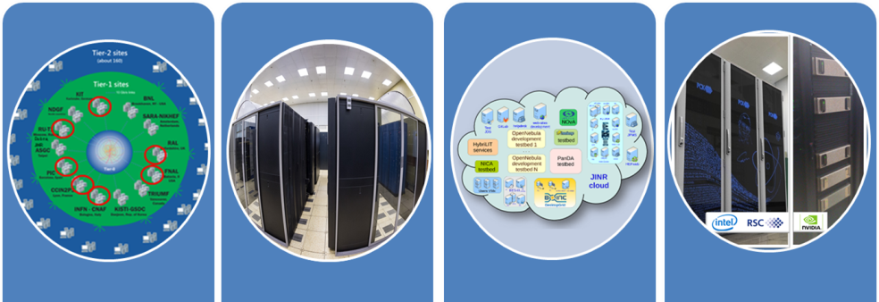
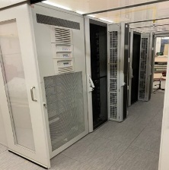
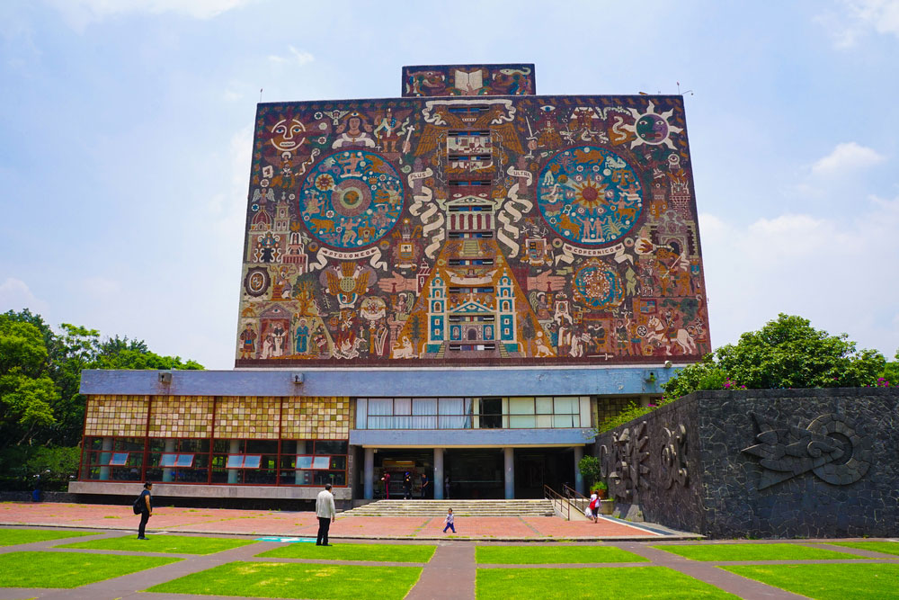
What was done
EOS
Tier-1
CICC/Tier-2
Clouds
Govorun
NICA Cluster
UNAM
Running
Running
Running
Running
Running
Running
The computing resources of the JINR Multifunctional Information and Computing Complex, clouds in JINR Member-States, cluster from Mexico University were combined using the DIRAC Interware.

Slide 6
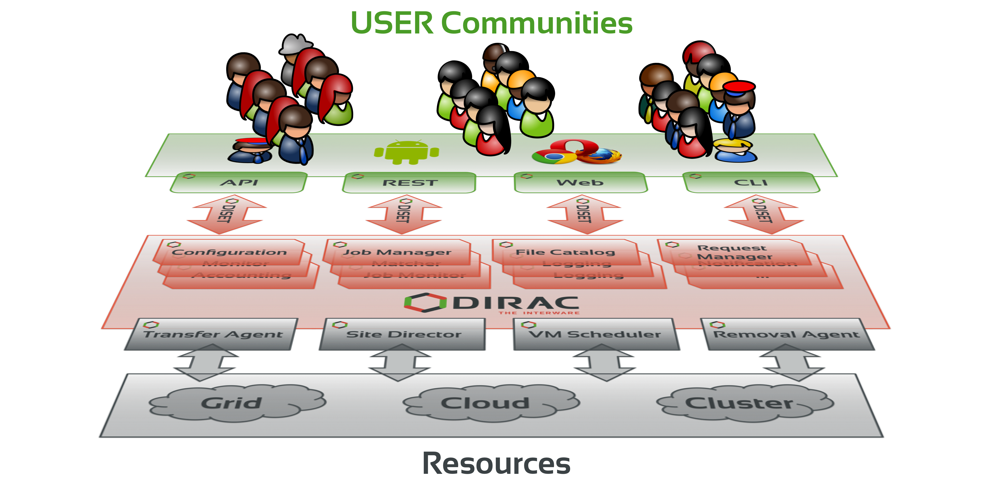
What is DIRAC?
DIRAC is a framework that provides all the necessary components to build ad-hoc grid infrastructures interconnecting computing resources of different types, allowing interoperability and simplifying interfaces. This allows to speak about the DIRAC interware.
Web
CLI
API
REST

Slide 7
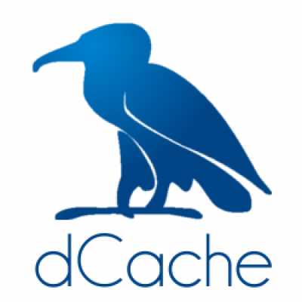
Why it is complex
EOS
dCache
Storage
Disk, Tape
Protocol
local, root
GridFTP, root
local
local
Auth Storage
Kerb. , x509
x509
ceph key
HybriLIT
Auth Jobs
Kerb. x509
x509
SSO
HybriLIT
Job Submit.
Slurm Grid
Grid
OpenNebula
Slurm
Component
Tier-2/CICC
Tier-1
Cloud
Govorun/HybriLIT
* This is a simplified schema to demonstrate complexity and variability of protocols and accesses approaches

Slide 8
Why DIRAC?
1. Single system for all aspects of computing
User Interface
API
Central configuration
Workload management
Data management
Integration tools
File Catalog
Workflow management
Metadata management
Accounting
Management

Slide 9
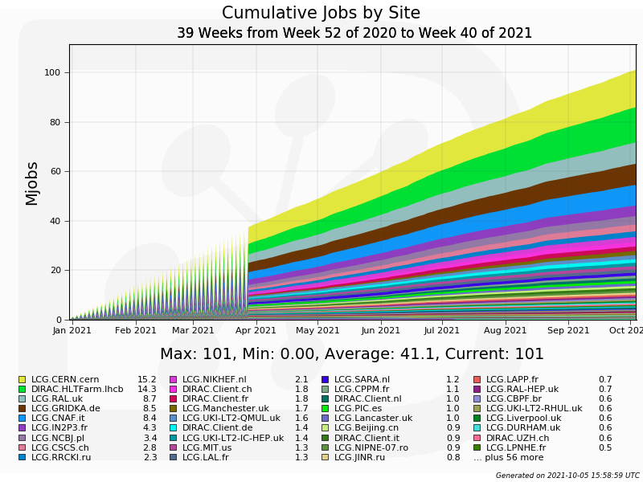
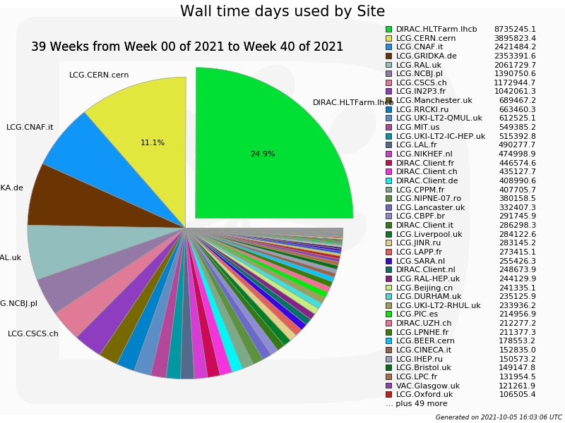
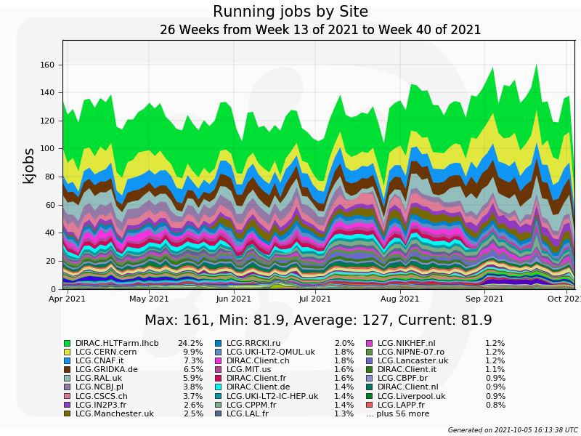
Why DIRAC?
2. Good performance

Slide 10
Why DIRAC?
3. Active users and developers community

Slide 11
History of DIRAC at JINR
2013 – Development of monitoring system for BES-III installation. First tries to setup and configure DIRAC infrastructure.
2017 – DIRAC Interware installed; basic configuration done. Used for educational purposes. dCache storage integrated, Tier2 integrated.
2018 – HybriLIT integrated. JINR cloud integrated using OCCI protocol. Tests of full cycle of Monte-Carlo for BM@N were performed.
2019 – Clouds of JINR Member-States integrated by module developed in JINR. MPD starts using DIRAC for massive Monte-Carlo production. Tier1, Govorun and EOS integrated in DIRAC.
2020 – Folding@Home jobs submitted to clouds via DIRAC. Baikal-GVD jobs submitted to JINR and PRUE clouds.

Slide 12
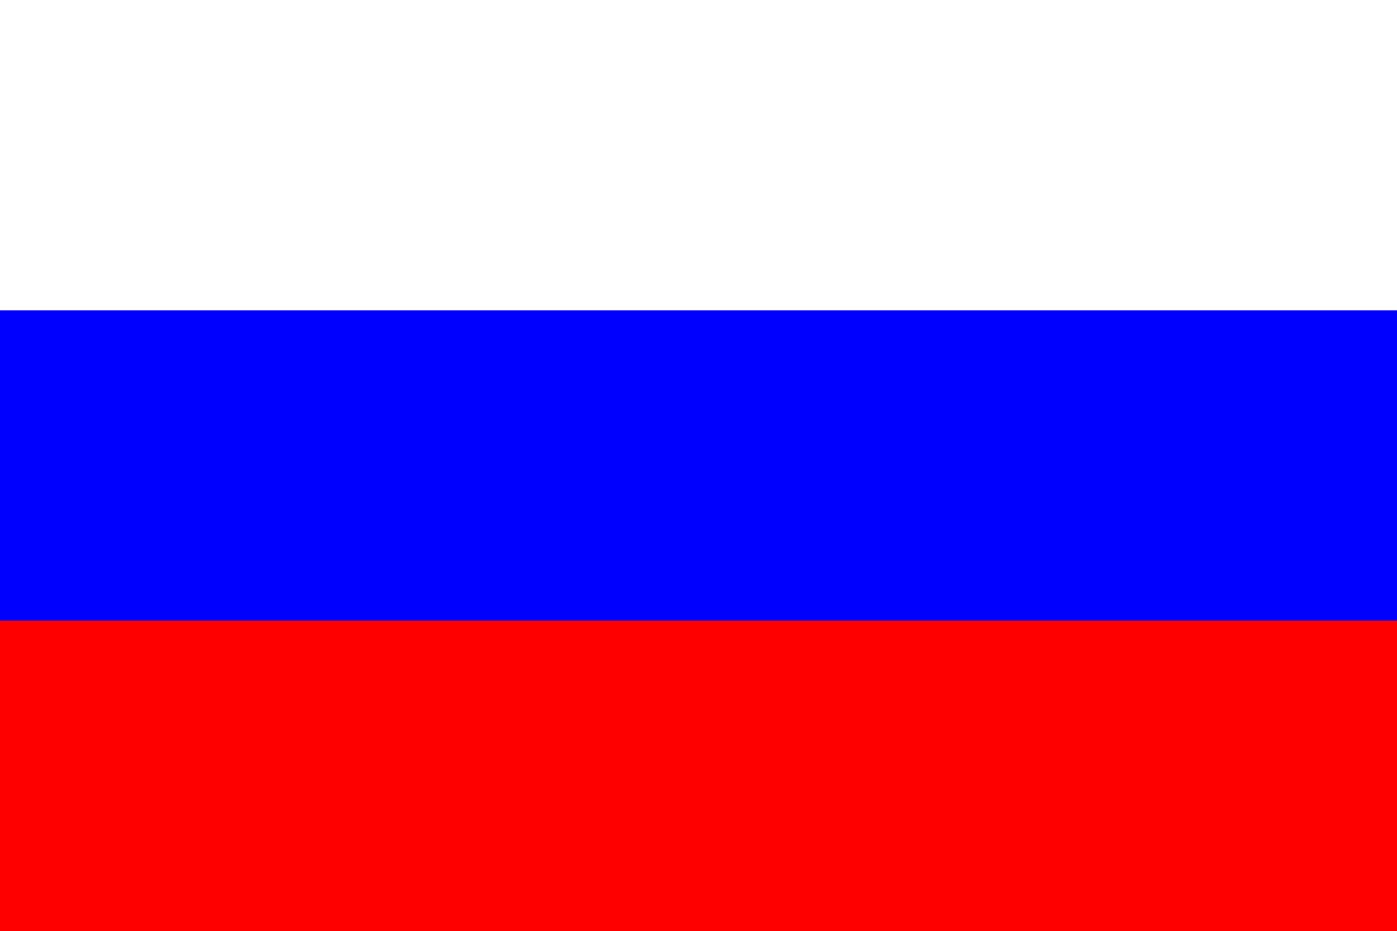
Computing Resources
MPD collaboration
JINR
Tier-1
920 slots
CICC/Tier-2
1000 slots
Cloud
80 slots
Govorun
184-870 slots
NICA Cluster
250 slots
UNAM
100 slots
Clouds
IPANAS
16 slots
INP
132 slots
SU
48 slots
INRNE
20 slots
INP
50 slots
REA Plehanova
132 slots
NOSU
84 slots
STI-SCI
98 slots
Total amount of cores exceeds 3000

Slide 13
Steps
1. DIRAC setup, configuration, development and tuning
2. Integration of computing and storage resources
3. Elaboration of approaches for effective use of resources

Slide 14
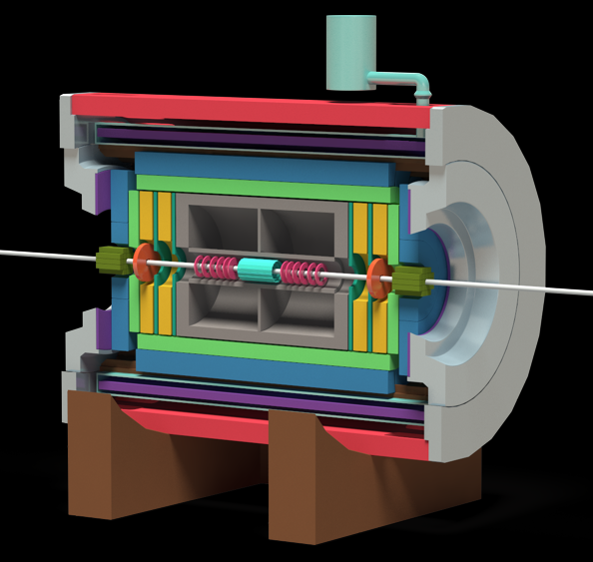
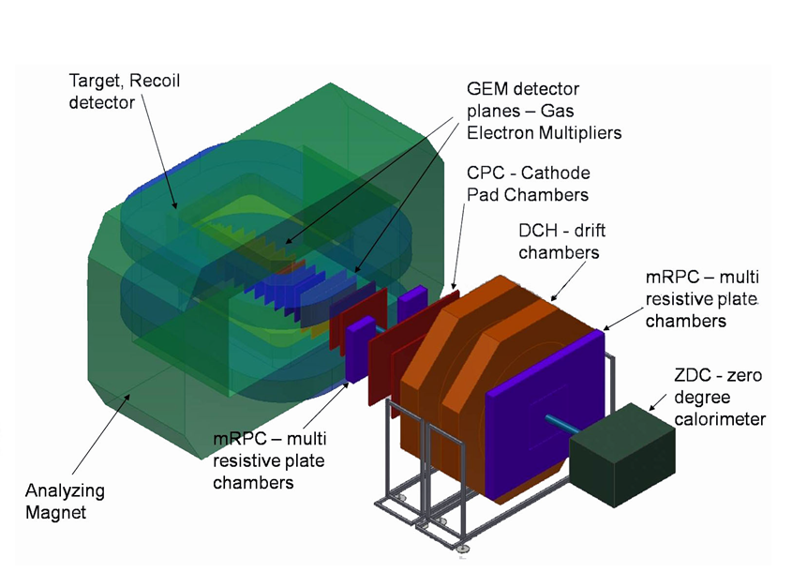
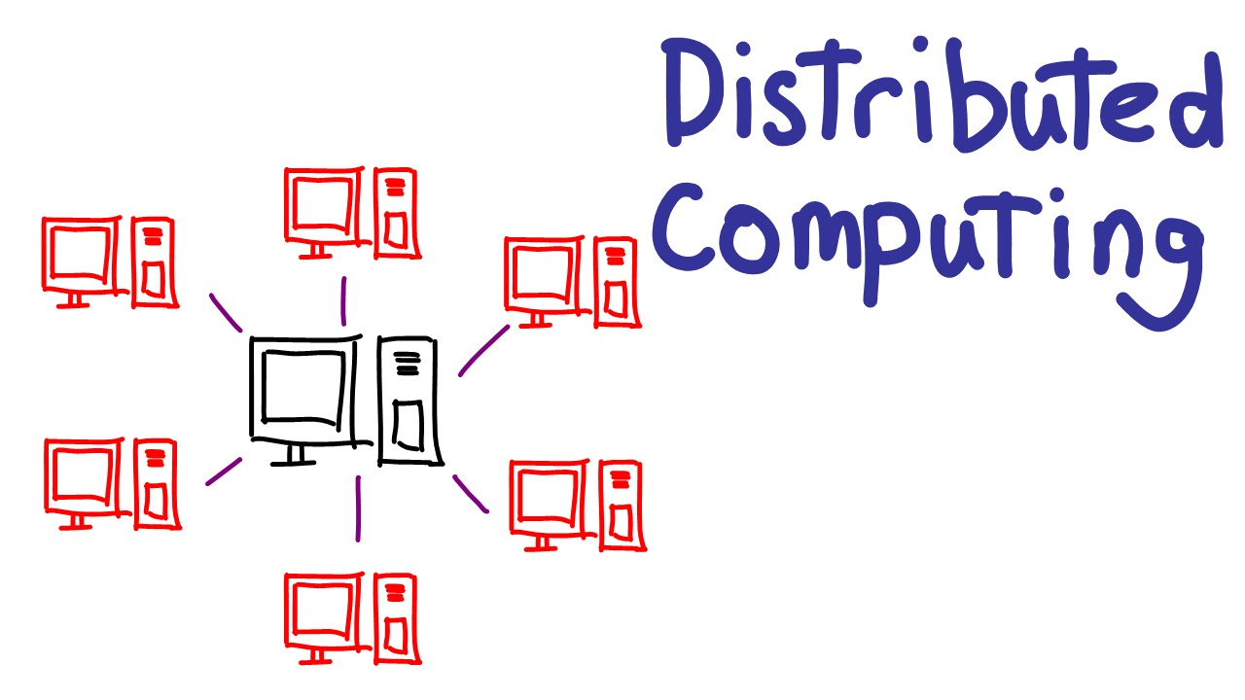
What do we use DIRAC for?
MPD@NICA
Baikal-GVD
BM@N
Monte-Carlo – Real
Analysis – Maybe
Monte-Carlo – Real
Monte-Carlo – Real
Reconstruction – Tests
Folding@HOME
Teaching

Slide 15
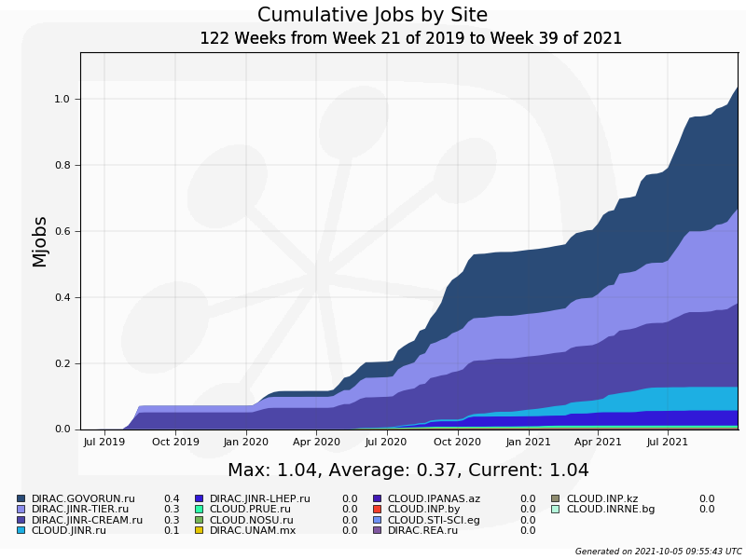
Statistics: jobs done
1 Million jobs

Slide 16
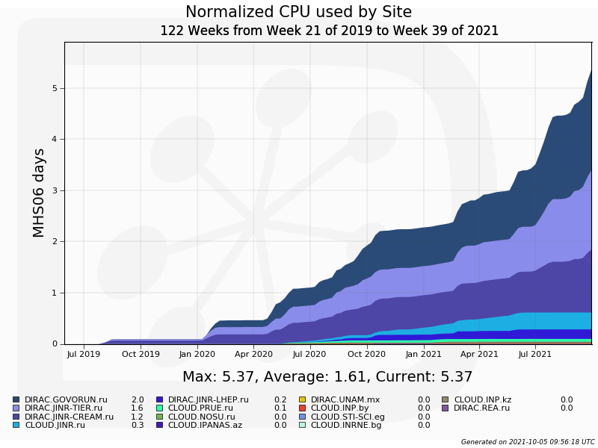
Statistics: normalized time
Equivalent of 830 years
of computation on one core

Slide 17
Ratio: normalized time
Use of all resources united by DIRAC increase speed at least 2.7 times. (Compared with use of only Govorun supercomputer)

Slide 18
Ratio: between experiments

Slide 19
Individual CPU core performance study
Centralized job management gives possibility for centralized and unified performance study of different computing resources.
Before running user jobs DIRAC Pilots execute benchmark for CPU core they are running on.
Benchmark is DiracBenchmark2012 or DB12. It evaluate just CPU core performance. Disk I/O, RAM speed, Network, CPU caches and other highly important aspects of performance are neglected by DB12.

Slide 20
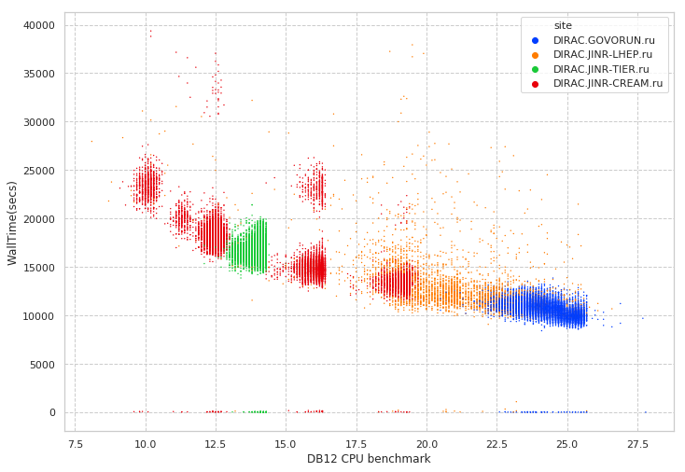
New: performance analysis

Slide 21
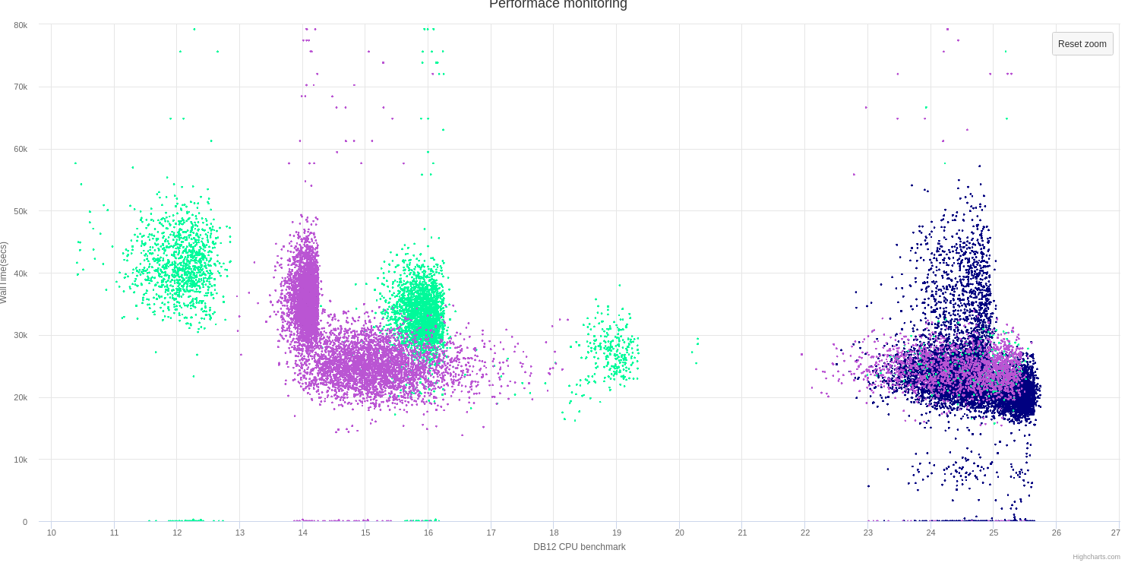
Discoveries
Wrong AMD processors estimation
Speed loss on high ram Govorun nodes

Slide 22
Conclusion on MPD+DIRAC
After 2 years of active operations, DIRAC proved to be useful and effective tool for HTC jobs in JINR.
>1M jobs successfully done (830 years of wall time).
So far, all available major computing resources were successfully integrated to DIRAC.
DIRAC is used not only as workload management system but also as a data management system. And tests to use it as workflow management system were successfully performed.
All this could not be possible without cooperation with users and resource administrators

Slide 23
DIRAC: Igor Pelevanyk, Andrey Tsaregorodtzev Baikal-GVD: Dmitry Zaborov BM@N: Konstantin Gertsenberger, Dmitry Tsvetkov MPD: Oleg Rogachevskiy, Andrey Moshkin SPD: Alexey Zhemchugov Responsible for resources: Cloud: Nikolay Kutovskiy, Nikita Balashov dCache: Vladimir Trofimov Govorun: Dmitry Podgainy, Dmitry Belyakov, Maxim Zuev LHEP cluster: Boris Schinov Tier-1,Tier-2, EOS: Valery Mitsyn
List of participants

Slide 24
Detailed articles
1. Gergel, V., V. Korenkov, I. Pelevanyuk, M. Sapunov, A. Tsaregorodtsev, and P. Zrelov. 2017. Hybrid Distributed Computing Service Based on the DIRAC Interware.
2. Korenkov, V., Pelevanyuk, I. & Tsaregorodtsev, A. 2019, "Dirac system as a mediator between hybrid resources and data intensive domains", CEUR Workshop Proceedings, pp. 73.
3. Balashov, N.A., Kuchumov, R.I., Kutovskiy, N.A., Pelevanyuk, I.S., Petrunin, V.N. & Tsaregorodtsev, A.Y. 2019, "Cloud integration within the DIRAC Interware", CEUR Workshop Proceedings, pp. 256.
4. Korenkov, V., Pelevanyuk, I. & Tsaregorodtsev, A. 2020, Integration of the JINR hybrid computing resources with the DIRAC interware for data intensive applications.
5. Kutovskiy, N., Mitsyn, V., Moshkin, A., Pelevanyuk, I., Podgayny, D., Rogachevsky, O., Shchinov, B., Trofimov, V. & Tsaregorodtsev, A. 2021, "Integration of Distributed Heterogeneous Computing Resources for the MPD Experiment with DIRAC Interware", Physics of Particles and Nuclei, vol. 52, no. 4, pp. 835-841.
6. Pelevanyuk, I., "Performance evaluation of computing resources with DIRAC interware", AIP Conference Proceedings 2377, 040006 (2021)

