Slide 1
Design and implementation of the event catalogue for physics analysis in the NICA experiments Artyom Degtyarev, Evgeny Alexandrov, Igor Alexandrov, Alexander Chebotov, Konstantin Gertsenberger, Peter Klimai, Alexander Yakovlev 13.10.2021
The XXV International Scientific Conference of Young Scientists and Specialists (AYSS-2021)

Slide 2
IT systems in particle collision experiments
Allows to automate data processing, storage and analysis
Important type – event metadata systems
Implemented in the ATLAS LHC, CMS, BES III and other experiments

Slide 3
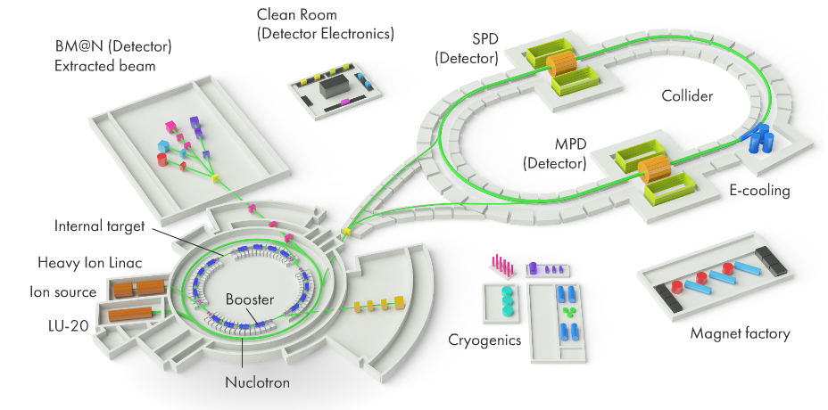
NICA experiment

Slide 4
NICA experiment
Purpose – to study different features of strongly interacting matter:
Equation-of-state, microscopic structure of strongly interacting matter, in-medium modifications of hadrons
Theoretical models suggest different scenarios, so new data is needed
BM@N – first experiment

Slide 5
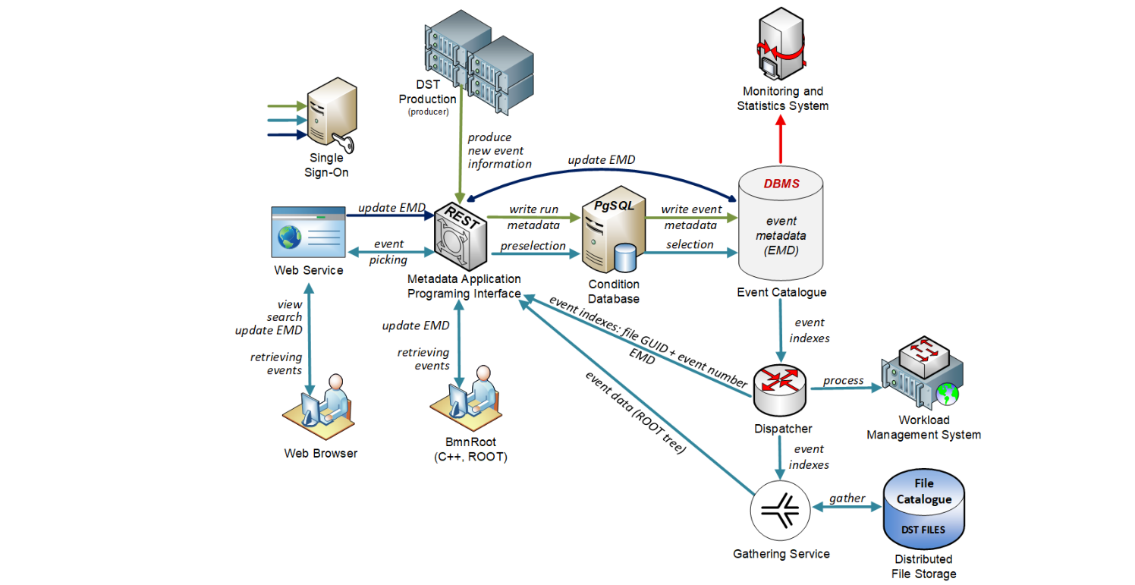
Event Metadata System - construction

Slide 6
Event Metadata System – DST files
DST files of the BM@N contain the following data:
file header with some service information
run header with the corresponding information
hierarchical ROOT tree (with name ‘​bmndata’), which includes reconstructed event data

Slide 7
Event Metadata System – selection criteria
period number and run number
software version
event time (a start point in time is sufficient to not store a corresponding time interval)
number of primary and all reconstructed tracks
track number of positively and negatively charged particles from the primary vertex
primary and secondary particles found
number of hits by detectors
total input and output charge in the event and other

Slide 8
Event Metadata System – main functions
Summary description of particle collision events and their identifiers
Recording and storing event metadata in the Event Catalog
Providing convenient and quick access to the metadata
Online and offline interfaces for selecting events of interest

Slide 9
Event catalog – choice of DBMS
Several billions events and more are planned to be collected for the BM@N experiment
System scalability and query performance are important
Testing on a dataset with from 500 million to several billion events

Slide 10
Event catalog – choice of DBMS, SQL vs. NoSQL
Relational – highly structured, flexible in queries, easy to administer
Non-relational –horizontal scalability, decentralization and fault tolerance, it’s easier to change data structure working with the database
PostgreSQL, HBase and Cassandra chosen for testing

Slide 11
Data storage in Cassandra
PRIMARY KEY
Partition key
Clustering key
Column
Row 1
Clustering key: val1
Clustering key: val2
Name
Partition key: val1
Column 1
Column 2
Column 1
Column 2
Value
Row 2
Clustering key: val3
Clustering key: val1
Partition key: val2
Column 1
Column 2
Column 1

Slide 12
PostgreSQL vs. Cassandra
In PostgreSQL indexes can be used to improve performance
Cassandra has a more flexible way of storing data
PostgreSQL has more flexibility in queries
In 3 of 4 tests Cassandra is 3-5 times faster, but in another test about 3 times slower
PostgreSQL was chosen as being easier to administer and resilient to more queries

Slide 13
REST API
Kotlin, Ktor framework
JDBC for database connectivity
Jackson for serialization and deserialization
Configuration files are provided in YAML
JSON formatting
POST and GET requests

Slide 14
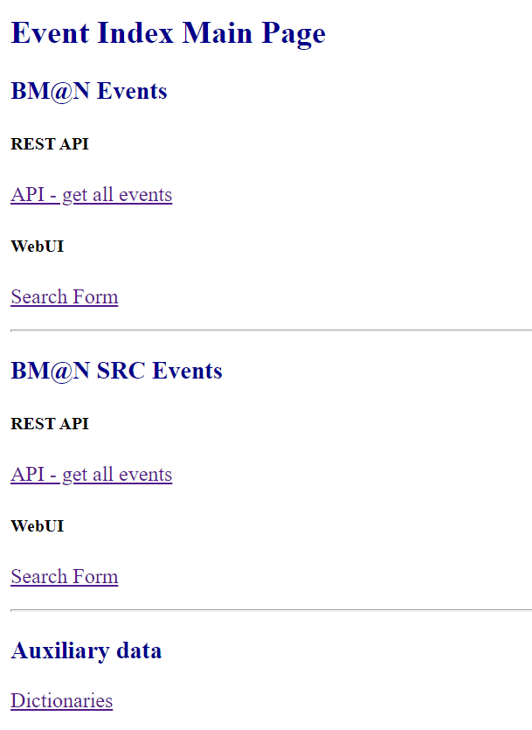
WEB UI prototype

Slide 15
Summary
Architecture of the Event Metadata System
Comparison of different DBMS’s
Approaches to the development of databases
REST API and the WEB UI

Slide 16
Future plans
To complete integration with FairRoot-based software frameworks (such as BmnRoot)
Ensure high availability and data backups
Add monitoring
Add script automated deployment

Slide 17
Thanks for your attention!
The work was funded by the Russian Foundation for Basic Research (RFBR) grant according to the research project №18-02-40125.

