Slide 1
Optimization parameters of reactivity modulator for reactor NEPTUN, to reduce the level of power fluctuation
Hassan А. А., E. P. Shabalin, V I Savander
Дубна, 2021

Slide 2
Content
The concept of a pulsed neutron source "NEPTUNE", the main features of the Neptune reactor.
Description of the problem of non-stationary processes of reactor power (fluctuations of the pulse amplitude, the possibility of oscillatory instability).
Proposed solutions to the problem of non-stationary processes.
Methodology.
Conclusion.

Slide 3
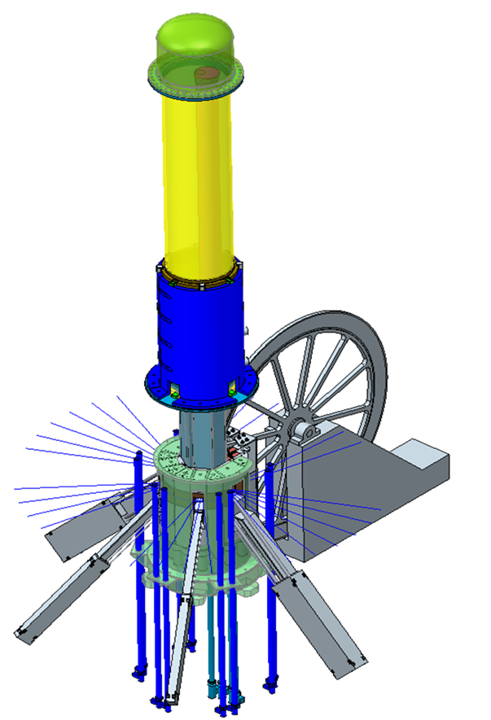
1- MAIN FEATURES OF THE REACTOR NEPTUN:
1 - The proposed source will have a peak neutron flux up to 5 ${10}^{16} n.\sec^{−1}.{cm}^{−2}$ and a time average flux density of up to${10}^{14} n.\sec^{−1}.{cm}^{−2}(in IBR−2M: 0.7{ 10}^{16} and$ ${10}^{13}$).
2 - The generation time of fast neutrons (τ) in the neptunium core is 5-7 times shorter than that in the core with plutonium (the task of having a short pulses of neutrons becomes easier).
3 - A low value of the delayed neutrons fraction (β-eff) determines a low background power in the intervals between pulses (3-4 times less).
4 - Possibility of using neutron moderating materials as a Reactivity Modulator (RM) ( like high-temperature resistance - hydride’s metal Ti$H_{2, }YH2).$
5 – There is no reactivity effect from the fuel burnup (it is possible to work without additional fuel loading during the entire reactor cycle):
Np237 (n absorption) Np238 (β-decay, (2.117 days) Pu238 (Fissionable material)

Slide 4
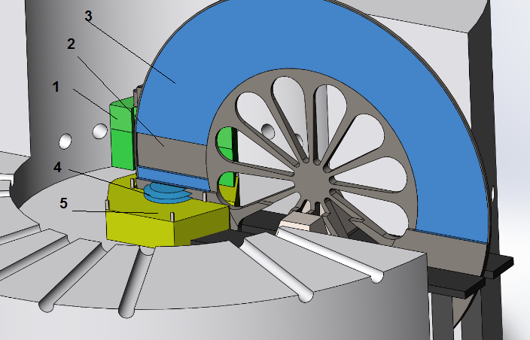
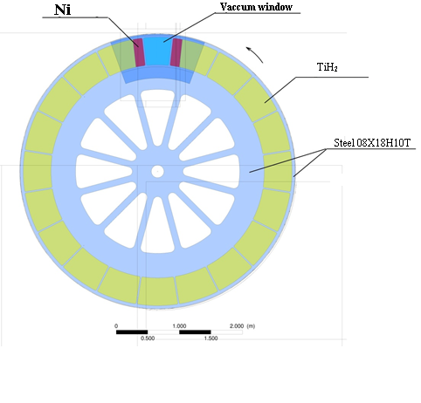
Concept of the IBR-3 reactor (NEPTUNE)
Reactore core,
Vacuum,
Ti$H_{2, }$
Moderator (water),
Be as a reflector.

Slide 5
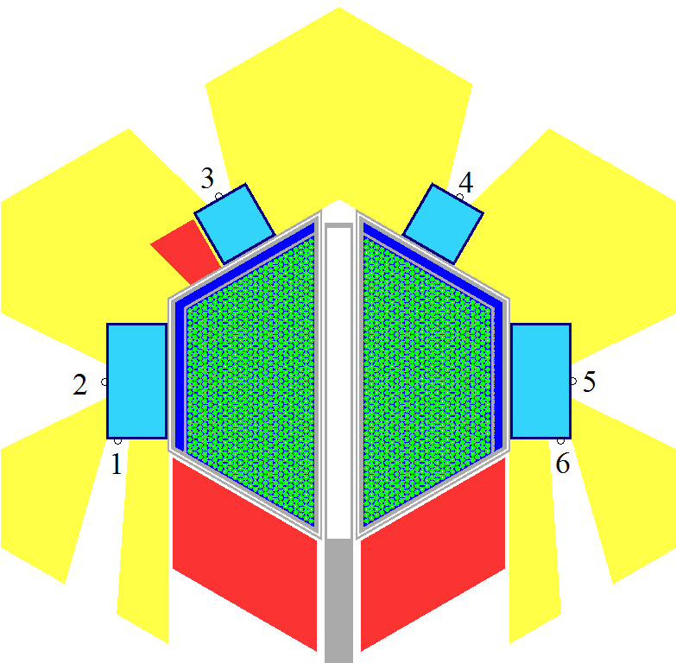
The reactor with the biological protection.
Cross-section of the IBR-3 reactor.

Slide 6
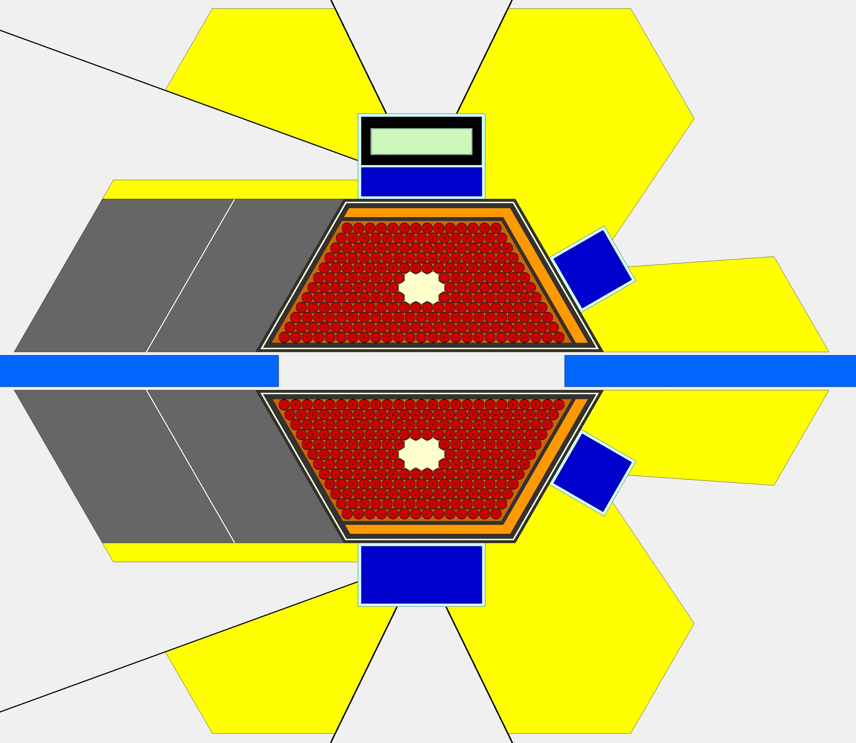
The main parameters of the reactor
Параметр | Значение
AVERAGE THERMAL POWER , MW | 12 - 15
OPERATING MODE | pulsed
PULSE FREQUENCY, Hz | 10
FUEL | NpN
CLADDING MATERIAL OF FUEL RODS | S.Steel ЧС-68
COOLER | Na
REFLECTOR | NICKEL ALLOY + BERYLLIUM
MODERATOR, PREMODERATOR | Hydrides, water, beryllium
COOLANT TEMPERATURE AT THE INLET TO THE CORE AND AT THE OUTLET, ⁰С | 290-390
PRESSURE DROP THROUGH THE CORE, Pa | 0,33·10⁵
FLUENCE ON THE REACTOR SURROUNDING’S FOR 20,000 h, n / СМ² | 4,1·10²²
AVERAGE NEUTRON THERMAL FLUX AT THE SURFACE OF WATER MODERATOR, 2π- equivalent 10¹³ cm⁻²∙sec⁻¹ | 12
EFFECTIVE FRACTION OF DELAYED NEUTRONS | 0,00131
GENERATION TIME OF THE SPONTANEOUS NEUTRONS , n,sec | 30

Slide 7
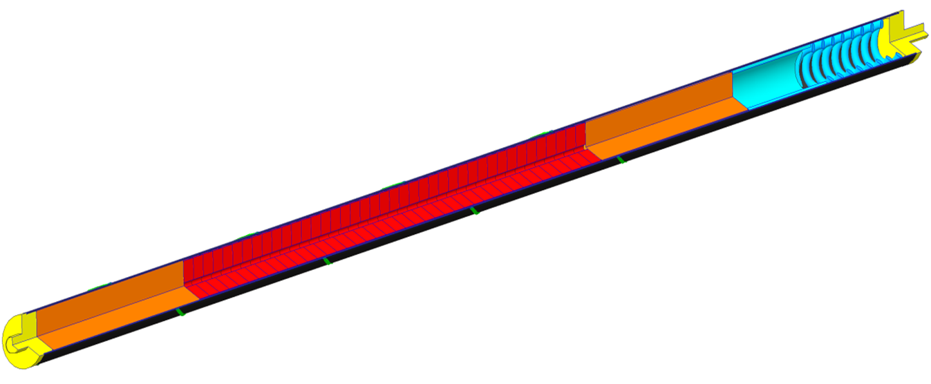
FUEL ROD
Параметр | Значение
Nominal fuel rod length, мм | 750-800 мм
Fuel column height, мм | 410 мм
Outer clad diameter, мм | 17,5
Inner clad diameter, мм | 16,7
Diameter of central hall, мм | 2
Fuel | NpN, tablet
Density of fuel, gm /см³ | 13,4
Total mass of fuel , кг | 500-550 k gm

Slide 8
2- The problem of non-stationary in reactor’s power:
$\frac{Q_{n}}{Q_{0}}$ = $e^{(\frac{∆ρ}{β_{puls}})}$ (1)
${ θ}_{effective}≅{(\frac{\tilde{τ}}{α V^{2}})}^{\frac{1}{3}}$ (2)
$β_{puls}≅0.5 {(∝ V^{2} {\tilde{τ}}^{2})}^{\frac{1}{3}}$ (3)
$T= \frac{\frac{γ_{1}}{α_{1}}+\frac{γ_{2}}{α_{2}}}{∆K} − γ_{1}τ_{2}= \frac{γ_{1}τ_{1}+ γ_{2}τ_{2}}{∆K} − γ_{1}τ_{2}= \frac{\tilde{τ}}{∆K}− γ_{1}τ_{2}$ (4)
where;
$θ_{effective} :$pulse duration, Q : pulse energy power
α : The coefficient of parabola for RM perturbation curve
$V$ : Linear velocity of RM ,
$\tilde{ τ}$ : Average neutron generation time,
β_{pulse} : Impulse delayed neutron fraction,
T : Reactor period.
From the kinetic theory of IBR-type reactors formulas 1.2.3.4 are taken.
For the Np reactor core; α ≈ 10⁻⁵ см⁻² , v =62 м/sec и τ = 10 nano sec., according to eq. (3) β_{pulse} = 3.5 10⁻⁵.
For this value of β_{puls} and at reactivity fluctuations in order of ± 10⁻⁵ к _{eff} the pulse power will rise to ± 33 % , and at reactivity fluctuation in order of + 2.5 10⁻⁵ к _{eff} ,the oscillations of pulse power will already reach 2 Q ₀ - i.e. the limit level.

Slide 9
3- Proposed solution to the problem of non-stationary problem of the reactor power:
To reduce power fluctuations and increase the instability limit, “β_{puls}” must be increased.
There are two solutions that must be applied together in order to increase “β_{puls}” and avoid change the power duration.
A) Through increasing the prompt neutron generation time ($\tilde{ τ}$ );
B) and increase the coefficient of parabola for RM (α).
- An increase in the neutron generation life time in the NEPTUN reactor can be achieved by adding at the periphery of the core isotopes that can fission by epi-thermal neutrons.
Suitable candidates for this are Pu-239 with the first fission resonance of 0.3 eV and U - 235 with its weak resonances in this energy range.
- Increase in the coefficient of parabola can be achieved by optimizing the reactivity modulator, by reducing the vacuum width and adding at the ends of window reflector slice from Ni.

Slide 10
3- METHODOLOGY
3,1;
For the calculation, the SERPENT code (2.1.32) and the ENDF / B-VII B nuclear data library were used; to solve computational problems, the supercomputer Govorun, LIT, JINR was used.
In the first row next to water moderator the fuel compositions (NpN) was replaced by one of the following compositions:
PuN + NpN, at different volumes percent (10 + 90/ 15 + 85 and 20 + 80 vol % for PuN and NpN respectively).
Pu + ZrN, at different volumes percent (10 + 90, 15 + 85, 20 + 80 and 25 + 75 vol % for PuN and ZrN respectively).
UN at different U-235 enrichments (25%, 50% and 60%).
UN + NpN at different volumes percent and U-235 enrichments (40 + 60 vol% and 40% enrichment, 40 + 60 vol% and 90% enrichment and 50 + 50 vol% and 50% enrichment).
And each of the previous options was tested with three different thicknesses of Gd filter (0.1, 0.3 and 0.5 cm).

Slide 11
4,1 Generation time:
The best results for PuN was found to be (15% PuN + 85% NpN) at 0.1 cm Gd and (20% PuN + 80% NpN) at 0.1 cm Gd. and
and for UN, the addition was for (40% UN (40% enrichment) + 60% NpN) on a 0.1 cm Gd filter and (50% UN (50% enrichment) + 50% NpN) also on a 0.1 cm Gd filter.
All of these options provide the proposed generation times and do not greatly increase the neutron background between pulses, and the next section will discuss further analysis for these compositions only.

Slide 12
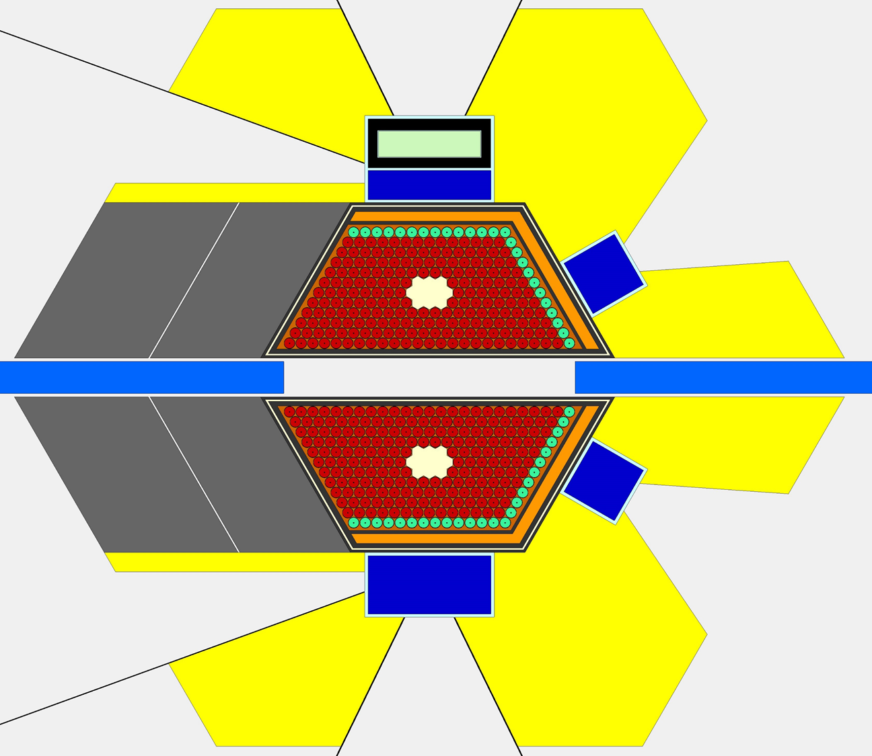
5
Figure 3. Neptunium core with U-235 or Pu-239 addition at the periphery.
1- NpN fuel rod.
2- water moderator.
3- fuel rod with additions.
4- Gd layer,
5- First channel,
6- Second channel.
6
1
2
3
4

Slide 13
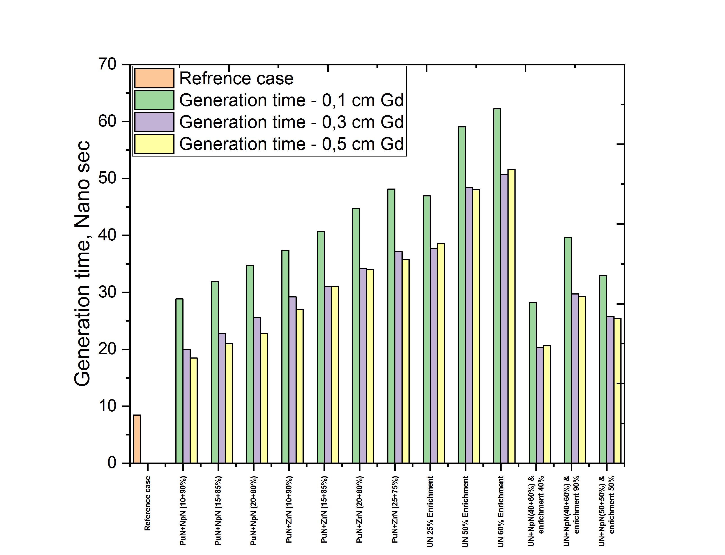
RESULTS:
1- Время генерации нейтронов:

Slide 14
3- METHODOLOGY
3,2;
Increase in the coefficient of parabola can be achieved by optimizing the reactivity modulator, by reducing the vacuum width and adding at the ends of window reflector slice from Ni.
1 30 cm Vacuum and 0 cm Ni
2 30 cm Vacuum and 5 cm Ni
3 30 cm Vacuum and 10 cm Ni
4 30 cm Vacuum and 15 cm Ni
5 35 cm Vacuum and 0 cm Ni
6 35 cm Vacuum and 5 cm Ni
7 35 cm Vacuum and 10 cm Ni
8 35 cm Vacuum and 15 cm Ni
9 40 cm Vacuum and 0 cm Ni
10 40 cm Vacuum and 5 cm Ni
11 40 cm Vacuum and 10 cm Ni
40 cm Vacuum and 15 cm Ni
45 cm Vacuum and 0 cm Ni
45 cm Vacuum and 5 cm Ni
45 cm Vacuum and 10 cm Ni
45 cm Vacuum and 15 cm Ni

Slide 16
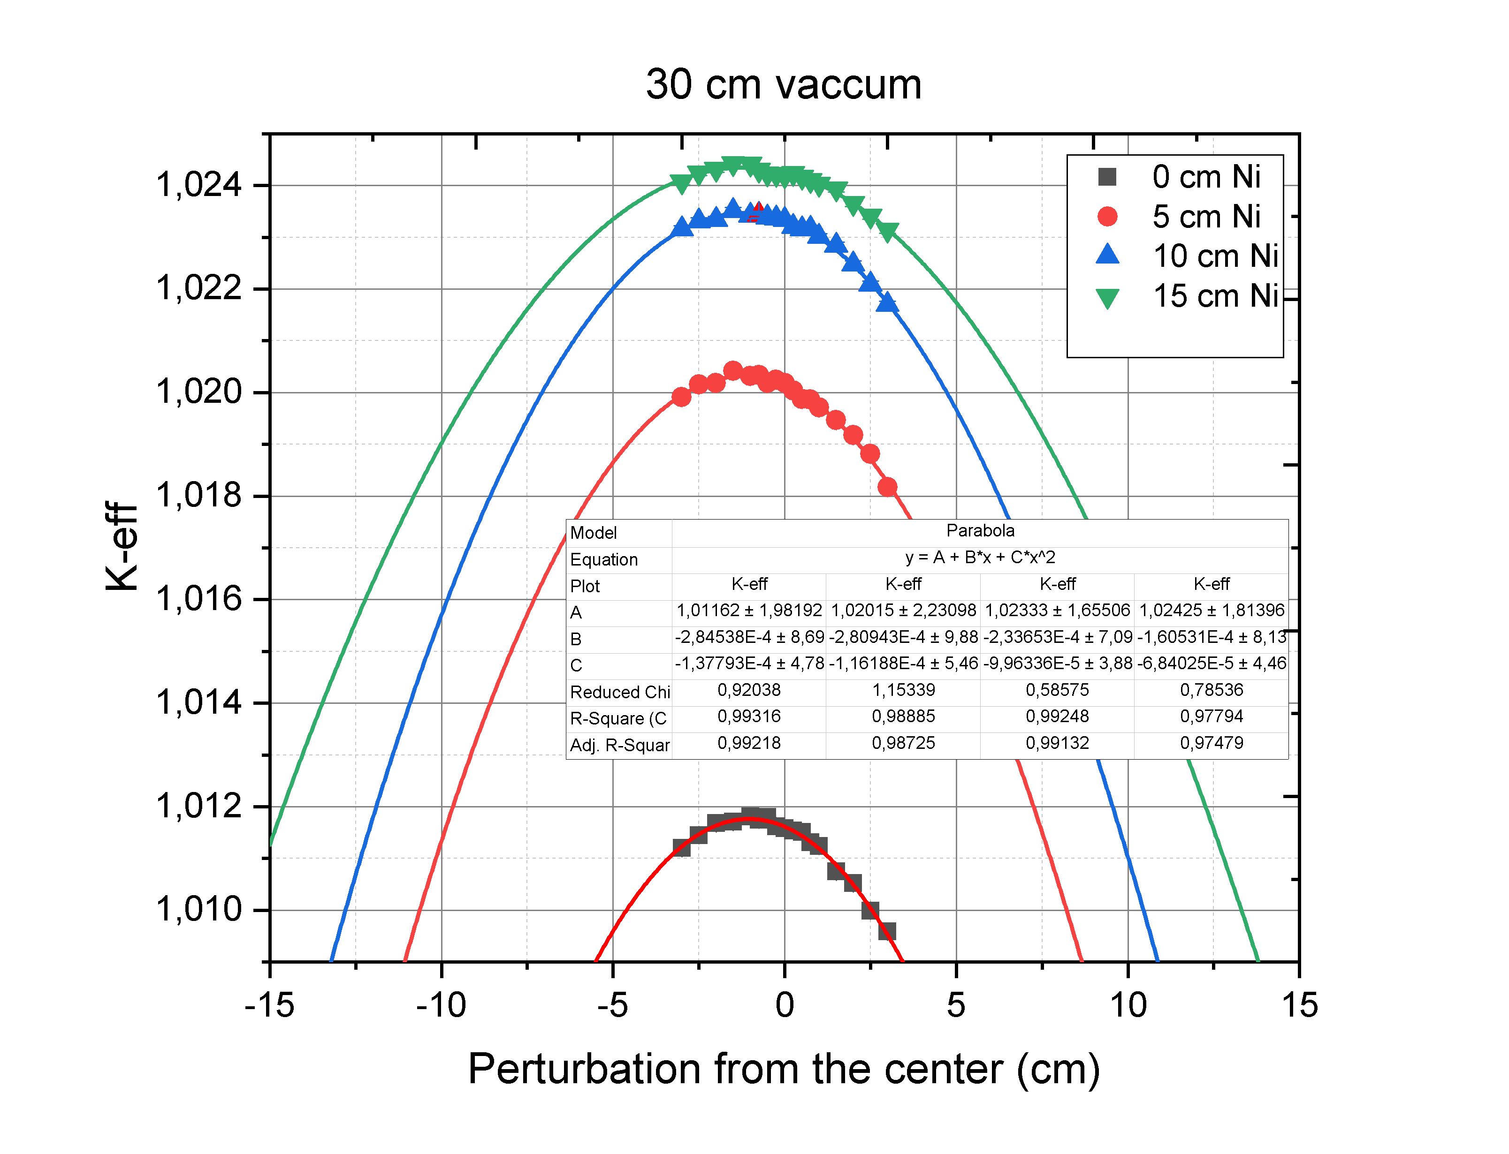
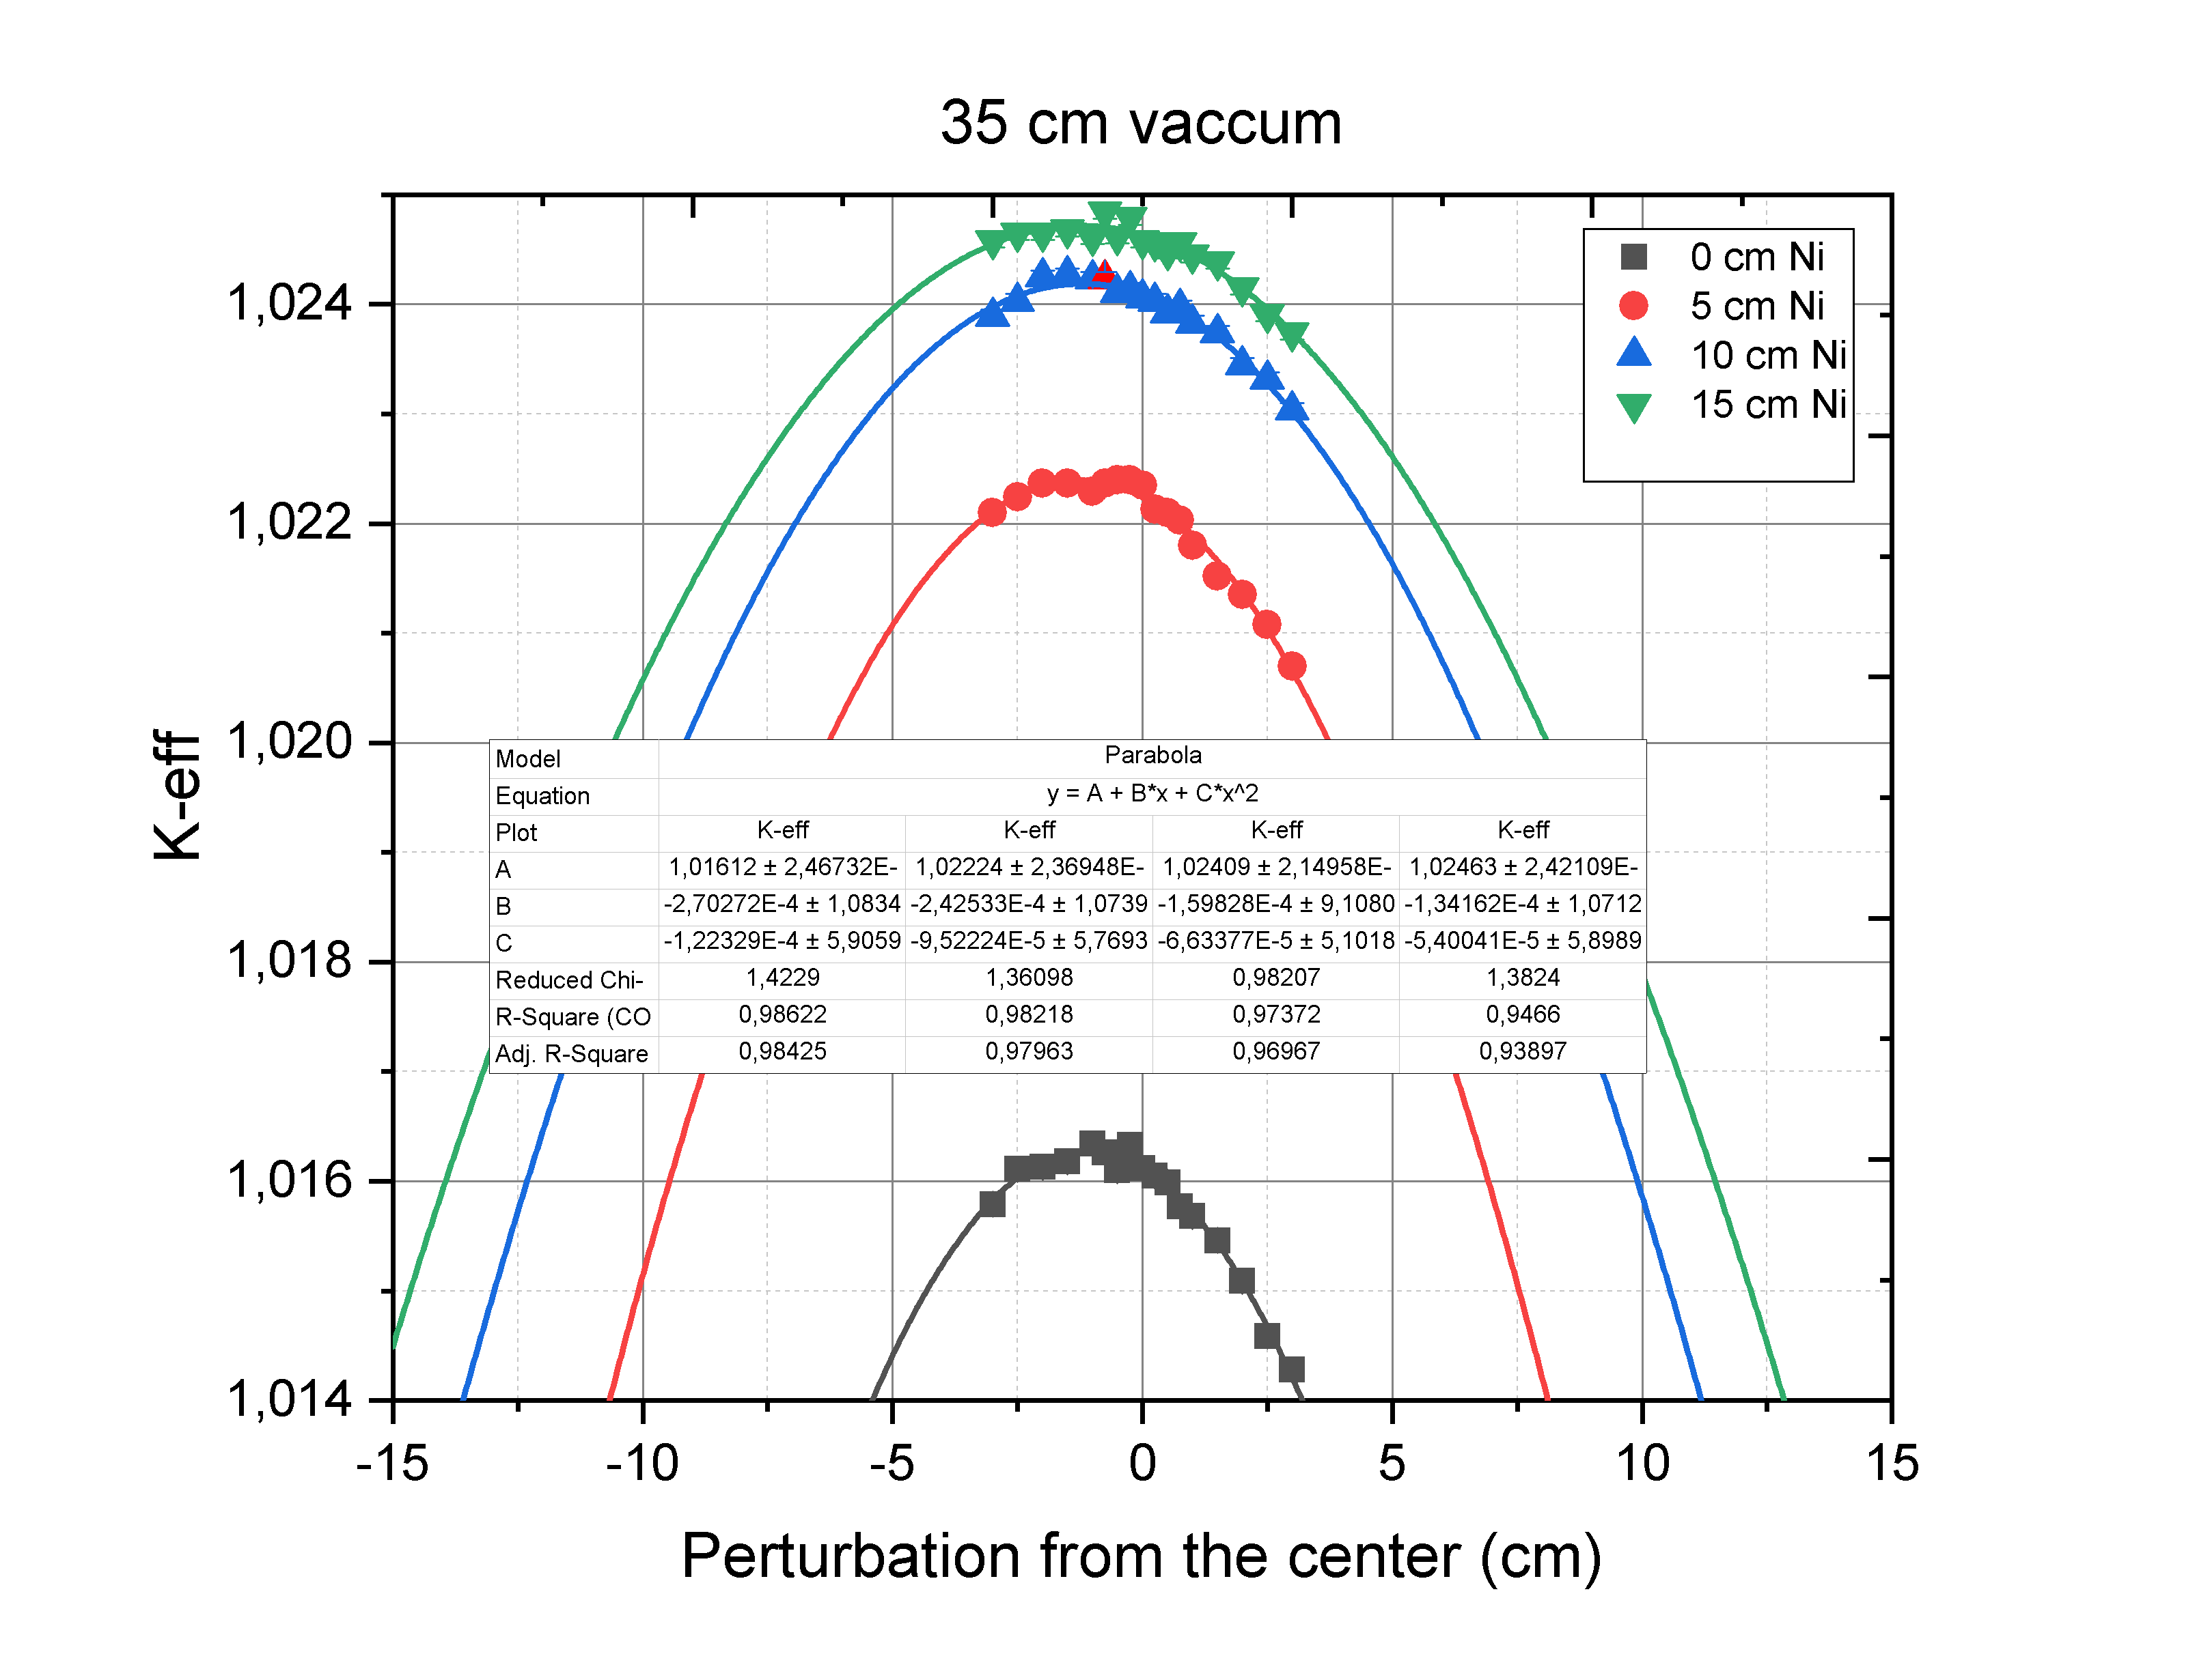
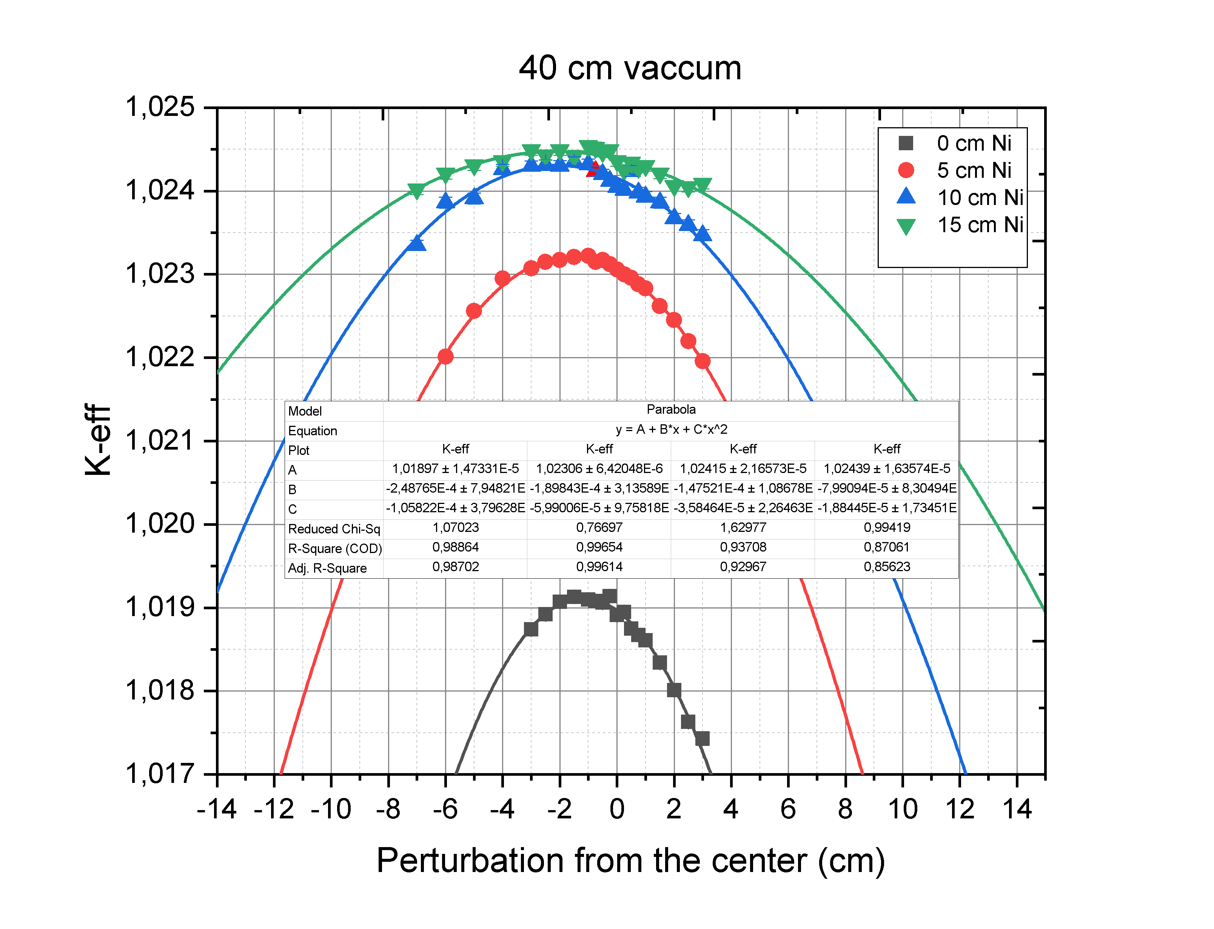
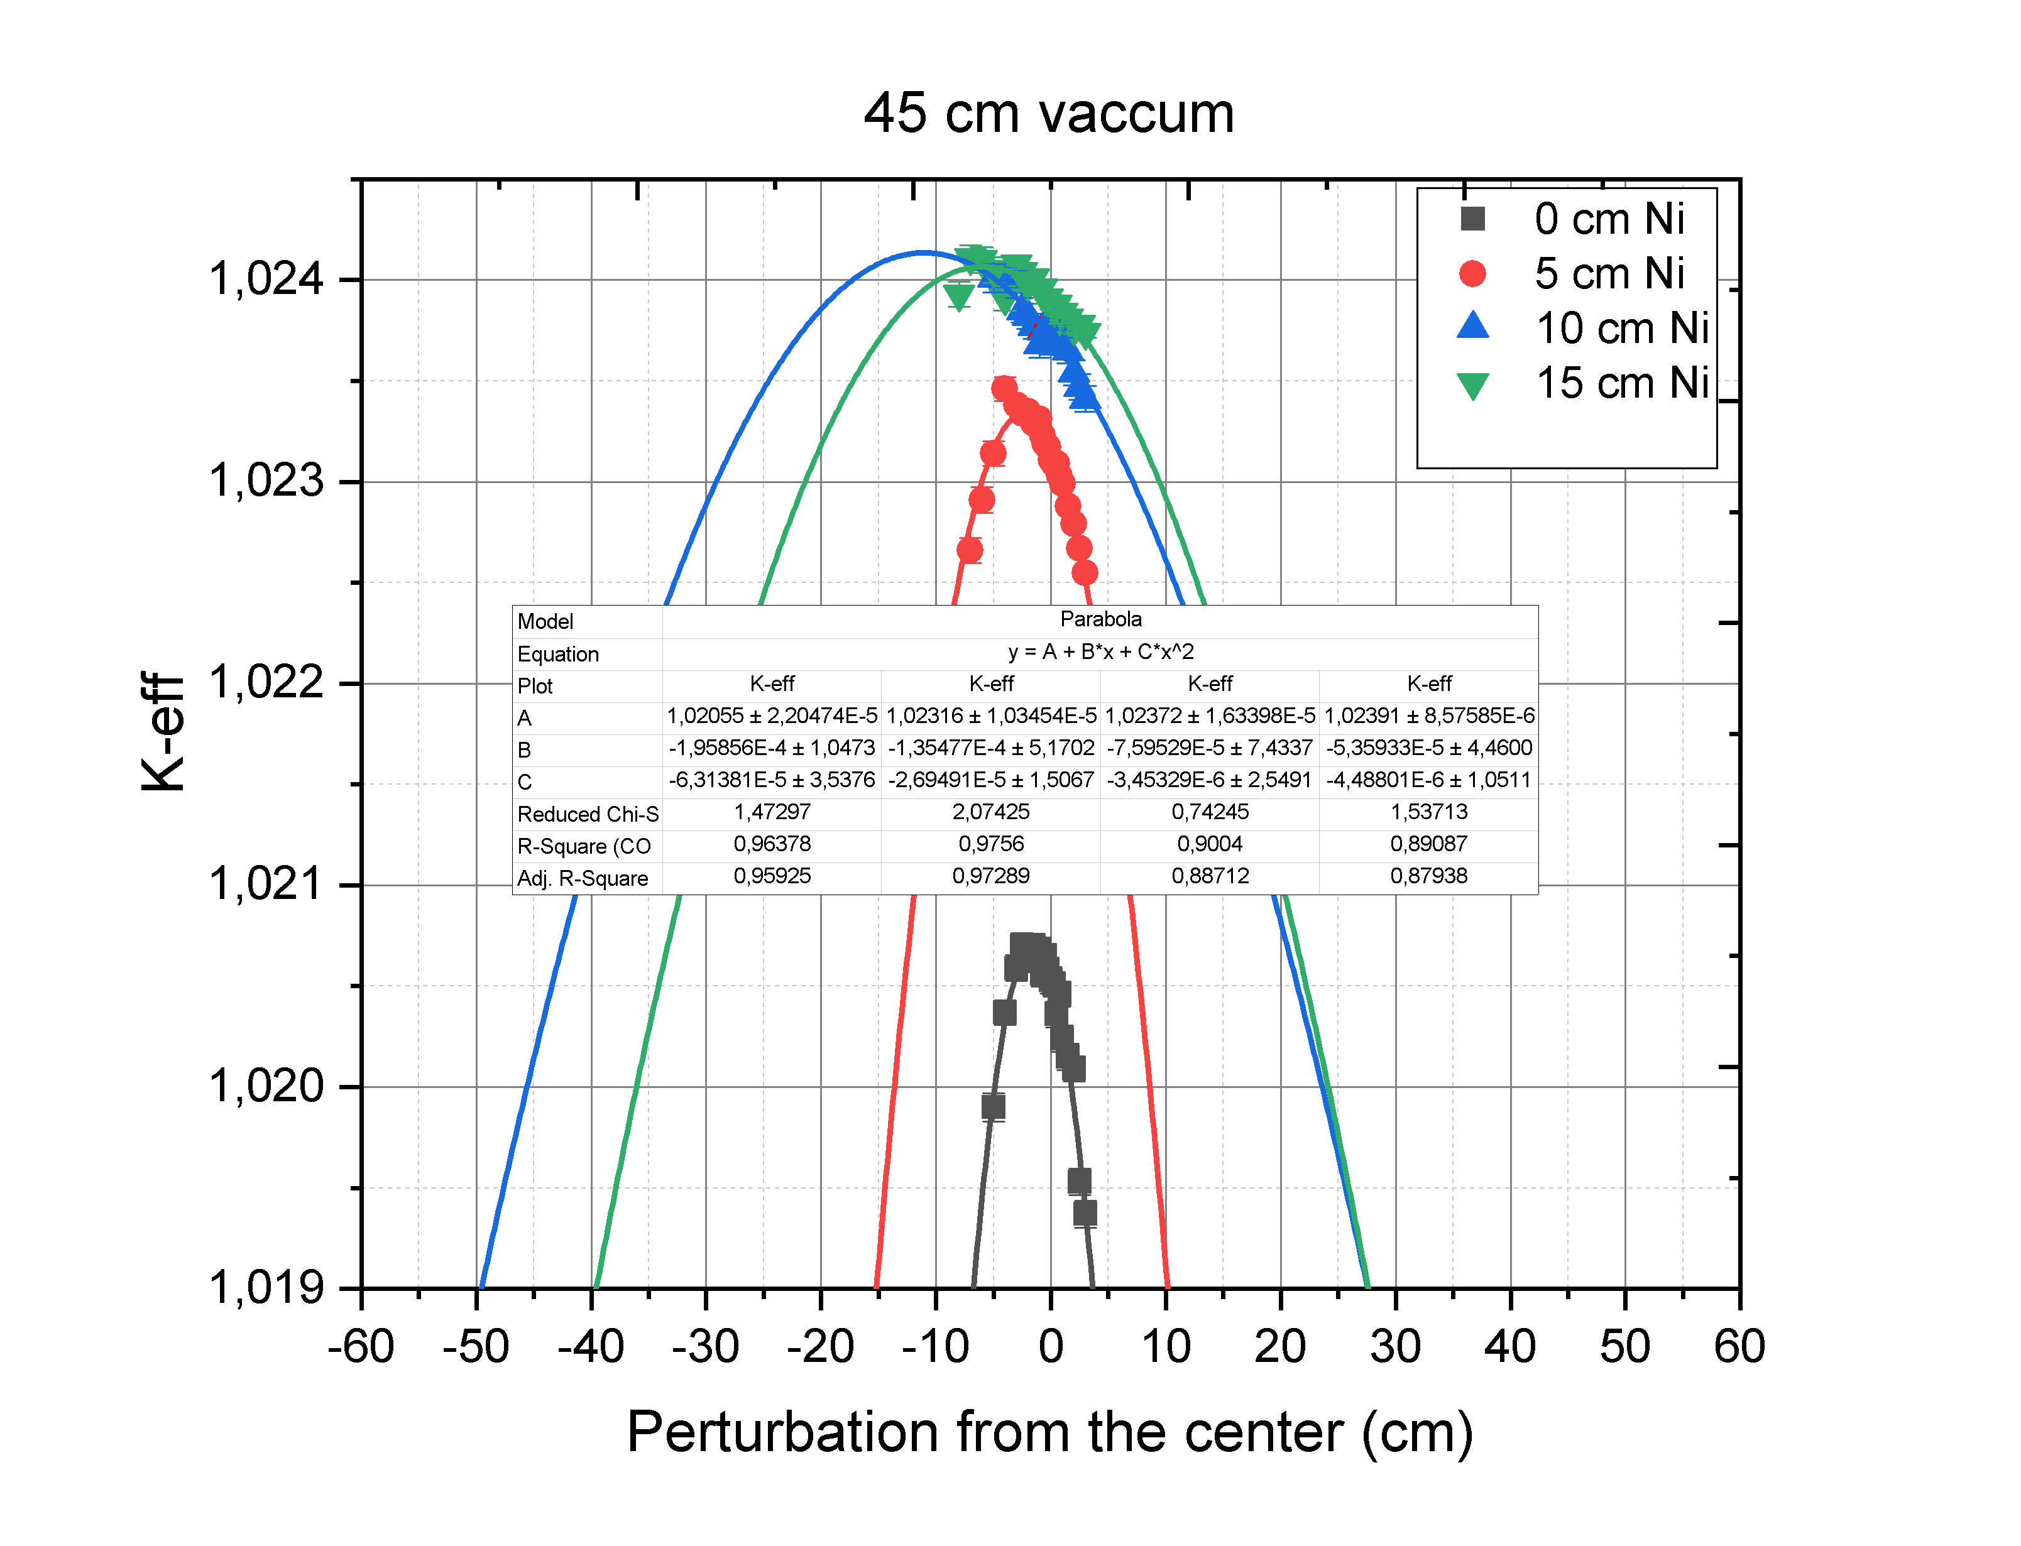

Slide 17
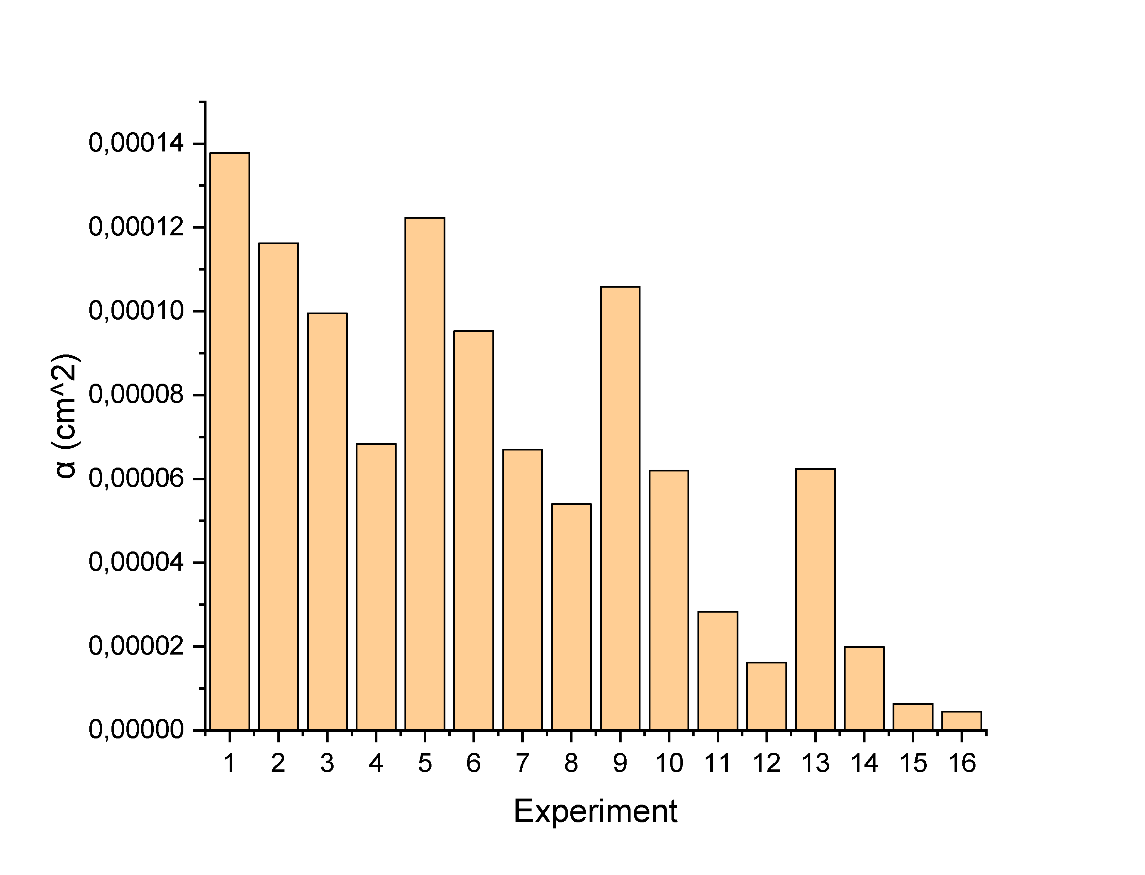

Slide 18
5 – Conclusion.
A proposed method is presented to reduce the pulse power fluctuations and instability in the core of IBR-3 (NEPTUNE), Which can be summarized in the following:
in increasing the "beta - pulse" parameter by increasing the generation time of the prompt neutron and parabola parameter.
This can be achieved by adding uranium or plutonium to the fuel elements bordering with moderators with the simultaneous introduction of a gadolinium filter and Increase in the coefficient of parabola can be achieved by optimizing the reactivity modulator, by reducing the vacuum width and adding at the ends of window reflector slice from Ni .
Numerical computer simulations used to get the acceptable concentrations of fissile elements that realize the increase in the generation time of the prompt neutron to 30 n.sec and the "beta - pulse" value by a factor of 2.1 and increasing Parameter of parabola to 1,38E-04 by 10 times.
Additions of uranium and plutonium simultaneously reduce the coefficient of non-uniformity of energy release and somewhat increase the neutron flux from the moderator.
Fuel elements doped with uranium are more convenient to operate in comparison with plutonium, without overloading.
The resulting beta impulse value is expected to be 8-9 10-5, which will be 60% of the similar value for the IBR-2.

Slide 19
Thank you for your patience.

