Slide 1
Altered organization of collagen fibers in the uninvolved human colon mucosa 10 cm and 20 cm away from the malignant tumor
Assistent professor Sanja Despotović
Institute of Histology and embryology “Aleksandar Đ. Kostić”
Faculty of Medicine, University of Belgrade

Slide 2
Tumor-stroma interactions
Tumors are consider as a complex heterocellular systems whose initiation and progression occur exclusively through numerous and multidirectional interactions between mutated cells and all components of the environment in which the tumor develops

Slide 3
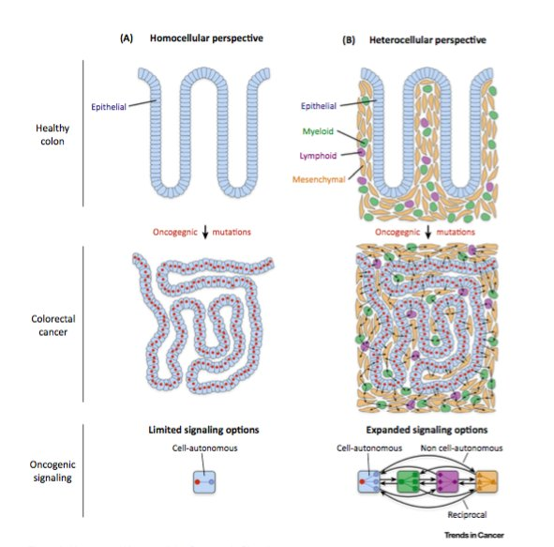

Slide 4
Tumor-stroma interactions
Tumor stroma includes all cellular and structural components of the tumor except the tumor cells: extracellular matrix components (connective tissue fibers and components of the ground substance), blood and lymphatic vessels, nerve fibers, fibroblasts, myofibroblasts, nerve cells and immune cells that infiltrate tumor

Slide 5
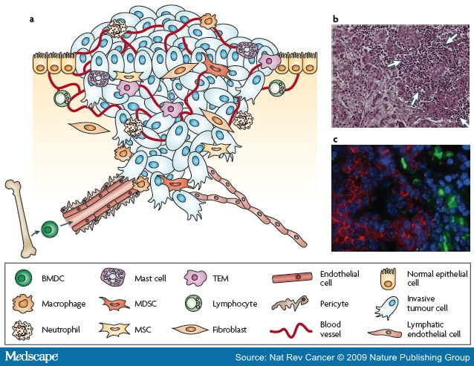
Tumor-stroma interactions

Slide 6
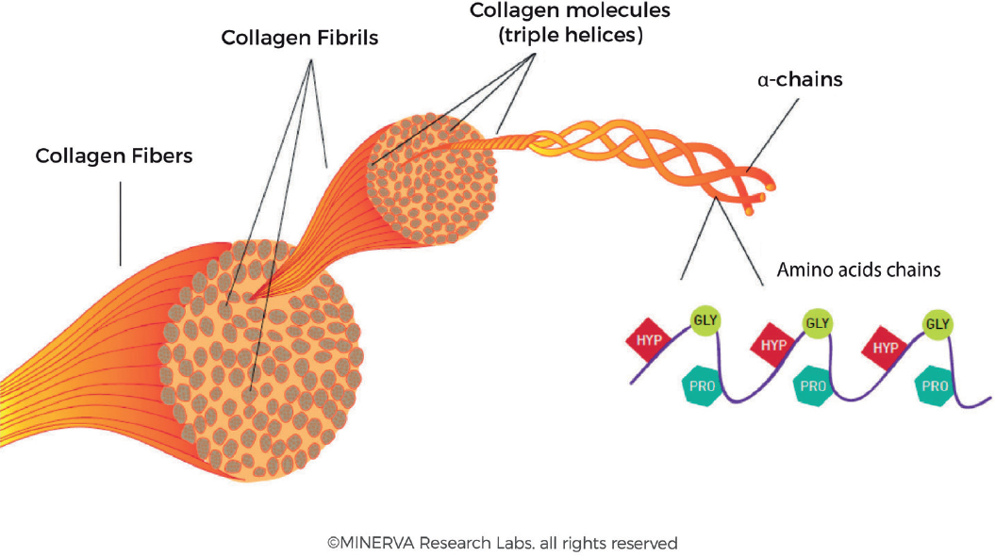
Extracellular Matrix (ECM)
Complex and dynamic structure affecting cell adhesion, proliferation, morphology, migartion, regulate tissue morphogenesis and fluid volume in tissue;
Collagen type I

Slide 7
Transitional mucosa
The term “transitional mucosa” refers to the mucosa located up to 2 cm away from the tumor;
There are genetics, epigenetics and biochemical changes in the transitional mucosa that resemble tumor

Slide 8
Uninvolved mucosa distant from the tumor
The growing tumor itself or the factors released by the tumor could act both locally and at the distance (systemic effects of the tumor)
“Filed carcinogenesis” concept: first, there is an altered filed in the colon mucosa, and then a tumor develops on the altered “field”

Slide 9
Remodeling of ECM of the lamina propria in the uninvolved human rectal mucosa 10 cm and 20 cm away from the malignant tumor (Despotović et al, 2017)

Slide 10
Remodeling of ECM of the lamina propria in the uninvolved human rectal mucosa 10 cm and 20 cm away from the malignant tumor (Despotović et al, 2017)

Slide 11
To quantify morphological parameters and organization of collagen fibers and to investigate posible causes of collagen remodelling (change in synthesis, degradation and collagen cross-linking) in the colon mucosa 10 cm and 20 cm away from the cancer in comparison with healthy mucosa

Slide 12
Materials and Methods: Tissue samples
Colonoscopy tissue samples from Department of gastrointestinal endoscopy, University Hospital Center “Dr Dragiša Mišović-Dedinje”, Belgarde, Serbia
Table 1. Demographic characteristics of patients included in the study
Patients | Number | Age (years) | Gender
 |  |  | Male | Female
Cancer | 41 | 74.3 | 24 | 17
Healthy | 39 | 71.9 | 20 | 19

Slide 13
Materials and Methods: Second harmonic generation imaging (SHG) of colon tissue samples
Original lab frame nonlinear laser-scanning microscope (NLM)
The tunable mode-locked Ti:sapphire laser (Coherent, Mira 900) has been source of the infrared femtosecond pulses;
Zeiss EC Plan-Neofluar 40x/1.3 NA Oil objective
840 nm
SHG was detected in back-reflection arm
The narrow bandpass filter at 420 nm (Thorlabs FB420-10, FWHM 10 nm) blocks the scattered laser light and auto-fluorescence
The average laser power was 30 mW
The peak laser power was 2.5 kW

Slide 14
Materials and Methods: Quantitative analysis of collagen fibers in colon lamina propria
CT-FIRE and CURVE Align
FiberFit

Slide 15
Materials and Methods: SHG polarization anisotropy
to quantify alignment of collagen molecules inside fibers

Slide 16
Materials and Methods: SEM analysis of collagen fibers
JOEL JSM-6390LV SEM (JOEL, Japan)
Accelerating voltage 10 kV
Critical Point Dryer K850 (Quorum Technologies, Laughton, UK)

Slide 17
Materials and Methods: Immunohistochemistry
formalin-fixed paraffin-embedded sections
alphaSMA (DAKO, M0851, 1:500)
MMP9 (Abcam, ab38898, 1:500)
MMP2 (Abcam, ab37150, 1:500)
LOX (Abcam, ab174316, 1:500)
Color Picker Threshold plugin, Icy

Slide 18
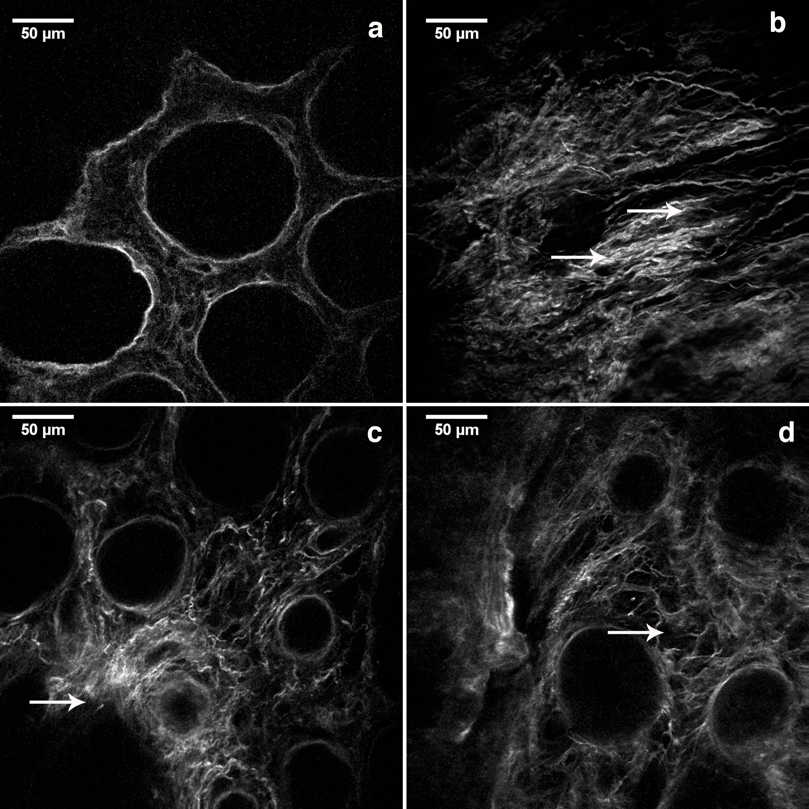
Results: SHG images of collagen fibers

Slide 19
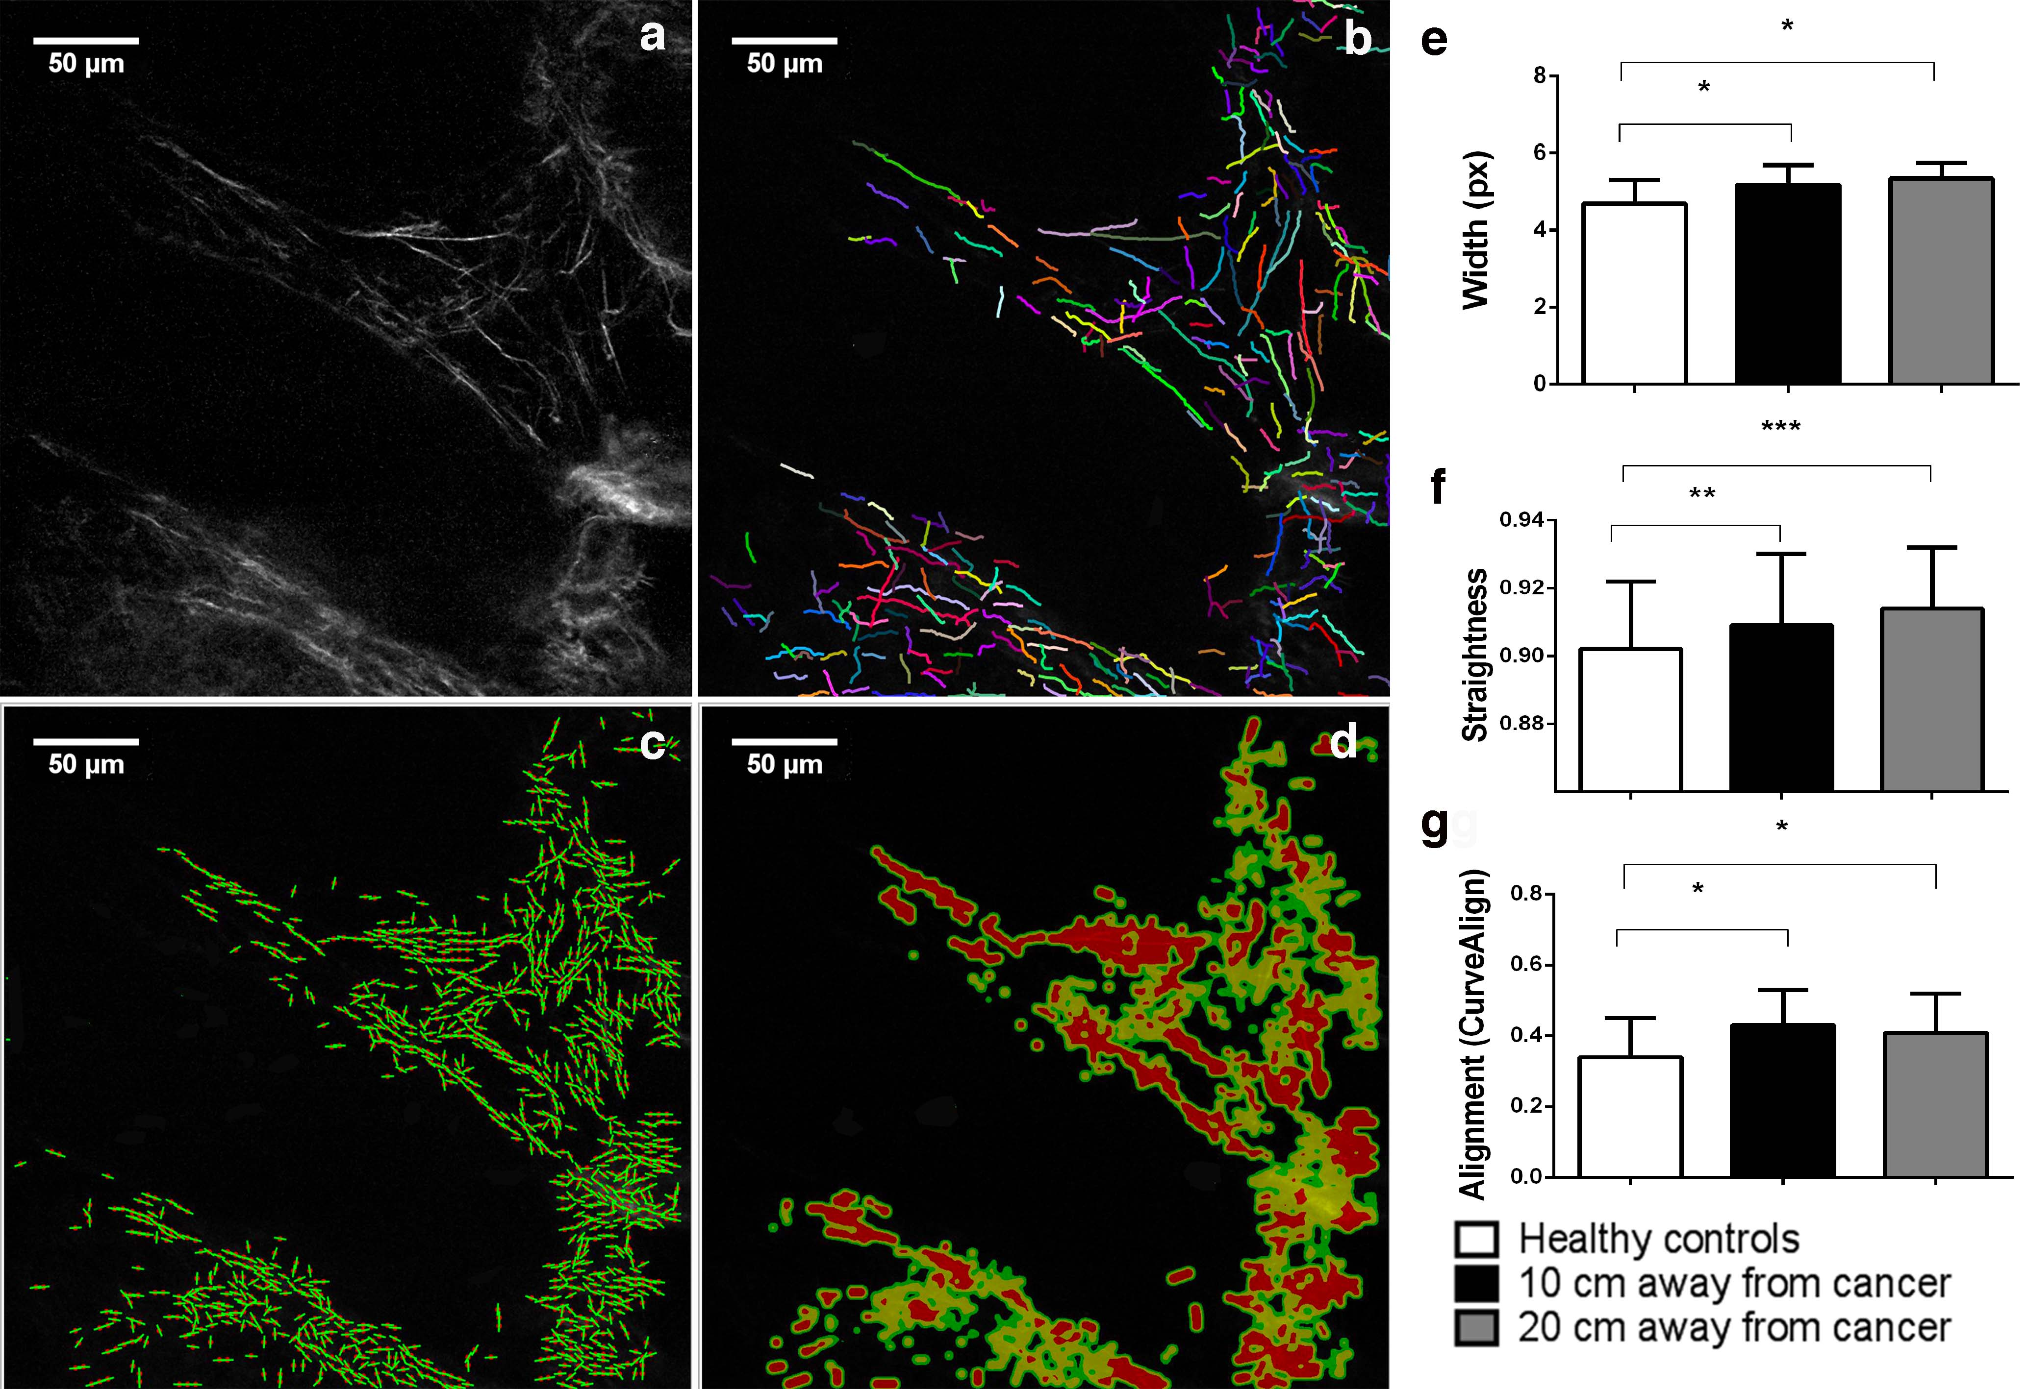
Results: CT-FIRE and CURVE Align analysis

Slide 20
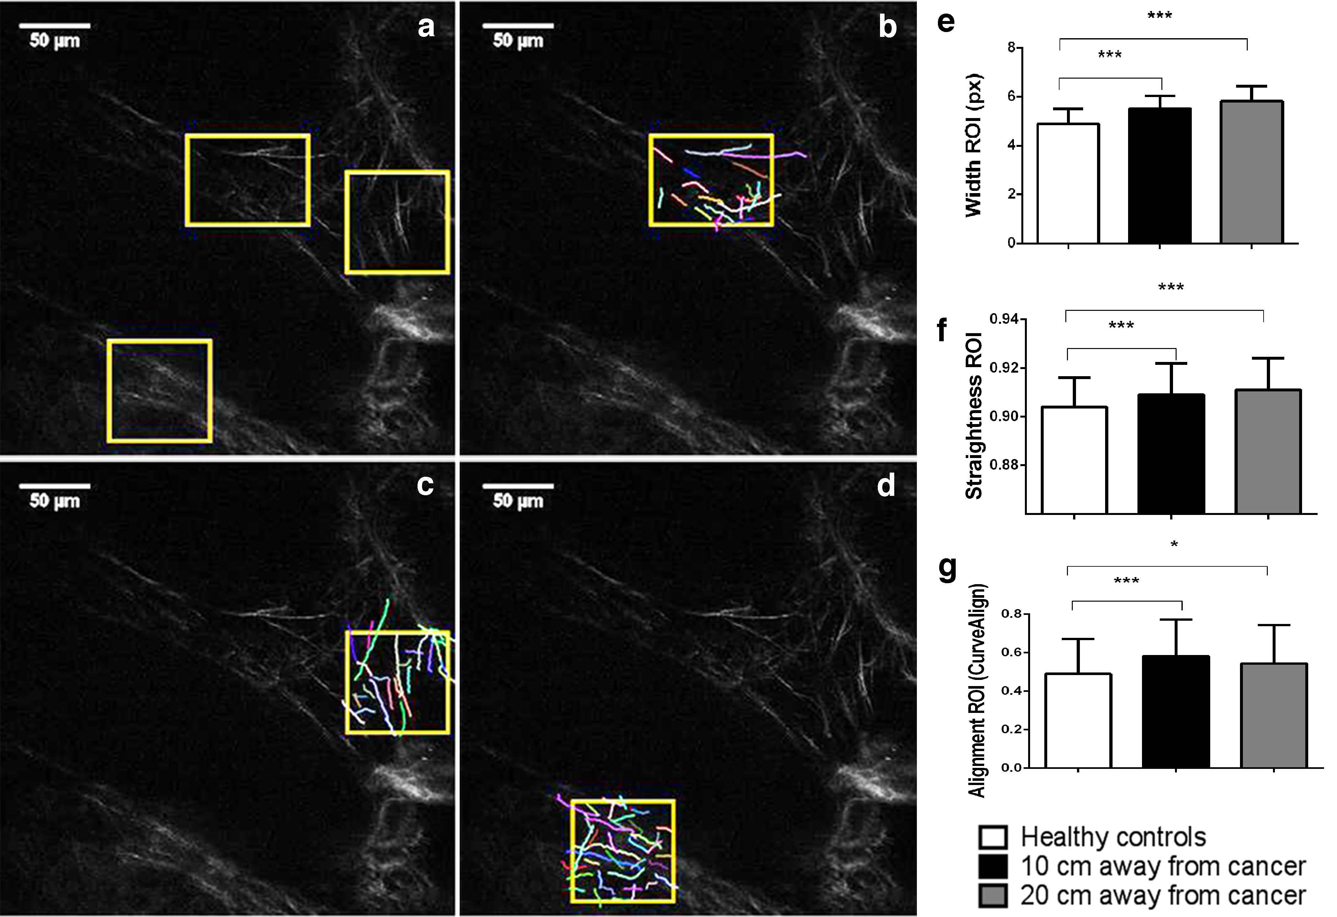
Results: CT-FIRE and CURVE Align analysis in ROIs

Slide 21
Results: Dispersion parameter κ and anisotropy coefficient β
 | Healthy control (n=32) | 10 cm away from cancer (n=35) | 20 cm away from cancer (n=35)
κ dispersion parameter | 0.51±0.22 | 0.91±0.53* | 1.11±0.67**
β coefficient | 0.26±0.03 | 0.31±0.004*** | 0.32±0.05***
*p>0.05 **p<0.01 ***p<0.001

Slide 22
Results: SEM images

Slide 23
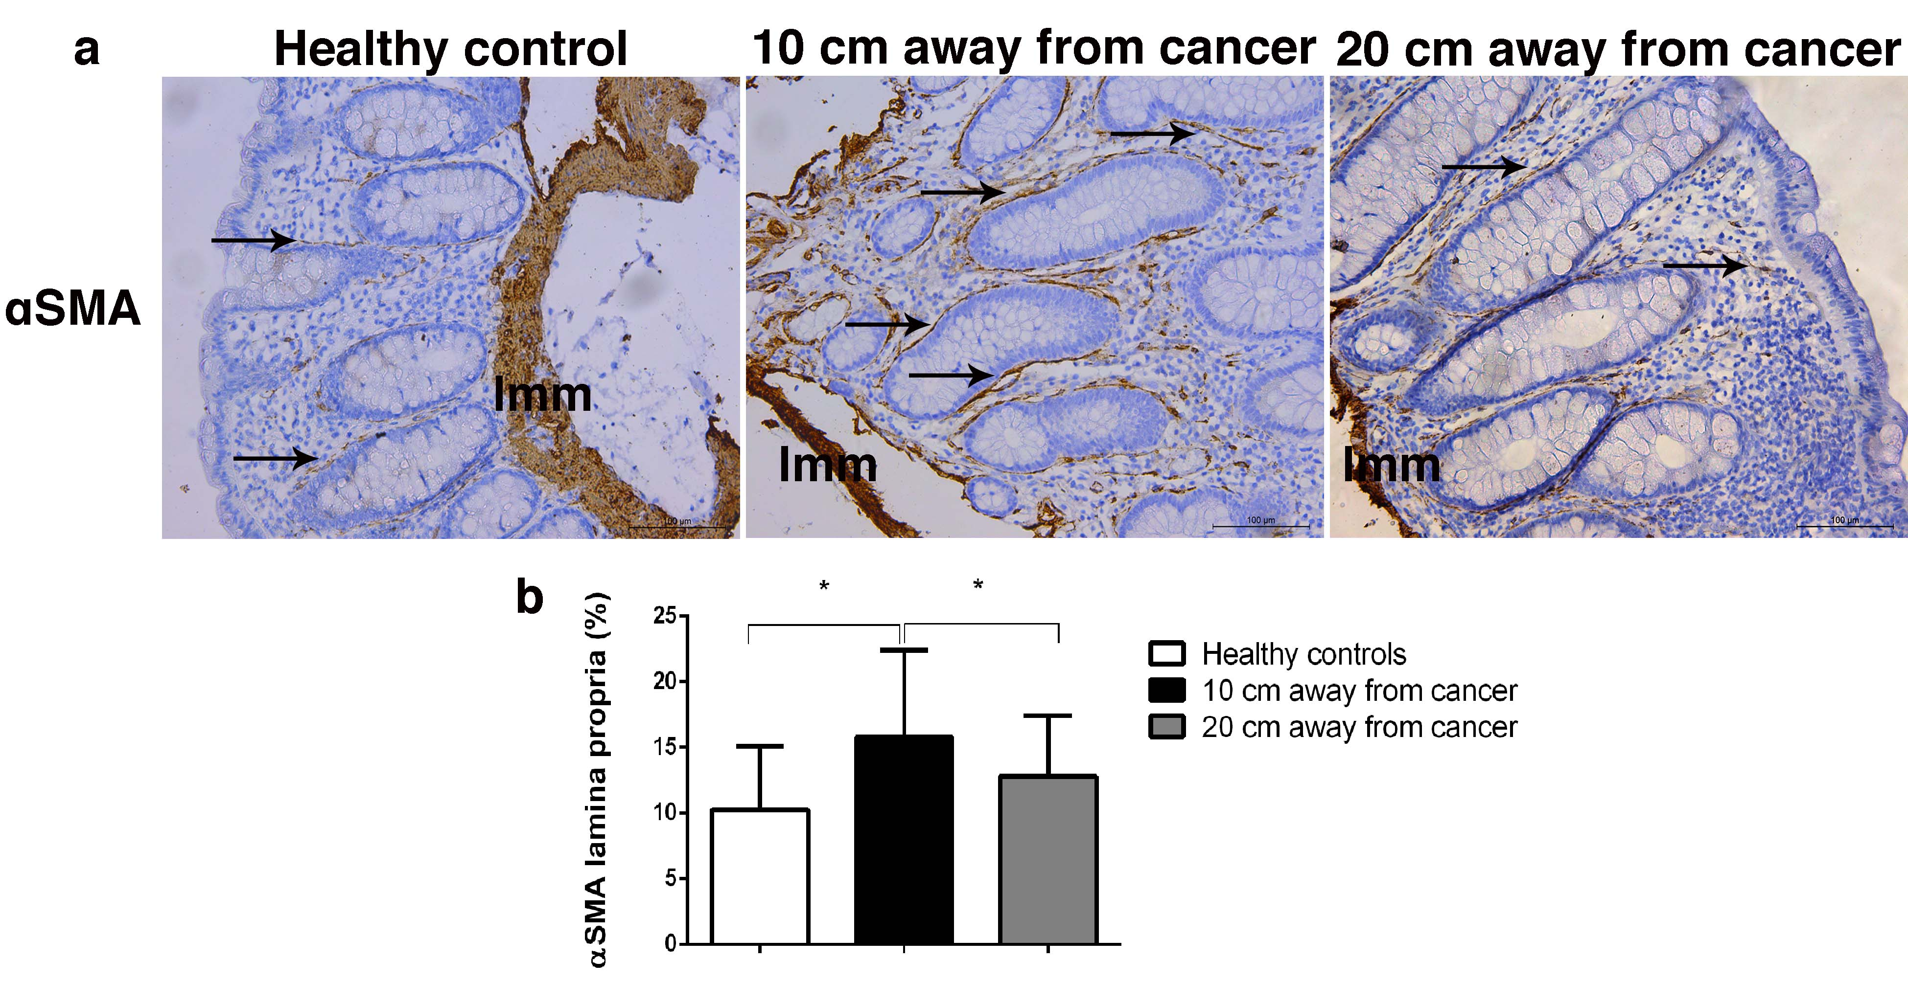
Results: alphaSMA

Slide 24
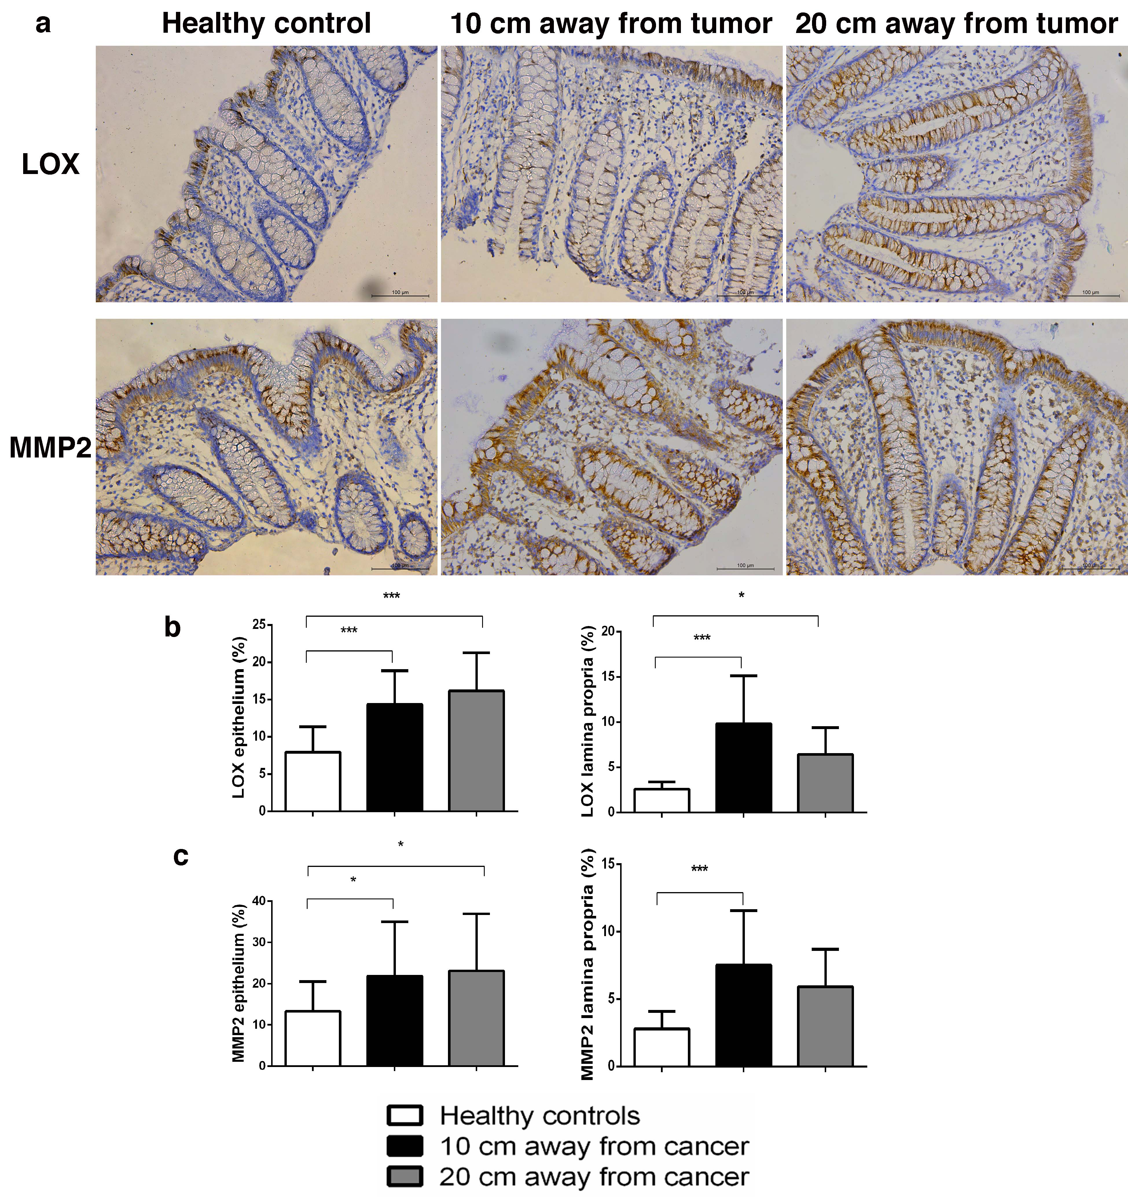
Results: LOX, MMP2

Slide 25
Results: MMP9

Slide 26
Morphology and organization of collagen fibers are changed 10 cm and 20 cm away from the cancer
Involvment of fibroblasts/myofibroblast, LOX and MMP2

Slide 27
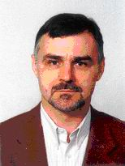
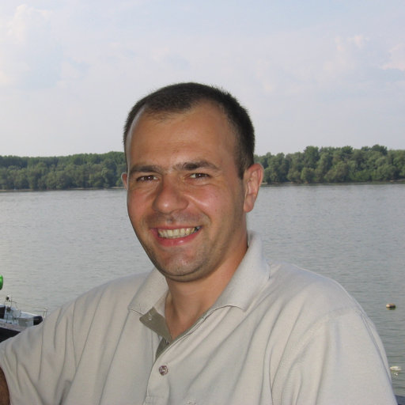
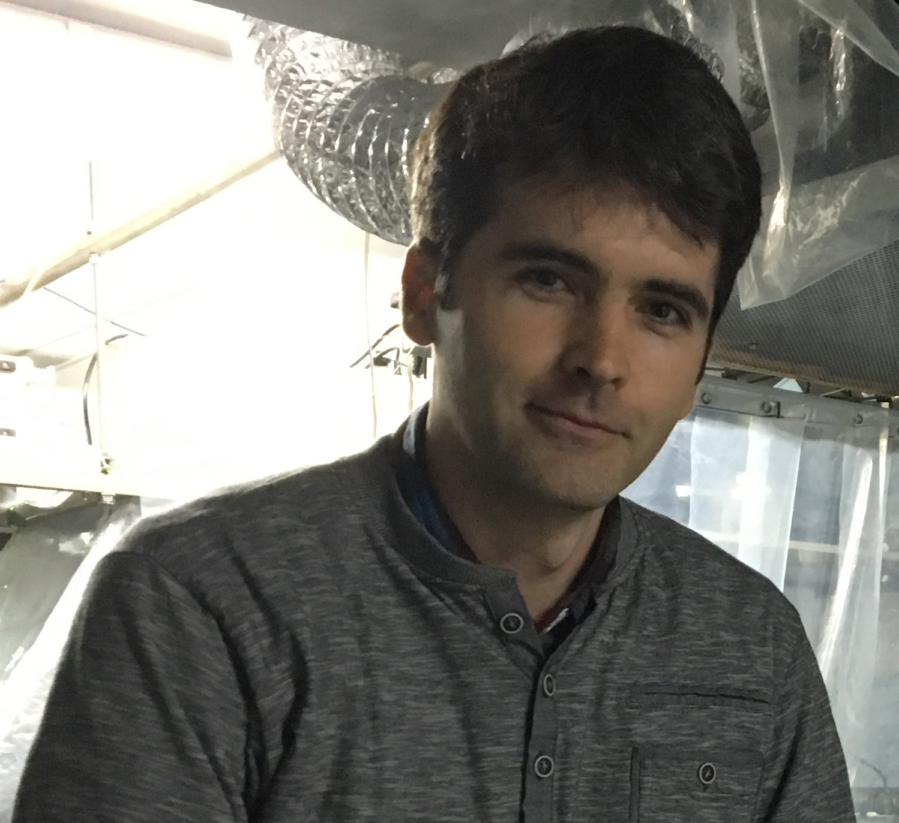
Professor dr N.Milićević
Associated professor dr A. Krmpot
Professor dr Ž.Milićević
Associated professor dr M. Rabasović

