Slide 1
Effect of charged lipids on amyloid-beta peptide interactions with phospholipid membranes
130th session of the Scientific Council
Dina Badreeva
Meshcheryakov Laboratory of Information Technologies, JINR, Dubna, Russia
23 September 2021 Dubna

Slide 2
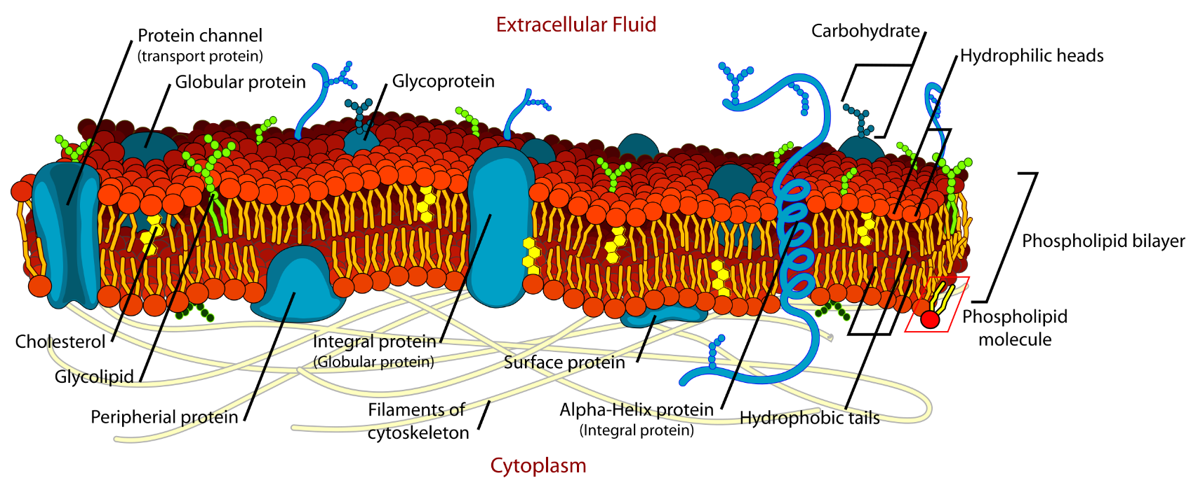
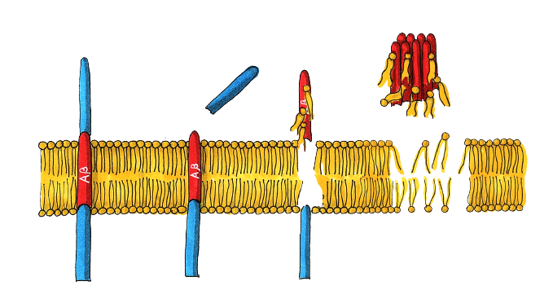
Motivation
cholinergic hypothesis
amyloid-beta hypothesis
tau hypothesis
Fig. 1. The model of membrane structure¹
APP
glycoprotein
Amyloid
aggregates
β-secretase
Destabilized membrane
γ-secretase
Fig. 2. The sketch of the amyloid hypothesis of Alzheimer's disease²
¹ Figure has been reproduced from wikipedia.org/wiki/Cell_membrane
² Figure has been reproduced from JINR news (15.02.2021// D.R. Badreeva, P. Hrubovčák, E.B. Dushanov, E.V. Ermakova, O.I. Ivankov, T. Kondela, A.I. Kuklin, S.A. Kurakin, T.N. Murugova, V.V. Skoi, D.V. Soloviov, Kh.T. Kholmurodov and N. Kučerka, Neutrons and molecular simulations: scrutinizing the neural membranes damage caused by amyloid beta peptide//)
Dina Badreeva/Scientific Council/23.09.21
2/11

Slide 3
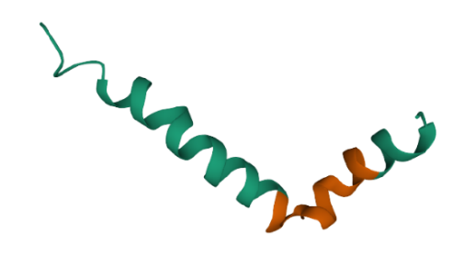
Objectives
Fig. 3. Aβ₁₋₄₂: DAEFRHDSGYEVHHQKLVFFAEDVGSNKGAIIGLMVGGVVIA
Questions:
How do the Aβ₂₅₋₃₅ peptides affect the structure of the lipid membranes? Where is the peptide located in membranes?
Does the lipid charge affect the peptide-membrane interactions?
Aβ₂₅₋₃₅
1,2-Dimyristoyl-sn-glycero-3-phosphocholine (DMPC)
Fig. 4. The snapshot of Aβ₂₅₋₃₅ positions in a model phospholipid membrane after 1 μs MD run (red points – water, cyan points – atoms of phosphorus, gray lines – DMPC lipids, blue lines – DMPS lipids)
1,2-dimyristoyl-sn-glycero-3-phospho-L-serine (DMPS)
T. Kondela, et al., Investigating the competitive effects of cholesterol and melatonin in model lipid membranes, BBA - Biomembranes, v. 1863, 9 (2021).
Dina Badreeva/Scientific Council/23.09.21
3/11

Slide 4
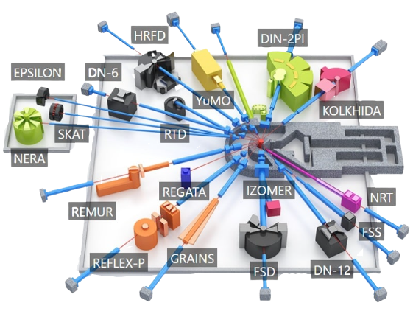
Materials and methods: small angle neutron scattering
Sample preparation:
DMPC, DMPS from Avanti Polar Lipids, Aβ25-35 from Abbiotec – lyophilized powder form; organic solvents (TFE, chloroform, TFA) from Sigma-Aldrich Chemie Gmbh;
Lipids → dissolved in chloroform mixture (50 mg/ml);
Peptides → dissolved in TFA → treated in ultrasonic bath (10-12min) → peptide disaggregation;
TFA → evaporated, peptide → redissolved in chloroform mixture (1.6 mg/ml);
Lipids and Aβ25-35 → mixed in microtubes (0.5 mol%) → dried to dryness;
Lipid/Aβ25-35 films → hydrated with D₂O (1% by mass) → frozen and thawed in several cycles;
Multilamellar solutions → extruded into ULVs (by the Avanti Mini Extruder® at room temperature without heating and with polycarbonate membranes (2000 Å, 1000 Å, and 500 Å)).
SANS details:
SANS → performed at the spectrometer YuMO at the IBR-2 pulsed reactor;
Beam → formed by two pinhole collimators (diameters 40 and 14 mm) → detected with two circular wire-ring detectors (distances 4.5 and 13 m);
Absolute intensity calibration → performed with the vanadium standard;
Liquid samples in 2-mm-thick flat quartz cuvettes → held in the multipositional sample holder connected to the Lauda liquid thermostat with temperature controller Pt-100 (temperature accuracy of ±0.03ºC) → several independent experimental cycles;
Collected scattering curves → corrected for background scattering from the buffer solution;
Analysis of SANS curves → performed with the SASFit program (models of bilayered vesicles or randomly oriented cylindrical core-shell objects with a circular cross-section).
Dina Badreeva/Scientific Council/23.09.21
4/11

Slide 5
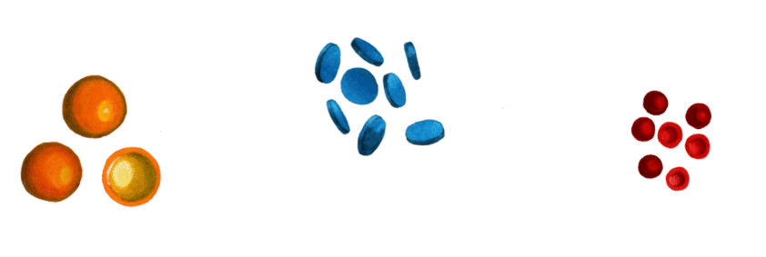
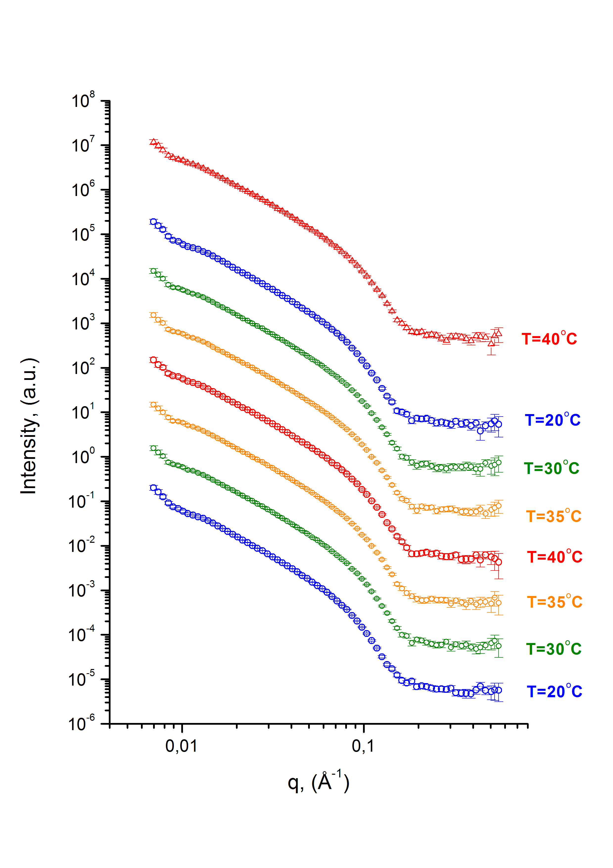
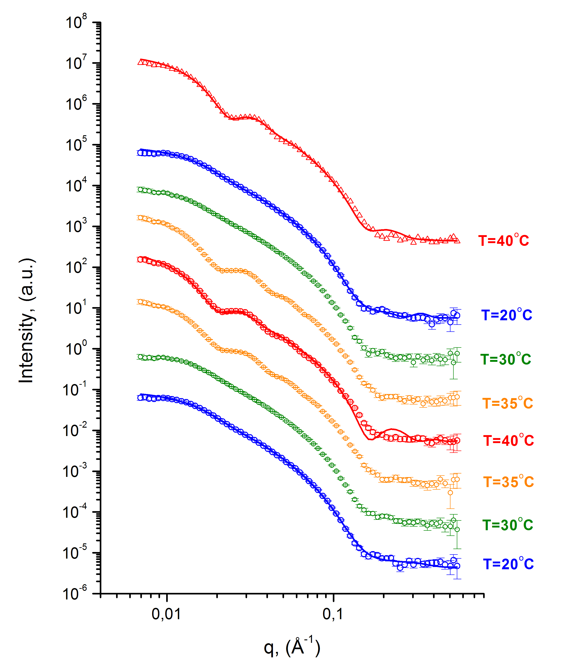
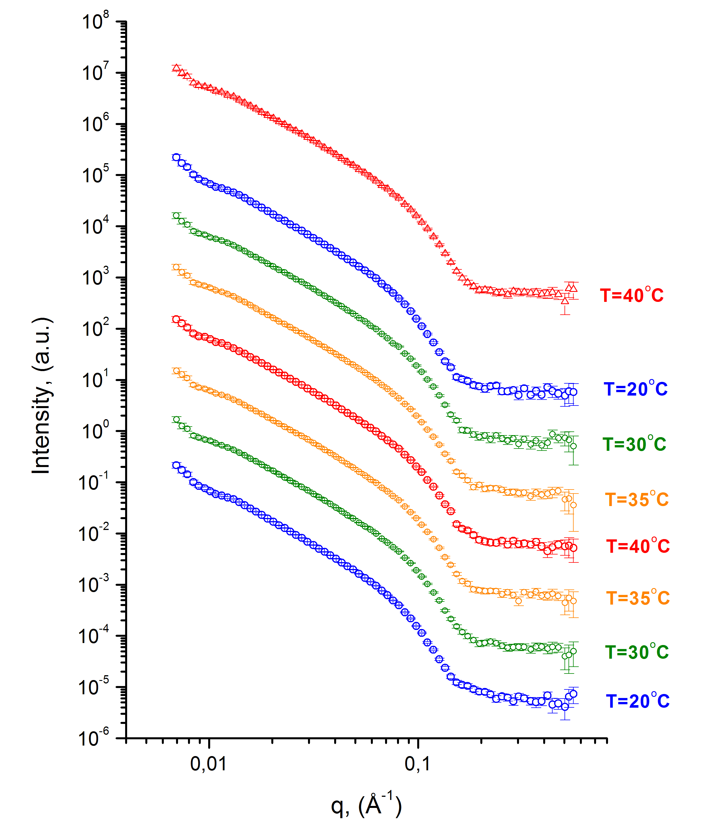
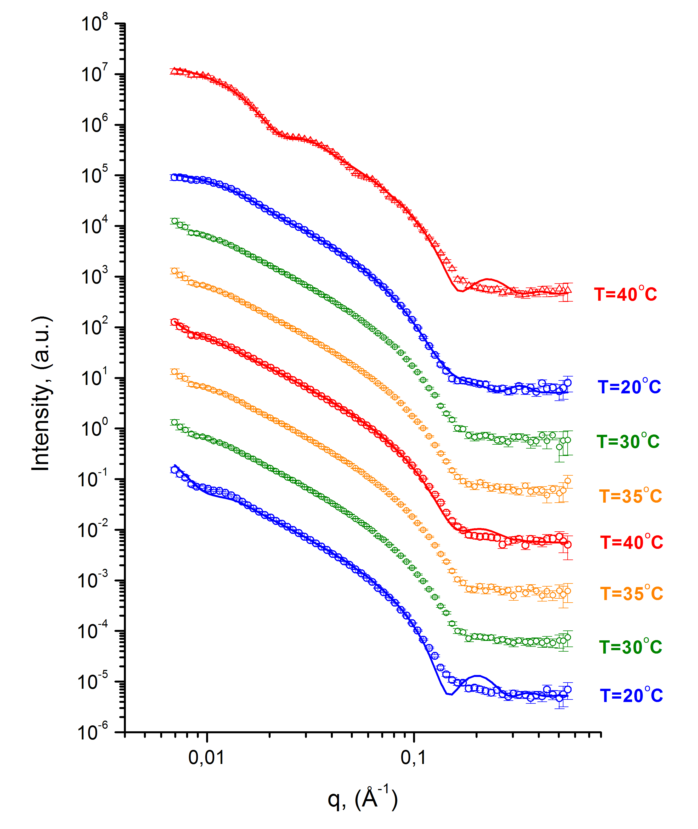
Small angle neutron scattering results
Uncharged membrane (DMPC)
Charged membrane (DMPC/DMPS)
EULVs (600 Å)
EULVs (600 Å)
T_{DMPC}(L_{β}→L_{α})=24°C
T_{DMPC}(L_{β}→L_{α})=24°C
BLSs (400 Å)
BLSs (400 Å)
SULVs (200 Å)
SULVs (200 Å)
A)
B)
C)
D)
without peptides
with peptides
without peptides
with peptides
O. Ivankov, et al. Amyloid-beta peptide (25-35) triggers a reorganization of lipid membranes driven by temperature changes. Scientific Reports. Nature. (doi: 10.21203/rs.3.rs-886431/v1, submitted)
Dina Badreeva/Scientific Council/23.09.21
5/11

Slide 6
Methods: molecular dynamics and umbrella sampling
System | 1 | 2 | 3 | 4 | 5 | 6
DMPC | 256 |  | 252 |  | 248
DMPS | 0 |  | 4 (1.5%) |  | 8 (3%)
Aβ₂₅₋₃₅ | - | 8 (3%) | - | 8 (3%) | - | 8 (3%)
Molecular dynamics details:
GROMACS 2019.3;
“Govorun” supercomputer (MLIT, JINR) (8 GPUs per run, multithreading, 1 μs – 7 days);
Starting configuration: CHARMM-GUI Membrane Builder and InflateGRO script;
Force field: CHARMM36m with TIP3P water molecules (40 per lipid);
NVT + NPT equilibrations: 50 ns for pure membranes, 100 ns for membranes with peptides;
Nose-Hoover thermostat at 293 K, 303 K, 323 K;
Parrinello-Rahman barostat at 1 bar of pressure;
MD run: 500 ns for pure membranes, 1 μs for membranes with peptides;
Constraints: LINCS algorithm;
Integration: leapfrog algorithm with time step of 2 fs;
Long-range electrostatic interactions: the smooth particle mesh Ewald algorithm; PBC in three dimensions;
Analysis: GROMACS tools.
Fig. 7. The snapshot of one of the starting configurations (red points – water, cyan points – atoms of phosphorus, gray lines – DMPC lipids, blue lines – DMPS lipids)
Umbrella sampling details:
Reaction coordinate: distance between the centers-of-mass of the peptide and the membrane;
12 windows spaced every 2 Å;
1 ns NPT equilibration;
100 ns run;
The force constant: 1000 kJ/mol/nm²;
The pulling rate: 0.02 nm/ns;
Analysis: the weighted histogram analysis method.
Dina Badreeva/Scientific Council/23.09.21
6/11

Slide 7
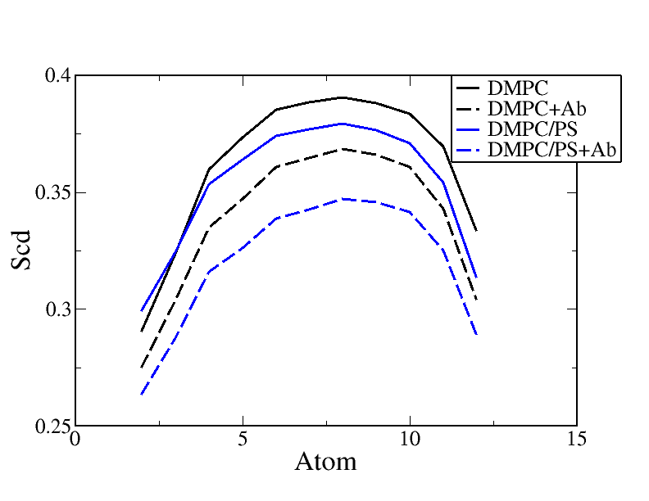
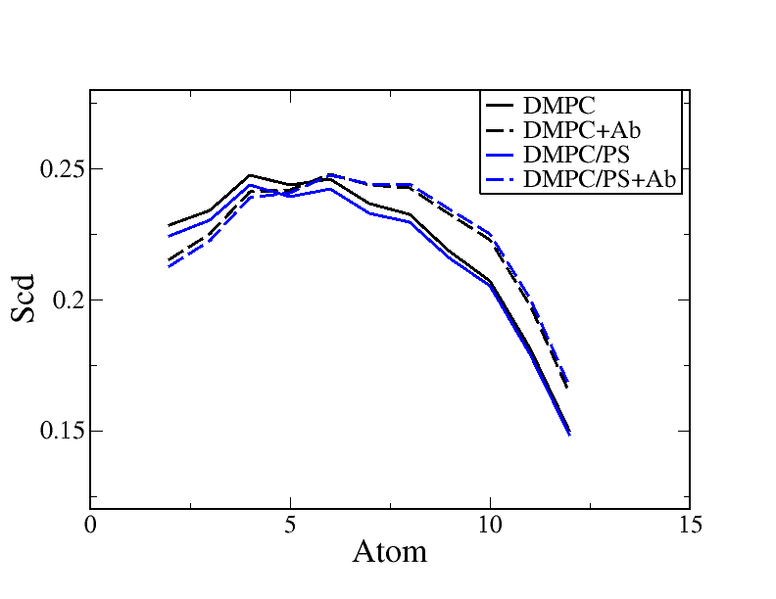
Molecular dynamics results
uncharged membrane
charged membrane
uncharged membrane with Aβ₂₅₋₃₅
charged membrane with Aβ₂₅₋₃₅
A)
B)
20°C
50°C
Fig. 9. Order parameters of lipid chains (S_{cd}=(3cos²θ_{cd}-1)/2) at temperatures of A) 20°C, B) 30°C
Dina Badreeva/Scientific Council/23.09.21
7/11

Slide 8
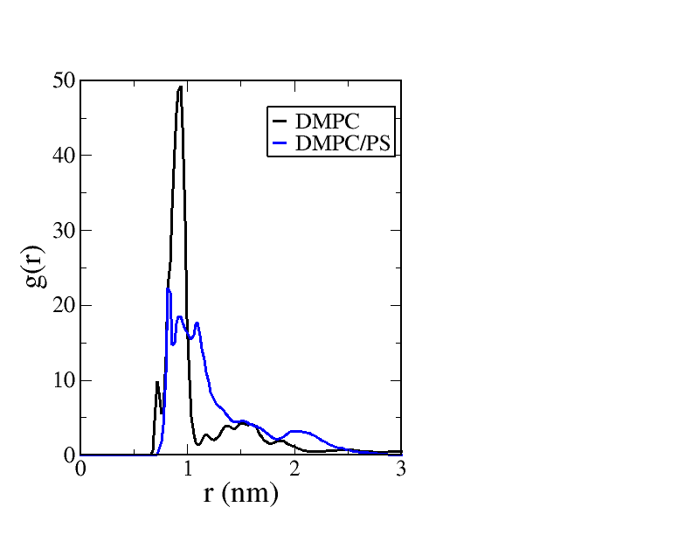
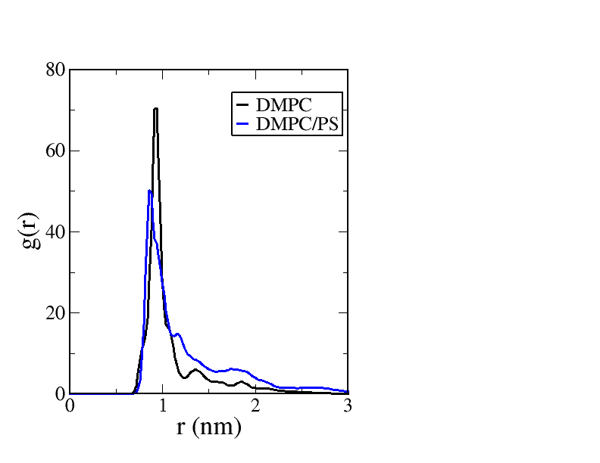
Molecular dynamics results
A)
B)
Fig. 10. Radial distribution function of peptide-peptide COM at temperatures of A) 30°C, B) 50°C
30°C
50°C
A)
B)
Fig. 11. The snapshots of Aβ₂₅₋₃₅ positions in A) DMPC/PS and B) DMPC/PS membranes at 30°C and 50°C accordingly after 1 μs run (cyan points – atoms of phosphorus, water and lipids are omitted)
Dina Badreeva/Scientific Council/23.09.21
8/11

Slide 9
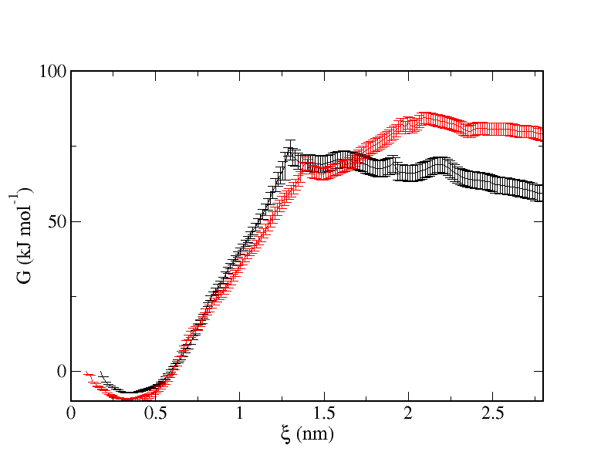
Umbrella sampling results
uncharged membrane
charged membrane
B)
Δ
A)
Fig. 13. The snapshots of Aβ₂₅₋₃₅ positions in A) DMPC, B) DMPC/PS membranes at 30°C (cyan points – atoms of phosphorus, water and lipids are omitted)
Fig. 12. Free-energy profiles of Aβ₂₅₋₃₅ peptide binding to the DMPC and DMPC/DMPS membranes at 30°C
S. Dante, et al., β-Amyloid 25 to 35 is intercalated in anionic and zwitterionic lipid membranes to different extents, Biophysical Journal, v. 83, 5 (2002)
Dina Badreeva/Scientific Council/23.09.21
9/11

Slide 10
Conclusions
The presence of Aβ₂₅₋₃₅ peptides affects the structural properties and the morphology of zwitterionic and anionic membranes:
The charged membranes undergo a transition from EULVs (outer diameter of 600 Å) to BLSs (outer diameter of 400 Å), and both charged and uncharged membranes undergo a transition reversibly between BLSs and SULVs (outer diameter of 200Å) during their phase transitions;
Aβ₂₅₋₃₅ peptides embedded into the membrane increase the total membrane thickness and the size of the obtained structures, and also the experimental and simulation results are consistent;
Also, peptides reduce the order parameter of lipid tails and increase disorder in the organization of lipid molecules; however, with an increase in temperature, this effect is reduced;
Electrostatic interaction of peptides and anionic lipid heads prevents peptides from leaving the surface of a membrane;
It can be assumed that the ability of Aβ to aggregate depends on the potential for hydrogen and electrostatic bonding between peptides and surrounding lipids: lipids with greater numbers of hydrogen bonding and anionic groups such as DMPS reduced Aβ aggregation and the structural destabilization caused by Aβ;
Aggregated Aβ did not leave the hydrophobic core of any of the MD studied membranes, but despite the stability of the aggregates, it is possible that aggregated Aβ can leave the membrane core over time that is inaccessible for all–atom MD simulations.
The following steps:
O. Ivankov, E. Ermakova, D. Badreeva, N. Kučerka, et al. Charged lipids modulate the reorganization effect of amyloid-beta peptide on the membranes (in preparation);
Coarse-grained molecular dynamics to look in what way Aβ₂₅₋₃₅ changes the shape of membranes;
Study of Aβ₂₅₋₃₅ effect on dynamics properties of lipid membranes within inelastic X-ray scattering and molecular dynamics.
Dina Badreeva/Scientific Council/23.09.21
10/11

Slide 11
Acknowledgment
This work has been supported by the Russian Science Foundation under grant № 19-72-20186.
Our group:
N. Kučerka (FLNP, JINR, Russia & Comenius University in Bratislava, Slovakia)
E.B. Dushanov (LRB, JINR, Russia & Dubna State University, Russia)
O.I. Ivankov (FLNP, JINR, Russia & ISPNPP NAS, Ukraine)
E.V. Ermakova (FLNP, JINR, Russia)
T. Kondela (FLNP, JINR, Russia & Comenius University in Bratislava, Slovakia)
Kh.T. Kholmurodov (FLNP, JINR, Russia & Dubna State University, Russia)
S.A. Kurakin (FLNP, JINR, Russia & KFU, Russia)
T.N. Murugova (FLNP, JINR, Russia & MIPT, Russia)
V.V. Skoi (FLNP, JINR, Russia & MIPT, Russia)
D.V. Soloviov (FLNP, JINR, Russia & MIPT, Russia & ISPNPP NAS, Ukraine)
Dina Badreeva/Scientific Council/23.09.21
11/11

Slide 12
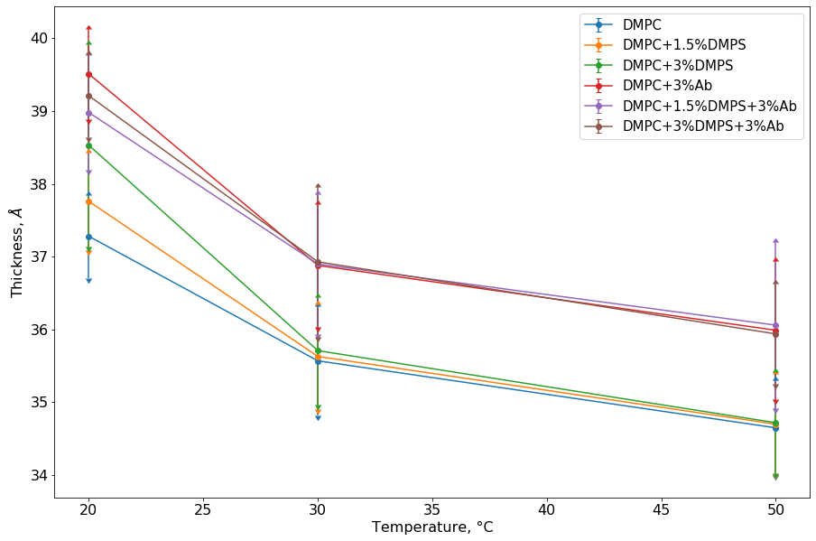
Molecular dynamics results
Fig. 8. Dependence of membrane thickness on temperature and its composition (the distance between phosphorus atoms of lipid head group)
Dina Badreeva/Scientific Council/23.09.21
7/12

Slide 13
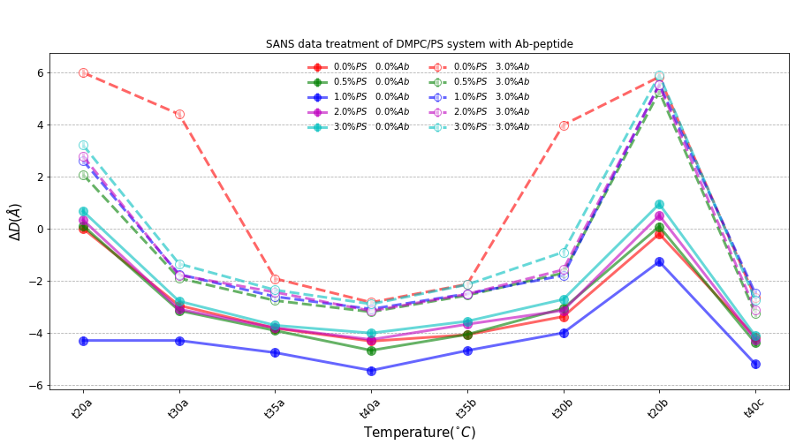
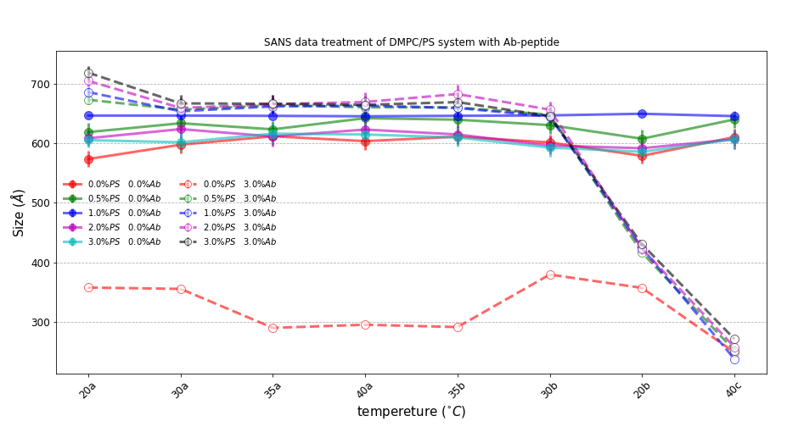
Small angle neutron scattering results
Fig. 6. The relative changes in membrane thickness ΔD (with respect to the neat DMPC at T=20°C) (A) and the changes in the size of the structures (B) for DMPC and DMPC/DMPS (solid lines), and DMPC+Aβ25-35 and DMPC+DMPS+Aβ₂₅₋₃₅ (dashed lines)
A)
B)
BLSs
3-shell vesicle model and a model of randomly oriented cylindrical shells with circular cross-section
EULVs
SULVs
Dina Badreeva/Scientific Council/23.09.21
6/12

Slide 14
Molecular dynamics results
A)
B)
C)
A)
B)
Fig. 12. Radial distribution function of peptide-peptide COM at temperatures of A) 20°C, B) 30°C, C) 50°C
Dina Badreeva/Scientific Council/23.09.21
10/12

