Slide 1






















130th session of the
JINR Scientific Council
(23-24 september 2021)
First steps in implementation of the JINR Long-Term Development Strategic Plan
Grigory Trubnikov
Notes:
1

Slide 2



Strategy Architecture (6 key blocks):
JINR 2030+
Human resources
Social Environment
Innovation
PR
Outreach
RESEARH
Management
Elements of the
“JINR 2030+” environment
JINR DNA – International Research Topical Plan
Notes:
2

Slide 3
SCIENTIFIC INFRASTRUCTURE
AND INNOVATIONS

Slide 4
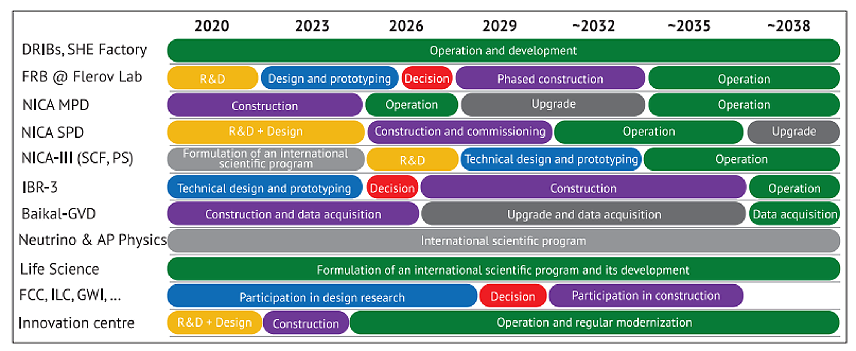
STRATEGIC PLANS: DEVELOPMENT OF SCIENTIFIC INFRASTRUCTURE
FOR BASIC AND APPLIED RESEARCH

Slide 5
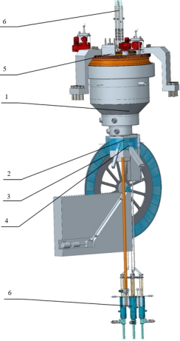
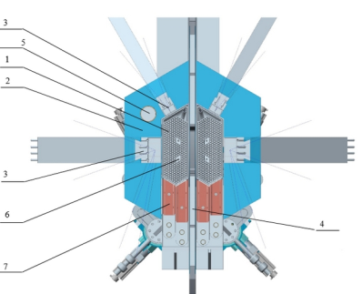
Scientific highlights
Project of the New Neutron Source
Conceptual technical proposal of Neptune (by NIKIET) – 1st step of the roadmap
1 – reactor;
2 – stationary reflector;
3 – reactivity modulator;
4 – moderators;
5 – rotary plugs;
6 – CPS actuators;
7 – RS of RSS
Dimensions:
– height (including CPS actuators) 14,2 м;
– core height 3,54 м;
– core diameter 3,2 м;
– modulator wheel diameter 3,72 м.
Notes:
At present, work is underway to create a new neutron source – “Neptun” (IBR-3) fast pulsed reactor with neptunium nitride fuel. A technical proposal for the reactor has been received. The next stage is the development of sketch and design projects, conducting an investment feasibility study, as well as making a decision on construction (2023). R&D work has begun on neptunium nitride fuel.
В настоящее время продолжаются работы по созданию нового источника нейтронов – импульсного быстрого реактора «Нептун» (ИБР-3) с топливом на основе нитрида нептуния. Получено техническое предложение реакторной установки. Следующий этап – разработка эскизного и обликового проектов, обоснование инвестиций, а также принятие решение о сооружении (2023 г.). Начаты работы по проведению НИОКР по топливу на основе нитрида нептуния.
5

Slide 6
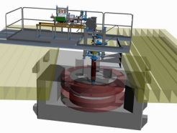

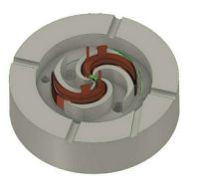
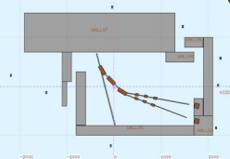
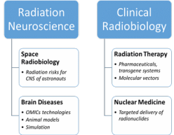
International Innovation Centre for Nuclear Technology Research
Development of technologies and methods in the field of nuclear and radiation medicine, radiation materials science, advanced training of specialists for JINR Member States for radiation biology, medical physics, material studies.
Main stages:
Radiation biology: OMICS@LRB and neuroradiobiological studies. Radiation neuroscience. Approaches to increase radiosensitivity: pharmaceuticals, transgene systems, targeted delivery (molecular vectors) and radionuclide;
ARIADNA: Applied beams@NICA (ions from MeV/u to GeV/u): radiobiological studies (400-800 MeV/n); radiation testing of semiconductor electronics (3; 150-350 MeV/n); nuclear physics @ 1-4.5 GeV/n. Period of realization: 2021–2024;
New facility with DC-140 cyclotron for electronic component testing, radiation material science, track pore membrane research and production, etc. Period of realization: 2021–2023;
New research proton cyclotron (MSC-230) for R&D in beam therapy: treatment planning; radiomodificators for photon and proton therapy, flash-therapy, pencil beam, other breakthrough technologies. As a pilot facility for future medical centre. Period of realization: 2021–2024.
New facility: Radiochemical Laboratory Class-I for production of radioisotopes (Ac²²⁵, ^{99m}Tc) for nuclear medicine in photonuclear reactions @ 40MeV Rhodotron accelerator. Period of realization: 2022–2026;
DC-140 (schematic design)
SC-230 (schematic design)
NICA beamlines
from MeV/u to GeV/u (schematic design)
Notes:
6

Slide 7
DEVELOPMENT OF JINR
AS INTERNATIONAL INTERGOVERNMENTAL
RESEARCH ORGANIZATION
AND EXPANSION OF THE PARTNER NETWORK
Notes:
7

Slide 8
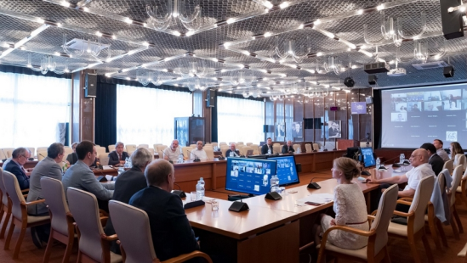
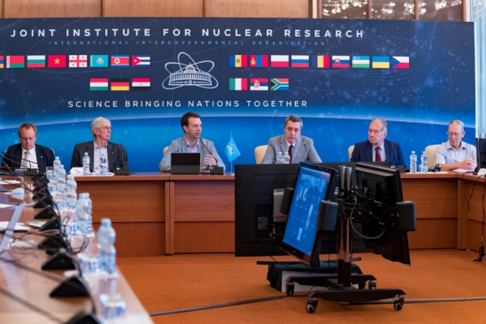
First meeting of Working Group@JINR CP for Strategic issues
On 22 July 2021 the first meeting of the Working Group on Strategic Issues (WGSI) was held in a mixed format under the chairmanship of the representative of the Czech Republic Ivan Štekl.
The Working Group was established by the decision of the Committee of Plenipotentiaries of JINR in March 2021.
The Secretariat for the WGSI headed by vice-director L. Kostov was established by decree of Director
Major goals of WGSI:
to be a reliable tool contributing to closer participation of the Member States in the JINR activities;
to increase the spread of information and the degree of elaboration of issues for discussion by Plenipotentiaries at CP meetings.
Highlights of the meeting:
presentation of the draft regulations on associated membership in JINR;
decision to present the principles and rules of the WGSI operation to the CP members for approval.
Notes:
On 22 July 2021, the first meeting of the Working Group on Strategic Issues was held in a mixed format under the chairmanship of the representative of the Czech Republic Ivan Štekl. The group was established by the decision of the Committee of Plenipotentiaries of JINR in March this year. JINR directorate established Working Group secretariat headed by Vice-Director Latchesar Kostov.
Experts and specialists from 15 JINR Member States appointed by decisions of Plenipotentiary Representatives, as well as Plenipotentiaries of the Czech Republic, Cuba, Georgia, Poland, Slovakia, and Vietnam took part in the event. The President of the Vietnam Atomic Energy Institute also attended the meeting. Working group considered its organizational basics, regulations on associated membership, code of the JINR flag and the draft regulations on its use. As a result the drafts of these documents are available in the documentary section of JINR web site. They will be presented for approval by Plenipotentiaries at the upcoming November CP session in Bulgaria.
8

Slide 9
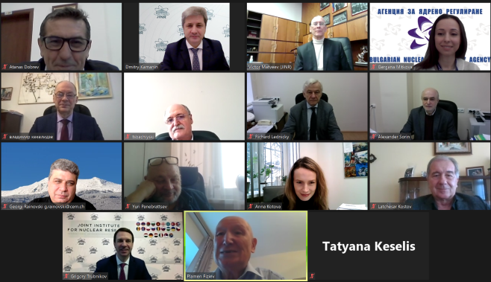

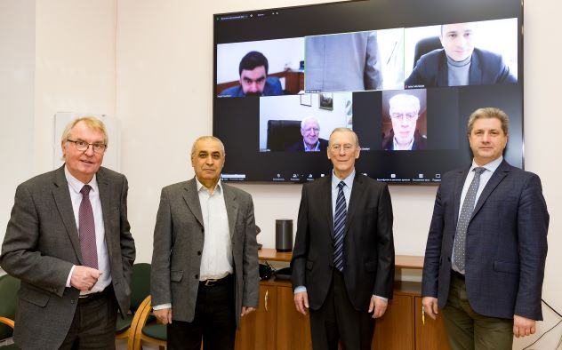
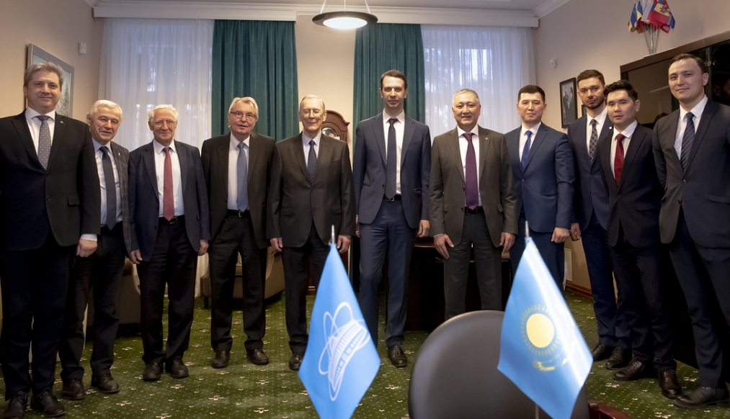
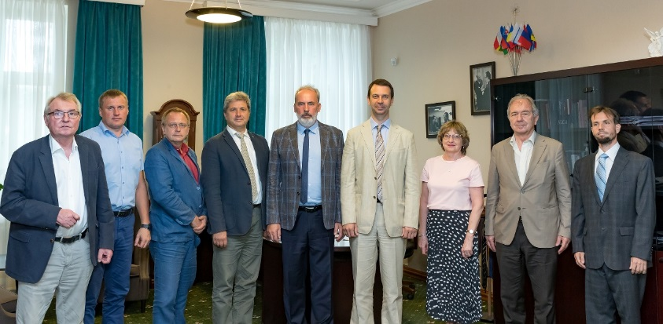
Meetings with newly appointed Plenipotentiaries
26.02.2021 / Zoom
Tsanko Bachiyski, Plenipotentiary of Bulgaria.
preparation for Year of Bulgaria in JINR;
information center at Sofia University
18.03.2021 / Zoom
Arif Mamed oglu Gashimov,
Plenipotentiary of Azerbaijan.
Enhancing cooperation with NICA;
Upcoming visit of delegation to JINR
18.03.2021 / Zoom
Sargis Hayotsyan, Plenipotentiary of Armenia.
Network of PLI in Armenia;
Cooperation with ERPHI
23.03.2021 / In-person
Batyrzhan Karakozov,
Plenipotentiary of Kazakhstan.
Basic facilities in RK, opening JINR Branch;
AYSS conference in October in Kazakhstan
19.07.2021 / In-person
Fedor Šimkovic, Plenipotentiary of Slovakia.
presence of young researchers at JINR;
increase in participation of high-tech Slovak enterprises in JINR projects
cross Days of JINR in Slovakia and Days of Slovakia in JINR
Participation of Slovakia in creation of JINR Innovation Centre
Notes:
Within the last six months, the JINR Directorate has had a number of meetings with newly appointed Plenipotentiary Representatives outlined the most important areas of cooperation and further development of contacts with account to pandemic. Meeting with Tsanko Bachiyski, Plenipotentiary of Bulgaria, with Arif Mamed oglu Gashimov, Plenipotentiary of Azerbaijan, and with Sargis Hayotsyan, Plenipotentiary of Armenia, were held via zoom in February-March this year. An in-person meeting in March with Batyrzhan Karakozov, Plenipotentiary of Kazakhstan, touched many initiatives and, in particular, organization of the conference of young scientists in Almaty in October this year. An in-person meeting in July with Fedor Šimkovic, Plenipotentiary of Slovakia, noted importance of presence of young Slovak researchers, including students and postgraduates, as well as the increase in participation of high-tech enterprises of Slovakia in JINR projects, participation in creation of the JINR Innovation Centre and many others.
9

Slide 10
ARE-JINR: TODAY and TOMORROW - Cairo, 13-14 September, 2021
Upgrading the status of Egypt in JINR up to the full membership
“Strategic Opportunities for Advancing Global Collaborative Perspectives Towards Achieving 2030 Main Research Goals”
Ceremonial opening of the JINR Information Centre at the headquarter of ASRT
Participants:
JINR delegation headed by Acad. G. Trubnikov;
Directorate of ASRT, headed by Prof. M. Sakr;
Arab Atomic Energy Agency’s Head of Scientific Affairs Directorate Daw Saad Mosbah;
Egyptian leading scientists
Honorable speakers:
– the Ambassador of the Russian Federation to Egypt H. E. Georgiy Borisenko;
– the Ambassador of Romania to Egypt H. E. Mihai Stuparu;
– the Ambassador of Bulgaria in Egypt H. E. Deyan Angelov;
The participants of the ceremonial opening of the event:
JINR Director Academician Grigory Trubnikov;
Chairman of the Egyptian Atomic Energy Agency (EAEA)
Prof. Amr El-Hag Ali;
President of ASRT Prof. Mahmoud Sakr;
Minister of Higher Education and Scientific Research of Egypt
H. E. Khaled Abdel-Ghaffar.
Topic parallel sessions
Main highlights:
discussion of the prospects for the development of the information center and its role in the development of scientific communication in both Egypt and the MENA region;
demonstration of educational films prepared by the UC as one of the training tools for the potential audience of the Information Center.
Radiobiology, Genetics, and Radiation Therapy
Nuclear analytical techniques, neutron radiography
Archaeology and Cultural Heritage
High energy physics, NICA, SPD, and MPD
Nanotechnology Applications
Theoretical Physics and Advanced Mathematics
Analysis of Big Data, Computation
Notes:
On September 13 the scientific workshop “Egypt – JINR: Today and Tomorrow” started in Cairo. The participants of the ceremonial opening of the event were welcomed by the Chairman of the Egyptian Atomic Energy Agency (EAEA) Prof. Amr El-Hag Ali, the President of ASRT Prof. Mahmoud Sakr, and the Minister of Higher Education and Scientific Research of Egypt H. E. Khaled Abdel-Ghaffar. The welcome addresses on behalf of the JINR Member States were delivered by: the Ambassador of the Russian Federation H. E. Georgiy Borisenko , the Ambassador of Romania H. E. Mihai Stuparu and the Ambassador of Bulgaria H. E. Deyan Angelov. JINR delegation was presented by the members of Directorate, Chief Scientific secretary, UC Director, ICD Director, the directors and deputy directors of laboratories. A number of the leading specialists of JINR laboratories and Egyptian research centers took part in the topical parallel sessions of the workshop. The agenda of the event included the meetings of the JINR’s leadership with the leaders of ASRT, the Ministry of Higher Education and the administration of the higher educational institutions and research institutes of the Egypt.
On September 14 a ceremonial opening of the JINR Information Centre took place at the headquarters of the Egyptian Academy of Scientific Research and Technology. The ceremony was attended by the directorate of JINR, ASRT, Head of Scientific affairs Directorate of Arab Atomic Energy Authority Daw Mesbah and leading scientific researches of Egypt.
10

Slide 11
JINR delegation's visit to Bulgaria, 15-18 September
15 September - Arrangement of the new recreation area with the assistance of JINR, BNRA and Kozloduy NNP in Sofia South Park;
17 September - festive scientific session “65 years of Bulgaria-JINR cooperation”:
Reports on the contribution of Bulgarian scientists to JINR development and participation of Bulgaria in the JINR-CERN cooperation
Presentation of the JINR Development Strategy up to 2030 and beyond.
16 September – Opening ceremony of the JINR Information Centre, the first in the European Union, at the premised of the Physical Faculty of Sofia University “St. Kliment Ohridski”:
The Agreement on Opening of JINR Information Centre and the Agreement on Cooperation in Scientific-Research Activity and HR Development, aimed at widening cooperation between JINR and Sofia University in science, research, innovation, personnel training and popularization of natural science, were signed by Ltchesar Kostov and Rector of Sofia University “St. Kliment Ohridski” Prof. Anastas Gerdjikov;
ICD Director Dmitry Kamanin presented JINR IC network development, its work opportunities and achievements;
UC Director Stanislav Pakuliak made a report on the importance of JINR IC activity in education, and its development on the basis of IC.
Notes:
JINR delegation headed by its Vice-Directors Ltchesar Kostov and Vladimir Kekelidze was on a visit to Sofia from 15 to 18 September 2021. The Bulgarian side was represented by the Plenipotentiary Representative of Bulgaria to JINR, Chairman of Bulgarian Nuclear Regulatory Agency Tsanko Bachiyski, employees of the Ministry of Education and Science and the Bulgarian Academy of Science. The programme started on 15 September in Sofia South Park where a new recreation area was arranged with the assistance of JINR, Regulatory Agency and Kozloduy Nuclear Power Plant. On 16 September, JINR Information Centre was ceremonially opened at the Physical Faculty of Sofia University. Ltchesar Kostov and Rector of the University Prof. Anastas Gerdjikov signed the Agreement on Opening of JINR Information Centre and the Agreement on Cooperation in Scientific-Research Activity and HR Development. On 17 September, a festive scientific session “65 years of Bulgaria-JINR cooperation” took place in the Central Military Club. It included reports on the contribution of Bulgarian scientists to JINR development and participation of Bulgaria in the JINR-CERN cooperation.
11

Slide 12
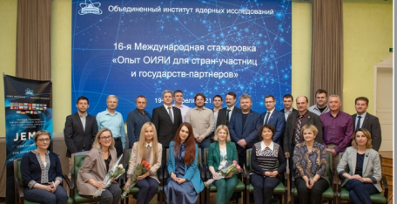
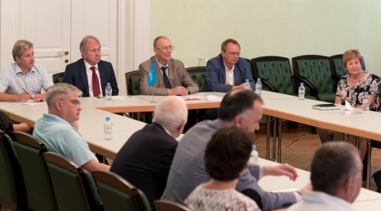
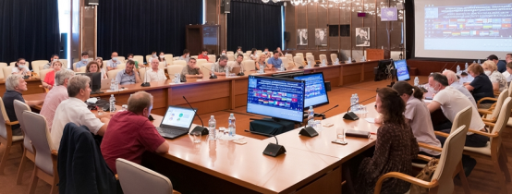
JEMS Programme resumed its work: attention to the Universities
JEMS-17, 24 – 28 May
RAU and Alikhanyan NL,
Armenia
GGU, Gomel, Belarus
SFEDU, Rostov-on-Don
NEFU, Yakutsk
KFU, Kazan
KChSU, Karachaevsk
ChSU, Grozny
JEMS-16, 19 – 23 April
Sofia University, Bulgaria
ISU, Irkutsk
TPU, Tomsk
FEFU, Vladivostok
National Cancer Centre, Belarus
Round Tables “JINR Information Centres”
Video conferencing with IC in the South
of Russia (NOSU)
Plans to open the new JINR Information Centres in , Bulgaria, Armenia, Serbia,
Kazakhstan and several Universities of Russia,
JEMS-18, 5 – 9 July
MEPhI, Moscow
NCFU, Stavropol
KBSU, Nalchik
SFEDU, Rostov-on-Don
Bulgaria
Sofia University
University of Plovdiv
BNRA, Sofia
Kozloduy NPP
Notes:
After a year of delay, JEMS trainig programme for decision-makers in science and international scientific cooperation resumed its work. JEMS trainings in April, May and in July this year were held in Russian and attracted participants from Russian Federation and open for travel Member states. Most remarkable feature of these three JEMS was attendance of the universities, what has been reflected in its programme. Ways to attract youth to science, experience, and tools for establishing JINR Information Centres, as well as the concept of JINR associated staff, were discussed at the special round tables dedicated to the development of JINR interaction with universities.
Following the programme of the Year of Bulgaria in JINR, Bulgarian delegation representing universities of Sofia and Plovdiv, as well as the Bulgarian Nuclear Regulatory Agency and the Kozloduy Nuclear Power Plant took part in the most recent JEMS.
12

Slide 13

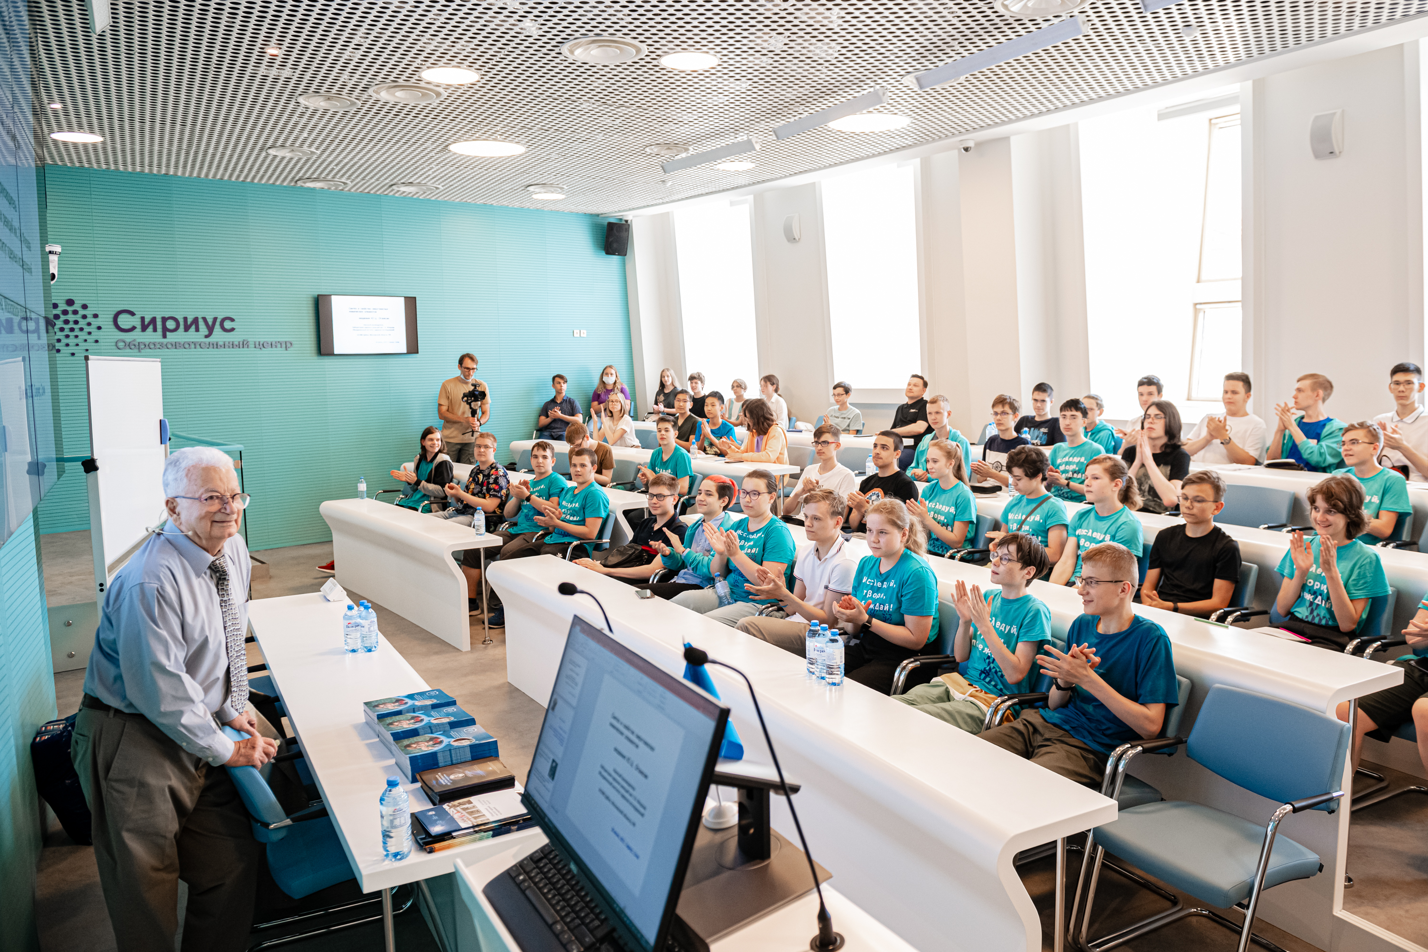

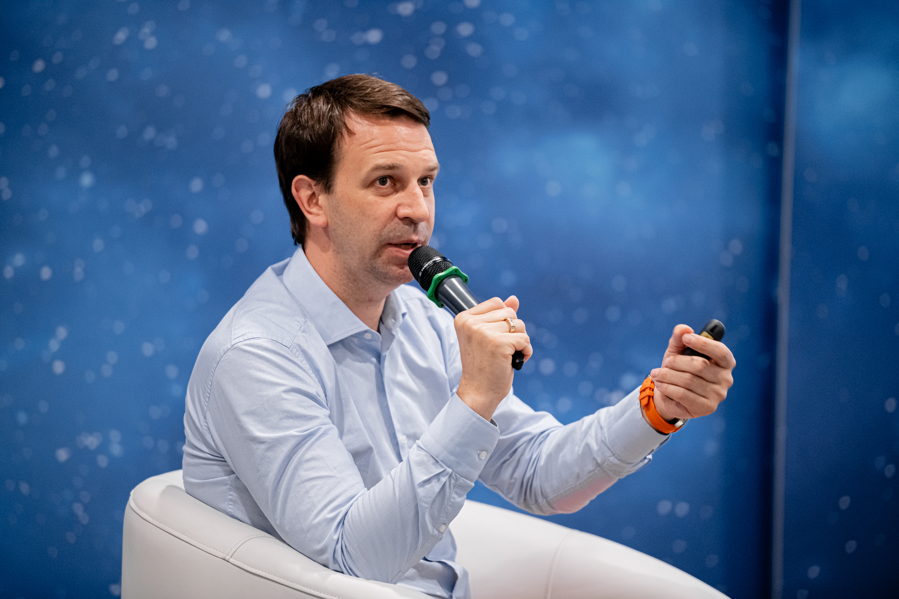
STRATEGIC OUTREACH:
Social communications group IN ACTION
‘Big Break’ project
online lectures by JINR scientists (26, 28, 30 July)
Science festivals:
Stem Fest (06 February), Geek Picnic (21 August)
Lectures by Yu. Ts. Oganessian and G.V. Trubnikov
at Educational Centre “Sirius” (17 June)
Online Lectures for foreign students Virtual Science Camp (26 January, 9 February, 26 & 30 March, 13 April
Career Days at MePhi (17 January); at MIPT (11 June)
Forum "Start of a Career: Spring" for students of NRNU MEPhI (12-30 April)
All-Russia Forum of Science Communicators (18 May)
National marathon Nauka Ryadom (lit. “Science is nearby”)
virtual excursion for schoolchildren to the NICA accelerator complex (11 June)
Popular science at Dubna schools – lectures and experiments by JINR employees
Notes:
13

Slide 14
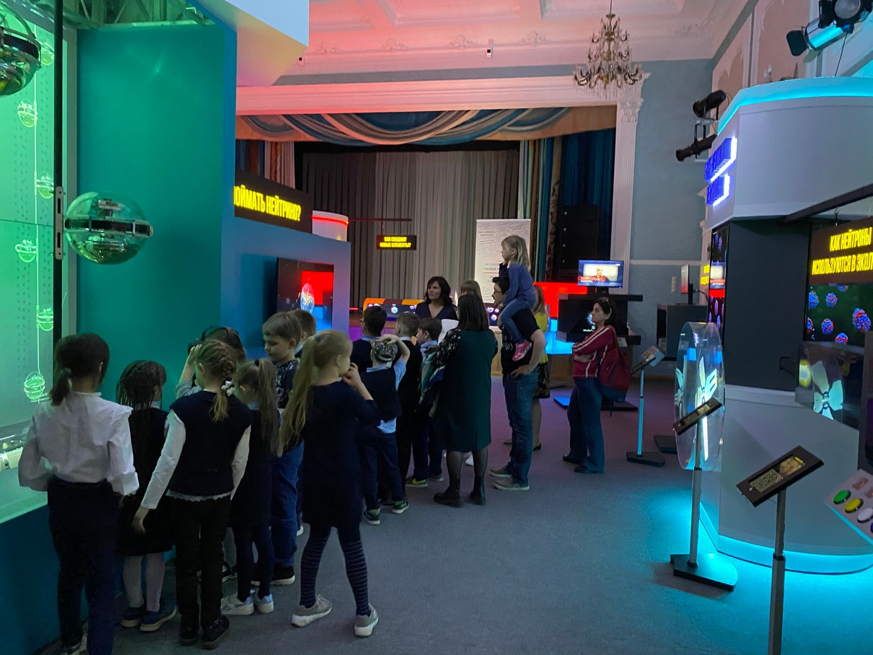
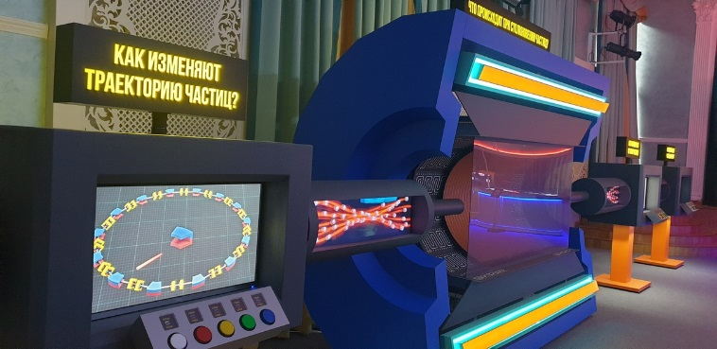
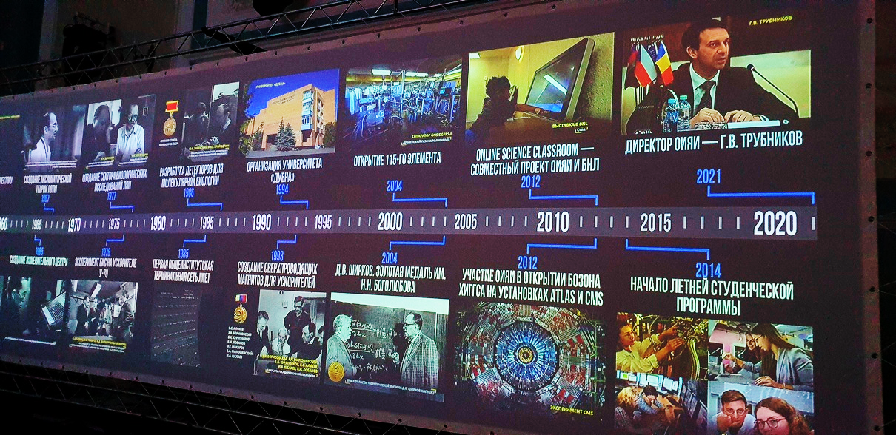
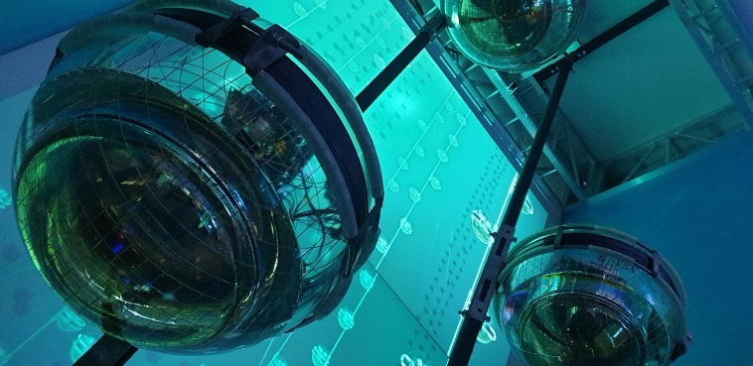
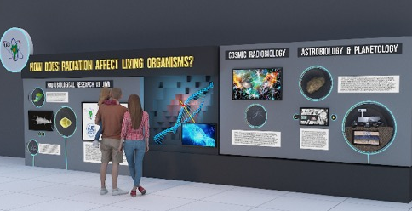
Exhibition dedicated to the 65th anniversary of JINR
VBLHEP ‒ NICA/MPD
FLNR ‒ SHE FACTORY
FLNP – IBR-2
DLNP ‒ Project BAIKAL-GVD
LIT ‒ Central Information and Computer Complex
JINR Timeline
Nuclear Physics and Life Sciences
JINR – International Intergovernmental Organization
Number of visitors since April ≈1500
Official delegations
JINR employees
School students
University students
General public
Notes:
14

Slide 15
IMPROVING THE PERFORMANCE OF
THE TOPICAL PLAN REALIZATION
AND
ADMINISTRATIVE MANAGEMENT

Slide 16
JINR Topical Plan (TP): Strategy for steady improvement
Today’s structure: TP -> directions (6) ->Themes (42) ->projects & activities (many).
Potential problems: weak bound of themes/projects and resources (MP, $, infrastructure); many small projects/activities under umbrella theme provided by same human resources -> risk of non-achieving plans; themes & projects of different nature (pure research, installation construction, experiments and collaborations, R&D) mixed;
PAC’s and Sc.Council are very effective for us (including cross-PAC’s): evaluation and assessment of current projects and activities. Except flagship projects, others are prolonged until end of 2023.
Steady evaluation and tuning with goal to start new 7-year Program (2024-2030) with the modernized TP: optimized, prioritized, structured, flexible, bound*, balanced**.
Strategy 2030+ says: “The document defining the organizational basis for the effective scientific activity at JINR is the annually updated Topical Plan. It must be balanced and provided with the financial and human resources available to the Institute.” The principle of regular analysis of the quality of scientific results, performance of the leaders of the theme/project/ collaboration and updating the administrative structure for supporting scientific themes and areas, monitoring of the implementation and timely completion of projects, etc are necessary tools.
* bound: goals and time-line, resources, Lab management.
** balanced: basic research, R&D, applied research, organization.

Slide 17
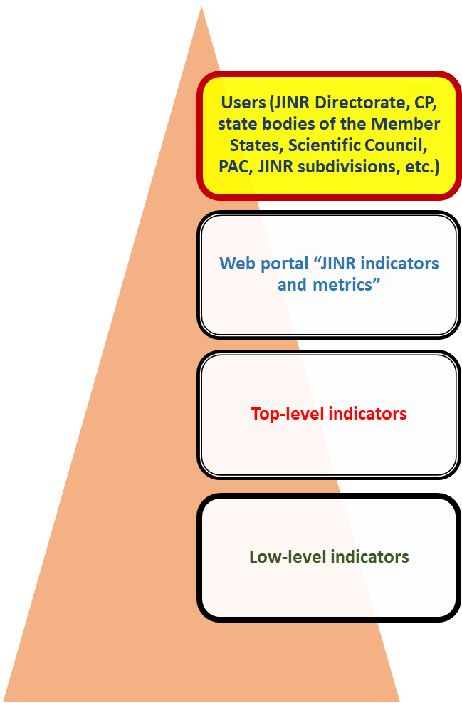
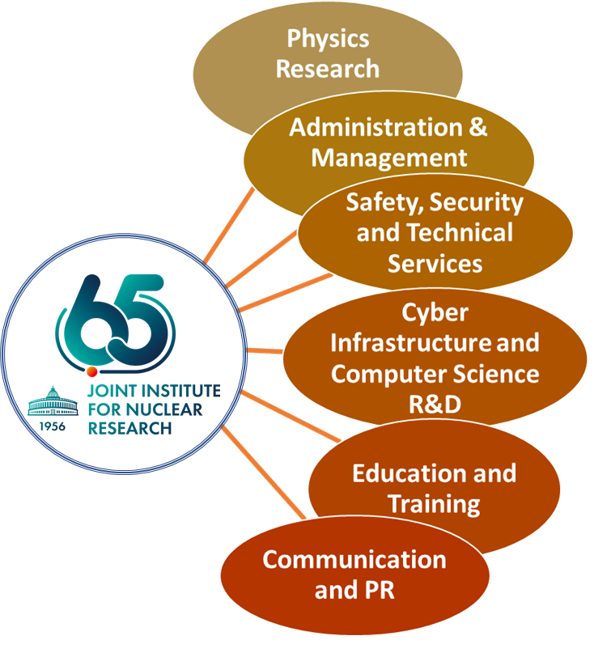
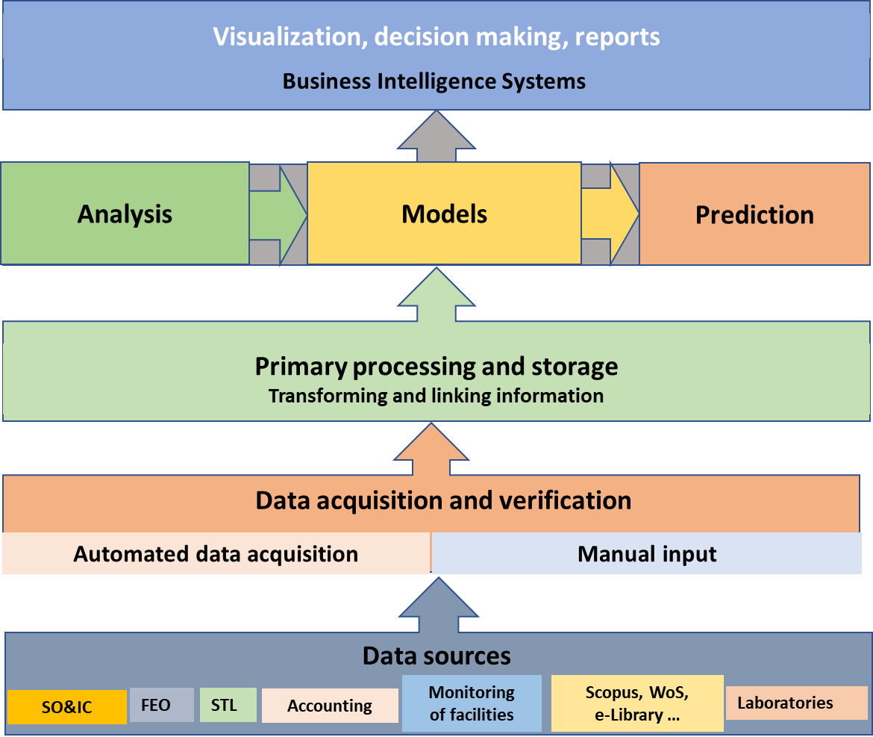
DIGITAL JINR: step by step
Analyze the current Digitalization Index of the JINR. Availability of Digital Services.
Develop an information system for monitoring metrics of the JINR development strategy
Create a model of the Digital Research Organization on basis of JINR. This is not about digitalization of processes, but about Instrument to evaluate Research Capacity and Efficiency.
Notes:
There is a concept of “Digital JINR” is being under development. This activity includes:
Analysis of the current JINR Digital Index;
Development of an information system for monitoring the indicators and metrics for the implementation of the JINR development strategy;
Creation of a model of the JINR digital twin to test the decisions made.
17

Slide 18
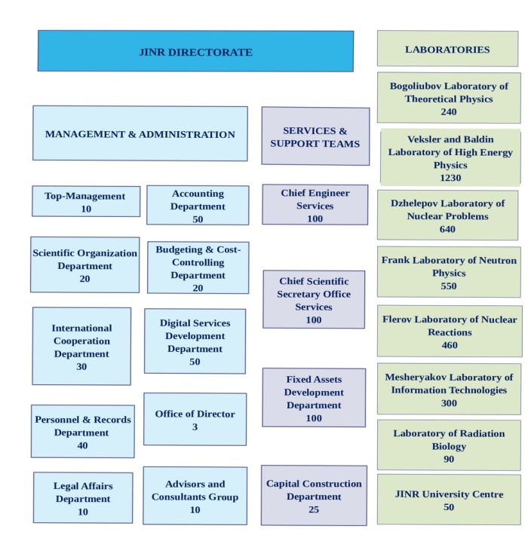
REORGANIZATION OF THE MANAGEMENT AND ADMINISTRATION SYSTEM, SERVICES AND SUPPORT TEAMS
The management and administration bodies of the Institute were reorganized into a number of departments with direct subordination to the JINR Directorate. The services of the Chief Scientific Secretary, together with the services of the Chief Engineer, are separated from the management structure. At the same time, there was optimisation of staff by > 80 employees.
Divisions with new functions have appeared in the management structure - Digital Service Department, expert and analytical group in the Scientific Organization Department, etc.
This restructuring and modernization have made the management system more compact and flexible, and the interaction of the departments with the Directorate of the Institute, with each other and with the Laboratories to be much more direct.

Slide 19
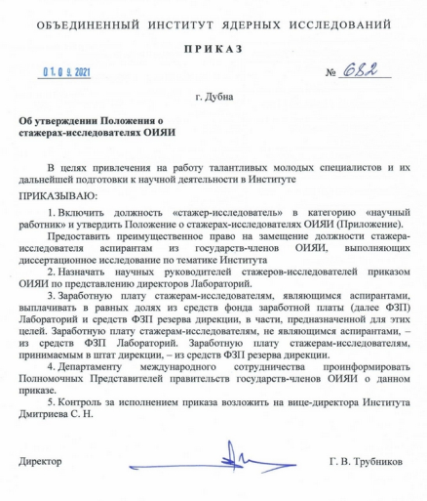
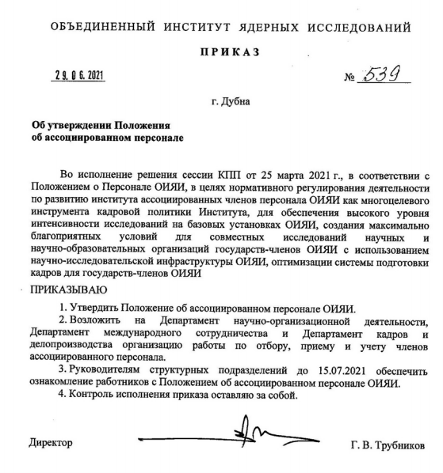
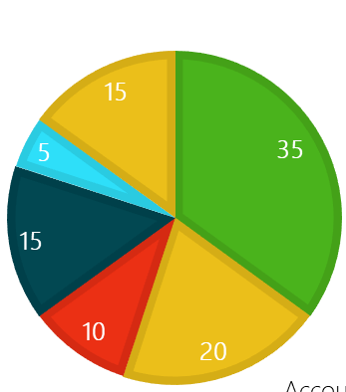
TUNING THE STRUCTURE OF PERSONNEL
Another JINR Order put into effect the Regulation on employment and status of Trainee Researcher – a category of research staff, designed to support PhD students and young researchers from JINR member states.
Personnel structure – scientists, specialists (engineers and technicians), employees, managers, researchers, associated personnel:
2030
scientists
specialists
employees
workers
managers
researchers
2020
15
The JINR Order put into effect the Regulation on Associated Personnel, a special category of long-term visitors from the scientific organizations collaborating with JINR on a regular basis.
This is expected to enhance the human potential of the Institute.
associated personnel
By 2030 - JINR personnel to increased by ~7000 staff:
<5000 - employees +> 1500 - associated personnel.
1500-2000 new researchers to JINR orbit

Slide 20
WEB-SITE FOR STRATEGY PASSPORT:
MONITORING INDICATORS OF CAPACITY AND PERFORMANCE OF JINR

Slide 21

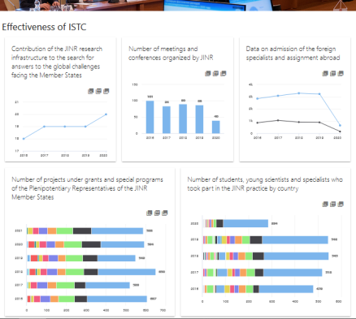
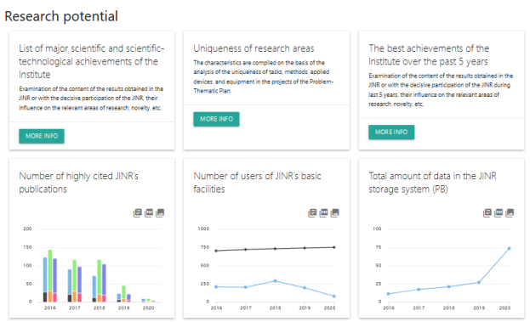
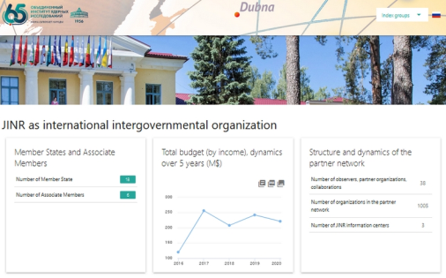
A web based PORTAL FOR MONITORING CAPACITY AND PERFORMANCE of JINR
Monitoring of the JINR performance and capacity is implemented via a web-based portal of a system of quantitative and qualitative characteristics and indicators grouped into six classes: JINR as international intergovernmental organization, Effectiveness of international scientific cooperation, Research potential and capacity, Effectiveness of scientific work, Personnel potential, Staff parameters.

Slide 22


TUNING THE STRATEGY
The assessment of implementation of the JINR Long-Term Development Strategy up to 2030 and beyond has been launched in July 2021. The goal of this action is to assess in a short report the implementation of the main recommendations of the 2019 Long-Term Development Strategy aproved by CP.
The assessment will serve in particular as a basis for a timely launch of the next JINR 7-years plan to be prepared in 2022-2023. The reports should be available by the end of November 2021 and are expected to be presented at the SC and CP meetings in 2022.

Slide 23
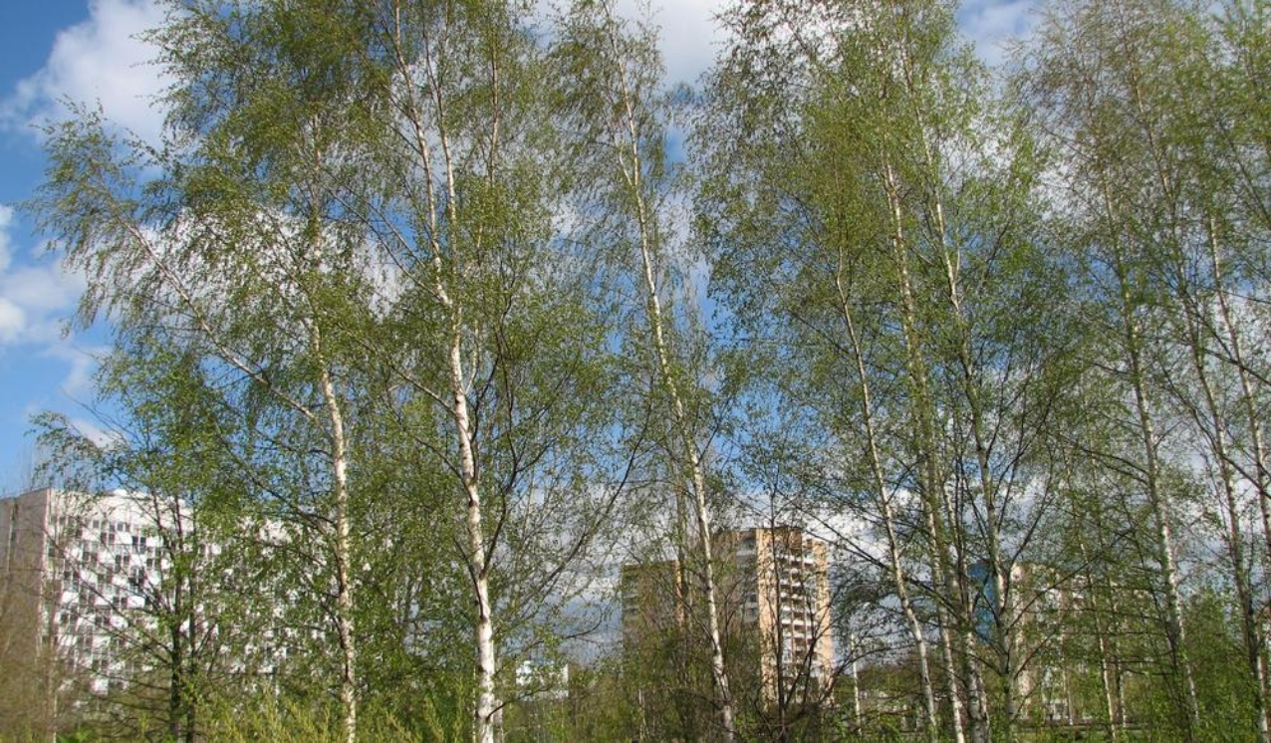
Thank you
for your attention!
Notes:
23

