Slide 1
Super Heavy Elements
The objectives & Issues to be discussed
Yuri Oganessian
Flerov Lab JINR
Meeting SHE at JINR
June30 – July 2, 2021, Dubna, Moscow reg., RF

Slide 2
Настоящее совещание по научной тематике связано с проблемой
синтеза и изучением свойств сверхтяжелых элементов
Текущие и будущие исследования будут представлены и обсуждены
в трех форматах:
1. Развитие работ и полученные к настоящему времени результаты
по гранту РАН – МНВО 2020-2022 гг «Сверхтяжелые элементы».
2. Заседание Совета РАН по физике тяжелых ионов.
Состояние дел по сооружению комплекса NICA и подготовке
первых экспериментов на этом комплексе
3. Работы в ОИЯИ и в институтах РОСАТОМ-а в создании и
развитиии комплекса «Фабрика сверхтяжелых элементов»

Slide 3
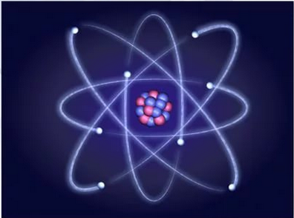
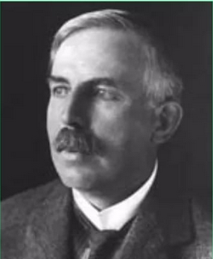
electron
Ernst Rutherford
1911
Nucleus
Yu. Oganessian SHE – meeting at JINR, June30 – July2, 2021, Dubna, Moscow reg.
Notes:
Rutherford's model was called also as the "Planetary model” of the atom. The nucleus, like the Sun, carries almost the entire mass of the atom, and the electrons, like the planets, rotate around the nucleus at a great distance.

Slide 4
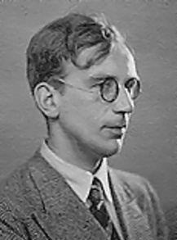
In attempts to describe the properties of nuclear matter, George Gamow suggested that this is structure less (amorphous) matter.
And the spherical atomic nucleus is like a drop of charged liquid
In fact, the density of nuclear liquid
is 10¹⁵ times more than that of water
George Gamow 1928
This was the first theoretical model of the atomic nucleus.
G Gamow 1928
Yu. Oganessian SHE – meeting at JINR, June30 – July2, 2021, Dubna, Moscow reg.
Notes:
This was the first theoretical model of the atomic nucleus. Gamow's theory was a great success.
In particular, after the discovery of nuclear fission of uranium Niels Bohr and John Wheeler based on a liquid drop model developed a theory of nuclear fission.

Slide 5
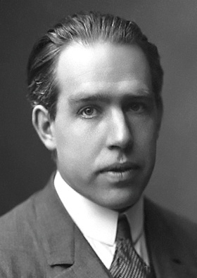
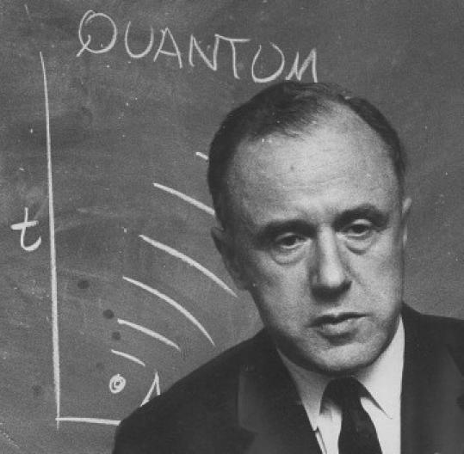
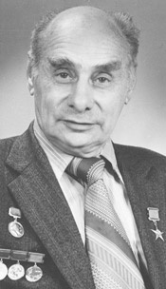
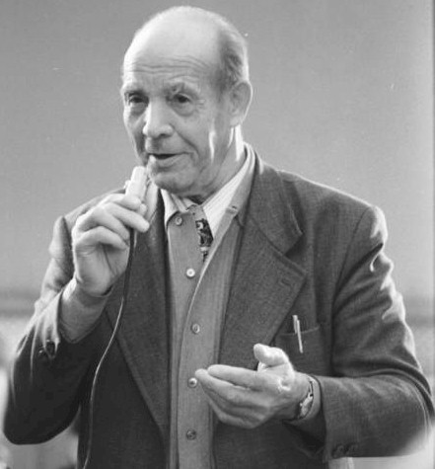
Nuclear fission
N. Bohr
J.A. Wheeler
1939
1940
G.N. Flerov
B_{f}=6 MeV
10¹⁶ years (exp.)
10⁻¹⁹ s
B_{f}=0
Z≥100
K.A. Petrzhak
Yu. Oganessian SHE – meeting at JINR, June30 – July2, 2021, Dubna, Moscow reg.
Notes:
According to Bohr and Wheeler heavy nucleus is protected against fission by potential barrier. The fission barrier height for Uranium is 6 MeV. Penetration of barrier, as was shown by G. Flerov and K. Petrzahk, takes very long time. With increasing atomic number of the nucleus, the height of the fission barrier decreases. Vanishing of the barrier leads to nuclear fission into two fragments in very short time (10⁻¹⁹ second).
In the liquid drop theory similar situation occurs at Z≥100.

Slide 6
Nuclear Shells
Shell
correction
⁴⁸Ca
¹⁰⁰Ni
Strutinski 1967
¹³²Sn
²⁰⁸Pb
Mass defect (MeV)
Fermi
energy
Liquid Drop Model
(1966)
The energy of nuclear levels
More
Bound
Less
bound
More
Bound
Mass number

Slide 7
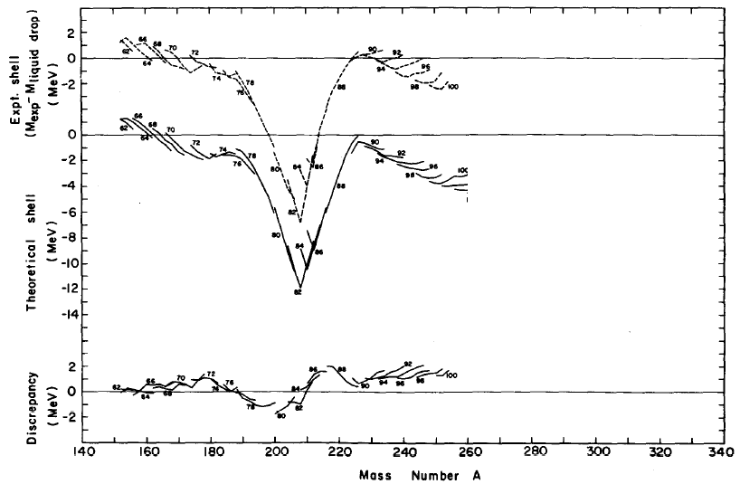
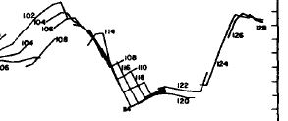
Macro-microscopic theory (Liquid Drop energy + Shell effect)
Nilsson, Thompson, and Tsang, 1969
Experiment
²⁰⁸Pb
Theory
Z=108
N=162
Z=114
N=184
Z=82
N=126
Sobiczewski A, Gareev F A and Kalinkin B N
1966 Phys. Lett. 22, 500
Notes:
New theory explained the increased binding energy of protons and neutrons by 14 MeV in nucleus of lead-208. Theory predicted increased binding energy for a heavier yet unknown nucleus with Z = 108 and N = 162 also. Even stronger effect was expected for more heavy (super heavy) nucleus with Z = 114 and N = 184.

Slide 8
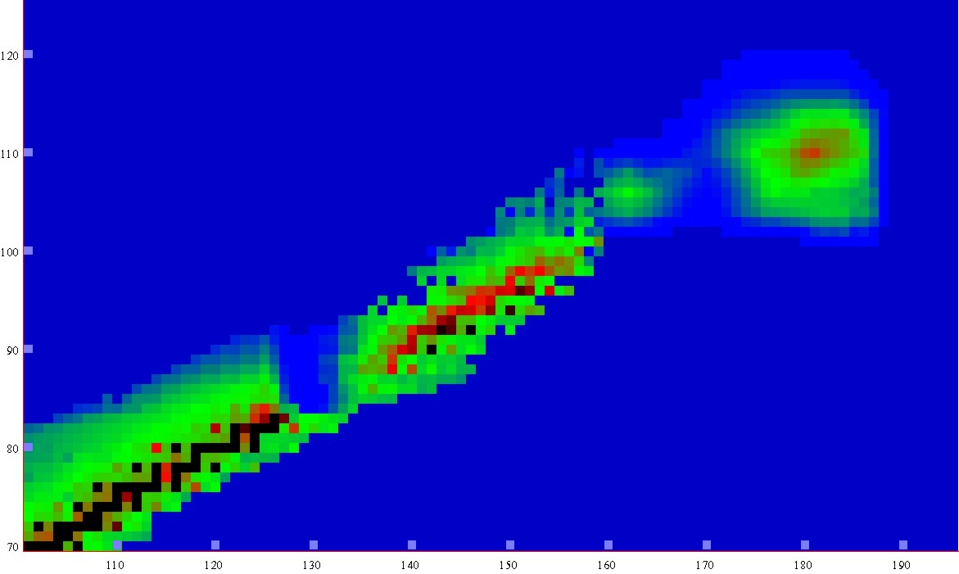
Half-lives
Macroscopic theory
-5
0
5
10
15
LogT_{1/2} s
New lands
New lands
1μs
1s
1h
d
1Myear
Island of
Stability
120
Island of
Stability
A limit of SHE
existence
Shoal
110
shoal
Proton number
T_{1/2} ≤ 10⁻¹⁴ s
Peninsula
100
peninsula
Sea of Instability
90
Continent
continent
80
70
100
110
120
130
140
150
160
170
180
190
Neutron number
Notes:
8
Amorphous matter (nuclear liquid drop) determines the existence of elements only within the first hundred.
On the contrary, in the microscopic theory, in the field of trans-actinides, the existence of a large zone (island) of long-lived super heavy elements is predicted.

Slide 9
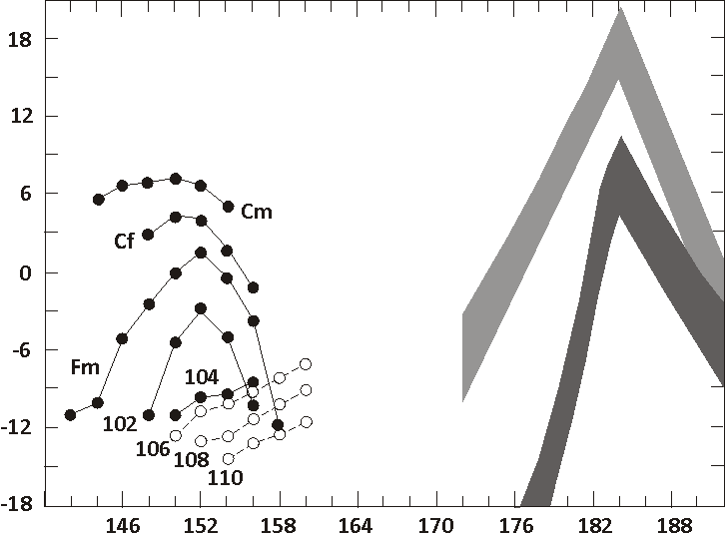
Fiset and Nix
(1972)
Age of Earth
Log of the Spontaneous Fission Half Lives (years)
1 y
Randrup et al.
(1974)
1 s
1 μs
Z=114
Neutron number
Yu. Oganessian SHE – meeting at JINR, June30 – July2, 2021, Dubna, Moscow reg.
Notes:
In the literature of the early 70s, one could find the results of many calculations of the half-lives of super heavy elements. The results of calculation for isotopes of the element 114 in two options are presented in the figure. In the left part the spontaneous fission half-life of known isotopes are shown. In the right part are isotopes of the element 114. Note, for the magic number N = 184, predicted half-lives comparable to (or even more) the age of the Earth. This means that element 114 can be found in nature also.

Slide 10
Experimenters rushed to find this Island
Los Alamos (USA)
Berkeley (USA)
Dubna (JINR)
Oak Ridge (USA)
Mainz (Germany)
Darmstadt (Germany)
Orsay (France)
Würenlingen (Switzerland)
Tokyo (Japan) some later
1970-1985
Unfortunately
in all attempts
super heavy elements
were not found
Yu. Oganessian SHE – meeting at JINR, June30 – July2, 2021, Dubna, Moscow reg.
Notes:
Текст на слайде

Slide 11
Reactions of synthesis
Act.+⁴⁸Ca
Cold fusion
Nh
Light ions
Neutron
capture
Yu. Oganessian SHE – meeting at JINR, June30 – July2, 2021, Dubna, Moscow reg.
Notes:
11
11
Let's look at the situation with popular picture, which shows: the end of the “continent” of stable nuclei, the Th and U “peninsula” along with neighboring transuranic elements and the mystical “Island of Stability”. What ship (reaction) could be taken to sail to this Island?
1. The synthesis of nuclei in sequential neutron capture in high-flux nuclear
reactors or even in huge neutron fluxes of nuclear explosions does not
allow move further than fermium-257.
2. The use of light ions (up to neon) allows us to travel only half the way to
the coveted Island.
3. In the reactions of cold fusion of massive nuclei with great difficulty only
three atoms of element 113 were obtained. But they are located much to
the left of Stability Island.
There are too few neutrons in colliding nuclei. This is a fundamental limitation for this method of synthesis.

Slide 12
Reaction of synthesis
artificial element made in
high flux nuclear reactor,
²⁴⁴Pu, ²⁴⁸Cm, ²⁴⁹Bk …
target
n
48
288
292
from
accelerator
244
to separator
Ca
Pu
Fl
Fl
projectiles
n
n
rare and very
expensive isotope of Ca
fusion & cooling
Yu. Oganessian SHE – meeting at JINR, June30 – July2, 2021, Dubna, Moscow reg.
Notes:
The flerovium- 292 nuclei formed in the fusion is heated to energy of about 40 MeV. The cooling of the nucleus occurs through the evaporation of neutrons. Cooled nuclei, due to the recoil energy obtained from fusion with calcium-48, leave the target layer and move in the beam direction toward the detectors.

Slide 13
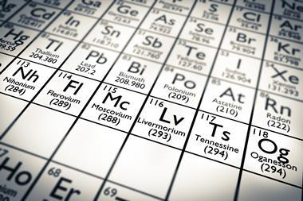
2000-2015
From ⁴⁸Ca induced reactions

Slide 14
Macro – microscopic theory
(Liquid Drop energy + Shell corrections)
120
Z
²⁹⁸Fl
110
²⁷⁰Hs
²⁵²Fm
Island of SHE
100
²³⁸U
90
140
150
160
170
N
180
190
Yu. Oganessian SHE – meeting at JINR, June30 – July2, 2021, Dubna, Moscow reg.

Slide 15
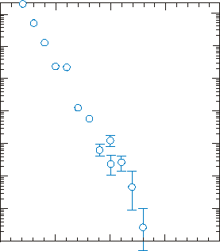
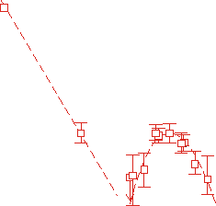
Total evaporation residues cross sections
(pb)
100000
²⁰⁸Pb + ⁵⁰Ti,⁵⁴Cr,⁵⁸Fe,⁶⁴Ni,⁷⁰Zn
10000
Cross sections
1000
100
SHE
10
⁴⁸Ca-induced
reactions
1
Cold fusion
0.1
0.01
100
105
110
115
120
Atomic number

Slide 16
Alpha-decay

Slide 17


126
Modern purely microscopic theory
124
²⁹⁹120
120
120
Z
²⁸⁷Fl
114
110
²⁷⁰Hs
²⁵²Fm
Island of SHE
100
N=184
²³⁸U
90
140
150
160
170
N
180
190

Slide 18
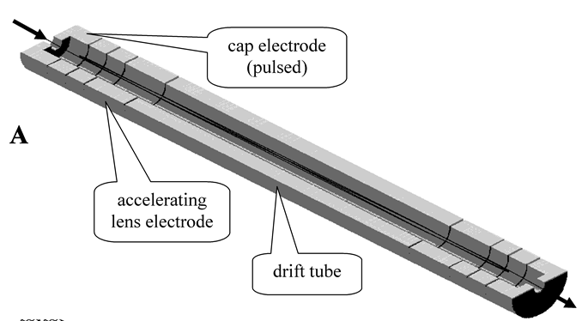
A very promising in this area is a MR-TOF method
(multiple reflections of an SH-atom from electric mirrors)
developed at GSI (Darmstadt).
М.И. Явор ИАП РАН
General view of the ion mirror.
cap electrode
(pulsed)
ΔM/M ≤ 10⁻⁶
accelerating
lens electrode
drift tube)
The upper half electrode
is removed

Slide 19
Synthesis of new elements at SHE Factory
⁵⁴Cr + ²⁴⁸Cm → 3n + ²⁹⁹120
Г.Г. Адамян ОИЯИ
⁵⁰Ti + ²⁴⁹Bk → 3n + ²⁹⁶119
Alpha decay of new nuclei leads
to the known decay chains.
298
Fl
known nuclei
Test reactions:
²³⁸U + ⁵⁴Cr → ²⁹²Lv*
²⁴²Pu + ⁵⁰Ti → ²⁹²Lv*
²⁴⁵Cm + ⁴⁸Ca→ ²⁹³Lv*
σ_{3n}= 4pb

Slide 20
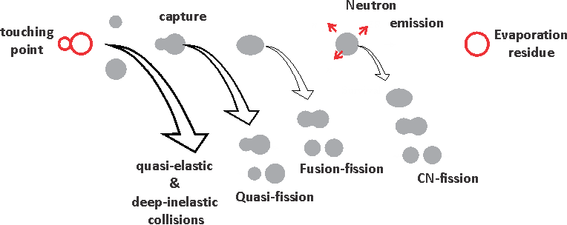
The first
traffic lights
М.Г. Иткис ОИЯИ
⁵⁰Ti
⁵⁴Cr
Z=120
touch
capture
survival
mass assymetric
quasi-fission
discovered
at FLNR (1999)

Slide 21
SHE-Factory
joining of efforts
Isotope production:
Cm-248
Bk-249
Cf-251
New accelerator
High beam
dose of : Ca-48
Ti-50
Ni-64
SC- recoil separator
equipped with
Gas Catcher
On-line separator
& sophisticated
Detectors
To be increased
5 times
Factor 10-15
Depend on
target durability
А.А. Тузов НИИ АР
Н.В. Завьялов ВНИИЭФ
Factor 2-3
is closely linked
to the intellect
И.В. Калагин ОИЯИ
Yu. Oganessian SHE – meeting at JINR, June30 – July2, 2021, Dubna, Moscow reg.

Slide 22
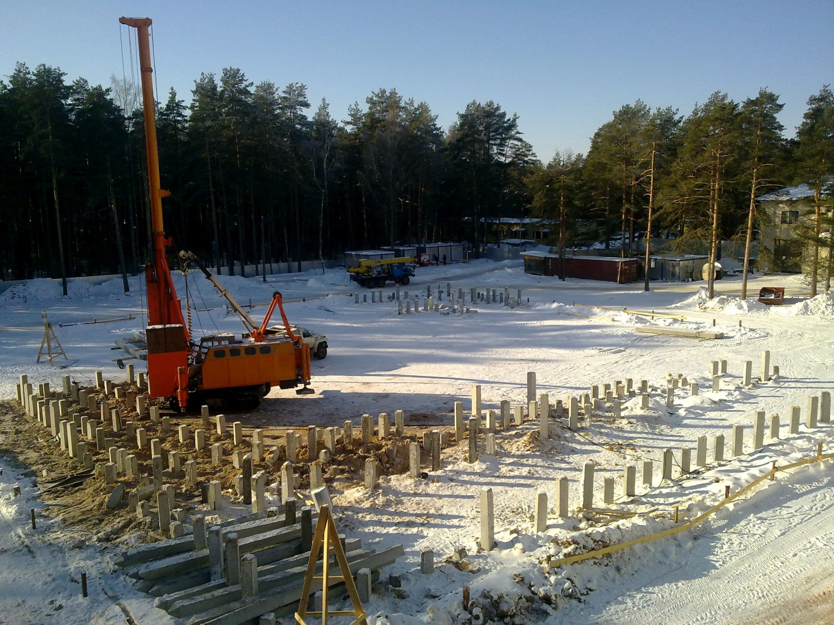
March 2012, Dubna
Super Heavy Element Factory
Notes:
At the beginning of 2012, we began to build the SHE-Factory

Slide 23
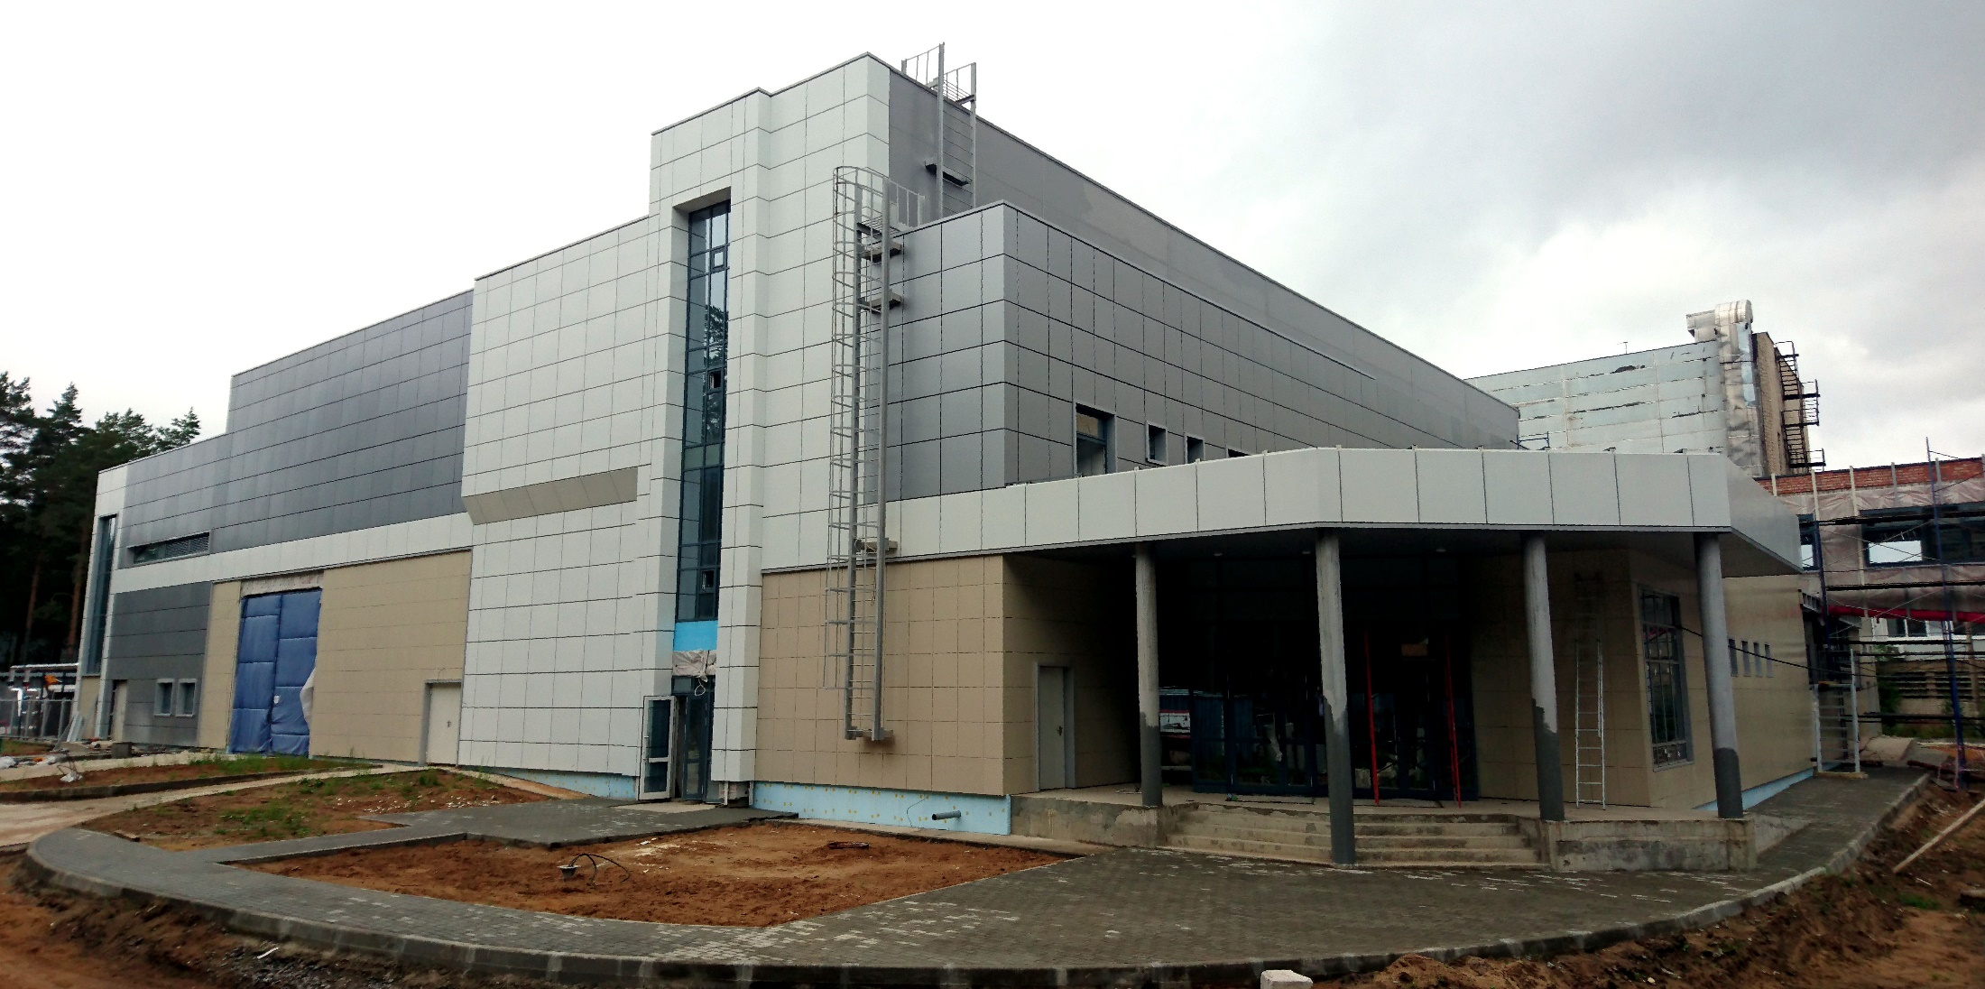
August 2017, Dubna
SHE-Factory
Yu. Oganessian SHE – meeting at JINR, June30 – July2, 2021, Dubna, Moscow reg.

Slide 24
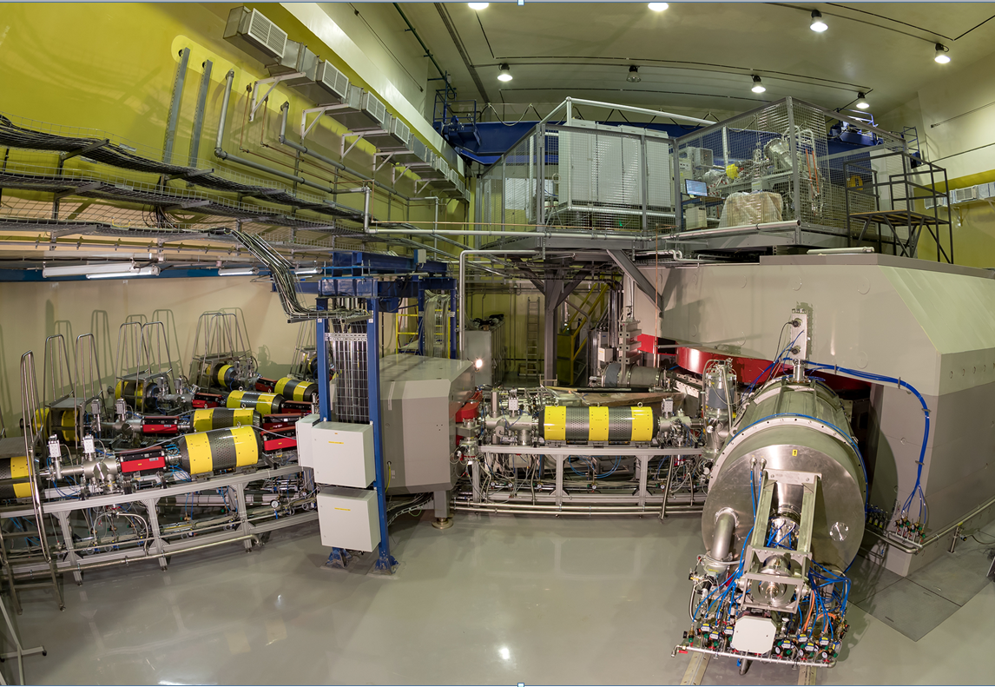
Yu. Oganessian SHE – meeting at JINR, June30 – July2, 2021, Dubna, Moscow reg.

Slide 25
New DC-280 cyclotron of the SHE-Factory was launched
on March 25, 2018
Ion mass range ______________ 12 – 238
Ion beam energy______________ 4 - 8 MeVˑA
⁴⁸Ca-beam intensity____________ 5 pµA demonstrated
at consumption of ⁴⁸Ca___1.5 mg/h
The total transmission of ⁴⁸Ca¹⁰ ⁺ beam particles from the ECR ion source to the target is about 50%
I will tell you separately
about the ²³⁸U ion beam
now is 7.5 pµA

Slide 26
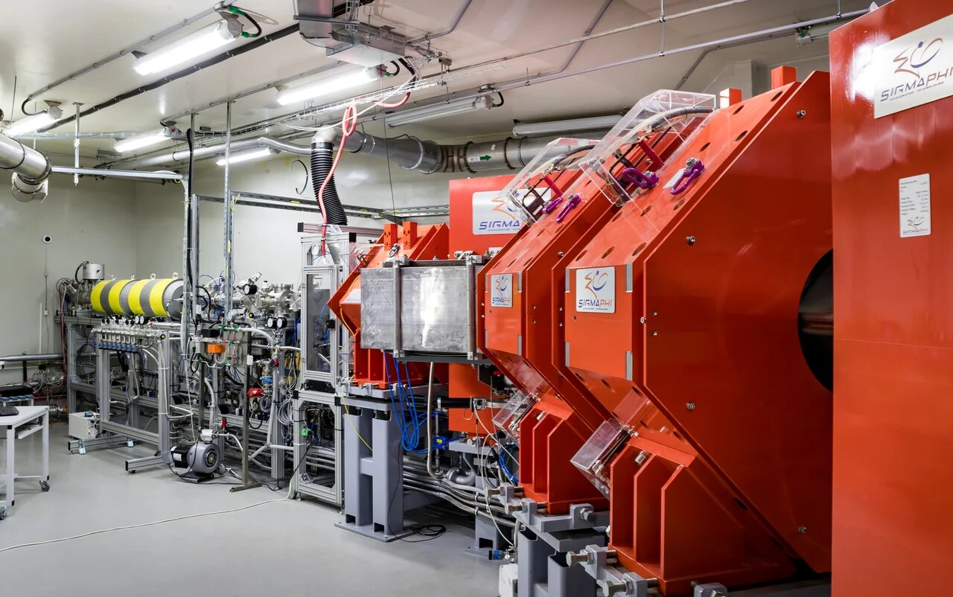
DGFRS-II separator
Yu. Oganessian SHE – meeting at JINR, June30 – July2, 2021, Dubna, Moscow reg.

Slide 27
First experiment
Production of the isotope ²⁸⁸Mc (Z=115) in reaction:
²⁴³Am + ⁴⁸Ca.
  Nov.2020 – Jan.2021
Yu. Oganessian SHE – meeting at JINR, June30 – July2, 2021, Dubna, Moscow reg.

Slide 28
Experiments at SHE-Factory
3 events
2003
В. Утенков / А. Карпов ОИЯИ
6
55 events
²⁴³Am + ⁴⁸Ca
290
289
Mc
286
285
Nh
EC
not found
281
Rg
EC
not found
289
Mt
289
Bh
289
Db
Yu. Oganessian SHE – meeting at JINR, June30 – July2, 2021, Dubna, Moscow reg.

Slide 29
Luminosity
Setup | Beam Intensity (pµA) | Luminosity (10³¹/cm²ˑs) | Factor | Years
DGFRS-1 | 1.0 | 0.16 | 1 | 2000-2020
DGFRS-2 | 1.25 | 0.4 | 2.5 | March 2021
 | 1.50 | 0.5 | 3.0 | May 2021
 | 3.0 | 1.2 | 7.2 | June 2021
 | 5.0 | 2.0 | 12.0
 | 10.0 | 4.0 | 24.0
SHE
σ_{3n}= 1-10 pb
1 event
σ_{3n}= 0.01 pb
With the ion beam 3 pµA we will be able to start experiments on the synthesis of elements 119 and 120
Yu. Oganessian SHE – meeting at JINR, June30 – July2, 2021, Dubna, Moscow reg.

Slide 30
Super Heavy Atoms
&
Chemistry of the SHE

Slide 31
А.М. Сергеев РАН
В.М. Шабаев СПбГУ
Diving into the Dirac sea
E (keV)
positive energy continuum
500
1s_{1/2}
SHE
Z_{crqqit} ≈ 174 at R_{N} ≠ 0
0
Z
50
100
150
200
Z=137
at R_{N} ≠ 0
Z = Z_{cr}
-500
“atom” + positron
Z → (Ze−) + e⁺
negative energy continuum
occupied with electrons
Dirac sea
-1000
Yu. Oganessian SHE – meeting at JINR, June30 – July2, 2021, Dubna, Moscow reg.

Slide 32
10¹⁶ V/cm
RINGS
ΔE_{CM}= 5-6 MeV·A
U⁹²⁺
U⁹²⁺
merging beams
e⁻
U⁹²⁺
Z=91⁺
e⁺
U
U³⁵⁺
U
BUSTER
Z=91⁺
e⁺
U⁹²⁺
e⁻

Slide 33
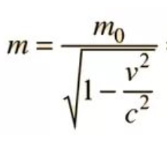
But the relativistic effect will manifest itself already
in synthesized SHEs with Z = 112-118
Z=118
SHE
P. Indelicato et al. Theor. Chim. Acta 120, 495 (2011)
-0.4
In this area the “relativistic effect”
will have a strong influence on the
elctronic structure and chemistry
of the heaviest elements
-0.6
1s-electron binding energy (MeV)
-0.8
173.17
-1.0
120
130
140
150
160
170
Atomic number
Yu. Oganessian SHE – meeting at JINR, June30 – July2, 2021, Dubna, Moscow reg.

Slide 34
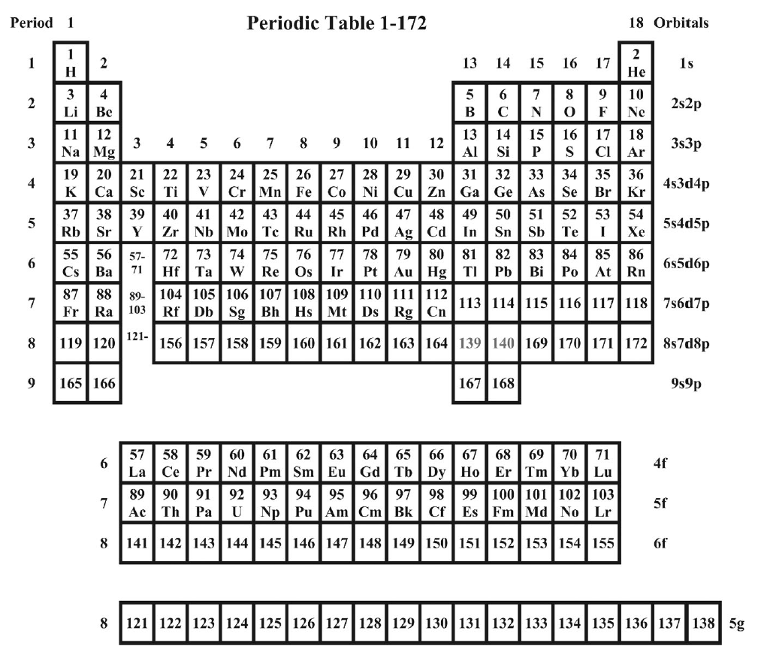
Periodic Table Z=1-138
1
Calculated in non-relativistic
Dirac-Fock approximation
2
3
4
5
6
SHE
Completion of
the 7-th row
113
114
115
Fl
Nh
Mc
116
117
118
Fl
Lv
Ts
Og
Does element 118 look like a noble gas?
6
the answer of theory is discouraging:
most likely not!
L A N T A N I D E S
4f
7
A C T I N I D E S
5f
8
6f
8
Yu. Oganessian SHE – meeting at JINR, June30 – July2, 2021, Dubna, Moscow reg.

Slide 35
Relativistic contraction
Z=118
n=2
n=3
n=4
n=1
Electron density (a.u.)
This screens the nuclear charge
for the outer electrons
… and Interactions
from all external electrons
must be taken into account
n=5
non
relativistic
n=6
nucleus
n=7
Distance (in a_{B})
Yu. Oganessian SHE – meeting at JINR, June30 – July2, 2021, Dubna, Moscow reg.

Slide 36
Noble gases
P. Schwerdtfeger et al/
Angewandte Chemie 2020 (to be published)
non-relativistic
boiling
R
melting
room
temperature
Temperature (K)
Rn
Og
Xe
Kr
Ar
Ne
He
Atomic number
Yu. Oganessian SHE – meeting at JINR, June30 – July2, 2021, Dubna, Moscow reg.

Slide 37
Noble gases
P. Schwerdtfeger et al/
Angewandte Chemie 2020 (to be published)
Og
relativistic
boiling
melting
room
temperature
Temperature (K)
Rn
Xe
Kr
Ar
Ne
He
Atomic number
Yu. Oganessian SHE – meeting at JINR, June30 – July2, 2021, Dubna, Moscow reg.

Slide 38
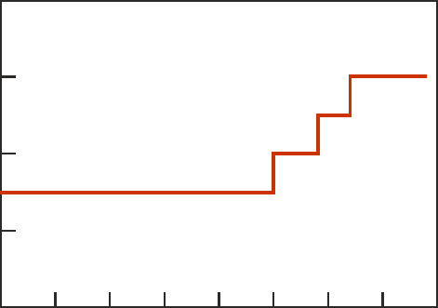
May - June 2021 Production of the isotope ²⁸⁷Fl (Z=114) in reaction:
²⁴²Pu + ⁴⁸Ca.
²⁴²Pu – target 40 mg
  ⁴⁸Са – beam intensity 1.5 -3.0 pµA
  Beam time 39 days
Second experiment
4
287
Fl
3
283
10.03 MeV
Cn
0.48 s
2
Beam intensity (pµA)
279
9.53 MeV
Ds
0.42 s
1
0.21 s
0
0
10
20
30
40
Days

Slide 39
3n
²⁴⁵Cm + ⁴⁸Ca
2n
2
²⁴²Pu + ⁴⁸Ca
Decay Chains of the Isotopes of Element 114
4n
²³⁸U + ⁴⁸Ca
3n
2n
4n
3n
²⁴⁸Cm + ⁴⁸Ca
²⁴²Pu + ⁴⁸Ca
290
3n
3n
²⁴⁹Cf + ⁴⁸Ca
²⁴⁴Pu + ⁴⁸Ca
4n
Fl
For chemical studies
5n
4n
3n
4n
3n
2n
26
73
0
about 10%
of α-decay
В. Утенков / А. Карпов ОИЯИ
9
Yu. Oganessian SHE – meeting at JINR, June30 – July2, 2021, Dubna, Moscow reg.

Slide 40
В. Першина GSI Germany
И.И. Тупицын СПбГУ
Super heavy atoms
Z | Isotope | Half-life
112 | ²⁸³Cn | 3.6 s
113 | ²⁸⁴Nh | 0.9 s
114 | ²⁹⁷Fl | 0.5 s
115 | ²⁸⁸Ms | 0,16 s
116 | ²⁹³Lv | 57 ms
117 | ²⁹⁴Ts | 51 ms
118 | ²⁹⁴Og | 0.6 ms
First experiment was conducted at Dubna
R. Eichler et al., Nature 447, (2007) 72
We will start with DGFRS-3 separator
Certainly, the “relativistic effect will increase rapidly with increasing
atomic number of SHE, which may be observed today for all SHE
from 112 to element 118

Slide 41
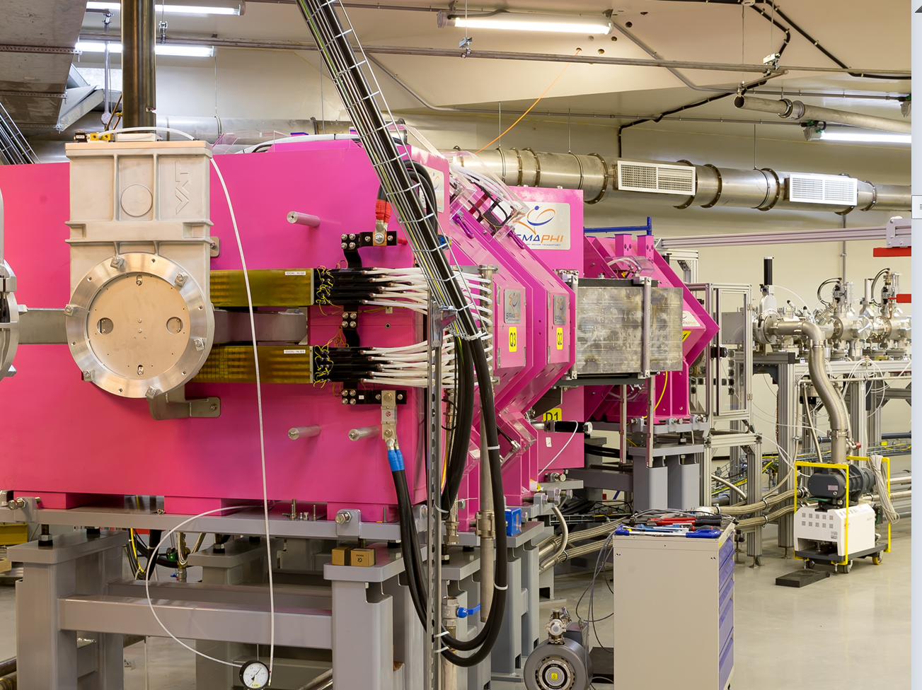
COLD
DGFRS-III separator
Yu. Oganessian SHE – meeting at JINR, June30 – July2, 2021, Dubna, Moscow reg.

Slide 42
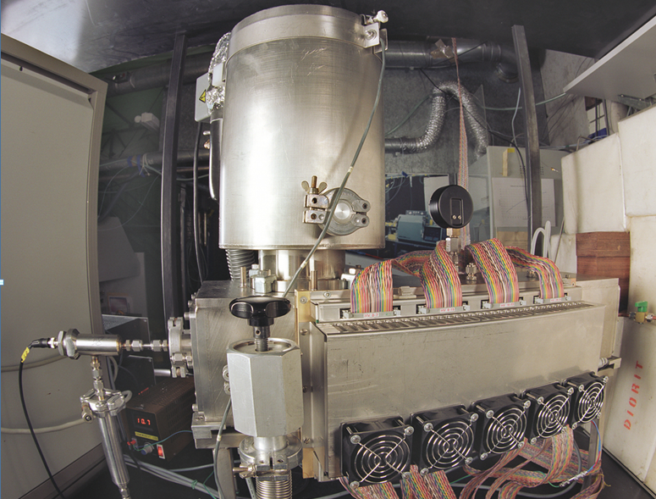
new setup COLD (PSI)
Co
Yu. Oganessian SHE – meeting at JINR, June30 – July2, 2021, Dubna, Moscow reg.

Slide 43
С.Н. Дмитриев ОИЯИ
Super heavy atoms
Z | Isotope | Half-life
112 | ²⁸³Cn | 3.6 s
113 | ²⁸⁴Nh | 0.9 s
114 | ²⁹⁷Fl | 0.5 s
115 | ²⁸⁸Ms | 0,16 s
116 | ²⁹³Lv | 57 ms
117 | ²⁹⁴Ts | 51 ms
118 | ²⁹⁴Og | 0.6 ms
First experiment was conducted at Dubna
R. Eichler et al., Nature 447, (2007) 72
We will start with DGFRS-3 separator
GASSOL SC gas-filled solenoid will allow us to stop SHE in a small volume of 1-2 cm³ and study the isotopes
with T_{1/2} ≥ 30 ms
Certainly, the “relativistic effect will increase rapidly with increasing
atomic number of SHE, which may be observed today for all SHE
from 112 to element 118
Yu. Oganessian SHE – meeting at JINR, June30 – July2, 2021, Dubna, Moscow reg.

Slide 44
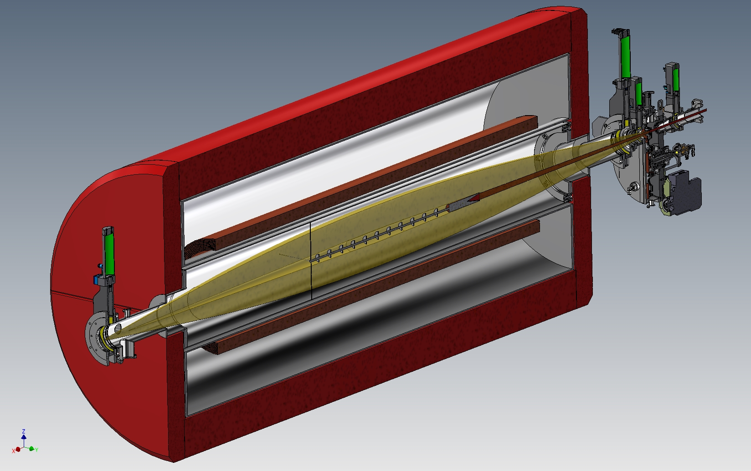
Д.И. Соловьев ОИЯИ
rotating
target
GASSOL
beam
axial screens
В. Першина GSI Germany
В.И. Тупицын СПбГУ
radial
screens
EVRs
beam
to He-gas
catcher
SC-coils
axial screens
beam stopper
recoil’s stopper
Yu. Oganessian SHE – meeting at JINR, June30 – July2, 2021, Dubna, Moscow reg.

Slide 45
Thermal adsorption of
elements 114-117
on the Au-surface
COLD
new setup (PSI)
He/Ar
Rn
SHE
1-3 cm³
He-filled
stopping chamber
Hg
from GASSOL

Slide 46
Сегодня, в 16:50
после перерыва на кофе
Доклад проф. А.А. Лутовинова
заместителя директора
Института космических исследований РАН

Slide 47
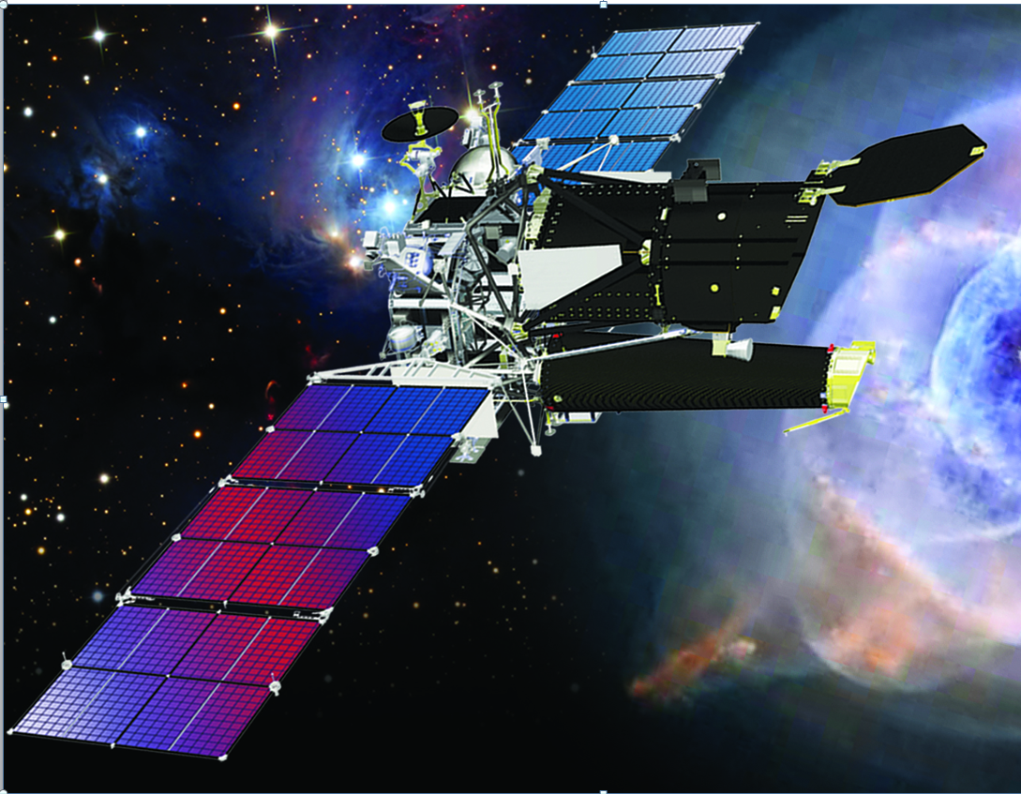
А.А. Лутовинов
ИКИ РАН
Map of the Universe

Slide 48
Massive Transfer Reactions
²³⁸U + ²³⁸U, ²⁴⁸Cm

Slide 49
Massive nucleon transfers in the interaction of the heaviest nuclei
²³⁸U
²⁴⁸Cm
Г.Н. Княжева ОИЯИ
²³⁸U
F₁
Z=184
A=476
2
New detector array
will be able to identify
a three-prong star
²⁶⁸No*
²⁰⁸Pb
3
F₂
1
Neutrons
New ECA-28 GHz
Ion source
EVR
1
No
Yu. Oganessian SHE – meeting at JINR, June30 – July2, 2021, Dubna, Moscow reg.

Slide 50
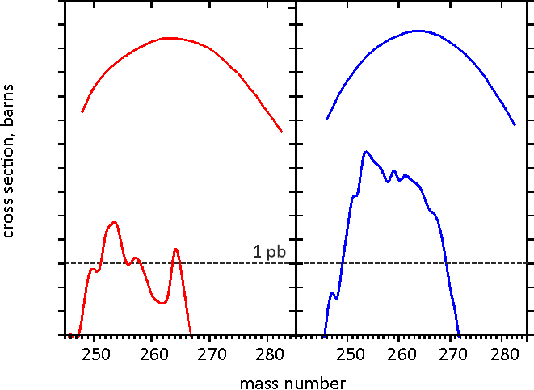
Nobelium isotopes produced by ²³⁸U induced reactions
by A.V. Karpov and V.V. Saiko, 2020
²³⁸U-target
²⁴⁸Cm-target
В.В. Сайко ОИЯИ
10⁻³
exited
exited
10⁻⁶
EVR’s
cross section (barns)
10⁻⁹
EVR’s
10⁻¹²
N=152
N=162
10⁻¹⁵
Yu. Oganessian SHE – meeting at JINR, June30 – July2, 2021, Dubna, Moscow reg.

Slide 51
С.Л. Богомолов ОИЯИ
В.А. Скалыга ИПФ РАН
И.Ю. Родин НИИЭФА
²³⁸U beam at SHE-Factory
50
32⁺
10
35⁺
39⁺
Beam intensity from the ion source (pµA)
1
42⁺
B_{C}
ECR 28 GHz
obtained
in Lanzhou (China)
ECR 14 GHz
0.1
widely used
32⁺
5
6
7
8
9
10
E_{LAB} (MeVˑA)
Yu. Oganessian SHE – meeting at JINR, June30 – July2, 2021, Dubna, Moscow reg.

Slide 52
Последний день 2 июля
Утреннее заседание в этом зале
10:00 - 11:20
Коллайдер NICA
11:40 – 13:00
Обед
13:30 - 15:00

Slide 53
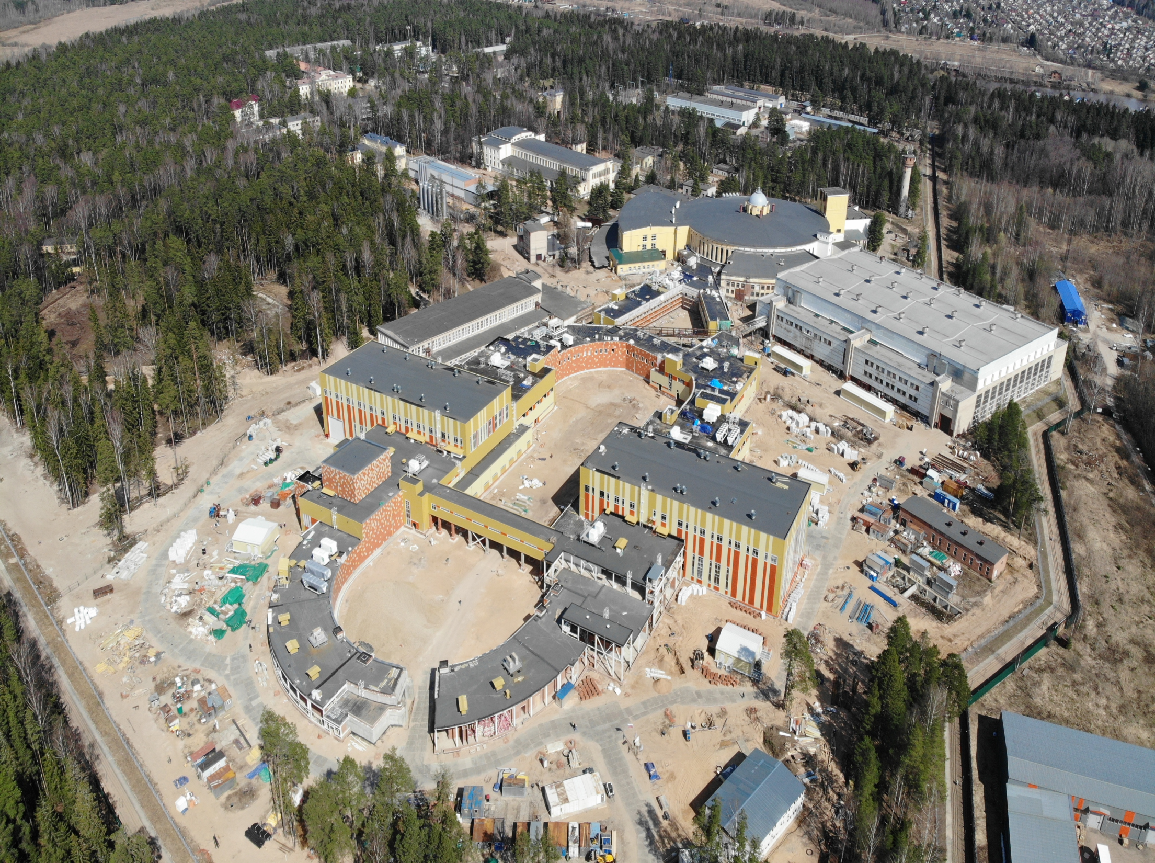
April 2021, Dubna
Collider NICA
В.Д. Кекелидзе ОИЯИ
Д.В. Дементьев ОИЯИ
В.А. Киреев ОИЯИ
А.В. Гуськов ОИЯИ

Slide 54
Спасибо за внимание!

