Slide 1

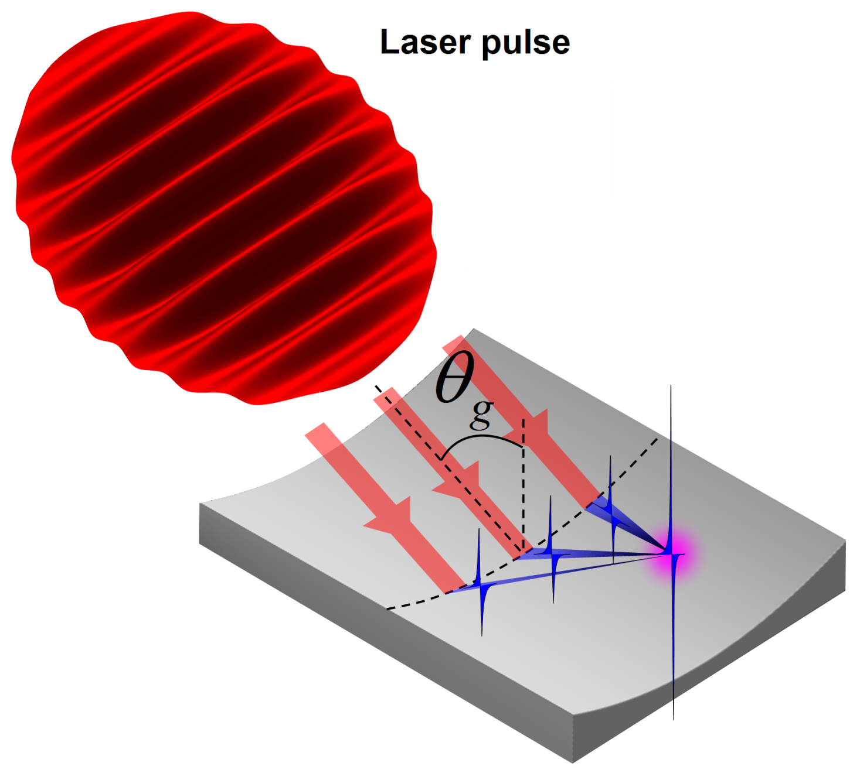
Ionization of Vacuum by Extreme Light Fields
Alexander Sergeev
Russian Academy of Sciences
JINR, Dubna, June 30, 2021

Slide 2
Extreme light physics
How intense is "Extreme Light" ?
Today's frontiers in power, intensity, and duration of laser pulses
W (J)
100 J
10¹⁶ W
I (W/сm²) =
=
=
= 10²³ W/сm²
τ (s) S (сm²)
10⁻¹⁴s 10⁻⁷сm²
10⁻⁷ сm²
10 Femtosecond pulse duration
10 Petawatt peak power
Few wavelength focal spot

Slide 3
Intensity and field scales of magnitude
e A
Schwinger field
а=mc²/ħω≈500000
10¹⁶ W
a =
I (W/сm²)=
=10²³W/сm²
mc²
10⁻⁷ сm²
Ions become relativistic
а≈5000
“Atomic intensity”
I ≈ 3 10¹⁶ W/cm²
E ≈ E_{a} = m²e⁵ / ħ⁴
a ≈ 0.1
Strong Nonlinear QED phenomena
а=2e²mc/3ħ²ω≈2000
Radiation reaction а=(3λ/4π r_{e})^{1/3}≈500
Electrons become relativistic а≈1
Intraatomic field а=eE_{at}/mcω≈0.1
10¹⁴
10¹⁶
10¹⁸
10²⁰
10²²
10²⁴
10²⁶
10²⁸
10³⁰
W/сm²
E_{a} = m²e⁵ / ħ⁴
present
future
Es = m²c³ / eħ
Corresponds to intraatomic field
that holds electron at first orbit in Hydrogen atom
Holds virtual electron-positron pairs in the quantum vacuum of the Dirac

Slide 4
E_{s} / E_{a} ≈ 137 ³ ≈ 2.6 10 ⁶
The today’s optical field E at the focus is 3 orders of magnitude greater than the atomic field E >> E_{a} = m²e⁵ / ħ⁴, which holds the electron in the first Bohr orbit of a hydrogen atom. However, this is 3 orders of magnitude less than the Schwinger field E << Es = m²c³ / eħ, which keeps virtual electron-positron pairs in the quantum vacuum of the Dirac Sea

Slide 5
Motivation
Today’s PW scale lasers provide maximum intensity 10²² W/cm²
Upcoming 10 PW facilities (ELI NP, Apollon, SIOM, CoReLs) will achieve 10²³ W/cm²
100 PW (SubExawatt) scale lasers will provide operation at 10 ²⁴ W/cm² – 10 ²⁵ W/cm² where a new and very rich physics exists. New state of matter is a boiler that comprises strongly coupled optical photons,
  e-e+ plasma, and gamma photons
New physics is featured by
Ionization of quantum vacuum
Emergence of ultrarelativistic, ultradense e-e+ plasma
GeV Gamma-Ray sources with extreme brilliance
Giant magnetic fields and currents
SubExawatt scale lasers enable production of even higher intensities 10 ²⁶ W/cm² – 10 ²⁸W/cm² by efficient energy conversion in plasma
    at attosecond time frames and approach the Schwinger limit

Slide 6
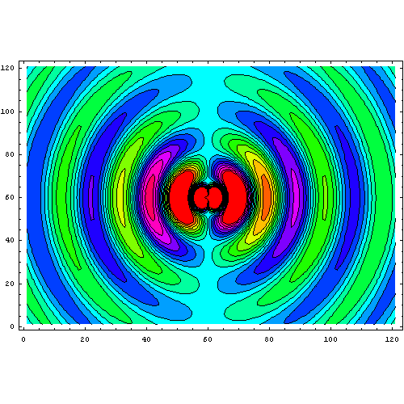
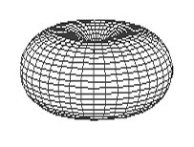
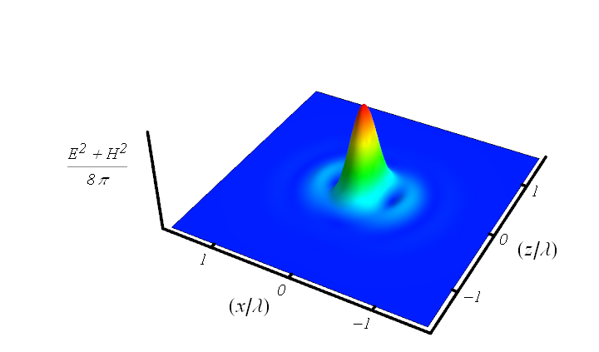


How to maximize field intensity at given power ?
Rule of thumb for coherent combining of several beams:
To maximize the electric field at focusing point,
radiation of several combining beams should reproduce
configuration of phase conjugated dipole radiation field
I. Gonoskov, A. Aiello, S. Heugel, and G. Leuchs, Phys. Rev. A (2012)
z
x
Minimum focusing volume:
Converging dipole wave as an exact solution of Maxwell equations:

Slide 7
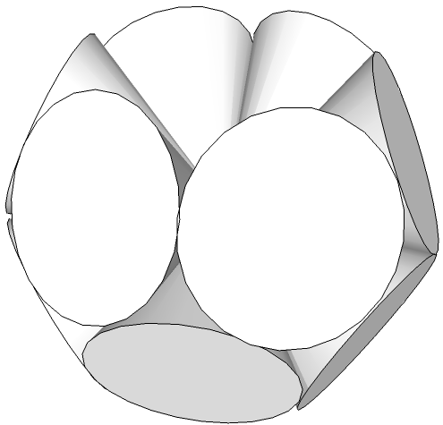
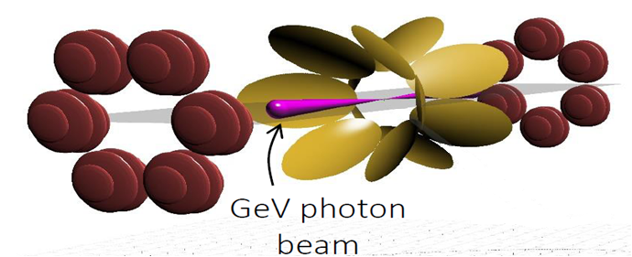
How to achieve intensity 10²³-10²⁵ W/cm²
Geometry | Power per channel | Intensity, ×10²⁵W/cm² | I/I(f=1.2) | Equivalent power (f=1.2)
Single beam (f=1.2) | P₀=10 PW | 0.06 | 1 | 10 PW
Single beam (f=1.2) | P₀=200 PW | 1.2 | 1 | 200 PW
Dipole-Wave | P₀=200 PW | 16.7 | 13.9 | 2800 PW
Double-Belt-12 12× (f=0.96) | P₀/12 | 13.4 | 11.2 | 2200 PW
Double-Belt-12
XCELS design: Coherent combining to mimic a converging dipole wave
A. Gonoskov, A. Bashinov, I. Gonoskov,C. Harvey, A. Ilderton, A. Kim, M. Marklund, G. Mourou, A. Sergeev, PRL (2014)

Slide 8
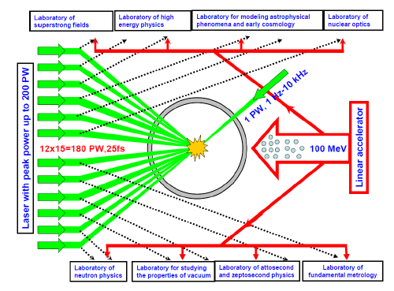
XCELS facility
XCELS- EXawatt Center for Extreme Light Studies
is based on a new laser facility comprising of 12 amplification channels,
each of them providing 400 J, 25 fs pulses, with the total pulse power of
almost 200 PW. A new research institute will be built around this laser facility.
12 channels
15 PW each
400 J, 25 fs, 910 nm
Quality: 3 divergence limits
Intensity 10²⁴-10²⁵ W/cm²

Slide 9
XCELS Layout
Key technologies for XCELS facility:
OPCPA technique
3 kJ, 1.5 ns Nd: glass pump lasers
30x30 cm² KD*P crystals
50x100 cm², broad band
(25 fs), 0.2 J/cm² damage threshold
gratings with 910 nm central
wavelength
5. Tight focusing optical system

Slide 10
Amazing new physics of laser-particle-vacuum interaction at light intensity > 10²³ W/cm²
Radiation dominated regime:
Particles become efficient convertors of energy from optical to gamma range
Trajectories of particles
change dramatically;
no more relativistic Newton
mechanics
New sources of
gamma radiation:
controlled, brilliant,
collimated
New state of matter:
strongly coupled
optical fields, ultrarelativistic
electron-positron plasma and
gamma radiation
Advanced Instrument for Modeling: A.Gonoskov et al Phys. Rev. E92 (2015)

Slide 11
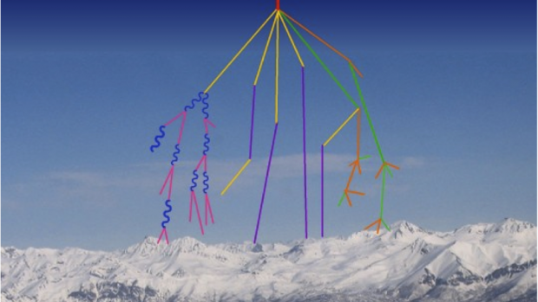
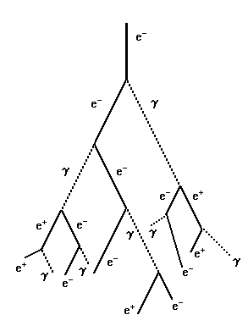
QED cascades
A.R. Bell and J. G. Kirk, Phys. Rev. Lett. (2008)
A.M. Fedotov, N. B. Narozhny, G. Mourou, G. Korn, Phys. Rev. Lett. (2010)
E. N. Nerush, I. Yu. Kostyukov, A. M. Fedotov, N. B. Narozhny, N. V. Elkina, and H. Ruhl,
Phys. Rev. Lett. (2011)
V.F.Bashmakov, E.N.Nerush, I.Yu.Kostyukov, A.M.Fedotov, N.B.Narozhny
Phys. Plasmas (2014)
Message: Vacuum behaves like a rather dense dielectric medium at ionization.
Cascades start at much lower fields (10²⁴-10²⁵ W/cm²) as compared to
Sauter-Schwinger limit (10²⁹ W/cm²)

Slide 12
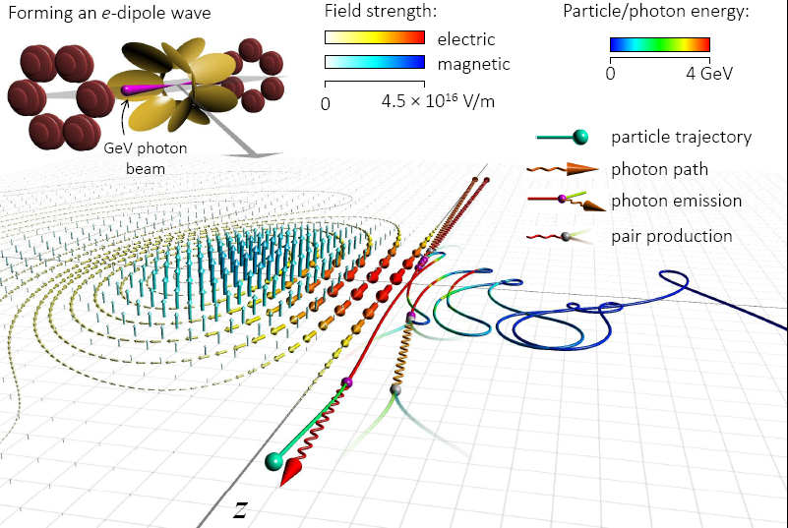
Anomalous radiation trapping and gamma ray emission
A. Gonoskov, A. Bashinov, I. Gonoskov,C. Harvey, A. Ilderton, A. Kim, M. Marklund, G. Mourou, A. Sergeev, PRL (2014)

Slide 13
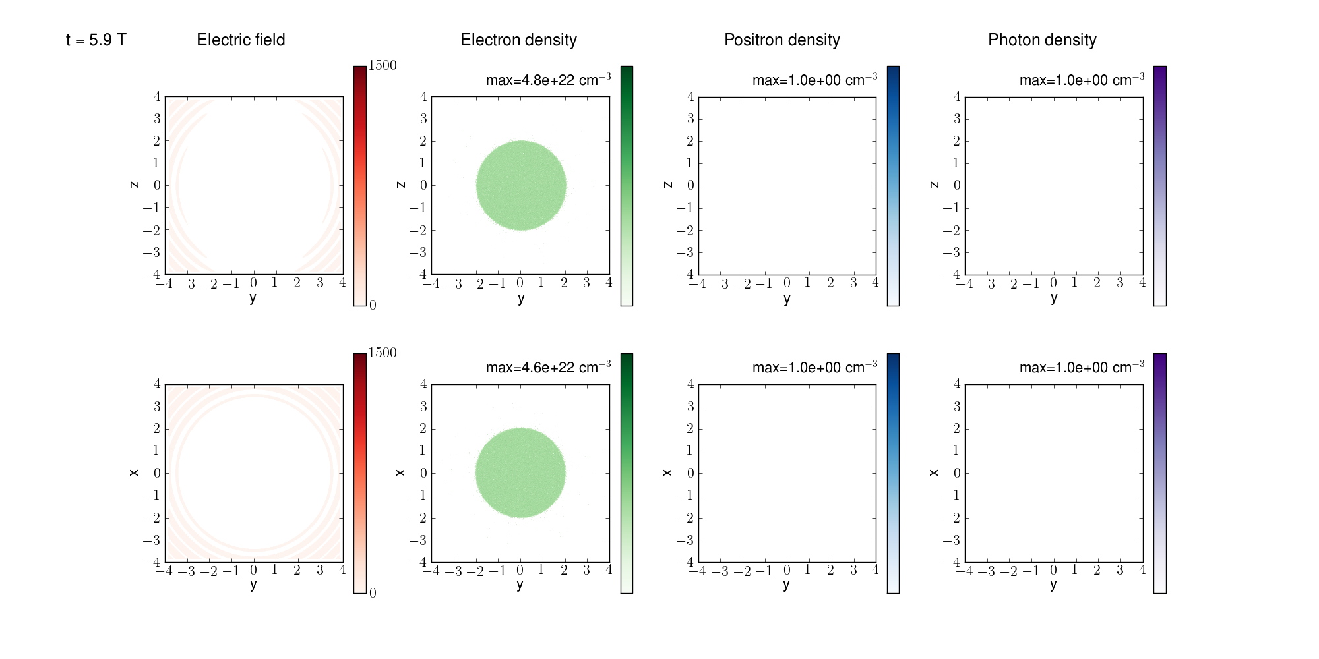
QED cascades in dipole wave
P=100 PW, t=5.9 T

Slide 14
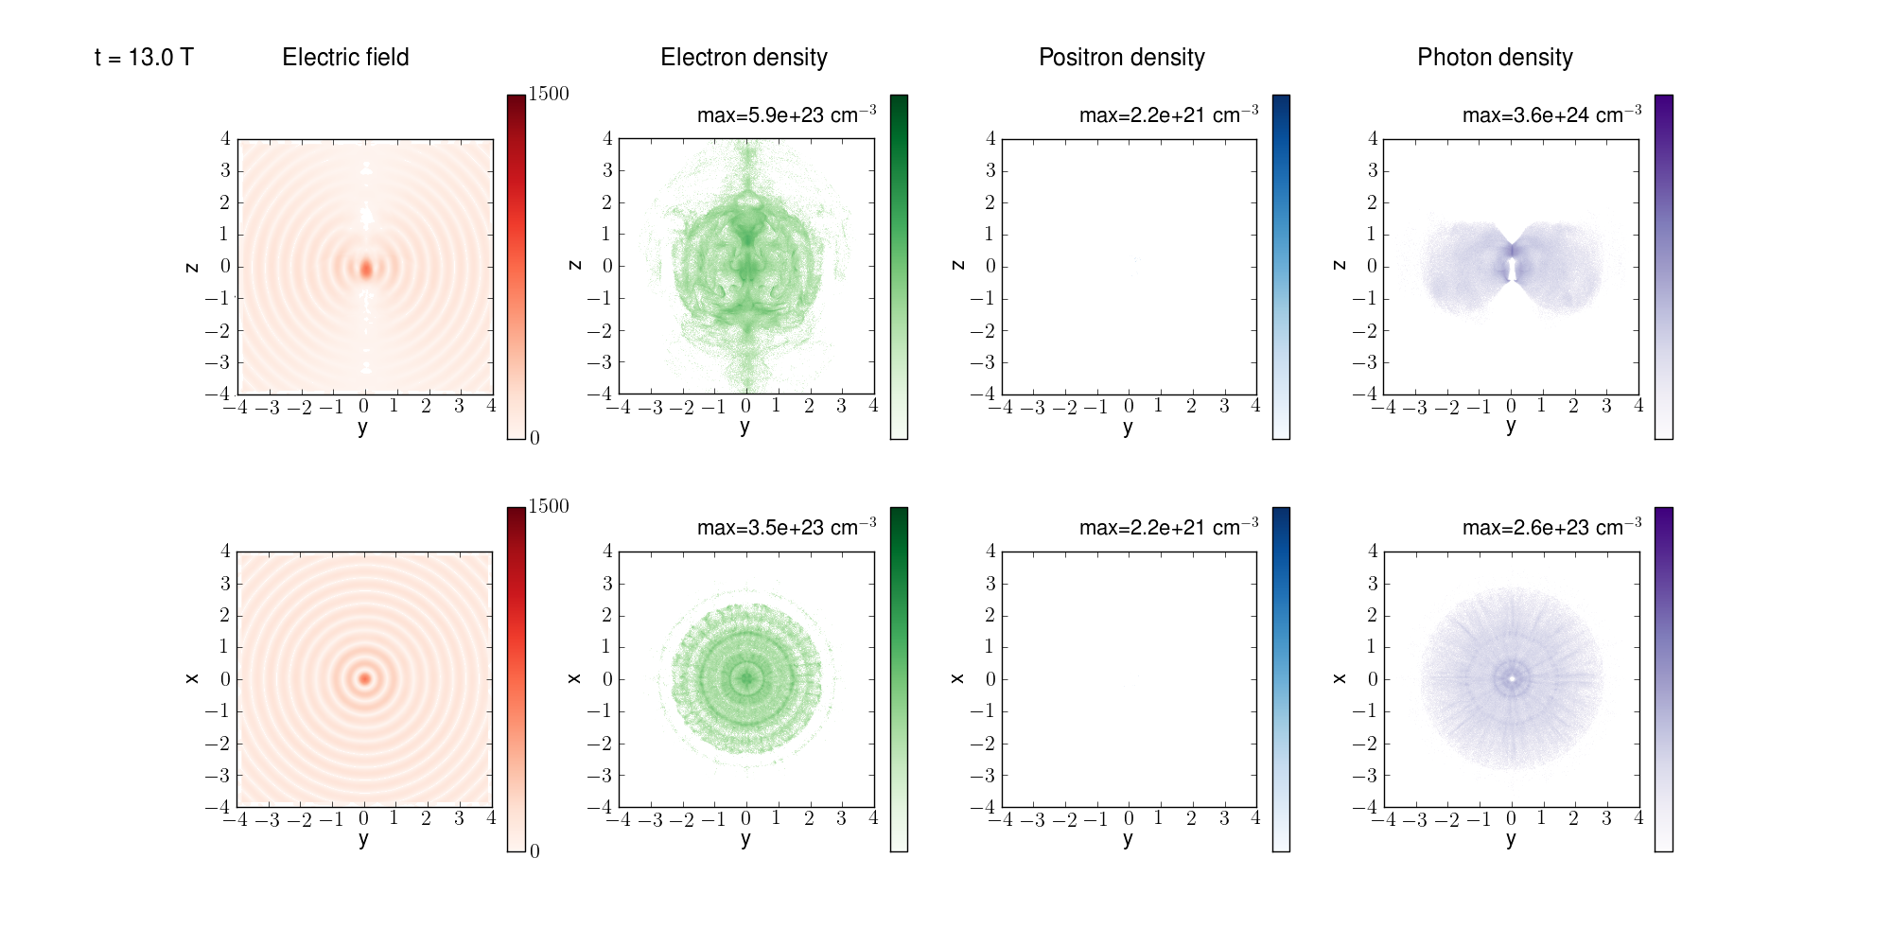
QED cascades in dipole wave
P=100 PW, t=13 T

Slide 15
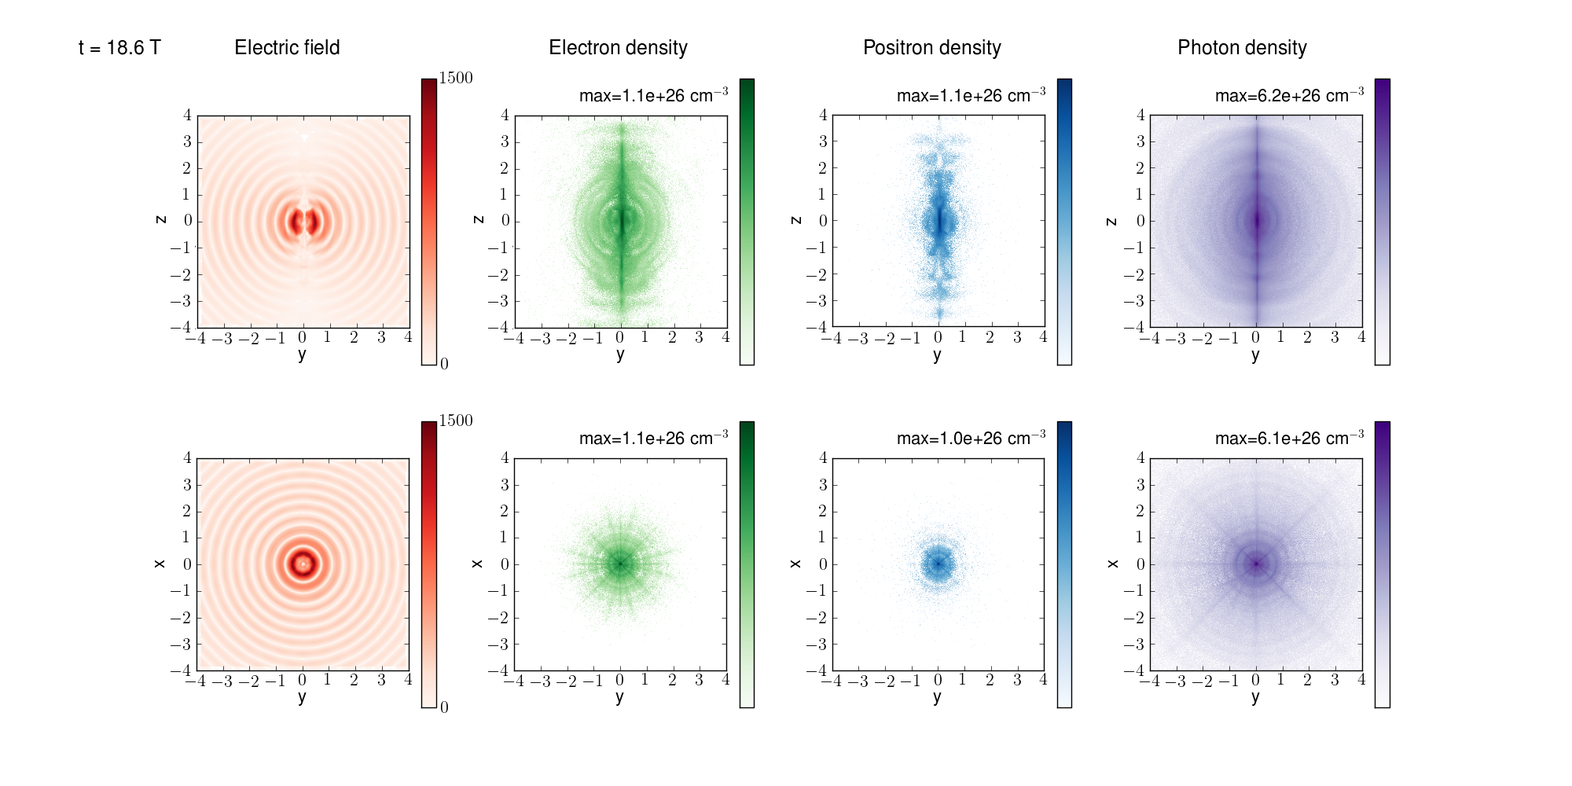
QED cascades in dipole wave
P=100 PW, t=18.6 T

Slide 16
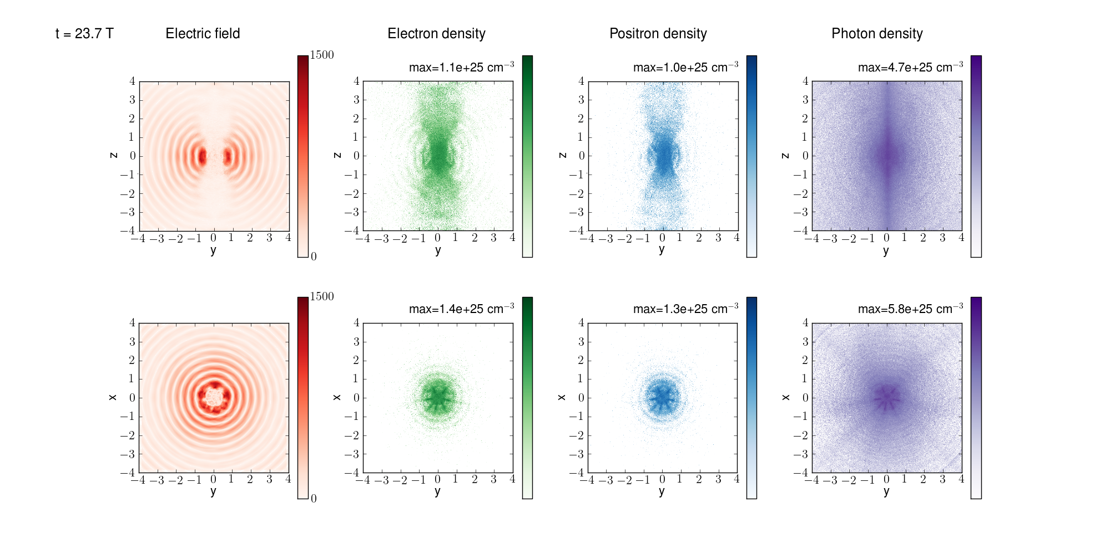
QED cascades in dipole wave
Max electron density > 10 ²⁶ cm⁻³,
Max photon density 6 10 ²⁶ cm⁻³,
10¹³ photon/pulse (E>100 MeV), 10¹⁰ photon/pulse (E>1 GeV)
Limitation by optical pulse refraction from plasma
How nuclei behave in this environment? Can we observe γ-γ collision effects? …………?

Slide 17
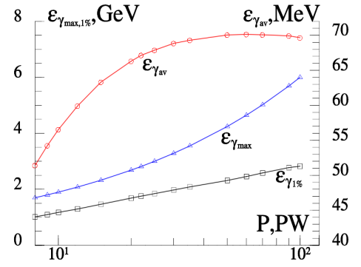
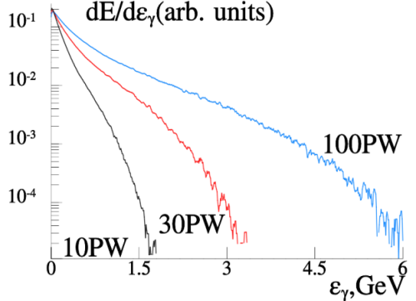
Gamma ray source characteristics
Left. Dependence of average (red line with circles), maximal (blue line with triangles) photon energy and energy at the level 1% (black line with squares) on incoming power P.
Right. Normalized spectra of electron-positron plasma radiation for 10, 30 and 100PW.

Slide 18
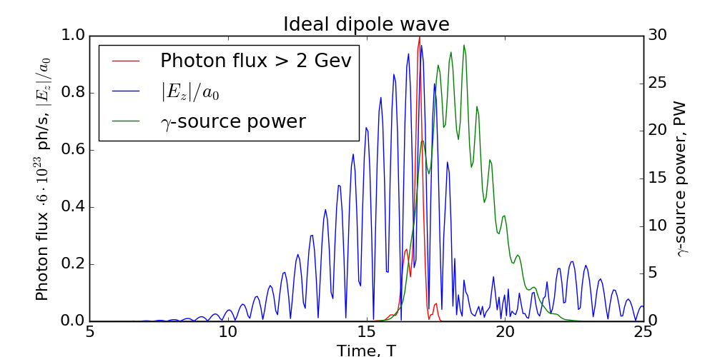
Gamma photon yield for ideal dipole wave
2 GeV photons are emitted only near the maximum of the laser pulse producing sub-period gamma burst
The rear part of the pulse is transformed to gamma quanta with the lower energies almost completely, resulting in overall 34% efficiency (40 PW laser power)

Slide 19
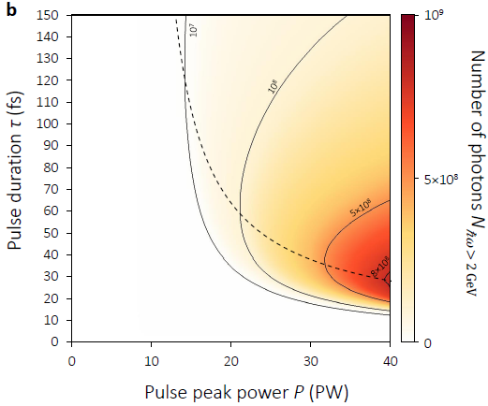
Optimization of GeV photon yield
Nonlinear stage begins at leading edge
Nonlinear stage begins at peak of pulse
There is no nonlinear stage, or nonlinear stage begins at rear front
Maximum photon number slightly vary for power P>40 PW

Slide 20
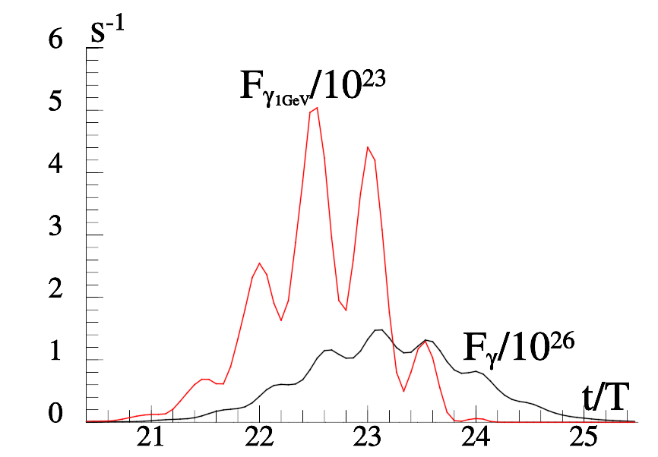
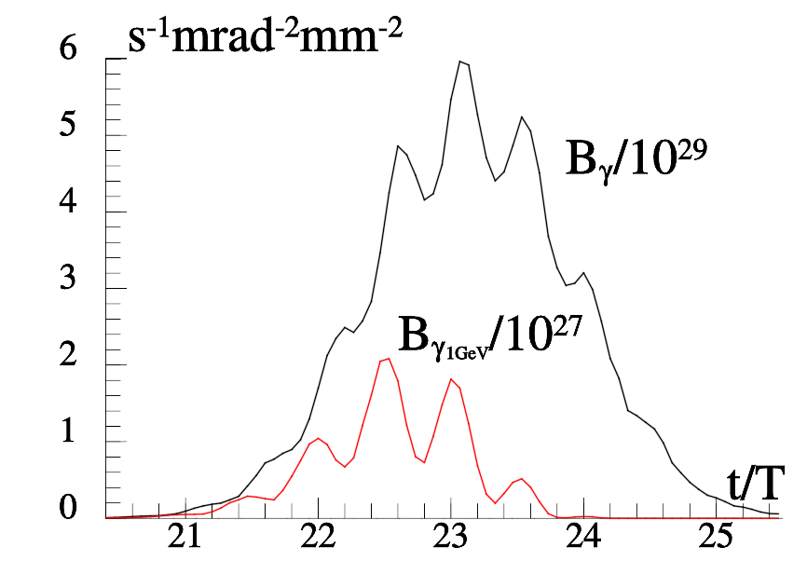
Optimization of GeV photon brilliance
How to make the most brilliant gamma source?
Do not allow degradation of optical wave structure (shorter pulse)
In the case of particular experiments for the Gaussian pulse with the peak power P = 40PW, the duration of τ = 15 fs and the density of the target 10¹⁶cm⁻³. The measured flux and brilliance are shown as a function of time. The duration of the generated gamma pulse is 4.5 fs, maximal brilliance is 6 10²⁹ s⁻¹mrad⁻²mm⁻² , the number of photons for energies >100MeV is 10¹¹. The photon flux for energies greater 1 GeV is 510²³s⁻¹, number of photons is 10⁹.The beam width for the gamma photons is 2 mrad.
A.Gonoskov, A.Bashinov, E.Efimenko et al., PRX, 2017

Slide 21
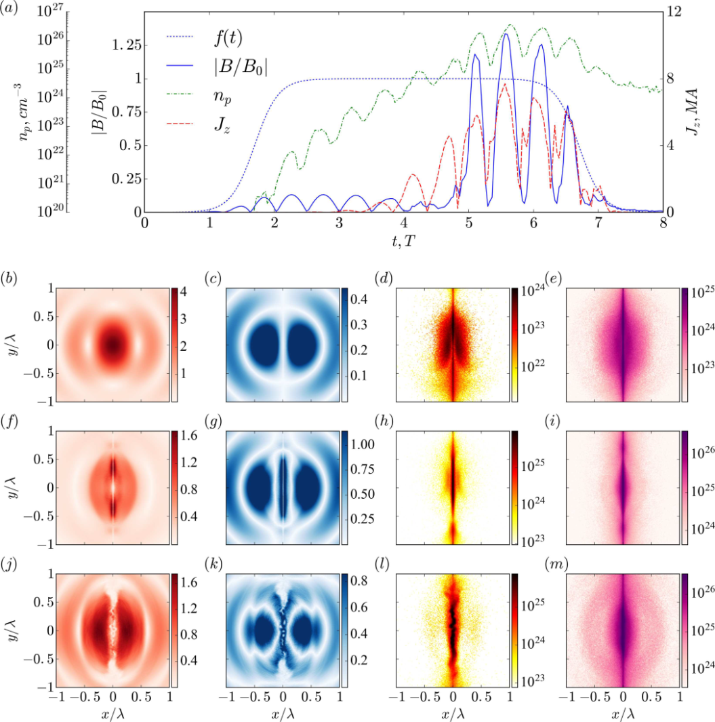
Plasma pinching in e-e+ cascade at P>20 PW
Plasma-field dynamics for 27 PW. (a) Temporal evolution, f(t) - laser pulse envelope, B/B0 -magnetic field in the plane z = 0 at = 1/60, np – maximum pair density, Jz - current through the cylinder with radius 0.1. Electric (b,f,j) and magnetic (c,g,k) fields, positron (d,h,l)and photon (e,i,m) distributions at the stages of (b-e) linear QED cascade, (f-i) plasma column pinching and (j-m) pinch breakdown due to bending instability.
E.S. Efimenko et al “Laser-driven plasma pinching in e−e+ cascade” Phys.Rev. E (2019)

Slide 22
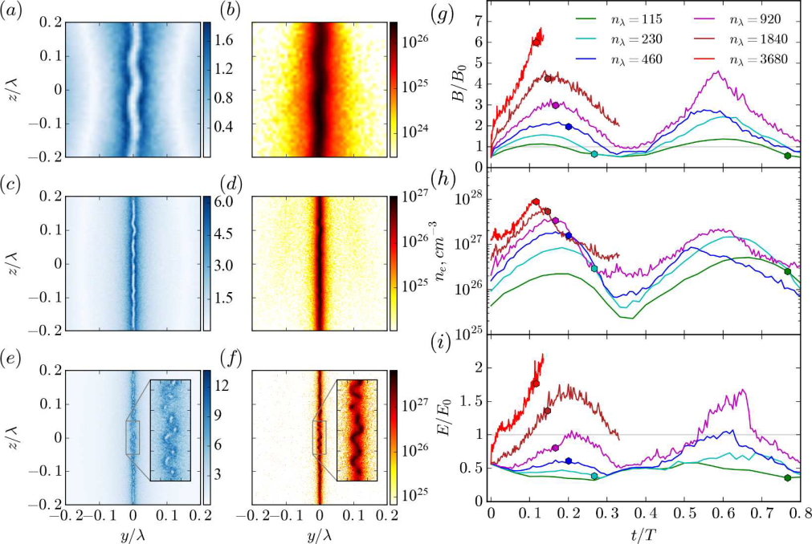
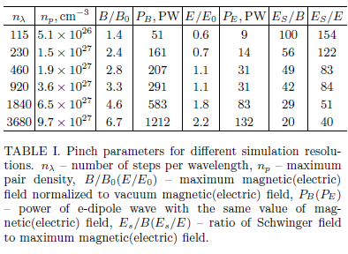
Plasma pinching in e-e+ cascade
and Schwinger field approaching
B/Es =1/20 corresponds to 10 ²⁷W/cm²

Slide 23
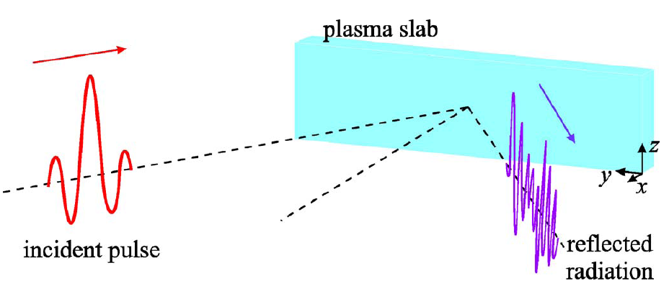
XCELS 10²⁶ W/cm²-and-Beyond Program
Overcritical plasma surface
Incident pulse 10¹⁸ -10²³ W/cm²
Re-emitted pulse
Oscillating Mirror Model (OMM)
S.V. Bulanov et al., Phys. Plasmas (1994)
S.R. Lichters et al., Phys. Plasmas (1996)
S. Gordienko et al, PRL (2004)
N. M. Naumova et al, PRL (2004)
T. Baeva et al., PRE (2006)
D. an der Brugge at al, Phys. Plasmas (2010)
Incident pulse >10²³ W/cm²
Relativistic Electronic Spring (RES) Model
A.Gonoskov et al, PRE (2011)
J.Fuchs et al, EJP (2014)

Slide 24
Effect of Relativistic Electronic Spring
Stages:
1) pushing of electrons and the formation of a thin current layer- nanoplasmonic structure, which results in energy transfer from the laser field to the plasma fields and particles;
2) backward motion of the electrons towards the incident wave with conversion of energy accumulated in the plasma and laser field energy into the kinetic energy of an ultrarelativistic electron bunch;
3) radiation of the attosecond pulse by an electron bunch due to conversion of the kinetic energy and laser field energy to the XUV and X- ray range.
Y
X
electrons
Z
ions

Slide 25

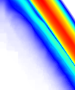
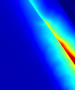
Optimal Conditions and Efficiency of
Giant Attosecond Pulse Generation
A.Gonoskov et al, Phys. Rev. E (2011)
J. Fuchs et al, EJP (2014)
Classifcation of Interaction Type:
OMM- oscillating mirror
RES - relativistic electronic spring
RIST - relativistically induced
solid target transparency
RIST
RIST
RES
RES
N_{e}, cm⁻³
N_{e}, cm⁻³
S=5
δ
S=5
OMM
OMM
I, W/cm²
I, W/cm²
δ = W_{acc} / W_{cycle} – coefficient of energy transformation
a_{g}/a_{in} – amplitude enhancement
M. Behmke et al, PRL (2011)
experiment

Slide 26
Groove Shape Target and Superluminal Focal Spot

Slide 27
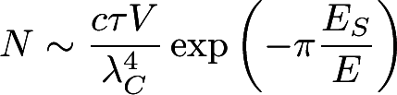

Pair Production from Vacuum with
Attosecond Superluminal Probe
For 200 PW and 10²³W/cm² at the groove target 0.5 mm wide
we have 10²⁸ W/cm² in the volume V~10nm³
Number of pairs N~10⁹
Cascades are strongly suppressed due superluminal motion of the focal area
10²⁸ W/cm²
10 nm
v_{f} = c/sinθ
0.5 mm

Slide 28
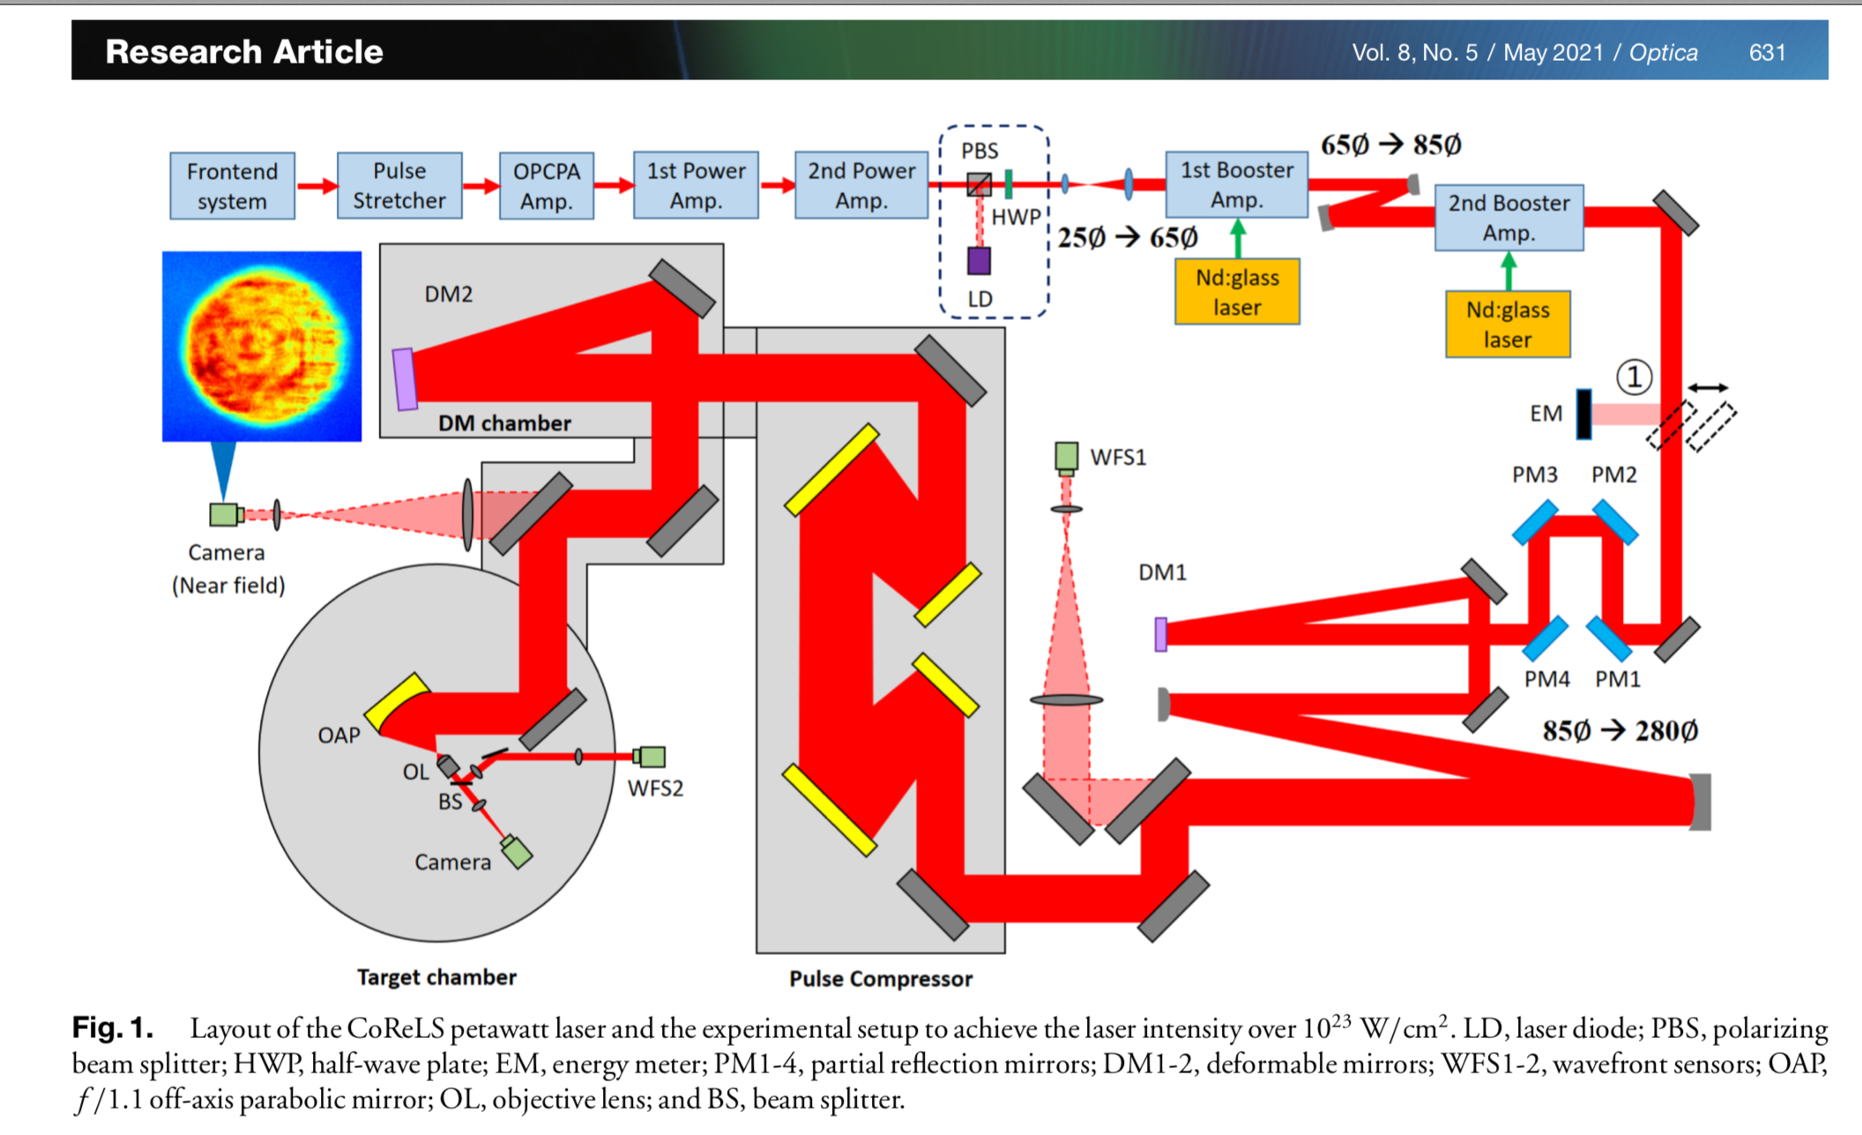
10²³ W/cm², 20 fs, 4 PW at CoReLS (GIST, Korea)

Slide 29
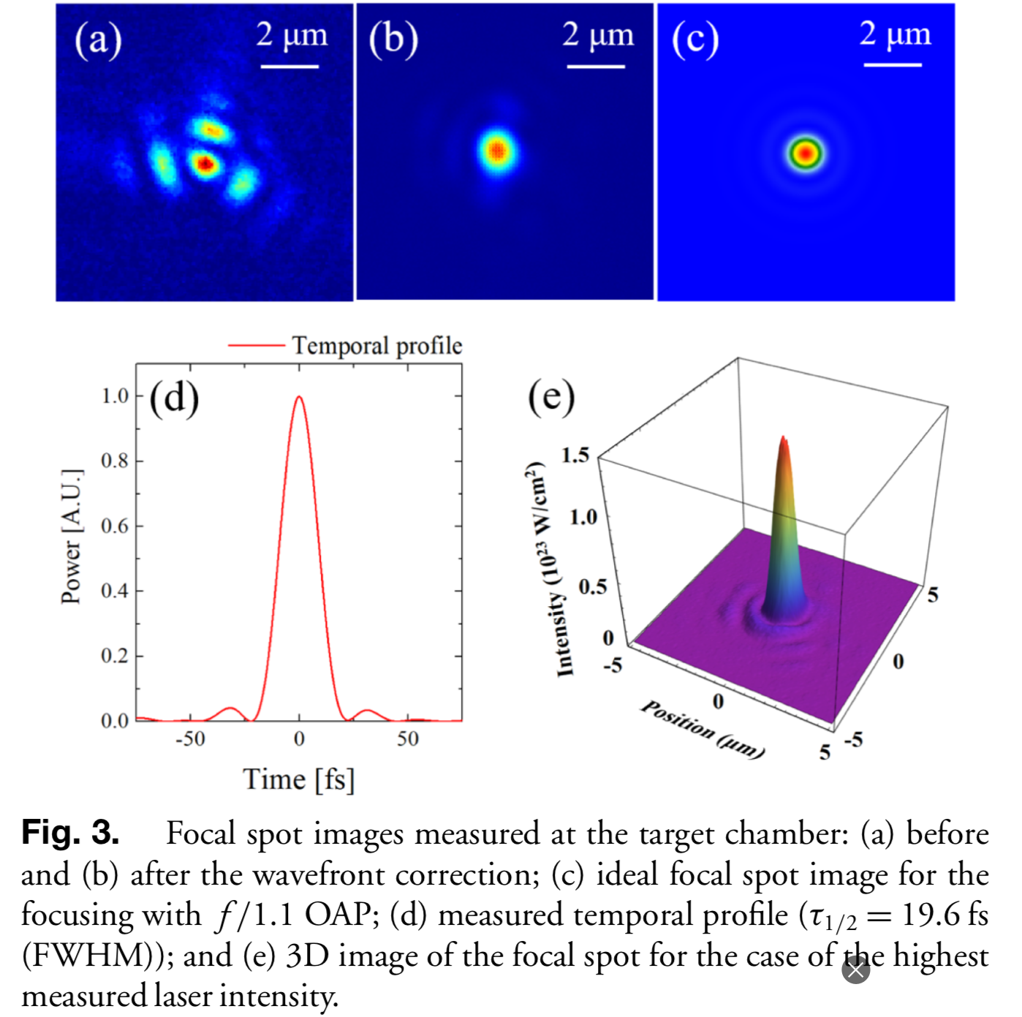
10²³ W/cm², 20 fs, 4 PW at CoReLS (GIST, Korea)

Slide 30
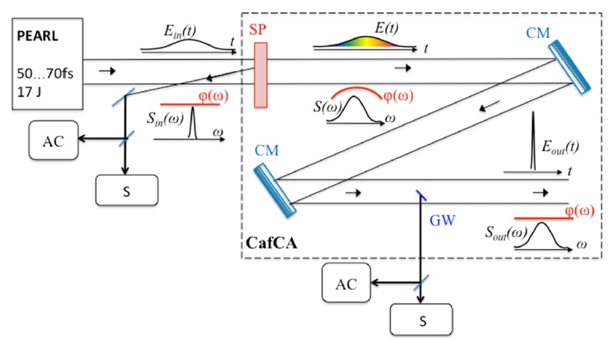
11 fs, 1.5 PW at PEARL (IAP RAS)
^{СМ: -325 фс2}
^{-250 фс2}
^{-200 фс2}

Slide 31
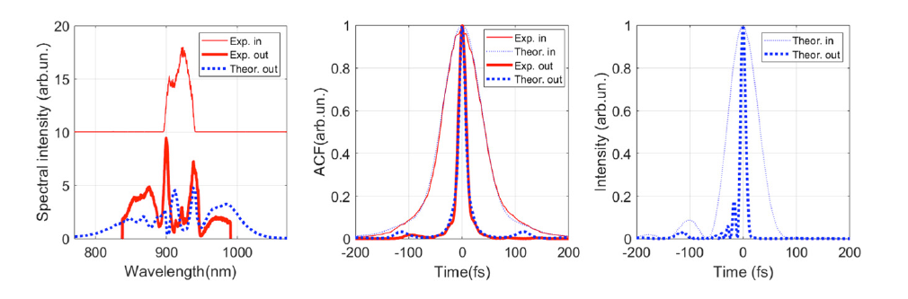
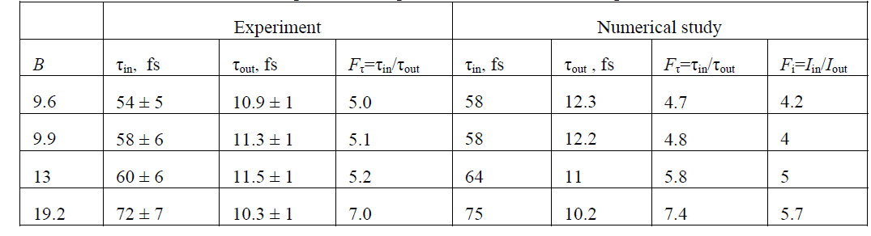
11 fs, 1.5 PW at PEARL (IAP RAS)
Spectra
ACF
Pulse
семинар ОНДиО 22 июня 2021г.

Slide 32
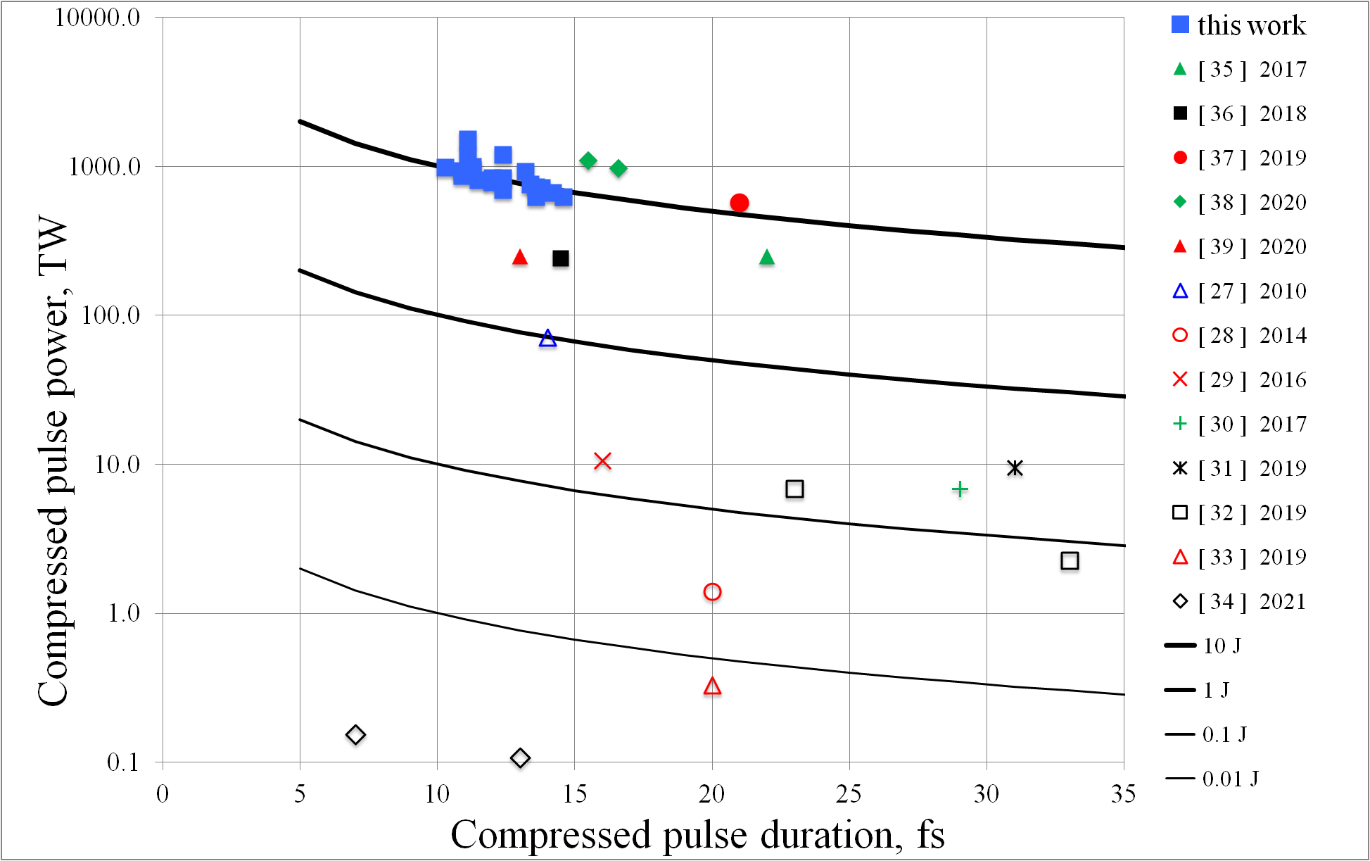
11 fs, 1.5 PW at PEARL (IAP RAS)
V.Ginzburg et al., submitted, 2021

Slide 33
In Conclusion
We are at the entrance to a new realm of physical phenomena
10-100 Petawatt-scale lasers will bring particle dynamics in the radiation dominated regime
QED cascades and radiation trapping of particles produce ultrarelativistic, ultradense e-e+ plasma that efficiently convert optical energy to gamma rays
Controllable directed gamma ray sources of GeV photons with extreme brilliance will be soon available as a new instrument to study nuclear matter and vacuum physics
Laboratory astrophysics will be provided with Gigagauss and Teragauss magnetc fields on the Earth
By energy conversion from femtosecond to attosecond scale, the Schwinger field can be approached and time-space structure of vacuum can be studied

