Slide 1
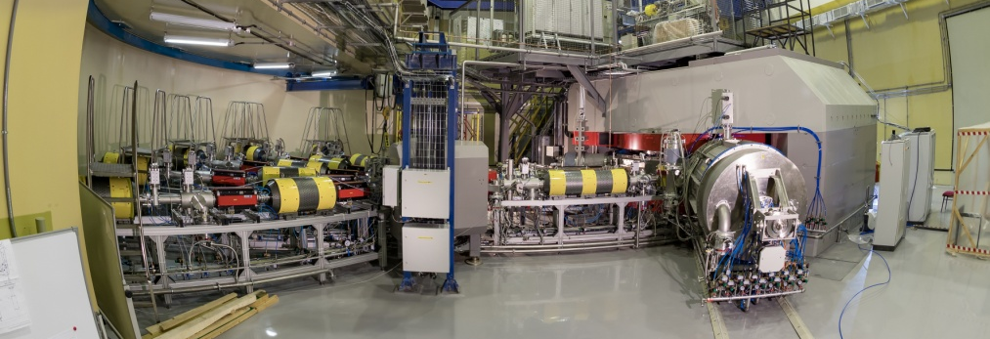
ФЛЕРОВИЙ (Z=114) и МОСКОВИЙ (Z=115) на Фабрике СТЭ Переход к синтезу элементов c Z > 118 В.К. Утёнков / А.В. Карпов Лаборатория ядерных реакций им. Г.Н. Флерова
ДЦ-280
«Сверхтяжелые элементы», Дубна, 30 июня – 2 июля 2021 г.

Slide 2
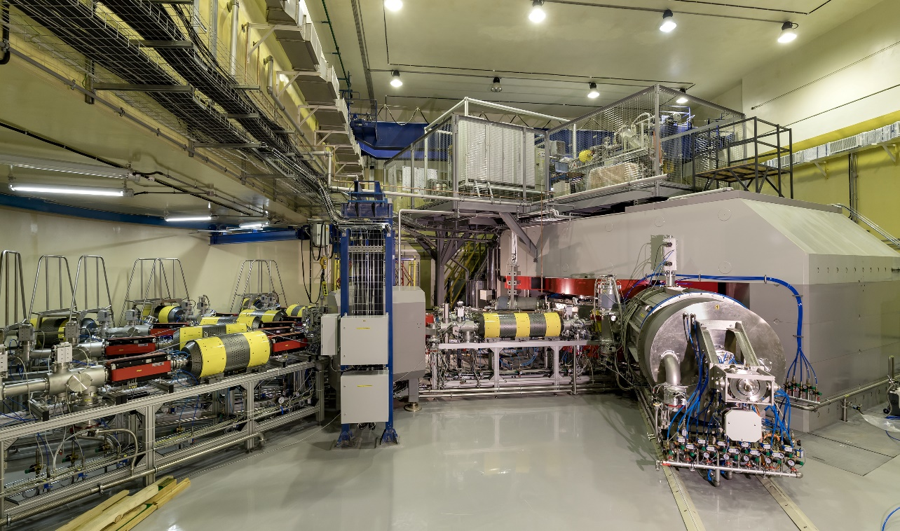
Cyclotron DC-280 Factory of superheavy elements
Beam of ⁴⁸Ca
Intensity: 6∙10¹³ ions/s
Energy: ~300 MeV
Efficiency:
~50%

Slide 3
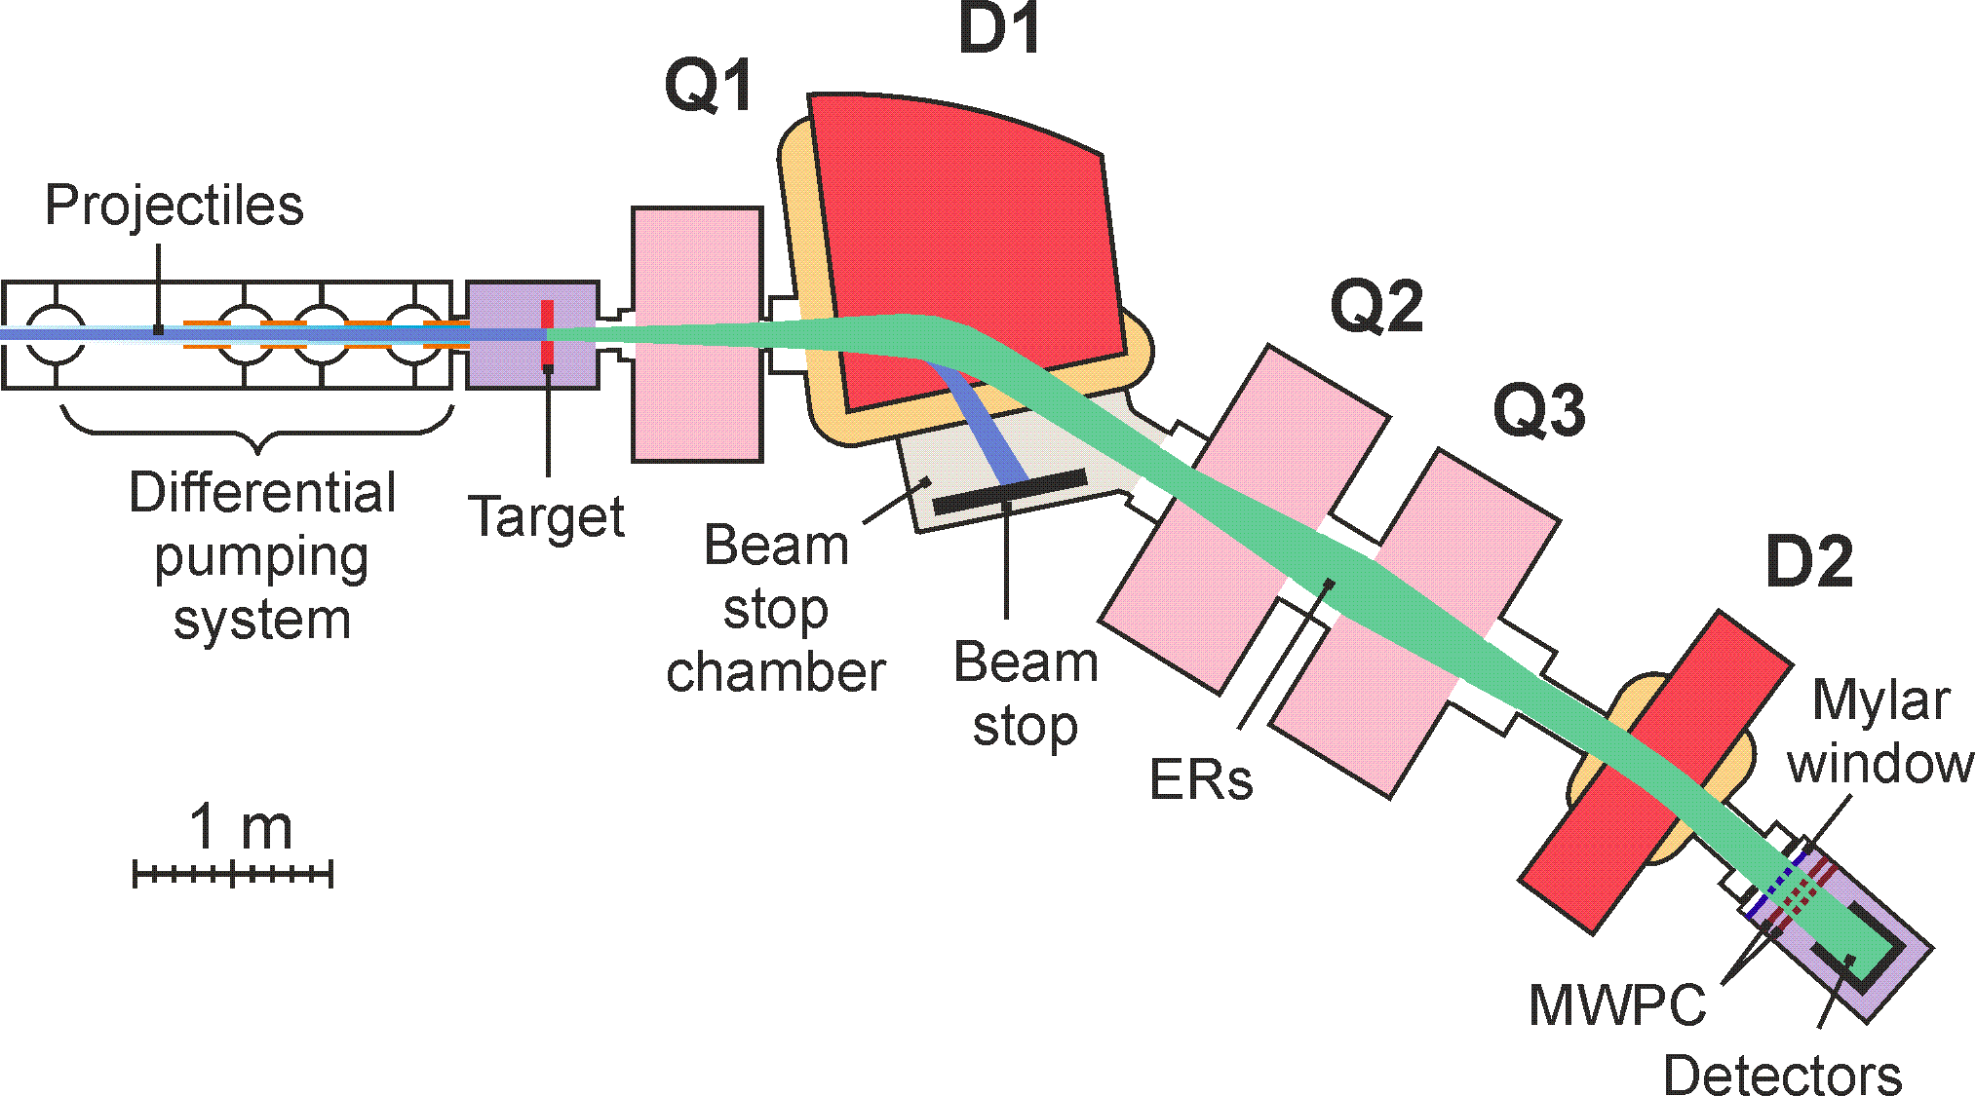
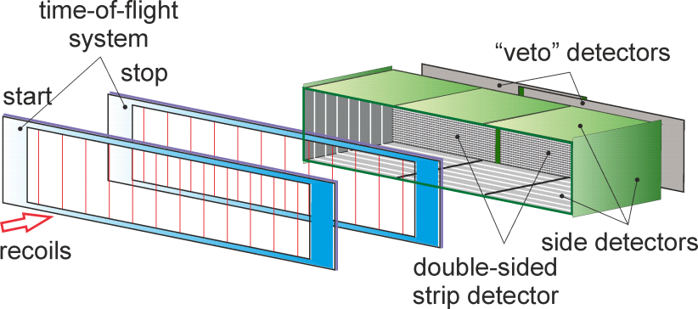
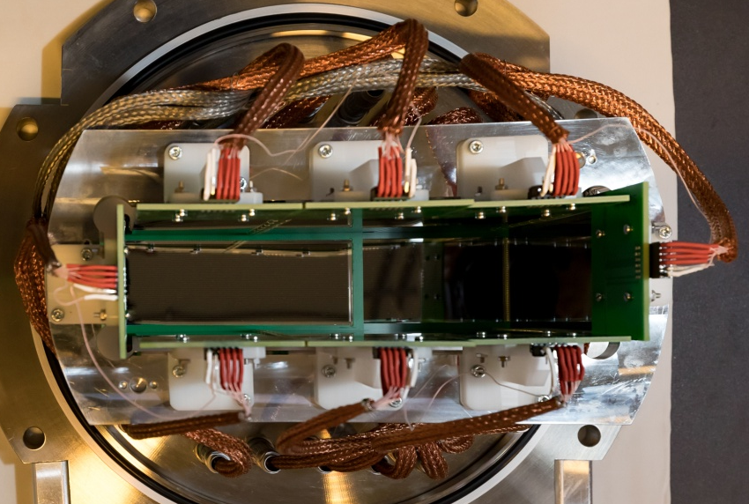
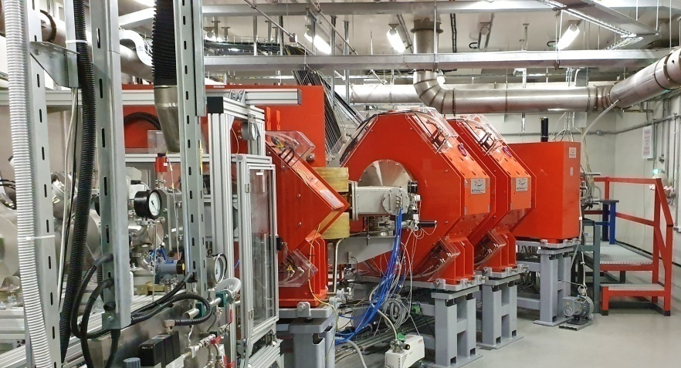
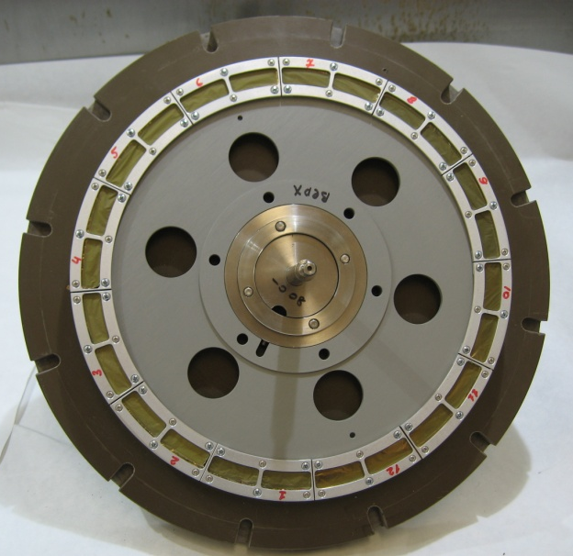
Gas-Filled Separator, DGFRS-2
DC-280
beam
²⁴²Pu 24-cm target wheel 12 sectors
48×220 DSSD &
60×120 SSSD
Digital and analog electronics

Slide 4
²⁴³Am+⁴⁸Ca→²⁹¹Mc*
24 days in Nov.-Dec. 2020
16 days in Jan.-Feb. 2021

Slide 5
Results of the first experiment ²⁴³Am + ⁴⁸Ca
Technical tasks:
Transmission
Background
Image size on detector
Systematics of charge states
Test of digital and analog data acquisition systems
Scientific tasks:
Excitation function for xn-evaporation channels
Decay properties
Сross sections for the pxn channel
EC branch for ²⁸⁸Mc and ²⁸⁴Nh
E (MeV) | 243.9 | 240.9 | 239.1
Dose, 10¹⁸ | 8.0 | 2.2 | 2.3
N ²⁸⁸Mc/²⁸⁹Mc | 30 / 5 | 16 /1 | 9 / 0
I = 1.2-1.3 pμA ~ (7-8)∙10¹² ions/s

Slide 6
Transmission
From ²⁰⁶Pb(⁴⁸Ca,2n)²⁵²No test reaction: 55±7%
From ²⁴³Am(⁴⁸Ca,2-3n)^{288,289}Mc reaction:
Comparison of results at the same ⁴⁸Ca energy
 | DGFRS @ U400 | DGFRS-2 @ DC-280
Target thickness, mg/cm² | 0.37 | 0.43
Beam dose, 10¹⁸ | 3.3 | 3.4
No decay chains | ²⁸⁸Mc – 6 ²⁸⁹Mc – 0 | ²⁸⁸Mc – 13 ²⁸⁹Mc – 2
Yield | 1 | 1.8-2.1

Slide 7
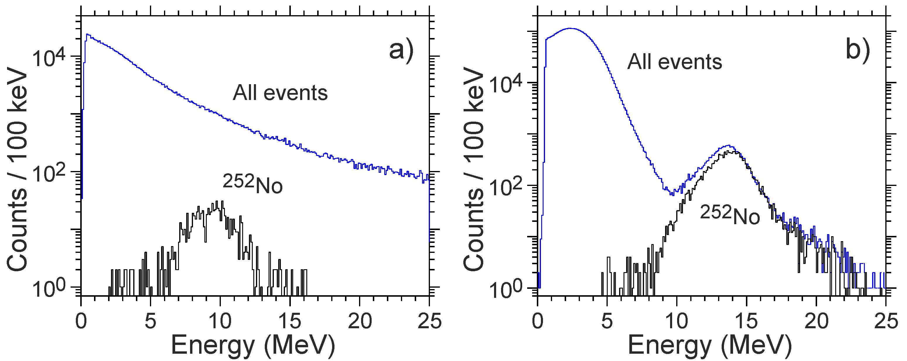
Background conditions
²⁰⁶Pb+⁴⁸Ca →²⁵²No+2n (Cross section 0.5 mb)
Background suppression is 200+ higher at the DGFRS-2 than at DGFRS
DGFRS @ U400
DGFRS-2 @ DC-280
Energy spectra of all the particles registered by MWPC (top blue line) and of ²⁵²No (bottom black line) nuclei produced in the ²⁰⁶Pb(⁴⁸Ca,2n) reaction using separators DGFRS (a) and DGFRS-2 (b).

Slide 8
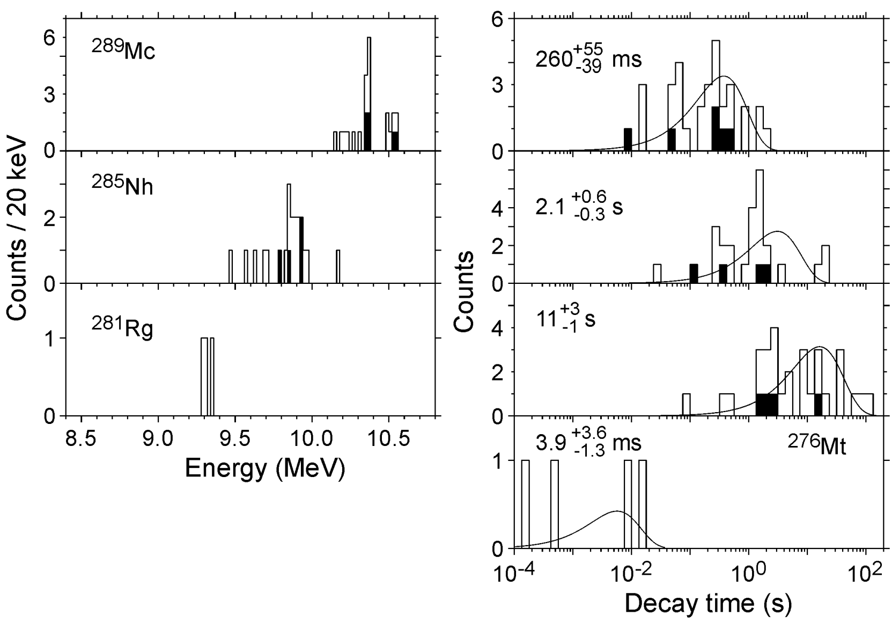
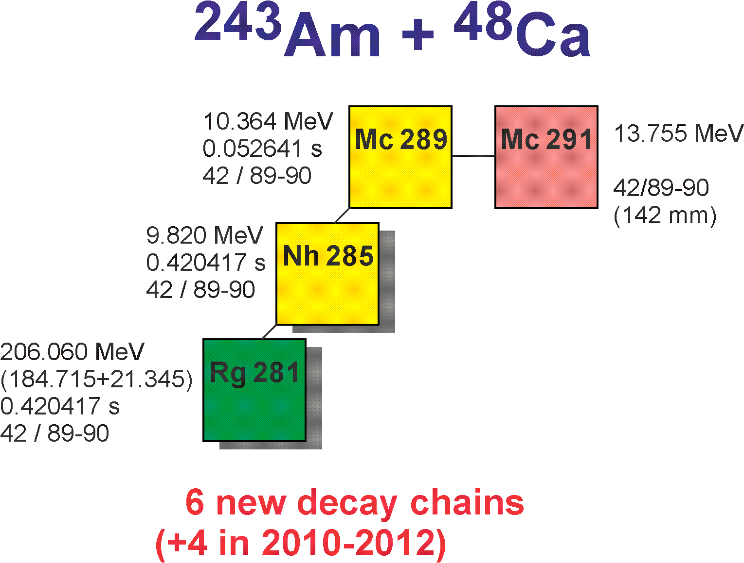
Results of the first experiment
²⁸⁹Mc decay properties
DGFRS, TASCA, BGS, DGFRS-2

Slide 9
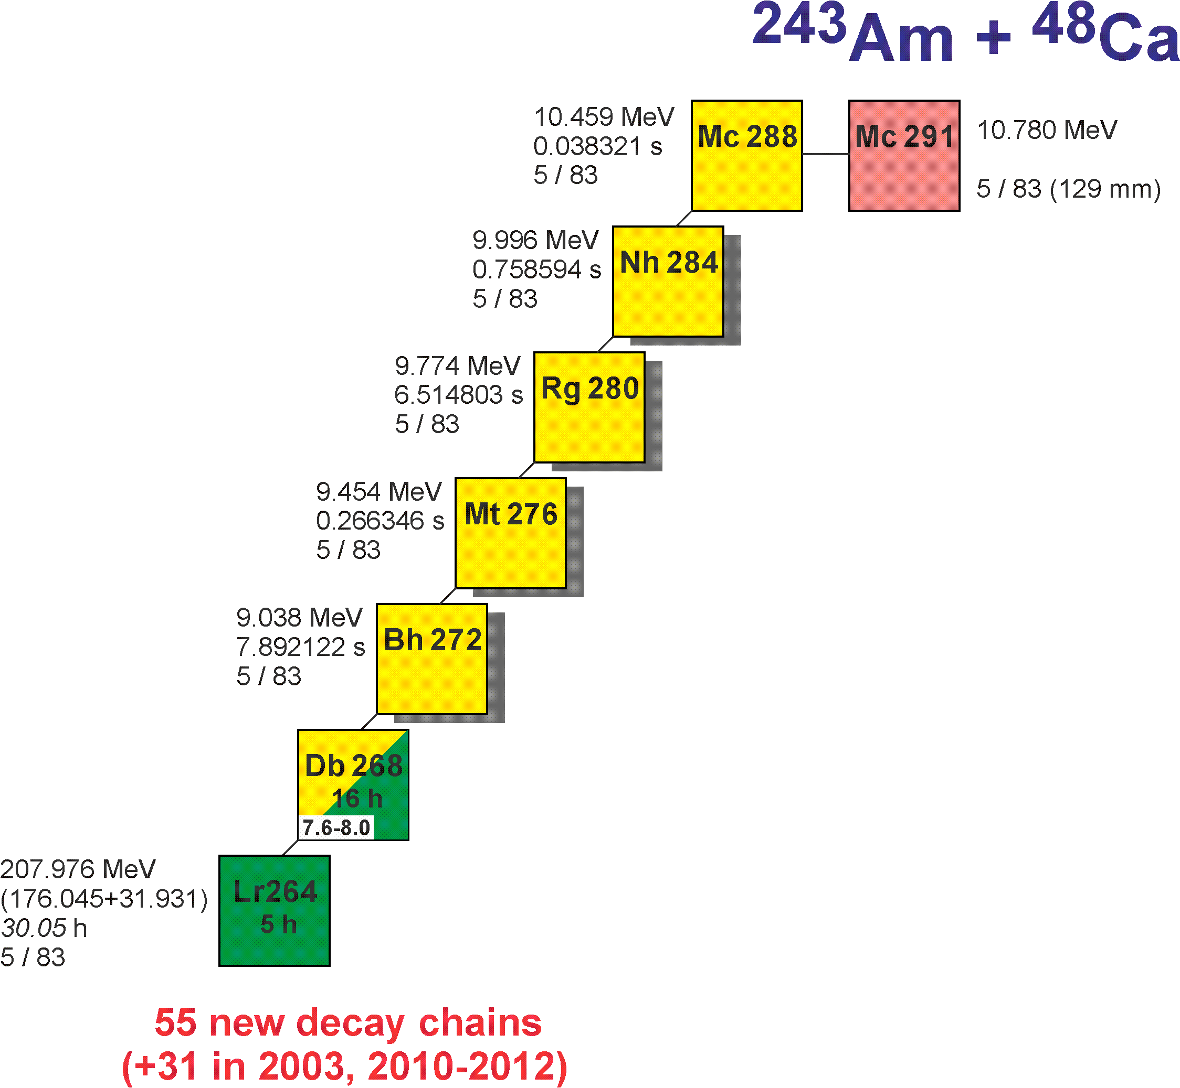
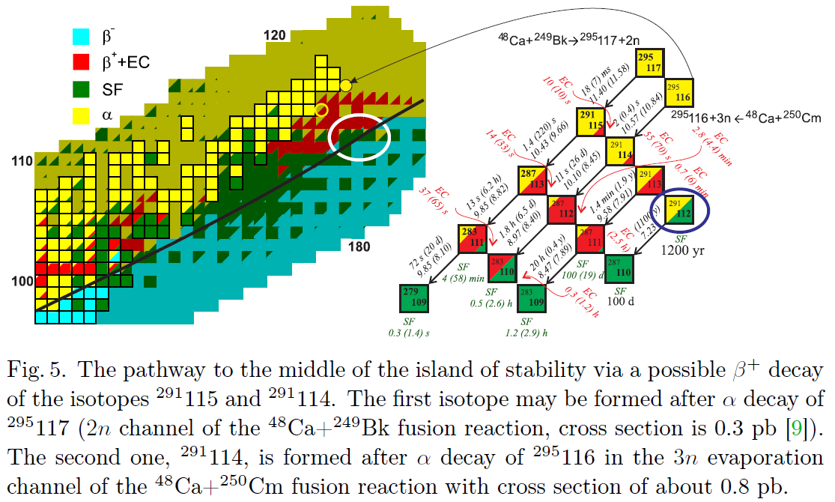
Results of the first experiment
EC?

Slide 10
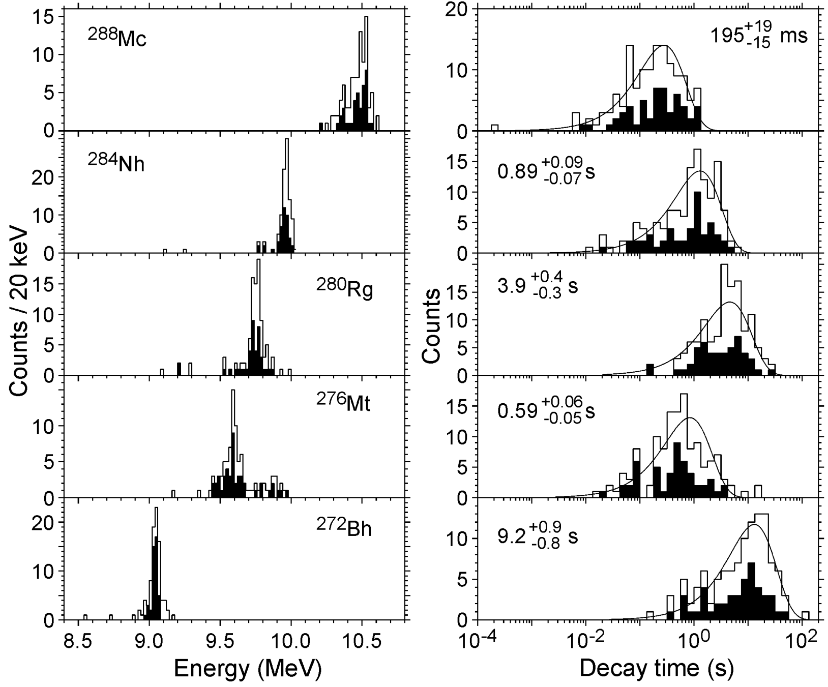
Results of the first experiment
²⁸⁸Mc decay properties
DGFRS, JINR
TASCA, GSI
BGS, LBNL
DGFRS-2, JINR

Slide 11
First observation of α−decay of ²⁶⁸Db and new isotope ²⁶⁴Lr
b_{α} (²⁶⁸Db) = 55 (⁺²⁰₋₁₅) % T_{1/2} (²⁶⁸Db) = 16 (⁺⁶₋₄) h T_{1/2} (²⁶⁴Lr, SF) = 4.9 (^{+2.1}_{-1.3}) h

Slide 12
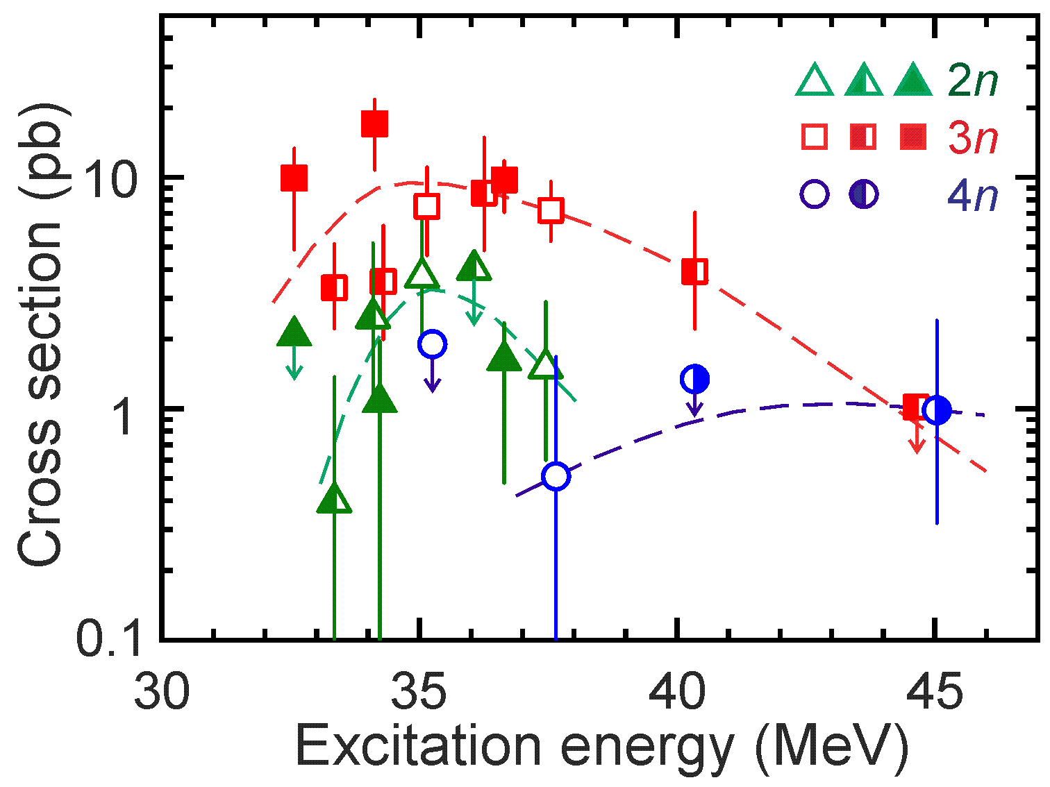
Results of the first experiment
Excitation function
DGFRS, TASCA, DGFRS-2

Slide 13
²⁴²Pu+⁴⁸Ca→²⁹⁰Fl*
Completed in June 2021

Slide 14
Preparation of experiment on chemistry of Fl and Cn Results of the experiment ²⁴²Pu+⁴⁸Ca
E=242 MeV, Beam dose=1.1 10⁺¹⁹
N (²⁸⁷Fl / ²⁸⁶Fl) = 70 / 12
E=247 MeV, Beam dose=5.0 10⁺¹⁸
N (²⁸⁷Fl / ²⁸⁶Fl) = 3 / 15
I = 1.5 - 3.0 pμA

Slide 15
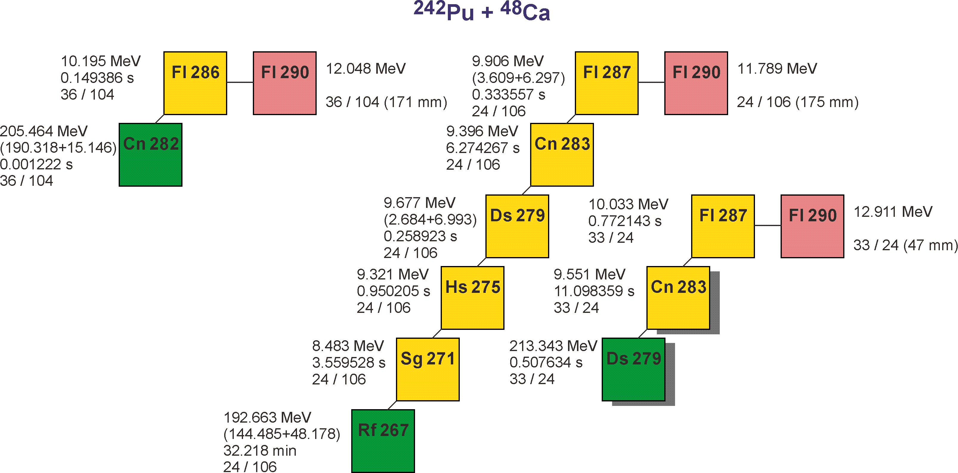
Results of the first experiment ²⁴²Pu+⁴⁸Ca
27
64
9

Slide 16
Synthesis of new elements 119 and 120

Slide 17
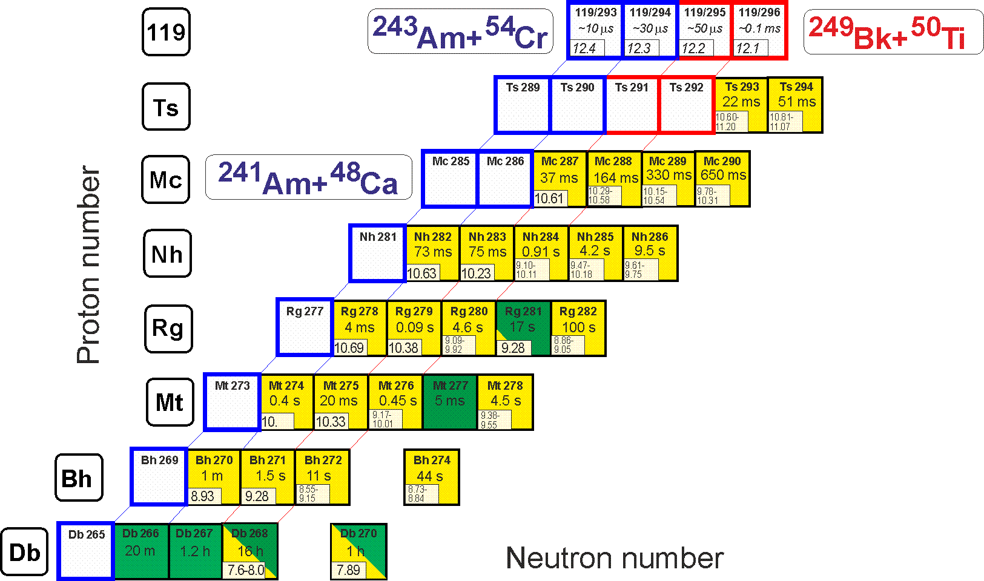
Synthesis of element 119: ²⁴⁹Bk+⁵⁰Ti
σ=0.05 pb,
h_{t}=0.4 mg/cm²,
ε_{coll}=0.7+,
I_{beam}=3 pμA → ≈1 event per month

Slide 18
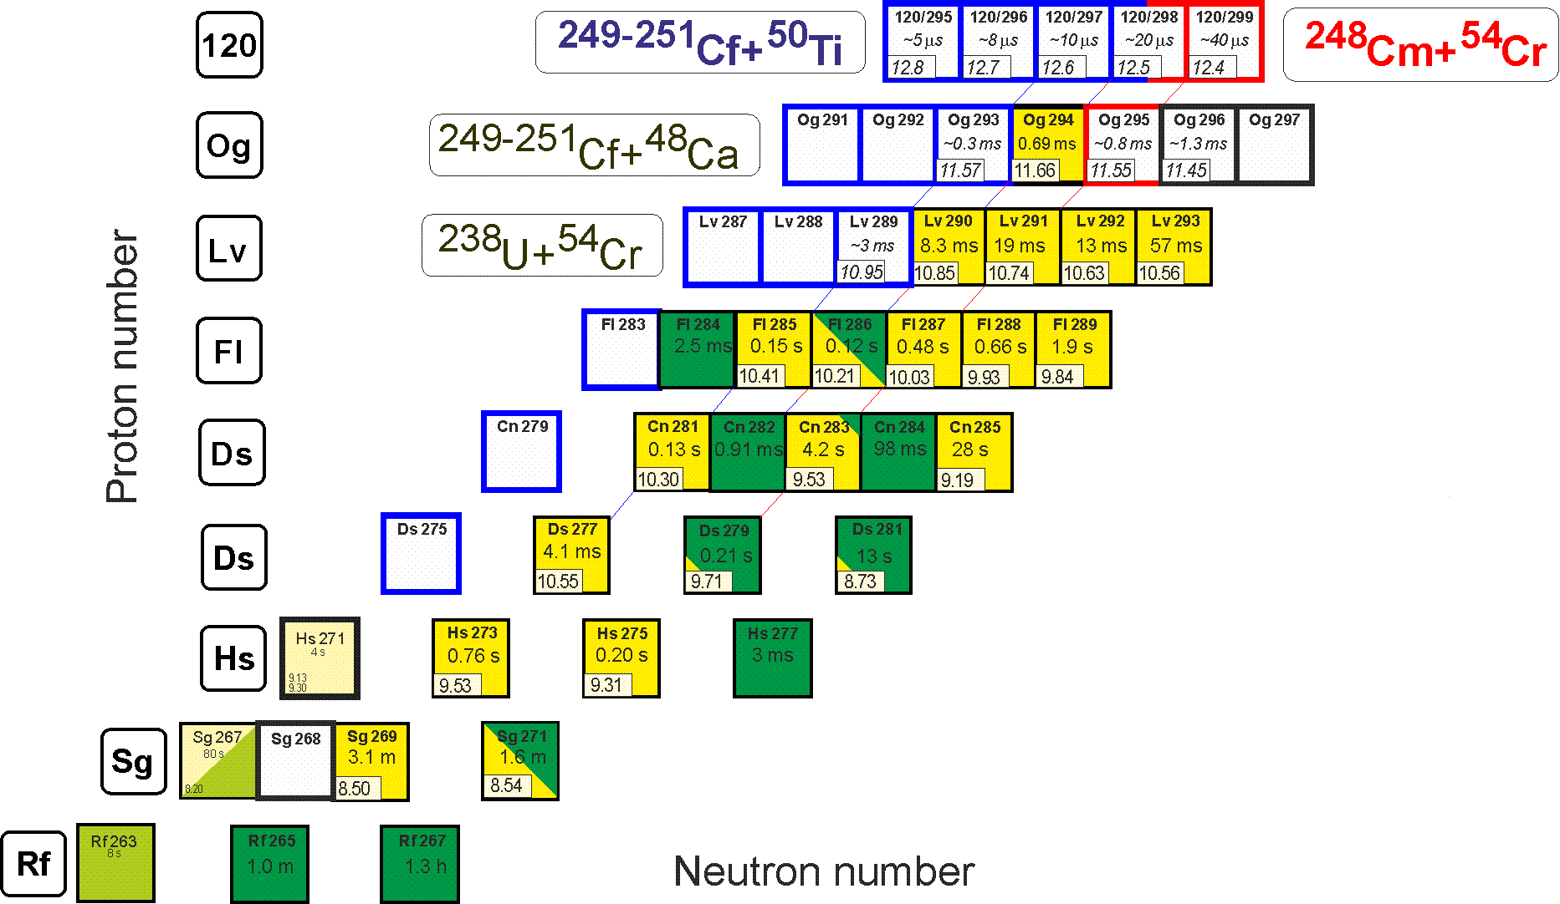
Synthesis of element 120
σ=0.05 pb,
h_{t}=0.4 mg/cm²,
ε_{coll}=0.7+,
I_{beam}=3 pμA → ≈1 event per month

Slide 19
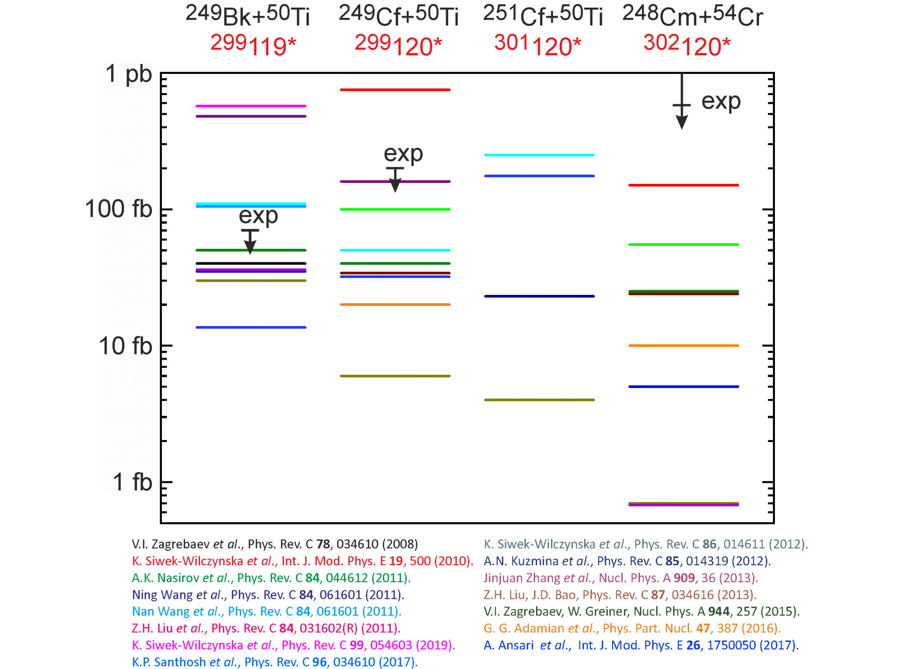
Predicted cross sections for
synthesis of elements 119 and 120
⁵⁰Ti + ²⁴⁹Bk
⁵⁰Ti + ²⁴⁹⁻²⁵¹Cf
⁵⁴Cr + ²⁴⁸Cm
Test reactions are due

Slide 20
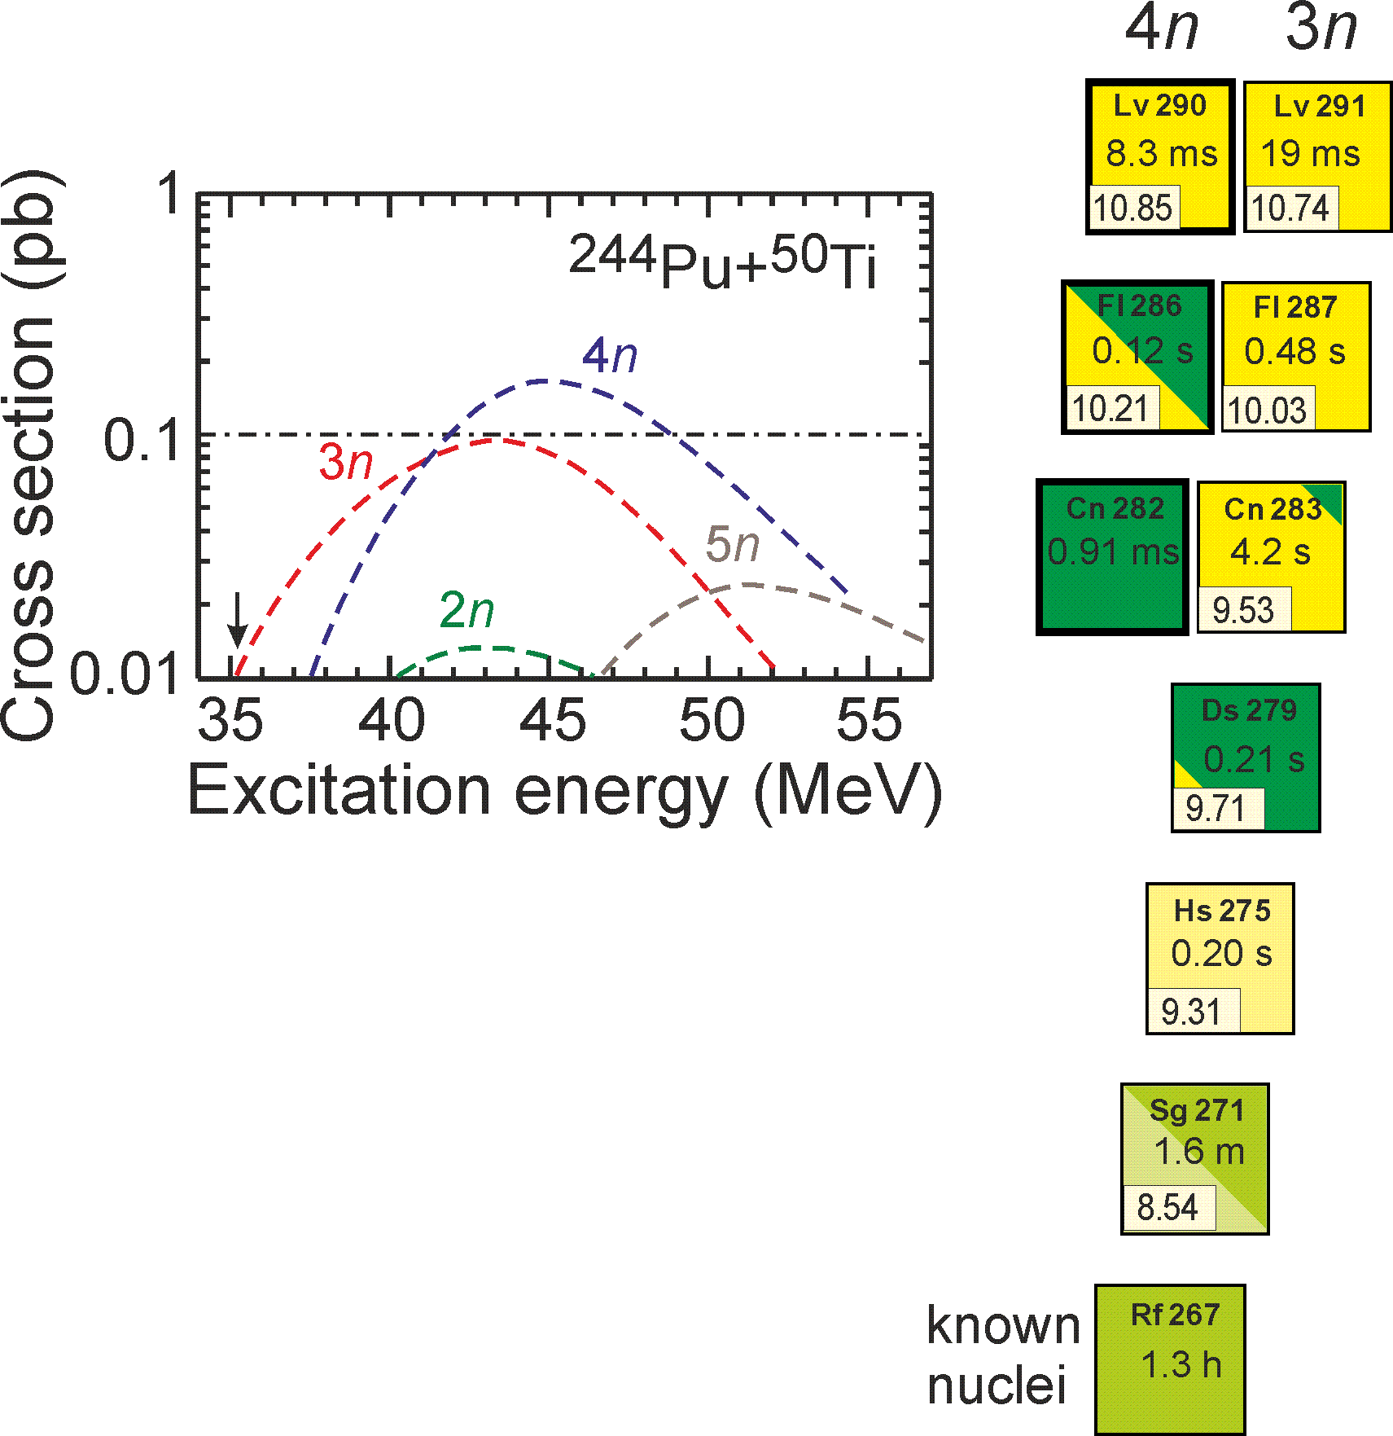
Preparation to synthesis of elements 119 and 120: ⁴⁸Ca → ⁵⁰Ti
²⁴⁴Pu+⁵⁰Ti → ²⁹⁴Lv*
²⁴⁵Cm+⁴⁸Ca → ²⁹³Lv* (~3 pb)
σ=0.2 pb,
h_{t}=0.3 mg/cm²,
ε_{coll}=0.7+,
I_{beam}=1.5 pμA → ≈3 events per 2 months
V. Zagrebaev and W. Greiner
0.2-0.3 pb
G. Adamian et al.
0.1 pb

Slide 21
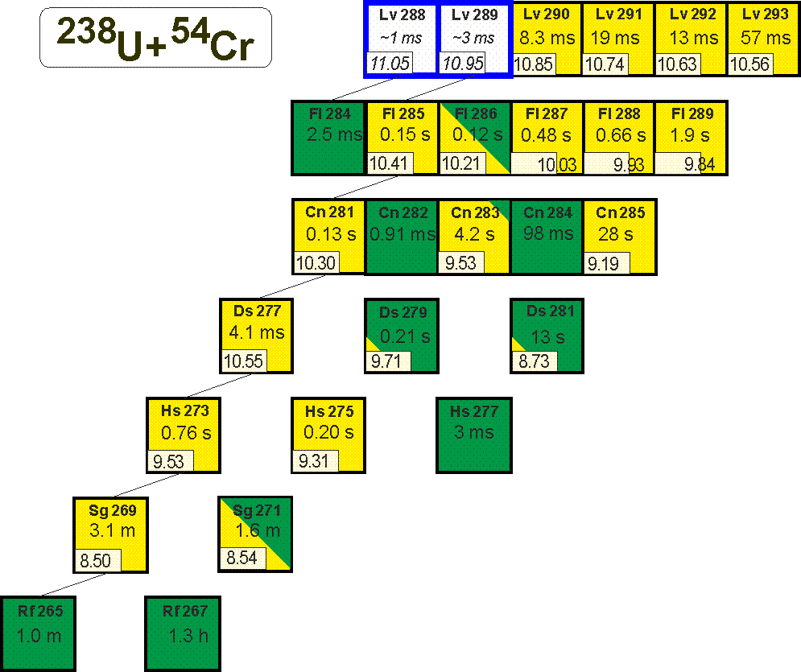
Preparation to synthesis of elements 119 and 120: ⁴⁸Ca → ⁵⁴Cr
²⁴²Pu+⁵⁰Ti → ²⁹²Lv*
²³⁸U+⁵⁴Cr → ²⁹²Lv*
²⁴⁵Cm+⁴⁸Ca → ²⁹³Lv* (~3 pb)
σ=0.015 pb,
h_{t}=0.4 mg/cm²,
ε_{coll}=0.7+,
I_{beam}=3 pμA → ≈3 events per 9 months
G. Adamian et al.
0.015 pb

Slide 22
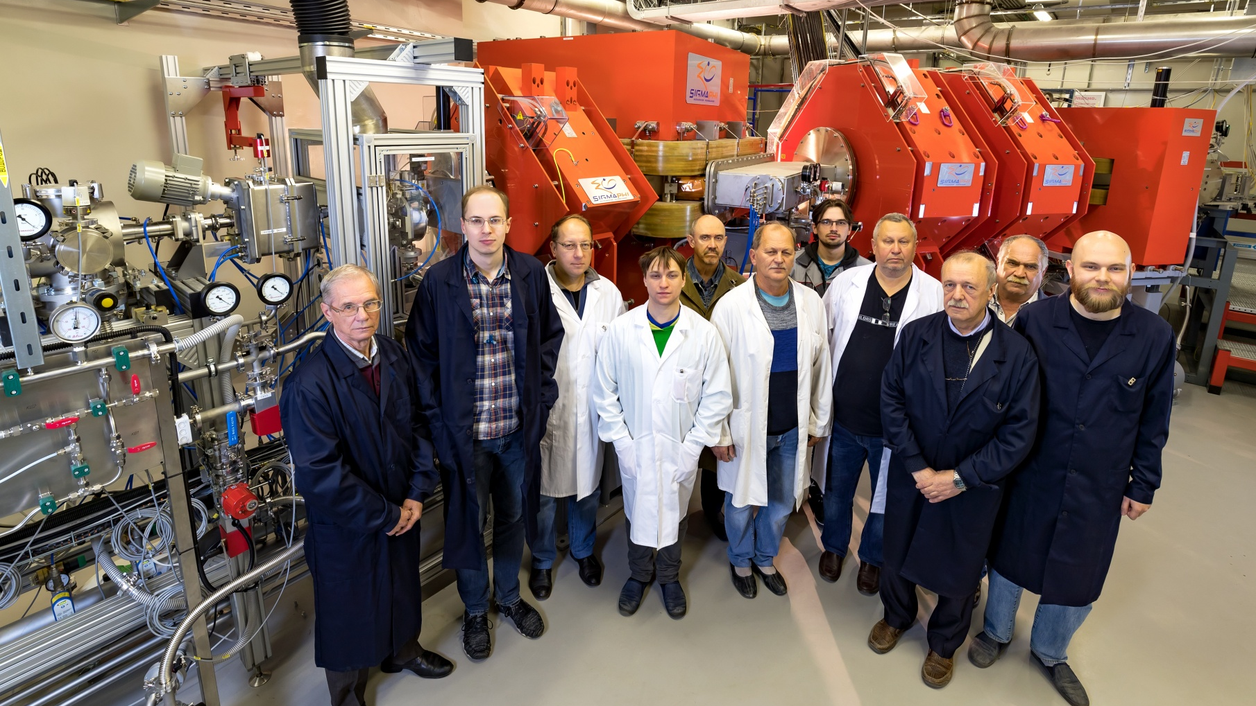
СПАСИБО ЗА ВНИМАНИЕ!

