Slide 1
Квази-деление - первый светофор на пути образования сверхтяжелых элементов
М.Г. ИТКИС
ЛЯР ОИЯИ 30.06.2021

Slide 2
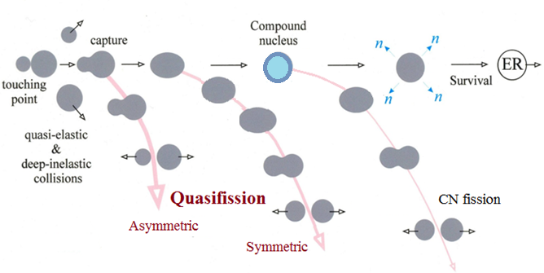
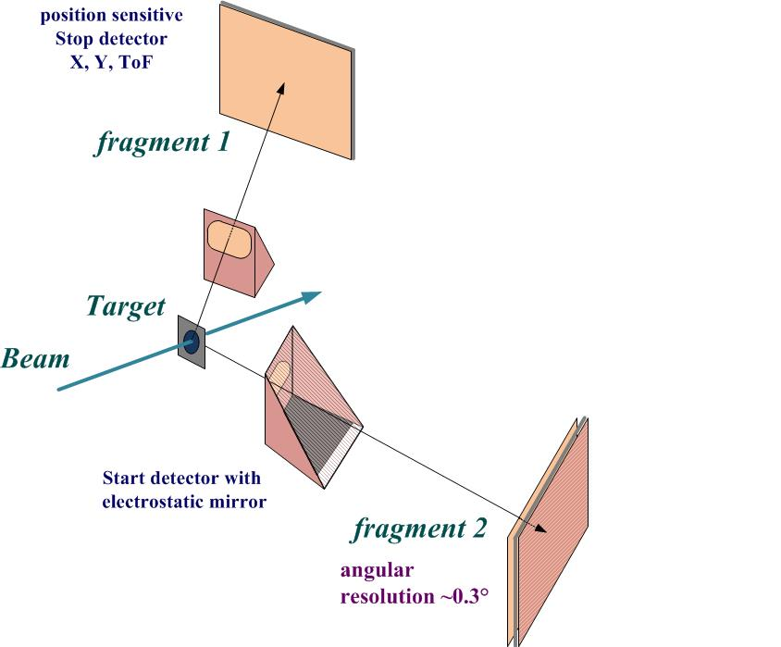
Reaction channels in collisions of heavy ions
Double arm Time-of-Flight spectrometer CORSET
The study of binary channel of heavy-ion-induced reactions (fusion-fission, quasifission and deep-inelastic processes).
Time resolution | 150-180 ps
ToF base | 10-30 cm
ToF arm rotation range | 15°-165°
Solid angle | 100 -200 msr
Angular resolution | 0.3°
Mass resolution | 2-4 u
Notes:
at energies around the Coulomb barrier the complete fusion of two massive nuclei is suppressed by competing binary process, the quasifission (QF), in which the composite system separates in two main fragments without forming a CN.
QF happens to be the most important mechanism that prevents the formation of SHE in the fusion of heavy nuclei.

Slide 3
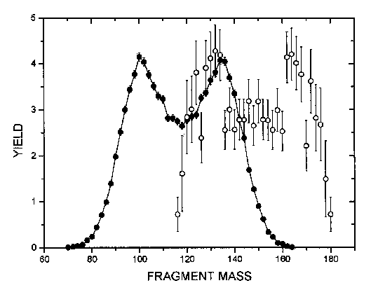
Reactions with ⁴⁸Ca
E*≈ 33 MeV
The sharp change of the MED triangular shape for the reaction ⁴⁸Ca + ²⁰⁸Pb, where Fusion-Fission process dominates, to the Quasifission shape of MED for the ²⁸⁶112-²⁹⁶116 nuclei.
The wide two-humped mass distribution with high peak of heavy fragment near double magic lead (M_{H}≈208) for the Quasifission process.
In spite of the dominating role of the Quasifission process for these reactions we assume that in the symmetric region of the fragment masses (A/2±20) FF process coexists with QF.
The Fusion-Fission mass distribution is asymmetric in shape with mass of the light fragment M_{L}≈132-134 amu (see on the framings)
Yield,%
Fragment mass (u)
FLNR 1999

Slide 4
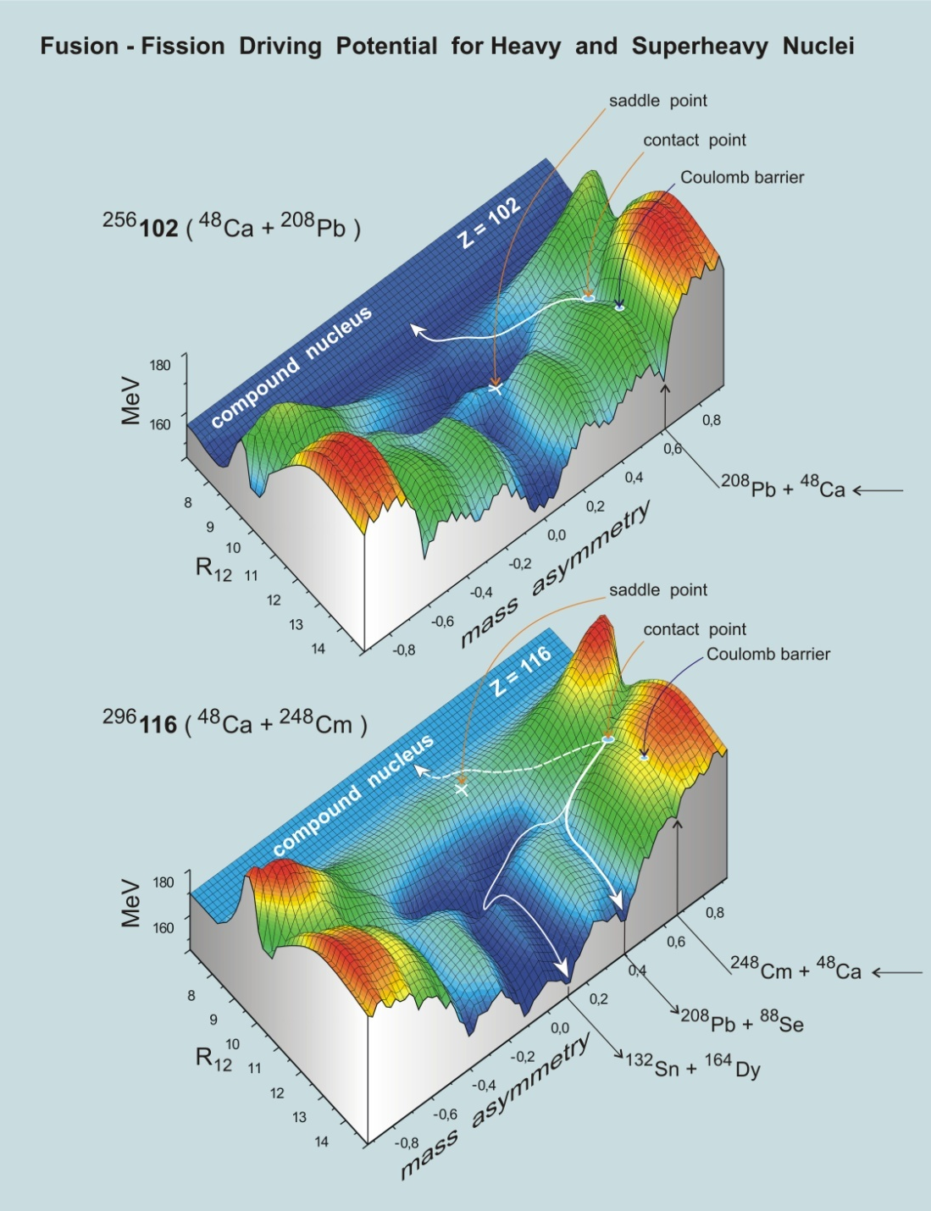
Calculated by
V.A. Zagrebaev

Slide 5
Shell effects manifestation

Slide 6
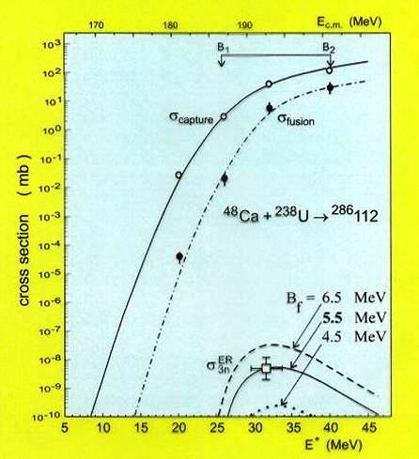
Fission barrier of superheavy nuclei
Theory
114 element | Barrier
P. Moller et al. | 8.6 MeV
A. Sobitczewski et al. | 5.3 MeV
A. Mamdouh et al. | 6.6 MeV
Frankfurt (RMF, NL-Z2) | 3.7 MeV
Frankfurt (SHF, Skl3) | 8.2 MeV
V. Zagrebaev | 6.4 MeV
Experiment
Nucleus | E* MeV | σ^{fus} mb | σ^{ER} pb | B^{fis} MeV
²⁸³⁻²⁸⁶112 | 33.0 | <5 | 3.4 | 5.5
²⁸⁸⁻²⁹²114 | 36.5 | <4 | 0.5 | 6.7
²⁹²⁻²⁹⁶116 | 34.8 | <2 | 0.5 | 6.4
The fission barriers of superheavy nuclei with Z=112-116 and N~180 are really quite high, which results in their relative high stability.

Slide 7
Cold Fusion Reactions
At the transition from No(Z=102) to Og(Z=118) the capture cross section drops down by a factor of 1.5*10³,
and the contribution of the symmetric fragments (A_{CN}/2±20) to the capture cross section - by a factor of 5*10⁵.

Slide 8
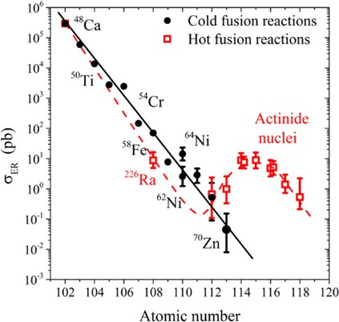

Slide 9
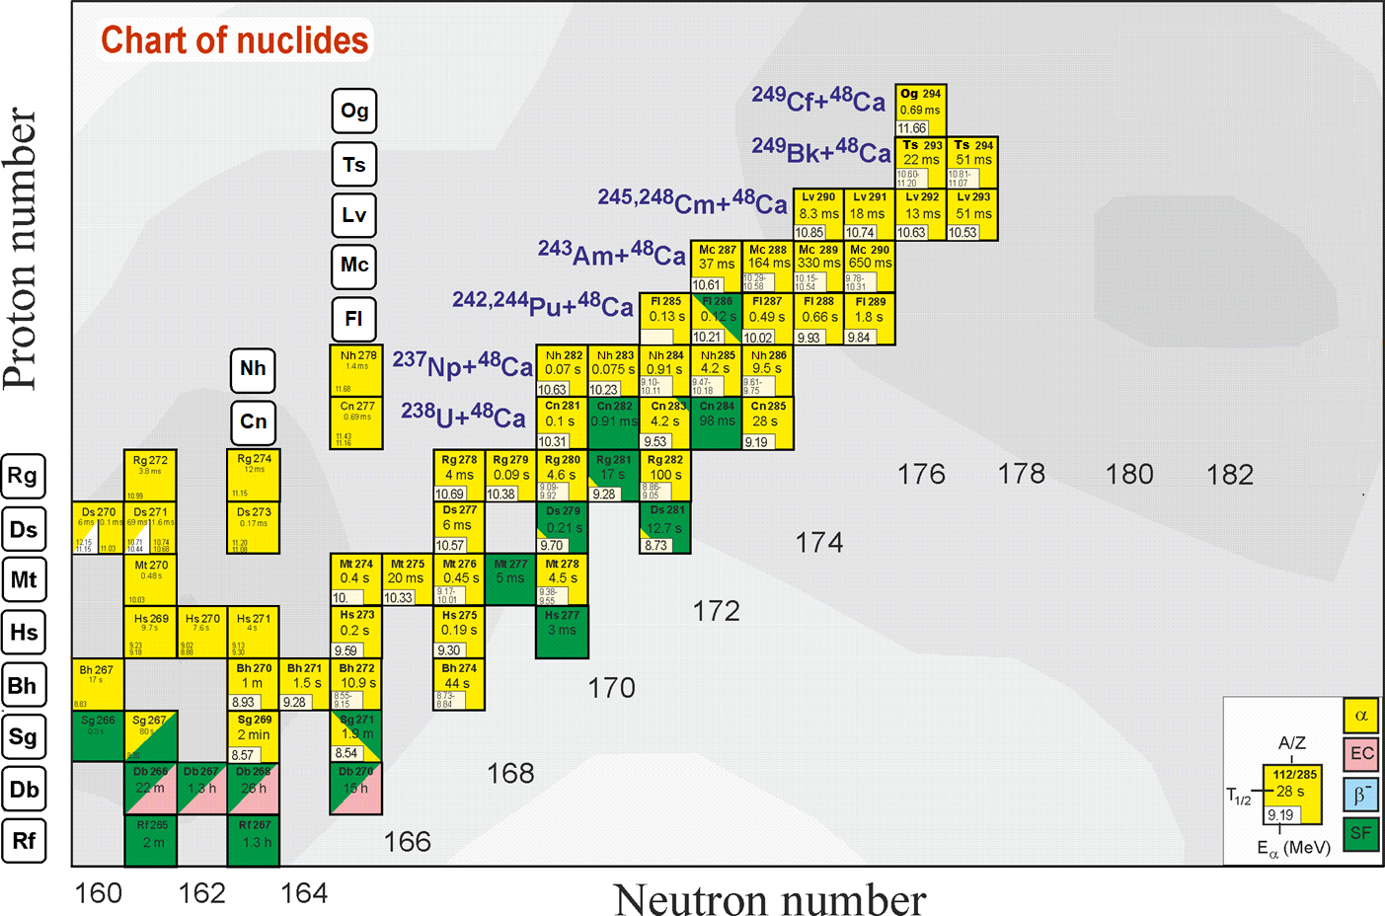
Search for superheavies
What is the next step?
Ti, Cr, Ni, Fe ?
Z = 120
Still far from the “island of stability” !!!
What is the next double magic superheavy nucleus?
Z = 114
184
“Inverse” quasifission
can be used to produce
new neutron-rich
SHE
Notes:
50 years ago The existence of island of stability in the region of nuclei with Z = 114 and N = 184 was predicted theoretically [A. Sobiczewski, F. A. Gareev, and B. N. Kalinkin, Phys. Lett. 22, 500 (1966)]
That caused the experimental investigations in the field of the superheavy element (SHE) synthesis.
Nowadays more than 30 isotopes of superheavy elements with Z = 108-118 have been synthesized both in cold an hot fusion reactions
In the Flerov Laboratory of Nuclear Reactions a great success was achieved in the synthesis of superheavy elements in hot fusion reactions of ⁴⁸Ca ions with actinide target nuclei.
Unfortunately, nuclei with Z > 118 cannot be synthesized in ⁴⁸Ca-induced reactions since ²⁴⁹Cf is the heaviest target material available for these purposes.
One of the possible pathways to synthesize new isotopes of superheavy elements with Z = 118 -126 is the reactions of actinide targets with Ti, Cr, Fe and Ni ions.
The interest in damped collisions of heavy nuclei is conditioned by the necessity to find new ways to produce neutron-rich superheavy elements (SHE). Few years ago the inverse (antisymmetrizing) quasifission (QF) process, was proposed to produce SHE in the collisions of transactinides [1]. The low-energy damped collisions of intermediate mass nuclei are less difficult for experimental study than the reactions with transactinides. One may expect that the antisymmetrizing shell effect will be similar in both cases [2].
To study the role of shell effects in inverse QF, the binary reaction channels in the reactions ^{156,160}Gd + ¹⁸⁶W at the Coulomb barrier energy have been investigated. In these reactions the projectile and target nuclei are located between the closed shells with Z = 50, N = 82 (double magic tin) and Z = 82, N = 126 (double magic lead) which should play a significant role in the nucleon transfer process. To form lead-like fragment the projectile nucleus has to transfer about 22 nucleons to the target.

Slide 10
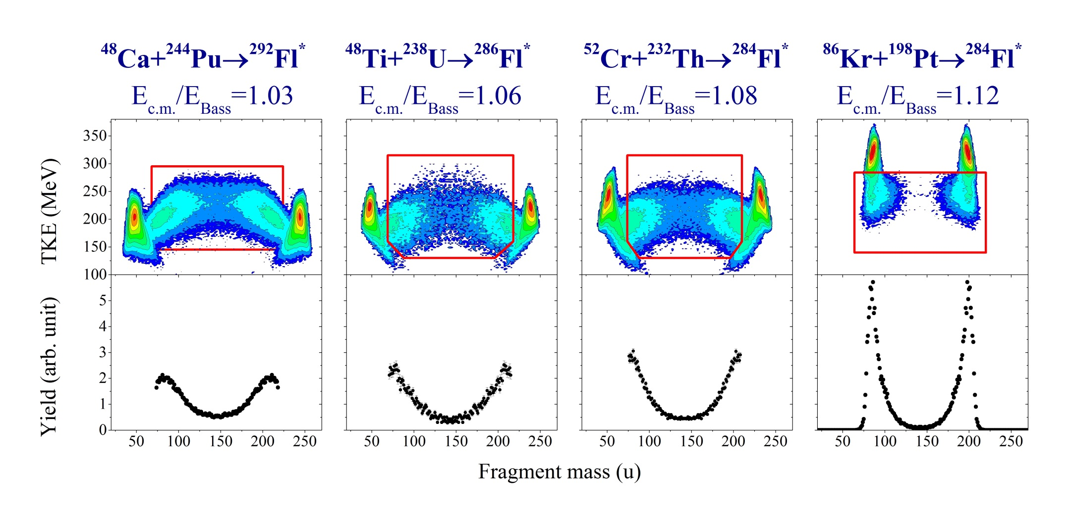
Mass and Energy distributions in the reactions leading to the formation of Z=114
QF+CNF
QF+CNF?
QF+CNF?
QF
QF increases
CNF decreases
Z_{t}Z_{p}=1880
X_{m}=0.721
Z_{t}Z_{p}=2024
X_{m}=0.776
Z_{t}Z_{p}=2160
X_{m}=0.806
Z_{t}Z_{p}=2808
X_{m}=0.917

Slide 11
Cross sections of symmetric fragment formations
For 4n channel (E*=40÷50MeV):
⁴⁸Ca+²³⁸U→⁴⁸Ca+²⁴⁴Pu
σ(A_{CN}/2±20) drops ∼2 times
⁴⁸Ca+²³⁸U→⁴⁸Ti+²³⁸U
σ(A_{CN}/2±20) drops ∼10 times
For 3n channel (E*=30÷40MeV):
⁴⁸Ca+²³⁸U→⁴⁸Ca+²⁴⁴Pu
σ(A_{CN}/2±20) drops ∼10 times
⁴⁸Ca+²³⁸U→⁴⁸Ti+²³⁸U
σ(A_{CN}/2±20) drops ∼100 times
4n
3n
For the studied reactions the excitation energies at the barrier energy vary strongly ( 36MeV for the Ca+Pu, 44MeV for the Ti+U and 41MeV for the Cr+Th). It leads to decreasing the CS for the Ti+U and Cr+Th for 3n ER channel.

Slide 14
Cold Fusion Reactions
QF contribution to capture cross section
~5% ~60% >90% DIC DIC
Notes:
~

Slide 15
Fusion Probability
Fusion
Probability
drops down
⁵⁰Ti + ²⁴⁸Cm → ²⁹⁸Og
>10 times
50-100 times

Slide 16
Fusion probability in the reactions with strongly deformed nuclei
P_{CN} ( E_{c.m.}) = P₀ / {1 + exp [ α ( β – E_{c.m.}/E_{Bass} ) ] }
Notes:
P_{CN} is defined as the probability for CN formation from the configuration of two nuclei in contact. As it was mentioned above, the cross section of the evaporation residues is approximately a few picobarns for these reactions.
Thus we deduced the fusion probability using the measured mass-energy distributions as the ratio between the number of events attributed to CN fission in the framework of the present analysis and all fissionlike fragments
The fusion probabilities obtained from the analysis of mass-energy distributions of fissionlike fragments for the reactions with strongly deformed target nuclei: ⁴⁸Ca + ¹⁵⁴Sm, ³⁶S + ²³⁸U, ⁴⁸Ca + ²³⁸U, ²⁴⁴Pu, ²⁴⁸Cm, and ⁴⁸Ti + ²³⁸U in dependence on the energy above the Bass barrier
The deduced values of P_{CN} in dependence on the interaction energy may be approximated by the simple formula proposed by Zagrebaev for fusion probability of cold fusion reactions
P₀, α and β are empirical constants
The differences between the estimated values of P_{CN} and the results of the fitting procedure are typically 2–5% and do not exceed 10%.

Slide 17
⁴⁸Ca + ²⁴⁸Cm
( E_{c.m.}/E_{B} = 1.00)
Normal
← Quasifission →
Inverse
¹⁶⁰Gd + ¹⁸⁶W
(E_{c.m.}/E_{B} = 1.01)
The inverse quasifission process proposed to produce SHE in collisions of transactinides and the role of shell effects in inverse QF can be studied in the experiments with less heavy nuclei [V. Zagrebaev and W. Greiner, J.Phys.G 34 (2007) 2265].

Slide 18
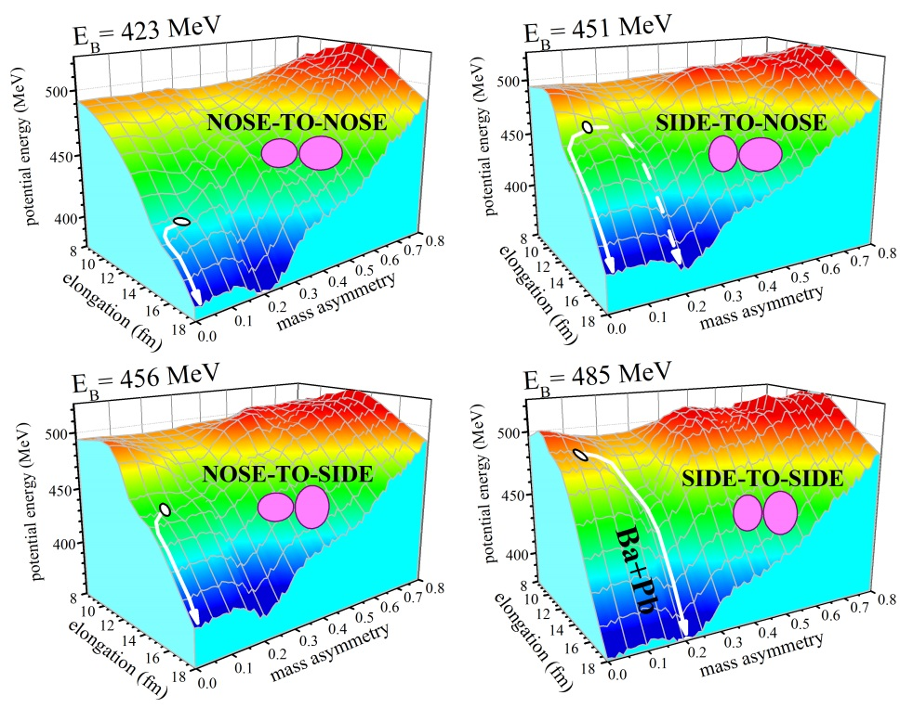
Orientation effect in the reaction ¹⁸⁶W+¹⁶⁰Gd
Calculated by A. Karpov
E.M. Kozulin et al, PRC, 2016s
The resent study of the reaction ¹⁸⁶W+¹⁶⁰Gd shows that the orientation effect caused by the strong deformation of colliding nuclei also plays an important role in the formation of the reaction fragments that can give a gain in the yield of Pb-like fragments in the case of side-to-side configurations. At energy 935 MeV which is above the barrier for side-to-side collision it was found that the formation cross sections of Pb-like fragments with mass∼208a.u. on about 50 time higher than for fragments formed in the ¹⁶⁰Gd+¹⁸⁶W at energy 860 MeV.

Slide 19


Thank You!

