Slide 1







Барионная материя на Нуклотроне (BM@N)
Дмитрий Дементьев для коллаборации BM@N
ЛФВЭ ОИЯИ

Slide 2
Outline
BM@N experiment at NICA;
Heavy ion program at BM@N;
Upgrade of the BM@N experiment;
Summary

Slide 3
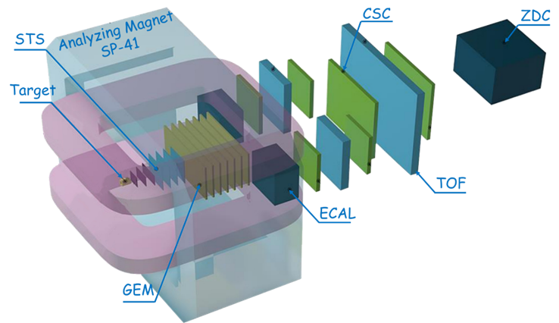
NICA Heavy Ion Complex
BM@N: beams from p to Au, heavy ion energy 1-3.8 AGeV, Au intensity up to 2 MHz
BM@N

Slide 4
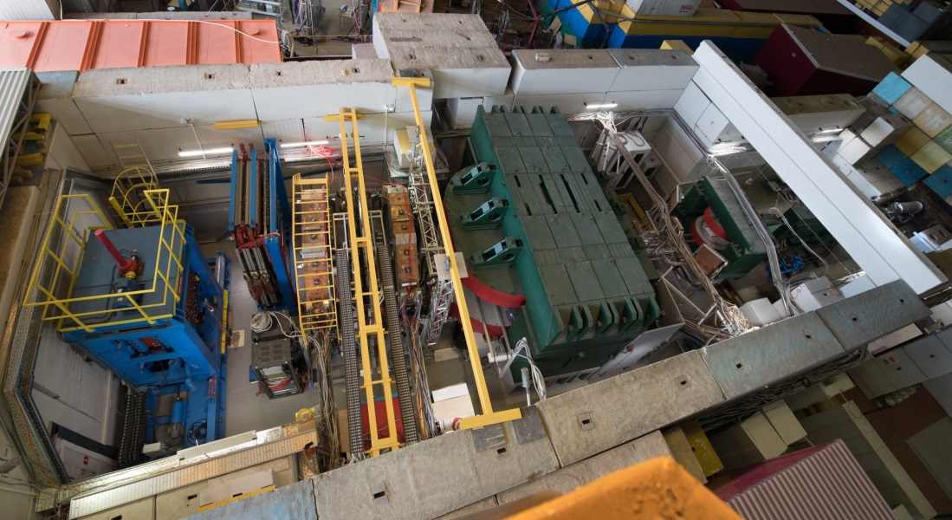
Baryonic Matter at Nuclotron Experiment
Dipole magnet with 6 (half) GEM tracking chambers and 3 Silicon stations inside
Neutron detector
Drift chambers for tracking
Forward hadron calorimeter
Beam direction
mRPC Time-of-flight detectors

Slide 5
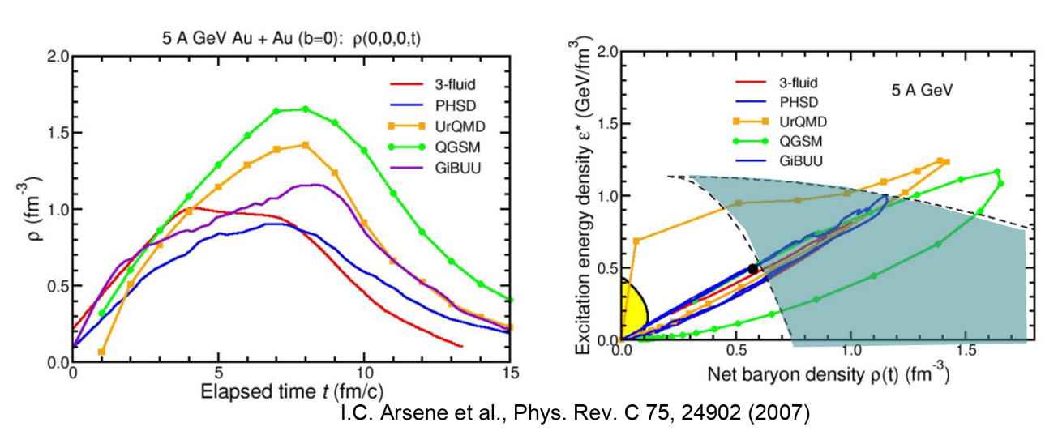

Heavy Ion program at BM@N
4$ρ_{0}$
The research program of BM@N includes:
Scouting the location of transition between hadronic and partonic dominated matter;
Onset of deconfinement and chiral symmetry restoration;
Searching the critical endpoint of a possible 1st order phase transition at Nuclotron energies;
Exploring the high net-baryon density EoS for symmetric nuclear matter ;
Study of the ΛN, ΛNN, and ΛΛN interactions

Slide 6
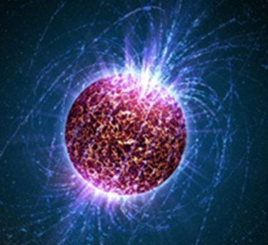
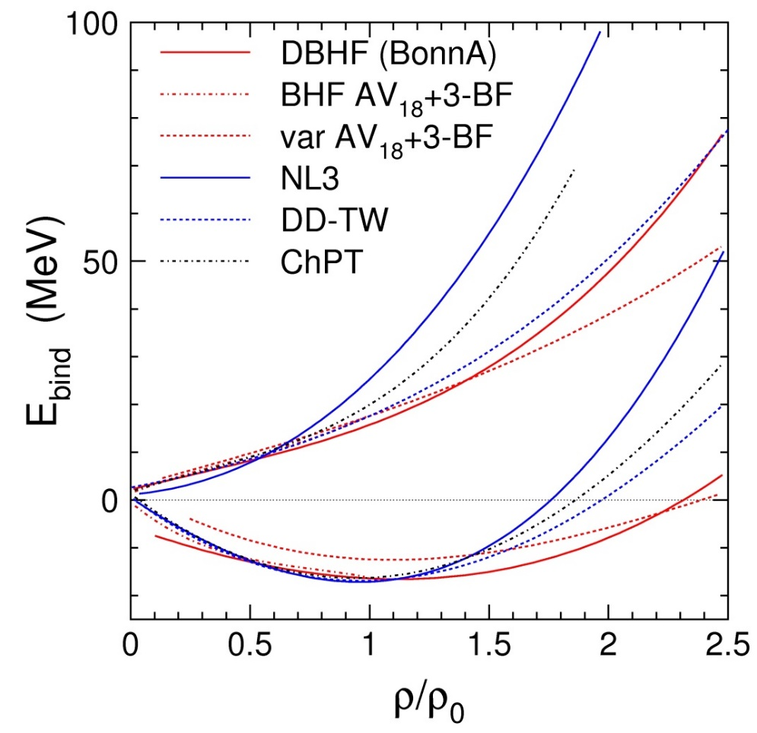
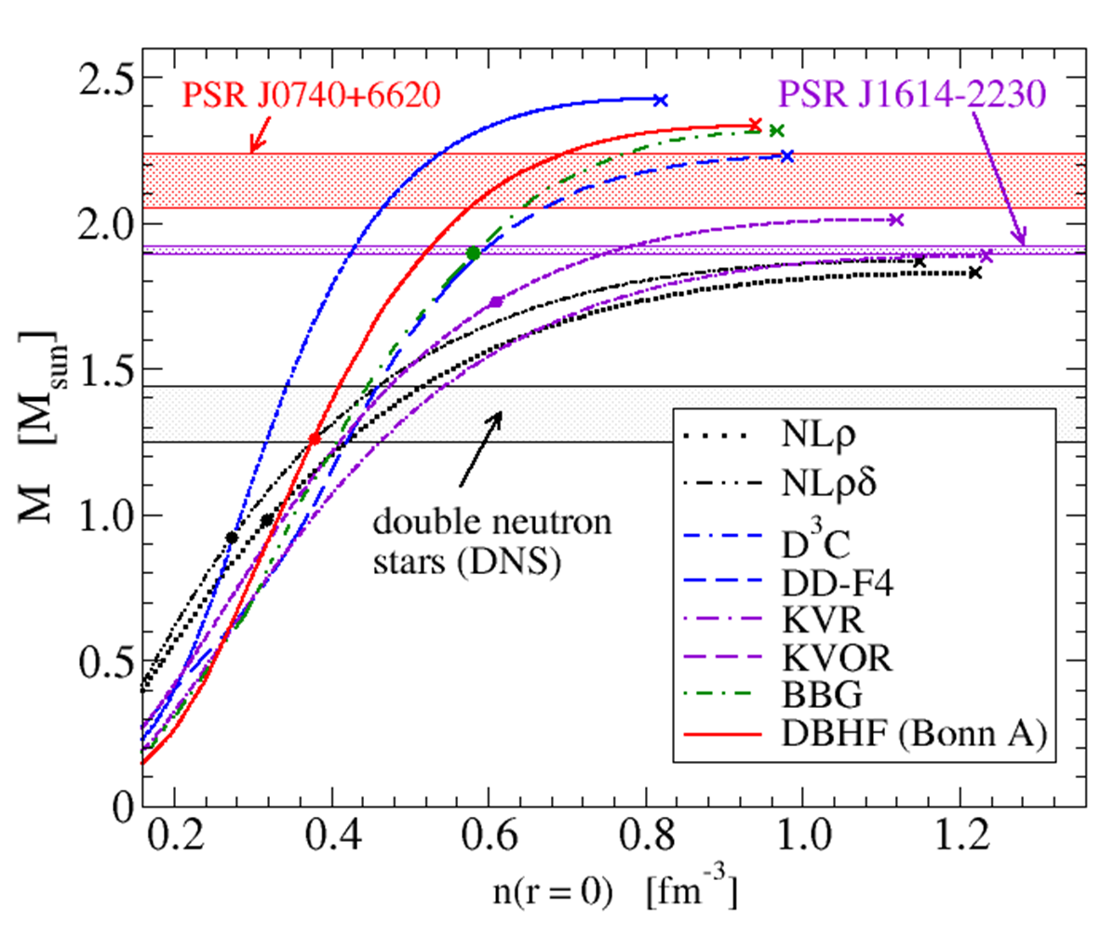
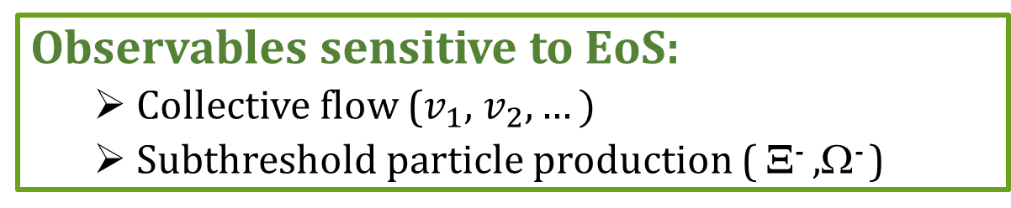
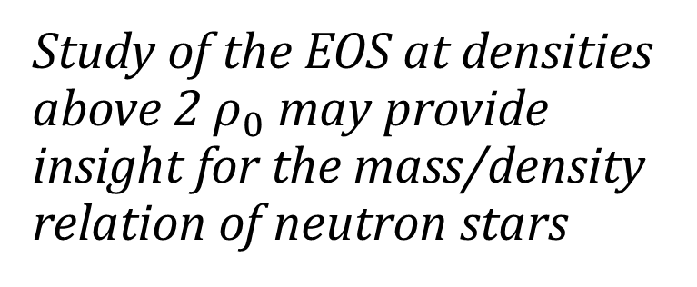
Study of the EOS of nuclear matter
Study of the EOS at densities above 2 ${\text{ρ}}_{0}$ may provide insight for the mass/density relation of neutron stars
Ch. Fuchs and H.H. Wolter, EPJA 30 (2006) 5
Observables sensitive to EoS:
  Collective flow ($v_{1}$, $v_{2},…)$
  Subthreshold particle production ( Ξ⁻ ,Ω⁻ )
Mass-density relation of neutron stars for different EOS
T. Klaehn et al., Phys. Rev. C74: 035802, 2006. Update by D. Blaschke, priv. comm.

Slide 7
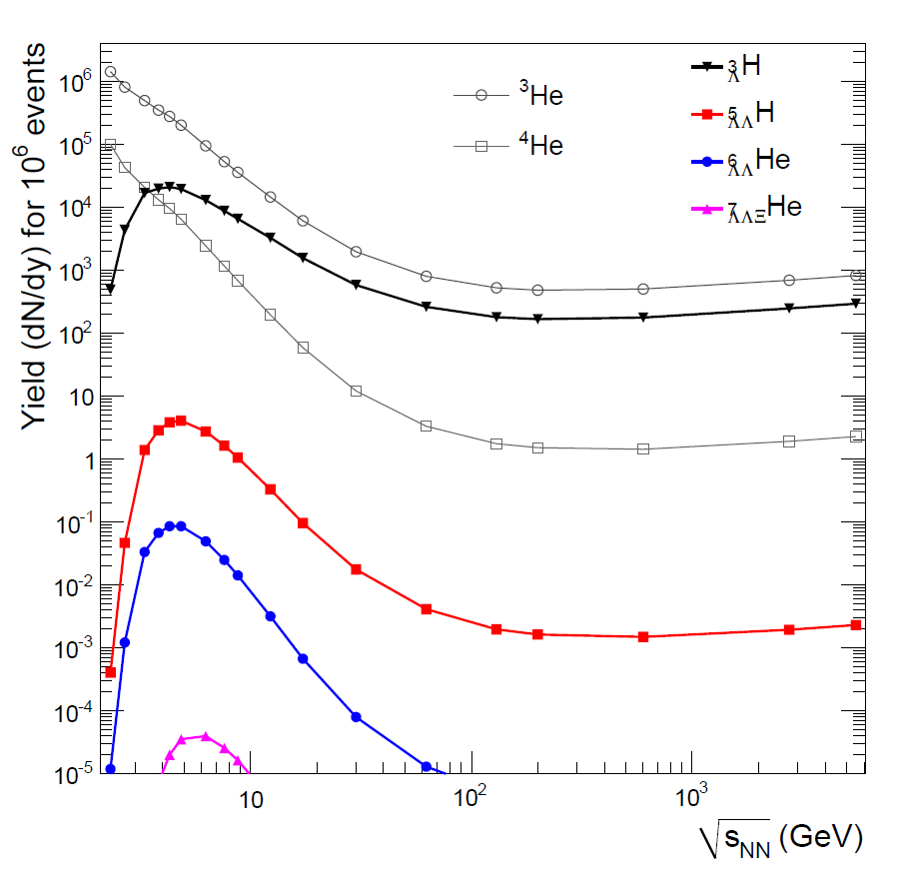
Hypernuclei production in heavy-ion collisions
Maximum yield predicted for √s=3-5 GeV
Precision measurements of lifetime and mass of hypernuclei will shed light on the ΛN, ΛNN, and ΛΛN interactions
BM@N
A. Andronic et al., Phys. Lett. B697 (2011) 203

Slide 8
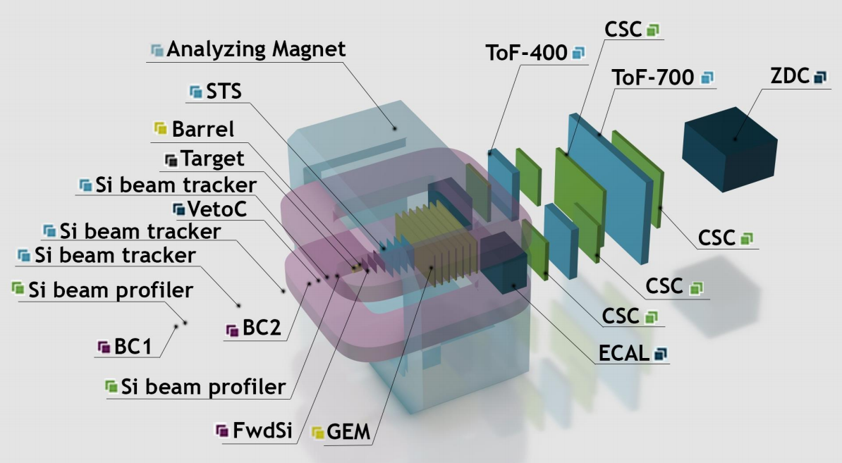
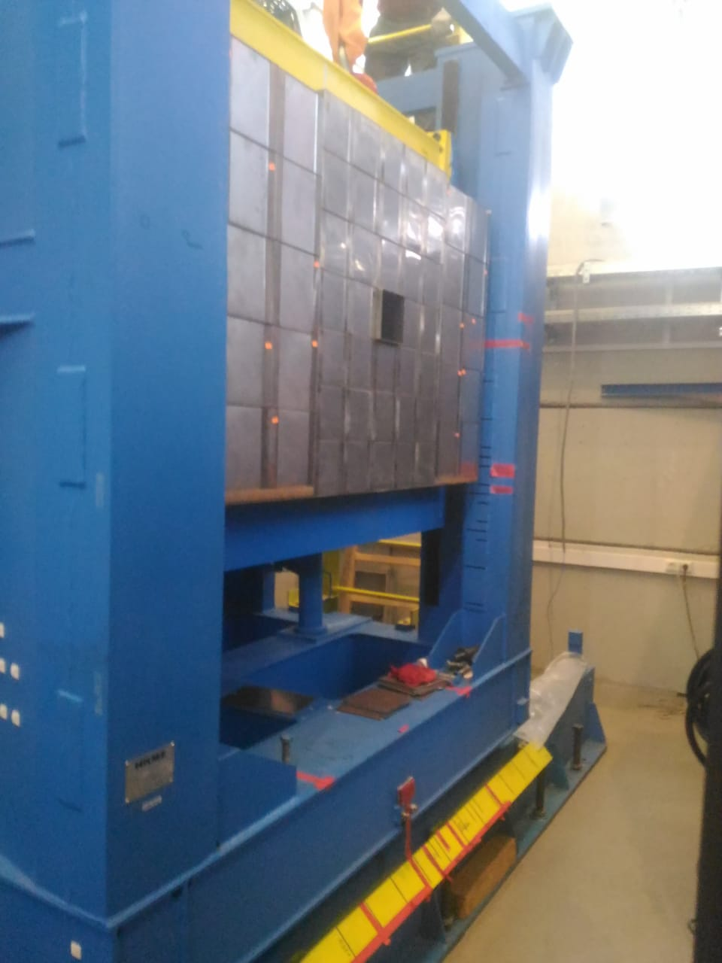
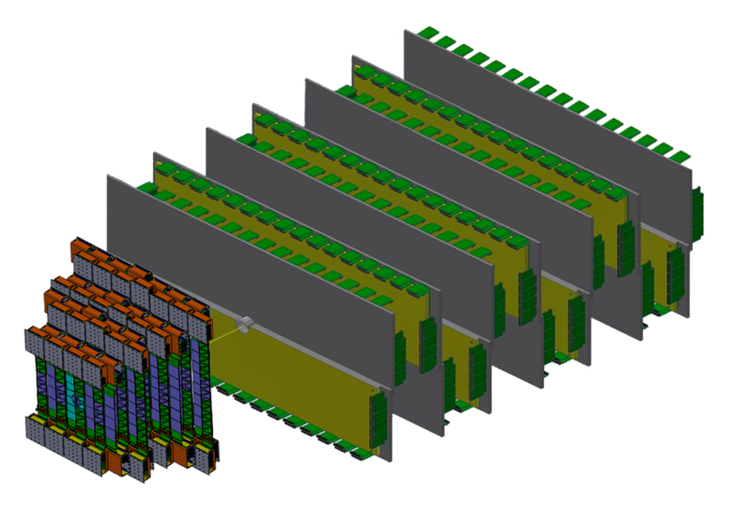
BM@N upgrade for heavy ion collisions
New hybrid tracking system:
  4x stations of Silicon Tracking System (STS) with double-sided silicon microstrip sensors;
  7x planes of Gas-Electron-Multiplier chambers (GEM)
Vacuum beam pipe
Upgrade of the outer tracking system based on Cathode Strip Chambers
New Forward Hardron Calorimeter (FHCal) instead of ZDC
Fall 2021 - start new experiments with Kr beams
2022+ -start experiments with heavy ion beams up to Au, Bi, Pb
FHCal
New hybrid tracker (STS +GEM)

Slide 9
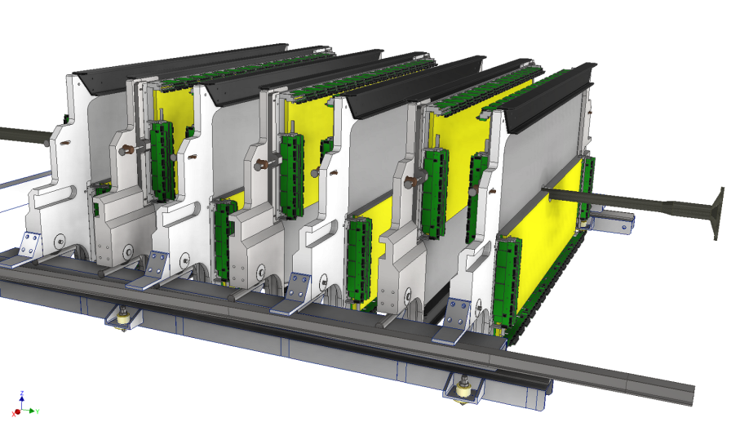
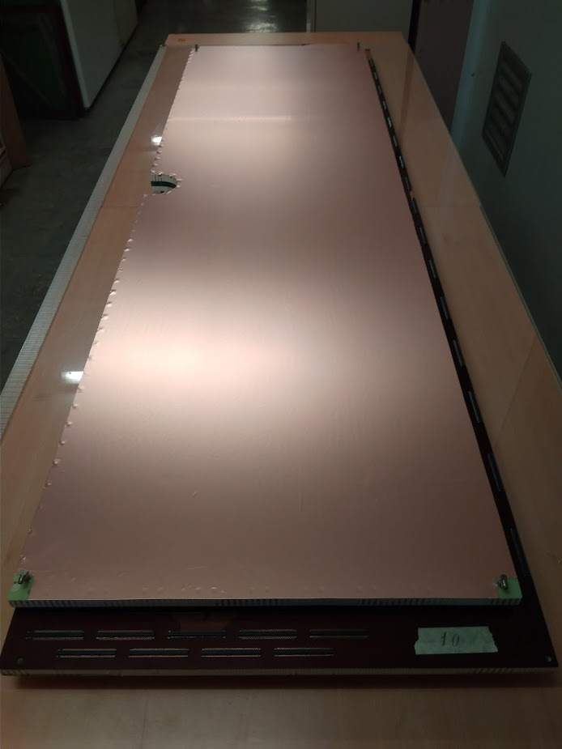
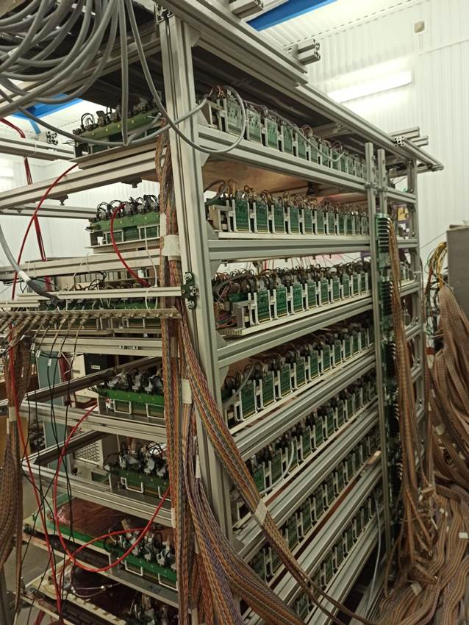
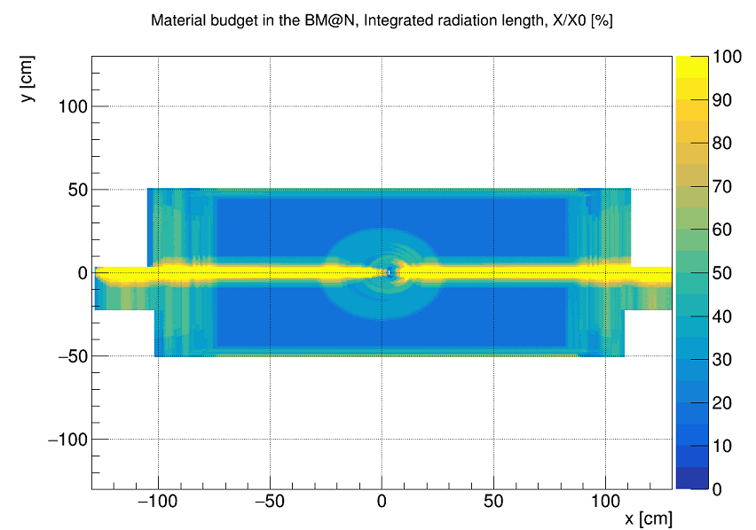
GEM central tracker
7 upper GEM 163x45 cm² chambers produced at CERN were integrated into BM@N
7 lower GEM 163x39 cm² chambers were assembled, delivered to BM@N and tested
GEM team
Two-coordinate GEM planes;
Stereo angle between strips: 15°;
Pitch: 0.8 mm
Photo of assembled GEM chamber
Setup of GEM detectors for cosmic tests
Material budget of GEM tracker

Slide 10
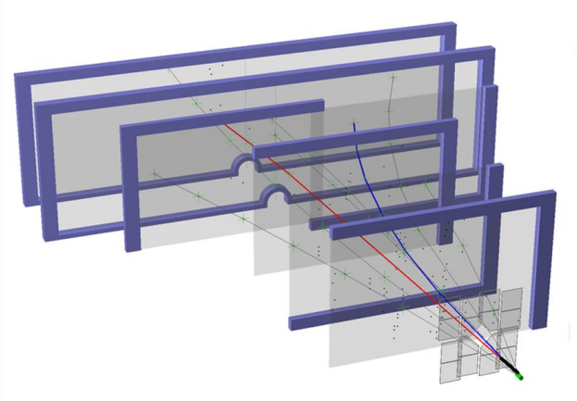
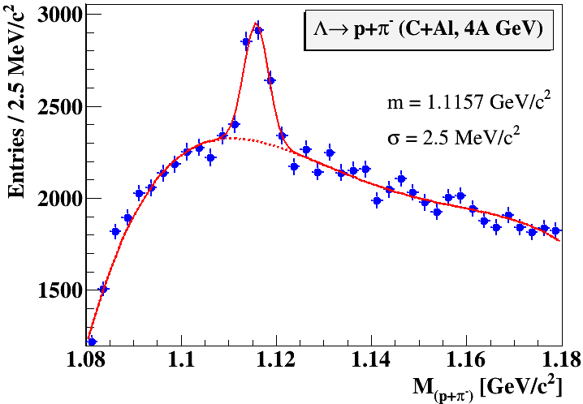
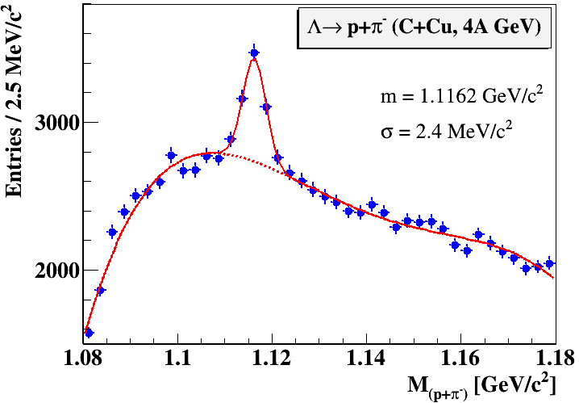
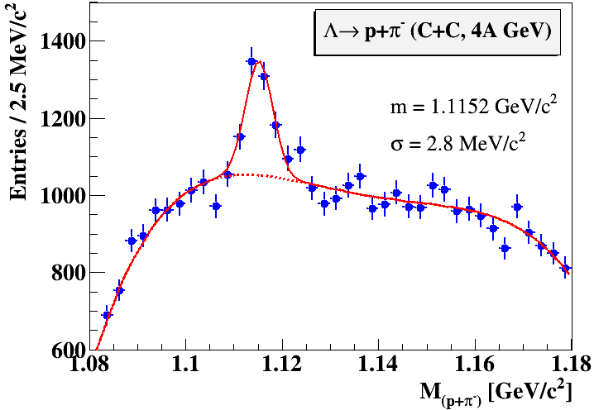
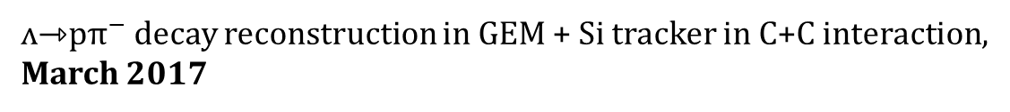
ʌ decay reconstruction in carbon beams with GEM tracker
ʌ⇾p${\text{π}}^{−}$ decay reconstruction in GEM + Si tracker in C+C interaction,
March 2017
experimental limitations of the first setup:
  low granularity of tracking systems (small S/B ratio);
  no vacuum beam pipe in BM@N (large background)

Slide 11
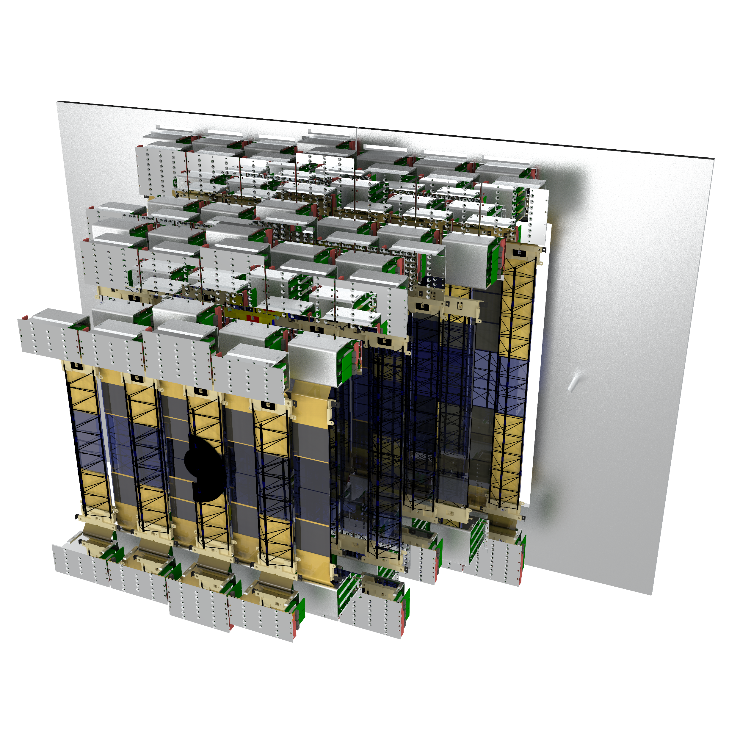
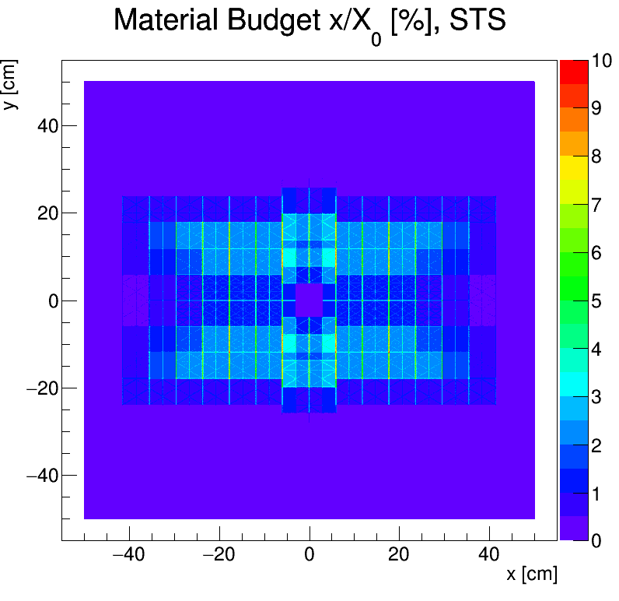
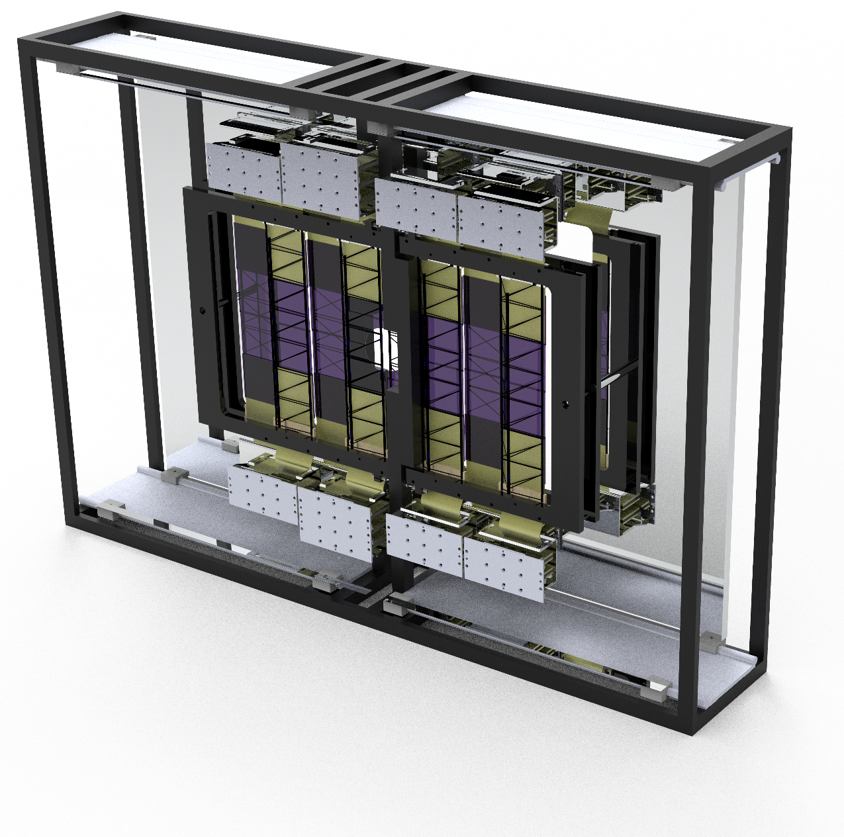
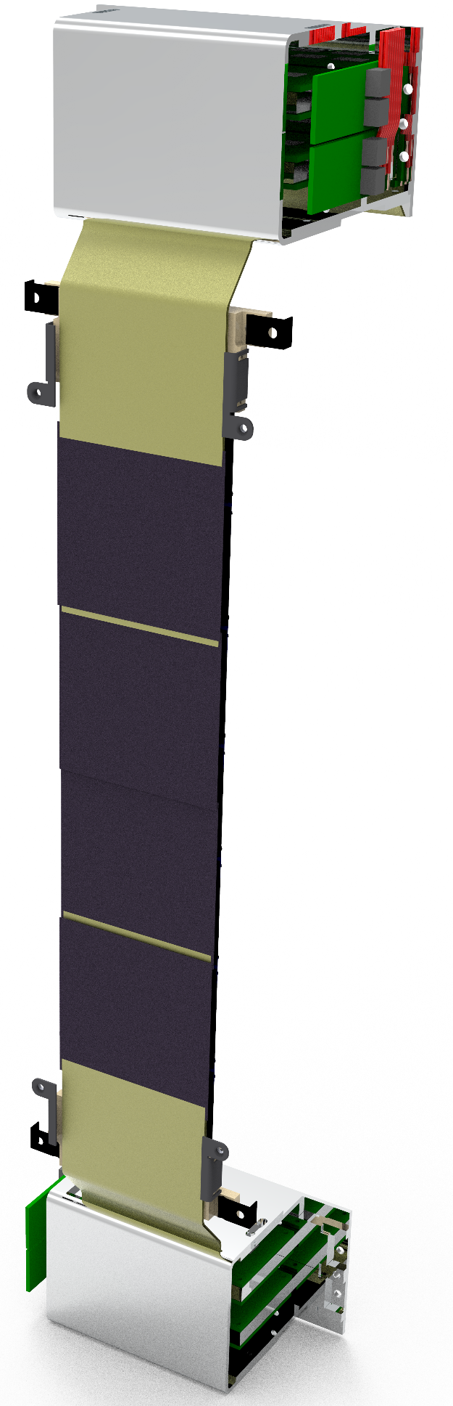
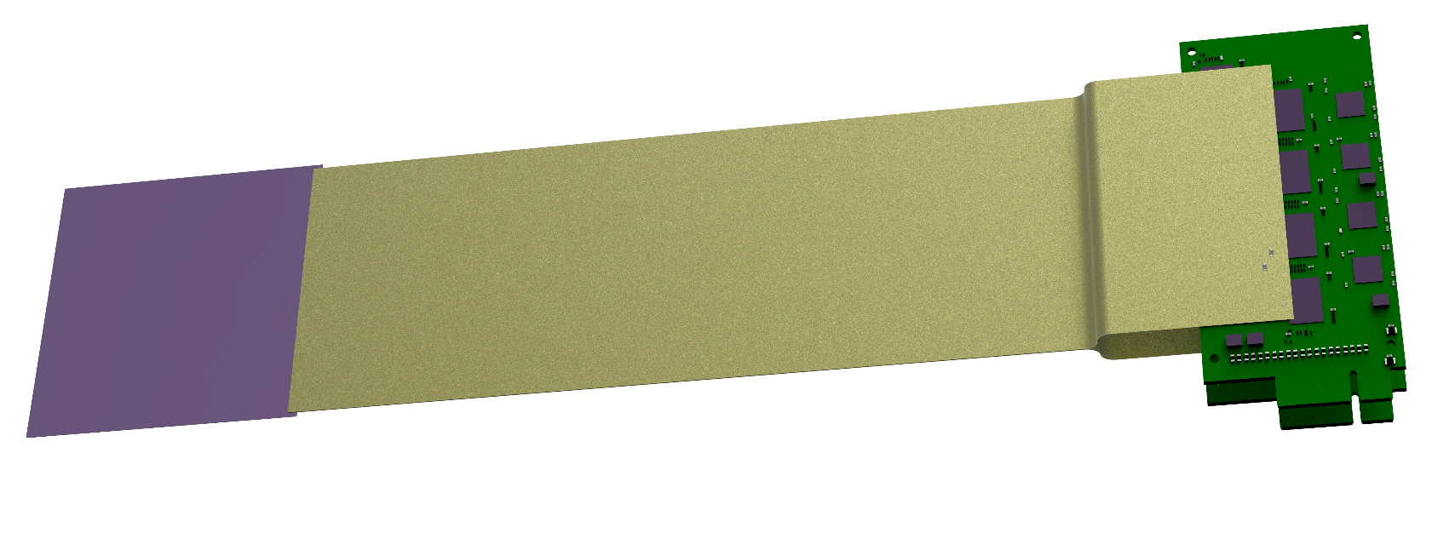
Silicon Tracking System
Technical solutions:
double-sided silicon microstrip sensors
  hit spatial resolution ≈ 25 µm
  material budget per tracking station: ≈ 0.3% – 2% X₀
  radiation tolerance up to 1 × 10¹⁴ n/cm² (1 MeV equivalent)
self-triggering front-end electronics, time-stamp resolution ≈ 12,5 ns
low-mass detector modules/ladders
The project is being implemented as a joint effort of CBM and BM@N STS teams under the GSI-JINR Roadmap Agreement
STS team
STS Material budget
2022 – installation of the first two stations
2024 - commissioning of the full STS
4 x STS stations
34 x Ladders
292 x Modules

Slide 12
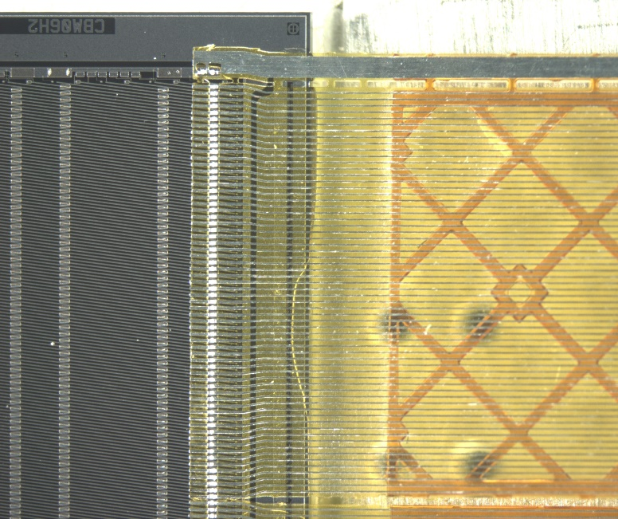
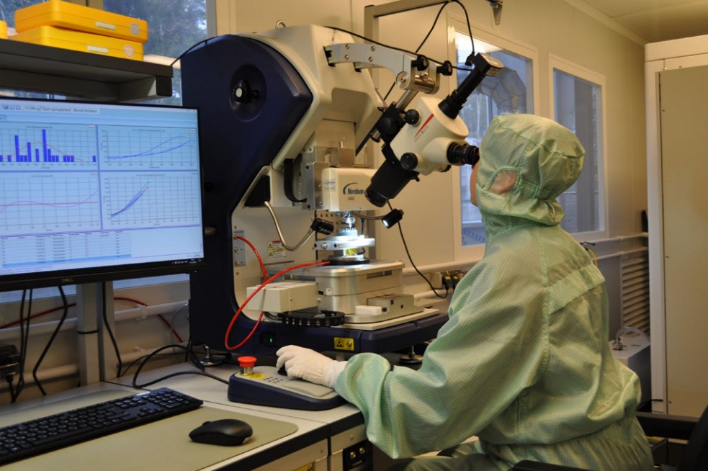
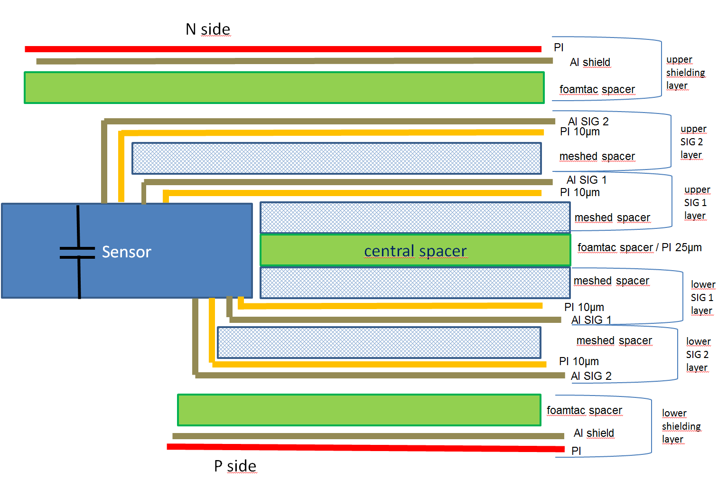
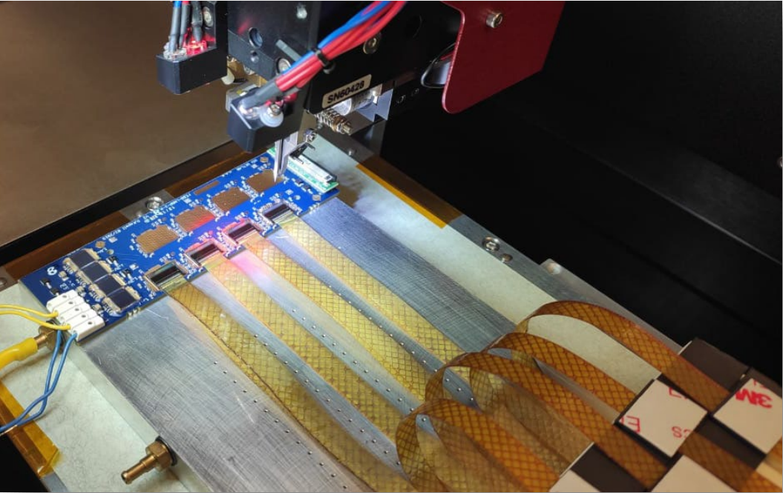
STS modules
STS team
Cable stack
Sensor
FEE
STS module
STS XYTER ASIC Tab-bonded
with micro-cables
Module assembly at JINR
N-side read-out
Performance:
noise: 1090 ±150 e (N-side);
1350 ±200 e (P-side);
r/o threshold: 7000 e;
signal-to-noise: 15±3 ;
hit detection eff.: > 95%;
P-side
read-out
cable stack: thickness ~ 800 µm / 0.23% X₀

Slide 13
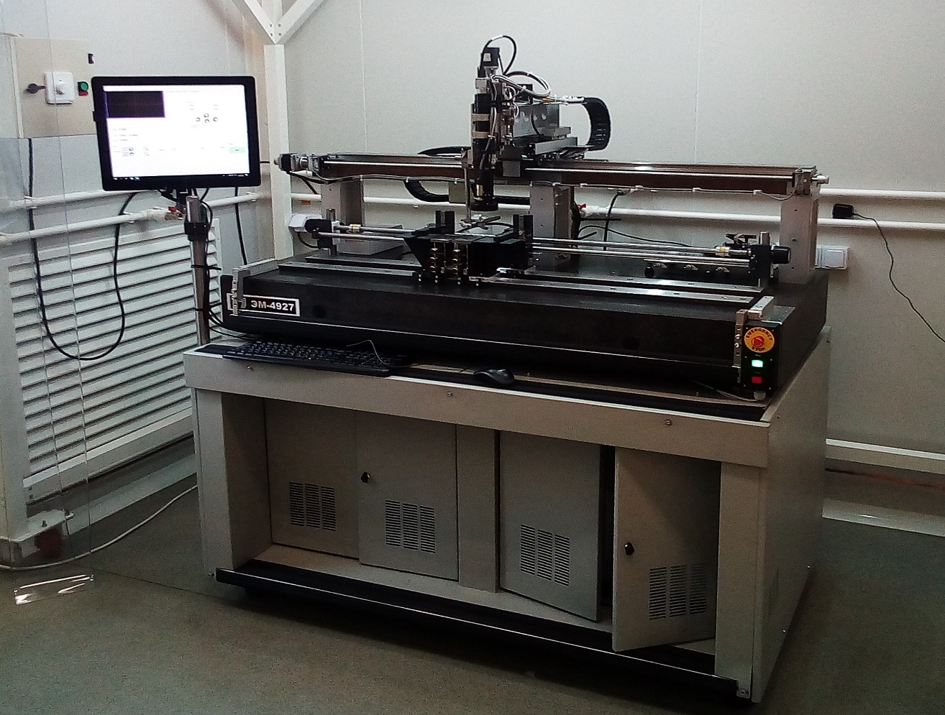
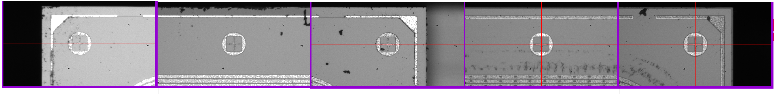
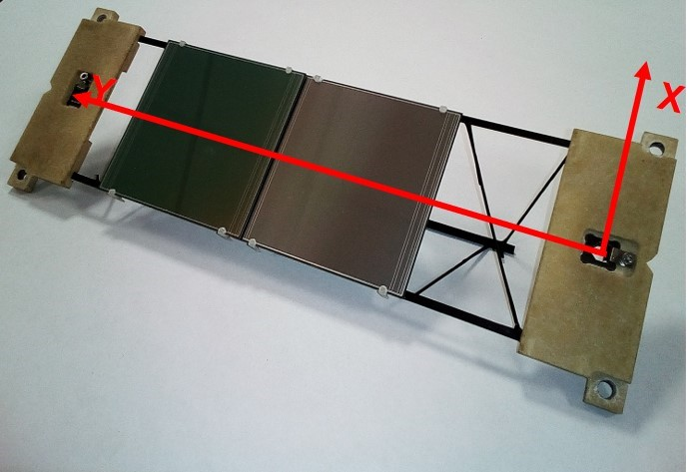
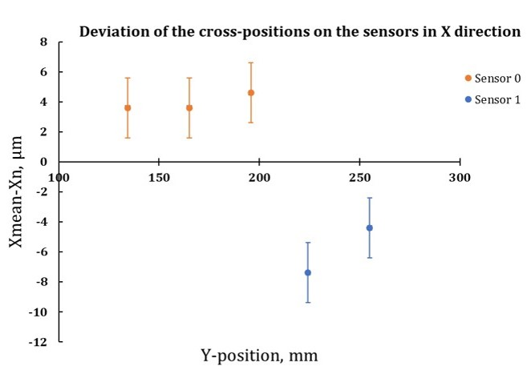
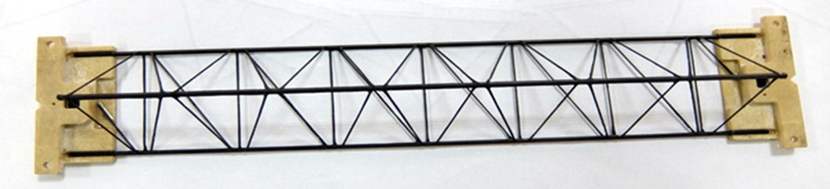

STS ladders
STS team
Fiducial marks on sensors
Ladder assembly device
CF-truss with bearings
Mockup of the ladder
Measured deviations of X coordinates of the fiducial
marks on the sensors from the mean value.

Slide 14
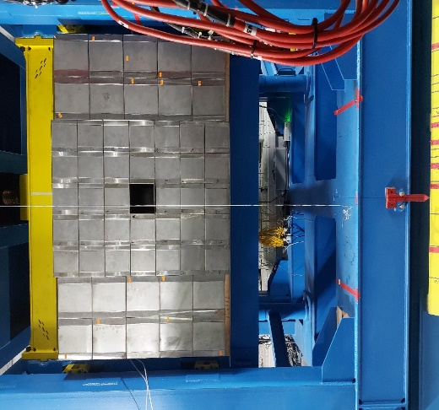
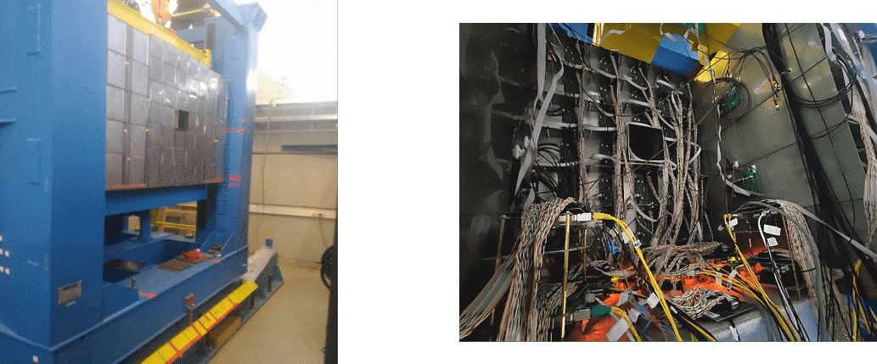
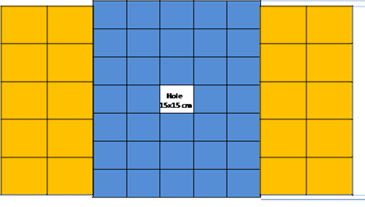
Forward Hardon Calorimetr
Determination of:
Orientation of the reaction plane
Collision centrality
20 PSD CBM modules - transverse size
20x20 cm², length 5.6 λ_{int}.
34 MPD/NICA like modules - transverse size 15x15cm², length 4 λ_{int}.
FHCal is completely assembled and installed at the BM@N
Team of INR RAS, Troitsk
CBM modules MPD modules

Slide 15
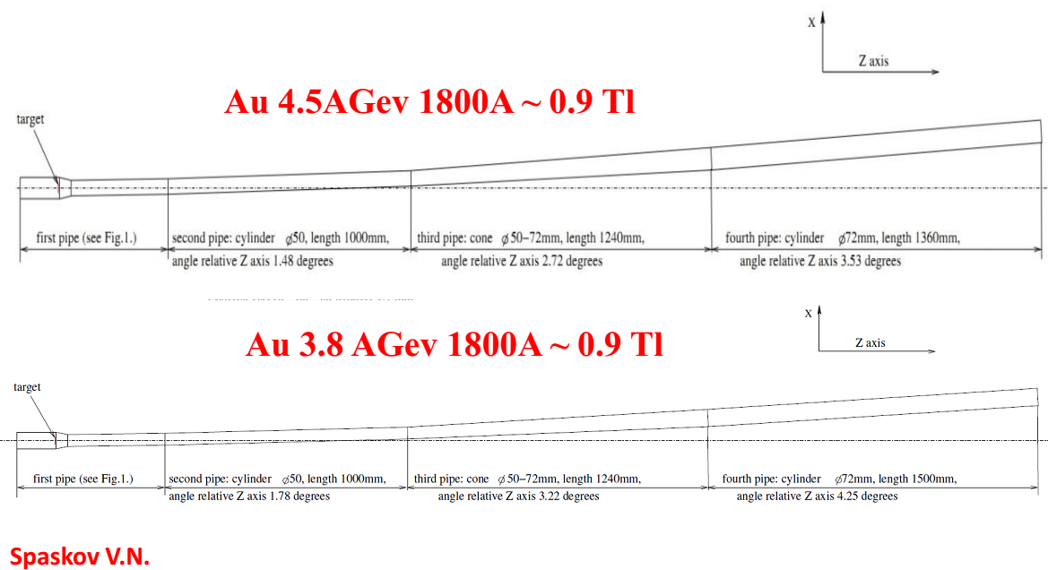
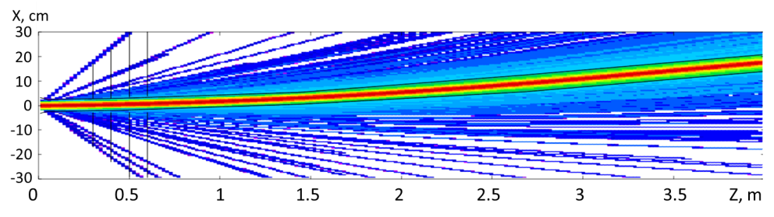
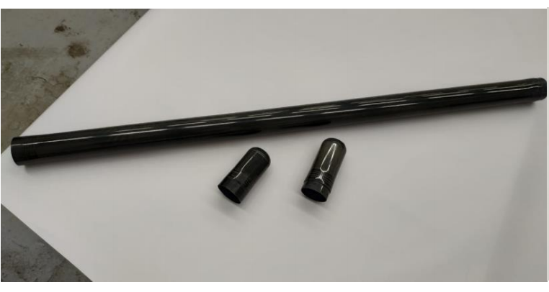
Beam pipe downstream the target
Beam pipe is made of 1 mm thick carbon fiber;
Consists of four parts with a non-flange connectors;
FLUKA simulations have shown that the proposed beam pipe is well suited to guide the high intensity beam;
First vacuum tests have shown an insignificant leakage level of side surfaces of the sample, vacuum up to 10⁻⁵ Torr.
1 meter prototype of the BM@N carbon
beam pipe (DD “Arkhipov”)
A. Senger, P. Senger, S. Piyadin,V. Spaskov, A.Kubankin

Slide 16
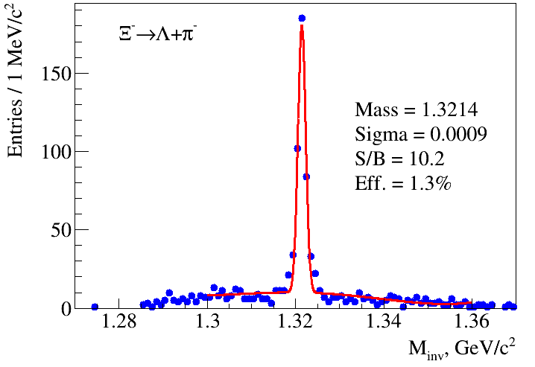
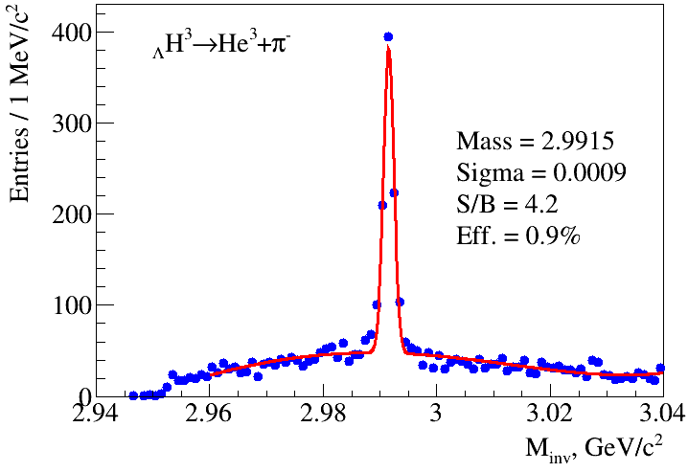
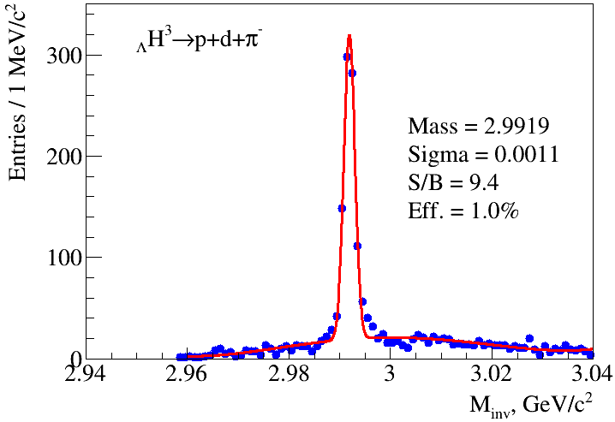
Physics performance simulations of the tracking system
Ξ⁻ and _{Λ}H³ reconstruction in central Au+Au at 4A GeV
Generator: PHQMD (V. Kireyeu), 500k events, Au+Au at 4A GeV, b = 0-5 fm
Statistics: ≈ 2⋅10⁶ Λ , ≈ 2⋅10⁴ Ξ⁻, ≈ 8.4⋅10⁴ _{Λ}H³
Detectors: STS + GEMs + TOF
A.Zinchenko, M.Kapishin, I.Rufanov, V.Vasendina

Slide 17
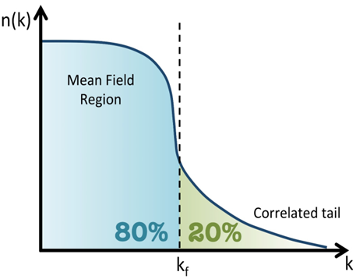
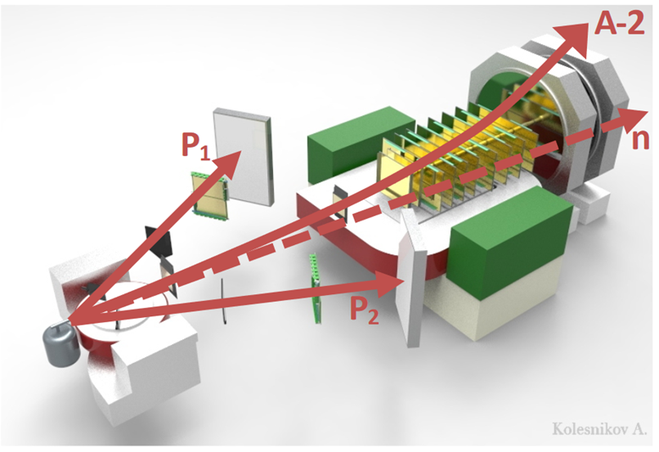
Short-Range Correlations (SRC) at BM@N
k<k_{F} Mean field region: Single nucleons
k>k_{F} High momentum region: Correlated pairs of nucleons, which are close together in space with a high relative momentum, but a low c.m. momentum compared to the Fermi momentum k_{F}. SRC probe nucleonic and partonic degrees-of-freedom in nuclear systems.
Experiment at BM@N with a 4A GeV C-beam:
¹²C + p → 2p + ¹⁰₅B + n (np SRC)
¹²C + p → 2p + ¹⁰₄Be + p (pp SRC)
First fully exclusive measurement in inverse kinematics probing the residual A-2 nuclear system!

Slide 18
Summary
Nuclotron energy range is well suited for the study of high density baryonic matter
BM@N is being upgraded in order to start experiments with heavy ion beams up to Au in 2022
Stages of BM@N experiment:
2021: beams of Kr and Xe;
2022: Au beams with max. intensity 0.5 MHz and trigger rate 10 kHz, installation of 2 stations of STS;
2023: Au beams with max. intensity 2 MHz and trigger rate 50 kHz;
2024: Installation of the full STS.

Slide 19
СПАСИБО ЗА ВНИМАНИЕ!

