Slide 1

BM@N heavy ion physics program
M.Kapishin
M.Kapishin BM@N experiment

Slide 2
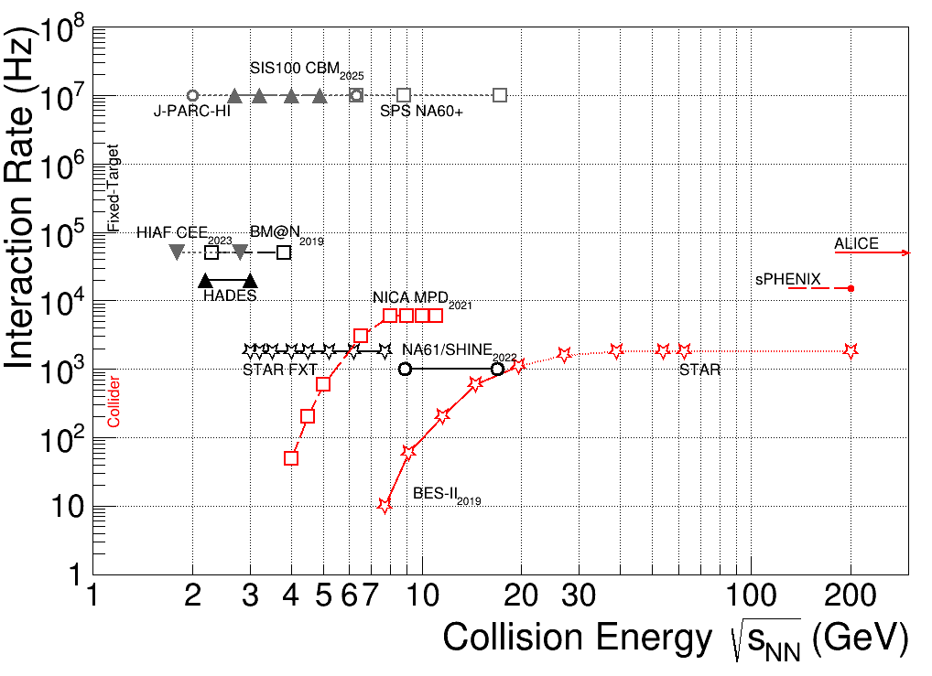
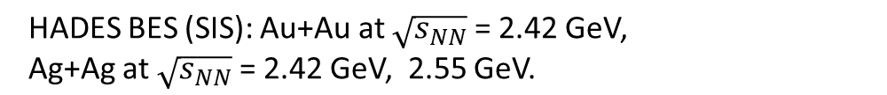
Heavy Ion Collision Experiments
region of max.
baryonic density
BM@N: √s_{NN}= 2.3 - 3.3 GeV MPD: √s_{NN}= 4 - 11 GeV
BM@N competitors:

Slide 3
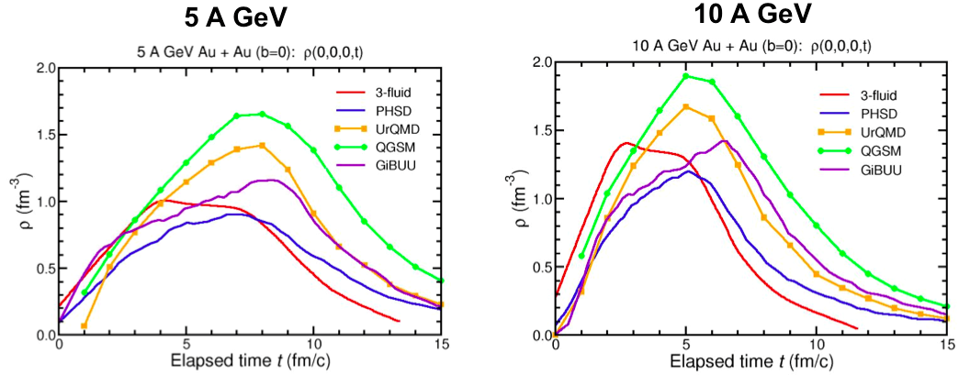
Explore high density baryonic matter
Baryonic densities in central Au+Au collisions
FAIR SIS-100 / Nuclotron
5 ρ₀
I.C. Arsene at al., Phys. Rev. C75 (2007) 34902.
M.Kapishin BM@N experiment
3

Slide 4
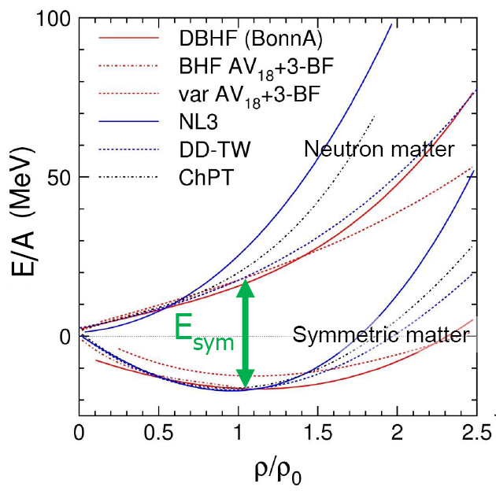
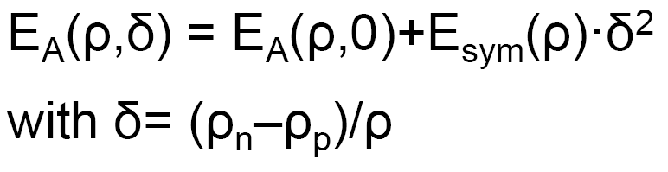
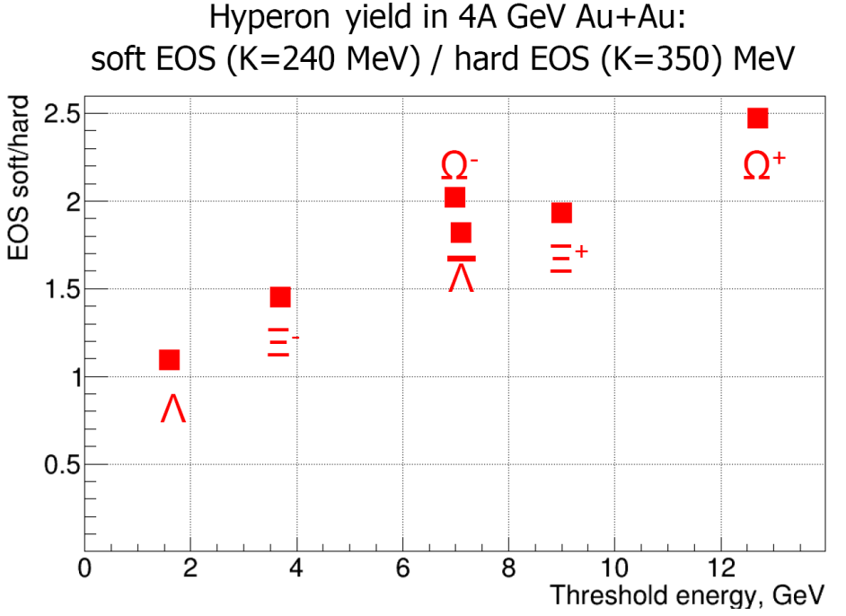
EOS of symmetric and asymmetric nuclear matter
EOS: relation between density, pressure, temperature, energy and isospin asymmetry
E/A(ρ_{o}) = -16 MeV
Curvature defined by nuclear incompressibility: K = 9ρ² δ²(E/A)/δρ²
►Study symmetric matter EOS at ρ=3-5 ρ⁰
→ elliptic flow of protons, mesons and hyperons
→ sub-threshold production of strange mesons and hyperons
→ extract K from data to model predictions
►Constrain symmetry energy E_{sym}
→ elliptic flow of neutrons vs protons
→ sub-threshold production of particles with opposite isospin
PHQMD preliminary calculations
M.Kapishin BM@N experiment
4

Slide 5
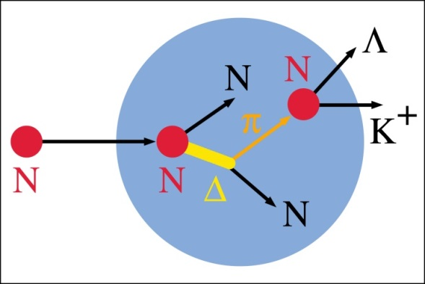
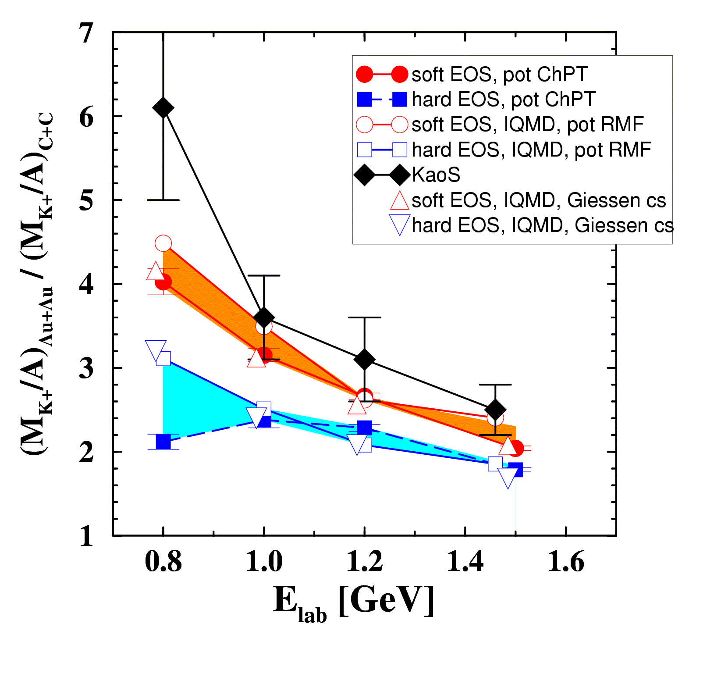
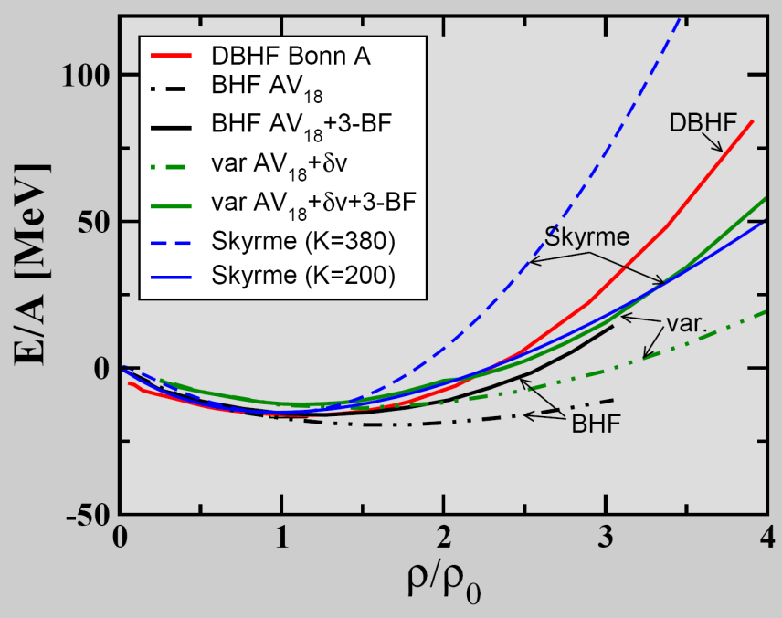
BM@N physics case and observables
The QCD matter equation-of-state at high densities
➢ particle production at (sub)threshold energies via multi-step processes
Example: subthreshold K⁺ production at GSI
Idea: K⁺ yield ∝ density ∝ compressibility
pp → K⁺Λ p
(E_{thres}= 1.6 GeV)
K⁺ from Au+Au/C+C
?
Experiment:
C. Sturm et al., (KaoS Collaboration)
PRL 86 (2001) 39
Theory: QMD: Ch. Fuchs et al., PRL86 (2001) 1974
IQMD Ch. Hartnack, J. Aichelin, J. Phys. G 28 (2002) 1649

Slide 6
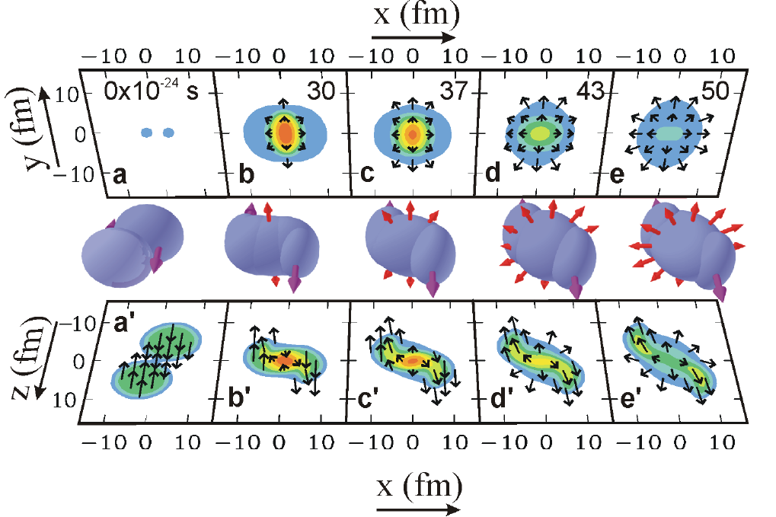
Time (x axis) , transverse (y axis) and longitudinal (z axis) dynamics of Au+Au collision
P. Danielewicz, R. Lacey, W.G. Lynch, Science 298 (2002) 1592

Slide 7

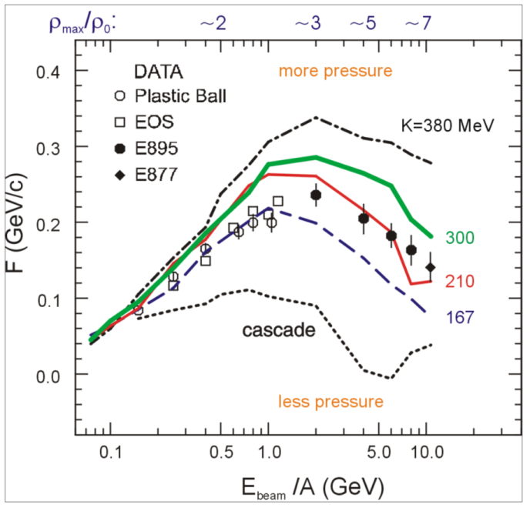
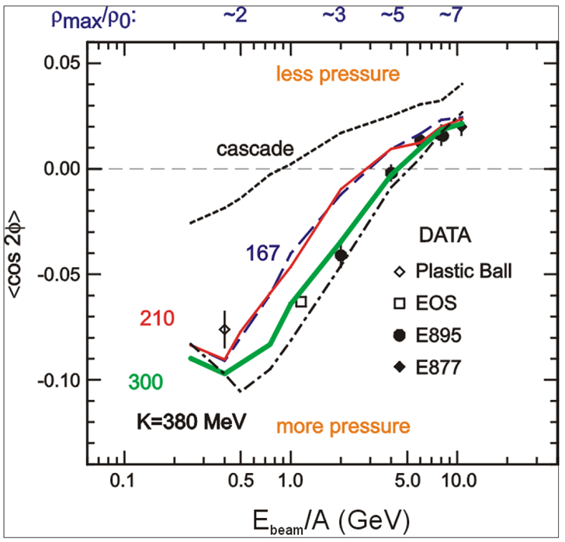
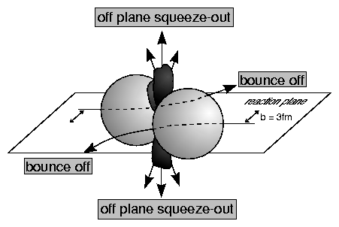
Study of EoS: Collective flow of identified particles
➢ collective flow of identified particles (π,K,p,Λ,Ξ,Ω,...) driven by the pressure gradient in the early fireball
BM@N MPD
→ Nuclear incompressibility: K = 9ρ² δ²(E/A)/δρ²
Azimuthal angle distribution: dN/dφ ∝ (1 + 2v₁ cosφ + 2v₂ cos2φ)
Proton flow in Au+Au collisions
in-plane flow ~ v₁ out-of-plane flow v₂
P. Danielewicz, R. Lacey, W.G. Lynch, Science 298 (2002) 1592
BM@N range
M.Kapishin BM@N experiment

Slide 8
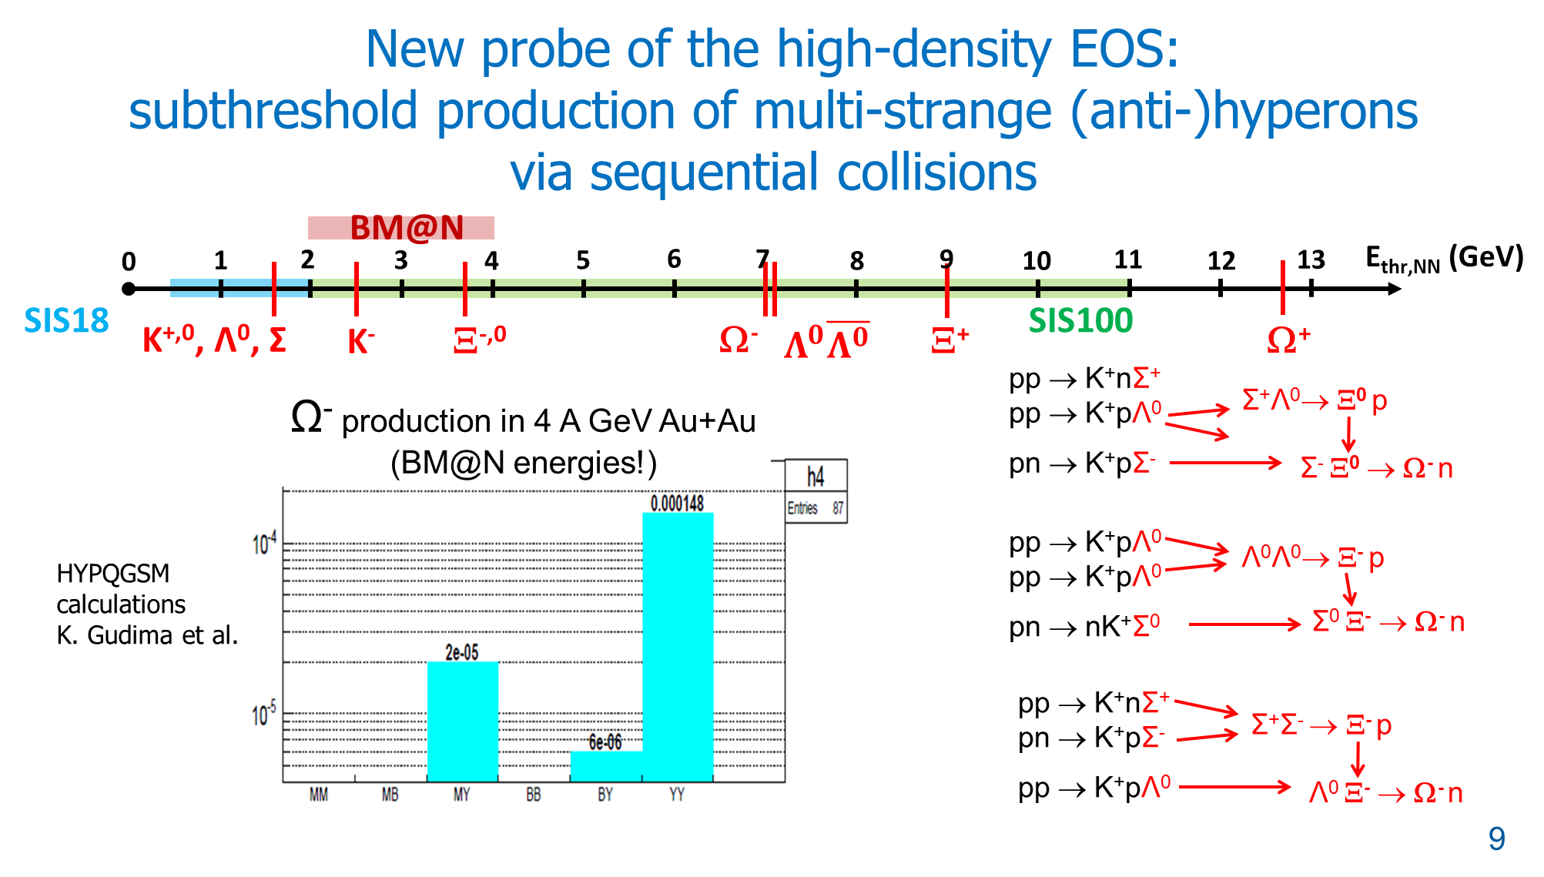

Slide 9
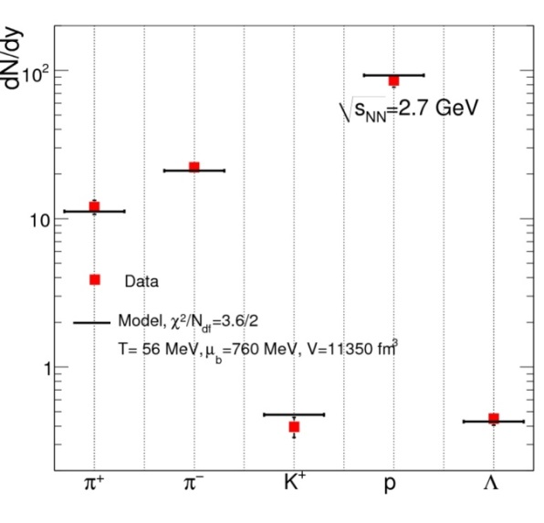
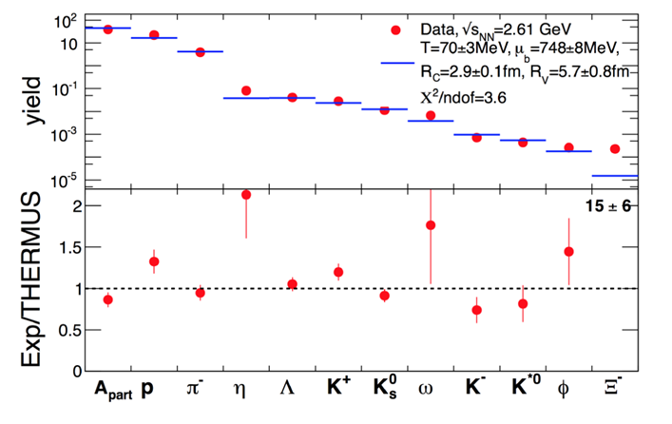
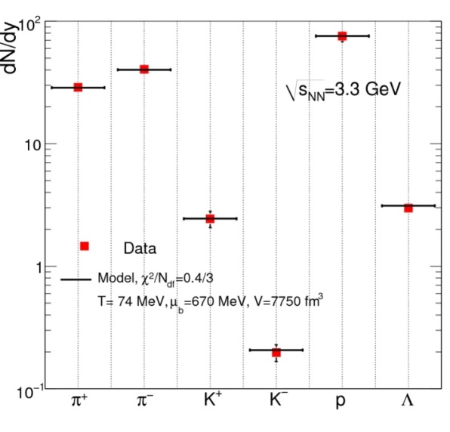
BM@N physics case and observables
The QCD matter equation-of-state at neutron high densities
➢ particle production at (sub)threshold energies via multi-step processes:
multi-strange hyperons
Competitors for BM@N : HADES at lower energy, old AGS measurements of π±, K±, p, Λ yields
STAR fixed target program
2 A GeV
HADES: Ar + KCl 1.76 A GeV
G. Agakishiev et al., arXiv:1512.07070
AGS
Au+Au
4 A GeV

Slide 10

BM@N physics case and observables
The QCD matter equation-of-state at high densities
➢ particle production at (sub)threshold energies via multi-step processes:
multi-strange hyperons
Hyperon yields at the Nuclotron
4 A GeV min. bias Au+Au collisions, multiplicities from statistical model,
Beam intensity 10⁶/s , reaction rate 10⁴/s, accelerator duty factor = 0.25
Experimental run for 2200 hours (3 months)
2∙10¹⁰ interactions
2∙10¹² beam ions
Particle | E_{thr}NN GeV | M central | M m.bias | ε % | Yield/s m. Bias | Yield / 2200 hours m. Bias
Ξ⁻ | 3.7 | 1⋅10⁻¹ | 2.5⋅10⁻² | 1 | 2.5 | 5⋅10⁶
Ω⁻ | 6.9 | 2⋅10⁻³ | 5⋅10⁻⁴ | 1 | 5⋅10⁻² | 1⋅10⁵
Anti-Λ | 7.1 | 2⋅10⁻⁴ | 5⋅10⁻⁵ | 3 | 1.5⋅10⁻² | 3⋅10⁴
Ξ⁺ | 9.0 | 6⋅10⁻⁵ | 1.5⋅10⁻⁵ | 1 | 1.5⋅10⁻³ | 3⋅10³
Ω⁺ | 12.7 | 1⋅10⁻⁵ | 2.5⋅10⁻⁶ | 1 | 2.5⋅10⁻⁴ | 5⋅10²
M.Kapishin BM@N experiment

Slide 11
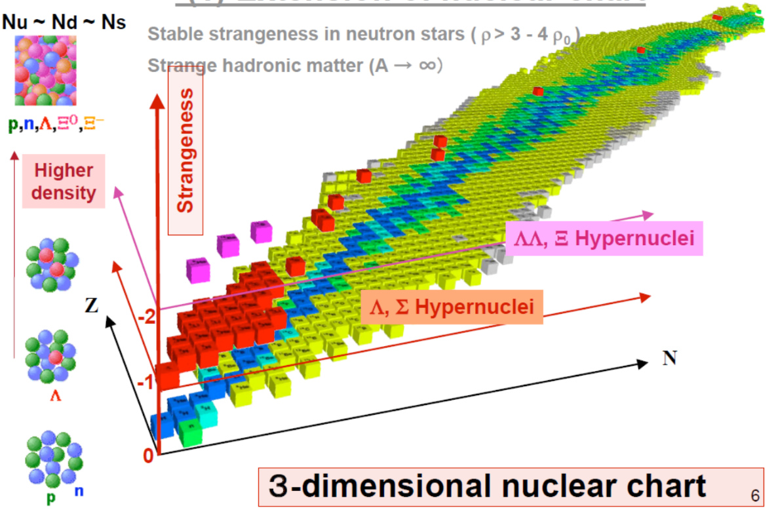
Strangeness as 3rd axis of nuclei chart populated by hyper-nuclei
Stable strangeness in neutron stars (ρ > 3 -4 ρ₀ )

Slide 12
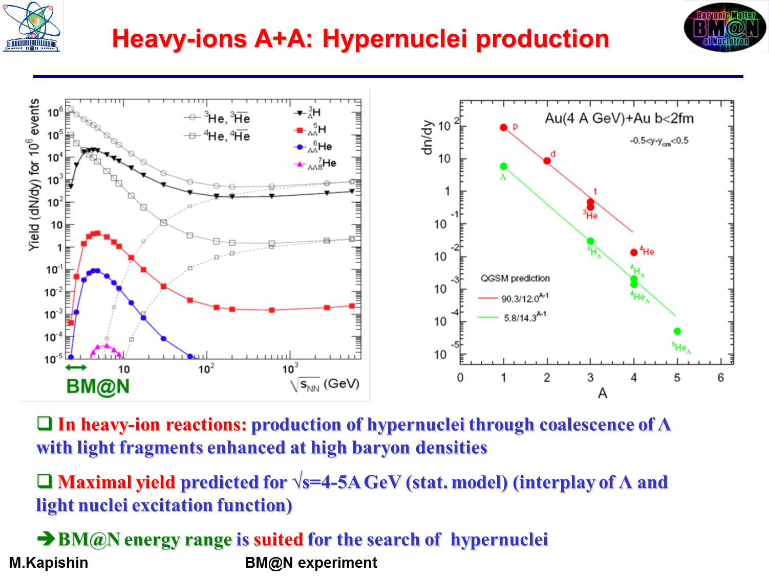
MPD
Hyper- nucleus | Yield / 2200 hours
_{Λ}³H | 1⋅10⁶
_{ΛΛ}⁵H | 100
► BM@N energy range is suited for search of hyper-nuclei
M.Kapishin BM@N experiment

Slide 13

Hypernuclei results of STAR at √s_{NN}= 3 GeV (³_{Λ}H, ⁴_{Λ}H)
(= 2.9 AGeV)
Lifetimes
Spectra
Rapidity distribution
Yields confirm thermal model
Collective flow

Slide 14
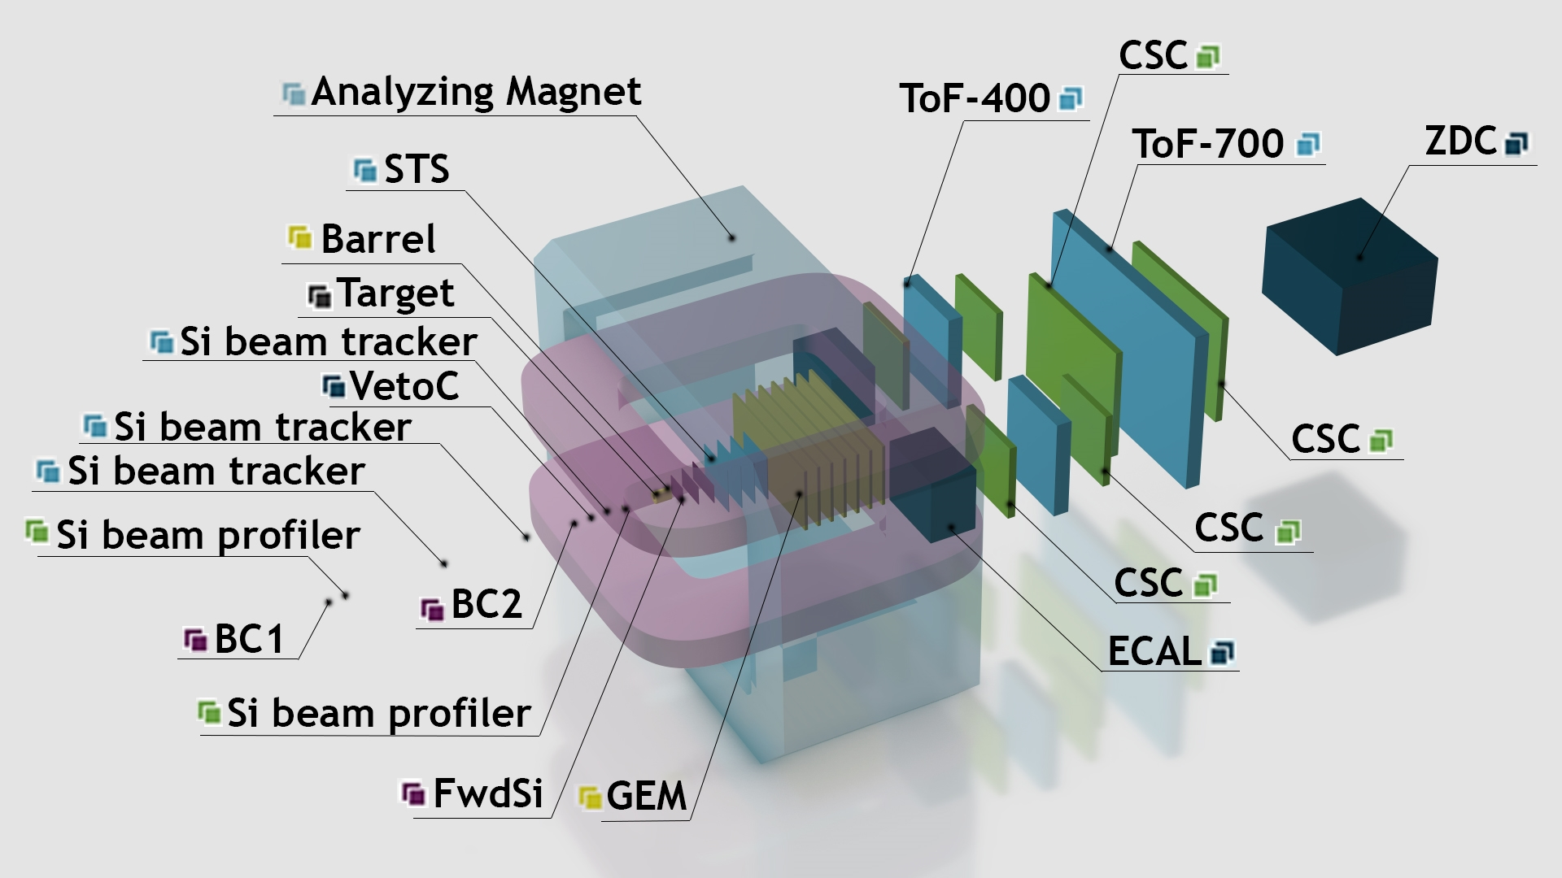
Configuration of BM@N detector for heavy ion program (without beampipe)
M.Kapishin BM@N experiment

Slide 15
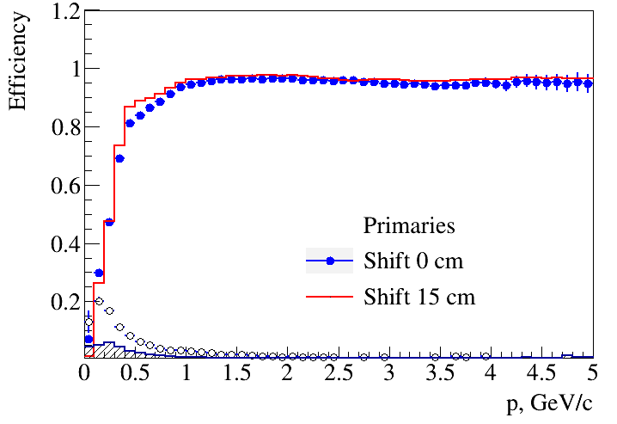
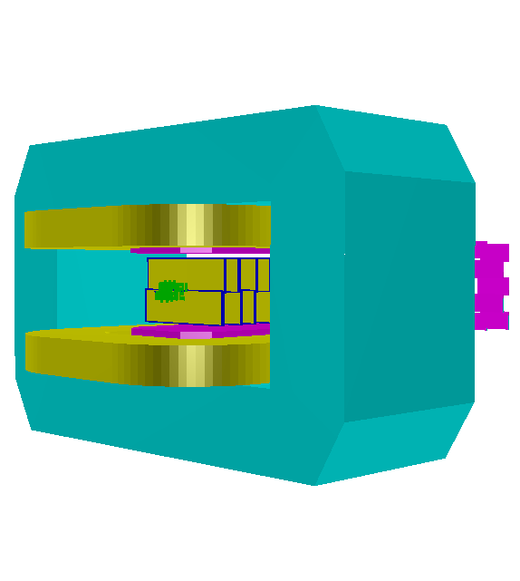
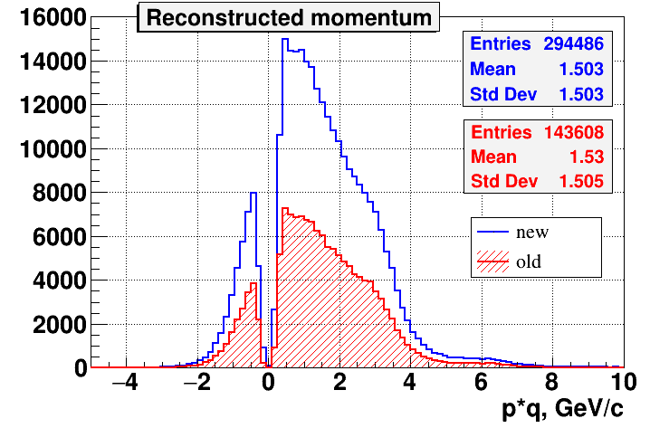
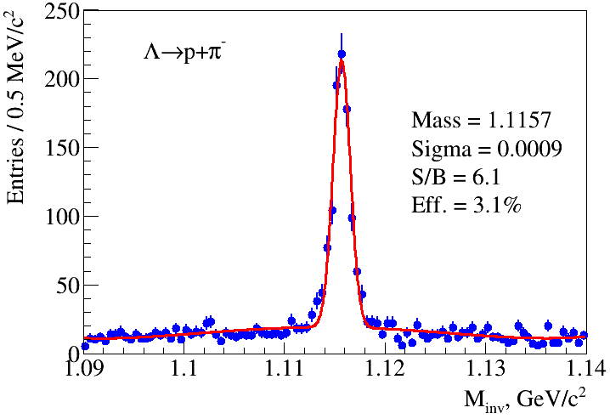
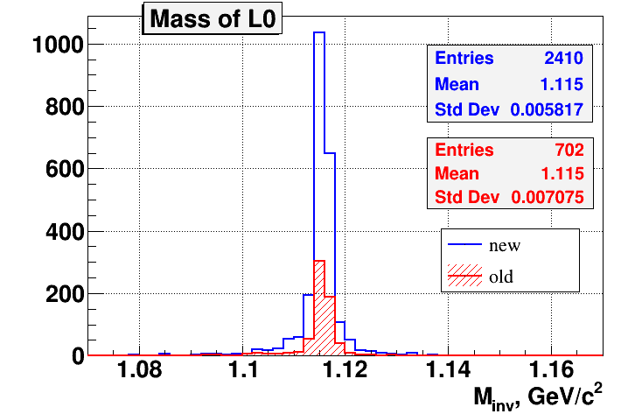
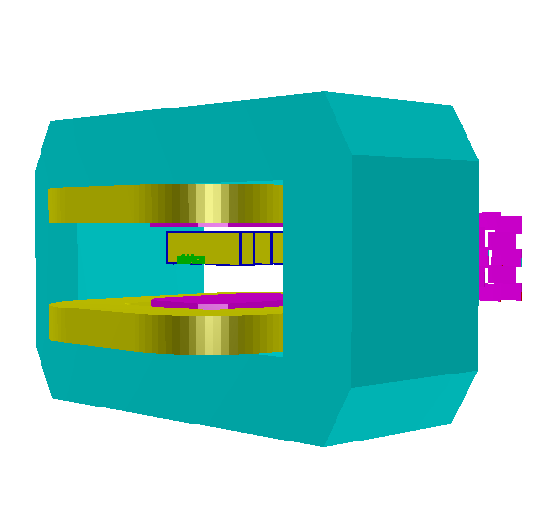
1st stage of hybrid central tracker: 3 Forward Si + GEM (Spring 2022 configuration)
A.Zinchenko, V.Vasendina
DCM-QGSM model
Kr + Pb , T₀= 2.4 AGeV
3 Forward Si + 7 GEM,
New configuration 2022
ε
Configuration 2021
Old configuration, March 2018
New vs Old (2018) configuration
ε(track) increased by 2
ε(Λ) increased by 3.5
Only upper part equipped with detectors
M.Kapishin BM@N experiment

Slide 16
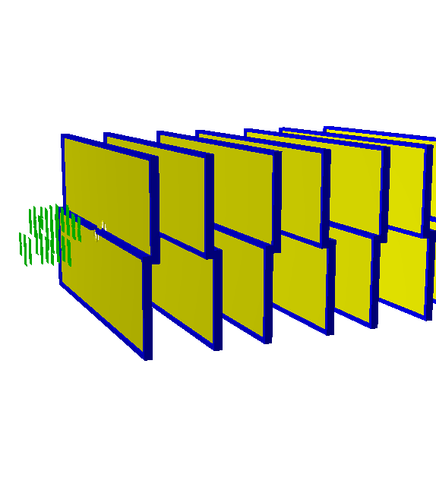
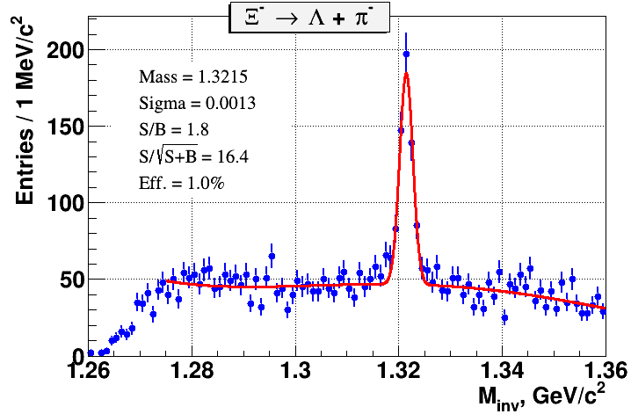
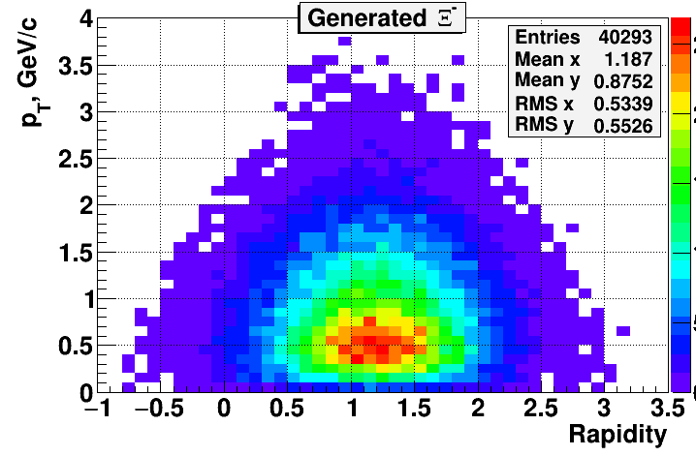
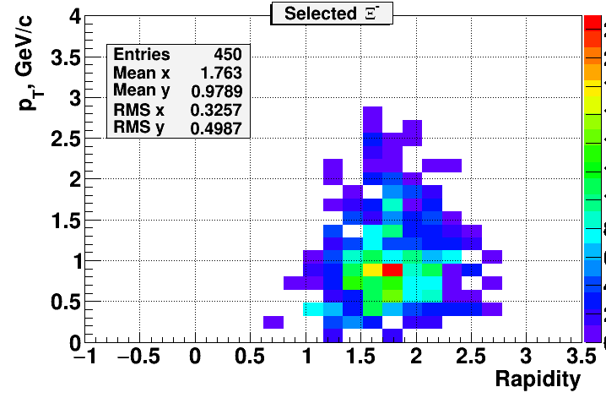
Cascade reconstruction in Xe +A interactions: 3 Forward Si + GEM
A.Zinchenko, V.Vasendina
DCM-QGSM model: Xe + Sn , T₀= 3.9 AGeV
3 Forward Si + 7 GEM
5M min bias events
phase space of reconstructed Ξ⁻
M.Kapishin BM@N experiment

Slide 17
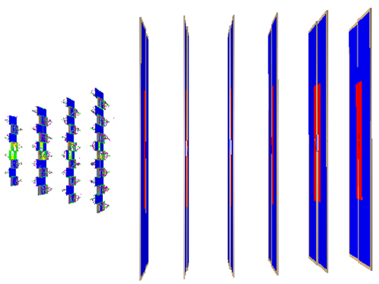
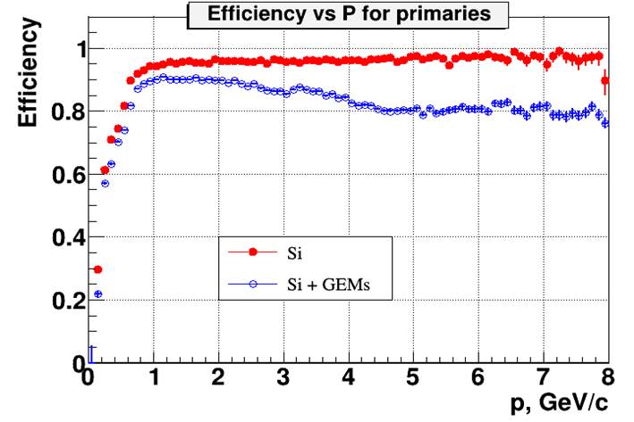
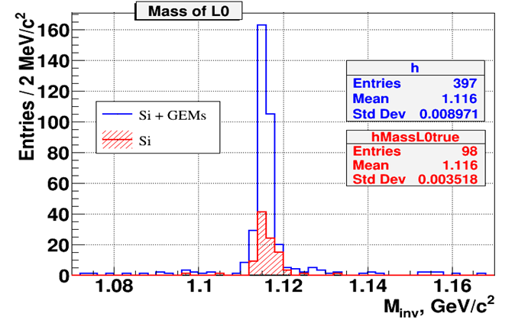
Simulation of hybrid central tracker for heavy ion runs: STS +GEM
A.Zinchenko, V.Vasendina
QGSM model, Au+Au, T₀ = 4 AGeV
GEM
STS
Hybrid STS + GEM tracker:
► 4 times increase in number of reconstructed Λ hyperons
M.Kapishin BM@N experiment

Slide 18
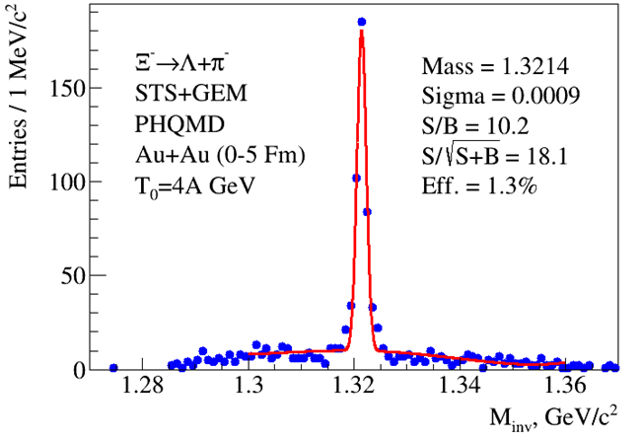
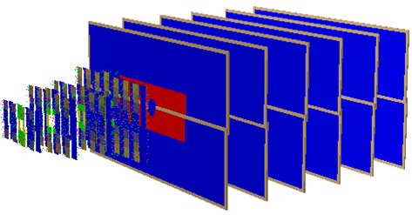
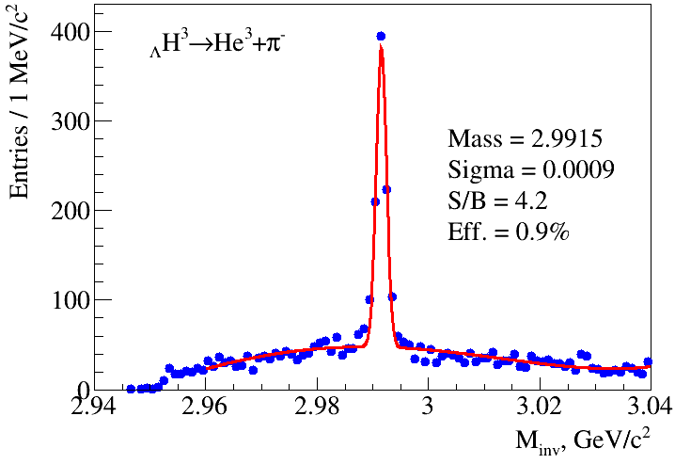
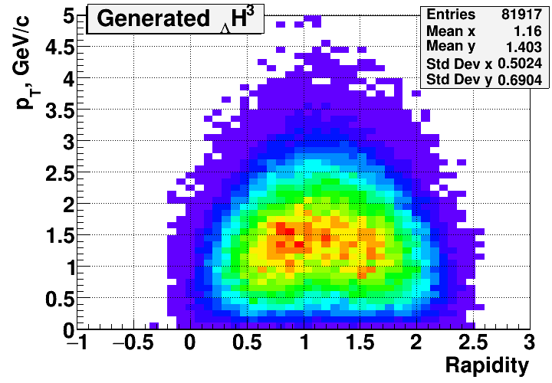
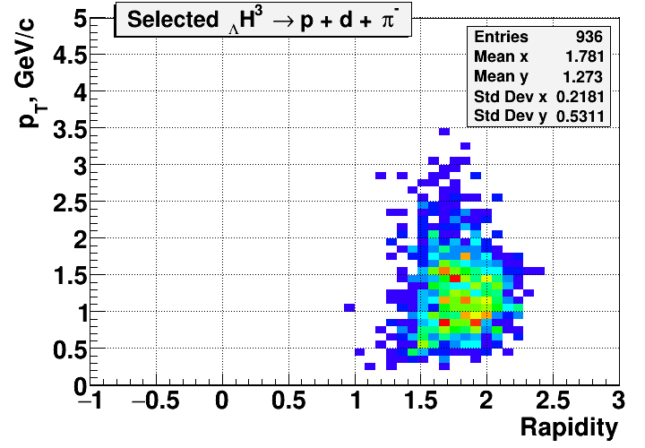
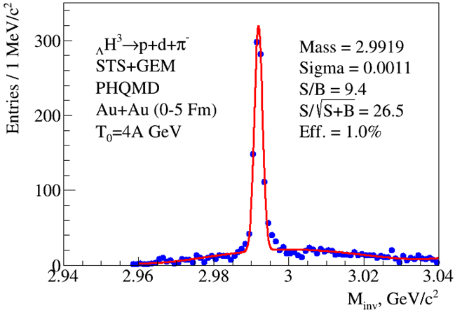
Simulation of hybrid central tracker for heavy ion runs: Ξ⁻ and _{Λ}H³ reconstruction
A.Zinchenko, V.Vasendina
PHQMD model, Au+Au, T₀ = 4A GeV, b = 0-5 fm, 500k events
_{Λ}H³ phase space
M.Kapishin BM@N experiment

Slide 19
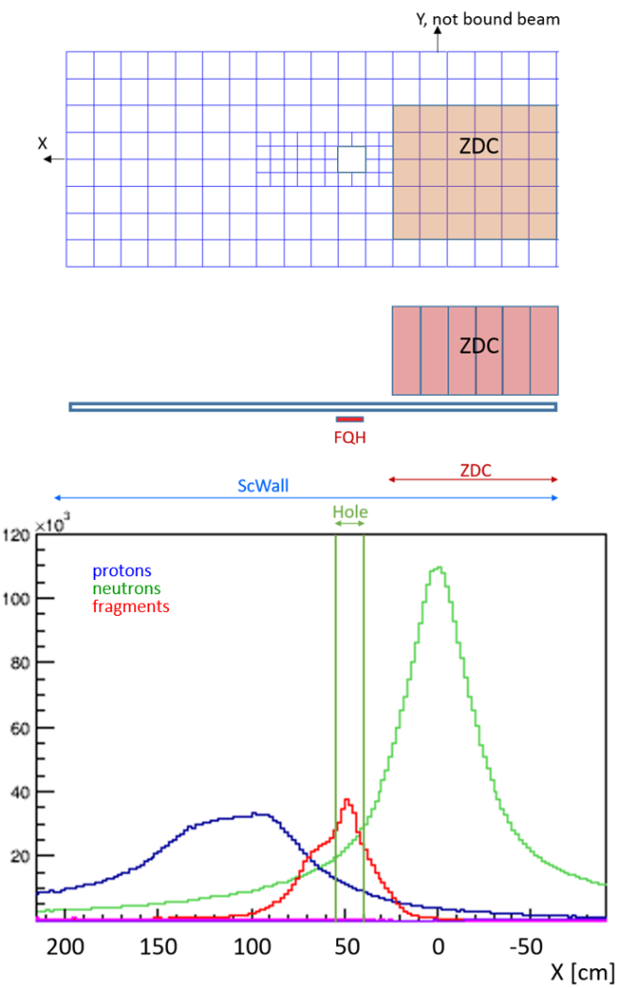
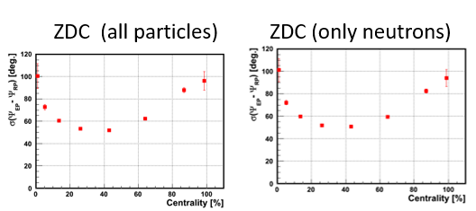
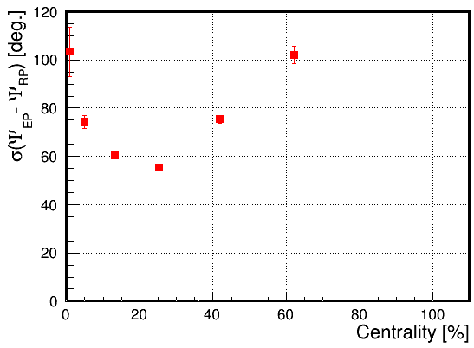
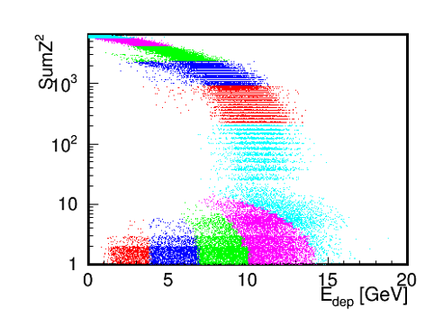
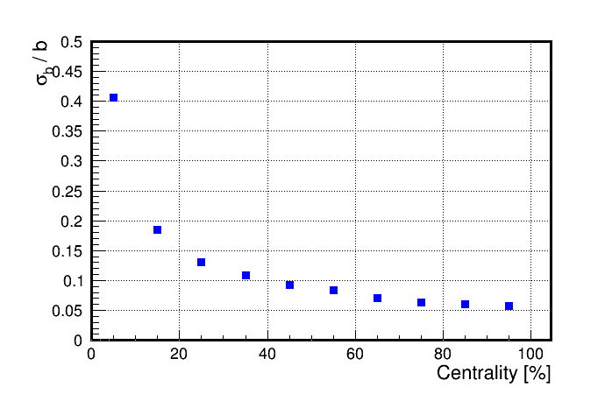
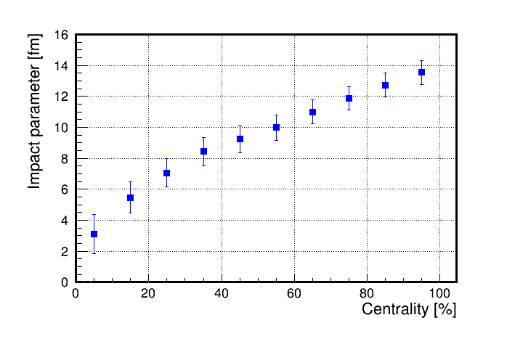
EP reconstruction with FHCAL , Scint Wall and FQH
Event Plane resolution
ScWall (charged fragments)
To measure neutron collective flow need:
►EP from identified protons and fragments
►granular neutron detector to measure single neutrons
Neutron profile in front of ZDC
Centrality resolution: Z² (FQH + ScWall) vs E_{dep} (ZDC)
M.Kapishin BM@N experiment

Slide 20
Heavy ion program goals and observables
1. BM@N energy range is very promising (EOS, symmetry energy, hypernuclei)
2. Sensitive probes have to be measured multi-differential (p_{T}, y)
and as function of beam energy (2 – 4 GeV/u)
➢ EOS for high-density symmetric matter:
- Collective flow of protons and light fragments in Au+Au collisions:
Centrality, event plane, identification of fragments
- Ξ⁻ (dss) and Ω⁻ (sss) hyperons: Yields, spectra, p_{T} vs. y from Au+Au and C+C collisions
➢ Symmetry energy at high baryon densities:
- Particles with opposite isospin I₃=±1: Σ*⁺(uus)/Σ*⁻(dds)
- Proton vs neutron collective flow (need highly granulated neutron detector)
➢ Λ-N and Λ-NN interactions
- Hypernuclei: Yields, lifetimes, masses of ³_{Λ}H, ⁴_{Λ}H, ⁵_{Λ}H, ⁴_{Λ}He, ⁵_{Λ}He, …
➢ Phase transition from hadronic to partonic matter:
- Deconfinement: excitation function of Ξ⁻ (dss), Ω⁻ (sss) (EOS observables)
- Transition to scaling of collective flow of mesons / hyperons with number of quarks (partonic matter)
- Critical endpoint: higher order moments of the proton multiplicity distribution

Slide 21
Plan to start BM@N heavy ion program with a middle weight ion beams Xe (Kr) in Spring 2022
► first need to trace beam through BMN and monitor its profile and ► 1 week technical run to prove / adjust BMN detector performance
► physics run with Xe (Kr) beam for 800 hours
• operate 1st stage of hybrid central tracker (3 Fwd Si + 7 GEM)
• maximal beam energy (up to 3.9-4.0 AGeV)
targets: with weights closest to Kr, Xe: RbBr (Kr), CsI (Xe)
• trigger: central + intermediate interactions, Min. bias events for monitoring, beam intensity: few 10⁵ Hz, Event statistics per target, beam: ≥ 10⁹
Future runs with heavy ion Au (Bi) beams
We foresee 2000-3000 hours of data taking per year. We assume the parallel operation of the Booster-Nuclotron for the BM@N experiment during data acquisition in the MPD experiment at the NICA collider.
Future upgrade for measurements of neutron collective flow:
► Need to develop a new neutron detector of high granularity to cover whole azimuthal range to measure single neutrons and finally → collective flow of neutrons
► Up to now only measurements of neutron flow have been done in GSI in Au+Au at 0.4 and 1 AGeV. BM@N can extend measurement of neutron collective flow to higher energies (baryon densities)

Slide 22
Hyperon yields in Xe + Cs collisions
4 A GeV Xe+Cs collisions, multiplicities from PHSD model,
Beam intensity 5 ∙10⁵/s, reaction rate 0.5∙10⁴/s, accelerator duty factor = 0.25
Experimental run for 800 hours (33 days)
3.6∙10⁹ interactions
3.6∙10¹¹ beam ions
Particle | E_{thr}NN GeV | M b<10 fm | ε % | Yield/s b<10fm | Yield / 800 hours b<10 fm
Λ | 1.6 | 1.5 | 3 | 220 | 1.6⋅10⁸
Ξ⁻ | 3.7 | 2.3⋅10⁻² | 1 | 1.1 | 8⋅10⁵
Ω⁻ | 6.9 | 2.6⋅10⁻⁵ | 1 | 1.3⋅10⁻³ | 900
Anti-Λ | 7.1 | 1.5⋅10⁻⁵ | 3 | 2.2⋅10⁻³ | 1600
M.Kapishin BM@N experiment

Slide 23
Beam parameters and setup at different stages of the BM@N experiment
Year | 2016 | 2017 spring | 2018 spring | 2022 spring | 2023 | After 2023
Beam | d(↑) | C | Ar,Kr, C(SRC) | Xe (Kr) | Au (Bi) | Au (Bi)
Max.inten sity, Hz | 0.5M | 0.5M | 0.5M | 0.5M | 0.5M | 2M
Trigger rate, Hz | 5k | 5k | 10k | 10k | 10k | up to 50k
Central tracker status | 6 GEM half planes | 6 GEM half planes | 6 GEM half planes + 3 forward Si planes | 7 GEM full planes + 3 forward Si planes | 7 GEM full planes + 4 forward Si + 2 large STS planes | 7 GEM full planes + 4 large STS planes
Experimental status | technical run | technical run | technical run+physics | stage 1 physics | stage1 physics | High rate stage 2 physics
M.Kapishin BM@N experiment

Slide 24

Thank you
for attention!
M.Kapishin BM@N experiment

Slide 25
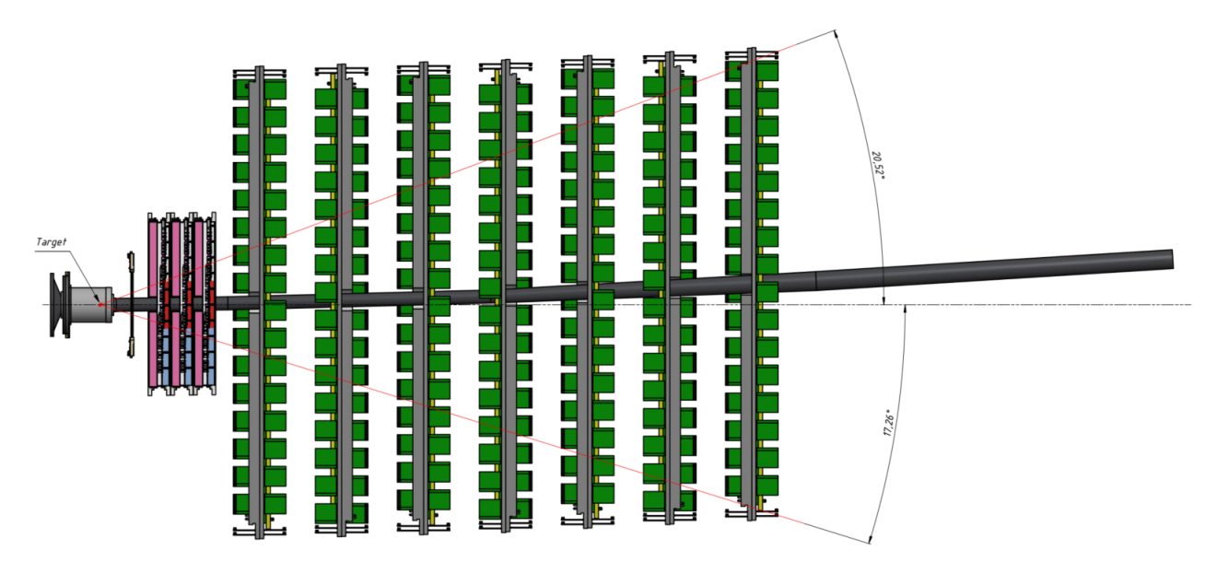
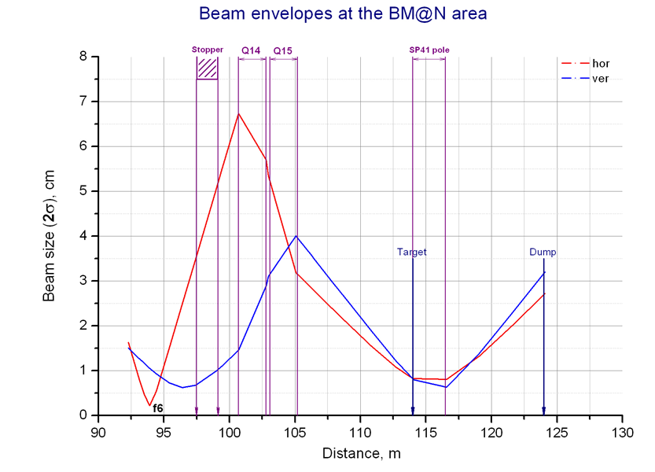
Beam tracing through BMN beam pipe and profile monitoring
7 GEM
3 Fwd Si
beam
Additional beam profile meter
Beam profile meters
First task of the next run → trace beam and monitor its profile in the end of the setup (try to find optimal trajectory to reduce background)
C¹² 2017 Ar 2018 Kr 2018
σ_{X} = 6 mm 5 mm 5.3 mm
σ_{Y} = 4.9 mm 5 mm 3.2 mm

Slide 26
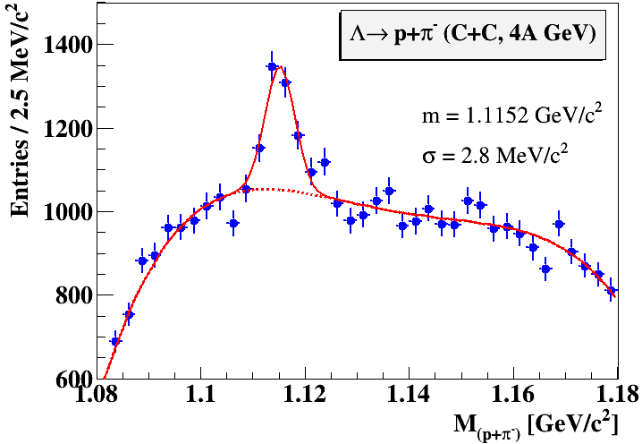
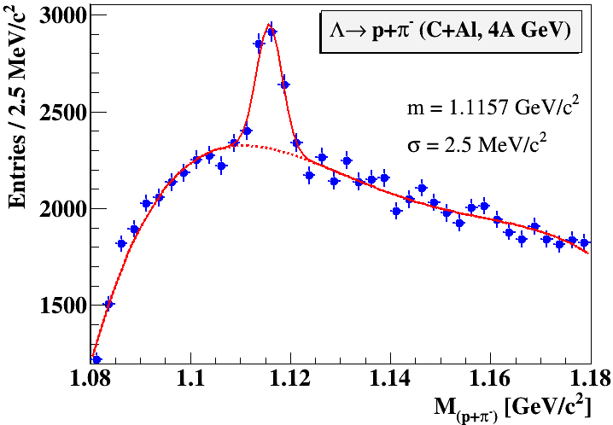
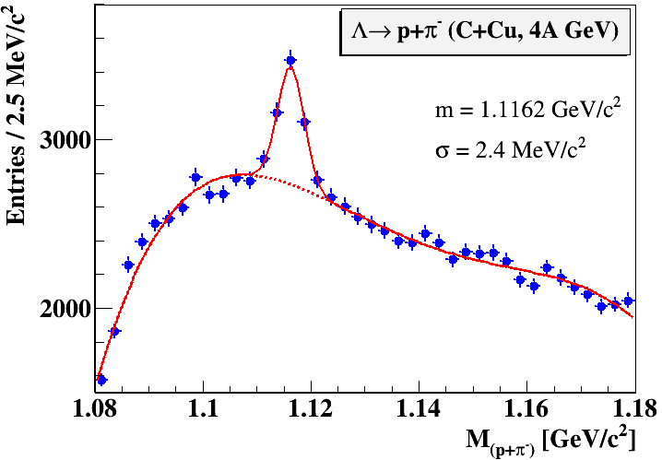
Λ hyperon signals in 4A GeV Carbon- nucleus interactions
C beam 4 AGeV
C + C,Al,Cu → Λ + X minimum bias
Λ signal width 2.4 – 2.8 MeV
C+C: 4.6M triggers
C+Al: 5.3M triggers
C+Cu: 5.3M triggers
2.5 days of data taking
M.Kapishin BM@N experiment

Slide 27



Λ hyperon yield in 4A GeV Carbon- nucleus min bias interactions
measured kinematic range 0.1<p_{T}<1.05 GeV/c, 0.03<y*< 0.93
data are corrected for acceptance and reconstruction efficiency
Yield of Λ in C+C, C+Al, C+ Cu minimum bias interactions in dependence on rapidity y* in c.m.s. y* = y_{lab}-1.17
► y* spectrum becomes softer with increase of target atomic weight
Data compared with predictions of DCM-QGSM and UrQMD models
► DCM-QGSM overestimates data in C+C interactions, but more compatible with data measured with heavier targets (C+Cu)
► UrQMD predictions are more consistent with data in normalization
M.Kapishin BM@N experiment

Slide 28



Λ hyperon invariant p_{T} spectra in 4A GeV Carbon-nucleus interactions
Fit of invariant p_{T} spectra of Λ yields in C+C, C+Al, C+Cu minimum bias interactions by function:
1/p_{T}·d²N/dp_{T}dy = A·exp(-(m_{T}-m_{Λ})/T), m_{T}=√(m_{Λ}²+p_{T}²)
Inv slope T in comparison with predictions of DCM-QGSM and UrQMD models
 | T [MeV] C+C | T [MeV] C+Al | T [MeV] C+Cu
BM@N Preliminary | 113 ± 14 ± 11 | 146 ± 19 ± 15 | 170 ± 24 ± 20
DCM-QGSM | 124±4 | 123±4 | 130±4
UrQMD | 105±4 | 123±4 | 133±4
M.Kapishin BM@N experiment

Slide 29


Status of particle identification
L.Kovachev, Yu.Petukhov
Ar beam , 3.2 AGeV , Ar + Al,Cu,Sn → X
Aim:
Yields of π, p, t, He³, d/He⁴ in argon - nucleus interactions (combination of ToF-400 and ToF-700)

Slide 30


Λ hyperon signals in 3.2A GeV Argon- nucleus interactions
P.Batyuk
Ar+Cu interaction reconstructed in central tracker
Ar (3.2 AGeV) + Target → Λ + X
Λ signal width 3.3 MeV
Aim:
Yields of Λ hyperons in argon - nucleus interactions
M.Kapishin BM@N experiment

Slide 31


►Collective flows v₁, v₂
M.Kapishin BM@N experiment

Slide 32


Quark degrees-of-freedom at neutron star core density?
3-stage schematic model
(point-like nucleons)
2-body forces
many-body forces
baryons overlap
pQCD
G. Baym et al.,
Rep. Prog. Phys. 81 (2018) 056902
nucleons with
hard core and pion cloud
K. Fukushima,T. Kojo, W. Weise, Phys. Rev. D 102 (2020) 096017 arXiv:2008.08436
BM@N density range
Models provide a stiff EOS above ∼ 4 ρ₀ as required for the stability of neutron stars with 2 M_{Sun}

Slide 33
BM@N physics case and observables
The QCD matter equation-of-state at high densities
➢ particle production at (sub)threshold energies via multi-step processes:
multi-strange hyperons
Direct multi-strange hyperon production:
pp → Ξ⁻ K⁺K⁺p (E_{thr} = 3.7 GeV)
pp → Ω⁻ K⁺K⁺K⁰p (E_{thr} = 7.0 GeV)
pp → Λ⁰Λ⁰ pp (E_{thr} = 7.1 GeV)
pp → Ξ⁺ Ξ⁻ pp (E_{thr} = 9.0 GeV)
pp → Ω⁺ Ω⁻ pp (E_{thr} = 12.7 GeV
p
p
p
p
Λ⁰
(uds)
Hyperon production via multiple collisions
pp → K⁺Λ⁰p, pp → K⁺K⁻pp,
pΛ⁰→ K⁺ Ξ⁻ p, πΛ⁰→ K⁺ Ξ⁻ π,
Λ⁰Λ⁰→ Ξ⁻ p, Λ⁰K⁻ → Ξ⁻ π⁰
3 . Λ⁰ Ξ⁻ → Ω⁻ n, Ξ⁻K⁻ → Ω⁻ π⁻
Antihyperons
1. Λ⁰ K⁺ → Ξ⁺π⁰ ,
2. Ξ⁺ K⁺ → Ω⁺ π⁺.
p
K⁺
p
Λ⁰
Ξ⁻
(uds)
(dss)
p
Ω⁻
K⁺
p
p
Λ⁰
(uds)
(sss)
K⁺
p
n
4 A GeV Au+Au central collisions: M(Λ) ≈ 5

Slide 34

The symmetry energy E_{sym} at high density
Elliptic flow neutrons/protons
Particles with opposite isospin ?
I₃ | particle | production | E_{thr} GeV | decay
+1 | Σ*⁺(uus) | pp → Σ*⁺K⁺n pp → Σ*⁺K⁰p pn → Σ*⁺K⁰n | 2.34 | Σ*⁺ → Λπ⁺
-1 | Σ*⁻(dds) | pn → Σ*⁻K⁺p nn → Σ*⁻K⁺n | 2.34 | Σ*⁻ → Λπ⁻
π⁻/π⁺
Au+Au 400A MeV
n/p flow
n/p flow
π⁻/π⁺
π⁻/π⁺
W.-M. Guo et al., Phys. Lett. B738 (2014) 397
ASY-EOS: Elliptic flow of neutrons/charged particles
34

Slide 35

Hypernuclei as laboratory for the study of ΛN, ΛNN, and ΛΛN interactions to unravel the hyperon puzzle in neutron stars
Both the chemical potentials of nucleons μ_{n} and hyperons μ_{Λ} increase with increasing baryon density.
If μ_{n} > μ_{Λ}, neutrons decay into hyperons, the EOS softens, and prevents the existence of massive neutron stars.
Measure ΛN, ΛNN, and ΛΛN interactions !
W. Weise, arXiv:1905.03955v1, to appear in JPS Conf. Proc (Lambda single particle potential in neutron star matter from Chiral SU(3) EFT interactions)

Slide 36


Slide 37


Searching for the critical endpoint of the
1st order phase transition
Ratio of 4th/2nd moment of (net)-proton multiplicity distribution
STAR collaboration,
arXiv:2001.02852
low energies ?
?
37

Slide 38


Slide 39


Slide 40


