Slide 1

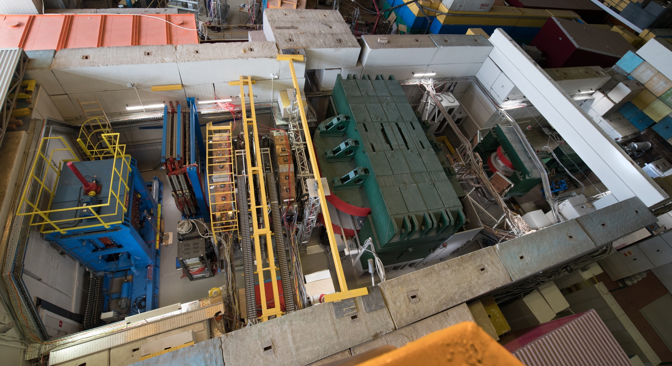
Project BM@N: Studies of Baryonic Matter at the Nuclotron
Report for 2017-2021 , Prolongation for 2022-2026
M.Kapishin BM@N experiment

Slide 2
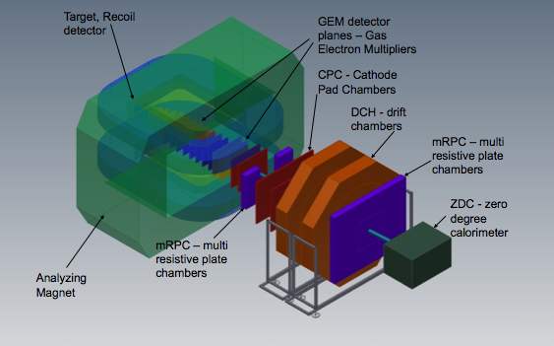
Baryonic Matter at Nuclotron
(BM@N) Collaboration:
10 Countries, 19 Institutions, 234 participants
JINR: 111 participants (FTE = 82)
University of Wroclaw, Poland → MoU signed;
Institute of Nuclear Research RAS, Moscow, Russia → MoU signed;
NRC Kurchatov Institute, Moscow;
Institute of Theoretical & Experimental Physics, NRC KI, Moscow, Russia;
Moscow Engineer and Physics Institute, Russia;
Skobeltsin Institute of Nuclear Physics, MSU, Russia → MoU signed;
Moscow Institute of Physics and Technics, Moscow, Russia → MoU signed;
Massachusetts Institute of Technology, Cambridge, USA.
University of Plovdiv, Bulgaria → MoU signed;
St.Petersburg University;
Shanghai Institute of Nuclear and Applied Physics, CFS, China;
Nuclear Physics Institute CAS, Czech Republic→ MoU signed;
CEA, Saclay, France;
TU Darmstadt, Germany;
GSI & FAIR, Germany;
Tubingen University, Germany → MoU signed;
Tel Aviv University, Israel;
Joint Institute for Nuclear Research;
Warsaw University of Technology, Poland→ MoU signed;
7th BM@N Collaboration meeting on April 19-20 → 25 parallel talks, 13 plenary talks
BM@N: 12 referred publications, 98 conference talks

Slide 3
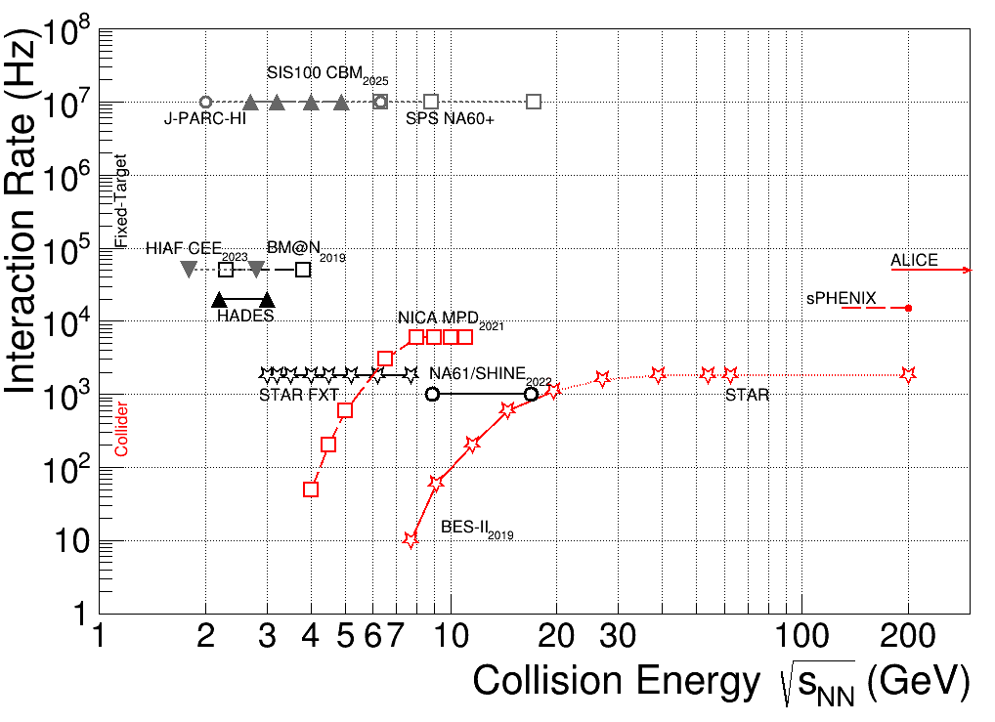
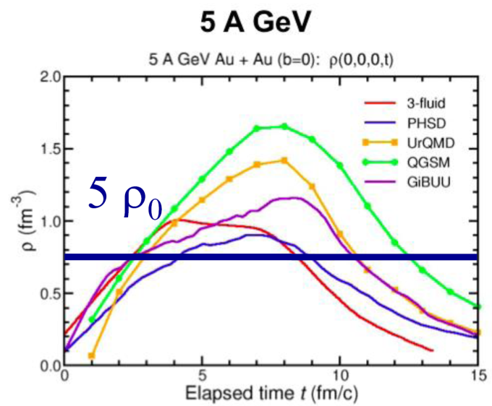
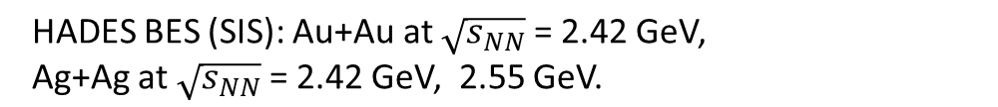
Heavy Ion Collision Experiments
region of max.
baryonic density
BM@N: √s_{NN}= 2.3 - 3.3 GeV MPD: √s_{NN}= 4 - 11 GeV
BM@N competitors:

Slide 4
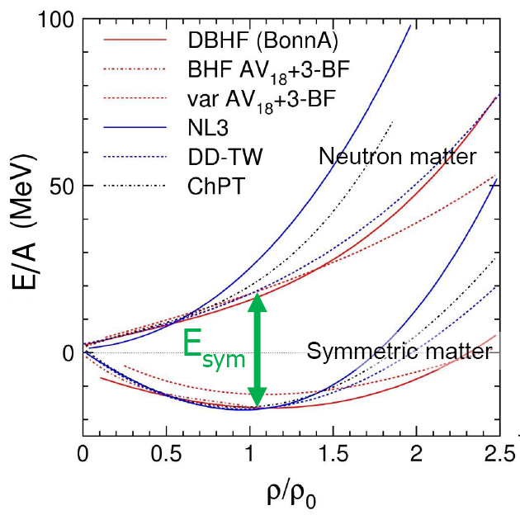
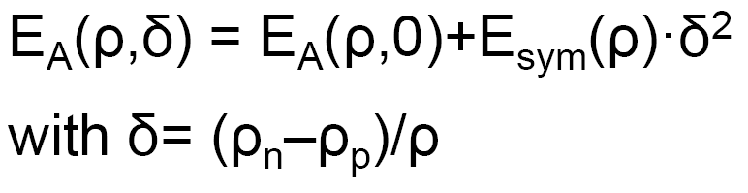
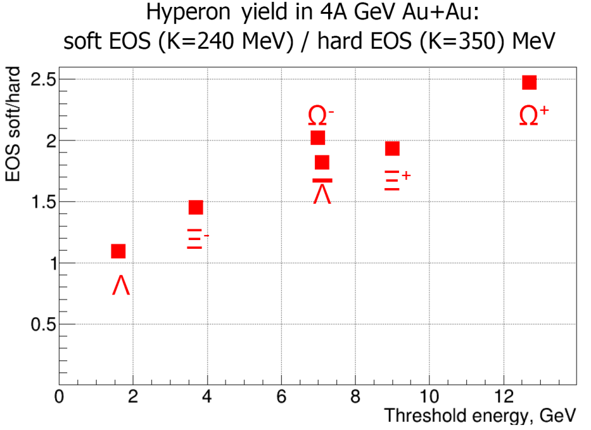
EOS of symmetric and asymmetric nuclear matter
EOS: relation between density, pressure, temperature, energy and isospin asymmetry
E/A(ρ_{o}) = -16 MeV
Curvature defined by nuclear incompressibility: K = 9ρ² δ²(E/A)/δρ²
►Study symmetric matter EOS at ρ=3-5 ρ₀
→ elliptic flow of protons, mesons and hyperons
→ sub-threshold production of strange mesons and hyperons
→ extract K from data to model predictions
►Constrain symmetry energy E_{sym}
→ elliptic flow of neutrons vs protons
→ sub-threshold production of particles with opposite isospin
PHQMD preliminary calculations
M.Kapishin BM@N experiment
4

Slide 5

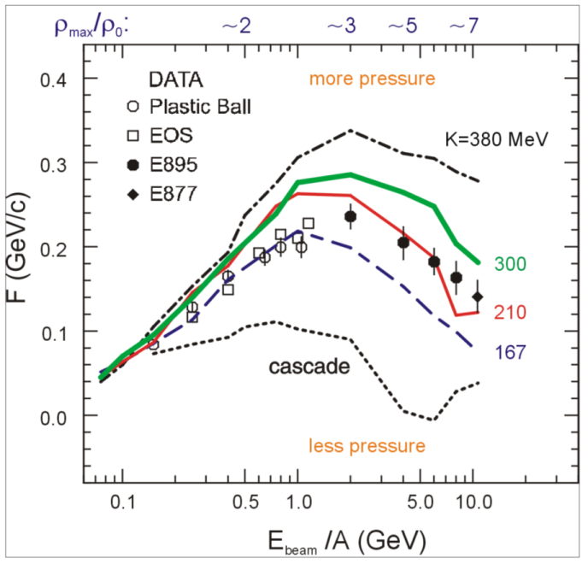
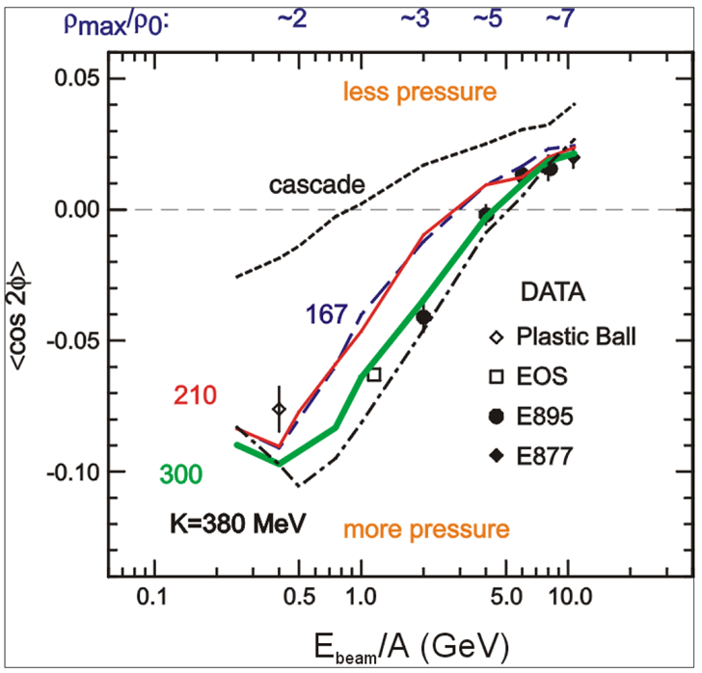
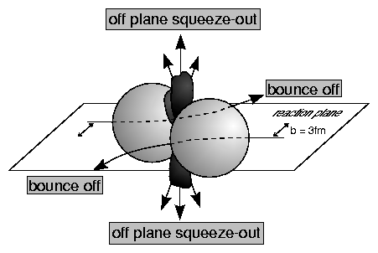
Study of EoS: Collective flow of identified particles
➢ collective flow of identified particles (π,K,p,Λ,Ξ,Ω,...) driven by the pressure gradient in the early fireball
BM@N MPD
→ Nuclear incompressibility: K = 9ρ² δ²(E/A)/δρ²
Azimuthal angle distribution: dN/dφ ∝ (1 + 2v₁ cosφ + 2v₂ cos2φ)
Proton flow in Au+Au collisions
in-plane flow ~ v₁ out-of-plane flow v₂
P. Danielewicz, R. Lacey, W.G. Lynch, Science 298 (2002) 1592
BM@N range
M.Kapishin BM@N experiment

Slide 6

BM@N physics case and observables
The QCD matter equation-of-state at high densities
➢ particle production at (sub)threshold energies via multi-step processes:
multi-strange hyperons
Hyperon yields at the Nuclotron
4 A GeV min. bias Au+Au collisions, multiplicities from statistical model,
Beam intensity 10⁶/s , reaction rate 10⁴/s, accelerator duty factor = 0.25
Experimental run for 2200 hours (3 months)
2∙10¹⁰ interactions
2∙10¹² beam ions
Particle | E_{thr}NN GeV | M central | M m.bias | ε % | Yield/s m. Bias | Yield / 2200 hours m. Bias
Ξ⁻ | 3.7 | 1⋅10⁻¹ | 2.5⋅10⁻² | 1 | 2.5 | 5⋅10⁶
Ω⁻ | 6.9 | 2⋅10⁻³ | 5⋅10⁻⁴ | 1 | 5⋅10⁻² | 1⋅10⁵
Anti-Λ | 7.1 | 2⋅10⁻⁴ | 5⋅10⁻⁵ | 3 | 1.5⋅10⁻² | 3⋅10⁴
Ξ⁺ | 9.0 | 6⋅10⁻⁵ | 1.5⋅10⁻⁵ | 1 | 1.5⋅10⁻³ | 3⋅10³
Ω⁺ | 12.7 | 1⋅10⁻⁵ | 2.5⋅10⁻⁶ | 1 | 2.5⋅10⁻⁴ | 5⋅10²
M.Kapishin BM@N experiment

Slide 7
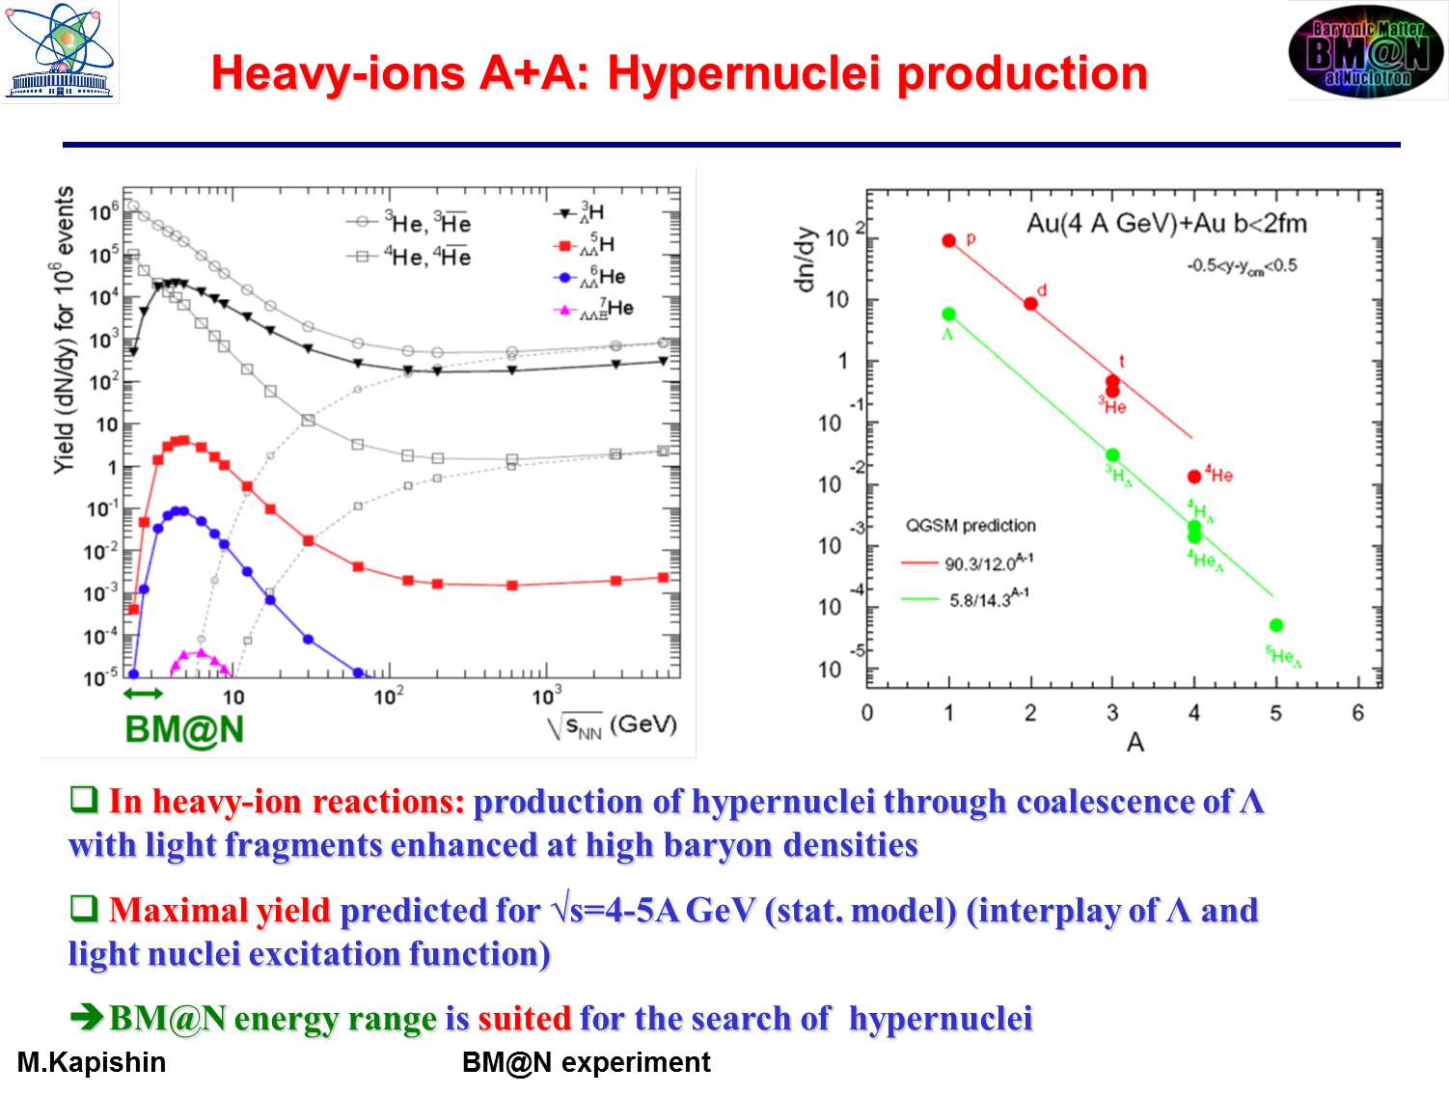
MPD
Hyper- nucleus | Yield / 2200 hours
_{Λ}³H | 1⋅10⁶
_{ΛΛ}⁵H | 100
► BM@N energy range is suited for search of hyper-nuclei
M.Kapishin BM@N experiment

Slide 8
Hyperon yields in Xe + Cs collisions
First BM@N physics run with Xe beam in 2022:
4 A GeV Xe+Cs collisions, multiplicities from PHSD model,
Beam intensity 5 ∙10⁵/s, reaction rate 0.5∙10⁴/s, accelerator duty factor = 0.25
Experimental run for 800 hours (33 days)
3.6∙10⁹ interactions
3.6∙10¹¹ beam ions
Particle | E_{thr}NN GeV | M b<10 fm | ε % | Yield/s b<10fm | Yield / 800 hours b<10 fm
Λ | 1.6 | 1.5 | 3 | 220 | 1.6⋅10⁸
Ξ⁻ | 3.7 | 2.3⋅10⁻² | 1 | 1.1 | 8⋅10⁵
Ω⁻ | 6.9 | 2.6⋅10⁻⁵ | 1 | 1.3⋅10⁻³ | 900
Anti-Λ | 7.1 | 1.5⋅10⁻⁵ | 3 | 2.2⋅10⁻³ | 1600
M.Kapishin BM@N experiment

Slide 9
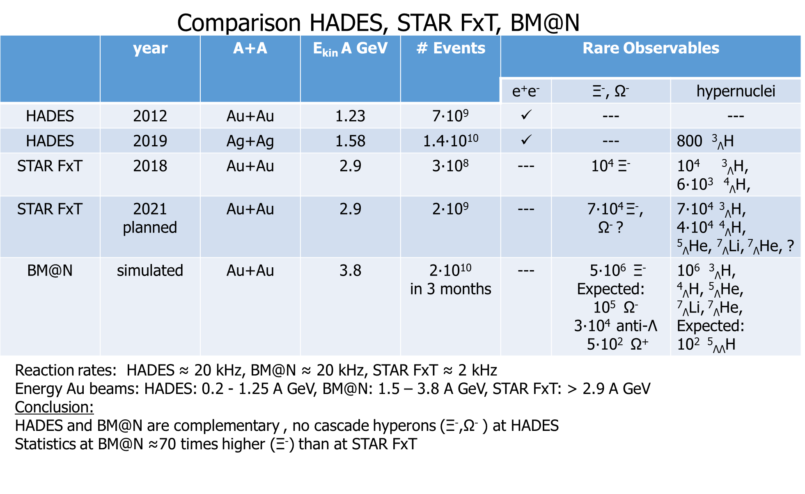

Slide 10
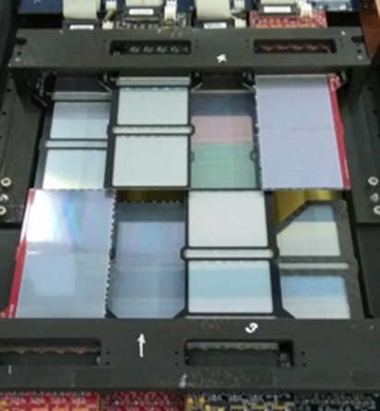
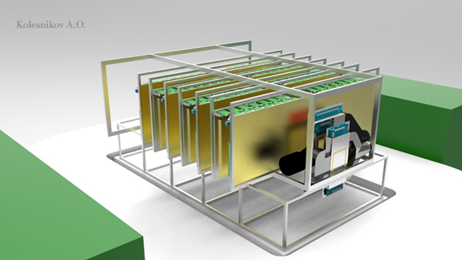
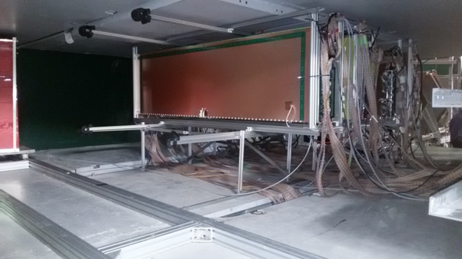
BM@N central tracker in Ar and Kr runs
CSC
DCH-1,2
Ar beam, T₀= 3.2 GeV/n
GEM
MWPC
ZDC
Kr beam, T₀= 2.4 GeV/n
T₀T
X
BM
+ data with C beam, of 4.0, 4.5 GeV/n
Z
Analyzing magnet SP-41
3 Si planes
ECAL
ToF-400,700
Central tracker: 3 Forward Si detectors and 6 GEM detectors
M.Kapishin BM@N experiment

Slide 11
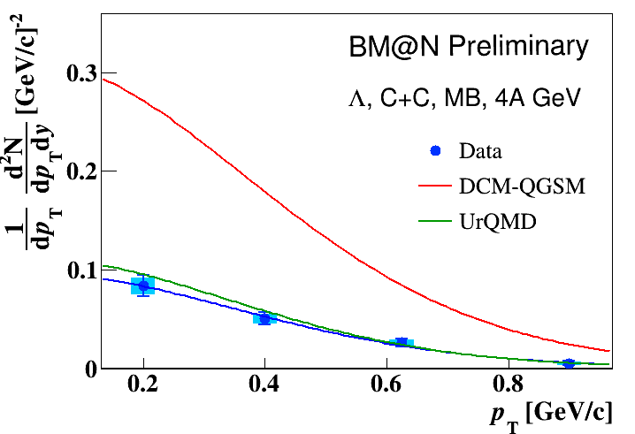
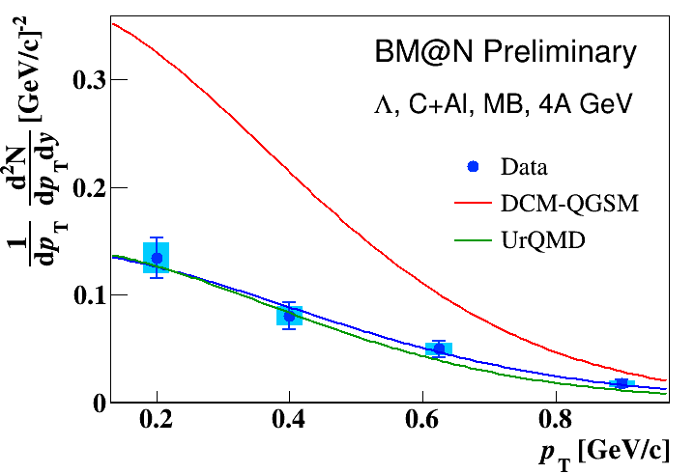
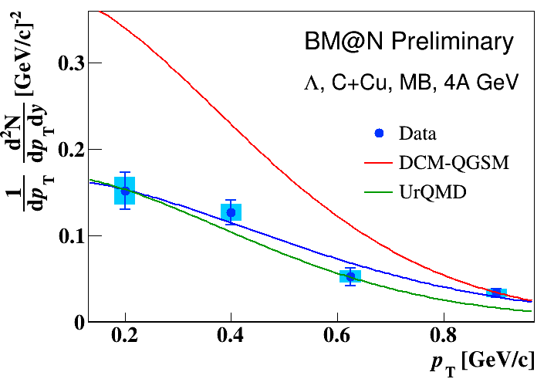
Λ hyperon invariant p_{T} spectra in 4A GeV Carbon-nucleus interactions
Fit of invariant p_{T} spectra of Λ yields in C+C, C+Al, C+Cu minimum bias interactions by function:
1/p_{T}·d²N/dp_{T}dy = A·exp(-(m_{T}-m_{Λ})/T), m_{T}=√(m_{Λ}²+p_{T}²)
Inv slope T in comparison with predictions of DCM-QGSM and UrQMD models
 | T [MeV] C+C | T [MeV] C+Al | T [MeV] C+Cu
BM@N Preliminary | 113 ± 14 ± 11 | 146 ± 19 ± 15 | 170 ± 24 ± 20
DCM-QGSM | 124±4 | 123±4 | 130±4
UrQMD | 105±4 | 123±4 | 133±4
M.Kapishin BM@N experiment

Slide 12
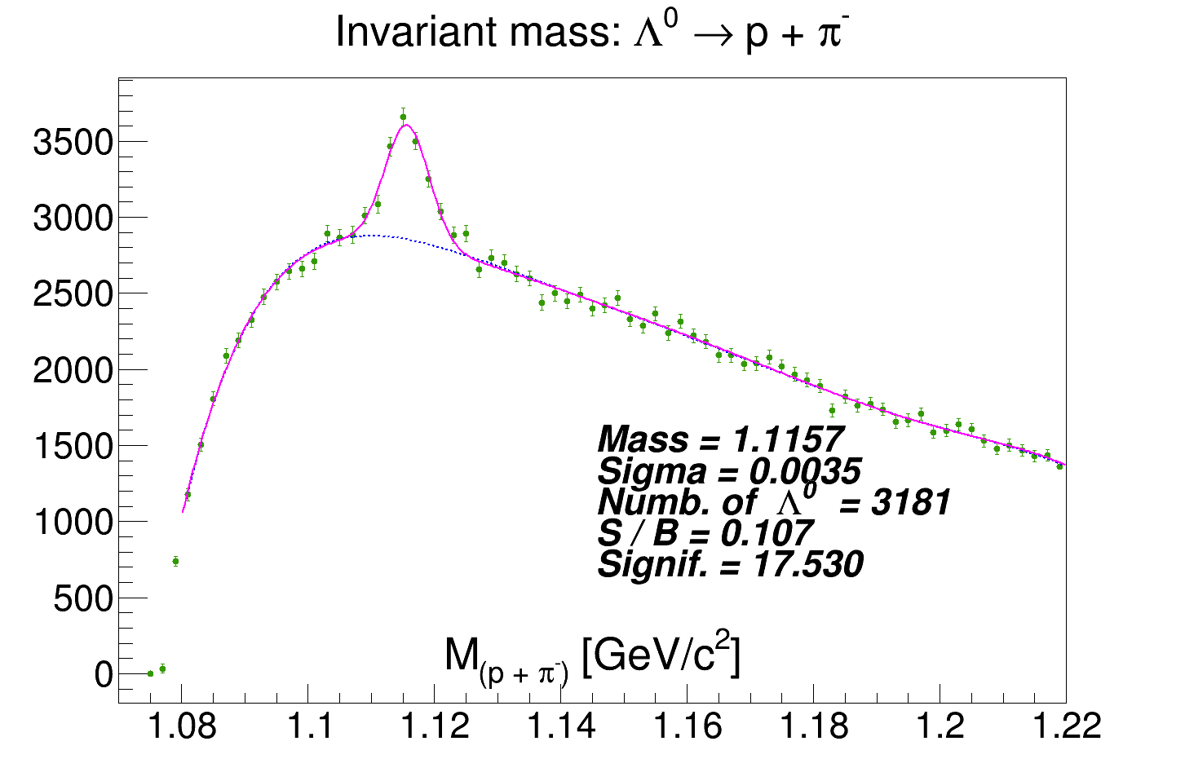
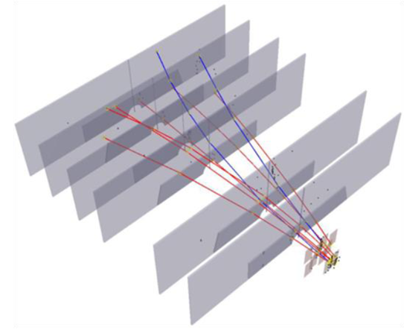
Λ hyperon signals in 3.2A GeV Argon- nucleus interactions
P.Batyuk,
Ar+Cu interaction reconstructed in central tracker
Ar (3.2 AGeV) + Target → Λ + X
Λ signal width 3.5 MeV
Aim:
Yields of Λ hyperons in argon - nucleus interactions
M.Kapishin BM@N experiment

Slide 13
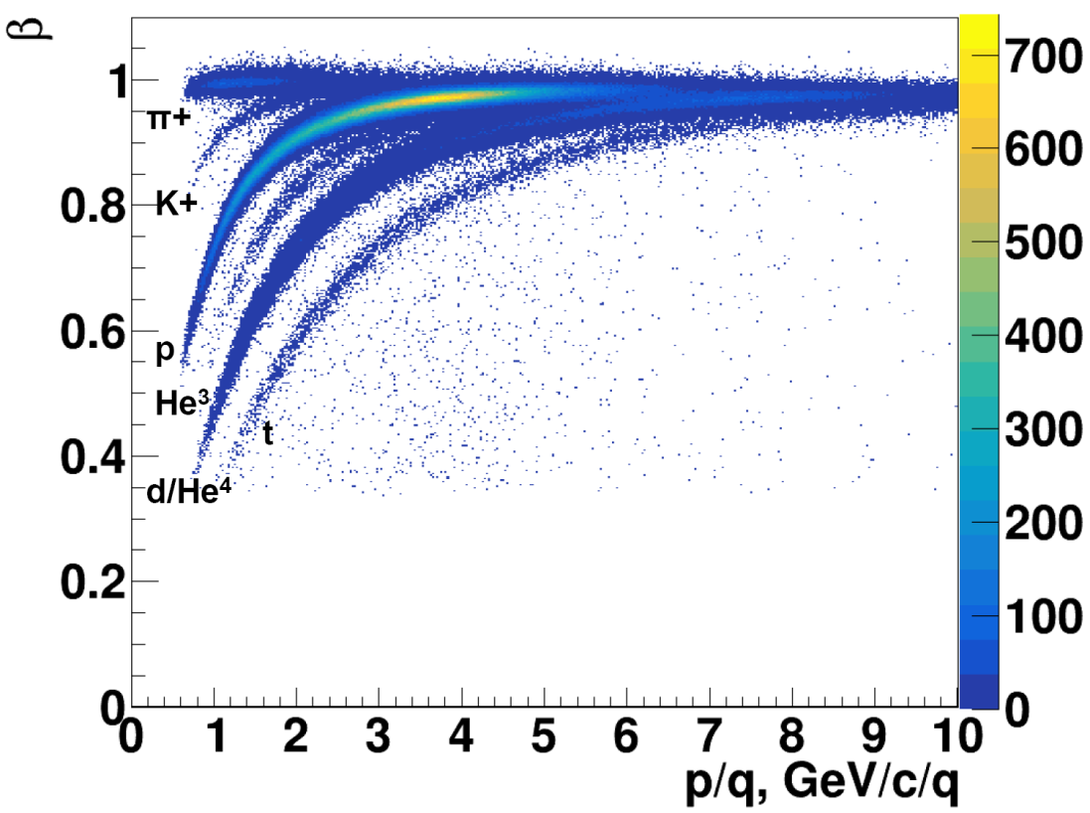
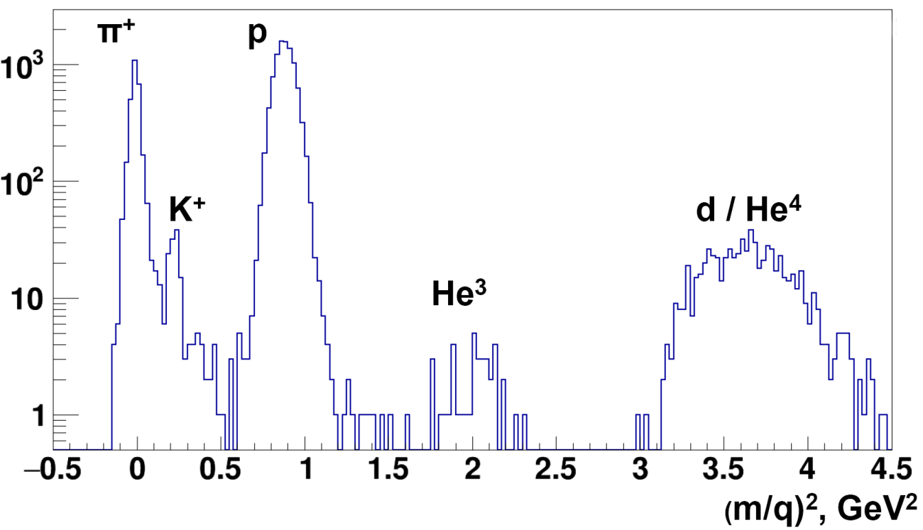
Status of TOF-700 particle identification
L.Kovachev, Yu.Petukhov
Ar beam , 3.2 AGeV , Ar + Al,Cu,Sn → X
Aim:
Yields of π, p, t, He³, d/He⁴ in argon - nucleus interactions (combination of ToF-400 and ToF-700)

Slide 14
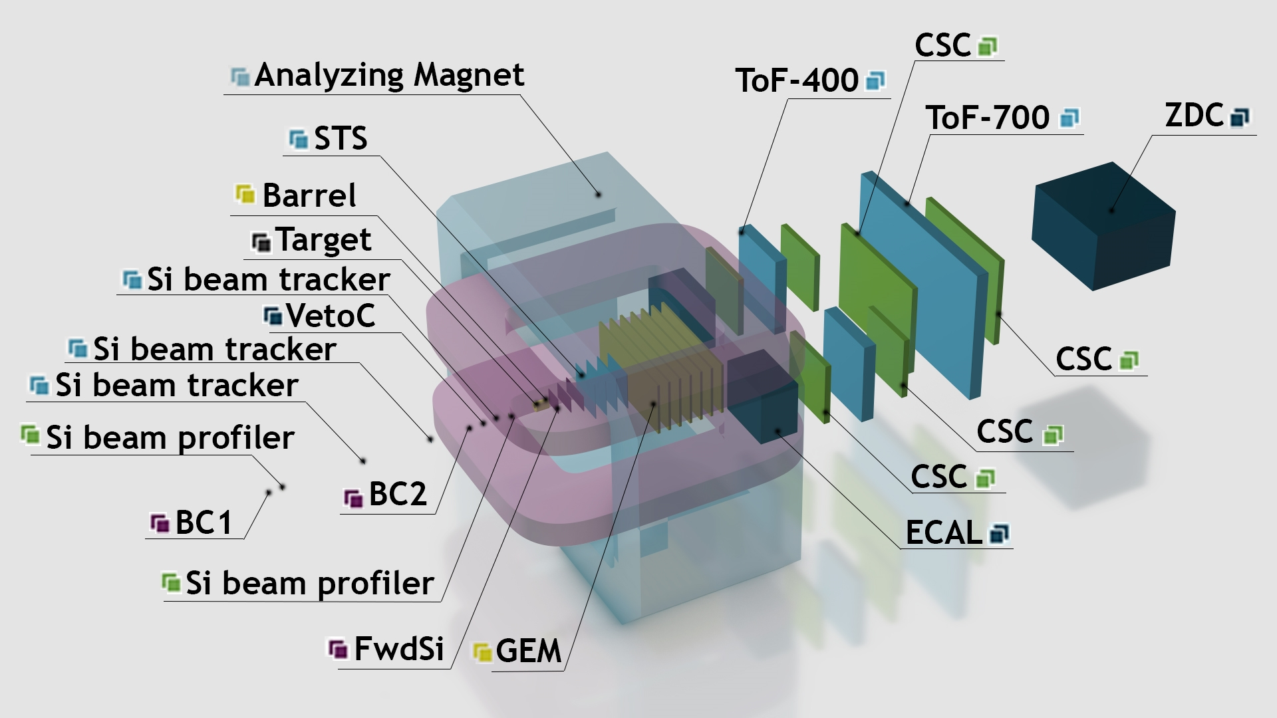
Configuration of BM@N detector for heavy ion program (without beampipe)
M.Kapishin BM@N experiment

Slide 15
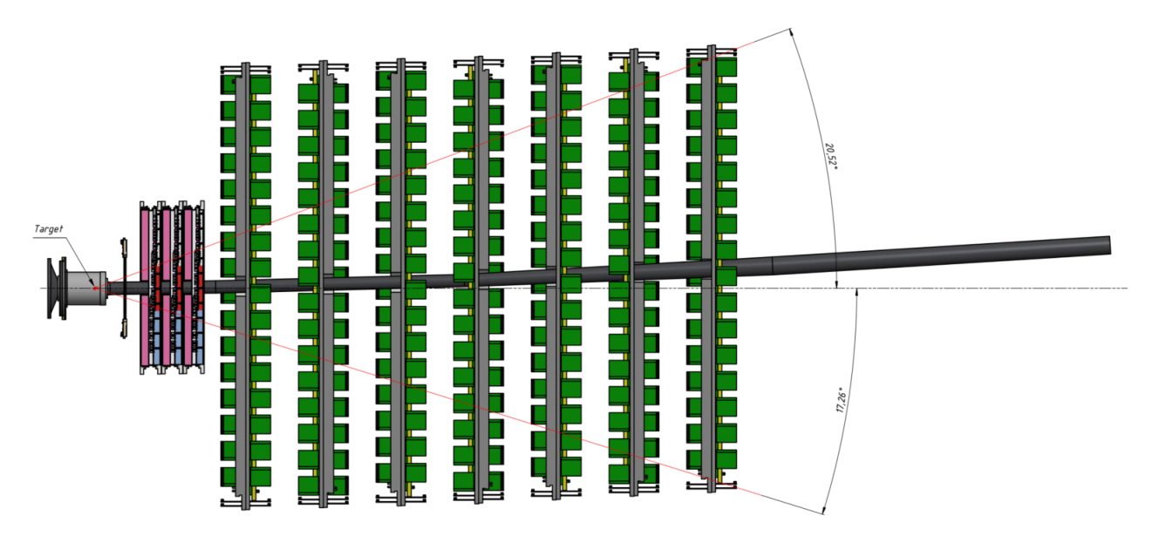
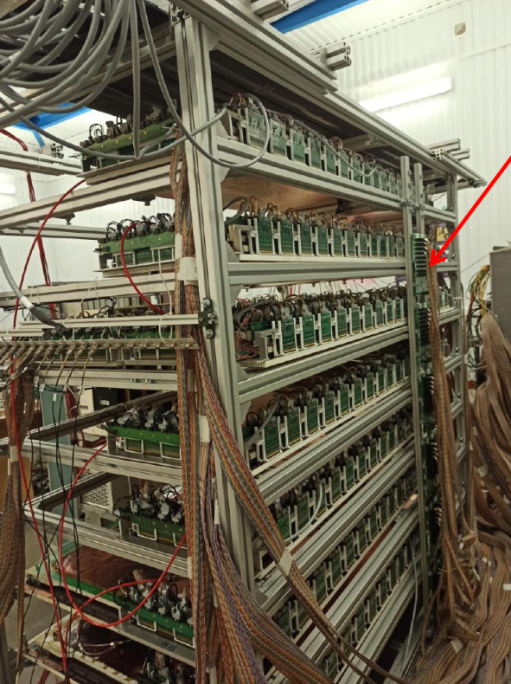
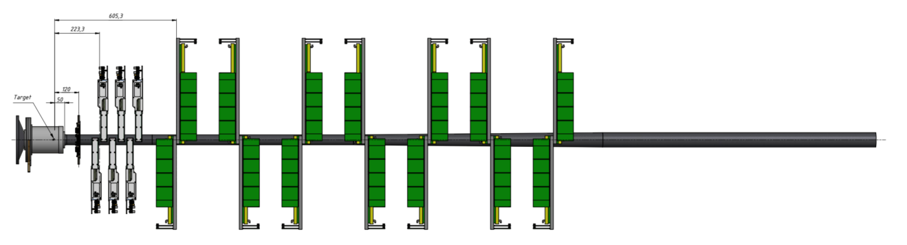
Initial Hybrid Central Tracker for heavy ion runs in 2022: Forward Si + GEM
7 GEM stations
GEM group
Group of N.Zamiatin
3 Forward Si stations
Carbon fiber vacuum beam pipe
Heavy ion beam intensity ~few 10⁵ Hz
Target trigger
3 Forward Si stations
Vertical projection
M.Kapishin BM@N experiment

Slide 16
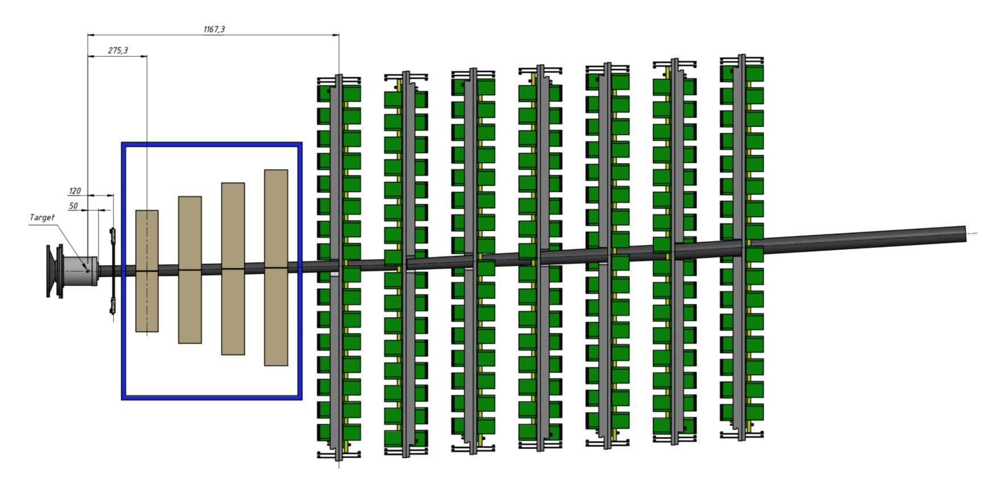
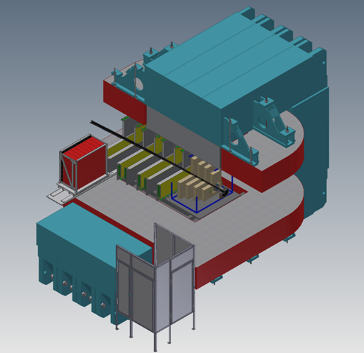
Stage2 Hybrid Central Tracker for high intensity heavy ion runs: STS +GEM
after 2023
4 STS stations
7 GEM stations
Target + trigger detectors
JINR, MSU, GSI/FAIR, Tübingen Uni, WUT
For heavy ion beam intensities of few 10⁶ Hz
→ keep 4 STS + 7 GEM
→ fast FEE and readout electronics
M.Kapishin BM@N experiment

Slide 17
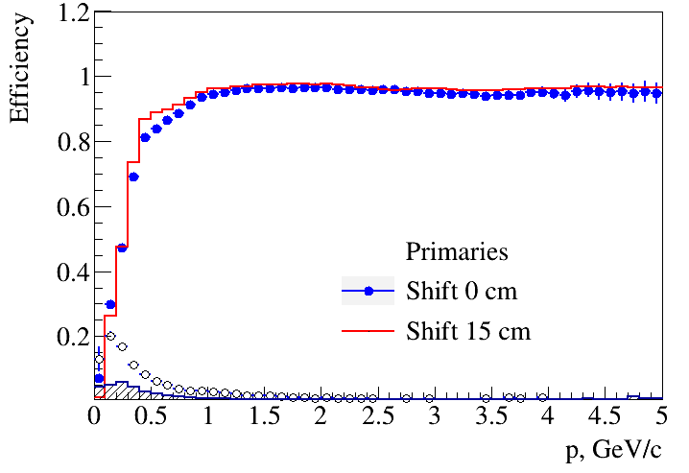
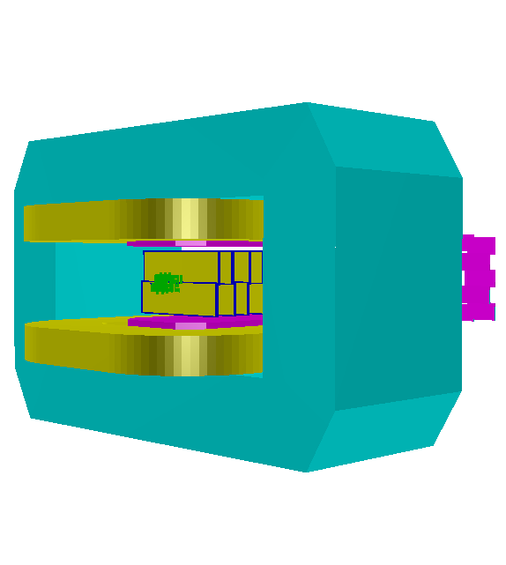
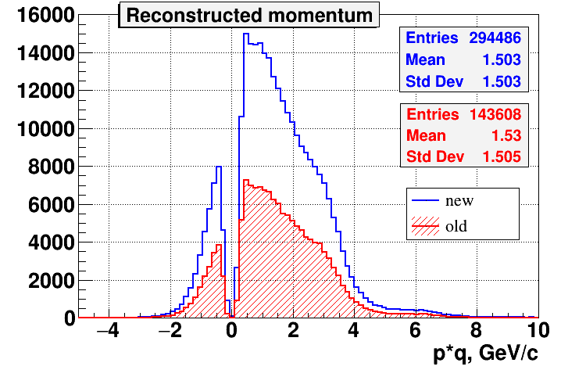
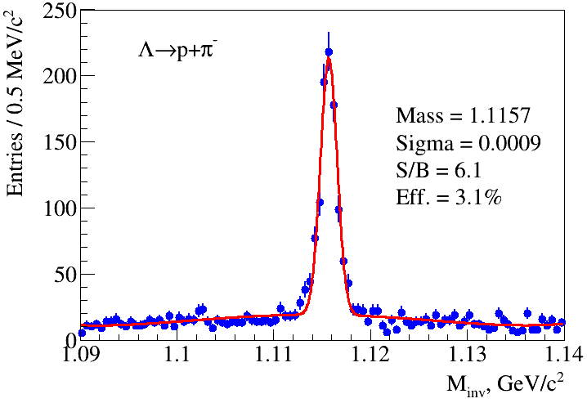
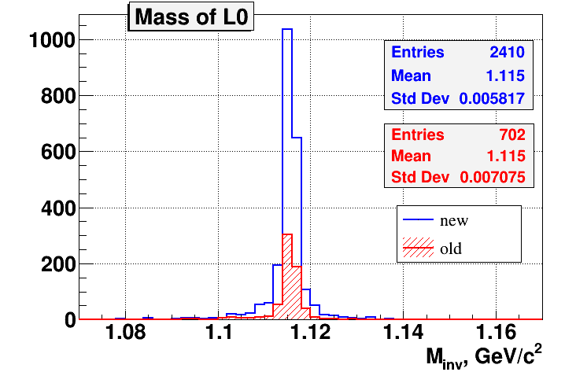
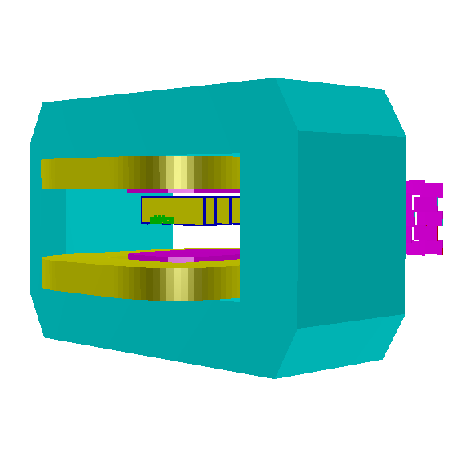
1st stage of hybrid central tracker: 3 Forward Si + GEM (Spring 2022 configuration)
A.Zinchenko, V.Vasendina
DCM-QGSM model
Kr + Pb , T₀= 2.4 AGeV
3 Forward Si + 7 GEM,
New configuration 2022
ε
Configuration 2021
Old configuration, March 2018
New vs Old (2018) configuration
ε(track) increased by 2
ε(Λ) increased by 3.5
Only upper part equipped with detectors
M.Kapishin BM@N experiment

Slide 18
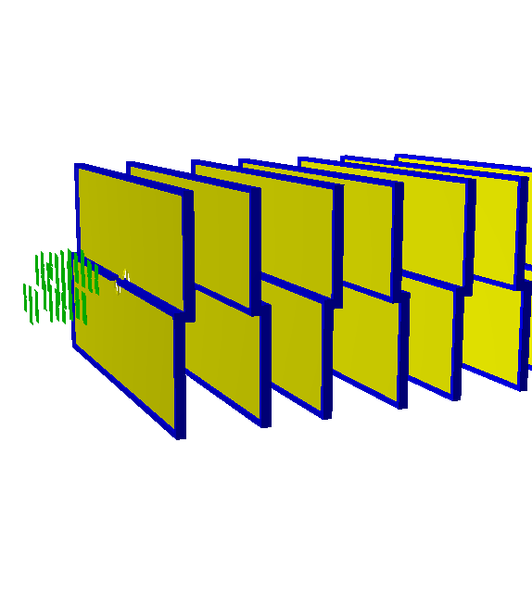
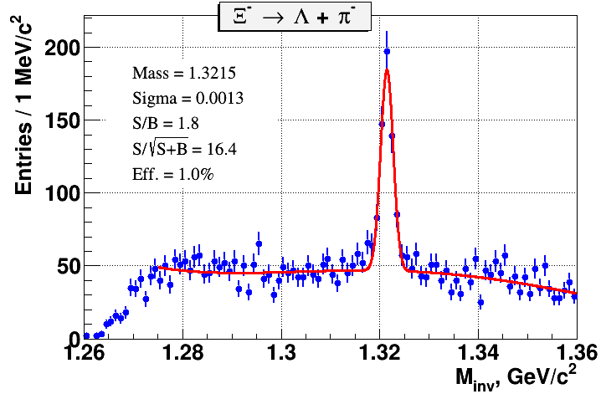
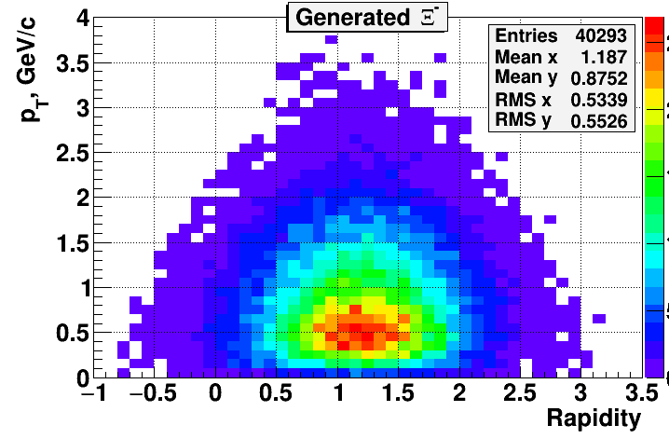
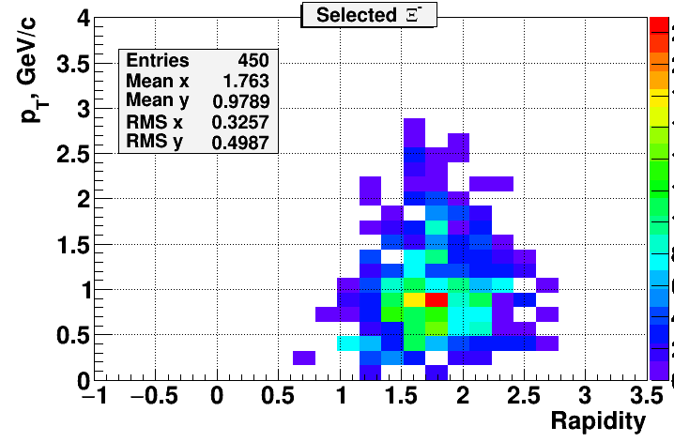
Cascade reconstruction in Xe +A interactions: 3 Forward Si + GEM
A.Zinchenko, V.Vasendina
DCM-QGSM model: Xe + Sn , T₀= 3.9 AGeV
3 Forward Si + 7 GEM
5M min bias events
phase space of reconstructed Ξ⁻
M.Kapishin BM@N experiment

Slide 19
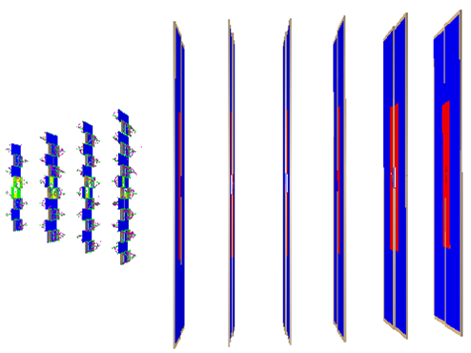
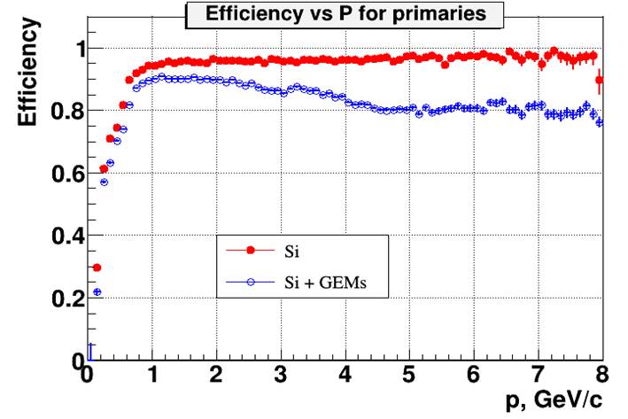
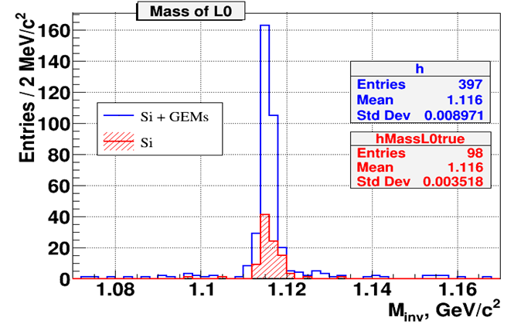
Simulation of hybrid central tracker for heavy ion runs: STS +GEM
A.Zinchenko, V.Vasendina
QGSM model, Au+Au, T₀ = 4 AGeV
GEM
STS
Hybrid STS + GEM tracker:
► 4 times increase in number of reconstructed Λ hyperons
M.Kapishin BM@N experiment

Slide 20
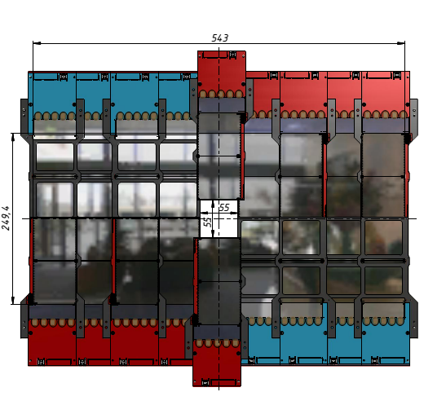
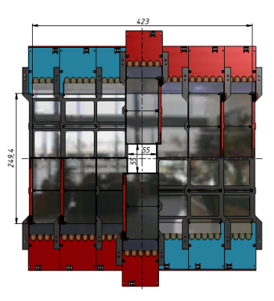
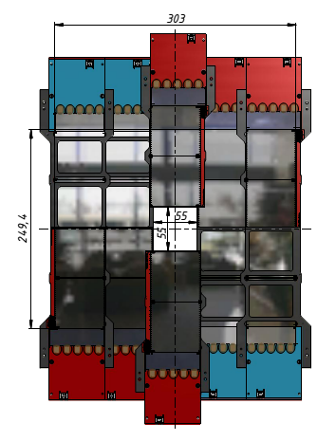
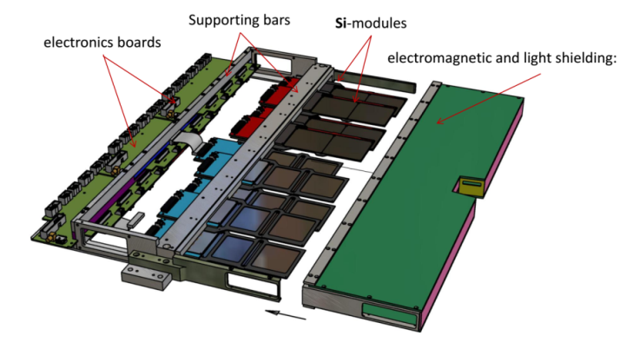
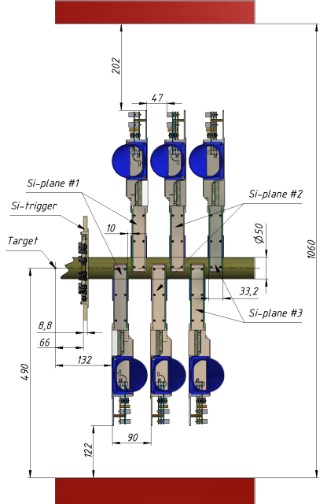
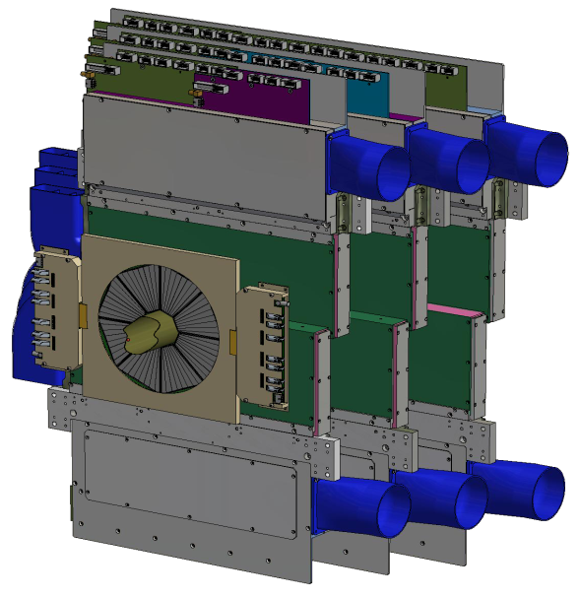
Forward Si tracking detectors
Group of N.Zamiatin
Three sizes of Si-planes
Half-plane design
ASICs VATAGP7.1 (IDEAS, Norway)
• Proven technology and FEE readout electronics → used in C, Ar, Kr runs
• Development, production, tests and installation according to time schedule → in autumn 2021
Design of the Si-planes
on the BM@N beam-channel
M.Kapishin BM@N experiment

Slide 21
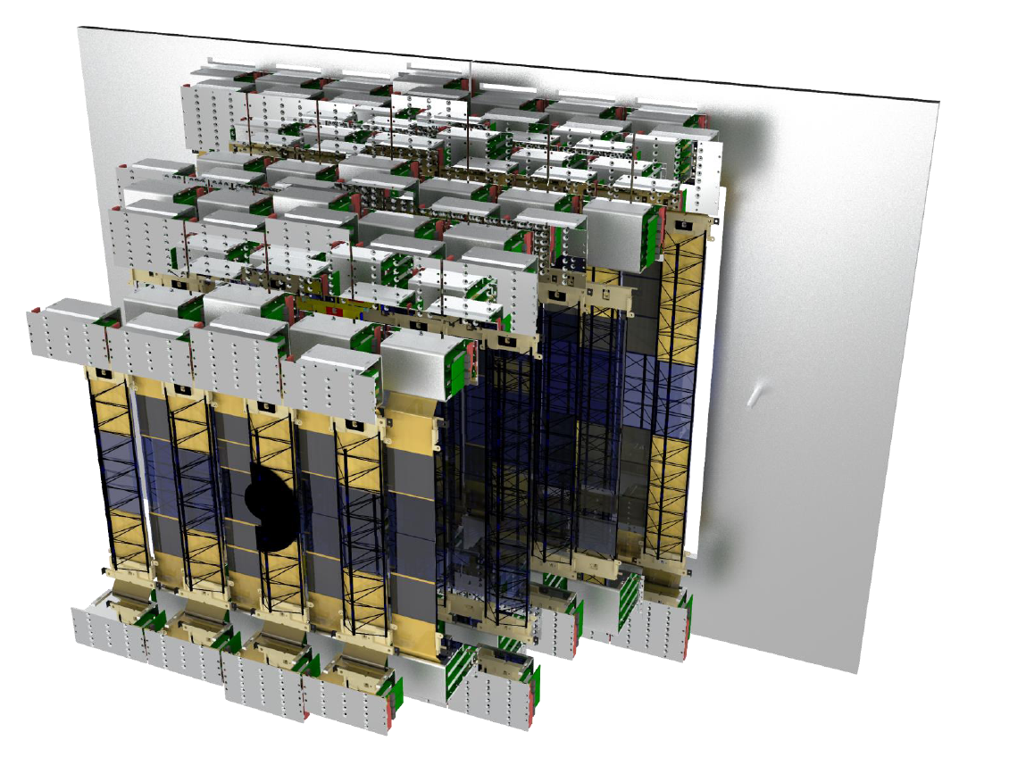
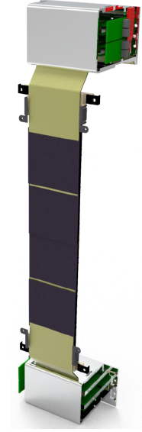


Development of STS tracking system
4 STS stations
JINR, MSU, GSI, WUT groups
Current activities, supported by BMBF-JINR roadmap:
Module & ladder assembly
Mainframe development
STS-XYTER ASIC certification
FEB v2.1 development
Readout electronics development
GBT x EMU board
FEB to GBTxEMU connectors
►
34 ladders
292 modules

Slide 22




Beam, Si tracking detectors and target station
S.Piyadin, Yu.Gusakov
A.Kubankin group (Belgorod)
Group of N.Zamiatin
Movable beam profile detector
beam
Target station with 3 targets in vacuum box
Barrel detector around target
beam
►All detectors and target station to be ready in autumn 2021
► Detector performance in heavy ion beam should be tested in first run
Si multiplicity detector
M.Kapishin BM@N experiment

Slide 23






EP reconstruction with FHCAL , Scint Wall and FQH
Event Plane resolution
ScWall (charged fragments)
To measure neutron collective flow need:
►EP from identified protons and fragments
►granular neutron detector to measure single neutrons
Neutron profile in front of ZDC
Centrality resolution: Z² (FQH + ScWall) vs E_{dep} (ZDC)
M.Kapishin BM@N experiment

Slide 24
Beam parameters and setup at different stages of the BM@N experiment
Year | 2016 | 2017 spring | 2018 spring | 2022 spring | 2023 | After 2023
Beam | d(↑) | C | Ar,Kr, C(SRC) | Kr,Xe | Au (Bi) | Au (Bi)
Max.inten sity, Hz | 0.5M | 0.5M | 0.5M | 0.5M | 0.5M | 2M
Trigger rate, Hz | 5k | 5k | 10k | 10k | 10k | up to 50k
Central tracker status | 6 GEM half planes | 6 GEM half planes | 6 GEM half planes + 3 forward Si planes | 7 GEM full planes + 3 forward Si planes | 7 GEM full planes + 4 forward Si + 2 large STS planes | 7 GEM full planes + 4 large STS planes
Experimental status | technical run | technical run | technical run+physics | stage 1 physics | stage1 physics | High rate stage 2 physics
M.Kapishin BM@N experiment

Slide 25
Estimated expenditures for the project:
Studies of Baryonic Matter at the Nuclotron (BM@N)
Expenditure items | Total cost / resources | 1 year 2022 | 2 year 2023 | 3 year 2024 | 4 year 2025 | 5 year 2026
Direct project expences
1. Accelerator, hours | 14000 | 2000 | 3000 | 3000 | 3000 | 3000
2. Computing (proc*hours) / mln | 100 | 15 | 15 | 20 | 25 | 25
3. Laboratory workshop, hours | 2600 | 600 | 600 | 600 | 400 | 400
4. Laboratory design buro, hours | 1500 | 500 | 300 | 300 | 200 | 200
5. Equipment, materials, kUSD | 2670 | 1250 | 430 | 350 | 330 | 310
6.Research carried out under contracts, kUSD | 250 | 50 | 50 | 50 | 50 | 50
7.Traveling allowance, kUSD, including: a) non-ruble zone countries b) ruble zone countries c) protocol-based | 750 250 250 250 | 150 50 50 50 | 150 50 50 50 | 150 50 50 50 | 150 50 50 50 | 150 50 50 50
Total direct expenses, kUSD | 3670 | 1450 | 630 | 550 | 530 | 510
We request prolongation of the BM@N project for 2022-2026

Slide 26

Thank you
for attention!
M.Kapishin BM@N experiment

Slide 28


Slide 29






Simulation of hybrid central tracker for heavy ion runs: Ξ⁻ and _{Λ}H³ reconstruction
A.Zinchenko, V.Vasendina
PHQMD model, Au+Au, T₀ = 4A GeV, b = 0-5 fm, 500k events
_{Λ}H³ phase space
M.Kapishin BM@N experiment

Slide 30
Heavy ion program goals and observables
1. BM@N energy range is very promising (EOS, symmetry energy, hypernuclei)
2. Sensitive probes have to be measured multi-differential (p_{T}, y)
and as function of beam energy (2 – 4 GeV/u)
➢ EOS for high-density symmetric matter:
- Collective flow of protons and light fragments in Au+Au collisions:
Centrality, event plane, identification of fragments
- Ξ⁻ (dss) and Ω⁻ (sss) hyperons: Yields, spectra, p_{T} vs. y from Au+Au and C+C collisions
➢ Symmetry energy at high baryon densities:
- Particles with opposite isospin I₃=±1: Σ*⁺(uus)/Σ*⁻(dds)
- Proton vs neutron collective flow (need highly granulated neutron detector)
➢ Λ-N and Λ-NN interactions
- Hypernuclei: Yields, lifetimes, masses of ³_{Λ}H, ⁴_{Λ}H, ⁵_{Λ}H, ⁴_{Λ}He, ⁵_{Λ}He, …
➢ Phase transition from hadronic to partonic matter:
- Deconfinement: excitation function of Ξ⁻ (dss), Ω⁻ (sss) (EOS observables)
- Transition to scaling of collective flow of mesons / hyperons with number of quarks (partonic matter)
- Critical endpoint: higher order moments of the proton multiplicity distribution

Slide 31
Plan to start BM@N heavy ion program with a middle weight ion beams Xe (Kr) in Spring 2022
► first need to trace beam through BMN and monitor its profile and ► 1 week technical run to prove / adjust BMN detector performance
► physics run with Xe (Kr) beam
• operate 1st stage of hybrid central tracker (3 Fwd Si + 7 GEM)
• maximal beam energy (up to 3.9-4.0 AGeV)
targets: with weights closest to Kr, Xe: CsI (Xe)
• trigger: central + intermediate interactions, Min. bias events for monitoring, beam intensity: few 10⁵ Hz, Event statistics per target, beam: ≥ 10⁹
Future runs with heavy ion Au (Bi) beams
We foresee 2000-3000 hours of data taking per year. We assume the parallel operation of the Booster-Nuclotron for the BM@N experiment during data acquisition in the MPD experiment at the NICA collider.

