Slide 1






The heavy-ion program at the upgraded Baryonic Matter@Nuclotron Experiment at NICA
Dmitrii Dementev, Mikhail Kapishin, Yurii Murin, Hans-Rudolf Schmidt, Peter Senger for BM@N collaboration
Online Strangeness in Quark Matter Conference 2021

Slide 2
Outline
BM@N experiment at NICA
Heavy ion program at BM@N
Upgrade of BM@N experiment
Hybrid tracking system of BM@N
Timelines

Slide 3
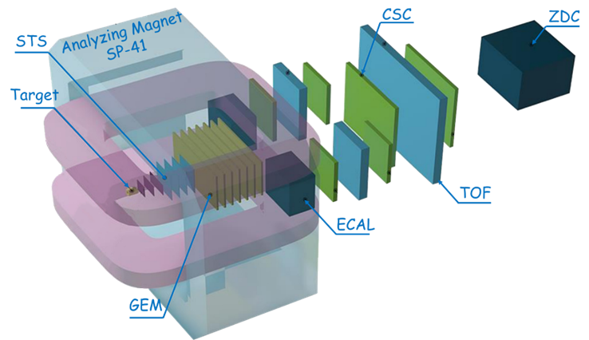
NICA Heavy Ion Complex
BM@N: beams from p to Au, heavy ion energy 1-3,8 AGeV, Au intensity up to 2 MHz
BM@N

Slide 4
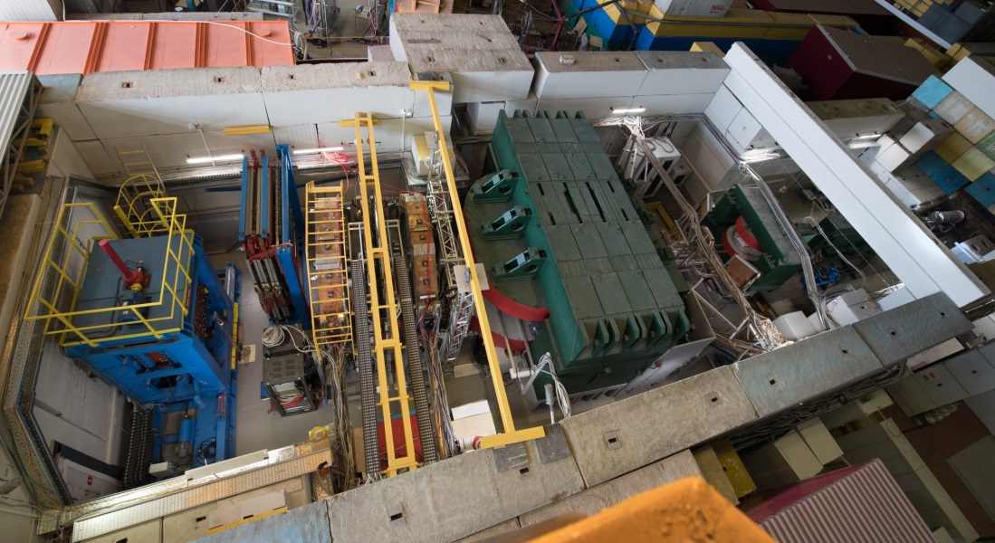
Baryonic Matter at Nuclotron Experiment
Dipole magnet with 6 (half) GEM tracking chambers and 3 Silicon stations inside
Neutron detector
Drift chambers for tracking
Forward hadron calorimeter
mRPC Time-of-flight detectors

Slide 5
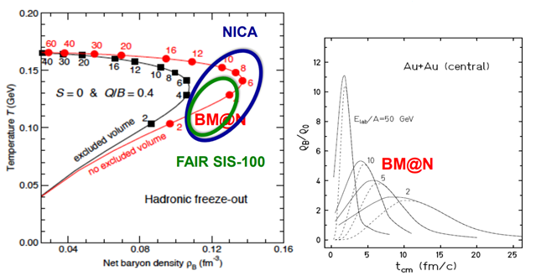
Heavy Ion program at BM@N
The research program of BM@N includes:
Scouting the location of transition between hadronic and partonic dominated matter;
Exploring the high-density EoS for symmetric nuclear matter ;
Search for hypernuclei

Slide 6
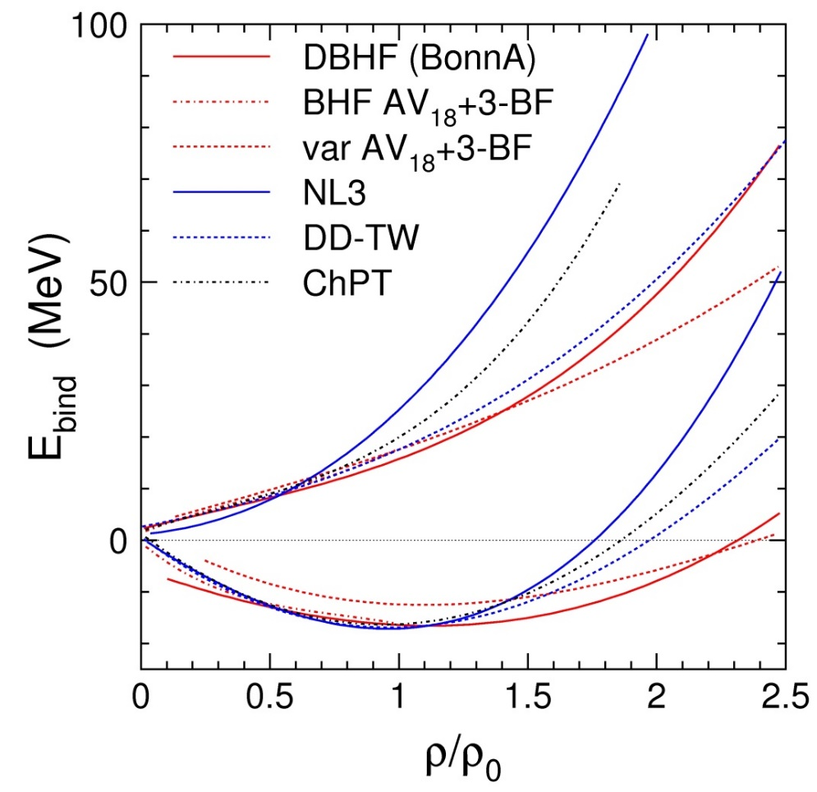
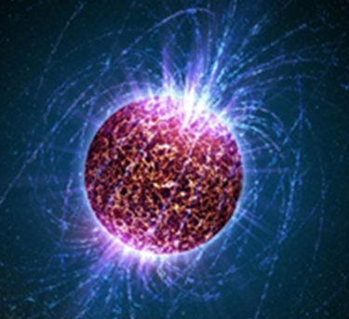
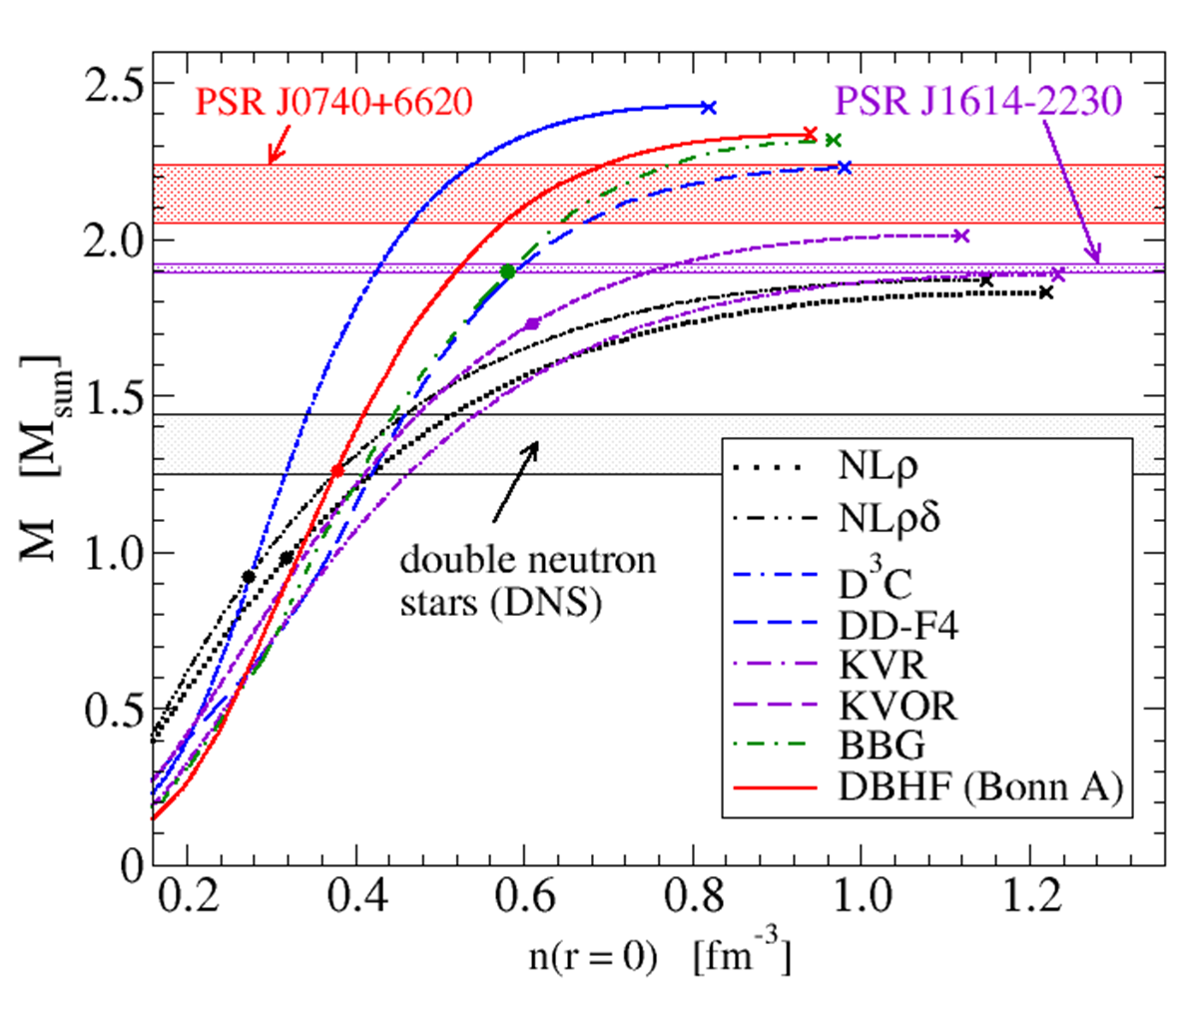
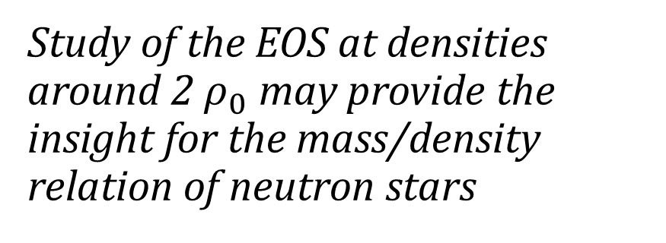
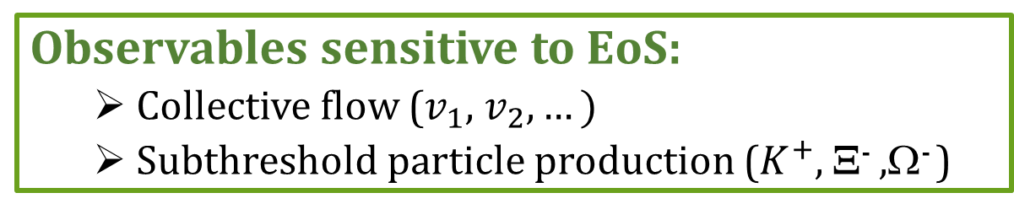
Study of the EOS of nuclear matter
Study of the EOS at densities around 2 ${\text{ρ}}_{0}$ may provide the insight for the mass/density relation of neutron stars
Ch. Fuchs and H.H. Wolter, EPJA 30 (2006) 5
Observables sensitive to EoS:
  Collective flow ($v_{1}$, $v_{2},…)$
  Subthreshold particle production ($K^{+}$, Ξ⁻ ,Ω⁻ )
Mass-density relation of neutron stars for different EOS
T. Klaehn et al., Phys. Rev. C74: 035802, 2006. Update by D. Blaschke, priv. comm.

Slide 7

Hypernuclei production in heavy-ion collisions
Maximum yield predicted for √s=4-5 AGeV
The discovery of new hypernuclei will shed light on the ΛN, ΛNN, and ΛΛN interactions
BM@N
A. Andronic et al., Phys. Lett. B697 (2011) 203

Slide 8
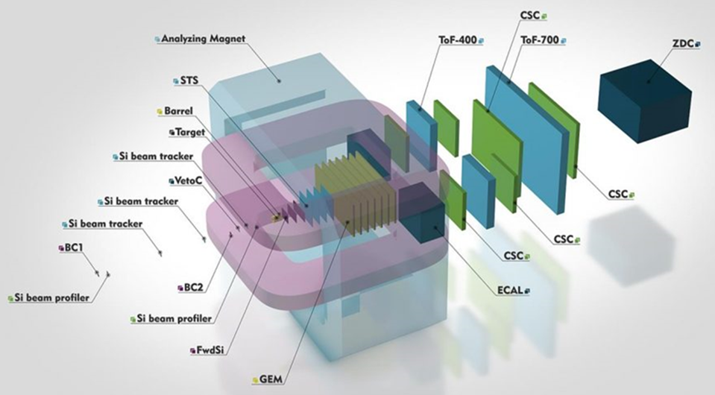
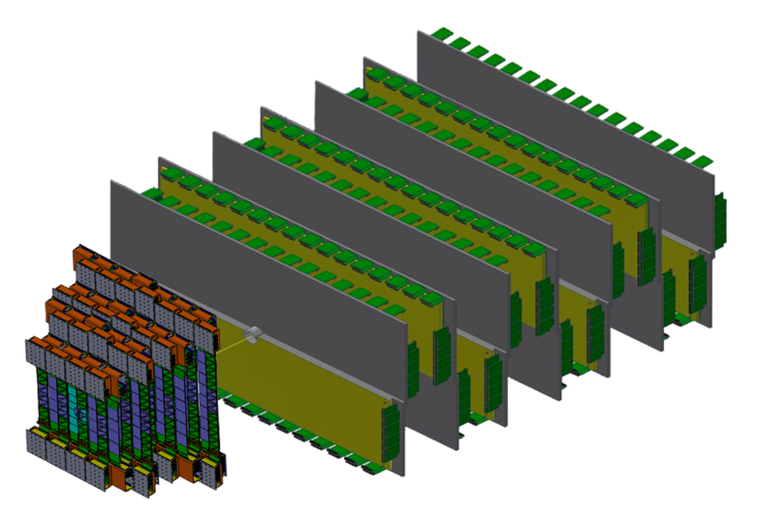
BM@N upgrade for heavy ion collisions
New hybrid tracker consists of STS and GEM planes
A new hybrid tracking system:
  4x stations of Silicon Tracking System (STS) with double-sided silicon microstrip sensors;
  7x planes of Gas-Electron-Multiplier chambers (GEM)
Vacuum beam pipe

Slide 9
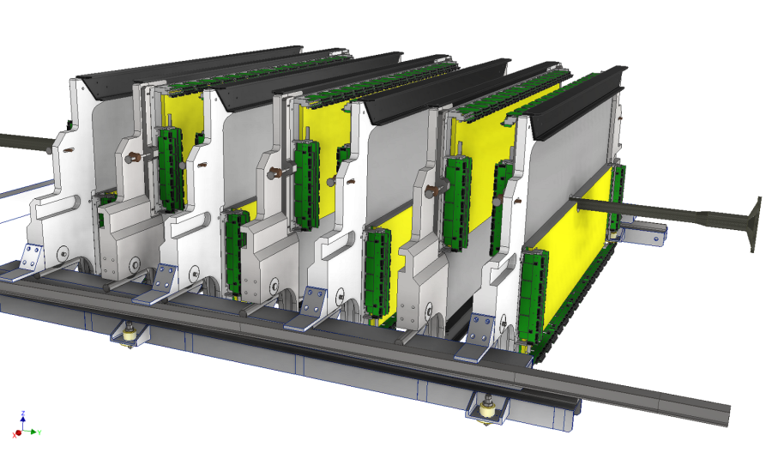
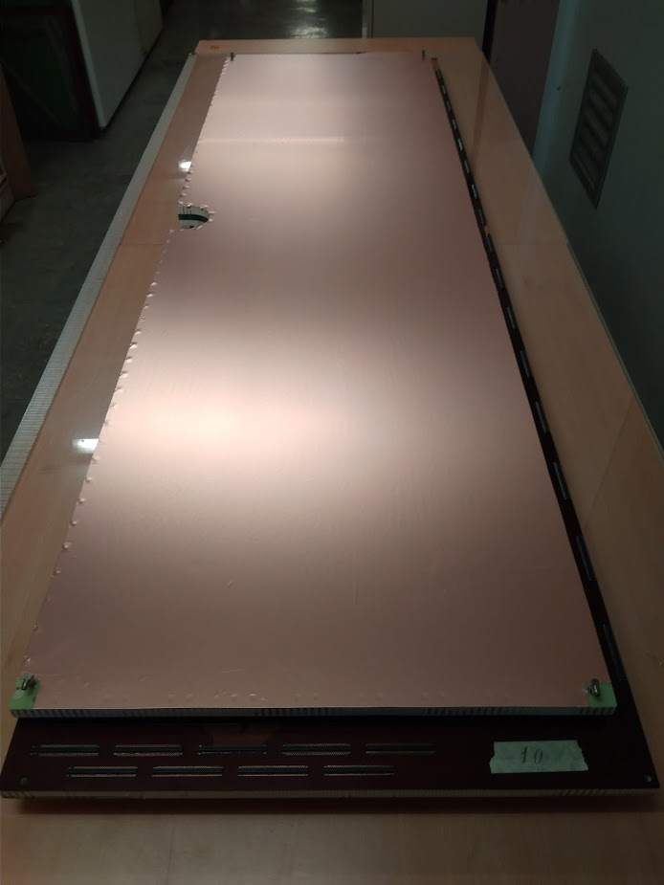
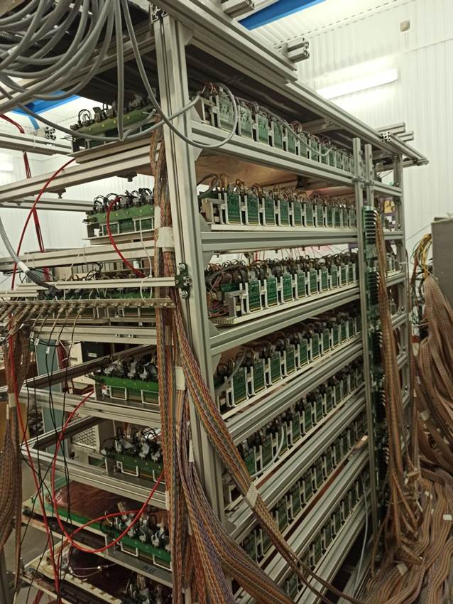
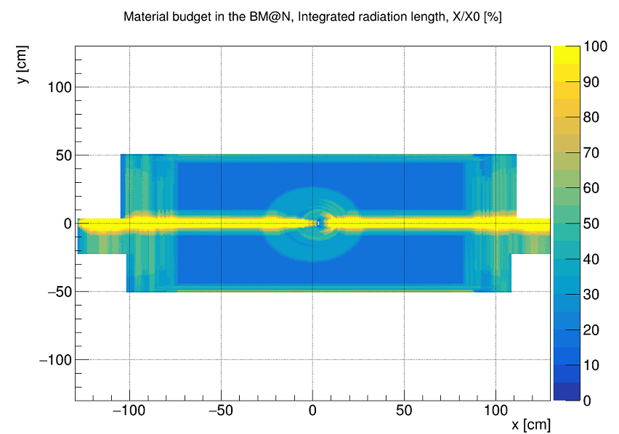
GEM central tracker
7 upper GEM 163x45 cm² chambers produced at CERN were integrated into BM@N
7 lower GEM 163x39 cm² chambers were assembled, delivered to BM@N and tested
GEM team
Two-coordinate GEM planes;
Stereo angle between strips: 15°;
Pitch: 0.8 mm
Photo of assembled GEM chamber
Setup of GEM detectors for cosmic tests
Material budget of GEM tracker

Slide 10
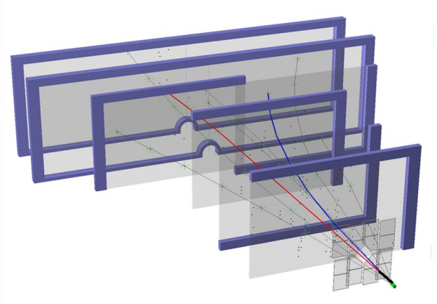
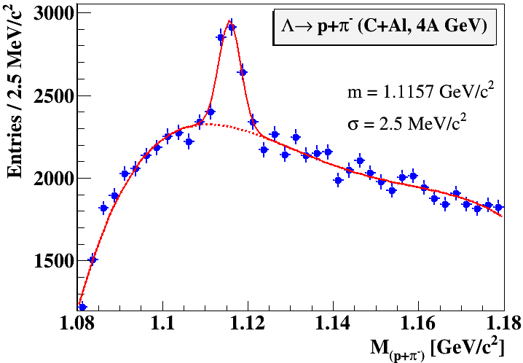
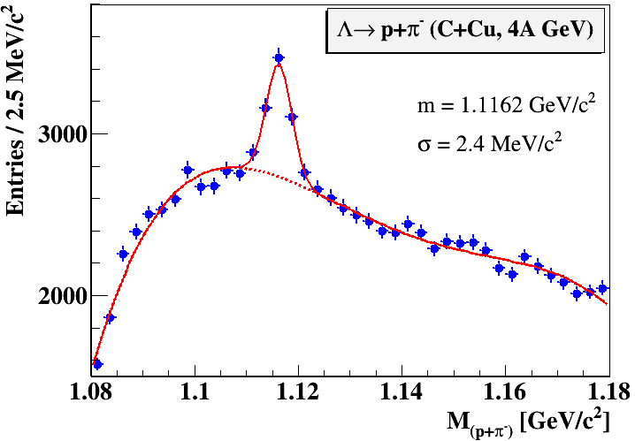
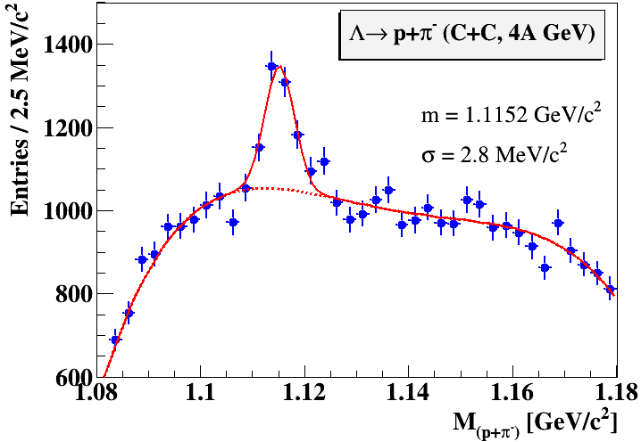
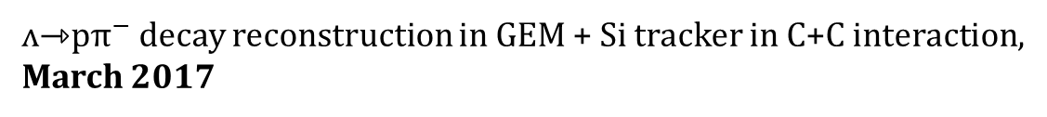
ʌ decay reconstruction in carbon beams with GEM tracker
ʌ⇾p${\text{π}}^{−}$ decay reconstruction in GEM + Si tracker in C+C interaction,
March 2017
experimental limitations of the first setup:
  low granularity of tracking systems (small S/B ratio);
  no vacuum beam pipe in BM@N (large background)

Slide 11
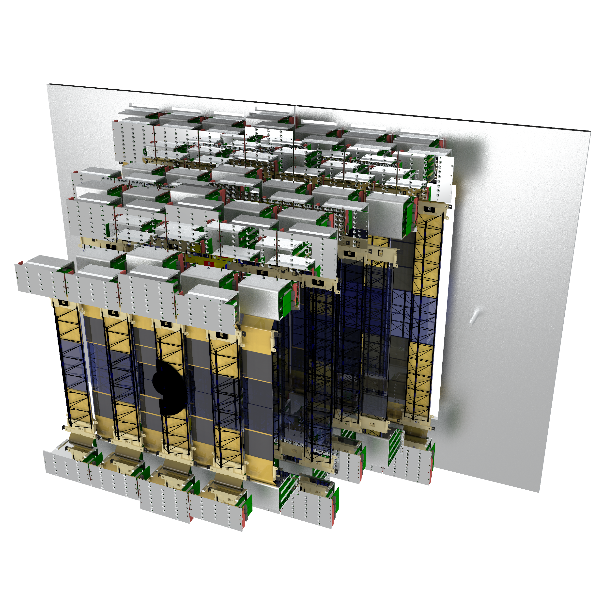
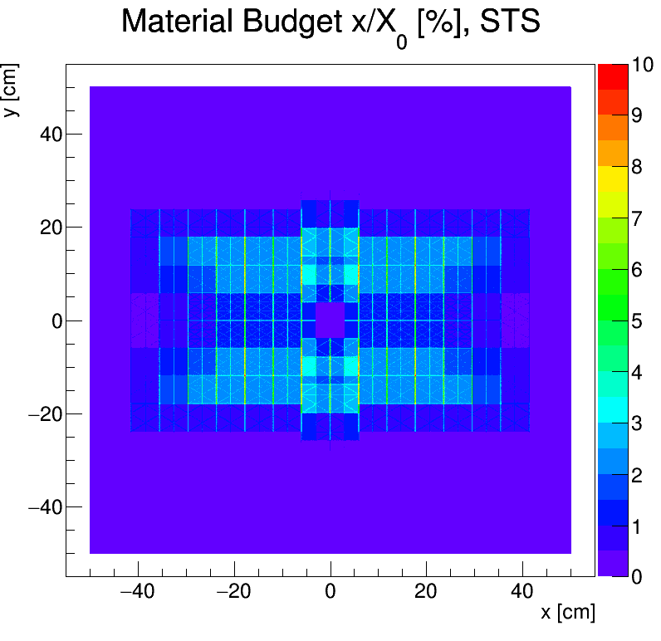
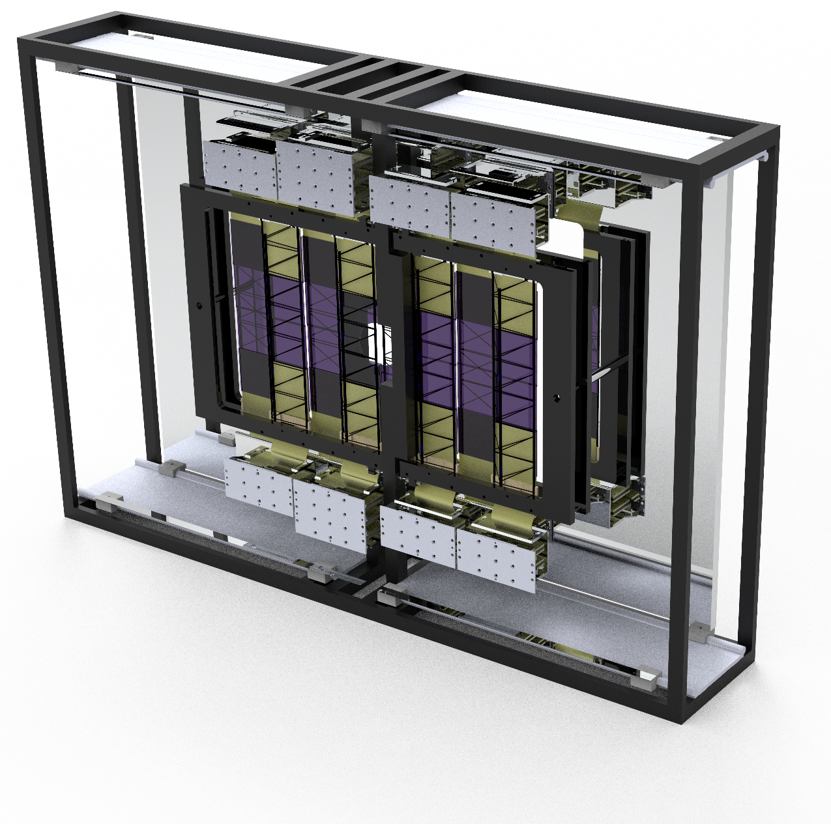
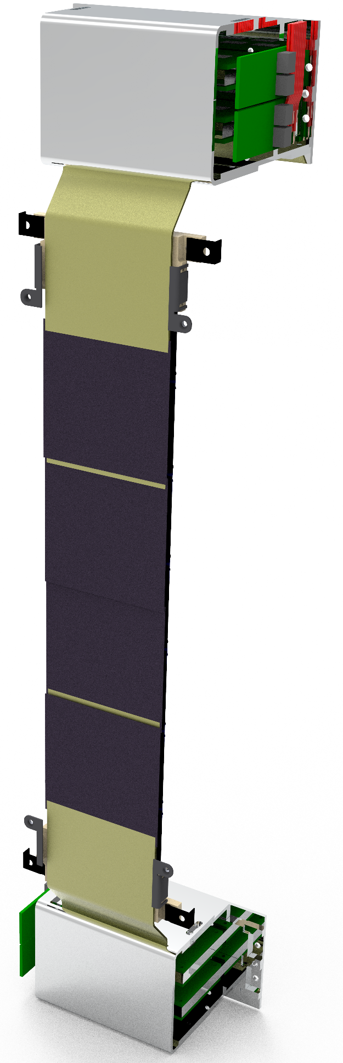
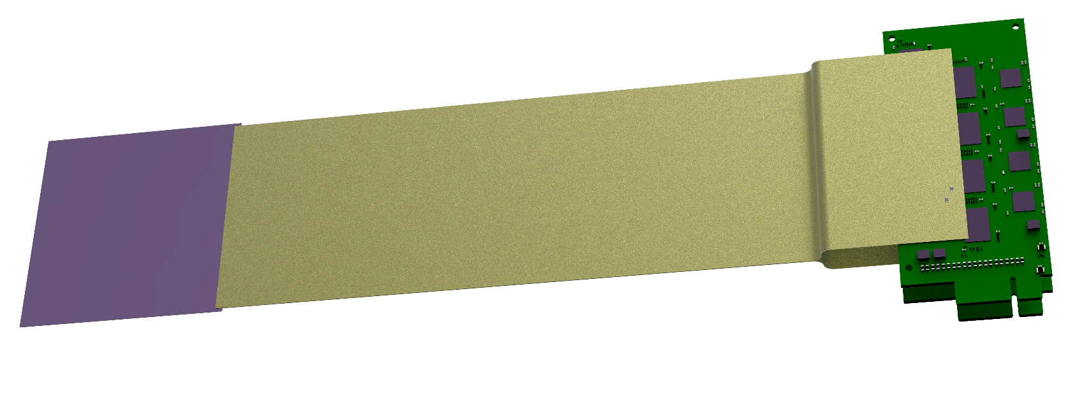
Silicon Tracking System
Technical solutions:
double-sided silicon microstrip sensors
  hit spatial resolution ≈ 25 µm
  material budget per tracking station: ≈ 0.3% – 2% X₀
  radiation tolerance up to 1 × 10¹⁴ n/cm² (1 MeV equivalent)
self-triggering electronics, time-stamp resolution ≈ 12,5 ns
low-mass detector modules/ladders
The project is being implemented as a joint effort of CBM and BM@N STS teams under the GSI-JINR Roadmap Agreement
STS team
STS Material budget
4 x STS stations
34 x Ladders
292 x Modules

Slide 12
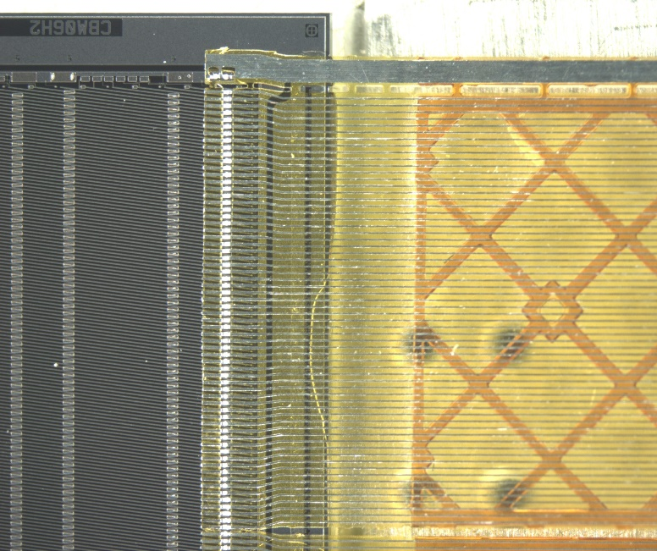
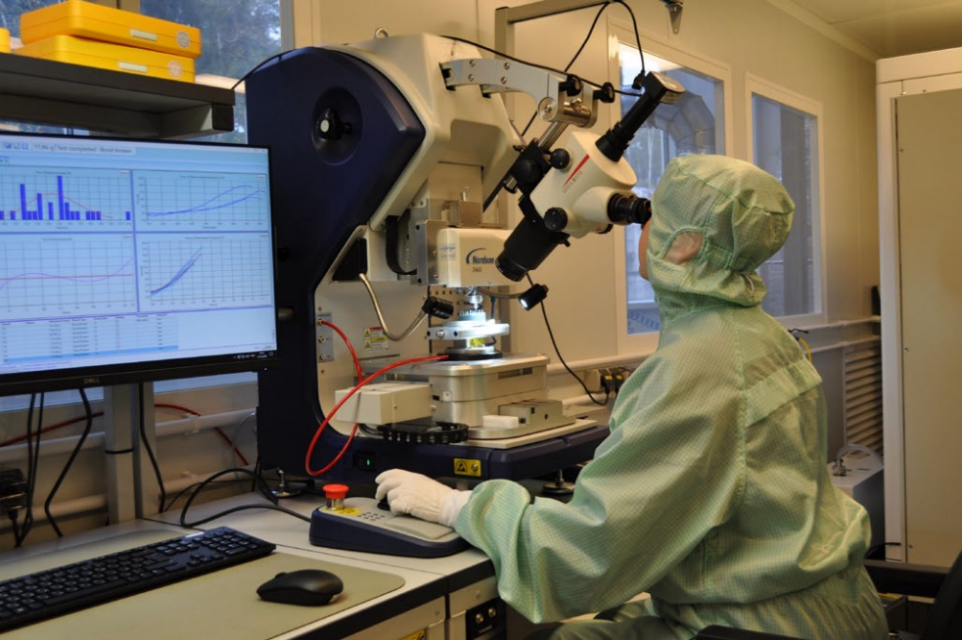
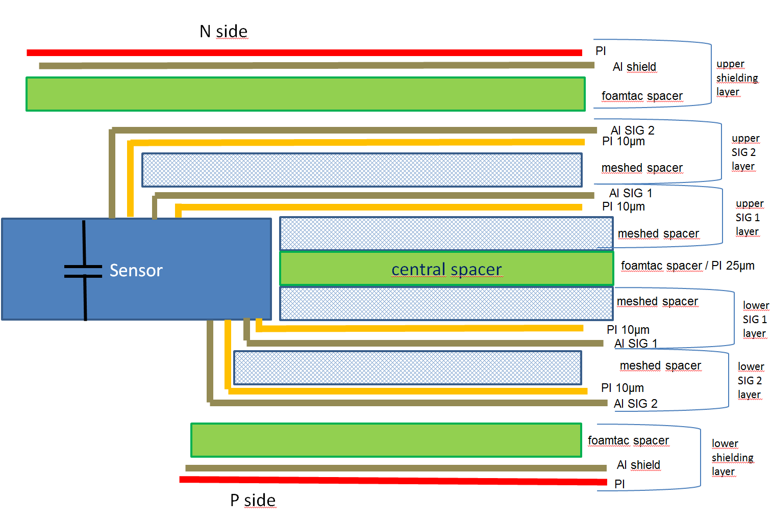
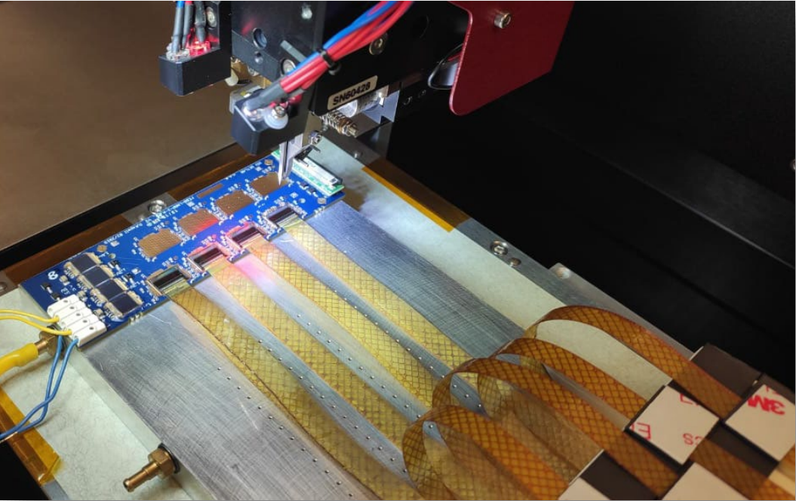
STS modules
STS team
Cable stack
Sensor
FEE
STS module
STS XYTER ASIC Tab-bonded
with micro-cables
Module assembly at JINR
N-side read-out
Performance:
noise: 1090 ±150 e (N-side);
1350 ±200 e (P-side);
r/o threshold: 7000 e;
signal-to-noise: 15±3 ;
hit detection eff.: > 95%;
P-side
read-out
cable stack: thickness ~ 800 µm / 0.23% X₀

Slide 13
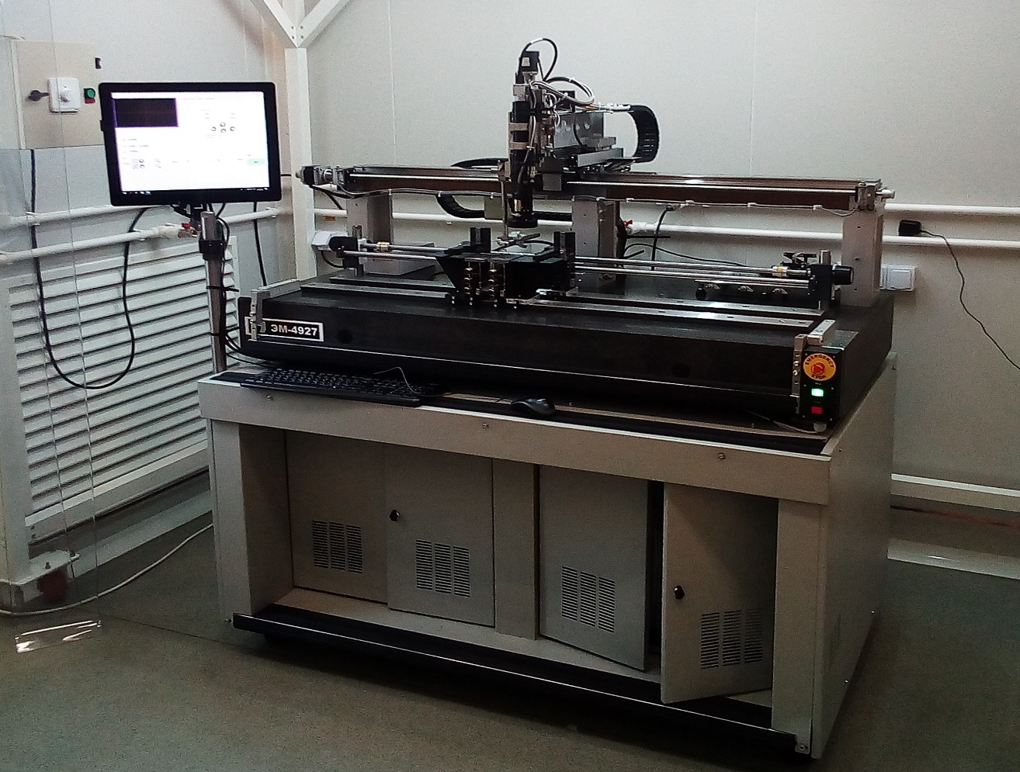
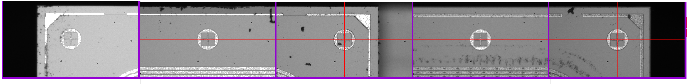
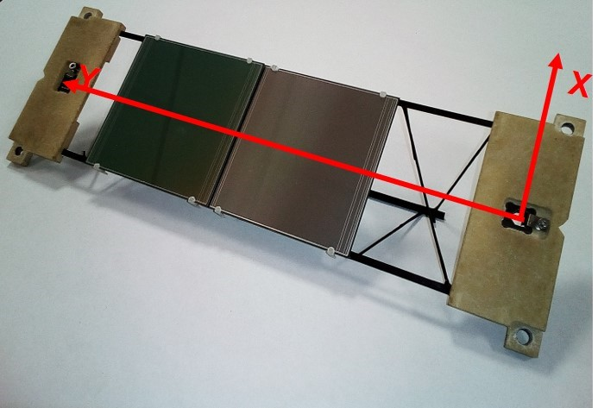
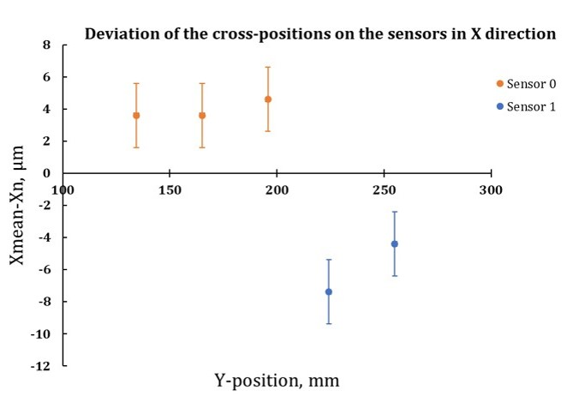
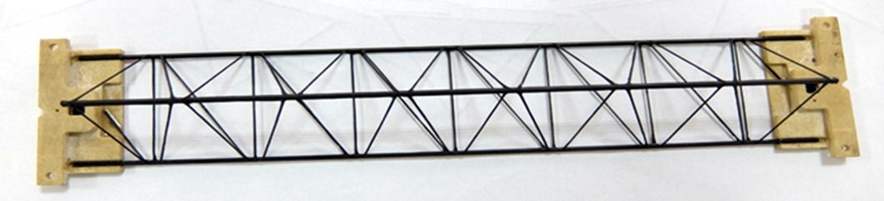

STS ladders
STS team
Fiducial marks on sensors
Ladder assembly device
CF-truss with bearings
Mockup of the ladder
Measured deviations of X coordinates of the fiducial
marks on the sensors from the mean value.

Slide 14
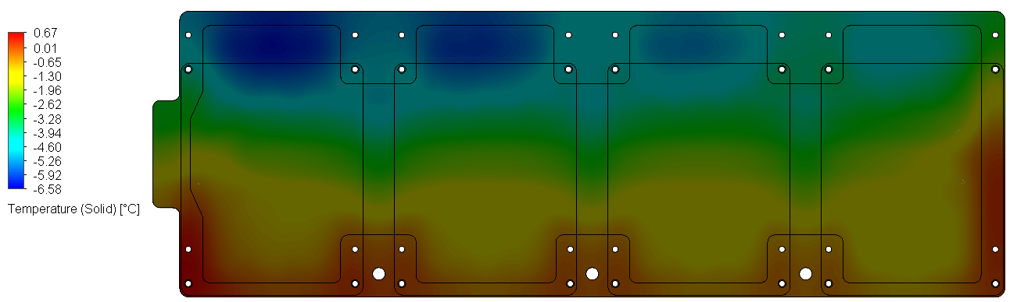
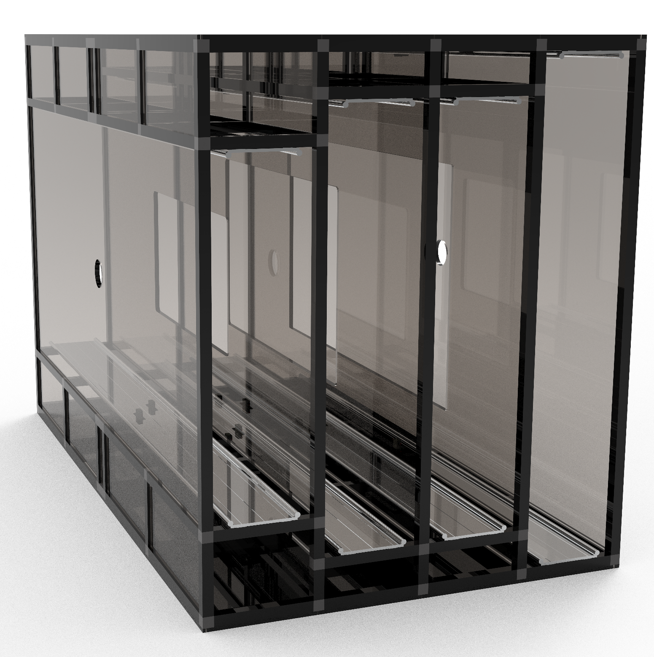
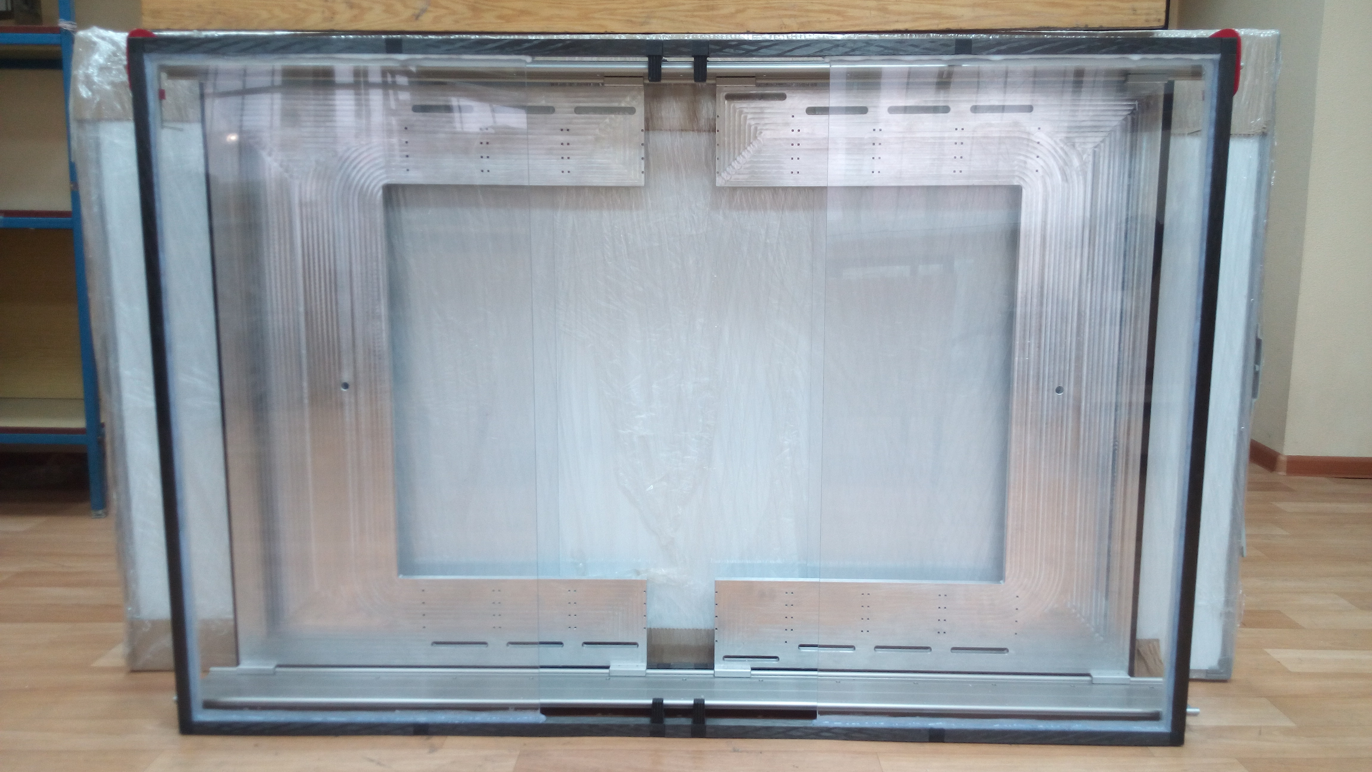
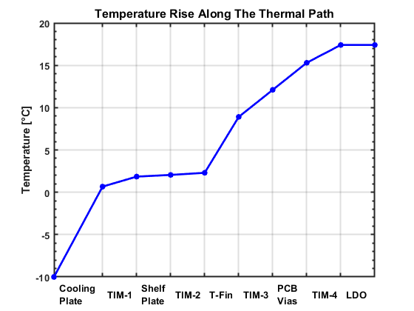
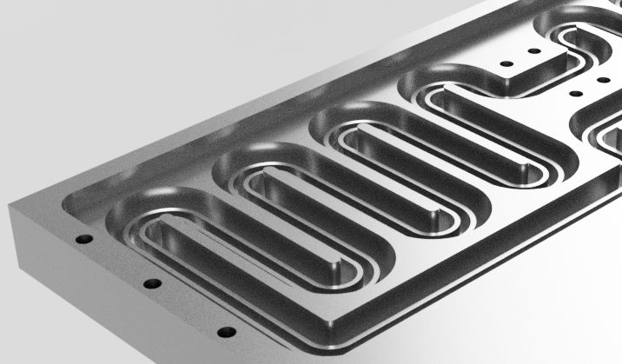
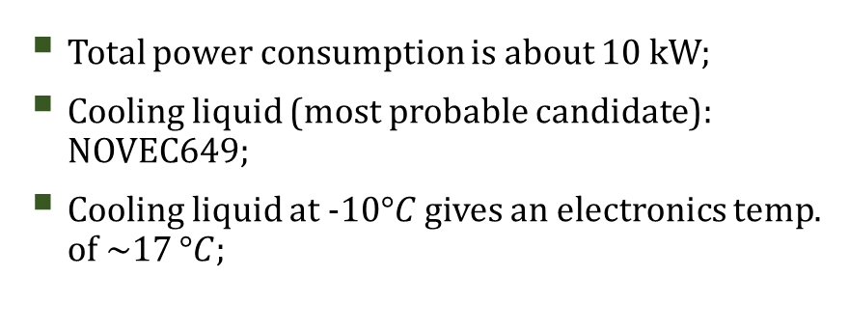
STS Mechanics and Cooling
Prototype of the mainframe
Produced at MSU
Mainframe of STS
Mainframe is made of CF-bars with Al connectors;
Total weight is ~300 kg;
Study of the structural stability of the Mainframe will be done at GSI
Total power consumption is about 10 kW;
Cooling liquid (most probable candidate): NOVEC649;
Cooling liquid at -10$°C$ gives an electronics temp. of ~17 $°C$;

Slide 15
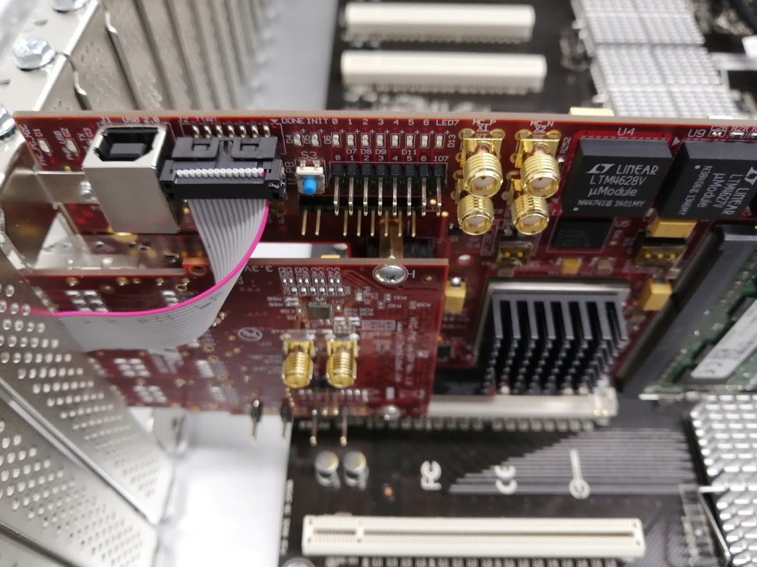
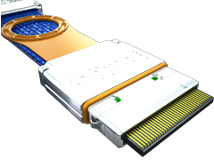
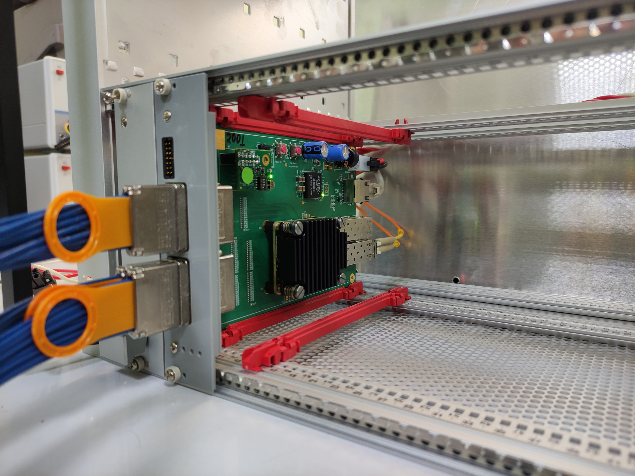
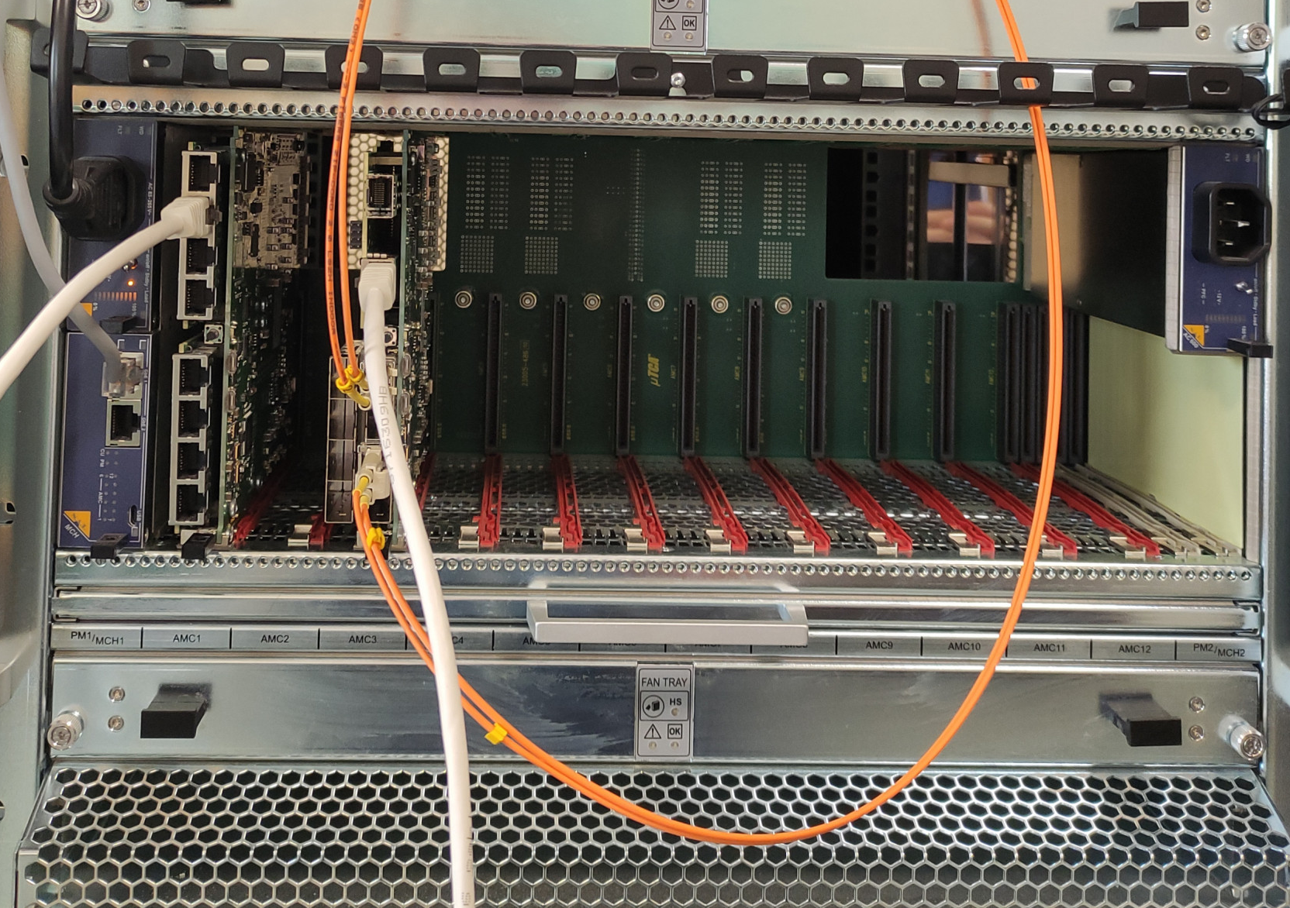
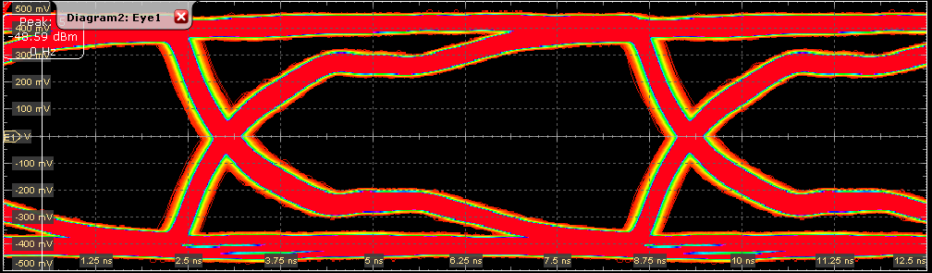
STS readout electronics
STS team
Computing System
GBTxEMU
48 e-links
3 x Sensors
Feb-8 FEE
elinks
Gbit opt.
Feb-8 FEE
2.35 MHit/s/elink
FPGA based emulator of CERN GBTx
serializer and data combiner chip
48 x 80 Mbit/s
to 3.84 Gbit/s optical
GERI-Board
FPGA based
PCIe Interface to computer system
Feb-8 FEE
Feb-8 FEE
BM@N
Data center
Feb-8 FEE
FEB-8 FEE
Data,
Synch,
commands
Data,
Synch,
commands
Synch,
commands
10 m twinax cable
TFC
Timing and Fast Control
Trigger,
WR

Slide 16
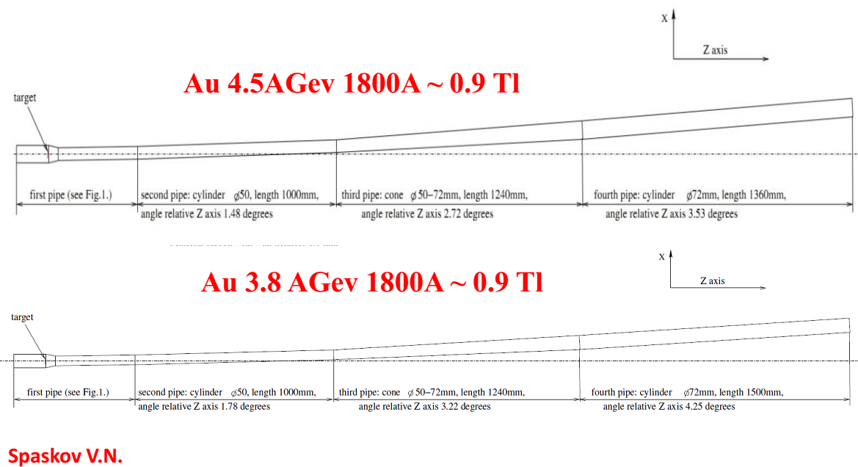
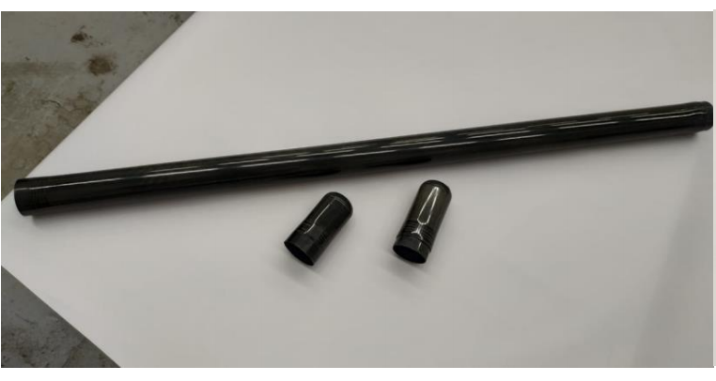
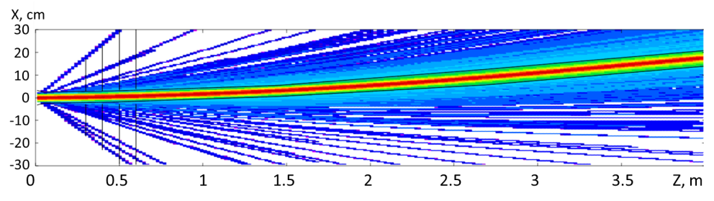
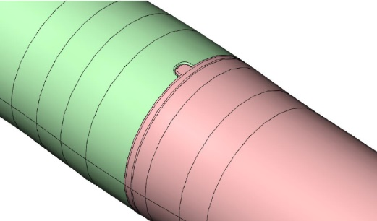
Beam pipe downstream the target
1 meter prototype of the BM@N carbon
beam pipe (DD “Arkhipov”)
Beam pipe is made of 1 mm thick carbon fiber;
Consists of four parts with a non-flange connectors;
FLUKA simulations have shown that the proposed beam pipe is well suited to guide the high intensity beam
First vacuum tests have shown an insignificant leakage level of side surfaces of the sample, vacuum up to 10⁻⁵.
Design of the non-flange connections
A. Senger, P. Senger, S. Piyadin,V. Spaskov, A.Kubankin

Slide 17
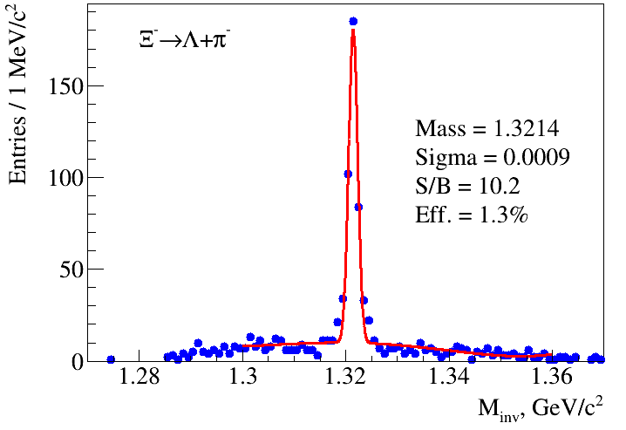
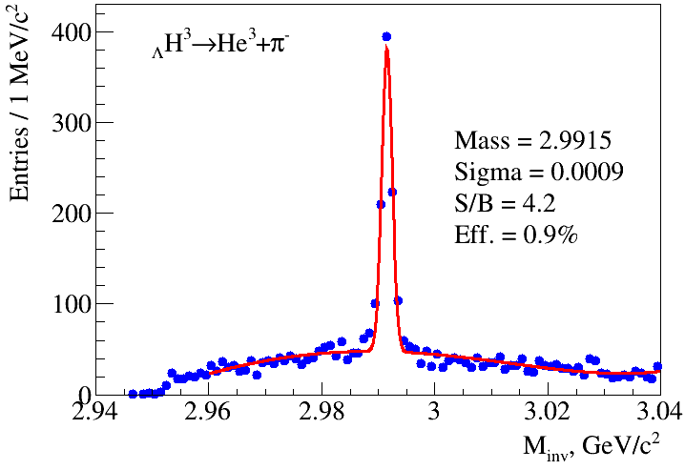

Physics performance simulations of the tracking system
Ξ⁻ and _{Λ}H³ reconstruction in central Au+Au at 4A GeV
Generator: PHQMD (V. Kireyeu), 500k events, Au+Au at 4A GeV, b = 0-5 fm
Statistics: ≈ 2⋅10⁶ Λ , ≈ 2⋅10⁴ Ξ⁻, ≈ 8.4⋅10⁴ _{Λ}H³
Detectors: STS + GEMs + TOF
A.Zinchenko, M.Kapishin, I.Rufanov, V.Vasendina

Slide 18
Beam parameters and setup at different stages of the experiment
Year | 2016 | 2017 spring | 2018 spring | fall 2021 | 2022 | 2023
Beam | d(↑) | C | Ar,Kr, C(SRC) | Kr,Xe | up to Au | up to Au
Max.inten sity, Hz | 0.5M | 0.5M | 0.5M | 0.5M | 0.5M | 0.5M
Trigger rate, Hz | 5k | 5k | 10k | 10k | 10k | 50k
Central tracker status | 6 GEM half planes | 6 GEM half planes | 6 GEM half planes + 3 forward Si planes | 7 GEM full planes + forward Si planes | 7 GEM full planes + forward Si + 2 large STS planes | 7 GEM full planes + 4 large STS planes
Experimental status | technical run | technical run | technical run+physics | physics run | stage1 physics | stage2 physics

Slide 19
Thank you for your attention!

