Slide 1
NICA project
resource loaded global plan
@2020.09.09

Slide 2
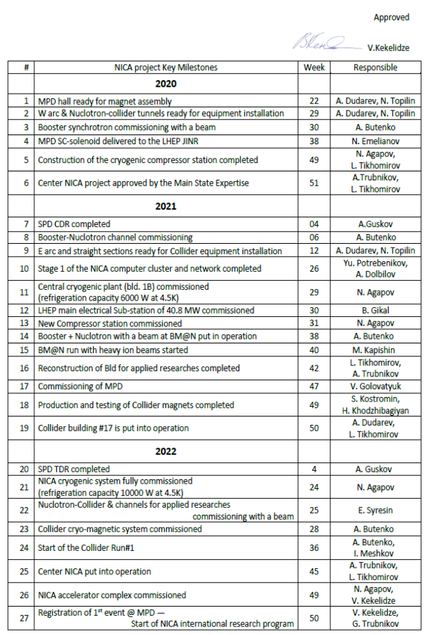
Key milestones
…main points
2020
Booster commissioning
construction cryogenic compressor station W49
2021
Booster – Nuclotron channel commissioning W06
LHEP electrical substation commissioning W49
BM@N run W40
MPD commissioning W47
@2020.09.09
2022
NICA cryogenic system fully commissioned W24
Start of Collider Run#1 W36

Slide 3
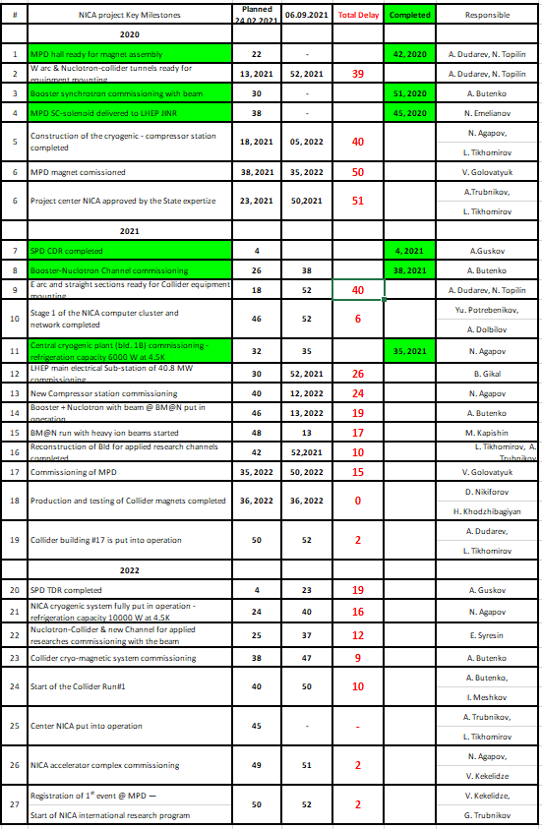
Key milestones
@2021.09.21

Slide 4
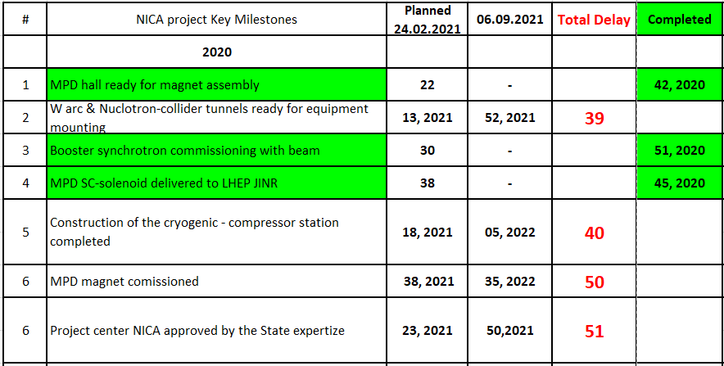
2020

Slide 5
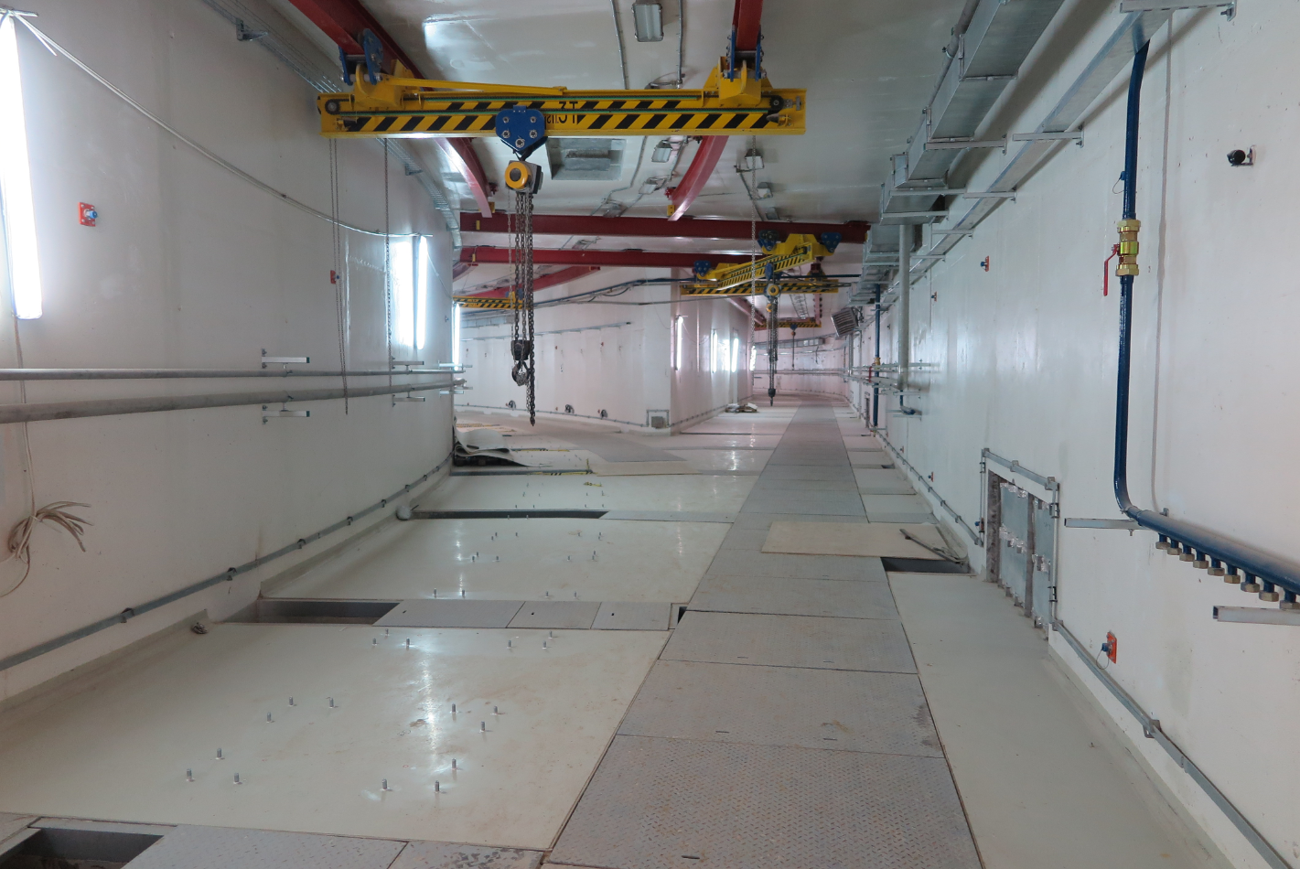
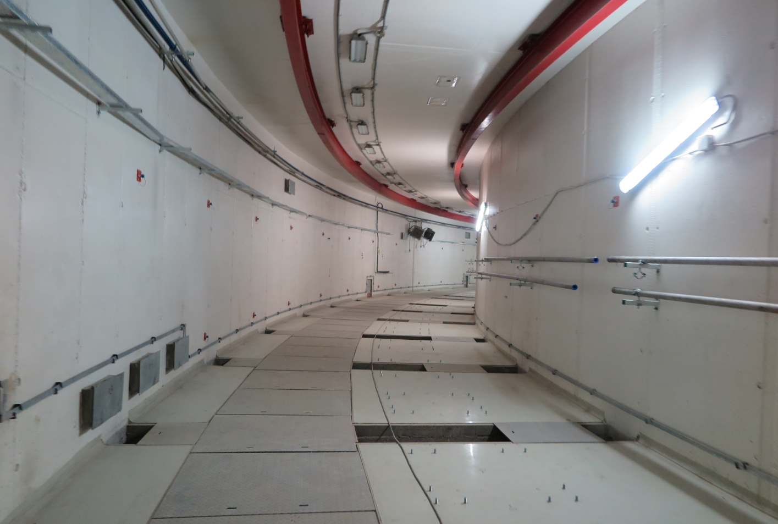
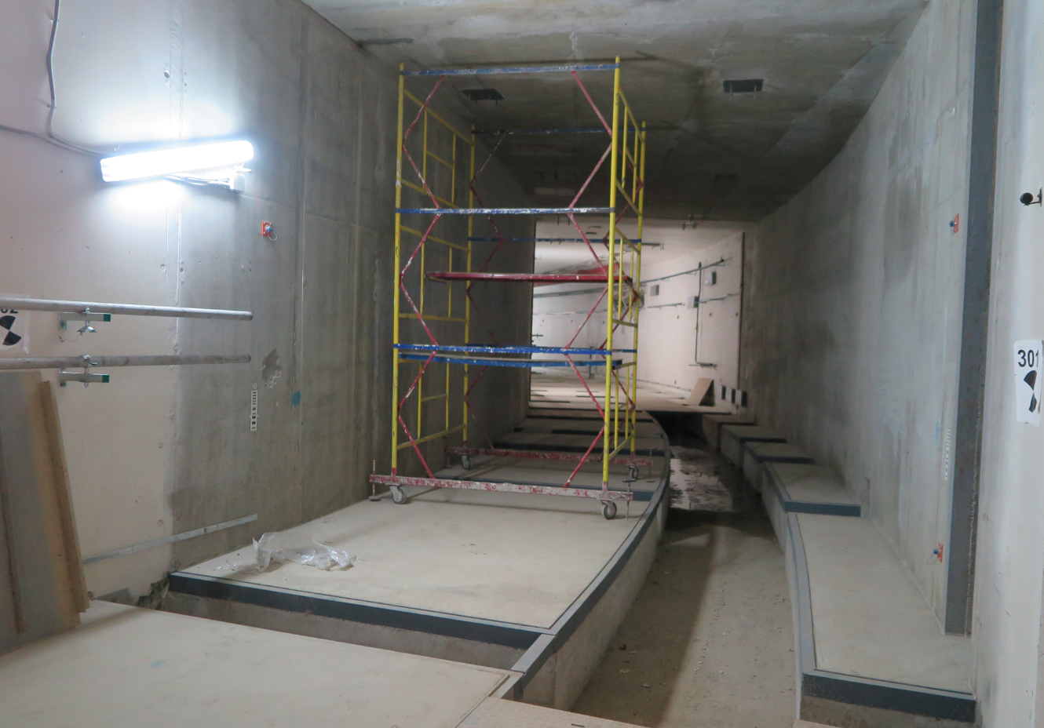
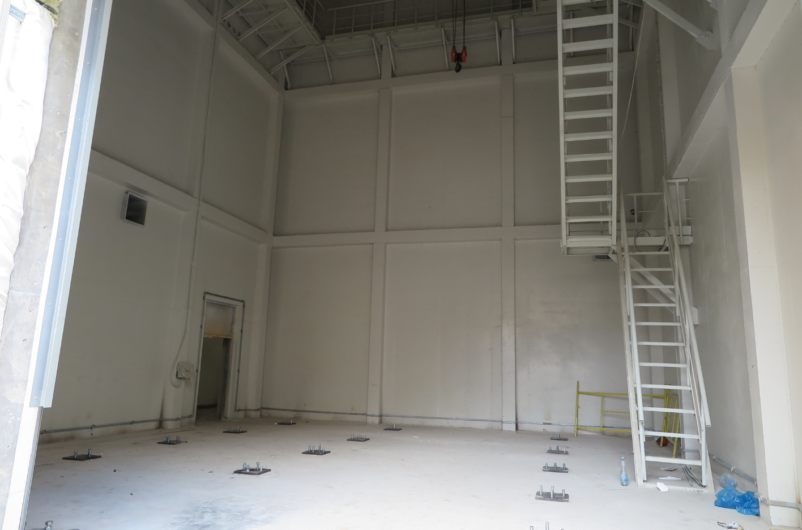
Bld #17

Slide 6
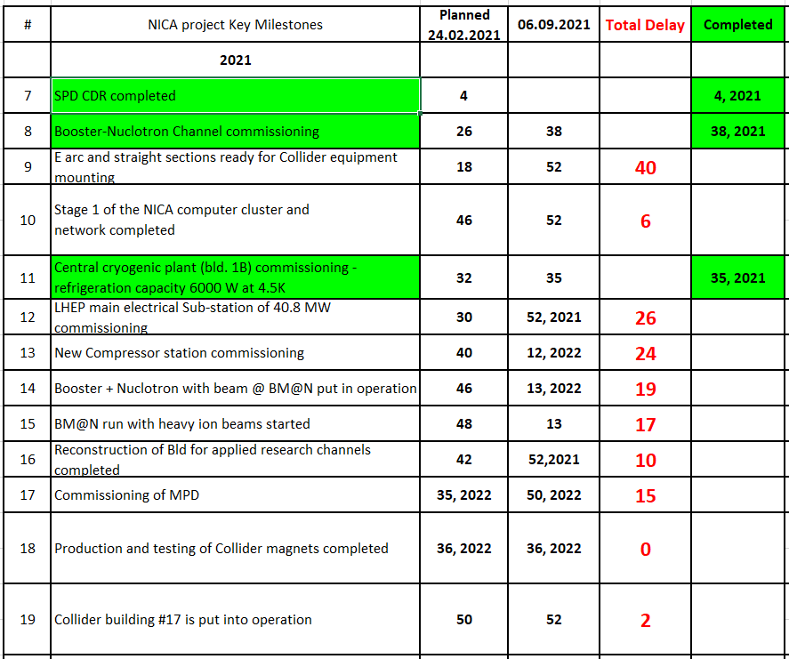
2021

Slide 7
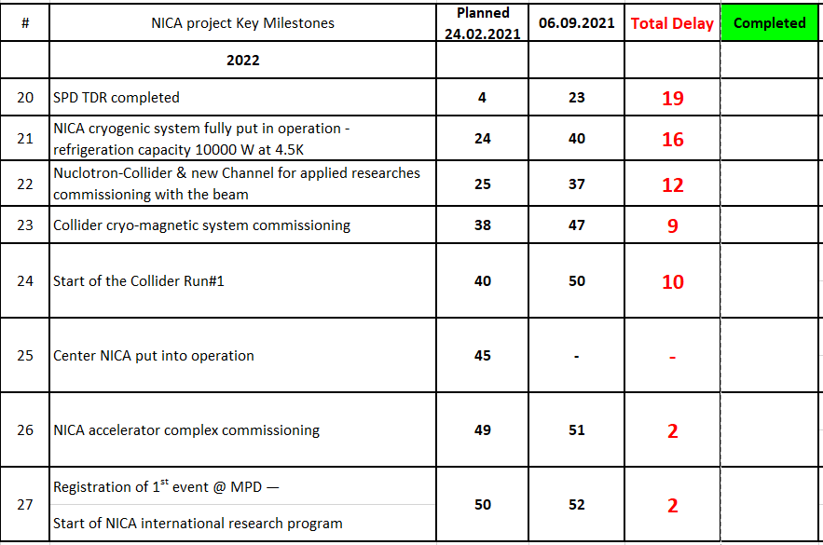
2022
6 milestones from 27 completed,
average arithmetic delay for rest of milestones is 20 weeks

Slide 8
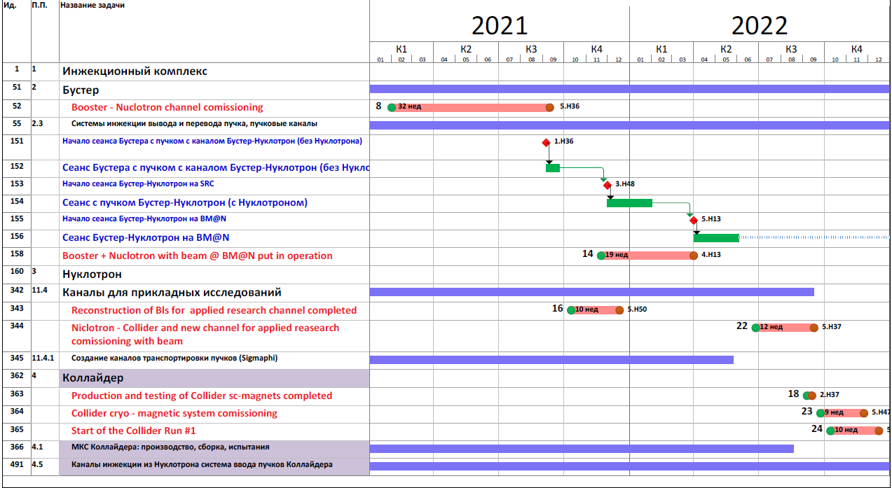

Slide 9
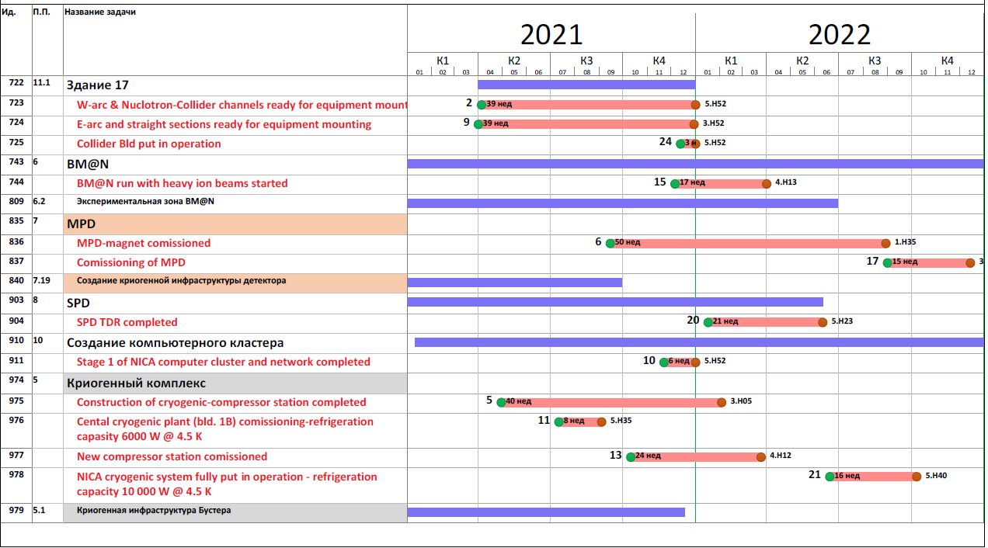
Спасибо!

