Slide 1





VIII-th Collaboration Meeting of the MPD Experiment at the NICA Facility
October 12-14, 2021
The progress of Ecal module production in China
Reporter: Chendi Shen
Yi Wang for China ECAL group
Department of Engineering Physics, Tsinghua University

Slide 2
Contents
1
  MPD-ECAL introduction
2
  Ecal module production
3
  Cosmic test of module
4
  5-D shashlyk Ecal
5
  Summary

Slide 3
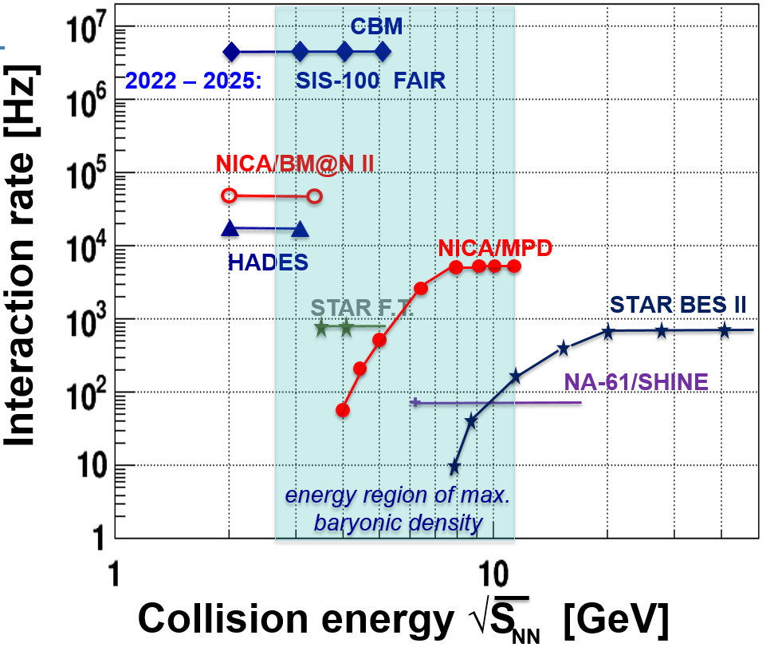

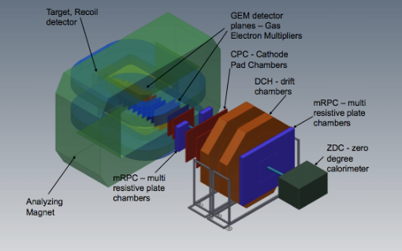

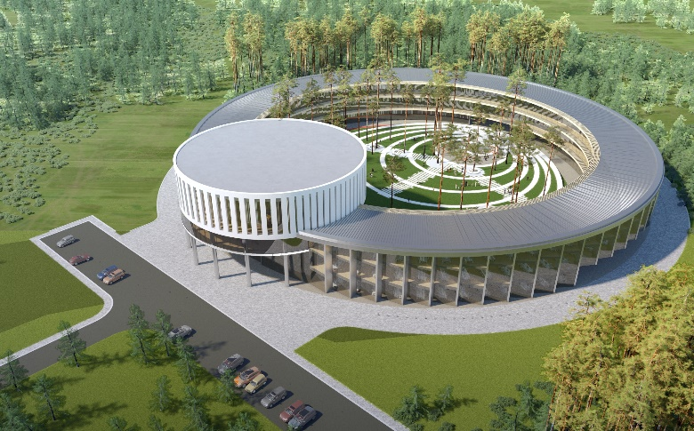
1
  About MPD-ECAL
BM@N
SPD
Collider ring (c=503 m)
MPD aims to: –
- study of hot and dense baryonic matter at the energy range of max baryonic density
- investigation of nucleon spin structure, polarization phenomena
Center NICA
MPD
ECal
Nuclotron ring (c=251,5 m)
applied research area
3
3

Slide 4
1
  About MPD-ECAL
MPD-Ecal requirement
Energy resolution: <5%/√E
The particle occupancy should not exceed 5%
Calorimeter must be able to operate in the
magnetic field up to 0.5T
Time resolution should be at least below 1ns
High segmentation, adequate space
resolution
Dense active medium with the small Moli’ere radius;
/10⁵
Dt distribution of dierent particles
Notes:
左图为mpd中心探测器的完整结构，有图蓝色部分为电磁量能器，mpd探测器的具体性能特点列举如下。

Slide 5
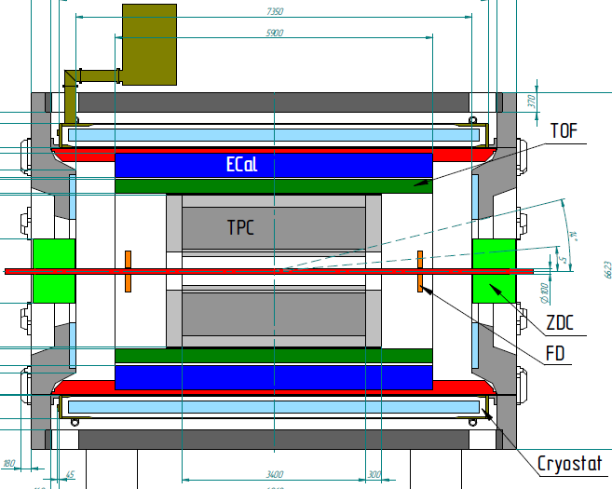
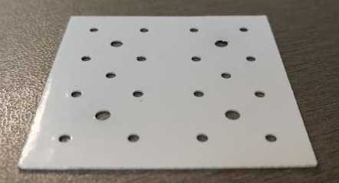
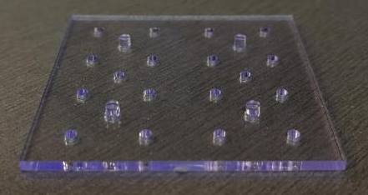
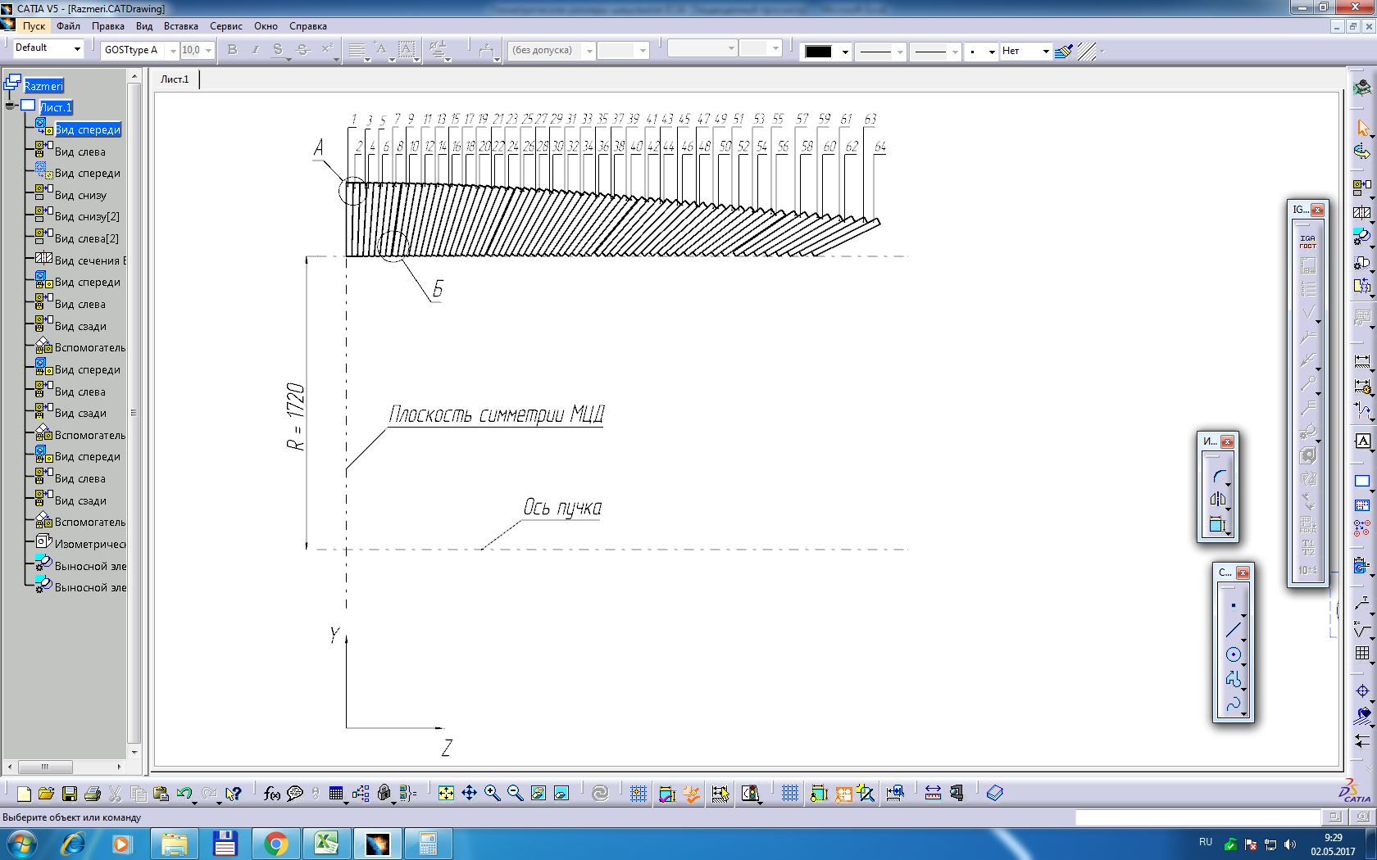
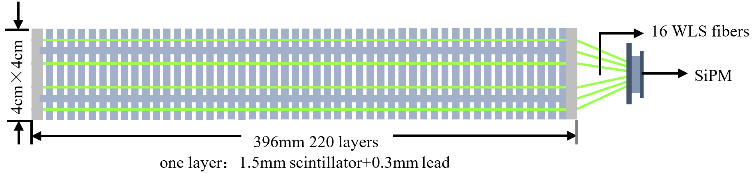
1
  About MPD-ECAL
Shashlyk Ecal structure
Parameters of main module
Transverse size, mm² | 40 x 40 | Scintillator thickness, mm | 1.5
WLS fibers | 16 | Moliere radius, mm | 62
Number of layers | 220 | Radiation length, X₀ | 11.8
Lead absorber thickness, mm | 0.3 | Effective radiation length, mm | 32.4
Colliding point

Slide 6
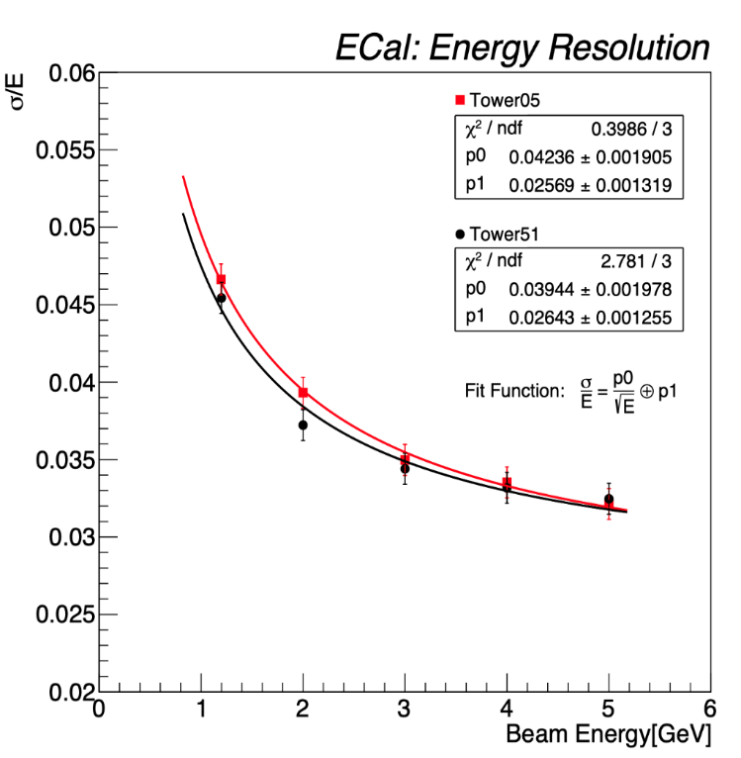
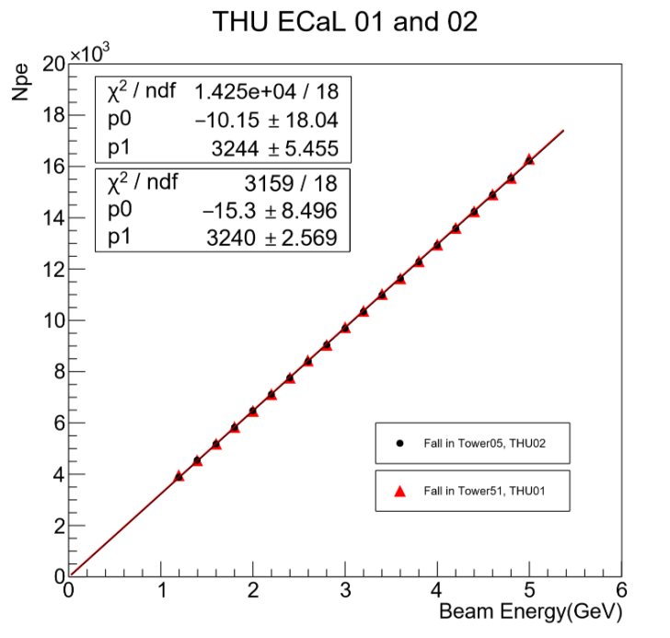
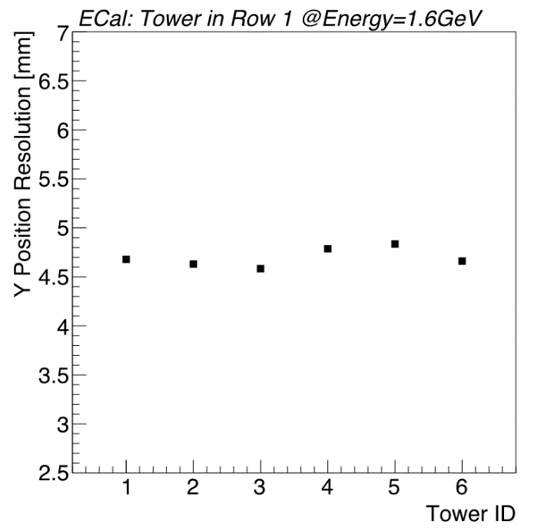
1
  About MPD-ECAL
Performance
Energy linearity
Energy resolution
Position resolution

Slide 7
1
  China MOST MPD ECal project
Hardware:
1) Construction of 8 sectors ECal prototype. 768 modules in total.
2) Production of FEE PCB (1800 FEEs)
3) R&D on fast readout electronics, time resolution is less than 150ps
Software and simulation
Schedule: 2020.6-2024.5
Institutes: Tsinghua University 60%
Shandong University 20%
Fudan University 10%
University of South China 10%
Huzhou University

Slide 8
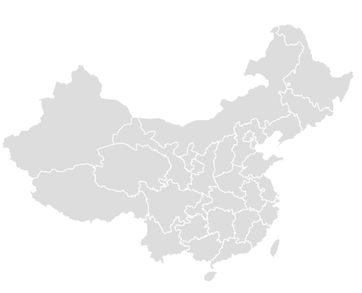
2
  Module production in China
Tsinghua University (60%)
Shandong University (20%)
Beijing
Qingdao
Fudan University (10%)
Shanghai
Hengyang
University of South China (10%)

Slide 9
2
  Module production in China
In the first stage (2020.6-2022.5), 8 sectors will be produced in China
8 sectors=16 half sectors=768 modules=12288 towers
1
2
3
4
5
6
7
8
Modules produced in each institutes
Material:
JINR: scintillator tiles
China: Other material
 | 1 | 2 | 3 | 4 | 5 | 6 | 7 | 8 | Total
THU | 19 | 19 |  | 38 | 96 | 96 | 96 | 96 | 460
SDU |  |  | 96 | 58 |  |  |  |  | 154
FDU |  | 77 |  |  |  |  |  |  | 77
USC | 77 |  |  |  |  |  |  |  | 77

Slide 10
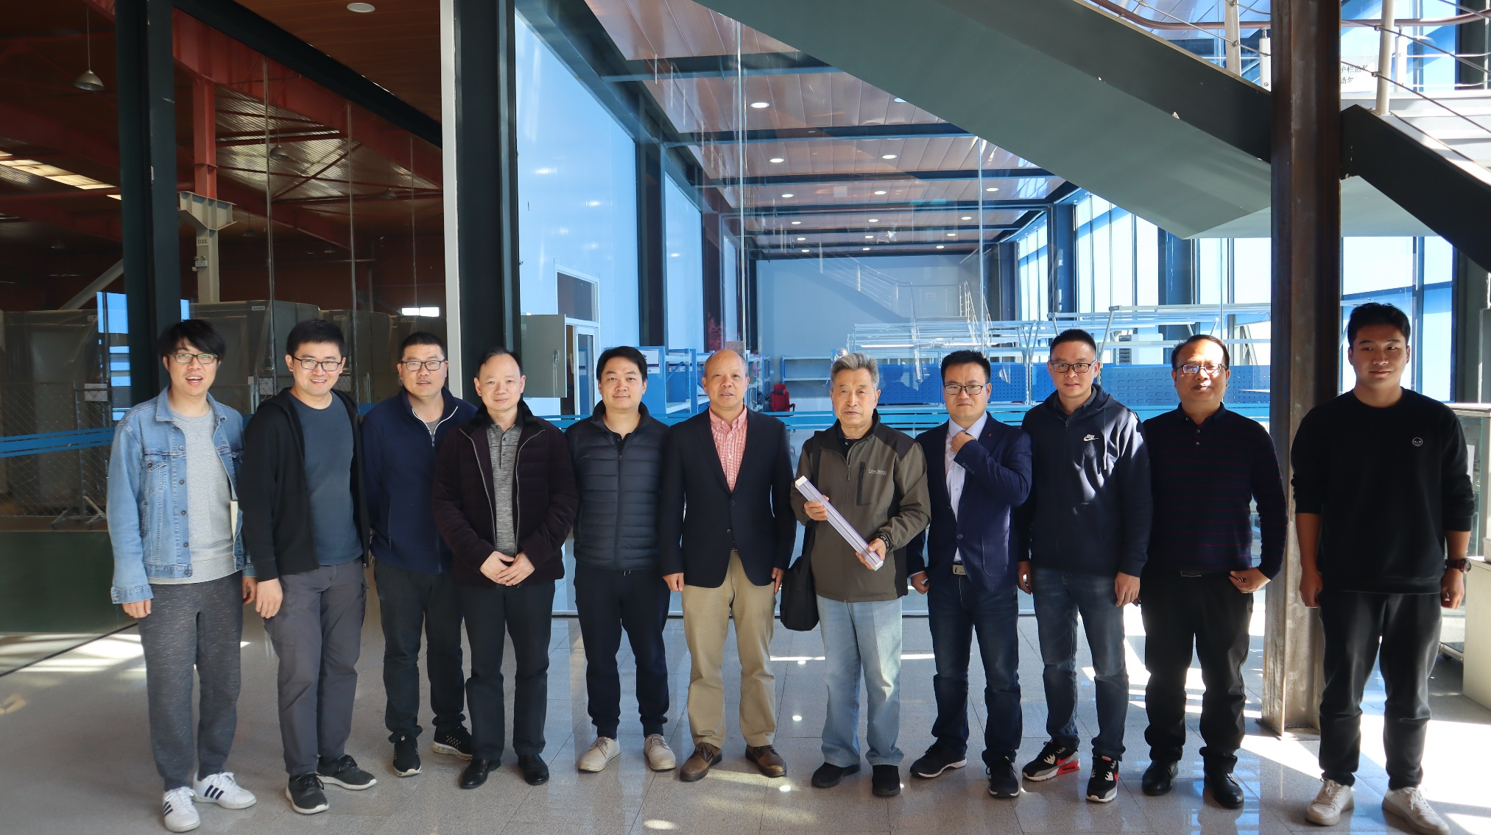
2
  Module production in China
same material
same standard
same procedure
same QA and QC
Four institutions have discussed and unified the process flow of ECal module production

Slide 11
 | 2020.10 | 2021.4 | 2021.8 | 2021.12 | 2022.04 | 2022.06
Lead painting
Steel wire & nut production
Aluminum plate production
Tooling production
WLSF purchase
CNC purchase
Scintillator tile shipment
Tower assembly
Tower pressurization
Tower milling
Tower gluing
Half-module milling
Module gluing
WLSF milling & painting
WLSF insertion & gluing
Module shipment
Module test

Slide 12
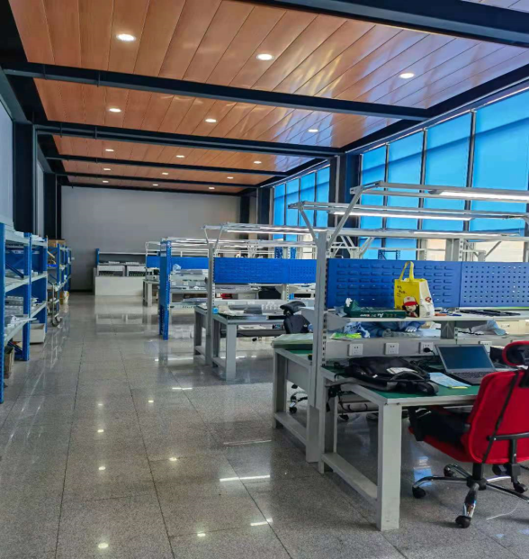
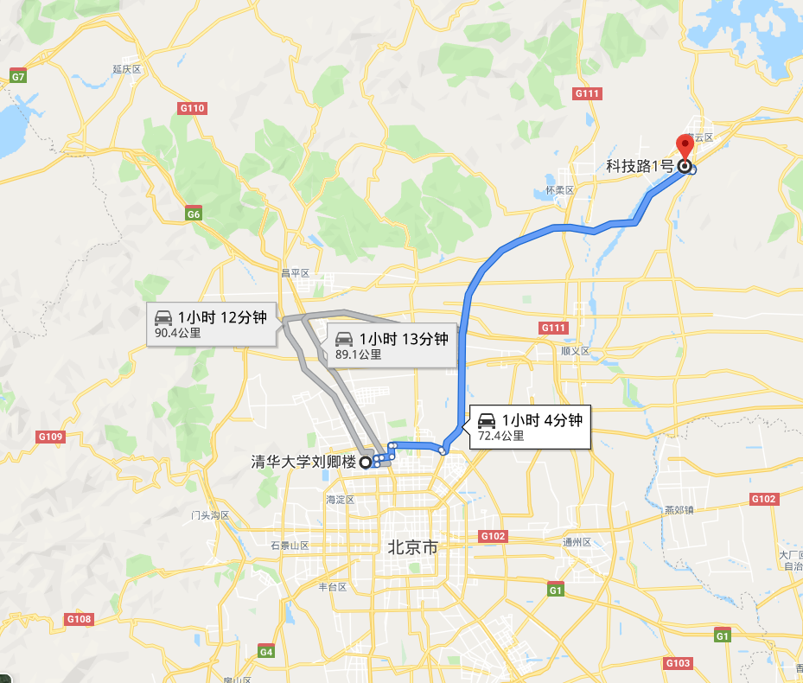
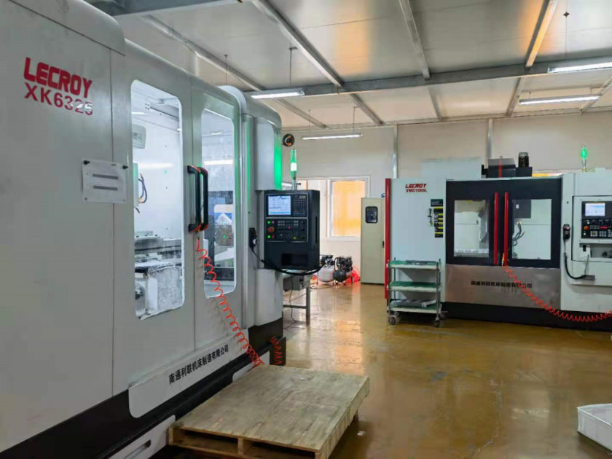
2
  Production Site (THU)
Assembling area
(two floors)
400 m²
NUCTECH
THU
Cutting area
(2 milling machine or more)

Slide 13
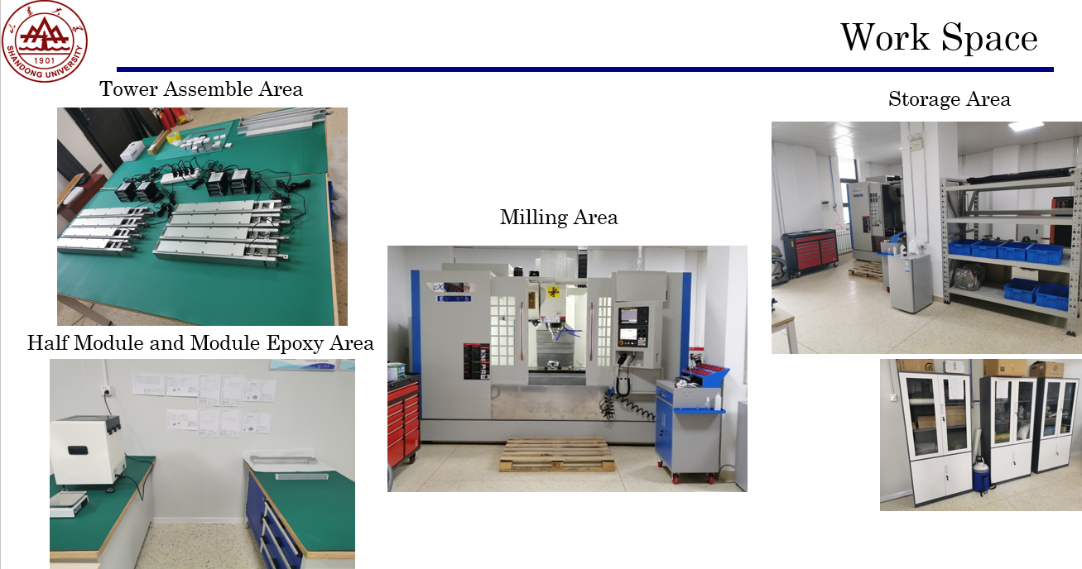
2
  Production Site @SDU

Slide 14
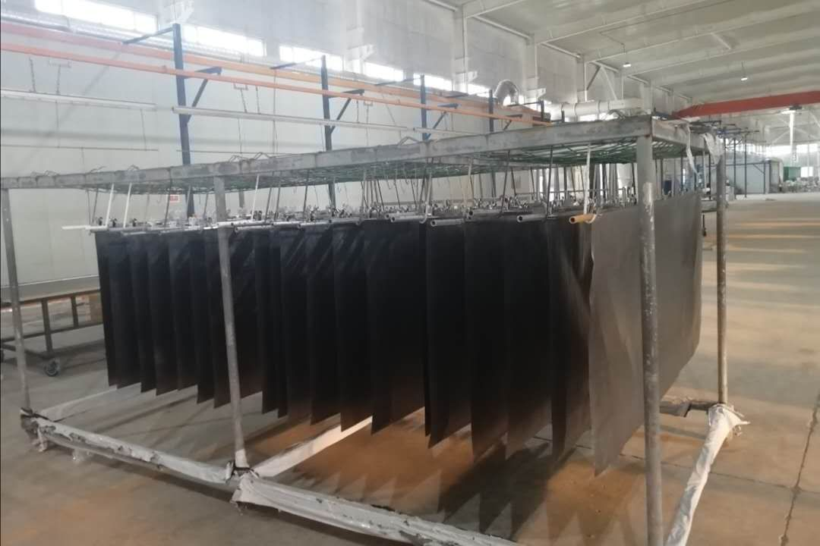
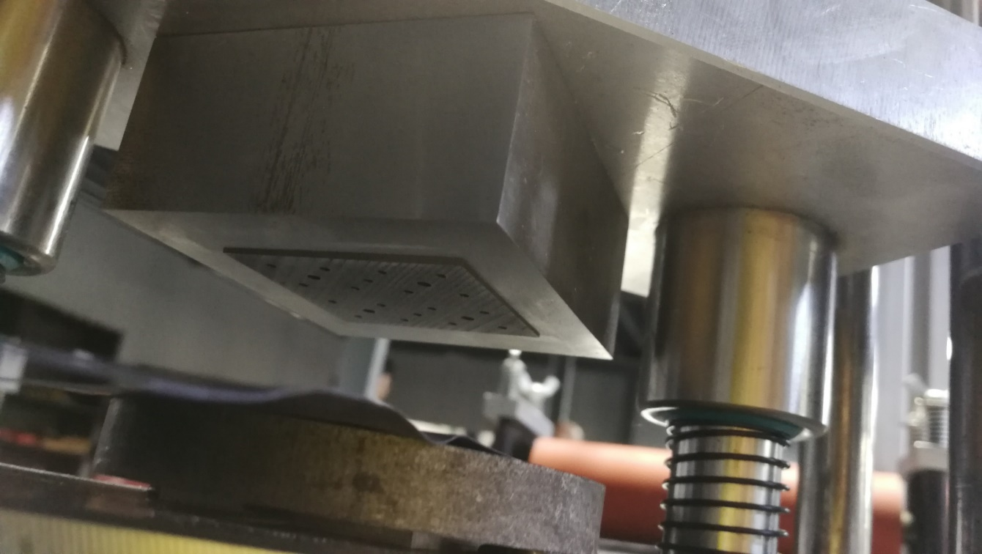
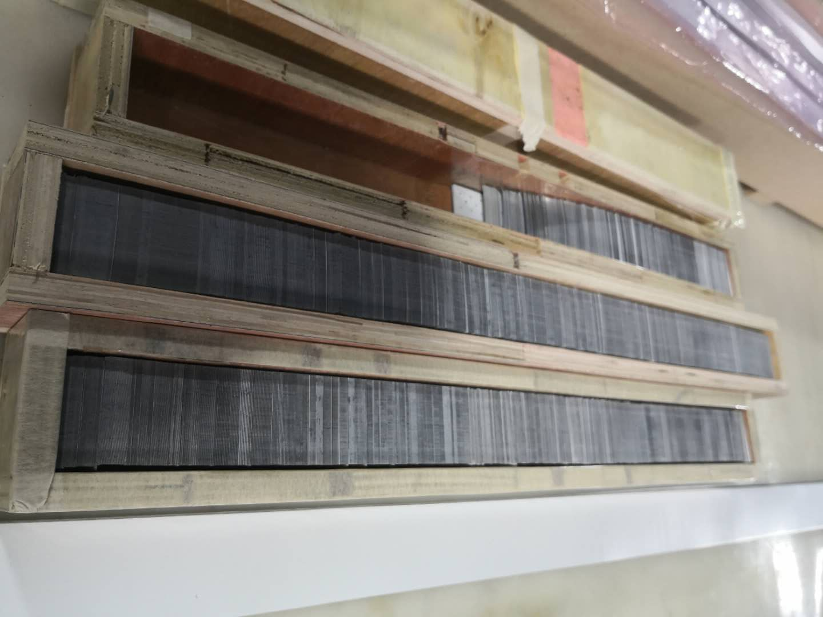
2
  Lead painting & cutting
Step1. Powder painting on the whole lead (large area).
Step2. Cutting lead into a circle with a width of 5cm.
Step3. Punching with automatic machine.
Thickness uniformity is very good by this method.
Notes:
1.Assembling a tower by using 220 alternating layers of lead and scintillator plates in the mold, pulled together with one loops of a steel string. Strings are ﬁxed by the two tension screws.
2.Sixteen towers are pressed with a special machine.
3.Sixteen towers are cut at a small angle and bonded into one module with two rows (each row consists of 8 towers).
4.The end of ﬁbers are glued in bunches and connected with SiPM separately.
5. Cut and polished the ﬁbers, connecting the PCB plate with SiPM detector and wrapped with shading paper

Slide 15
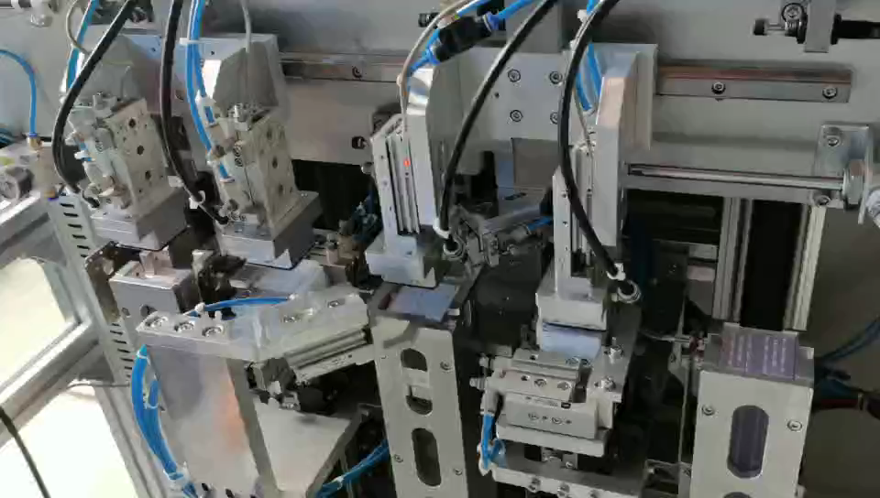
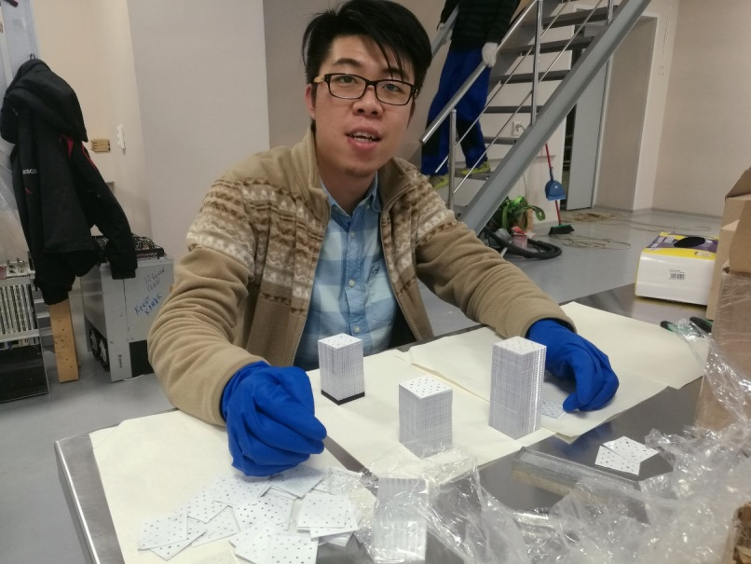
2
  Automatic tower assembly
Manual assembling, ~45min/tower
Assemble a tower in 20 min.
Fully automatic.

Slide 16
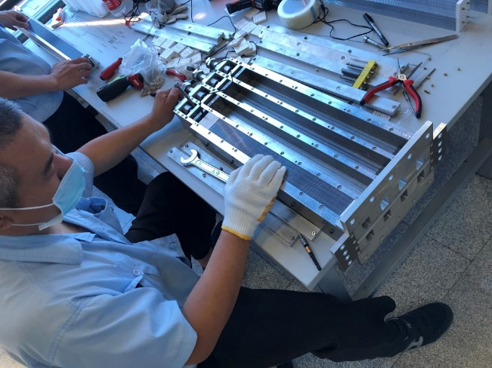
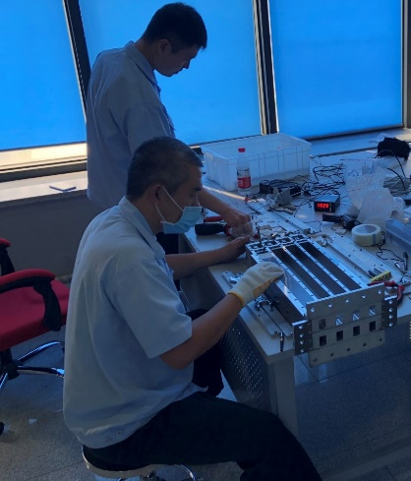
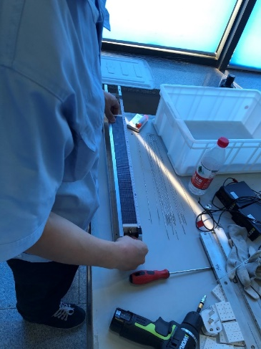
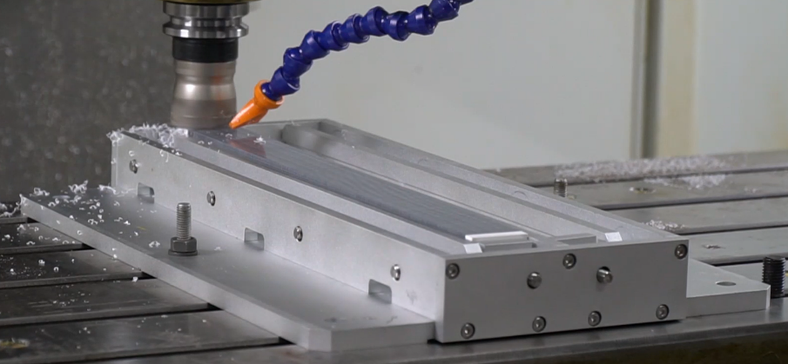
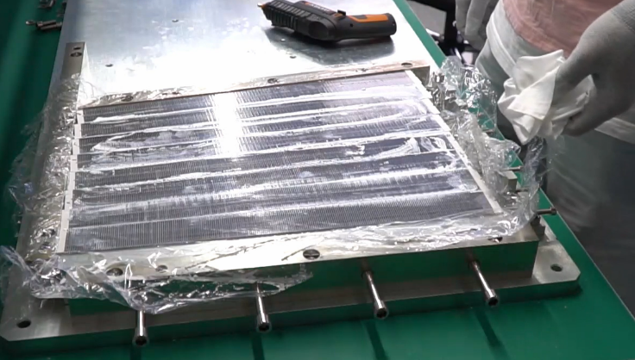
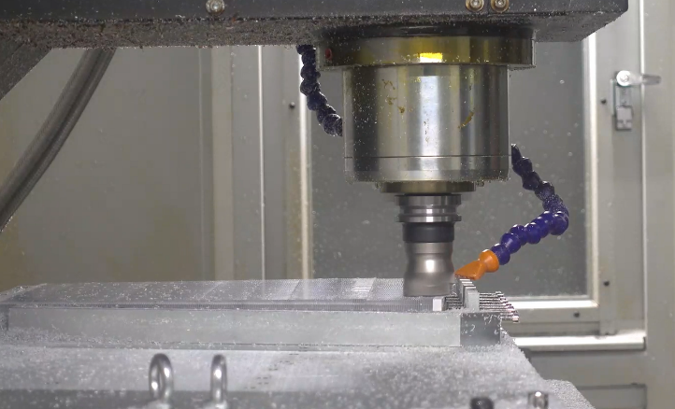
2
  process flow of module production (1)
Photo taken in 2021
Pre-pressure
Adjust length
Pressure transmission
Tower milling
Half-module gluing
Half-module milling

Slide 17
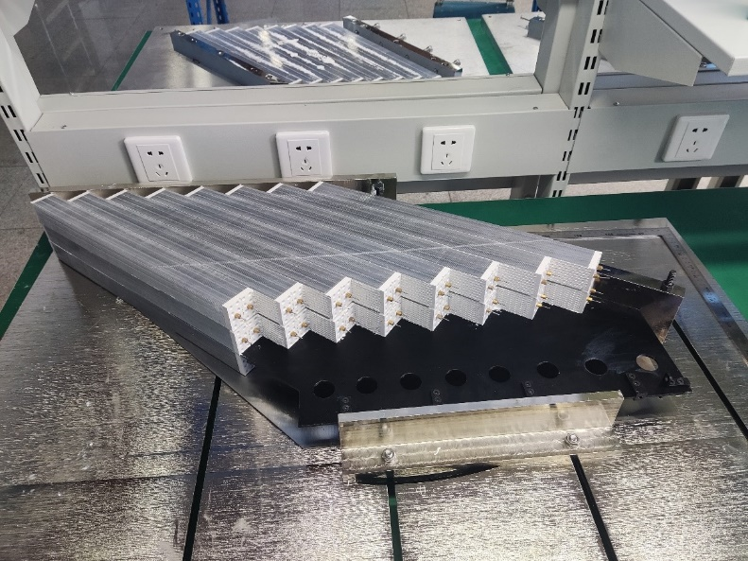
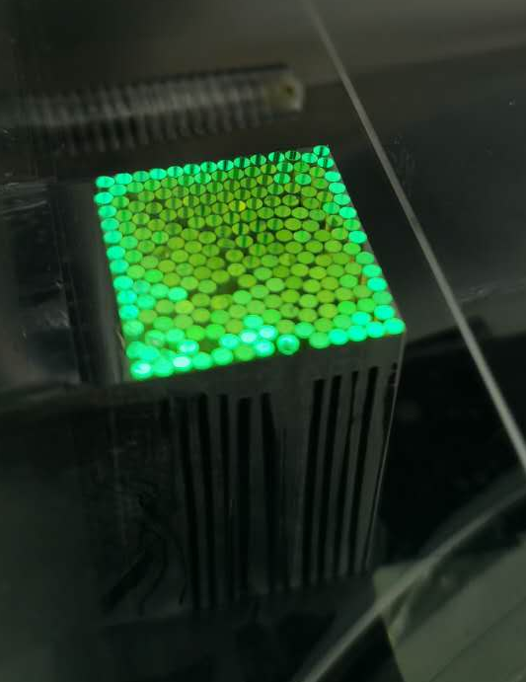
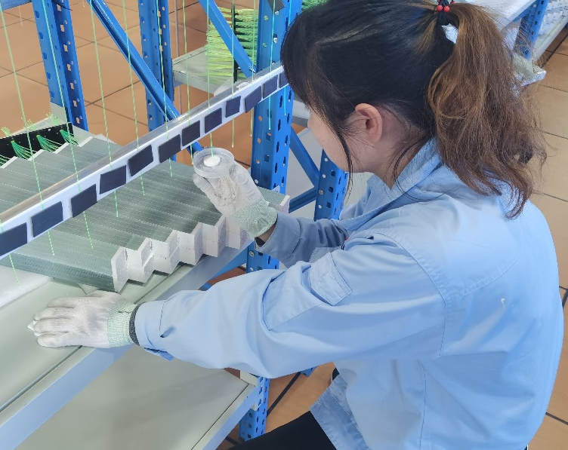
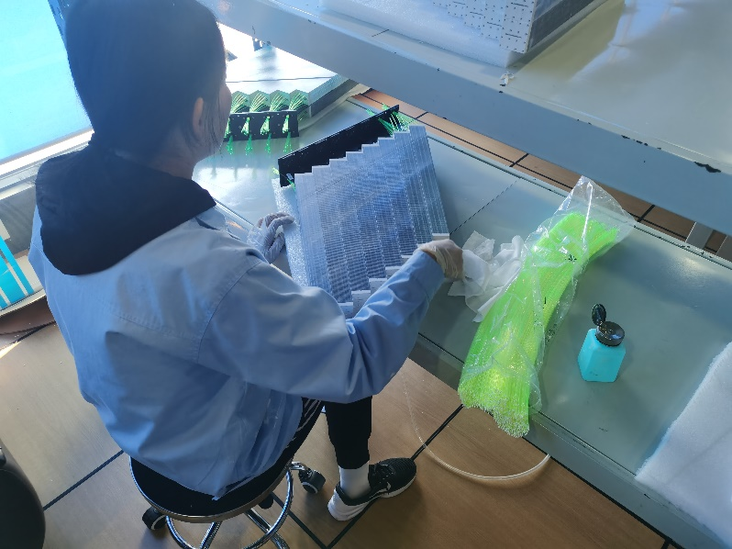
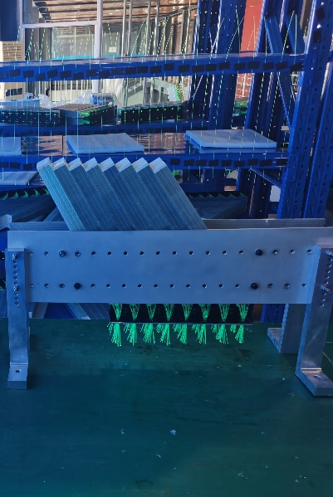
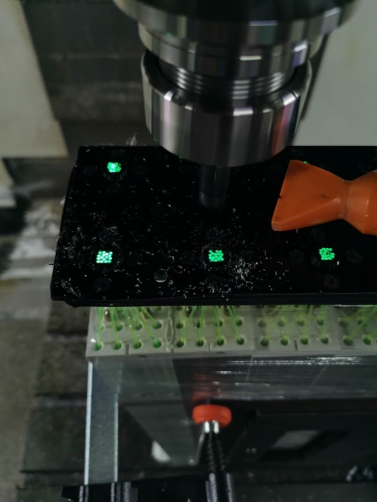
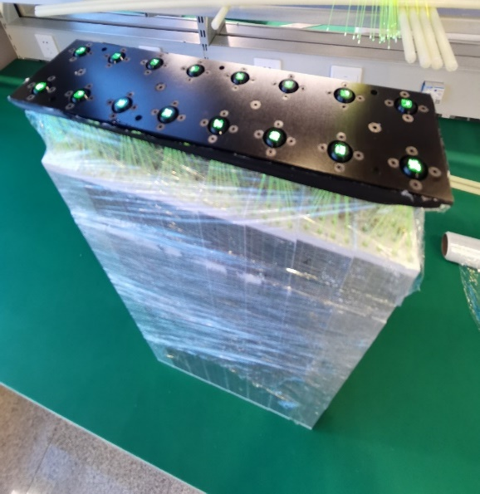
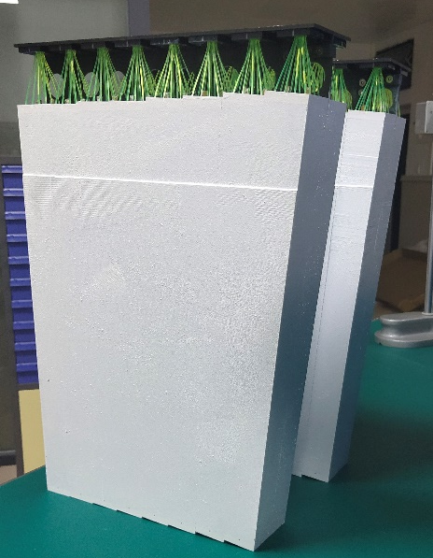
2
  process flow of module production (2)
Photo taken in 2021
Module gluing
WLSF cutting
WLSF painting
Fiber insertion & gluing
WLSF milling (diamond cutter)
Painting(finished)

Slide 18
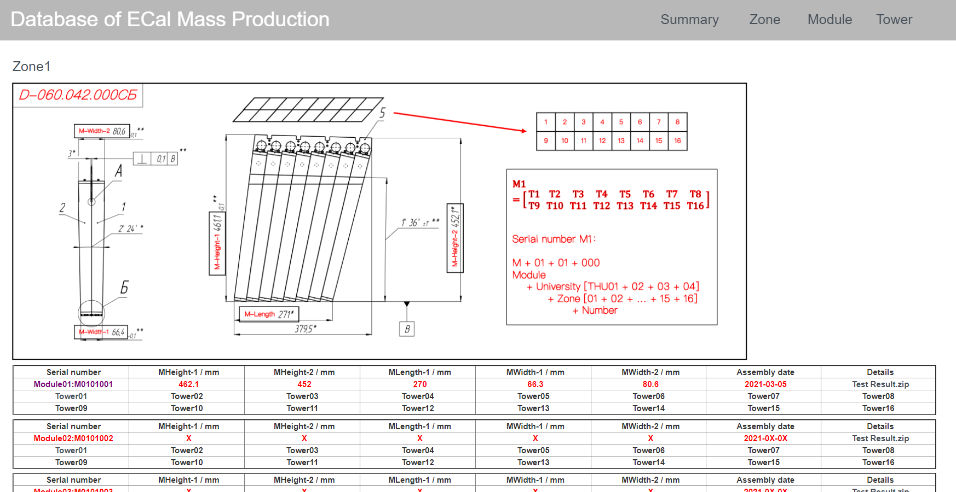
2
  Production data base
https://hepd2.ep.tsinghua.edu.cn/hepd/database/database.html
Cosmic test results: wave form, spectrum, energy,…

Slide 19
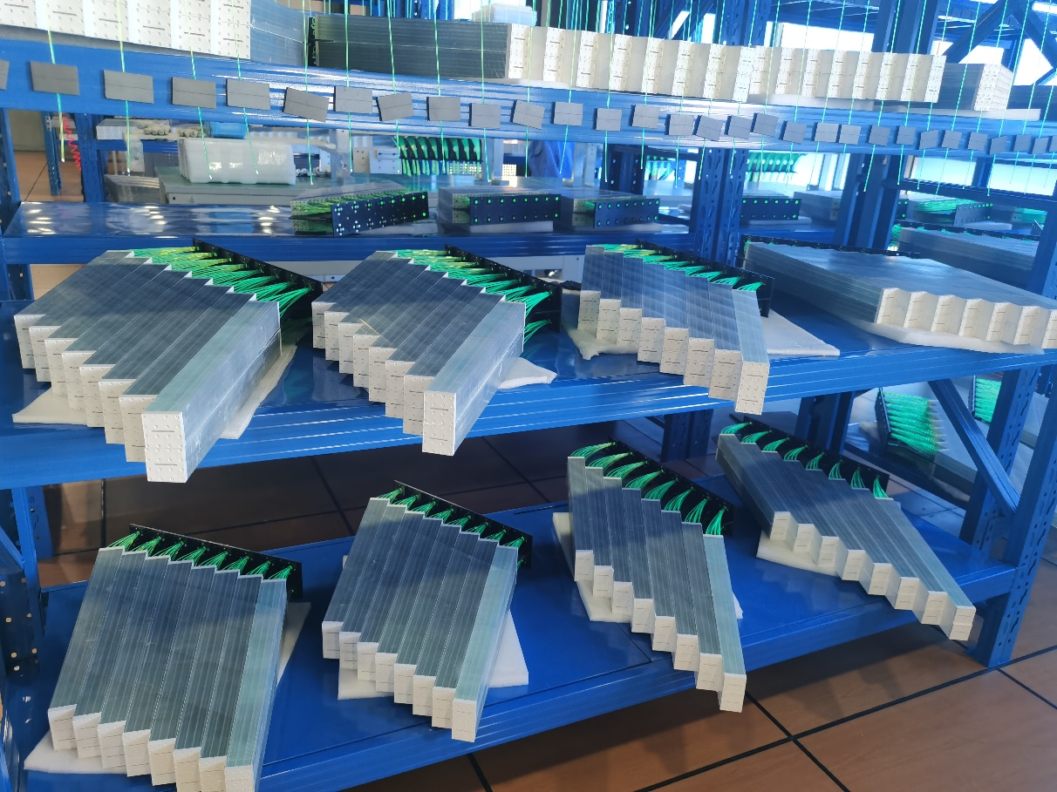
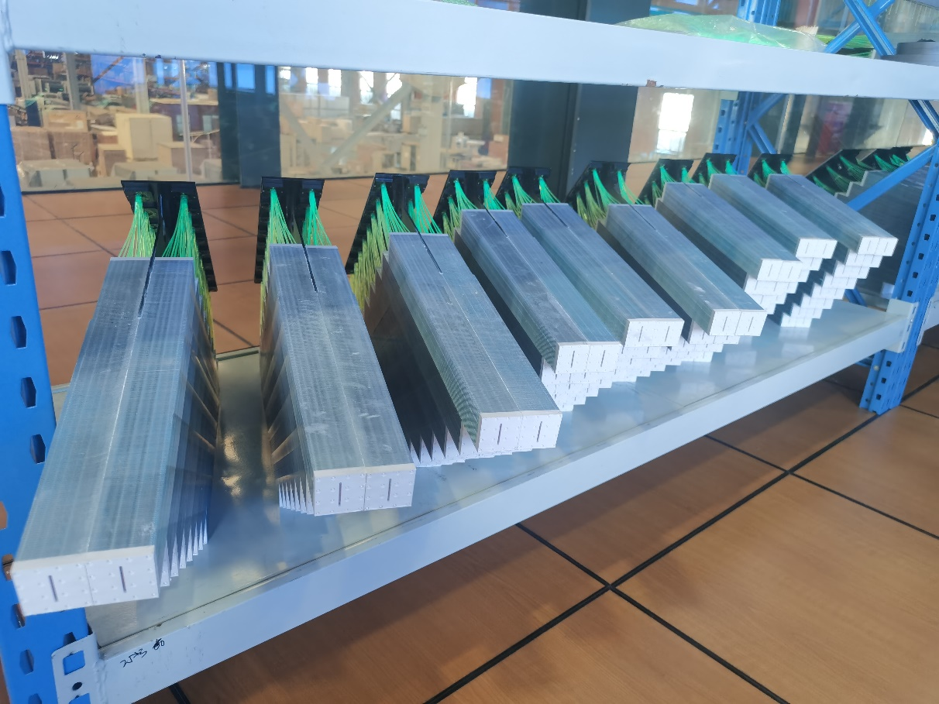
2
  Production schedule
More than 200 modules were produced until now, 10 modules have been shipped to JINR for cosmic test
Around 500 modules will be ready on this year
768 modules will be ready before June of 2022

Slide 20
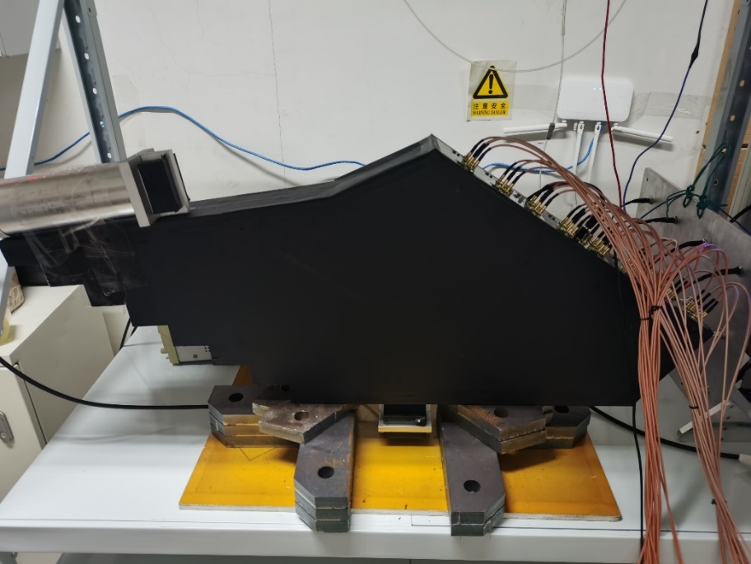
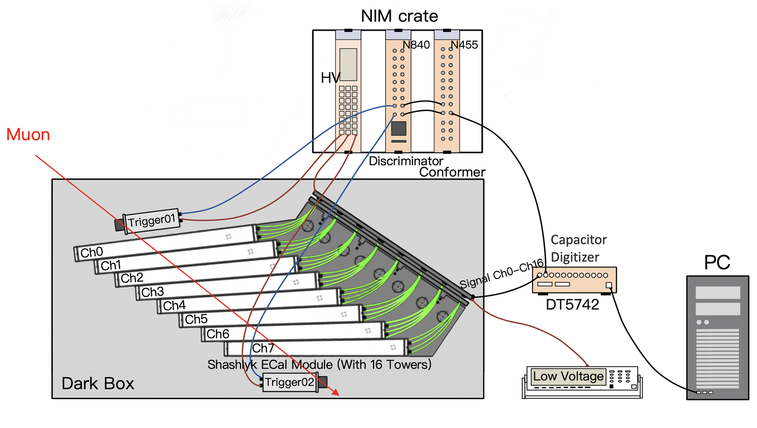
3
  Cosmic test of module
The cosmic test results can be used for QC!
2 Scintillator(4*4*8cm) for trigger

Slide 21
3
  Cosmic test of module
Response linearity of SiPM

Slide 22
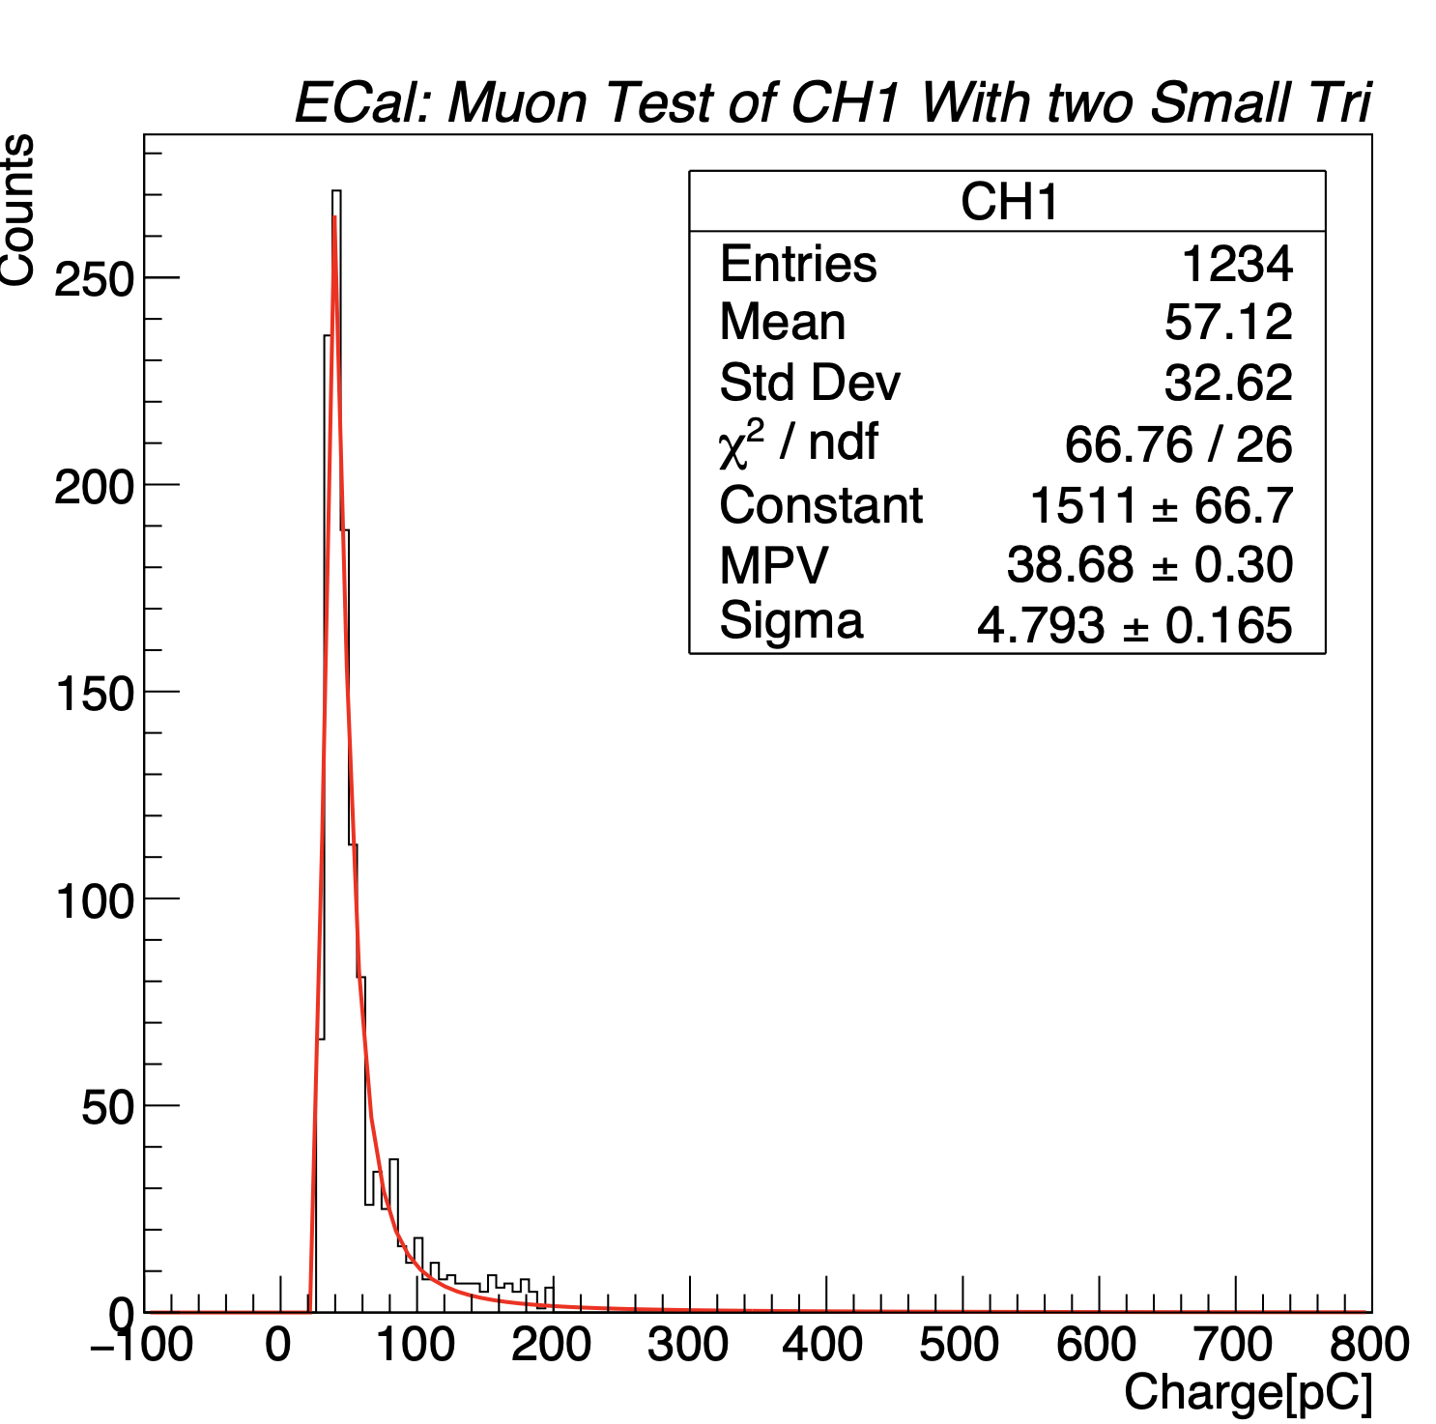
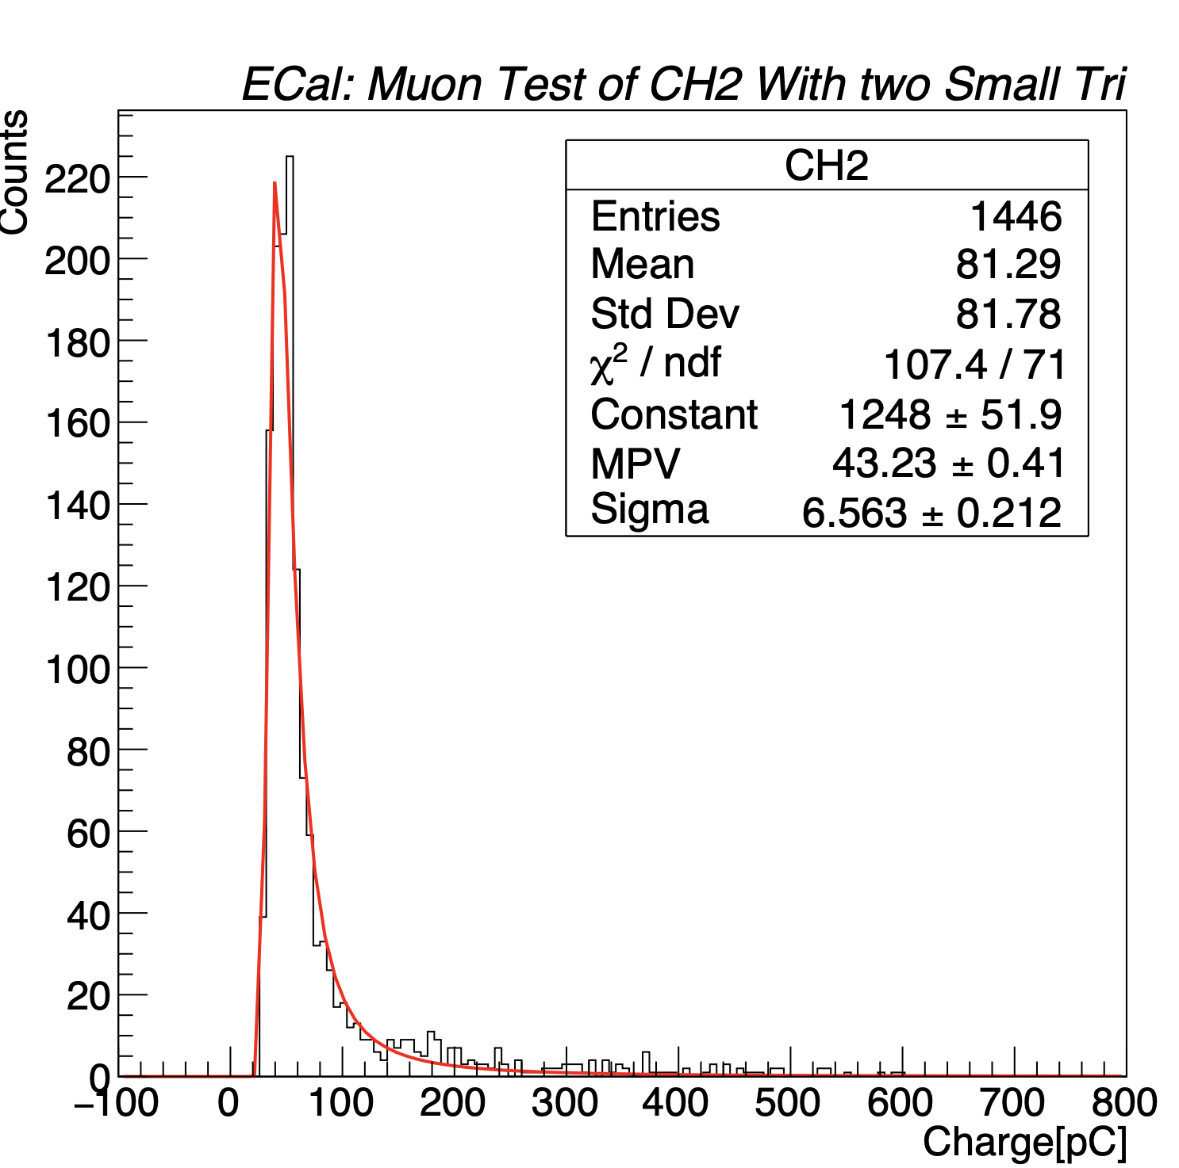
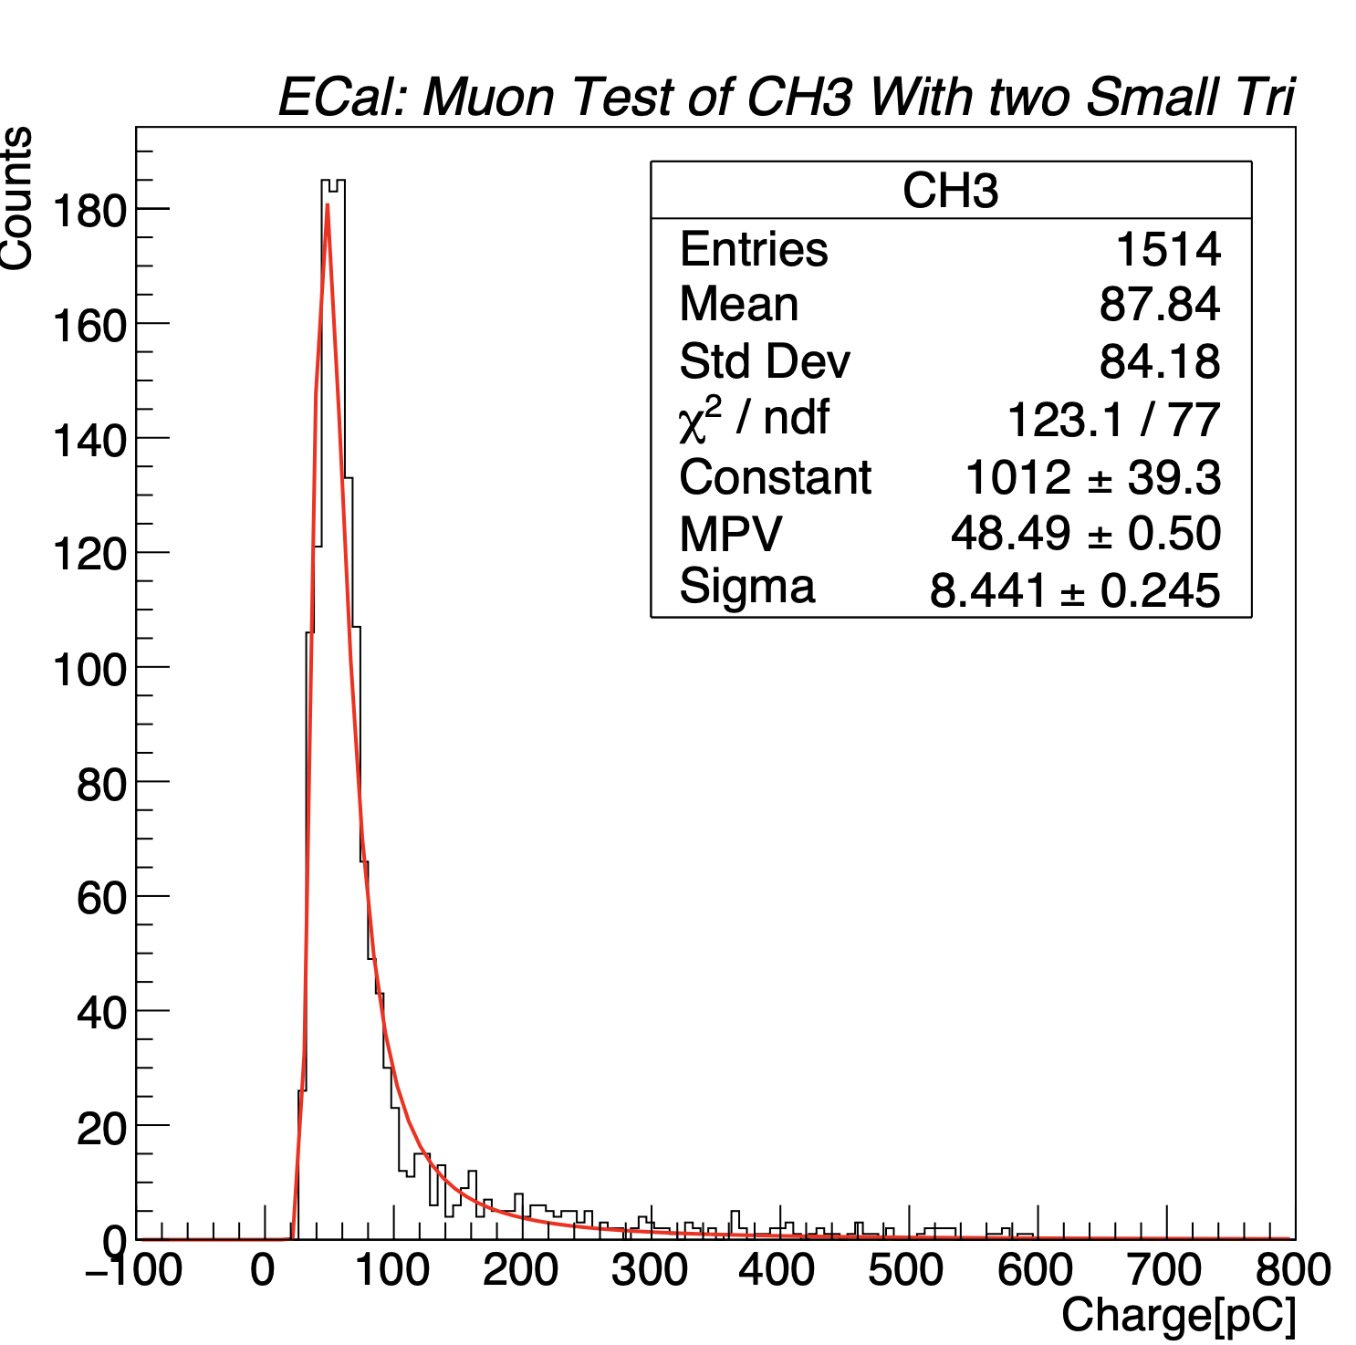
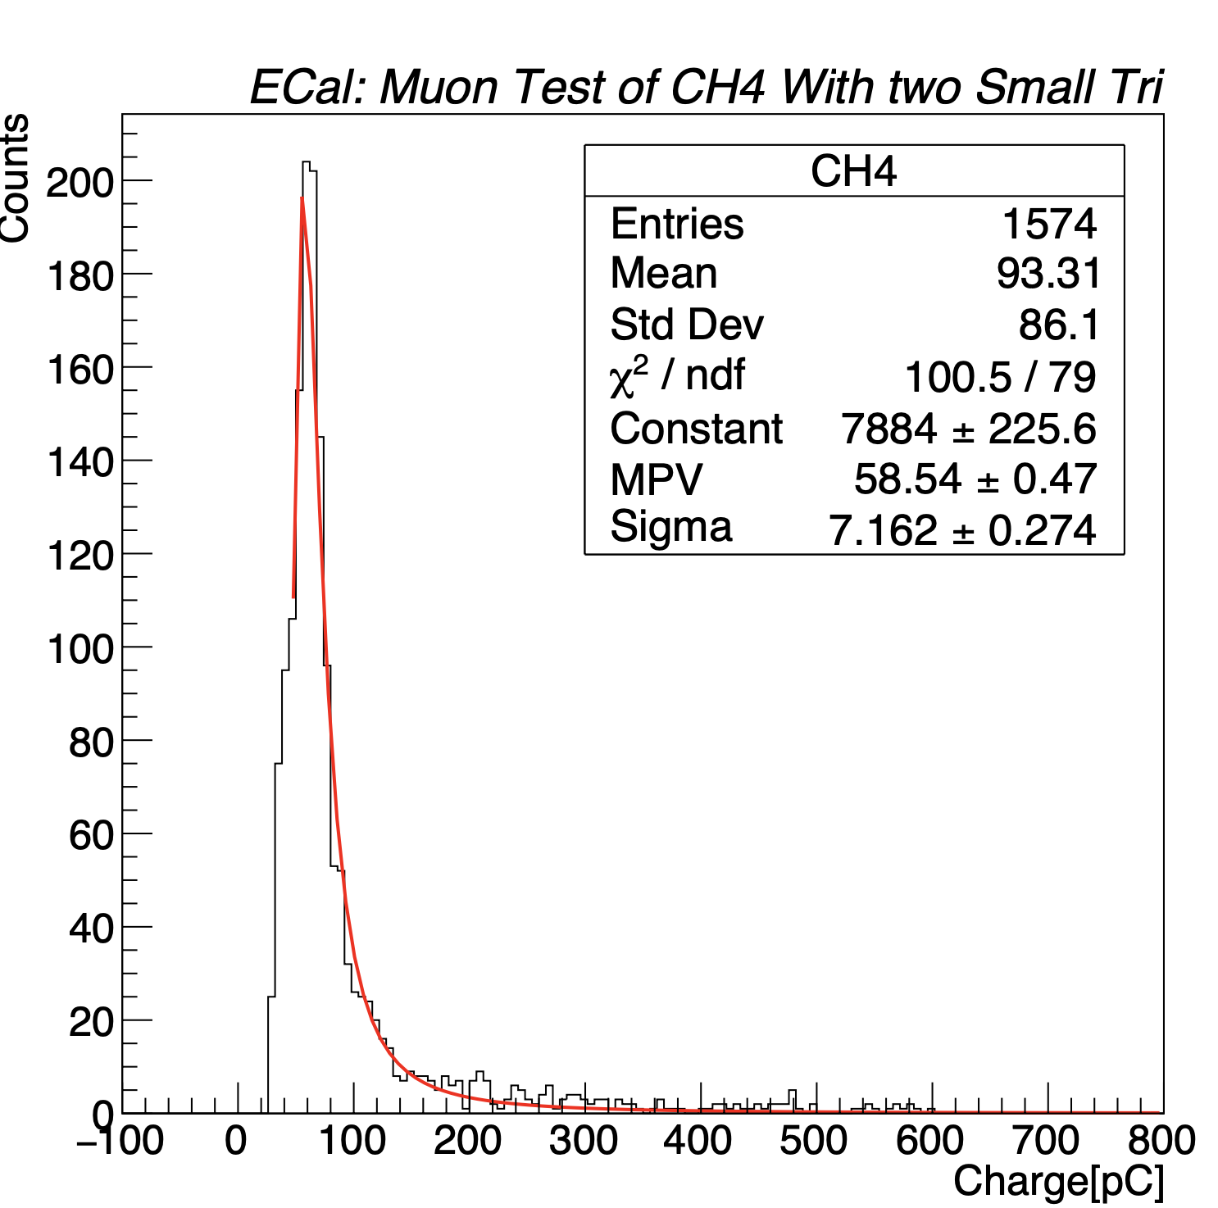

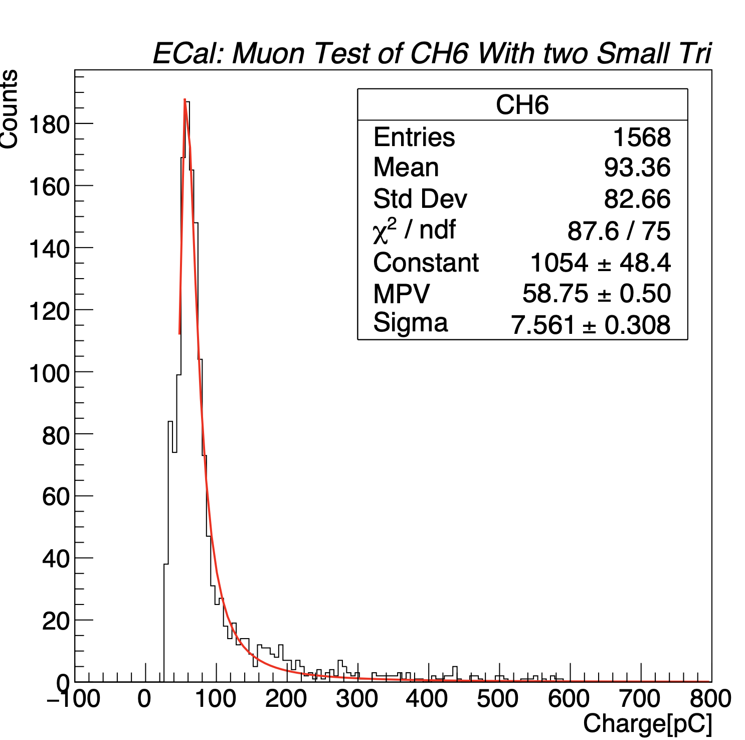
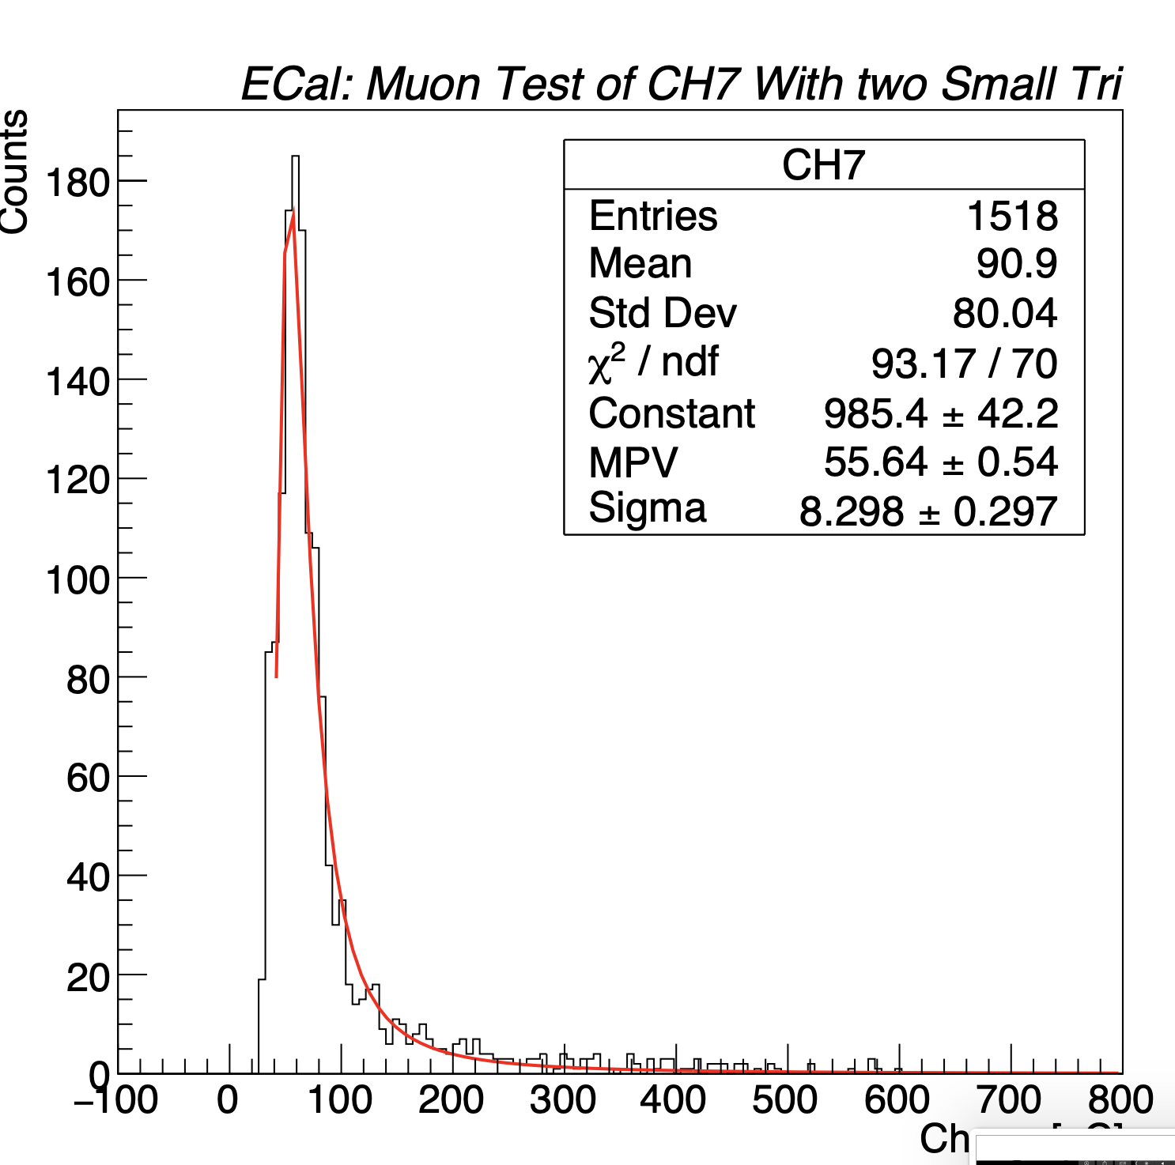
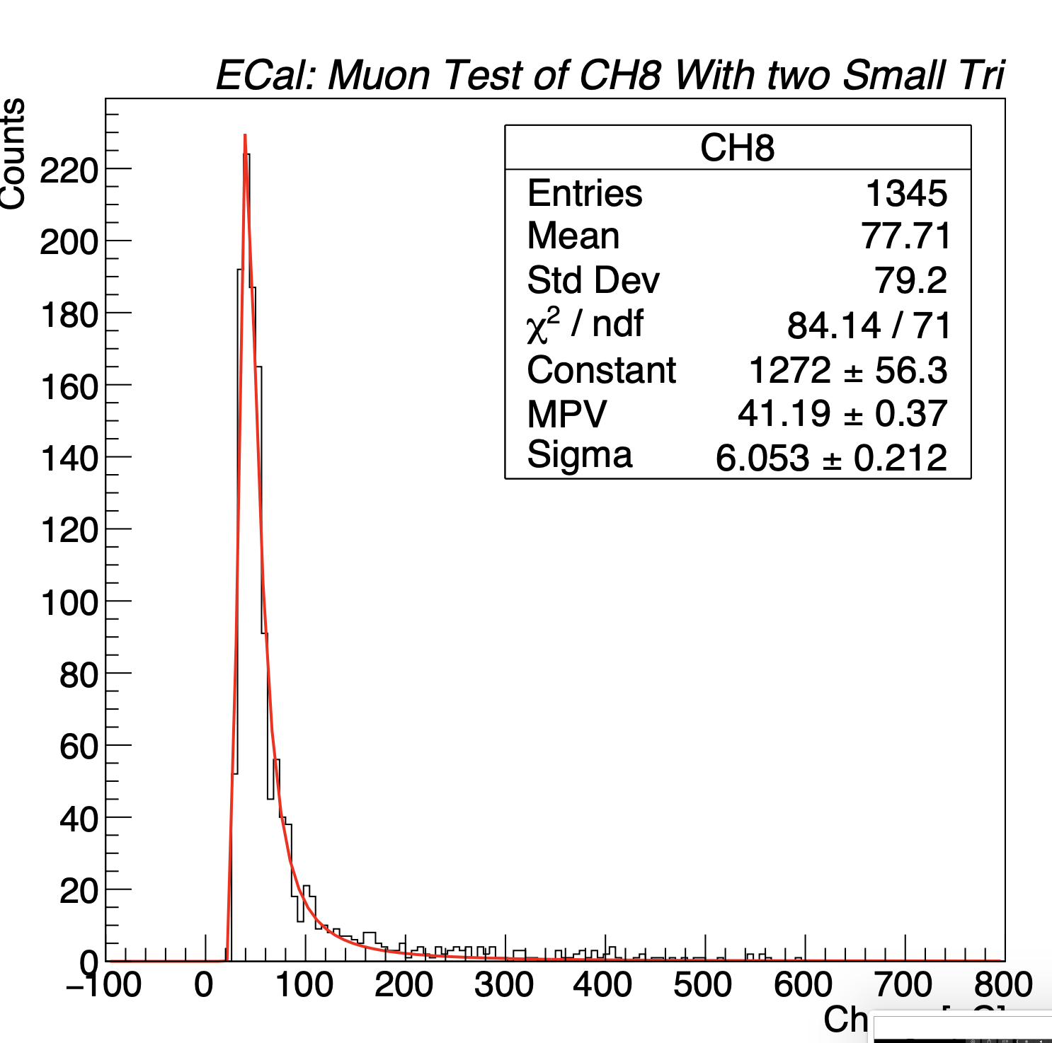
Energy spectrum of 8 towers

Slide 23
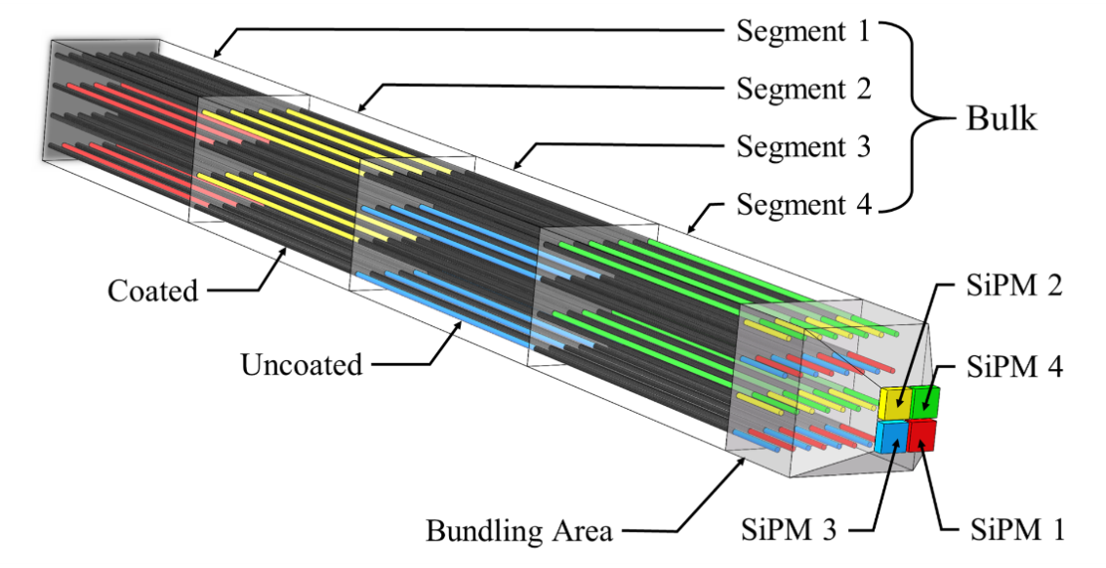
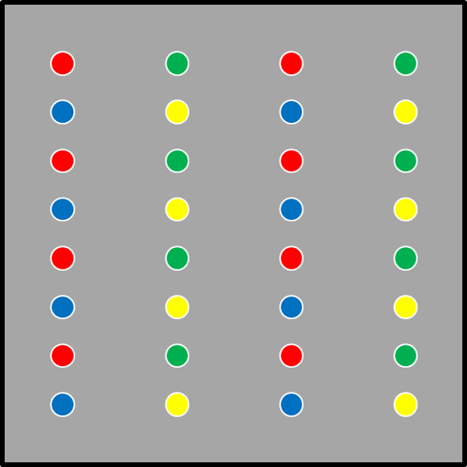

4
  Conceptional design of 5-D shashlyk ECAL
220 layer is separated into 4 parts, each part consists of 55 layers
Readout with 32 WLSFs, each part is readout with 8 WLSFs+SiPM
Mask technology of WLSF
5D: x,y,z, energy (5%), time (~50ps)
Masked

Slide 24



4
  Performance of 5-D shashlyk ECAL
Good PID by energy thickness distribution
Compared with MPD/ECAL：
Readout channel: 4 times
Npe: ~60%
Energy resolution: comparable
+depth distribution of energy deposition
good direction reconstruction (cluster)
+ 50ps time, good PID

Slide 25
Summary
Chinese group has setup the whole production line of MPD-ECal
200 Modules have been produced and 10 have been shipped to JINR
Around 500 modules will be ready on this year
768 modules will be ready by 2022.6
Detailed cosmic test will be done soon.

Slide 26

Thanks for your attention

