Slide 1


Global observables in heavy-ion collisions at NICA.
PWG1 status report
G. Feofilov, on behalf of the PWG1/MPD team
V.Fock Institute for Physics, Laboratory of Ultra-High Energy Physics, Saint-Petersburg State University
VIII MPD Collaboration meeting 12.10.2021—14.10.2021, JINR, Dubna
Notes:
1

Slide 2
PWG1-MPD status
People from Institutes – participants of the PWG1 activity:
SPbSU (St.Petersburg),
INR RAS (Troitsk, Moscow),
MEPhI (Moscow) and
MexNICA Collaboration (Mexica)
JINR
…
PWG1 co-conveners:
Alexander Ivashkin (INR RAS, RF) ivashkin@inr.ru
Grigory Feofilov(SPbSU,RF) g.feofilov@spbu.ru
Regular meetings in April – October 2021: 5 PWG1 meetings
https://indico.jinr.ru/category/343/
Please, visit our PWG1 WEB page: https://indico.jinr.ru/category/343/
Send us an e-mail to join the group!
Notes:
Include JINR (Dubna)

Slide 3
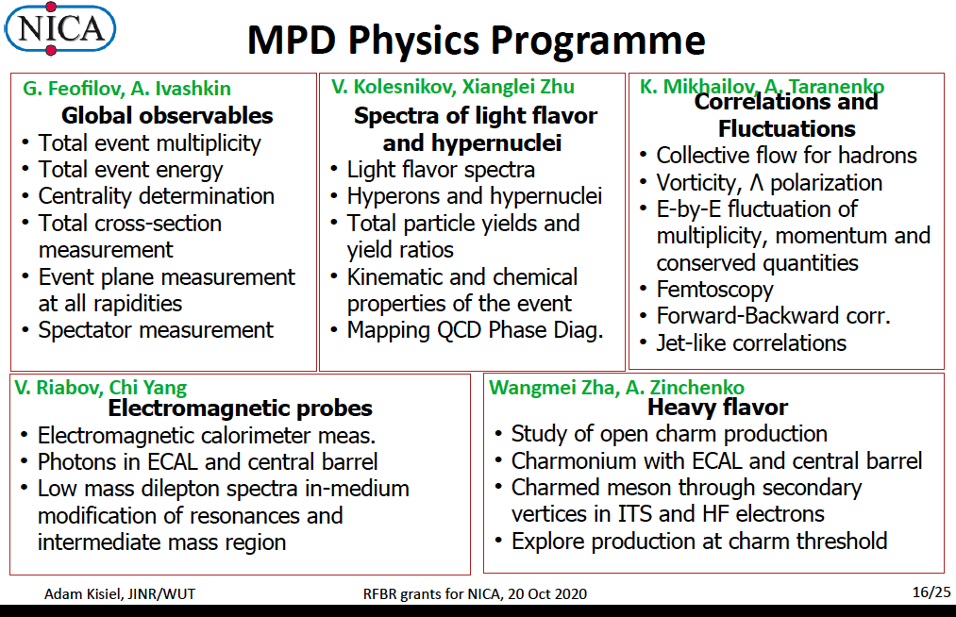

Slide 4
Layout of the talk
Introduction. Where are we today?
2) Discussion of the MC production
Task 1. Compare to STAR Au+Au data at √s_{NN}=9.2 GeV:
Task 2: New MC simulations. What is needed
3) The next steps

Slide 5
Some critical issues
What is expected to be new and could be better measured by the MPD in comparison with STAR@RHIC - from the point of view of Global Observables?
What was achieved by the PWG1 in the period April-October 2021?
What is still not quite in line with the expectations of the PWG1?

Slide 6
Where are we today?
Some talks at PWG1 meetings in 2021
07 Oct.”DCM-SMM – BiBi collisions at 9GeV”, by Mike Medina, I. Maldonado
30 Sept. “Some comments on recent MC simulations of Bi+Bi collisions”, Alexey Aparin
09 Sept."Centrality determination in MPD at NICA"¶ 20m
by Pedro Antonio Nieto Marín "Centrality determination in MPD at NICA".
The talk is prepared for the conference AYSS-2021.
24 June, "Study of centrality classes based on number of charged particles for the Multi-Purpose Detector (MPD) at NICA complex"¶ 20m Authors: Pedro Antonio Nieto Marín, Universidad Autónoma de Sinaloa, México; Alexey Aparin, Joint Institute for Nuclear Research
03 June “The near tasks for the MC production of a common set of data using the UrQMD, SMASH and DCM-QGSM-SMM event-generators for Bi+Bi collsions at sqrt(s_NN)=9.2 GeV.”
20 May, “Some PWG1 tasks for the MC production using the available event-generators”r¶ Speaker: Grigory Feofilov
15 April “On difference between DCM and Glauber model.” Dr Genis Musulmanbekov (JINR, LIT)

Slide 7
Discussion of the MC production
Task 1: to start and compare with STAR@RHIC)
Selection of the pseudorapidity intervals and centrality classes
STAR@RHIC: Au+Au collisions at √s _{NN}=9.2GeV, year 2008 , a short test run of ~3000 good events [1]
Energy dependence of particle ratios,π−/π+, p/p, K−/K+ and K/π, plotted as a function of √sNN. Results from 0–10% central Au+Au collisions at 9.2 GeV at midrapidity (|y|<0.5) are compared with those from AGS, SPS and RHIC.
Azimuthal anisotropy measurements
Pion interferometry measurements
[1] STAR Collaboration, Bulk Properties in Au+Au Collisions at √ s_{NN}= 9.2 GeV in STAR Experiment at RHIC, Nucl.Phys.A830:275c-278c,2009; arXiv:0907.1943v2

Slide 8
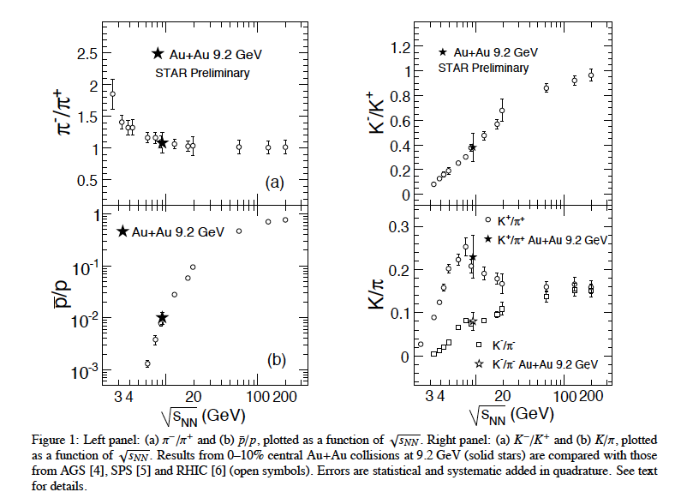
We have to start and compare with STAR@RHIC [1]
Energy dependence of particle ratios
[1] STAR Collaboration, Bulk Properties in Au+Au Collisions at √ s_{NN}= 9.2 GeV in STAR Experiment at RHIC, Nucl.Phys.A830:275c-278c,2009; arXiv:0907.1943v2
At midrapidity
(|y|<0.5)
Centrality
Class
0-10%

Slide 9
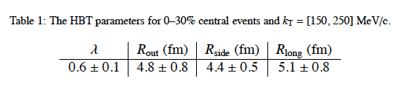
We have to start and compare with STAR@RHIC [1]
[1] STAR Collaboration, Bulk Properties in Au+Au Collisions at ‾‾‾√ sNN‾= 9.2 GeV in STAR Experiment at RHIC, Nucl.Phys.A830:275c-278c,2009; arXiv:0907.1943v2
Pion interferometry measurements
Centrality
class 0-30%

Slide 10
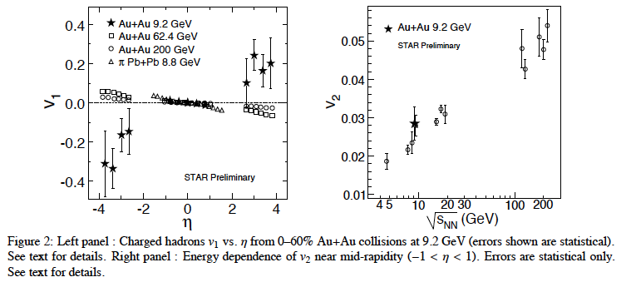
We have to start and compare with STAR@RHIC [1]
Azimuthal anisotropy measurements
[1] STAR Collaboration, Bulk Properties in Au+Au Collisions at √ s_{NN}= 9.2 GeV in STAR Experiment at RHIC, Nucl.Phys.A830:275c-278c,2009; arXiv:0907.1943v2
At midrapidity
(|η|<1.0)
Centrality
class 0-60%

Slide 11
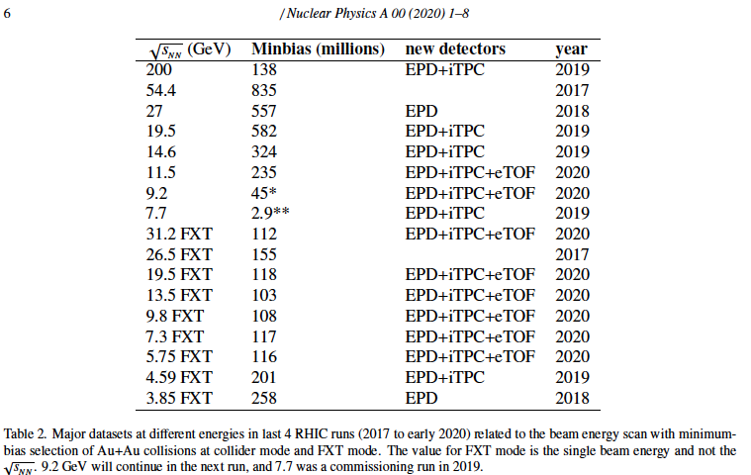
STAR@RHIC data-sets [2]
[2] https://www.osti.gov/servlets/purl/1762771 --we have to check the data-sets available!

Slide 12
Question: with very reach harvest of STAR data at RHIC what is expected to be new and done better by the MPD?

Slide 13
Question: with very reach harvest of STAR data at RHIC what is expected to be new and better by the MPD?
More precise selection of the centrality class in the MPD vs. STAR:
It will provide more accurate determination of the number of binary collisions (N_{coll}) and of the R_{AA} factor
Classes with narrow width of central collisions will eliminate considerably the trivial volume fluctuations and allow to get new results at the NICA energy:
in correlation measurements,
in elliptic flow measurements and flow fluctuations

Slide 14
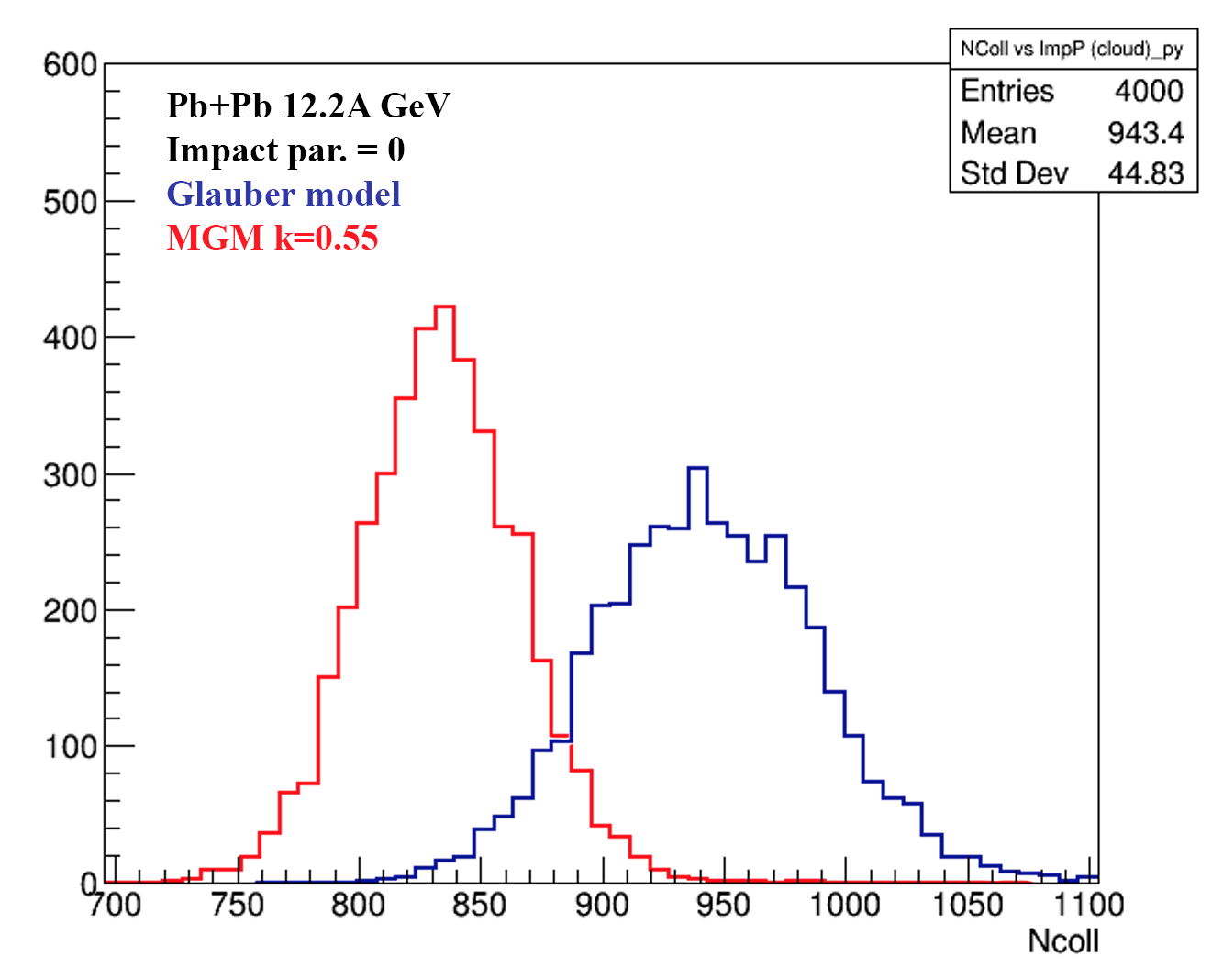
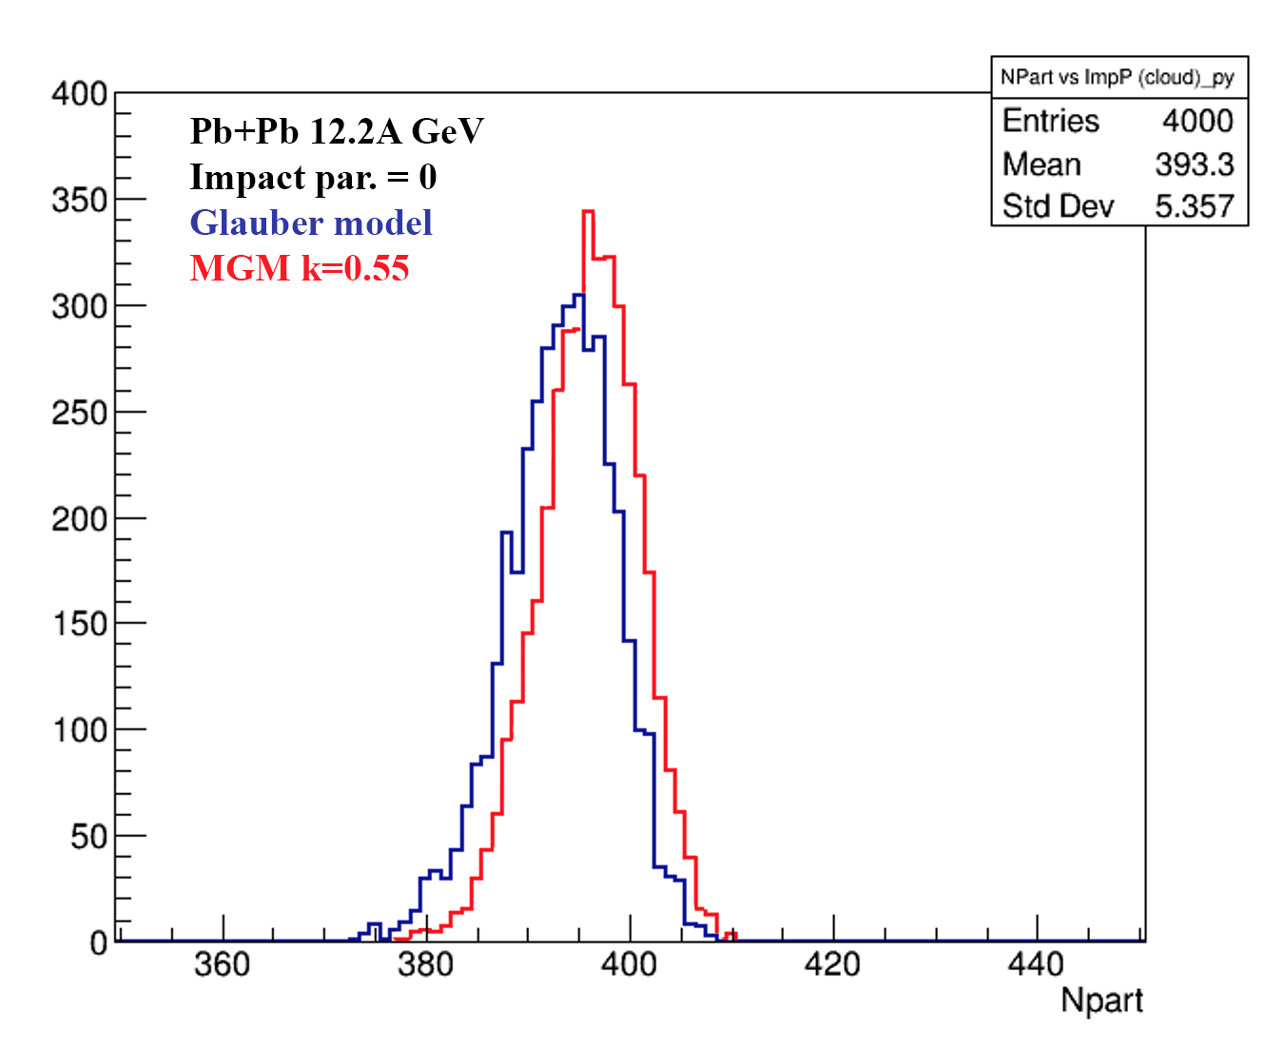
MGM and GM for Pb+Pb collisions:
N_{coll} and N_{part} mean values and fluctuations[1]
N_{coll}
N_{part}
Glauber model and MGM calculations of N_{coll} (left) and N_{part} (right) for Pb+Pb collisions at b=0
Account of energy-momentum conservation in multiparticle production process decreases considerably values of N_{coll}
[1] G.Feofilov et al, RFBR report “ Investigation of initial states…”

Slide 15
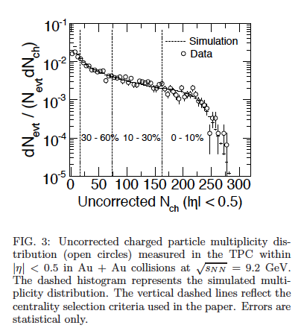

Multiplicity distribution at STAR@RHIC in Au+Au at √sNN= 9.2 GeV
PHYSICAL REVIEW C 81, 024911 (2010)
February 2010Physical Review C 81(2)
DOI:10.1103/PhysRevC.81.024911
SourcearXiv
https://www.researchgate.net/publication/235576464_Identified_particle_production_azimuthal_anisotropy_and_interferometry_measurements_in_AuAu_collisions_at_sNN92_GeV

Slide 16
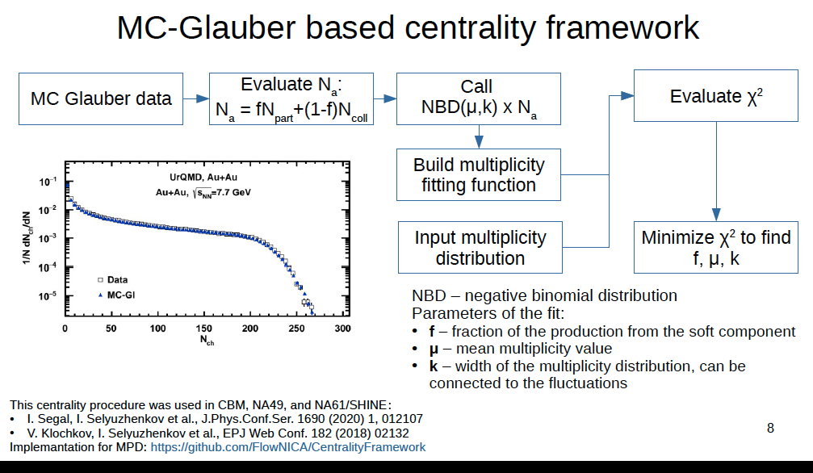
Slide from Petr Parfenov talk:

Slide 17
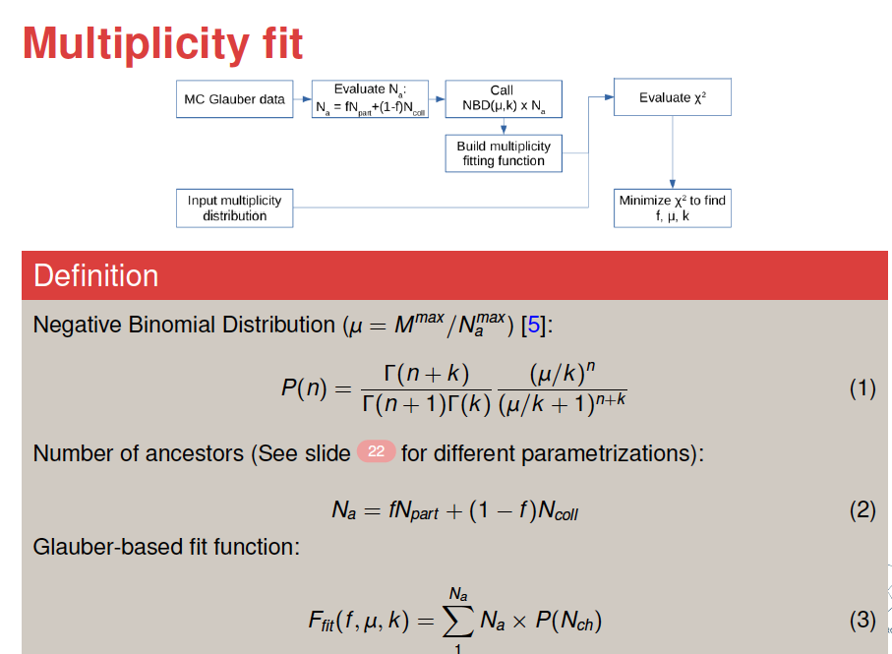
Slide from Pedro Nieto talk:

Slide 18
Parameters x and (f, μ, k) in standard Glauber-based approach ?
The systematic behavior of these parameters vs. collision energy appears to be rather strange (e.g. for “f”)
It should be checked!

Slide 19
Centrality classes selection to compare with STAR
What is needed:
MC simulations fo Bi+Bi collisions at 9.2 GeV for 0-10%, 0-30%, 30-60% and 0-60% and 10-30% multiplicity-based centrality classes
Central pseudorapidity intervals: |η|<0.5 and |η|<1.0
Statistics: ~ 100 mln min bias events -- ?
…something else?

Slide 20
Discussion of the MC production
Task 2:Selection of the pseudorapidity intervals and centrality classes for MPD analysis and MC simulations for the Physics Performance paper
---- Bi+Bi collisions at √s _{NN}=9.2GeV

Slide 21
Request 16: PWG1 -- DCM-SMM, min bias BiBi@9.2 GeV, 1 mln
For physics studies within PWG1 (centrality determination with
FHCal). Done.
dst:
/eos/nica/mpd/dirac/mpd.nica.jinr/vo/mpd/data/exp/dst-BiBi-09.2GeV-mp07-21-2kev/BiBi/09.2GeV-mb/DCMSMM/BiBi-09.2GeV-mp07-21-2kev
MiniDst
/eos/nica/mpd/dirac/mpd.nica.jinr/vo/mpd/data/MiniDST/dst-BiBi-09.2GeV-mp07-21-2kev/BiBi/09.2GeV-mb/DCMSMM/BiBi-09.2GeV-mp07-21-2kev
500 files, 2000 events per file
On NICA cluster
MiniDst:
/eos/nica/mpd/sim/data/MiniDst/dst-BiBi-09.2GeV-mp07-21-2kev/BiBi/09.2GeV-mb/DCMSMM/BiBi-09.2GeV-mp07-21-2kev
dst:
/eos/nica/mpd/sim/data/exp/dst-BiBi-09.2GeV-mp07-21-2kev/BiBi/09.2GeV-mb/DCMSMM/BiBi-09.2GeV-mp07-21-2kev
………the analysis has started
https://mpdforum.jinr.ru/t/request-16-pwg1-dcm-smm-min-bias-bibi-9-2-gev-1-mln/376

Slide 22
Request 14: PWG1 - UrQMD, 1M min. bias BiBi @ 9.2 GeV
This production will rely on GEANT4 to simulate the detector response and use UrQMD as an event generator and will be used for physics studies within PWG1 (centrality determination).
Done:
dst:
/eos/nica/mpd/sim/data/exp/dst-BiBi-09.2GeV-mp06-21-500ev/BiBi/09.2GeV-mb/UrQMD/BiBi-09.2GeV-mp06-21-500ev
minidst:
/eos/nica/mpd/dirac/mpd.nica.jinr/vo/mpd/data/MiniDST/dst-BiBi-09.2GeV-mp06-21-500ev/BiBi/09.2GeV-mb/UrQMD/BiBi-09.2GeV-mp06-21-500ev
….the analysis is in progress
https://mpdforum.jinr.ru/t/request-14-pwg1-urqmd-1m-min-bias-bibi-9-2-gev/377/3

Slide 23
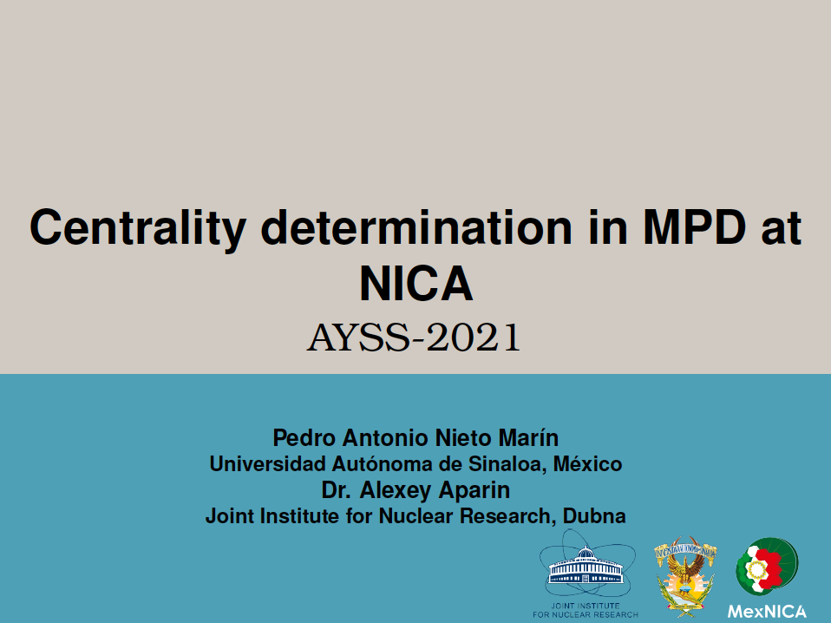
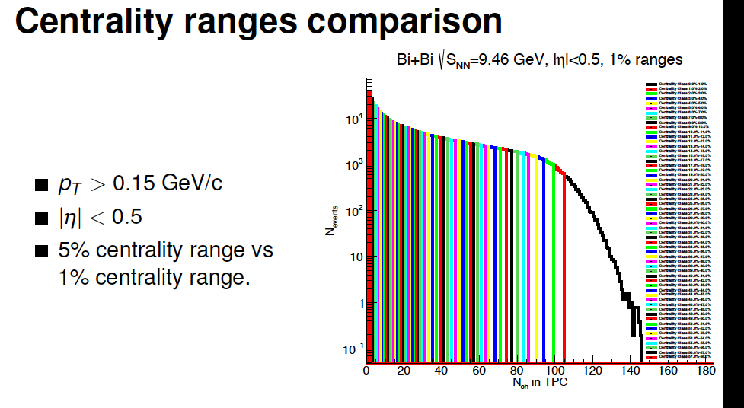

Centrality determination in MPD at NICA
Bi+Bi collisions at 7.7, 9 and 9.46 GeV using UrQMD.
600; 000 reconstructed events in MpdRoot Framework.

Slide 24
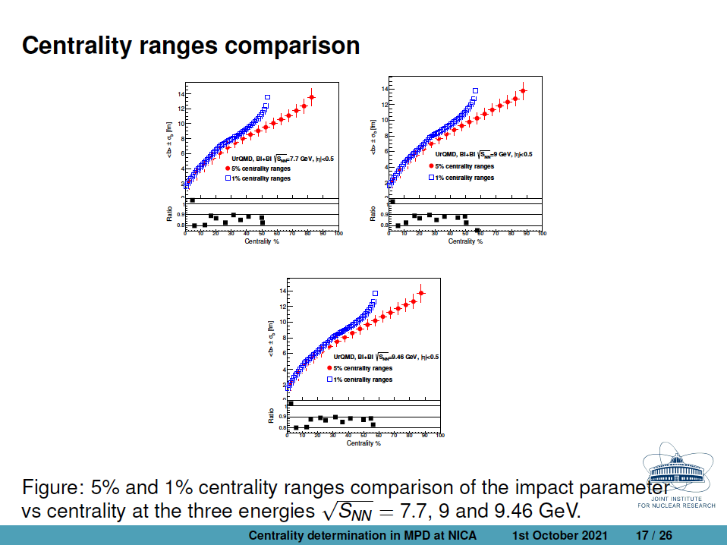

Slide 25
Centrality of relativistic heavy ion collisions
^{In} ^{ALICE as an example}
PHYSICAL REVIEW C 88, 044909 (2013)
FIG. 10. (Color online) Distribution of the sum of amplitudes in the VZERO scintillators. The distribution is fitted with the NBD- Glauber fit (explained in the text), shown as a line. The centrality classes used in the analysis are indicated in the figure. The inset shows a zoom of the most peripheral region.
Results indicate that selection of a narrow centrality class in multiplicity does not assume real selection of very central events in terms of the impact parameter

Slide 26
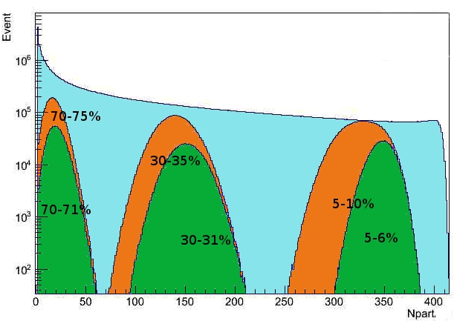
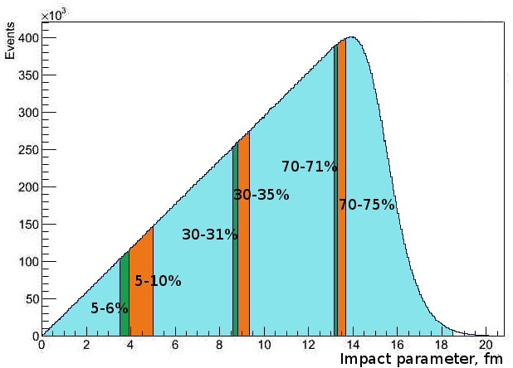
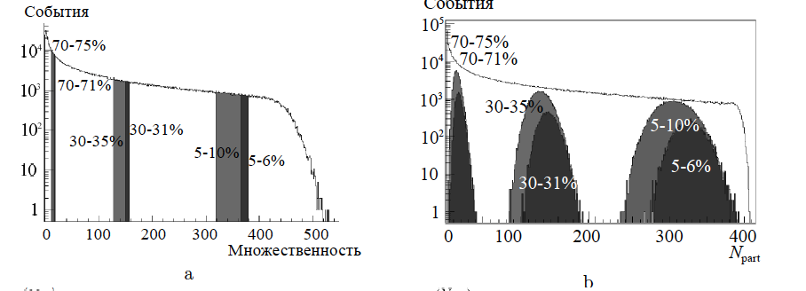
Impact parameter b, multiplicity and N_{part} in MC Glauber model
Percentile
MC Glauber, PbPb 2.76TeV
b
b
Some impact parameter centrality classes
Npart distribution in the different centrality classes
Results indicate that selection of a narrow centrality class in multiplicity does not assume real selection of very central events in terms of the impact parameter
Centrality and multiparticle production in ultrarelativistic nuclear collisions
Drozhzhova T.A., Kovalenko V.N., Seryakov A.Y., Feofilov G.A.
Physics of Atomic Nuclei. 2016. Т. 79. № 5. С. 737-748.

Slide 27
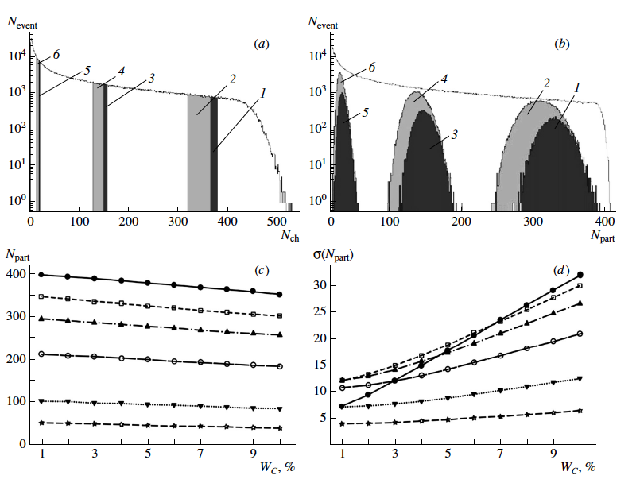
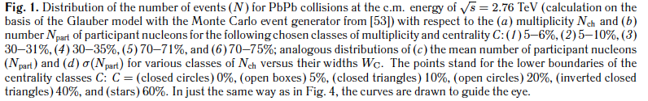
Centrality-wise optimization of the class width is needed

Slide 28
Two main approaches to determination of classes of centrality
Multiplicity in TPC as centrality class estimator
-- method was suggested by MEPHI/GSI team
Report by Petr Parfenov at the MPD Physics forum 15.04.2021r:
See https://indico.jinr.ru/event/2065/
https://github.com/FlowNICA/CentralityFramework
https://github.com/Dim23/GammaFit
Draft of analysis note:
https://github.com/FlowNICA/CentralityFramework/blob/master/Documentation/Centrality_AnalysisNote.pdf
Spectator nucleons with FHCal
– by the INR RAS team, see the PWG1 meetings Report by Vadim Volkov at the PWG1 meeting 01 April 2021
https://indico.jinr.ru/event/2066/
or RFBR conference:
https://indico.jinr.ru/event/1469/contributions/9905/attachments/8135/12126/ivashkin_RFBR_2020.pdf
Codes: https://github.com/qweek2/Centrality_NICA/tree/master
  .
Global observables in heavy-ion collisions at NICA.
PWG1 status report , MPD Collaboration meeting 21.04.2021—23.04.2021, JINR, Dubna

Slide 29
Some comments on Multiplicity-based methods
Very detailed analysis +documentation in two approaches used
Important for comparison with RHIC data
… but we have to continue to investigate the problems:
Multiplicity-based method is being used currently at the midrapiidty |η |<0.5: therefore, auto-correlations might be possible in the analysis of fluctuations etc. Different pseudorapidity intervals should be selected
Three parameters (f, μ, k) in standard Glauber-based approach …
Constant class width for all centrality classes (should be optimized)
Systematic errors and effects of various cuts on multiplicity distribution….one of the items for studies
Standard Glauber-based approach produces considerable bias to the number of binary collisions Ncoll….it is the old problem – it is also one of the items for further studies and checks with the MC event generators

Slide 30
FHCal energy measurements
Impact parameter
Event-plane reconstruction with spectators

Slide 31
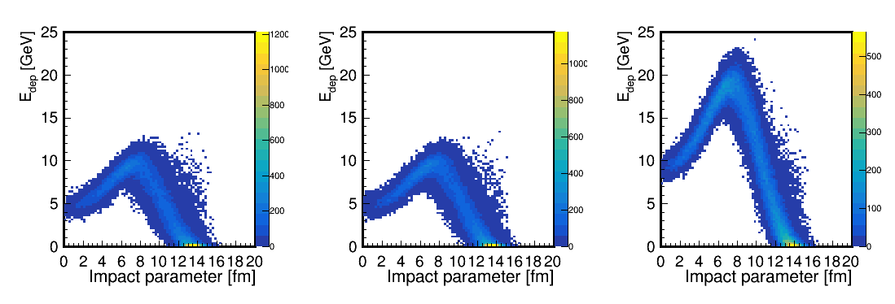
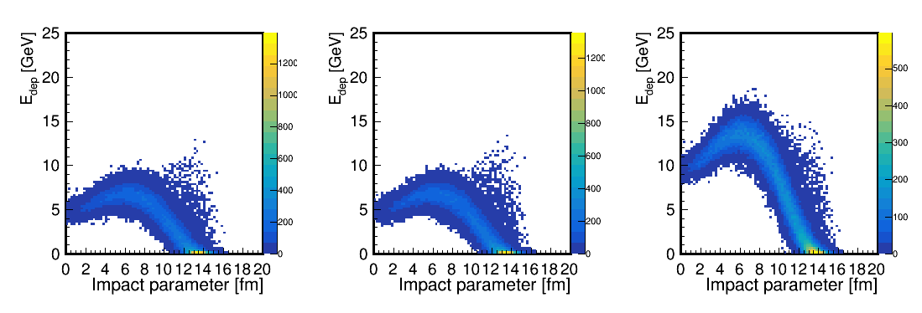
Fragmentation models/generators
Depending on fragmentation model, simulated energy deposition in FHCal can be quite different.
LAQGSM
DCM-SMM
Non-spectator’s contributions
For DCM-SMM, the maximum energy deposition in FHCal is about 30% less due to the larger number of intermediate mass fragments (effect of beam hole).
Accuracy depends on the fragmentation model.

Slide 32
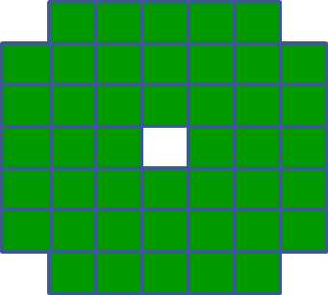
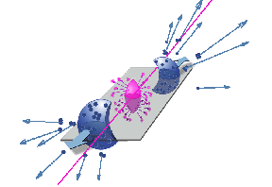
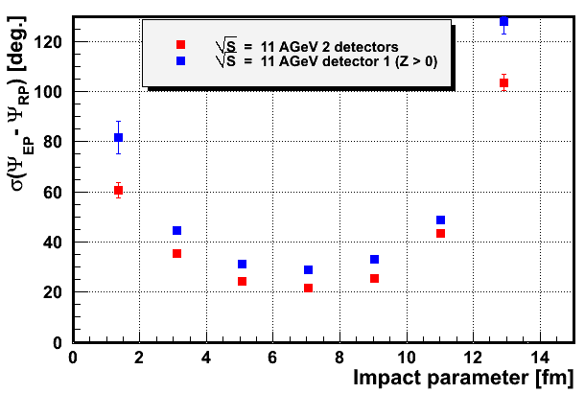
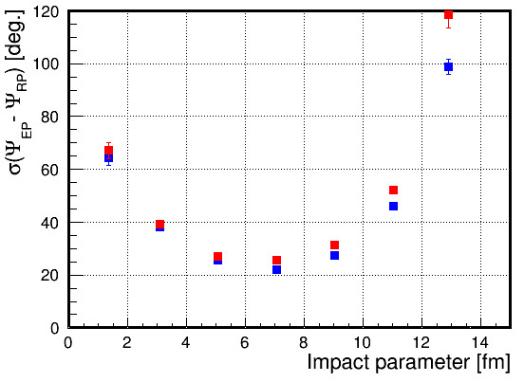
Reconstruction of the event plane with spectators
From energy and space distribution of spectators one can determine the event plane as an experimental estimate of the reaction plane.
E_{i} , (x_{i} ,y_{i}) – energy and coordinates of i-module.
spectators
Event plane in first FHCal part:
Event plane in both FHCal parts:
Resolution: difference between true reaction plane and reconstructed event plane.
(LAQGSM)
(DCM-SMM)
LAQGSM model
Detection of all types of the spectators (protons, neutrons) for both colliding nuclei would ensure the outstanding ~20⁰ angular resolution of the event plane!
New method for event plane determination now under development.

Slide 33
Proposals for MC simulations and analysis for the Physics Performance paper
Statistics for Bi+Bi collisions at 9.2 GeV: ~ 100 mln min bias events -- ?
Central pseudorapidity intervals for TPC physics analysis: |η|<0.5 and |η|<1.0
Different pseudorapidity intervals should be considered for multiplicity classes selections In order to avoid trivial autocorrelations : TPC tracks in 0.5 <|η|<1.5
Other pseudorapidity intervals: e.g. FFDs, which are symmetrically placed to the MPD center along the beam line 2.5 ≤| η |≤ 3.2 (also mini-BeBe – ?) could be aslo considered for the multiplicity classes selection
Class-wise optimization of the class width: MC simulations fo Bi+Bi collisions at 9.2 GeV for 0-1%, 0-3%, 0-5%, 0-7%, 0-10%, 0-20% multiplicity based centrality classes (and similar optimization for the FHCal classes)
Z-position of the interaction vertex should be taken into account in the new MC simulations production. Studies of z-cuts are needed.

Slide 34
The next steps:
The main two approaches (multiplicity-based and FHCal energy) to the determination of the classes of centrality are valid and important for the further investigations.
Other approaches to centrality classes definition (selection of pseudorapidity intervals, account of asymmetry of the total spectator volume in AAMCC and fragmentation processes, effects of nucleon stopping, etc… should be also developed further
The next steps in application of DCM-QGSM-SMM:
-- Accompany generated events by histograms of bulk observables.
-- Prepare the macros for determination of the Reaction Plane.
--- Improvement of spectator matter description.

Slide 35
Thank you for your attention!

Slide 36
Summary-1
Two approaches, are being developed for determination of centrality classes in AA collisions: (i) traditional multiplicity-based, and (ii) novel approach, based on spectators spatial distributions in FHCal
Theoretical considerations aimed at physics description of fragmentation processes in AA collisions and for understanding of the collision dynamics, are also in progress. An additional observable for centrality classes is proposed: a ratio of (a sum of fragment charges}²/{total Spect.Energy}.
Selecting multiplicity classes, as a proxy to centrality in heavy-ion collisions, is needed at the first stage of MPD data analysis to compare with the already existing results obtained at RHIC.
Codes for selecting events for classes for multiplicity are developed and accessible. Documentation is also provided (however, the working groups must interact closely with the PWG1)
Global observables in heavy-ion collisions at NICA.
PWG1 status report , MPD Collaboration meeting 21.04.2021—23.04.2021, JINR, Dubna

Slide 37
Summary-2
The choice of classes on the energy of spectators in the FHCAL calorimeter ---- the procedure is demonstrated based on the newly developed approach of accounting not only energy, but also the spatial distribution of energy of spectators hitting the calorimeter.
This new FHCAL technique provides an independent selection of classes of events (and it excludes also autocorrelations in the analysis of data on fluctuations and correlations of observables).
Some problems relevant to the centrality classes selection are revealed: -- The events with a rather wide set of impact parameters could be mixed into the class. The trivial volume fluctuations are to be minimized by centrality-wise optimization of the class width used. --The number of binary collisions obtained in a standard Glauber approach is usually model biased (e.g. Glauber). It should be taken into account in the MPD data physics analysis.
Global observables in heavy-ion collisions at NICA.
PWG1 status report , MPD Collaboration meeting 21.04.2021—23.04.2021, JINR, Dubna

Slide 38
