Slide 1


NICA Collider
Construction status and commissioning plans

Slide 2


Facility layout
2
Notes:
This is a view of major NICA facilities. The Nuclotron – supercoducting synchrotron with circumference of 250 meters was put in operation 24 years ago. The beams from Nuclotron are extracted to the experimental hall, where the first experiment of NICA program BM@N is located. The plan is to put in operation a booster in 2019, and collider - in 2020 simultaneously with the MPD.

Slide 3
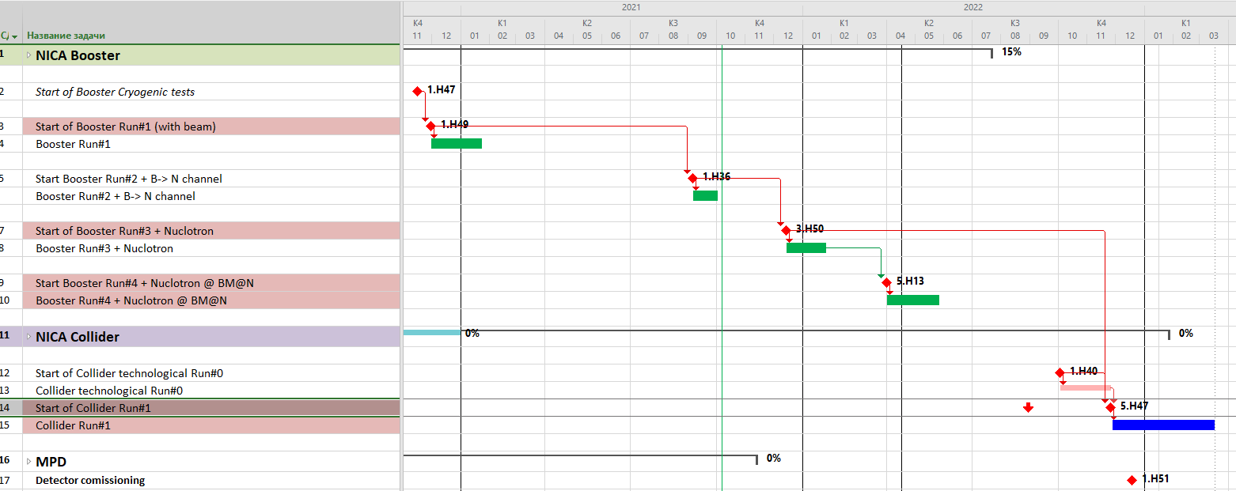
Key run-milestones
2021
2022
SRC
BM@N
NICA complex injection chain RUNs’ schedule
3

Slide 4
Facility components – status
2021
KRION
Linac HILac
KRION
Linac HILac
Ion sources
Booster (25 Tm)
1(2-3) single-turn injection,
storage of (2 ÷ 4)×10⁹ ions,
acceleration up to 100 MeV/u,
electron cooling, acceleration
up to 600 MeV/u
Ion sources
Booster (25 Tm)
1(2-3) single-turn injection,
storage of (2 ÷ 4)×10⁹ ions,
acceleration up to 100 MeV/u,
electron cooling, acceleration
up to 578 MeV/u
Linac LU-20
Linac LU-20
Fixed Target Area
Fixed Target Area
Slow resonance extraction
Stripping (80%) ¹⁹⁷Au³¹⁺ => ¹⁹⁷Au⁷⁹⁺
IP-2
Nuclotron (45 Tm)
injection of one bunch
of ≤ 2×10⁹ ions,
acceleration up to
1 - 4.5 GeV/u max.
Nuclotron (45 Tm)
injection of one bunch
of ≤ 2×10⁹ ions,
acceleration up to
1 - 4.5 GeV/u max.
Collider
L ≥ 10²⁷ см⁻²с⁻¹
IP-1
work in progress
assembly
commissioned / existing

Slide 5
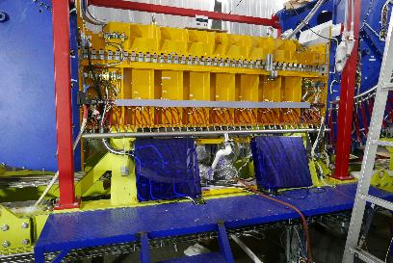
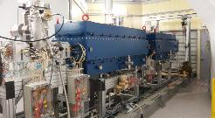
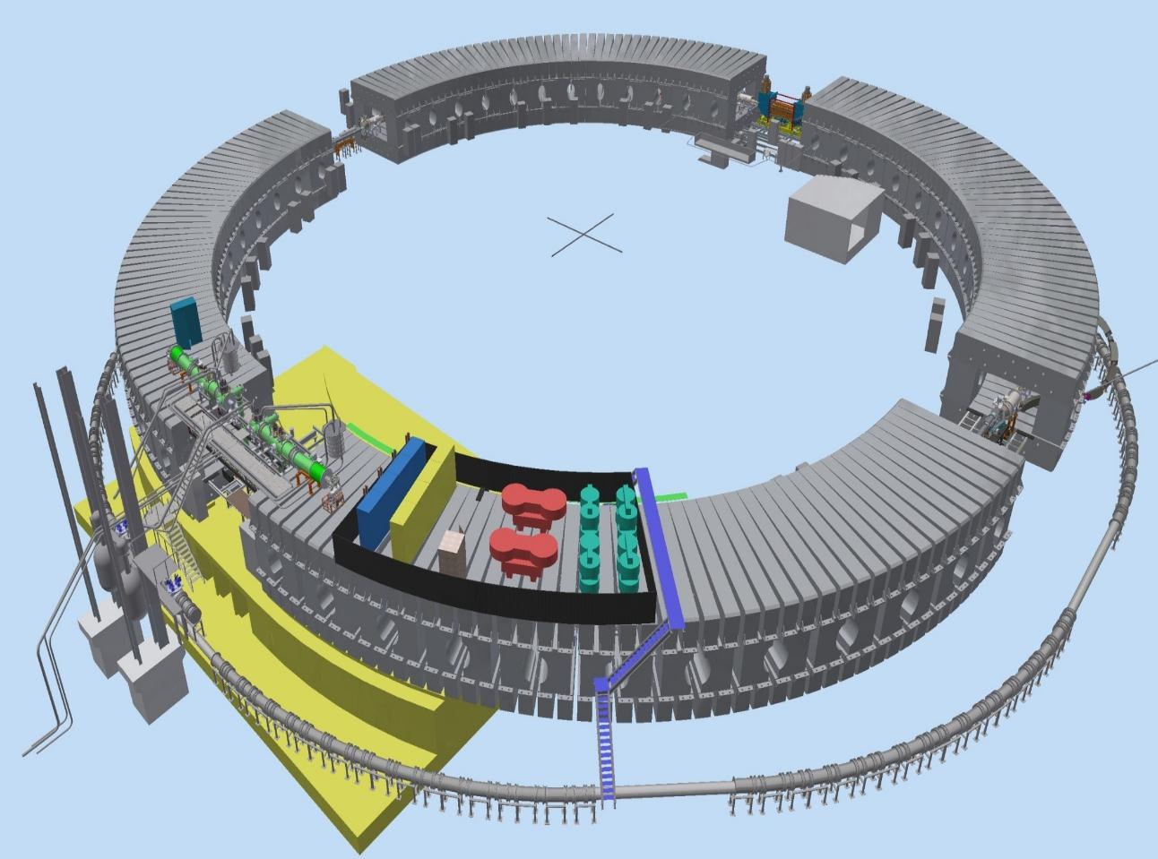
NICA Booster commissioned
Dec, 2020
Electron cooler
injection
Reference section
Power supply
extraction
RF stations
1. “Prepare” beam from KRION – HILAc for stripping (578 MeV/u)
2. Store ions at injection energy (multiple injection)
3. Cool the beam @ 60 MeV/u => small 6D emittance
Nuclotron
5

Slide 6
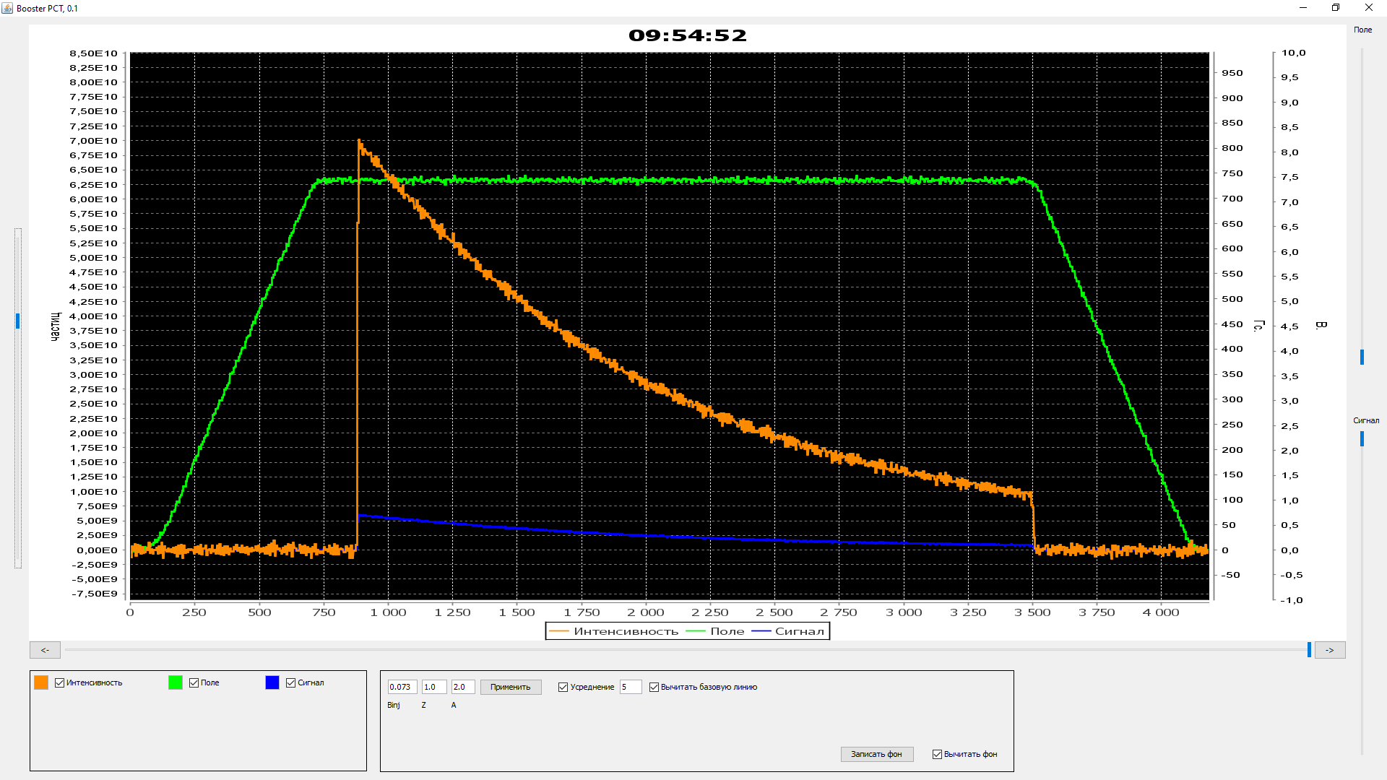
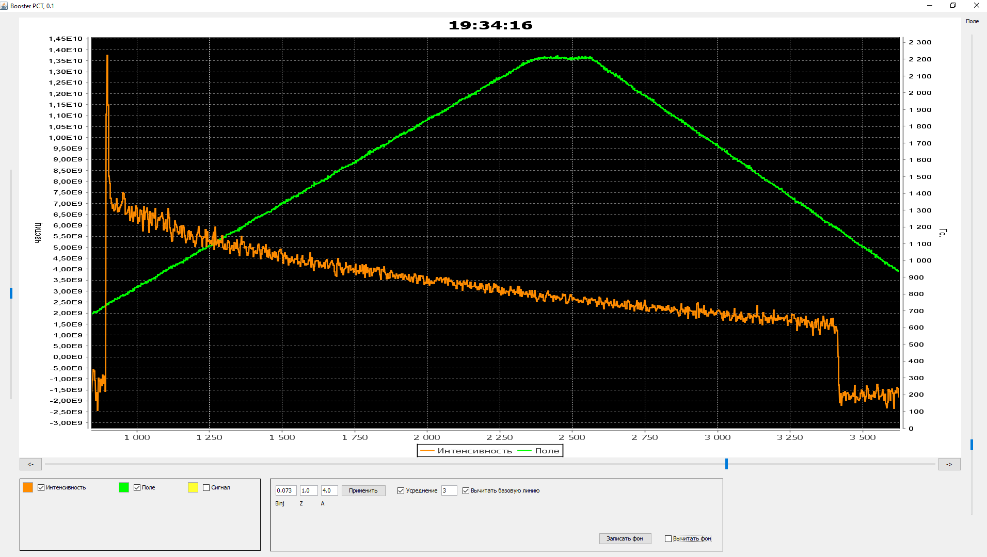
NICA Booster RUN #1
Parametric current transformer
Dec, 2020
7⋅10¹⁰
7⋅10¹⁰ elementary charges ~ 2⋅10⁹ Au³¹⁺
Life-time is about 1,3 s, equivalent pressure of residual gas is 2⋅10⁻⁸ Pa
Number of particles
Acceleration up to 100 MeV/u
Beam intensity

Slide 7
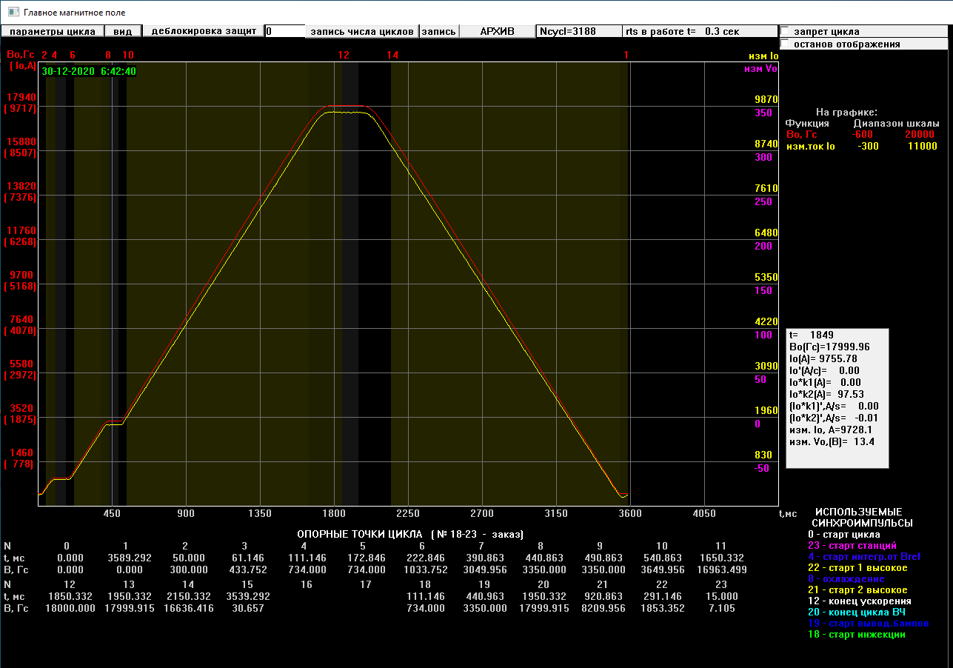
NICA Booster RUN #1
Dec, 2020
1.8 T
dB/dt = 1.2 T/s
Electron cooling plateau
Injection plateau

Slide 8
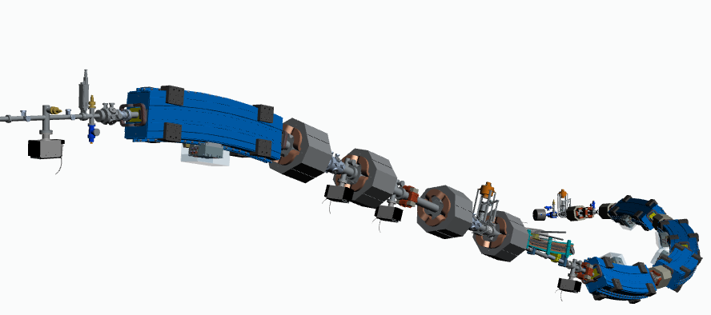
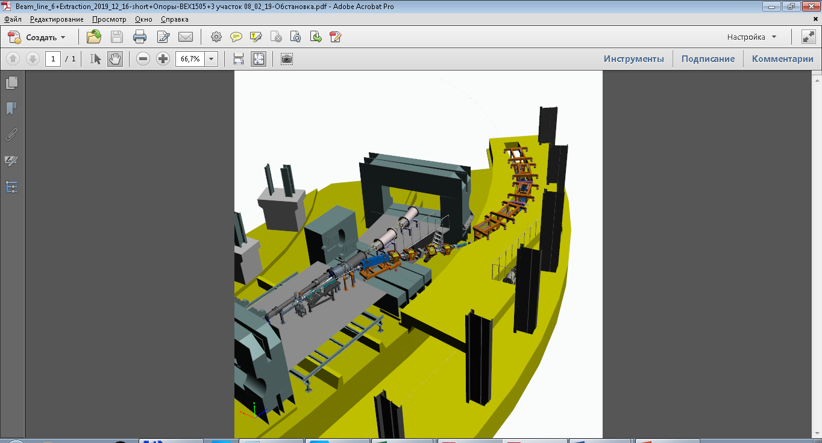
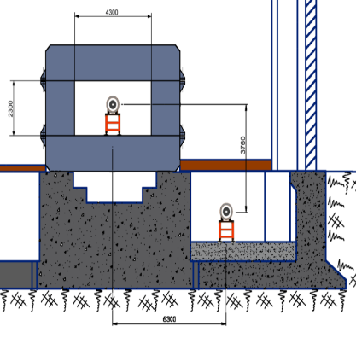
Beam extracted from Booster and transferred through cannel
Sep, 2021
Booster
Nuclotron

Slide 9
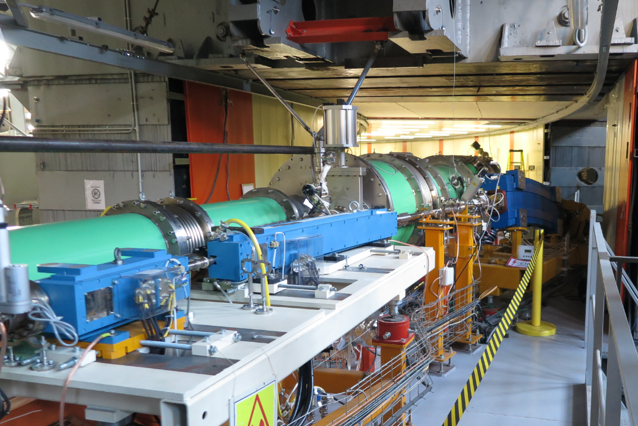
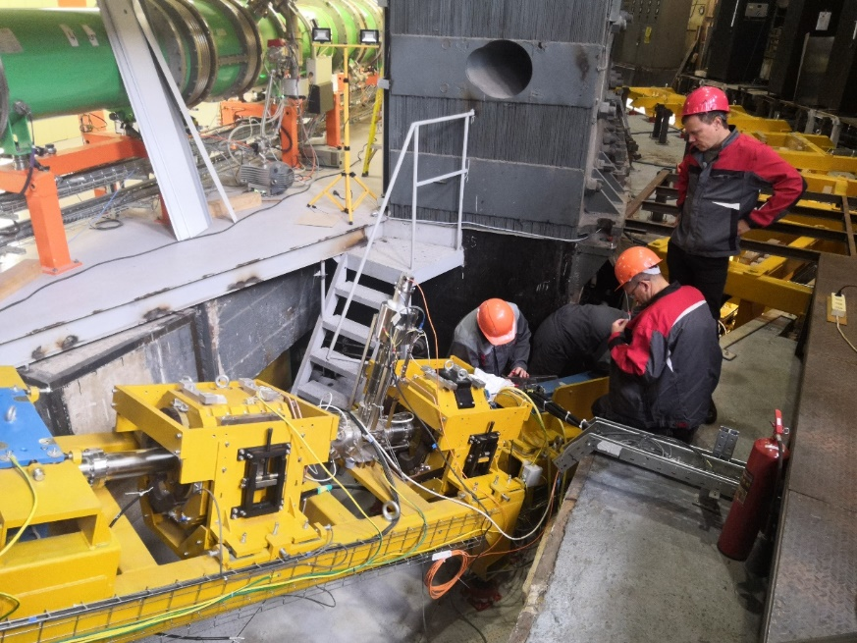
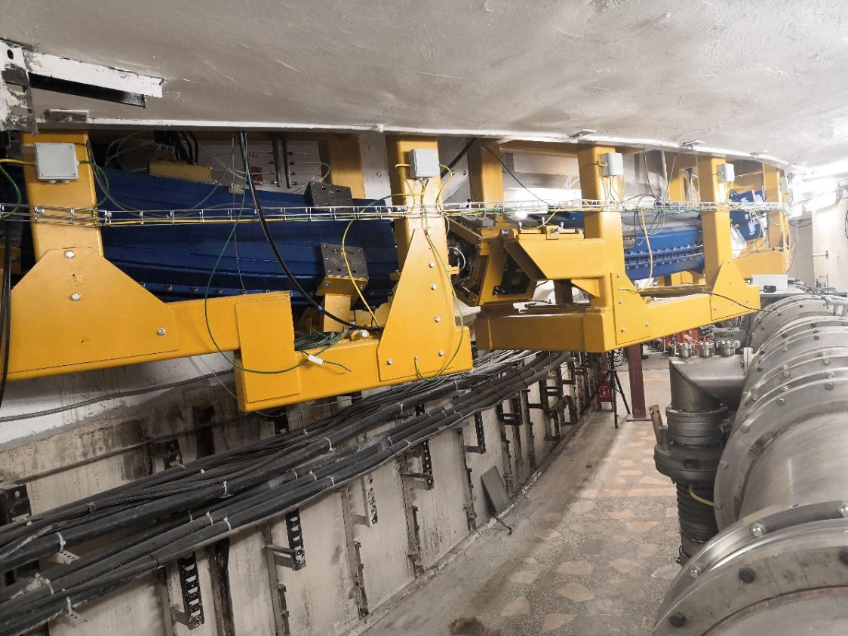
Beam extracted from Booster and transferred through cannel
Sep, 2021
Booster-Nuclotron channel 3D-geometry:
Beam transfer in horizontal + vertical direction

Slide 10
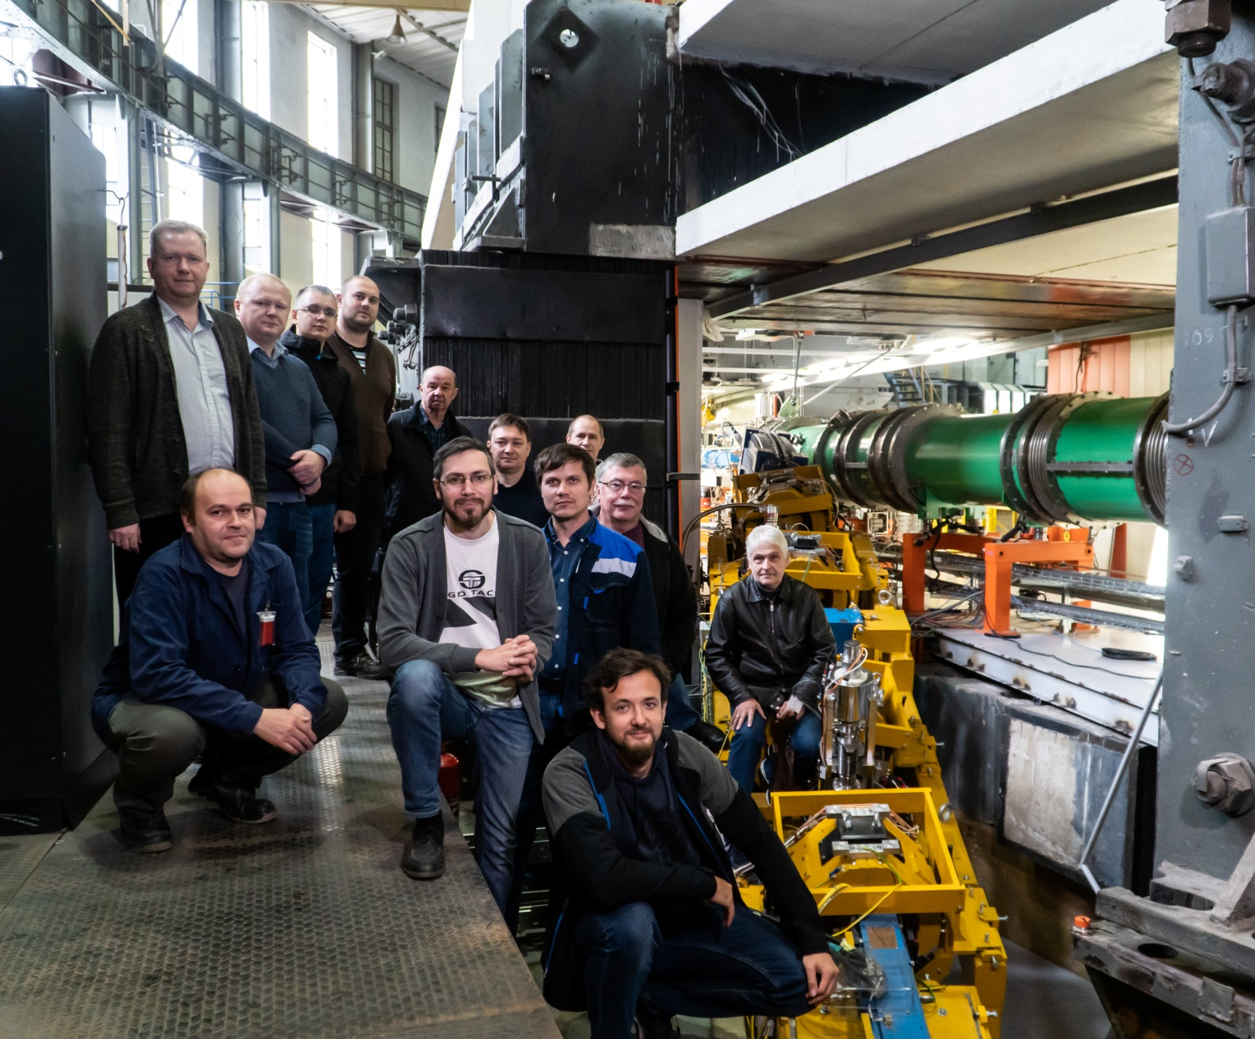
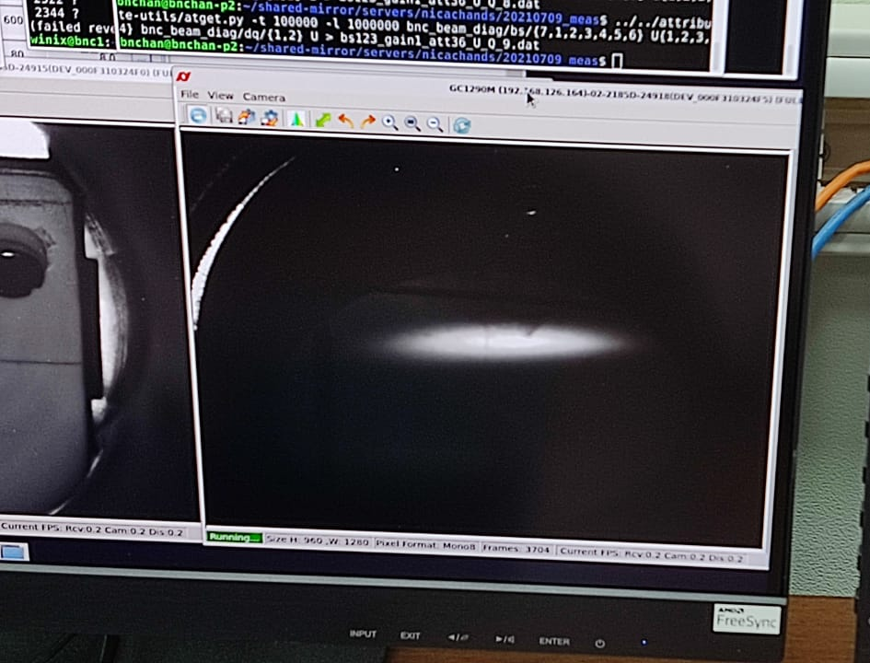
Beam extracted from Booster and transferred through cannel
Sep, 2021
Fe14+ beam profile at the luminophore plate at the exit from the channel
Joint JINR-BINP team

Slide 11
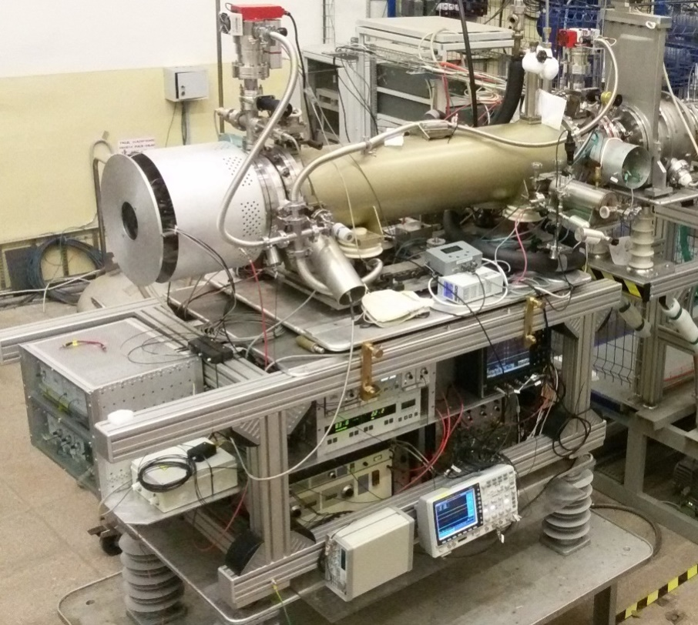
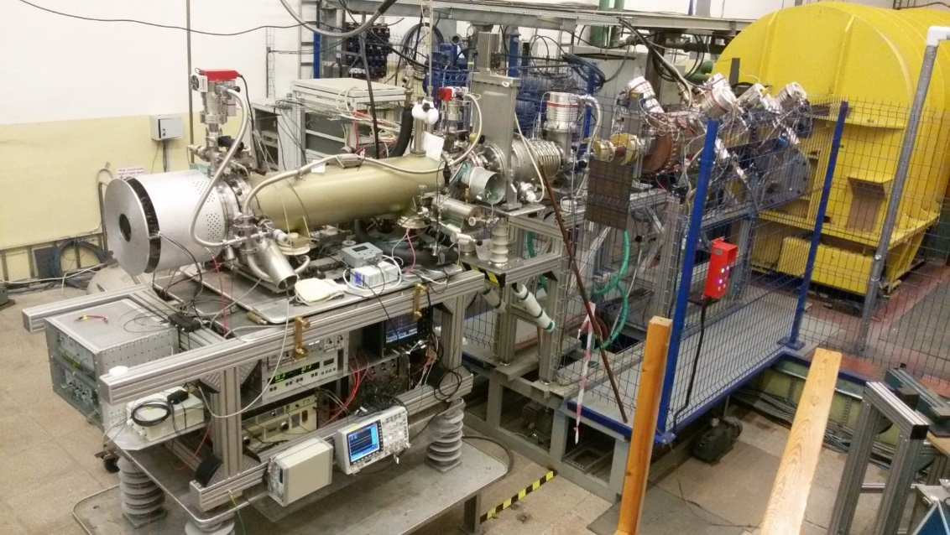
ESIS “KRION -6T”
heavy ion source
Development in progress
Theoretical and achieved parameters:
1) Magnetic field up to B= 6.0 Т, (5.0 T)
2) Energy of electron string E_{e} ≤ 25keV (E_{e}≤12keV)
KRION 6T was used during Nuclotron RUN #55 (March 2018)
for SRC & BM@N experiments
(Ar & Kr beams)

Slide 12
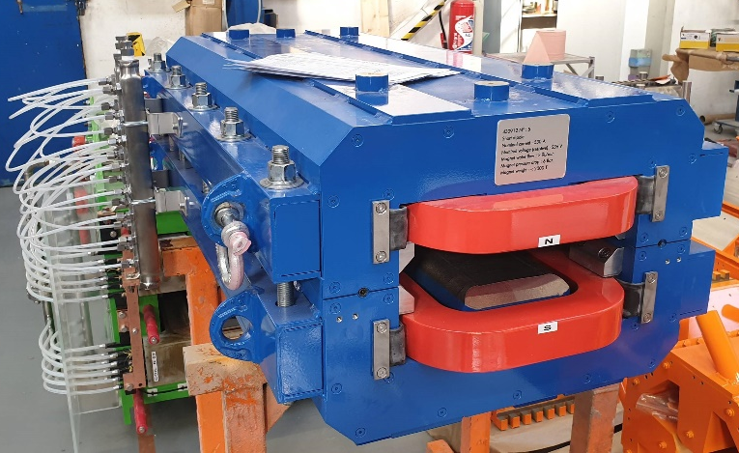
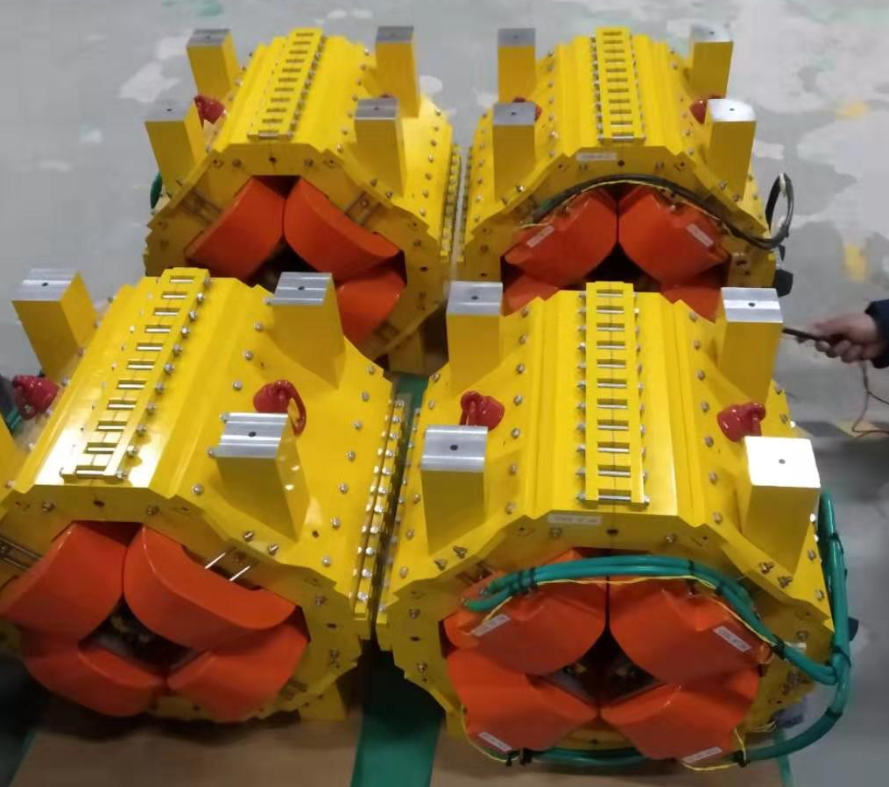
Nuclotron – Collider channel (Sigma-Phi)
magnets- completeness 100%
delivery 12.2020
beam pipes and diagnostics
- completeness 90%
delivery 03.2022
power supplies- completeness 10%
delivery 04.2022
assembly and testing- 04.2022 > 08.2022
Magnetic element | Number | Effective length, m | Max. magnetic field (gradient), T (T/m)
Long dipole | 21 | 2 | 1.5
Short dipole | 6 | 1.2 | 1.5
Quadrupole Q10 | 22 | 0.353 | 31
Quadrupole Q15 | 6 | 0.519 | 31
Steerer | 33 | 0.466 | 0.114
12

Slide 13
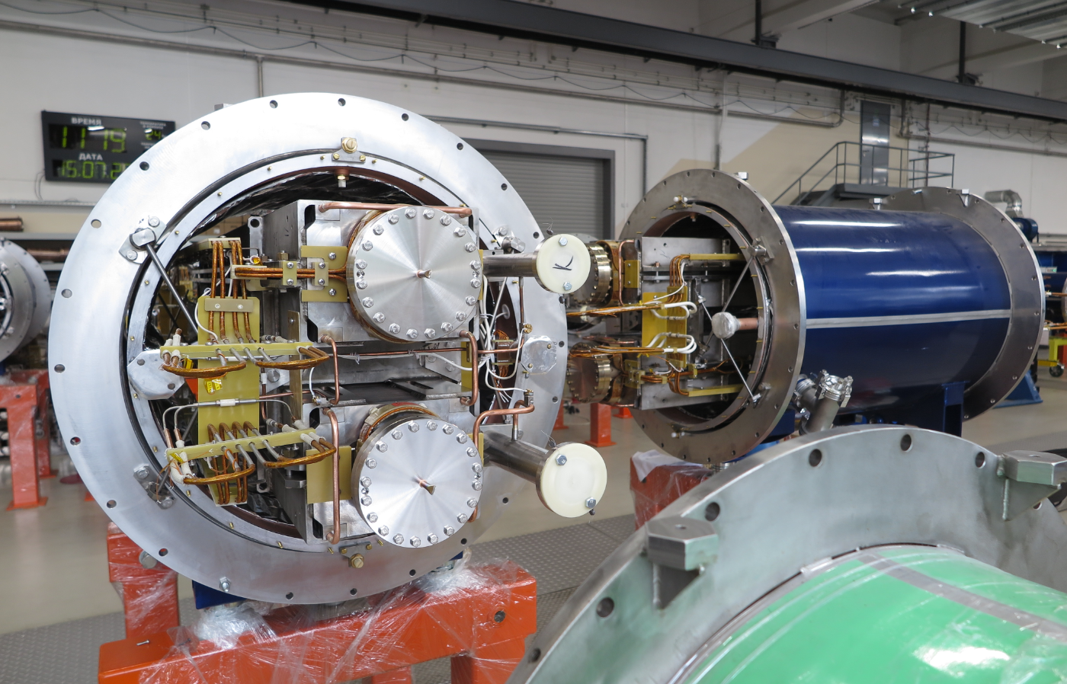
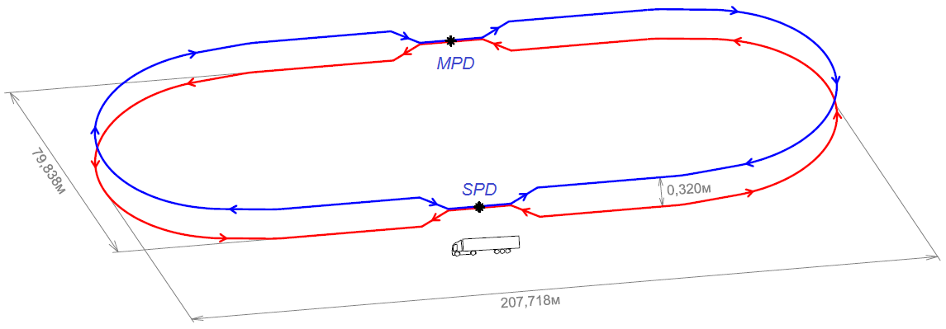
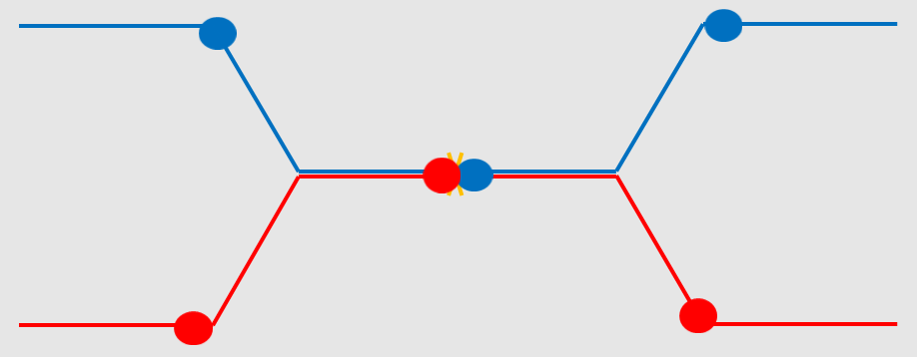
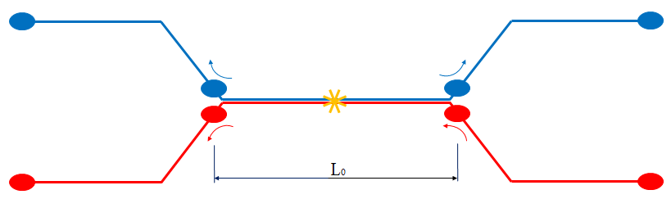
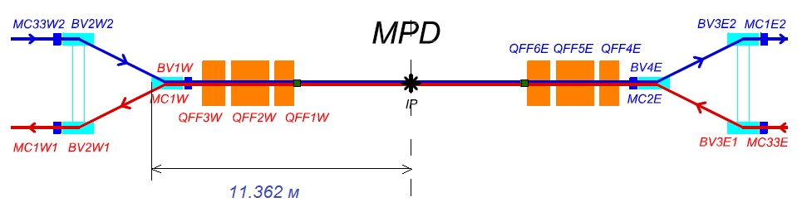

preparation of the collisions
inter-bunch distance is to be large enough
to avoid parasitic collisions
=>
fixed number of bunches in the ring
Detector
`
$$n_{b}=\frac{C_{ring}}{L_{0}}$$

Slide 14
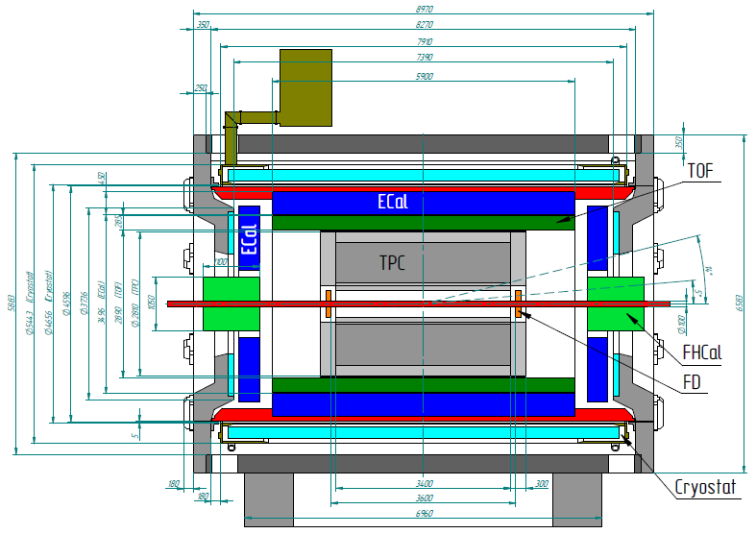
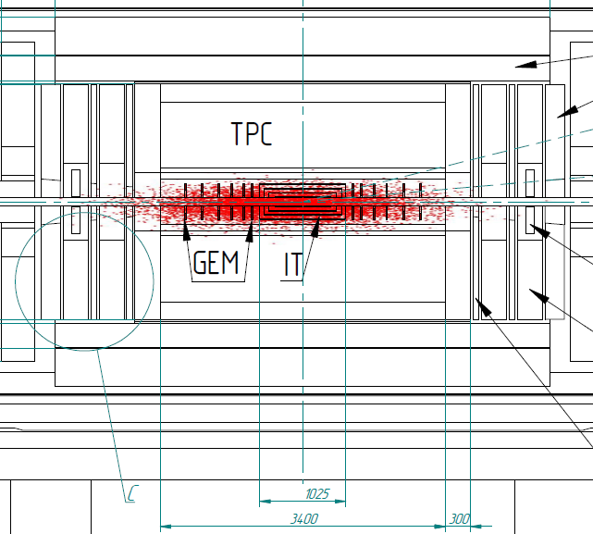
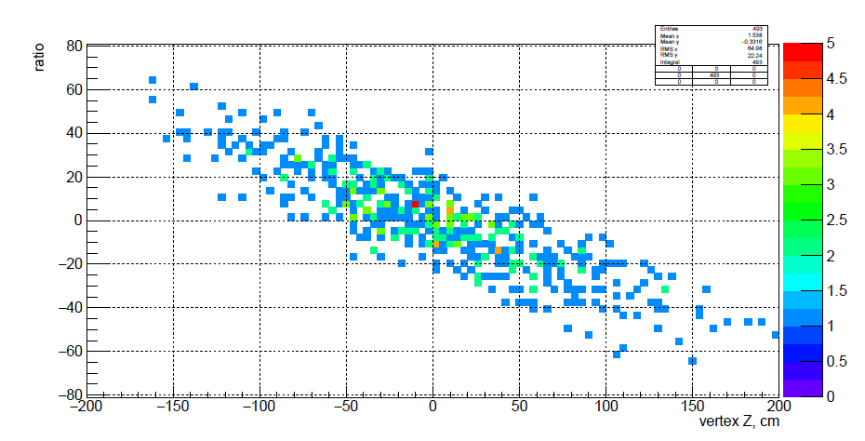
Required bunch long size
Particles Detector
MPD
Asymmetry of energy deposited in the left-right forward Hadron Calorimeters
$$6σ_{s}≅TPC$$
Central events, 11 GeV/n
$$σ_{s},σ_{p}→U_{RF}$$

Slide 15
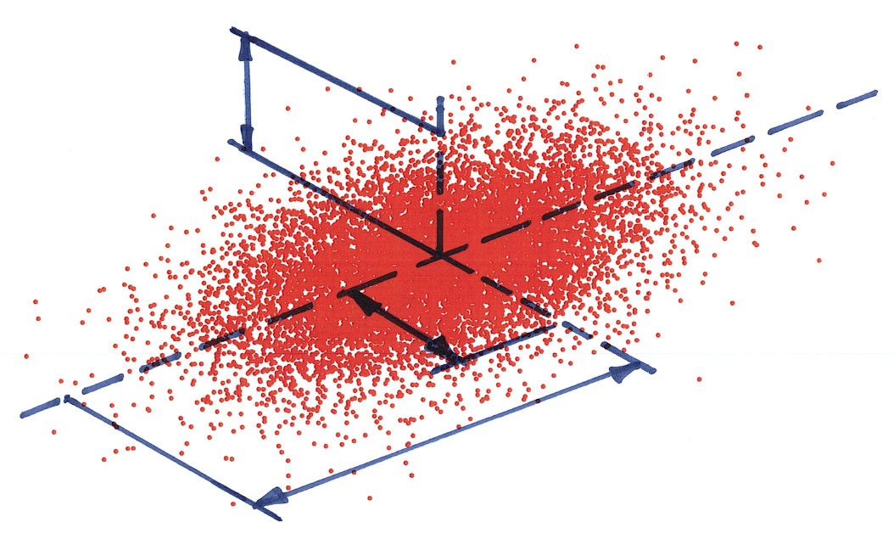
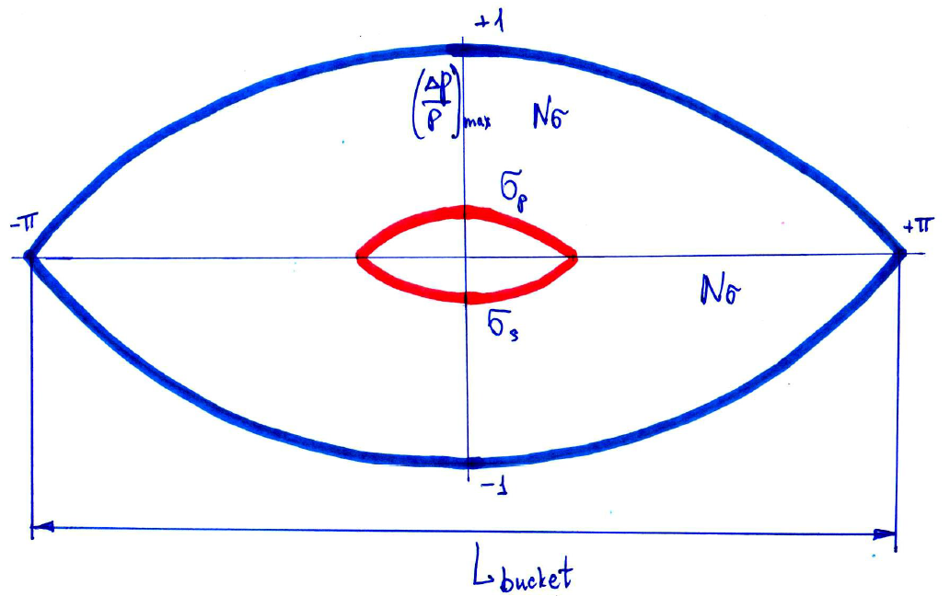
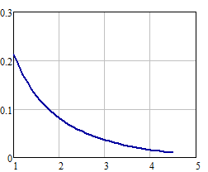
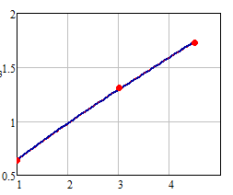
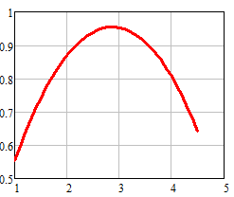
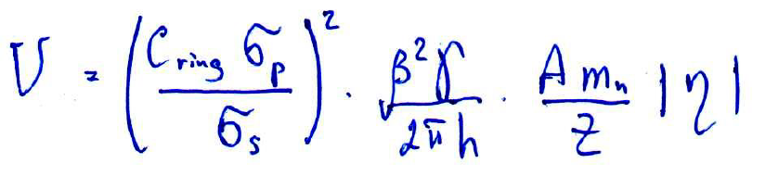
Required bunch long size 2
$$Nσ_{RF}=4$$
$$6σ_{s}≅TPC$$
$$σ_{y}$$
$$0.6m$$
$L_{bucket−desired}=Nσ_{RF}∙$ $σ_{s}∙π=7.5m$
$$σ_{x}$$
$$σ_{s}$$
$$η=\frac{1}{γ^{2}}−α$$
$$σ_{p}∙{10}^{3}$$
IBS- «thermal» equilibrium
$$n_{b}=22 (=\frac{C_{ring}}{L_{0}})$$
$$h=3∙n_{b}=66$$
$$L_{bucket−RF}=\frac{C_{ring}}{h}=7.6m$$
$$E_{k}[Gev/n]$$
$V_{RF−3}$[MV]
$$E_{k}[Gev/n]$$
$$E_{k}[Gev/n]$$
15

Slide 16
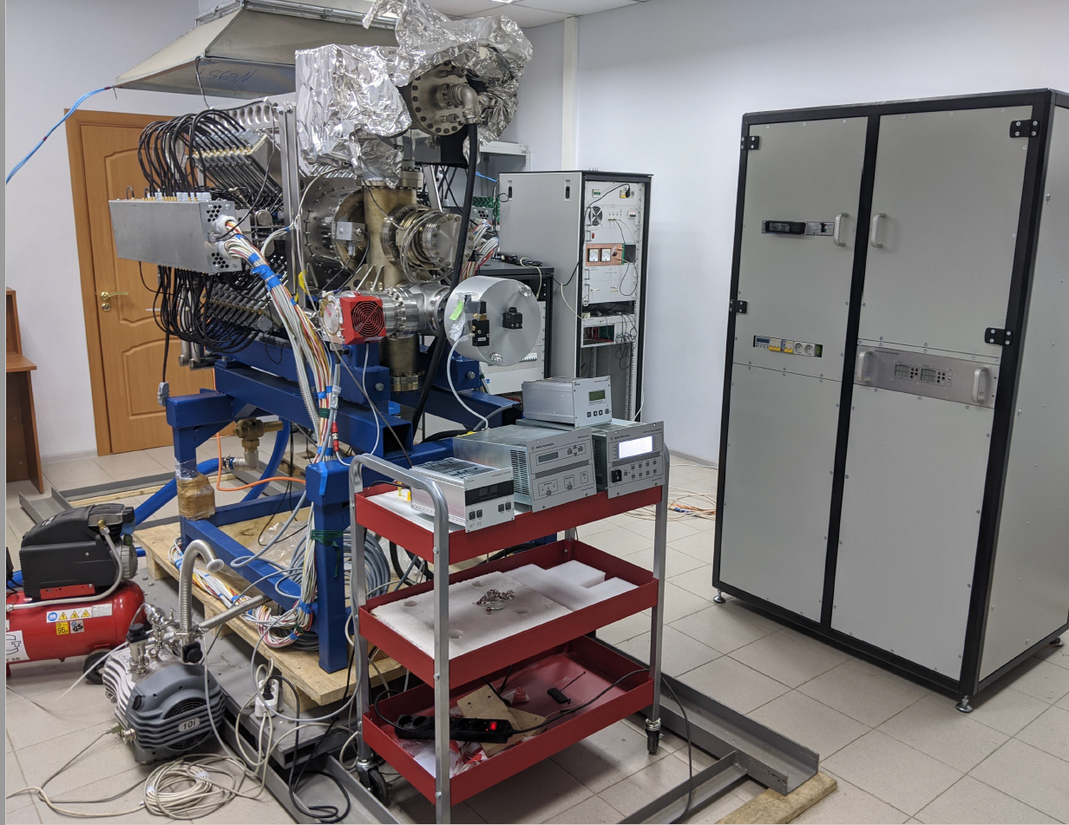
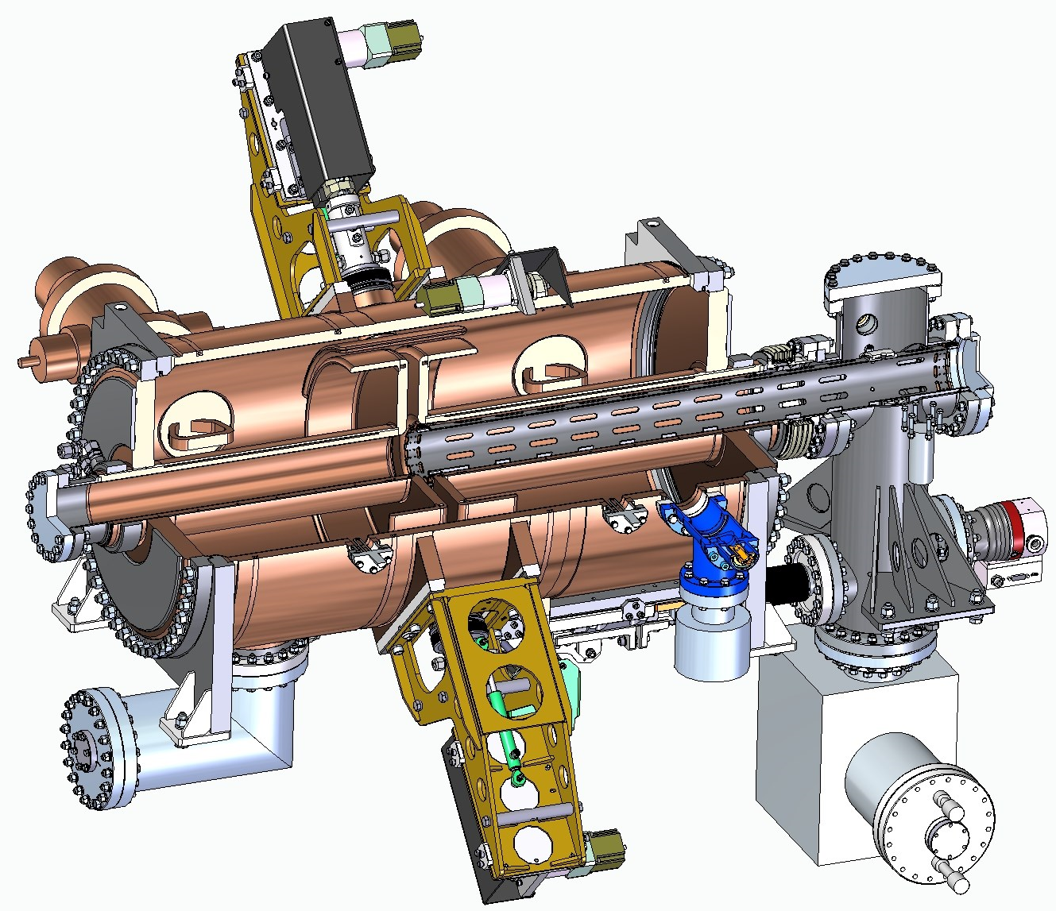
NW
Collider
RF-system
RF-1, RF-2 –stations at JINR
NE
RF-3 –under production
RF-1 @ JINR
2×RF2
ECool
MPD
1×RF1
5×RF3
W
2×RF2
E
2×RF2
4×RF3
2×RF3
1×RF1
5×RF3
RF-3 model
SPD
SW
SE
2×RF2
16
16
Ready for mounting 06,2022

Slide 17
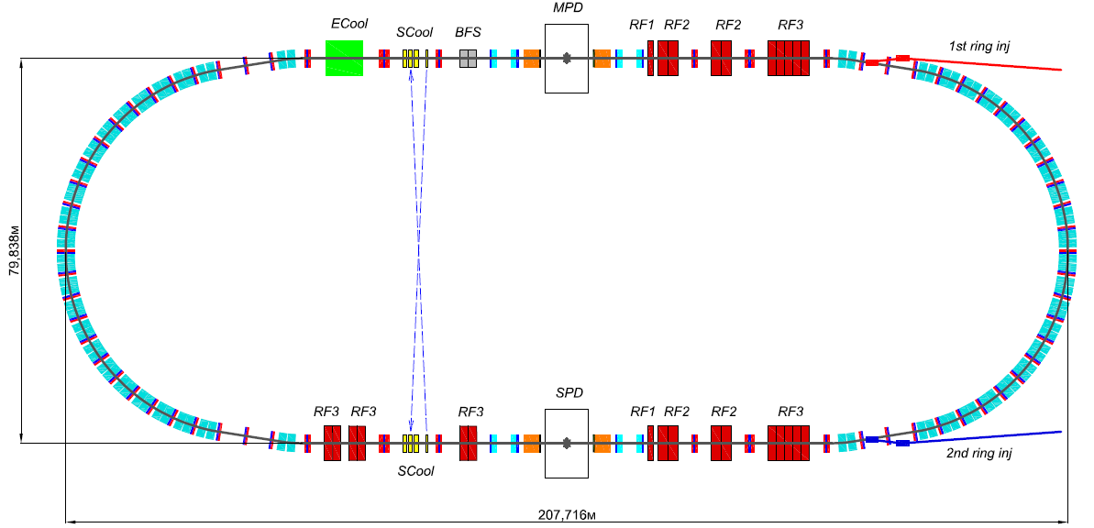
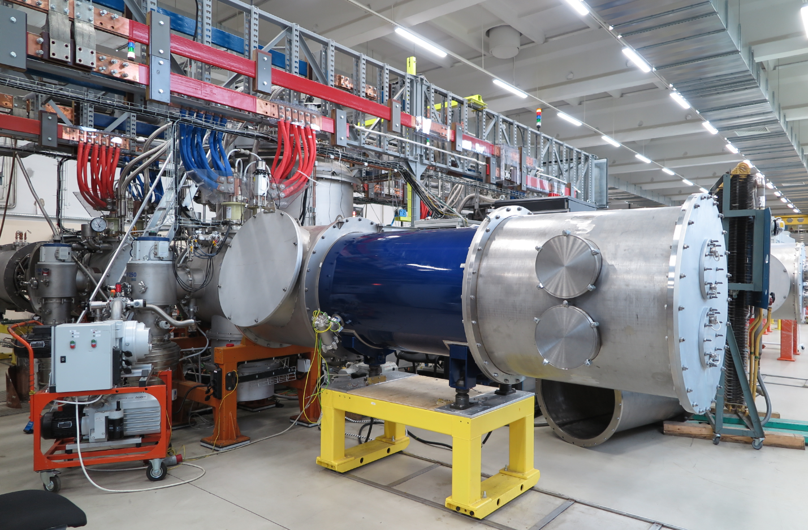
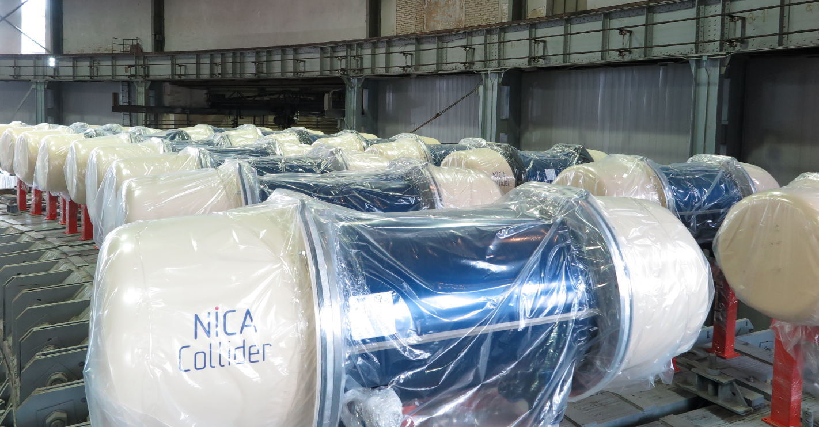
Collider
Run 1 start W50, 2022
Magnet modules – assembly & tests
Reference super period construction, production, assembly
Collider magnets electrical power supply system
RF-system
Beam diagnostics, control system
Vacuum system
Electron cooling system
Stochastic cooling system
Injection & beam dump system
Collimation system
Other collider engineering systems
All dipole magnets are ready for the mounting at the ring
Collider dipoles: 100 % tested
Collider quadrupoles: 35 % tested
17

Slide 18
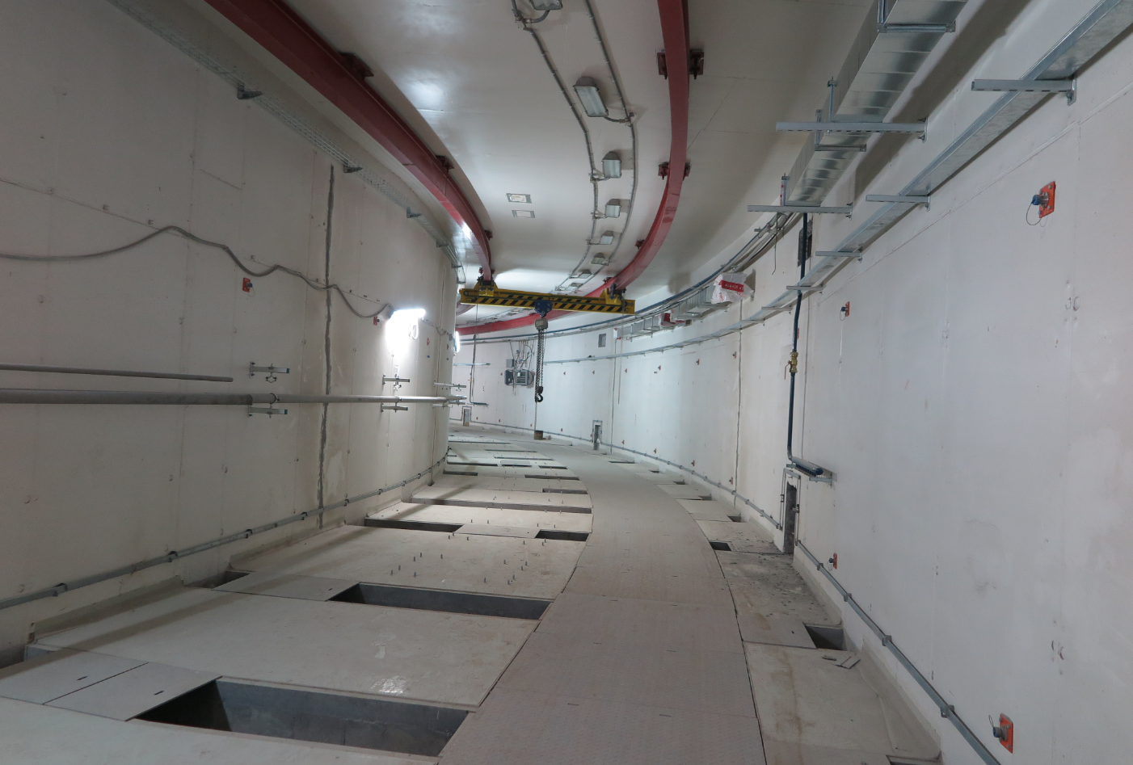
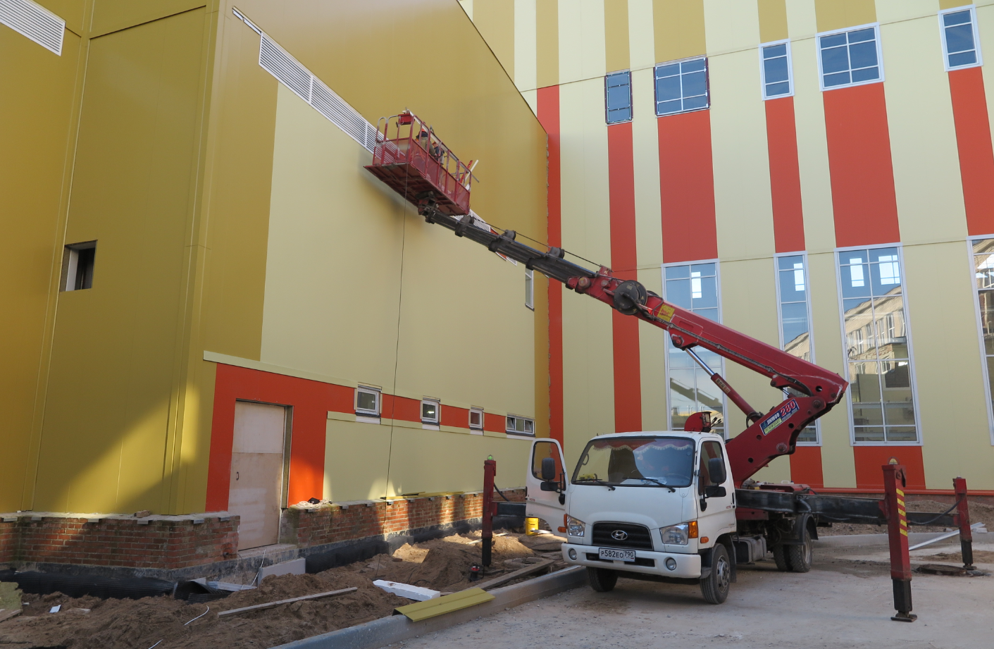
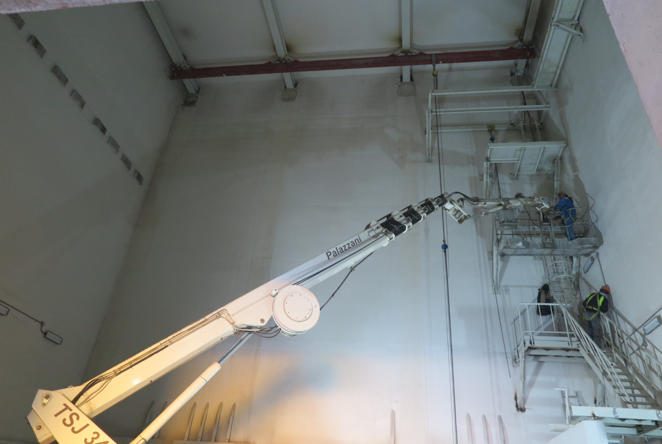
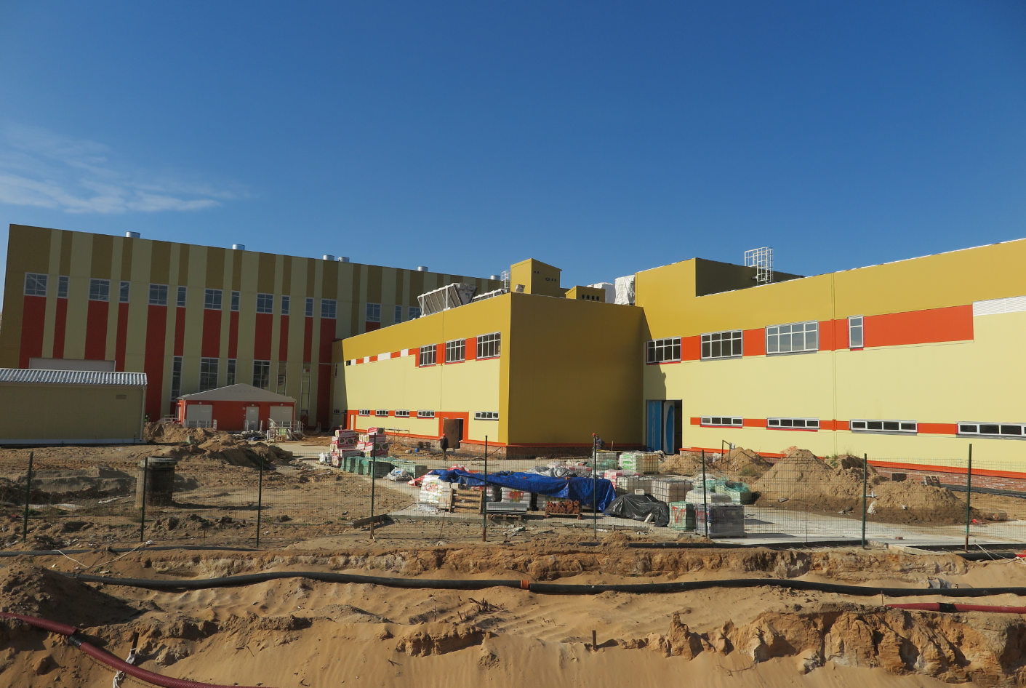
Collider building
Site & Buildings’ Infrastructure
05.10.2021

Slide 19
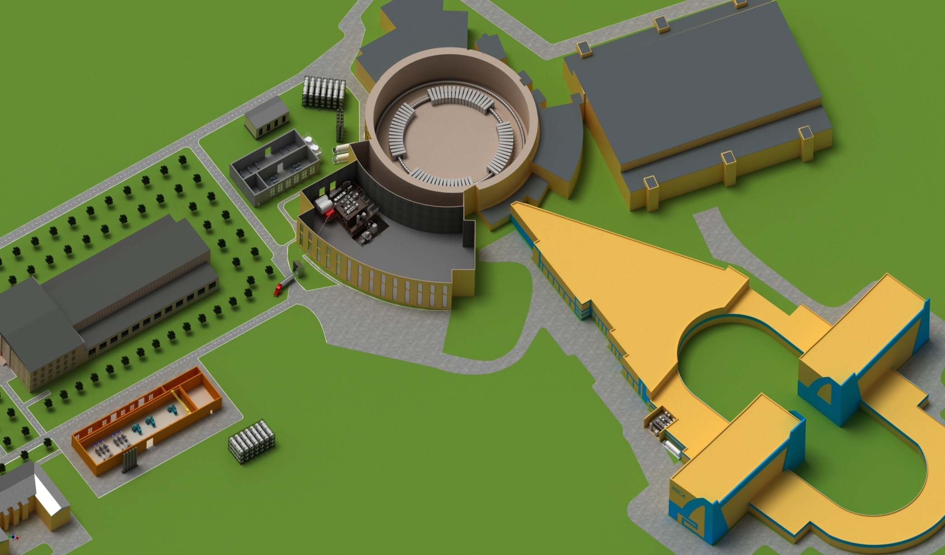
NICA complex cryogenic infrastructure
Liquefier OG-1000
Booster refrigerator
Collider refrigerators
New Compressor station

Slide 20
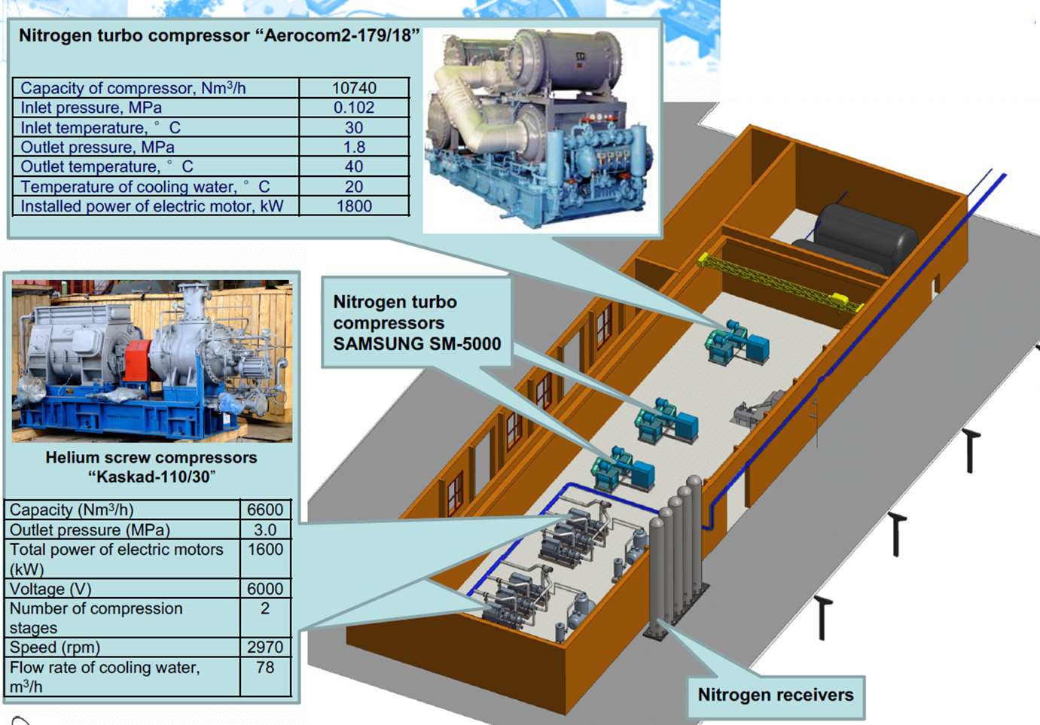
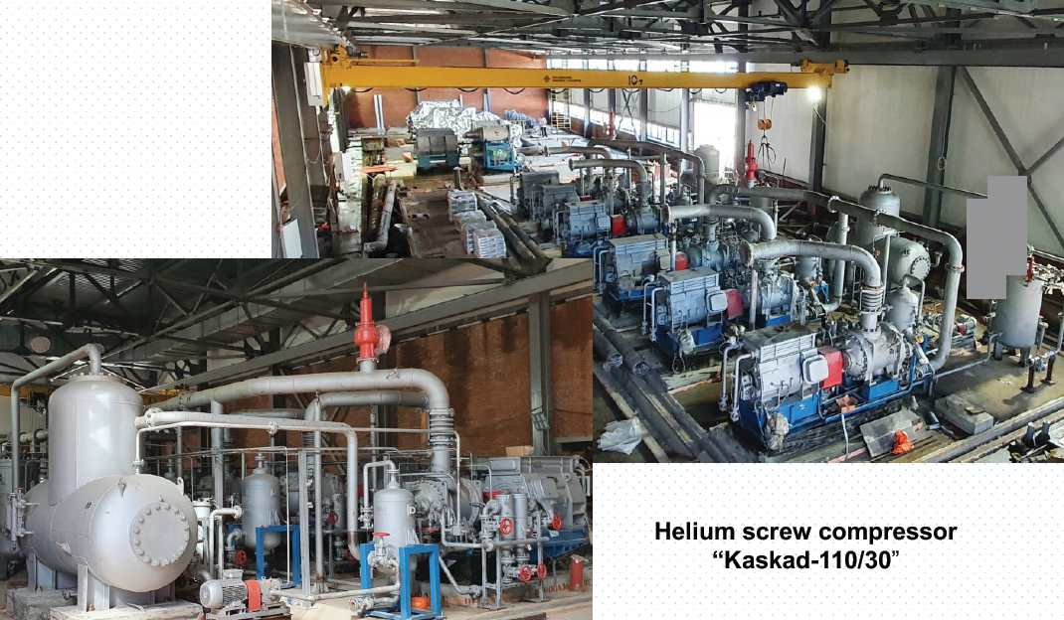
New compressor station
Building – under construction – completion March, 2022

Slide 21
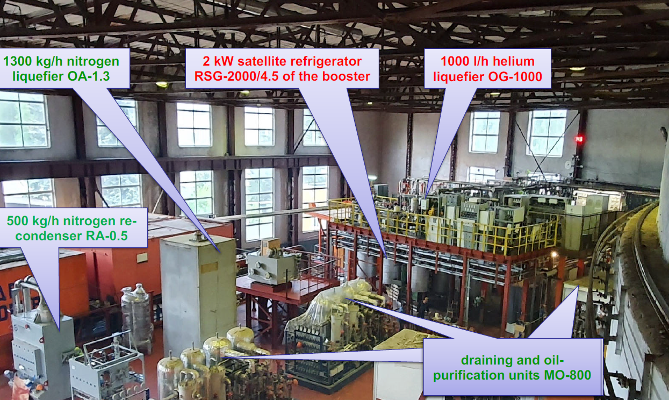
Central cryogenic plant Bld #1b
System automation is in progress
Project cryogenic capacity 6000W @ 4.5 K fulfilled– Jul, 2021

Slide 22
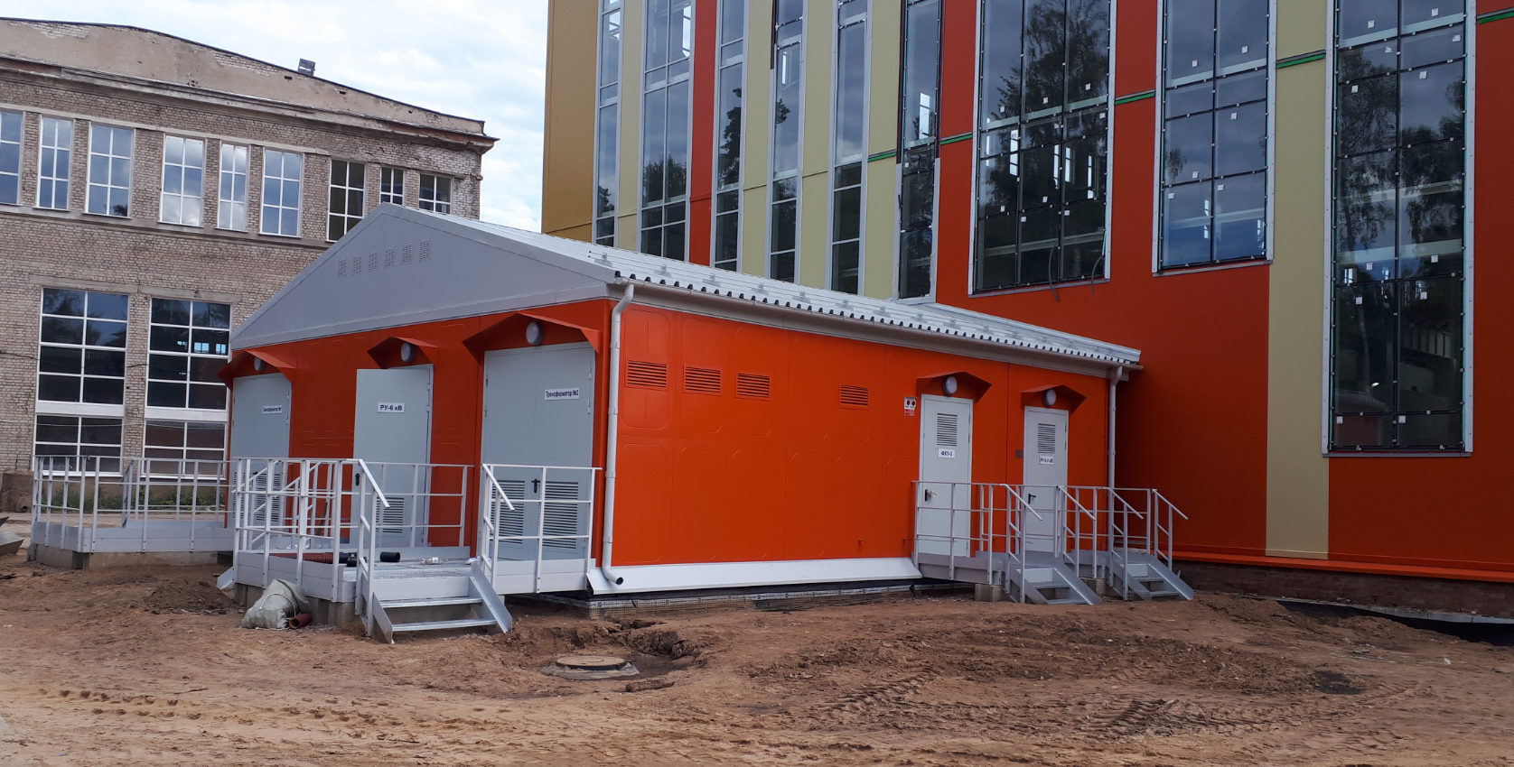
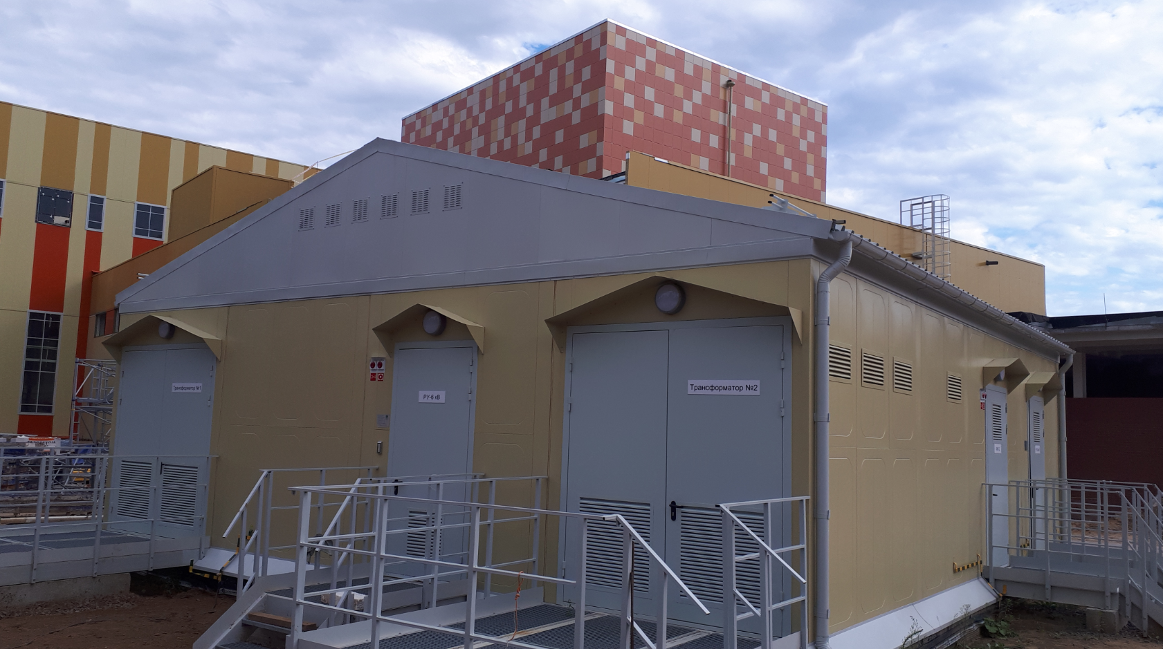
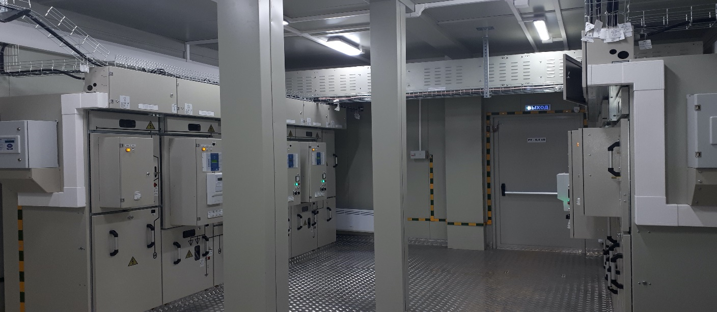

Electrical infrastructure
Substations of Bld 17
Thank you for your attention!
Substations of Bld #17 (11 MW) – completely finished Dec, 2020

