Slide 1
New approaches in the Event Display development for the MPD/NICA experiment
Alexander Krylov (LHEP)
Email: avkrylov@jinr.ru
Oleg Rogachevsky (LHEP)
Viktor Krylov (LNP)

Slide 2
Introduction
Modern experiments in nuclear physics last for years and require enormous human and energy resources.
There are various methods for monitoring engineering, network and computer systems of the experiment. As a rule, they have a common name for all - the Event Display and include a whole range of monitoring and control systems.
Modern technologies make it possible not to take into account the platform and type of operating system on which the Internet browser is launched. A program written in JavaScript will execute in the same way on every platform, including mobile devices with Internet access.

Slide 3
Modern Web Technologies
JavaScript Engine V8 (https://v8.dev/)
React framework (https://reactjs.org/)
WebGL
NodeJS (https://nodejs.org/en/)
N-API (C++ addone)

Slide 4
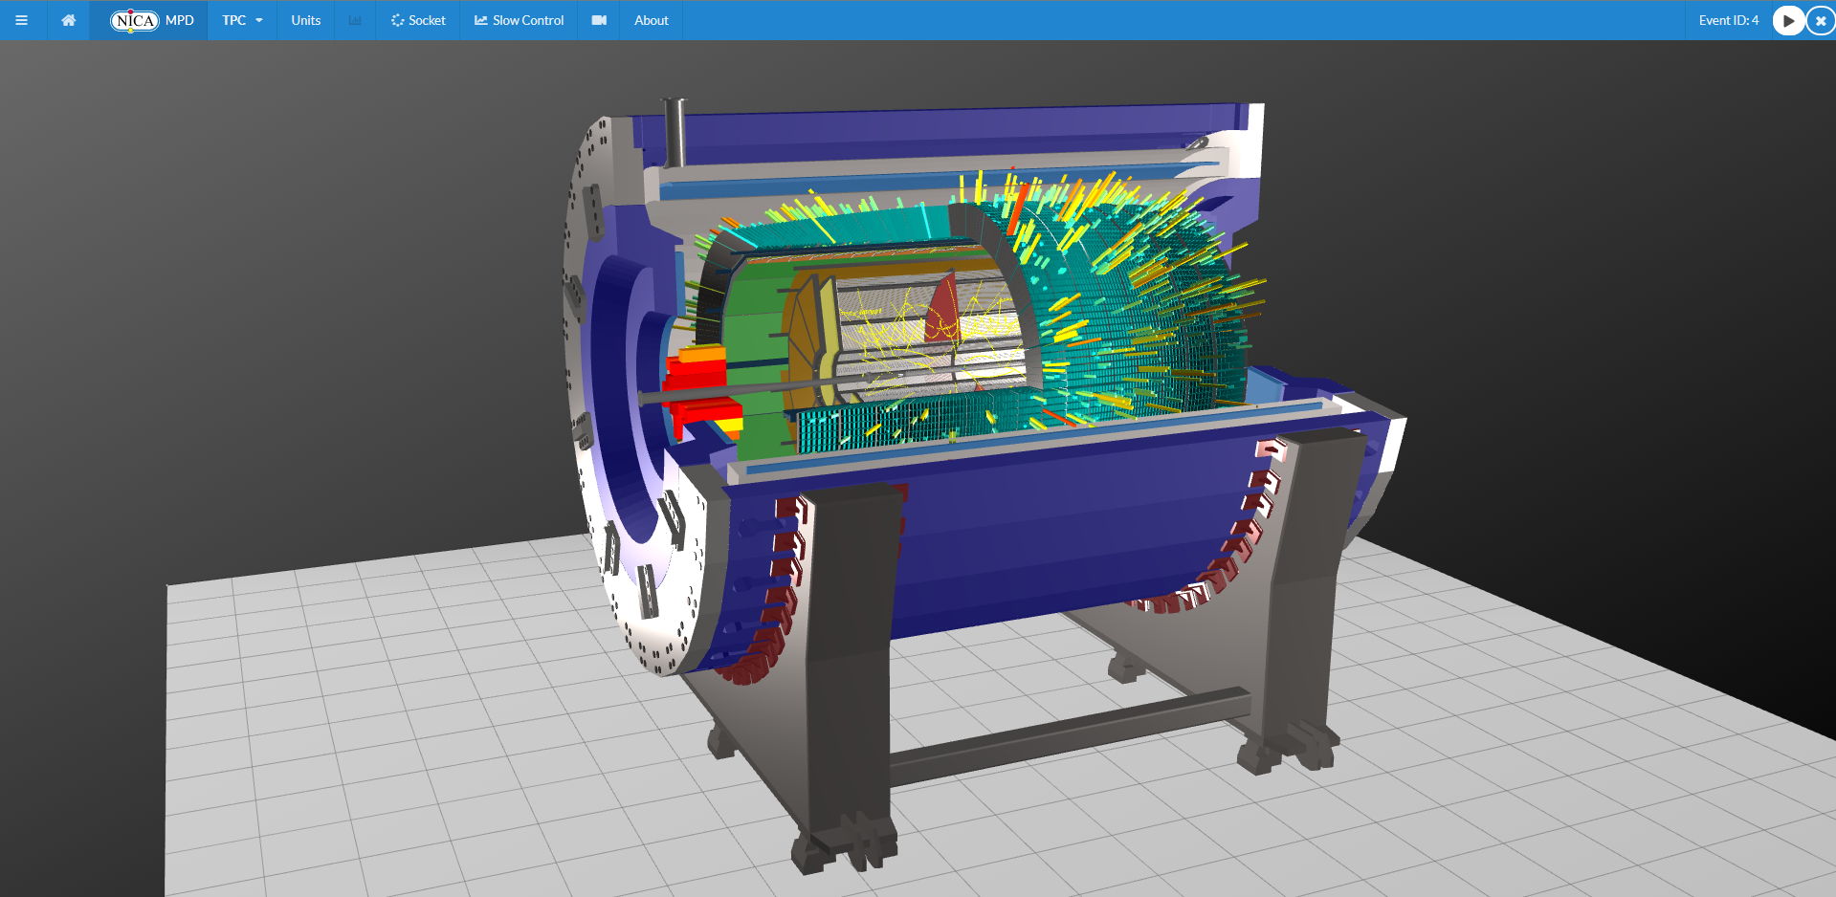
MPD Event Display Server (EDS)

Slide 5
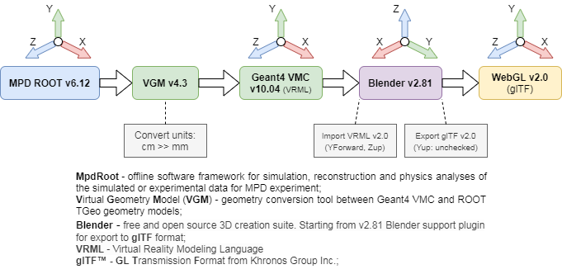
Geometry conversion scheme

Slide 6
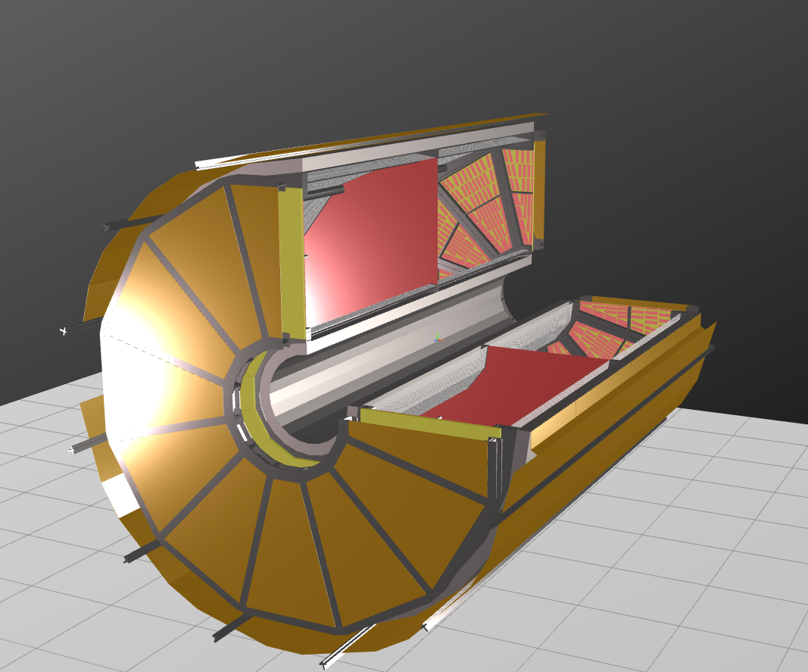
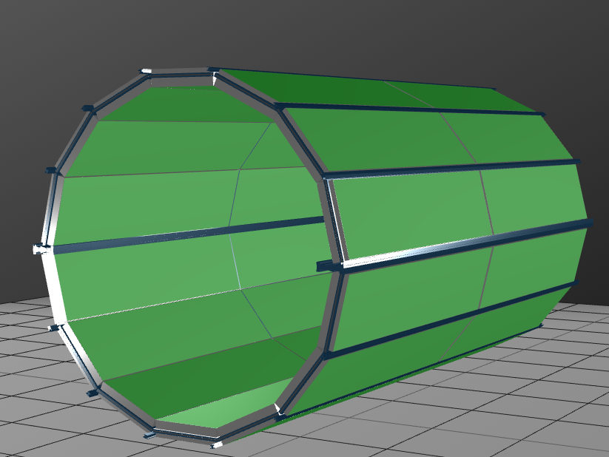
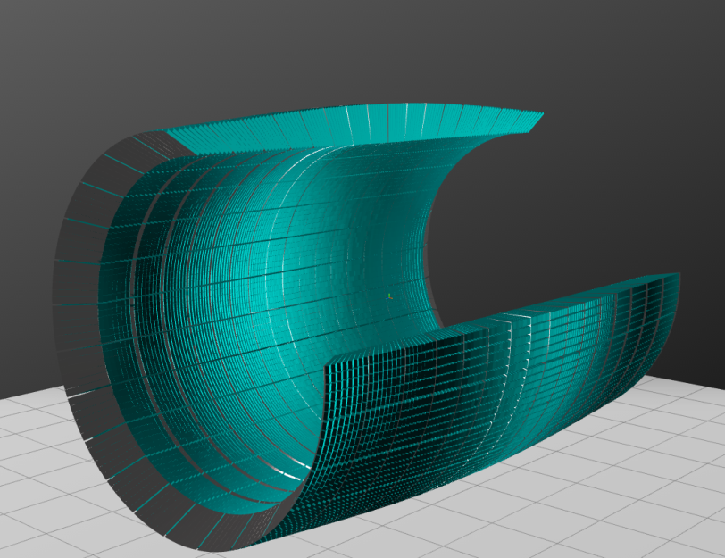
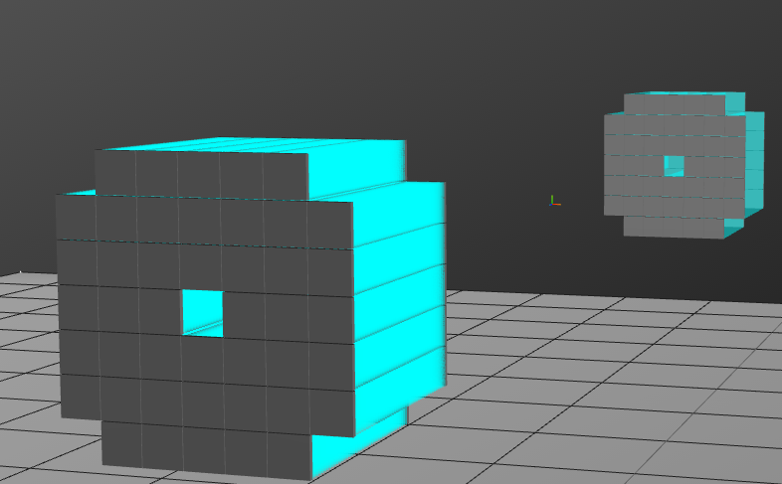
Detectors in EDS
TOF
TPC
ECal
FHCal

Slide 7
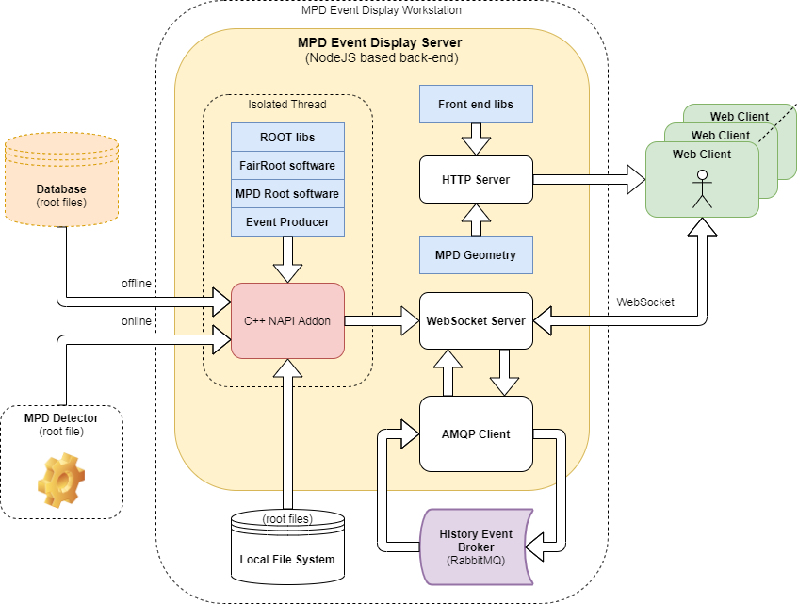
EDS data flow

Slide 8
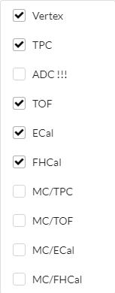
WebSocket Connection

Slide 9
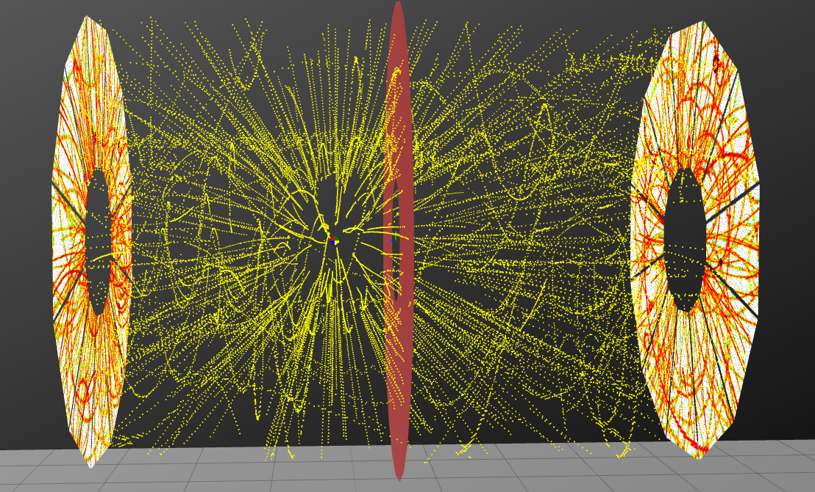
TPC Events in EDS

Slide 10
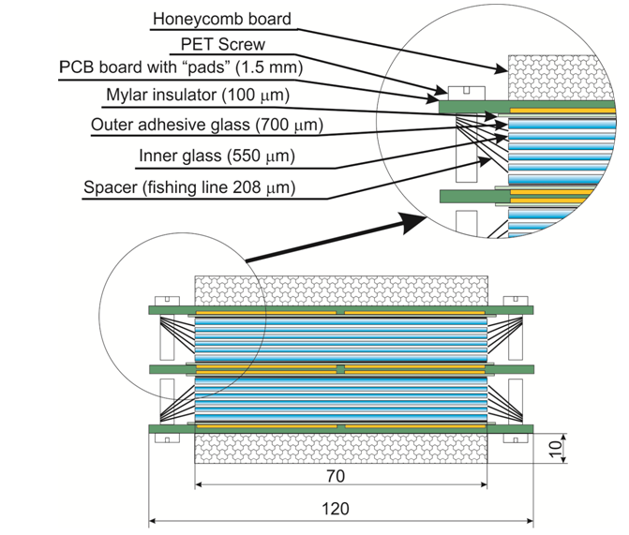
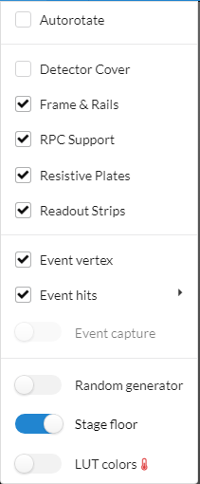
Time of Flight System (TOF)

Slide 11
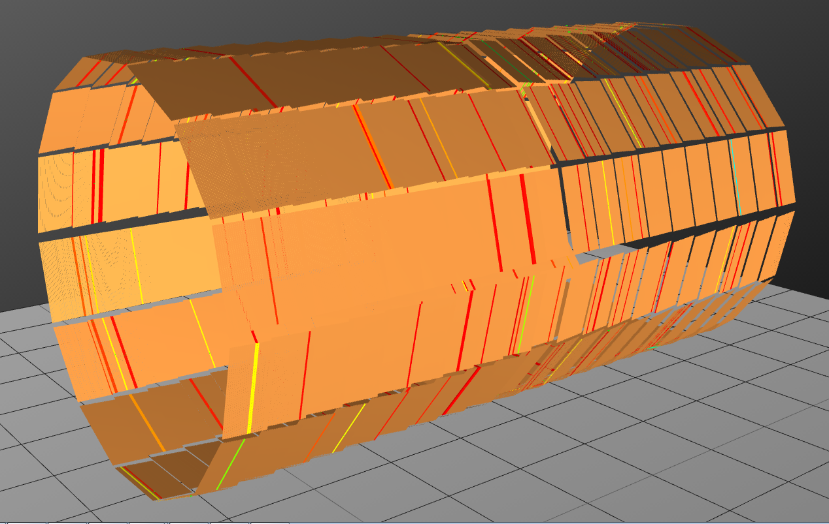
TOF Events in EDS

Slide 12
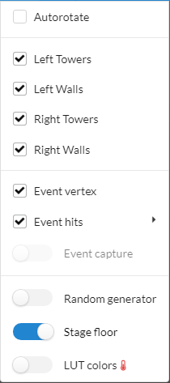
Electromagnetic calorimeter (ECal)

Slide 13
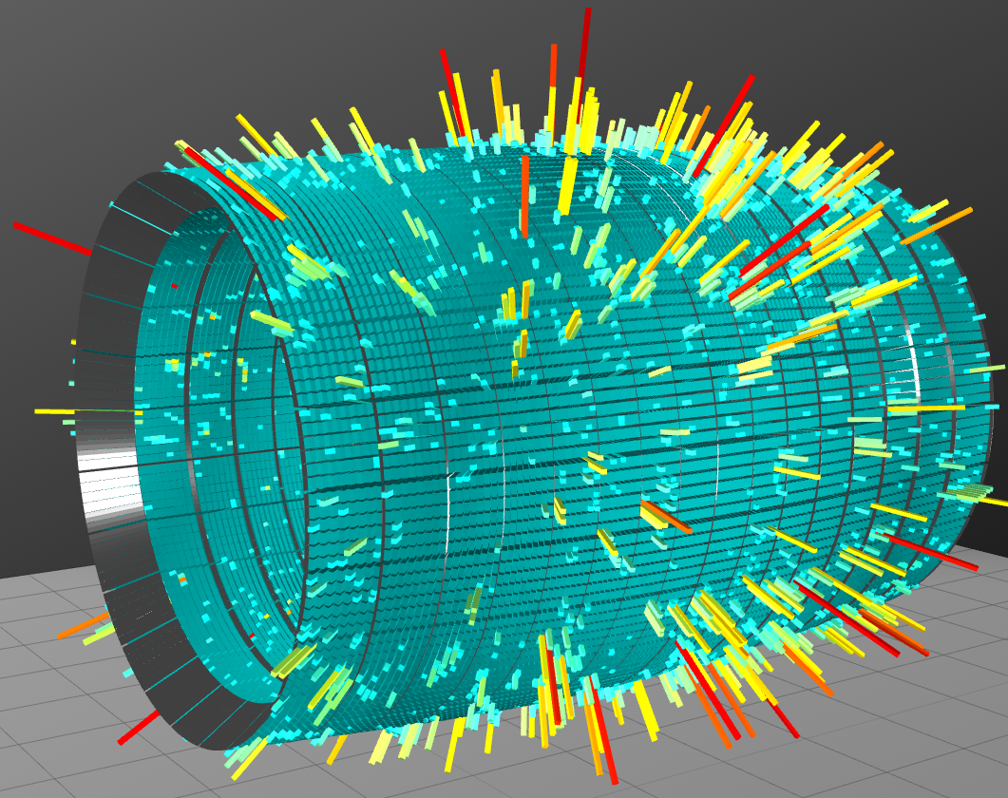
ECal Events in EDS

Slide 14
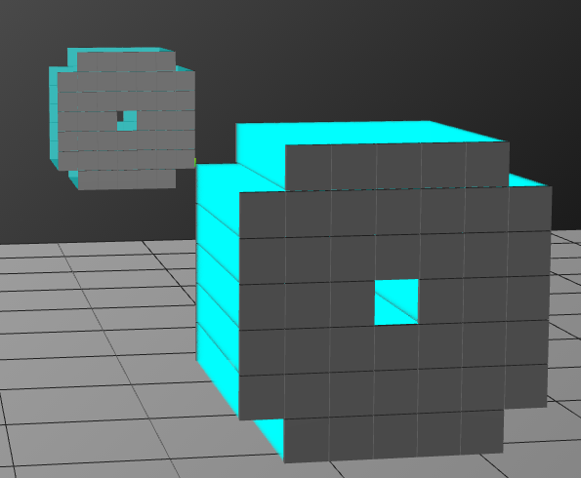
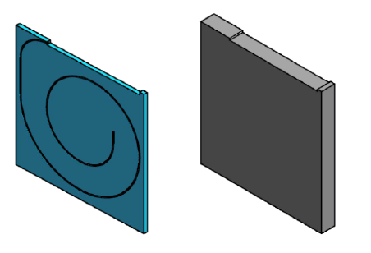
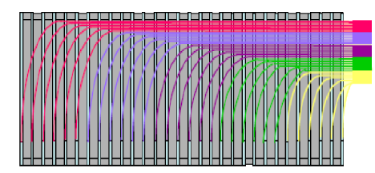
Forward Hadron Calorimeter (FHCal)

Slide 15
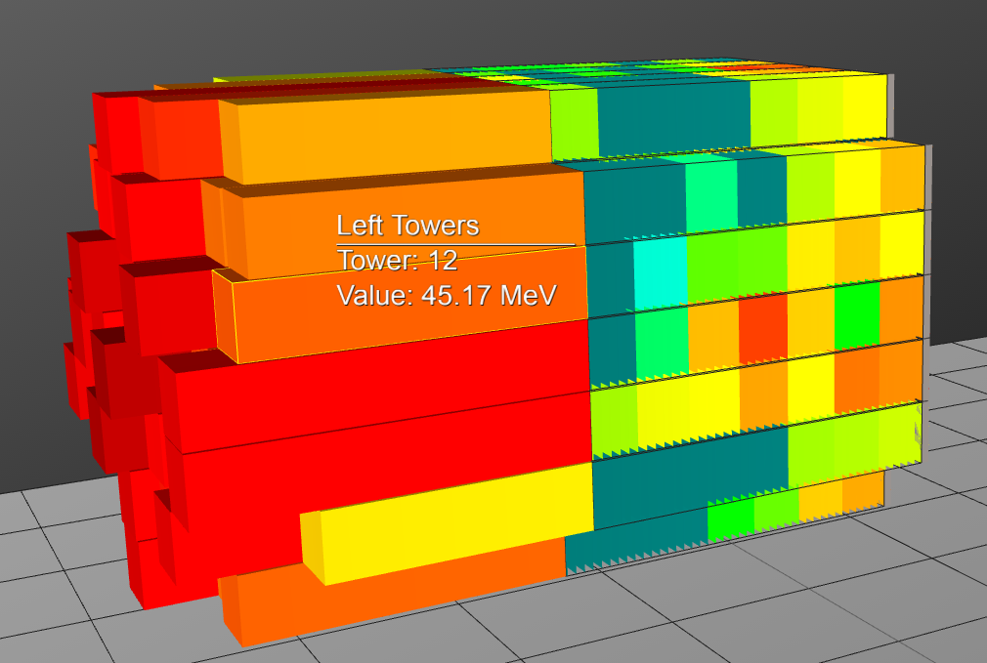
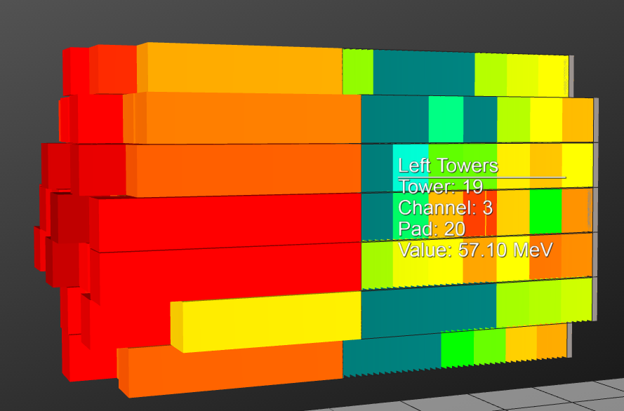
FHCal Events in EDS

Slide 16
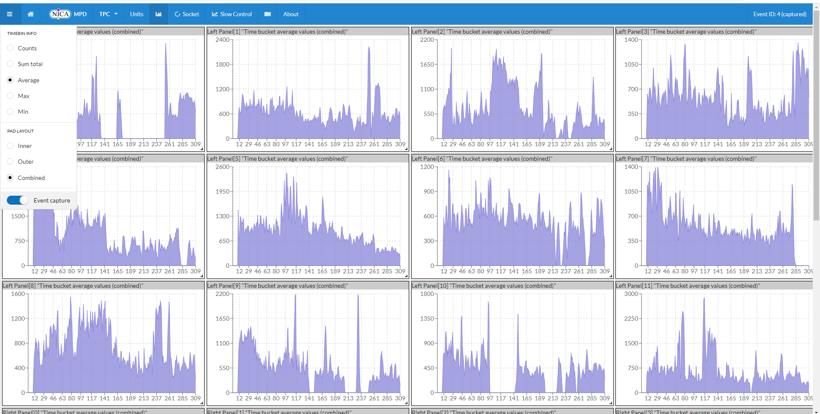
Event Info

Slide 17
Conclusion
The stable prototype of the Web interactive Event Display for the MPD detector is released and it has been tested on all major platforms and browsers, including mobile devices https://mpd-edsrv.jinr.ru/
The interactive graphics part based on WebGL allows showing more than 120K active sensors and 3D objects from different detectors in one scene without exceeding and annoying delays including mobile devices.
C++ Node API Add-on makes it possible to read ROOT data files on the server side of the Event Display directly in native code without any cost-sensitive transformation.
Message broker based on local RabbitMQ package allows synchronizing data flow from different sources with minimal delay (less than 25ms) even for large size events and keeps event history in the internal queues.

Slide 18
What to do next?
Add to the Event Display Server Fast Forward Detector (FFD);
Make agreement in ROOT data format for simulated events acceptable by Event Display;
Add interactions with MPD database;
Add slow control and engineering information for all detectors and other facilities;

Slide 19
Thank you for your attention!
Development team:
O.Rogachevsky, V.Krylov, A.Krylov, A.Bychkov, V.Voronuk, A.Moshkin
The work is supported from RFBR grant №18-02-40102

Slide 20
EDS Message broker

Slide 21
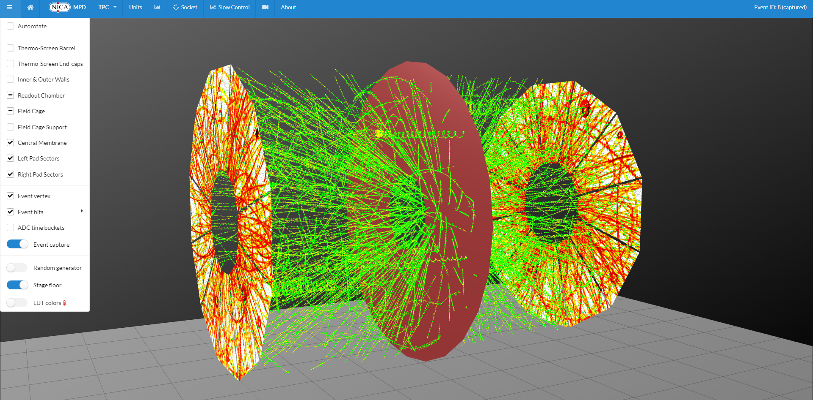
TPC huge event

Slide 22
TOF huge event

Slide 23
ECal huge event

