Slide 1
Status of the TOF TDR
V. Babkin on behalf of the TOF MPD group
Dubna, May 2017
Notes:
Good evening…
I am Vadim Babkin. I represent the TOF group of the MPD.
I'm going to show in this presentation our progress in design of the TOF system and plans for the near future.

Slide 2
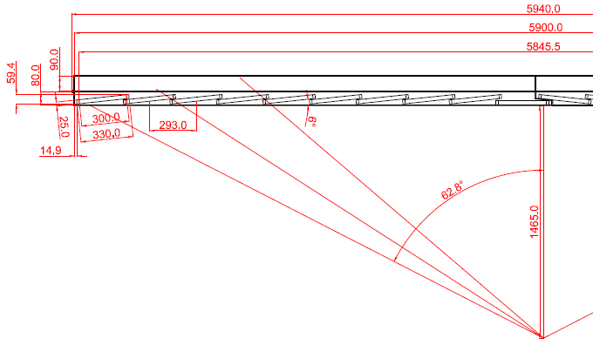
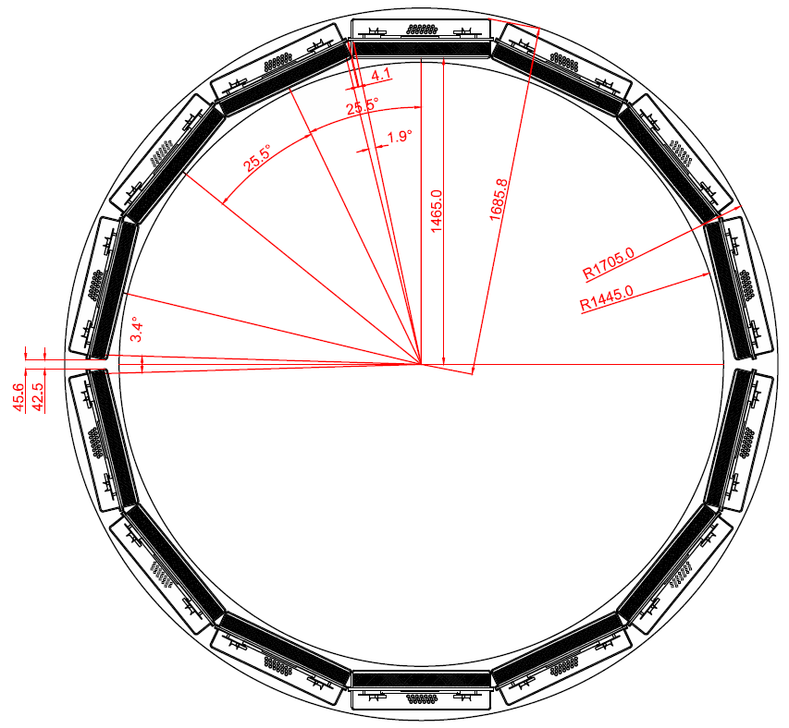
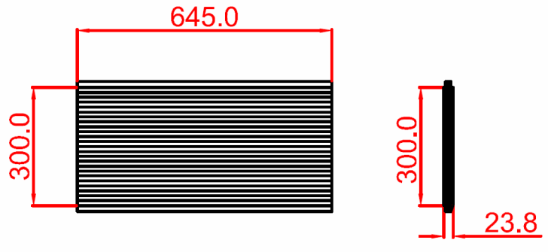
The MPD Time of Flight system design
Advantages of the design:
~94% estimated geometrical efficiency
Convience of integration (28 sec. ECal)
645x12.5 mm strip: 280х24 = 6720 strips → 13440 el.ch
Est. Occupancy = 0.17х80 = ~14%
Z-direction detectors layout
For TPC rail
φ-direction TOF modules layout
 | Number of detectors | Number of readout strips | Sensitive area, m² | Number of FEE cards | Number of FEE channels
MRPC | 1 | 24 | 0.2 | 2 | 48
Module | 10 | 240 | 1.85 | 20 | 480
Sector | 20 | 480 | 3.7 | 40 | 960
Barrel | 280 | 6720 | 51.8 | 560 | 13440 (1680 chips)
Notes:
Рассматривается вопрос об уменьшении длины модуля на 100-200 мм.
At the beginning, let me remind you about the current design of the barrel part of the TOF system.
It looks like a cylinder composed of 14 sectors. It is convenient for integration with ECal since it consists of 28 sectors.
The radius of the TOF cylinder is about one and half meters. The radius of the TOF cylinder is about one and half meters.
Detectors are arranged inside module with small angle to the beam line for better registration and geometrical efficiency.
In this table I present the numbers of the main parts of the barrel TOF.
Total the TOF contents 280 detectors and covers the area of 52 square meters. The total number of the electronics channels is 13440

Slide 3
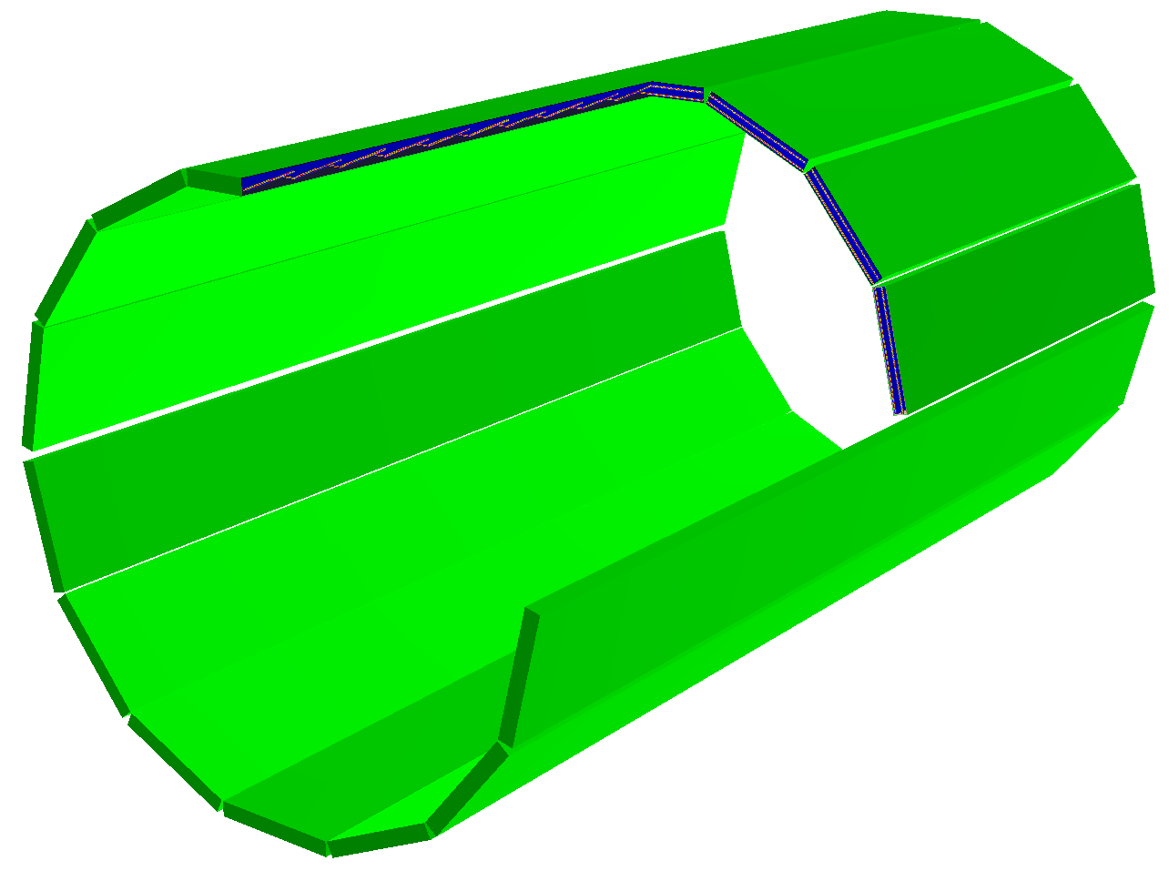
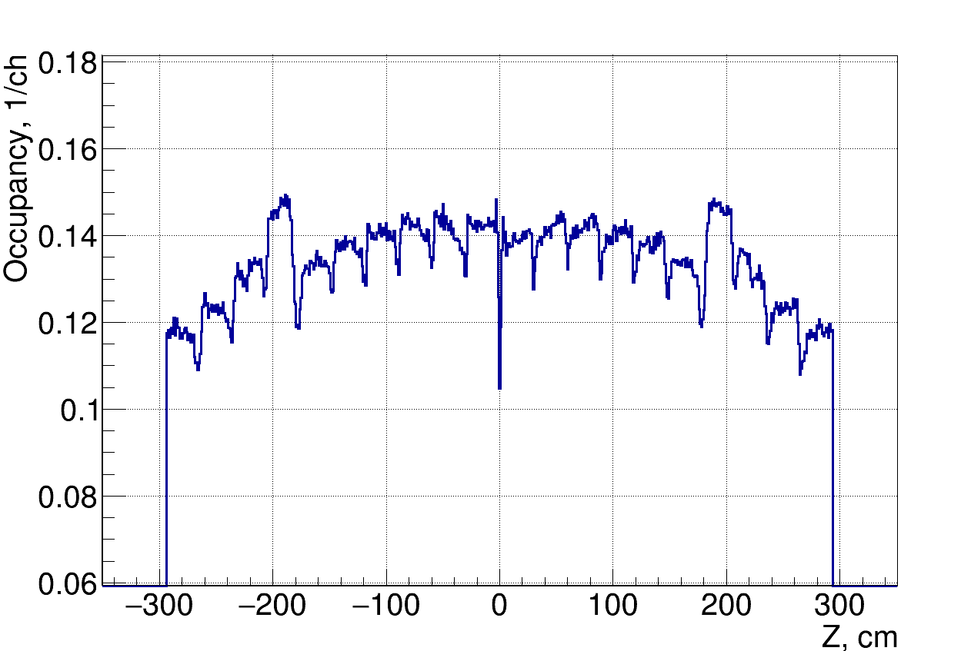
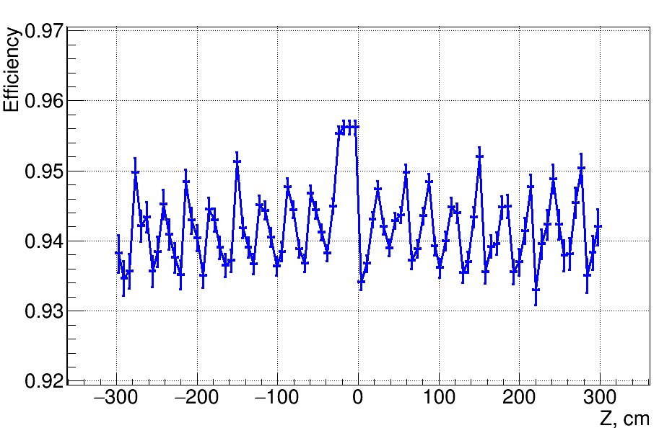
MC simulation
S. Lobastov
Maximum occupancy <15%
Geometry efficiency ~94%
Notes:
GEANT simulation was carried out for the construction described above. Mainly used QGSM generator.
clic
Indeed, it can be seen from the histograms, the occupancy does not exceed 15% and the geometric efficiency of the TOF detectors in this arrangement is ~ 94%.

Slide 4
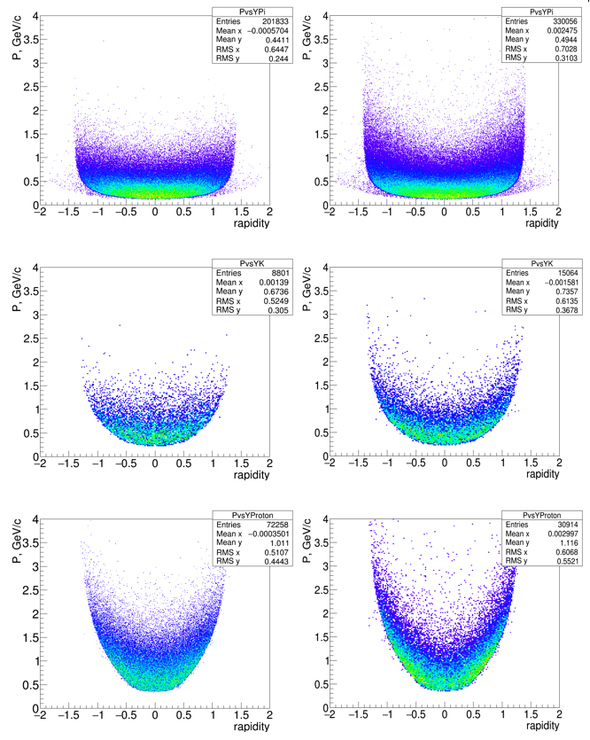
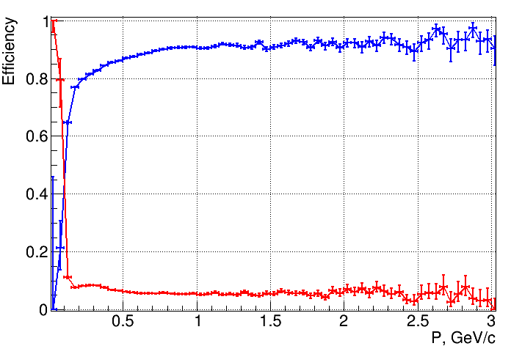
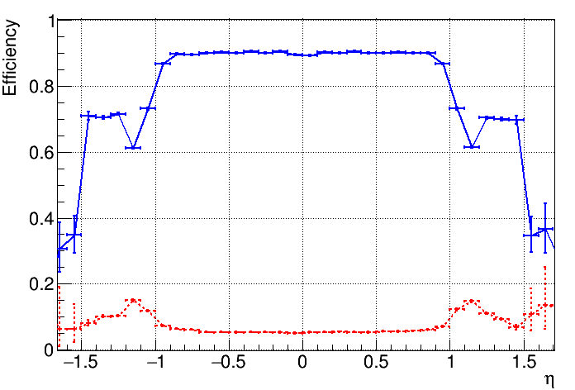

MC simulation
S. Lobastov
Matching for $\sqrt{S_{NN}}=11$ GeV
Efficiency
Contamination
Mean number of primary particles in one central collision: | π± |  | K± |  | P
Produced in 4π | 829.1 |  | 58.7 |  | 153.1
Produced in pseudorapidity |η| < 1.4 | 502.1 | 1.0 | 31.3 | 1.0 | 39.2 | 1.0
Registered in TOF (looses due to field B = 0.5 T, decay and interactions, geometry and registration efficiency) | 330.0 | 0.66 | 15.1 | 0.48 | 30.9 | 0.81
Matched with tracks | 303.1 | 0.60 | 14.4 | 0.46 | 27.8 | 0.74
MPD TOF phase-space for charged hadrons for $\sqrt{S_{NN}}=$5 GeV (left) and $\sqrt{S_{NN}}=$11 GeV.
From top to bottom: pions, kaons and protons. (1000 QGSM central events, B = 0.5 T).
Notes:
Momentum versus rapidity distributions of the primary hadrons reaching the TOF barrel are presented on the left.
The events were simulated by QGSM at energy $\sqrt{S_{NN}}=$ 5 GeV and 11 GeV. The produced particles were traced with the GEANT at the magnetic field B = 0.5 T, particle decays are also taken into account.
The distributions are for the region |η| < 1.4. Different empty regions for pions, kaons and protons are due to magnetic field and polar angle acceptance.
The momentum and pseudorapidity dependences of matching results for energy of ion collision of 11 GeV is presented on this graphs.
You can see, that the efficiency of matching is about 90% in almost all momentum range.
Efficiency is decreased for particles with low momentum due to large angles of crossing of TOF and strong multiple scattering.
In the table are summarized the absolute numbers and the fractions of different particle specie (per event) registered by the TOF detector and matched with TPC tracks.
This is the main simulation results at the moment. So… Let me begin the technical part of my presentation.

Slide 5
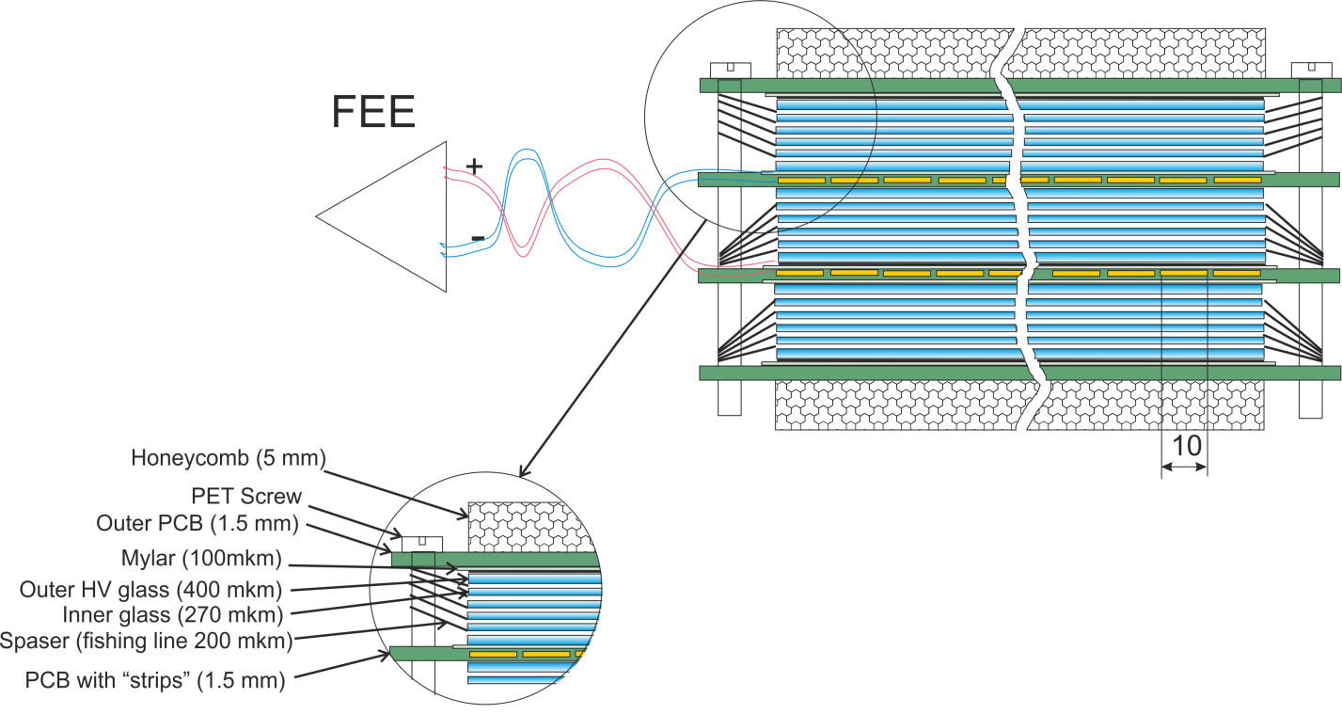
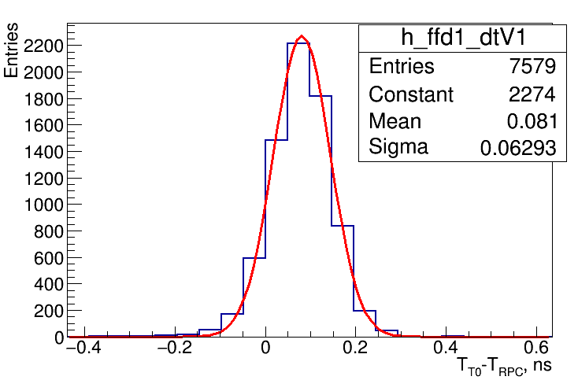
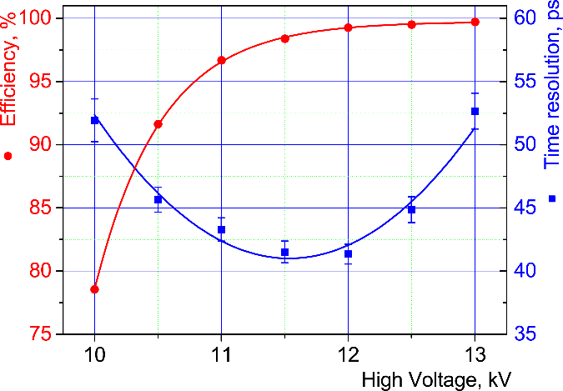
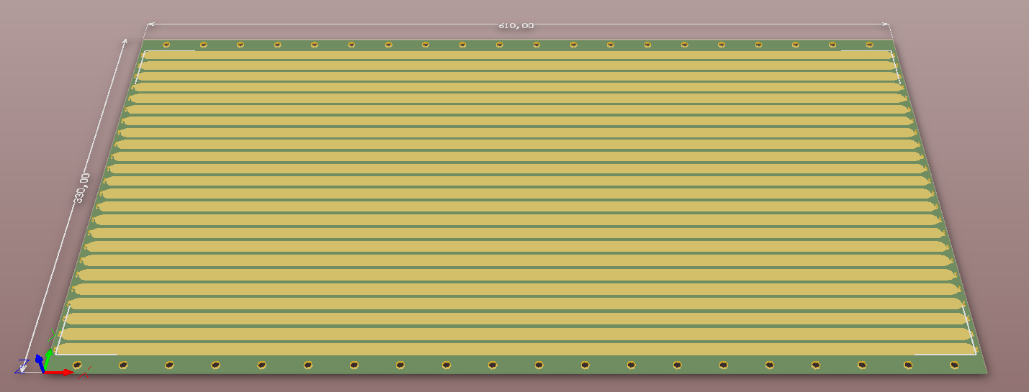
Triple-stack MRPC
Triple-stack MRPC cut view
Inner readout board with strips
Efficiency and time resolution of the MRPC versus HV
Notes:
The TOF system based on multigap resistive plate chamber (MRPC). We use triple-stack design with two-side strip differential readout.
This is the cat view of the triple-stack MRPC with strip readout. Each stack consists of 5 gas gaps of 200 mkm. Gaps are formed of common float glass with thickness of 280 microns.
The(i) active region is determined by the geometry of the entire TOF system. Currently it is 640 by 330 mm². The width of strips is 10 mm. Distance between them is 2.5 mm. Number of the strips is 24.
Beam test of this MRPC has shown that it has time resolution better then 50 ps (the best resolution which we achieved is 41 ps)

Slide 6
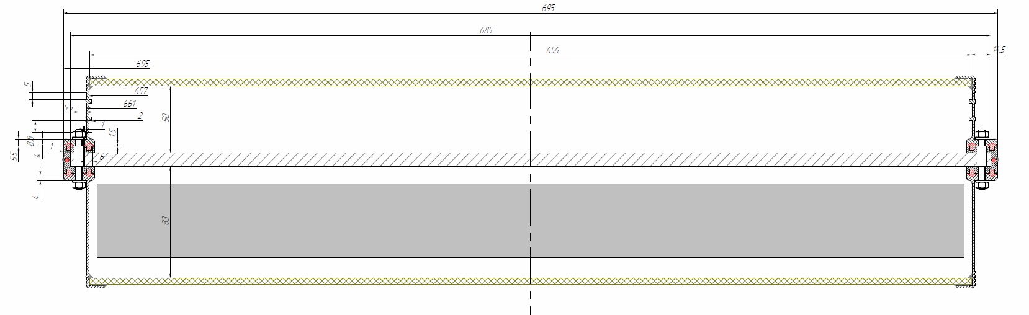
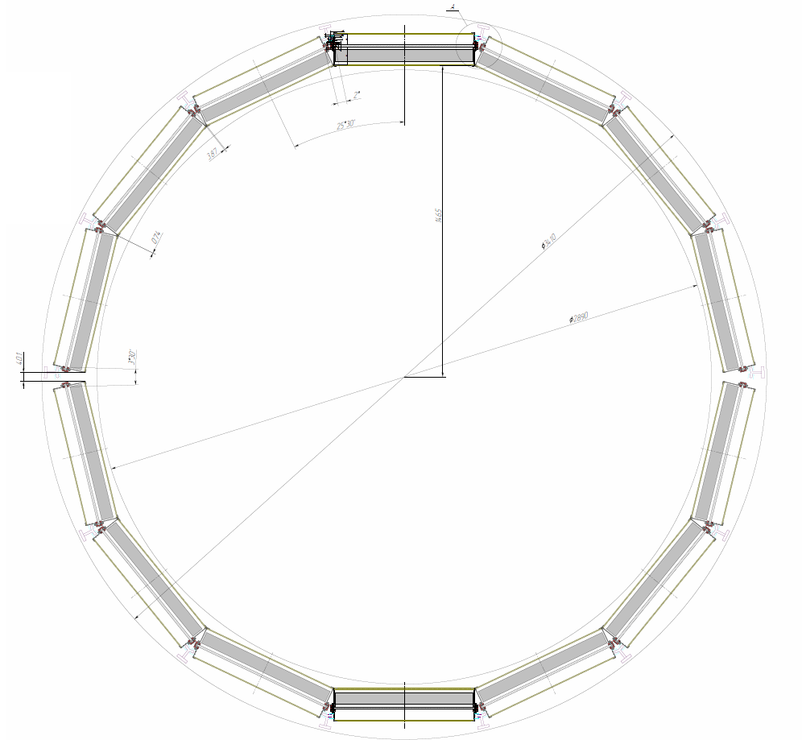
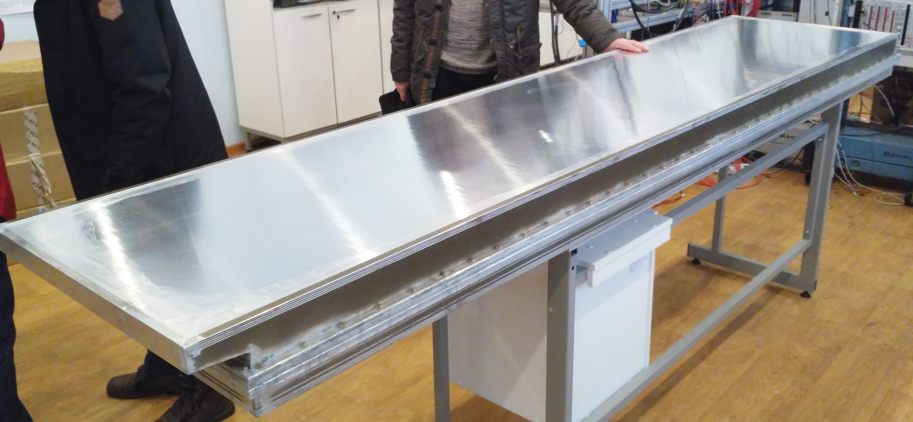
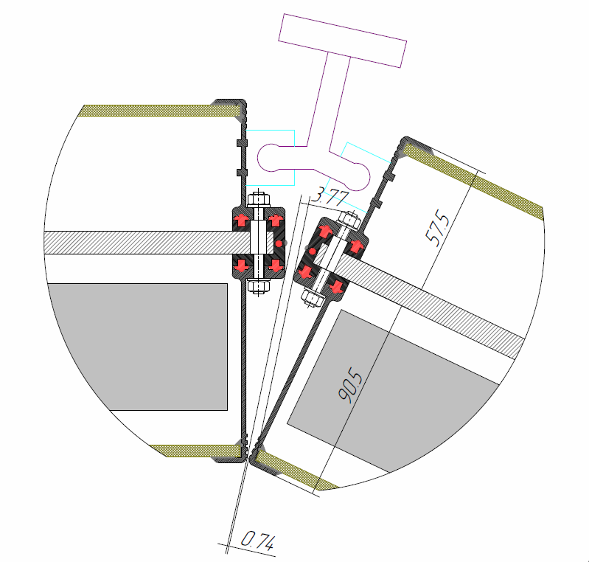
Aluminum gas & FEE box
NC PHEP BSU
“Artmash” (Minsk, Belarus)
A
A
Notes:
It was decided to manufacture a box made of aluminum. The walls of the box welded of aluminum profile of special shape, which is manufactured by extrusion.
The central panel and the cover are made of aluminum honeycomb panels. All the elements are pulled together by pins and nuts. This design lighter and more convenient than the previous one.
Clic
First prototype of this design was made small for one detector. We tested it with detector last Nuclotron Run. Results was very good. Next step is the full scale box.
Clic
Now we are testing it and, most likely, it will be the final design, because it satisfies most of the requirements.

Slide 7
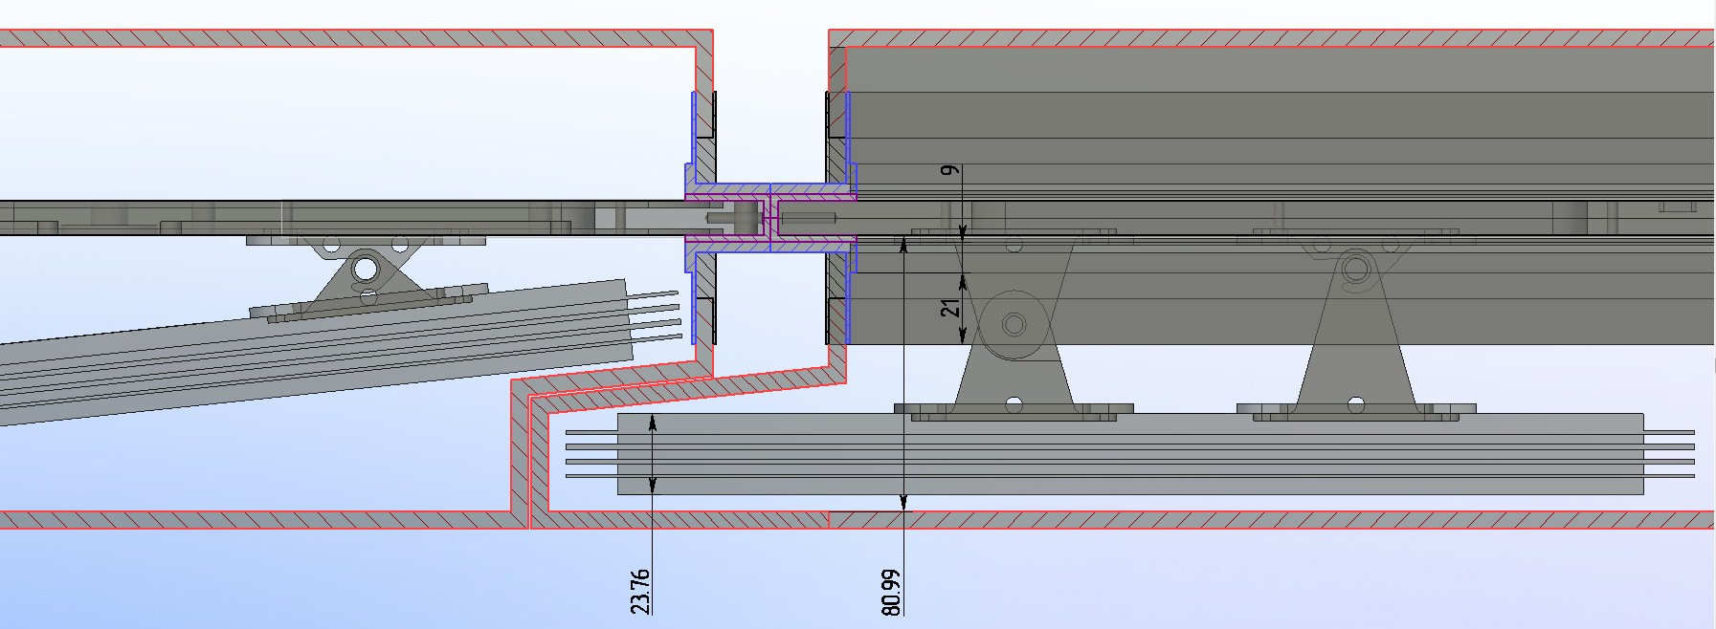
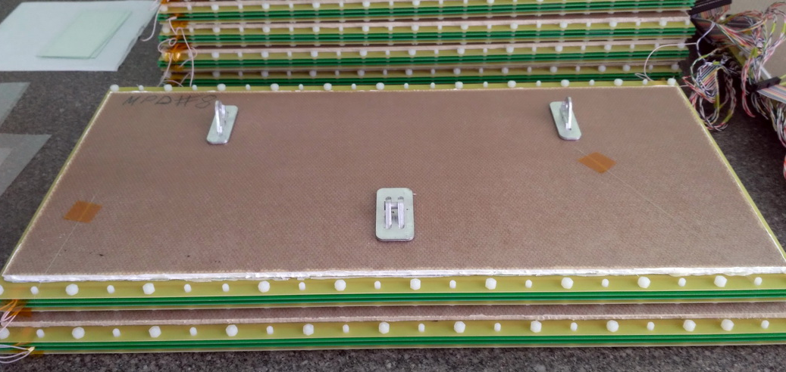
MRPC fixing inside the gas box
Notes:
Other new decision affected the fixation of the detector inside the box. The detector fixed on three points. First point is hook, two others are lugs with screws.
This mounting method is more convenient then the previous one.
We already began manufacturing of detectors for the first test box. On this picture you can see some new detectors with this new fixators.

Slide 8
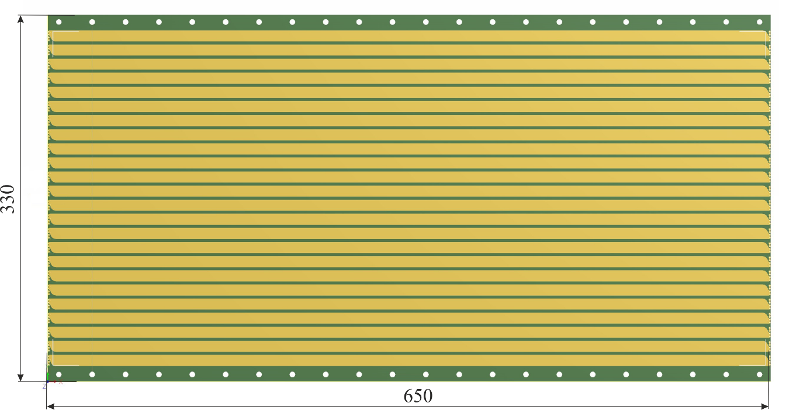
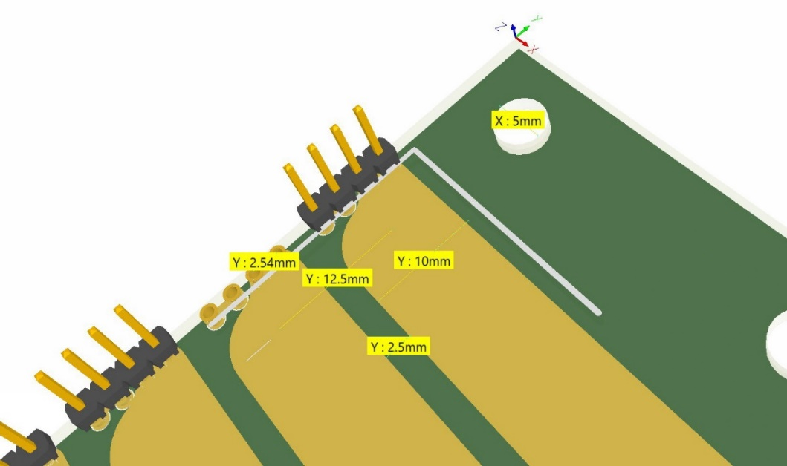
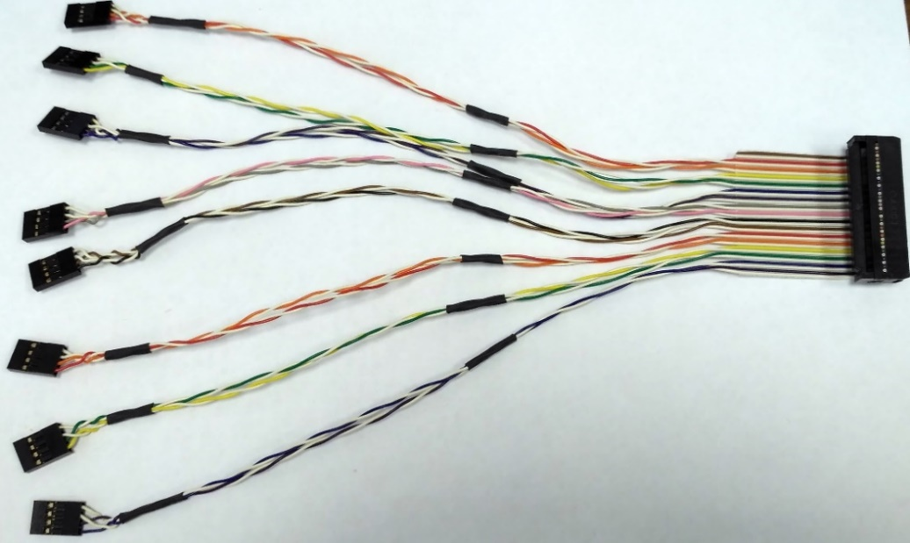
Signal readout
Readout board with overall dimensions
Signal connectors on the PCB
Doubled twisted pair cable for transferring signal to the preamp
Notes:
The TOF system based on multigap resistive plate chamber (MRPC). We use triple-stack design with two-side strip differential readout.
This is the cat view of the triple-stack MRPC with strip readout. Each stack consists of 5 gas gaps of 200 mkm. Gaps are formed of common float glass with thickness of 280 microns.
The(i) active region is determined by the geometry of the entire TOF system. Currently it is 640 by 330 mm². The width of strips is 10 mm. Distance between them is 2.5 mm. Number of the strips is 24.
Beam test of this MRPC has shown that it has time resolution better then 50 ps (the best resolution which we achieved is 41 ps)

Slide 9
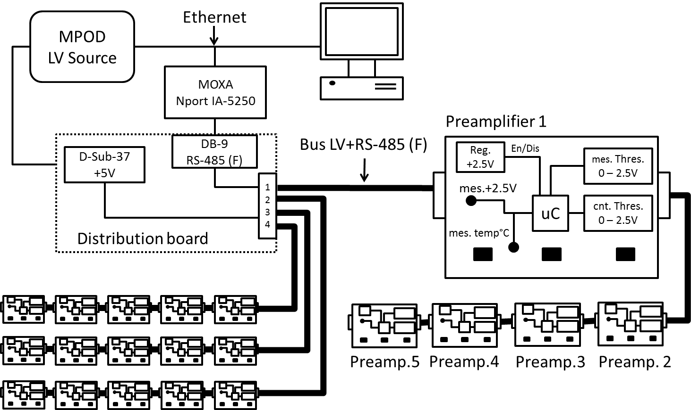
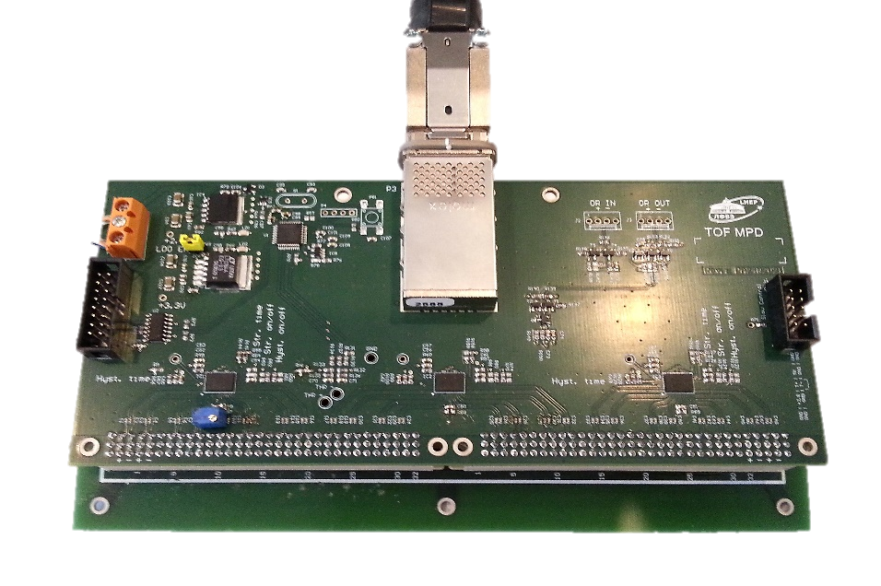
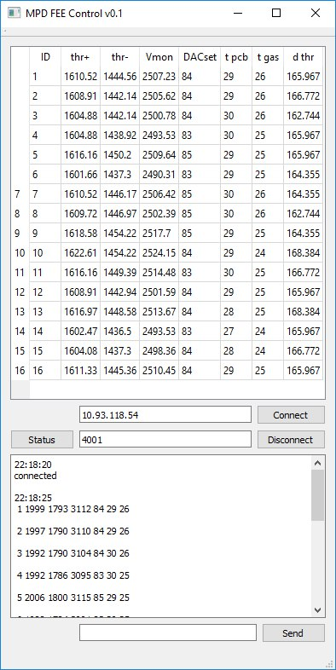
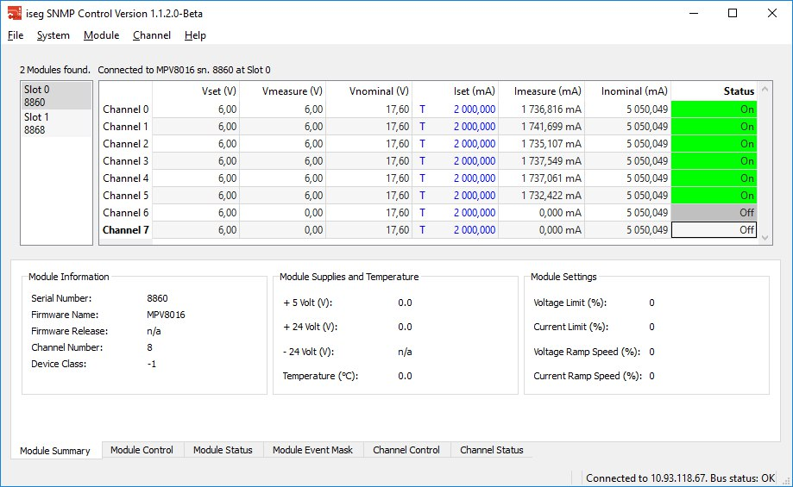
Front-end electronics
Updated NINO based 24-channels
preamplifier-discriminator board PA24N2V2I
Powering preamplifier board and connection scheme.
Stabilization of the voltage (+2.5V);
Differential input ( Zdiff = 55 Ohm);
Inputs capacitors for two-end strip readout;
CXP (InfiniBand) 100 Ω output connector;
Series “or” output for 24 channels;
Time resolution for one channel ≈ 7 ps;
“On board” slow control:
- voltage control & monitoring;
- preamplifier thresholds control;
- board temperature monitoring ±0.5 °С;
- gas volume temperature monitor.
Slow control GUI clients (left side for FEE, right LV source)
Notes:
Front-end electronics based on NINO chip. Currently, it is the best ASIC for these detectors.
On the basis of this chip by our electronics have been designed board specially for two ends strip readout.
It has new features:
…. read.
And for digitizing we use 72 channels VME TDC…. With 25 ps bin. Time resolution of the system of preamplifier and TDC is about 20 ps.

Slide 10
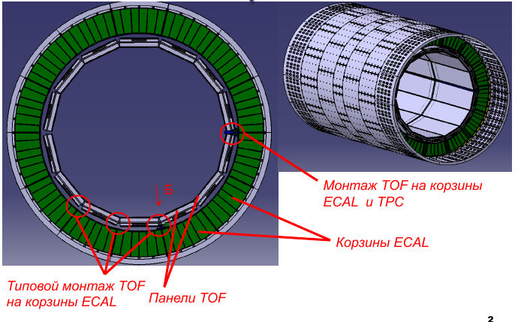


Installation of the TOF modules to the barrel MPD
Mounting of the TOF on the TPC rail
ECal modules
Typical TOF mounting on the Ecal frame
TOF modules
Notes:
One of the most difficult parts of the creation of the TOF system is a procedure of installation and service.
We are not yet finished the scenario of this procedure, but it is more clear now than in the past.
The firm "progresstech" (which specialize on the aircraft design) helps us to make installation and servicing most comfortable and easy.

Slide 11
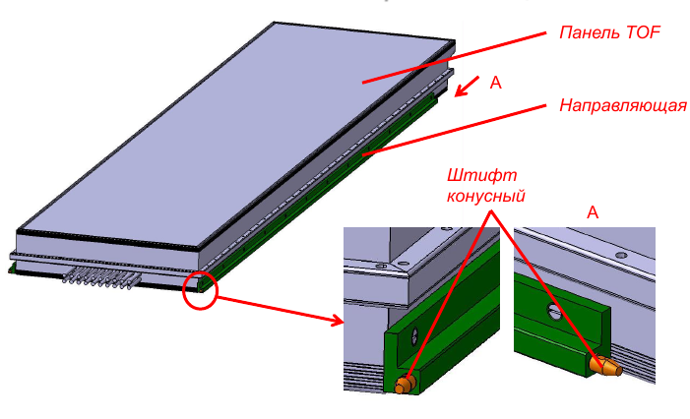
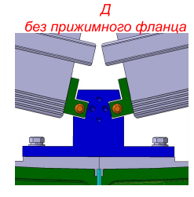
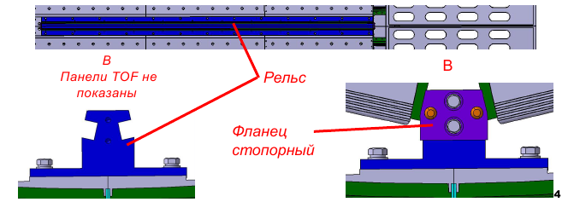
Installation of the TOF modules to the barrel MPD
Rails without clamping flange
TOF module
Guide (slider)
Cone pin
Rail
Clamping flange
The TOF module with the guides attached to it is set in the corresponding slots on the rails by means of snap all the way into the stop flange. Then it is centered by a conical pin. The final fixing is performed by pressing the flange, which is positioned on the rail by means of pins.
Notes:
The TOF module with the guides attached to it is set in the corresponding slots on the rails by means of snap all the way into the stop flange.
Then it is centered by a conical pin. The final fixing is performed by pressing the flange, which is positioned on the rail by means of pins.

Slide 12
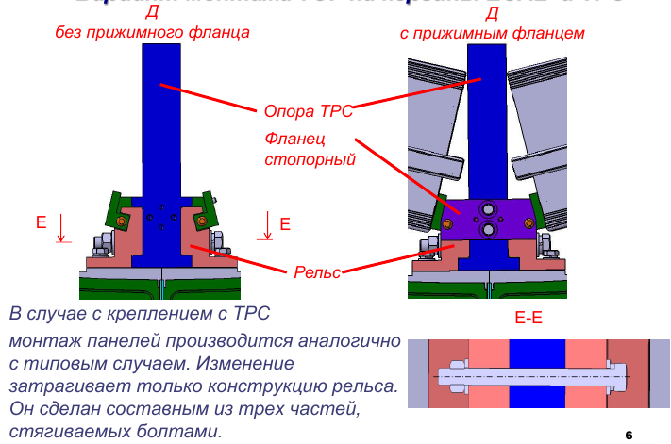
Installation of the TOF modules to the barrel MPD
without clamping flange
with clamping flange
TPC support
locking flange
Rail
In the case of fastening with TPC horizontal rail mounting of modules made similarly with a typical case. The change affects only the rail construction. It is composed of three parts which are tightened by bolts.
Notes:
In the case of fastening with TPC horizontal rail mounting of modules made similarly with a typical case.
The change affects only the rail construction. It is composed of three parts which are tightened by bolts.

Slide 13
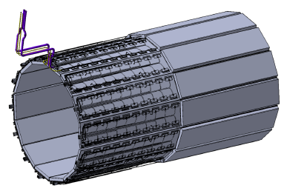
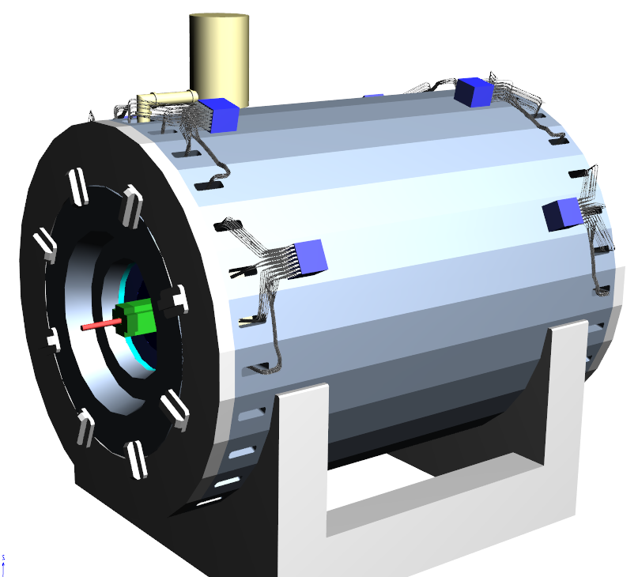
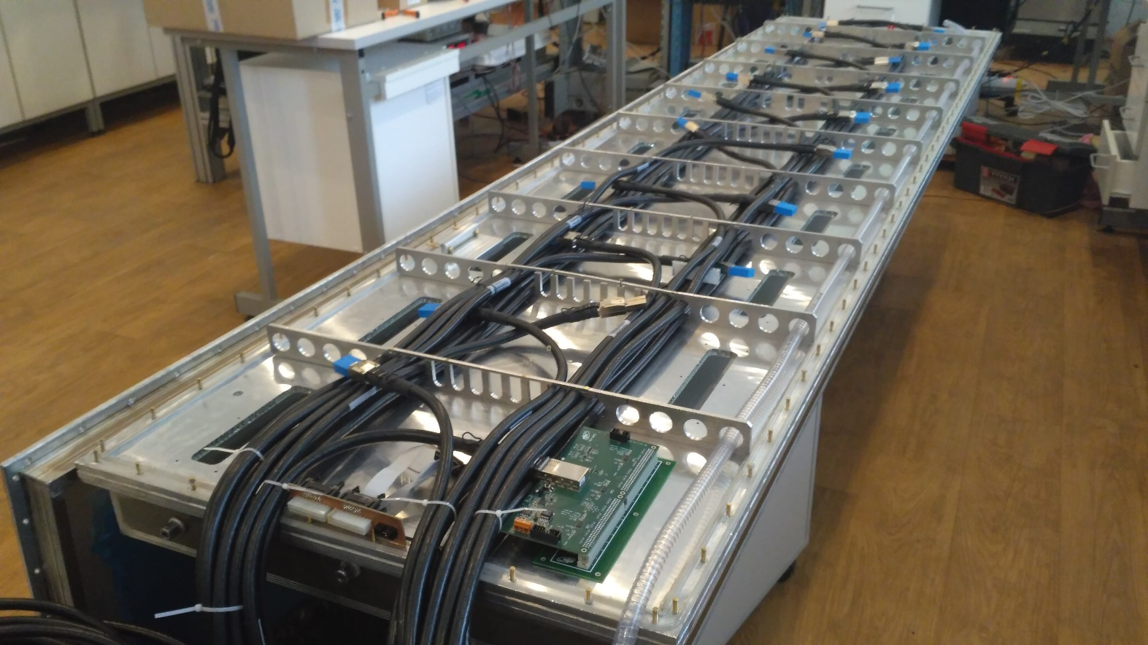
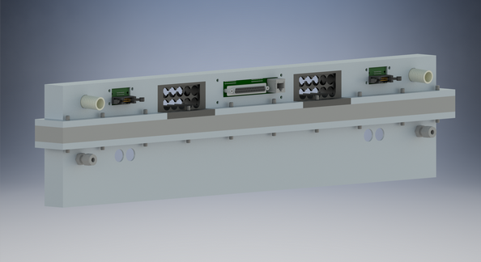
Cables and pipelines
VMEx64 crate
Air cooling
Trigger out
Signal cables
LV distribution
Slow control
Total cabling:
14 VME crates
196 TDC72VHL => 14 per crate
560 cables Molex CXP => 40 per crate
Cable lengths: 4 - 8 m
About 70 cm² in each technical
hole for cables and tubes.
Low heat dissipation
inside the barrel! ~10 W/m²
HV cable
NINO preamp
Molex InfiniBand cables
Gas connectors
HV connectors
Distribution board
Notes:
A very important part of creating the TOF system is the correct cabling.
This is single module with all communications that should be placed inside it.
The readout electronics must be as close as possible to the detector for achieving best time resolution.
But each crate radiates heat up to 300 W. Therefore we decided to fix them directly on the yoke.
Cables taking the signals from the FEE, LV cables, gas tubes and slow control buses will be routed through the center of the module to its outer ends.
Then they will come out from the external sides of the sector and pass through special holes in the yoke.
The space about 70 cm² (<1% of total size) is enough in each hole in the yoke for all TOF system cables, tubes.

Slide 14
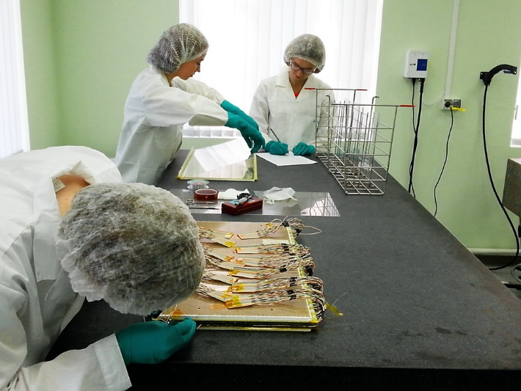
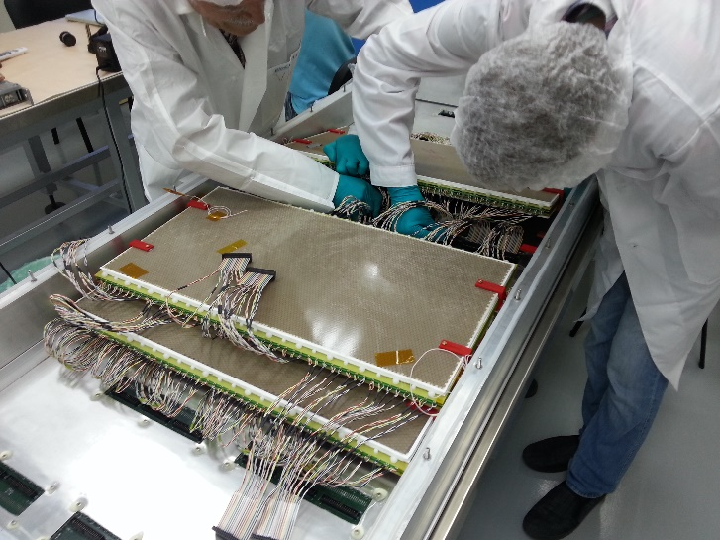
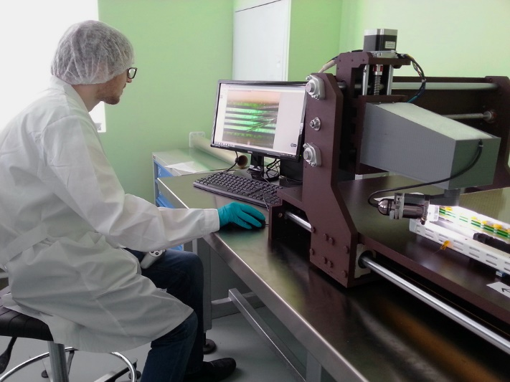
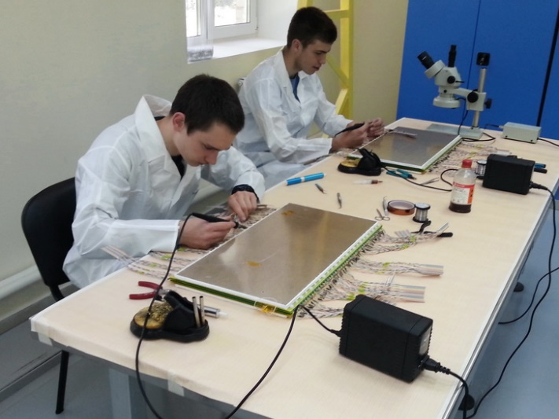
The TOF mass production preparation status
Materials are already bought for
assembling of 50 MRPC (5 mod):
280 μm float glass – 1000
400 μm float glass – 500
Honeycomb panel – 100
PCB with strips – 100
Purchased in 2017 :
280 μm float glass – 4000 (133%)
400 μm float glass – 2000 (133%)
Honeycomb panels – 500 (250 MRPCs)
PCB with strips – 500 (250 MRPCs)
Mylar, conductive paint, screws, monofilament line, wires, connectors are already purchased for the whole TOF system.
Workshop for the TOF detectors mass-production
Workshop staff: 3 physicists, 5 technicians, 2 electronics engineers
Productivity: ~ 1 detectors per day (1 module/2 weeks).
Photo of the RPC mounting
Painting
MRPC assembling process
Painting of the conductive layer
TOF module assembling
Control of MRPC quality and uniformity of gaps
Soldering of the signal cables
Notes:
We started mass-production of MRPC at the beginning of 2017. We are already bought materials for the first 50 MRPCs (5 modules).
For 2017 we plan purchase all necessary materials for the TOF production.
For the moment our workshop staff consists of: …
We evaluated our productivity and now the most realistic scenario is 1 detector per day. In this case we can assemble the barrel TOF for the 1 year and 2 months.
On these pictures I present some procedures of the TOF production. I made it when we made detectors for the BM@N experiment, but for the MPD it is almost the same.

Slide 15
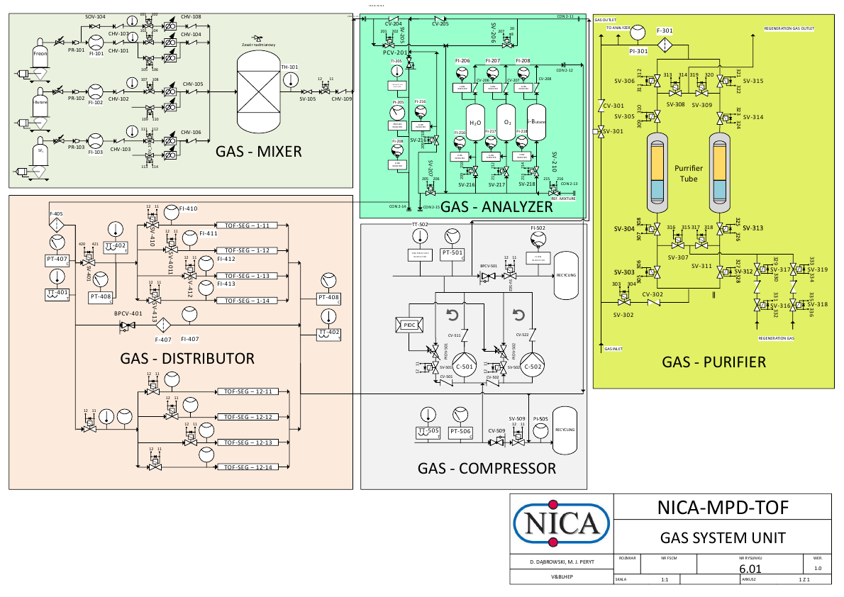
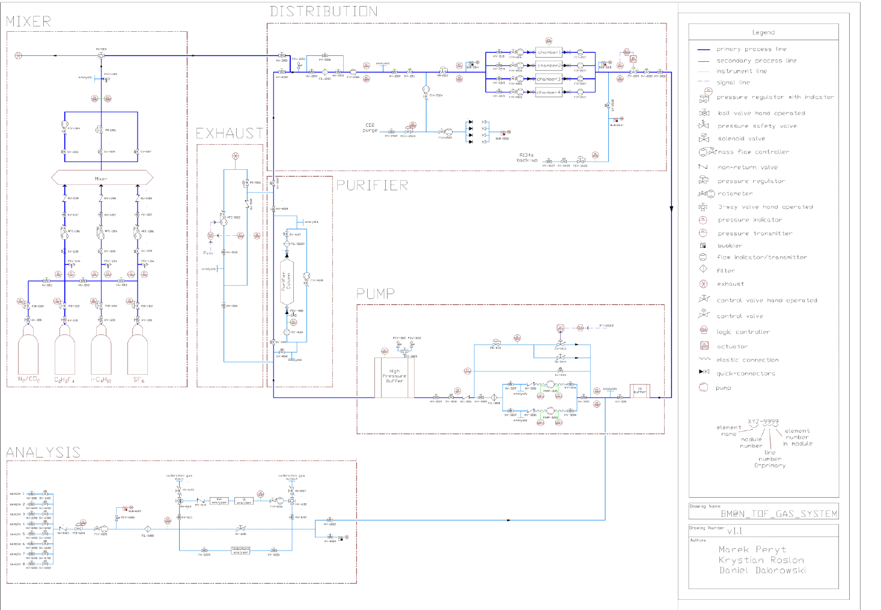

Gas system
Notes:
Concerning the service systems, I would like to highlight the progress in the production of the closed loop gas system.
It is developed by engineers from Warsaw University of Technology and we plan to test it on the cosmic stand this summer.
На стадии закупок… и дополнительного проектирования.

Slide 16
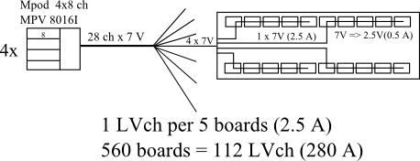
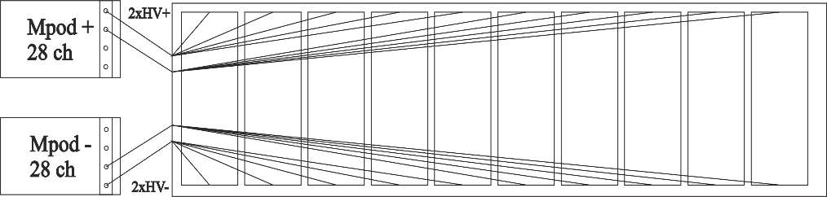
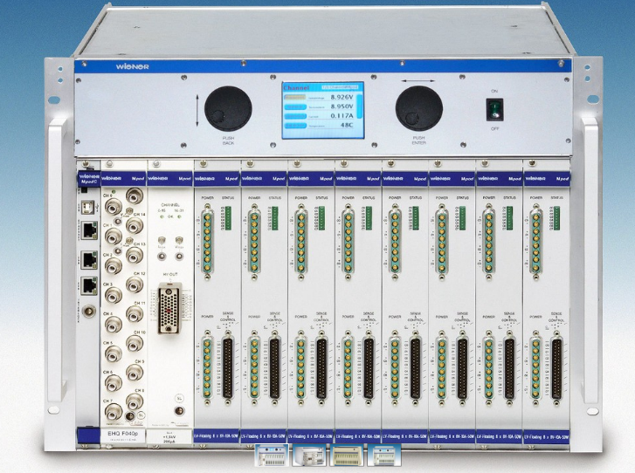
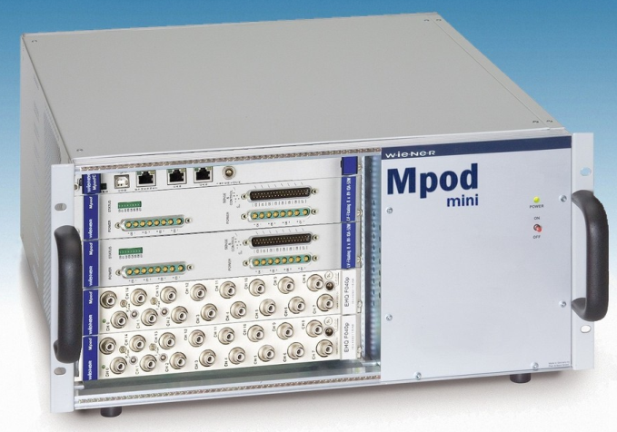
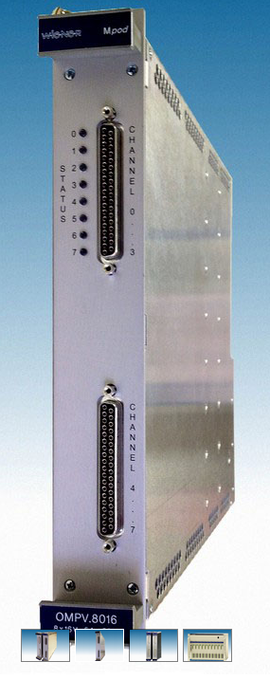
Service systems (HV, LV, cooling, slow control)
HV system requirements:
Minimum number of differential “±” channels: 56 (280)
Voltage range (one polarity): 8000 V
Total current through the whole system (~150 μA)
Precision of the current monitoring: ~10 nA
Multichannel structure
Remote control
LV system requirements:
560 (1120) NINO preamplifier-discriminator boards
Minimum number of LV channels (1 ch per 5 amp): 112
Supply voltage: 2.5V&3.3 V (<0.5 A/board, 2.5 A/LVch)
Maximum power consumption 2 kW
Multichannel structure
Remote control
HV distribution scheme
WIENER Mpod system and iSeg EHS 4080p(n) module

Slide 17
Notes:
I finish my presentation table with the schedule of works on creation TOF system. It can be seen that the work is going according to plan.
This year is scheduled to begin mass production of the detectors and electronics, as well as to put into operation the test stand.

Slide 18
Conclusions
Technical design of the MPD TOF system is practically complete.
The production of the TOF modules is started.
All materials for the TOF production will be purchased in full for the entire system in 2017.
Development of the readout electronics is complete now. Mass production already started.
Setup for testing TOF modules with cosmic radiation will be commissioned this year.
Service systems are in development and purchase state.
Notes:
That is all. In conclusion I would like to say that:

