Slide 1
Si-plates’ alignment for SPD of MiniSPD setup
Group № 1

Slide 2
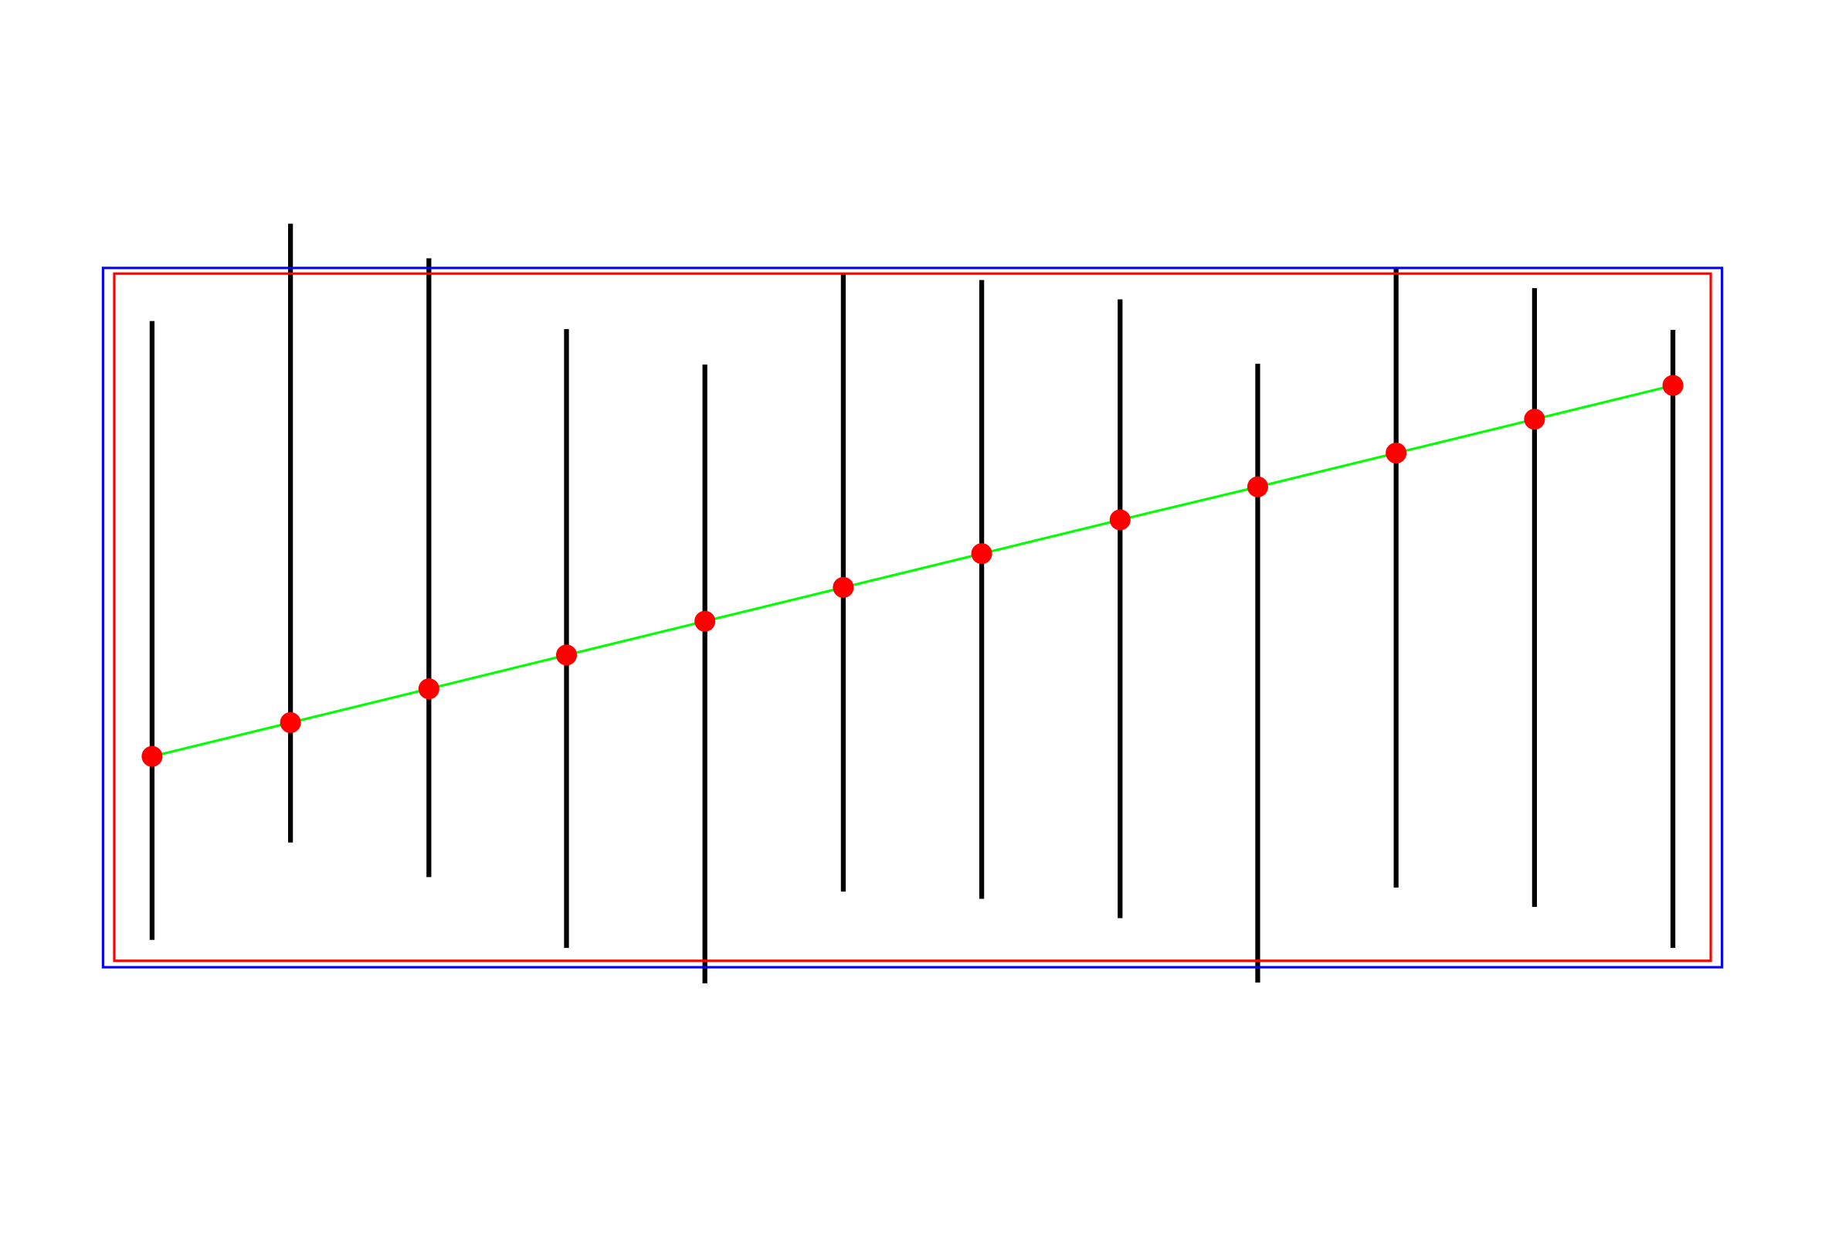
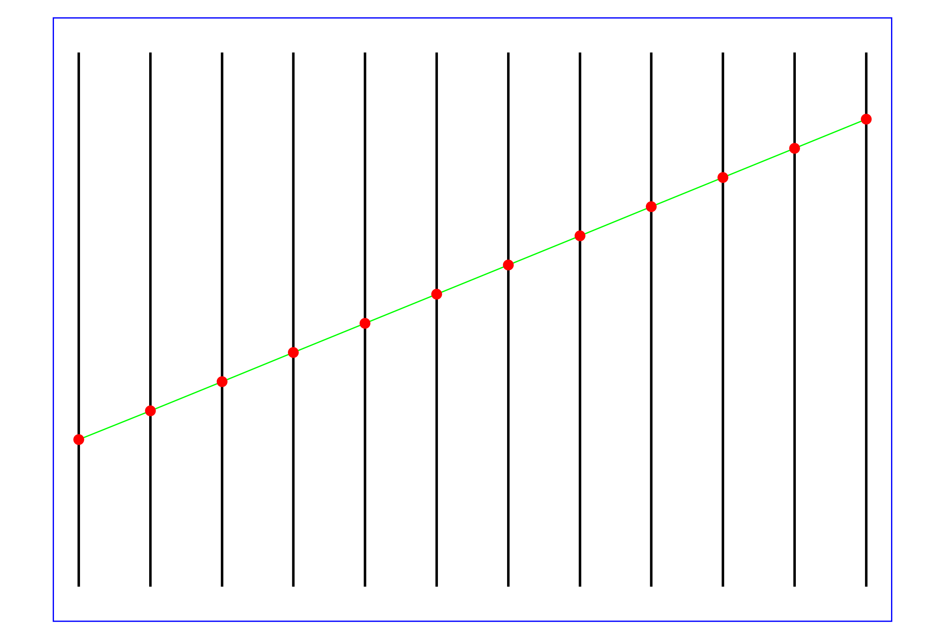
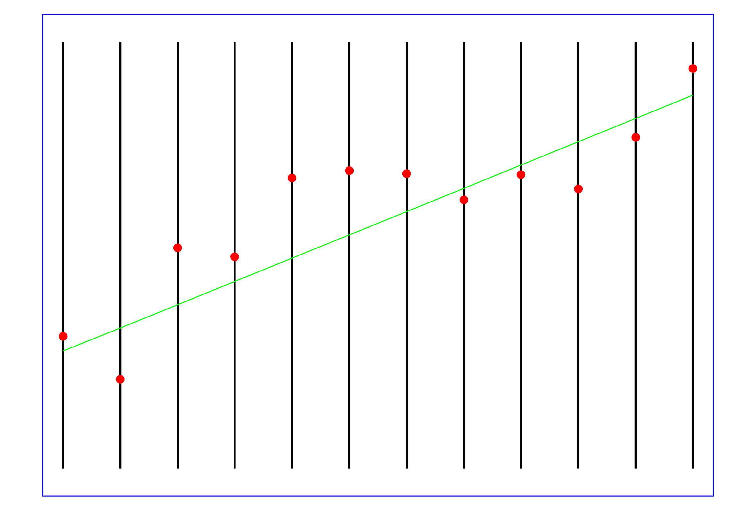
Alignment’s tasks
Reality
Aligned detectors
Nominal geometry

Slide 3
Functional minimization
Alignment is minimization of residuals of functional:
$F=\sum_{events}{\sum_{tracks}{\sum_{hits}{\left(\frac{d_{i}^{2}}{σ_{d_{i}}^{2}}\right)}}}$
$$d_{i}=u_{fit}−u_{mes}$$
Large number of parameters: track parameters (4 * number of tracks) and shifts (numbers of detectors), number of hits >> parameters.
$$u_{fit}→u_{j}\left(z_{i}\right)=\left(x_{0}+t_{x}z_{i}\right)cos\left(α_{i}\right)+\left(y_{0}+t_{y}z_{i}\right)sin\left(α_{i}\right)+Δu_{i}$$

Slide 4
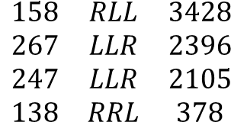
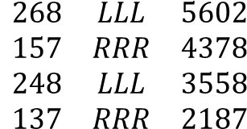
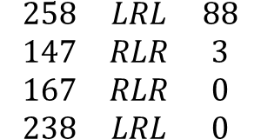
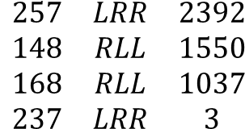
Possible combinations of Si-modules for tracks passing through MiniSPD setup
Nfile
Comb.
Ntracks
$$\begin{matrix}268 & LLL & 5602 \\ 157 & RRR & 4378 \\ 248 & LLL & 3558 \\ 137 & RRR & 2187\end{matrix}$$
2
1
I
Vertical tracks
4
5
$$\begin{matrix}158 & RLL & 3428 \\ 267 & LLR & 2396 \\ 247 & LLR & 2105 \\ 138 & RRL & 378\end{matrix}$$
II
6
3
Oblique tracks
$$\begin{matrix}257 & LRR & 2392 \\ 148 & RLL & 1550 \\ 168 & RLL & 1037 \\ 237 & LRR & 3\end{matrix}$$
III
$$\begin{matrix}258 & LRL & 88 \\ 147 & RLR & 3 \\ 167 & RLR & 0 \\ 238 & LRL & 0\end{matrix}$$
IV
8
7
Noise

Slide 5
U-plates, angle’s position of modules
Module | Angle in degrees
1 | +2,5
2 | +2,5
3 | -2,5
4 | +2,5
5 | +2,5
6 | -2,5
7 | -2,5
8 | +2,5
Module
1
4
8
Module
1
5
8
Module
2
4
8
The same orientation of modules for an only alignment of U-projection:
files 148, 258, 248

Slide 6
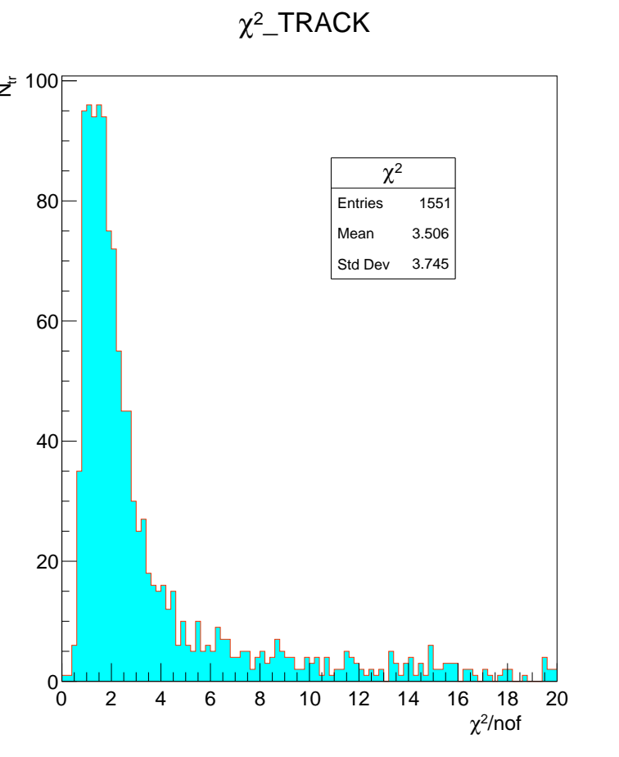
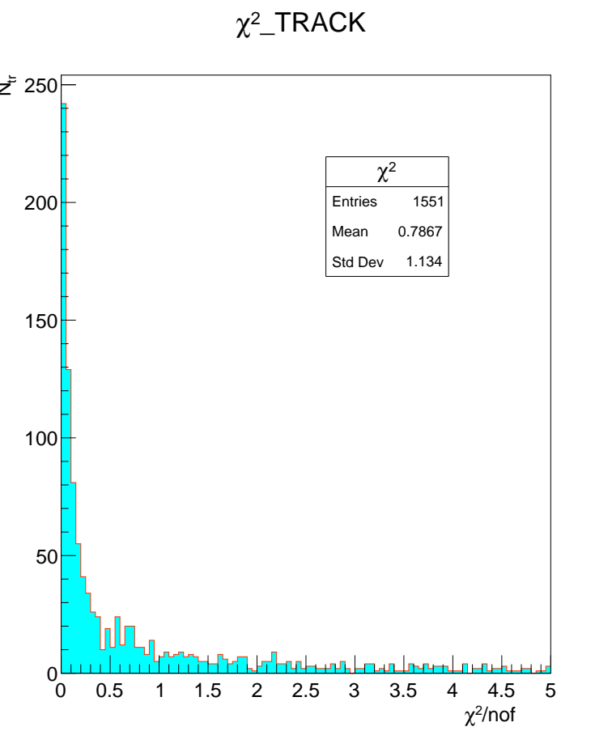
148-file
Shifts for 4th module
χ² distributions
Result of fit for global parameters
====================
I initial final
--- ----------- -----------
1 0.00000 0.00000
2 0.00000 0.00000
3 0.00313 0.00313 - x-side
4 0.40876 0.40876 - u-side
5 0.00000 0.00000
6 0.00000 0.00000
Total 1550 local fits, 635 rejected.
Before alignment
After alignment

Slide 7
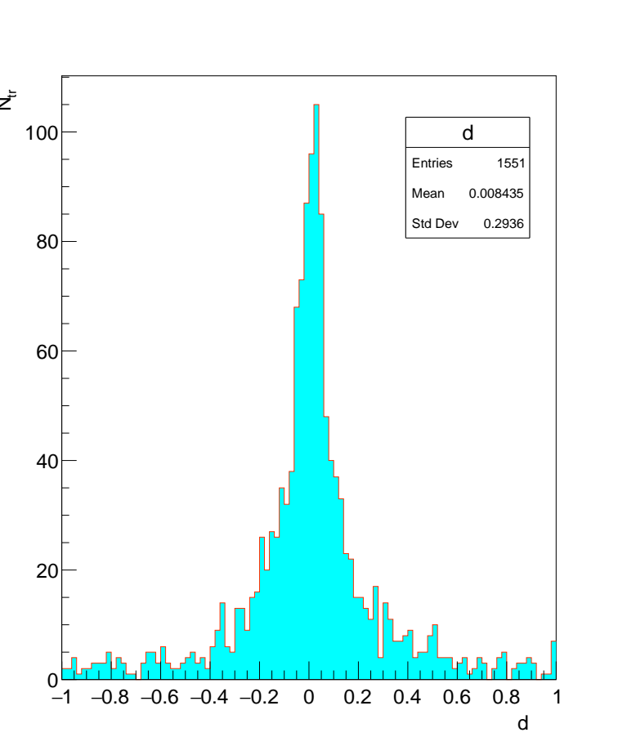
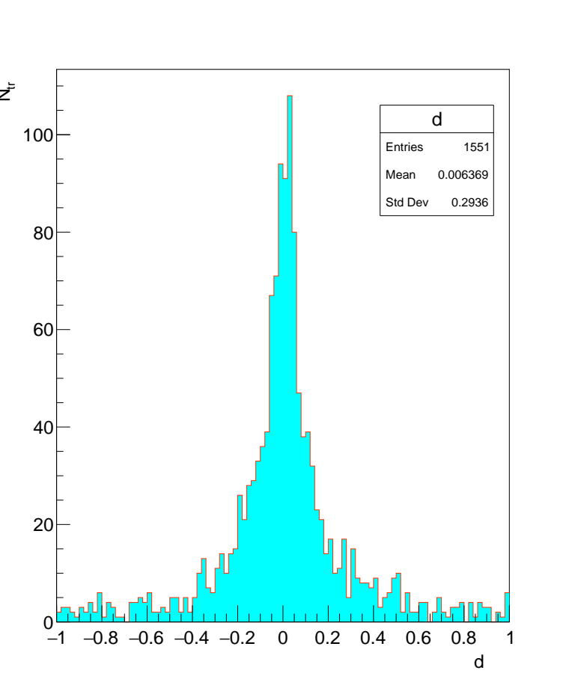
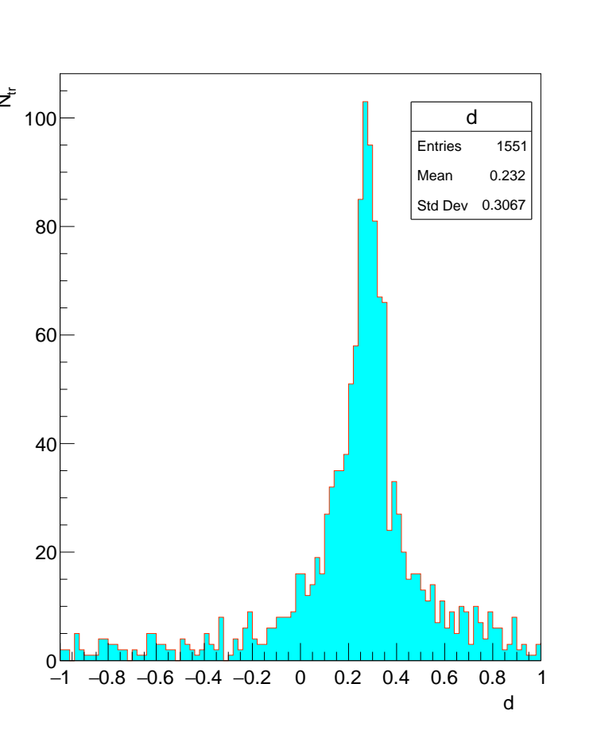
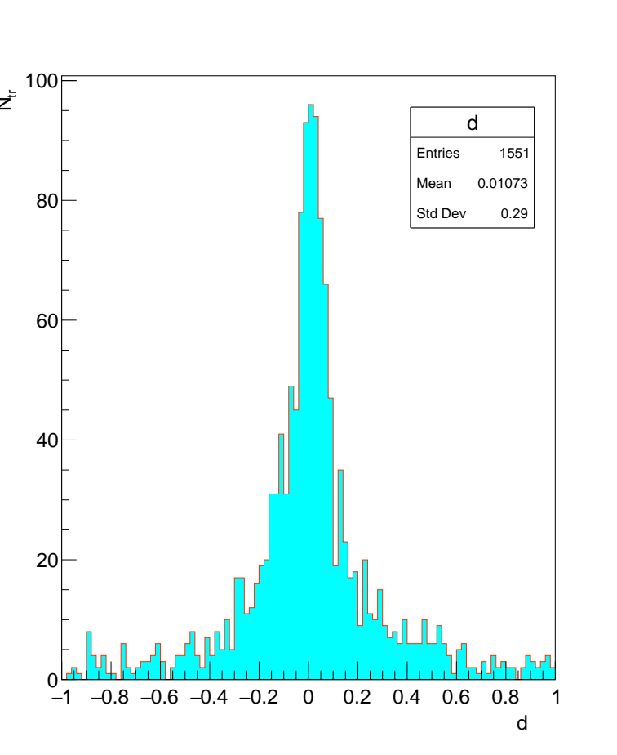
148-file
Before alignment
After alignment
X
X
U
U

Slide 8
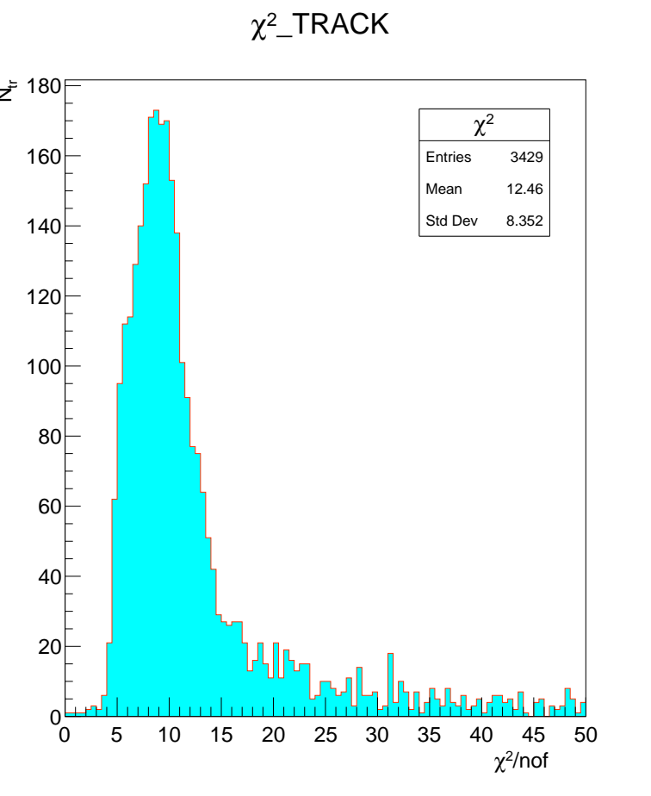
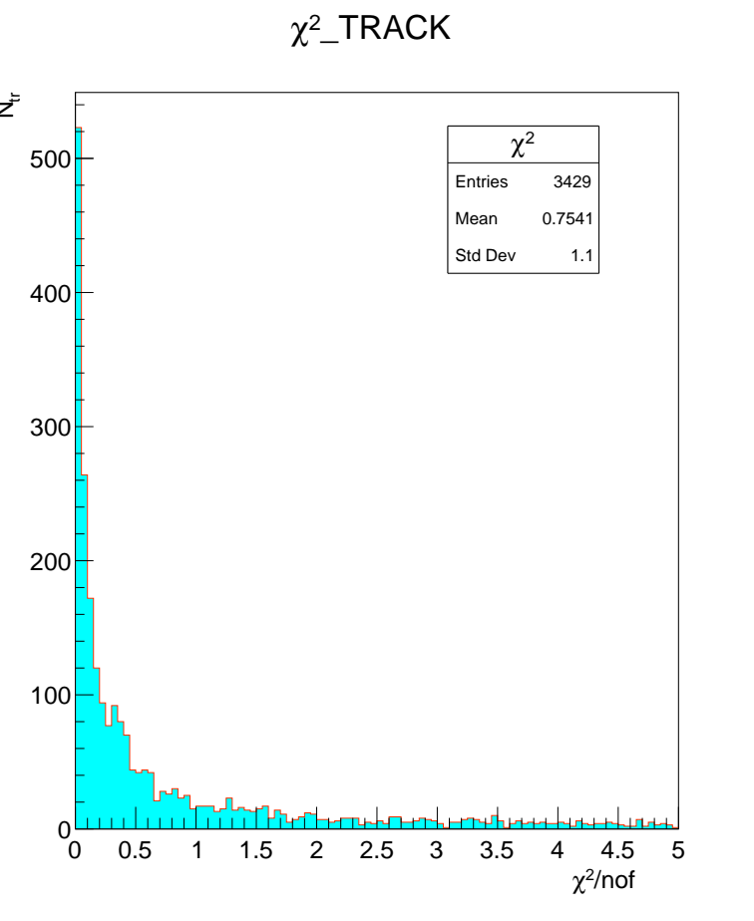
158-file
Shifts for 5th module
χ² distributions
Result of fit for global parameters
===============
I initial final
--- ----------- -----------
1 0.00000 0.00000
2 0.00000 0.00000
3 0.02798 0.02841 - x-side
4 0.97531 0.97572 - u-side
5 0.00000 0.00000
6 0.00000 0.00000
Total 3428 local fits, 1335 rejected.
Before alignment
After alignment

Slide 9
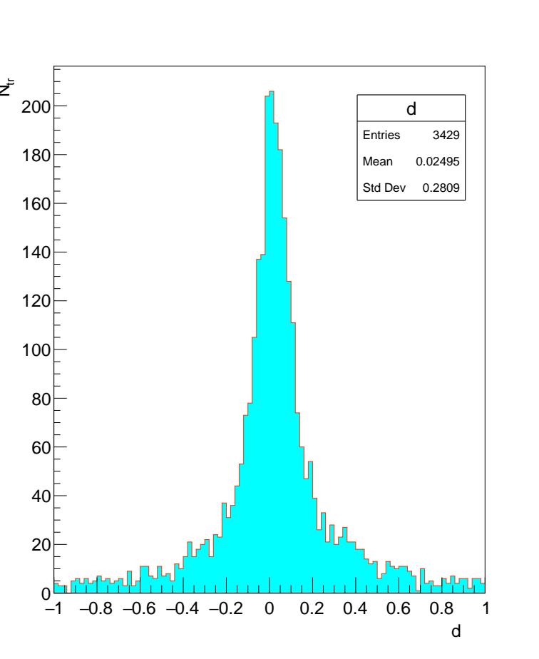
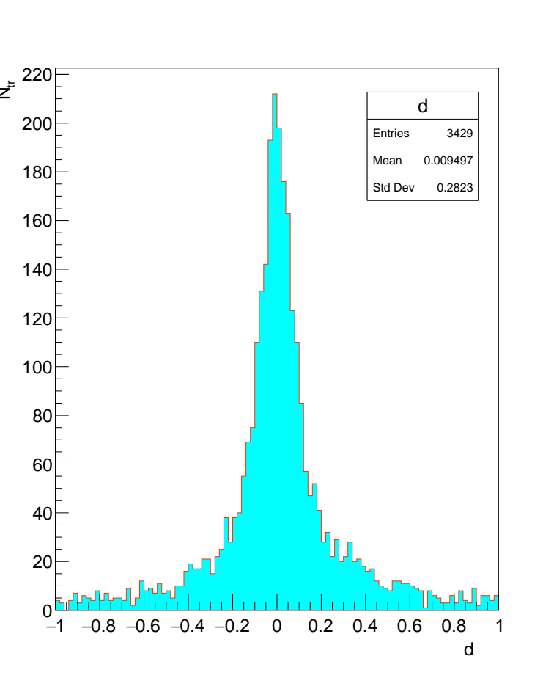
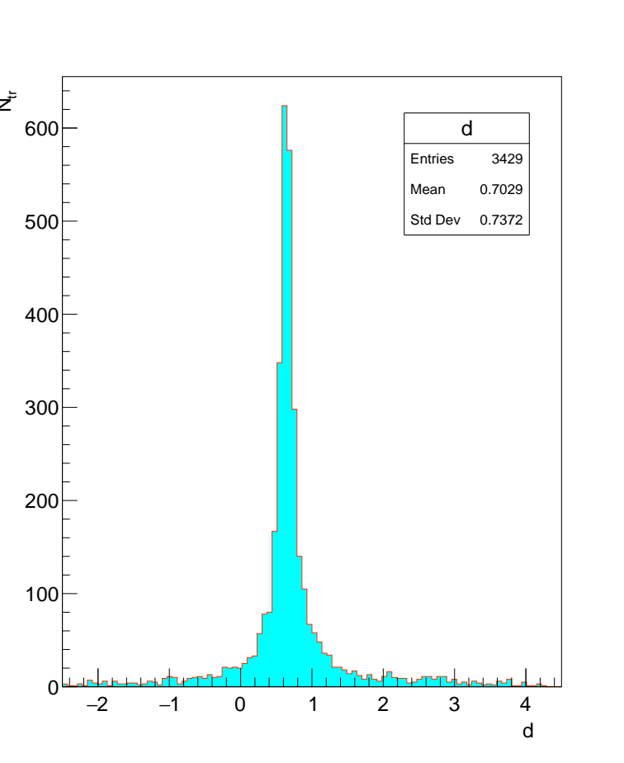
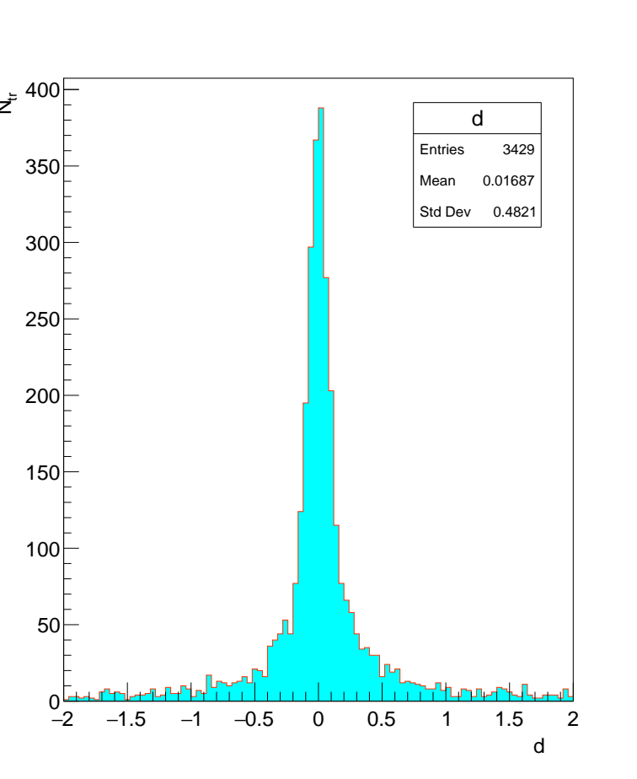
158-file
Before alignment
After alignment
X
X
U
U

Slide 10
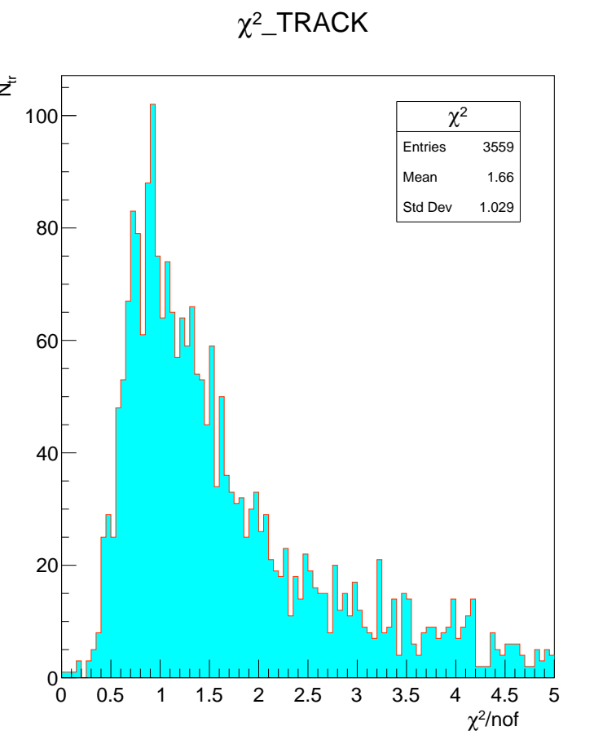
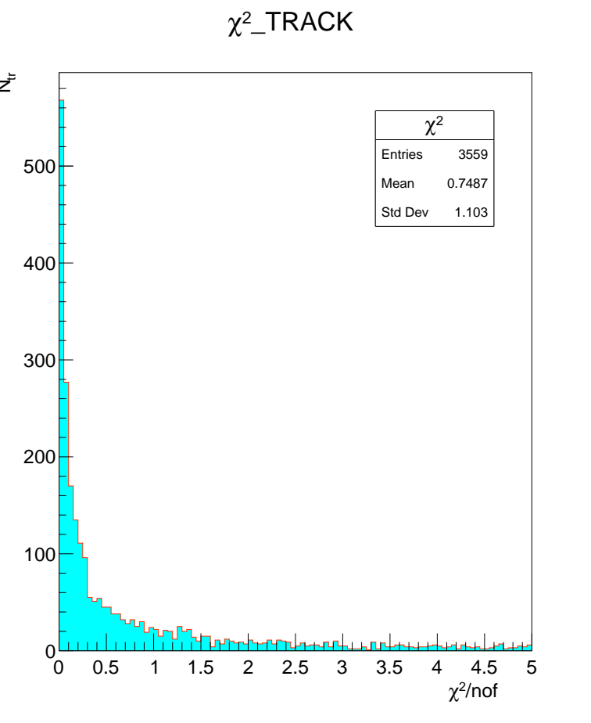
248-file
Shifts for 4th modules
χ² distributions
Result of fit for global parameters
==============
I initial final
--- ----------- -----------
1 0.00000 0.00000
2 0.00000 0.00000
3 -0.00378 -0.00365 - x-side
4 0.34720 0.34735 - u-side
5 0.00000 0.00000
6 0.00000 0.00000
Total 3558 local fits, 1409 rejected.
Before alignment
After alignment

Slide 11
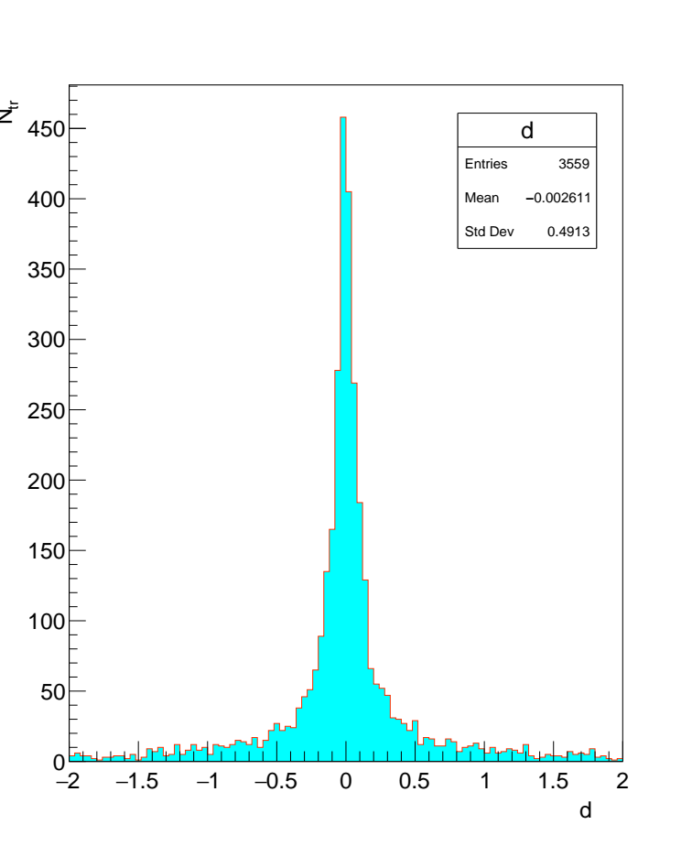
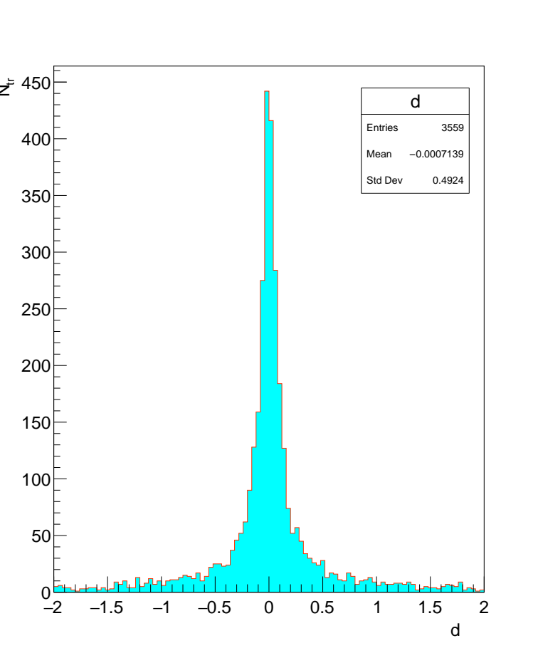
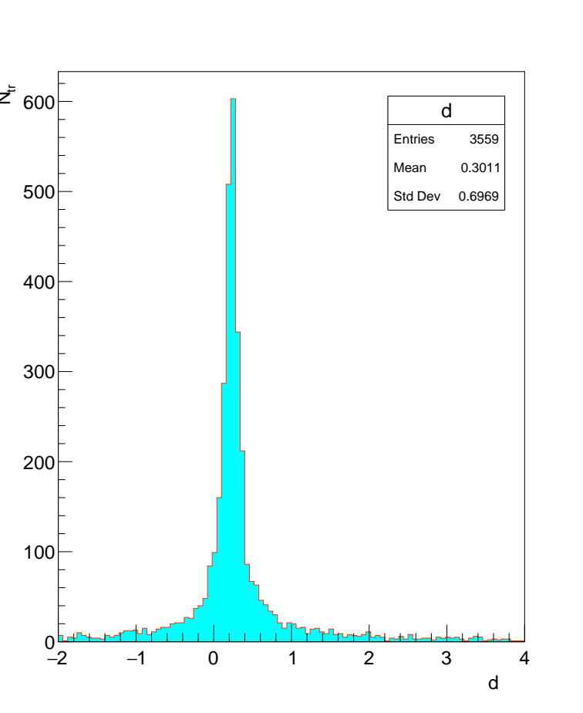
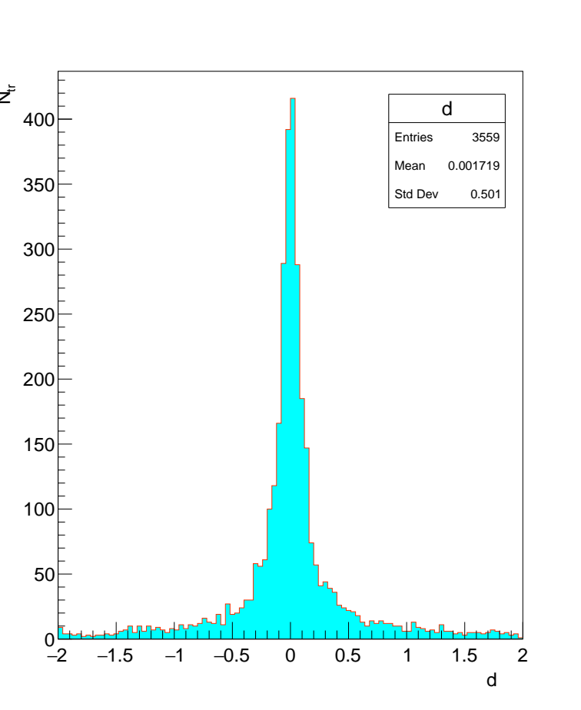
248-file
Before alignment
After alignment
X
X
U
U

Slide 12
Conclusion
1. The construction of 16 files was carried out to determine the single tracks of the MiniSPD setup. We distinguish 4 groups of tracks: vertical, oblique(RRL, LRR, ...) and false tracks, which are formed due to noise in the strips.
2. For groups 1, 2 and 3, spatial alignment was performed with finding of shifts by the x and U coordinates of the average Si-detector. The χ² and residuals distributions are also built before and after alignment ( I-iteration, II-iteration).
3. There is a noticeable difference in shifts for x and U coordinates. For the U coordinate, it is more than 10 times. Probably the values of the x coordinates soften χ² for tracks in space despite the inaccurate U coordinate.

Slide 13
Conclusion
4. So we compared χ² and residual distributions on x and U projection of tracks. Only three module combinations can be chosen for U projection of tracks out of possible: (1,4,8), (1,5,8) and (2,4,8). They have the same orientation (+2,5°). The χ² and residual distributions for x projection demonstrate good behavior. For U projection we observe much high residuals about 1 mm. Meanwhile for x projection they remain about 10 µ.
5. It is required to deal with the registration of the U coordinate (restoration of hits on the strips of the oblique plane). This work is in progress.

