Slide 1
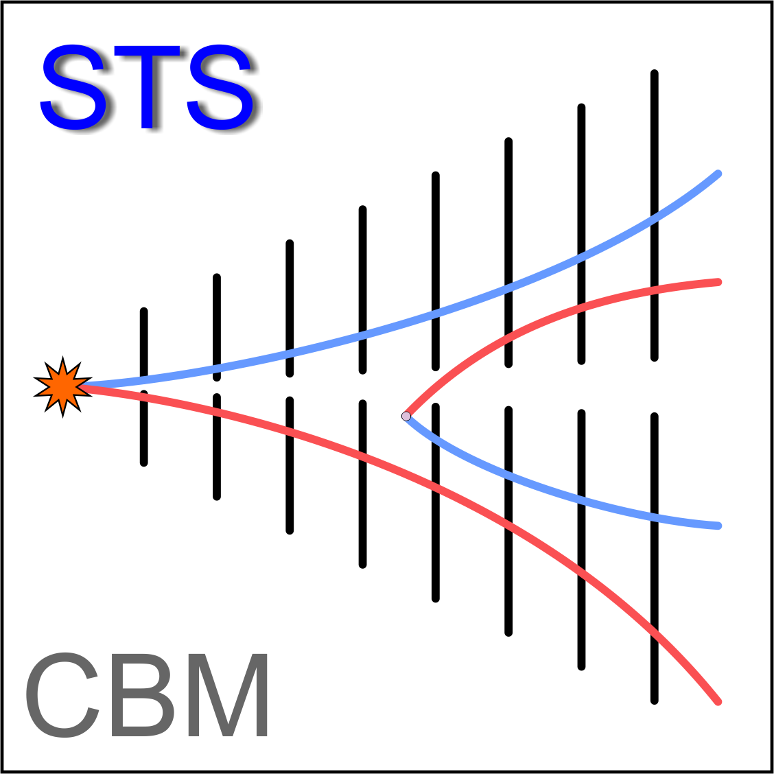
Temperature and Humidity control inside STS box
Marcel Bajdel
Goethe-Universität (Frankfurt)

Slide 2
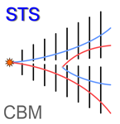
Sensors for HEP
Are there any commercial humidity sensors suitable for HEP?
Industrial high-precision dew point transmitters (e.g. Michell, Vaisala)
High performance, good accuracy, down to dew points-120°C
Instrumentation/readout/pump need to be placed in area with low/no radiation
Overall system is bulky and expensive (5k €)
No distributed sensing
Capacitive relative humidity sensors
Miniaturized
SHTxx not radiation resistant but as per CERN MK33-W sensors from IST are radiation hard
Magnetic field (?)
FBG/LPG based sensors
Relatively small
Magnetic field insensitive
Radiation hard
Difficult to integrate in a hardware interlock
Highly dependent on temperature changes
Readout device is expensive (20k €) but it can be used for hundreds of sensors
Forum Tracking Detector Mechanics

Slide 3
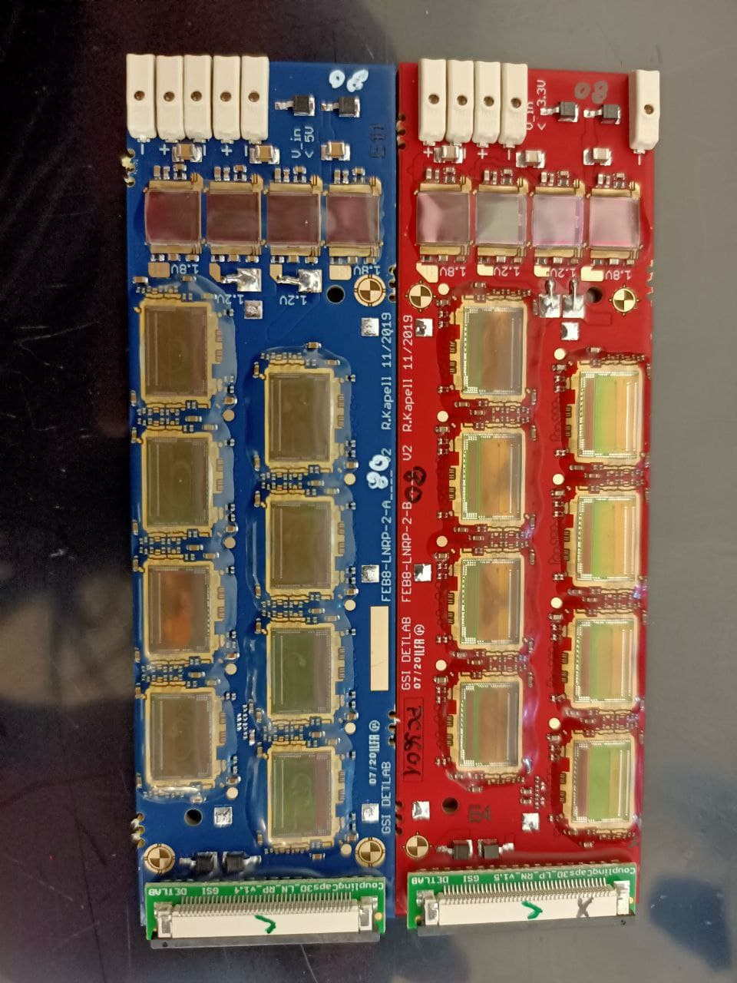
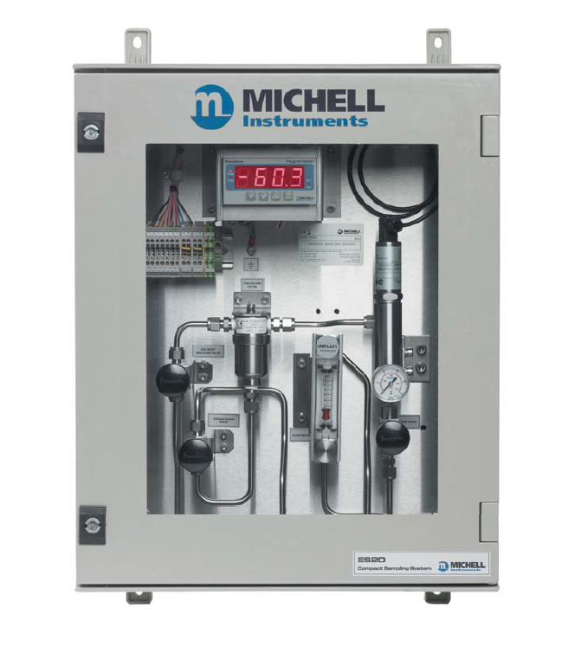
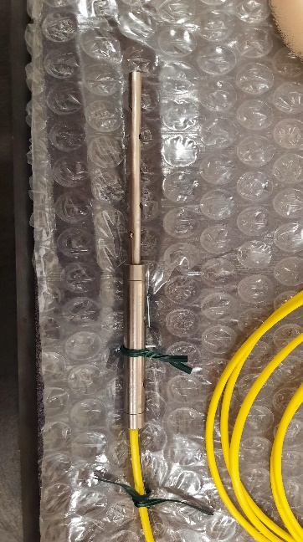
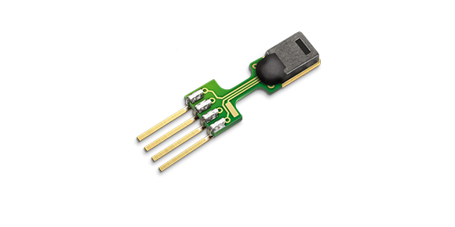
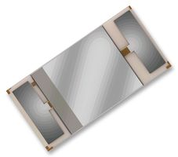
STS humidity and temperature
ASICs internal T sensor,
GBT SCA T sensor
Sniffing tube and readout system
Fiber Bragg Grating Fiber Optic Sensors
Commercial capacitive sensor (SHT85 and P14)

Slide 4
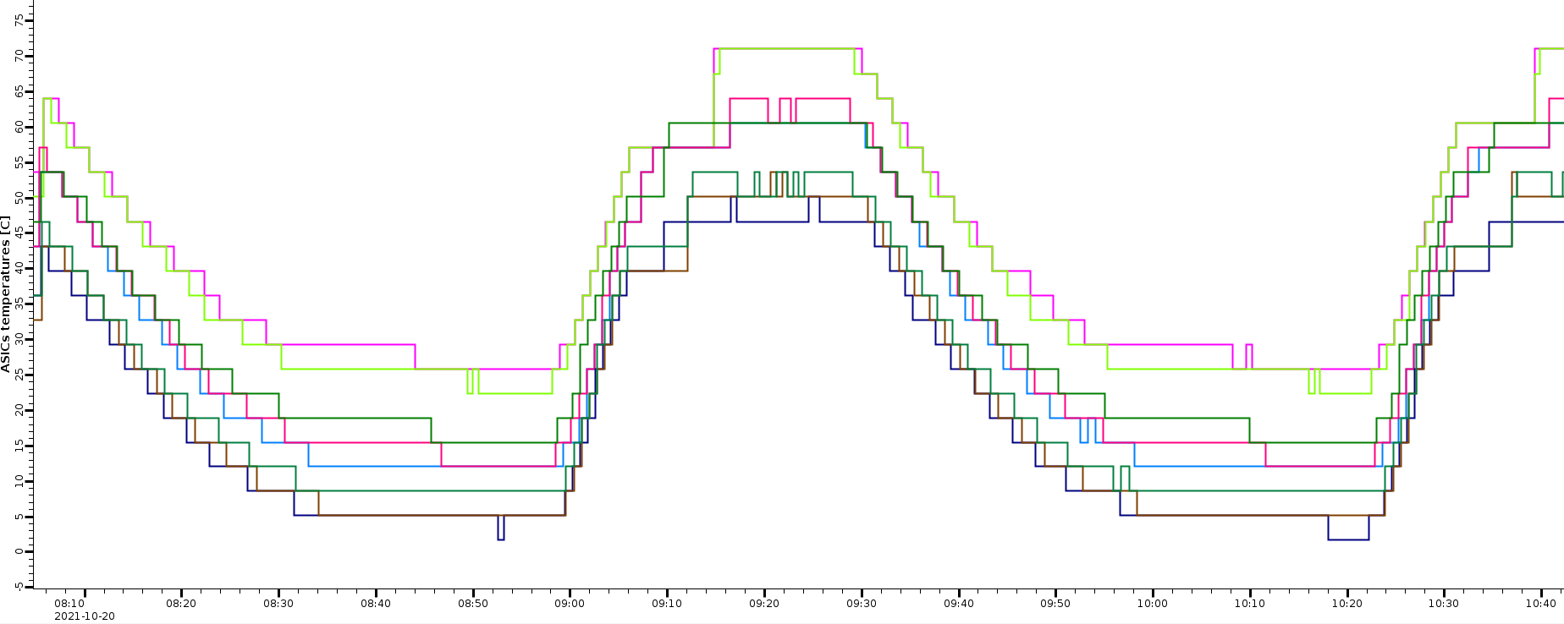
ASIC internal T sensor
Cooling block temp
from -30ºC to 20ºC
ASICs internal T sensor,
GBT SCA T sensor
Low precision (4ºC)
Can’t be readout during data taking
~14 000 T sensors – averaging per FEB BOX(?)
Easy integration with DCS

Slide 5
T FOS
P_{e} – photo-elastic constant, ϵ - strain induced on the fiber, α – thermal-expansion coefficient, ζ – thermo-optic coefficient
Peak reflectivity
FBG is in a strain-free conditions and strain effect is compensated, then:
$$\frac{∆λ_{B}}{λ_{B}}=S_{T}ΔT$$
Reflectivity of the T FBG

Slide 6
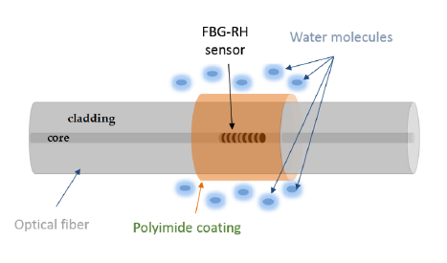
RH FOS
α_{t} - thermal expansion coeffiecient, α_{rh} – moisture expansion coefficient
$$\frac{∆λ_{B}}{λ_{B}}=S_{T}ΔT+S_{H}ΔRH$$
G.M. Berruti, CERN-THESIS-2015-321
Reflectivity of the RH FBG

Slide 7
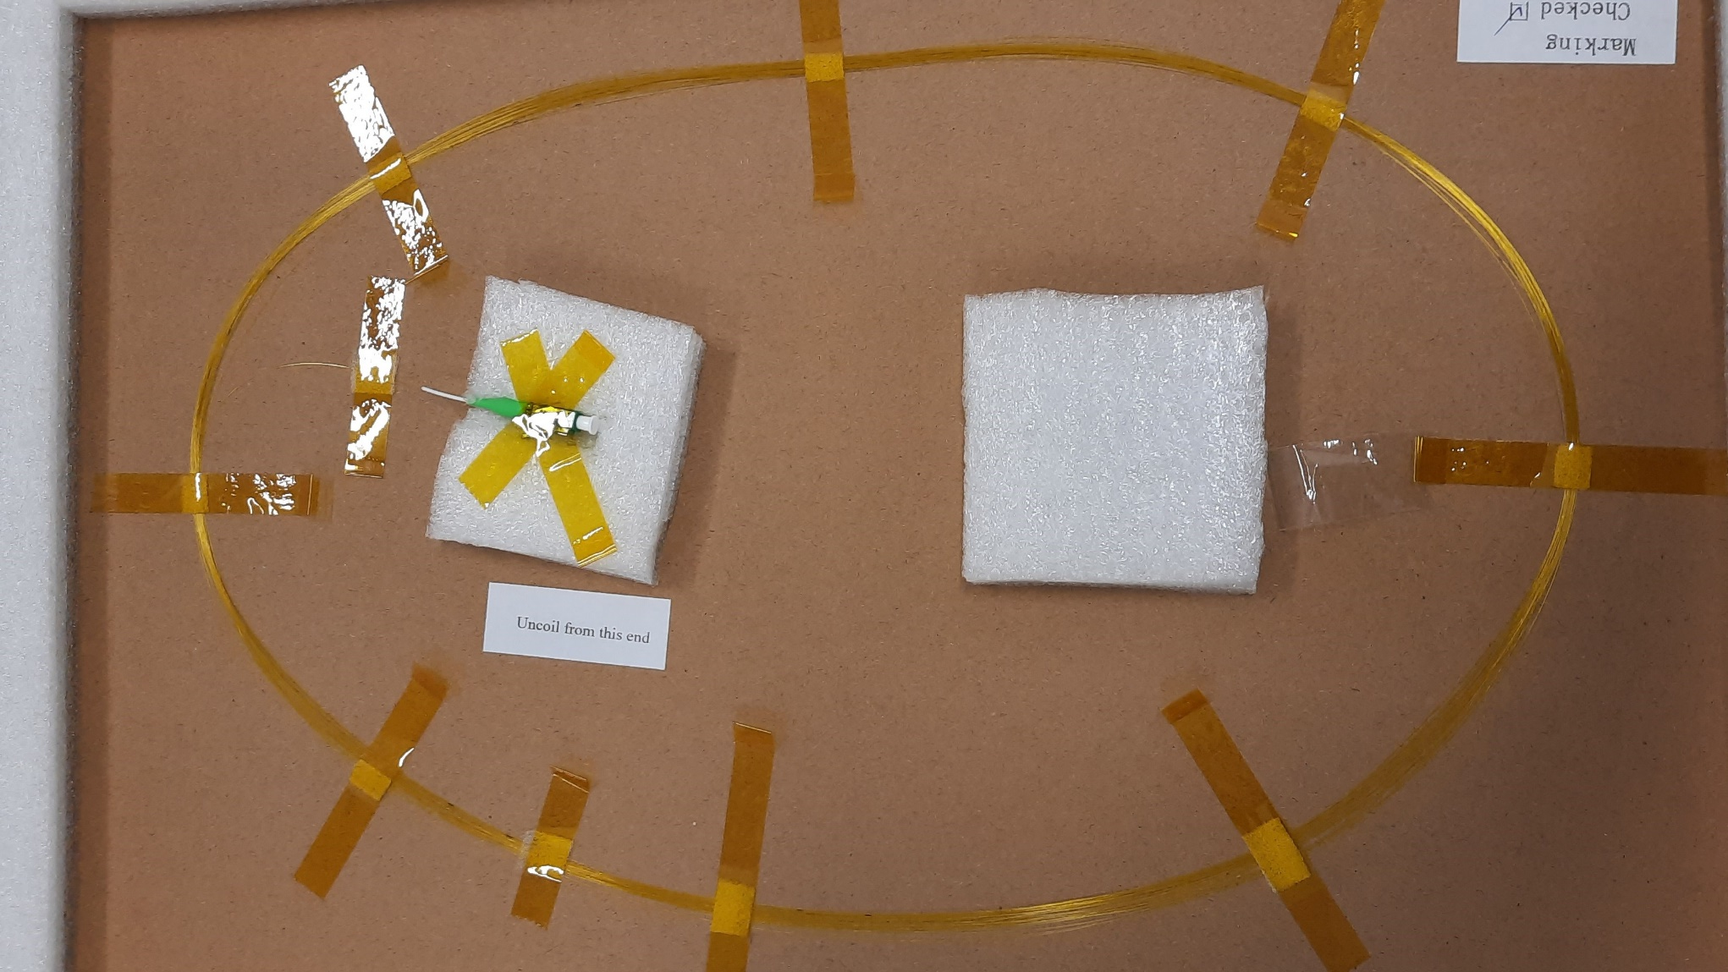
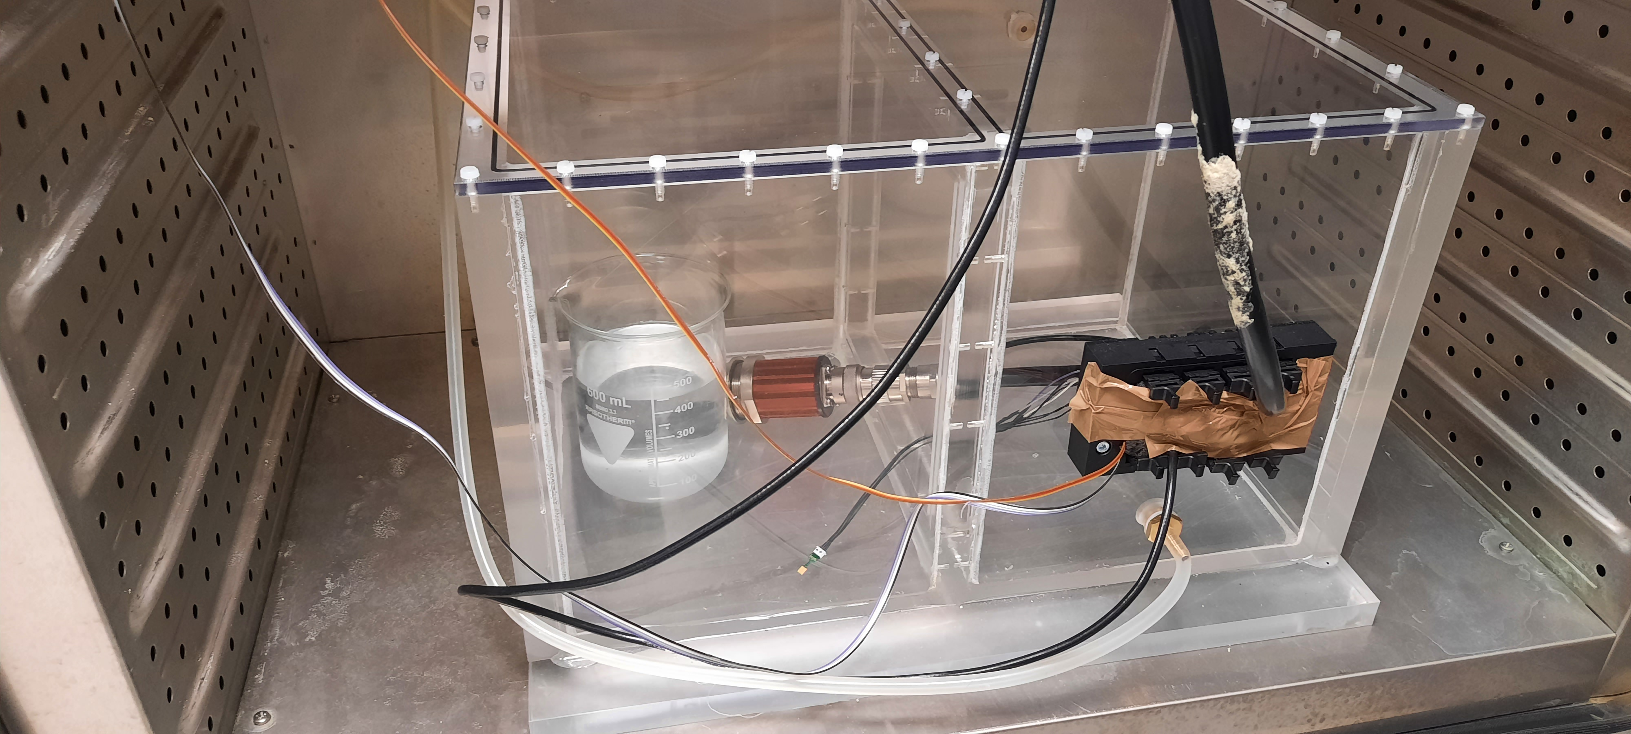
Testing
5xRH/T arrays to be packaged with carbon fiber packaging
Setup
Not radiation hard, to be packaged
Climatic chamber for temperature control
Saturated salt solution + N₂ for humidity control
SHT85 and Michell Chiller Mirror for calibration
Readout (interrogator) integrated in the DCS
2x single RH/T sensor with different humidity sensitivity
Radiation hard, custom packaging

Slide 8
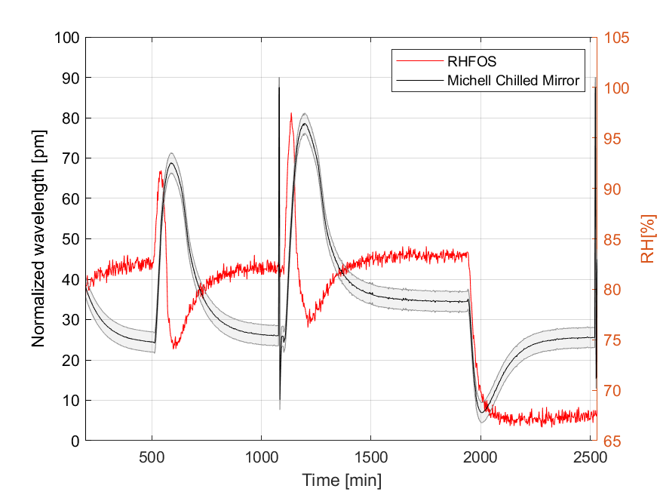
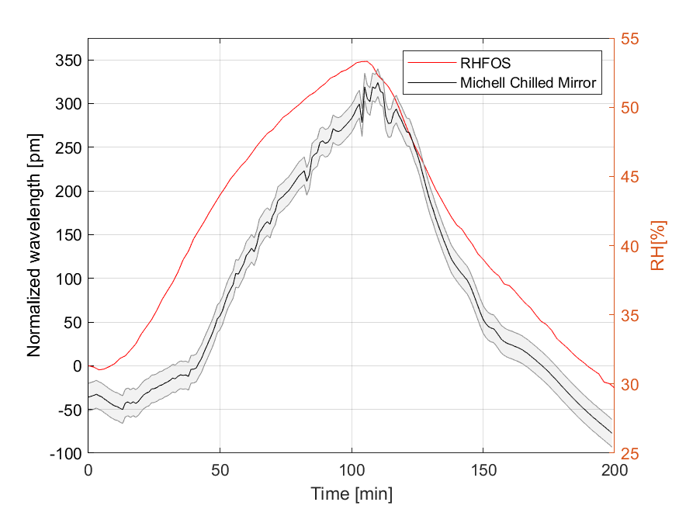
RH and T FOS
RH FOS response in comparison to the Michell Chilled Mirror

Slide 9
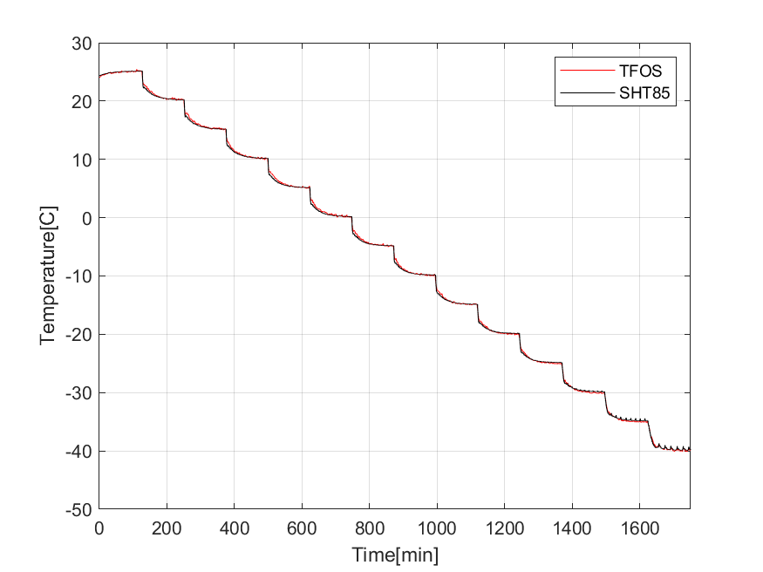
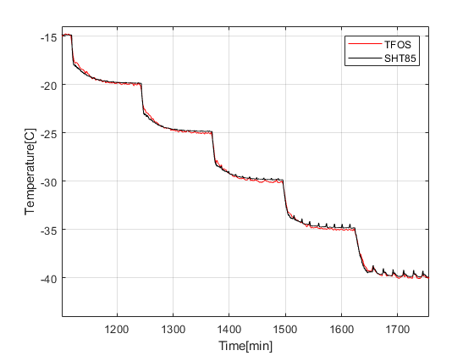
SHT85
TFOS 1-2% difference compared to PT1000 after nonlinear fitting

Slide 10
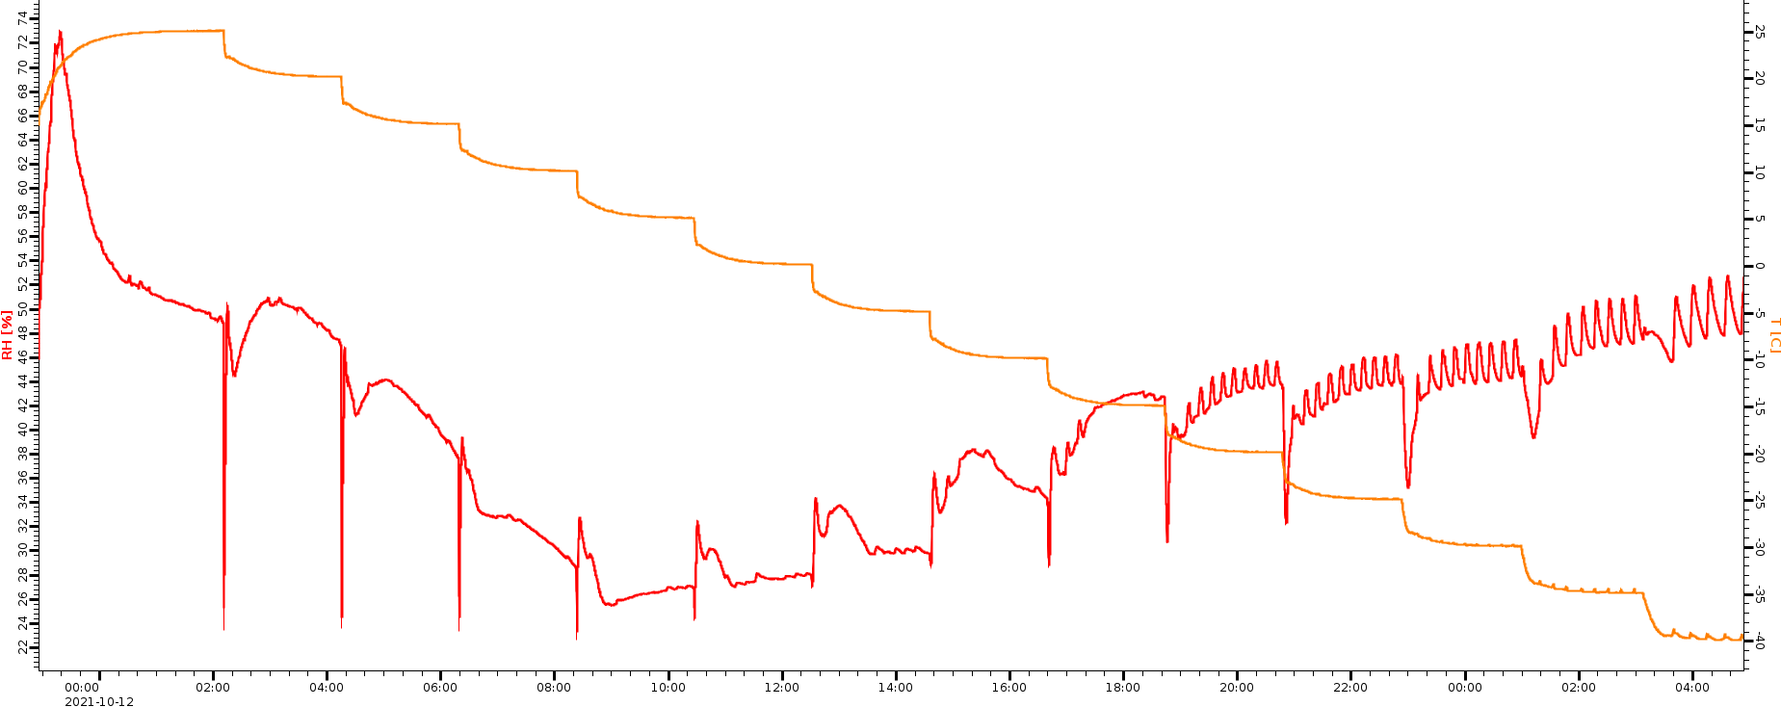
SHT85
SHT85 1-2% RH error down to 0ºC

Slide 11
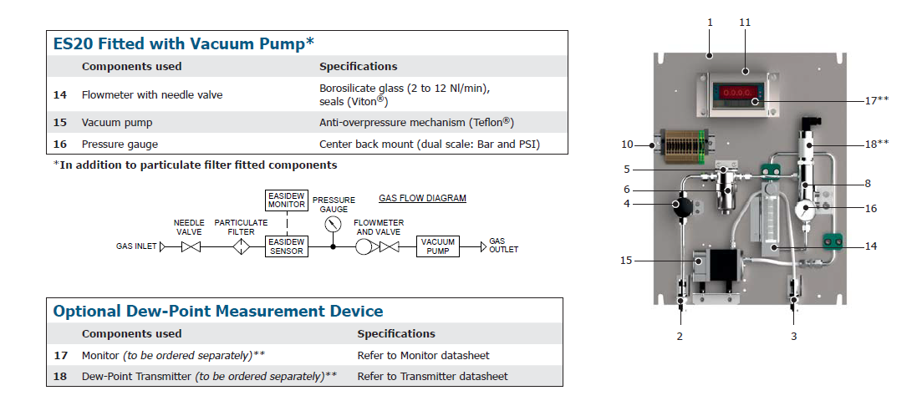
Sniffing system
Air will be sniffed from the STS box and measured ~25 meters away:
High precision of dew point measurement (1-2 ºC) down to -100ºC
Perfect for implementation in the interlock system
Two such devices will be tested in the Thermal Demonstrator

Slide 12
Conclusions
 | Radiation hardness | Magnetic field resilience | Miniaturized | Precision | Integration efforts | R&D needed | Price
Fiber Optic Sensors |  |  |  | Probably 1-2% RH(?) ~0,1 ºC T | High | Months - years | 20-30 k EUR + 50-500EUR per sensor
SHT85 |  |  |  | 1-2% RH down to 0ºC ~0,1ºC T | Low |  | 30 EUR per sensor + readout (?)
MK33-W |  |  |  | 1-2% RH down to 0ºC | Low | Months | 30 EUR per sensor + readout (?)
Sniffing system |  |  |  | 1-2ºC DP down to -100ºC | High |  | 5-6k EUR per device
ASIC internal T |  |  |  | Low 4ºC |  | Calibration

