Slide 1
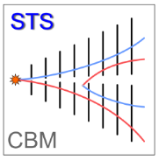
Cables, connectors and feed-througs for STS
20/10/2021
P.Koczoń, U.Frankenfeld, R.Kapell, O.Vasylyev, C.J.Schmidt DL/GSI

Slide 2
- new approach follows 8/16 channels topology trying to avoid lost channels - right half of the platform in the cave was elevated what allows for shorter LV connections

Slide 3
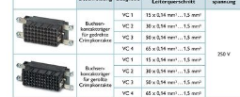
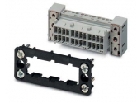
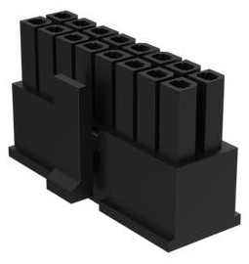
Schematics (LV)
PowerBoards
FEBs
PHOENIX pair of:
VC-D3-ST50-PE + VC-D3-BU50-PE
or VC-AR3/TR3/4m-S8888
PHOENIX VC-D3-ST50-PE
or VC-AR3/TR3/4m-S8888
8 ch 16 lines
á 0.75mm2
Flat SUMIDA cable
distributes voltages
among FEBs
AMPHENOL
10132445-16LF
(2x8pins two rows
8 LV Voltages)
18leads for 8 ch á 2x1.5mm² shielded SABIX
Power supplies
16 ch/module
under the platform
Patch Panel
4m
30m (23m?)
FEB Box
Feed through
on the STS front wall

Slide 4
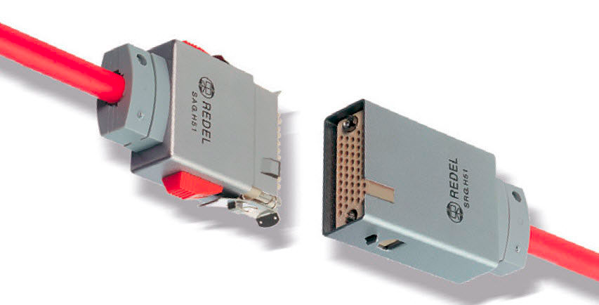
Schematics (HV)
PHOENIX VC3 pair
or REDEL
REDEL HV connector
REDEL 51pins
16 ch
>32 Pins
LEONI type HV cable
16 ch 32 lines
LEONI type HV cable
HV Distribution sto FEBs
d=1mm coax
Power Supplies
16 ch/module
upstairs
Redistribution
HVBox
30m (23m?)
Patch Panel
4m
FEB Box
Feed through
on the STS front wall

Slide 5
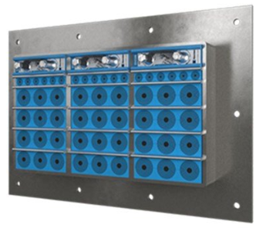
ROXTEC sealing (green on prev. slide) (to avoid moisture in the box)
Individual cables (16/32/54… bundled leads)
up to 22mm diameter
A dedicated adapter is constructed
for data light fiber cables

Slide 6
What’s in-house? - tendering for power supplies → close to be finished - connector samples - SUMIDA cable built in mSTS - offer(s) for LV /HV cables (SABIX, LEONI, BEDEA) - sealing material (samples) - cable installing company (offer for C17/STS-Lab)
What is missing?
- Man power and time
Detailed material knowledge
- radiation resilience of glues/glob top/isolation
Decisions about purchasing
PROTOTYPE/DEMONSTRATOR

