Slide 1
Power supply system for magnetic elements of transport channel for particle beam of the Accelerator complex
BM@N, NICA
V.Karpinskii on behalf of the team

Slide 2
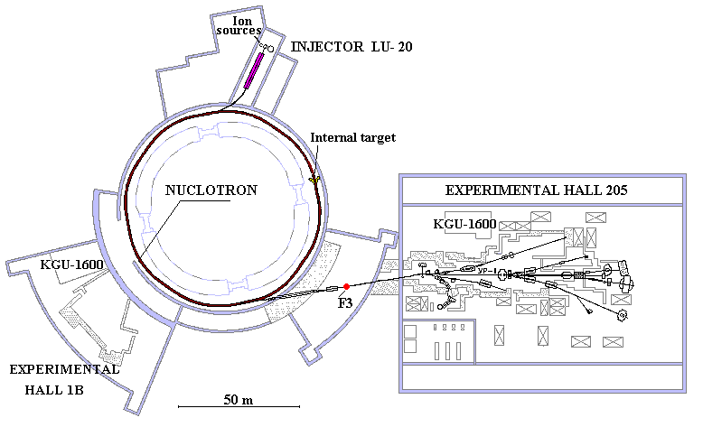
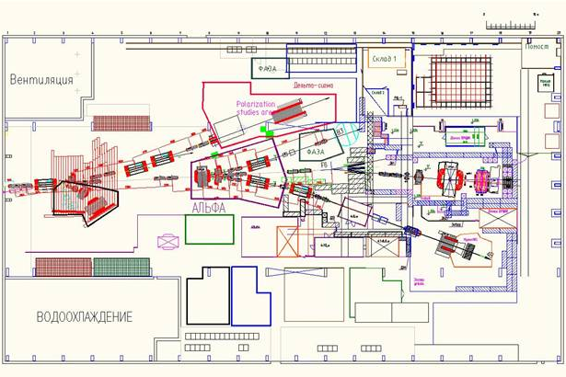
Power supply system for magnetic elements of transport channel for particle beam of the Accelerator complex, BM@N NICA
Accelerator complex,
beam transport channels
beam channel hall 205
Hall 205
Bld. 1
beam output channel from the Nuclotron
V.Karpinskii
November 2021

Slide 3
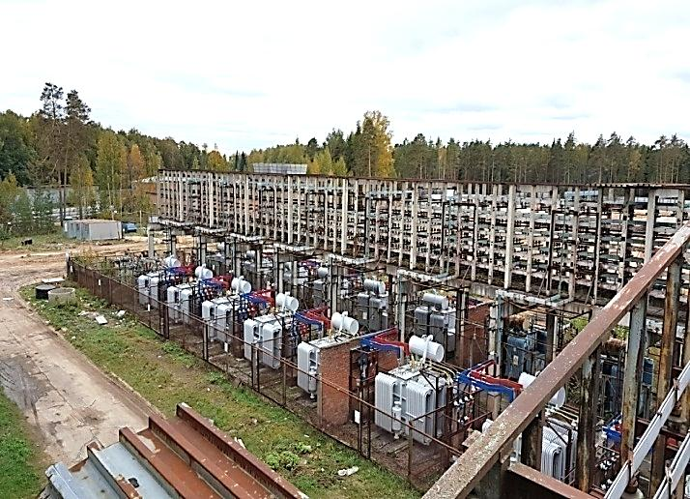
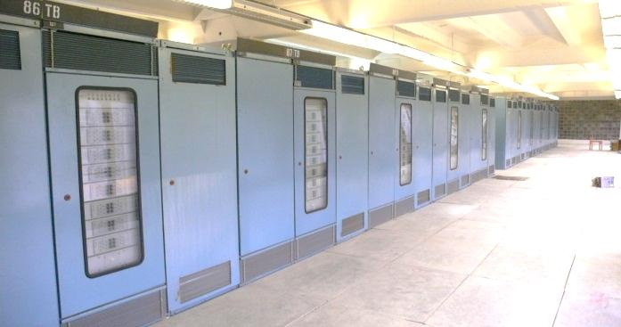
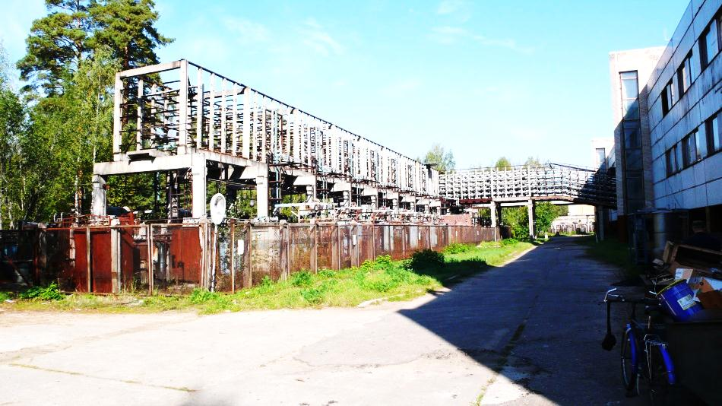
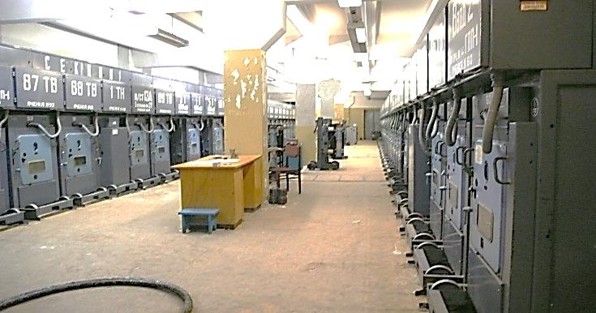
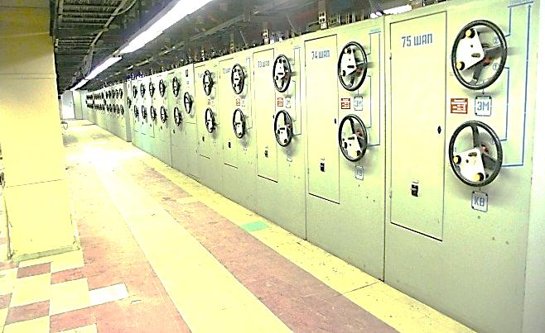
Power supply system for magnetic elements of transport channel for particle beam of the Accelerator complex, BM@N NICA
The old power system includes:
- SG15 substation with 64 cells with oil switch, 6 kV network,
25 power supplies, type «КВТМС" 130V x 3500A,
20 power supplies, type «ТВ", 230V x 1600A,
10 power supplies, type «КВ", 230V x 600A,
A total of 55 units of sources + associated equipment. The installed capacity is 20 MVA.
Accommodation in 3 floors of the addition building 205 and all bld. 208.
Power supply КВТМС, bld. 208
Power supply TB
bld. 208
bld. 205
SG15
power switchboard
V.Karpinskii
November 2021

Slide 4
Power supply system for magnetic elements of transport channel for particle beam of the Accelerator complex, BM@N NICA
Block diagram of power supply system
output channel beam from N
channel beam hall 205
Necessary:
- modernization of 2 substations SG-K and SG15,
- to make a distribution and reservation subsystem over a 0.69 kV network,
- to produce 43 precision current sources,
- to make a DC reservation subsystem,
- to create a subsystem for managing and controlling the all complex.
V.Karpinskii
November 2021
Notes:
individually

Slide 5
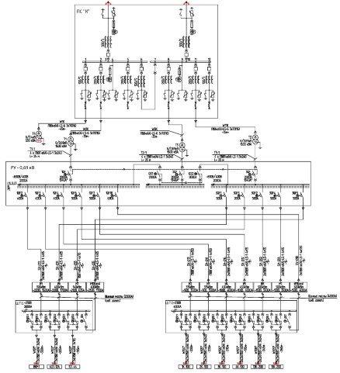
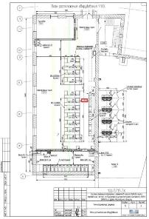
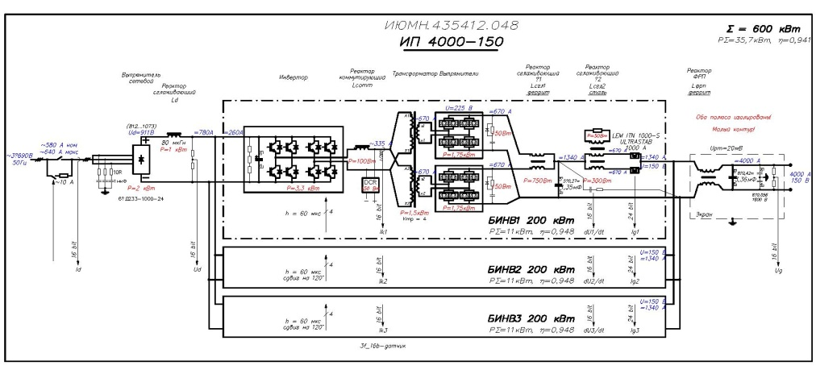
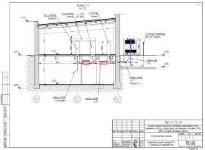
Power supply system for magnetic elements of transport channel for particle beam of the Accelerator complex, BM@N NICA
Power supply system of output channel of beam from the Nuclotron
Power supply
scheme
Placement,
bld.1B
Power supply convertor
4000A, 150V,
stability of the current – 100ppm
V.Karpinskii
November 2021

Slide 6
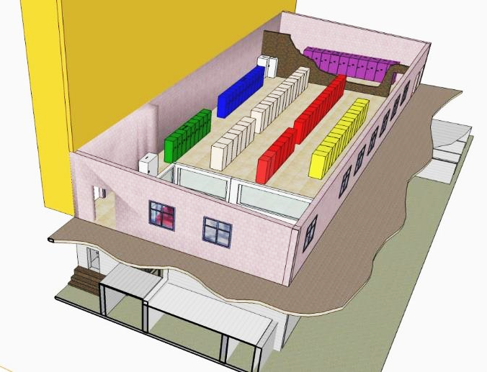
Power supply system for magnetic elements of transport channel for particle beam of the Accelerator complex, BM@N NICA
Power supply system of output channel of beam from the Nuclotron
bld. 1B
SG-0.69кV
SG-K
Power supply for application channels
SG-0.4кV
Power supply
Power switches
Control room
V.Karpinskii
November 2021

Slide 7
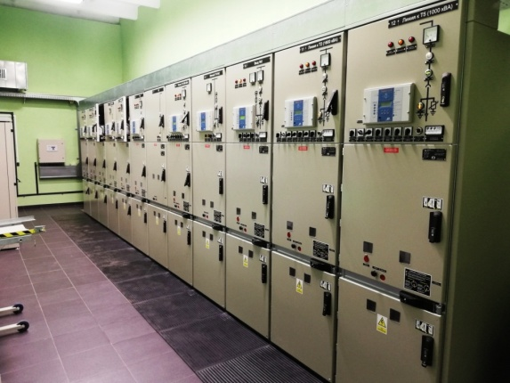
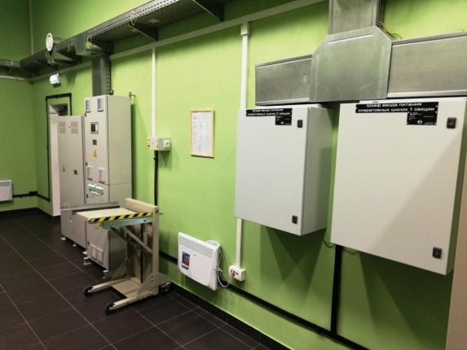
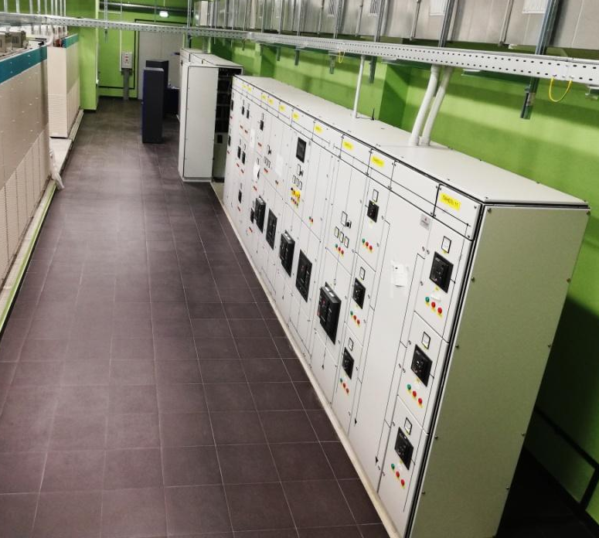
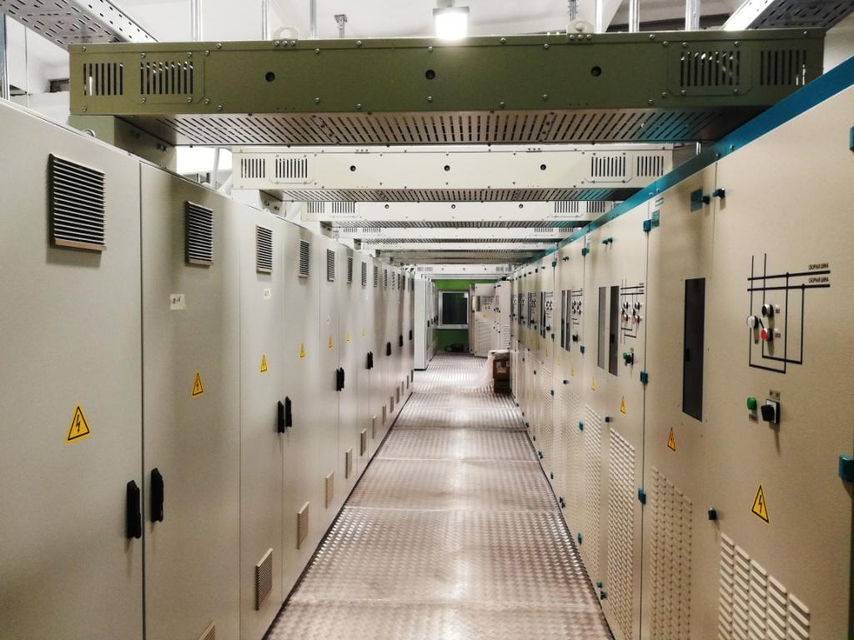
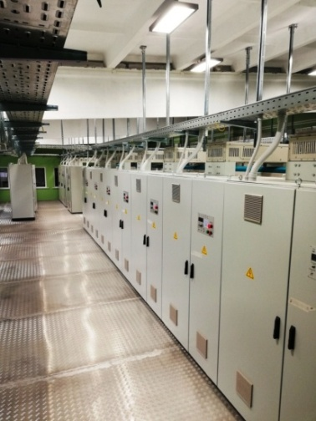
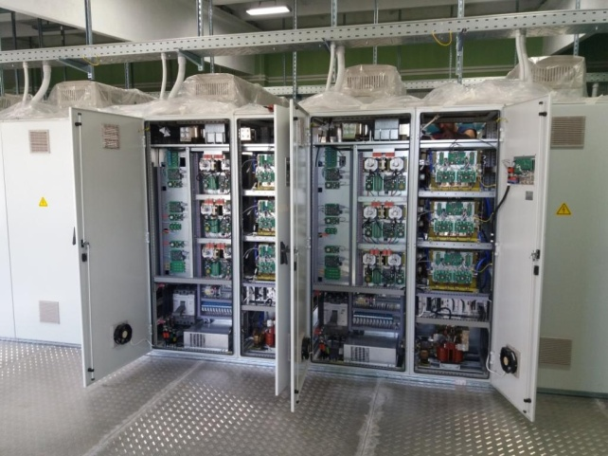
Power supply system for magnetic elements of transport channel for particle beam of the Accelerator complex, BM@N NICA
Power supply system of output channel of beam from the Nuclotron
SG-K, nets 6kV
SG-0.69кV
the main equipment was installed in 2020
Now, work is in progress to install cable lines from power sources to magnets.
The total length is more than 6 km
Power switches
Power supply
V.Karpinskii
November 2021
Notes:
Основное оборудование смонтированно в 2020 году the main equipment was installed in 2020
пуско наладка commissioning

Slide 8
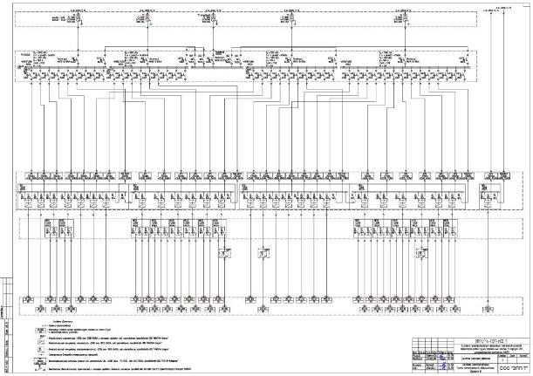
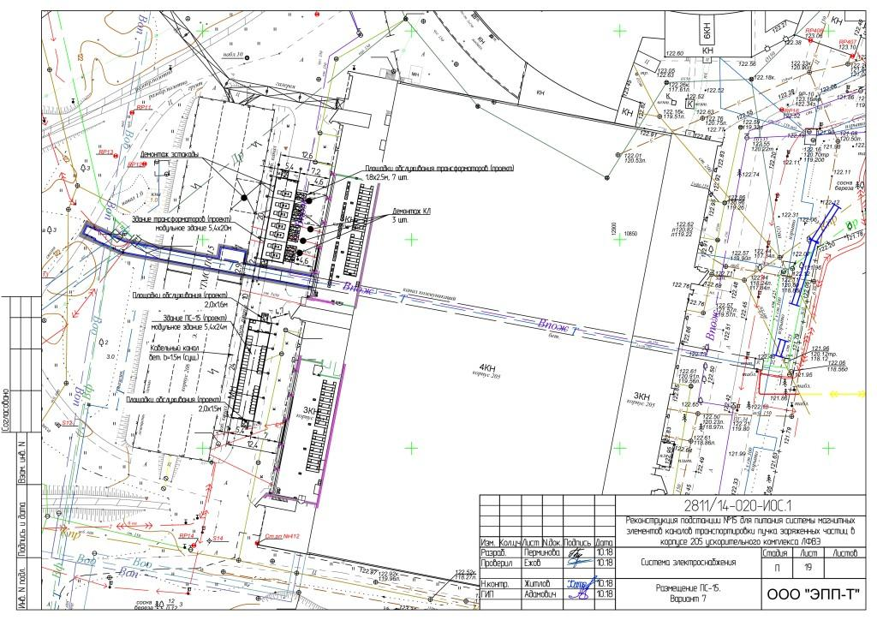
Power supply system for magnetic elements of transport channel for particle beam of the Accelerator complex, BM@N NICA
Power supply system of transport channels of beam hall 205
Power supply scheme
Equipment PSS
Placement,
bld.208, 205
Bld.1
Modular bld. Transformers
Hall 205
Bld. 208
beam transportation line
Modular bld. substation SG15
V.Karpinskii
November 2021

Slide 9
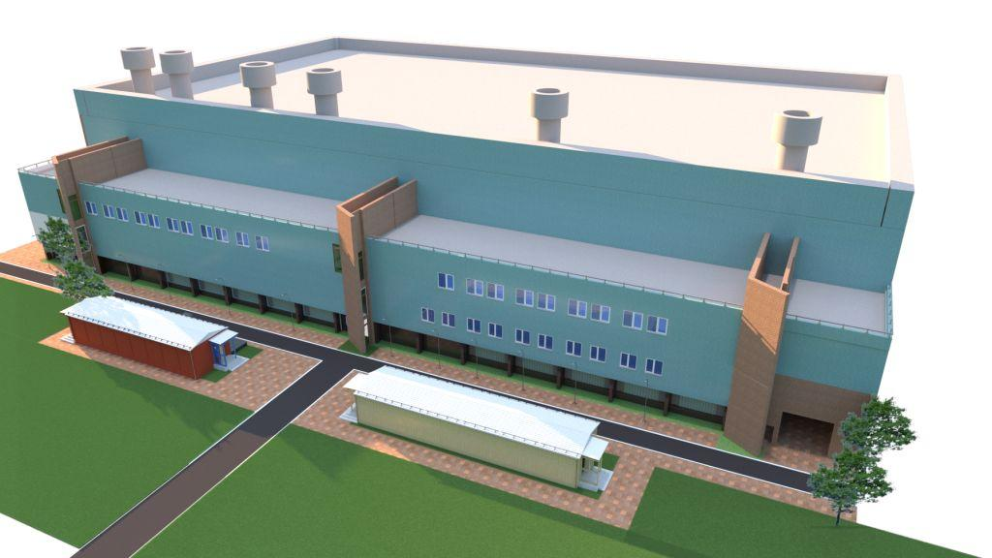
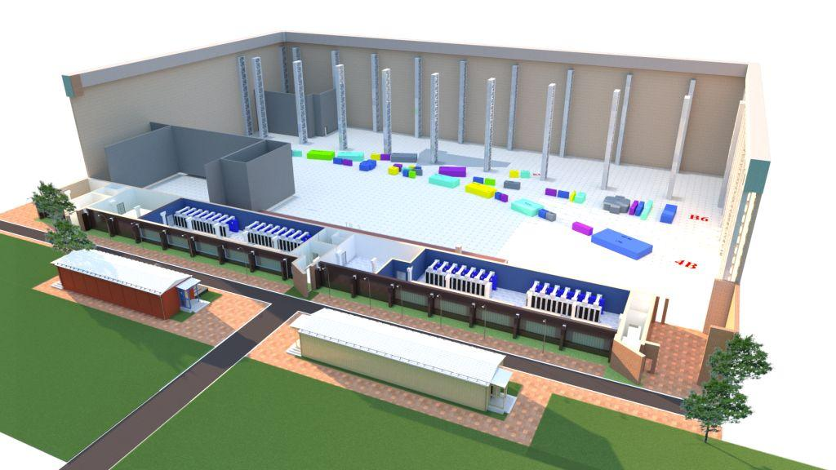
Power supply system for magnetic elements of transport channel for particle beam of the Accelerator complex, BM@N NICA
Location of the equipment PSS
bld.205
Magnets of channels
Magnets of chanels
Equipment PSS
Equipment PSS
Modular bld. Transformers
Modular bld. substation SG15
V.Karpinskii
November 2021

Slide 10
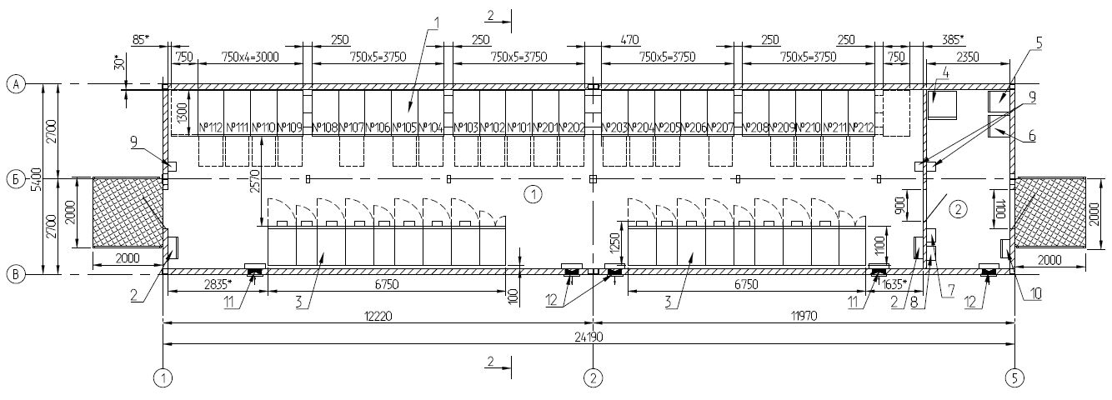
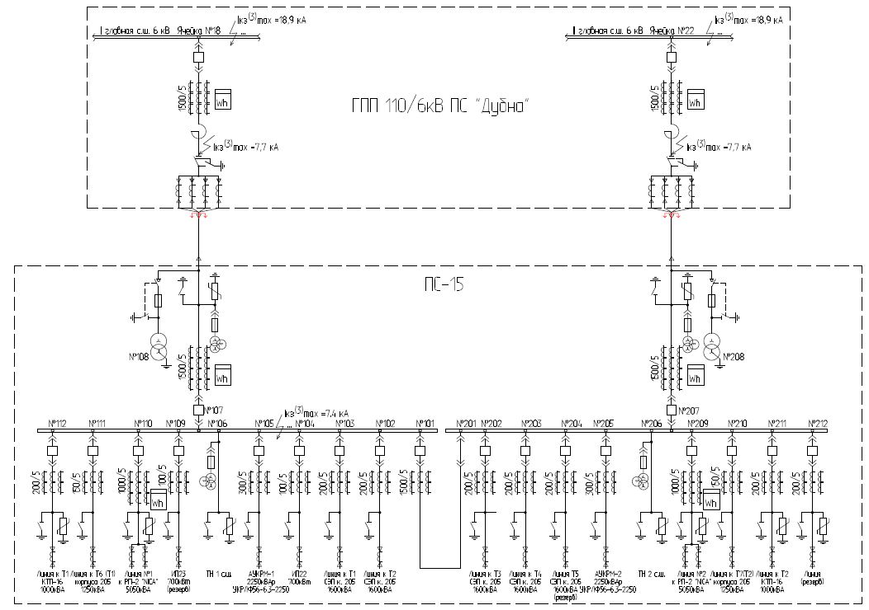
Develop of substation SG15
Power supply scheme SG15, 8MW
Plan modular building SG15
5,4m
25m
Main equipment
1. Modular bld. (lxwxh) 25x5.4x4.5 m
2. Busbar 2 sect., 2kA
3. Vacuum sw. BB/TEL 24 pieces 6 kV, 1-2kA
V.Karpinskii
November 2021

Slide 11
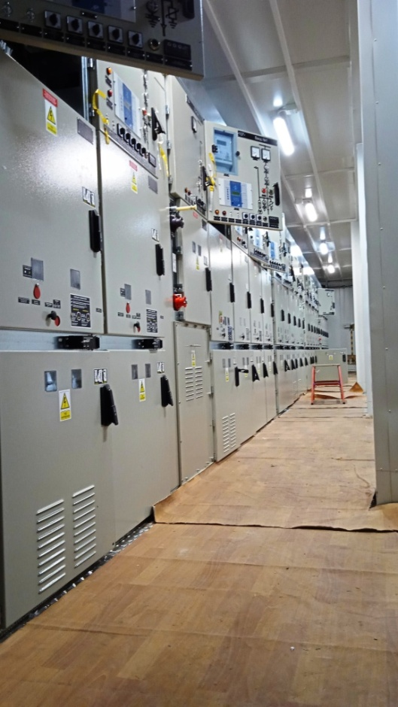
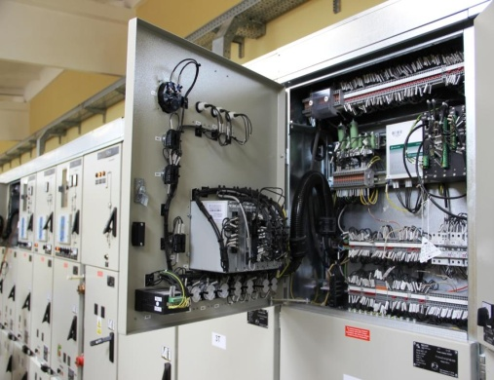
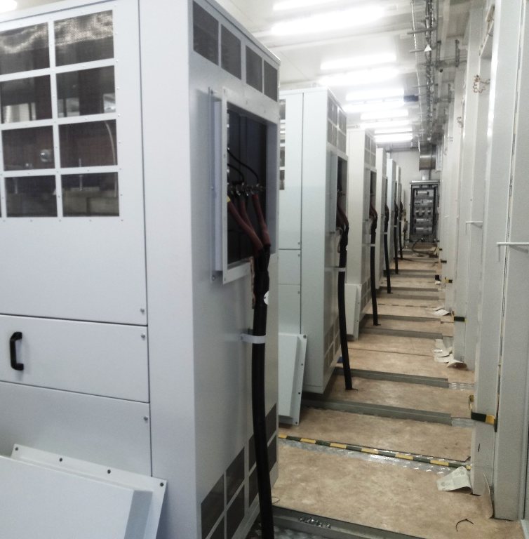
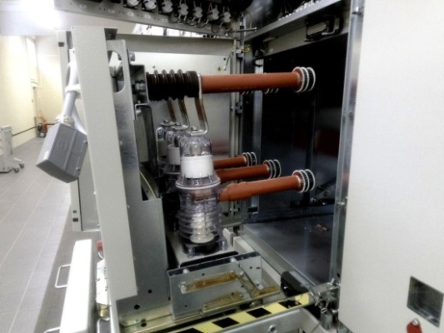
Develop of substation SG15 and Transformators
Equipment of substation SG15 and Transformer
Substation SG15,
HV cell D-12P classic
Relay protection equipment
Power Transformer 6/0.69 kV 1,6MW
Vacuum switch
BB/TEL 6 kV
V.Karpinskii
November 2021
Notes:
Состав подстанций

Slide 12
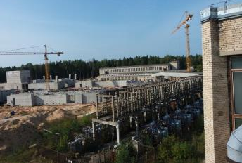
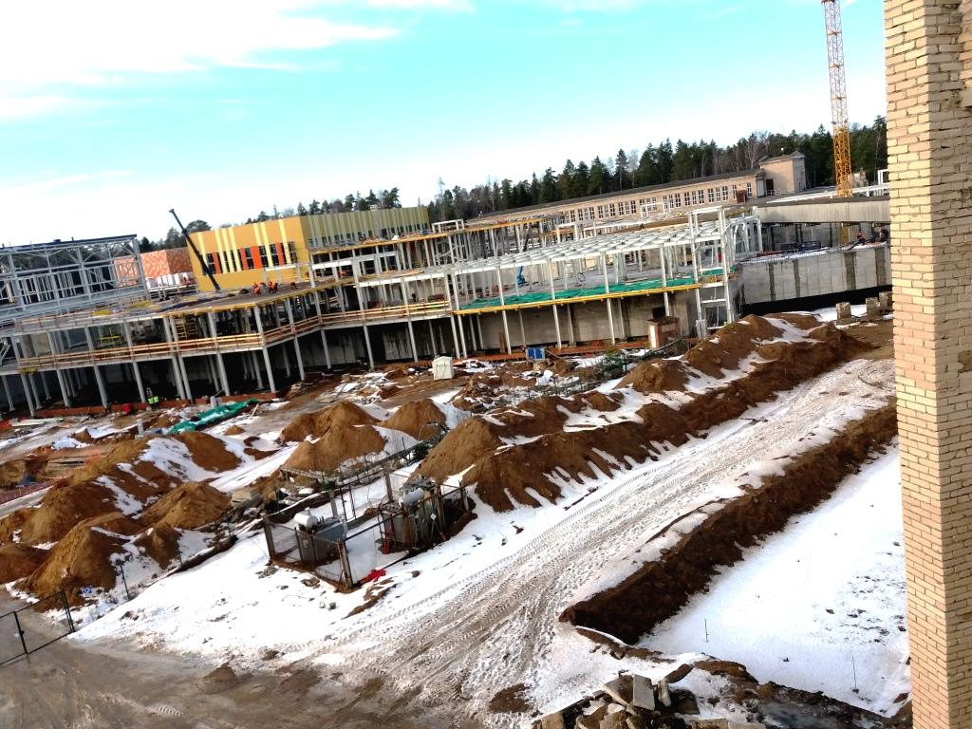
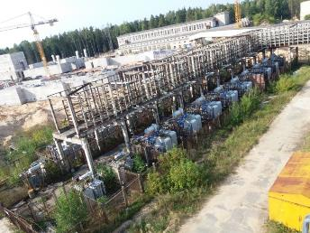
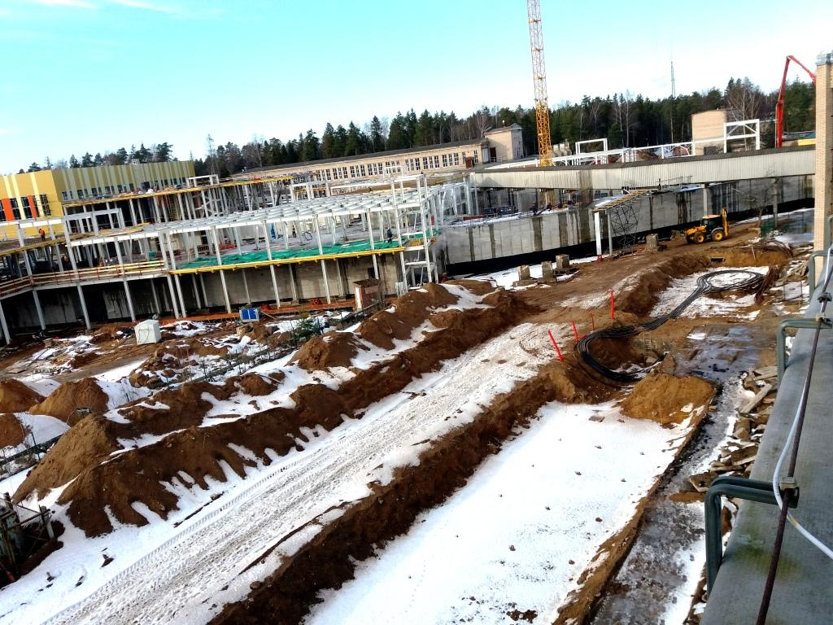
Power supply system for magnetic elements of transport channel for particle beam of the Accelerator complex, BM@N NICA
Bld. 208, august 2018
bld.208 , february 2020
V.Karpinskii
November 2021

Slide 13
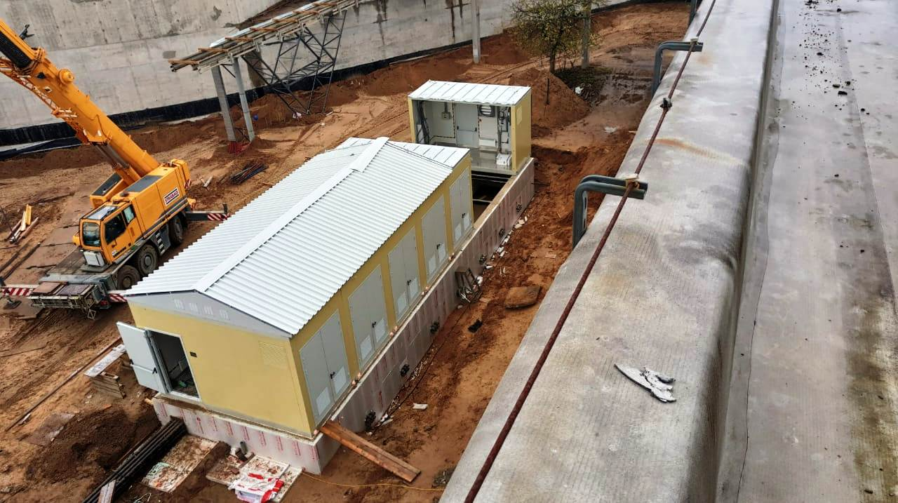
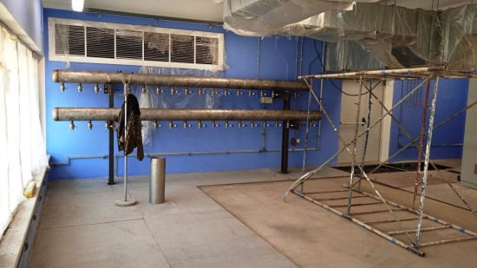
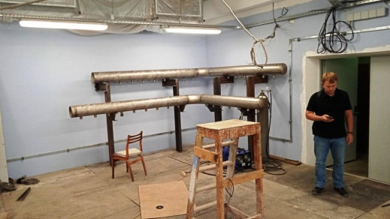
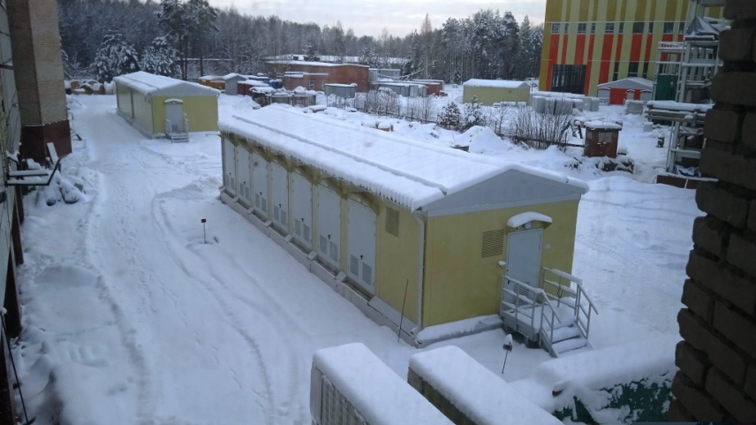
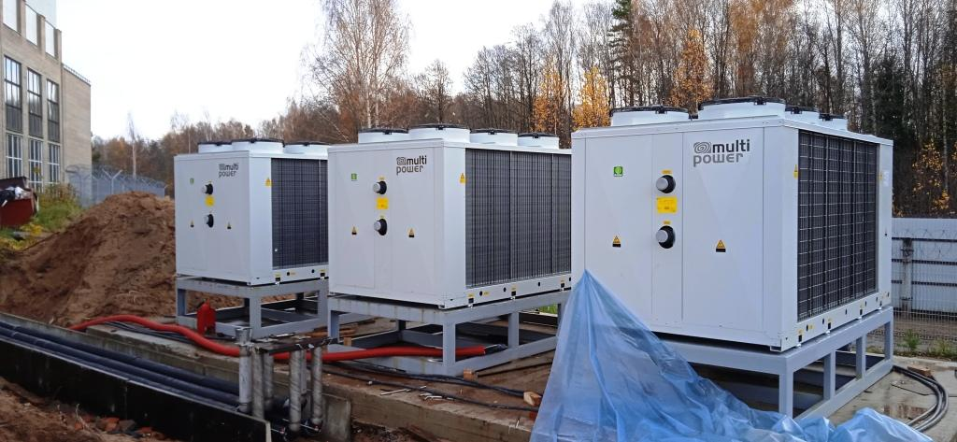
Power supply system for magnetic elements of transport channel for particle beam of the Accelerator complex, BM@N NICA
Mdl. bld. SG15 and Transf., autumn 2020
water cooling system
autumn 2021
V.Karpinskii
November 2021

Slide 14
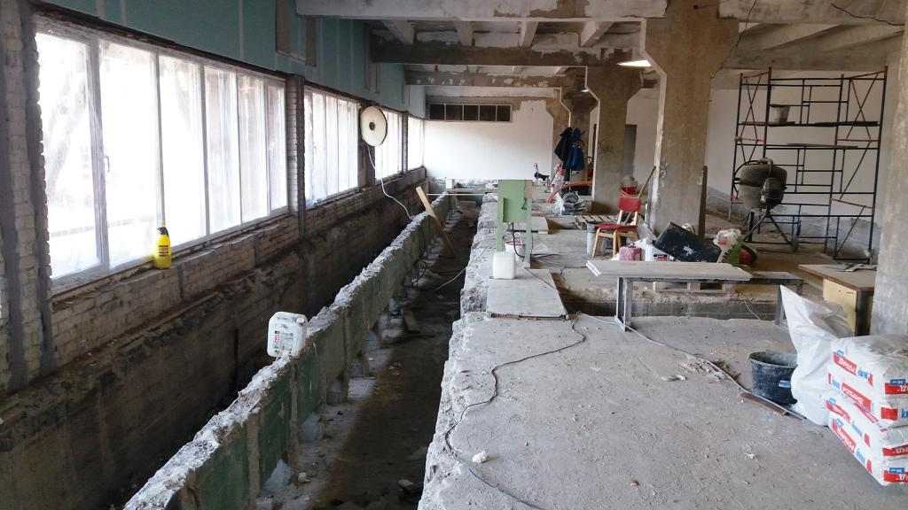
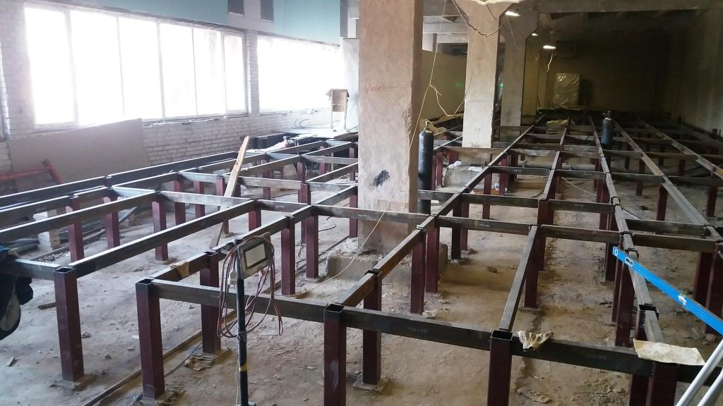
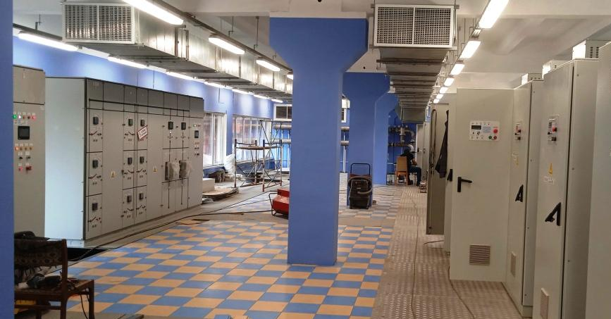
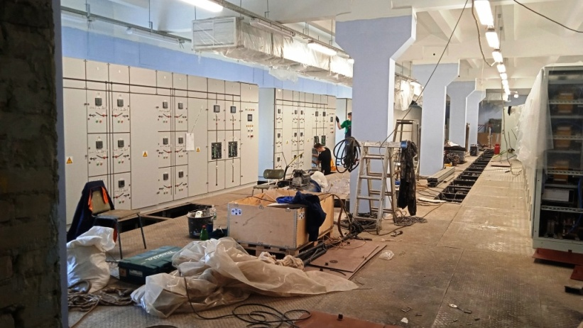
Power supply system for magnetic elements of transport channel for particle beam of the Accelerator complex, BM@N NICA
Room 108
autumn 2020
Room 111
autumn 2020
autumn 2021
autumn 2021
commissioning is underway
V.Karpinskii
November 2021

Slide 15
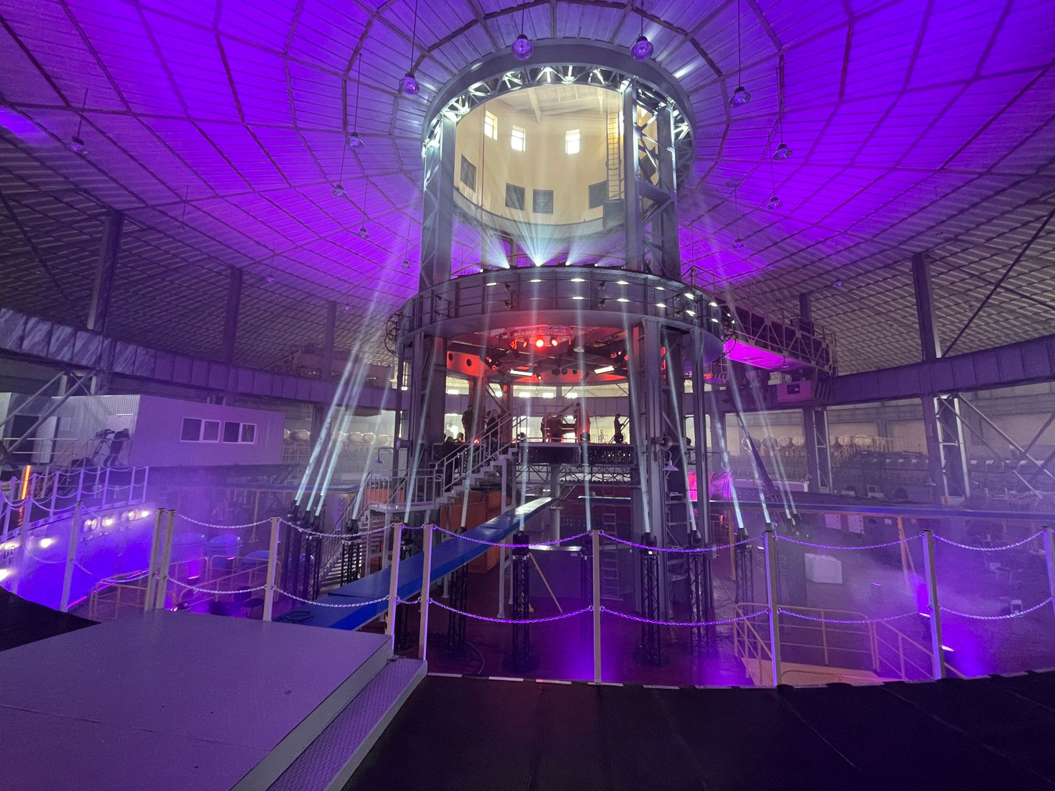
Thank you for your attention!

