Slide 1

NUCLOTRON-COLLIDER
BEAM TRANSFER SYSTEMS:
STATUS OF WORK
Tuzikov A.
on behalf of JINR team

Slide 2
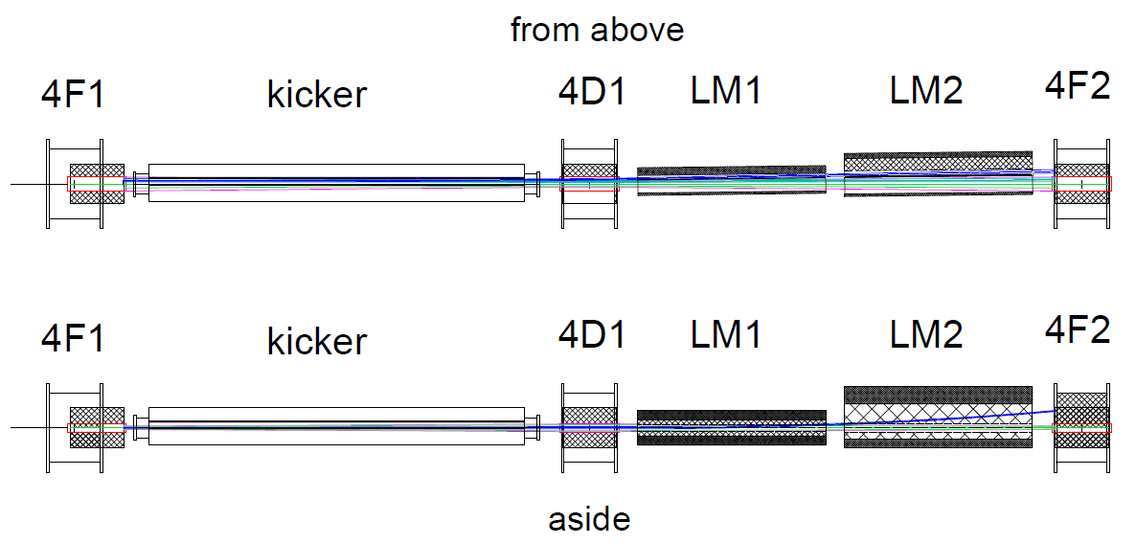
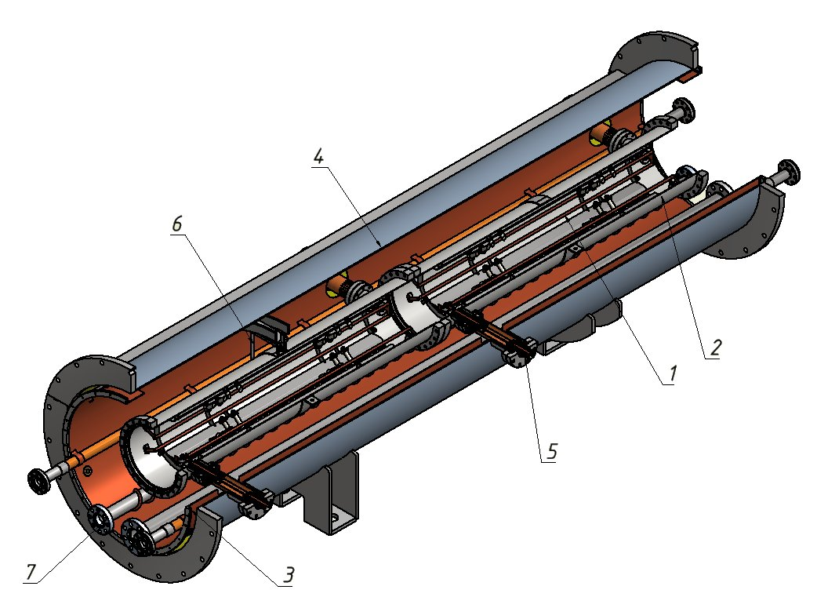
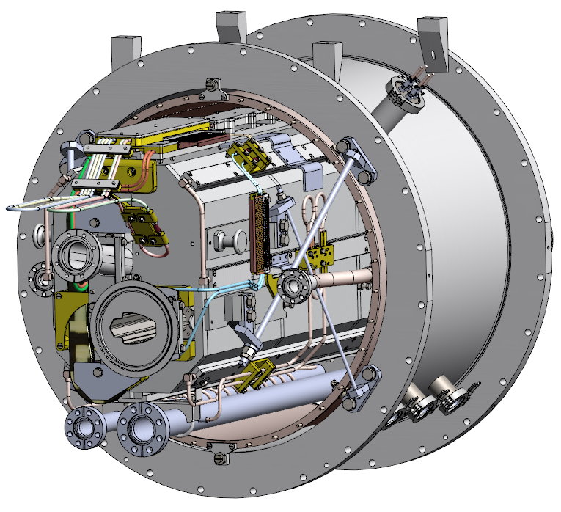
Beam extraction system of Nuclotron
Composition
NICA MAC 2021
Design development is in progress

Slide 3
Collider beam injection and dump systems
Composition of North-East injection/dump section
QF, QD – quadrupole; MC – multipole; KM – kicker; SM - septum
NICA MAC 2021
Design development is in progress

Slide 4
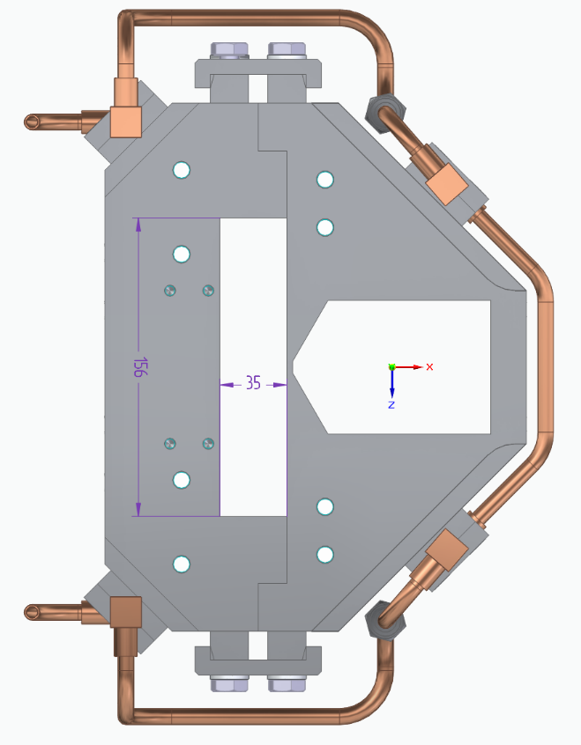
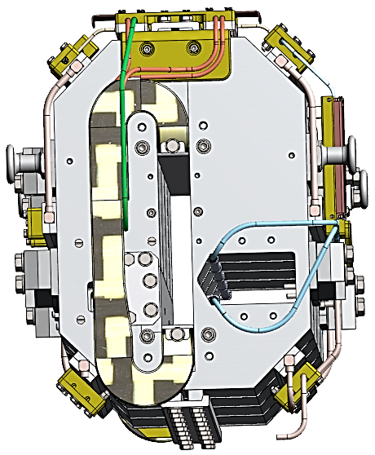
Beam extraction system of Nuclotron
Lambertson magnets
Length, m | 1.5; 1.5
Max magnetic field, T | 1; 1.3
Septum thickness, mm | 3; 15
Power supply system | serial to dipole magnets
Lambertson magnets are based on existing spare yokes for slow extraction system of Nuclotron. Design development is in progress.
Additional power supplies are assumed to be used in parallel to the main PS of Nuclotron for fine tuning of beam extraction trajectory.
NICA MAC 2021

Slide 5
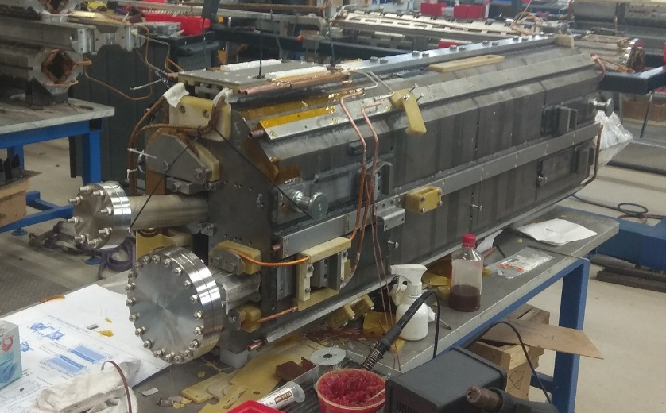
Beam extraction system of Nuclotron
Lambertson magnets:
analogous magnet for beam injection system of Nuclotron during assemblying
NICA MAC 2021

Slide 6
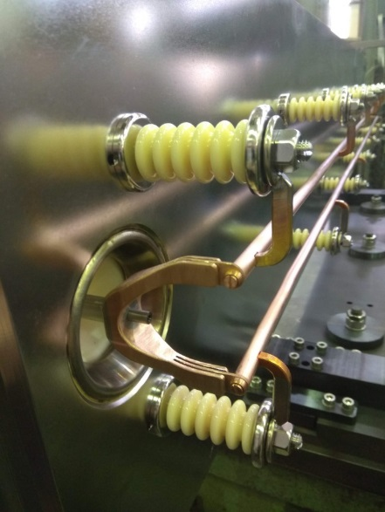
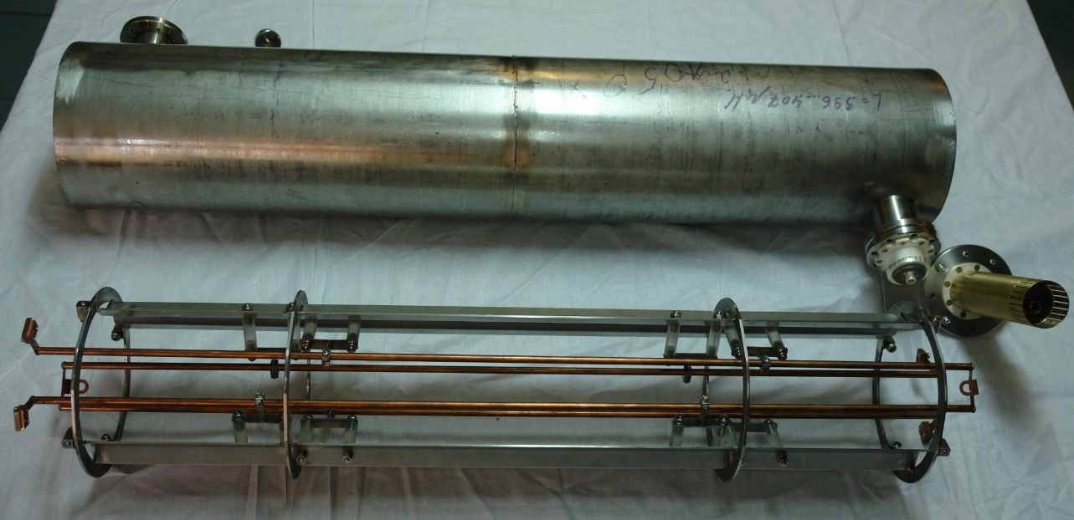
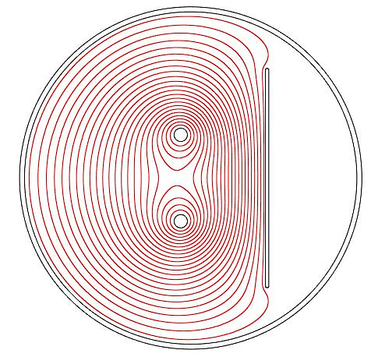
Beam extraction system of Nuclotron
Kicker
+
Length, m | 3
Max magnetic field, T | 0.11
Pulse duration, ns: rise plateau fall | 550 200 600
=
NICA MAC 2021

Slide 7
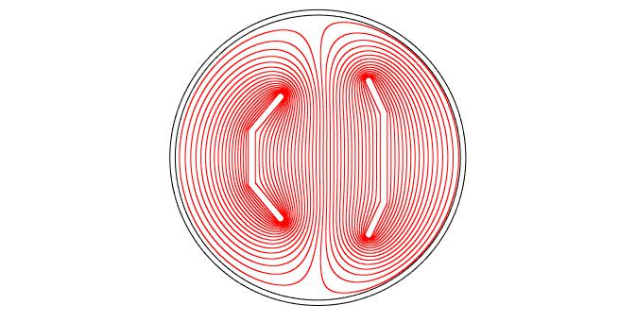
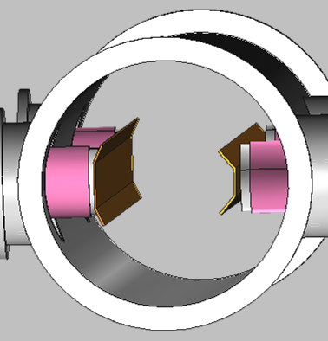
Collider beam injection and dump systems
Kickers
 | injection | dump
Length, m | 4 | 4
Max magnetic field, T | 0.05 | 0.11
Pulse duration, ns: rise plateau fall | 200 200 200 | 130 1700 >10000
Simplified model of kicker chamber with plates
NICA MAC 2021

Slide 8
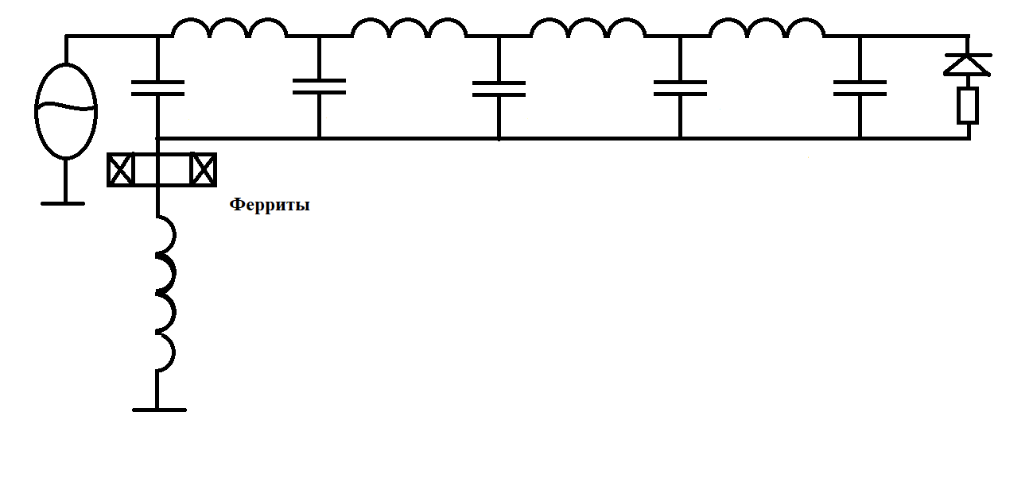
Collider beam injection and dump systems
Kicker post-pulses
Suppression of post-pulses by ferrite chokes
New approach to suppress post-pulses is to add chokes with ferrite cores in series to a load. The ferrite chokes filter high-frequency low-amplitude post-pulses but do not impact significantly on a main pulse due to saturation of a ferrite core at higher currents.
NICA MAC 2021

Slide 9
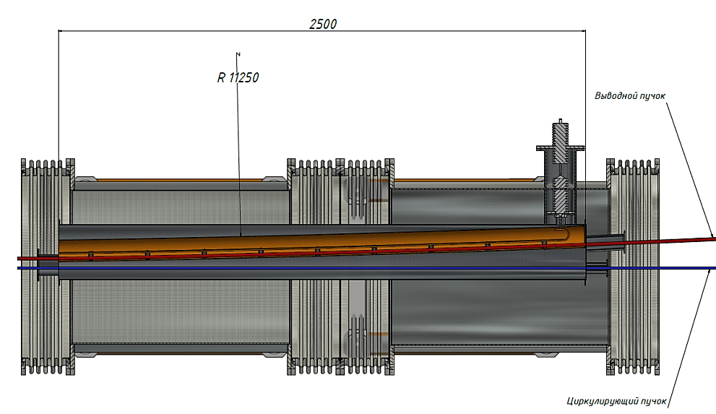
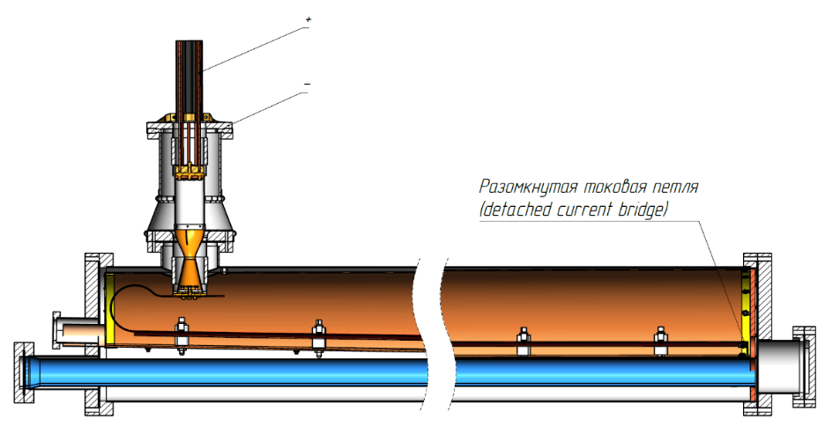
Collider beam injection and dump systems
Septa
Length, m | 2.5
Max magnetic field, T | 0.42
Gap, mm | 35
Septum thickness, mm | 3
Pulse shape | semisinusoidal
Pulse duration, μs | ~ 10
Technical design development is in progress. The main crucial items are low-inductive feedthroughs for current pulses of order 50 kA.
Power supply based on semi-conducting switches is developed.
Septum cryostat module
Septum’s internal chamber with feedthrough
NICA MAC 2021
9

Slide 10
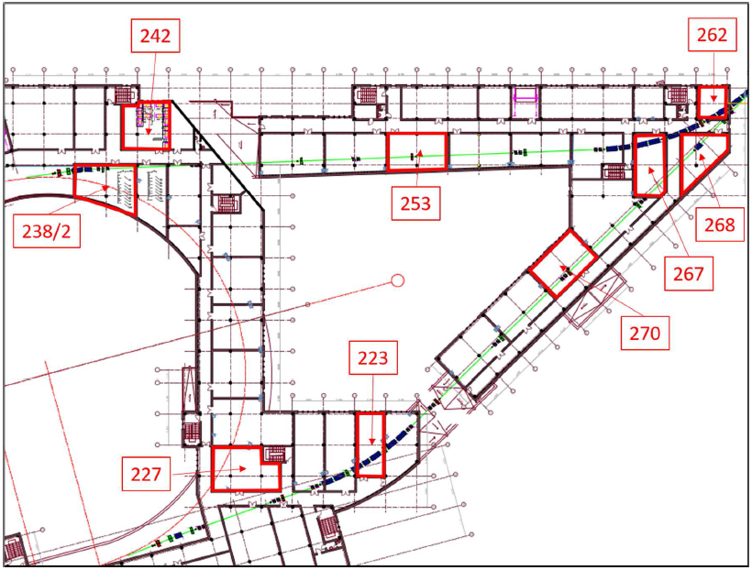
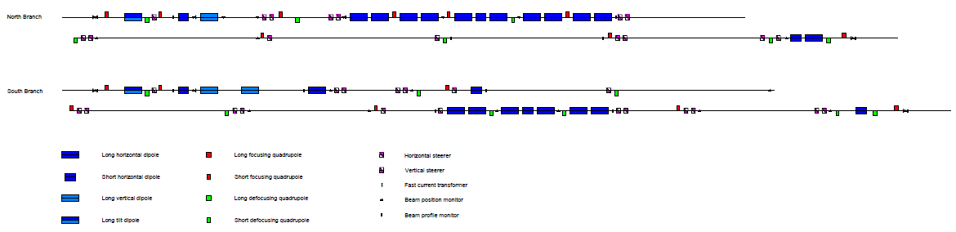
Nuclotron-Collider beam transport channel
Layout
Composition
NICA MAC 2021
JINR-SigmaPhi contract

Slide 11
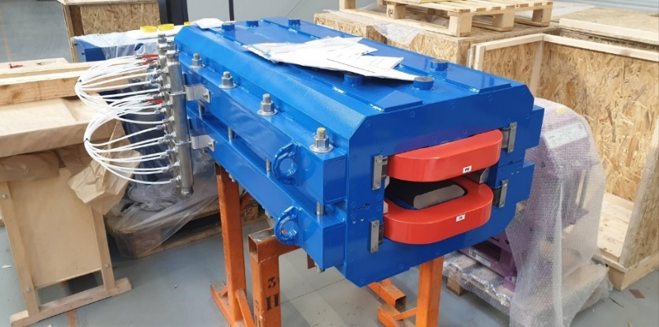
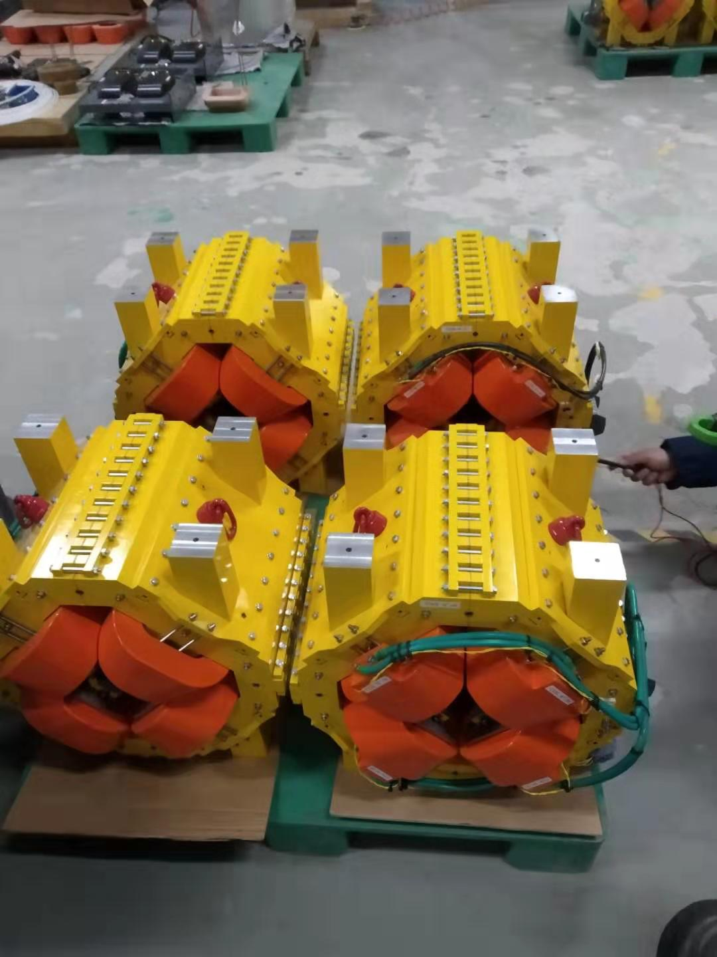
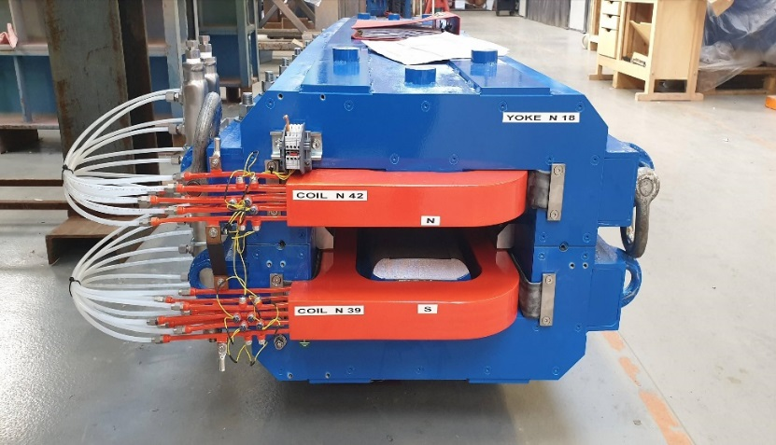
Nuclotron-Collider beam transport channel
Pulsed magnet elements
Magnetic element | Number | Effective length, m | Max. magnetic field (gradient), T (T/m)
Long dipole | 21 | 2 | 1.5
Short dipole | 6 | 1.2 | 1.5
Quadrupole Q10 | 22 | 0.353 | 31
Quadrupole Q15 | 6 | 0.519 | 31
Steerer | 33 | 0.466 | 0.114
NICA MAC 2021
Designed and fabricated by SigmaPhi

Slide 12
Nuclotron-Collider beam transport channel
Pulsed magnet elements
Delivered to JINR on March 2021
NICA MAC 2021

Slide 13
Nuclotron-Collider beam transport channel
Power supplies
There are two types of power supplies:
ramped
pulsed (or resonant)
Pulsed power supplies have two subtypes which differ by current stability on plateau
1000 ppm
300 ppm with active stabilization circuit
NICA MAC 2021

Slide 14
Nuclotron-Collider beam transport channel
Power supplies
Ramped power supplies (2/3 of PS system) is manufactured.
Purchasing of components of pulsed power supplies fabricated by Russian vendors is in progress. Delivery of components – February-May 2022. Assembly of pulsed PS – until September 2022.
Synchronization system for PS is developed by SigmaPhi and Cosylab and will be ready in spring 2022.
NICA MAC 2021

Slide 15
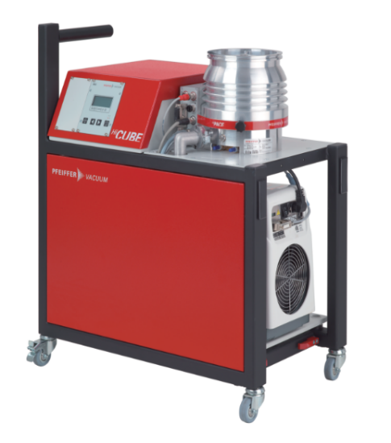
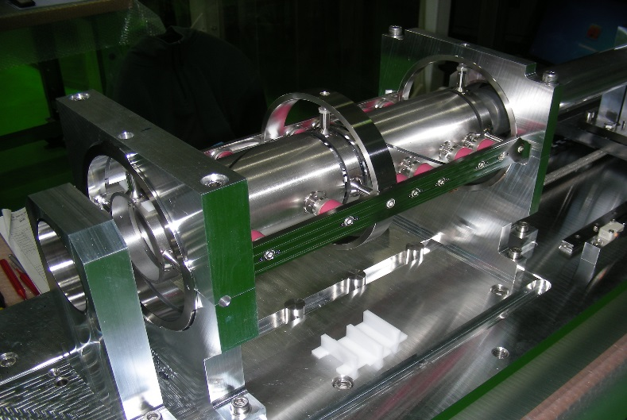
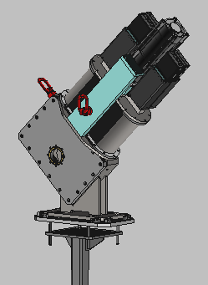
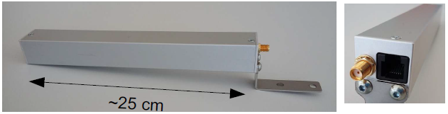
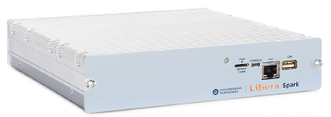
Nuclotron-Collider beam transport channel
Channel equipment
Beam diagnostics excluding beam profile monitors is purchased and manufactured. Full sets of beam diagnostics electronics, fast current transformers, beam loss monitors are ready for delivery to JINR. The first set of 6 pick-us are already delivered.
Design of beam profile monitors based on scintillating fibers is near completion. Manufacturing is started.
Purchasing of vacuum equipment and fabrication of vacuum chambers is completed.
Command and control system including software is near completion.
NICA MAC 2021

Slide 16
Nuclotron-Collider beam transfer systems
Schedule
December 2021 – delivery of beam diagnostics (excluding beam profile monitors) and support stands to JINR; start of surveying and mounting of support stands in the channel tunnels.
February 2022 – delivery of steerers and vacuum chambers and equipment to JINR.
March 2022 – magnetic measurements in pulsed mode at JINR site.
May 2022 – finish of mounting of magnets, beam diagnostics devices and vacuum system of the channel; tests of the vacuum system.
July-August 2022 – delivery of beam profile monitors, power supplies, equipment of command & control system; preparation of communication and engineering networks (Ethernet, intercom, mains power, water cooling system).
September 2022 – mounting of beam profile monitors; assembly and commissioning of power supply and command & control systems.
September-October 2022 – mounting of devices of Nuclotron extraction and Collider injection systems.
NICA MAC 2021

Slide 17
THANK YOU FOR ATTENTION

