Slide 1




Magnetic Field Quality and
Beam Dynamics
in the NICA Collider
M. M. Shandov, S. A. Kostromin, A. V. Phillippov
on behalf of the Beam dynamics group
Veksler and Baldin Laboratory of High Energy Physics,
Joint Institute for Nuclear Research, Dubna, Russia

Slide 2
Introduction
Outlines
NICA Collider Lattice & Main Parameters
Power Supplies Layout
Longitudinal Bunch Size. IBS & Colling Techniques
Magnetic Field Correction System
Future Plans
Transverse Beam Size
Magnetic Measurements

Slide 3
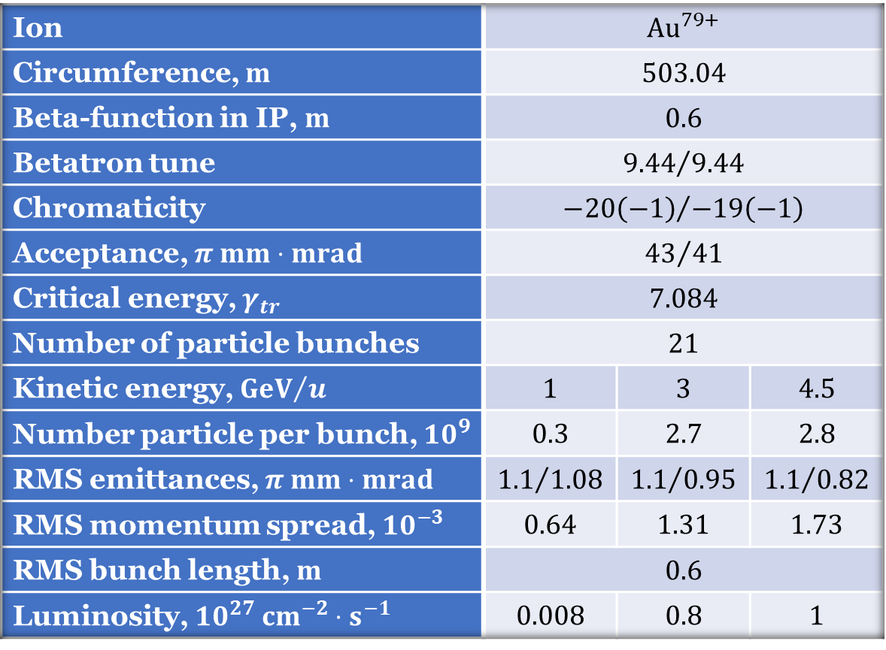
NICA Collider Main Parameters
Ion | $${Au}^{79+}$$
Circumference, $m$ | $$503.04$$
Beta-function in IP, $m$ | $$0.6$$
Betatron tune | $${9.44}/{9.44}$$
Chromaticity | $${−20\left(−1\right)}/{−19\left(−1\right)}$$
Acceptance, $π mm⋅mrad$ | $${43}/{41}$$
Critical energy, $γ_{tr}$ | $$7.084$$
Number of particle bunches | $$21$$
Kinetic energy, ${GeV}/u$ | $$1$$ | $$3$$ | $$4.5$$
Number particle per bunch, ${10}^{9}$ | $$0.3$$ | $$2.7$$ | $$2.8$$
RMS emittances, $π mm⋅mrad$ | $${1.1}/{1.08}$$ | $${1.1}/{0.95}$$ | $${1.1}/{0.82}$$
RMS momentum spread, ${10}^{−3}$ | $$0.64$$ | $$1.31$$ | $$1.73$$
RMS bunch length, $m$ | $$0.6$$
Luminosity, ${10}^{27} {cm}^{−2}⋅s^{−1}$ | $$0.008$$ | $$0.8$$ | $$1$$
Technical specifications of the “Object Collider NICA”, 2019

Slide 4
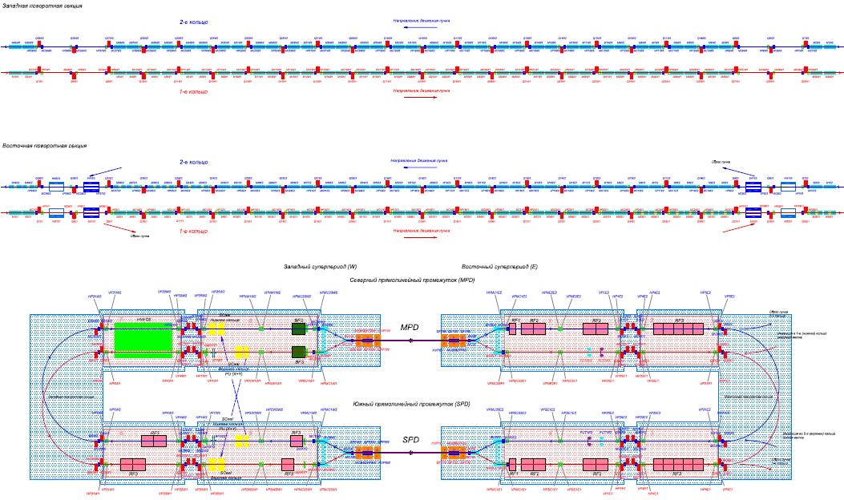
NICA Collider Scheme

Slide 5
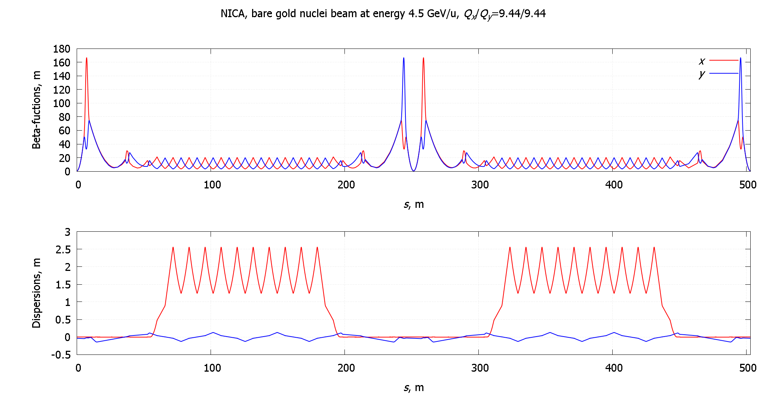
NICA Collider Lattice Functions

Slide 6
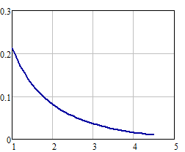
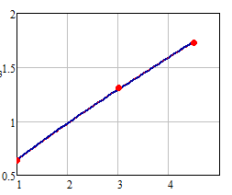
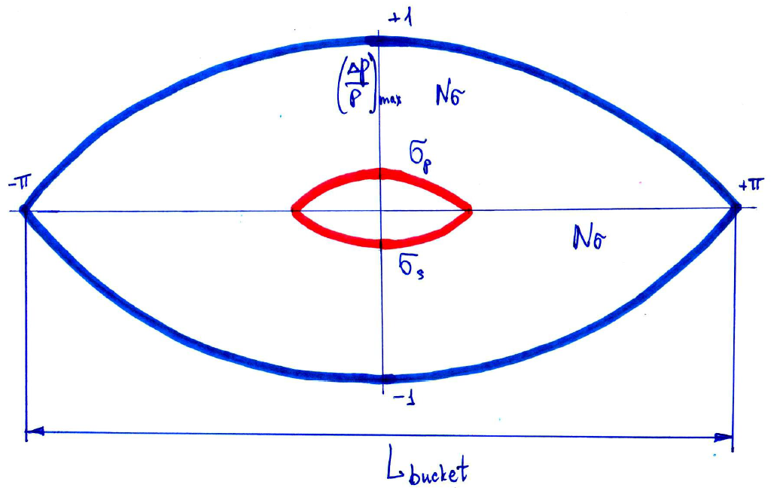
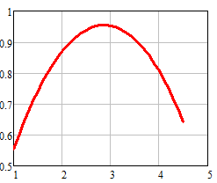

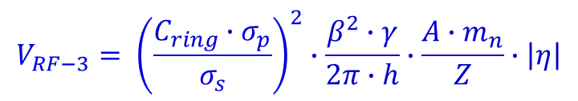
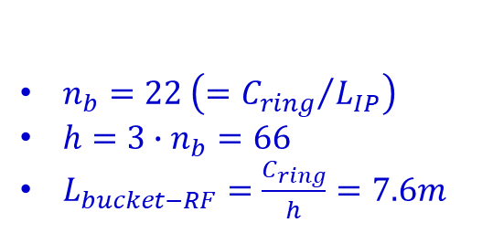







Longitudinal Bunch Size
$$η=\frac{1}{γ^{2}}−α$$
$$σ_{p}∙{10}^{3}$$
$Nσ_{RF}=4$; $6σ_{s}≅TPC$
$$σ_{s}=0.6 m$$
IBS-«thermal» equilibrium
$$E_{k}[GeV/u]$$
$$L_{bucket−desired}=Nσ_{RF}∙ σ_{s}∙π=7.5 m$$
$$E_{k}[GeV/u]$$
$$V_{RF−3} [MV]$$
$n_{b}=22 \left(={C_{ring}}/{L_{IP}}\right)$
$h=3∙n_{b}=66$
$L_{bucket−RF}=\frac{C_{ring}}{h}=7.6m$
$$V_{RF−3}= {\left(\frac{C_{ring}∙σ_{p}}{σ_{s}}\right)}^{2}∙\frac{β^{2}∙γ}{2π∙h}∙\frac{A∙m_{n}}{Z}∙\left|η\right|$$
$$E_{k}[GeV/u]$$

Slide 7
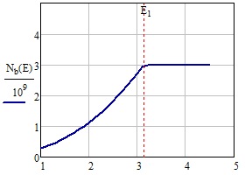
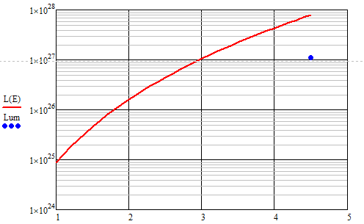
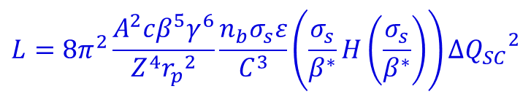


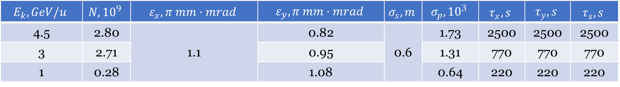
Intra-Beam Scattering
$$E_{k}, GeV/u$$ | $$N, {10}^{9}$$ | $$ε_{x}, π mm·mrad$$ | $$ε_{y}, π mm·mrad$$ | $$σ_{s}, m$$ | $$σ_{p},{10}^{3}$$ | $$τ_{x}, s$$ | $$τ_{y}, s$$ | $$τ_{s}, s$$
4.5 | 2.80 | 1.1 | 0.82 | 0.6 | 1.73 | 2500 | 2500 | 2500
3 | 2.71 |  | 0.95 | 11500 | 1.31 | 770 | 770 | 770
1 | 0.28 |  | 1.08 | 12500 | 0.64 | 220 | 220 | 220
$$L=8π^{2}\frac{A^{2}cβ^{5}γ^{6}}{Z^{4}{r_{p}}^{2}}\frac{n_{b}σ_{s}ε}{C^{3}}\left(\frac{σ_{s}}{β^{∗}}H\left(\frac{σ_{s}}{β^{∗}}\right)\right)∆{Q_{SC}}^{2}$$
$${∆Q или ΔQ}_{SC} <0,05 ?$$
$${∆Q=ΔQ}_{SC}+2ξ<0,05$$
project value
Space charge
dominated regime
IBS dominated regime
$$E_{k}[GeV/u]$$
$$E_{k}[GeV/u]$$

Slide 8
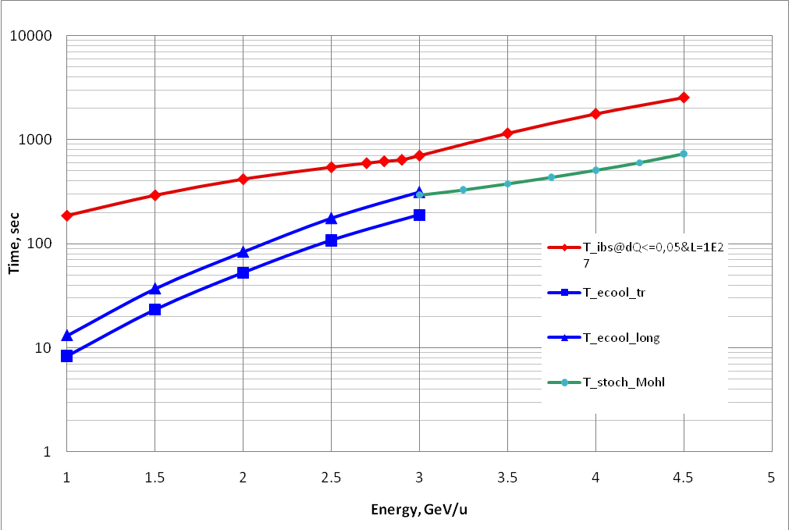
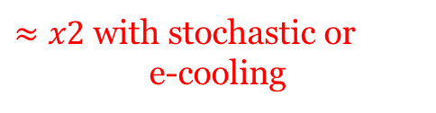


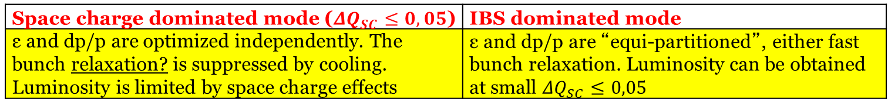
Cooling Technique
$$Time[s]$$
Two modes of the collider operation
10⁴
10³
10²
10
1
E-Cooling
Stochastic cooling
$≈x2$ with stochastic or
e-cooling
τ_{IBS} (3D equilibrium)
τ_{stoch} (D.Möhl)
τ⊥ e-cooling
τ|| e-cooling
IBS dominated regime: Stochastic cooling is used to suppress beam IBS influence
Space charge dominated regime: Electron cooling is used to maintain bunch 3D emittance
$$E_{k}[GeV/u]$$
1 1.5 2 2.5 3 3.5 4 4.5 5
Space charge dominated mode (${ΔQ}_{SC}≤0,05$) | IBS dominated mode
ε and dp/p are optimized independently. The bunch relaxation? is suppressed by cooling. Luminosity is limited by space charge effects | ε and dp/p are “equi-partitioned”, either fast bunch relaxation. Luminosity can be obtained at small ${ΔQ}_{SC}≤0,05$
I.N. Meshkov

Slide 9
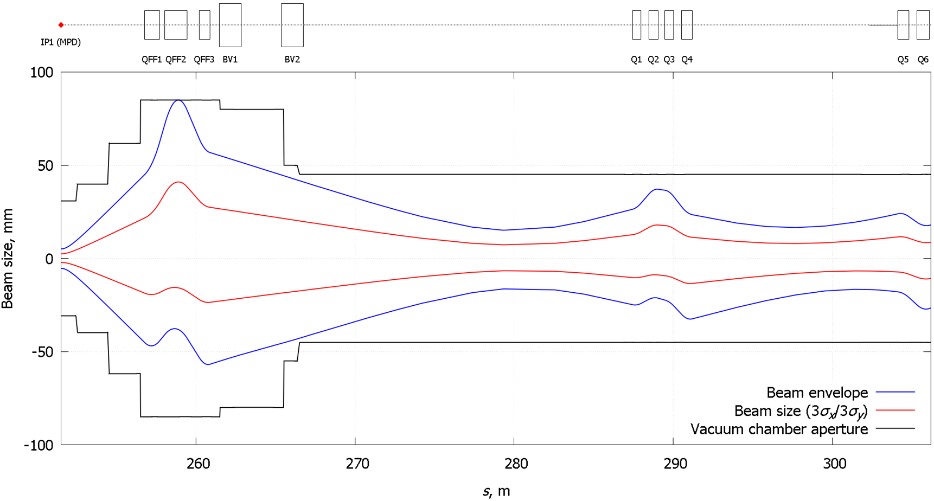
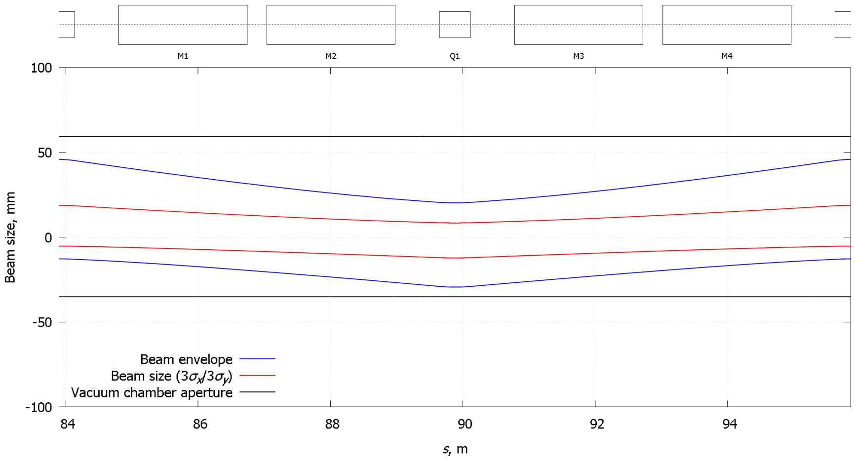
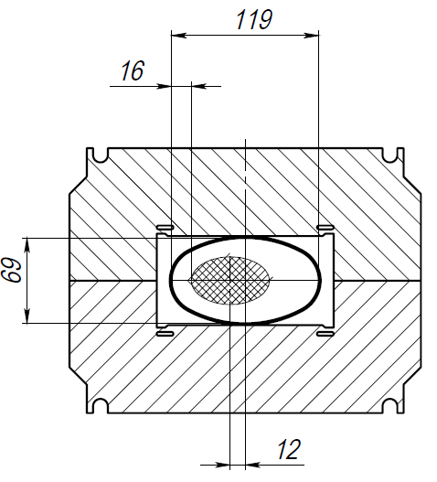
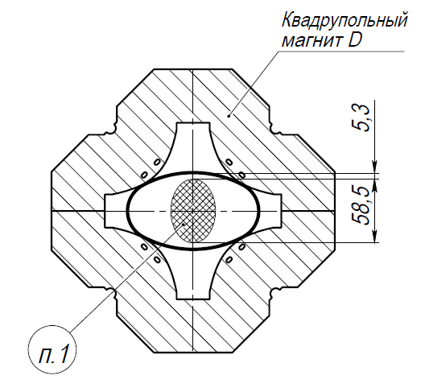
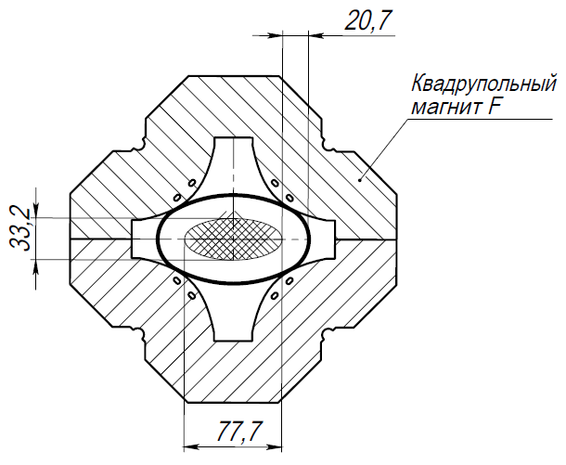

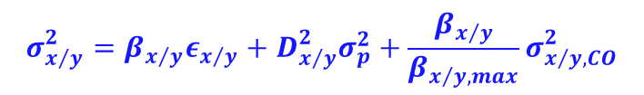
Transverse Beam Size
$$σ_{x/y}^{2}=β_{x/y}ε_{x/y}+D_{x/y}^{2}σ_{p}^{2}+\frac{β_{x/y}}{β_{x/y, max}}σ_{x/y, CO}^{2}$$
QD
QF
$$±3σ$$

Slide 10
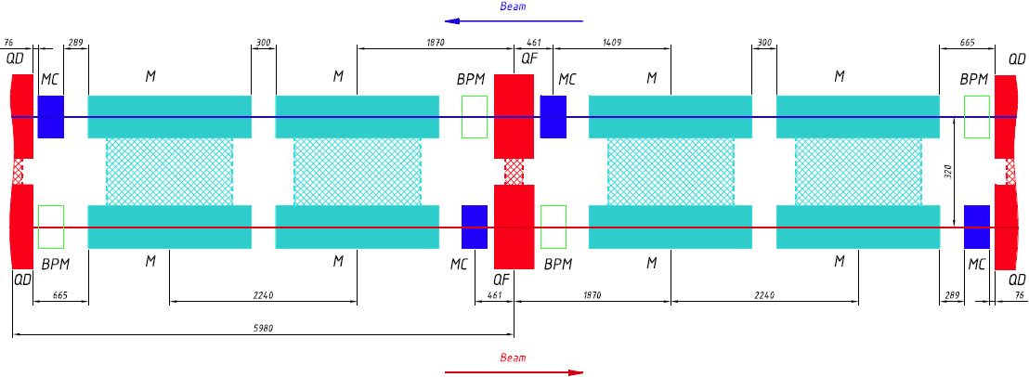
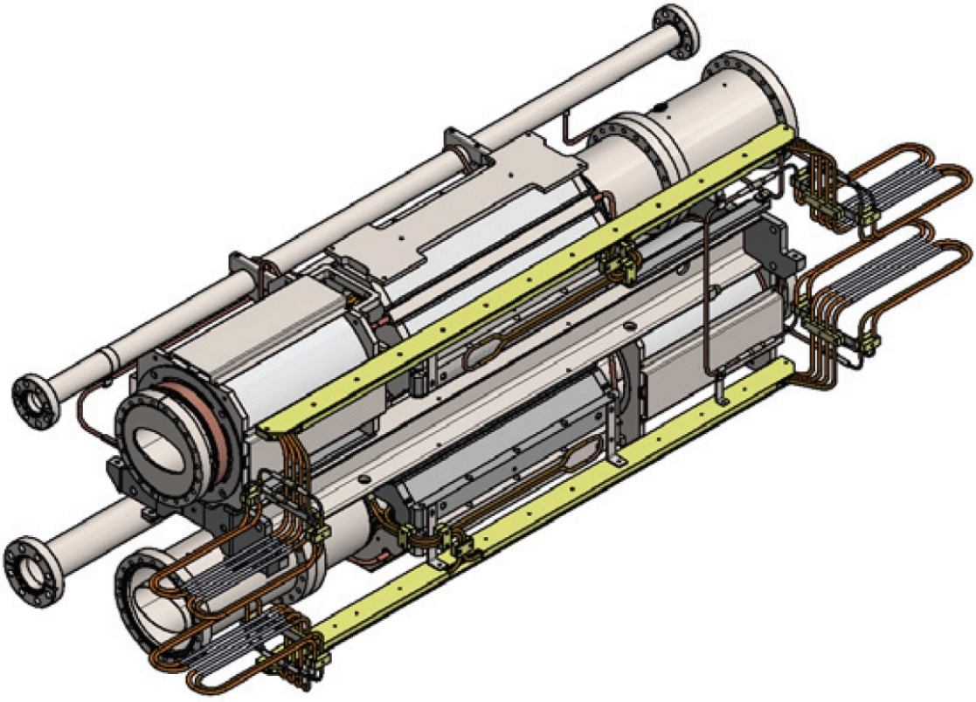
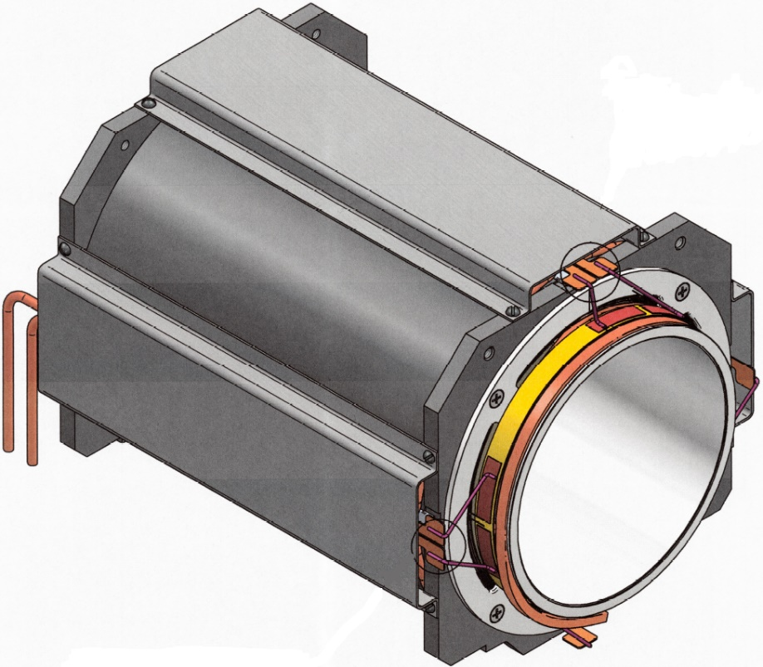
Transverse Beam Size
Superconducting magnets of the Collider of the NICA complex
D. Nikiforov

Slide 11
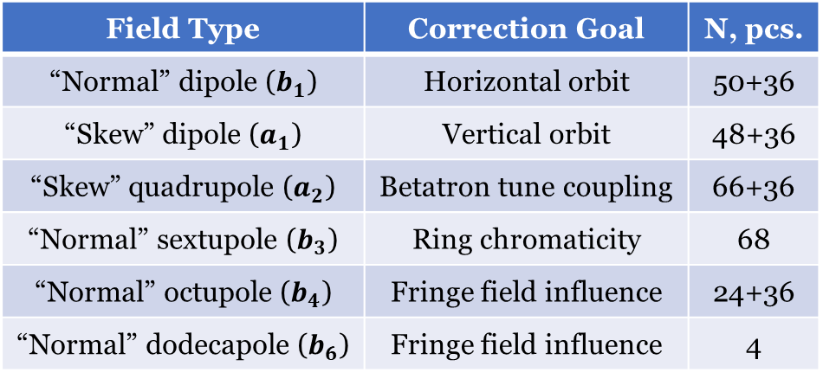
Magnetic Field Correction System
 | SPD |  |  |  |  |  |  |  |  |  |  |  |  |  |  |  |  |  |  | MPD
 | West Superperiod
 | South Straight Section |  |  | West Arc |  |  |  |  |  |  |  |  |  |  |  |  |  | North Straight Section
 | MC2* | MC1 | … | MC7 | MC8 | MC9 | MC10 | MC11 | MC12 | MC13 | MC14 | MC15 | … | MC26 | MC27 | MC28 | MC29 | … | MC33 | MC1*
b0
a0
a1
b2
b3
 |  | - 3 layers in coil
92 correctors in arcs (46 per each beam)
32 correctors in straight section
(16 per each beam)
4 correctors in straight section
(combined for 2 beams)
4 dodecapole correctors in central QFF
Total: 132 correctors with 404 coils
Field Type | Correction Goal | N, pcs.
“Normal” dipole ($b_{1}$) | Horizontal orbit | 50+36
“Skew” dipole ($a_{1}$) | Vertical orbit | 48+36
“Skew” quadrupole ($a_{2}$) | Betatron tune coupling | 66+36
“Normal” sextupole ($b_{3}$) | Ring chromaticity | 68
“Normal” octupole ($b_{4}$) | Fringe field influence | 24+36
“Normal” dodecapole ($b_{6}$) | Fringe field influence | 4

Slide 12
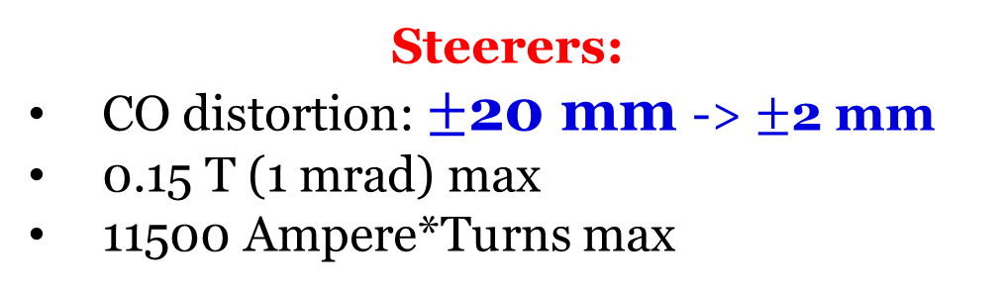
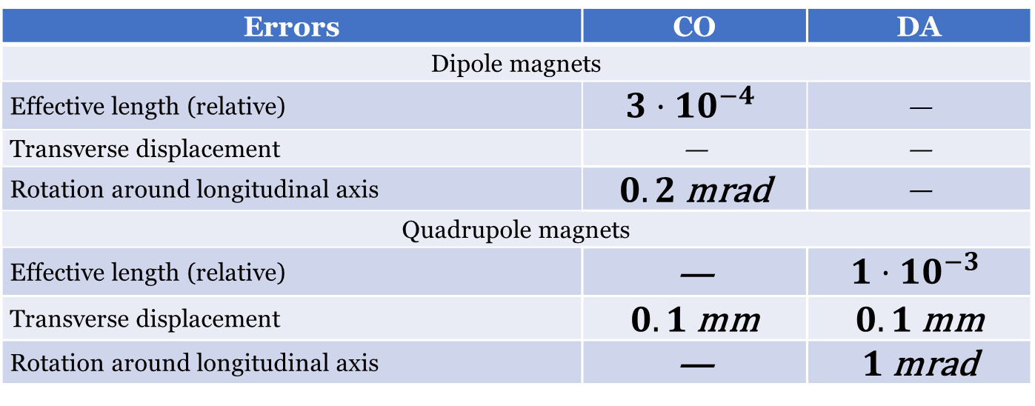
Dipole Correction
Errors | CO | DA
Dipole magnets
Effective length (relative) | $$3⋅{10}^{−4}$$ | —
Transverse displacement | — | —
Rotation around longitudinal axis | $0.2$mrad | —
Quadrupole magnets
Effective length (relative) | — | $$1⋅{10}^{−3}$$
Transverse displacement | $0.1$mm | $0.1$mm
Rotation around longitudinal axis | — | $1$mrad
Steerers:
CO distortion: $±\text{20}$mm -> $±\text{2}$ mm
0.15 T (1 mrad) max
11500 Ampere*Turns max

Slide 13
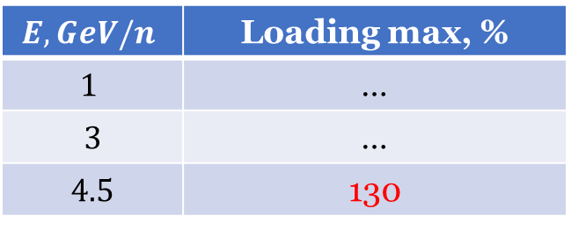
Coupling Correction
Motion Coupling:
Straight sections
Solenoids in MPD, SPD and E-cooler
Skew Quadrupoles:
20 pcs./ring
3 T/m max
12500 Ampere*Turns max
Loading max (4.5 GeV/u) 130 %
$$E, GeV/n$$ | Loading max, %
$$1$$ | …
$$3$$ | …
$$4.5$$ | 130

Slide 14
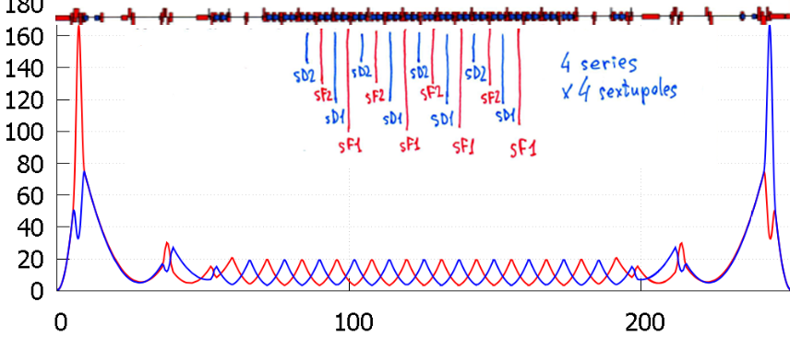
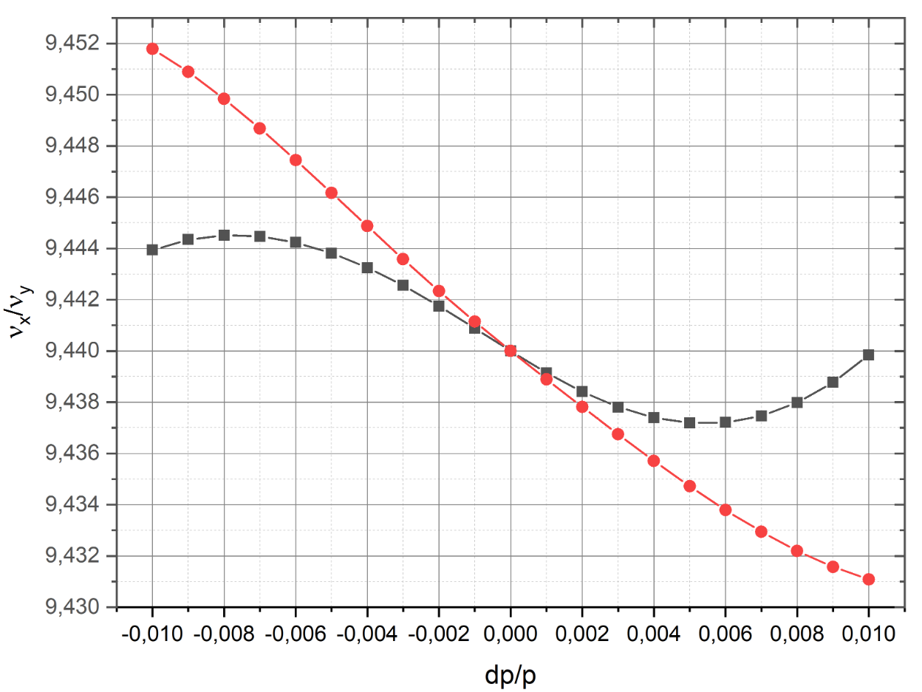


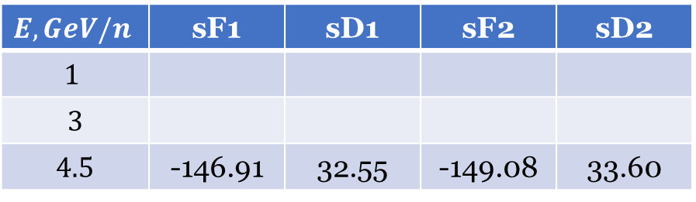
Chromaticity Correction
$${±4σ}_{p}$$
$${±1σ}_{p}$$
Sextupoles:
32 pcs./ring
190 T/m² max
8260 Ampere*Turns max for 1 layer
Loading max (4.5 GeV/u) 78.5 %
$$E, GeV/n$$ | sF1 | sD1 | sF2 | sD2
$$1$$
$$3$$
$$4.5$$ | -146.91 | 32.55 | -149.08 | 33.60

Slide 15
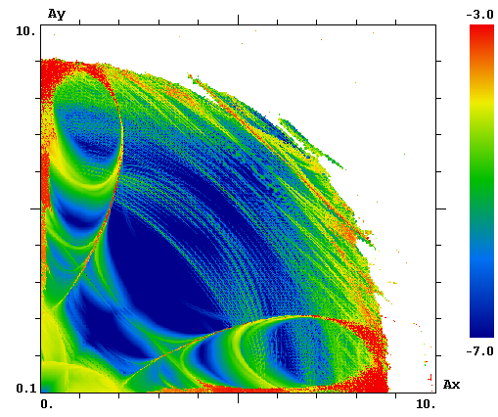
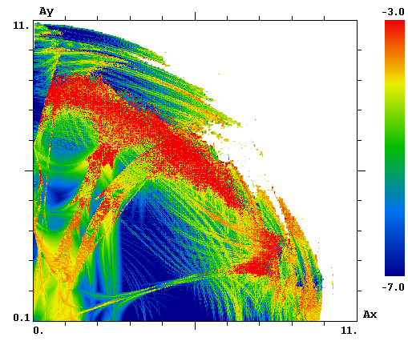
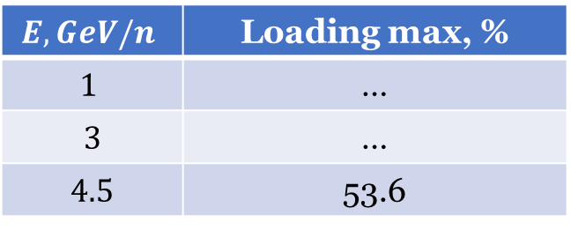


DA Correction
$$DA≈8÷9σ$$
Limited by
Quadrupole Fringe Fields
$$DA≈10÷11σ$$
Corrected
Octupoles:
3 series
12 pcs./ring
1300 T/m³ max
4890 Ampere*Turns max
Loading max (4.5 GeV/u) 53.6 %
$$E, GeV/n$$ | Loading max, %
$$1$$ | …
$$3$$ | …
$$4.5$$ | 53.6

Slide 16
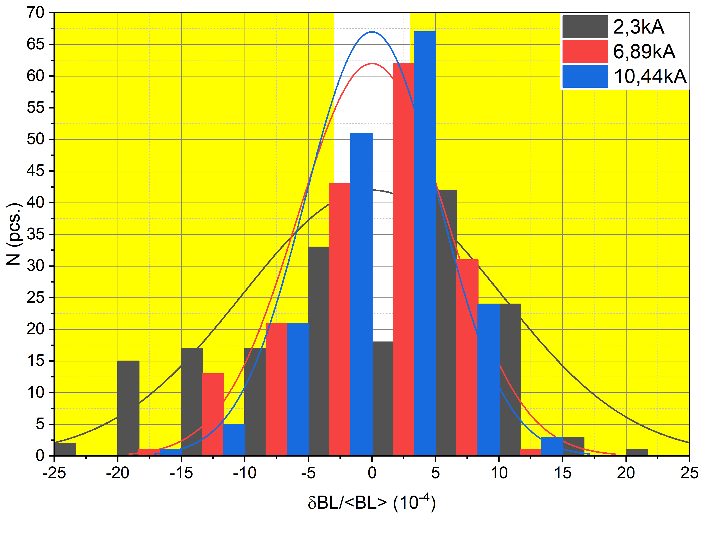
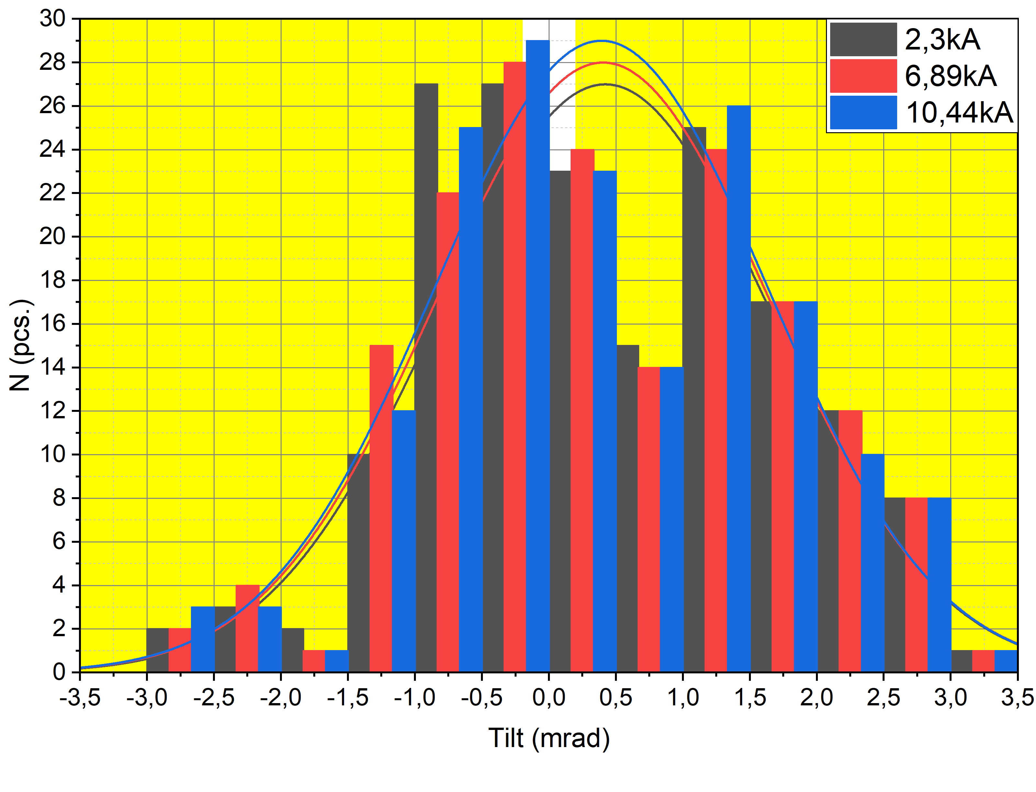
Magnetic Measurements. Dipoles
Dipoles: 100% tested

Slide 17
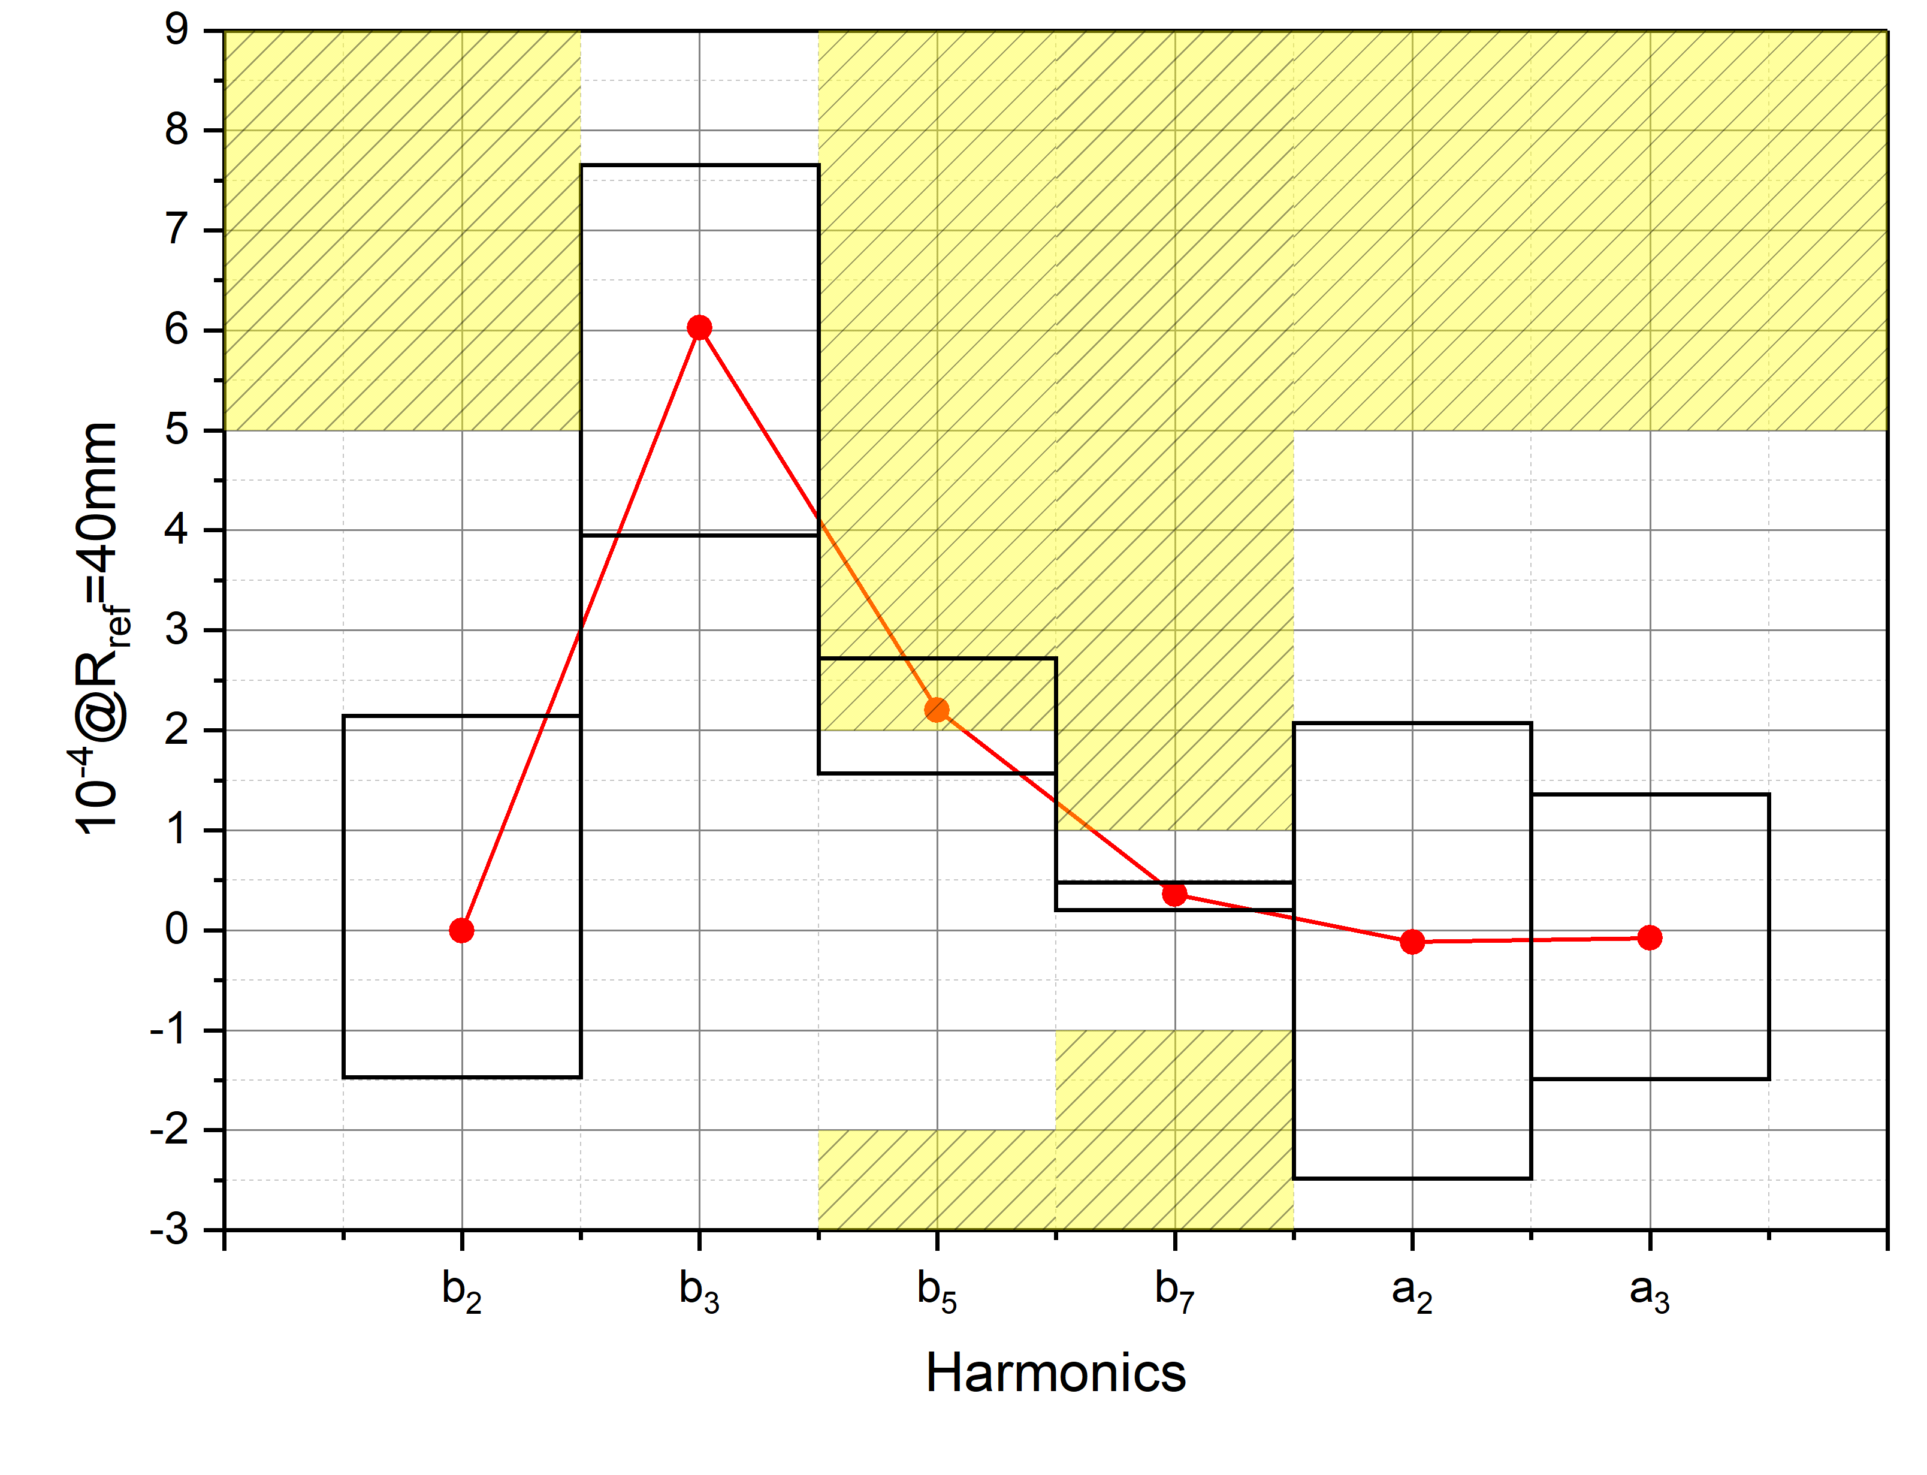
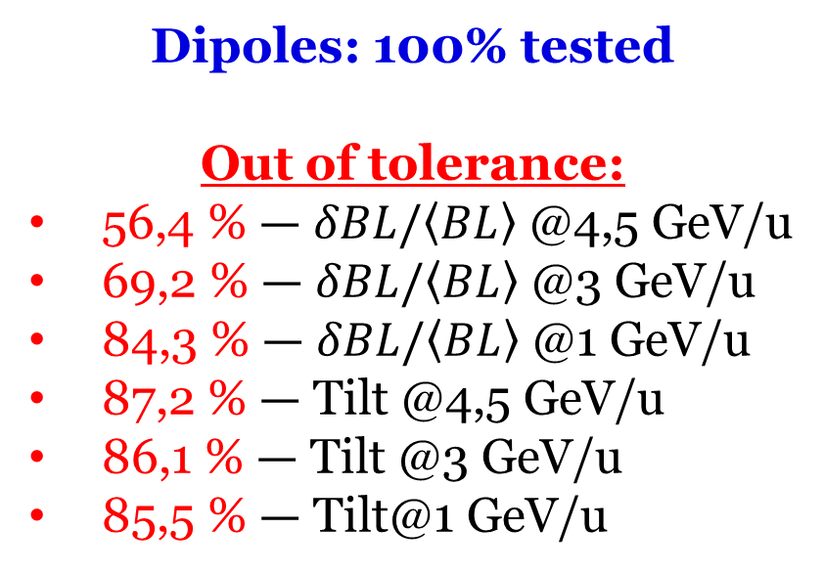
Magnetic Measurements. Dipoles
Dipoles: 100% tested
Out of tolerance:
56,4 % — $δBL/\left\langle BL\right\rangle$ @4,5 GeV/u
69,2 % — $δBL/\left\langle BL\right\rangle$ @3 GeV/u
84,3 % — $δBL/\left\langle BL\right\rangle$ @1 GeV/u
87,2 % — Tilt @4,5 GeV/u
86,1 % — Tilt @3 GeV/u
85,5 % — Tilt@1 GeV/u
Superconducting magnets of the Collider of the NICA complex
D. Nikiforov
10,44 kA

Slide 18
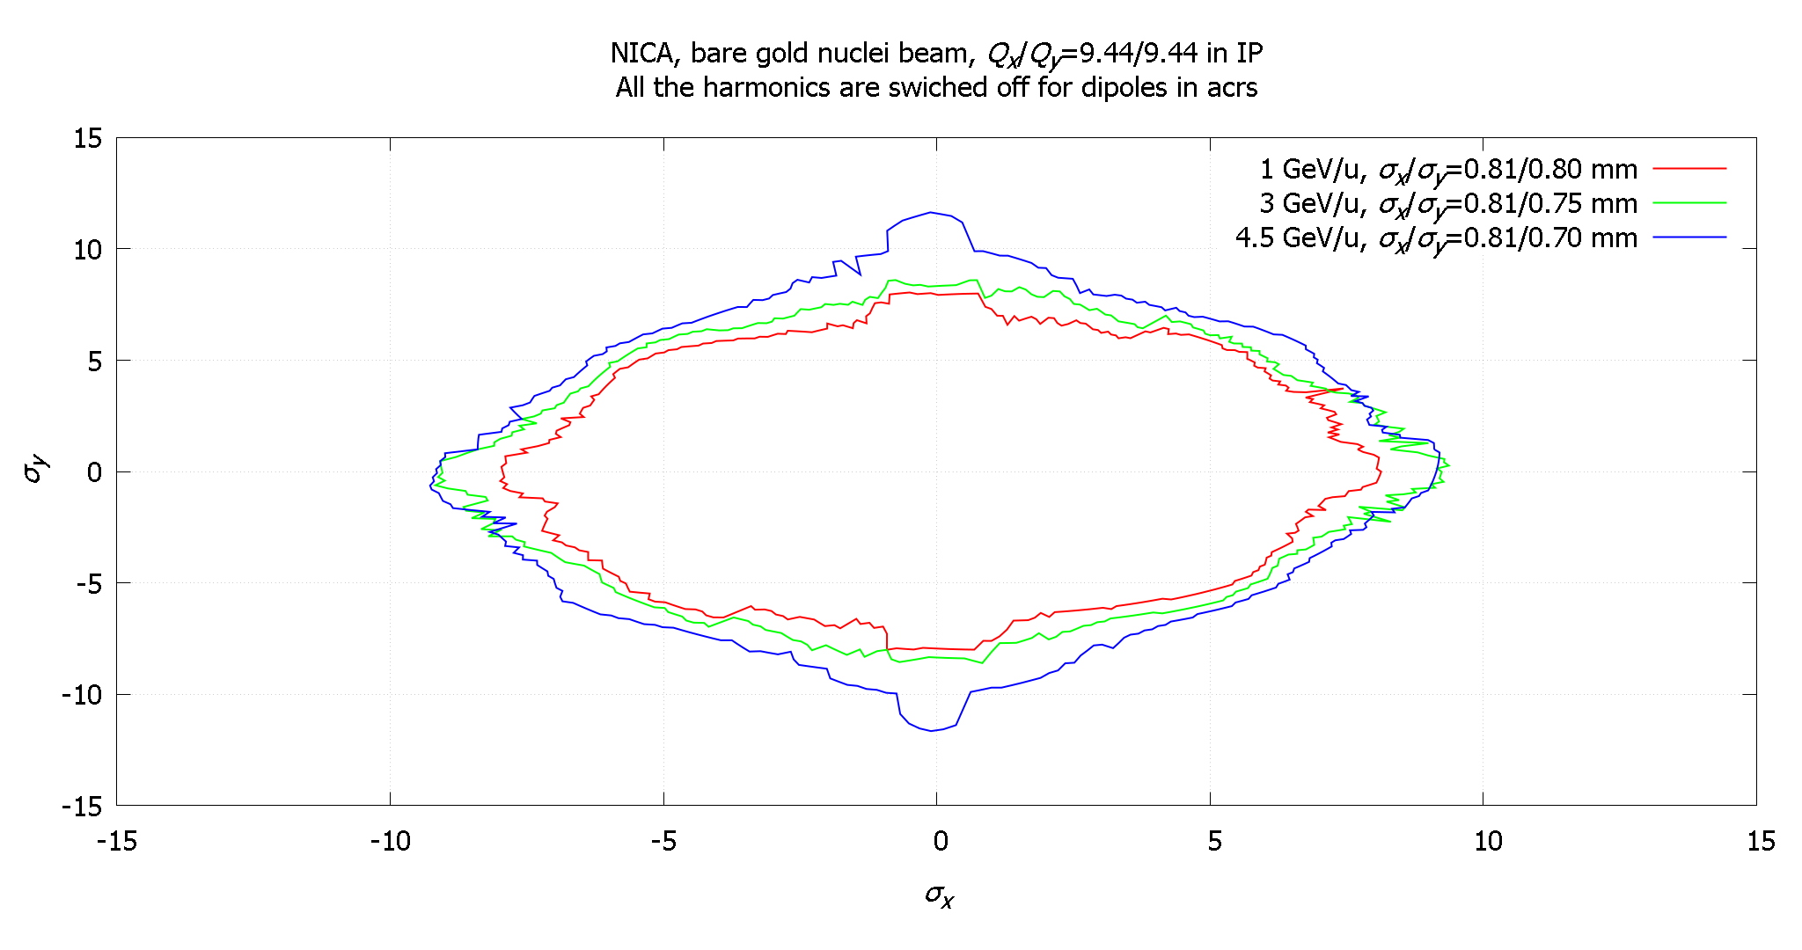
Magnetic Measurements. Dipoles

Slide 19
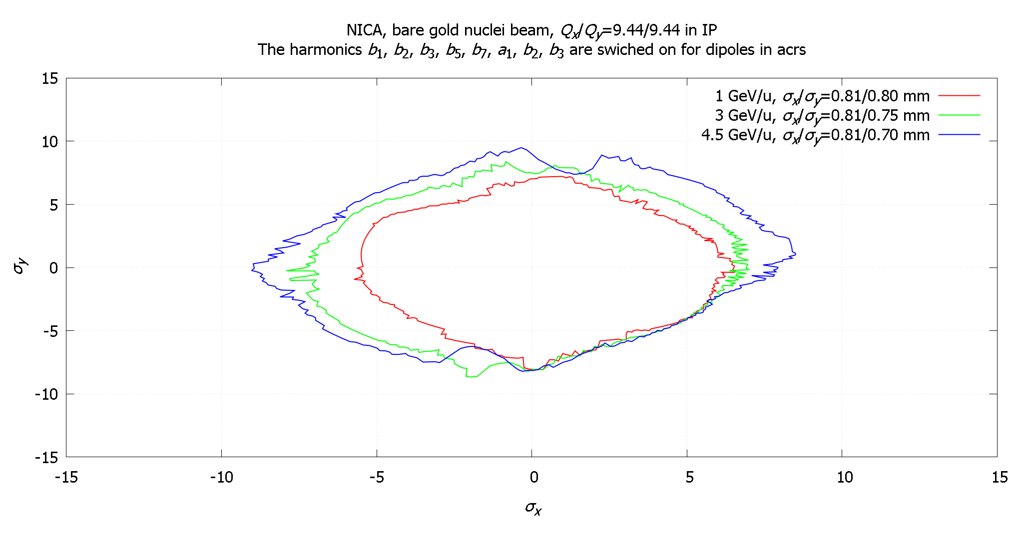
Magnetic Measurements. Dipoles

Slide 20
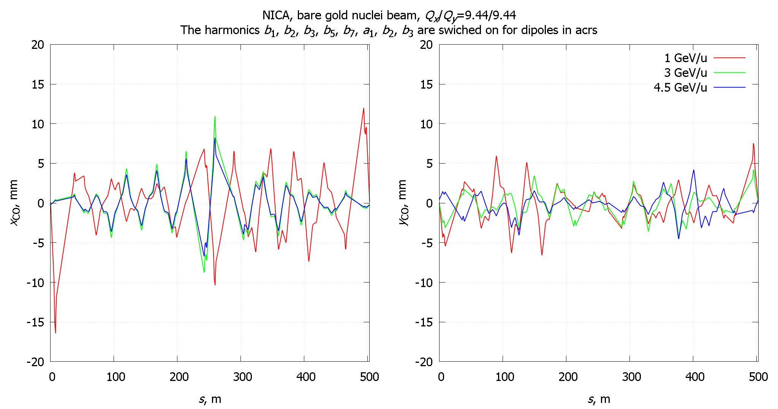
Magnetic Measurements. Dipoles

Slide 21
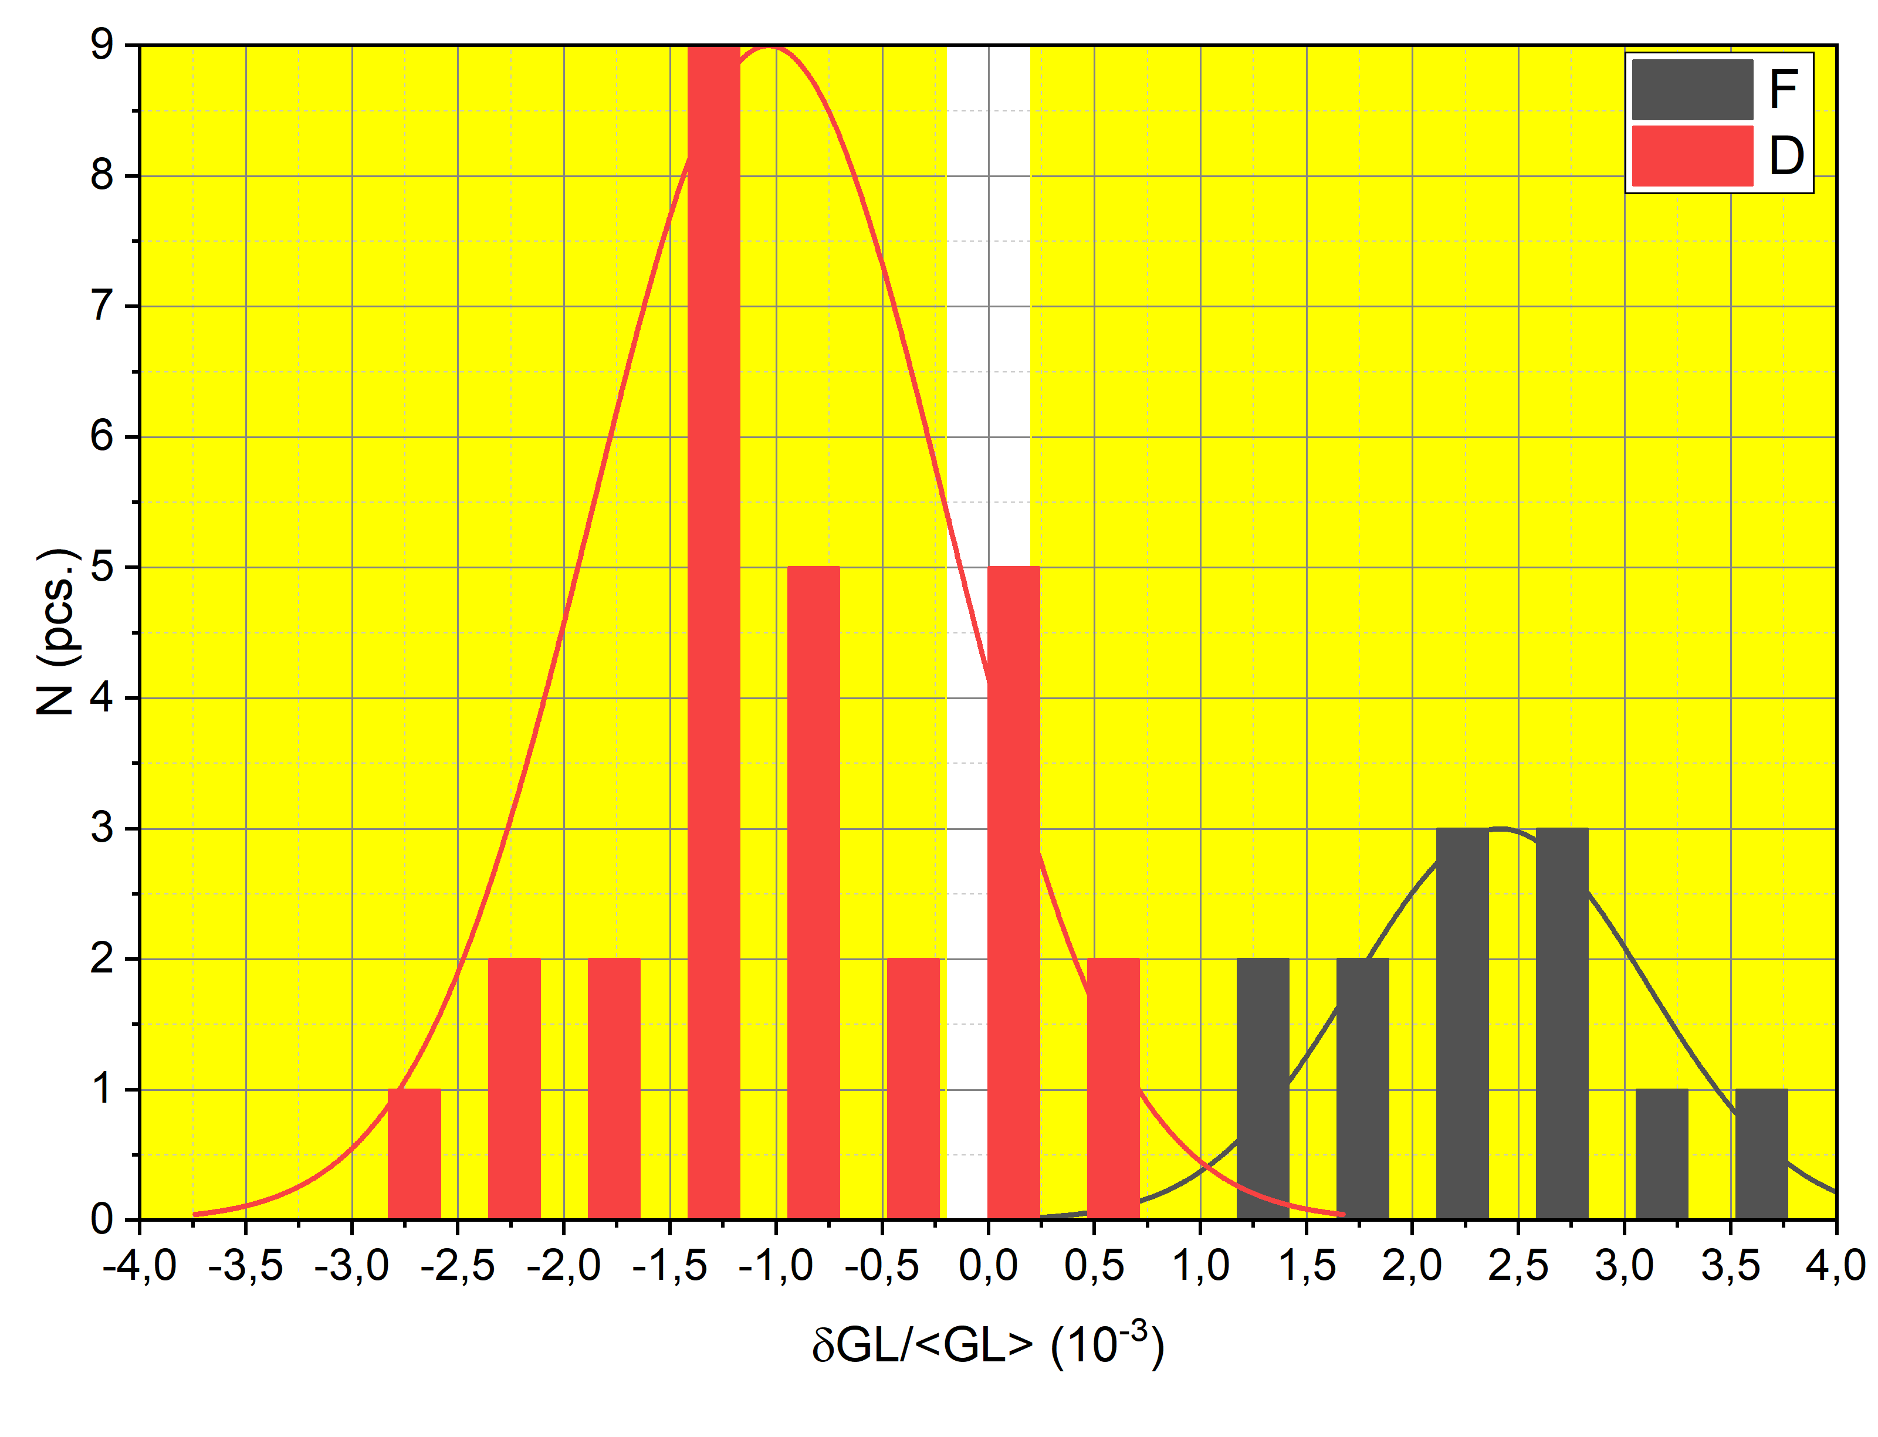
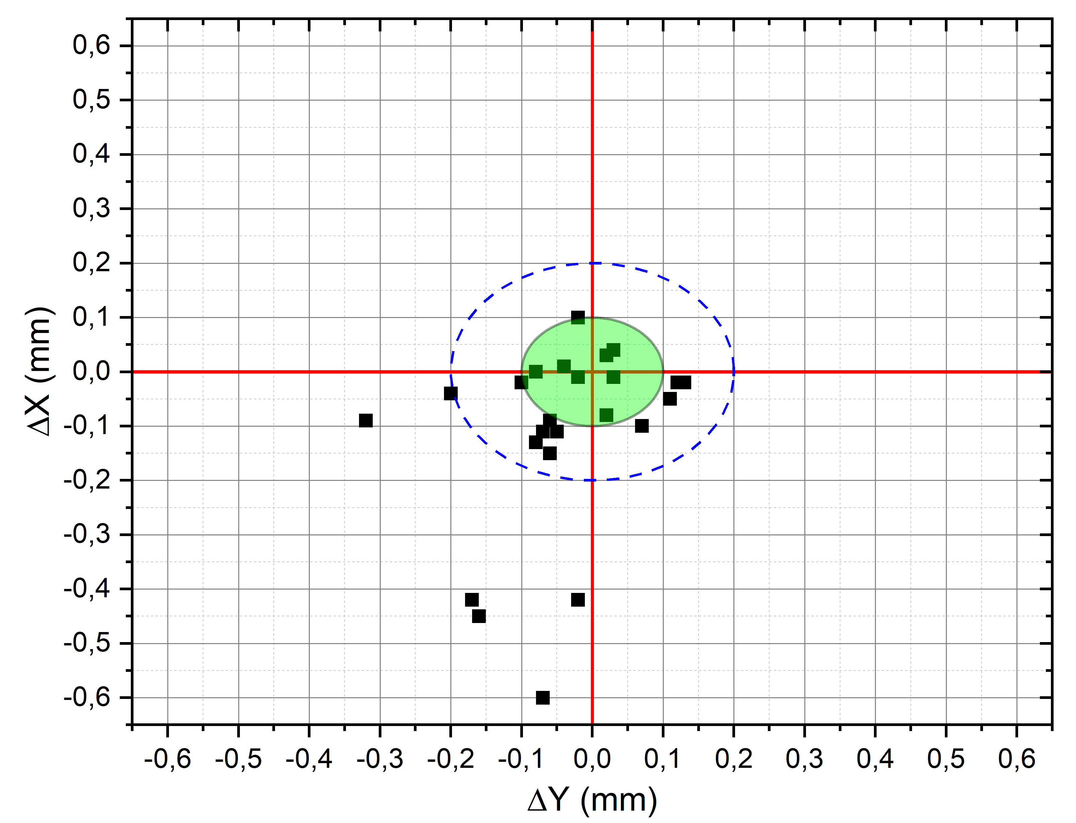
Magnetic Measurements. Quadrupoles
Tolerance 0,2mm
Tolerance 0,1mm
10,44 kA
Quadrupoles 41,7% tested

Slide 22
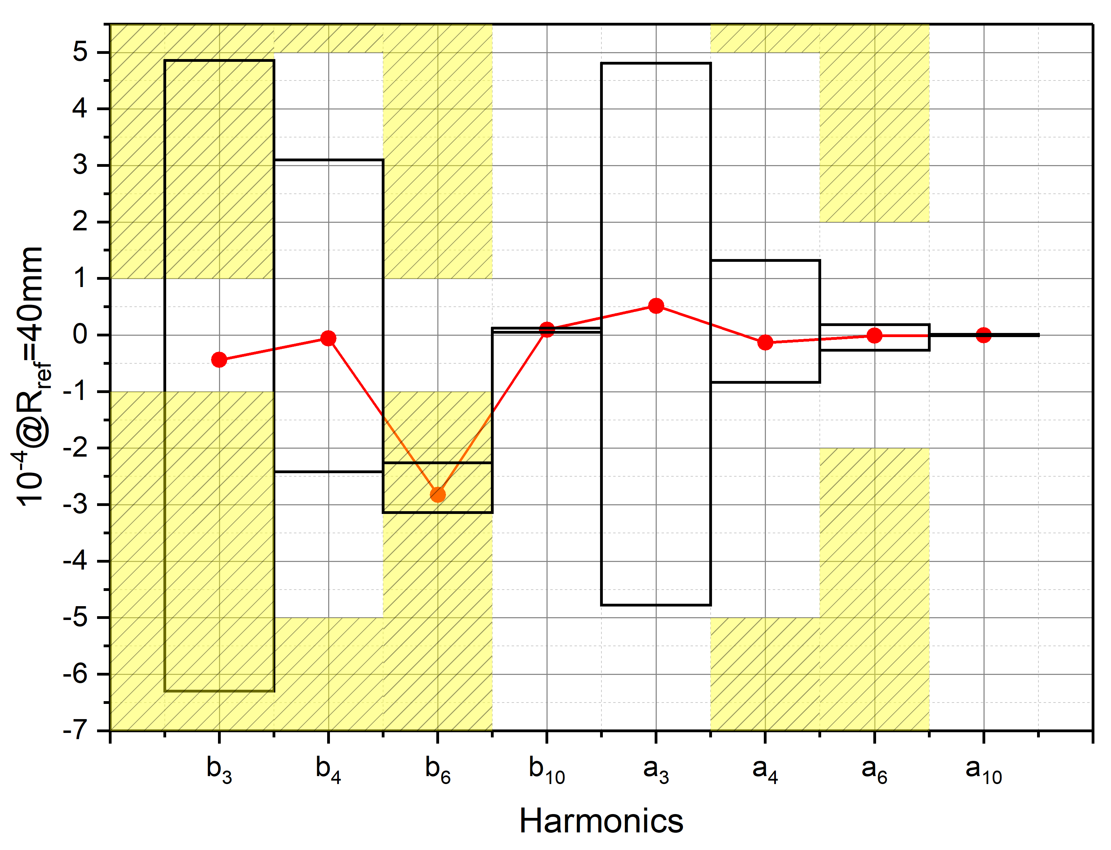
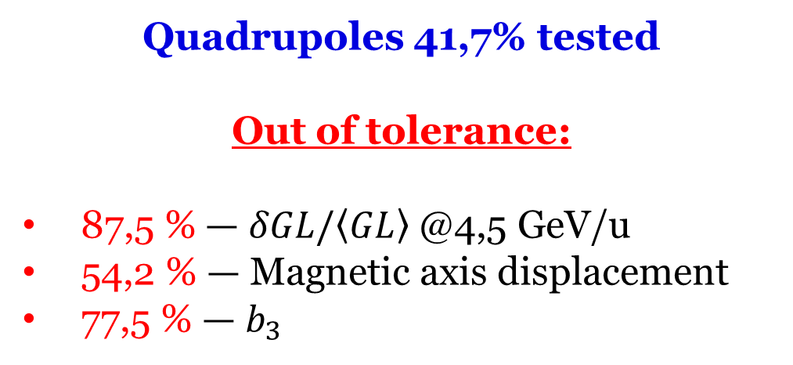
Magnetic Measurements. Quadrupoles
Quadrupoles 41,7% tested
Out of tolerance:
87,5 % — $δGL/\left\langle GL\right\rangle$ @4,5 GeV/u
54,2 % — Magnetic axis displacement
77,5 % — $b_{3}$
10,44 kA

Slide 23
Magnetic Measurements. Quadrupoles

Slide 24
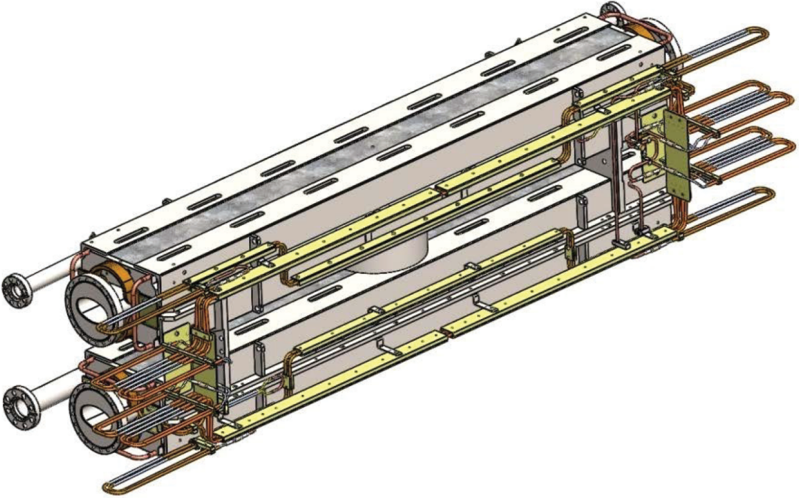
Alignment
Top and bottom yoke of the magnet connect together in one magnet
Top and bottom yoke doesn’t possible to align independently!

Slide 25
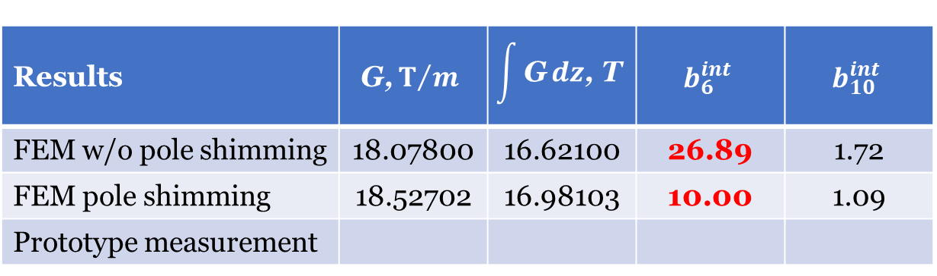
Magnetic Measurements. QFF
Results | $$\text{G}\text{,}T/m$$ | $$\int{\text{G}}dz\text{,} \text{T}$$ | $$b_{6}^{int}$$ | $$b_{10}^{int}$$
FEM w/o pole shimming | 18.07800 | 16.62100 | 26.89 | 1.72
FEM pole shimming | 18.52702 | 16.98103 | 10.00 | 1.09
Prototype measurement
Dodecapole corrector coils
4 pcs./ring
125000 T/m⁵ max
1000 Ampere*Turns max
Loading max (4.5 GeV/u) 45.2 %

Slide 26
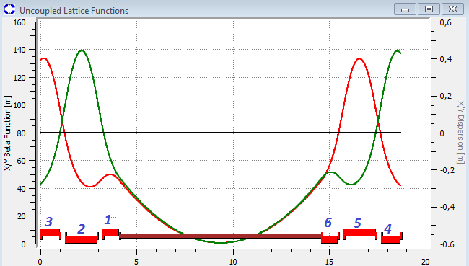
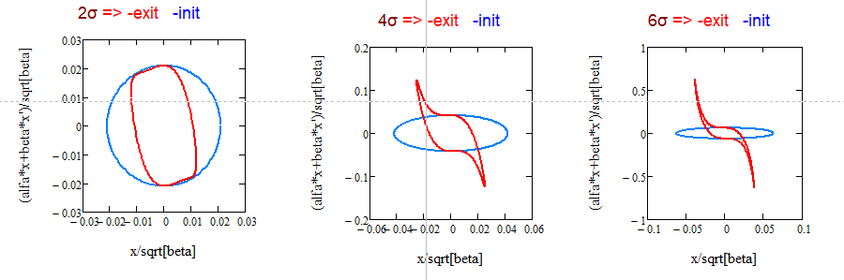

DA Correction. Analytical Estimation
Fringe fields in final focusing triplets
Fringe fields + octupoles
The results doesn’t approve by numerical calculation.
Work in progress

Slide 27
Power Supplies Layout
6 Main PS
BPS-1: 10kA x 60V
92 Additional PS
300A x 20V
BPS-2: 1kA x 30V
BPS-3: 600A x 20V
25% loading of the APS
Power Supply Systems for
the Collider Magnets
V. Karpinsky

Slide 28
Conclusion
The magnetic structure of the NICA Collider has been fixed.
DA of the NICA Collider is limited by the fringe fields of the quadrupole magnets (most especially, by the final focusing quads) and can be increased by the correction system up to 10÷11σ.

Slide 29

Conclusion
The magnetic field quality tolerance was established based on DA and CO calculations.
Errors | CO | DA
Dipole magnets
Effective length (relative) | $$3⋅{10}^{−4}$$ | —
Transverse displacement | — | —
Rotation around longitudinal axis | $0.2$mrad | —
Quadrupole magnets
Effective length (relative) | — | $$1⋅{10}^{−3}$$
Transverse displacement | $0.1$mm | $0.1$mm
Rotation around longitudinal axis | — | $1$mrad

Slide 30

Conclusion
Magnetic measurements for 100% dipoles and 41,7% quadrupoles were done.
Out of tolerance:
    56,4 % — $δBL/\left\langle BL\right\rangle$ @4,5 GeV/u
    87,2 % — Tilt @4,5 GeV/u
    87,5 % — $δGL/\left\langle GL\right\rangle$ @4,5 GeV/u
    54,2 % — Magnetic axis displacement
                (-0,6mm max)
    77,5 % — $b_{3}$

Slide 31
Conclusion
DA decrease to 5÷6σ if the results of the magnetic measurements has been taken into account.
Work in progress.

Slide 32
Conclusion and Future Plans
THANK YOU FOR ATTENTION !!!

